Slide 1
Integrating concurrency control and energy management in device drivers
Kevin Klues, Vlado Handziski , Chenyang Lu, Adam Wolisz, David Culler, David Gay , and Philip Levis

Slide 2
Sensor Networks
Where can we find them?
Simple answer: Everywhere!!
Industrial applications:
Petroleum
Radiation detection (Japan)
Global warming
Weather forecasting (Sometimes they get it right!!!)

Slide 3
Challenges
Ease of use
Withstand Harsh environmental conditions
Mobile
Light weight
Low power
Small battery
Energy Harvesting
Communication failures
Dynamic network topology
Must run unattended from days to years
Notes:
The main characteristics of a sensor network include:
Power consumption constrains for nodes using batteries or energy harvesting
Ability to cope with node failures
Mobility of nodes
Dynamic network topology
Communication failures
Heterogeneity of nodes
Scalability to large scale of deployment
Ability to withstand harsh environmental conditions
Easy of use
Unattended operation.

Slide 4
Motivation
Traditional Embedded Operating Systems
VxWorks – Multicore, preemptive, blocking
QNX – Multicore, Microkernel architecture, POSIX
eCos – One process, preemptive, multiple threads
TinyOS – Single Thread/Stack, non-blocking
Difficult to manage energy in traditional Operating Systems
Hard to tell the OS about future application workloads
All energy management logic pushed out to the application
Optimal energy savings at cost of application complexity
Notes:
eCos (embedded configurable operating system) is an open source, real-time operating system intended for embedded systems and applications which need only one process with multiple threads. It is designed to be customizable to precise application requirements of run-time performance and hardware needs. Essentially, this enables eCos developers to create their own application-specific operating system
VXWorks
The key features of the current OS are:
Multitasking kernel with preemptive and round-robin scheduling and fast interrupt response
User-mode applications ("Real-Time Processes", or RTP) isolated from other user-mode applications as well as the kernel via memory protection mechanisms.
SMP and AMP support
Fast, flexible inter-process communication including TIPC
Error handling framework
Binary, counting, and mutual exclusion semaphores with priority inheritance
Local and distributed message queues
POSIX PSE52 certified conformance in user-mode execution environment[13]
File systems: High Reliability File System (HRFS), FAT-based file system (DOSFS), Network File System (NFS)
IPv6 networking stack
VxSim simulator
QNX
As a microkernel-based OS, QNX is based on the idea of running most of the OS in the form of a number of small tasks, known as servers. This differs from the more traditional monolithic kernel, in which the operating system is a single very large program composed of a huge number of "parts" with special abilities. In the case of QNX, the use of a microkernel allows users (developers) to turn off any functionality they do not require without having to change the OS itself; instead, those servers are simply not run. With the QNX microkernel, kernel operations are relatively few and of short duration. This minimal locking approach improves the performance of the rest of the system because neither BKL or fine grained locking approaches are necessary.
TinyOS
TinyOS is a free and open source component-based operating system and platform targeting wireless sensor networks (WSNs). TinyOS is an embedded operating system written in the nesC programming language as a set of cooperating tasks and processes. It is intended to be incorporated into smartdust. TinyOS started as a collaboration between the University of California, Berkeley in co-operation with Intel Research and Crossbow Technology, and has since grown to be an international consortium, the TinyOS Alliance.
Because sensornets have limited resources and different use cases than traditional timesharing systems they tend to run small, customizable OSs with flexible abstraction layers. In practice sensornet operating systems (TinyOS, Contiki, MOS) like their embedded siblines, provide minimal energy management support. eCOS and VxWorks have interfaces for processor power control but peripheral device control is left to the application. TinyOS has power control interfaces that the application must explicily invoke.

Slide 5
Existing OS Approaches
Dynamic CPU Voltage Scaling
Vertigo – Application workload classes
Grace OS – Explicit real-time deadlines
Disk Spin Down
Coop-IO – Application specified timeouts
Energy Allocation
Cinder Operating System – Reserves and Taps
ACPI
OS directed configuration, power and thermal management of computing platforms
Notes:
Vertigo
Power management extensions for linux. Automatically classifies machine utilization into different types of episodes and automatically assigning deadlines to them. Deadline and classification information is derived from communication patterns between the executing tasks based on observations in the OS kernel.
Vertigo showed that having a process tell the OS its workload class greatly outpreforms simple hardware heuristics and fixed-interval averaging.
GRACE-OS integrates dynamic voltage scaling into soft real-time scheduling and decides how fast to execute applications in addition to when and how long to execute them. GRACE-OS makes such scheduling decisions based on the probability distribution of application cycle demands, and obtains the demand distribution via online profiling and estimation.
Demonstrates that receiving explicit real-time deadlines from applications allows an OS to reduce energy further.
Coop-I/O
Applications can declare open, read and write operations as deferrable and even abortable by specifing a time-out and a cancel flag. This information enables the operating system to delay and batch requests so that the number of power mode switches is reduced and the device can be kept longer in a low-power mode.
Cinder Operating System
Reserves and Taps – Isolation, Delegation, and Subdivision.
A reserve describes a right to use a given quantity of a resource, such as energy. When an application consumes a resource the Cinder kernel reduces the values in the corresponding reserve. The kernel prevents threads from performing actions for which their reserves do not have sufficient resources.
A tap transfers a fixed quantity of resources between two reserves per unit time, which controls the maximum rate at which a resource can be consumed.
Isolation – Isolate energy consumption (Same as CPU, Disk, Memory).
Delegation – Loan any of its available energy to another principal.
Subdivision – Partition available energy.
ECOSystem
Currentcy – Gives an application the ability to spend a certain amount of energy, up to a fixed cap. Works great for simple large applications but falls short when confronted with the complex multiple principle applications of today’s mobile systems. Ie, Web browsers run active code as well as plugins.
ACPI
ACPI establishes industry-standard interfaces enabling OS-directed configuration, power management, and thermal management of mobile, desktop, and server platforms. Defines platform-independent interfaces for hardware discovery, configuration, power management and monitoring. The specification is central to Operating System-directed configuration and Power Management (OSPM); which therefore removes device management responsibilities from legacy firmware interfaces. ACPI’s logic requires dedicated peripheral hardware support that the simple, low-power chips common to embedded systems do not have.
Despite all of these advances most modern operating systems still use very simplistic energy management policies. Behind all of the advanced libraries applications still use APIs which were designed before energy constraints were a major concern.

Slide 6
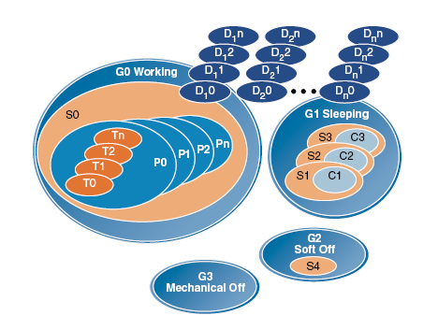
Device power management
Device Drivers Power Management
Mac OS X
Linux 2.6
Windows
ACPI
Platform Independent Specification
Hardware Support
Function Fixed Hardware Interface relies on AML
ACPI Component Architecture
Global States: G0-G3, (G0)S0, (G1)S1-S4, (G2)S5
Processor States: C0-C3
Device States: D0-D3
Performance States: P0-Pn (C0, D0)
Notes:
ACPI Advanced Configuration and Power Interface
Bytecode from an external source must be run by the system with full privileges
Function Fixed Hardware interfaces are platform-specific features, provided by platform manufacturers for the purposes of performance and failure recovery
The complexity of the ACPI specification leads to a lengthy and difficult implementation in OS software. The purpose of the ACPI Component Architecture is to simplify ACPI implementations for operating system vendors (OSVs) by providing major portions of an ACPI implementation in OS-independent ACPI modules that can be easily integrated into any OS.
Global states
G0 (S0): Working
G1, Sleeping subdivides into the four states S1 through S4:
S1: All processor caches are flushed, and the CPU(s) stop executing instructions. Power to the CPU(s) and RAM is maintained; devices that do not indicate they must remain on may be powered down.
S2: CPU powered off
S3: Commonly referred to as Standby, Sleep, or Suspend to RAM. RAM remains powered
S4: Hibernation or Suspend to Disk. All content of main memory is saved to non-volatile memory such as a hard drive, and is powered down.
G2 (S5), Soft Off: G2 is almost the same as G3 Mechanical Off, but some components remain powered so the computer can "wake" from input from the keyboard, clock, modem, LAN, or USB device.
G3, Mechanical Off: The computer's power consumption approaches close to zero, to the point that the power cord can be removed and the system is safe for dis-assembly (typically, only the real-time clock is running off its own small battery).
Device states
D0 Fully On is the operating state.
D1 and D2 are intermediate power-states whose definition varies by device.
D3 Off has the device powered off and unresponsive to its bus.
The CPU power states
C0 is the operating state.
C1 (Halt) is a state where the processor is not executing instructions, but can return to an executing state essentially instantaneously. All ACPI-conformant processors must support this power state. Some processors, such as the Pentium 4, also support an Enhanced C1 state (C1E or Enhanced Halt State) for lower power consumption.
C2 (Stop-Clock) is a state where the processor maintains all software-visible state, but may take longer to wake up. This processor state is optional.
C3 (Sleep) is a state where the processor does not need to keep its cache coherent, but maintains other state. Some processors have variations on the C3 state (Deep Sleep, Deeper Sleep, etc.) that differ in how long it takes to wake the processor. This processor state is optional.
Performance states
These states are implementation-dependent, but P0 is always the highest-performance state, with P1 to Pn being successively lower-performance states, up to an implementation-specific limit of n no greater than 16.
P-states
P0 max power and frequency
P1 less than P0, voltage/frequency scaled
Pn less than P(n-1), voltage/frequency scaled

Slide 7
Overview
Concurrency Control
Concurrency of I/O operations alone, not of threads in general
Synchronous vs. Asynchronous I/O
Asynchronous I/O can improve energy efficiency by allowing the OS to schedule it
Energy Management
Power state of device needed to perform I/O operations
Determined by pending I/O requests using Asynchronous I/O
Notes:
An OS can improve energy by putting peripherals into low power modes and dropping the processor to a sleep states when idle. The challenge lies in deciding when and how to do so. To manage energy well an OS must infer future application behavior.
Why concurrency?
Statement: The more workload information an application can give the OS, the more energy it can save when scheduling that workload.

Slide 8
Overview
Concurrency Control
Concurrency of I/O operations alone, not of threads in general
Synchronous vs. Asynchronous I/O
Asynchronous I/O can improve energy efficiency by allowing the OS to schedule it
Energy Management
Power state of device needed to perform I/O operations
Determined by pending I/O requests using Asynchronous I/O
Notes:
An OS can improve energy by putting peripherals into low power modes and dropping the processor to a sleep states when idle. The challenge lies in deciding when and how to do so. To manage energy well an OS must infer future application behavior.
Why concurrency?
Statement: The more workload information an application can give the OS, the more energy it can save when scheduling that workload.

Slide 9
Integrated Concurrency and Energy Management (ICEM)
Device driver architecture that manages energy
Implemented in TinyOS 2.0
Three driver classes: virtualized, shared, dedicated
Power Locks: synchronization primitives which couple energy, configuration, and concurrency management.
Component library: arbiters, power managers, and configurators.
Advantages of ICEM
Energy Efficient: within 1.6% of hand tuned implementation
Reduces code complexity: 400 vs 68 lines (nesC)

Slide 10
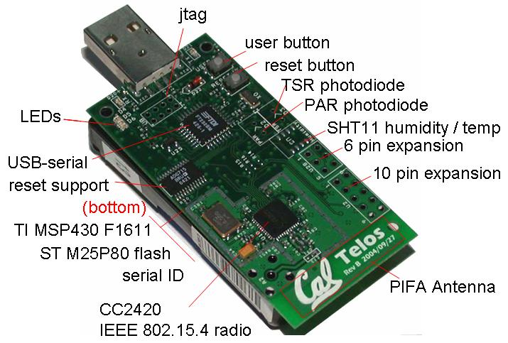
Hardware Platform
CPU
MSP430
8Mhz, 16-bit
I²C, SPI, ADC
10kB Ram
Radio
CC2420
250kbps, 802.15.4
Flash
ST M25P80
2Mb External
Total Solar
TSR Photodiode
Photo Active
PAR Photodiode
Temperature and Humidity
SHT11
Notes:
802.15.4
low-rate wireless personal area networks (LR-WPANs)
Data rates of 250 kbps, 40 kbps, and 20 kbps
It is the basis for the ZigBee,[1] WirelessHART, and MiWi specification
Fully Active: 30mA
Deepest Sleep State: 7-9uA

Slide 11
Hardware Platform
Six Major I/O Devices
Possible Concurrency
I²C, SPI, ADC
Energy Management
Power on peripherals only when needed

Slide 12
Example Application
Requirements
Every 5 Minutes
Sample all the sensors and log the readings to flash
Every 12 Hours
Retrieve new readings from flash and send to central collection unit
Pseudocode

Slide 13
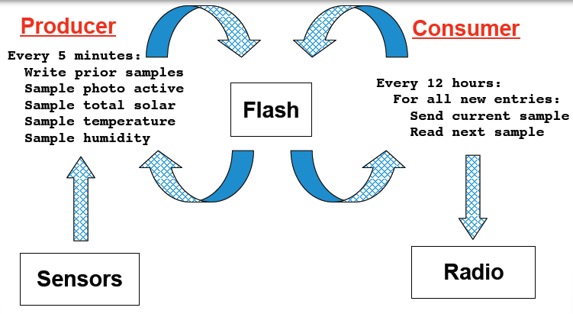
Example Application – Work Flow

Slide 14
Example Application – Work Flow

Slide 15
Example Application – Work Flow

Slide 16
Example Application – Work Flow

Slide 17
Example Application – Work Flow

Slide 18
Example Application – Work Flow

Slide 19
Example Application – Work Flow

Slide 20
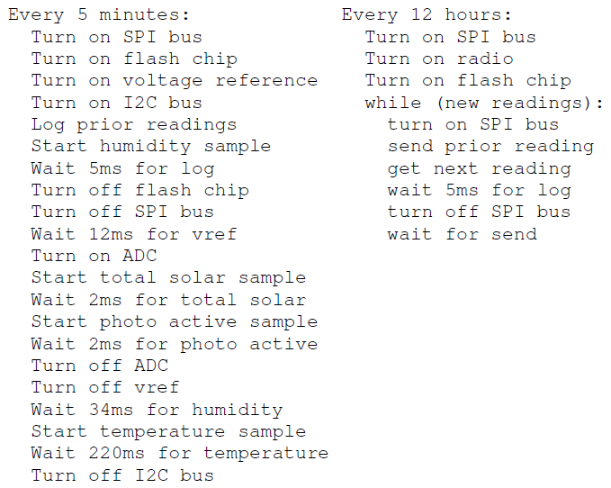
Example Application
Energy efficient application pseudo-code

Slide 21
Example Application
Energy efficient application Pseudocode
Device Power Control

Slide 22
Example Application
Energy efficient application Pseudocode
Device Wait Times

Slide 23
Example Application
ICEM Application – Look familiar?
Removed device control from application

Slide 24
ICEM Attributes
Three classes of drivers
Virtualized – Functional Interface
Dedicated – Functional and Power Interfaces
Shared – Functional and Lock Interfaces

Slide 25
Virtualized Device Driver
Provides a Functional interface
Assumes multiple users
Implemented for higher-level users that can tolerate longer latencies
Concurrency Control
Implicit control through buffering requests
Energy Management
Implicit management based on pending requests

Slide 26
Dedicated Device Driver
Provides a Functional and Power Control interface
Assumes one user
Implemented for lowest-level hardware independent abstractions
Concurrency Control
None
Energy Management
Explicit management through power control interface
Notes:
Complete control over the hardware

Slide 27
Shared Device Driver
Provides Functional and Lock interfaces
Assumes multiple users
Implemented for lower-level users that require stringent timing requirements
Concurrency Control
Explicit control through Lock requests
Energy Management
Implicit management base on pending requests

Slide 28
ICEM Attributes
Three classes of drivers
Virtualized – Functional Interface
Dedicated – Functional and Power Interfaces
Shared – Functional and Lock Interfaces
Power Locks – Split phase locks with integrated energy and configuration management
Notes:
The split-phase operations TinyOS provides are similar to traditional asynchronous I/O with one important difference: they know
when an application is aware that an I/O operation has completed.
In a threaded system, a device driver will resume threads blocked on select (or a similar function), but the scheduler may not run the device thread immediately. In contrast, an application making split-phase I/O requests receives explicit notification from a device driver upon its completion through a direct upcall. This subtle but important difference allows a device driver to know exactly when an application has been notified about the completion of an I/O event. ICEM leverages this knowledge, using application I/O requests to precisely control a device’s power state.

Slide 29
Power Locks
Used to synchronize access to drivers between software components
Idle Lock → Turn off device
Client could specify device configuration
Client request a lock, provide a callback function when it is given the lock
Deadlock problems could arise
Notes:
Traditionally, locks such as mutexes and semaphores are blocking constructs that protect critical sections or shared data structures.
However, as TinyOS does not have blocking calls, its locks must be split-phase.
As power lock requests are non-blocking, a component can request several locks in parallel and proceed when they are all granted.
This of course raises deadlock concerns!! – Open area for future work!

Slide 30
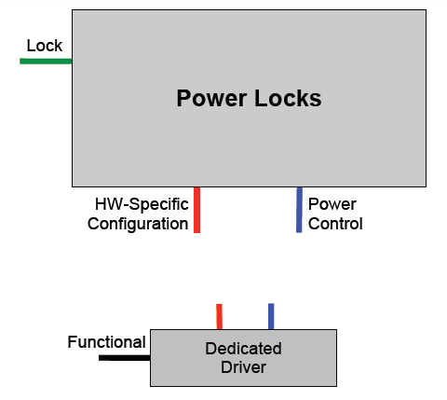
Power Locks
Notes:
Traditionally, locks such as mutexes and semaphores are blocking constructs that protect critical sections or shared data structures.
However, as TinyOS does not have blocking calls, its locks must be split-phase.

Slide 31
ICEM Attributes
Three classes of drivers
Virtualized – Functional Interface
Dedicated – Functional and Power Interfaces
Shared – Functional and Lock Interfaces
Power Locks – Split phase locks with integrated energy and configuration management
Component Library
Arbiters – manages I/O concurrency
Configurators – provides device specific configurations
Power Managers – provides energy management policy
Notes:
Arbiters:
The component library has two arbiter policies, round robin and first come first served
Power Managers:
At boot, all power managers have control over a lock and all devices are powered down. When a power manager receives a callback from its arbiter that the lock has been requested, it takes this as a signal that the device needs to be used and must be powered up. Conversely, when a power manager receives the lock from its arbiter, it takes this as a signal that the device is idle and may be powered down again.
The component library has two power manager policies, immediate and deferred. The former powers off a driver as soon as the lock falls idle, while the latter waits for a timeout.
Configurator:
Configurators are part of a lock granting path. They implement the Configuration interface that arbiters use. Configurators are for when power lock clients have a code preamble which should execute before they perform any operations. Configurators allow clients to incorporate this logic into an arbiter. This is useful when many clients have the same code preamble: one implementation can serve them all.

Slide 32
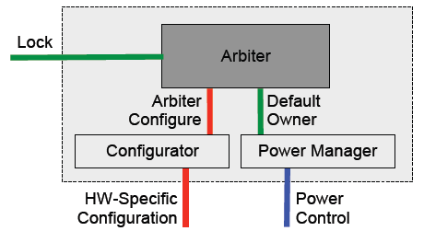
Component Library
Used to implement Power lock
Notes:
Arbiters:
The component library has two arbiter policies, round robin and first come first served
Power Managers:
At boot, all power managers have control over a lock and all devices are powered down. When a power manager receives a callback from its arbiter that the lock has been requested, it takes this as a signal that the device needs to be used and must be powered up. Conversely, when a power manager receives the lock from its arbiter, it takes this as a signal that the device is idle and may be powered down again.
The component library has two power manager policies, immediate and deferred. The former powers off a driver as soon as the lock falls idle, while the latter waits for a timeout.
Configurator:
Configurators are part of a lock granting path. They implement the Configuration interface that arbiters use. Configurators are for when power lock clients have a code preamble which should execute before they perform any operations. Configurators allow clients to incorporate this logic into an arbiter. This is useful when many clients have the same code preamble: one implementation can serve them all.

Slide 33
Component Library
Lock interface for concurrency control (FCFS, Round-Robin
ArbiterConfigure interface for automatic hardware configuration
DefaultOwner interface for automatic power management
Notes:
Arbiters:
The component library has two arbiter policies, round robin and first come first served

Slide 34
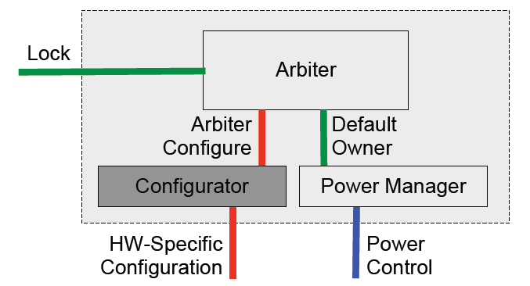
Component Library
Implement ArbiterConfigure Interface
Call hardware specific configuration from dedicated driver
Notes:
Configurator
Configurators are part of a lock granting path. They implement the Configuration interface that arbiters use. Configurators are for when power lock clients have a code preamble which should execute before they perform any operations. Configurators allow clients to incorporate this logic into an arbiter. This is useful when many clients have the same code preamble: one implementation can serve them all.

Slide 35
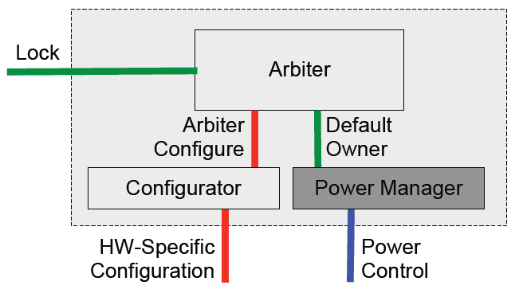
Component Library
Implement DefaultOwner interface
Power down device when device falls idle
Power up device when lock request is received
Provides Immediate and Deferred policies
Notes:
Power Manager
At boot, all power managers have control over a lock and all devices are powered down. When a power manager receives a callback from its arbiter that the lock has been requested, it takes this as a signal that the device needs to be used and must be powered up. Conversely, when a power manager receives the lock from its arbiter, it takes this as a signal that the device is idle and may be powered down again.
The component library has two power manager policies, immediate and deferred. The former powers off a driver as soon as the lock falls idle, while the latter waits for a timeout.

Slide 36
Shared Example Driver
MSP430 USART0
Three modes of operation - SPI, I²C, UART

Slide 37
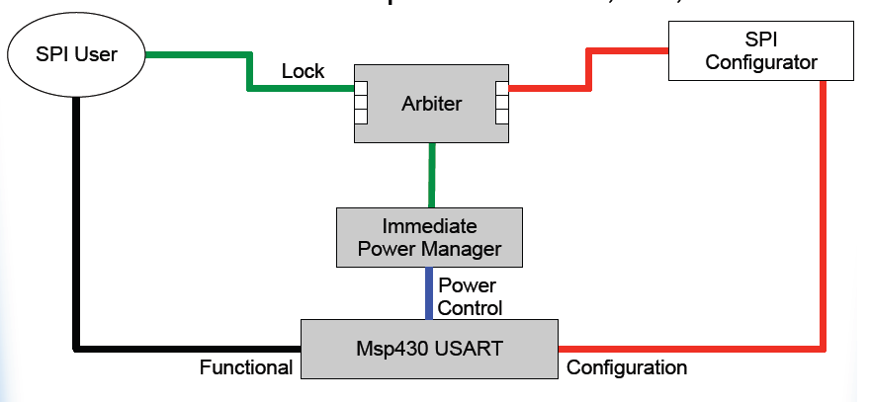
Shared Example Driver
MSP430 USART0
Three modes of operation - SPI, I²C, UART

Slide 38
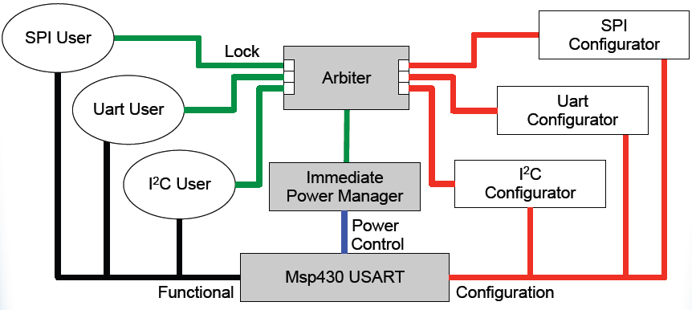
Shared Example Driver
MSP430 USART0
Three modes of operation - SPI, I²C, UART

Slide 39
Shared Example Driver
MSP430 USART0
Three modes of operation - SPI, I²C, UART
POWER LOCK
Notes:
Notice that each user is supplied a functional and lock interface characteristic of a SHARED driver

Slide 40
Drawbacks
ICEM Overhead
RAM and ROM – Library components require additional code space and memory.
CPU cycles – calls utilizing shared drivers must go through arbiters, power managers.

Slide 41
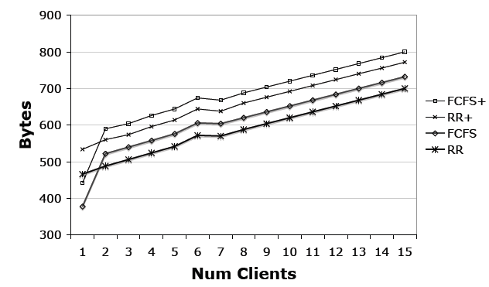
Arbiter Overhead
Arbiter Overhead (RAM)
350 – 550 bytes Initial overhead
Increases linearly with the number of clients
Notes:
Explain RR and FCFS
+ denotes a complete arbiter. A simple arbiter doesn’t support power management (has no default client)
For n clients
FCFS arbiter uses 6+n bytes of RAM (Array based queue)
RR arbiter uses 8 + [n/8] (Bitmask of pending requests)

Slide 42
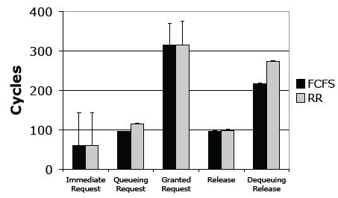
Arbiter Overhead
Arbiter Overhead (CPU)
Notes:
The bars are the additional cycles of a default client (to support power management).
The most expensive arbiter operation is the complete request-grant cycle which take 300-350 cycles.

Slide 43
Arbiter Overhead
Arbiter Overhead (CPU)

Slide 44
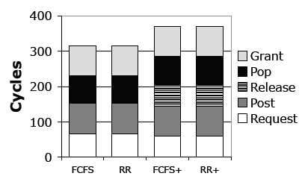
Arbiter Overhead
Arbiter Overhead (CPU)
Notes:
The most expensive arbiter operation is the complete request-grant cycle which take 300-350 cycles (@ 4Mhz 75-87uS). Full arbiters take longer because they must tell the default client to release the lock

Slide 45
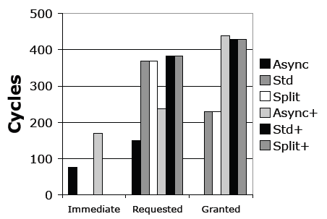
Power Manager Overhead
Power manager library components
RAM and ROM overhead
Cycle count overhead
Notes:
+ Denotes a deferred power manager. (Immediate power manager, lack of plus).
Adding power management can add up to an additional 400 cycles of overhead (@ 4Mhz 100uS).
They use immediate power managers for the bus and ADC and deferred power manager for the voltage reference (because of the 17ms wakeup time).

Slide 46
Drawbacks
ICEM Overhead
RAM and ROM – Library components require additional code space and memory.
CPU cycles – calls utilizing shared drivers must go through arbiters.
What does this overhead mean to power consumption?

Slide 47
Energy Overhead
Hand Tuned – Most energy efficient
ICEM – All concurrent operations
Serial+ – Optimal serial ordering
Serial- – Worst Case serial ordering
Notes:
Serial+ and Serial- are single threaded versions with blocking I/O calls that differ in their sensor sampling order which effect how often deferred drivers are powered on and off.

Slide 48
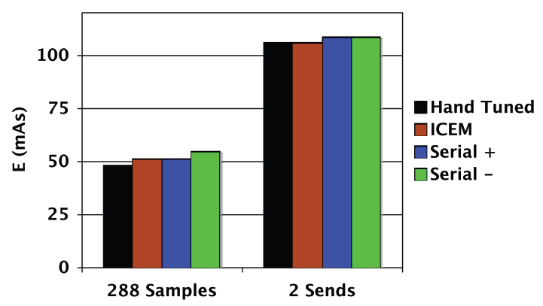
Energy Overhead
Application Energy per Day
5 Minute sampling interval
12 hour send cycle
Notes:
The serial+ implementation and the ICEM version have the same energy consumption during the sampling period. Serial- wastes more energy and the Hand tuned application uses less. Expected? Yes.
Notice that ICEM and the energy efficient hand tuned application have the same energy consumption (per day) during the send cycles.
Why is this important?

Slide 49
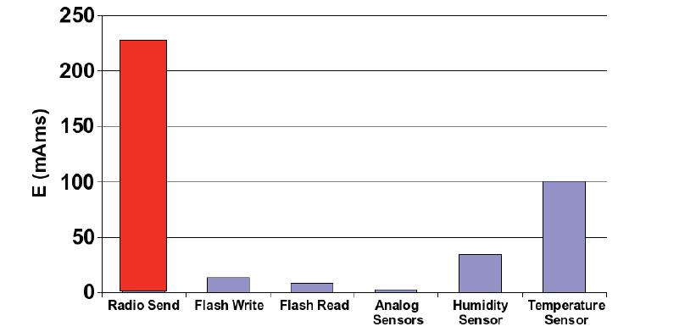
Energy Overhead
Average energy consumption
Notes:
The radio send function uses the most energy therefore the implementations with the more optimal send cycles will have greater lifetimes.

Slide 50
Energy Overhead
Overhead of ICEM vs Energy Efficient implementation
ADC Timeout + Power Lock Overhead
Overhead (Assume 288 samples per day)
2.9mAs/day ~= 1029 mAs/year
5.60% of total sampling energy
0.03% of total application energy
Notes:
Write Prior Samples – Log write and timeout times
Sample Photo active and sample total solar – Voltage reference warmup, analog samples, and voltage reference timeout
Sample Temperature and sample humidity – Humidity sample, temperature sample, and digital sensor timeout.
It is clear that the digital sensor readings dominate execution time and must be serialized (see hardware)

Slide 51
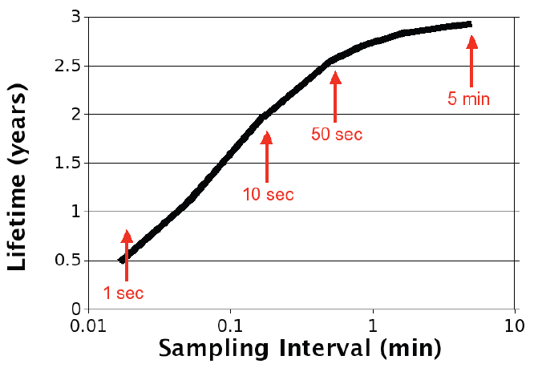
Hand-Tuned Node Lifetime
Assume 2 AA batteries ~= 2700mAh
2.93 Years with 5 minute sample interval

Slide 52
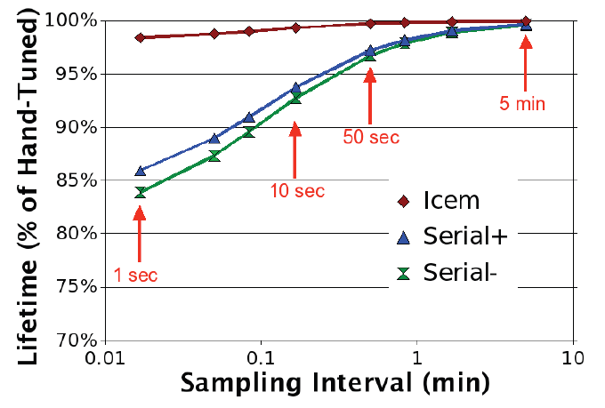
Node Lifetime Comparison

Slide 53
Conclusions
ICEM: Integrated Concurrency and Energy Management
Device driver architecture for ultra-low power device
Applications operate within 1.6% of hand-tuned optimal energy implementation (based on representative application)
Simplifies application and driver development
Based on the hypothesis that the most useful power management information an application can provide an OS is the potential concurrency of its I/O operations.
Application level concurrency allows the OS to save energy by efficiently scheduling I/O operations
Questions the assumption that sensornet applications must be responsible for all energy management and cannot use a standardized OS with a simple API.

Slide 54
Paper Analysis
What is new (2007)
OS power management support in a RTOS
Implemented in TinyOS – Split Phase
Using a traditionally passive mechanism to implement an active power policy
Idea that concurrency is the most important power information you can pass to the OS
What isn’t so new
The idea of abstracting power management controls from the application to the OS (OSPM)
Notes:
OSPM – Operating system directed power managment

Slide 55
Paper Quality
Pros
Major Conference (SOSP ‘07)
Credible Authors
Application using ICEM is within 1.6% energy consumption of the ideal implementation
Low overhead (Memory and Computational)
Reduces application complexity
Unique Solution
Notes:
Is the simple application really representative of most sensornet systems.
Implemented in TinyOS 2.0, Is this a pro or con? I would argue both.
Pro: Implementation proves it is viable
Cons: TinyOS is a small footprint OS that is single threaded (stack), non-blocking and has completion callback/upcall to eliminate polling. Would this concept scale?
Scalability

Slide 56
Paper Quality
Cons
Small number of citations (11 in 3.5 years)
Increases initial development time
All conclusions based on a “representative” simple application and hardware platform
Low Duty Cycle
All sensors sampled at same frequency
Solution based on assumption that the most important information an application can provide the OS is the potential concurrency of its I/O operations.
Potential for Deadlock
Scalability
Notes:
Is the simple application really representative of most sensornet systems.
Implemented in TinyOS 2.0, Is this a pro or con? I would argue both.
Pro: Implementation is viable.
Cons: TinyOS is a small footprint OS that is single threaded (stack), non-blocking and has completion callback/upcall to eliminate polling.
Is it scalable, portable, useable?

Slide 57
Questions?
Notes:
SOSP - Symposium of Operating Systems Principles
Is the simple application really representative of most sensornet systems
Implemented in TinyOS 2.0, Is this a pro or con?

Slide 58
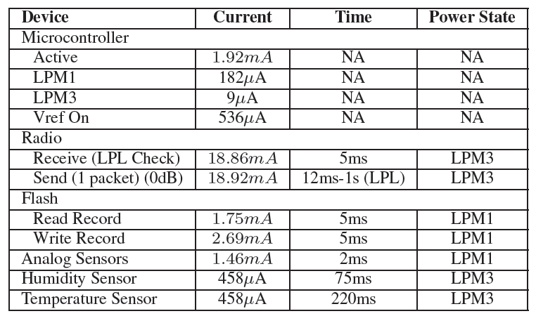
System Power
Notes:
The processor values are reported for each power state and include leakage currents of platform peripherals such as sensors, USB, and flash. The peripheral values do not include the processor current draw; instead, they show the lowest power state the processor can enter while that peripheral is in use. This is LPM3 for the radio because the SPI bus is off except for a few hundred microseconds of radio commands. It is
LPM1 for the flash because logging operations keep the SPI bus on. It is also LPM1 for the analog sensors because the ADC requires a clock source, while it is LPM3 for the two I2C sensors because the bus is in software on GPIO pins. Finally, the voltage reference requires a 17ms warmup time before it can be used.

Slide 59
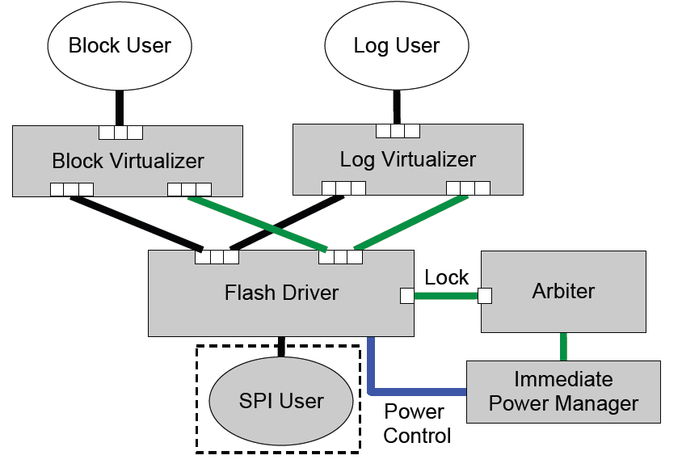
Virtualized Example Driver
Flash Storage

Slide 60
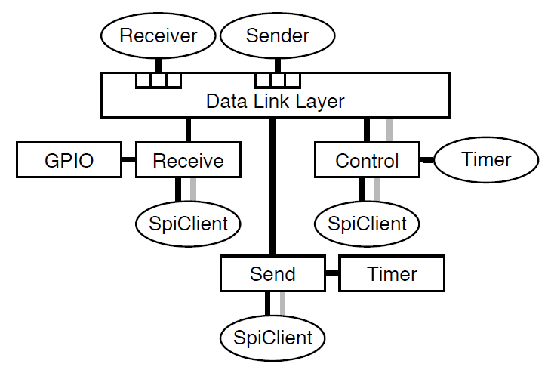
Example CC2420 Stack
3 Shared Drivers
SPI
2 Dedicated Drivers
GPIO
Timer
2 Virtualized Drivers
Send
Receive

Slide 61
Other Papers
V. Venkatachalam and M. Franz. “Power Reduction Techniques For Microprocessor Systems” ACM Computing Surveys, 37(3):195-237, 2005
Dutta, P., Culler, D., and Shenker, S. “Procrastination might lead to a longer and more useful life”. HotNets-VI (2007).

Slide 62
Device Driver Links
QNX Developer Support "http://www.qnx.com/developers/docs/6.3.0SP3/neutrino/sys_arch/power.html”
Linux Device Drivers “http://lwn.net/images/pdf/LDD3/”
Mac Os X Developers Library “http://developer.apple.com/library/mac/#documentation/DeviceDrivers/Conceptual/IOKitFundamentals/PowerMgmt/PowerMgmt.html”
The Windows 2000 device driver book “http://books.google.com/books?id=nZu3E_IZS34C&pg=PA187&lpg=PA187&dq=device+drivers+that+manage+power&source=bl&ots=dwTefjhD67&sig=WjjWzBABUZC53vbtjnYq4OZGso4&hl=en&ei=ONOcTe7FBYKftwe0ofnVBw&sa=X&oi=book_result&ct=result&resnum=6&ved=0CEIQ6AEwBQ#v=onepage&q=device%20drivers%20that%20manage%20power&f=false”

