Slide 1


DATA VISUALIZATION COMPETITION

Slide 2
BTAA Data Visualization Competition
Who: all students can compete individually or on a team
What: an original visualization from a selected dataset
Where: virtually and some local events!
When: February 9th through 13th, 2026 (submit visualization to Iowa LDW team by January 16th)
Why: to fight for Iowa…and possibly win some $$$
How: submit for Iowa competition on Data Hub link

Slide 3
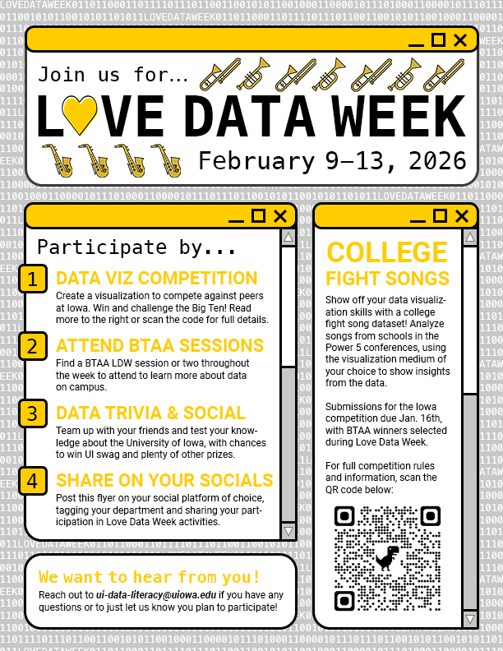
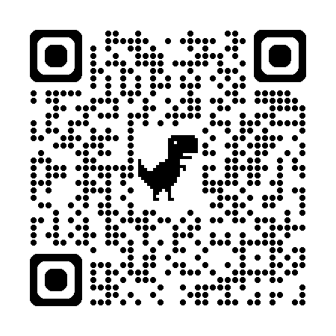
LDW - More Information
Visit our LDW page on the university’s Data Hub site:
hub.data.uiowa.edu

Slide 4
Questions? Contact me…
matthew-hodges@uiowa.edu
ui-data-literacy@uiowa.edu

