Slide 1
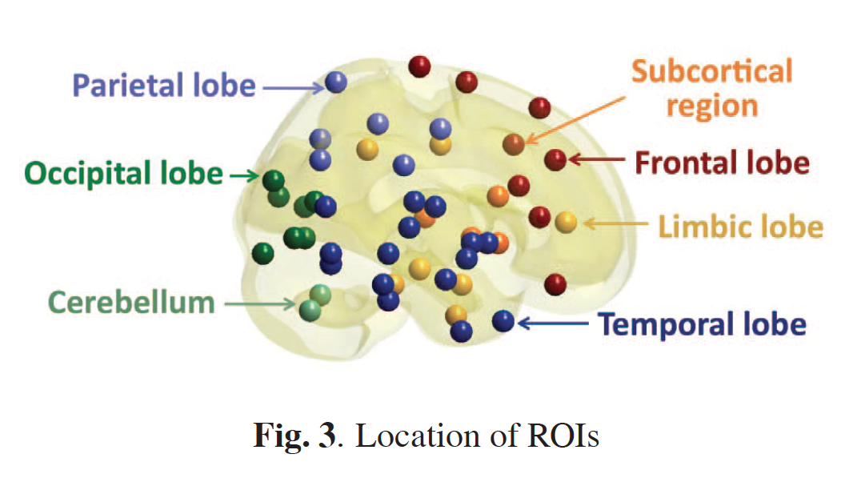
Discriminative persistent homology of brain networks, 2011 Hyekyoung Lee Chung, M.K.; Hyejin Kang; Bung-Nyun Kim;Dong Soo Lee
Constructing functional brain networks with 97 regions of interest (ROIs) extracted from FDG-PET data for
24 attention-deficit hyperactivity disorder (ADHD),
26 autism spectrum disorder (ASD) and
11 pediatric control (PedCon).
Data = measurement f_{j}
taken at region j
Graph: 97 vertices representing 97 regions of interest
edge exists between two vertices i,j if correlation
between f_{j} and f_{j} ≥ threshold
How to choose the threshold? Don’t, instead use persistent homology

Slide 2
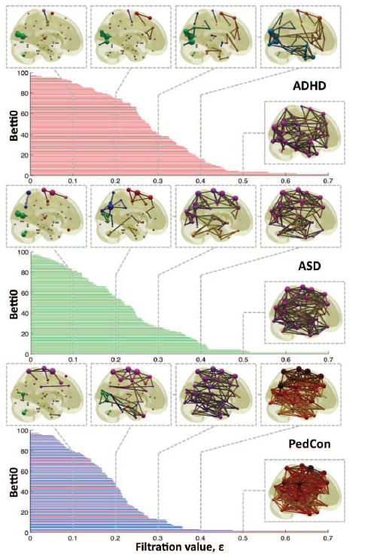

Vertices = Regions of Interest
Create Rips complex by growing epsilon balls (i.e. decreasing threshold) where distance between two vertices is given by
where f_{i} =
measurement at location i

Slide 3
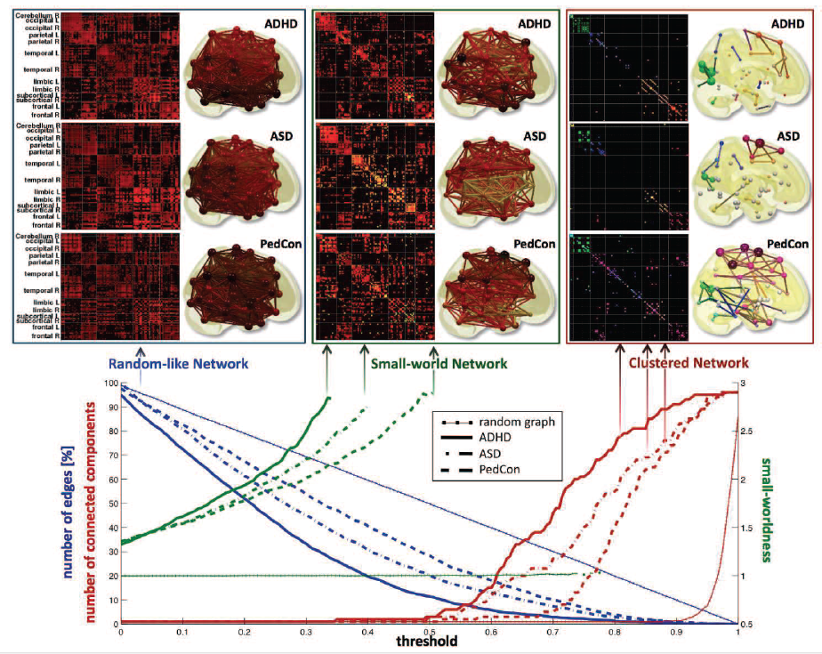

Slide 4
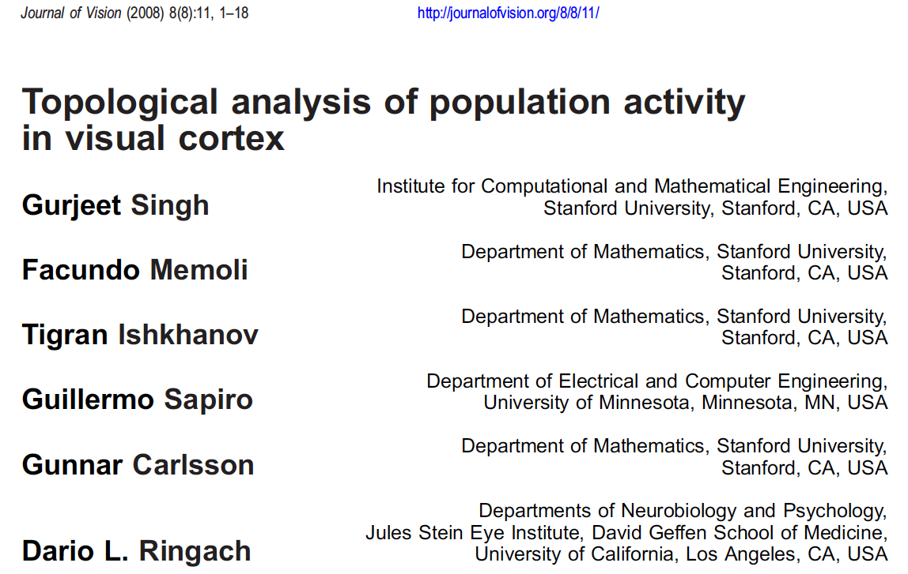

Slide 5
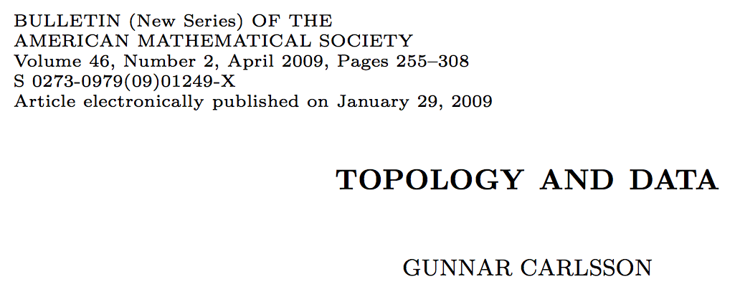
The primary visual cortex (V1)
1.) V1 is a component in the visual pathway, which begins with
the retinal cells in the eye,
proceeds through the lateral geniculate locus,
then to the primary visual cortex,
and then through a number of higher level processing units, such as V2, V3, V4, middle temporal area (MT), and others
2.) V1 performs low level tasks, such as edge and line detection, and its output is then processed for higher level and larger scale properties further along the visual pathway. However, the mechanism by which it carries out these tasks is not understood.

Slide 6
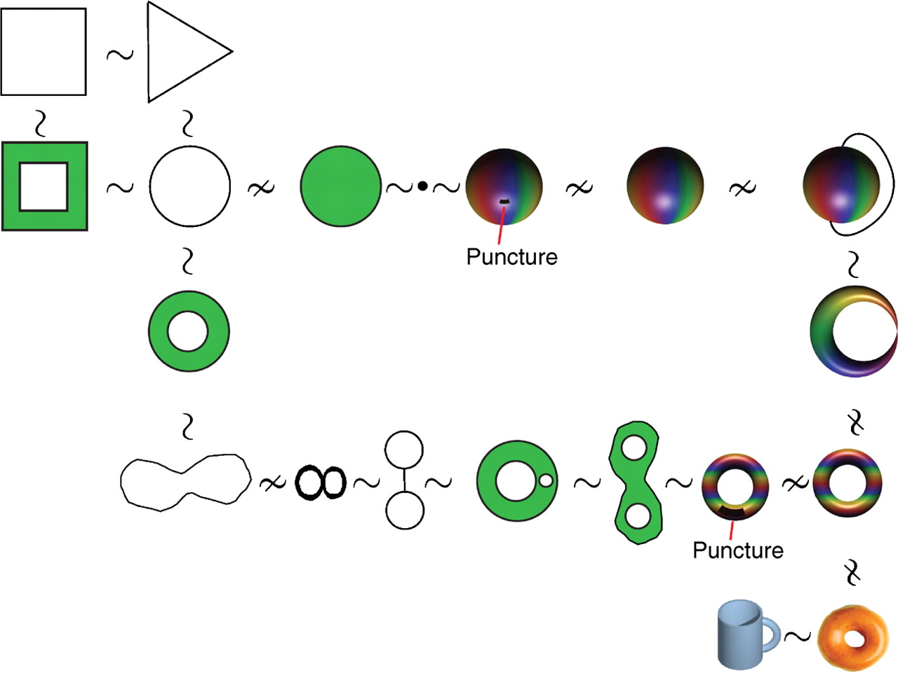

Topological equivalence in rubber-world.
Singh G et al. J Vis 2008;8:11
©2008 by Association for Research in Vision and Ophthalmology
Notes:
Topological equivalence in rubber-world. The figure illustrates the notion of equivalence by showing several objects (topological spaces) connected by the symbols ∼ when they are equivalent or by ≁ when they are not. The reader should think that all the objects shown are made of an elastic material and visualize the equivalence of two spaces by imagining a deformation between to objects.

Slide 7
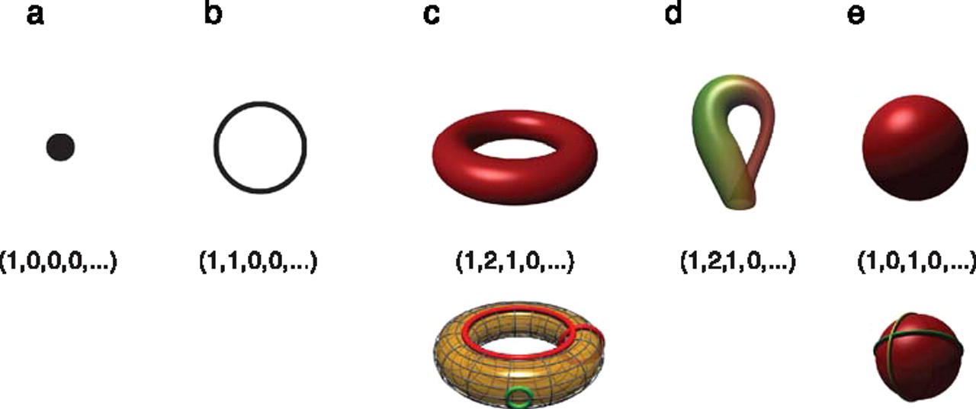
Betti numbers provide a signature of the underlying topology.
Singh G et al. J Vis 2008;8:11
©2008 by Association for Research in Vision and Ophthalmology
Notes:
Betti numbers provide a signature of the underlying topology. Illustrated in the figure are five simple objects (topological spaces) together with their Betti number signatures: (a) a point, (b) a circle, (c) a hollow torus, (d) a Klein bottle, and (e) a hollow sphere. For the case of the torus (c), the figure shows three loops on its surface. The red loops are “essential” in that they cannot be shrunk to a point, nor can they be deformed one into the other without tearing the loop. The green loop, on the other hand, can be deformed to a point without any obstruction. For the torus, therefore, we have b 1 = 2. For the case of the sphere, the loops shown (and actually all loops on the sphere) can be contracted to points, which is reflected by the fact that b 1 = 0. Both the sphere and the torus have b 2 = 1, this is due to the fact both surfaces enclose a part of space (a void).

Slide 8
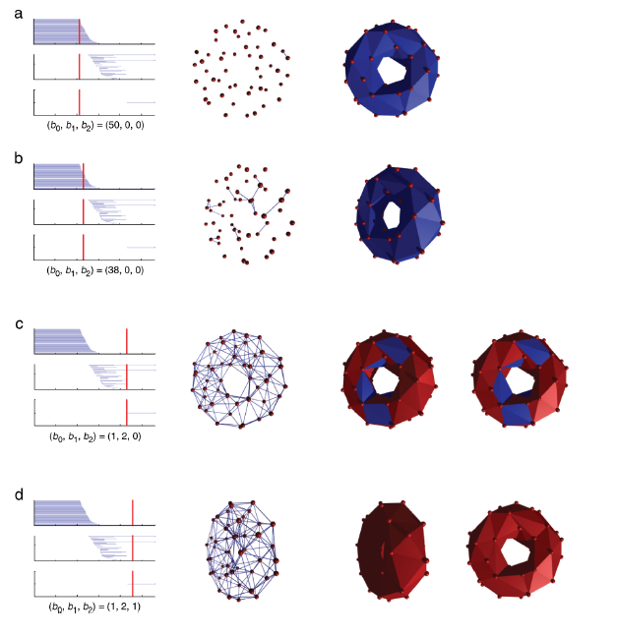
http://www.journalofvision.org/
content/8/8/11.full
Figure 4 animation

Slide 9
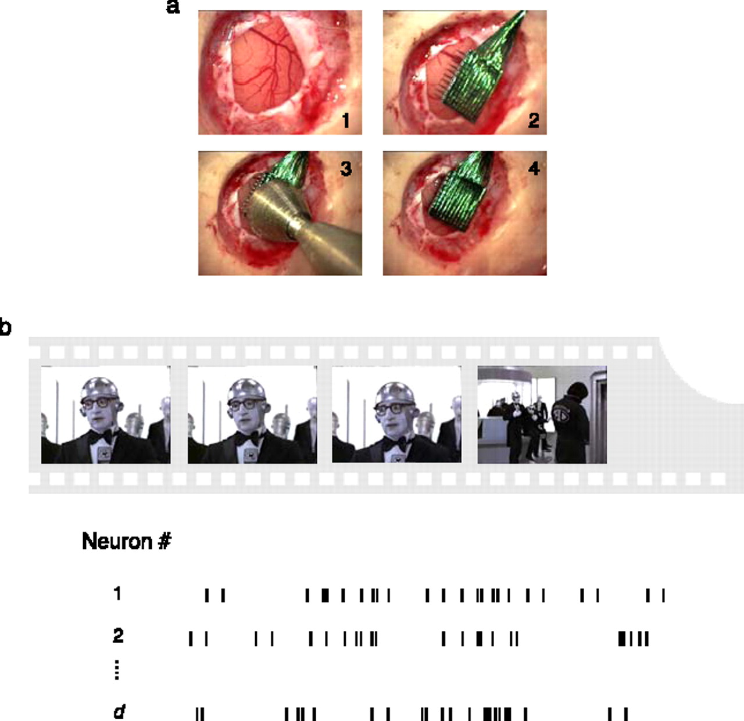
Experimental recordings in primary visual cortex.
Singh G et al. J Vis 2008;8:11
©2008 by Association for Research in Vision and Ophthalmology
Notes:
Experimental recordings in primary visual cortex. (a) Insertion sequence of a multi-electrode array into primary visual cortex (Nauhaus & Ringach, 2007). (b) Natural image sequences, sampled from commercial movies, were used to stimulate all receptive fields of neurons isolated by the array. In the spontaneous condition, activity was recorded while both eyes were occluded.

Slide 10
Studied via embedded electrode arrays
Record voltages at points in time at each electrode.
Spike train: lists of firing times for a neuron
obtained via spike sorting –i.e. signal processing.
Data = an array of N spike trains.
Compared spontaneous (eyes occluded) to evoked (via movie clips).
10 second segments broken into 50 ms bins
The 5 neurons with the highest firing rate in each ten second window were chosen
For each bin, create a vector in R⁵ corresponding to the number of firings of each of the 5 neurons.
200 bins = 200 data points in R⁵
Many 10 second segments = many data sets

Slide 11
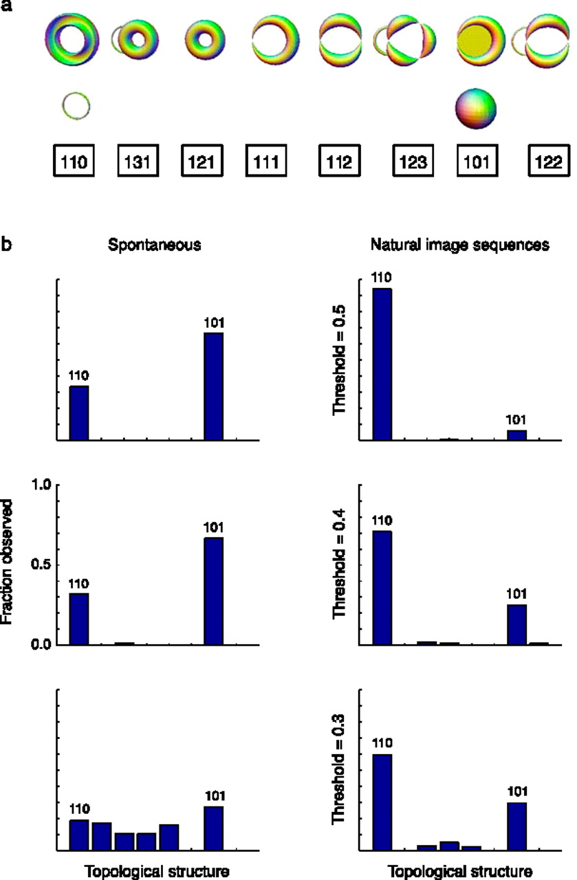
Estimation of topological structure in driven and spontaneous conditions.
Record voltages at points in time at each electrode.
Spike train: lists of firing times for a neuron
obtained via spike sorting –i.e. signal processing.
Data = an array of N spike trains.
Compared spontaneous (eyes occluded) to evoked (via movie clips).
10 second segments broken into 50 ms bins
Transistion between states about 80ms
The 5 neurons with the highest firing rate in each ten second window were chosen
For each bin, create a vector in R⁵ corresponding to the number of firings of each of the 5 neurons.
200 bins = 200 data points in R⁵.
Used 35 landmark points.
20-30minutes of data = many data sets
Control: shuffled data 52700 times.
Singh G et al. J Vis 2008;8:11
©2008 by Association for Research in Vision and Ophthalmology
Notes:
Estimation of topological structure in driven and spontaneous conditions. (a) Ordering of topological signatures observed in our experiments. Each triplet ( b 0, b 1, b 2) is shown along an illustration of objects consistent with these signature. (b) Distribution of topological signatures in the spontaneous and natural image stimulation conditions pooled across the three experiments performed. Each row correspond to signatures with a minimum interval length (denoted as the threshold) expressed as a fraction of the covering radius of the data cloud (see Appendix A for the definition of the covering radius).

Slide 12
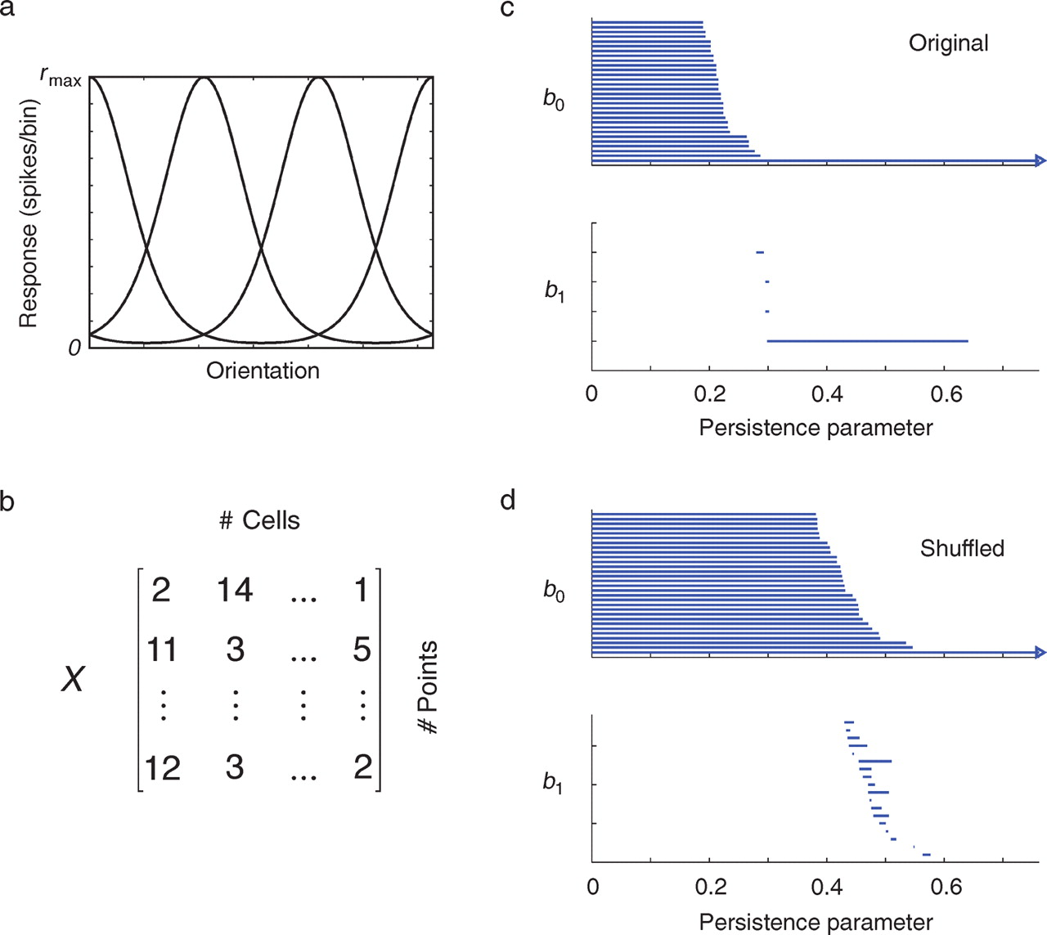
Testing the statistical significance of barcodes.
Singh G et al. J Vis 2008;8:11
©2008 by Association for Research in Vision and Ophthalmology
Notes:
Testing the statistical significance of barcodes. (a) We assume an initial population of Poisson-spiking neurons tuned for orientation. (b) The simulated response of this population to the presentation of different orientations is collected into a data matrix (or point cloud). (c) Analysis of the simulated data shows a long interval with a signature (b0, b1) = (1, 1), which correctly identifies the underlying object as a circle. (d) We also compute the barcodes by shifting the relative positions of the columns (data shuffling). In this case, the statistical distributions of spike counts for each axis remain unchanged, but their relationship is destroyed. By computing the distribution of maximal b1 lengths under this null hypothesis, we can evaluate the likelihood that our data was generated by the null hypothesis that there the coordinates of the points are independent.

Slide 13
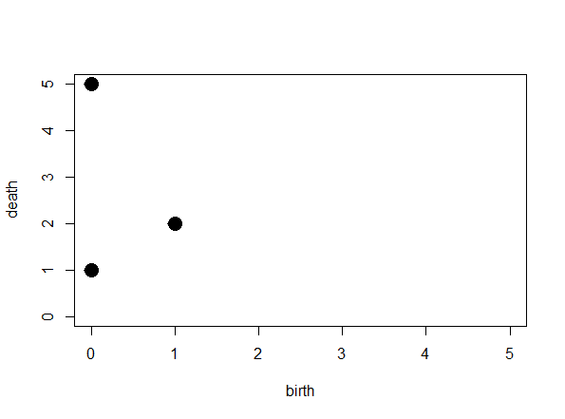
[ )
[ )
[ )
[ )
[
(3, 4)
(1, 2)
(2, 5)
(0, 1)
(0, 5)
The diagonal will be useful when we compute distance between persistence diagrams
Remember to add the diagonal

Slide 14
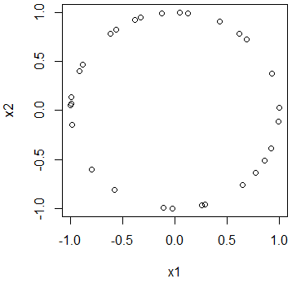
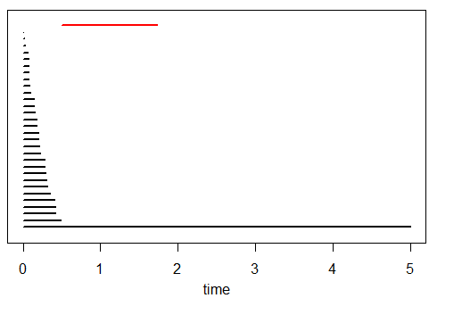
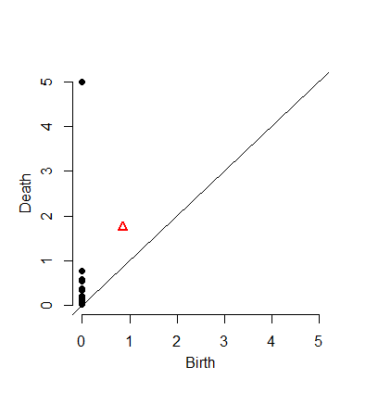
Barcode
A bar starts at the birth time of the cycle it represents and ends at its death time
This plot of points
(birth, death)
is called the
Persistence Diagram
where we also throw in the diagonal.

Slide 15
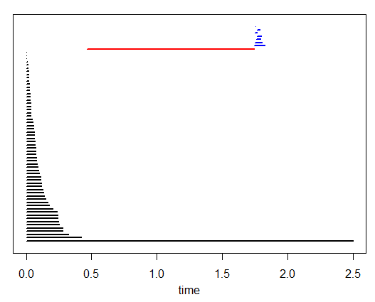
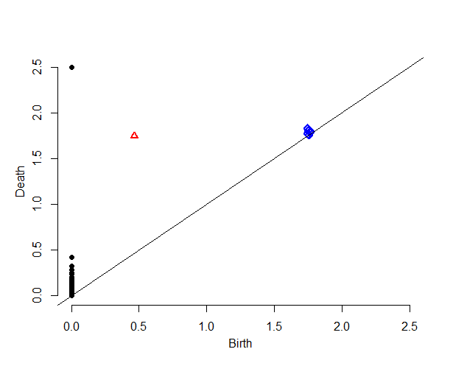
From the barcode:
1 persistent 0-dim cycle ➔ H₀ = 1
1 persistent 1-dim cycle ➔ H₁ = 1
No persistent 2-dim cycles ➔ H₂ = 0
Ignore bars with “small” length
Definition of “small” depends on dimension, data set, application, etc.
From the persistent diagram:
1 black point far from the diagonal ➔ H₀ = 1
1 red point far from diagonal ➔ H₁ = 1
All blue points close to diagonal ➔ H₂ = 0
Ignore points “close” to diagonal
Definition of “close” depends on dimension, data set, application, etc.

Slide 16
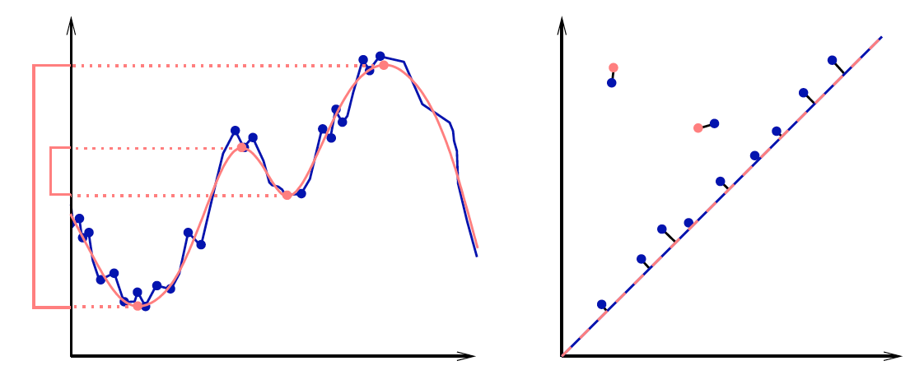
|| (x₁,…,x_{n}) – (y₁,…,y_{n}) ||∞ = max{|x₁ – y₁|,…,|x_{n} - y_{n}|}
Given sets X, Y and bijection g: X → Y,
Bottleneck Distance: d_{B}(X, Y) = inf sup || x – g(x) ||∞
g x

Slide 17
Bottleneck Distance.
Let Diag1and Diag2 be persistence diagrams.
The bottleneck distance is
the infimum over all bijections h: Diag1 → Diag 2 of
sup_{i} d(i; h(i)).

Slide 18
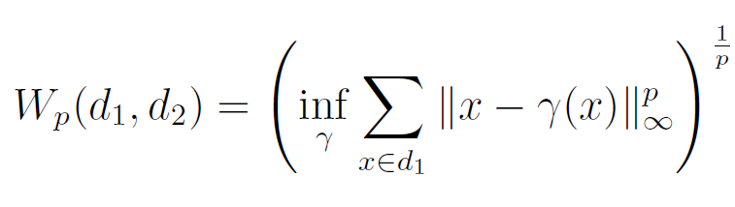
(Wasserstein distance). The p-th Wasserstein distance between two persistence diagrams,
d₁ and d₂, is defined as
where γ ranges over all bijections from d₁ to d₂.
Probability measures on the space of persistence
diagrams
Yuriy Mileyko1, Sayan Mukherjee2 and John Harer1

Slide 19
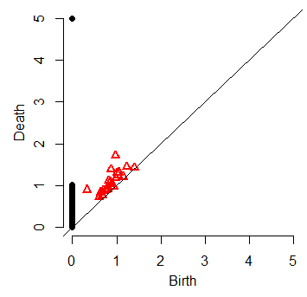
> print( bottleneck(Diag1, Diag2, dimension=0) )
[1] 0.4942465
> print( wasserstein(Diag1, Diag2, p=2, dimension=0) )
[1] 5.750874
> print( bottleneck(Diag1, Diag2, dimension=1) )
[1] 0.279019
> print( wasserstein(Diag1, Diag2, p=2, dimension=1) )
[1] 0.301575

Slide 20
For every rule, there is an exception.
Sometimes you are interested in points near the diagonal
– i.e, short bars,
– i.e, short-lived cycles.

Slide 21
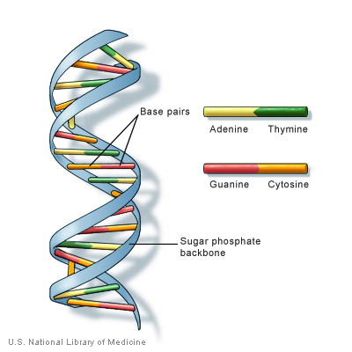
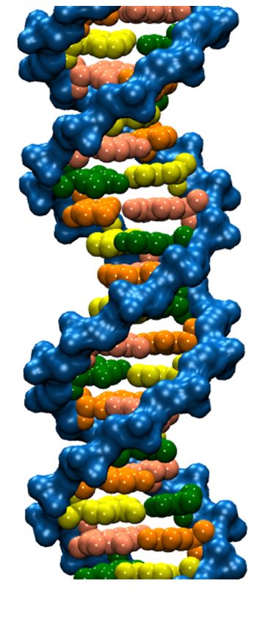
DNA trivia: Who are the authors of the 1953 paper on DNA with the following quotes:
“DNA is a helical structure”
with “two co-axial molecules.”
“period is 34 Å”
“one repeating unit contains ten
nucleotides on each of two . . . co-axial molecules.'’
“The phosphate groups lie on the outside of the structural unit, on a helix of diameter about 20 Å”
“the sugar and base groups must accordingly be turned inwards towards the helical axis.”

Slide 22

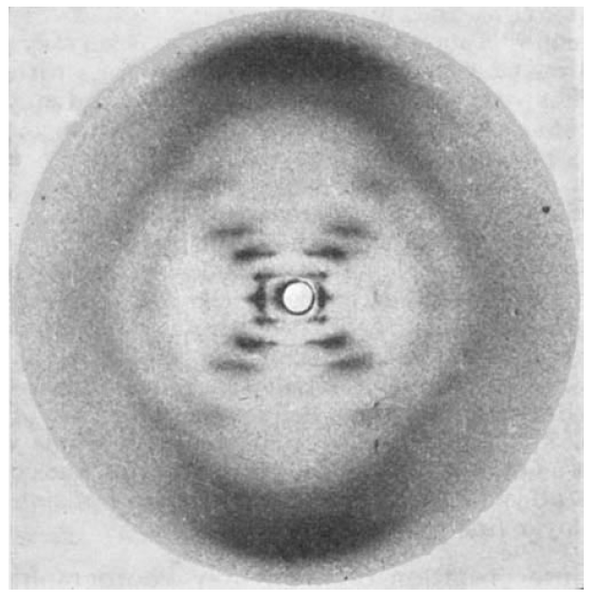


Slide 23
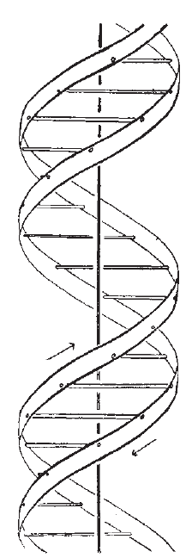


Also published in the same issue of Nature:

Slide 24
If someone gives you data, check with them BEFORE you share it with others.
If it involves human data, you may need approval from the ethics board.
If it involves human data, you may need to keep it secure – i.e, not on an unsecured laptop.

Slide 25
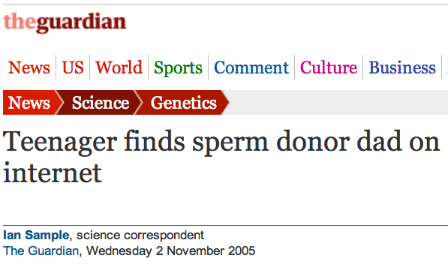
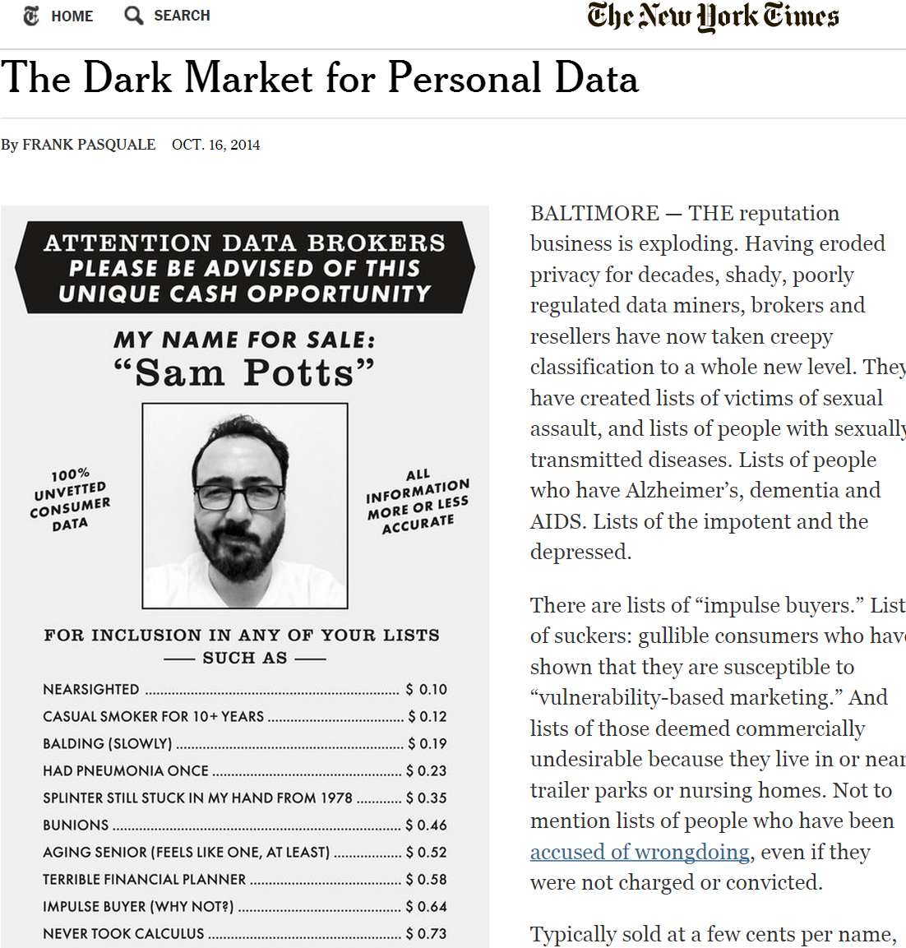
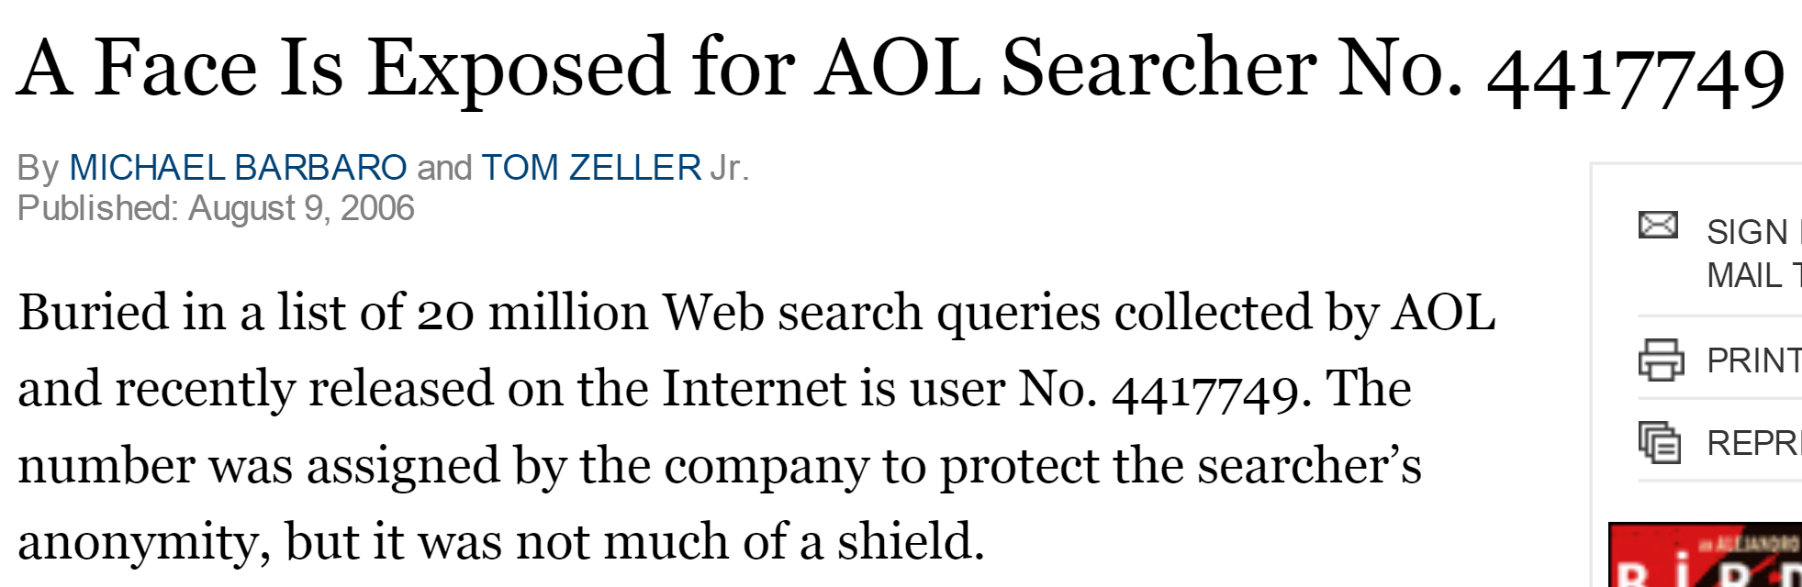

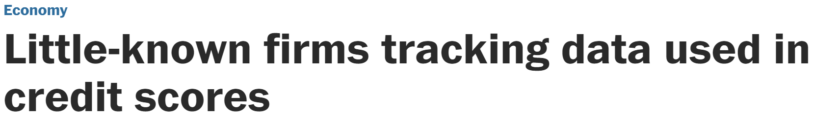

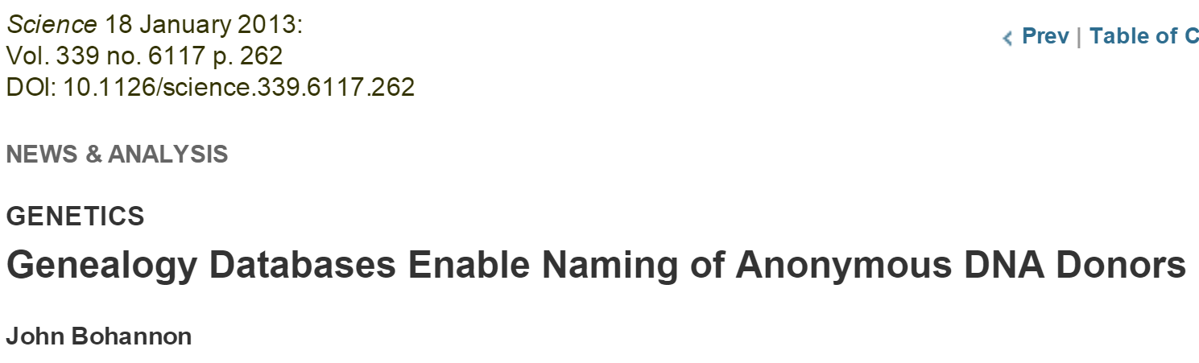
Data is NEVER fully anonymized
http://www.theguardian.com/science/2005/nov/03/genetics.news
http://www.nytimes.com/2014/10/17/opinion/the-dark-market-for-personal-data.html
http://www.nytimes.com/2006/08/09/technology/09aol.html, https://www.sciencemag.org/content/339/6117/262
http://www.washingtonpost.com/business/economy/little-known-firms-tracking-data-used-in-credit-scores/2011/05/24/gIQAXHcWII_story.html

Slide 26

http://jama.jamanetwork.com/article.aspx?articleid=1690694
JAMA. 2013;309(20):2083-2084. doi:10.1001/jama.2013.5048
“IN MARCH, THE PUBLICATION OF THE complete genome sequence of cancer cells from a Maryland woman who died in 1951 ignited an ethical firestorm. These cells, called HeLa because they were derived from the cervical tumor of Henrietta Lacks, have been widely cultured in laboratories and used in research.”

Slide 27
http://www.nature.com/news/deal-done-over-hela-cell-line-1.13511
1951 Biopsy of Henrietta Lacks’ tumour collected without her knowledge or consent. HeLa cell line soon established.
1971 The journal Obstetrics and Gynecology names Henrietta Lacks as HeLa source; word later spreads in Nature, Science and mainstream press.
1973 Lacks family members learn about HeLa cells. Scientists later collect their blood to map HeLa genes, without proper informed consent.
1996 Lacks family honored at the first annual HeLa Cancer Control Symposium, organized by former student of scientist who isolated HeLa cells.
2013 HeLa genome published without knowledge of the family, which later endorses restricted access to HeLa genome data.

Slide 28
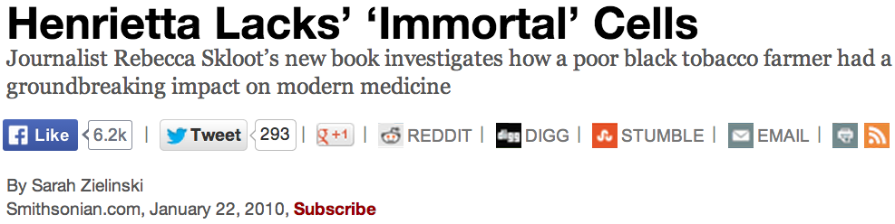
http://www.smithsonianmag.com/science-nature/Henrietta-Lacks-Immortal-Cells.html
…HeLa cells could float on dust particles in the air & travel on unwashed hands and contaminate other cultures. It became an enormous controversy. In the midst of that, one group of scientists tracked down Henrietta’s relatives to take some samples with hopes that they could use the family’s DNA to make a map of Henrietta’s genes so they could tell which cell cultures were HeLa and which weren’t, to begin straightening
out the contamination problem.

Slide 29
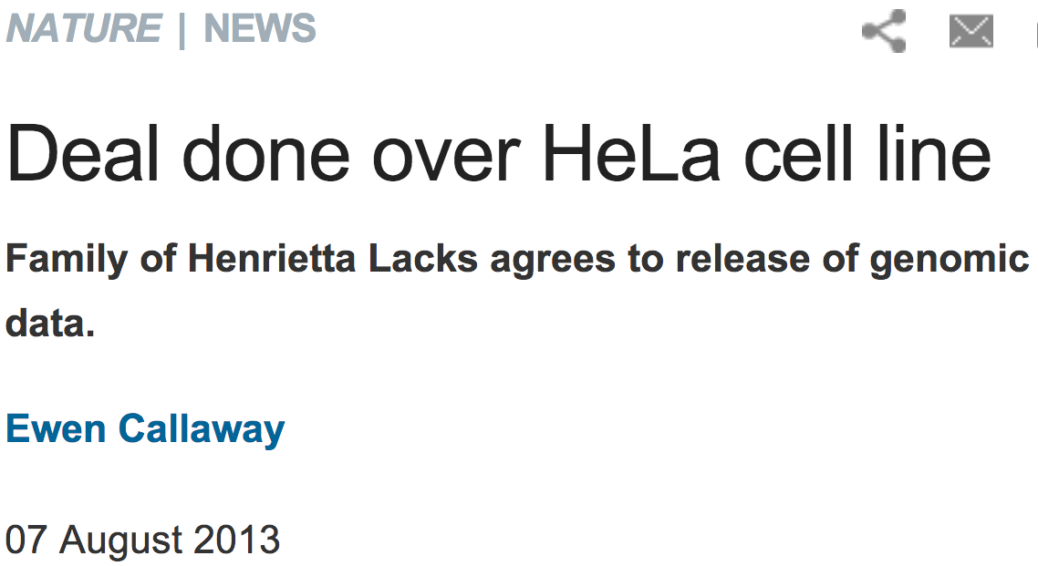
http://www.nature.com/news/deal-done-over-hela-cell-line-1.13511

Slide 30
http://www.npr.org/blogs/health/2013/01/17/169634045/some-types-of-insurance-can-discriminate-based-on-genes
In the USA, Under GINA (2009), it's (mostly) illegal for
an employer to fire someone based on his genes, and it's illegal for health insurers to raise rates or to deny coverage because of someone's genetic code.
But the law has a loophole: It only applies to health insurance. It doesn't say anything about companies
that sell life insurance, disability insurance or
long-term-care insurance.”
People who discover they have the gene, ApoE4, associated with Alzheimer’s are 5 times more likely
than the average person to go out and buy
long-term-care insurance.

Slide 31
http://www.theguardian.com/science/2005/nov/03/genetics.news

Slide 32
The boy took the saliva sample late and sent it off to an online genealogy DNA-testing service.
boy's genetic father had never supplied his DNA
2 men on the database matched his Y-chromosome
The two men did not know each other, but shared a surname, albeit with a different spelling.
genetic similarity of their Y-chromosomes suggested a 50% chance that the 2 men & the boy shared the same father, grandfather or great-grandfather.
bought information on everyone born in the same place and on the same date as his father.

Slide 33
Science 18 January 2013: Vol. 339 no. 6117 p. 262
NEWS & ANALYSIS GENETICS
Genealogy Databases Enable Naming of Anonymous DNA Donors by John Bohannon
Science 18 January 2013: Vol. 339 no. 6117 pp. 321-324
Identifying Personal Genomes by Surname Inference
Melissa Gymrek, Amy L. McGuire, David Golan, Eran Halperin, Yaniv Erlich
able to expose the identity of 50 individuals whose DNA was donated anonymously for scientific study through consortiums such as the 1000 Genomes Project.

