Slide 1
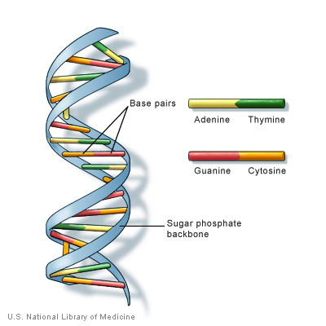
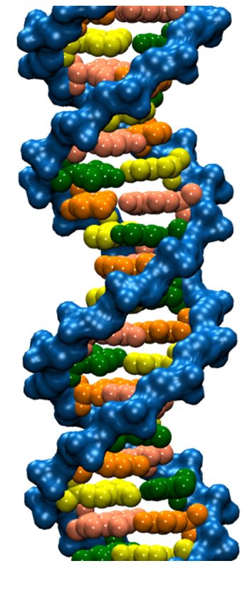
DNA trivia: Who are the authors of the 1953 paper on DNA with the following quotes:
“DNA is a helical structure”
with “two co-axial molecules.”
“period is 34 Å”
“one repeating unit contains ten
nucleotides on each of two . . . co-axial molecules.'’
“The phosphate groups lie on the outside of the structural unit, on a helix of diameter about 20 Å”
“the sugar and base groups must accordingly be turned inwards towards the helical axis.”

Slide 2

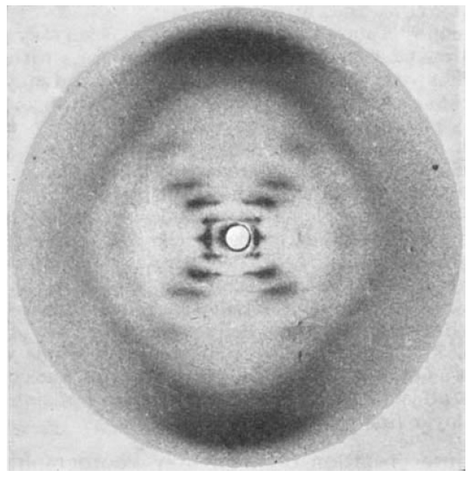
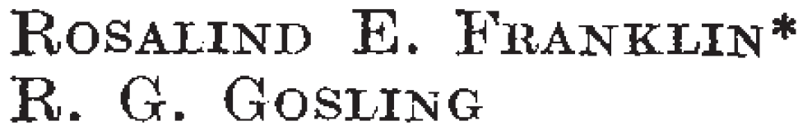

Slide 3
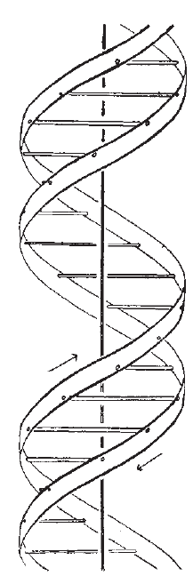
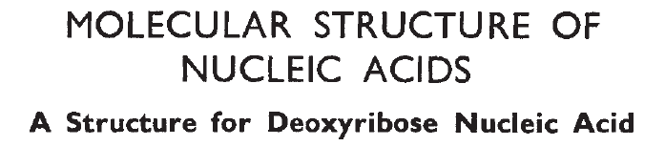
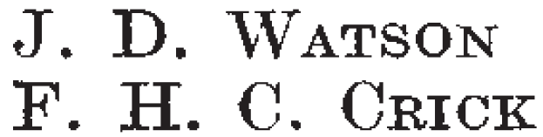
Also published in the same issue of Nature:

Slide 4
If someone gives you data, check with them BEFORE you share it with others.
If it involves human data, you may need approval from the ethics board.
If it involves human data, you may need to keep it secure – i.e, not on an unsecured laptop.

Slide 5
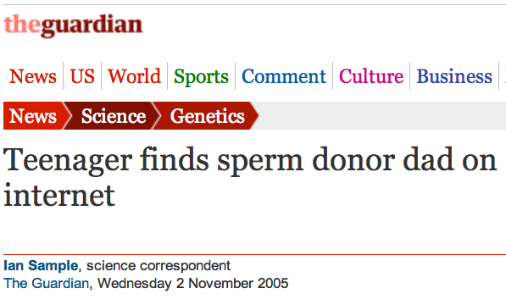
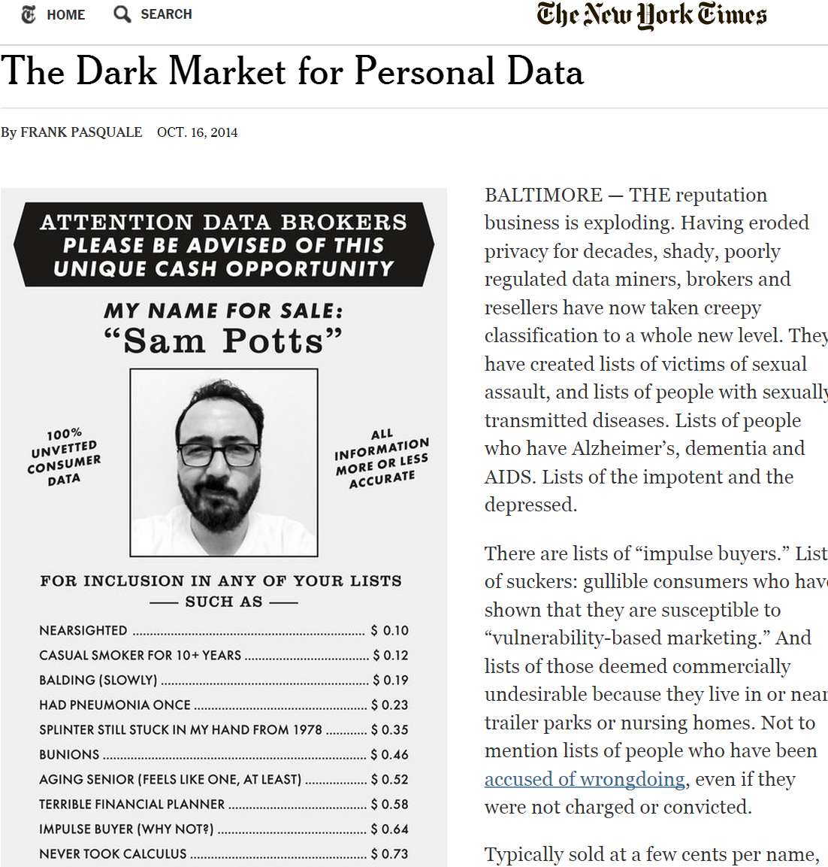
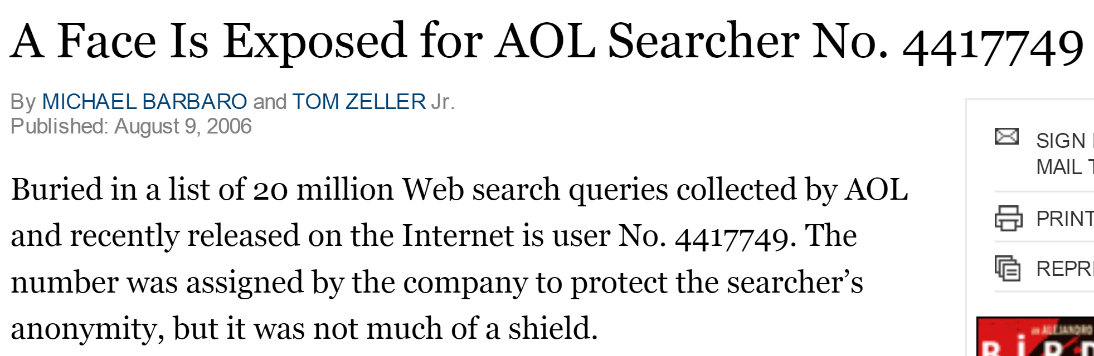

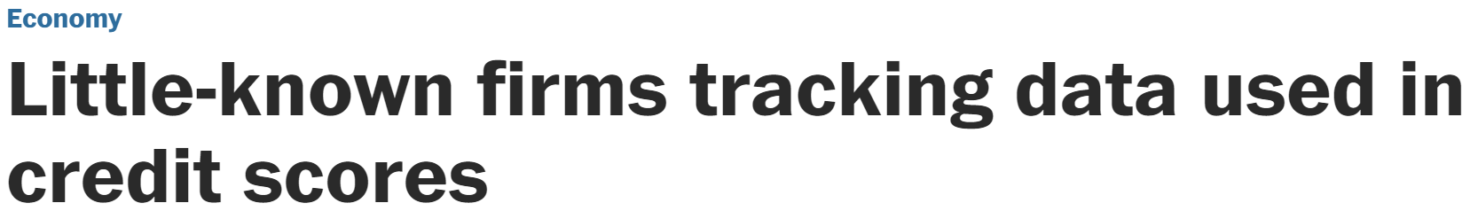

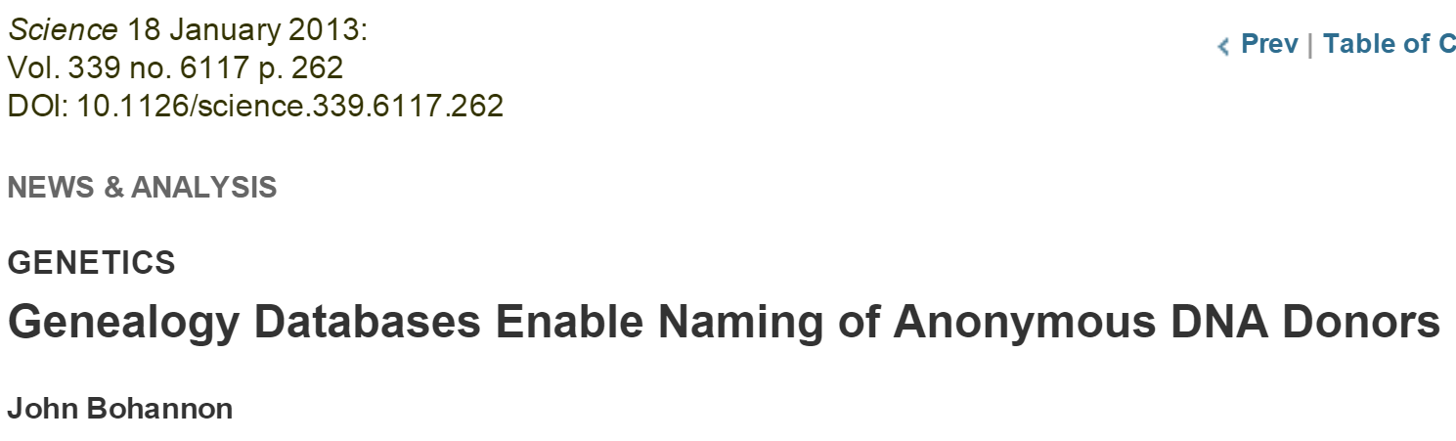
Data is NEVER fully anonymized
http://www.theguardian.com/science/2005/nov/03/genetics.news
http://www.nytimes.com/2014/10/17/opinion/the-dark-market-for-personal-data.html
http://www.nytimes.com/2006/08/09/technology/09aol.html, https://www.sciencemag.org/content/339/6117/262
http://www.washingtonpost.com/business/economy/little-known-firms-tracking-data-used-in-credit-scores/2011/05/24/gIQAXHcWII_story.html

Slide 6
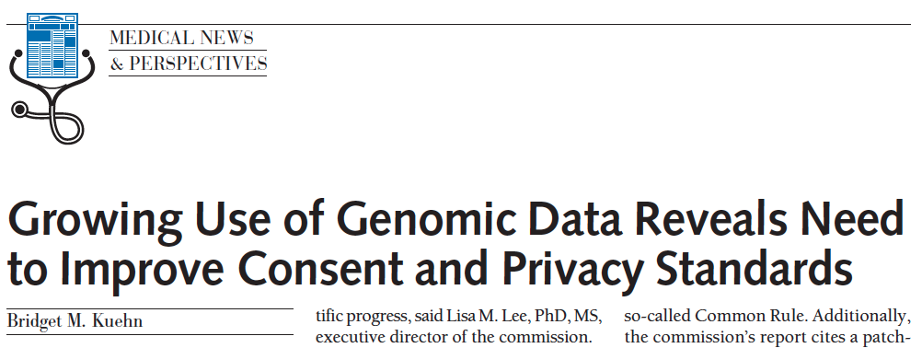
http://jama.jamanetwork.com/article.aspx?articleid=1690694
JAMA. 2013;309(20):2083-2084. doi:10.1001/jama.2013.5048
“IN MARCH, THE PUBLICATION OF THE complete genome sequence of cancer cells from a Maryland woman who died in 1951 ignited an ethical firestorm. These cells, called HeLa because they were derived from the cervical tumor of Henrietta Lacks, have been widely cultured in laboratories and used in research.”

Slide 7
http://www.nature.com/news/deal-done-over-hela-cell-line-1.13511
1951 Biopsy of Henrietta Lacks’ tumour collected without her knowledge or consent. HeLa cell line soon established.
1971 The journal Obstetrics and Gynecology names Henrietta Lacks as HeLa source; word later spreads in Nature, Science and mainstream press.
1973 Lacks family members learn about HeLa cells. Scientists later collect their blood to map HeLa genes, without proper informed consent.
1996 Lacks family honored at the first annual HeLa Cancer Control Symposium, organized by former student of scientist who isolated HeLa cells.
2013 HeLa genome published without knowledge of the family, which later endorses restricted access to HeLa genome data.

Slide 8
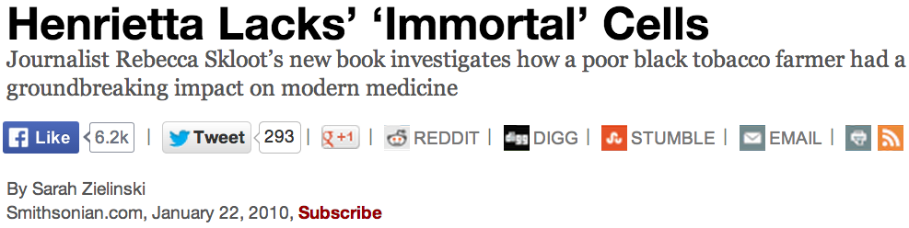
http://www.smithsonianmag.com/science-nature/Henrietta-Lacks-Immortal-Cells.html
…HeLa cells could float on dust particles in the air & travel on unwashed hands and contaminate other cultures. It became an enormous controversy. In the midst of that, one group of scientists tracked down Henrietta’s relatives to take some samples with hopes that they could use the family’s DNA to make a map of Henrietta’s genes so they could tell which cell cultures were HeLa and which weren’t, to begin straightening
out the contamination problem.

Slide 9
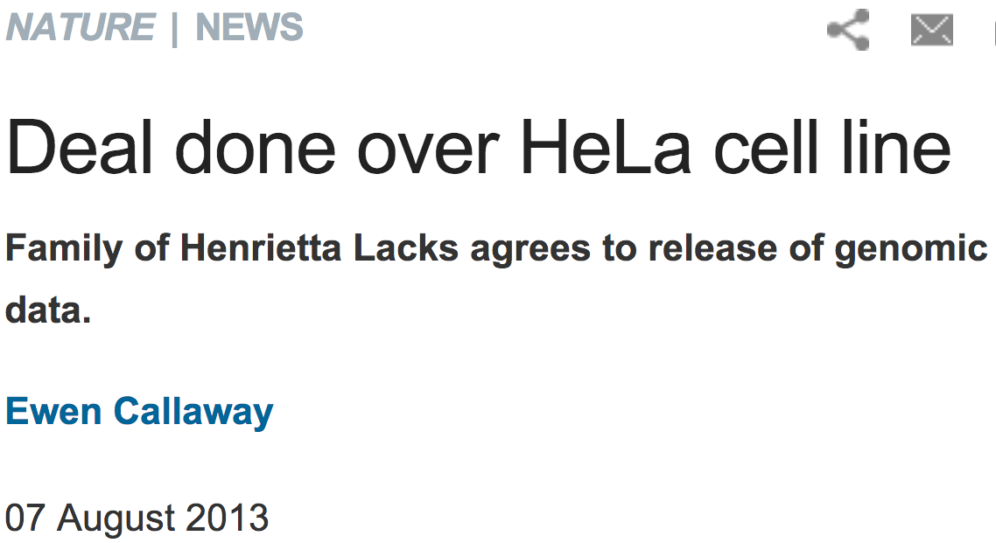
http://www.nature.com/news/deal-done-over-hela-cell-line-1.13511

Slide 10
http://www.npr.org/blogs/health/2013/01/17/169634045/some-types-of-insurance-can-discriminate-based-on-genes
In the USA, Under GINA (2009), it's (mostly) illegal for
an employer to fire someone based on his genes, and it's illegal for health insurers to raise rates or to deny coverage because of someone's genetic code.
But the law has a loophole: It only applies to health insurance. It doesn't say anything about companies
that sell life insurance, disability insurance or
long-term-care insurance.”
People who discover they have the gene, ApoE4, associated with Alzheimer’s are 5 times more likely
than the average person to go out and buy
long-term-care insurance.

Slide 11
http://www.theguardian.com/science/2005/nov/03/genetics.news

Slide 12
The boy took the saliva sample late and sent it off to an online genealogy DNA-testing service.
boy's genetic father had never supplied his DNA
2 men on the database matched his Y-chromosome
The two men did not know each other, but shared a surname, albeit with a different spelling.
genetic similarity of their Y-chromosomes suggested a 50% chance that the 2 men & the boy shared the same father, grandfather or great-grandfather.
bought information on everyone born in the same place and on the same date as his father.

Slide 13
Science 18 January 2013: Vol. 339 no. 6117 p. 262
NEWS & ANALYSIS GENETICS
Genealogy Databases Enable Naming of Anonymous DNA Donors by John Bohannon
Science 18 January 2013: Vol. 339 no. 6117 pp. 321-324
Identifying Personal Genomes by Surname Inference
Melissa Gymrek, Amy L. McGuire, David Golan, Eran Halperin, Yaniv Erlich
able to expose the identity of 50 individuals whose DNA was donated anonymously for scientific study through consortiums such as the 1000 Genomes Project.

