Slide 1
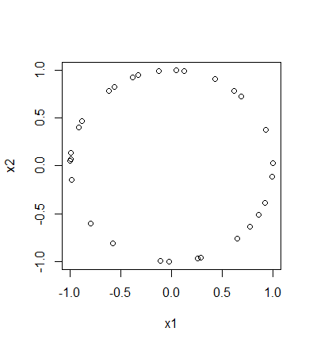
To install the TDA package on a PC:
install.packages("TDA")
To install the TDA package on a Mac:
install.packages("TDA", type = "source")
XX = circleUnif(30)

Slide 2
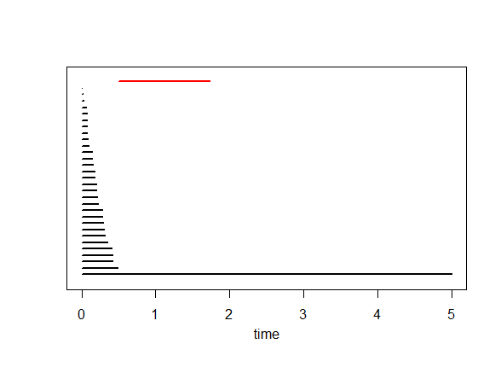
Plot of data points Barcode
Each bar in the barcode represents a cycle in some H_{i}.
The red bar represents the element in H₁ (i.e., the circle = 1 dimensional cycle = sum of edges where the boundary of this sum = 0).
Bars representing an element in H₀ (i.e, 0-dimensional cycles = vertices) are drawn in black

Slide 3
Plot of data points Barcode
Each bar in the barcode represents a cycle in some H_{i}.
A bar starts at the birth time of the cycle it represents and ends at its death time.

Slide 4
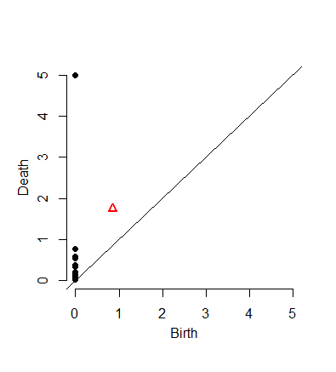
Barcode
A bar starts at the birth time of the cycle it represents and ends at its death time
For each cycle in H_{i} = bar in barcode, we can plot the point (birth, death)
where
birth = birth time of this cycle
death = death time of this cycle
Black point = cycle in H₀.
Red triangle = cycle in H₁.

Slide 5
Barcode
A bar starts at the birth time of the cycle it represents and ends at its death time
This plot of points
(birth, death)
is called the
Persistence Diagram
where we also throw in the diagonal.

Slide 6
H₀ = < a, b, c, d : tc + td, tb + c, ta + tb>
H₁ = <z₁, z₂ : t z₂, t³z₁ + t²z₂ >
[ )
[ )
[ )
[ )
[
z₁ = ad + cd + t(bc) + t(ab), z₂ = ac + t²bc + t²ab

Slide 7
Since we can’t plot (0, ∞), we instead plot (0, 5) where
5 = maximum time = maximum threshold
= 3rd argument in ripsDiag(XX,maxdimension,maxscale, …)
[ )
[ )
[ )
[ )
[
(3, 4)
(1, 2)
(2, 5)
(0, 1)
(0, ∞) → (0, 5)

Slide 8
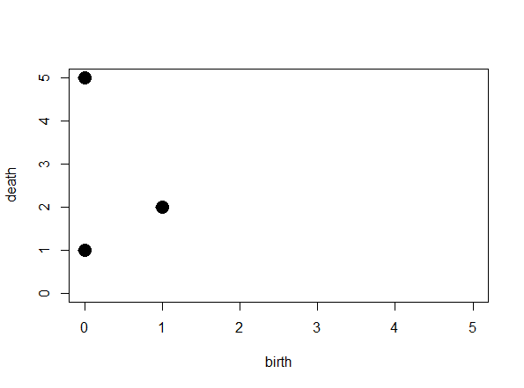
[ )
[ )
[ )
[ )
[
(3, 4)
(1, 2)
(2, 5)
(0, 1)
(0, 5)

Slide 9
[ )
[ )
[ )
[ )
[
(3, 4)
(1, 2)
(2, 5)
(0, 1)
(0, 5)
Remember to add the diagonal

Slide 10
[ )
[ )
[ )
[ )
[
(3, 4)
(1, 2)
(2, 5)
(0, 1)
(0, 5)
The diagonal will be useful when we compute distance between persistence diagrams
Remember to add the diagonal

Slide 11
The homology of a circle is as follows:
Rank of H₀ = 1
since a circle has only one component
Rank of H₁ = 1
since a circle has a single 1-d component
Rank of H₂ = 0
since we don’t have any 2-d circles.

Slide 12
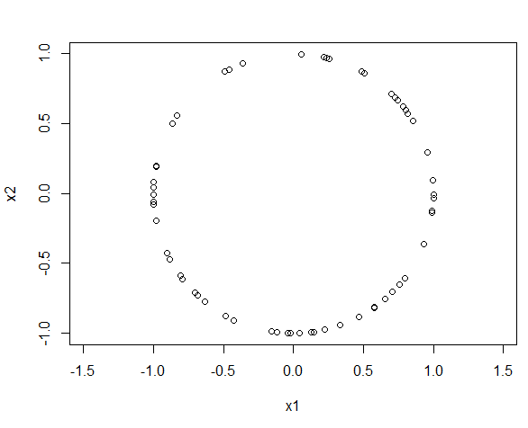
The homology of a circle is as follows:
Rank of H₀ = 1
since a circle has only one component
Rank of H₁ = 1
since a circle has a single 1-d component
Rank of H₂ = 0
since we don’t have any 2-d circles.
This data set consists of 60 points randomly taken from a circle of radius 1.
What should we expect the barcode to look like?
What should we expect the persistence diagram to look like?
Can we use TDA to determine that our points came from a circle

Slide 13
Can we use TDA to determine that our points came from a circle
The homology of a circle is as follows:
Rank of H₀ = 1 since a circle has only one component
Thus we expect 1 persistent (long) bar in the 0-dim barcode
plus some shorter bars that we can “ignore”
Rank of H₁ = 1: circle has a single 1-d cycle that does not bound surface
Thus we expect 1 persistent (long) bar in the 1-dim barcode
plus possible some shorter bars that we can “ignore”
Rank of H₂ = 0 since we don’t have any 2-d ccles.
Thus we expect 0 persistent (long) bars in the 2-dim barcode
plus possible some shorter bars that we can “ignore”

Slide 14
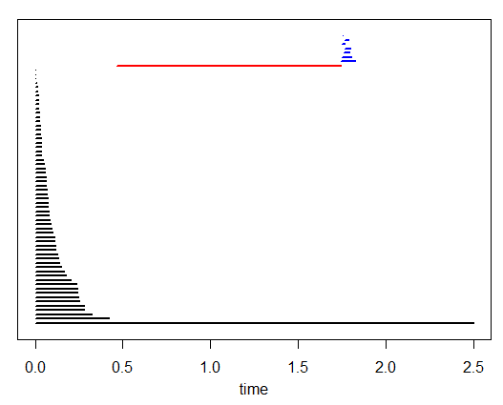
The homology of a circle is as follows:
Rank of H₀ = 1 since a circle has only one component
Thus we expect 1 persistent (long) bar in the 0-dim barcode
plus some shorter bars that we can “ignore”
Rank of H₁ = 1: circle has a single 1-d cycle that does not bound surface
Thus we expect 1 persistent (long) bar in the 1-dim barcode
plus possible some shorter bars that we can “ignore”
Rank of H₂ = 0 since we don’t have any 2-d ccles.
Thus we expect 0 persistent (long) bars in the 2-dim barcode
plus possible some shorter bars that we can “ignore”

Slide 15
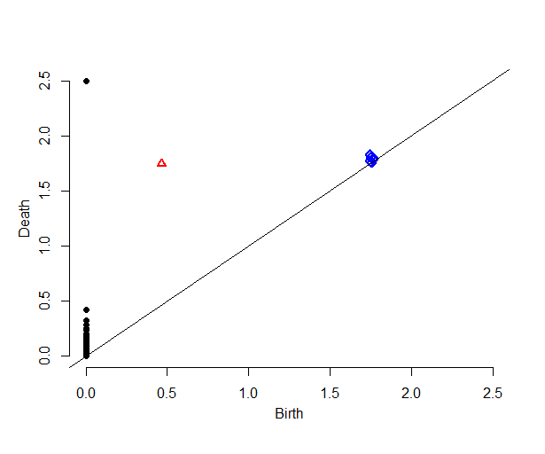
Our data set = 60 points randomly taken from a circle of radius 1
Can you determine from the barcode that our data set came from a circle?
Do you see 1 persistent 0-dim cycle?
Do you see 1 persistent 1-dim cycle?
Do you see 0 persistent 2-dim cycle?
Does the persistent diagram make sense?
1 black point (cycle in H₀) is far from the diagonal, while remaining black points are “close” to diagonal
1 red point (cycle in H₁) is far from diagonal
All blue points (cycles in H₂) are close to diagonal

Slide 16
From the barcode:
1 persistent 0-dim cycle ➔ H₀ = 1
1 persistent 1-dim cycle ➔ H₁ = 1
No persistent 2-dim cycles ➔ H₂ = 0
Ignore bars with “small” length
Definition of “small” depends on dimension, data set, application, etc.
From the persistent diagram:
1 black point far from the diagonal ➔ H₀ = 1
1 red point far from diagonal ➔ H₁ = 1
All blue points close to diagonal ➔ H₂ = 0
Ignore points “close” to diagonal
Definition of “close” depends on dimension, data set, application, etc.

Slide 17
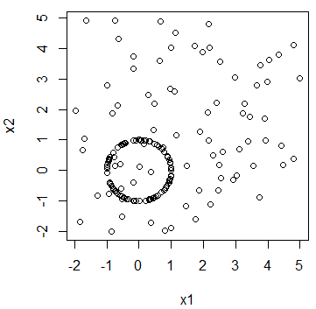
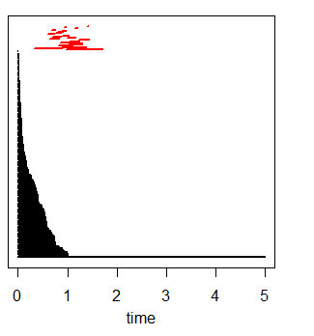
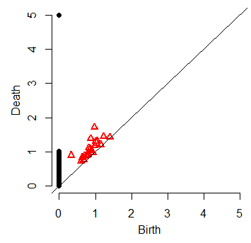
On Thursday in B5 MLH you will explore the difference between circle and (circle + various amounts of noise)

