Slide 1
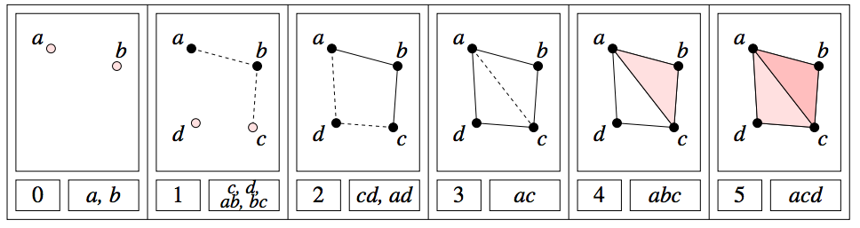
A filtered complex is an increasing sequence of simplicial complexes: C⁰ C¹ C² …
U
U
U
http://link.springer.com/article/10.1007%2Fs00454-004-1146-y

Slide 2
A filtered complex is an increasing sequence of simplicial complexes: C⁰ C¹ C² …
U
U
U
a, b is in C⁰ C¹ C² … C⁵
{a, b, c} is in C⁴ C⁵
₀
U
₀
U
₀
U
U
₀
₂
U
₂
http://link.springer.com/article/10.1007%2Fs00454-004-1146-y

Slide 3
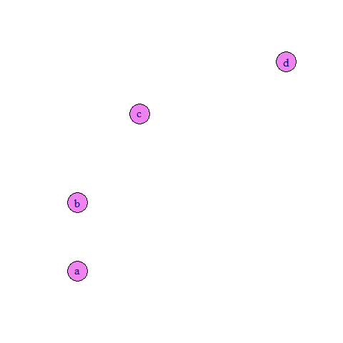
Filtered complex from data points:

Slide 4
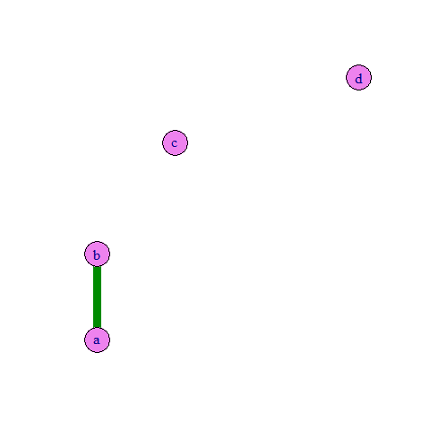
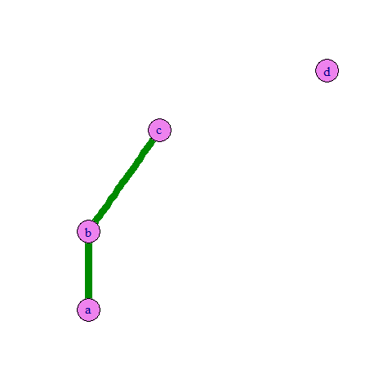
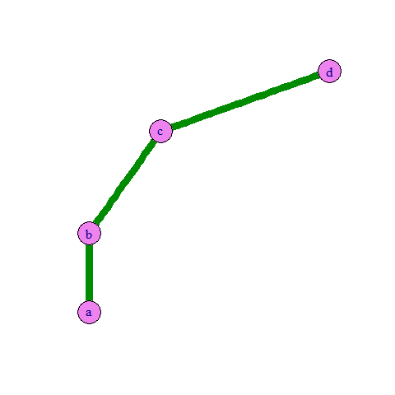
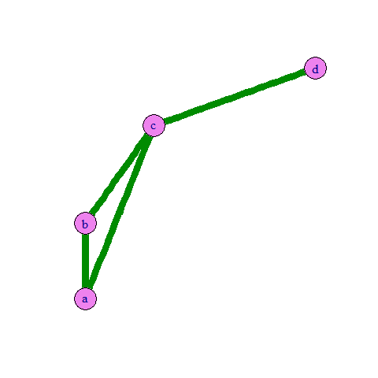
Filtered 1d-complex from data points:

Slide 5
Filtered Rips complex from data points:

Slide 6
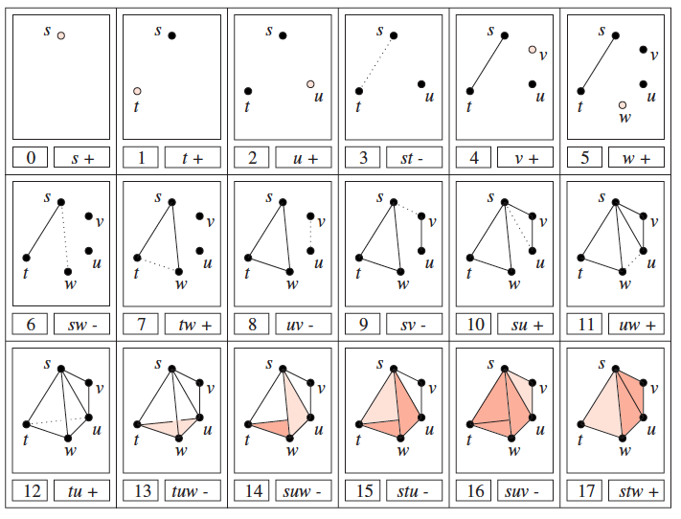
A filtered complex is an increasing sequence of simplicial complexes: C⁰ C¹ C² …
U
U
U
Notes:
Superscript = time, subscript = dimension

Slide 7
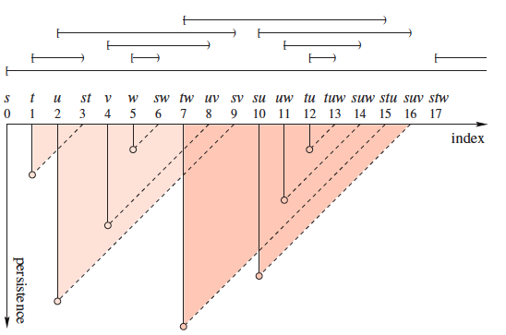
Barcode for H₀
H₀ = Z₀/B₀ =
cycles
boundaries

Slide 8
Barcode for H₁
H₁ = Z₁/B₁ =
cycles
boundaries

Slide 9
Barcode for H₂
H₂ = Z₂/B₂ =
cycles
boundaries

Slide 10
Topological Persistence and Simplification:link.springer.com/article/10.1007/s00454-002-2885-2

Slide 11
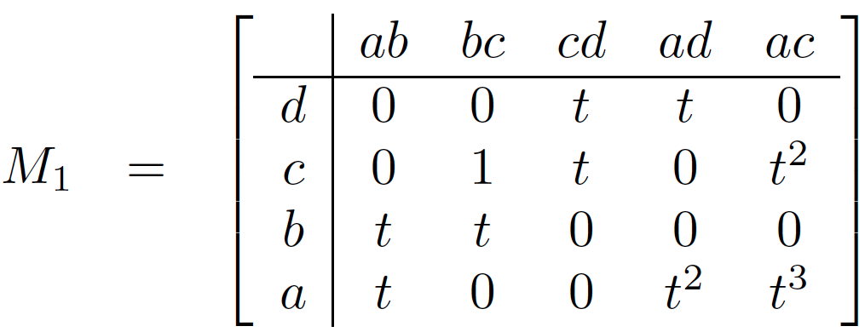
Computing Persistent Homology by Afra Zomorodian, Gunnar Carlsson
_{i, p}
H_{k} =
Z_{k} / ( B_{k} Z_{k} )
_{i}
_{i+p}
_{i}
U
http://link.springer.com/article/10.1007%2Fs00454-004-1146-y

Slide 12
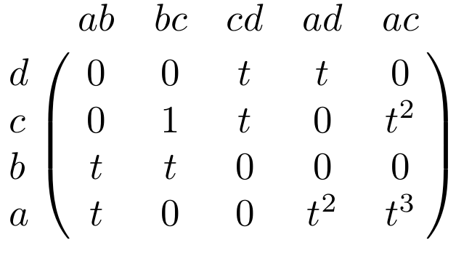
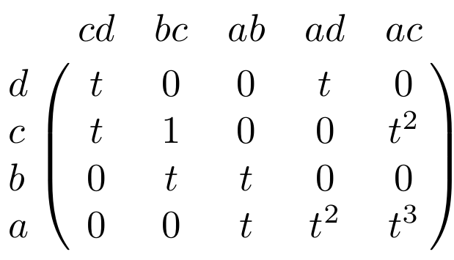
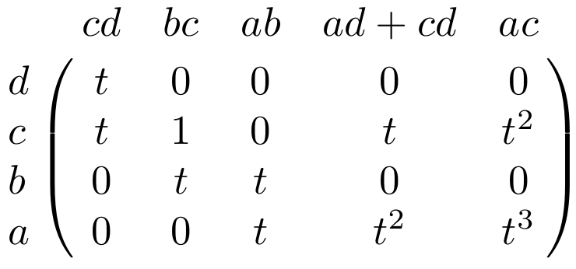
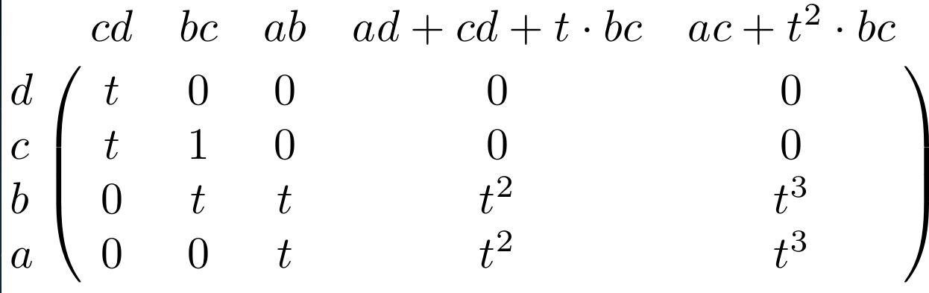

Slide 13
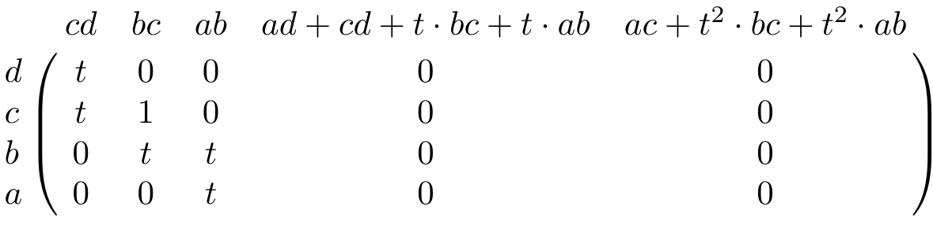

Slide 14
<z₁, z₂ : tz₂, t³z₁ + t²z₂ > where
z₁ = ad + cd + t(bc) + t(ab), z₂ = ac + t²bc + t²ab
_{i, p}
_{i}
_{i+p}
_{i}
H₁ = Z₁ / ( B₁ Z₁ )
U
deg z₁ = 2, deg z₂ = 3, deg tz₂ = 4, deg t³z₁ + t²z₂ = 5

Slide 15
H₀ = < a, b, c, d : tc + td, tb + c, ta + tb>
H₁ = <z₁, z₂ : t z₂, t³z₁ + t²z₂ >
[ )
[ )
[ )
[ )
[
z₁ = ad + cd + t(bc) + t(ab), z₂ = ac + t²bc + t²ab

Slide 16
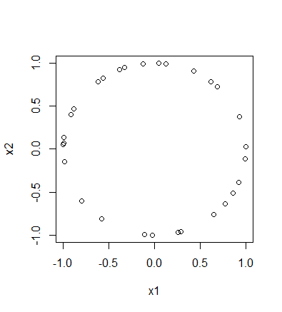
To install the TDA package on a PC:
install.packages("TDA")
To install the TDA package on a Mac:
install.packages("TDA", type = "source")
XX = circleUnif(30)

Slide 17
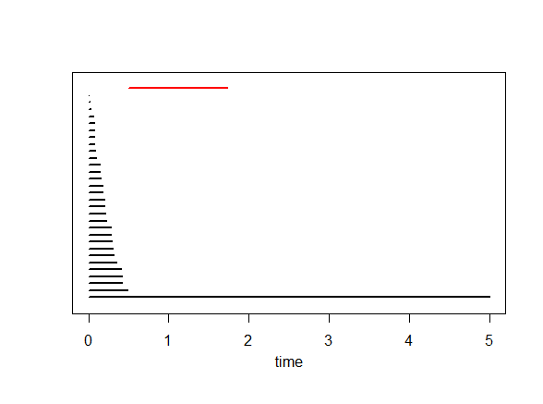
Barcode

Slide 18
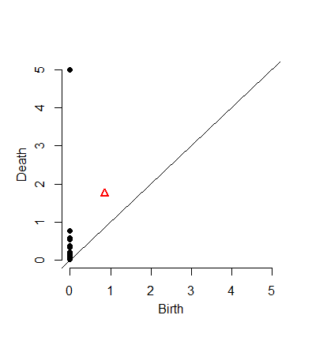
Barcode
Persistence Diagram

Slide 19
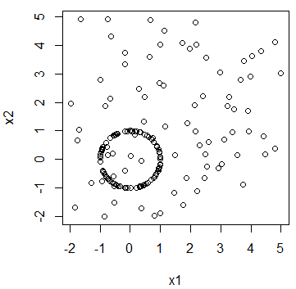
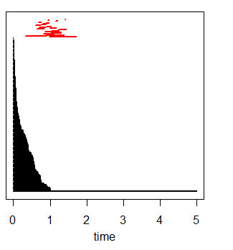
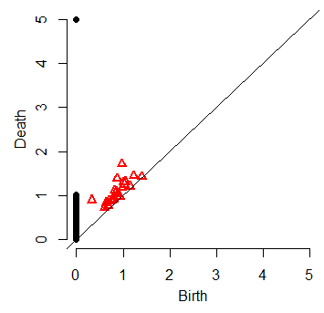

Slide 20
Bottleneck Distance.
Let Diag1and Diag2 be persistence diagrams.
The bottleneck distance is
the infimum over all bijections h: Diag1 → Diag 2 of
sup_{i} d(i; h(i)).

Slide 21
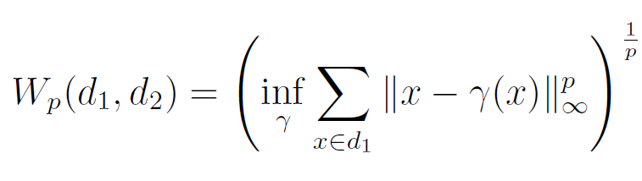
(Wasserstein distance). The p-th Wasserstein distance between two persistence diagrams,
d₁ and d₂, is defined as
where γ ranges over all bijections from d₁ to d₂.

Slide 22
> print( bottleneck(Diag1, Diag2, dimension=0) )
[1] 0.4942465
> print( wasserstein(Diag1, Diag2, p=2, dimension=0) )
[1] 5.750874
> print( bottleneck(Diag1, Diag2, dimension=1) )
[1] 0.279019
> print( wasserstein(Diag1, Diag2, p=2, dimension=1) )
[1] 0.301575

