Slide 1
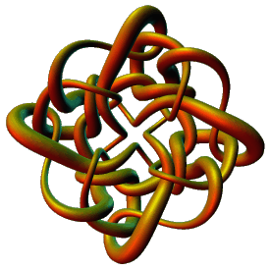
Topological Data Analysis
Applications IV
Isabel K. Darcy
Mathematics Department
Applied Mathematical and
Computational Sciences (AMCS)
University of Iowa
http://www.math.uiowa.edu/~idarcy
This work was partially supported by the Joint DMS/NIGMS Initiative to Support Research in the Area of Mathematical Biology (NSF 0800285).

Slide 2
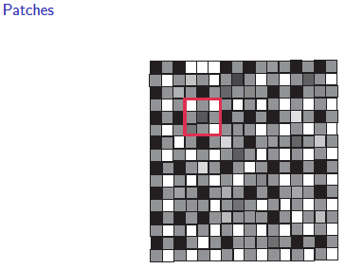
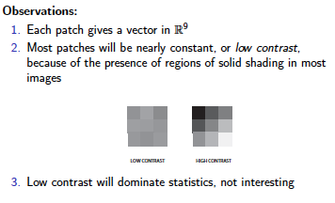
Lee-Mumford-Pedersen [LMP] study only high contrast patches.
Collection: 4.5 x 10⁶ high contrast patches from a
collection of images obtained by van Hateren and van der Schaaf
http://www.kyb.mpg.de/de/forschung/fg/bethgegroup/downloads/van-hateren-dataset.html

Slide 3
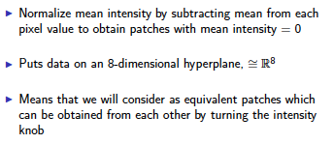
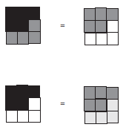

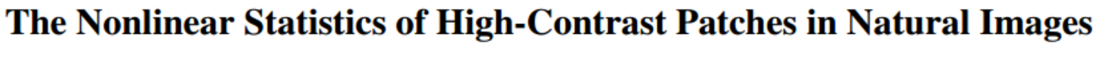
Lee, Pedersen, Mumford

Slide 4
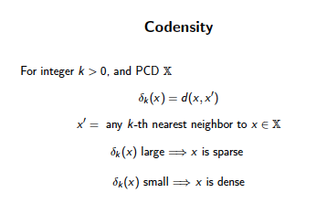
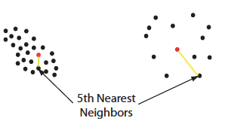

Large values of k:
measuring density of large neighborhoods of x,
Smaller values mean we are using smaller neighborhoods
← smoothed out version

Slide 5
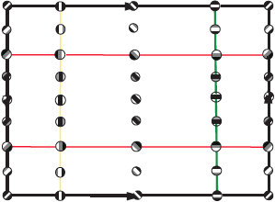
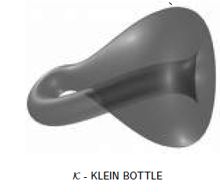
M(100, 10) U Q
where |Q| = 30
On the Local Behavior of Spaces of Natural Images, Gunnar Carlsson, Tigran Ishkhanov, Vin de Silva, Afra Zomorodian, International Journal of Computer Vision 2008, pp 1-12.

Slide 6
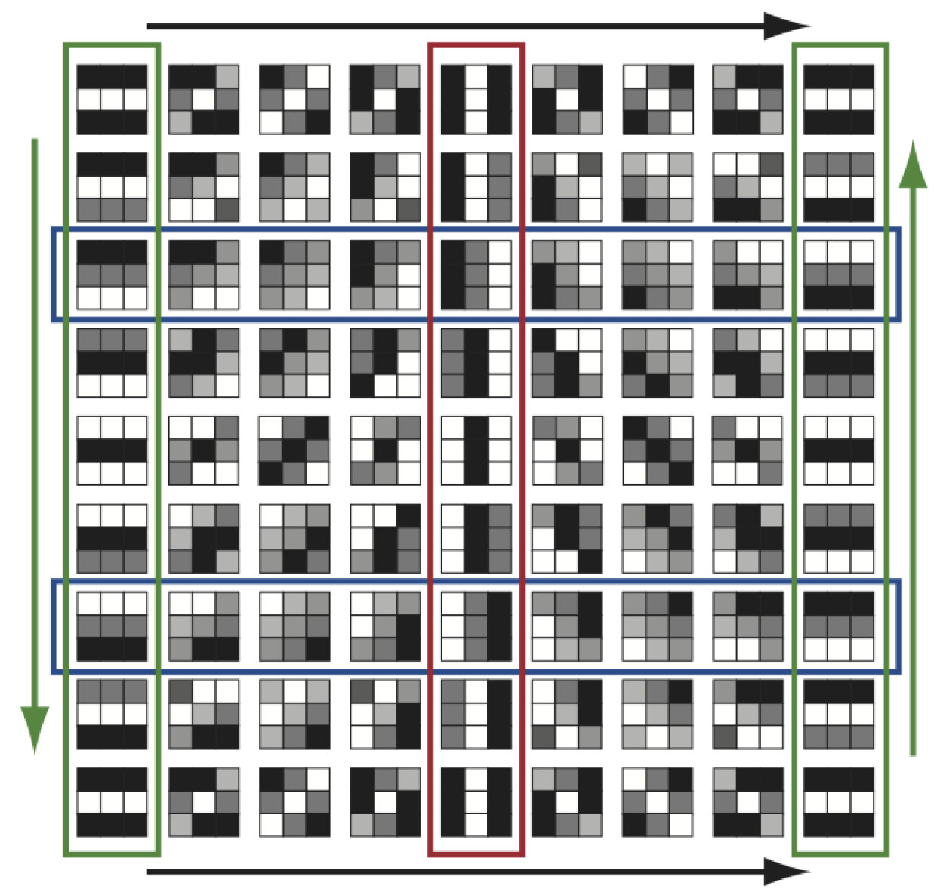
http://www.maths.ed.ac.uk/~aar/papers/ghristeat.pdf

Slide 7
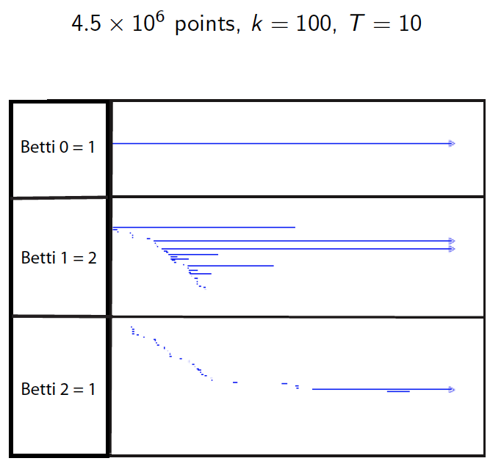

Slide 8
is a point in S⁷
Data set M has over 8 × 10⁶ points in S⁷.

Slide 9
is a point in S⁷
Data set M has over 8 × 10⁶ points in S⁷.
Randomly choose 5000 points.
Take the T% densest points.

Slide 10
is a point in S⁷
Data set M has over 8 × 10⁶ points in S⁷.
Randomly choose 5000 points.
Take the T% densest points.
Choose a subset of 50 Landmark points.

Slide 11
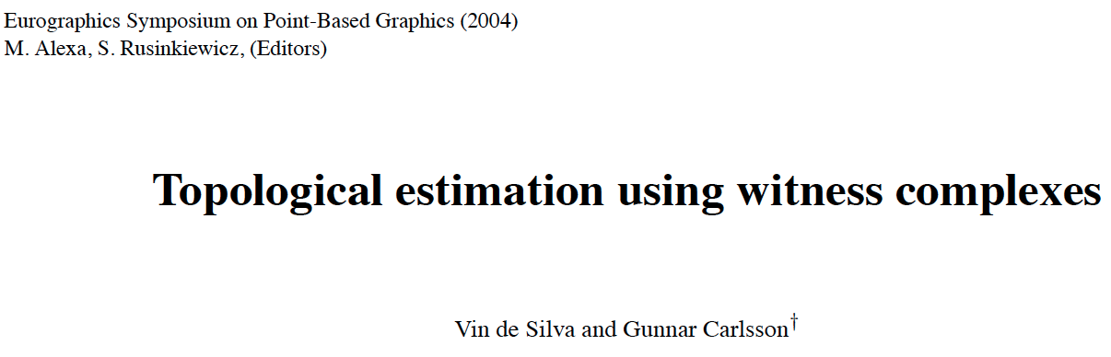
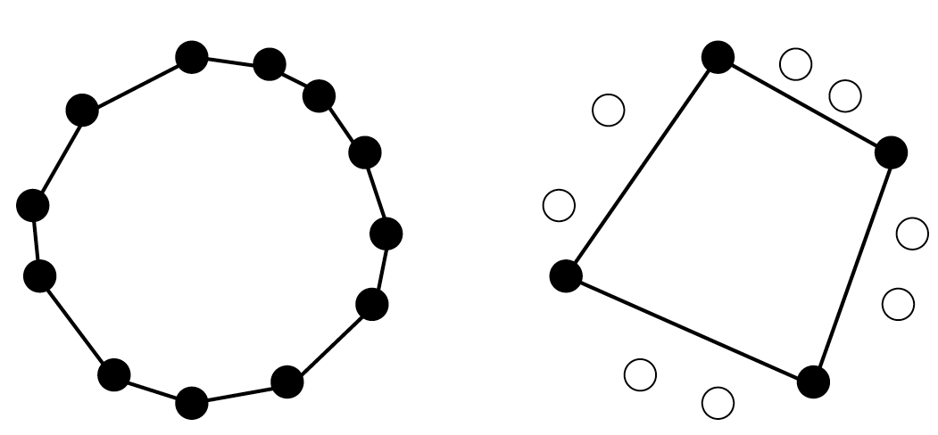
comptop.stanford.edu/preprints/witness.pdf

Slide 12
Witness complex
Let D = set of point cloud data points.
Choose L D, L = set of landmark points.
U

Slide 13
Witness complex
Let D = set of point cloud data points.
Choose L D, L = set of landmark points.
Normally L is a small subset, but in this example, L is a large red subset.
U

Slide 14
W∞(D) = Witness complex
v₀,v₁,...,v_{k} span a k-simplex
iff
there is a point w ∈ D, whose k+1 nearest
neighbours in L are v₀,v₁,...,v_{k}
and all the faces of {v₀,v₁,...,v_{k}} belong to the witness complex.
w is called a “weak” witness.
Let D = set of point cloud data points.
Choose L D,
L = set of landmark points = vertices.
U

Slide 15
W∞(D) = Witness complex
v₀,v₁,...,v_{k} span a k-simplex
iff
there is a point w ∈ D, whose k+1 nearest
neighbours in L are v₀,v₁,...,v_{k}
and all the faces of {v₀,v₁,...,v_{k}} belong to the witness complex.
w is called a “weak” witness.
Let D = set of point cloud data points.
Choose L D,
L = set of landmark points = vertices.
U

Slide 16
W₁(D) = Lazy witness complex
Let L = set of landmark points.
1-skeletion of W₁(D) = 1-skeletion of W∞ (D).
Create the flag (or clique) complex:
Add all possible simplices of dimensional > 1.

Slide 17
W₁(D) = Lazy witness complex
Let L = set of landmark points.
1-skeletion of W₁(D) = 1-skeletion of W∞ (D).
Create the flag (or clique) complex:
Add all possible simplices of dimensional > 1.

Slide 18
W₁(D) = Lazy witness complex
Let L = set of landmark points.
1-skeletion of W₁(D) = 1-skeletion of W∞ (D).
Create the flag (or clique) complex:
Add all possible simplices of dimensional > 1.

Slide 19
Choosing Landmark points:
A.) Random
B.) Maxmin
1.) choose point l₁ randomly
2.) If {l₁, …, l_{k-1}} have been chosen, choose l_{k} such that {l₁, …, l_{k-1}} is in D - {l₁, …, l_{k-1}} and
min {d(l_{k}, l₁), …, d(l_{k}, l_{k-1})} ≥ min {d(v, l₁), …, d(v, l_{k-1})}

Slide 20
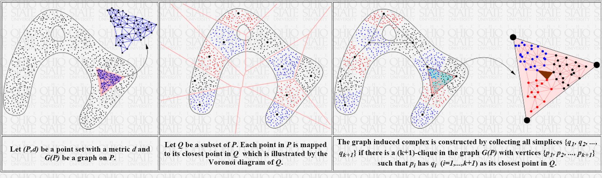
Tamal K. Dey http://www.cse.ohio-state.edu/~tamaldey/ Graph Induced Complex: A Data Sparsifier for Homology Inference
Video: http://www.ima.umn.edu/videos/?id=2497
Slides: http://web.cse.ohio-state.edu/~tamaldey/talk/GIC/GIC.pdf
Paper: http://web.cse.ohio-state.edu/~tamaldey/paper/GIC/GIC.pdf
Graph Induced Complex on Point Data T. K. Dey, F. Fan, and Y. Wang,
(SoCG 2013) Proc. 29th Annu. Sympos. Comput. Geom. 2013, 107-116.
Website: http://web.cse.ohio-state.edu/~tamaldey/GIC/gic.html
The efficiency of extracting topological information from point data depends largely on the complex that is built on top of the data points. From a computational viewpoint, the most favored complexes for this purpose have so far been Vietoris-Rips and witness complexes. While the Vietoris-Rips complex is simple to compute and is a good vehicle for extracting topology of sampled spaces, its size is huge--particularly in high dimensions. The witness complex on the other hand enjoys a smaller size because of a subsampling, but fails to capture the topology in high dimensions unless imposed with extra structures. We investigate a complex called the {em graph induced complex} that, to some extent, enjoys the advantages of both. It works on a subsample but still retains the power of capturing the topology as the Vietoris-Rips complex. It only needs a graph connecting the original sample points from which it builds a complex on the subsample thus taming the size considerably. We show that, using the graph induced complex one can (i) infer the one dimensional homology of a manifold from a very lean subsample, (ii) reconstruct a surface in three dimension from a sparse subsample without computing Delaunay triangulations, (iii) infer the persistent homology groups of compact sets from a sufficiently dense sample. We provide experimental evidences in support of our theory.

Slide 21

http://www.sas.upenn.edu/~vnanda/perseus/index.html
Perseus is based on discrete Morse theory

Slide 22
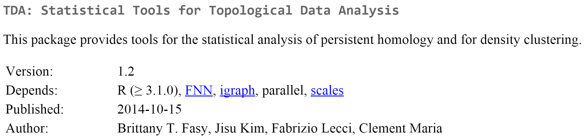
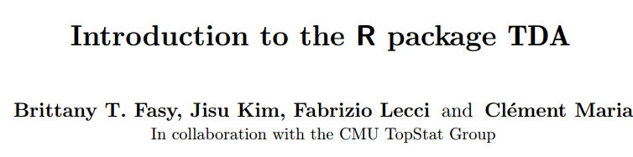
http://cran.r-project.org/web/packages/TDA/index.html
http://cran.r-project.org/web/packages/TDA/vignettes/article.pdf
Includes Dionysis

Slide 23
To analyze data
1.) Download data from web or better yet, get it from a collaborator (or start by creating test data).
2.) Choose how to model
a.) Use standard methods
like Carlsson et al and image data.
b.) Be creative.
3.) Compute.
a.) Consider using Witness or GIC
b.) Software: Perseus, GIC, Dionysis, etc. (test it).
4.) Validate
5.) Try a 2nd approach: E.g, mapper.

Slide 24
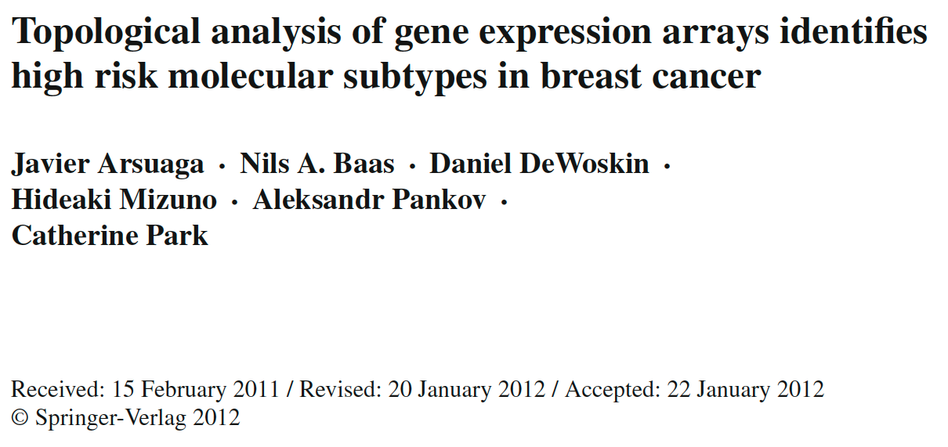
http://link.springer.com/article/10.1007%2Fs00200-012-0166-8

Slide 25
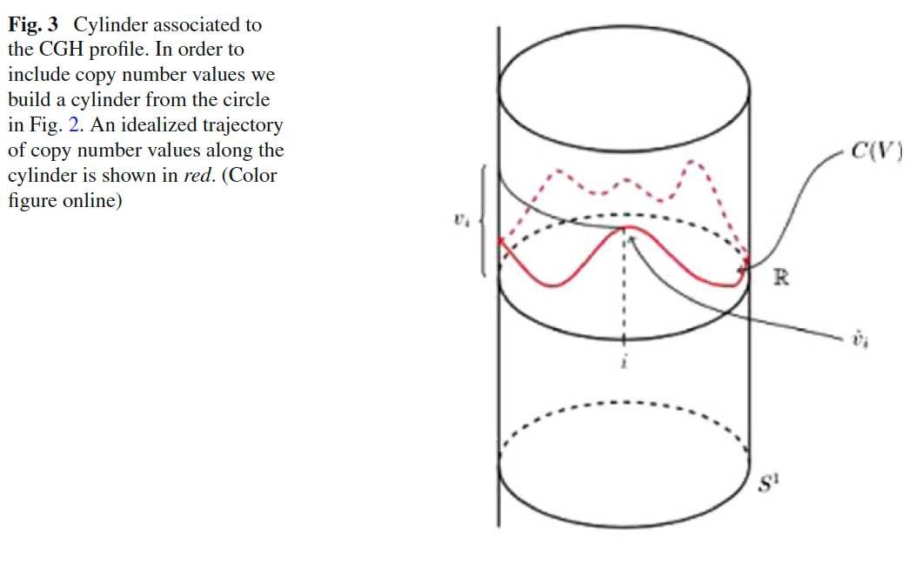

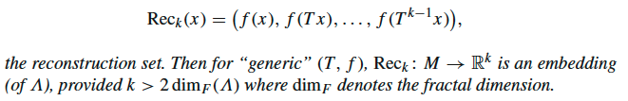
Topological analysis of gene expression arrays identifies high risk molecular subtypes in breast cancer
a delay embedding theorem gives the conditions under which a chaotic dynamical system can be reconstructed from a sequence of observations of the state of a dynamical system.
From: http://en.wikipedia.org/wiki/Takens’_theorem

Slide 26
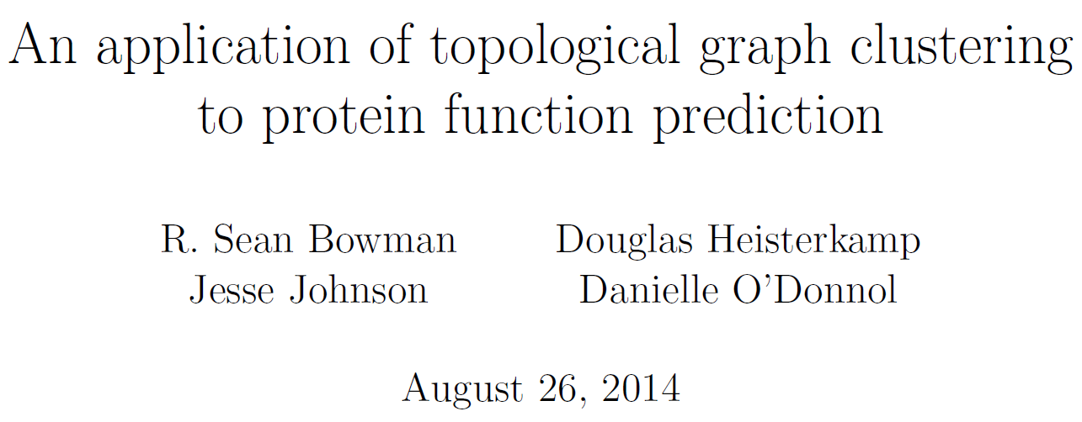
Uses thin position to cluster data
http://arxiv.org/abs/1408.5634

Slide 27
To analyze data
1.) Download data from web or better yet, get it from a collaborator (or start by creating test data).
2.) Choose how to model
a.) Use standard methods
like Carlsson et al and image data.
b.) Be creative.
3.) Compute.
a.) Consider using Witness or GIC
b.) Software: Perseus, GIC, Dionysis, etc. (test it).
4.) Validate
5.) Try a 2nd approach: E.g, mapper.

Slide 28
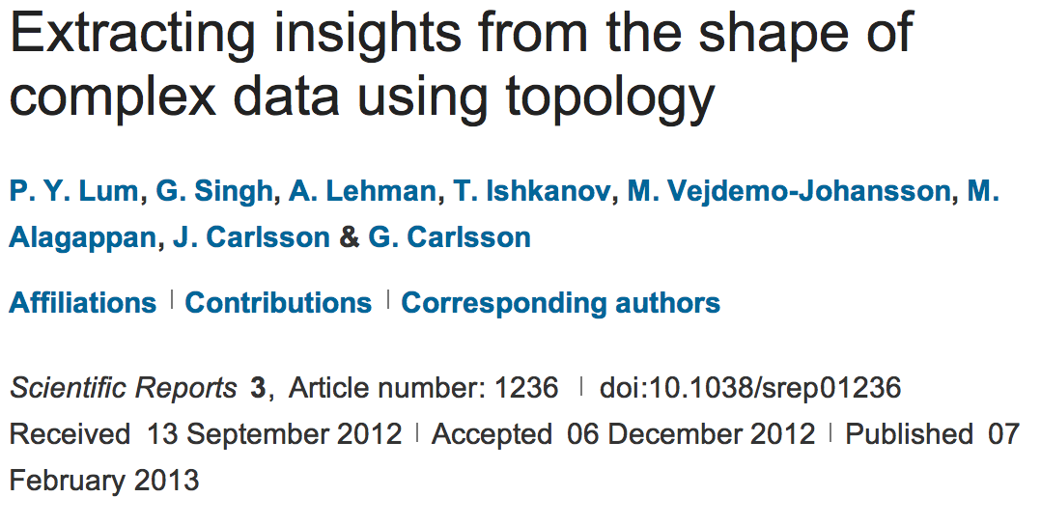
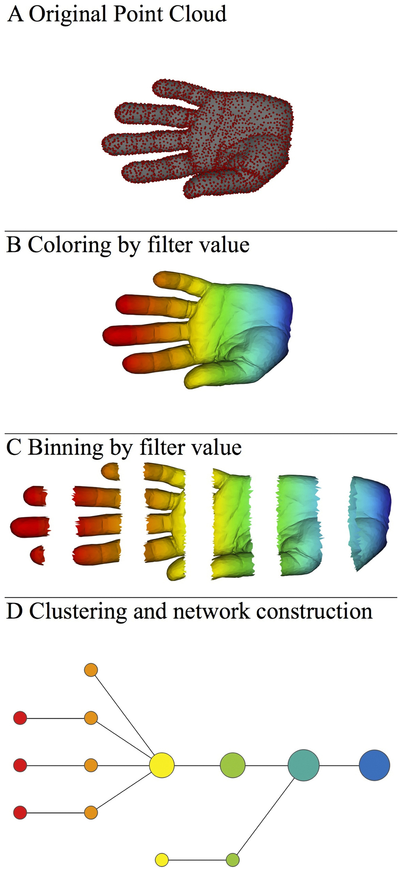
http://www.nature.com/srep/2013/130207/srep01236/full/srep01236.html

Slide 29

A) Data Set
Example: Point cloud data
representing a hand.
http://www.nature.com/srep/2013/130207/srep01236/full/srep01236.html

Slide 30
Data Set:
Example: Point cloud data
representing a hand.
Function f : Data Set → R
Example: x-coordinate
f : (x, y, z) → x
http://www.nature.com/srep/2013/130207/srep01236/full/srep01236.html

Slide 31
Function f : Data Set → R
Ex 1: x-coordinate
f : (x, y, z) → x
http://www.nature.com/srep/2013/130207/srep01236/full/srep01236.html

Slide 32
Function f : Data Set → R
Ex 1: x-coordinate
f : (x, y, z) → x
http://www.nature.com/srep/2013/130207/srep01236/full/srep01236.html

Slide 33
Function f : Data Set → R
Ex 1: x-coordinate
f : (x, y, z) → x
http://www.nature.com/srep/2013/130207/srep01236/full/srep01236.html

Slide 34
Put data into overlapping bins.
Example: f⁻¹(a_{i}, b_{i})
( ( ) ( ) ( ) ( ) ( ) )
Function f : Data Set → R
Ex 1: x-coordinate
f : (x, y, z) → x
http://www.nature.com/srep/2013/130207/srep01236/full/srep01236.html

Slide 35
Put data into overlapping bins.
Example: f⁻¹(a_{i}, b_{i})
( ( ) ( ) ( ) ( ) ( ) )
Function f : Data Set → R
Ex 1: x-coordinate
f : (x, y, z) → x
http://www.nature.com/srep/2013/130207/srep01236/full/srep01236.html

Slide 36
Data Set
Example: Point cloud data
representing a hand.
Function f : Data Set → R
Example: x-coordinate
f : (x, y, z) → x
Put data into overlapping bins.
Example: f⁻¹(a_{i}, b_{i})
http://www.nature.com/srep/2013/130207/srep01236/full/srep01236.html

Slide 37
D) Cluster each bin
http://www.nature.com/srep/2013/130207/srep01236/full/srep01236.html
Notes:
Need covering Resolution multiscale

Slide 38
D) Cluster each bin
http://www.nature.com/srep/2013/130207/srep01236/full/srep01236.html
Notes:
Need covering Resolution multiscale

Slide 39
D) Cluster each bin
& create network.
Vertex = a cluster of a bin.
Edge = nonempty intersection
between clusters
http://www.nature.com/srep/2013/130207/srep01236/full/srep01236.html
Notes:
Need covering Resolution multiscale

Slide 40
D) Cluster each bin
& create network.
Vertex = a cluster of a bin.
Edge = nonempty intersection
between clusters
http://www.nature.com/srep/2013/130207/srep01236/full/srep01236.html
Notes:
Need covering Resolution multiscale

Slide 41
A) Data Set
Example: Point cloud data
representing a hand.
B) Function f : Data Set → R
Example: x-coordinate
f : (x, y, z) → x
Put data into overlapping bins.
Example: f⁻¹(a_{i}, b_{i})
Cluster each bin & create network.
Vertex = a cluster of a bin.
Edge = nonempty intersection
between clusters
http://www.nature.com/srep/2013/130207/srep01236/full/srep01236.html

Slide 42
Note: we made many, many choices
It helps to know what you are doing when you make choices, so collaborating with others is highly recommended.

Slide 43
We chose how to model the data set
A) Data Set
Example: Point cloud data
representing a hand.
http://www.nature.com/srep/2013/130207/srep01236/full/srep01236.html
Notes:
Be creative. Use ideas from pure and applied math (including stat) as well as area of application
Missing data, noise

Slide 44
Function f : Data Set → R
Ex 1: x-coordinate
f : (x, y, z) → x
Chose filter function
http://www.nature.com/srep/2013/130207/srep01236/full/srep01236.html

Slide 45
Function f : Data Set → R
Ex 1: x-coordinate
f : (x, y, z) → x
Ex 2: y-coordinate
g : (x, y, z) → y
Chose filter function
http://www.nature.com/srep/2013/130207/srep01236/full/srep01236.html

Slide 46
Function f : Data Set → R
Ex 1: x-coordinate
f : (x, y, z) → x
Chose filter function
Possible filter functions:
Principle component analysis
L-infinity centrality:
f(x) = max{d(x, p) : p in data set}
Norm: f(x) = ||x || = length of x
http://www.nature.com/srep/2013/130207/srep01236/full/srep01236.html
Notes:
Need distance
Depends on what prop you want to explore
Can also choose any co-domain

Slide 47
Chose bins
Put data into overlapping bins.
Example: f⁻¹(a_{i}, b_{i})
If equal length intervals:
Choose length.
Choose % overlap.
http://www.nature.com/srep/2013/130207/srep01236/full/srep01236.html
Notes:
Need covering Resolution multiscale

Slide 48
Chose how to cluster.
Normally need a definition of distance between data points
Cluster each bin & create network.
Vertex = a cluster of a bin.
Edge = nonempty intersection
between clusters
http://www.nature.com/srep/2013/130207/srep01236/full/srep01236.html

Slide 49
Note: we made many, many choices
It helps to know what you are doing when you make choices, so collaborating with others is highly recommended.

Slide 50
Note: we made many, many choices
“It is useful to think of it as a camera, with lens adjustments and other settings. A different filter function may generate a network with a different shape, thus allowing one to explore the data from a different mathematical perspective.”
http://www.nature.com/srep/2013/130207/srep01236/full/srep01236.html

Slide 51
Note: we made many, many choices
“It is useful to think of it as a camera, with lens adjustments and other settings. A different filter function may generate a network with a different shape, thus allowing one to explore the data from a different mathematical perspective.”
False positives???
http://www.nature.com/srep/2013/130207/srep01236/full/srep01236.html

Slide 52
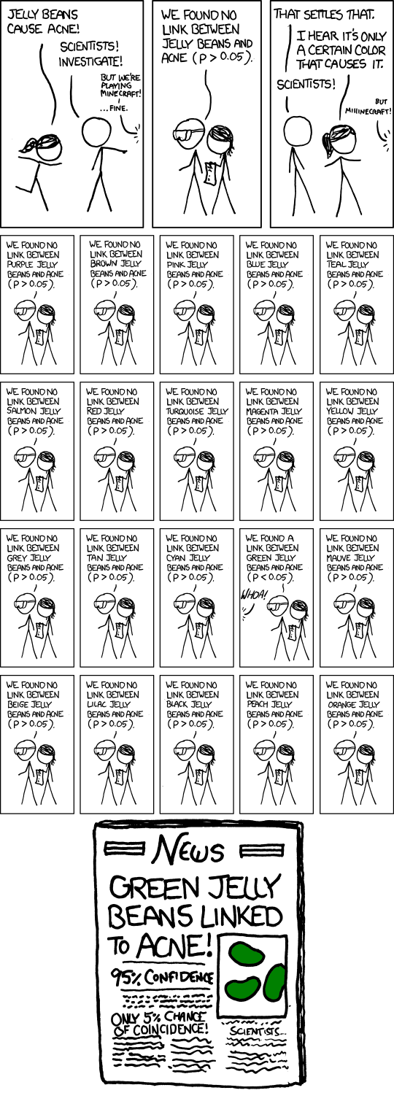
False Positives will occur

Slide 53
Note: we made many, many choices
“It is useful to think of it as a camera, with lens adjustments and other settings. A different filter function may generate a network with a different shape, thus allowing one to explore the data from a different mathematical perspective.”
False positives vs persistencia
http://www.nature.com/srep/2013/130207/srep01236/full/srep01236.html

Slide 54
Function f : Data Set → R
Ex 1: x-coordinate
f : (x, y, z) → x
Chose filter function
http://www.nature.com/srep/2013/130207/srep01236/full/srep01236.html

Slide 55
Function f : Data Set → R
Ex 1: x-coordinate
f : (x, y, z) → x
Chose filter function
( ( ) ( ) ( ) ( ) ( ) )
http://www.nature.com/srep/2013/130207/srep01236/full/srep01236.html

Slide 56
Chose filter
Only need to cover the data points.
http://www.nature.com/srep/2013/130207/srep01236/full/srep01236.html

Slide 57
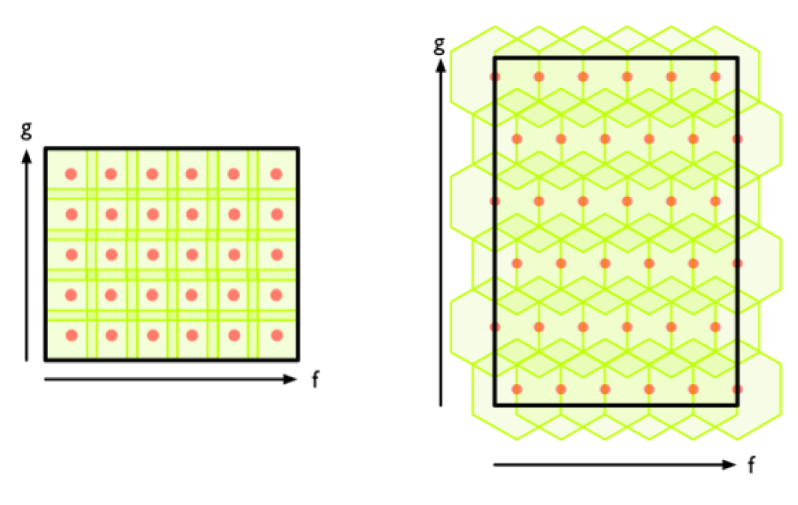
Chose filter
http://www.nature.com/srep/2013/130207/srep01236/full/srep01236.html

Slide 58
Chose filter
http://www.nature.com/srep/2013/130207/srep01236/full/srep01236.html

Slide 59
Application 3 (in paper): Basketball
Data: rates (per minute played) of rebounds, assists, turnovers, steals, blocked shots, personal fouls, and points scored for 452 players.
➔ Input: 452 points in R⁷
For each player, we have a vector
= (r, a, t, s, b, f, p) in R⁷
Distance: variance normalized Euclidean distance.
Clustering: Single linkage.
( min , min , min , min , min , min , min )
rebounds assists turnovers steals blocked shots personal fouls points scored
http://www.nature.com/srep/2013/130207/srep01236/full/srep01236.html

Slide 60
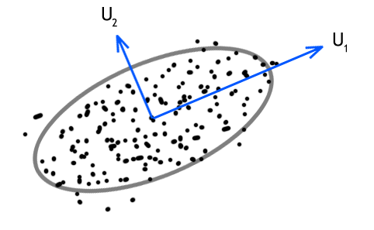
Filters: principle and secondary SVD values.
http://commons.wikimedia.org/wiki/File:SVD_Graphic_Example.png
Data
http://www.nature.com/srep/2013/130207/srep01236/full/srep01236.html

Slide 61
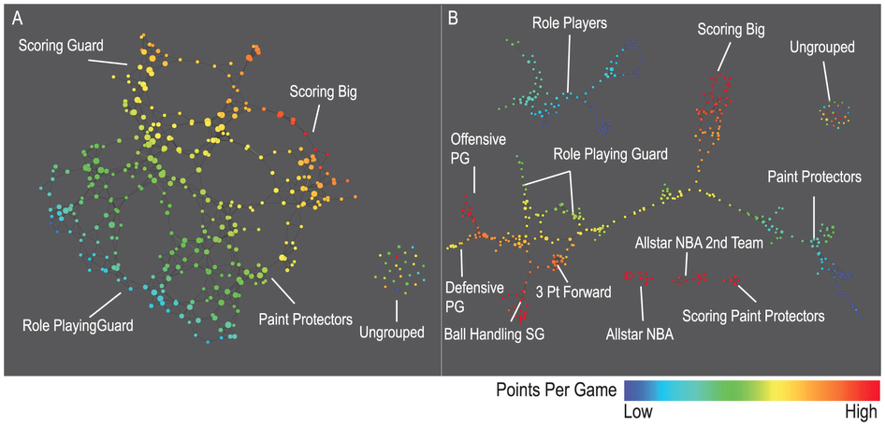
A) Low resolution map at 20 intervals for each filter B) High resolution map at 30 intervals for each filter. The overlap is such at that each interval overlaps with half of the adjacent intervals, the graphs are colored by points per game, and a variance normalized Euclidean distance metric is applied. Metric: Variance Normalized Euclidean; Lens: Principal SVD Value (Resolution 20, Gain 2.0x, Equalized) and Secondary SVD Value (Resolution 20, Gain 2.0x, Equalized). Color: red: high values, blue: low values.
http://www.nature.com/srep/2013/130207/srep01236/full/srep01236.html

Slide 62
LeBron James , Kobe Bryant, Brook Lopez
A) Low resolution map at 20 intervals for each filter B) High resolution map at 30 intervals for each filter. The overlap is such at that each interval overlaps with half of the adjacent intervals, the graphs are colored by points per game, and a variance normalized Euclidean distance metric is applied. Metric: Variance Normalized Euclidean; Lens: Principal SVD Value (Resolution 20, Gain 2.0x, Equalized) and Secondary SVD Value (Resolution 20, Gain 2.0x, Equalized). Color: red: high values, blue: low values.
http://www.nature.com/srep/2013/130207/srep01236/full/srep01236.html
Notes:
Compare how graphs drawn. Note disconnected means not close Don’t be mislead by graph drawing

Slide 63
Topological Data Analysis (TDA): Three key ideas of topology that make extracting of patterns via shape possible.
1.) coordinate free.
No dependence on the coordinate system chosen.
Can compare data derived from different platforms
vital when one is studying data collected with different technologies, or from different labs when the methodologies cannot be standardized.
http://www.nature.com/srep/2013/130207/srep01236/full/srep01236.html

Slide 64
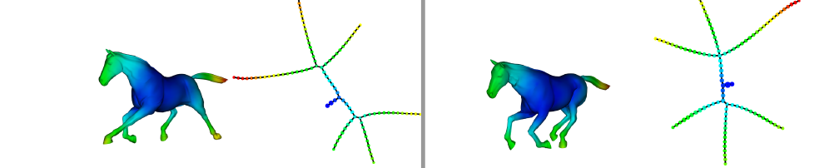
Topological Data Analysis (TDA): Three key ideas of topology that make extracting of patterns via shape possible.
2.) invariant under “small” deformations.
less sensitive to noise
Topological Methods for the Analysis of High Dimensional
Data Sets and 3D Object Recognition, Singh, Mémoli, Carlsson
Figure from http://comptop.stanford.edu/u/preprints/mapperPBG.pdf
http://www.nature.com/srep/2013/130207/srep01236/full/srep01236.html

Slide 65
Topological Data Analysis (TDA): Three key ideas of topology that make extracting of patterns via shape possible.
3.) compressed representations of shapes.
Input: dataset with thousands of points
Output: network with
13 vertices and 12 edges.
http://www.nature.com/srep/2013/130207/srep01236/full/srep01236.html

Slide 66
http://www.nature.com/srep/2013/130207/srep01236/full/srep01236.html

Slide 67
Topological Data Analysis (TDA): Three key ideas of topology that make extracting of patterns via shape possible.
1.) coordinate free.
No dependence on the coordinate system chosen.
Can compare data derived from different platforms
2.) invariant under “small” deformations.
less sensitive to noise
3.) compressed representations of shapes.
Input: dataset with thousands of points
Output: network with 13 vertices and 12 edges.
http://www.nature.com/srep/2013/130207/srep01236/full/srep01236.html

Slide 68

http://www.pnas.org/content/early/2011/04/07/1102826108

Slide 69
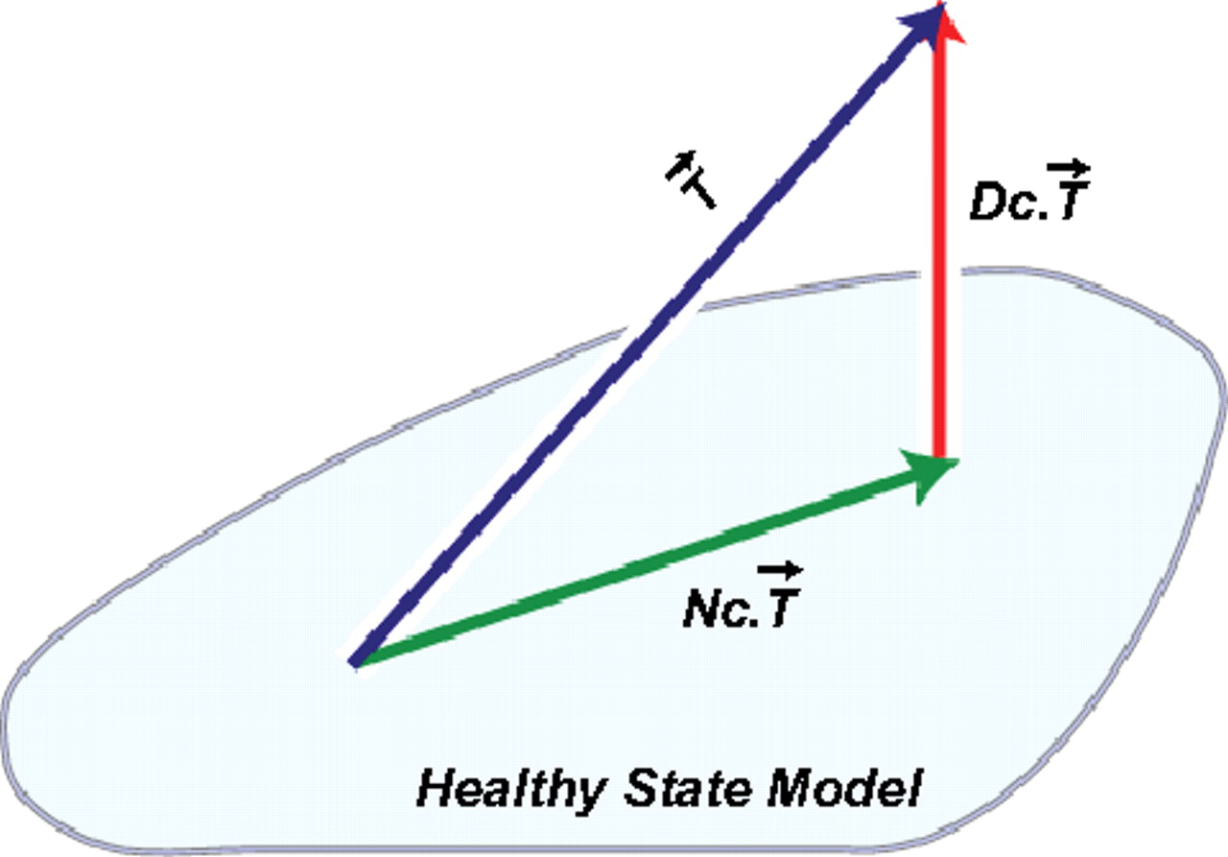
DSGA decomposition of the original tumor vector into the Normal component its linear models fit onto the Healthy State Model and the Disease component vector of residuals.
Nicolau M et al. PNAS 2011;108:7265-7270
©2011 by National Academy of Sciences
Notes:
DSGA decomposition of the original tumor vector into the Normal component its linear models fit onto the Healthy State Model and the Disease component vector of residuals.

Slide 70
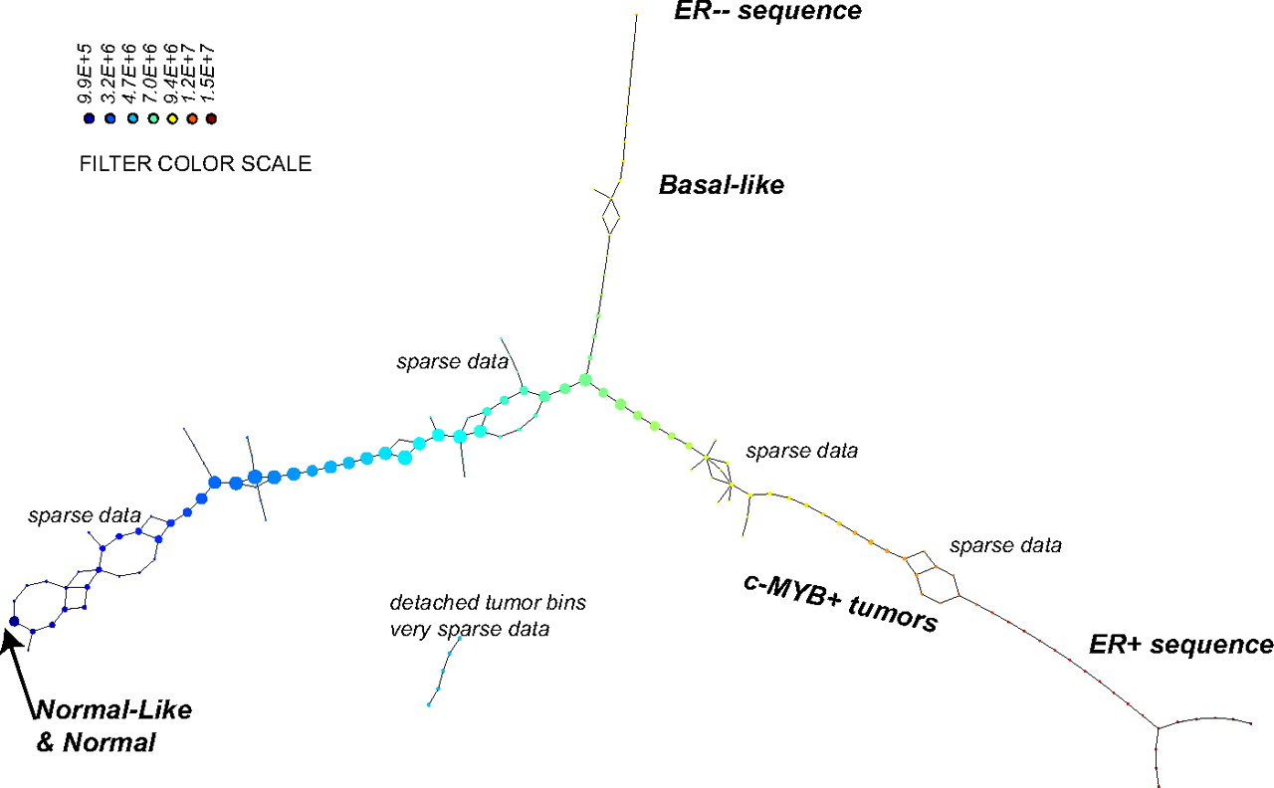
PAD analysis of the NKI data. The output has three progression arms, because tumors (data points) are ordered by the magnitude of deviation from normal (the HSM). Each bin is colored by the mean of the filter map on the points. Blue bins contain tumors whose total deviation from HSM is small (normal and Normal-like tumors). Red bins contain tumors whose deviation from HSM is large. The image of f was subdivided into 15 intervals with 80% overlap. All bins are seen (outliers included). Regions of sparse data show branching. Several bins are disconnected from the main graph. The ER− arm consists mostly of Basal tumors. The c-MYB+ group was chosen within the ER arm as the tightest subset, between the two sparse regions.
PAD analysis of the NKI data.
Nicolau M et al. PNAS 2011;108:7265-7270
©2011 by National Academy of Sciences
Notes:
PAD analysis of the NKI data. The output has three progression arms, because tumors (data points) are ordered by the magnitude of deviation from normal (the HSM). Each bin is colored by the mean of the filter map on the points. Blue bins contain tumors whose total deviation from HSM is small (normal and Normal-like tumors). Red bins contain tumors whose deviation from HSM is large. The image of f was subdivided into 15 intervals with 80% overlap. All bins are seen (outliers included). Regions of sparse data show branching. Several bins are disconnected from the main graph. The ER− arm consists mostly of Basal tumors. The c-MYB+ group was chosen within the ER arm as the tightest subset, between the two sparse regions.

Slide 71



Slide 72
Application 1: breast cancer gene expression
Data: microarray gene expression data from 2 data sets, NKI and GSE2034
Distance: correlation distance
Filters: (1) L-infinity centrality:
f(x) = max{d(x, p) : p in data set}
captures the structure of the points far removed from the center or norm.
(2) NKI: survival vs. death
GSE2034: no relapse vs. relapse
Clustering: Single linkage.

Slide 73
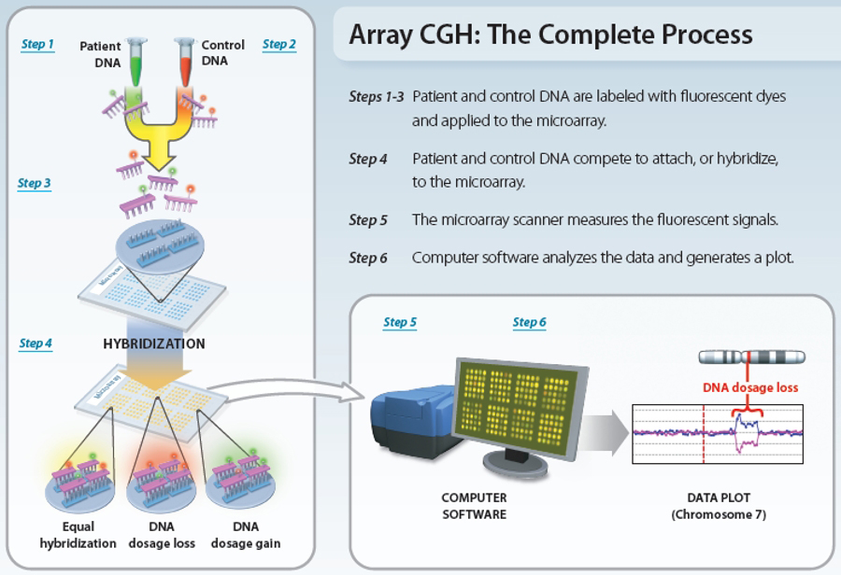
www.nature.com/scitable/topicpage/microarray-based-comparative-genomic-hybridization-acgh-45432

Slide 74
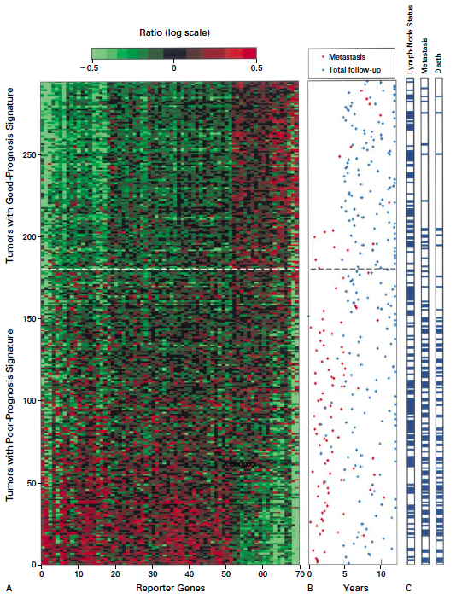
Gene expression profiling predicts clinical outcome of breast cancer
van 't Veer LJ, Dai H, van de Vijver MJ, He YD, Hart AA, Mao M, Peterse HL, van der Kooy K, Marton MJ, Witteveen AT, Schreiber GJ, Kerkhoven RM, Roberts C, Linsley PS, Bernards R, Friend SH
Nature. 2002 Jan 31;415(6871):530-6.

Slide 75
2 breast cancer data sets:
1.) NKI (2002):
gene expression levels of 24,000 from 272 tumors. Includes node-negative and node-positive patients, who had or had not received adjuvant systemic therapy. Also includes survival information.
2.) GSE203414 (2005)
expression of 22,000 transcripts from total RNA of frozen tumour samples from 286 lymph-node-negative patients who had not received adjuvant systemic treatment. Also includes time to relapse information.

Slide 76
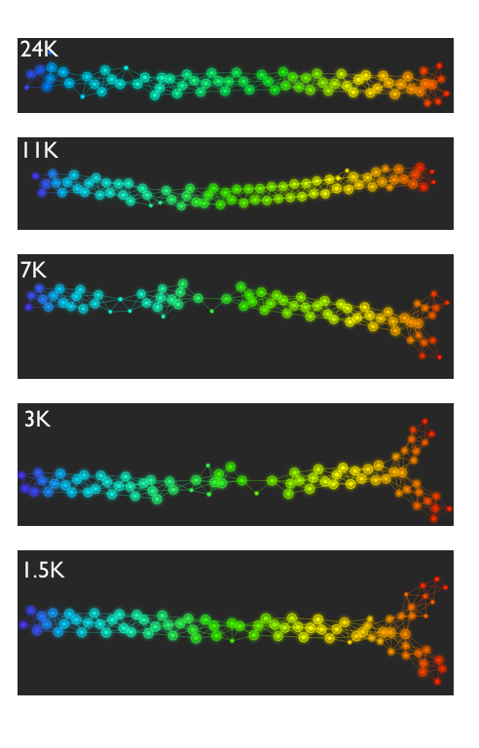
Fig. S1. Shape of the data becomes more distinct as the analysis columns are restricted to the top
varying genes.
24K: all the genes on the microarray were used in the analysis;
11K: 10,731 top most varying genes were used in the analysis;
7K: 6.688 top most varying genes were used in the analysis;
3K: 3212 top most varying genes were used in the analysis;
1.5K: 1553 top most varying genes were used in the analysis.
Graphs colored by the L-infinity centrality values. Red: high; Blue: low
http://www.nature.com/srep/2013/130207/srep01236/full/srep01236.html

Slide 77
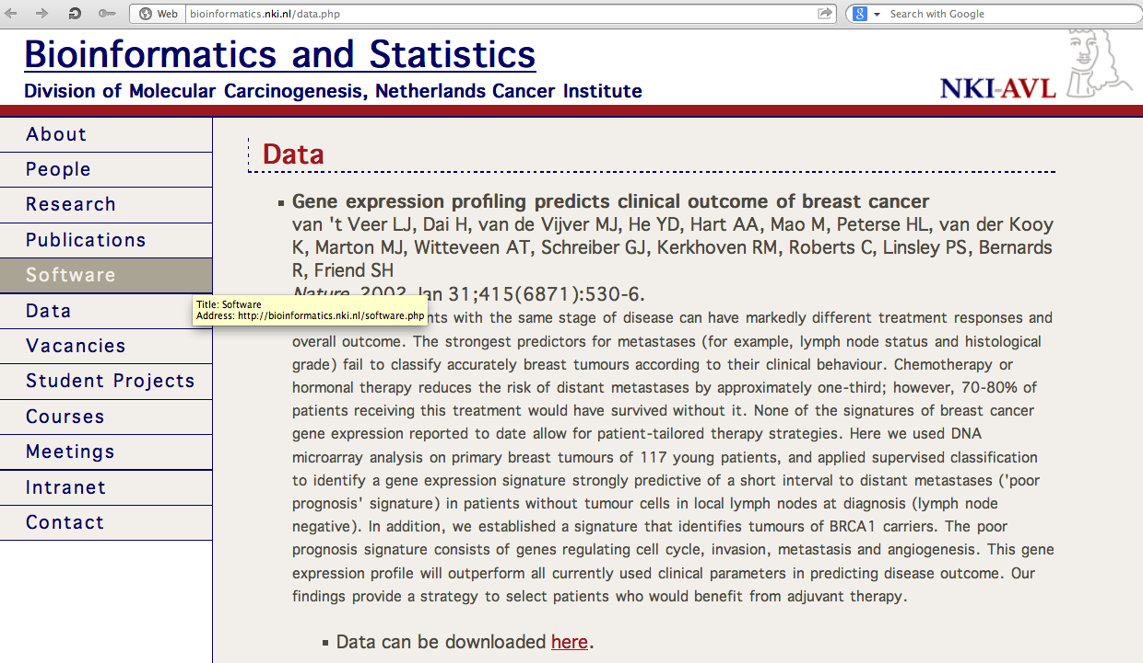
http://bioinformatics.nki.nl/data.php

Slide 78
Comparison of our results with those of Van de Vijver and colleagues is difficult because of differences in patients, techniques, and materials used.
Their study included node-negative and node-positive patients, who had or had not received adjuvant systemic therapy, and only women younger than 53 years.
microarray platforms used in the studies differ—Affymetrix and Agilent.
Of the 70 genes in the study by van't Veer and co-workers, 48 are present on the Affymetrix U133a array, whereas only 38 of our 76 genes are present on the Agilent array. There is a three-gene overlap between the two signatures (cyclin E2, origin recognition complex, and TNF superfamily protein).
Despite the apparent difference, both signatures included genes that identified several common pathways that might be involved in tumour recurrence. This finding supports the idea that although there might be redundancy in gene members, effective signatures could be required to include representation of specific pathways.
From: Gene-expression profiles to predict distant metastasis of lymph-node-negative primary breast cancer, Yixin Wang et al, The Lancet, Volume 365, Issue 9460, 19–25 February 2005, Pages 671–679

Slide 79
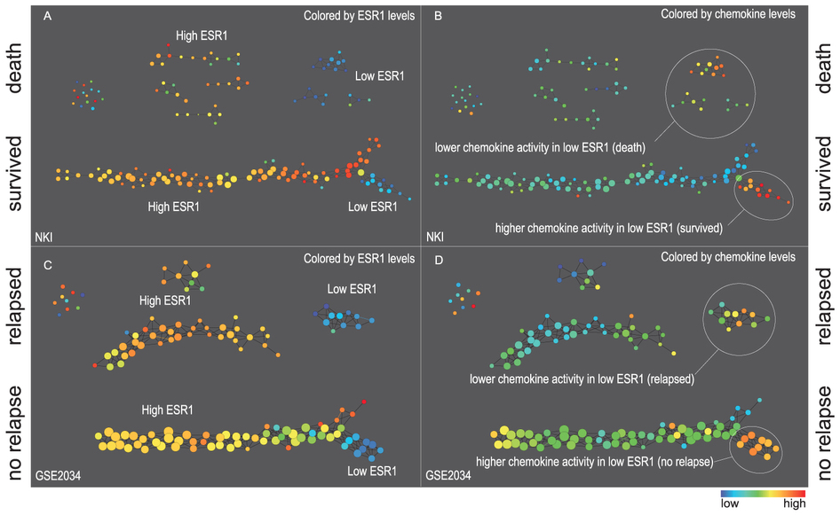
Two filter functions, L-Infinity centrality and survival or relapse were used to generate the networks. The top half of panels A and B are the networks of patients who didn't survive, the bottom half are the patients who survived. Panels C and D are similar to panels A and B except that one of the filters is relapse instead of survival. Panels A and C are colored by the average expression of the ESR1 gene. Panels B and D are colored by the average expression of the genes in the KEGG chemokine pathway. Metric: Correlation; Lens: L-Infinity Centrality (Resolution 70, Gain 3.0x, Equalized) and Event Death (Resolution 30, Gain 3.0x). Color bar: red: high values, blue: low values.
http://www.nature.com/srep/2013/130207/srep01236/full/srep01236.html

Slide 80
Identifying subtypes of cancer in a consistent manner is a challenge in the field since sub-populations can be small and their relationships complex
High expression level of the estrogen receptor gene (ESR1) is positively correlated with improved prognosis, given that this set of patients is likely to respond to standard therapies.
But , there are still sub-groups of high ESR1 that do not respond well to therapy.
Low ESR1 levels are strongly correlated with poor prognosis
But there are patients with low ESR1 levels but high survival rates
Many molecular sub-groups have been identified,
But often difficult to identify the same sub-group in a broader setting, where data sets are generated on different platforms, on different sets of patients and at a different times, because of the noise and complexity in the data.
http://www.nature.com/srep/2013/130207/srep01236/full/srep01236.html

Slide 81
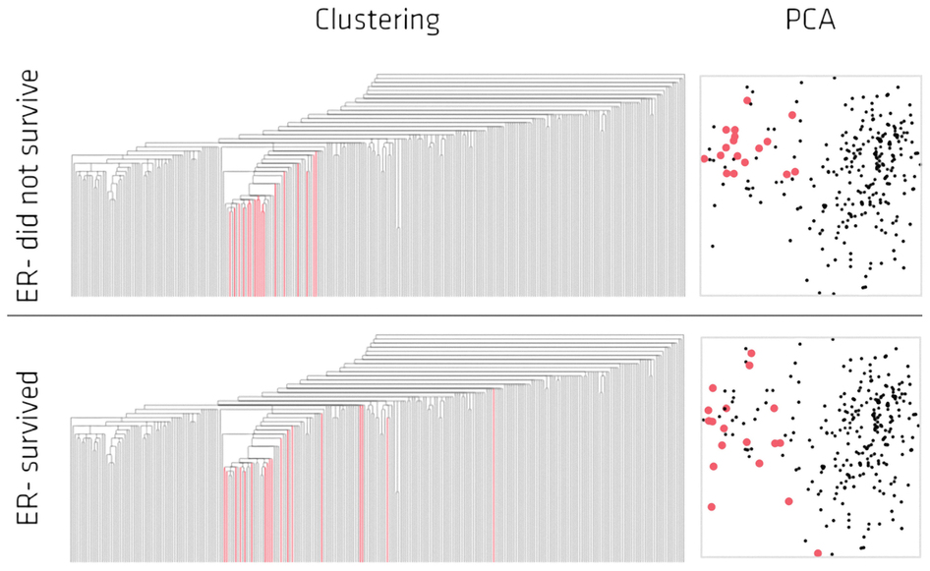
Highlighted in red are the lowERNS (top panel) and the lowERHS (bottom panel) patient sub-groups.
http://www.nature.com/srep/2013/130207/srep01236/full/srep01236.html

Slide 82
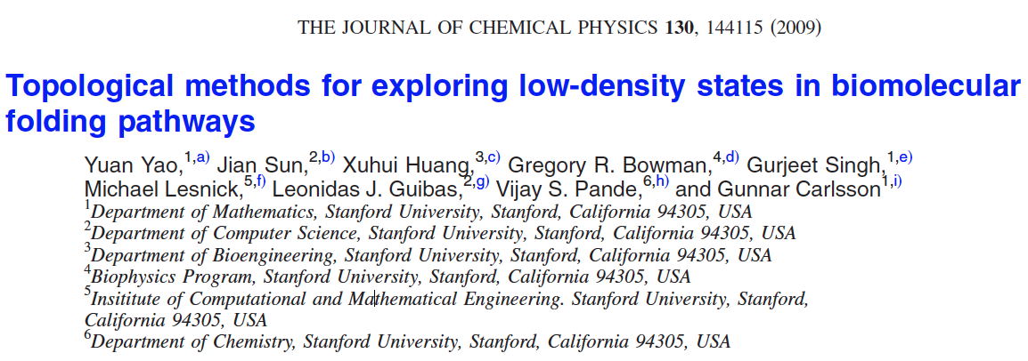
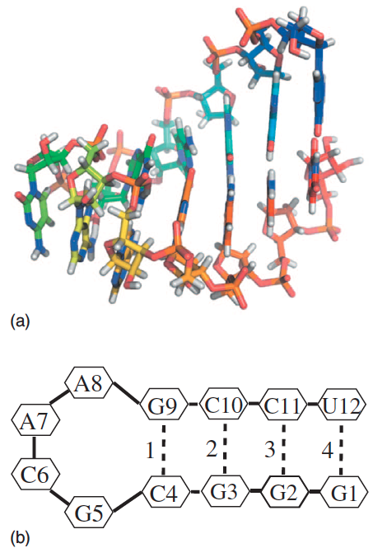
http://scitation.aip.org/content/aip/journal/jcp/130/14/10.1063/1.3103496

Slide 83
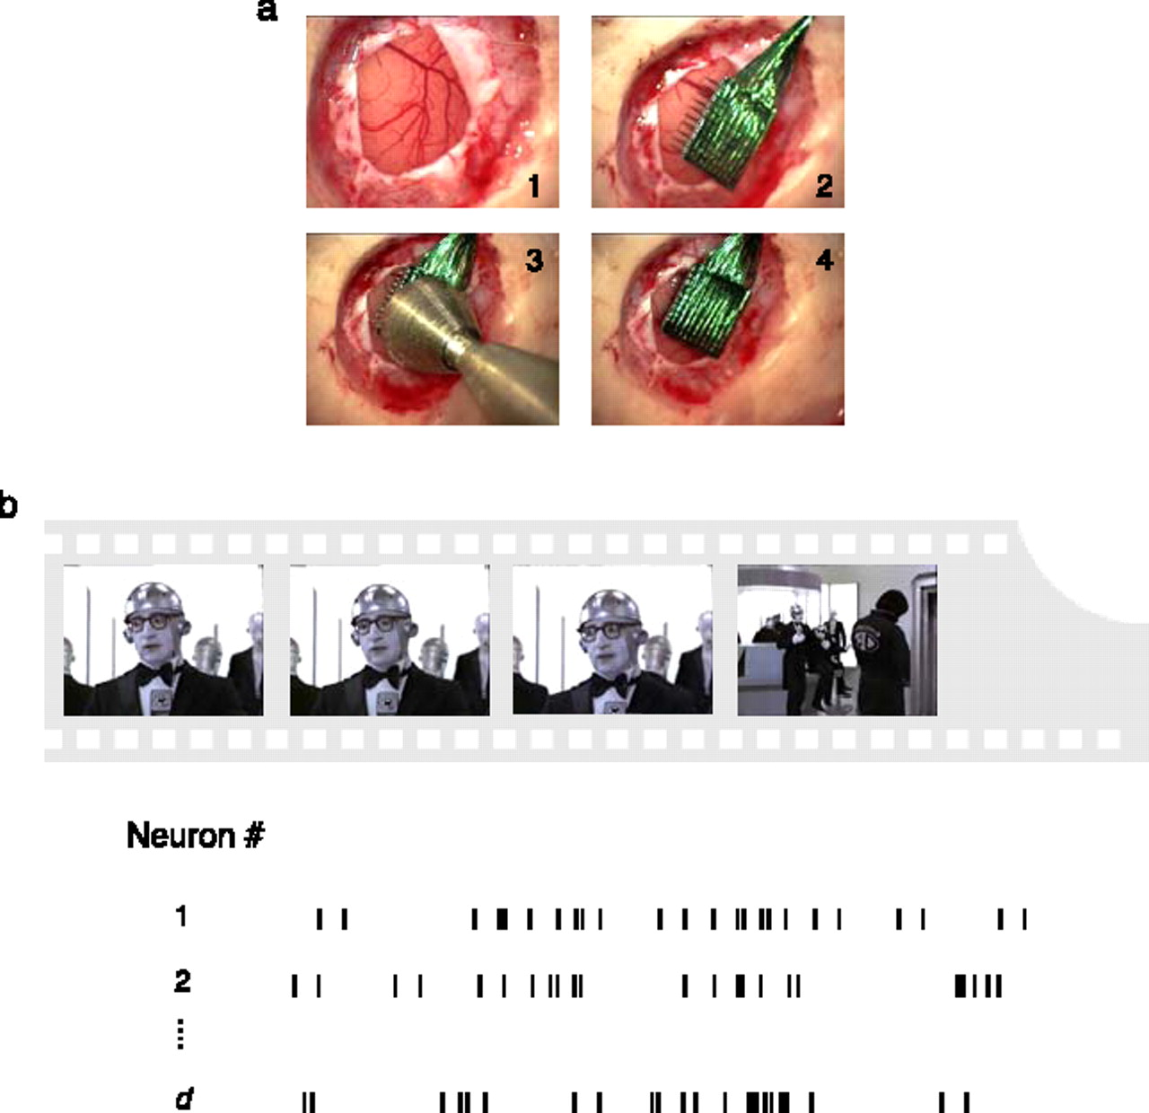

Back to persistent homology:
Topological analysis of population activity in visual cortex.
By Singh, Memoli, Ishkhanov, Sapiro,
Carlsson, Ringach
J Vis June 30, 2008
Experimental recordings in primary visual cortex.
Singh G et al. J Vis 2008;8:11
©2008 by Association for Research in Vision and Ophthalmology
Notes:
Experimental recordings in primary visual cortex. (a) Insertion sequence of a multi-electrode array into primary visual cortex (Nauhaus & Ringach, 2007). (b) Natural image sequences, sampled from commercial movies, were used to stimulate all receptive fields of neurons isolated by the array. In the spontaneous condition, activity was recorded while both eyes were occluded.

Slide 84
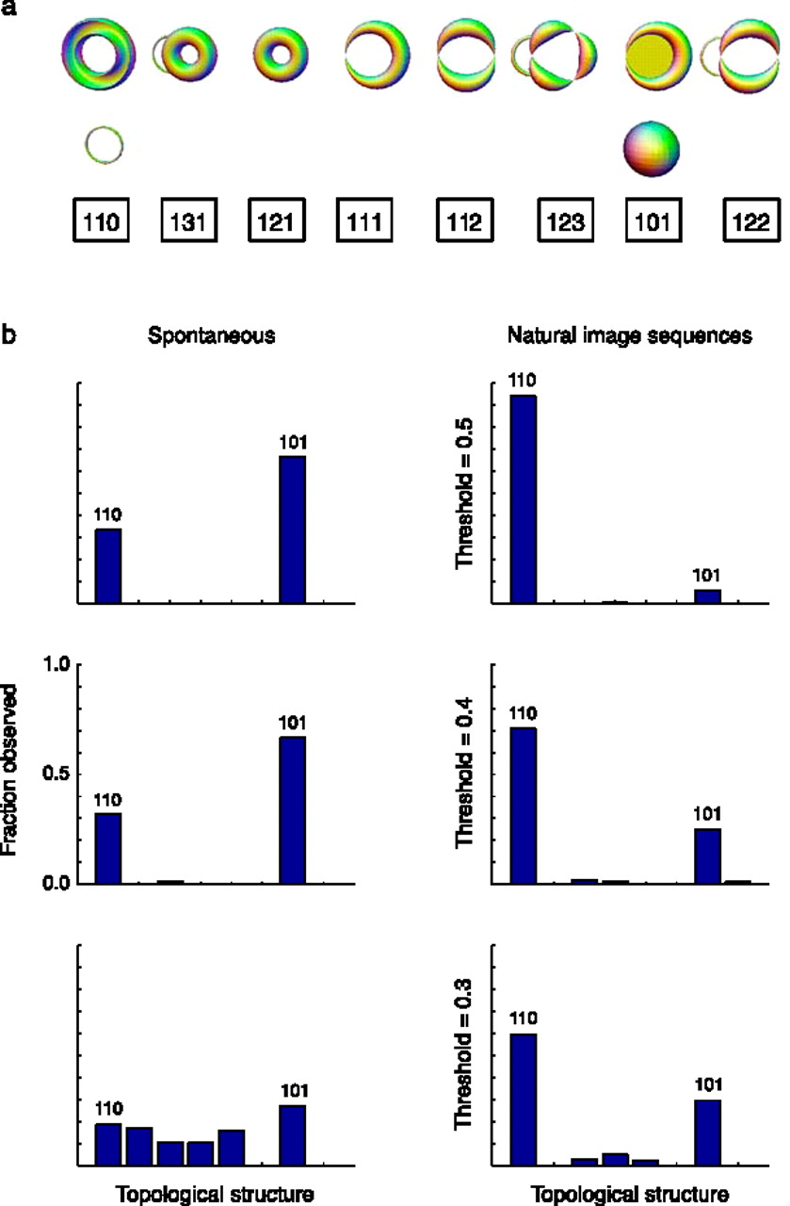
Estimation of topological structure in driven and spontaneous conditions.
Record voltages at points in time at each electrode.
Spike train: lists of firing times for a neuron
obtained via spike sorting –i.e. signal processing.
Data = an array of N spike trains.
Compared spontaneous (eyes occluded) to evoked (via movie clips).
10 second segments broken into 50 ms bins
Transistion between states about 80ms
The 5 neurons with the highest firing rate in each ten second window were chosen
For each bin, create a vector in R⁵ corresponding to the number of firings of each of the 5 neurons.
200 bins = 200 data points in R⁵.
Used 35 landmark points.
20-30minutes of data = many data sets
Control: shuffled data 52700 times.
Singh G et al. J Vis 2008;8:11
©2008 by Association for Research in Vision and Ophthalmology
Notes:
Estimation of topological structure in driven and spontaneous conditions. (a) Ordering of topological signatures observed in our experiments. Each triplet ( b 0, b 1, b 2) is shown along an illustration of objects consistent with these signature. (b) Distribution of topological signatures in the spontaneous and natural image stimulation conditions pooled across the three experiments performed. Each row correspond to signatures with a minimum interval length (denoted as the threshold) expressed as a fraction of the covering radius of the data cloud (see Appendix A for the definition of the covering radius).

