Slide 1
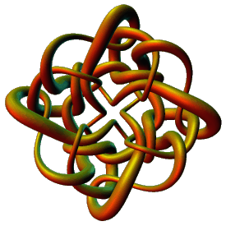
Topological Data Analysis
Applications I
Isabel K. Darcy
Mathematics Department
Applied Mathematical and
Computational Sciences (AMCS)
University of Iowa
http://www.math.uiowa.edu/~idarcy
This work was partially supported by the Joint DMS/NIGMS Initiative to Support Research in the Area of Mathematical Biology (NSF 0800285).
©2008 I.K. Darcy. All rights reserved

Slide 2
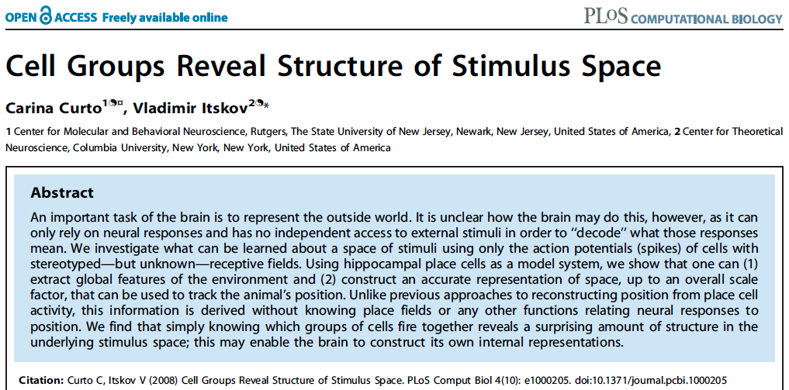
http://www.ploscompbiol.org/article/info%3Adoi%2F10.1371%2Fjournal.pcbi.1000205
2008
First paper to use only the spiking activity of place cells to determine the topology (and geometry) of the environment using homology (and graphs).

Slide 3

Edvard Moser
May-Britt Moser
John O’Keefe
http://www.nature.com/news/nobel-prize-for-decoding-brain-s-sense-of-place-1.16093

Slide 4

http://www.nature.com/news/neuroscience-brains-of-norway-1.16079
May-Britt Moser
Edvard Moser
John O’Keefe
http://www.nature.com/news/nobel-prize-for-decoding-brain-s-sense-of-place-1.16093

Slide 5
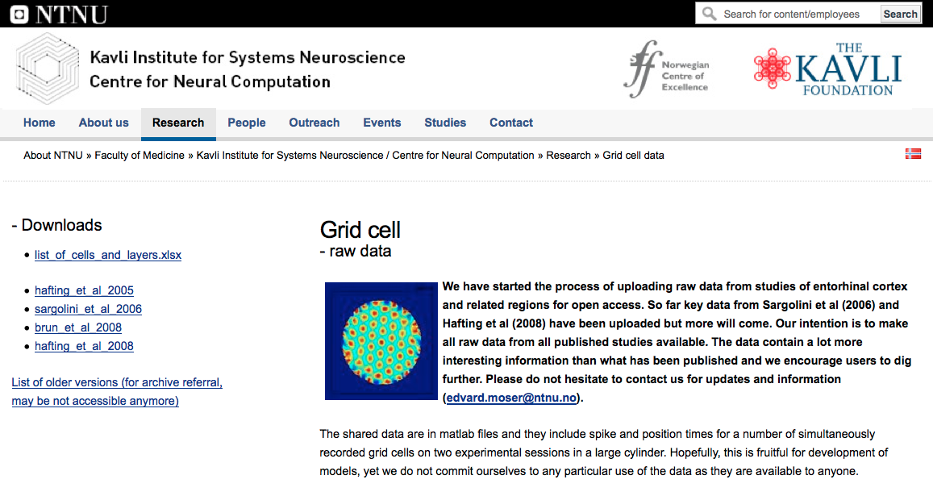
http://www.ntnu.edu/kavli/research/grid-cell-data

Slide 6
http://www.ploscompbiol.org/article/info%3Adoi%2F10.1371%2Fjournal.pcbi.1000205
2008
First paper to use only the spiking activity of place cells to determine the topology (and geometry) of the environment using homology (and graphs).

Slide 7
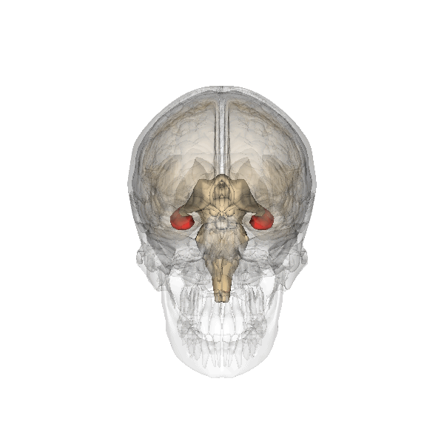
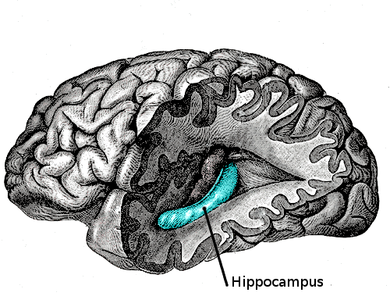
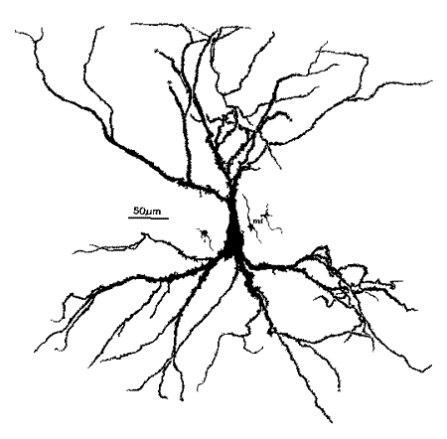
place cells = neurons in the hippocampus that are involved in spatial navigation
http://en.wikipedia.org/wiki/File:Gray739-emphasizing-hippocampus.png
http://en.wikipedia.org/wiki/File:Hippocampus.gif
http://en.wikipedia.org/wiki/File:Hippocampal-pyramidal-cell.png

Slide 8
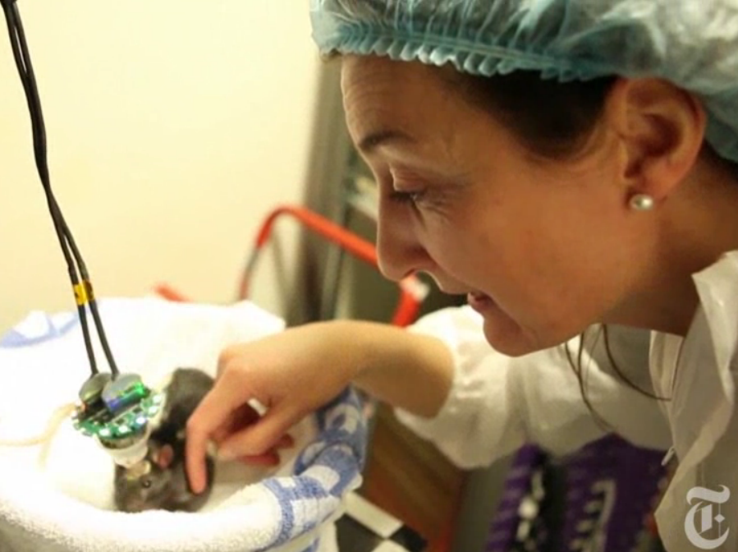
http://www.nytimes.com/2014/10/07/science/nobel-prize-medicine.html

Slide 9
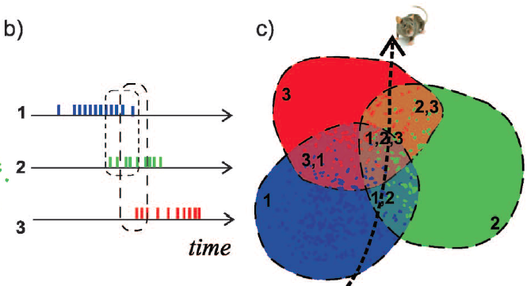
http://www.ploscompbiol.org/article/info%3Adoi%2F10.1371%2Fjournal.pcbi.1002581

Slide 10
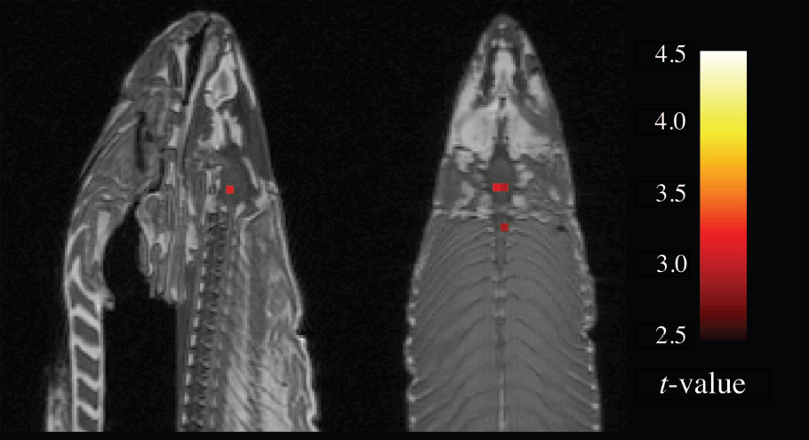
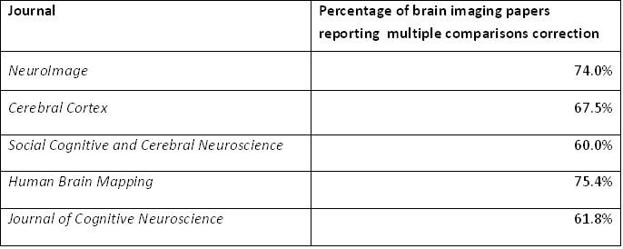
2012 Ignoble Prize
The Ig Nobel Prizes honor achievements that make people LAUGH, and then THINK.
http://www.improbable.com/ig/

Slide 11
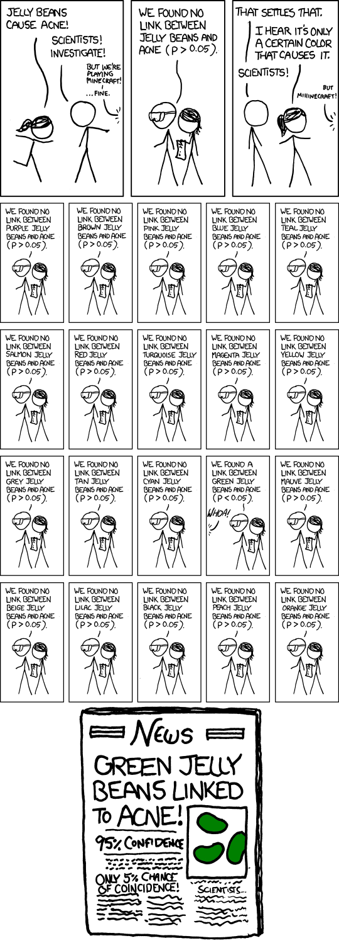
False Positives will occur

Slide 12
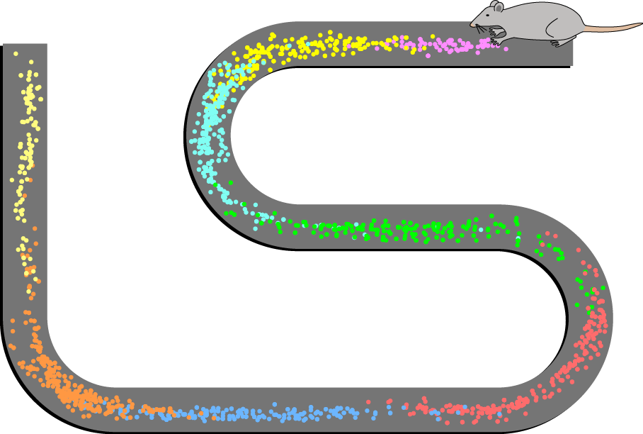
How can the brain understand the spatial environment based only on action potentials (spikes) of place cells?
http://upload.wikimedia.org/wikipedia/en/5/5e/Place_Cell_Spiking_Activity_Example.png

Slide 13
How can the brain understand the spatial environment based only on action potentials (spikes) of place cells?
http://upload.wikimedia.org/wikipedia/en/5/5e/Place_Cell_Spiking_Activity_Example.png

Slide 14
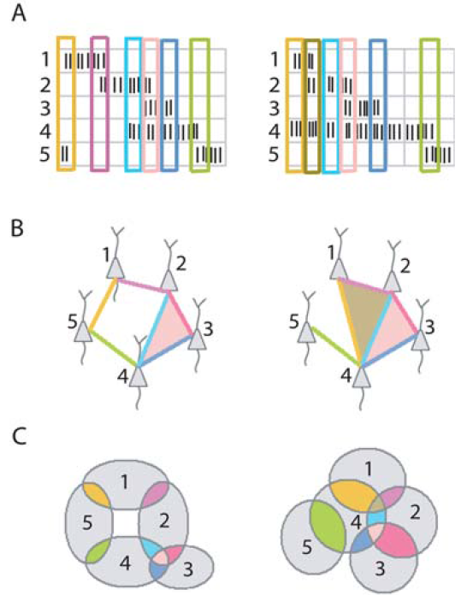
Idea: Can recover the topology of the space traversed by the mouse by looking only at the spiking activity of place cells.
http://www.ploscompbiol.org/article/info%3Adoi%2F10.1371%2Fjournal.pcbi.1000205

Slide 15
Building blocks for a simplicial complex
0-simplex = vertex = v
1-simplex = edge = {v₁, v₂}
Note that the boundary of this edge is v₂ + v₁
v₁
v₂
e
2-simplex = triangle = {v₁, v₂, v₃}
v₂
Note that the boundary
of this triangle is the cycle
e₁ + e₂ + e₃
= {v₁, v₂} + {v₂, v₃} + {v₁, v₃}
e₁
e₂
v₁
v₃
e₃
Notes:
The building blocks for a simplicial complex consist of zero simplices which are zero dimensional vertices, one simplices which are one-dimensional edges, and 2-simplices which are two dimensional triangles,

Slide 16
Building blocks for a simplicial complex
3-simplex = {v₁, v₂, v₃, v₄} = tetrahedron
boundary of {v₁, v₂, v₃, v₄} =
{v₁, v₂, v₃} + {v₁, v₂, v₄} + {v₁, v₃, v₄} + {v₂, v₃, v₄}
n-simplex = {v₁, v₂, …, v_{n+1}}
v₂
v₂
Fill in
v₄
v₄
v₁
v₃
v₁
v₃
Notes:
To distinguish between the 2-dimensional boundary of a tetrahedron and the three dimensional 3-simplex, I’ll use dark blue when the simplex is filled in and we have a solid three dimensional tetrahedron.
Thus on the left we have the boundary of the three simplex which consists of the sum of its four 2-dimensional faces while on the right we have the three simplex, the solid filled in tetrahedron.
We can also have higher dimensional n-simplices.
Let’s now create a simplicial complex.

Slide 17
Creating a simplicial complex
0.) Start by adding 0-dimensional vertices
(0-simplices)
Notes:
To create a simplicial complex, we start by adding 0-simplices (ie 0-dimensional vertices). So our step zero will be to add 0-simplices.

Slide 18
Creating a simplicial complex
1.) Next add 1-dimensional edges (1-simplices).
Note: These edges must connect two vertices.
I.e., the boundary of an edge is two vertices

Slide 19
Creating a simplicial complex
2.) Add 2-dimensional triangles (2-simplices).
Boundary of a triangle = a cycle consisting of 3 edges.
Notes:
Step 2.) Add 2-dimensional triangles (2-simplices). But we can only add a triangle where 3 edges form a triangle since the Boundary of a triangle is a cycle consisting of 3 edges.
The boundary of a simplex must exist before we can add that simplex.
Note we can also use n set of three vertices to identify a 2-simplex. But to add a 2-simplex, we must have its three boundary edges in the complex.

Slide 20
Creating a simplicial complex
3.) Add 3-dimensional tetrahedrons (3-simplices).
Boundary of a 3-simplex
= a cycle consisting of its four 2-dimensional faces.
Notes:
Continuing to increase in dimension, in step 3, we Add 3-dimensional tetrahedrons (3-simplices). But we can only add the tetrahedron if it’s faces are already part of the simplicial complex that we have created so far. That is we can only add a 3-simplex if there are 4 2-dimensionals that form the boundary of a tetrahedron, then we can add a 3-simplex by filling it in.
I can identify a 3-simples with four vertices.
Note all the 2-dimensionals must be triangles. Thus I cannot fill in this pyramid because it has a square base.

Slide 21
Creating a simplicial complex
n.) Add n-dimensional n-simplices, {v₁, v₂, …, v_{n+1}}.
Boundary of a n-simplex
= a cycle consisting of (n-1)-simplices.
Notes:
In step n, we can add n-simplices, but only if its boundary, a sum of (n-1) dimensional simplices was created in the previous step, the n-1 step where we added n-1 - simplices.
In our example, the highest dimensional simplex is a 3-simplex, this solid tetrahedron, so we have a 3-dimensional simplicial complex.
This partitioning of an object into 0-simplices, 1-simplices, 2-simplices, etc. is called a triangulation of the object. An object is called a simplicial complex if it has a triangulation.
Let us now triangulate a couple of familiar examples.

Slide 22
Place field = region in space where the firing rates are significantly above baseline
http://www.ploscompbiol.org/article/info%3Adoi%2F10.1371%2Fjournal.pcbi.1002581

Slide 23
Creating a simplicial complex
Notes:
So we will connect every pair of vertices if their distance is less than 1.8 cm. If the center of these points represent the 0-dimensional vertices, then this distance is less than our threshold, so we add an edge. Similarly this pair of points satisfy our definition of close, so we add an edge
The distance between this pair of vertices is greater than 1.8, so we won’t connect them with an edge. Continuing to add edges between vertices whenever their distance is less than our threshold of 1.8cm, we now have

Slide 24
Creating a simplicial complex
1.) Adding 1-dimensional edges (1-simplices)
Add an edge between data points that are “close”
Notes:
a one dimensional simplicial complex. Note that we have clustered our data into five disjoint connected sets. So this is one way to cluster our data – that is grouping our data points into disjoint sets based on some definition of similarity. In this case, we have 5 clusters.
We can now add higher dimensional simplices.

Slide 25
Creating the Čech simplicial complex
1.) B₁ … B_{k+1} ≠ ⁄ , create k-simplex {v₁, ... , v_{k+1}}.
U
U
0
Notes:
Thus we now have the Vietoris Rips simplicial complex. Note we get the same simplex by adding one dimension at a time

Slide 26
Creating the Čech simplicial complex
1.) B₁ … B_{k+1} ≠ ⁄ , create k-simplex {v₁, ... , v_{k+1}}.
U
U
0
Notes:
Thus we now have the Vietoris Rips simplicial complex. Note we get the same simplex by adding one dimension at a time

Slide 27
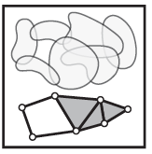
Consider X an arbitrary topological space.
Let V = {V_{i} | i = 1, …, n } where V_{i} X ,
The nerve of V = N(V) where
The k -simplices of N(V) =
nonempty intersections of
k +1 distinct elements of V .
For example,
Vertices = elements of V
Edges = pairs in V which intersect nontrivially.
Triangles = triples in V which intersect nontrivially.
http://www.math.upenn.edu/~ghrist/EAT/EATchapter2.pdf

Slide 28
Consider X an arbitrary topological space.
Let V = {V_{i} | i = 1, …, n } where V_{i} X ,
The nerve of V = N(V) where
The k -simplices of N(V) =
nonempty intersections of
k +1 distinct elements of V .
For example,
Vertices = elements of V
Edges = pairs in V which intersect nontrivially.
Triangles = triples in V which intersect nontrivially.
Čech complex =
Mathematical nerve,
not biological nerve
http://www.math.upenn.edu/~ghrist/EAT/EATchapter2.pdf

Slide 29
Creating the Čech simplicial complex
1.) B₁ … B_{k+1} ≠ ⁄ , create k-simplex {v₁, ... , v_{k+1}}.
U
U
0
Notes:
Thus we now have the Vietoris Rips simplicial complex. Note we get the same simplex by adding one dimension at a time

Slide 30
Mathematical
Nerve Lemma: If V is a finite collection of subsets of X with all non-empty intersections of subcollections of V contractible, then N(V) is homotopic to the union of elements of V.
http://www.math.upenn.edu/~ghrist/EAT/EATchapter2.pdf

Slide 31
Idea: Can recover the topology of the space traversed by the mouse by looking only at the spiking activity of place cells.
Vertices = place cells
Add simplex if place cells co-fare within a specified time period
http://www.ploscompbiol.org/article/info%3Adoi%2F10.1371%2Fjournal.pcbi.1000205

Slide 32
Cell group = collection of place cells that co-fire within a specified time period (above a specified threshold) .
Simplices correspond to cell groups.
dimension of simplex = number of place cells in cell group - 1
http://www.ploscompbiol.org/article/info%3Adoi%2F10.1371%2Fjournal.pcbi.1000205

Slide 33
2012 Ignoble Prize
The Ig Nobel Prizes honor achievements that make people LAUGH, and then THINK.
http://www.improbable.com/ig/
Activated compared to other voxels
fMRI of dead salmon
The salmon was shown images of people in social situations, either socially inclusive situations or socially exclusive situations.
The salmon was asked to respond, saying how the person in the situation must be feeling.
http://blogs.scientificamerican.com/scicurious-brain/2012/09/25/ignobel-prize-in-neuroscience-the-dead-salmon-study/

Slide 34
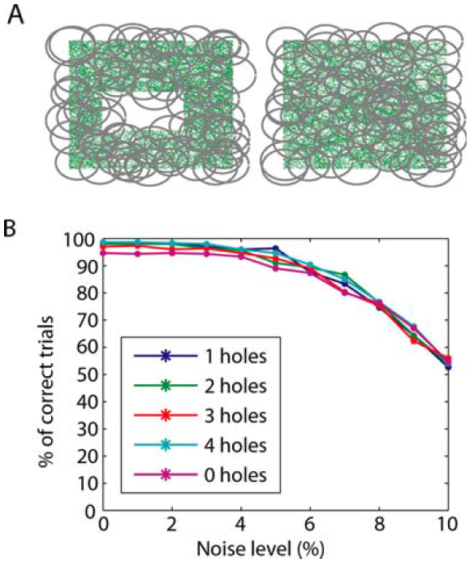
Recovering the topology
Trial is correct if H_{i} correct for i = 0, 1, 2, 3, 4.
http://www.ploscompbiol.org/article/info%3Adoi%2F10.1371%2Fjournal.pcbi.1000205

Slide 35
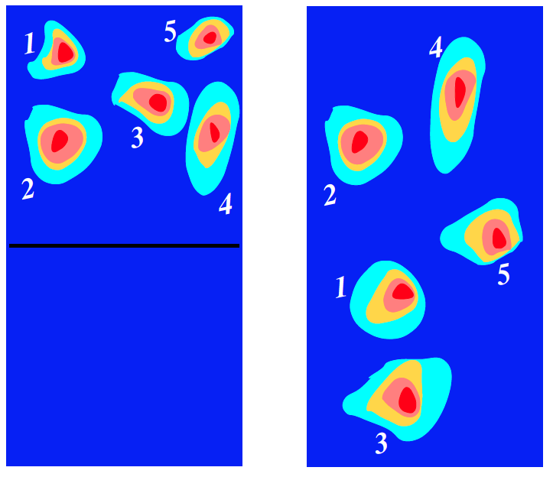
Remodeling: the hippocampus can undergo rapid context dependent remapping.
http://arxiv.org/abs/q-bio/0702052

Slide 36
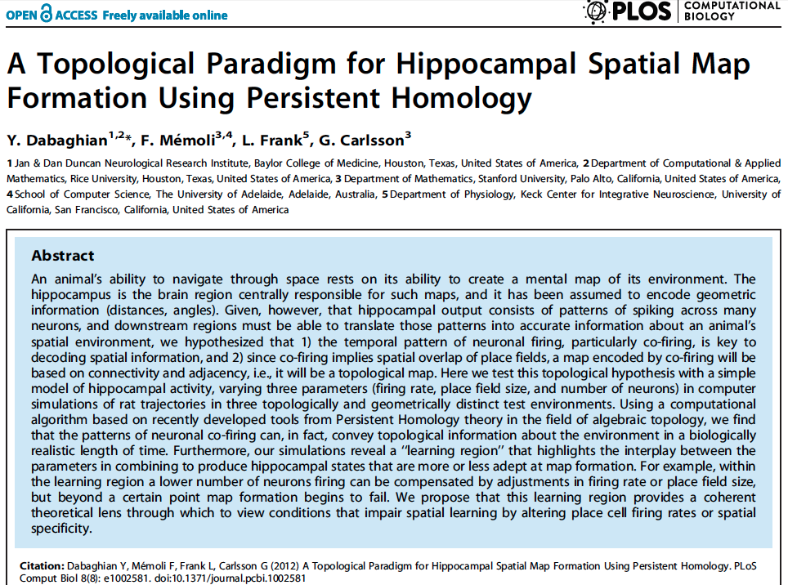
http://www.ploscompbiol.org/article/info%3Adoi%2F10.1371%2Fjournal.pcbi.1002581
2012

Slide 37

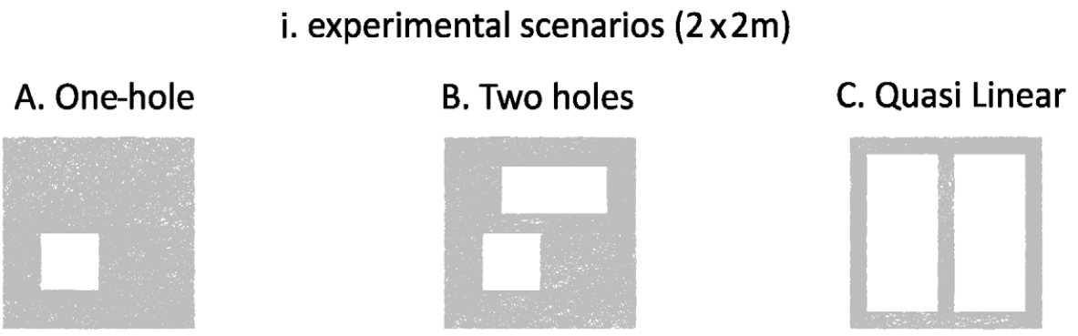
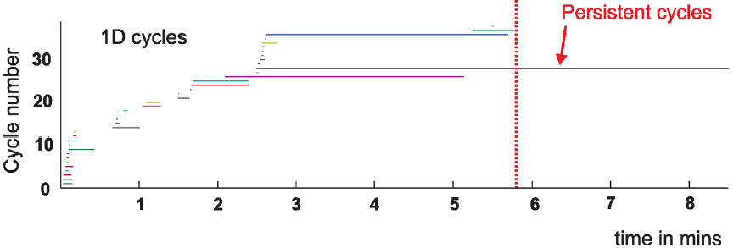
2012

Slide 46
Cycles
Time

Slide 47
Cycles
Time

Slide 48
Cycles
Time

Slide 49
Cycles
Time

Slide 50
Cycles
Time

Slide 51
Cycles
Time

Slide 52
Cycles
Time

Slide 53
Cycles
Time

Slide 54
Cycles
Time

Slide 55
Cycles
Time

Slide 56
Cycles
Time

Slide 57
Cycles
Time

Slide 58
Cycles
Time

Slide 59
2012

Slide 60
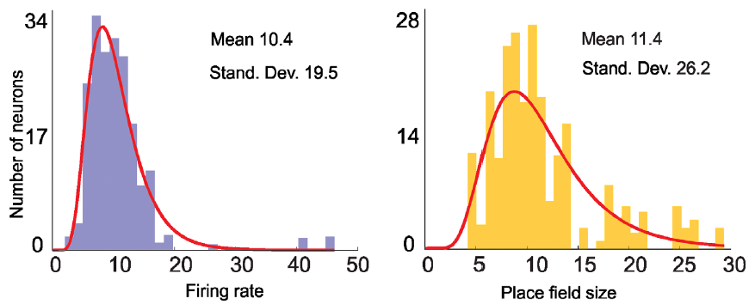

Slide 61
Data obtained via computer simulations

Slide 62
http://www.ntnu.edu/kavli/research/grid-cell-data

Slide 63
Note the above examples use the Čech complex to determine the topology of the mouse environment.
But often in topological data analysis for computational efficiency, one uses the Rips complex instead of the Čech complex.
Unfortunately there is no nerve lemma for the Rips complex.

Slide 64
Creating the Vietoris Rips simplicial complex
0.) Start by adding 0-dimensional data points
Note: we only need a definition of closeness between data points. The data points do not need to be actual points in R^{n}
Notes:
We start again by adding our 0-simplices, our data points. I can indicate the threshold using a ball centered at my data point. The diameter of the ball will be my threshold, so if two balls intersect then the distance between the vertices is less than the threshold, so we connect the pair of vertices with an edge if and only if the balls intersect, so we can get edges after which we can then add all possible higher dimensional simplices.
Note how I grew my balls. As the diameter increases, my threshold which is equal to my diameter increases.

Slide 65
Creating the Vietoris Rips simplicial complex
Step 0.) Start by adding data points
= 0-dimensional vertices (0-simplices)
Notes:
Starting with 0-simplices, our data points in step 0

Slide 66
Creating the Vietoris Rips simplicial complex
1.) Adding 1-dimensional edges (1-simplices)
Add an edge between data points that are “close”
Notes:
In step 1 Adding 1-simplices connecting data points that are “close”.

Slide 67
Creating the Vietoris Rips simplicial complex
2.) Add all possible simplices of dimensional > 1.
Notes:
And then adding an n-simplex whenever we have n+1 points that are close.
Thus we now have the Vietoris Rips simplicial complex. Note we get the same simplex by adding one dimension at a time.
What if I increase my threshold?

Slide 68
Vietoris Rips complex = flag complex = clique complex
2.) Add all possible simplices of dimensional > 1.
Notes:
Thus we now have the Vietoris Rips simplicial complex. Note we get the same simplex by adding one dimension at a time

Slide 69
Creating the Čech simplicial complex
1.) B₁ … B_{k+1} ≠ ⁄ , create k-simplex {v₁, ... , v_{k+1}}.
U
U
0
Notes:
Thus we now have the Vietoris Rips simplicial complex. Note we get the same simplex by adding one dimension at a time

Slide 70
Creating the Čech simplicial complex
1.) B₁ … B_{k+1} ≠ ⁄ , create k-simplex {v₁, ... , v_{k+1}}.
U
U
0
Notes:
Thus we now have the Vietoris Rips simplicial complex. Note we get the same simplex by adding one dimension at a time

