Slide 1
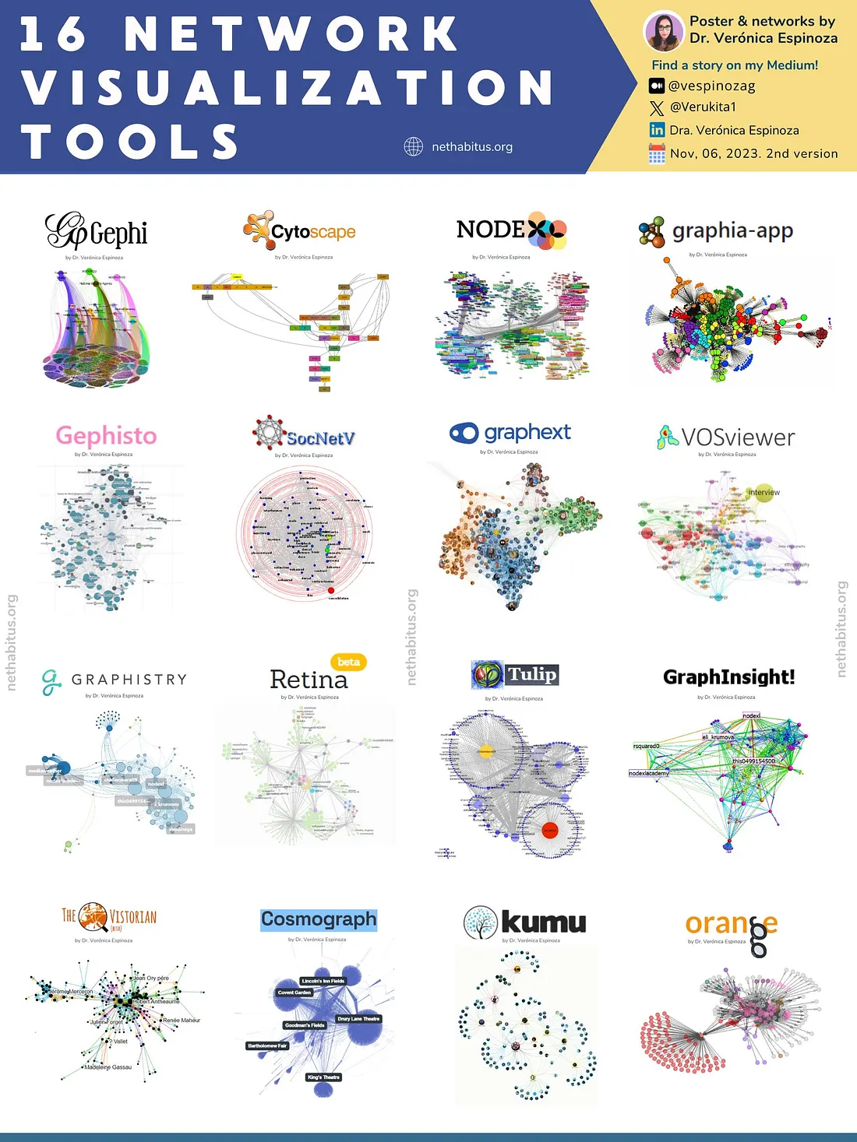
A poster from https://medium.com/@vespinozag/16-network-visualization-tools-that-you-should-know-2c26957b707e
"16 network visualization tools that you should know! | by Dr. Veronica Espinoza | Medium“
See website for brief description of each tool.

Slide 2
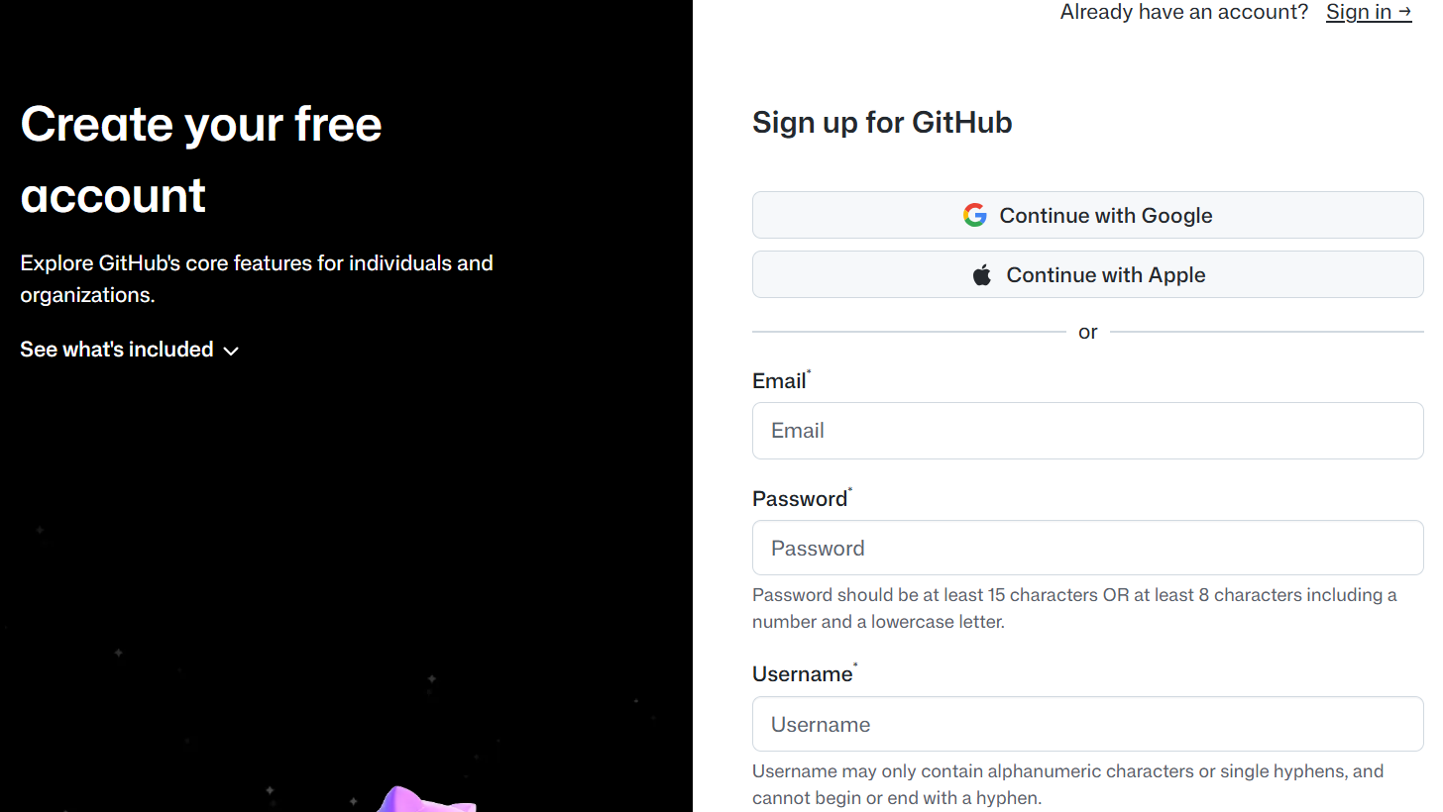
https://github.com/signup
Gitlab at UI: https://research-git.uiowa.edu/users/sign_in

Slide 3

https://education.github.com/pack

Slide 4
Introduction to
Gurjeet Singh , Facundo Mémoli and Gunnar Carlsson’s
Mapper Algorithm
Guest lecturer: Isabel K. Darcy
Mathematics Department/Applied Mathematical & Computational Sciences
University of Iowa
http://www.math.uiowa.edu/~idarcy/
This material is based upon work supported by the National Science Foundation under Grant No. DMS-1407216: EXTREEMS-QED: Large Data Analysis and Visualization at the University of Iowa
Any opinions, findings, and conclusions or recommendations expressed in this material are those of the author(s) and do not necessarily reflect the views of the National Science Foundation.

Slide 5
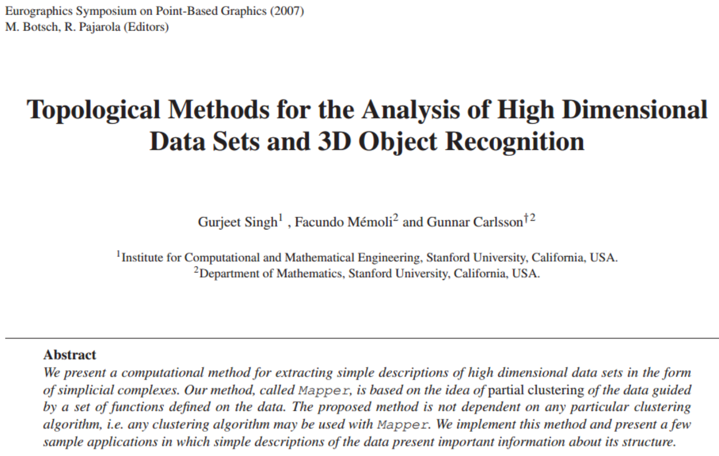
Mapper

Slide 6

http://www.ayasdi.com/

Slide 7
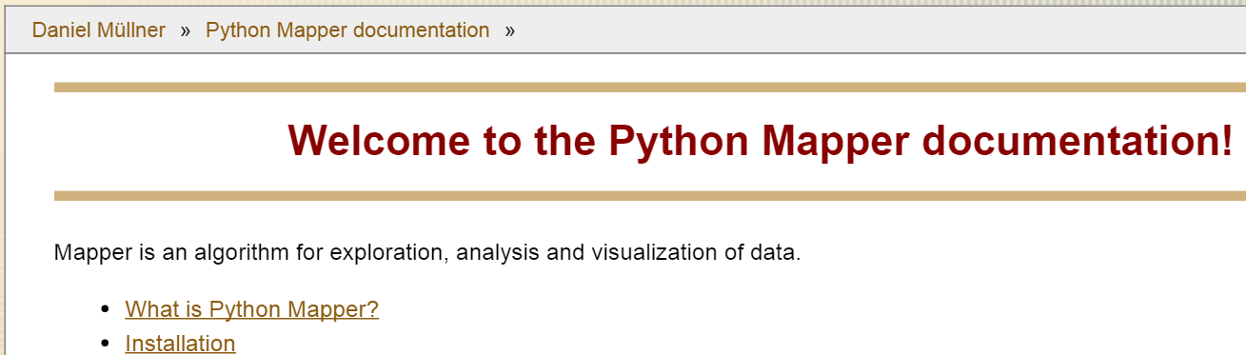
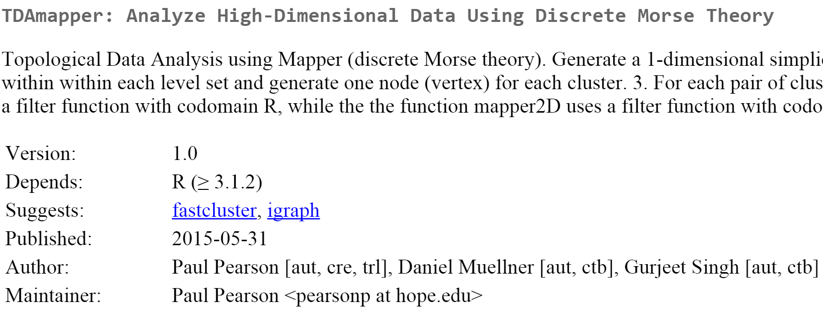
http://danifold.net/mapper/
https://cran.r-project.org/web/packages/TDAmapper/

Slide 8
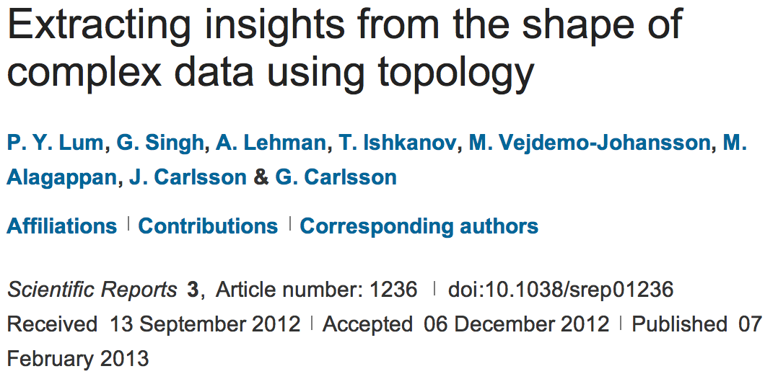
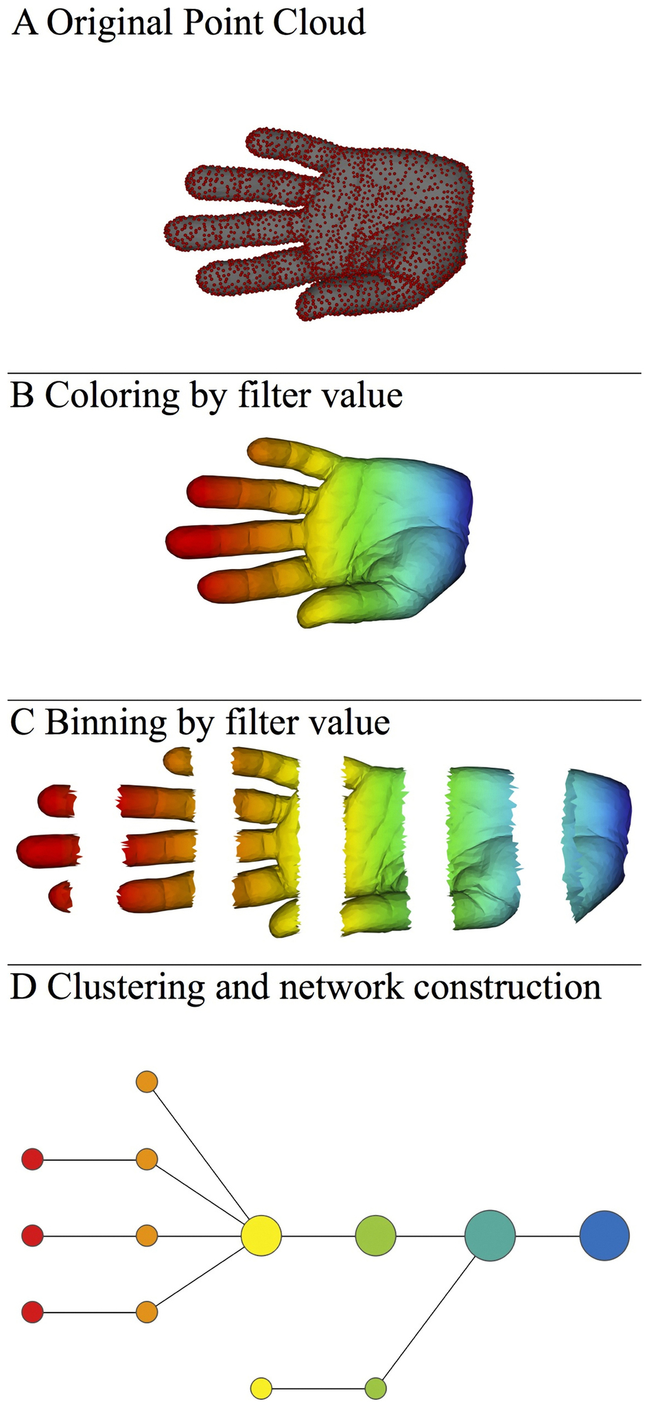
http://www.nature.com/srep/2013/130207/srep01236/full/srep01236.html

Slide 9
Mapper
Data Overlapping bins Graph
http://www.nature.com/srep/2013/130207/srep01236/full/srep01236.html

Slide 10

A) Data Set
Example: Point cloud data
representing a hand.
http://www.nature.com/srep/2013/130207/srep01236/full/srep01236.html

Slide 11
Function f : Data Set → R
Ex 1: x-coordinate
f : (x, y, z) → x
http://www.nature.com/srep/2013/130207/srep01236/full/srep01236.html

Slide 12
Function f : Data Set → R
Ex 1: x-coordinate
f : (x, y, z) → x
http://www.nature.com/srep/2013/130207/srep01236/full/srep01236.html

Slide 13
Function f : Data Set → R
Ex 1: x-coordinate
f : (x, y, z) → x
http://www.nature.com/srep/2013/130207/srep01236/full/srep01236.html

Slide 14
Put data into overlapping bins.
Example: f⁻¹(a_{i}, b_{i})
( ( ) ( ) ( ) ( ) ( ) )
Function f : Data Set → R
Ex 1: x-coordinate
f : (x, y, z) → x
http://www.nature.com/srep/2013/130207/srep01236/full/srep01236.html

Slide 15
Put data into overlapping bins.
Example: f⁻¹(a_{i}, b_{i})
( ( ) ( ) ( ) ( ) ( ) )
Function f : Data Set → R
Ex 1: x-coordinate
f : (x, y, z) → x
http://www.nature.com/srep/2013/130207/srep01236/full/srep01236.html

Slide 16
Data Set
Example: Point cloud data
representing a hand.
Function f : Data Set → R
Example: x-coordinate
f : (x, y, z) → x
Put data into overlapping bins.
Example: f⁻¹(a_{i}, b_{i})
http://www.nature.com/srep/2013/130207/srep01236/full/srep01236.html

Slide 17
D) Cluster each bin
http://www.nature.com/srep/2013/130207/srep01236/full/srep01236.html
Notes:
Need covering Resolution multiscale

Slide 18
D) Cluster each bin
http://www.nature.com/srep/2013/130207/srep01236/full/srep01236.html
Notes:
Need covering Resolution multiscale

Slide 19
D) Cluster each bin
Vertex = a cluster of a bin.
http://www.nature.com/srep/2013/130207/srep01236/full/srep01236.html
Notes:
Need covering Resolution multiscale

Slide 20
D) Cluster each bin
& create network.
Vertex = a cluster of a bin.
Edge = nonempty intersection
between clusters
http://www.nature.com/srep/2013/130207/srep01236/full/srep01236.html
Notes:
Need covering Resolution multiscale

Slide 21
D) Cluster each bin
& create network.
Vertex = a cluster of a bin.
Edge = nonempty intersection
between clusters
http://www.nature.com/srep/2013/130207/srep01236/full/srep01236.html
Notes:
Need covering Resolution multiscale

Slide 22
A) Data Set
Example: Point cloud data
representing a hand.
B) Function f : Data Set → R
Example: x-coordinate
f : (x, y, z) → x
Put data into overlapping bins.
Example: f⁻¹(a_{i}, b_{i})
Cluster each bin & create network.
Vertex = a cluster of a bin.
Edge = nonempty intersection
between clusters
http://www.nature.com/srep/2013/130207/srep01236/full/srep01236.html

Slide 23
To understand software, it helps to apply it to a variety of examples.

Slide 24

What graph do you get when you apply mapper to the ideal trefoil knot if filter = projection to x-axis?
( ( ) ( ) ( ) ( ) ( ) )

Slide 25
1.) Put data into overlapping bins.
( ( ) ( ) ( ) ( ) ( ) )
Example: f⁻¹(a_{i}, b_{i})

Slide 26
Put data into overlapping
bins.

Slide 27
Cluster each bin.

Slide 28
Cluster each bin.
Each cluster is represented by a vertex.

Slide 31
Create a graph representing the data set:
Cluster each bin.
Each cluster is represented by a vertex.
Draw an edge between 2 vertices if
their clusters have points in common.

Slide 33
Create a graph representing the data set:
Cluster each bin.
Each cluster is represented by a vertex.
Draw an edge between 2 vertices if
their clusters have points in common.

Slide 36
D
C
A
B
E

Slide 37
A
E
D
C
B

Slide 38
2
3
4
1
A
E
D
C
B

Slide 39
3
2
1
4
A
E
D
C
B

Slide 40
4
1
3
2
E
A
D
B
C

Slide 41
D
C
2
3
4
A
B
E
1
A
E
D
B
C
4
1
3
2
4
1
3
2
E
A
E
D
A
D
C
B
B
C

Slide 42
4
1
3
2
E
A
D
B
C

Slide 43
4
1
3
2
E
A
D
B
C

Slide 44
What graph do you get when you apply mapper to the above blob if filter = projection to x-axis?

Slide 45
( ( ) ( ) ( ) ( ) ( ) )

Slide 46
( ( ) ( ) ( ) ( ) ( ) )

Slide 47
( ( ) ( ) ( ) ( ) ( ) )

Slide 48
( ( ) ( ) ( ) ( ) ( ) )

Slide 49
( ( ) ( ) ( ) ( ) ( ) )

Slide 50
( ( ) ( ) ( ) ( ) ( ) )

Slide 51
( ( ) ( ) ( ) ( ) ( ) )

Slide 52
( ( ) ( ) ( ) ( ) ( ) )

Slide 53
( ( ) ( ) ( ) ( ) ( ) )

Slide 54
( ( ) ( ) ( ) ( ) ( ) )

Slide 56
To understand software, it helps to apply it to a variety of examples.

Slide 57
A) Data Set
Example: Point cloud data
representing a hand.
B) Function f : Data Set → R
Example: x-coordinate
f : (x, y, z) → x
Put data into overlapping bins.
Example: f⁻¹(a_{i}, b_{i})
Cluster each bin & create network.
Vertex = a cluster of a bin.
Edge = nonempty intersection
between clusters
http://www.nature.com/srep/2013/130207/srep01236/full/srep01236.html

Slide 58
Note: we made many, many choices
It helps to know what you are doing when you make choices, so collaborating with others is highly recommended.

Slide 59
We chose how to model the data set
A) Data Set
Example: Point cloud data
representing a hand.
http://www.nature.com/srep/2013/130207/srep01236/full/srep01236.html
Notes:
Be creative. Use ideas from pure and applied math (including stat) as well as area of application
Missing data, noise

Slide 60
Function f : Data Set → R
Ex 1: x-coordinate
f : (x, y, z) → x
Chose filter function
http://www.nature.com/srep/2013/130207/srep01236/full/srep01236.html

Slide 61
Function f : Data Set → R
Ex 1: x-coordinate
f : (x, y, z) → x
Ex 2: y-coordinate
g : (x, y, z) → y
Chose filter function
http://www.nature.com/srep/2013/130207/srep01236/full/srep01236.html

Slide 62
Function f : Data Set → R
Ex 1: x-coordinate
f : (x, y, z) → x
Chose filter function
Possible filter functions:
Principle component analysis
L-infinity centrality:
f(x) = max{d(x, p) : p in data set}
Norm: f(x) = ||x || = length of x
http://www.nature.com/srep/2013/130207/srep01236/full/srep01236.html
Notes:
Need distance
Depends on what prop you want to explore
Can also choose any co-domain

Slide 63
Chose bins
Put data into overlapping bins.
Example: f⁻¹(a_{i}, b_{i})
If equal length intervals:
Choose length.
Choose % overlap.
http://www.nature.com/srep/2013/130207/srep01236/full/srep01236.html
Notes:
Need covering Resolution multiscale

Slide 64
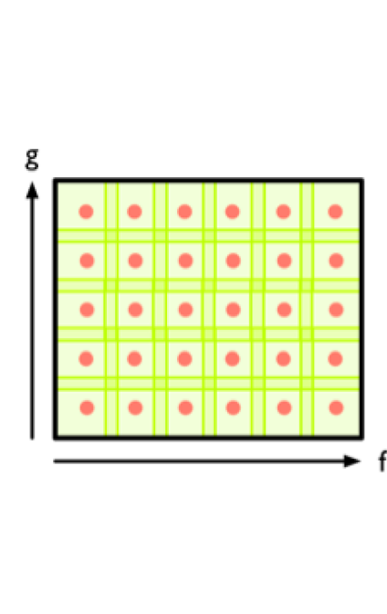
Create overlapping bins:
http://www.nature.com/srep/2013/130207/srep01236/full/srep01236.html

Slide 65
Chose how to cluster.
Normally need a definition of distance between data points
Cluster each bin & create network.
Vertex = a cluster of a bin.
Edge = nonempty intersection
between clusters
http://www.nature.com/srep/2013/130207/srep01236/full/srep01236.html

Slide 66
Note: Many, many choices were made
It helps to know what you are doing when you make choices, so collaborating with others is highly recommended.

Slide 67
Note: Many, many choices were made
“It is useful to think of it as a camera, with lens adjustments and other settings. A different filter function may generate a network with a different shape, thus allowing one to explore the data from a different mathematical perspective.”
http://www.nature.com/srep/2013/130207/srep01236/full/srep01236.html

Slide 68
Note: we made many, many choices
“It is useful to think of it as a camera, with lens adjustments and other settings. A different filter function may generate a network with a different shape, thus allowing one to explore the data from a different mathematical perspective.”
False positives???
http://www.nature.com/srep/2013/130207/srep01236/full/srep01236.html

Slide 69
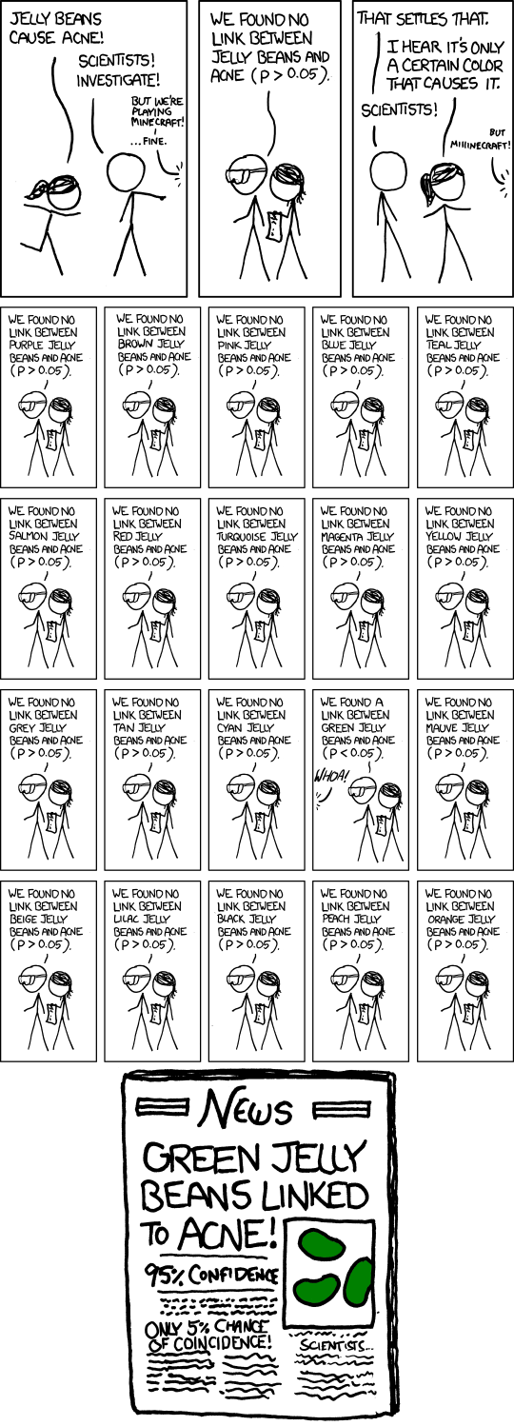
False Positives will occur
https://xkcd.com/882/

Slide 70
Note: Many, many choices were made
“It is useful to think of it as a camera, with lens adjustments and other settings. A different filter function may generate a network with a different shape, thus allowing one to explore the data from a different mathematical perspective.”
False positives vs. robustness
http://www.nature.com/srep/2013/130207/srep01236/full/srep01236.html

Slide 71
Three key ideas of topology that make extracting of patterns via shape possible.
1.) coordinate free.
No dependence on the coordinate system chosen.
Can compare data derived from different platforms
2.) invariant under “small” deformations.
less sensitive to noise
3.) compressed representations of shapes.
Input: dataset with thousands of points
Output: network with 13 vertices and 12 edges.
http://www.nature.com/srep/2013/130207/srep01236/full/srep01236.html

