Slide 1
Good coding style
R:
Tidyverse https://style.tidyverse.org/
13 Jelinski Lab R code Style Guide and Standards
https://jelinski-lab-pedology.github.io/open-science-guidebook/09a-r-style-guide.html
Google https://google.github.io/styleguide/Rguide.html
Google style guide for multiple programming languages:
https://google.github.io/styleguide/

Slide 2
https://techlasi.com/savvy/software-engineering-best-practices/
Automated Testing Frameworks
Modern testing strategies leverage automation at multiple levels:
Unit Testing: Testing individual components in isolation
Integration Testing: Verifying interactions between components
End-to-End Testing: Testing complete user workflows
Popular testing frameworks in 2026 include:
Language | Unit Testing | Integration | End-to-End
JavaScript | Jest, Vitest | Cypress, Playwright | Cypress, Playwright
Python | pytest, unittest | pytest | Robot Framework, Playwright
Java | JUnit 5, TestNG | Spring Test | Selenium, Playwright
Go | testing package, testify | Ginkgo | Playwright, Cypress
Rust | rust-test | mockito | WebdriverIO

Slide 3
https://www.geeksforgeeks.org/r-language/rtest-streamlined-testing-framework-for-r-language/
https://www.numberanalytics.com/blog/ultimate-guide-unit-testing-testthat-r
https://r-pkgs.org/testing-basics.html

Slide 4
https://github.com/Joecstarr/MfaCoBPM/blob/main/README.md
Citations
Boehm, B. W. (1989). Software risk management. IEEE Computer Society Press. https://books.google.com/books?id=ittWAAAAMAAJ
Col Lawrence Nixon. (n.d.). RISK MANAGEMENT (RM) GUIDELINES AND TOOLS. DEPARTMENT OF THE AIR FORCE.
Garvey, P. R. (2008). Analytical Methods for Risk Management (0 ed.). Chapman and Hall/CRC. https://doi.org/10.1201/9781420011395
Internationale Elektrotechnische Kommission & Internationale Organisation für Normung (Eds.). (2019). Risk management: Risk assessment techniques (Edition 2.0). IEC Central Office, Commission Electrotechnique Internationale.
Pressman, R. S. (2015). Software engineering: A practitioner's approach (Eighth edition). McGraw-Hill Education.
Thomsett, R. (1992). The Indiana Jones School of Risk Management. American Programmer, 5(7), 10-18.
Wiggins, G. P., & McTighe, J. (2008). Understanding by design (Expanded 2nd ed, [Nachdr.]). Association for Supervision and Curriculum Development.
Williams, R. C., Walker, J. A., & Dorofee, A. J. (1997). Putting risk management into practice. IEEE Software, 14(3), 75-82. https://doi.org/10.1109/52.589240
Yourdon, E. (1995). When good enough software is best. IEEE Software, 12(3), 79 81- https://doi.org/10.1109/52.382191

Slide 5
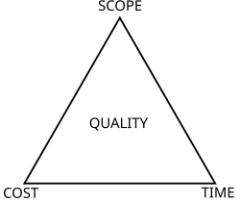
https://en.wikipedia.org/wiki/Project_management_triangle
The project management triangle (called also the triple constraint, iron triangle and project triangle) is a model of the constraints of project management. While its origins are unclear, it has been used since at least the 1950s.^{[1]} It contends that:
The quality of work is constrained by the project's budget, deadlines and scope (features).
The project manager can trade between constraints.
Changes in one constraint necessitate changes in others to compensate or quality will suffer.
For example, a project can be completed faster by increasing budget or cutting scope. Similarly, increasing scope may require equivalent increases in budget and schedule. Cutting budget without adjusting schedule or scope will lead to lower quality.

Slide 6
https://project-management.com/what-is-project-management/
Project management is the application of specific knowledge, skills, methodologies, and techniques to achieve specific and measurable project goals, including successful project completion.
The typical project management life cycle consists of five phases: initiation, planning, execution, monitoring and control, and closure.
Project management differs from general management in that it relates directly to the goals and time-bound objectives achieved within the scope of a project itself, on a limited timeline, rather than an ongoing one

Slide 7
https://www.projectmanager.com/guides/project-management
What Is Project Management?
Project management is a process that allows project managers to plan, execute, track and complete projects with the help of a project team. To do so, they must use project management principles, skills, methodologies and tools to lead team members through each of the project management steps which are known as the project lifecycle.
Project management is made up of five key components: initiation, planning, execution, monitoring and controlling, and project closure. Initiation defines the project objectives and its feasibility. Planning outlines tasks, timelines, resources and budgets. Execution implements that plan, while monitoring and controlling track the project progress against that plan. Finally, project closure delivers the final output and obtains stakeholder approval, among other things.
Remaining figures are from Joe Starr’s thesis:
4.1.3 Software Engineering and Life Cycle

Slide 8
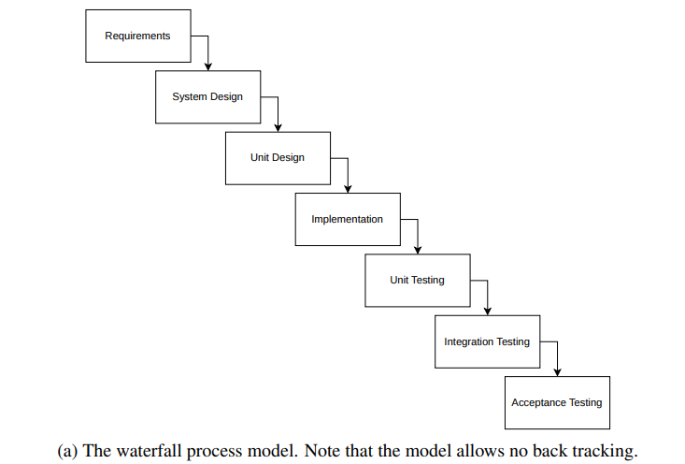
Example: LibreText
- Table of contents

Slide 9
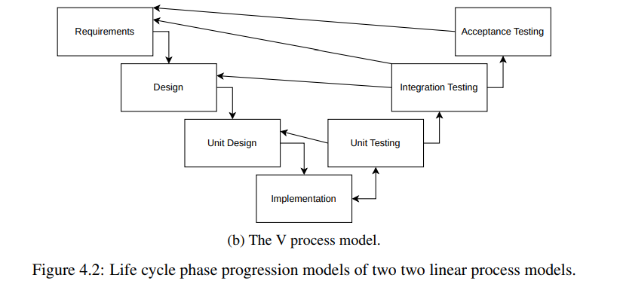

Slide 10
