Slide 1
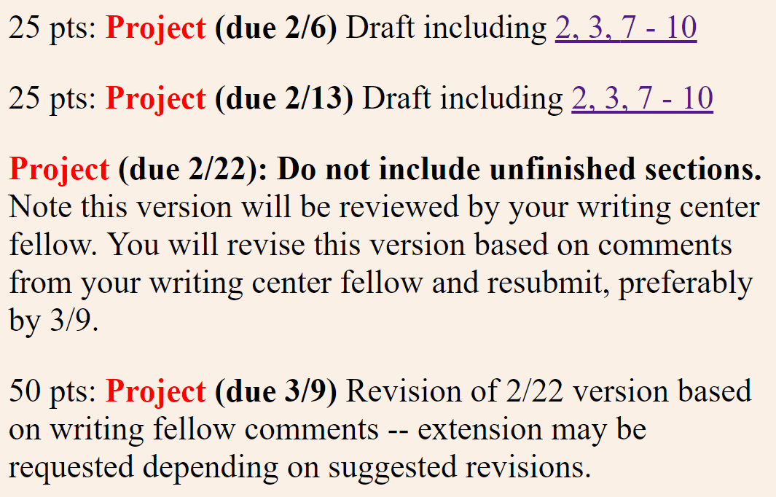
25 + 25 + 50 = 100 for 2, 3, 7-10

Slide 2

https://writingcenter.uiowa.edu/#services
Math 3900 students will be assigned writing fellows.

Slide 3
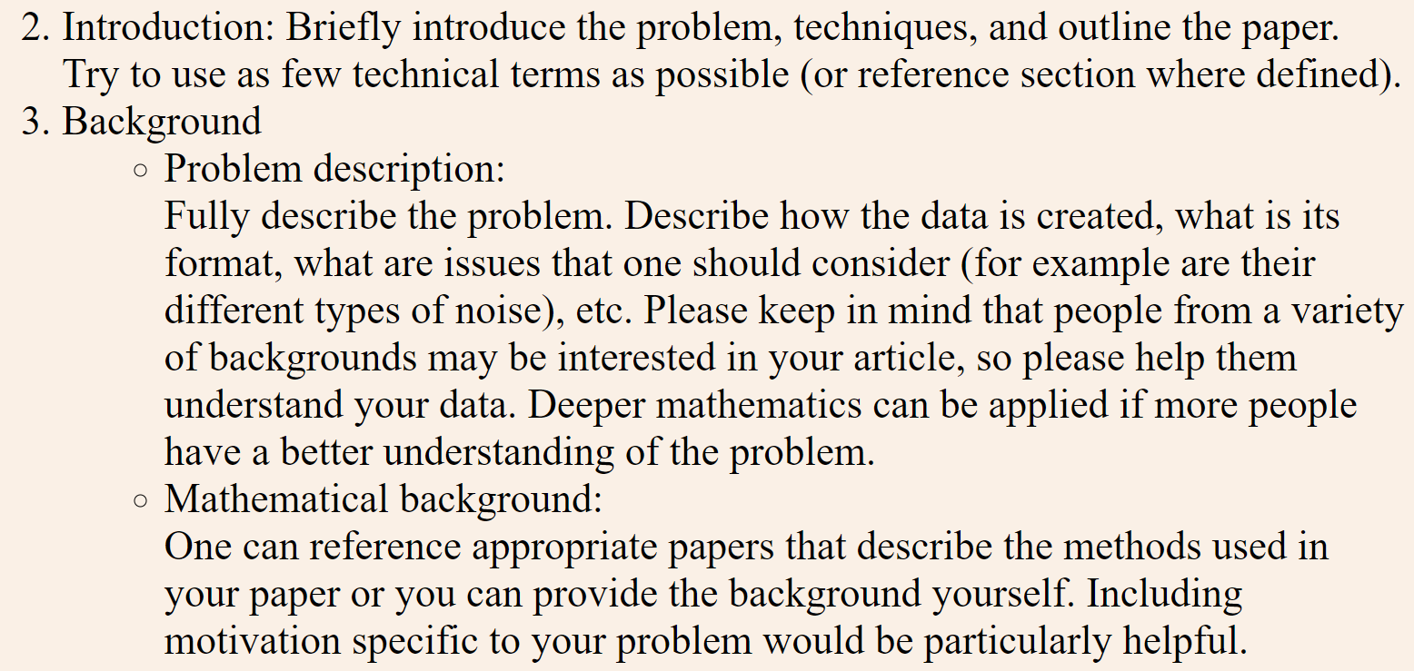
For March 9
For Feb 22: Focus on explaining the TDA mapper algorithm including benefits and negatives.

Slide 4
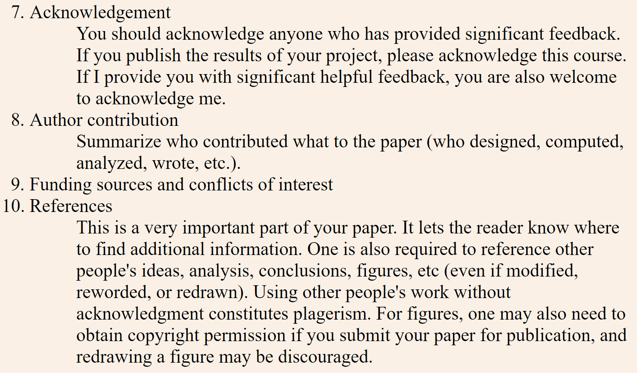

Slide 5
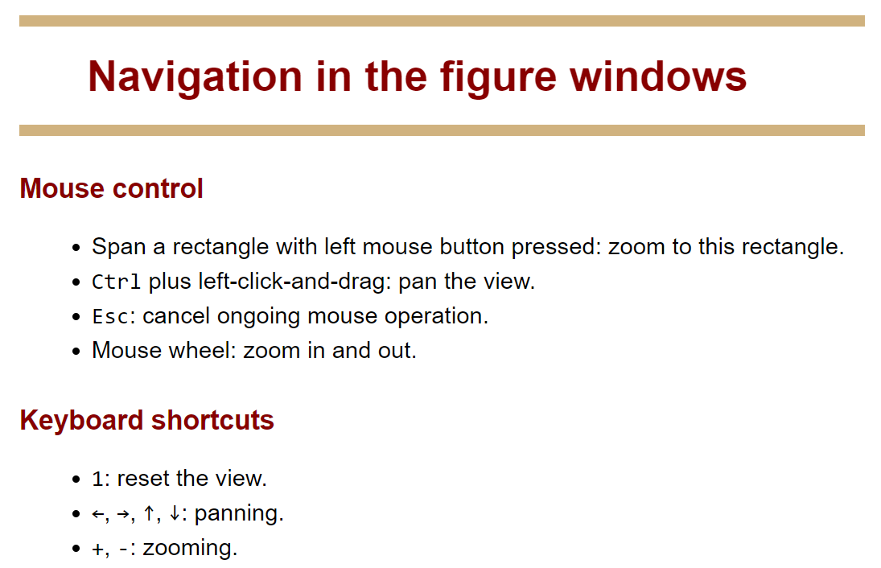
http://danifold.net/mapper/figure_navigation.html

Slide 6
We have seen 3 basic types of filters
  1.) Projection
      Ex: PCA
  2.) distance from norm
      Ex: Eccentricity
  3.) Density
      Ex: Knn-Density

Slide 7
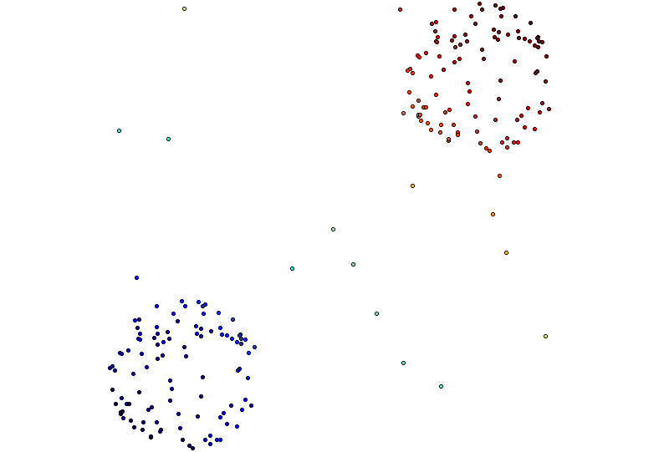
Distance Matrix Eigenvector, Mean Centered Distance Matrix
Order of eigenvector: 0
5 intervals, 50% Overlap

Slide 8
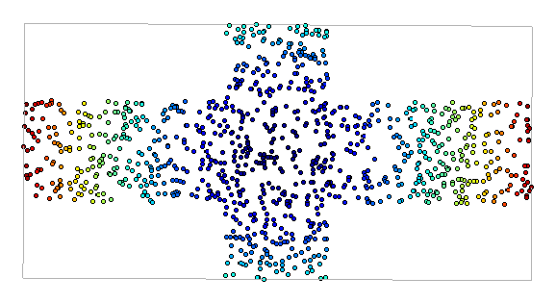
Metric: Euclidian
Filter Function: Eccentricity with exponent = 1
Cover: Uniform 1-d cover
Clustering: Single
modified slide from Maria Gommel

Slide 9
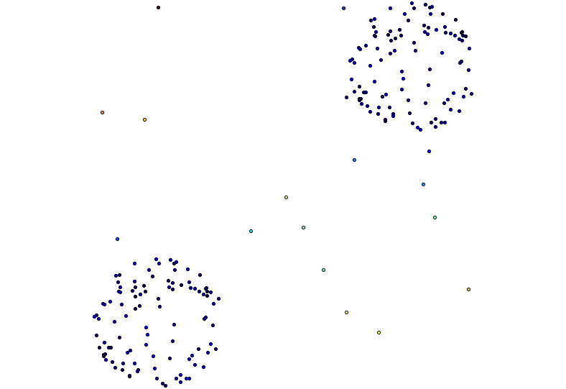
knn distance with k = 5
3 intervals, 50% overlap
[ ( ) ) ]
(

Slide 10
knn distance with k = 5
3 intervals, 50% overlap
3 intervals, 20% overlap
5 intervals, 50% overlap

Slide 11
Talk this Friday

Slide 12
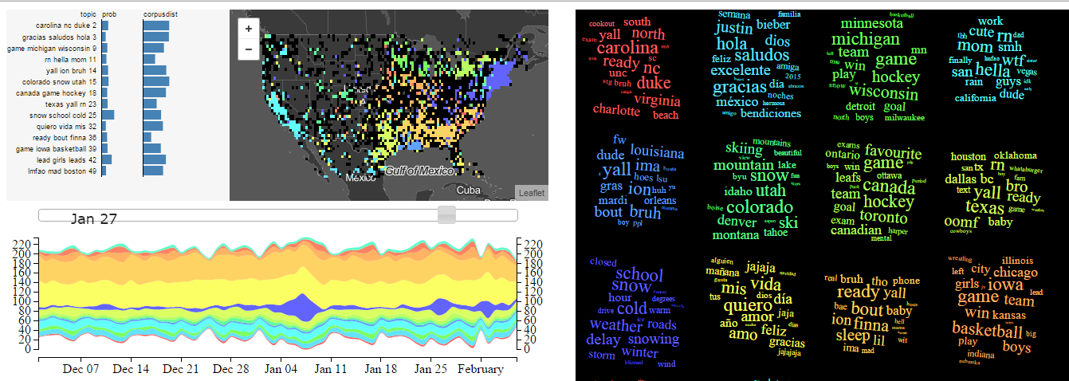
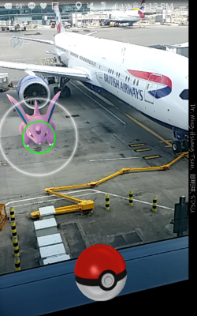
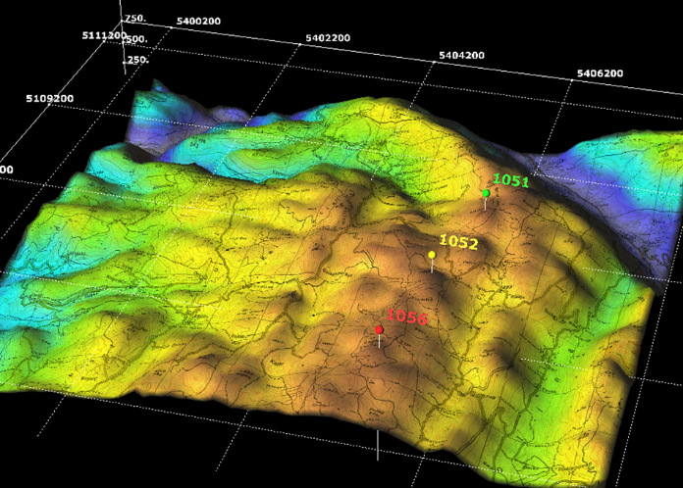
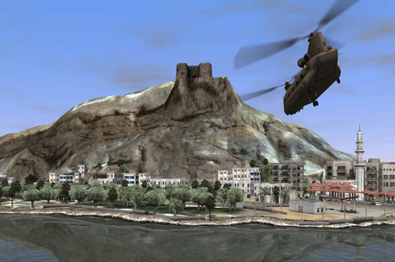
Caglar Koylu, Professor, Dept. of Geography, UI
Uncovering complex patterns from big spatial interaction data: A computation-visualization framework
February 9, 2018 - 3:30pm to 4:30pm Location: 218 MLH
Slide modified from: https://drive.google.com/drive/folders/0B8M300Hbnx9leDBERlhkS1JPZkE

Slide 13
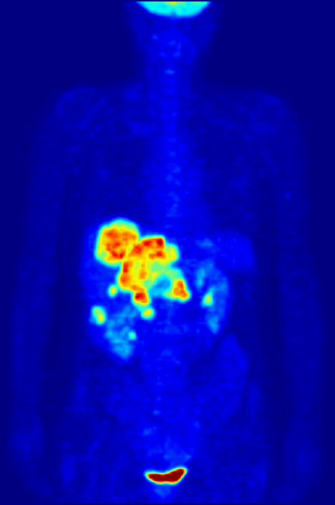
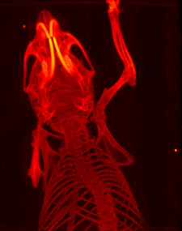
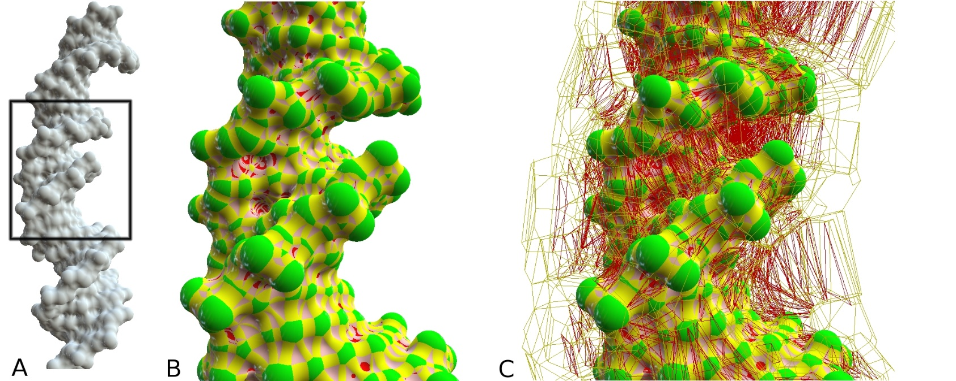
Scientific Visualization
Leverage existing scientific methods
by providing insight through visual methods
Large and complex multivariate datasets
Slide modified from: https://drive.google.com/drive/folders/0B8M300Hbnx9leDBERlhkS1JPZkE

Slide 14
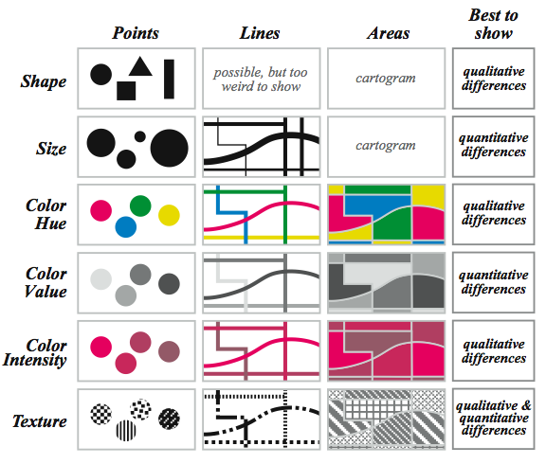
Visual variables for quantitative phenomena
Krygier and Wood, 2002
Slide modified from: https://drive.google.com/drive/folders/0B8M300Hbnx9leDBERlhkS1JPZkE

Slide 15
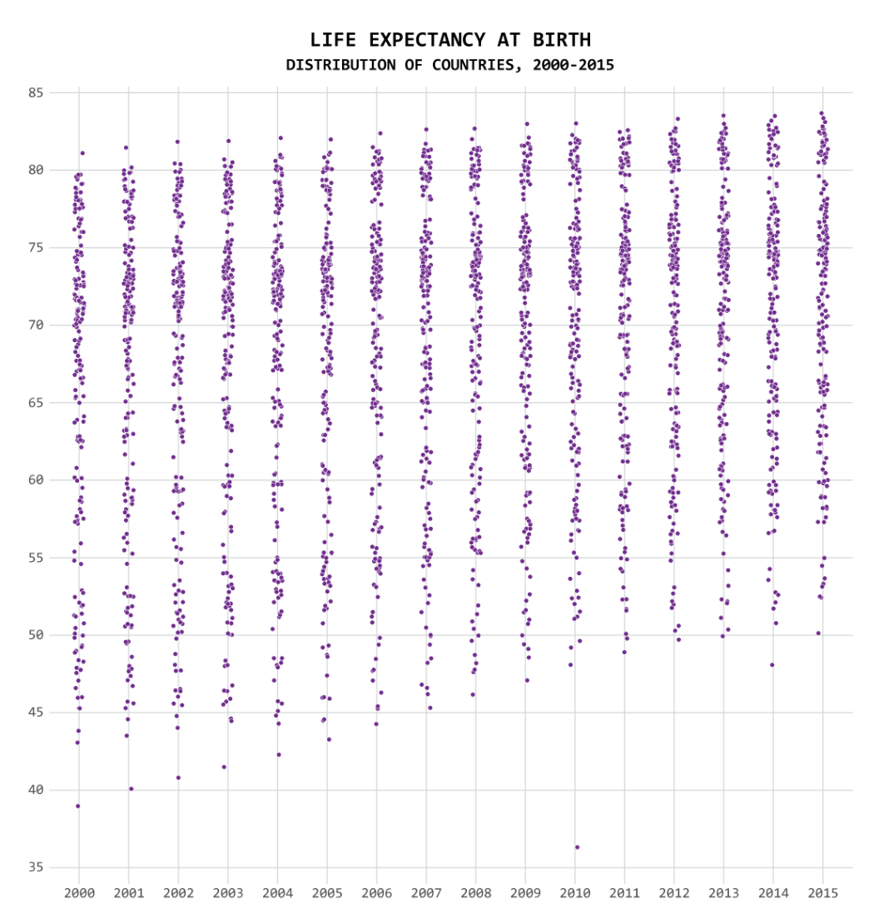
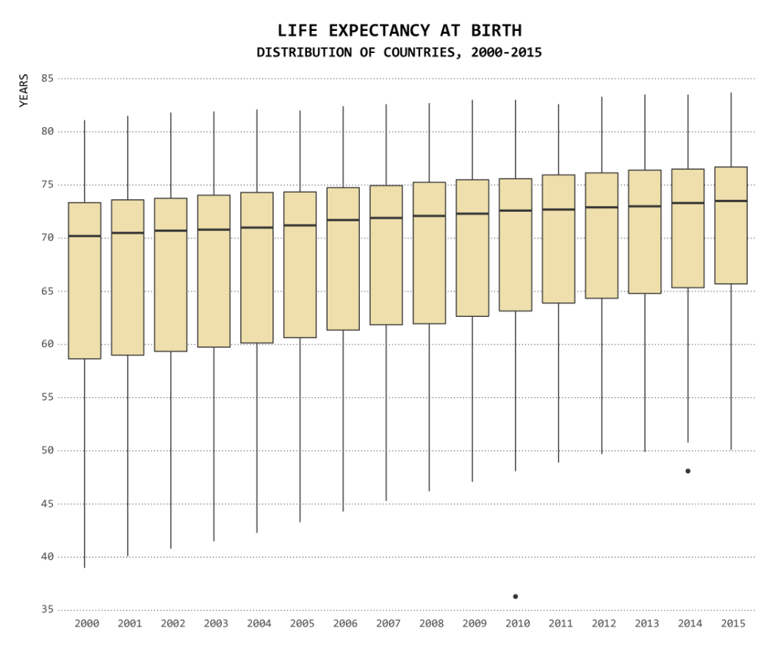
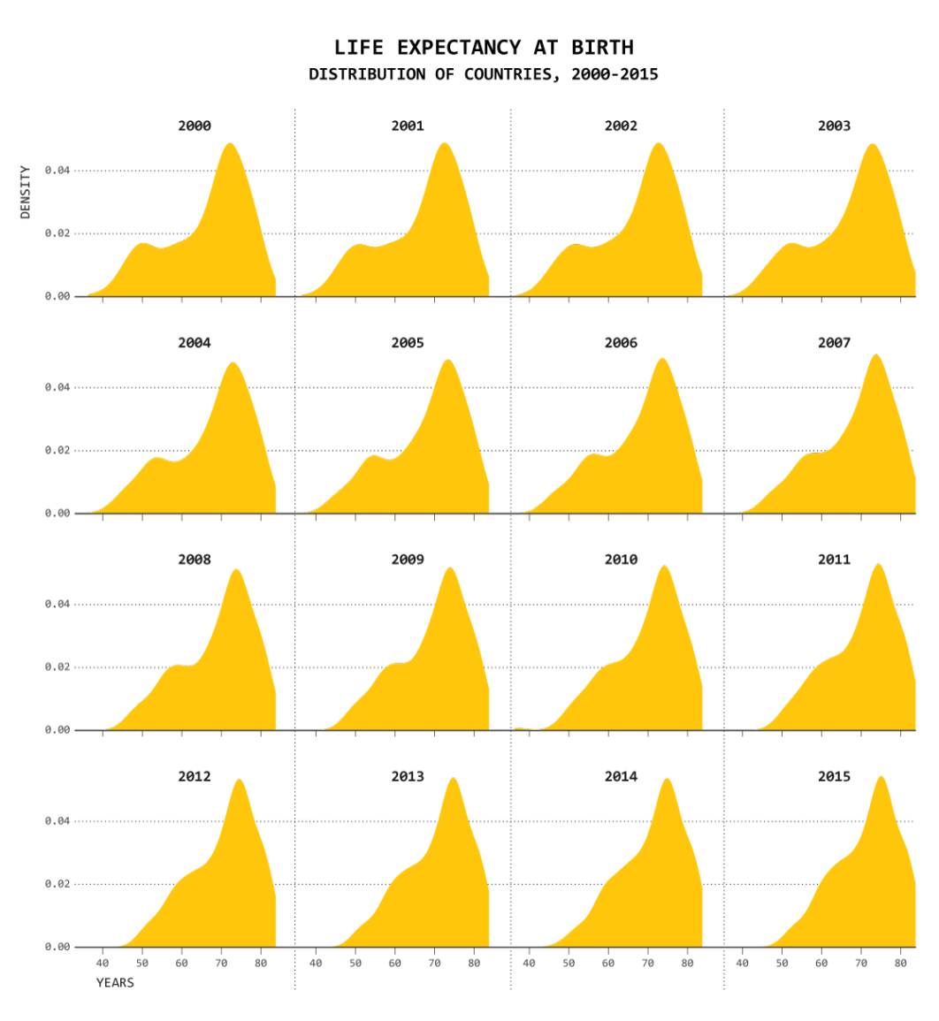
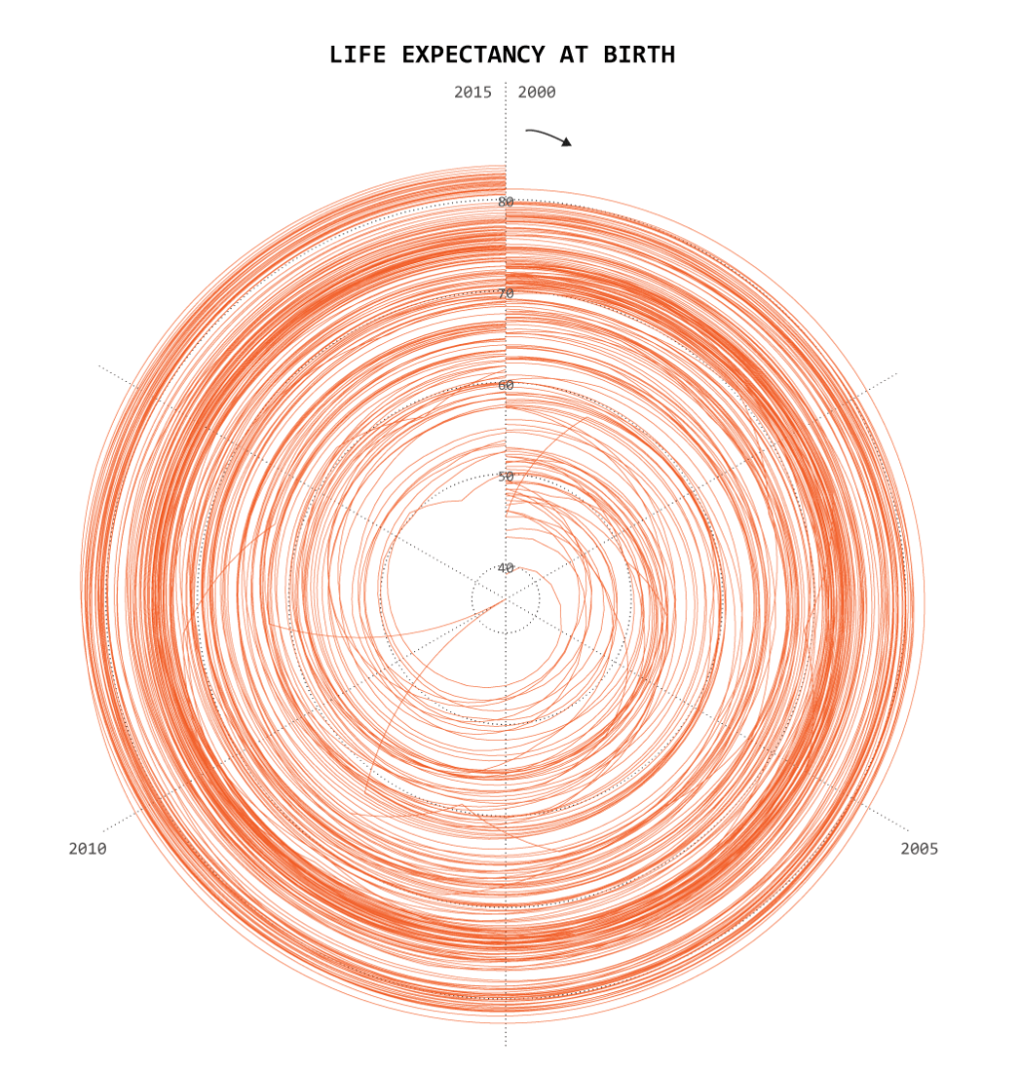
One Dataset, Visualized 25 Ways
https://flowingdata.com/2017/01/24/one-dataset-visualized-25-ways/

Slide 16
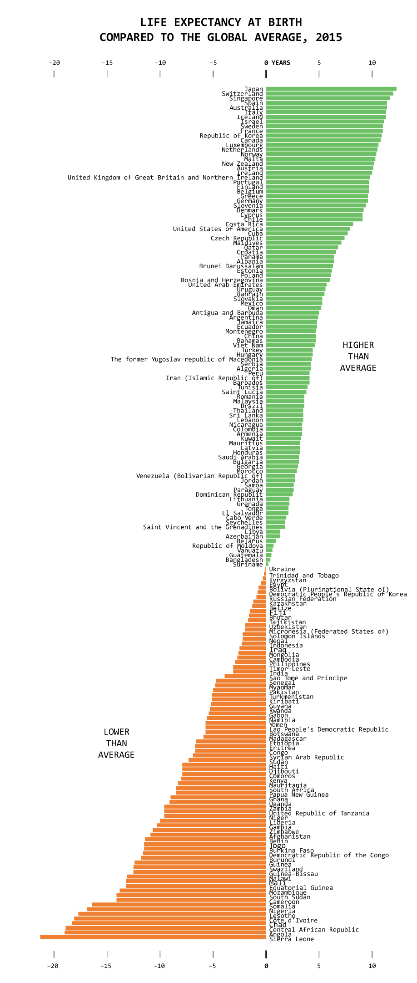
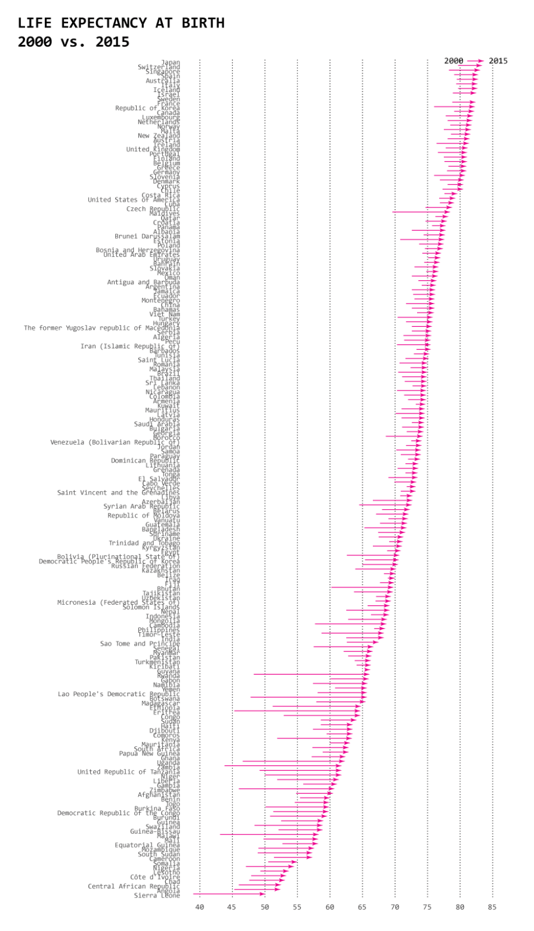

Slide 18
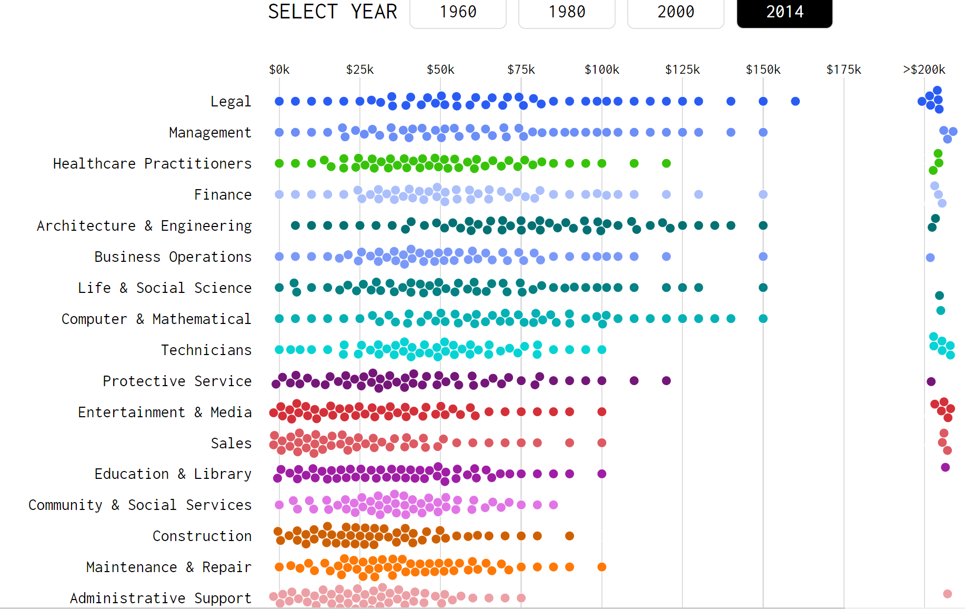
https://flowingdata.com/2016/06/28/distributions-of-annual-income/

Slide 19
Caglar Koylu, Professor, Dept. of Geography, UI
Uncovering complex patterns from big spatial interaction data: A computation-visualization framework
February 9, 2018 - 3:30pm to 4:30pm Location: 218 MLH
Slide modified from: https://drive.google.com/drive/folders/0B8M300Hbnx9leDBERlhkS1JPZkE

Slide 20
Why TDA mapper:
partial answer

Slide 21
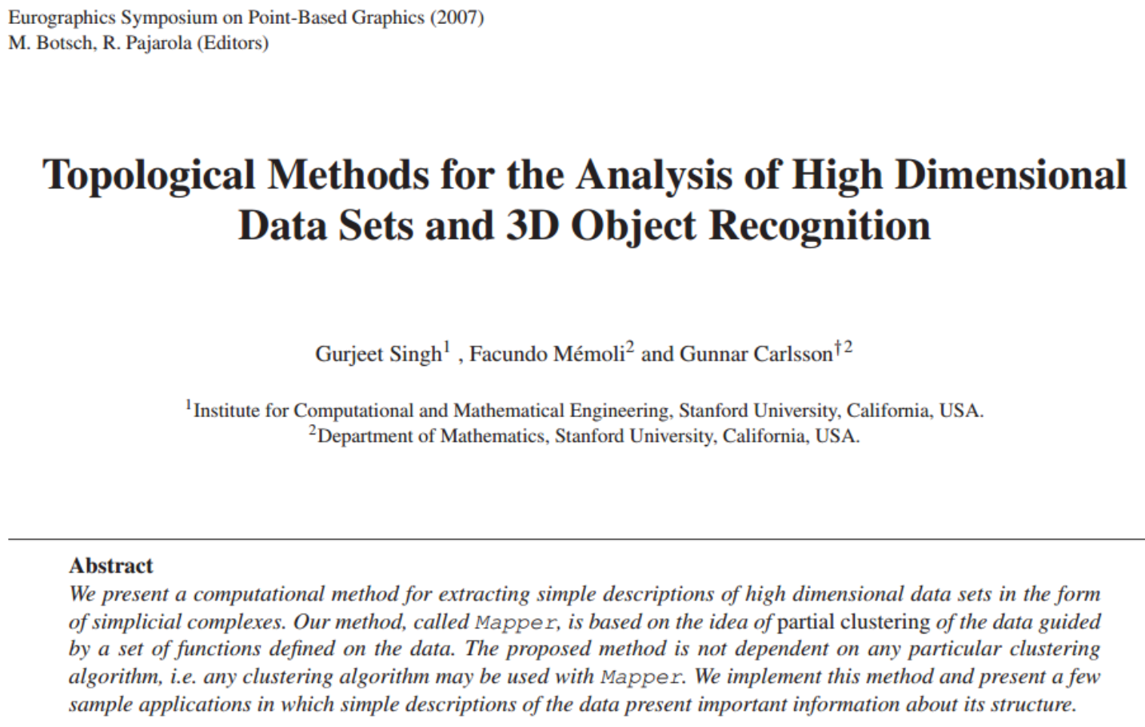
Mapper
http://cs233.stanford.edu/ReferencedPapers/mapperPBG.pdf

Slide 22
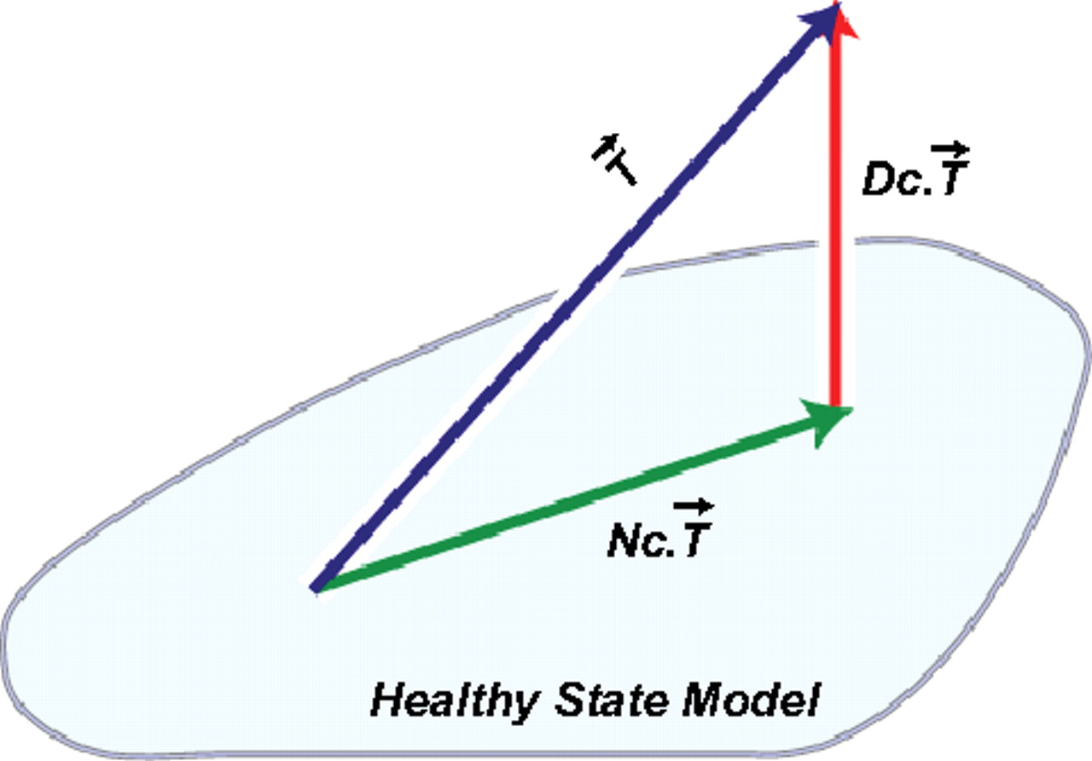
Introduction
The purpose of this paper is to introduce a new method for the qualitative analysis, simplification and visualization of high dimensional data sets, as well as the qualitative analysis of functions on these data sets.
Ex: 1.) f(x) = ||x||
2.) g(x₁, …, x_{n-1}) = x_{n}
3.) DSGA decomposition of the original tumor
vector into the Normal component its
linear models fit onto the Healthy State
Model and the Disease component vector of residuals.
http://www.pnas.org/content/early/2011/04/07/1102826108

Slide 23
Some quantitative analysis is also possible

Slide 24
The idea is to provide another tool for a generalized notion of coordinatization for high dimensional data sets. Coordinatization can of course refer to a choice of real valued coordinate functions on a data set,
http://cs233.stanford.edu/ReferencedPapers/mapperPBG.pdf

Slide 25
Dimensionality Reduction: Given dataset D R^{N}
Want: embedding f: D → R^{n} where n << N
    which “preserves” the structure of the data.
Many reduction methods:
f₁: D → R, f₂: D → R, … f_{n}: D → R
(f₁, f₂, … f_{n}): D → R^{n}
Many are linear, M: R^{N} → R^{n}, Mx = y
But there are also non-linear dimensionality reduction algorithms.
U

Slide 26
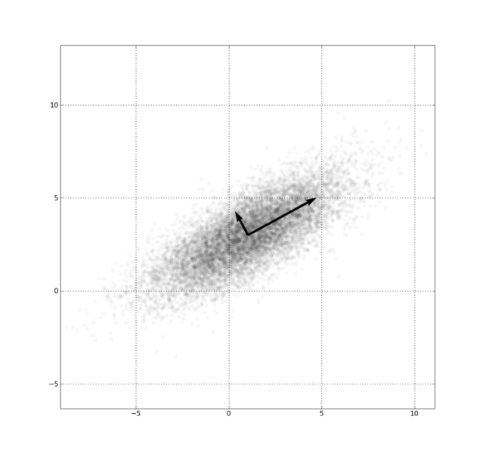
Example: Principle component analysis (PCA)
http://en.wikipedia.org/wiki/File:GaussianScatterPCA.png

Slide 27
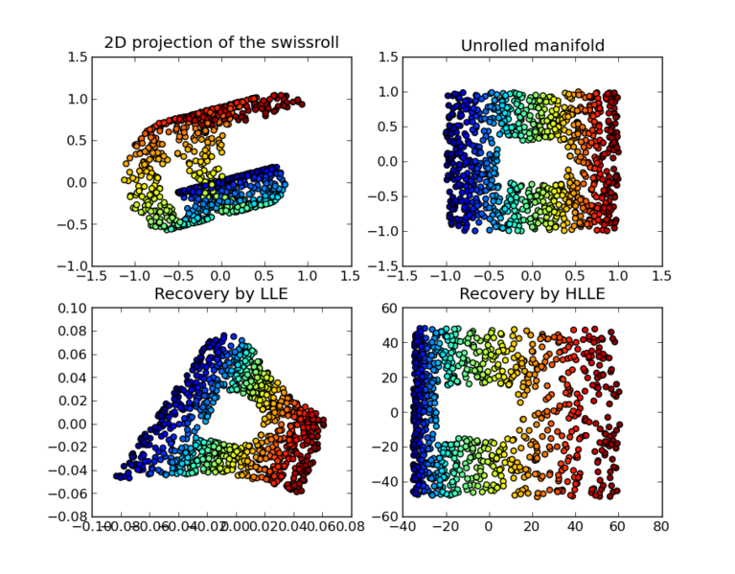
https://en.wikipedia.org/wiki/Nonlinear_dimensionality_reduction

Slide 28
f₁: D → R, f₂: D → R, … f_{n}: D → R
(f₁, f₂, … f_{n}): D → R^{n}

Slide 29
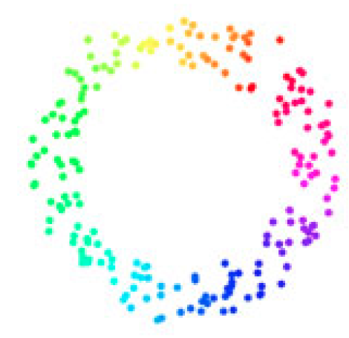
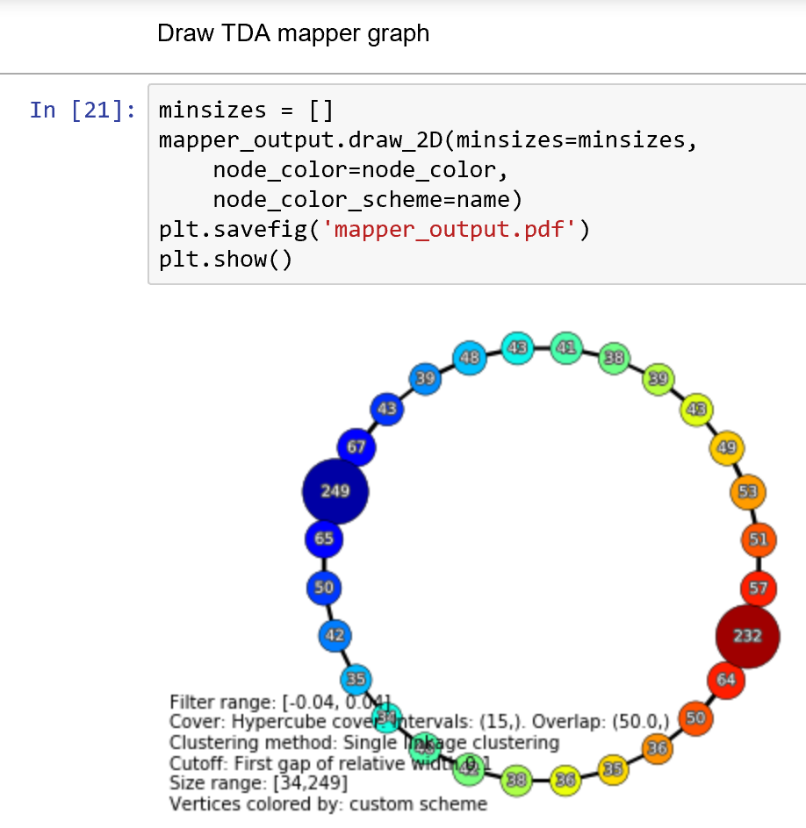
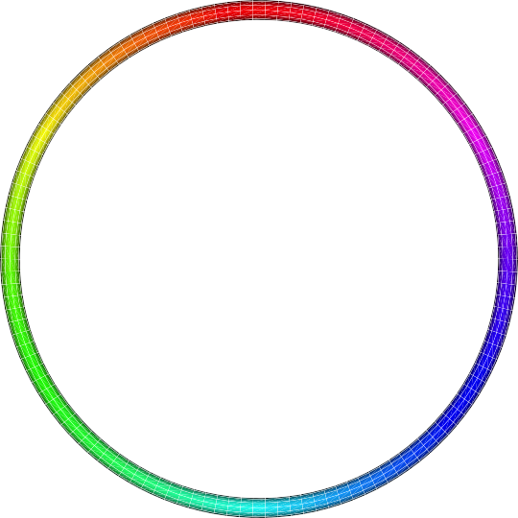
Goal
f: D → S¹ which “preserves” the structure of the data.
circle courtesy of knotplot.com

Slide 30
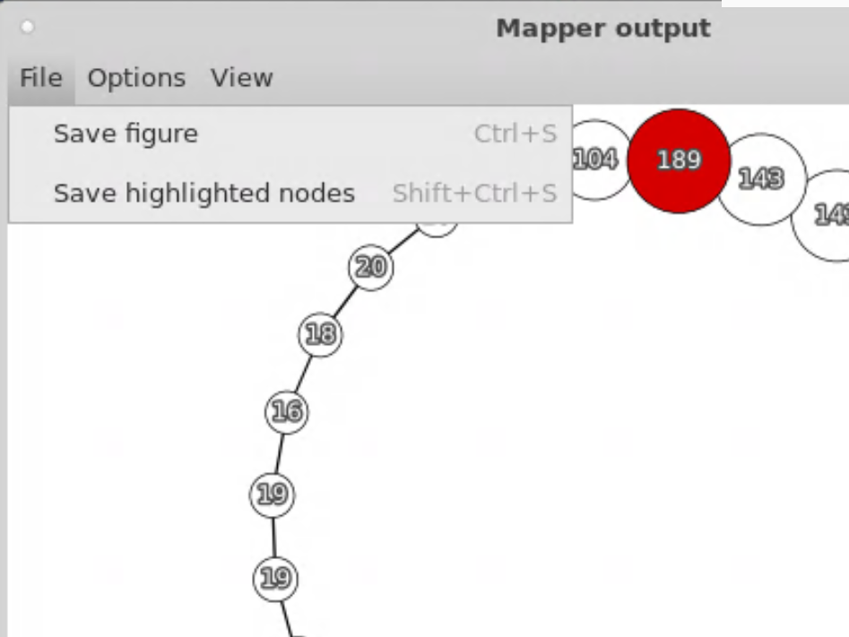
http://danifold.net/mapper/mapperoutputwindow.html

Slide 31
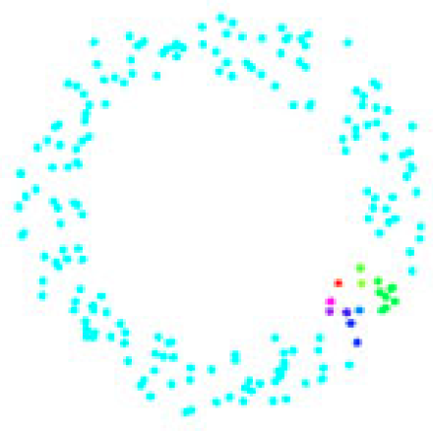
circle courtesy of knotplot.com

Slide 32
The idea is to provide another tool for a generalized notion of coordinatization for high dimensional data sets. Coordinatization can of course refer to a choice of real valued coordinate functions on a data set, but other notions of geometric representation (e.g., the
Reeb graph [Ree46]) are often useful and reflect interesting information more directly.

Slide 33
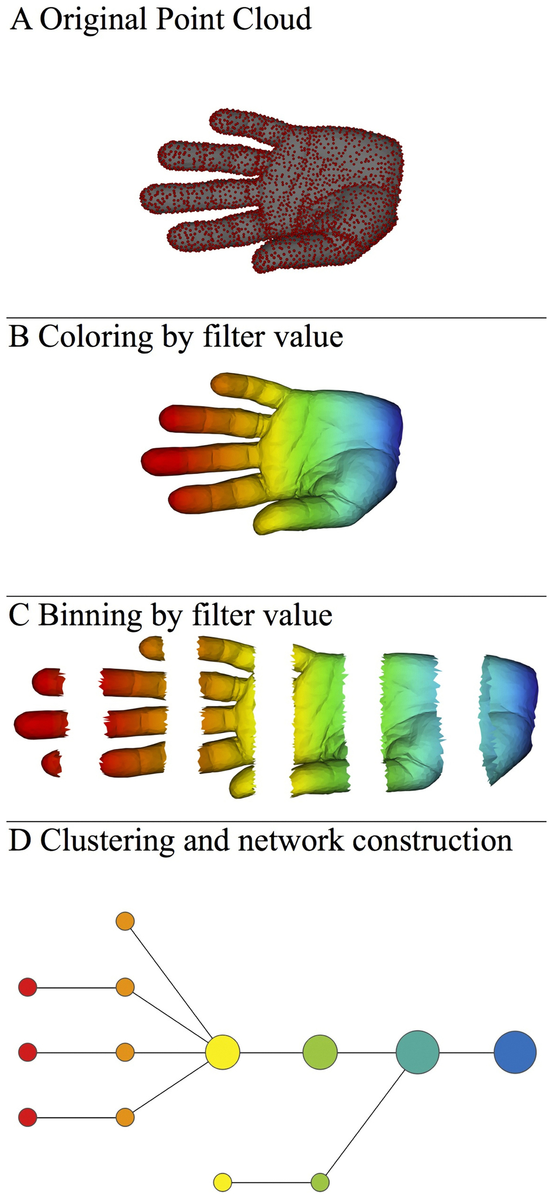
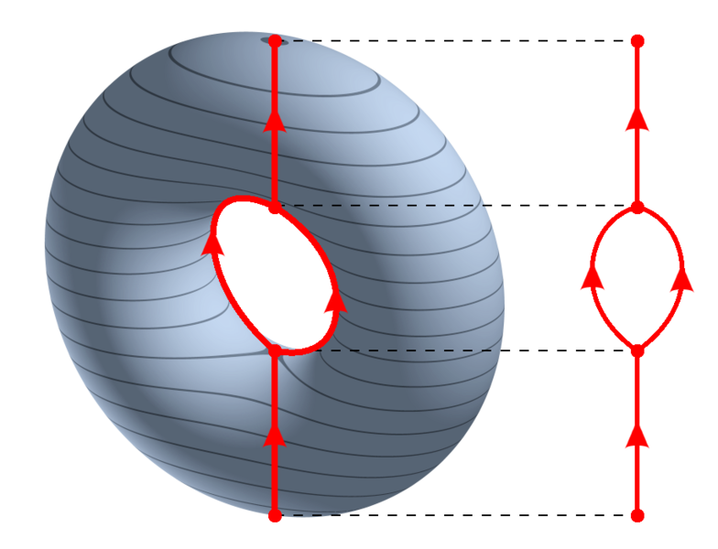
https://en.wikipedia.org/wiki/Reeb_graph
http://www.nature.com/srep/2013/130207/srep01236/full/srep01236.html

Slide 34
Thursday lab
Jupyter Notebook

Slide 35
Lab 4 goals
1.) Create slide(s) similar to last week where
For artificial data set, slide includes picture of data set and several different pythonmapper outputs for this data set (similar to last week's sample.pptx). Upload to Lab 4 slides on ICON.
Also include slides from a “real” data set. Put your name on these slides.
These slides will be collated and posted on ICON so that the entire class can see what data sets you are interested in and see sample mapper outputs.
2.) Take Survey 2/8 on ICON.
3.) Work with R, jupyter notebook (optional), pythonmapper.
4.) Spend time working with a real data set. You can find a real data set via
googling (or duckduckgoing, etc): "topic of interest" type:.csv
http://archive.ics.uci.edu/ml/datasets.html
https://www.kaggle.com/datasets
Using the following command in R: data()

Slide 36

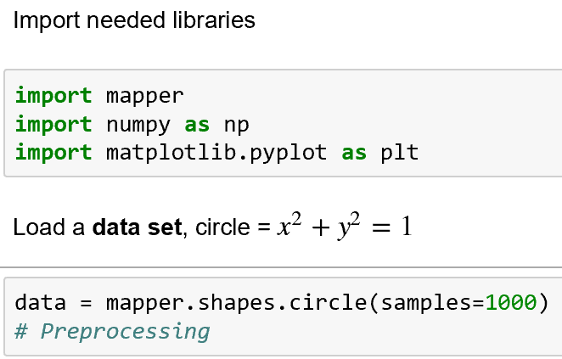

Slide 39
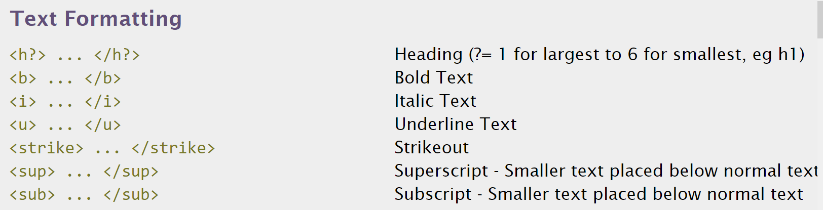
http://www.simplehtmlguide.com/cheatsheet.php

Slide 40
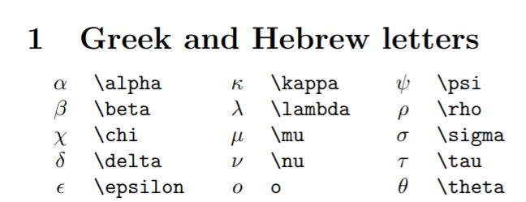
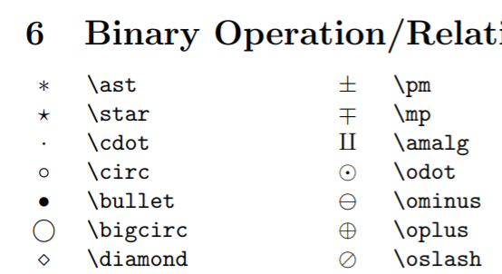
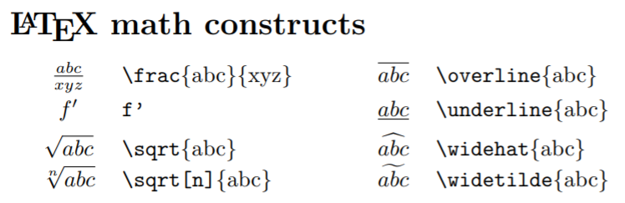
http://reu.dimacs.rutgers.edu/Symbols.pdf
Put latex command between $ signs,e.g.: $\alpha$

Slide 42
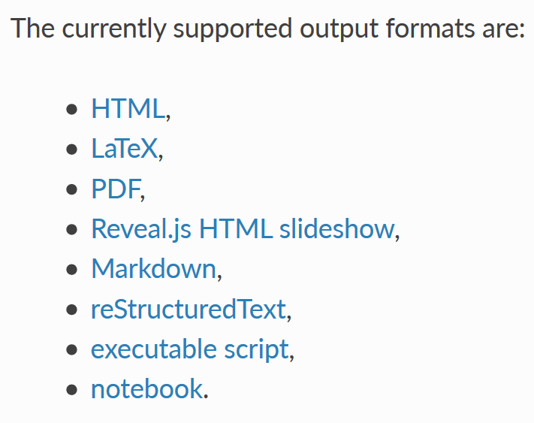
A jupyter notebook can be converted into a variety of formats per
https://nbconvert.readthedocs.io/en/latest/usage.html

Slide 43
Topology

Slide 44
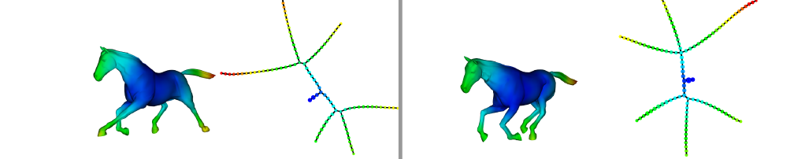
Topological Data Analysis (TDA): Three key ideas of topology that make extracting of patterns via shape possible.
2.) invariant under “small” deformations.
less sensitive to noise
Topological Methods for the Analysis of High Dimensional
Data Sets and 3D Object Recognition, Singh, Mémoli, Carlsson
Figure from http://comptop.stanford.edu/u/preprints/mapperPBG.pdf
http://www.nature.com/srep/2013/130207/srep01236/full/srep01236.html

Slide 45
Geometry
=
=

Slide 46
Topology
=
=

Slide 47
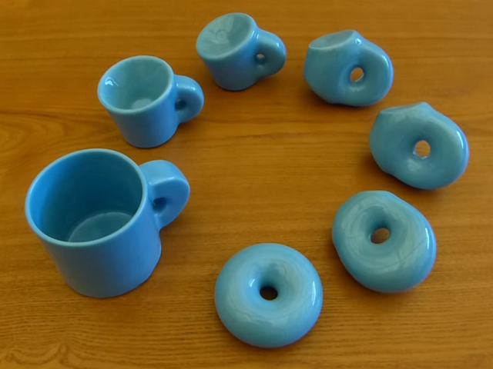

http://images.gmanews.tv/webpics/2016/10/Untitled_2016_10_05_15_45_40.png
http://2.bp.blogspot.com/-SGwFwBjFnBs/ThBqTV1TVUI/AAAAAAAAARw/F1ftHB0teJE/s1600/coffee+cup+as+donut.png

Slide 48
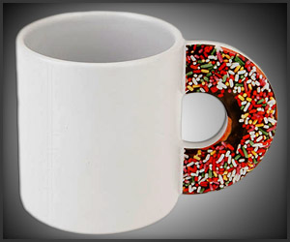
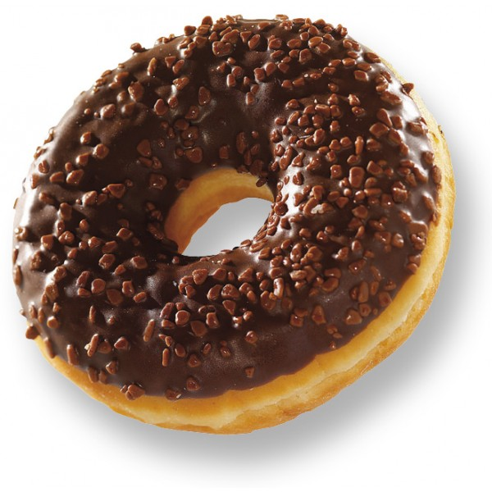
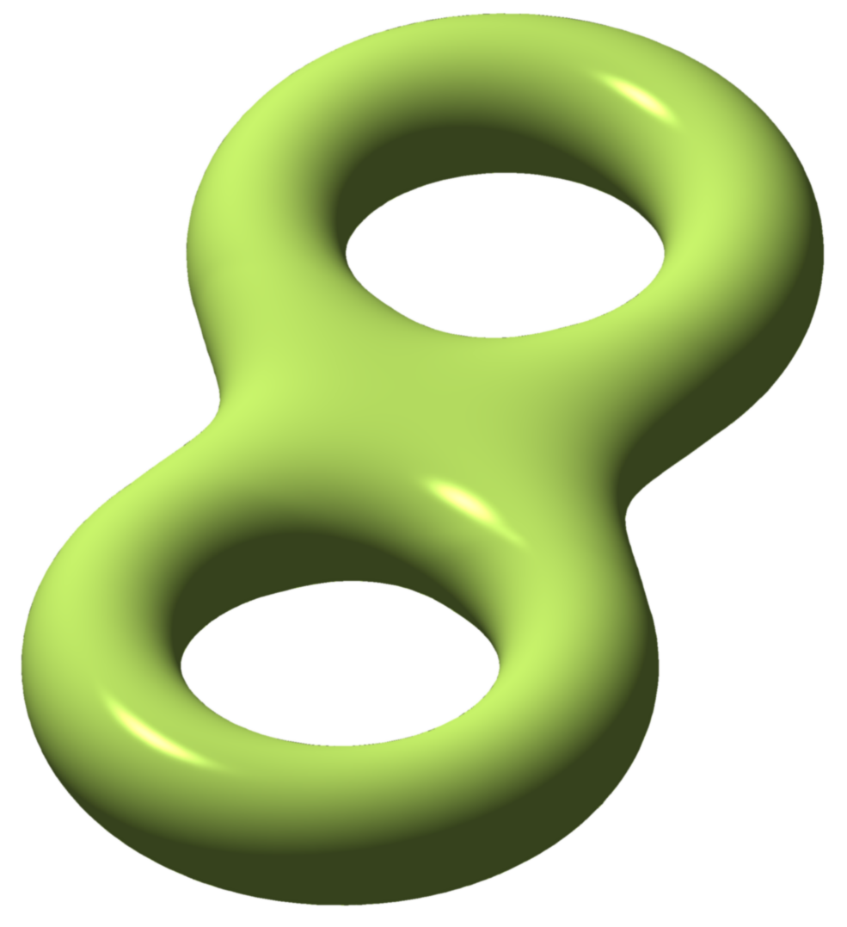
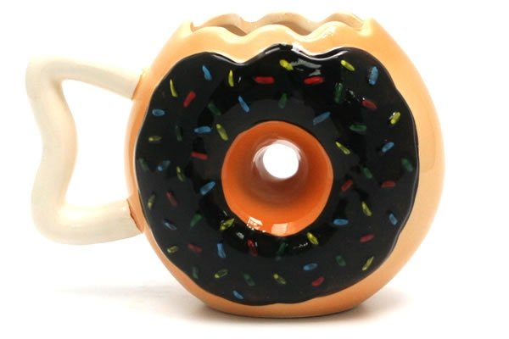
http://images.gmanews.tv/webpics/2016/10/Untitled_2016_10_05_15_45_40.png
http://2.bp.blogspot.com/-SGwFwBjFnBs/ThBqTV1TVUI/AAAAAAAAARw/F1ftHB0teJE/s1600/coffee+cup+as+donut.png
https://www.geekalerts.com/u/Donut-Mug.jpg
torus = donut
http://www.prevogel.fr/156-thickbox_default/donut-chocolat-surgel%C3%A9-vandermoortele.jpg
Not a donut (ie not a torus)
=
http://www.yellowoctopus.com.au/media/catalog/product/y/e/yellow-octopus-donutmug.jpg
https://en.wikipedia.org/wiki/Euler_characteristic

Slide 49
We propose a method which can be used to reduce high dimensional data sets into simplicial complexes with far fewer points which can capture topological and geometric information at a specified resolution.
http://cs233.stanford.edu/ReferencedPapers/mapperPBG.pdf

Slide 50
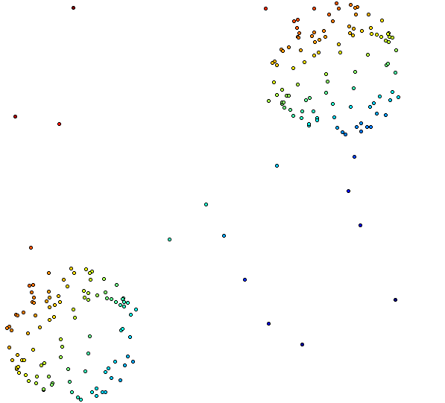
Distance Matrix Eigenvector, Mean Centered Distance Matrix
Order of eigenvector: 1
20 intervals, 80% Overlap

Slide 51
Building blocks for a simplicial complex
0-simplex = vertex = v
1-simplex = edge = {v₁, v₂}
Note that the boundary of this edge is v₂ + v₁
v₁
v₂
e
2-simplex = triangle = {v₁, v₂, v₃}
v₂
Note that the boundary
of this triangle is the cycle
e₁ + e₂ + e₃
= {v₁, v₂} + {v₂, v₃} + {v₁, v₃}
e₁
e₂
v₁
v₃
e₃
Notes:
The building blocks for a simplicial complex consist of zero simplices which are zero dimensional vertices, one simplices which are one-dimensional edges, and 2-simplices which are two dimensional triangles,

Slide 52
Creating a simplicial complex
1.) Next add 1-dimensional edges (1-simplices).
Note: These edges must connect two vertices.
I.e., the boundary of an edge is two vertices

Slide 53
Creating a simplicial complex
1.) Next add 1-dimensional edges (1-simplices).
Note: These edges must connect two vertices.
I.e., the boundary of an edge is two vertices

Slide 54
Creating a simplicial complex
n.) Add n-dimensional n-simplices, {v₁, v₂, …, v_{n+1}}.
Boundary of a n-simplex
= a cycle consisting of (n-1)-simplices.
Notes:
In step n, we can add n-simplices, but only if its boundary, a sum of (n-1) dimensional simplices was created in the previous step, the n-1 step where we added n-1 - simplices.
In our example, the highest dimensional simplex is a 3-simplex, this solid tetrahedron, so we have a 3-dimensional simplicial complex.
This partitioning of an object into 0-simplices, 1-simplices, 2-simplices, etc. is called a triangulation of the object. An object is called a simplicial complex if it has a triangulation.
Let us now triangulate a couple of familiar examples.

Slide 55
Example: Triangulating the disk.
disk = { x in R² : ||x || ≤ 1 }
=
Notes:
Recall that a triangle is topologically equivalent to a circular disk. So as long as I have 3 edges forming a triangle, I can add a 2-dimensional face.

Slide 56

Example: Triangulating the disk.
disk = { x in R² : ||x || ≤ 1 }
Fist image from http://openclipart.org/detail/1000/a-raised-fist-by-liftarn
Notes:
I now get to punch my topological triangle in order to form the bottom hemisphere.

Slide 57
Example: Triangulating the sphere.
sphere = { x in R³ : ||x || = 1 }
Notes:
And finally, we fill in the topological triangles with two dimensional faces, We fill in this front face with a triangle. We fill in this side face with the triangle, as well as this back face. The bottom hemisphere is also a topological triangle. It’s boundary consists of three edges so we can also fill it in with a face. In case you don’t see that,

Slide 58
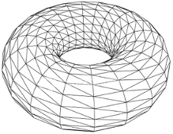
Triangulation of a torus
http://mangrovetds.sourceforge.net/documentation/html/torus_complex.png

Slide 59
Distance Matrix Eigenvector, Mean Centered Distance Matrix
Order of eigenvector: 1
20 intervals, 80% Overlap

Slide 60
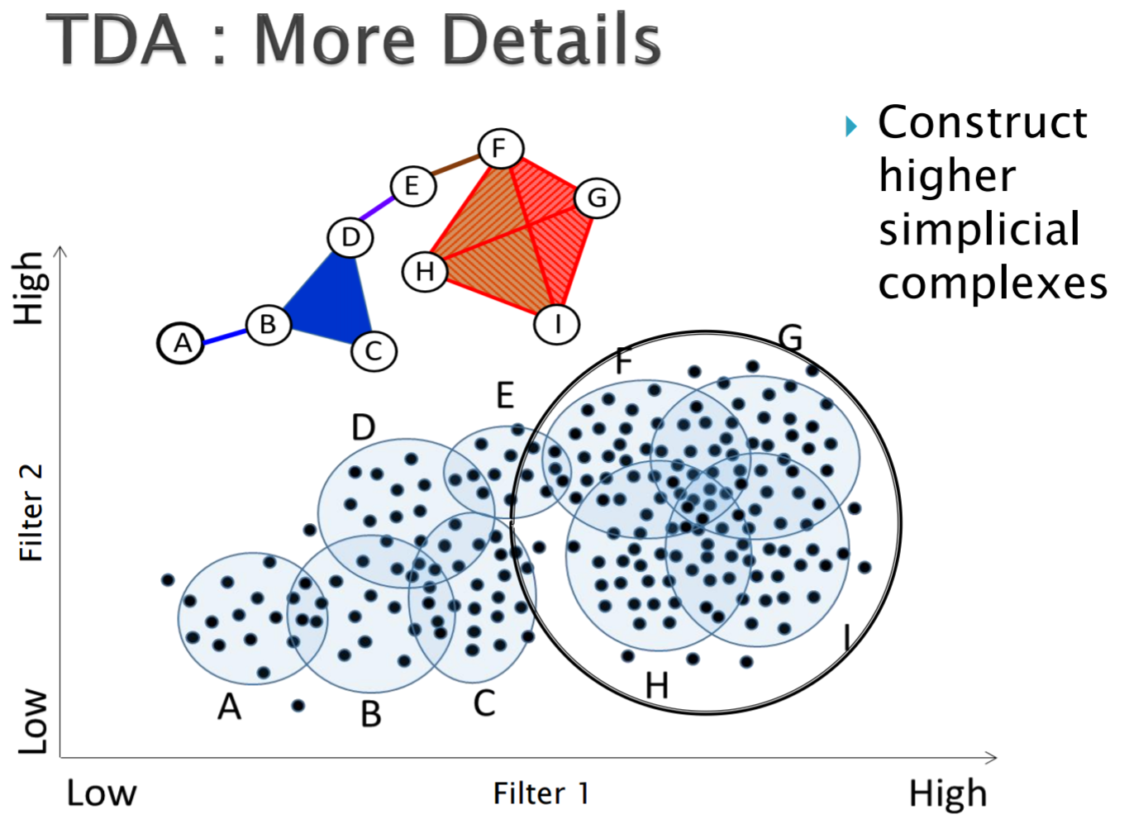
http://www.math.wsu.edu/math/faculty/bkrishna/AbsAlgTopo_PSB2016/Slides_Topology.pdf

Slide 61
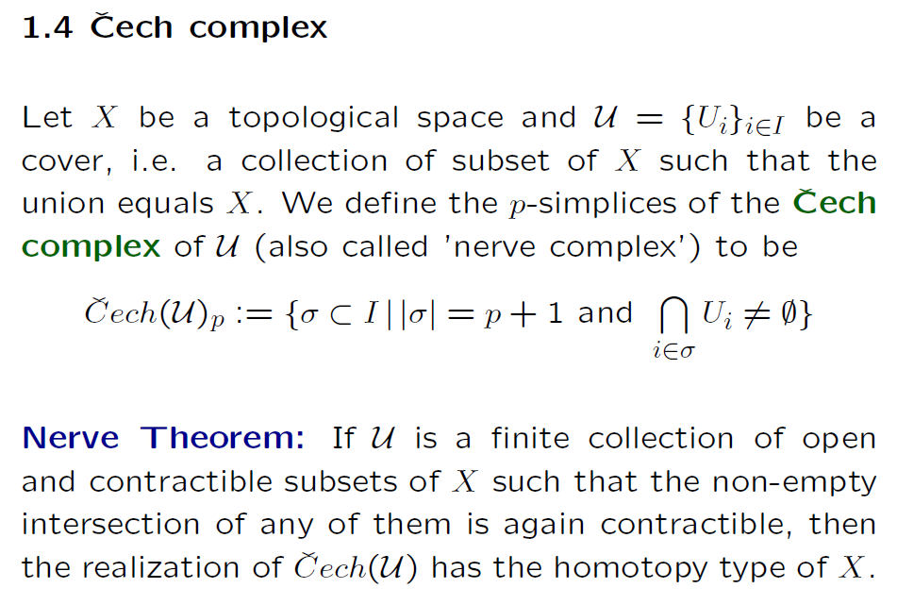
https://people.maths.ox.ac.uk/tillmann/CAT2016lectures.pdf

Slide 62
http://www.math.wsu.edu/math/faculty/bkrishna/AbsAlgTopo_PSB2016/Slides_Topology.pdf

Slide 63
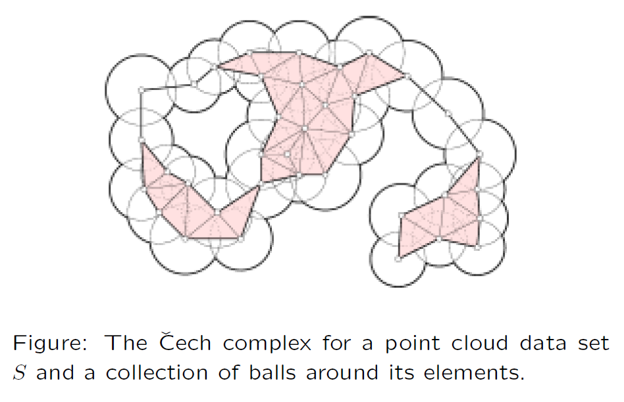
https://people.maths.ox.ac.uk/tillmann/CAT2016lectures.pdf

Slide 64
Creating the Čech simplicial complex
1.) B₁ … B_{k+1} ≠ ⁄ , create k-simplex {v₁, ... , v_{k+1}}.
U
U
0
Notes:
Thus we now have the Vietoris Rips simplicial complex. Note we get the same simplex by adding one dimension at a time

Slide 65
Creating the Čech simplicial complex
1.) B₁ … B_{k+1} ≠ ⁄ , create k-simplex {v₁, ... , v_{k+1}}.
U
U
0
Notes:
Thus we now have the Vietoris Rips simplicial complex. Note we get the same simplex by adding one dimension at a time

Slide 66
Creating the Vietoris Rips simplicial complex
1.) Adding 1-dimensional edges (1-simplices)
Notes:
In step 1 Adding 1-simplices connecting data points that are “close”.

Slide 67
Creating the Vietoris Rips simplicial complex
2.) Add all possible simplices of dimensional > 1.
Notes:
And then adding an n-simplex whenever we have n+1 points that are close.
Thus we now have the Vietoris Rips simplicial complex. Note we get the same simplex by adding one dimension at a time.
What if I increase my threshold?

Slide 68
Vietoris Rips complex = flag complex = clique complex
2.) Add all possible simplices of dimensional > 1.
Notes:
Thus we now have the Vietoris Rips simplicial complex. Note we get the same simplex by adding one dimension at a time

Slide 69
Creating the Čech simplicial complex
1.) B₁ … B_{k+1} ≠ ⁄ , create k-simplex {v₁, ... , v_{k+1}}.
U
U
0
Notes:
Thus we now have the Vietoris Rips simplicial complex. Note we get the same simplex by adding one dimension at a time

Slide 70
Creating the Čech simplicial complex
1.) B₁ … B_{k+1} ≠ ⁄ , create k-simplex {v₁, ... , v_{k+1}}.
U
U
0
Notes:
Thus we now have the Vietoris Rips simplicial complex. Note we get the same simplex by adding one dimension at a time

Slide 71

Create overlapping bins:
http://www.nature.com/srep/2013/130207/srep01236/full/srep01236.html

Slide 72
Create overlapping bins:
http://www.nature.com/srep/2013/130207/srep01236/full/srep01236.html

