Slide 1

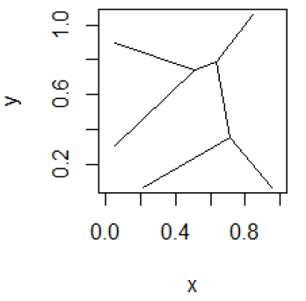
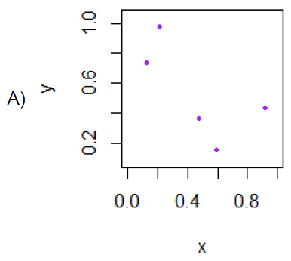
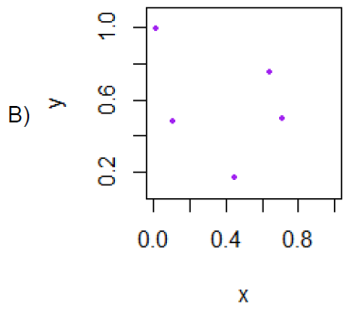
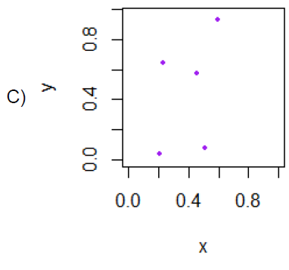
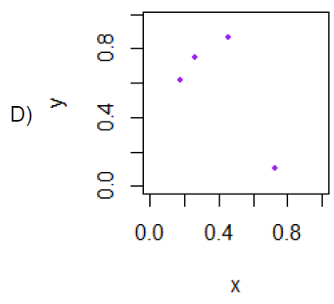

Slide 2
Voronoi diagram:
Suppose your data points live in R^{n}.
Choose data point v.
The Voronoi cell associated with v is
H(v,w)
U
w ≠ v
The Voronoi cell associated with v is
C_{v}= { x in R^{n} : d(x, v) ≤ d(x, w) for all w ≠ v }
Notes:
data points.
In this very simplified case my data points lie in a two-dimensional plane. Normally data points are high dimensional.
For example, I may be comparing the expression or thousands of genes in tumor cells to healthy cells using microarray data. OR I might be comparing politicians voting records. Or I might be comparing the stats of basketball players. These three applications were all, by the way, published by Lum et al this past February in Nature’s Scientific Reports. I have included a link to their paper on my youtube site.
http://www.nature.com/srep/2013/130207/srep01236/full/srep01236.html

Slide 3
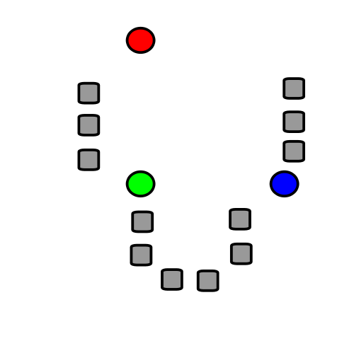
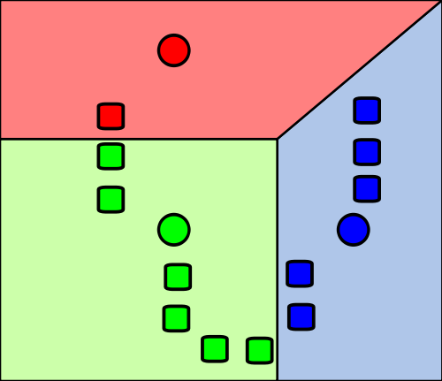
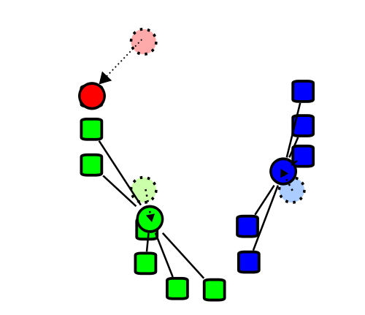
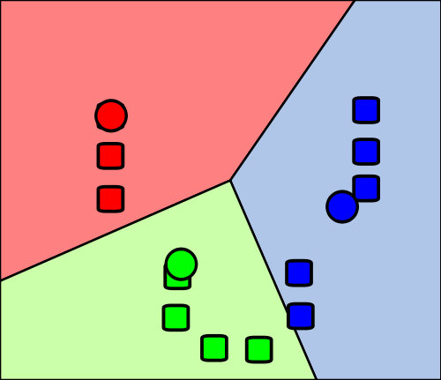
Re-partition data set into 3 voronoi cells corresponding to the 3 centroids
Figure modified from https://en.wikipedia.org/wiki/File:K_Means_Example_Step_1.svg

Slide 4
Applications of k-means clustering:
1.) Group like items together
2.) Reduce the size of your data set.
3.) Color quantization.
  (a) Reduce memory use.
  (b) Certain devices might have limited number of colors for display.

Slide 5
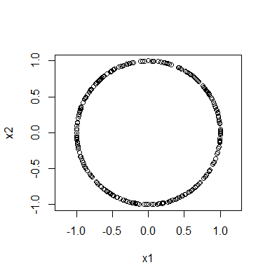
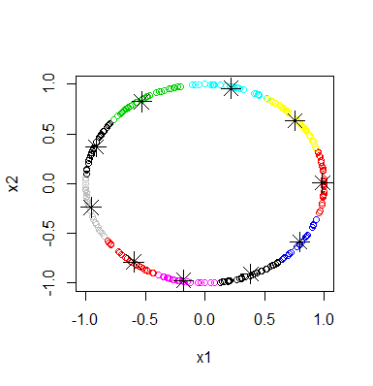
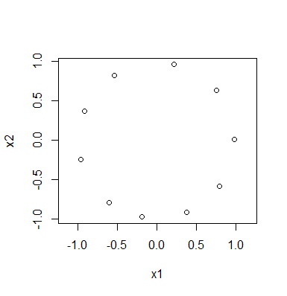
Rstudio:
library("TDA")
circle = circleUnif(300, r = 1)
plot(circle, asp = 1)
cl <- kmeans(circle, 10)
plot(circle,col=cl$cluster)
points(cl$centers, pch=8, cex = 2)
plot(cl$centers, asp = 1)

Slide 6
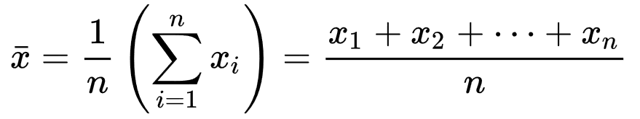
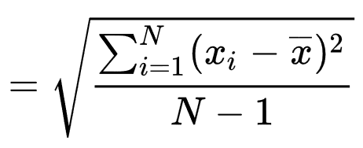
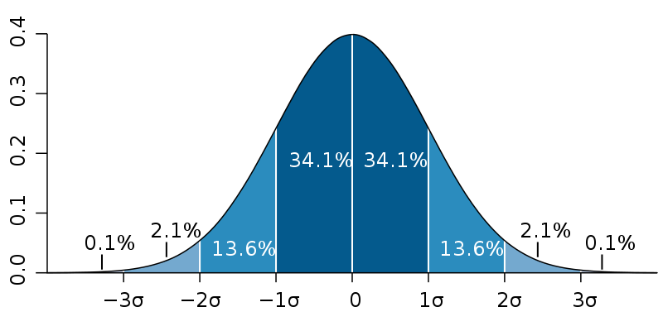
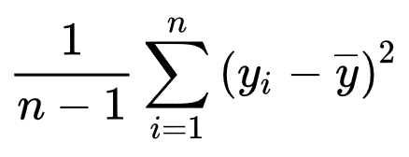
https://commons.wikimedia.org/wiki/File:Standard_deviation_diagram.svg
https://en.wikipedia.org/wiki/Standard_deviation

Slide 7
If your data follows a normal distribution:
https://commons.wikimedia.org/wiki/File:Standard_deviation_diagram.svg
But often data does NOT follow a normal distribution:

Slide 8
For k-means,
There are many methods for determining k
k = number of desired clusters

Slide 9
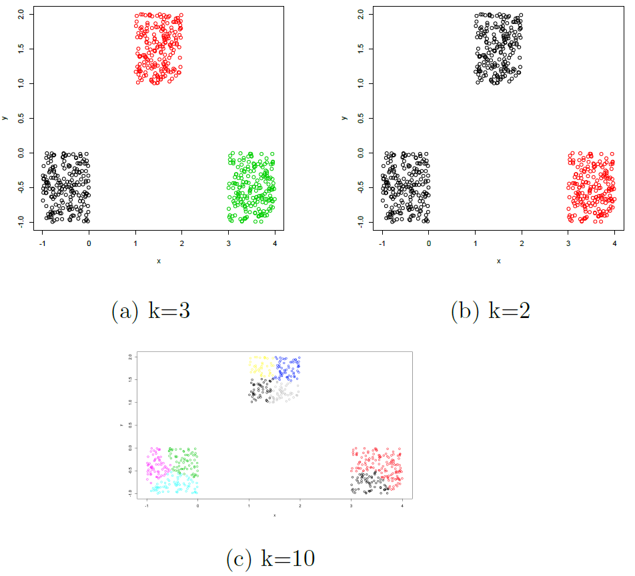
Figures courtesy of Wako Bungula

Slide 10
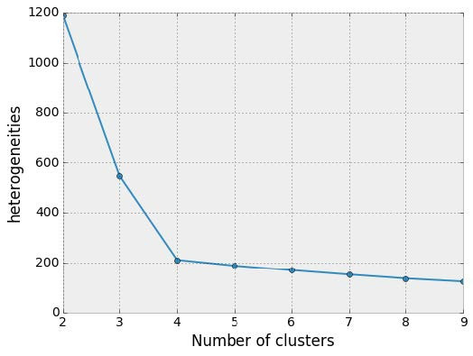
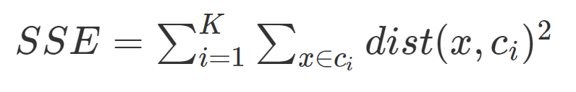
Elbow method
http://sites.northwestern.edu/msia/2016/12/
08/k-means-shouldnt-be-our-only-choice/

Slide 11
Figures courtesy of Wako Bungula

Slide 12
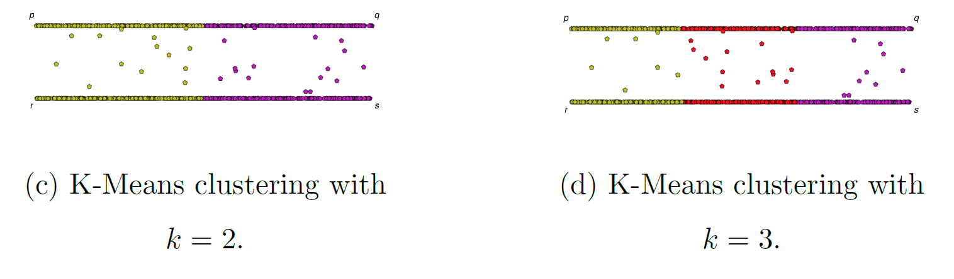
Figures courtesy of Wako Bungula

Slide 13
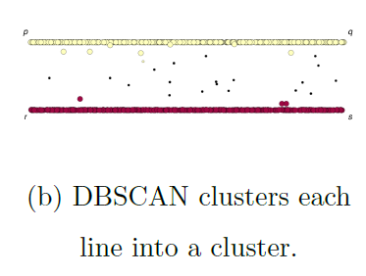
Figures courtesy of Wako Bungula

Slide 14
If you care about closeness:
Complete linkage
Average linkage
Ward’s linkage
K-means
If you care about connected components:
  Single linkage
  DBscan
Figures courtesy of Wako Bungula

Slide 15
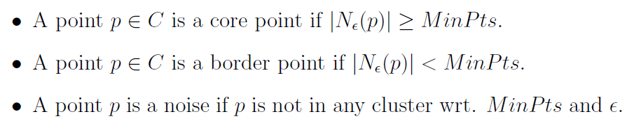
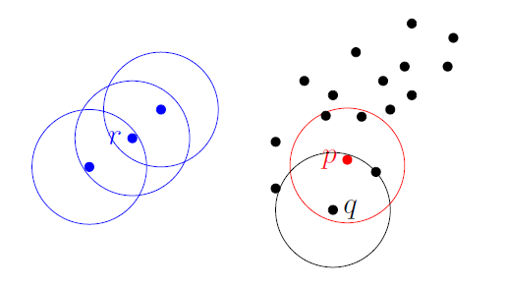
Dbscan (Density-based spatial clustering of applications with noise )
Figures courtesy of Wako Bungula

Slide 16
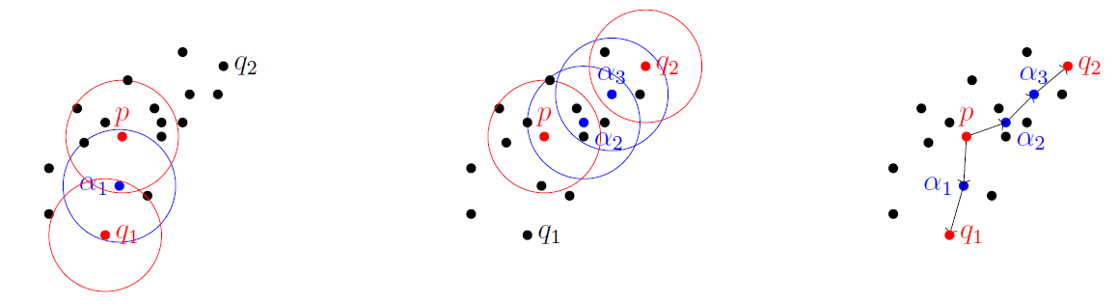
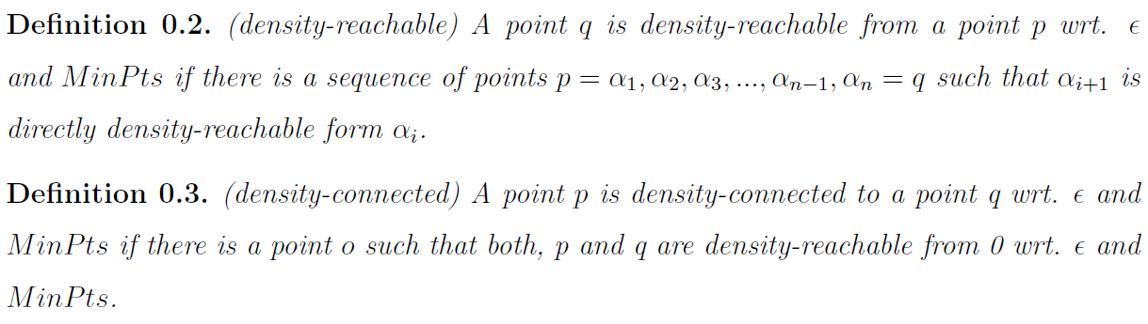
Figures courtesy of Wako Bungula

Slide 17
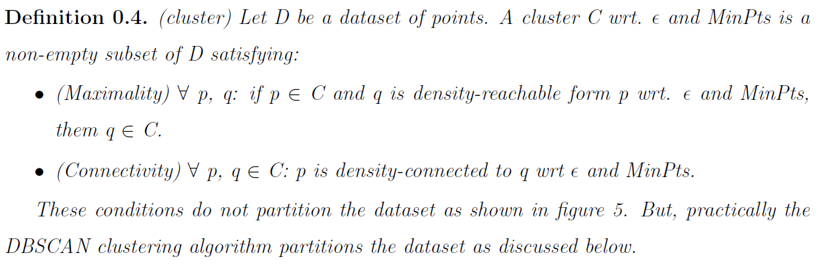
Figures courtesy of Wako Bungula

Slide 18
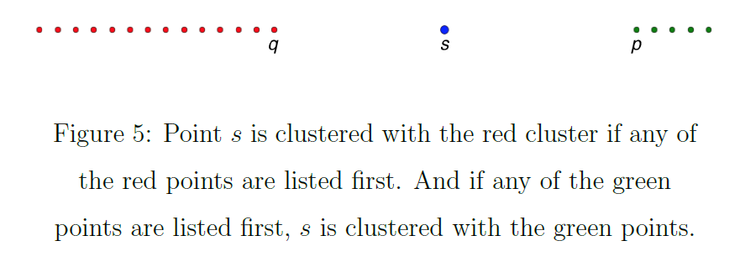
Figures courtesy of Wako Bungula

Slide 19
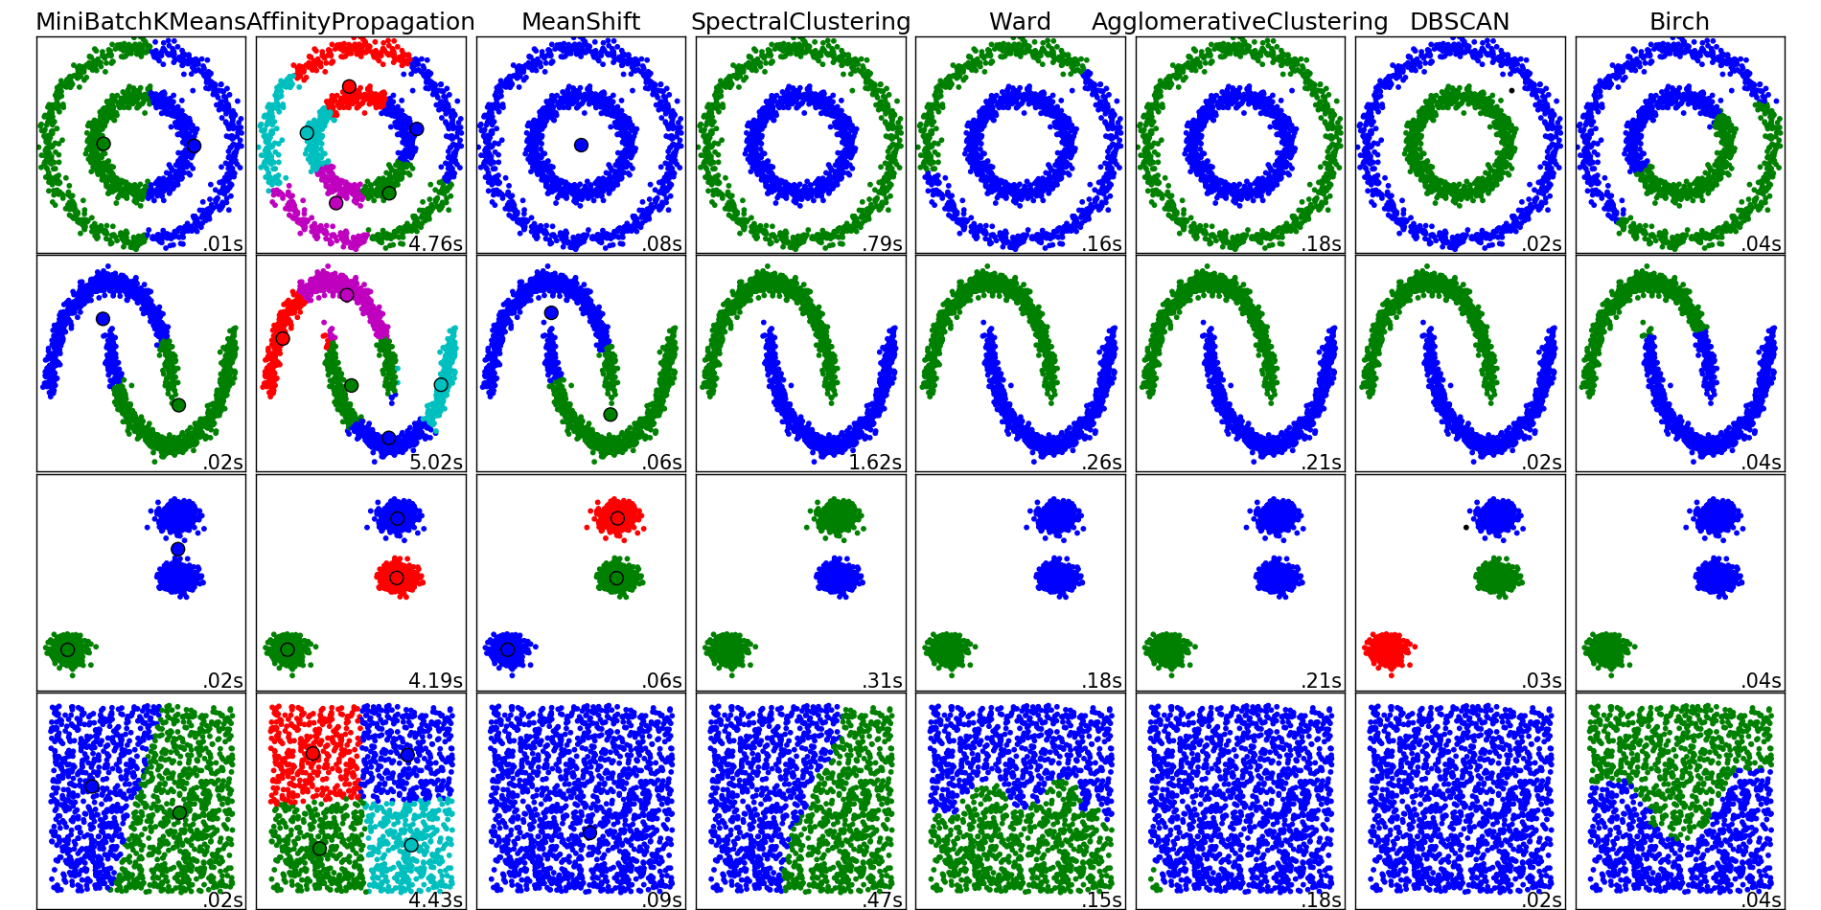
http://scikit-learn.org/stable/auto_examples/cluster/plot_cluster_comparison.html

