Slide 1
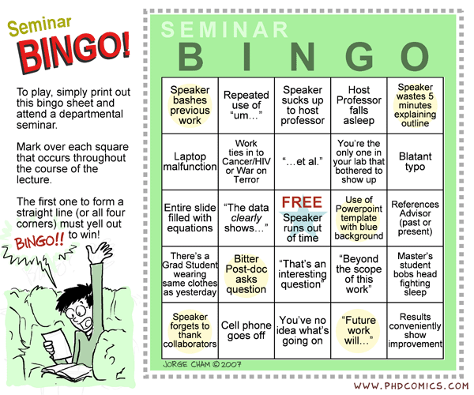
http://www.phdcomics.com/comics/archive.php?comicid=847

Slide 2
Advice for creating slides:
Advice #1
Don’t use latex (e.g. beamer or even prosper)
Use powerpoint and start with blank sides (no formatting)
Create math formulas using latex and use screen capture of
pdf opened in Adobe (not e.g. TexWorks) to include image
in your powerpoint slides
Advice #2
Ignore all advice.
Simple slides are better than distracting slides
Don’t waste time creating fancy slides that won’t convey more information.

Slide 3
https://www.cs.duke.edu/brd/Teaching/Giving-a-talk/giving-a-talk.html
Opinion: Do not use a pointer (but green is better than red):
Pointers are guaranteed to annoy at least 35% of your audience
If you're nervous, the pointer dramatically magnifies the shaking of your hand.
People cannot find where a laser points very quickly.
Very few speakers are capable of speaking without playing with the thing that's in their hands. It's distracting.
A Fine Point: Using your shadow is infinitely better than using a pointer. But, if you can reach the screen, you should touch it (the screen) to point to things, instead of using your shadow. The audience will like the tactility of this gesture. It's ok if your hand makes a slight noise when you hit the screen, or the screen shakes. This discontinuity may wake a few people up. Seriously.

Slide 4
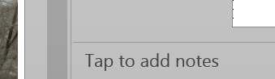
Don’t have a slide filled with only with lots of words
See previous slide for example of what you should not do.
Lot’s of white space is good.
Write in full sentences, not longer than 1 or 2 lines.
A picture is worth a thousand words.
  Captions are nice, especially if you hand out slides,
  Include citation.
  When drawing figures, use thick lines.
If you hand out slides, you might consider including notes.

Slide 5
Are your slides accessible?
Keep in mind that about 4 – 8% of your audience will be colorblind
Using color is still a good idea, but also use other methods to denote color when possible:
Dark vs. medium (if background light).
Use different line thicknesses to denote
different colors.
Consider checking your slides, etc. at
http://www.checkmycolours.com/
See also
http://www.dyslexia-plus.co.uk/dyslexia/teaching.htm
http://en.wikipedia.org/wiki/File:The_Dress_(viral_phenomenon).png

Slide 6
Font style
Use a sans-serif typeface (e.g. Ariel, Calibri, etc).
For list of sans-serif, see
http://en.wikipedia.org/wiki/List_of_typefaces#Sans-serif
If you are using another person’s computer to present, use a standard font and have a pdf back-up.
Don’t use a serif font such as Times New Roman
as they are poorly displayed by some projectors and some people find them hard to read even when projected properly.

Slide 7
Font Size
http://www.labnol.org/software/tutorials/advice-select-best-fonts-for-powerpoint-presentation-slides/3355/
Font size: “no font smaller than thirty points or just find out the age of the oldest person in your audience and divide it by two.”
Note: For my teaching in a small classroom, I use 24pt font, but sometimes I will use 18pt depending on concept covered.
For online lectures, I use a minimum of 32pt, so they can be viewed on a phone.
Print out your slides 6 per page in black and white and make sure they are very readable.

Slide 8

Avoid distractions
Often better to show entire list at once, but sometimes line by line is better.
Don’t use fancy transitions between slides
Don’t use all capital letters and avoid italics.
  Do not have any images behind text.
  Use a plain background.
  Don’t use unnecessary animations.
  Only use animations that
  illustrate a point.
  Don’t use prezi unless you
  have a good reason to use it.

Slide 9
Avoid distractions
Often better to show entire list at once, but sometimes line by line is better.

Slide 10
Avoid distractions
Often better to show entire list at once, but sometimes line by line is better.
Don’t use fancy transitions between slides

Slide 11
Avoid distractions
Often better to show entire list at once, but sometimes line by line is better.
Don’t use fancy transitions between slides, but can use on rare occasions to mark a transition in your talk (and wake up the audience).

Slide 12
Avoid distractions
Often better to show entire list at once, but sometimes line by line is better.
Don’t use fancy transitions between slides
Don’t use ALL CAPITAL LETTERS and avoid italics.

Slide 13
Avoid distractions
Often better to show entire list at once, but sometimes line by line is better.
Don’t use fancy transitions between slides
Don’t use all capital letters and avoid italics.
  Do not have any images behind text.

Slide 14
Avoid distractions
Often better to show entire list at once, but sometimes line by line is better.
Don’t use fancy transitions between slides
Don’t use all capital letters and avoid italics.
  Do not have any images behind text.

Slide 15

Avoid distractions
Often better to show entire list at once, but sometimes line by line is better.
Don’t use fancy transitions between slides
Don’t use all capital letters and avoid italics.
  Do not have any images behind text.

Slide 16

Avoid distractions
Often better to show entire list at once, but sometimes line by line is better.
Don’t use fancy transitions between slides
Don’t use all capital letters and avoid italics.
  Do not have any images behind text.

Slide 17

Avoid distractions
Often better to show entire list at once, but sometimes line by line is better.
Don’t use fancy transitions between slides
Don’t use all capital letters and avoid italics.
  Do not have any images behind text.

Slide 18

Avoid distractions
Often better to show entire list at once, but sometimes line by line is better.
Don’t use fancy transitions between slides
Don’t use all capital letters and avoid italics.
  Do not have any images behind text.

Slide 19
Avoid distractions
Often better to show entire list at once, but sometimes line by line is better.
Don’t use fancy transitions between slides
Don’t use all capital letters and avoid italics.
  Do not have any images behind text.
  Use a plain background.

Slide 20
Avoid distractions
Often better to show entire list at once, but sometimes line by line is better.
Don’t use fancy transitions between slides
Don’t use all capital letters and avoid italics.
  Do not have any images behind text.
  Use a plain background .
  Use a dark background for a dark and/or large room

Slide 21
Avoid distractions
Often better to show entire list at once, but sometimes line by line is better.
Don’t use fancy transitions between slides
Don’t use all capital letters and avoid italics.
  Do not have any images behind text.
  Use a plain background.
  Use a dark background for a dark and/or large room

Slide 22
Avoid distractions
Often better to show entire list at once, but sometimes line by line is better.
Don’t use fancy transitions between slides
Don’t use all capital letters and avoid italics.
  Do not have any images behind text.
  Use a plain background.
  Use a dark background for a dark and/or large room

Slide 23
Avoid distractions
Often better to show entire list at once, but sometimes line by line is better.
Don’t use fancy transitions between slides
Don’t use all capital letters and avoid italics.
  Do not have any images behind text.
  Use a plain background.
  Use a dark background for a dark and/or large room

Slide 24
Avoid distractions
Often better to show entire list at once, but sometimes line by line is better.
Don’t use fancy transitions between slides
Don’t use all capital letters and avoid italics.
  Do not have any images behind text.
  Use a plain background.
  Use a dark background for a dark and/or large room

Slide 25
Avoid distractions
Often better to show entire list at once, but sometimes line by line is better.
Don’t use fancy transitions between slides
Don’t use all capital letters and avoid italics.
  Do not have any images behind text.
  Use a plain background.
  Use a dark background for a dark and/or large room

Slide 26
Avoid distractions
Often better to show entire list at once, but sometimes line by line is better.
Don’t use fancy transitions between slides
Don’t use all capital letters and avoid italics.
  Do not have any images behind text.
  Use a plain background.
  Use a light background for a light and/or small room.
  Better to leave lights on so people don’t fall asleep.

Slide 27
Avoid distractions
Often better to show entire list at once, but sometimes line by line is better.
Don’t use fancy transitions between slides
Don’t use all capital letters and avoid italics.
  Do not have any images behind text.
  Use a plain background.
  Don’t use unnecessary animations.

Slide 28
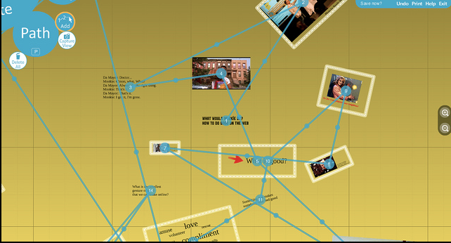
Avoid distractions
Often better to show entire list at once, but sometimes line by line is better.
Don’t use fancy transitions between slides
Don’t use all capital letters and avoid italics.
  Do not have any images behind text.
  Use a plain background.
  Don’t use unnecessary animations.
  Only use animations that
  illustrate a point.
  Don’t use prezi unless you
  have a good reason to use it.

Slide 29
Avoid distractions
Often better to show entire list at once, but sometimes line by line is better.
Don’t use fancy transitions between slides
Don’t use all capital letters and avoid italics.
  Do not have any images behind text.
  Use a plain background.
  Don’t use unnecessary animations.
  Only use animations that
  illustrate a point.
  Don’t use prezi unless you
  have a good reason to use it.

Slide 30
Align text to the left and avoid justifying
Align text to the left and avoid justifying

Slide 31
http://www.bbk.ac.uk/lib/disability-support/support-for-bbk/support-for-bbk/designingforallPowerpoints.doc
Use an Office Theme for slide layout
Font size 24 point or greater
Font style without serif e.g. Arial or Calibri
Good colour contrast
No large blocks of all capital letters, underline or italics
Text is left aligned
Images/tables/graphs are on their own on the slide or are to the right of text
Images/videos/graphs are explained in the slide notes
No text over images or patterned backgrounds
Multimedia files are located where the students can get to them
Slide content: concise slide content that would fit on a post card
Slide content: bullet points with full stops used where relevant
Notes field used to expand content/provide additional examples/describe images and diagrams
Internal hyperlinks used where relevant to aid navigation
External hyperlinks to docs/files and videos point to a web location where the student can access them
Sound added to slide transitions for students with visual impairments
Animations added to make text points appear one at a time (but use “appear”) if desired

Slide 32
http://www.garrreynolds.com/preso-tips/design/
1. Keep it Simple
  Lots of white space is good: The less clutter you have on your slide, the more powerful your visual message will become.
2. Limit bullet points & text
  3. Limit transitions & builds (animation)
  Only use animations that illustrate a point.
  Don’t use unnecessary animations.
4. Use high-quality graphics
5. Have a visual theme, but avoid using PowerPoint templates
6. Use appropriate charts
7. Use color well
8. Choose your fonts well
  use the same font set throughout your entire slide presentation, and use no more than two complementary sans-serif fonts (e.g., Arial and Arial Bold).
9. Use video or audio when appropriate.
10. Spend time in the slide sorter (or print out your slides at least 6 to a page).

Slide 33
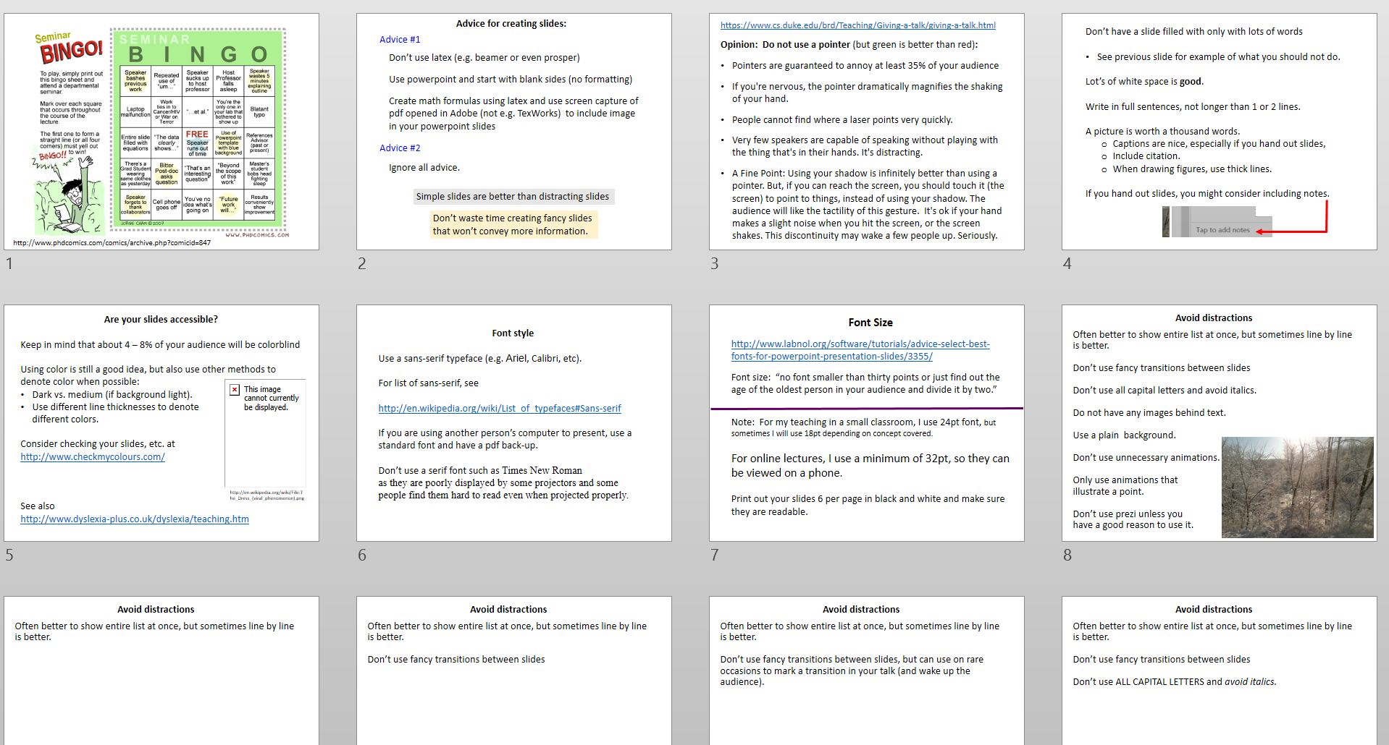
Use slide sorter to organize your talk.
or print out your slides at least 6 to a page

Slide 34
Content of talk:
Motivate and use pictures and examples.

Slide 35
Content of talk:
Motivate and use pictures and examples.
Motivate and use pictures and examples.

Slide 36
Content of talk:
Motivate and use pictures and examples.
Motivate and use pictures and examples.
Motivate and use pictures and examples.
Motivate and use pictures and examples.
Motivate and use pictures and examples.
Motivate and use pictures and examples.
Motivate and use pictures and examples.
Motivate and use pictures and examples.
Motivate and use pictures and examples.
Motivate and use pictures and examples.
Motivate and use pictures and examples.
Motivate and use pictures and examples.
Motivate and use pictures and examples.
Motivate and use pictures and examples.

Slide 37
You rarely have time to get into details. Thus
Illustrate the main point and skip anything extraneous to this.
Motivate the main point.
Use examples and pictures to motivate and illustrate the main point.
Use visual aids. For example, rope to illustrate knotting.

Slide 38
Parts of a talk
Introduction
The story
Conclusion/Summary.

Slide 39
Parts of a talk
Introduction
The story
Conclusion/Summary.
Parts of a talk
Tell them what you are going to tell them.
Tell them.
Then tell them what you told them.
Consider telling a story.

Slide 40
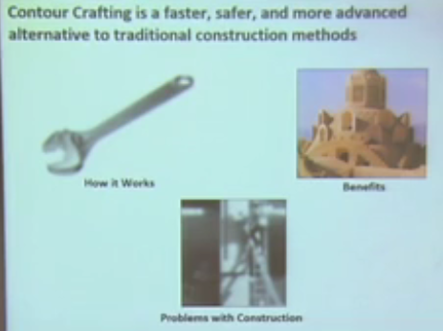
Do NOT have an outline slide.
If you must have an outline slide, have a very short one with figures.
You can then use these figures to indicate when you start a new topic.
When giving the talk, spend very little time on your outline slide.
A slide from a talk given by Amel Awadelkarim, a junior in engineering science, on an innovative way to construct buildings.
http://writing.engr.psu.edu/models.html

Slide 41
In an assertion-evidence slide, the headline is a sentence that succinctly states the slide’s main message
Photograph, drawing, diagram, or graph
supporting the headline message (no bulleted list)
Call-out(s), if needed:
no more than two lines
PowerPoint Template: http://writing.engr.psu.edu/AE_template_PSU.ppt
Notes:
41
This file presents a template for making Assertion–Evidence (A–E) slides in a technical presentation. The design advocated by this template arises from pages 113-152 of The Craft of Scientific Presentations (Springer, 2003) and from the first Google listing for “presentation slides”:
http://www.writing.engr.psu.edu/slides.html
To follow this template, make sure that you create the slide within this PowerPoint file. Working with a New Slide (under Insert in older versions or as a button on the Home tab in version 2007) , you should first craft a sentence headline that states an assertion about your topic. Having no assertion translates to having no slide. In the body of the slide, you should then support that headline assertion visually: photographs, drawings, diagrams, equations, or words arranged visually. Use supporting text only where necessary. Do not use bulleted lists, because bulleted lists do not reveal the connections between details.
This slide shows one orientation for the image and supporting text. Other orientations exist, as shown in the sample slides that follow.

Slide 42


Topological Distances on
DNA Knots and Links
Isabel K. Darcy
Annette Honken
Mathematics Department
Applied Mathematical and Computational Sciences (AMCS)
University of Iowa
http://www.math.uiowa.edu/~idarcy
Acknowledge your collaborators
This work was partially supported by the Joint DMS/NIGMS Initiative to Support Research in the Area of Mathematical Biology (NSF 0800285).
©2008 I.K. Darcy. All rights reserved

Slide 43
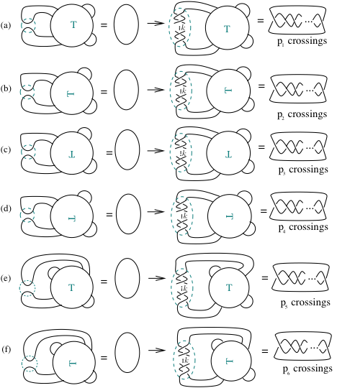

Can also solve some 4-string and n-string tangle equations.
Joint work with Soojeong Kim, Pusan National University
Acknowledge your collaborators

Slide 44
Bad way to end
The end

Slide 45
Bad way to end
Thank you

Slide 46
Bad way to end
Questions?

Slide 47
Bad way to end
Additional References
World Blind Union PowerPoint Guidelines
http://icevi.org/13thWC/pdf/Guidelines%20for%20POWERPOINT%20PRESENTATION.pdf
http://www.ifla.org/files/assets/hq/officers/documents/wbu-visual-presentations-guidelines-summary.pdf
Even a Geek Can Speak Paperback – July 1, 2006
by Joey Asher
http://research.microsoft.com/en-us/um/people/simonpj/papers/giving-a-talk/giving-a-talk.htm

Slide 48
Slightly better way to end
Questions?
Nice figure
http://homepage.math.uiowa.edu/~idarcy

Slide 49
Much better way to end
Summary of main points
Nice figures
http://homepage.math.uiowa.edu/~idarcy
Questions?

Slide 50
https://hbr.org/2013/06/how-to-give-a-killer-presentation
As hard as it may be to give a great talk, it’s really easy to blow it. Here are some common mistakes that TED advises its speakers to avoid.
1. Take a really long time to explain what your talk is about.
2. Speak slowly and dramatically. Why talk when you can orate?
3. Make sure you subtly let everyone know how important you are.
4. Refer to your book repeatedly. Even better, quote yourself from it.
5. Cram your slides with numerous text bullet points and multiple fonts.
6. Use lots of unexplained technical jargon to make yourself sound smart.
7. Speak at great length about the history of your organization and its glorious achievements.
8. Don’t bother rehearsing to check how long your talk is running.
9. Sound as if you’re reciting your talk from memory.
10. Never, ever make eye contact with anyone in the audience.

Slide 51
Additional References
World Blind Union PowerPoint Guidelines
http://icevi.org/13thWC/pdf/Guidelines%20for%20POWERPOINT%20PRESENTATION.pdf
http://www.ifla.org/files/assets/hq/officers/documents/wbu-visual-presentations-guidelines-summary.pdf
Even a Geek Can Speak Paperback – July 1, 2006
by Joey Asher
http://research.microsoft.com/en-us/um/people/simonpj/papers/giving-a-talk/giving-a-talk.htm

Slide 52
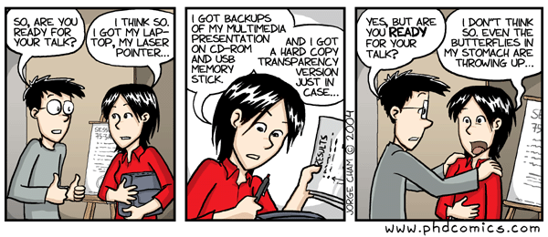
http://www.phdcomics.com/comics/archive.php?comicid=493

Slide 53
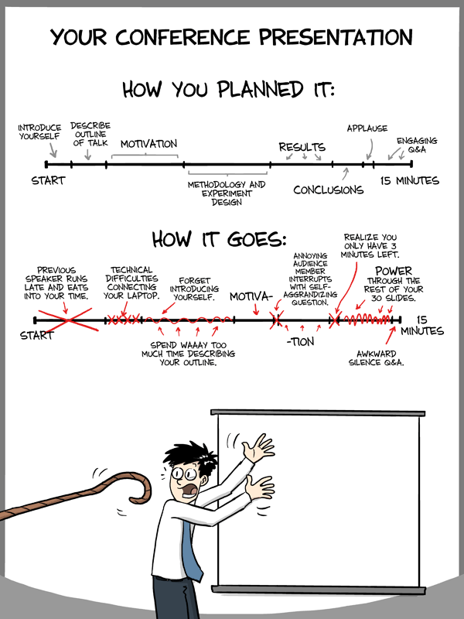
"Piled Higher and Deeper" by Jorge Cham www.phdcomics.com
http://www.phdcomics.com/comics/archive.php?comicid=1553

Slide 56
http://writing.engr.psu.edu/slides.html
http://writing.engr.psu.edu/csp.html
http://writing.engr.psu.edu/assertion_evidence.html
http://www.writing.engr.psu.edu/AE_checklist.pdf
http://writing.engr.psu.edu/research.html

