Slide 1
Step 1: Download R and install R:
http://streaming.stat.iastate.edu/CRAN/
Step 2: Download and install Rstudio after you install R:
http://www.rstudio.com/products/rstudio/download/
For some potentially useful tips, see:
http://socserv.mcmaster.ca/jfox/Courses/R/ICPSR/
R-install-instructions.html

Slide 2
From: http://socserv.mcmaster.ca/jfox/Courses/R/ICPSR/R-install-instructions.html
Installing R on Windows
Instead of installing R in the standard location, C:\Program Files\R\R-3.1.1, I suggest that you use C:\R\R-3.1.1. This will allow you to install packages without running R with administrator privileges and will avoid problems that sometimes occur when there are spaces in paths.
Installing R on Mac OS X
Note: Some people have experienced problems with the mavericks build of R for OS X, and so you may prefer to install the snowleopard build even if you are running mavericks.

Slide 3
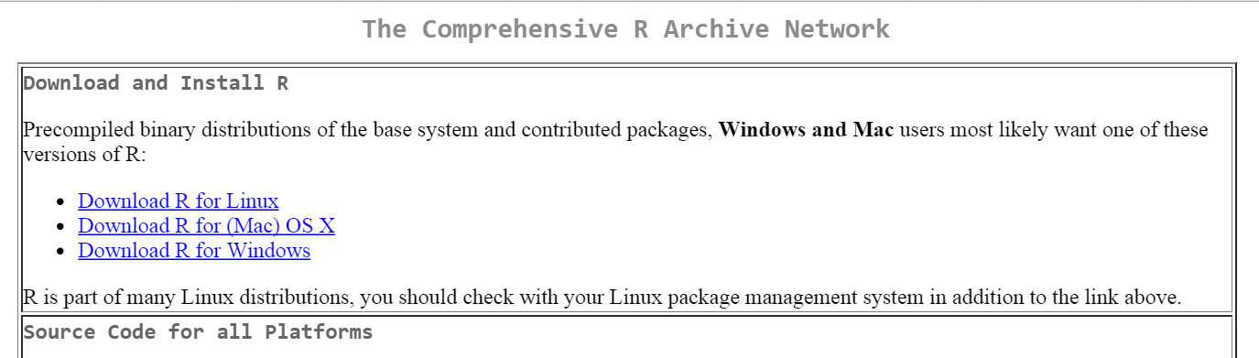
http://streaming.stat.iastate.edu/CRAN/

Slide 4
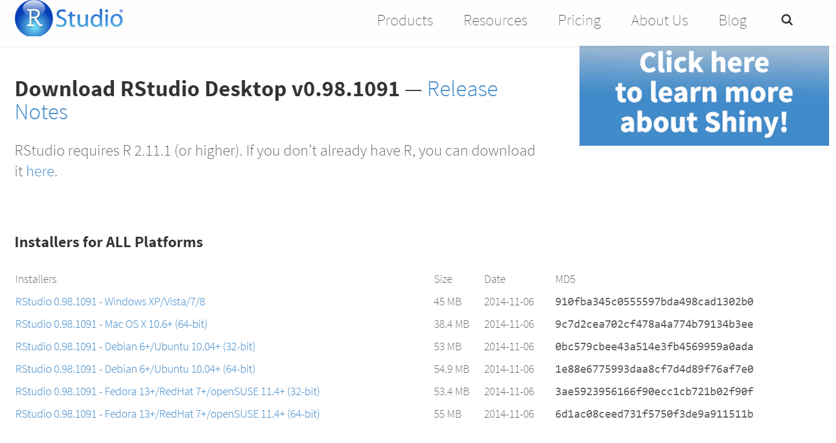
http://www.rstudio.com/products/rstudio/download/

