Slide 1
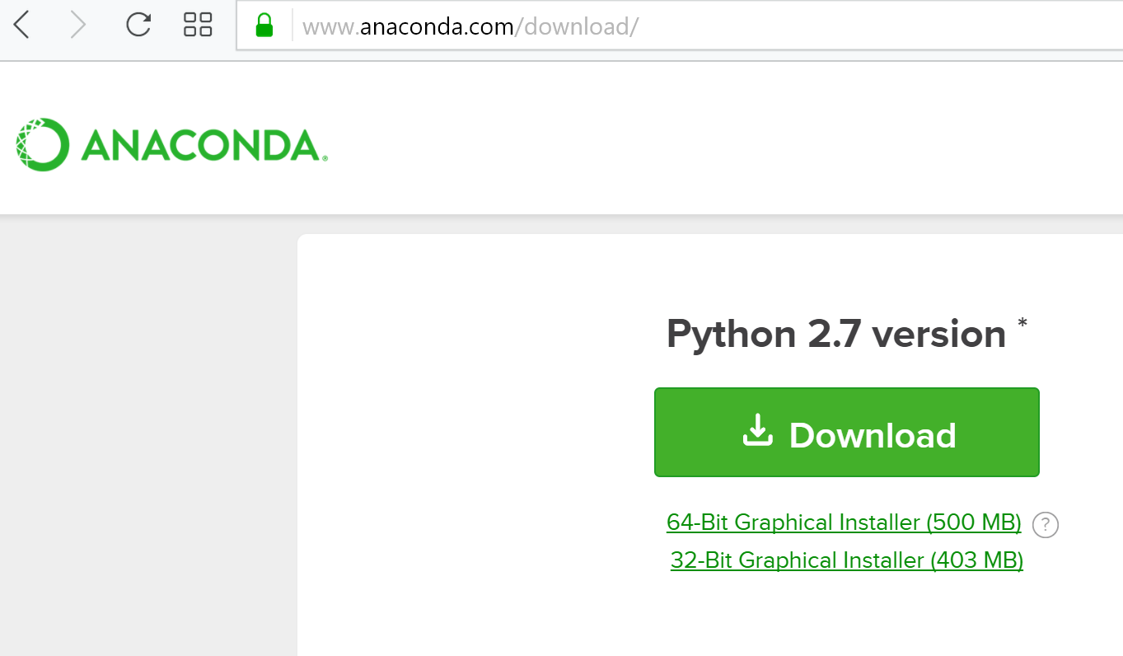
Download Anaconda from https://www.anaconda.com/download/
Make sure you install Python 2.7 version, not 3.6 (python mapper requires 2.7)
32 bit version may be less buggy, so click here to install 32 bit version

Slide 2
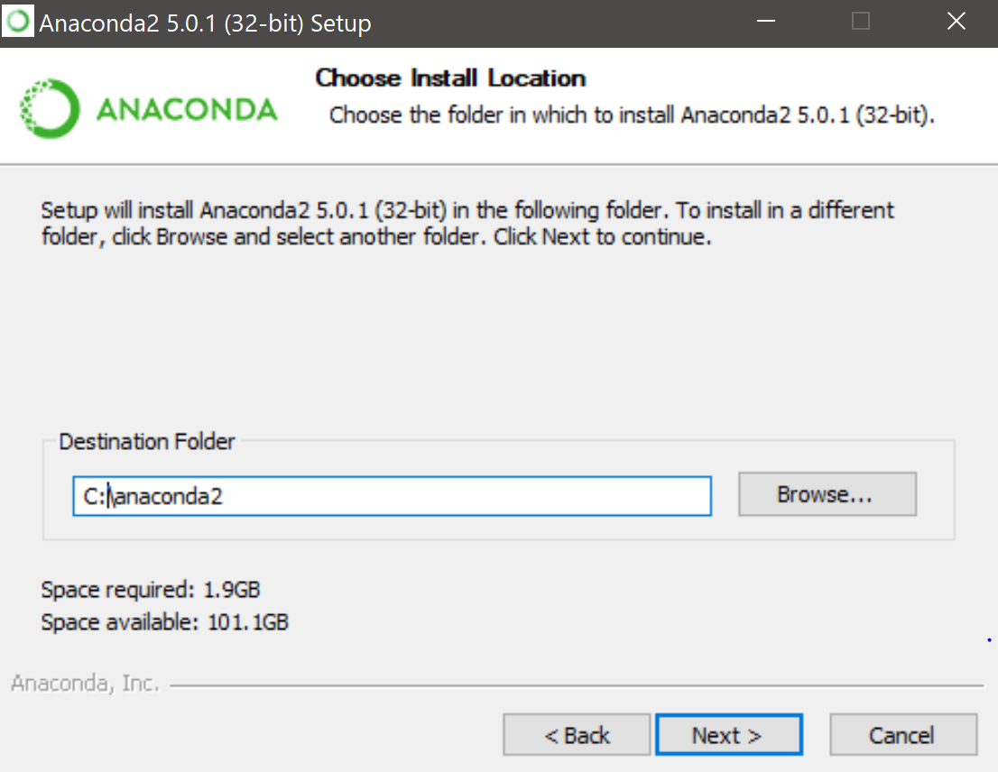
I installed it in the following directory by editing the location below

Slide 3
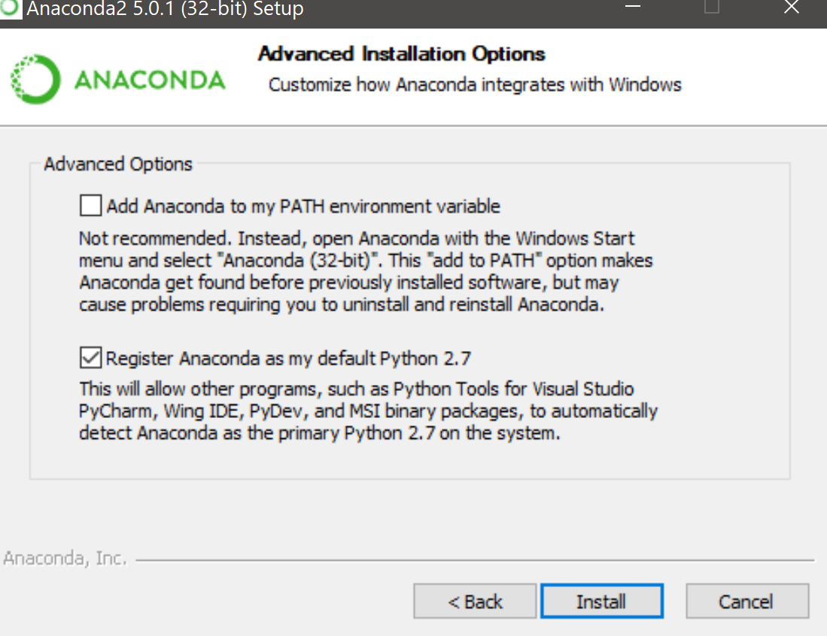
I checked both boxes to avoid possible PATH problems, but if you wish to later change your default python to the newer python3, you may have problems if you check the top box.

Slide 4
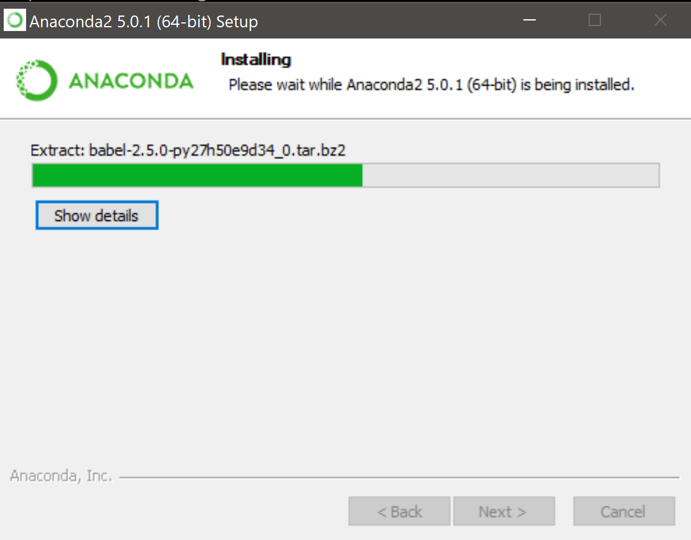
Be patient. This step takes awhile

Slide 5
Open a command prompt window (search for cmd in start window)
  Change into the directory where you put Anaconda and into
  the Scripts subdirectory via the following command
    cd /D C:\Anaconda2\Scripts
  Install the following using pip
    pip install wheel
    pip install matplotlib
    pip install pyopengl
    pip install fastcluster
    pip install mapper
    pip install cmappertools
You might not need to install all of these as you might already have, for example, wheel and matplotlib, but then you’ll just get a requirement already satisfied message. Also, not sure if the non-gui version needs pyopengl

Slide 6

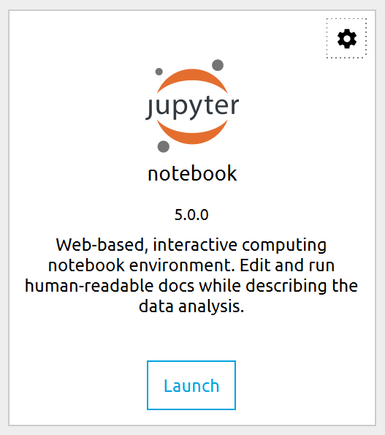
To run, open Anaconda Navigator
Click to launch Jupyter notebook

