Slide 1

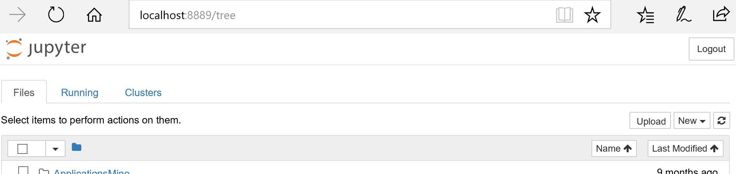
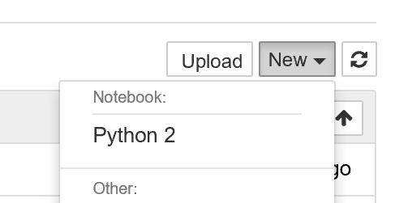
Click on Upload to Upload mapper.ipynb
Click on New, Python2 to open new Python2 notebook

Slide 2
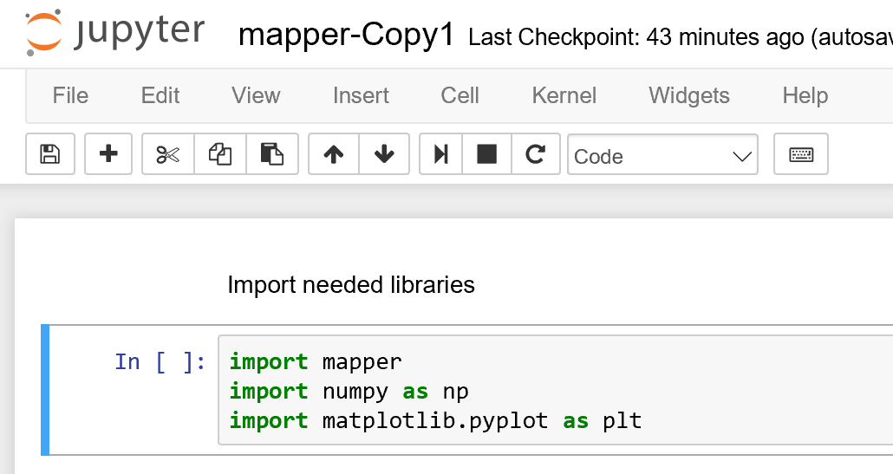
Click to run highlighted line
Can also press shift enter to run a cell
Highlighted line indicated by blue strip.

Slide 3
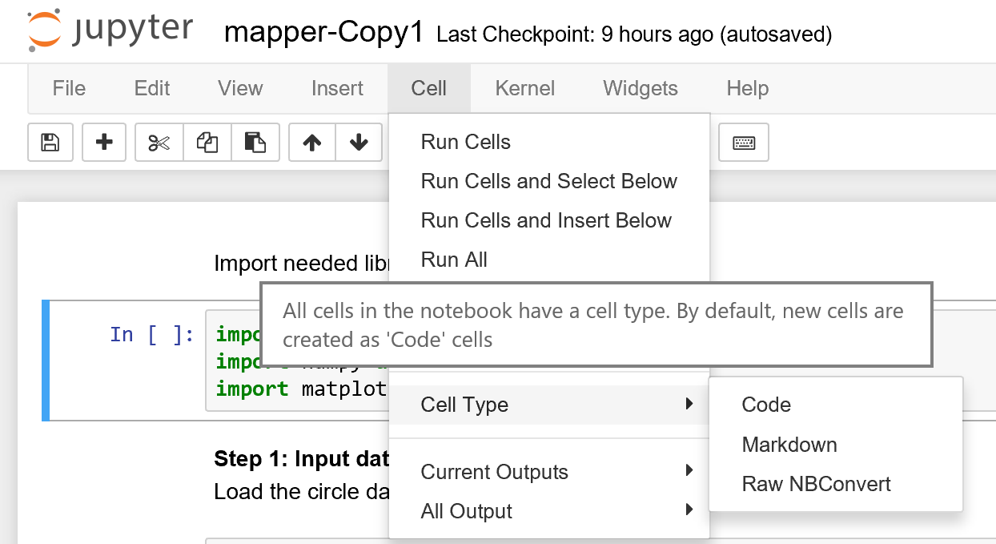
Or click on one of these to run cells
To change cell type

Slide 4
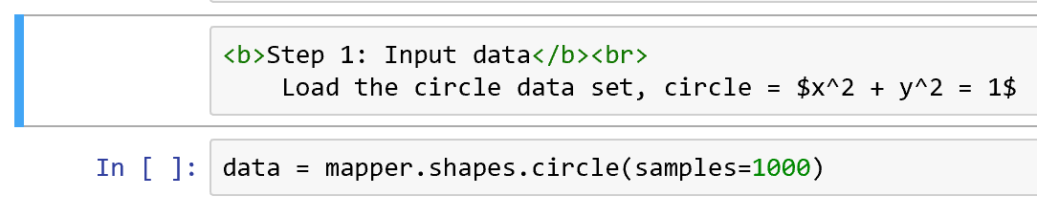
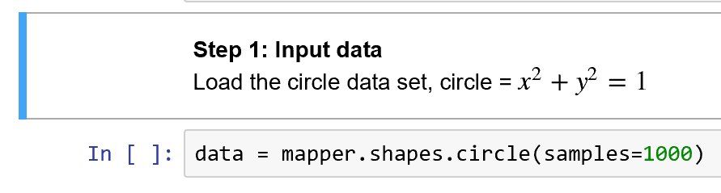
If you run a Markdown cell, you get nice looking text, note Markdown cells do not have In [ ]: in front of them
In [ ]: means this cell contains code. After your run this cell, the bracket [ ] will contain a number indicating the order in which you have run your code cells.

Slide 5
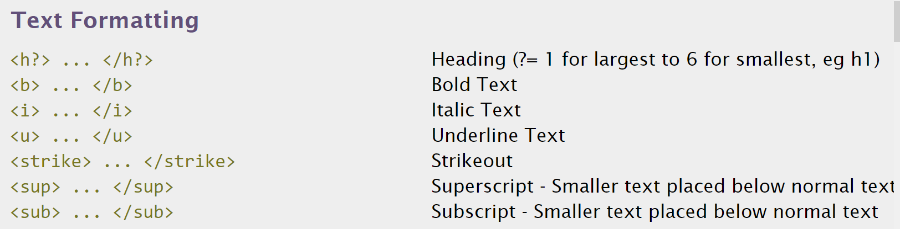
http://www.simplehtmlguide.com/cheatsheet.php

Slide 6
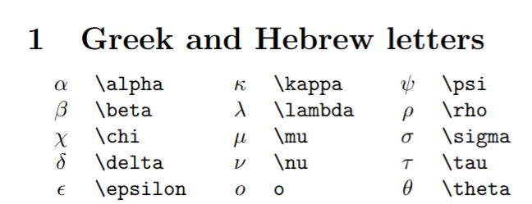
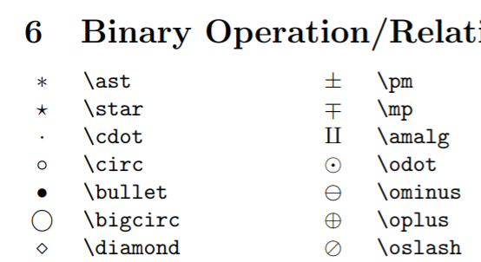
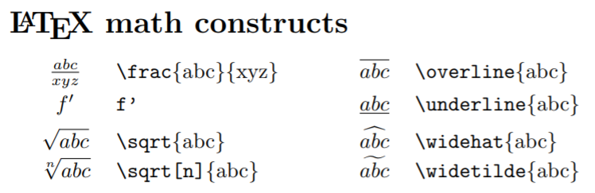
http://reu.dimacs.rutgers.edu/Symbols.pdf
Put latex command between $ signs,e.g.: $\alpha$

