Slide 2
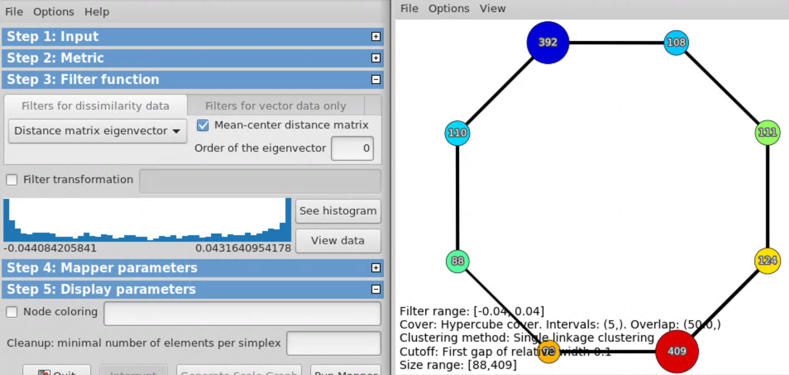
Default coloring is average filter value

Slide 3
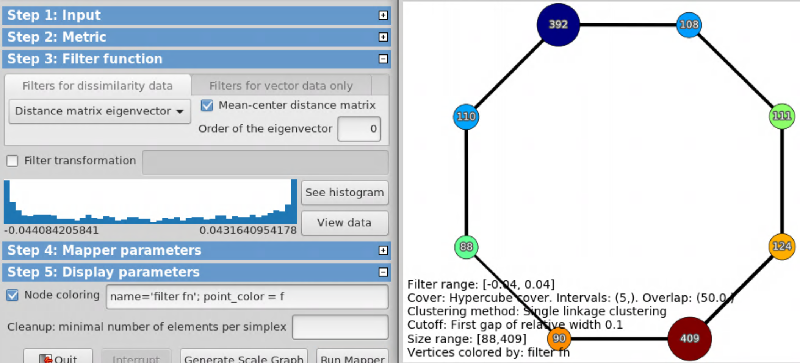
Can also specify color by filter function via
point_color = f

Slide 4
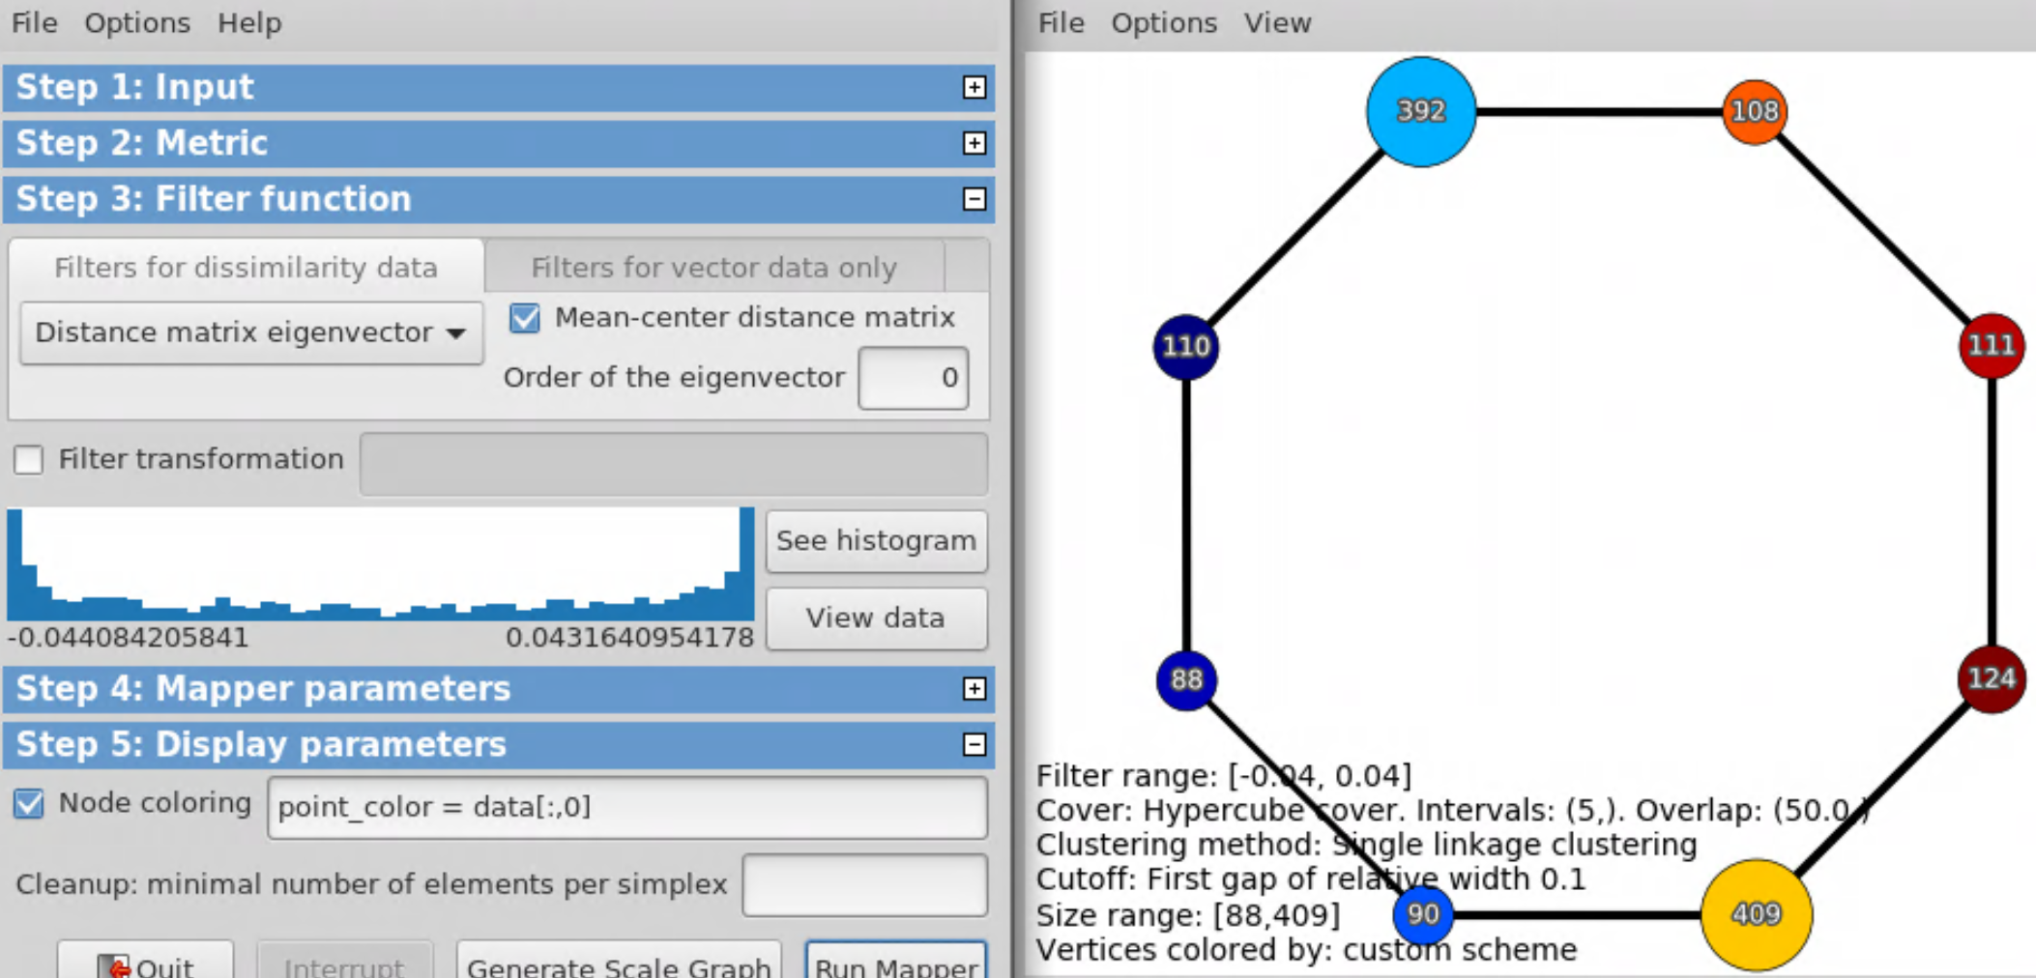
point_color = data[:,0]

Slide 5
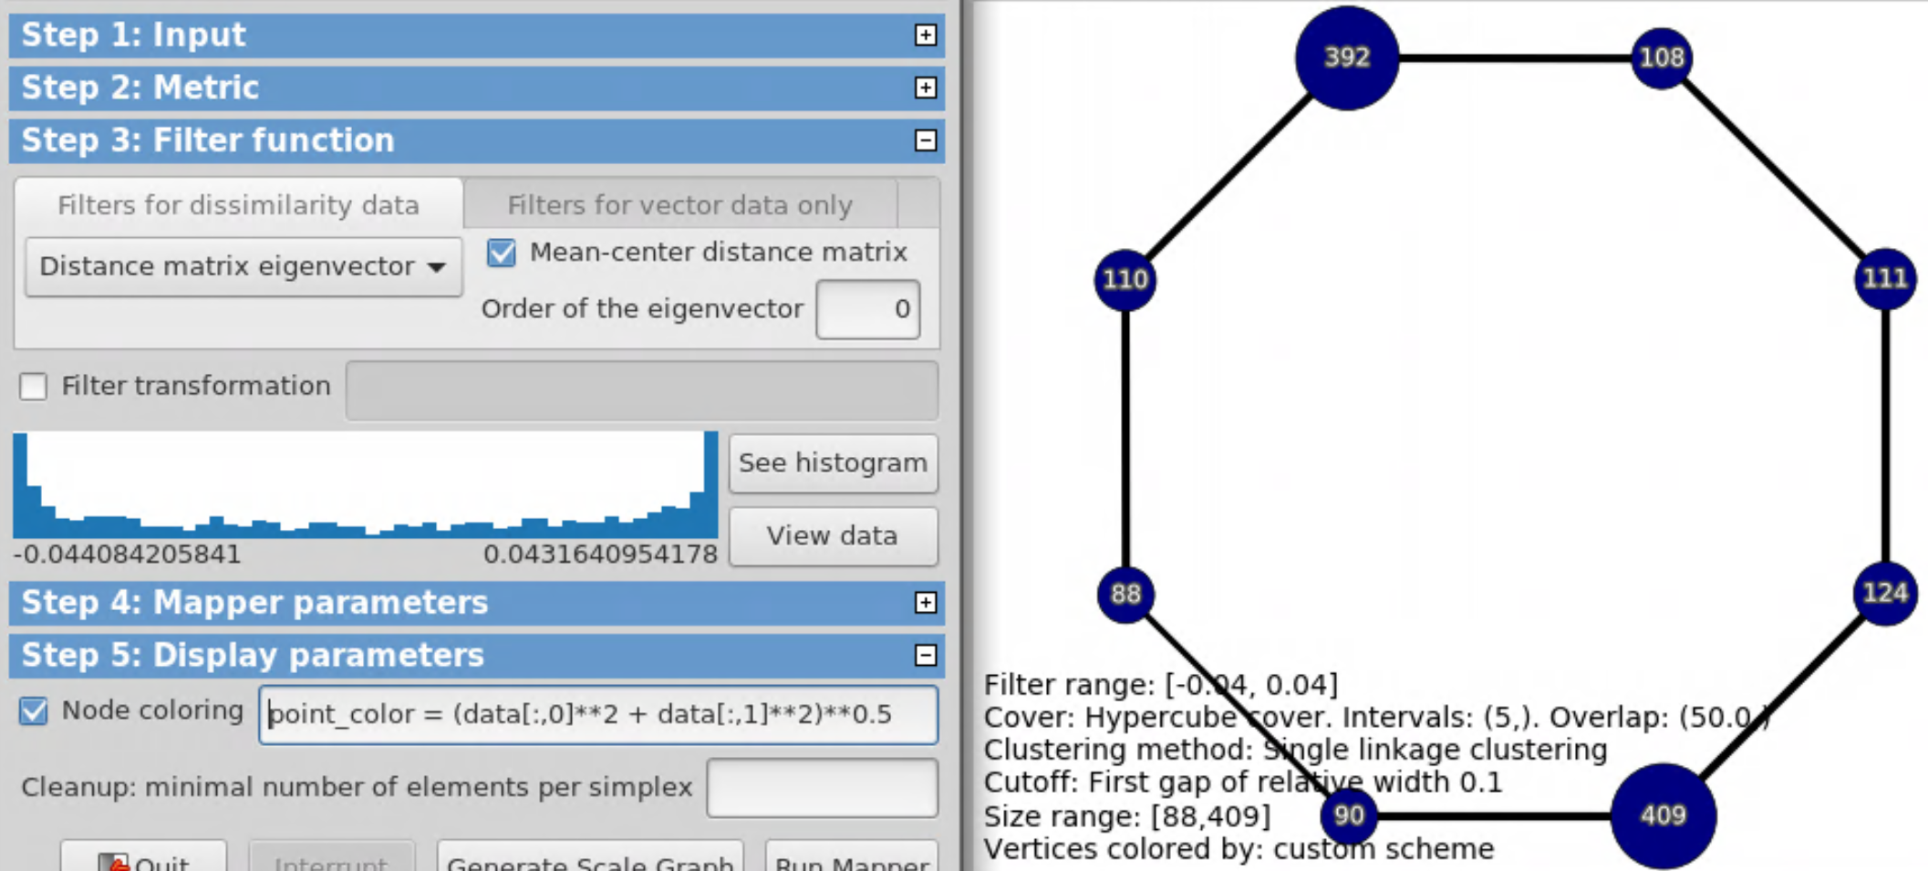
point_color = (data[:,0]**2 + data[:,1]**2)**0.5

Slide 6
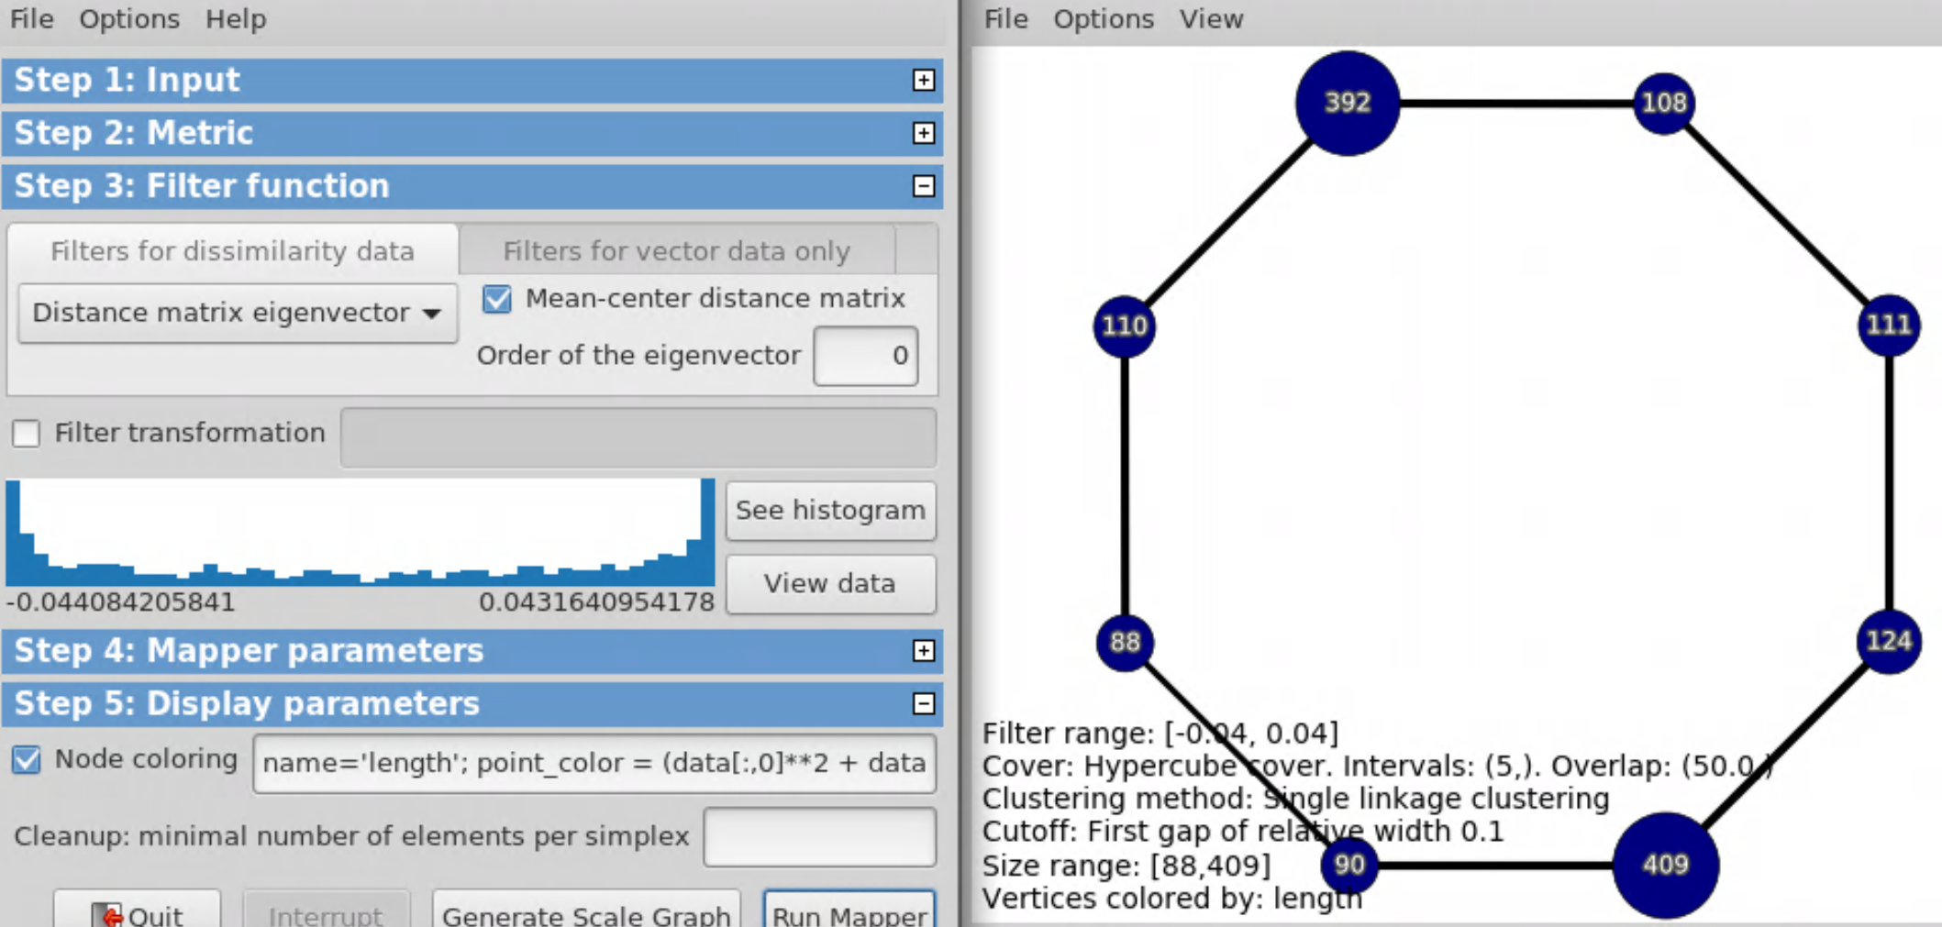
name = ‘length’;
point_color = (data[:,0]**2 + data[:,1]**2)**0.5

Slide 7
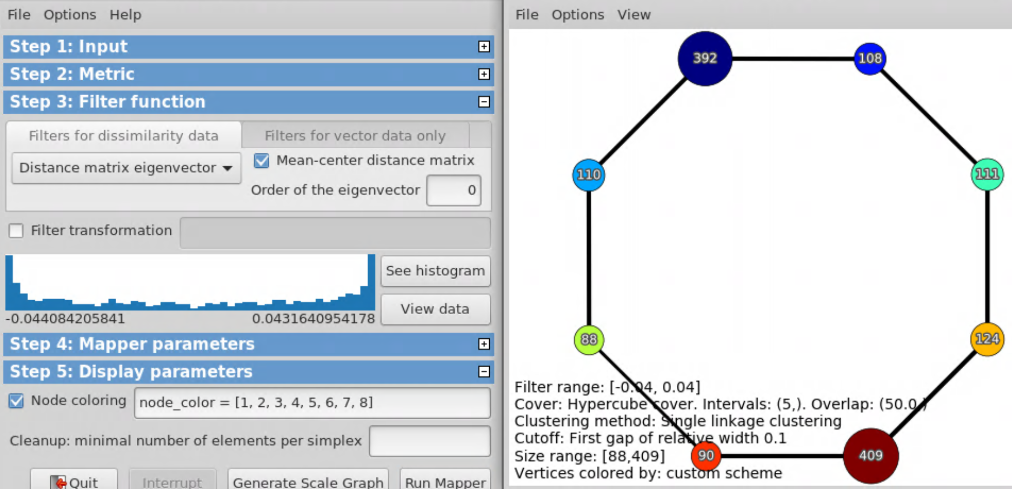
Alternatively, can specify node color
node_color = [1, 2, 3, 4, 5, 6, 7, 8]

