Slide 1
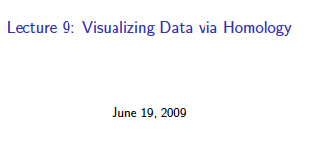
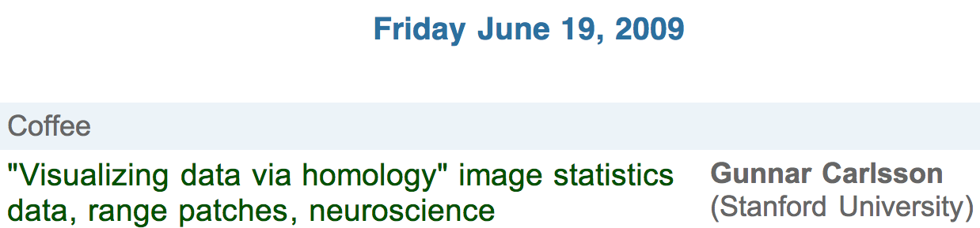
http://www.ima.umn.edu/videos/?id=856
http://ima.umn.edu/2008-2009/ND6.15-26.09/activities/Carlsson-Gunnar/imafive-handout4up.pdf

Slide 2
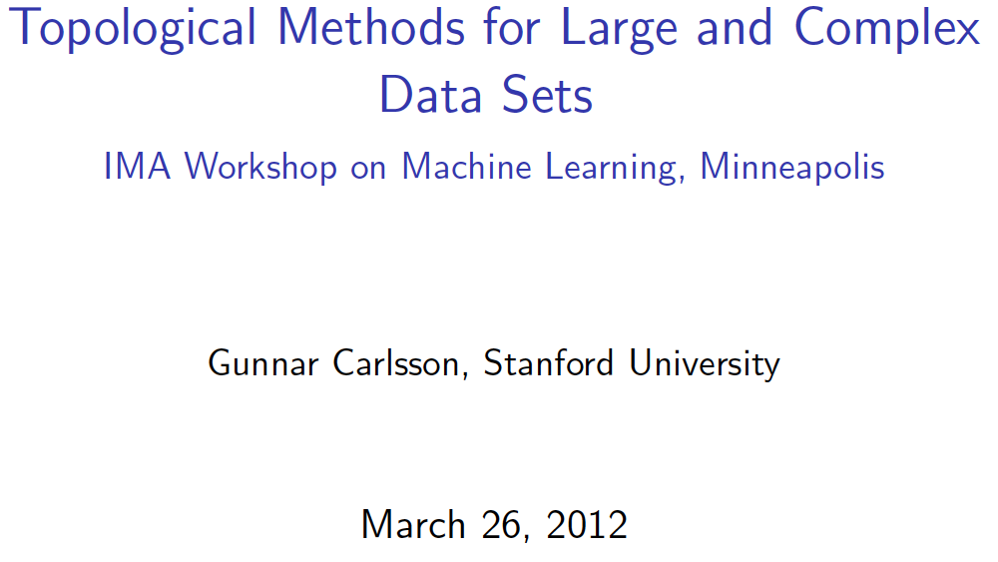
Application to Natural Image Statistics
With V. de Silva, T. Ishkanov, A. Zomorodian
http://www.ima.umn.edu/videos/?id=1846
http://www.ima.umn.edu/2011-2012/W3.26-30.12/activities/Carlsson-Gunnar/imamachinefinal.pdf

Slide 3
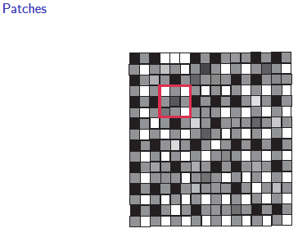
An image taken by black and white digital camera can be viewed as a vector, with one coordinate for each pixel
Each pixel has a “gray scale” value, can be thought of as a real number (in reality, takes one of 255 values)
Typical camera uses tens of thousands of pixels, so images lie in a very high dimensional space, call it pixel space, P

Slide 4
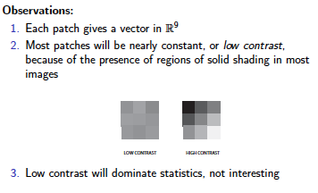
Lee-Mumford-Pedersen [LMP] study only high contrast patches.
Collection: 4.5 x 10⁶ high contrast patches from a
collection of images obtained by van Hateren and van der Schaaf
http://www.kyb.mpg.de/de/forschung/fg/bethgegroup/downloads/van-hateren-dataset.html

Slide 5
Lee-Mumford-Pedersen [LMP] study only high contrast patches.
Collection: 4.5 x 10⁶ high contrast patches from a
collection of images obtained by van Hateren and van der Schaaf
Choose how to model your data

Slide 6
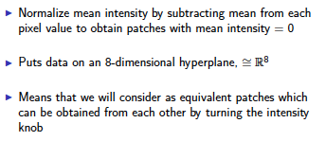
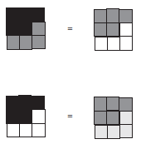

Choose how to model your data
Consult previous methods.

Slide 7
What to do if you are overwhelmed by the number of possible ways to model your data (or if you have no ideas):
Do what the experts do.
Borrow ideas.
Use what others have done.

Slide 8
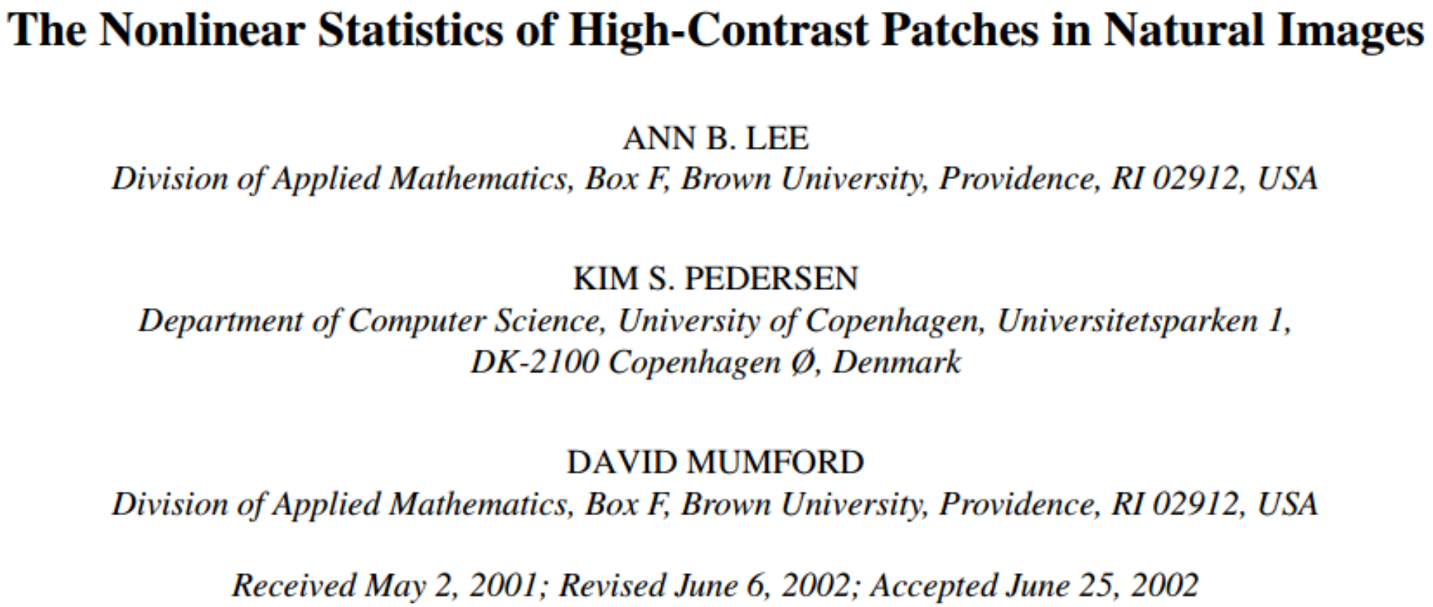
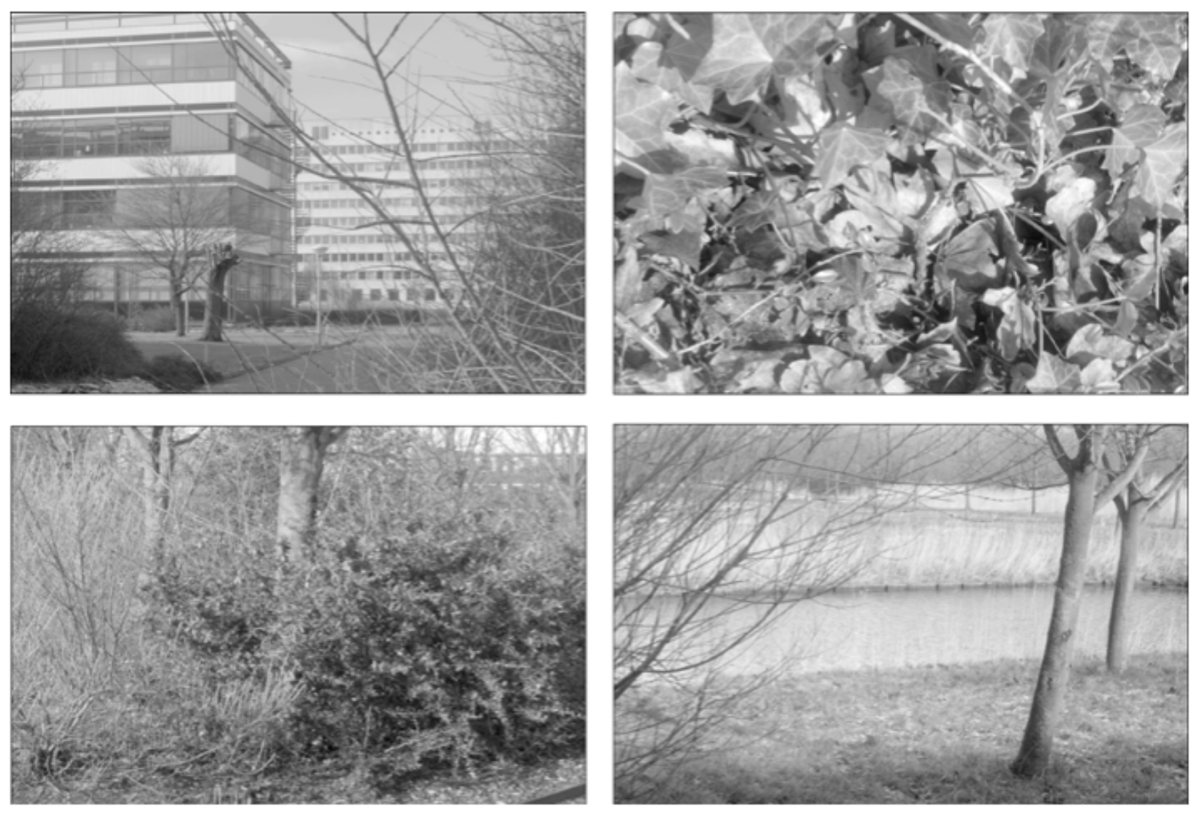
Carlsson et al used

Slide 9
Carlsson et al used
The majority of high-contrast optical patches are concentrated around a 2-dimensional C₁ submanifold
embedded in the 7-dimensional sphere.

Slide 10
Persistent Homology: Create the Rips complex
0.) Start by adding 0-dimensional data points
is a point in S⁷
Notes:
We can compute the number of clusters for a variety of diameters.
We start with 17 data points, so if the diameter is 0, we have 17 clusters. Increasing the diameter, these 2 balls intersect so I now have 16 clusters.
If we continue to increase the diameter, we will eventually create the complex we saw before with 5 clusters, etc until we only have one cluster left.
Eventually this entire page will be purple, but right now, we know have one component.
To choose the threshold, one can determine how long a particular number of clusters lasts, for example for what set of radii do we have five clusters. If we have five clusters for the largest set of radii, then have gives us a good idea where to set the threshold and which simplicial complex best models our data.
I have put links to better animations on my on my YouTube site which may better illustrate this persistence concept. Next month, we will also talk much more about persistence during the live lectures for this course. This is just a preliminary introduction.

Slide 11
For each fixed ε, create Rips complex from the data
is a point in S⁷
1.) Adding 1-dimensional edges (1-simplices)
Add an edge between data points that are close
Notes:
a one dimensional simplicial complex. Note that we have clustered our data into five disjoint connected sets. So this is one way to cluster our data – that is grouping our data points into disjoint sets based on some definition of similarity. In this case, we have 5 clusters.
We can now add higher dimensional simplices.

Slide 12
For each fixed ε, create Rips complex from the data
2.) Add all possible simplices of dimensional > 1.
is a point in S⁷
Notes:
Thus we now have the Vietoris Rips simplicial complex. Note we get the same simplex by adding one dimension at a time

Slide 13
For each fixed ε, create Rips complex from the data
In reality used Witness complex (see later slides).
2.) Add all possible simplices of dimensional > 1.
is a point in S⁷
Notes:
Thus we now have the Vietoris Rips simplicial complex. Note we get the same simplex by adding one dimension at a time

Slide 14
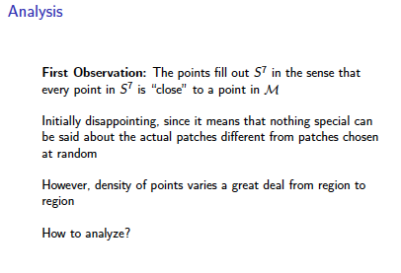
Probe the data

Slide 15
Probe the data

Slide 16
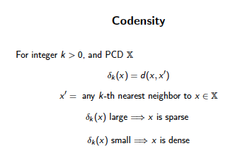
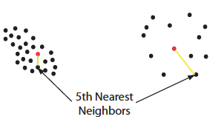

Can use function on data to probe the data

Slide 17
Large values of k:
measuring density of large neighborhoods of x,
Smaller values mean we are using smaller neighborhoods

Slide 18
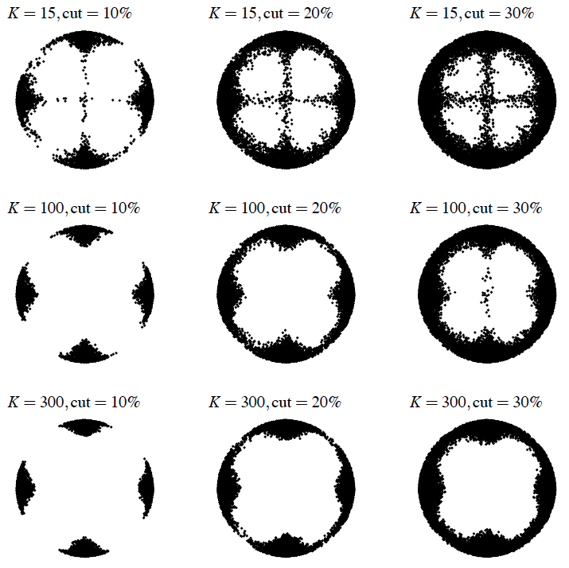
Eurographics Symposium on Point-Based Graphics (2004)
Topological estimation using witness complexes
Vin de Silva and Gunnar Carlsson

Slide 19
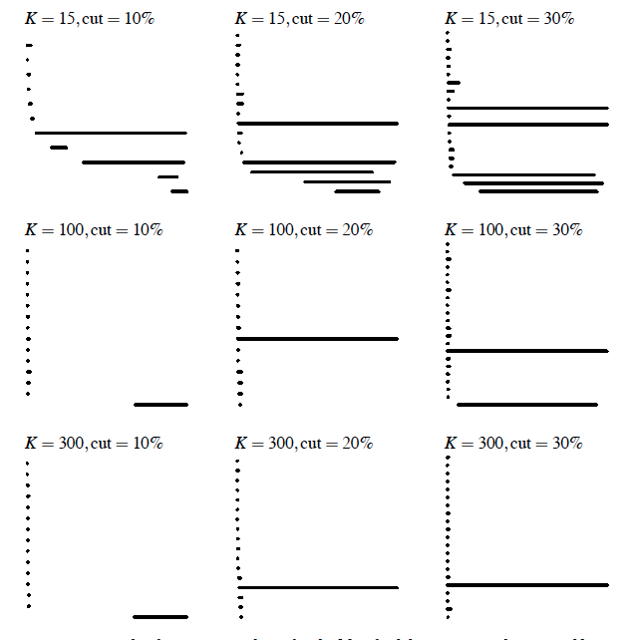
Eurographics Symposium on Point-Based Graphics (2004)
Topological estimation using witness complexes
Vin de Silva and Gunnar Carlsson

Slide 20
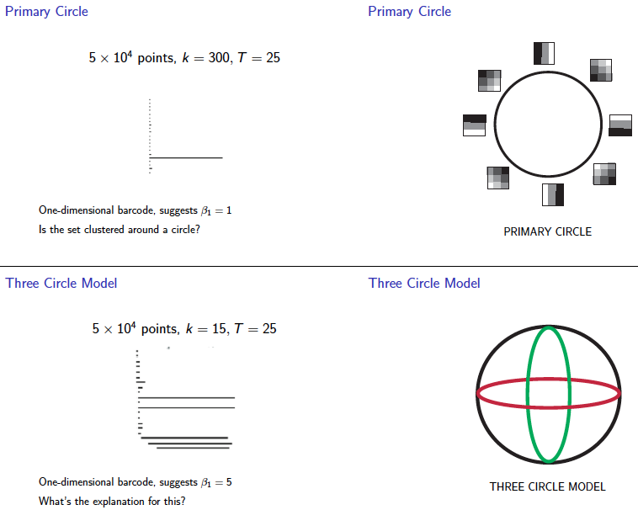
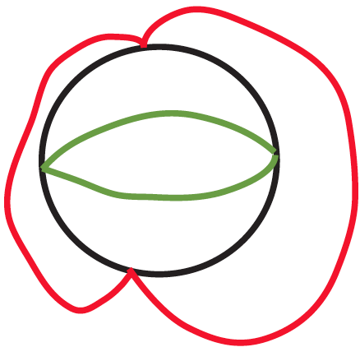

Slide 21
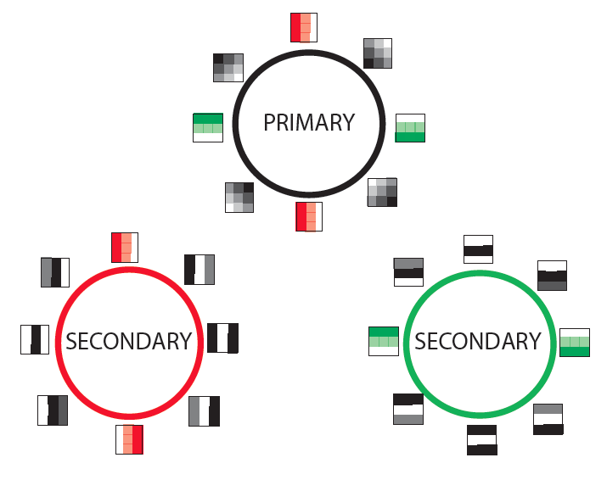

Slide 22
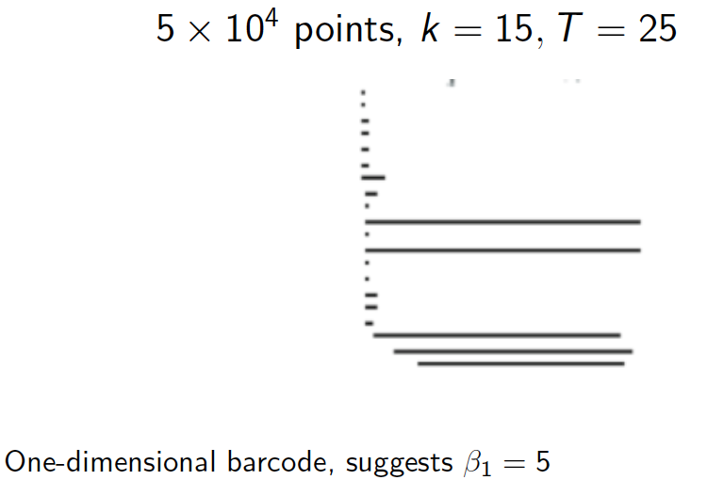

Slide 23
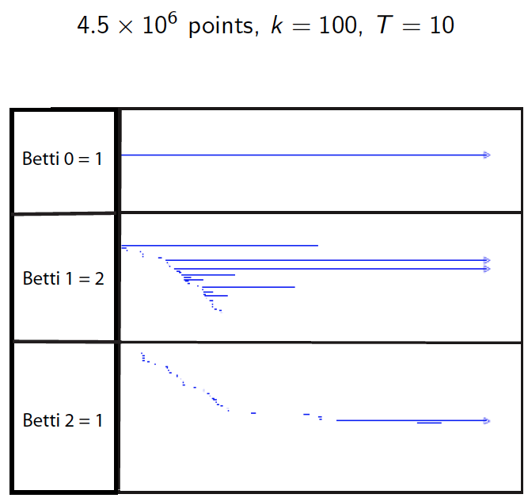

Slide 24
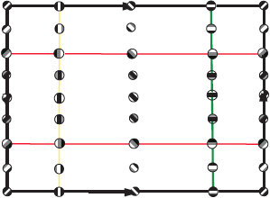

Slide 25
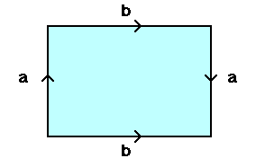
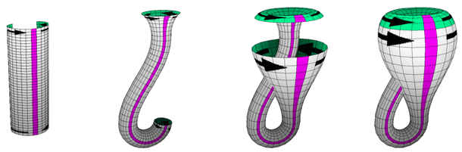
From: http://www.math.osu.edu/~fiedorowicz.1/math655/Klein2.html
Klein Bottle
From:
http://plus.maths.org/content/imaging-maths-inside-klein-bottle

Slide 26
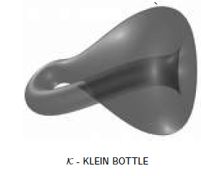
M(100, 10) U Q
where |Q| = 30
On the Local Behavior of Spaces of Natural Images, Gunnar Carlsson, Tigran Ishkhanov, Vin de Silva, Afra Zomorodian, International Journal of Computer Vision 2008, pp 1-12.

Slide 27
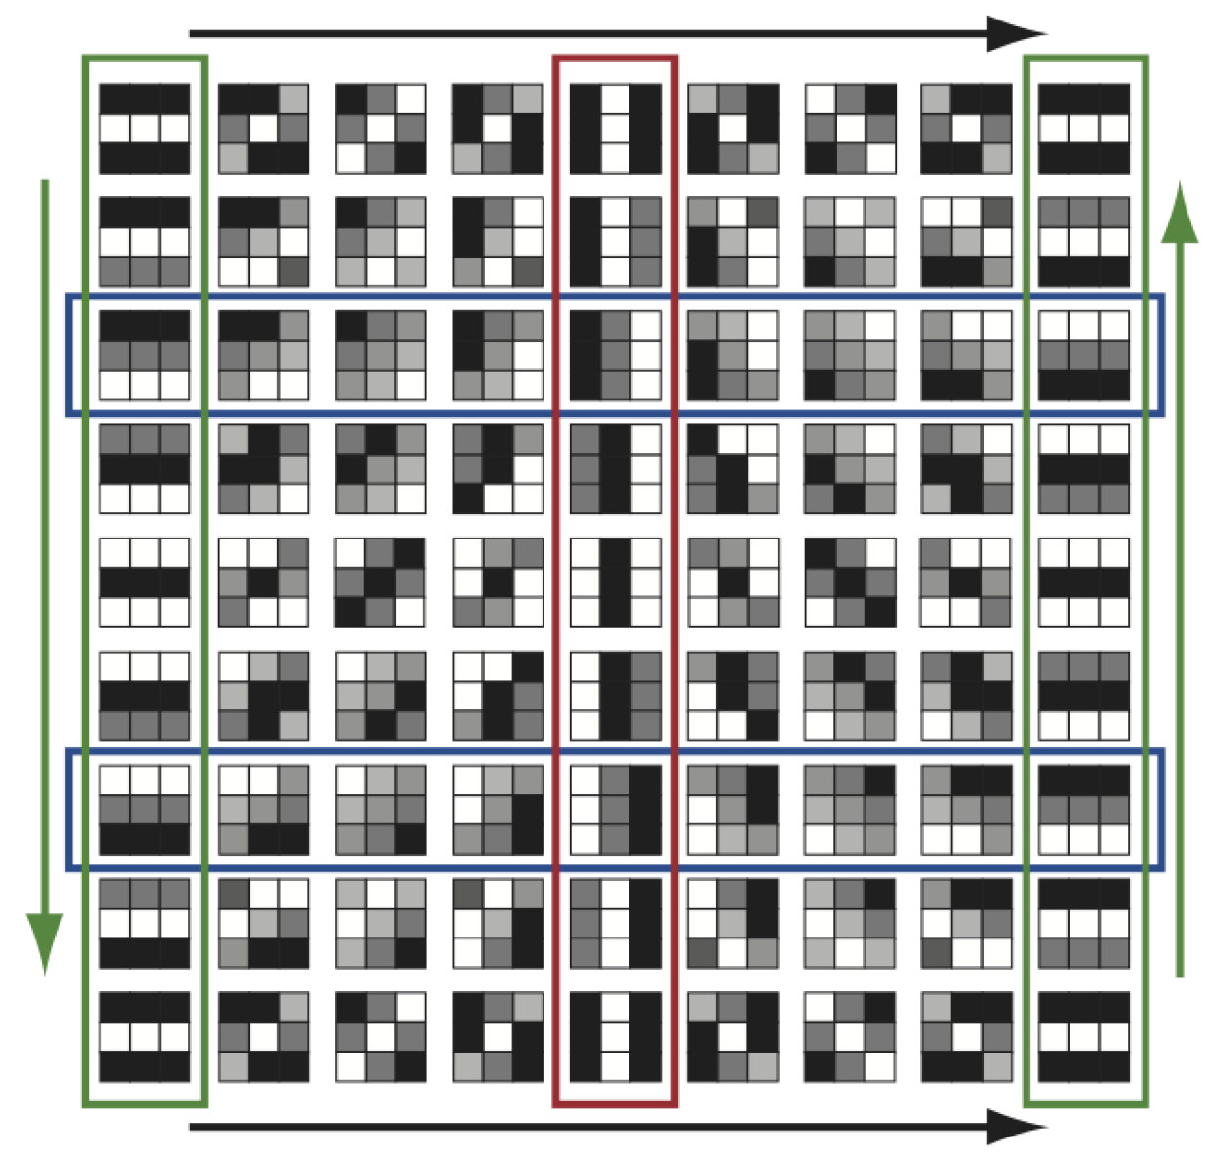
http://www.maths.ed.ac.uk/~aar/papers/ghristeat.pdf

Slide 28
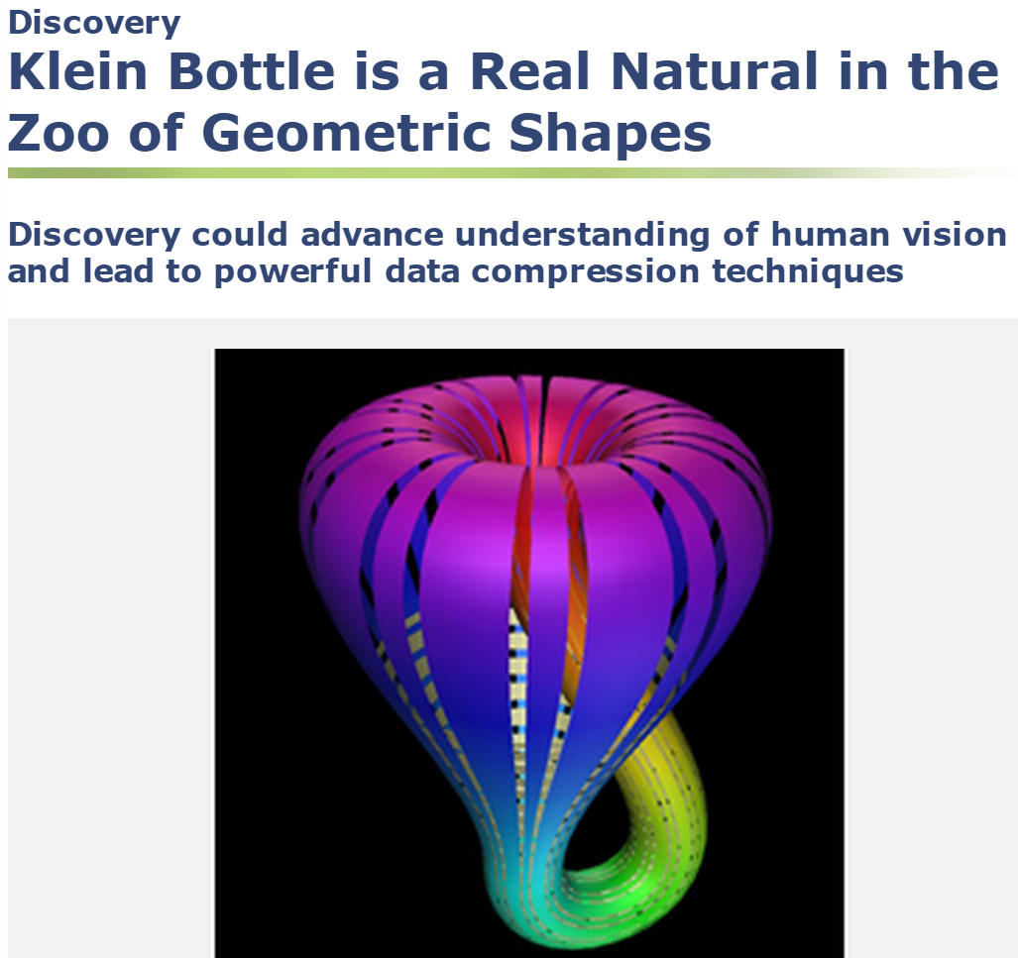
http://www.nsf.gov/discoveries/disc_summ.jsp?cntn_id=112392

Slide 29
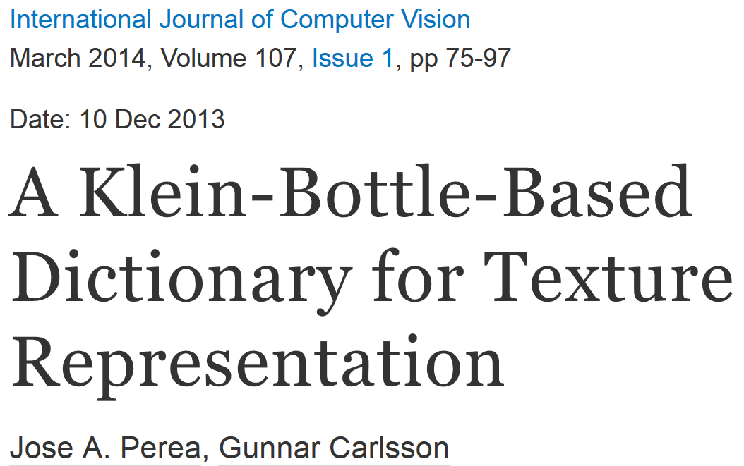
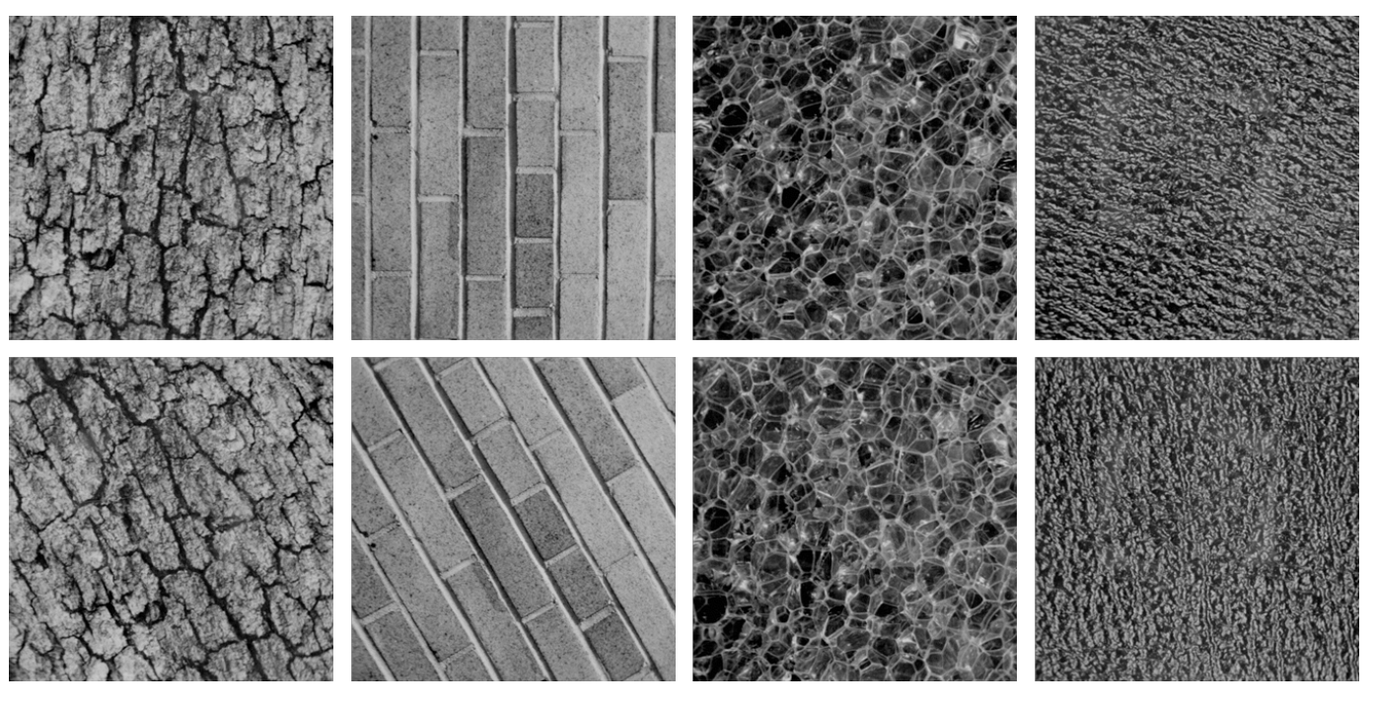
Combine your analysis with other tools

Slide 30
