Slide 1
Creating a simplicial complex
Step 0.) Start by adding 0-dimensional vertices
(0-simplices)
Notes:
Recall that to create a simplicial complex, we start by adding 0-simplices (ie 0-dimensional vertices). So our step zero will be to add 0-simplices, but in this case our 0-dimensional points will be

Slide 2

Creating a simplicial complex
1.) Adding 1-dimensional edges (1-simplices)
Add an edge between data points that are “close”
Notes:
So we can measure (or calculate) the distance between two points to determine if they are “close”. But we still need to define close.

Slide 3
Creating a simplicial complex
1.) Adding 1-dimensional edges (1-simplices)
Let T = Threshold
Connect vertices v and w with an edge iff
the distance between v and w is less than T
Notes:
Thus we will choose a threshold. We will connect a pair of vertices with an edge if and only if their distance is less then our chosen threshold.
But it is not always obvious how to choose the threshold. This problem can be dealt with by using persistence which we will briefly introduce later in this lecture. For now let’s somewhat arbitrarily choose a distance, say 1.8 cm.

Slide 4
Creating a simplicial complex
1.) Adding 1-dimensional edges (1-simplices)
Let T = Threshold =
Connect vertices v and w with an edge iff
the distance between v and w is less than T
Notes:
So we will connect every pair of vertices if their distance is less than 1.8 cm. If the center of these points represent the 0-dimensional vertices, then this distance is less than our threshold, so we add an edge. Similarly this pair of points satisfy our definition of close, so we add an edge
The distance between this pair of vertices is greater than 1.8, so we won’t connect them with an edge. Continuing to add edges between vertices whenever their distance is less than our threshold of 1.8cm, we now have

Slide 5
Creating a simplicial complex
1.) Adding 1-dimensional edges (1-simplices)
Add an edge between data points that are “close”
Note: we only need a definition of closeness between data points. The data points do not need to be actual points in R^{n}
Notes:
a one dimensional simplicial complex. Note that we have clustered our data into five disjoint connected sets. So this is one way to cluster our data – that is grouping our data points into disjoint sets based on some definition of similarity. In this case, we have 5 clusters.
We can now add higher dimensional simplices.

Slide 6
Creating the Vietoris Rips simplicial complex
2.) Add all possible simplices of dimensional > 1.
Notes:
Thus we now have the Vietoris Rips simplicial complex. Note we get the same simplex by adding one dimension at a time

Slide 7
Creating the Vietoris Rips simplicial complex
0.) Start by adding 0-dimensional data points
Use balls to measure distance (Threshold = diameter).
Two points are close if their corresponding balls intersect
Notes:
We start again by adding our 0-simplices, our data points. I can indicate the threshold using a ball centered at my data point. The diameter of the ball will be my threshold, so if two balls intersect then the distance between the vertices is less than the threshold, so we connect the pair of vertices with an edge if and only if the balls intersect, so we can get edges after which we can then add all possible higher dimensional simplices.
Note how I grew my balls. As the diameter increases, my threshold which is equal to my diameter increases.

Slide 8
Creating the Vietoris Rips simplicial complex
0.) Start by adding 0-dimensional data points
Use balls of varying radii to determine persistence of clusters.
H. Edelsbrunner, D. Letscher, and A. Zomorodian, Topological persistence and
simplication, Discrete and Computational Geometry 28, 2002, 511-533.
Notes:
We can compute the number of clusters for a variety of diameters.
We start with 17 data points, so if the diameter is 0, we have 17 clusters. Increasing the diameter, these 2 balls intersect so I now have 16 clusters.
If we continue to increase the diameter, we will eventually create the complex we saw before with 5 clusters, etc until we only have one cluster left.
Eventually this entire page will be purple, but right now, we know have one component.
To choose the threshold, one can determine how long a particular number of clusters lasts, for example for what set of radii do we have five clusters. If we have five clusters for the largest set of radii, then have gives us a good idea where to set the threshold and which simplicial complex best models our data.
I have put links to better animations on my on my YouTube site which may better illustrate this persistence concept. Next month, we will also talk much more about persistence during the live lectures for this course. This is just a preliminary introduction.

Slide 9
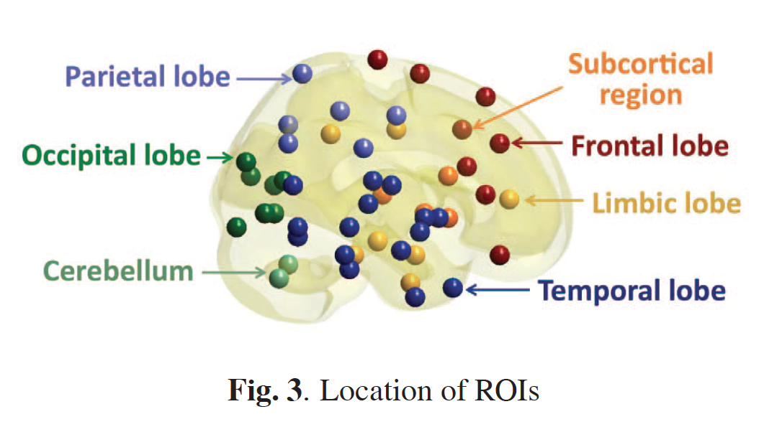
Discriminative persistent homology of brain networks, 2011 Hyekyoung Lee Chung, M.K.; Hyejin Kang; Bung-Nyun Kim;Dong Soo Lee
Constructing functional brain networks with 97 regions of interest (ROIs) extracted from FDG-PET data for
24 attention-deficit hyperactivity disorder (ADHD),
26 autism spectrum disorder (ASD) and
11 pediatric control (PedCon).
Data = measurement f_{j}
taken at region j
Graph: 97 vertices representing 97 regions of interest
edge exists between two vertices i,j if correlation
between f_{j} and f_{j} ≥ threshold
How to choose the threshold? Don’t, instead use persistent homology

Slide 10
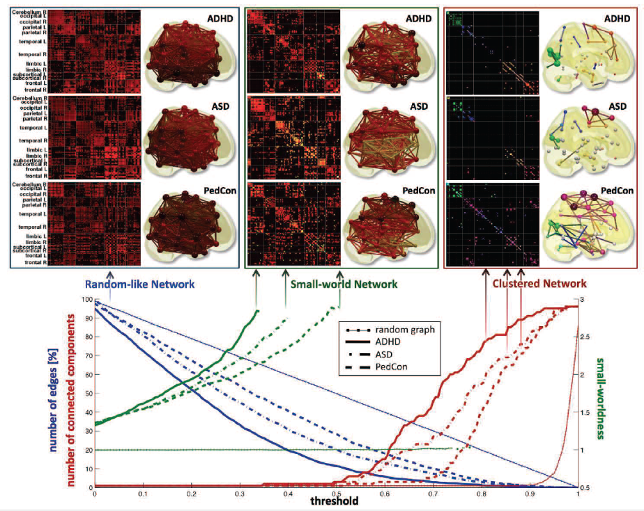

Slide 11
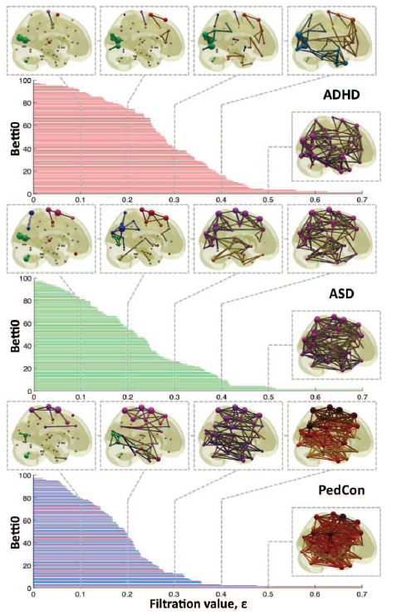

Vertices = Regions of Interest
Create Rips complex by growing epsilon balls (i.e. decreasing threshold) where distance between two vertices is given by
where f_{i} =
measurement at location i

Slide 12
0-simplex = vertex = v
1-simplex = oriented edge = (v_{j}, v_{k})
Note that the boundary of this edge is v_{k} – v_{j}
v_{j}
v_{k}
e
2-simplex = oriented face = (v_{i}, v_{j}, v_{k})
v₂
Note that the boundary of this face is the cycle
e₁ + e₂ + e₃
e₁
e₂
v₁
v₃
e₃
Notes:
A simplicial complex consists of vertices which are also called 0 simplices since they are 0 dimensional. When working over the integers. Ie if our coefficients are integers, we have oriented 1 dimensional edges which are also called 1 simplices. In the next lecture we will discuss using Z mod coefficients which will greatly simplify calculations. We will always use pictures or a symbol such as e to denote an edge. However, we could also use an ordered pair to denote an edge that points from vj to vk.
A face is a 2-simplex. Again we will use pictures or a symbol such as f to denote a 2-simplex, but one can also use an ordered triple where 2 triples are equivalent if one is an even permutation of the other, but we will not get into or need such details.
But ordered tuples can be useful when discussing higher dimensional simplices. For example a 3 simplex can be denoted (v1, v4). A 3 simplex is 3 dimensional so we can draw it, we get a tetrahedron. I can’t draw the 4-dimensional 4-simplex, but when working with high dimensional data, high dimensional simplices definitely exist.

