Slide 1
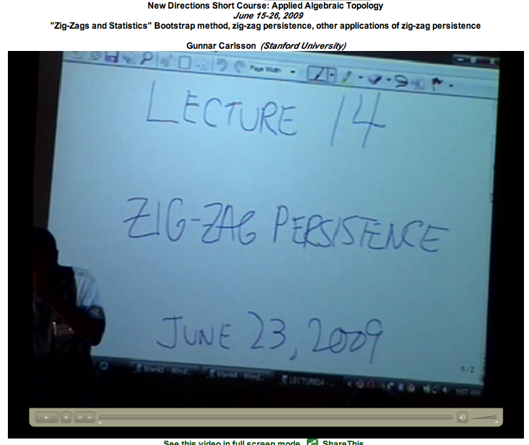
http://www.ima.umn.edu/videos/?id=863
http://www.ima.umn.edu/2008-2009/ND6.15-26.09/activities/Carlsson-Gunnar/lecture14.pdf

Slide 2

http://geometrica.saclay.inria.fr/workshops/TGDA_07_2009/workshop_files/slides/deSilva_TGDA.pdf

Slide 3
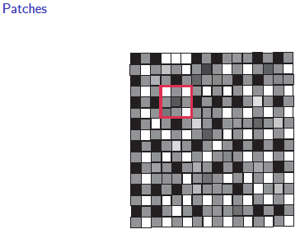
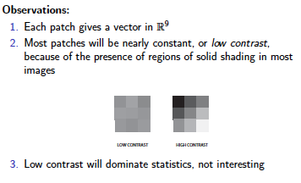
Lee-Mumford-Pedersen [LMP] study only high contrast patches.
Collection: 4.5 x 10⁶ high contrast patches from a
collection of images obtained by van Hateren and van der Schaaf
Recall from Sept 20 lecture

Slide 4
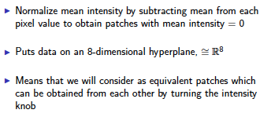
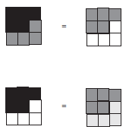


Slide 5
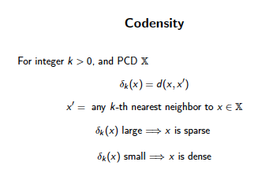
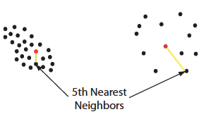


Slide 6
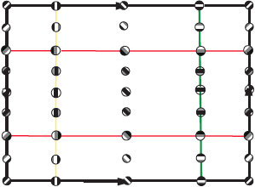
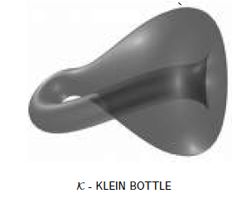
M(100, 10) U Q
where |Q| = 30
On the Local Behavior of Spaces of Natural Images, Gunnar Carlsson, Tigran Ishkhanov, Vin de Silva, Afra Zomorodian, International Journal of Computer Vision 2008, pp 1-12.

Slide 7
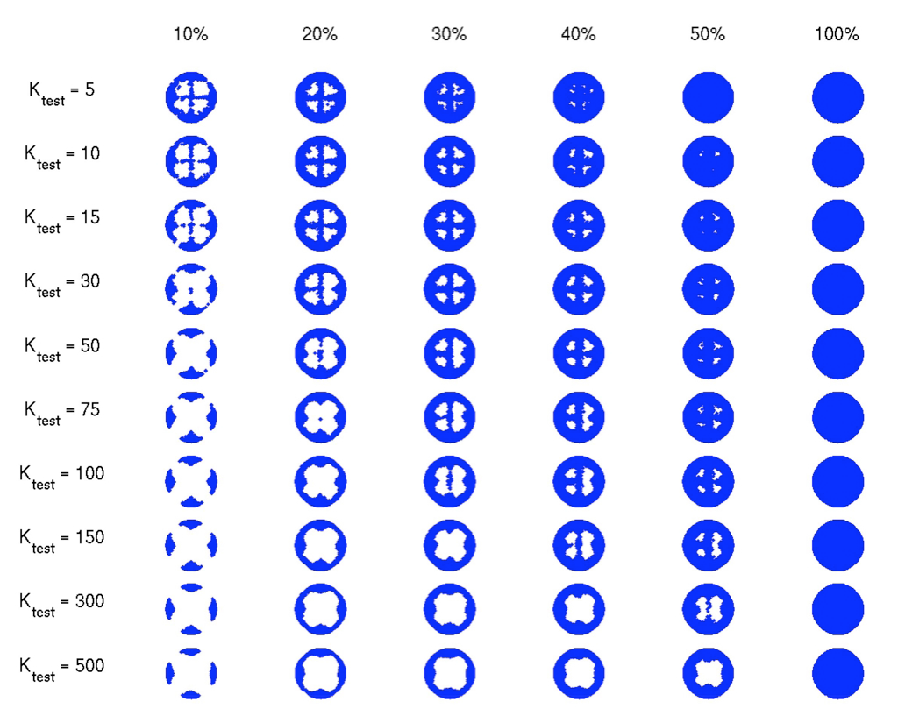

Slide 8
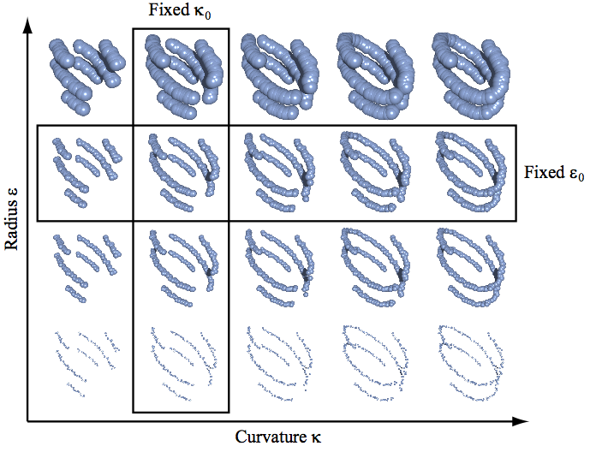
The Theory of Multidimensional Persistence, Gunnar Carlsson, Afra Zomorodian
"Persistence and Point Clouds" Functoriality, diagrams, difficulties in classifying diagrams,
multidimensional persistence, Gröbner bases, Gunnar Carlsson
http://www.ima.umn.edu/videos/?id=862

Slide 9
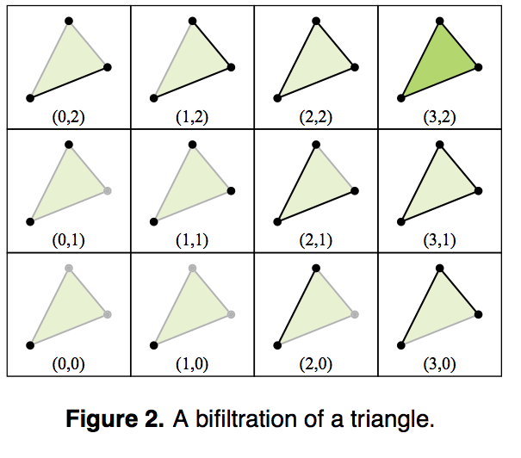

Slide 10
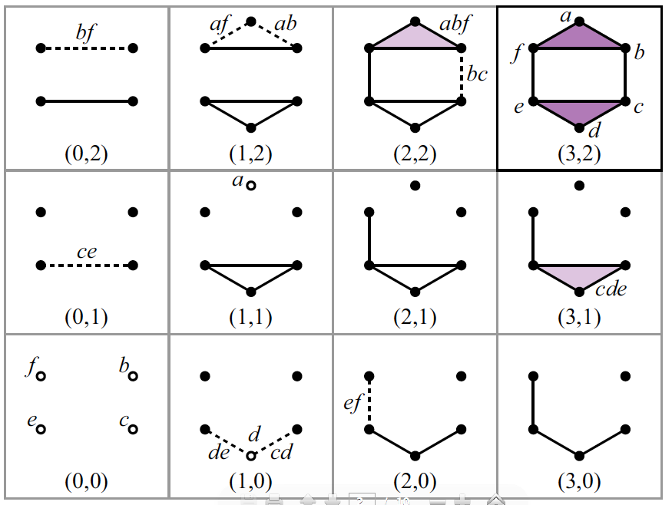

Slide 11
The Theory of Multidimensional Persistence, Gunnar Carlsson, Afra Zomorodian
"Persistence and Point Clouds" Functoriality, diagrams, difficulties in classifying diagrams,
multidimensional persistence, Gröbner bases, Gunnar Carlsson
http://www.ima.umn.edu/videos/?id=862

Slide 13
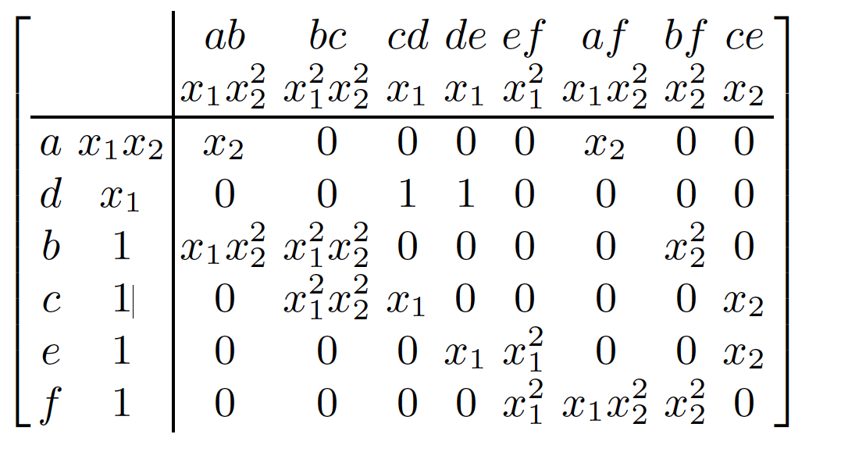
Computing Multidimensional Persistence,
Gunnar Carlsson, Gurjeet Singh, and Afra Zomorodian

Slide 14
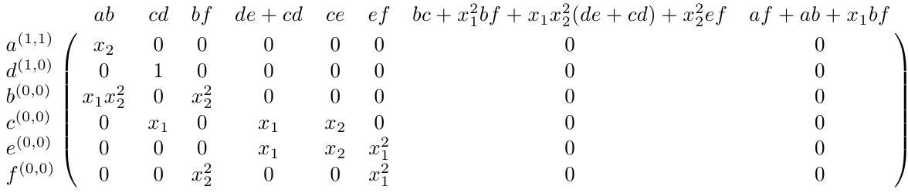

Slide 18
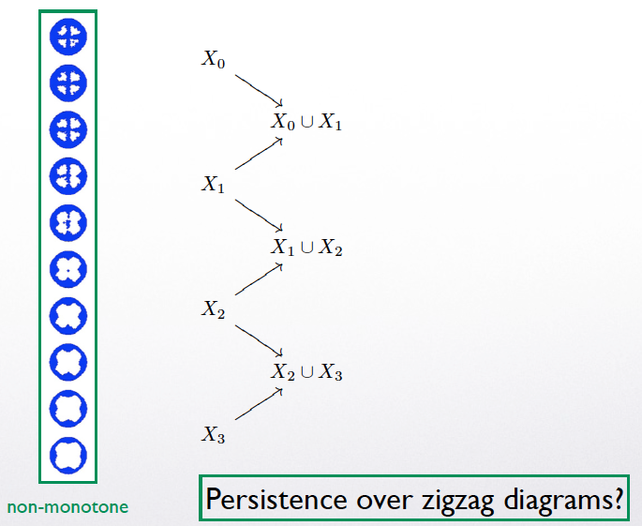

Slide 19
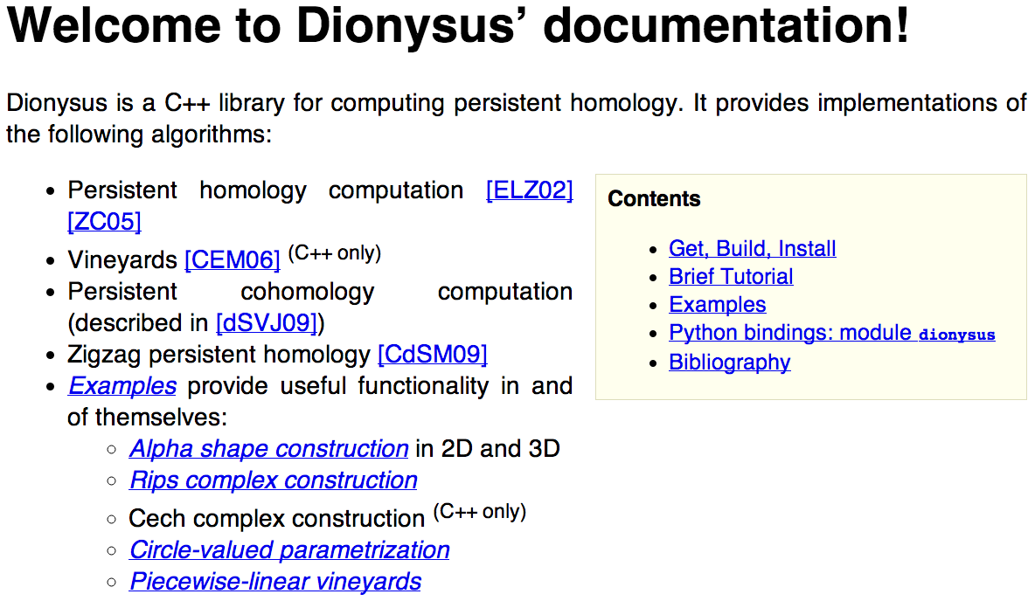
http://www.mrzv.org/software/dionysus/

Slide 20
Time varying data
X[t₀, t₁] = data points existing at time t for t in [t₀, t₁]
X[t₁, t₂] X[t₂, t₃]
X[t₀, t₂] X[t₁, t₃] X[t₂, t₄]

Slide 21
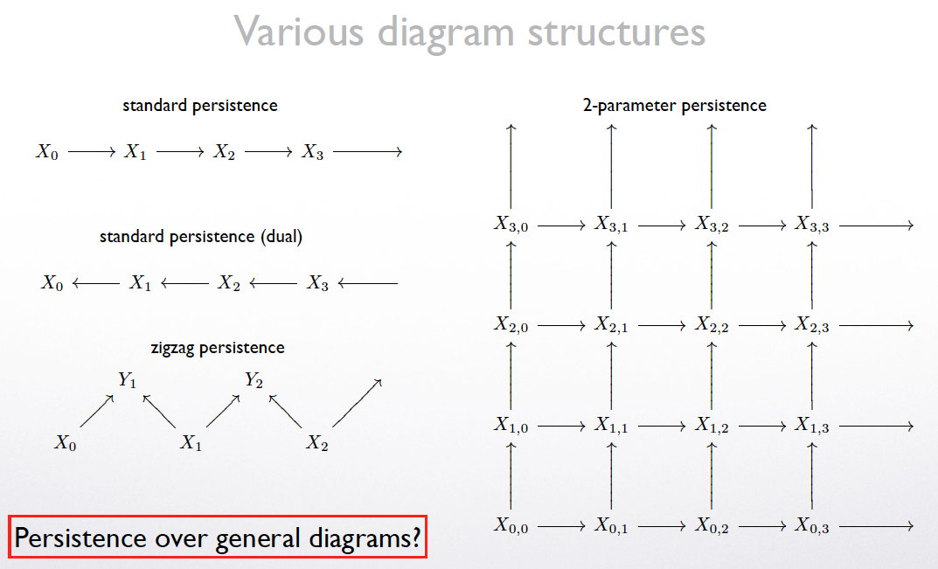

Slide 22
Time varying data
X[t₀, t₁] = data points existing at time t for t in [t₀, t₁]
X[t₁, t₂] X[t₂, t₃]
X[t₀, t₂] X[t₁, t₃] X[t₂, t₄]
VR(X[t₁, t₂], ε) VR(X[t₂, t₃], ε)
VR(X[t₀, t₂], ε) VR(X[t₁, t₃], ε) VR(X[t₂, t₄], ε)

Slide 23
Time varying data
X[t₀, t₁] = data points existing at time t for t in [t₀, t₁]
X[t₁, t₂] X[t₂, t₃]
X[t₀, t₂] X[t₁, t₃] X[t₂, t₄]
VR(X[t₁, t₂], ε) VR(X[t₂, t₃], ε)
VR(X[t₀, t₂], ε) VR(X[t₁, t₃], ε) VR(X[t₂, t₄], ε)
C⁰ ⬅ C¹ ➔ C² ⬅ C³ ➔ C⁴

Slide 24
C¹ C³
C⁰ C² C⁴
H¹ H³
H⁰ H² H⁴

Slide 25
Persistent Homology:
C⁰ ➔ C¹ ➔ C² ➔ C³ ➔ C⁴
H⁰ ➔ H¹ ➔ H² ➔ H³ ➔ H⁴
H_{k}^{i, p} = Z_{k}^{i} /(B_{k}^{i+p} Z_{k}^{i}) = L(i, i+p)( H_{k}^{i})
U
Zigzag Homology:
C⁰ ⬅ C¹ ➔ C² ⬅ C³ ➔ C⁴
H⁰ ⬅ H¹ ➔ H² ⬅ H³ ➔ H⁴

