Slide 1
http://www.plosone.org/article/info%3Adoi%2F10.1371%2Fjournal.pone.0002856
2008
And section 9.1 in Computational Topology: An Introduction By Herbert Edelsbrunner, John Harer

Slide 2
Goal: To determine what genes are involved in a particular periodic pathway
Application: segmentation clock of mouse embryo.
1 somite develops about every 2 hours
What genes are involved in somite development?

Slide 3
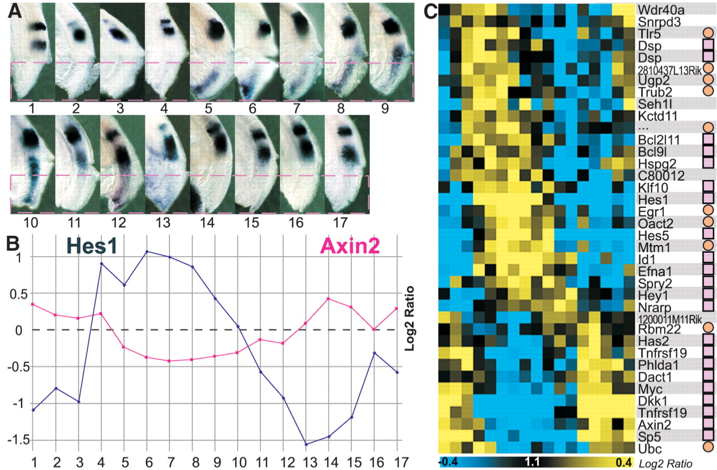
Fig. 2. Identification of cyclic genes based on the PSM microarray time series.
M Dequéant et al. Science 2006;314:1595-1598
Published by AAAS
Notes:
Identification of cyclic genes based on the PSM microarray time series. (A) Left side of the 17 mouse embryos, whose right posterior PSMs (below red hatched line) were dissected for microarray analysis. Embryos were ordered along one segmentation clock cycle according to the position of Lfng stripes in their left PSM as revealed by in situ hybridization (fig. S1). (B) Log₂ ratios of the expression levels of the Hes1 (blue) and Axin2 (red) cyclic genes in each microarray of the time series. (C) Phaseogram of the cyclic genes identified by microarray and L-S analysis. Blue, decrease in gene expression; yellow, increase in gene expression; pink squares, genes validated by in situ hybridization; and orange circles, nonvalidated genes, that is, not evidently cyclical as detected by in situ hybridization.

Slide 4
Not period 2:

Slide 5
Persistence:
For each of 7549 genes, create
f_{k}: S¹ → R, k = 1, …, 7549
f_{k} (time point i) = amount of RNA at time point i for
gene k

Slide 6
17 time points → 17 equally space time points
microarry expression of gene k at time i → ranked
order of microarry expression of gene k at time i
(0.41, 0.63, 0.11, 0.23, 0.59, …) → (3, 5, 1, 2, 4, …).
f_{k} (time point i) = RNA intensity at time point i for
gene k.
π(f_{k}) = replace RNA intensity with rank order.
g(x_{i}) =[ π(f_{k})(x_{i}) – 1] / (17 – 1), for i = 1, …, 17.
g(x) obtained by linear interpolation for x ≠ x_{i} for some i. Note: 0 ≤ g(x) ≤ 1

Slide 7
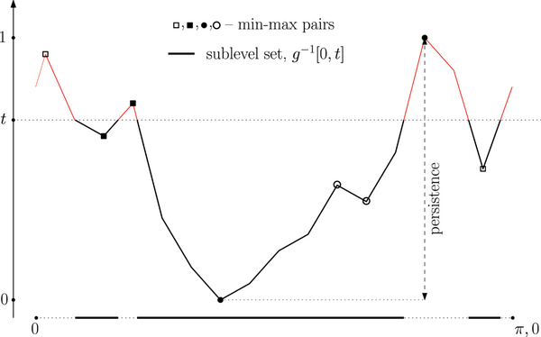
Figure 8. Function g(x) for the expression pattern of Axin2.
g: S¹ → R
( 0, )
( 14, )
( 15, )
( 3, )
( 13, )
( 1, )
( 2, )
( 12, )
( 10, )
( 16, )
( 4, )
( 11, )
( 8, )
( 9, )
( 5, )
( 7, )
( 6, 0 )
Dequéant M-L, Ahnert S, Edelsbrunner H, Fink TMA, et al. (2008) Comparison of Pattern Detection Methods in Microarray Time Series of the Segmentation Clock. PLoS ONE 3(8): e2856. doi:10.1371/journal.pone.0002856
http://www.plosone.org/article/info:doi/10.1371/journal.pone.0002856

Slide 9
Not period 2 implies Φ^{q}(f) large.

Slide 10
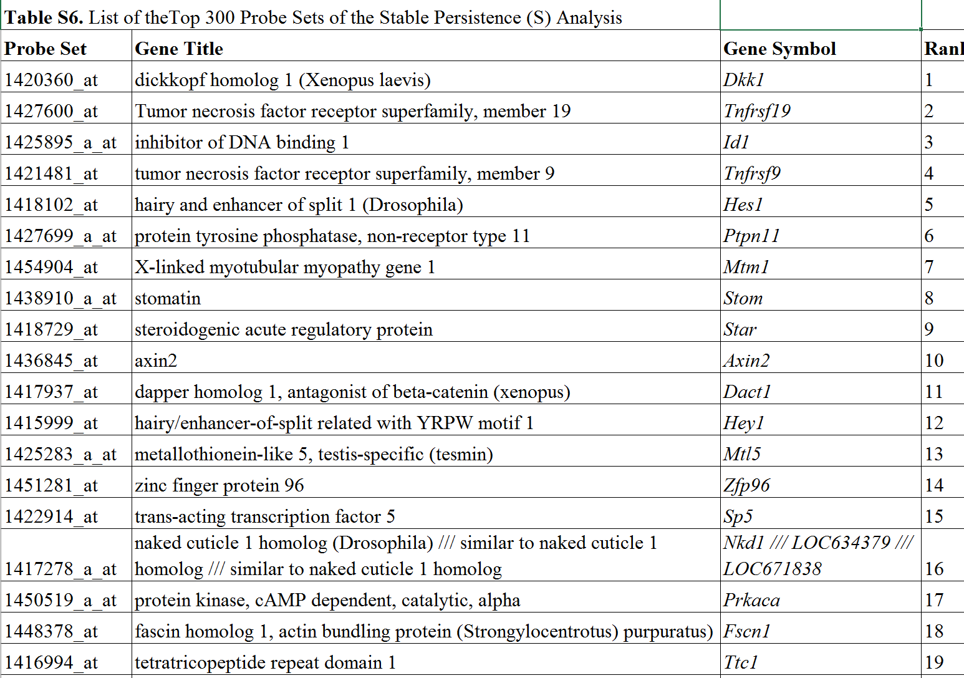
http://journals.plos.org/plosone/article?id=10.1371/journal.pone.0002856

Slide 11
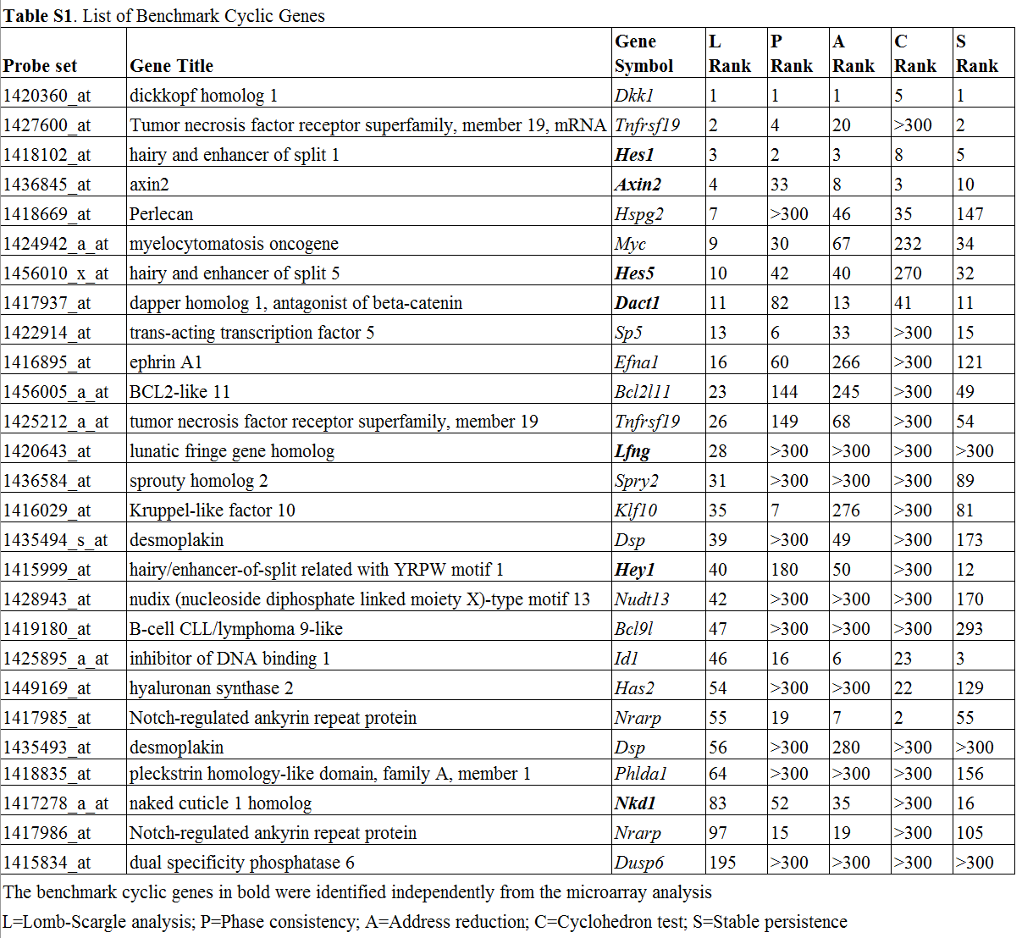
http://journals.plos.org/plosone/article?id=10.1371/journal.pone.0002856
L=Lomb-Scargle analysis;
P=Phase consistencyA=Address reduction; C= Cyclo-hedron test;
S=Stable persistence
The benchmark cyclic genes in bold were identified independ-ently from the microarray analysis

Slide 12
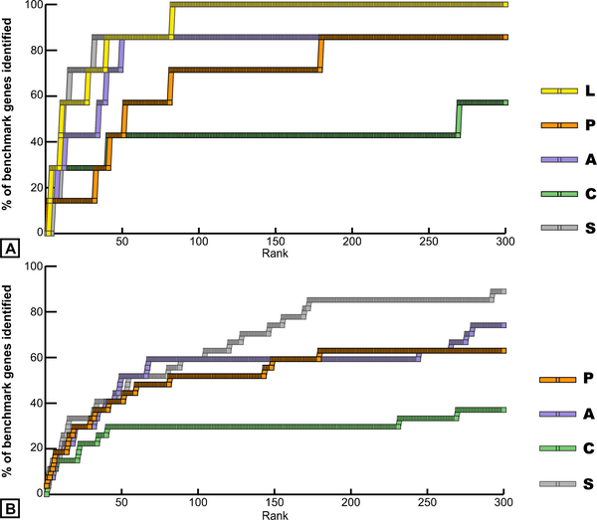
Figure 1. Identification of benchmark cyclic genes in the top 300 probe set lists of the five methods.
Dequéant M-L, Ahnert S, Edelsbrunner H, Fink TMA, et al. (2008) Comparison of Pattern Detection Methods in Microarray Time Series of the Segmentation Clock. PLoS ONE 3(8): e2856. doi:10.1371/journal.pone.0002856
http://www.plosone.org/article/info:doi/10.1371/journal.pone.0002856

Slide 13
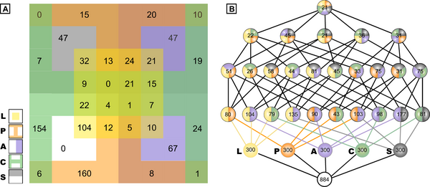
Figure 2. Comparison of the intersection of the top 300 ranked probe sets from the five methods.
Dequéant M-L, Ahnert S, Edelsbrunner H, Fink TMA, et al. (2008) Comparison of Pattern Detection Methods in Microarray Time Series of the Segmentation Clock. PLoS ONE 3(8): e2856. doi:10.1371/journal.pone.0002856
http://www.plosone.org/article/info:doi/10.1371/journal.pone.0002856

Slide 14
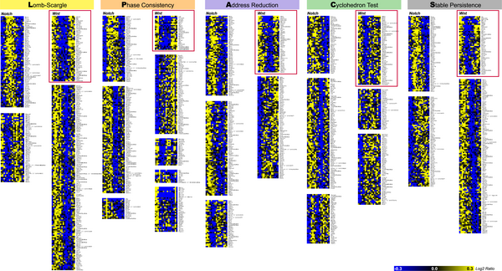
Figure 3. Clustering analysis of the top 300 ranked probe sets from the five methods.
Dequéant ML, Ahnert S, Edelsbrunner H, Fink TMA, Glynn EF, et al. (2008) Comparison of Pattern Detection Methods in Microarray Time Series of the Segmentation Clock. PLoS ONE 3(8): e2856. doi:10.1371/journal.pone.0002856
http://127.0.0.1:8081/plosone/article?id=info:doi/10.1371/journal.pone.0002856

Slide 15
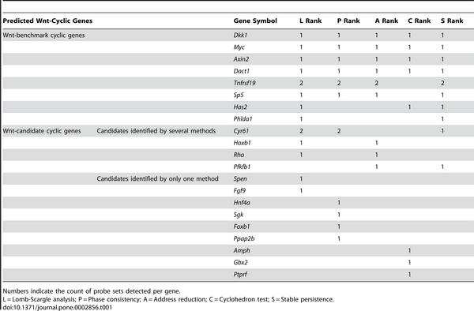
Table 1. Composition of the Wnt Clusters of the Five Methods.
Dequéant ML, Ahnert S, Edelsbrunner H, Fink TMA, Glynn EF, et al. (2008) Comparison of Pattern Detection Methods in Microarray Time Series of the Segmentation Clock. PLoS ONE 3(8): e2856. doi:10.1371/journal.pone.0002856
http://127.0.0.1:8081/plosone/article?id=info:doi/10.1371/journal.pone.0002856

Slide 16
Persistent homology results are stable:
Add noise to data does not change barcodes significantly.

Slide 17
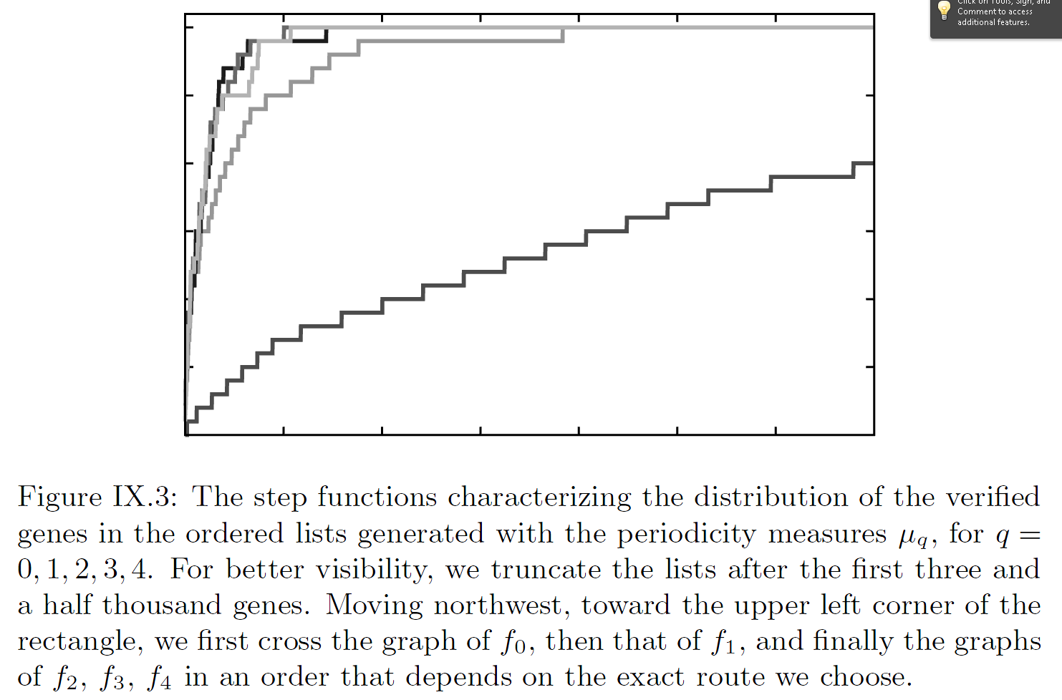
http://www.ams.org/publications/authors/books/postpub/mbk-69

Slide 18
Persistent homology results are stable:
Add noise to data does not change barcodes significantly.
Figure 8. Function g(x) for the expression pattern of Axin2.
Dequéant M-L, Ahnert S, Edelsbrunner H, Fink TMA, et al. (2008) Comparison of Pattern Detection Methods in Microarray Time Series of the Segmentation Clock. PLoS ONE 3(8): e2856. doi:10.1371/journal.pone.0002856
http://www.plosone.org/article/info:doi/10.1371/journal.pone.0002856

Slide 19
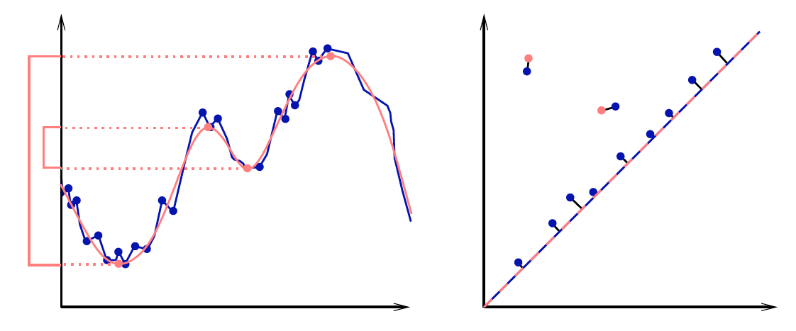
|| (x₁,…,x_{n}) – (y₁,…,y_{n}) ||∞ = max{|x₁ – y₁|,…,|x_{n} - y_{n}|}
Given sets X, Y and bijection g: X → Y,
Bottleneck Distance: d_{B}(X, Y) = inf sup || x – g(x) ||∞
g x

Slide 20
(Wasserstein distance). The p-th Wasserstein distance between two persistence diagrams,
d₁ and d₂, is defined as
where γ ranges over all bijections from d₁ to d₂.
Probability measures on the space of persistence
diagrams
Yuriy Mileyko1, Sayan Mukherjee2 and John Harer1

Slide 21
Persistent homology results are stable:
Add noise to data does not change barcodes significantly.

Slide 22
TDA is a form of Exploratory Data Analysis (EDA)
https://onlinecourses.science.psu.edu/stat857/node/4
Exploratory Data Analysis (EDA) is described as data-driven hypothesis generation.
http://en.wikipedia.org/wiki/Exploratory_data_analysis
In statistics, exploratory data analysis (EDA) is an approach to analyzing data sets to summarize their main characteristics, often with visual methods. A statistical model can be used or not, but primarily EDA is for seeing what the data can tell us beyond the formal modeling or hypothesis testing task.
Exploratory data analysis was promoted by John Tukey starting in the 1960’s.

Slide 23
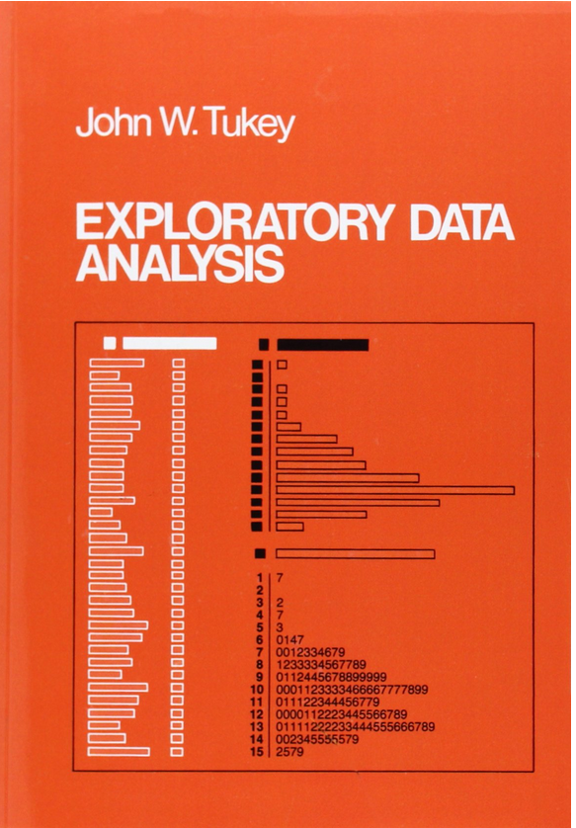
http://www.jstor.org/discover/10.2307/2392291?uid=3739256&uid=2&uid=4&sid=21106098896651
Exploratory Data Analysis
John W. Tukey, Princeton University
ISBN-10: 0201076160
ISBN-13: 9780201076165
©1977 • Pearson • Paper, 688 pp
Published 01/01/1977 • Instock

Slide 24
http://www.uta.edu/faculty/sawasthi/Statistics/stdatmin.html#eda1
EDA vs. Hypothesis Testing
As opposed to traditional hypothesis testing designed to verify a priori hypotheses about relations between variables (e.g., "There is a positive correlation between the AGE of a person and his/her RISK TAKING disposition"), exploratory data analysis (EDA) is used to identify systematic relations between variables when there are no (or not complete) a priori expectations as to the nature of those relations. In a typical exploratory data analysis process, many variables are taken into account and compared, using a variety of techniques in the search for systematic patterns.

Slide 25
http://www.uta.edu/faculty/sawasthi/Statistics/stdatmin.html#eda1
EDA vs. Hypothesis Testing
Hypothesis testing: verify a priori hypotheses
Exploratory data analysis (EDA): No (or not complete) a priori
expectations as to the nature of those relations.

Slide 26
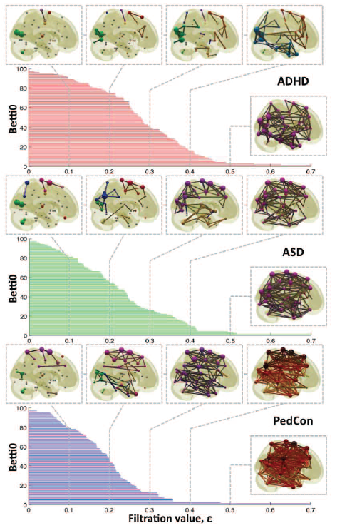
For H₀, can observe how fast connections form, possibly noting concavity
Vertices = Regions of Interest
Create Rips complex by growing epsilon balls (i.e. decreasing threshold) where distance between two vertices is given by
where f_{i} =
measurement at location i
http://ieeexplore.ieee.org/xpls/icp.jsp?arnumber=5872535

Slide 27
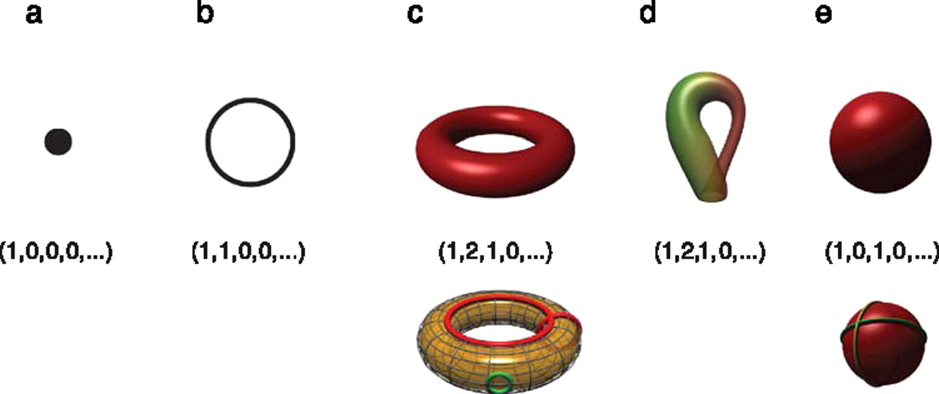
Betti numbers provide a signature of the underlying topology.
Use (β₀, β₁, β₂, …) for classification, where β_{i} = rank of H_{i}
Singh G et al. J Vis 2008;8:11
©2008 by Association for Research in Vision and Ophthalmology
Notes:
Betti numbers provide a signature of the underlying topology. Illustrated in the figure are five simple objects (topological spaces) together with their Betti number signatures: (a) a point, (b) a circle, (c) a hollow torus, (d) a Klein bottle, and (e) a hollow sphere. For the case of the torus (c), the figure shows three loops on its surface. The red loops are “essential” in that they cannot be shrunk to a point, nor can they be deformed one into the other without tearing the loop. The green loop, on the other hand, can be deformed to a point without any obstruction. For the torus, therefore, we have b 1 = 2. For the case of the sphere, the loops shown (and actually all loops on the sphere) can be contracted to points, which is reflected by the fact that b 1 = 0. Both the sphere and the torus have b 2 = 1, this is due to the fact both surfaces enclose a part of space (a void).

Slide 28
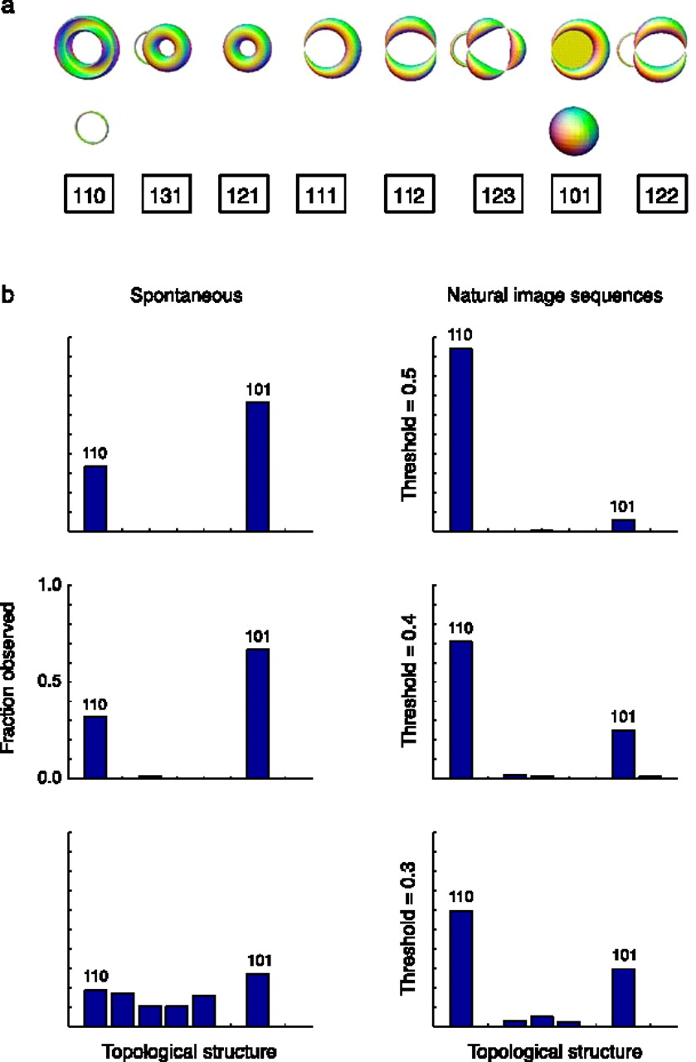
Estimation of topological structure in driven and spontaneous conditions.
Record voltages at points in time at each electrode.
Spike train: lists of firing times for a neuron
obtained via spike sorting –i.e. signal processing.
Data = an array of N spike trains.
Compared spontaneous (eyes occluded) to evoked (via movie clips).
10 second segments broken into 50 ms bins
Transistion between states about 80ms
The 5 neurons with the highest firing rate in each ten second window were chosen
For each bin, create a vector in R⁵ corresponding to the number of firings of each of the 5 neurons.
200 bins = 200 data points in R⁵.
Used 35 landmark points.
20-30minutes of data = many data sets
Control: shuffled data 52700 times.
Singh G et al. J Vis 2008;8:11
©2008 by Association for Research in Vision and Ophthalmology
Notes:
Estimation of topological structure in driven and spontaneous conditions. (a) Ordering of topological signatures observed in our experiments. Each triplet ( b 0, b 1, b 2) is shown along an illustration of objects consistent with these signature. (b) Distribution of topological signatures in the spontaneous and natural image stimulation conditions pooled across the three experiments performed. Each row correspond to signatures with a minimum interval length (denoted as the threshold) expressed as a fraction of the covering radius of the data cloud (see Appendix A for the definition of the covering radius).

Slide 29
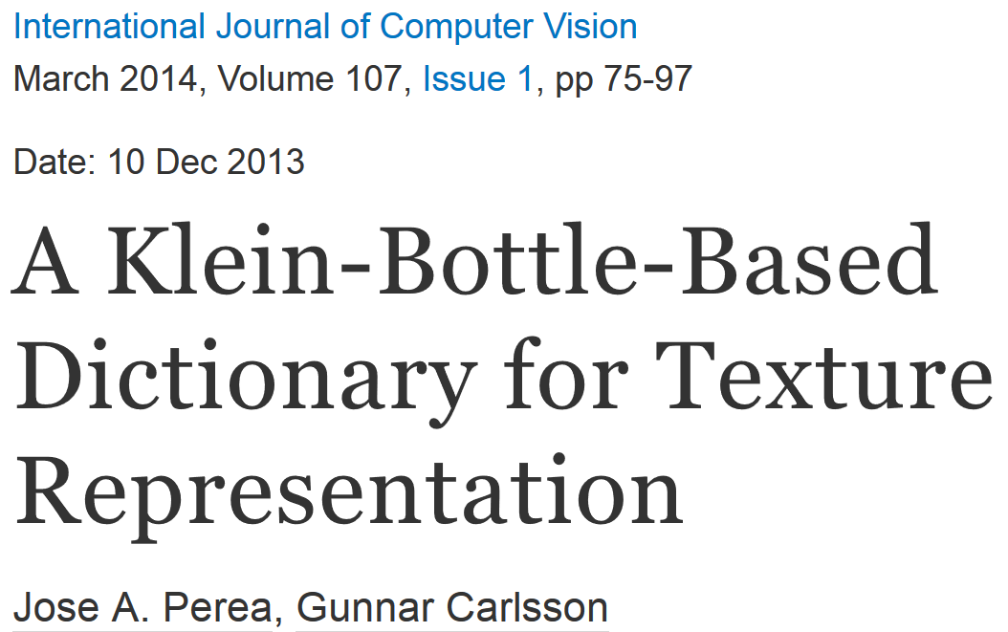
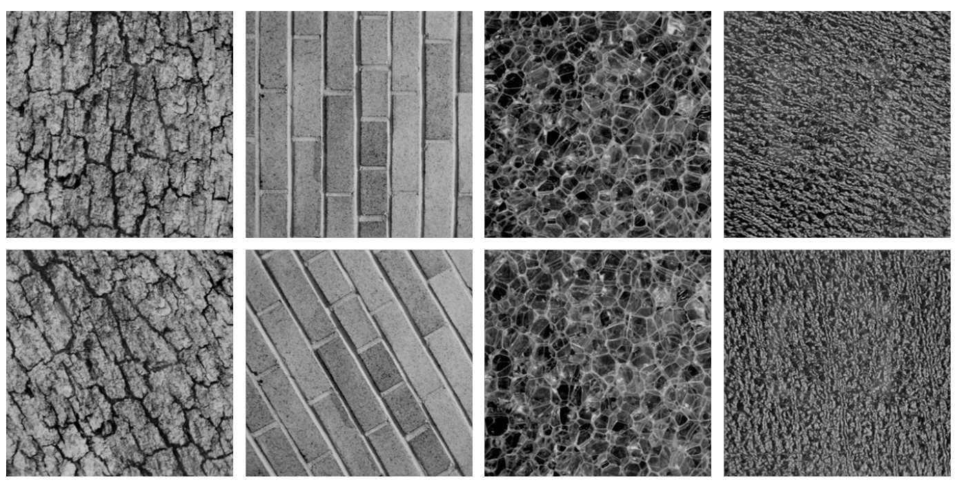
Combine your analysis with other tools

Slide 30
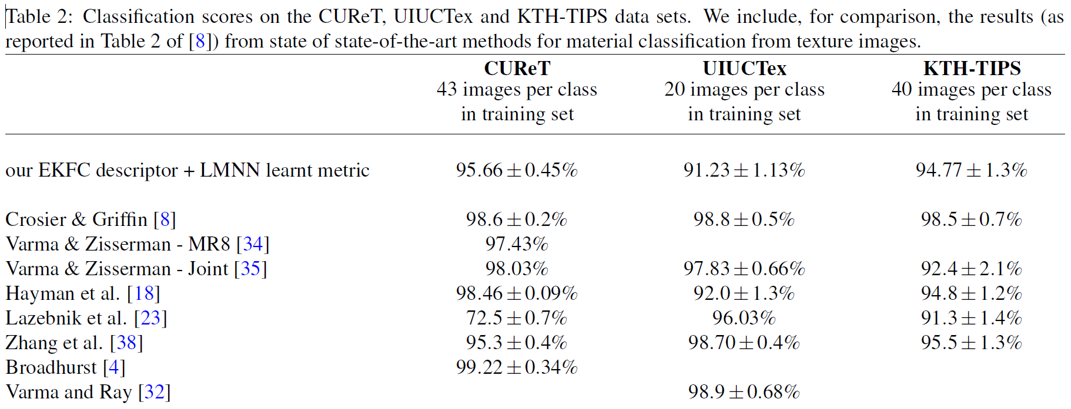

Slide 31
http://en.wikipedia.org/wiki/Machine_learning
Machine learning is a scientific discipline that explores the construction and study of algorithms that can learn from data.[1] Such algorithms operate by building a model from example inputs and using that to make predictions or decisions,[2]:2 rather than following strictly static program instructions.
https://www.cs.princeton.edu/courses/archive/spring08/cos511/scribe_notes/0204.pdf
Machine learning studies computer algorithms for learning to do stuff.
The emphasis of machine learning is on automatic methods. In other words, the goal is to devise learning algorithms that do the learning automatically without human intervention or assistance.

Slide 32
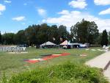
Image Categorization
Training
Training Labels
Training Images
Image Features
Classifier Training
Trained Classifier
Testing
Image Features
Trained Classifier
Prediction
Outdoor
Test Image
http://cs.brown.edu/courses/cs143/lectures/15.ppt

Slide 33
cs.brown.edu/courses/cs143/lectures/17.ppt

Slide 35
https://www.python.org/
Download newer 3.4.3 or older 2.7.9 version

Slide 36
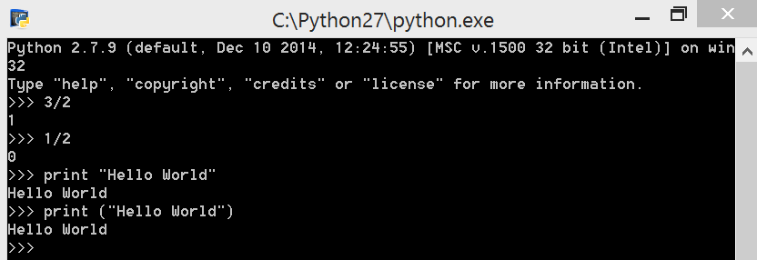
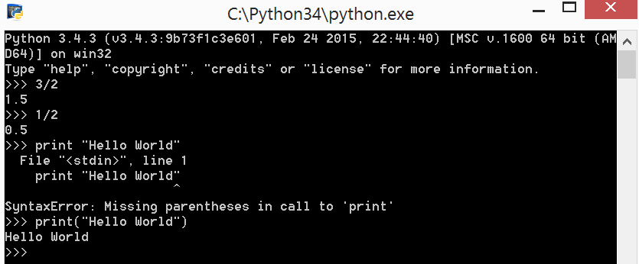

Slide 37
https://www.python.org/
Download newer 3.4.3 or older 2.7.9 version

Slide 38
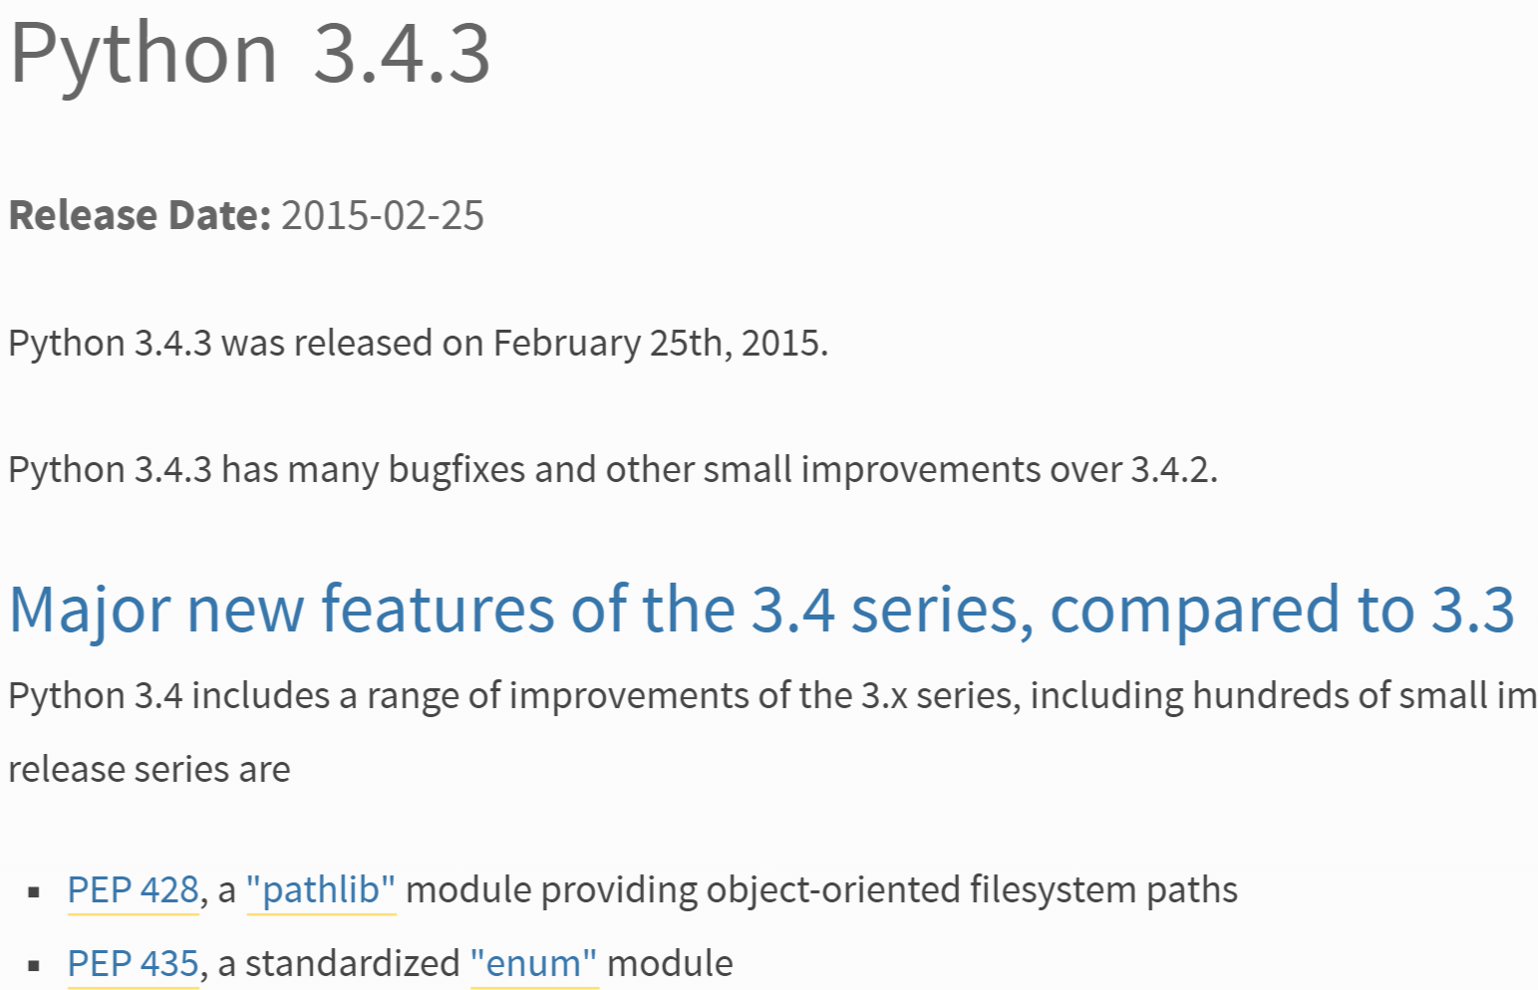
https://www.python.org/downloads/release/python-343/

Slide 39
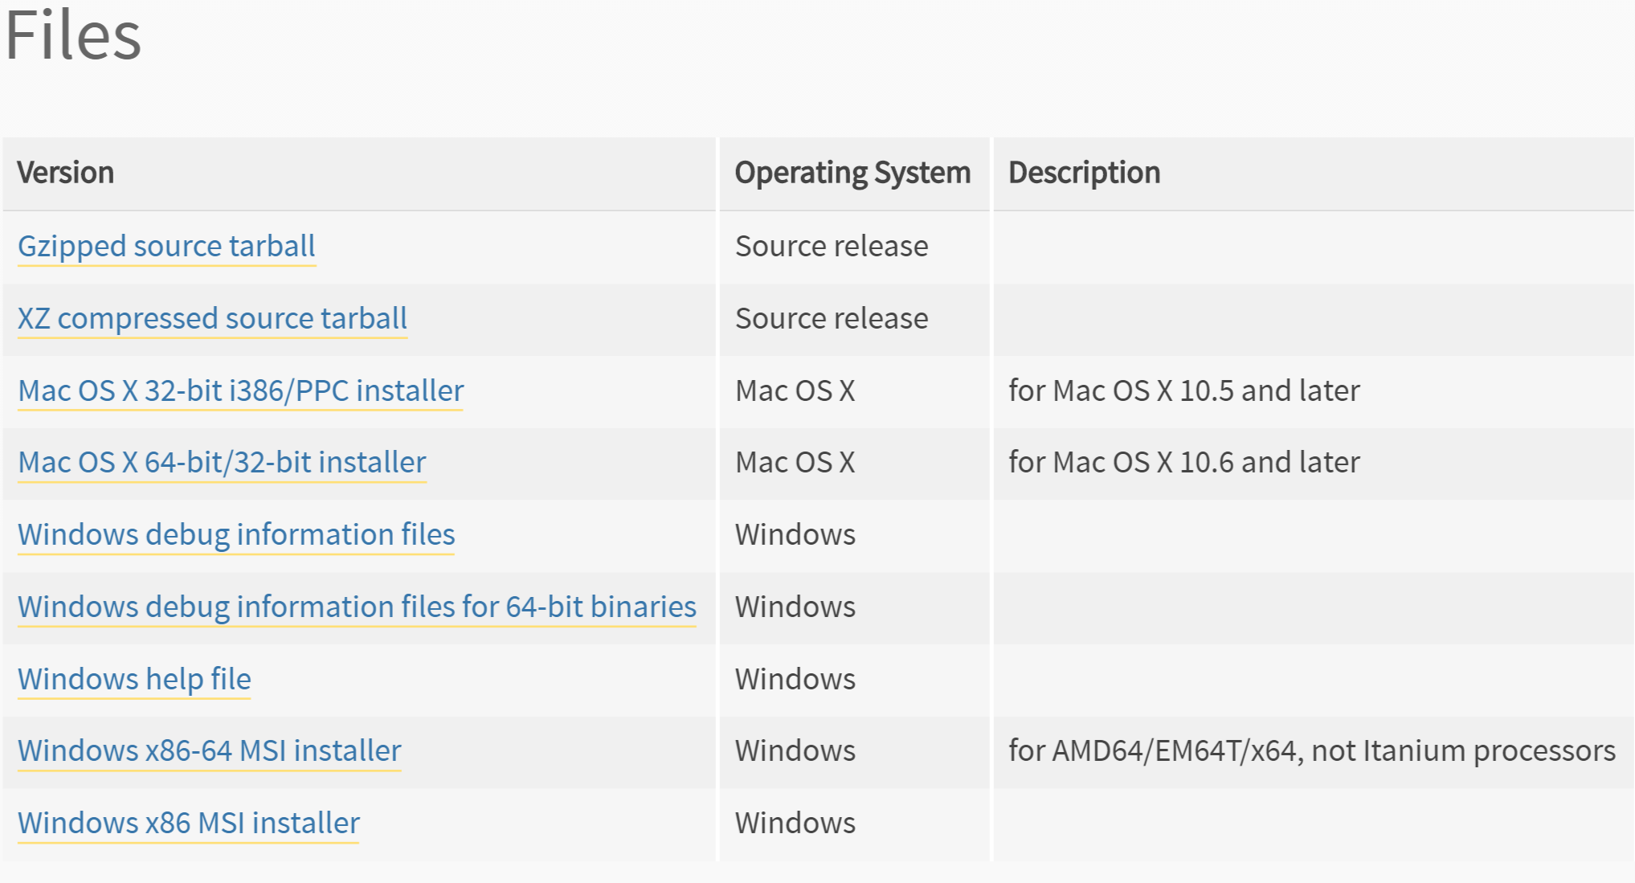
https://www.python.org/downloads/release/python-343/
Bottom of webpage:

Slide 40
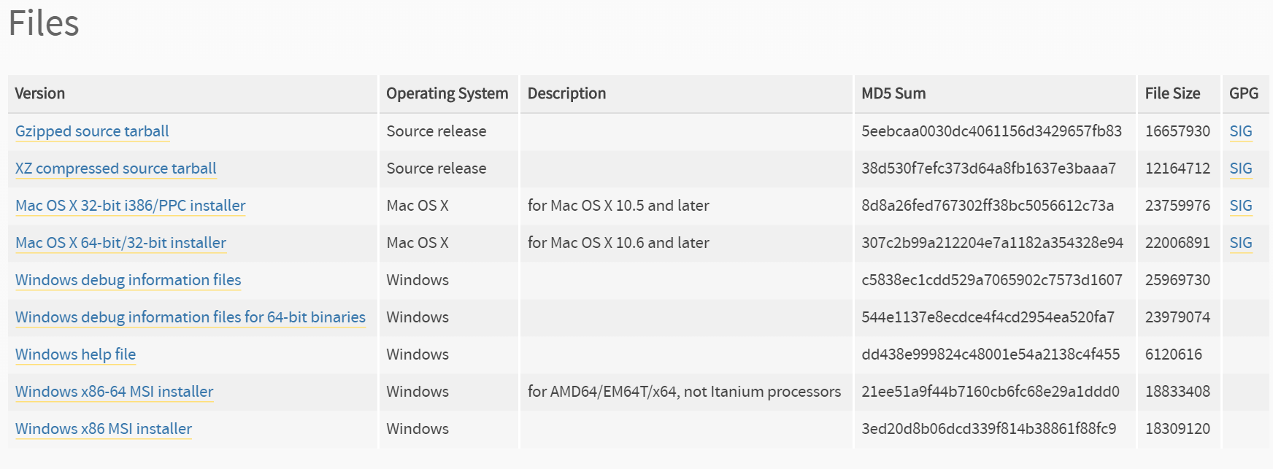
https://www.python.org/downloads/release/python-279/
Bottom of webpage:

Slide 41
https://www.python.org/

Slide 42
https://www.python.org/about/gettingstarted/

Slide 43
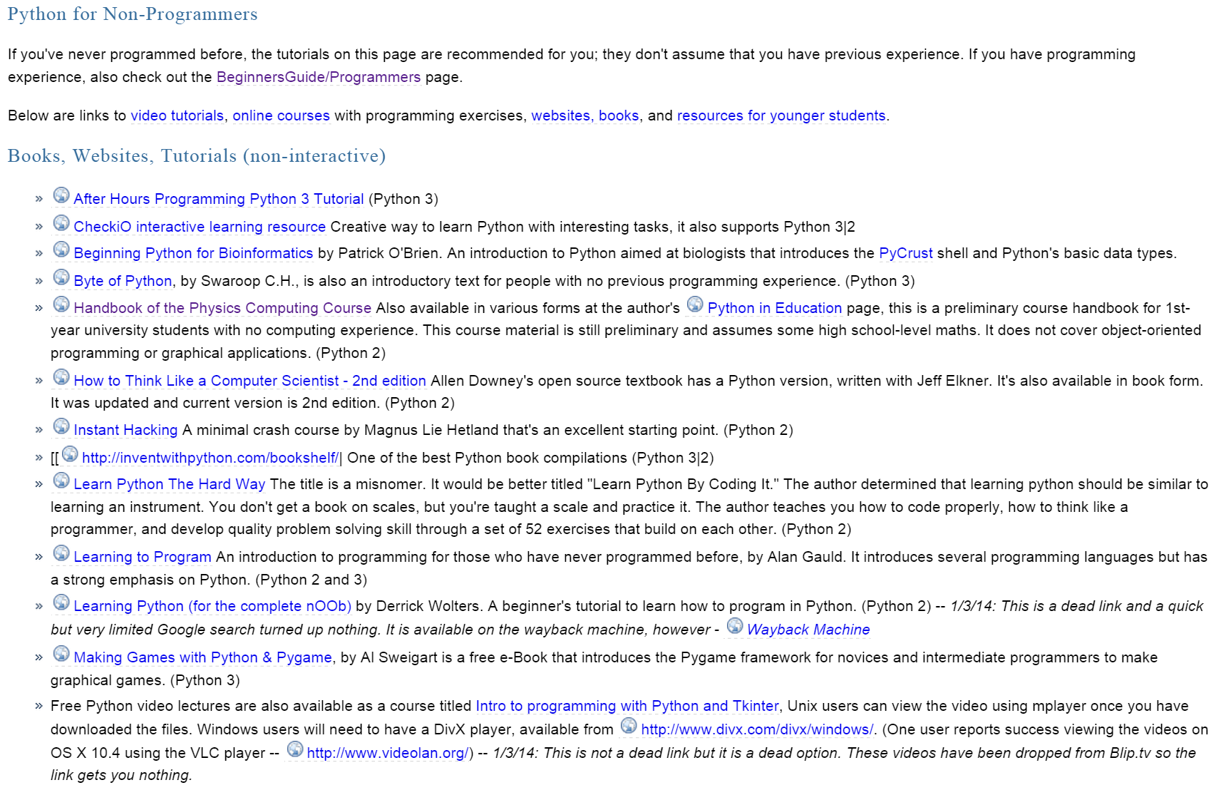
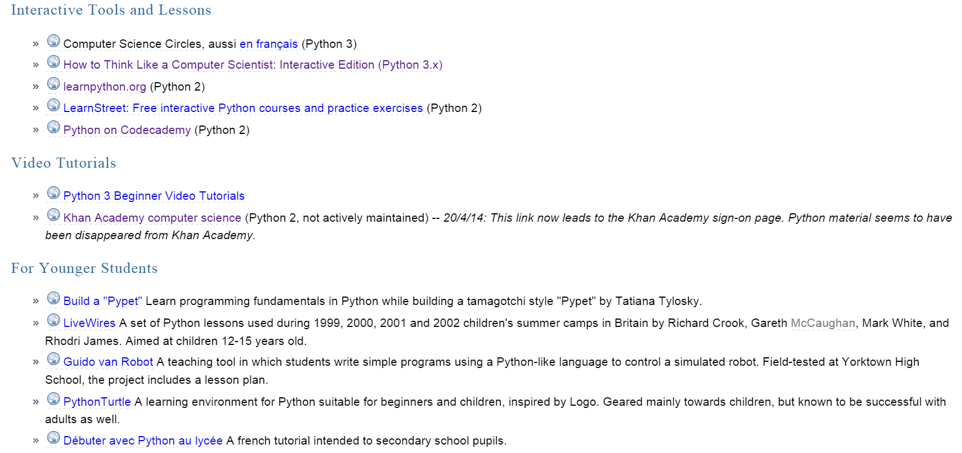
https://wiki.python.org/moin/BeginnersGuide/NonProgrammers

Slide 44
python script for comparing 2 files, oldOut.txt and newOut.txt
import itertools
with open('oldOut.txt') as f1, open('newOut.txt') as f2:
for lineno, (line1, line2) in enumerate(itertools.izip(f1, f2), 1):
if line1 != line2:
print line1, line2, 'mismatch', lineno
The above code was modified from:
http://stackoverflow.com/questions/20686674/how-to-compare-two-files-and-print-mismatched-line-number-in-python
To run and output into a file: python same.py > file.txt
where python script filename: same.py
output filename: file.txt

Slide 45
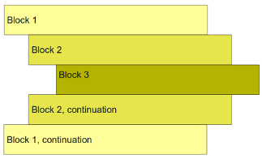
http://www.python-course.eu/python3_blocks.php
https://www.python.org/dev/peps/pep-0008/#tabs-or-spaces
Tabs or Spaces?
Spaces are the preferred indentation method.
Tabs should be used solely to remain consistent with code that is already indented with tabs.
Python 3 disallows mixing the use of tabs and spaces for indentation.
Python 2 code indented with a mixture of tabs and spaces should be converted to using spaces exclusively.
When invoking the Python 2 command line interpreter with the -t option, it issues warnings about code that illegally mixes tabs and spaces. When using -tt these warnings become errors. These options are highly recommended!

Slide 46
same.py
import itertools
with open('oldOut.txt') as f1, open('newOut.txt') as f2:
for lineno, (line1, line2) in enumerate(itertools.izip(f1, f2), 1):
if line1 != line2:
print line1, line2, 'mismatch', lineno
file.txt
-1-1-1-1-1-1-1-1Gauss -1 3 -2 1 -3 2
-1-1-1-1-1-1-1-1Gauss: -1 3 -2 1 -3 2
mismatch 1
11111111Gauss 2 -1 3 -2 1 -3
11111111Gauss: 2 -1 3 -2 1 -3
mismatch 11

Slide 47
yamltoR.py
f = open('lesson.yaml',"r")
data_line = f.readlines()
for i in data_line:
if i[:16] == " CorrectAnswer:":
print(i[17:])
f.close()

Slide 48
yamltoRwithComments.py
f = open('lesson.yaml',"r")
data_line = f.readlines()
for i in data_line:
if i[:16] == " CorrectAnswer:":
print(i[17:])
else:
print("#"+i)
f.close()

Slide 49
PEP 8 - Style Guide for Python Code
https://www.python.org/dev/peps/pep-0008/

Slide 51
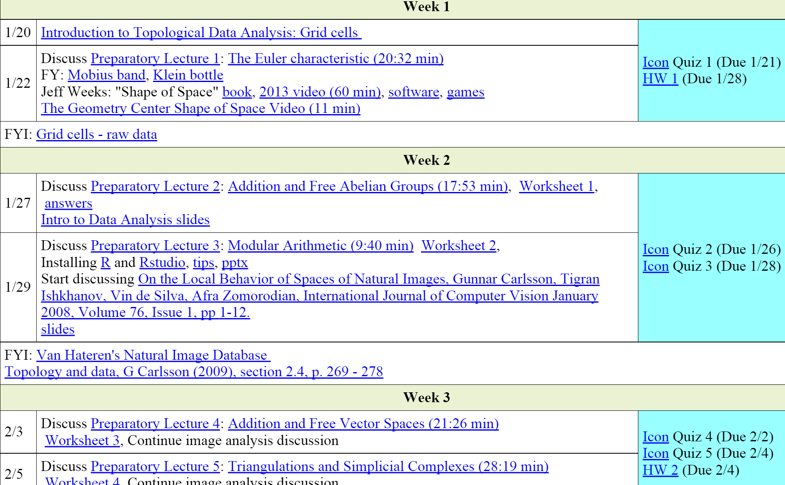
Possible modifications for next time
------------------------------------------------------ Introduction to data and shape
How did you like the you tube lectures?
How did you like the in-class worksheets?
Would you have liked more videos and in class worksheets?
---------------------------------------------------------------Computer Lab: Intro to R
HW due 2/5 (individual or group HW): Describe a data set (use feedback from writing center)

Slide 52
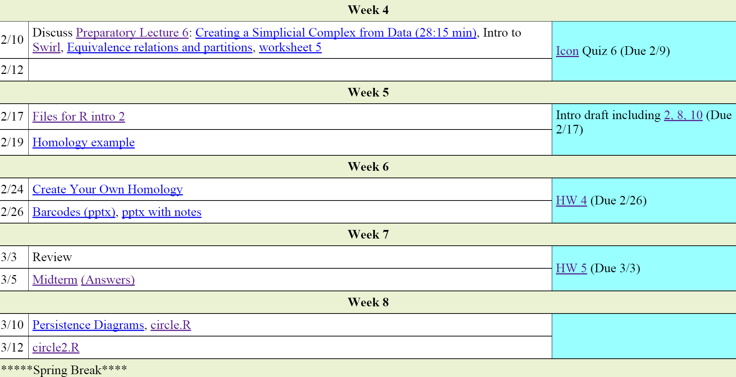
Possible modifications for next time
Starting week 1: Class wiki project describing topology including deformation retract.
Draft of commented R code, due 2/12
Outline due 2/19
Draft OR Poster due 3/12

Slide 53
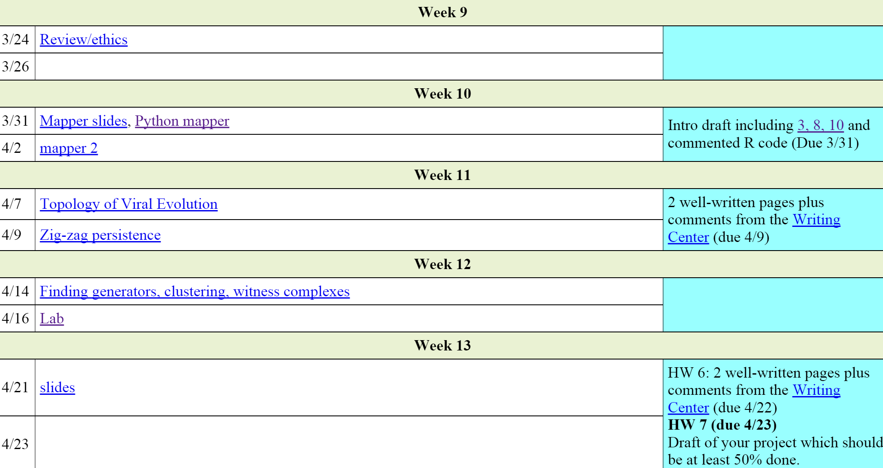
Possible modifications for next time
Should I ask TA to post deadlines on ICON?
Slides due 4/23

Slide 54
http://www.teachmepython.com/hello-world/
http://interactivepython.org/runestone/static/thinkcspy/toc.html#t-o-c
https://www.python.org/
There are many places to learn python.
Python For Beginners includes links to a variety of resources at Python for Non-Programmers and Python for Programmers
For beginners: codecademy. Intro-active lessons that you can do in your web browser. You can also learn HTML & CSS, Javascript, jQuery, Ruby, PHP at Codecademy
Coursera course
Python via Lynda. Note Lynda is free to all UI students/staff/faculty by logging in here

