Slide 1
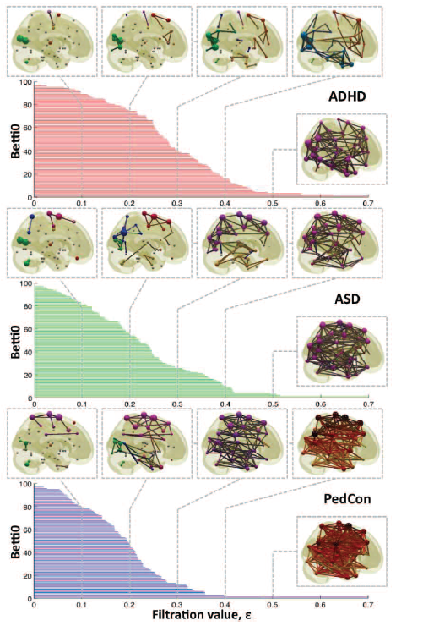
For H₀, can observe how fast connections form, possibly noting concavity
Vertices = Regions of Interest
Create Rips complex by growing epsilon balls (i.e. decreasing threshold) where distance between two vertices is given by
where f_{i} =
measurement at location i
http://ieeexplore.ieee.org/xpls/icp.jsp?arnumber=5872535

Slide 2
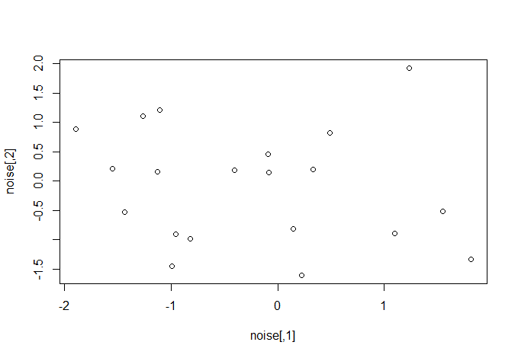
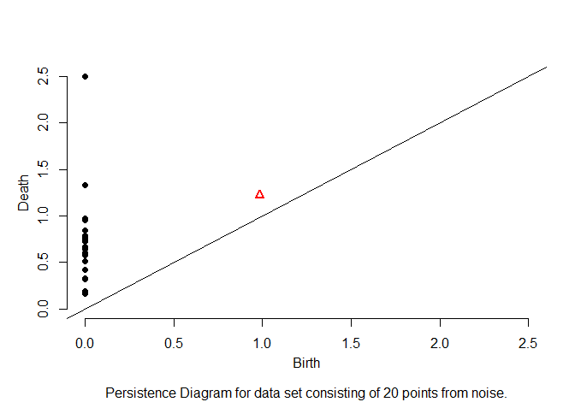
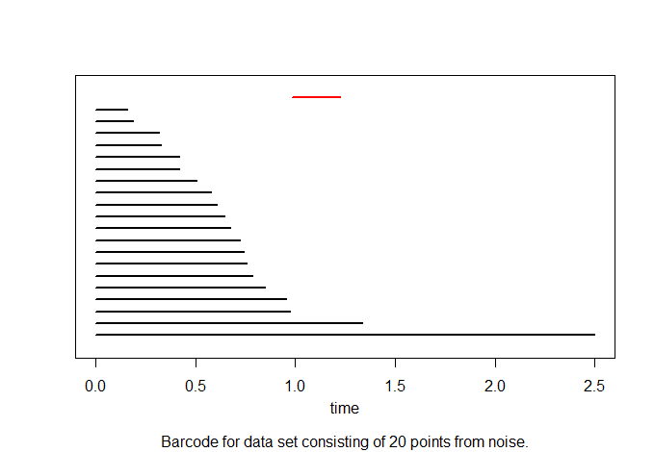

Slide 3
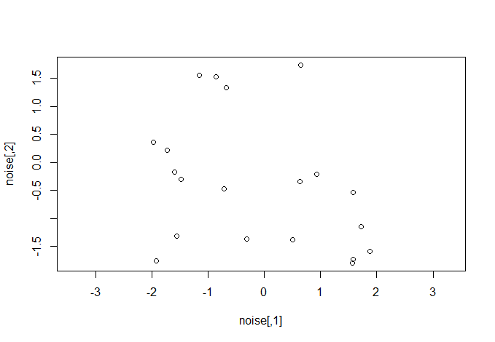
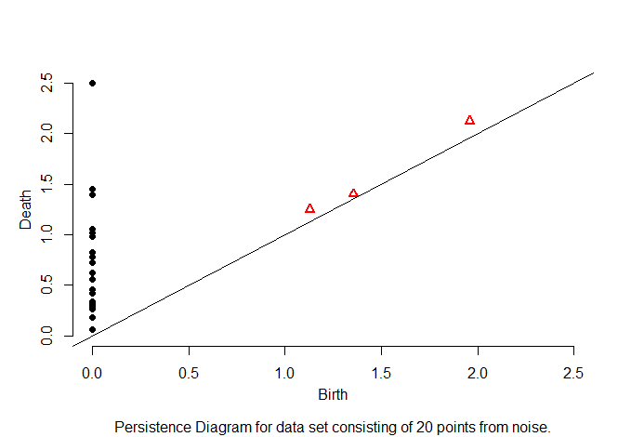
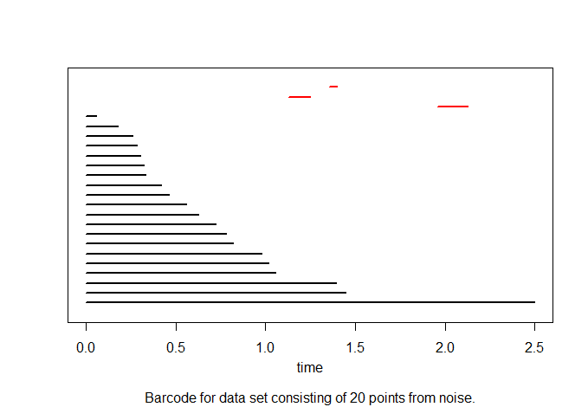

Slide 4
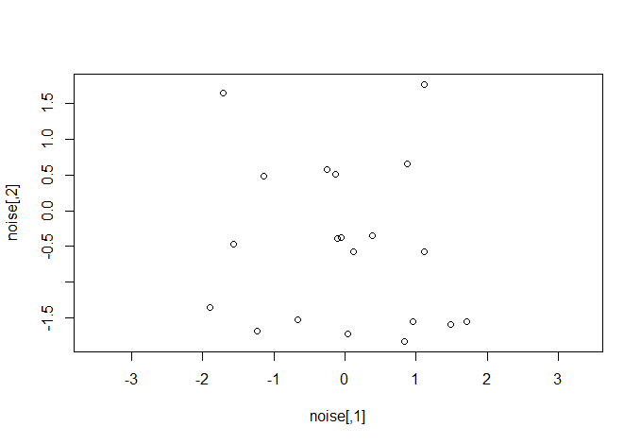
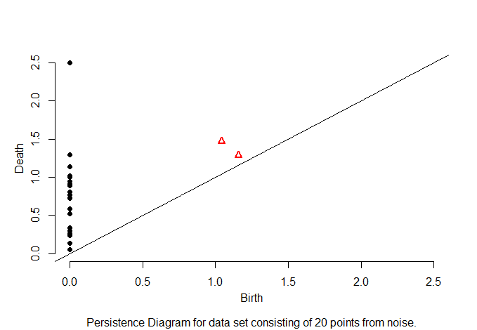
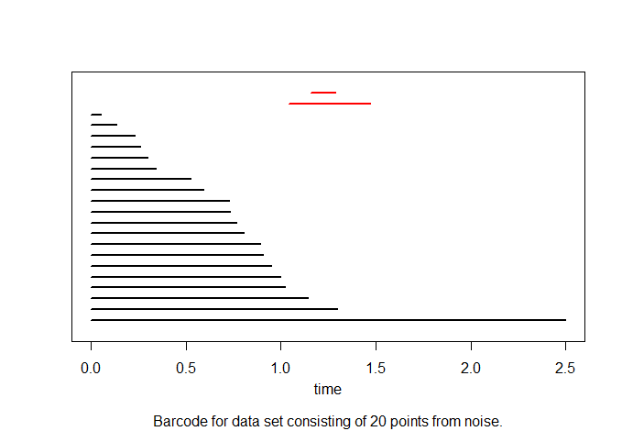

Slide 6
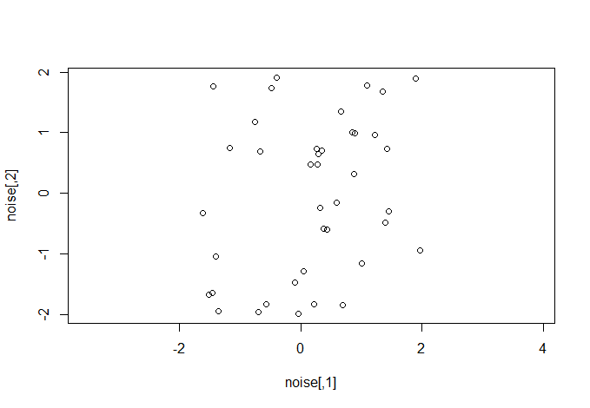
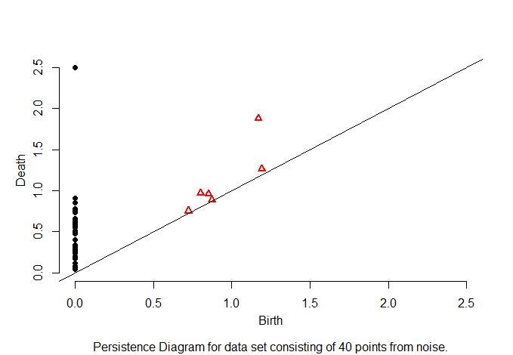
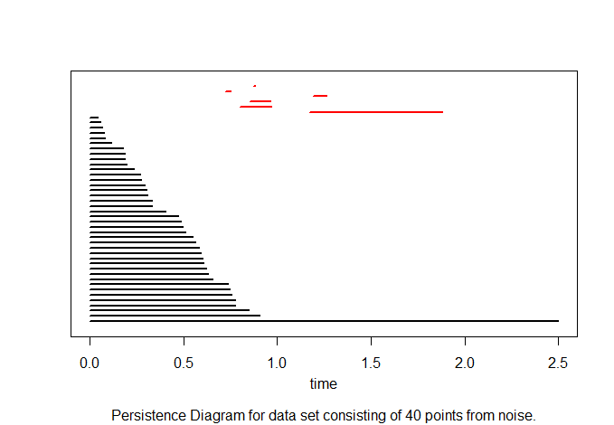

Slide 7
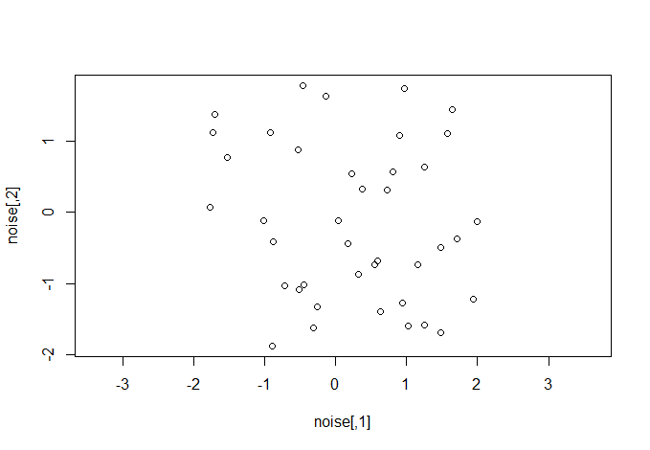
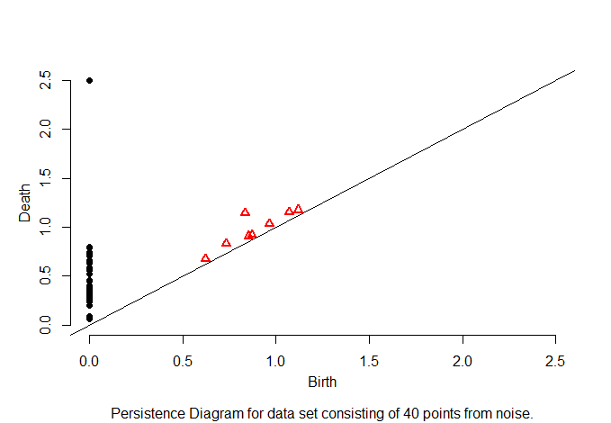
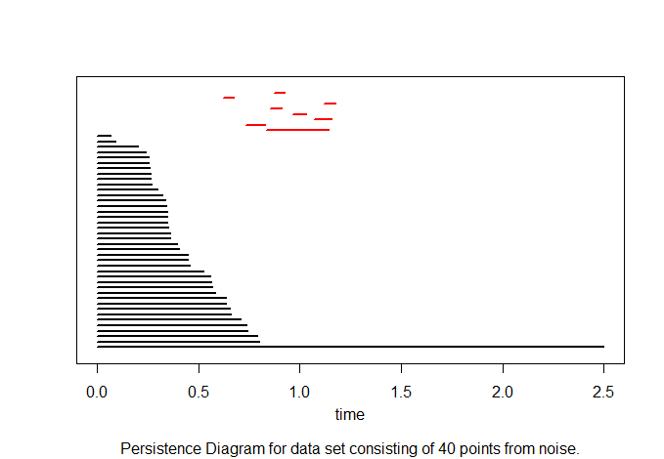

Slide 8
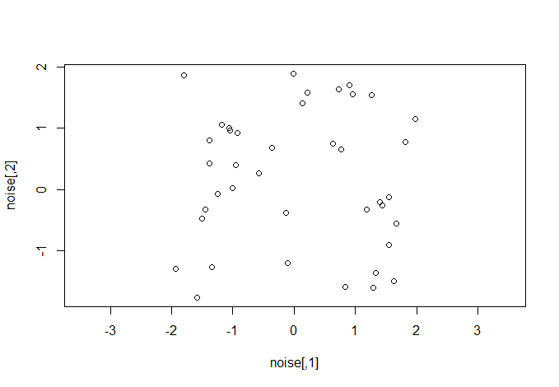
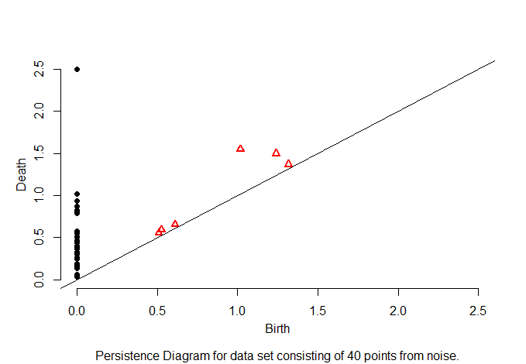
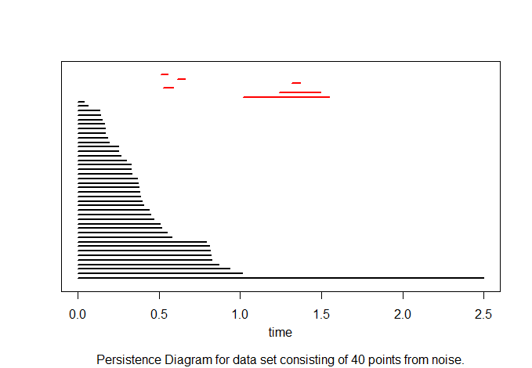

Slide 11
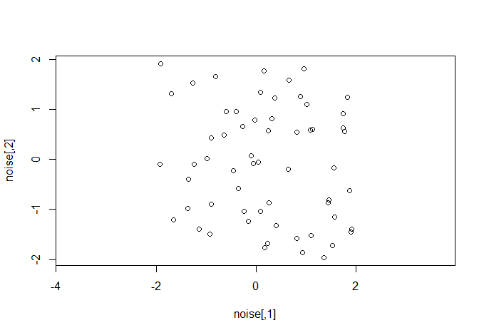
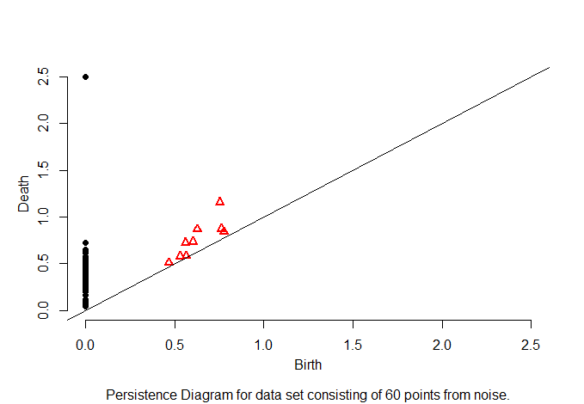
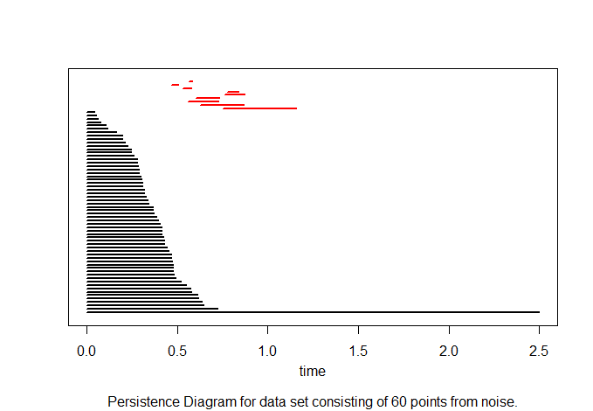

Slide 13
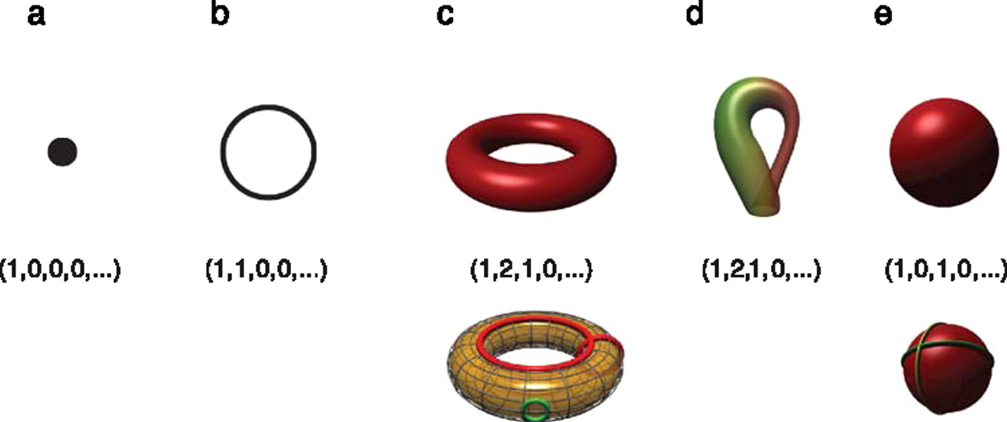
Betti numbers provide a signature of the underlying topology.
Use (β₀, β₁, β₂, …) for classification, where β_{i} = rank of H_{i}
Singh G et al. J Vis 2008;8:11
©2008 by Association for Research in Vision and Ophthalmology
Notes:
Betti numbers provide a signature of the underlying topology. Illustrated in the figure are five simple objects (topological spaces) together with their Betti number signatures: (a) a point, (b) a circle, (c) a hollow torus, (d) a Klein bottle, and (e) a hollow sphere. For the case of the torus (c), the figure shows three loops on its surface. The red loops are “essential” in that they cannot be shrunk to a point, nor can they be deformed one into the other without tearing the loop. The green loop, on the other hand, can be deformed to a point without any obstruction. For the torus, therefore, we have b 1 = 2. For the case of the sphere, the loops shown (and actually all loops on the sphere) can be contracted to points, which is reflected by the fact that b 1 = 0. Both the sphere and the torus have b 2 = 1, this is due to the fact both surfaces enclose a part of space (a void).

Slide 14
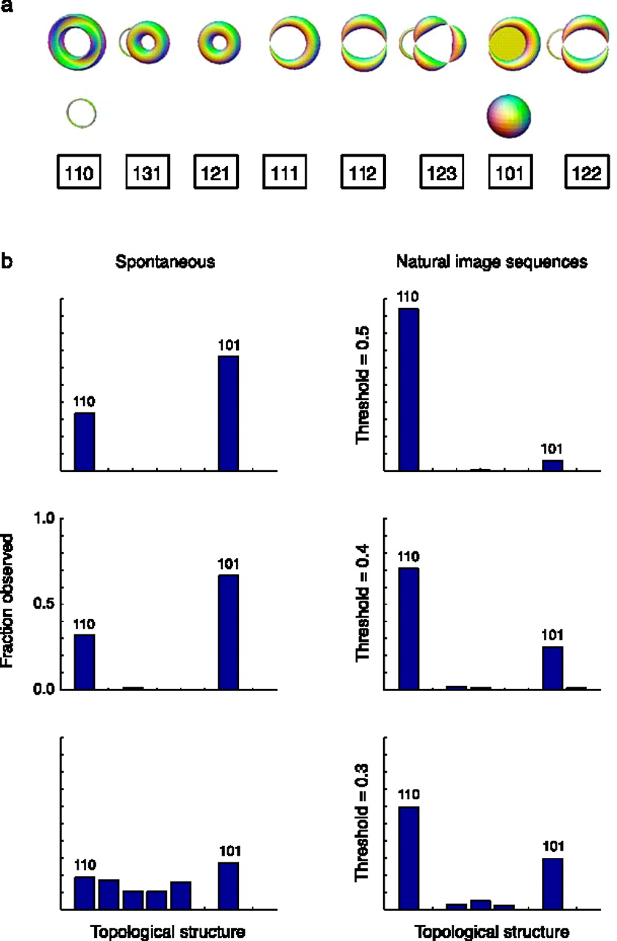
Estimation of topological structure in driven and spontaneous conditions.
Record voltages at points in time at each electrode.
Spike train: lists of firing times for a neuron
obtained via spike sorting –i.e. signal processing.
Data = an array of N spike trains.
Compared spontaneous (eyes occluded) to evoked (via movie clips).
10 second segments broken into 50 ms bins
Transistion between states about 80ms
The 5 neurons with the highest firing rate in each ten second window were chosen
For each bin, create a vector in R⁵ corresponding to the number of firings of each of the 5 neurons.
200 bins = 200 data points in R⁵.
Used 35 landmark points.
20-30minutes of data = many data sets
Control: shuffled data 52700 times.
Singh G et al. J Vis 2008;8:11
©2008 by Association for Research in Vision and Ophthalmology
Notes:
Estimation of topological structure in driven and spontaneous conditions. (a) Ordering of topological signatures observed in our experiments. Each triplet ( b 0, b 1, b 2) is shown along an illustration of objects consistent with these signature. (b) Distribution of topological signatures in the spontaneous and natural image stimulation conditions pooled across the three experiments performed. Each row correspond to signatures with a minimum interval length (denoted as the threshold) expressed as a fraction of the covering radius of the data cloud (see Appendix A for the definition of the covering radius).

Slide 15
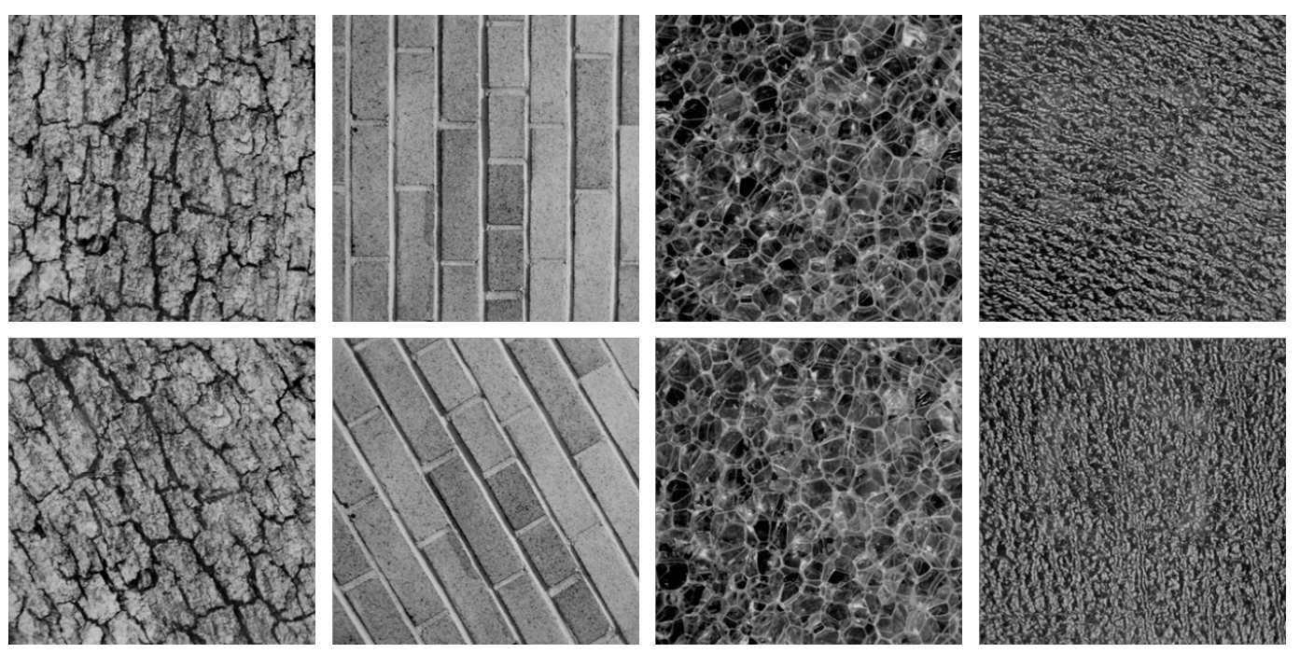
Combine your analysis with other tools

Slide 16
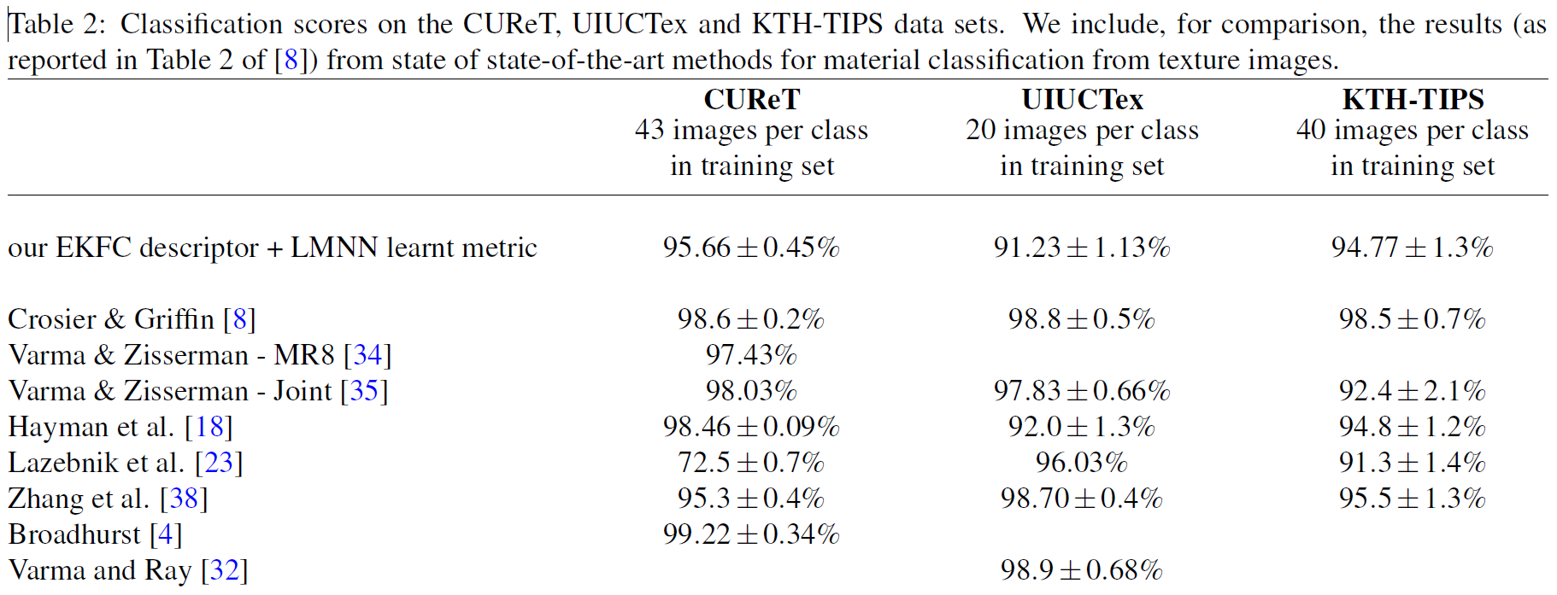

Slide 17
http://www.plosone.org/article/info%3Adoi%2F10.1371%2Fjournal.pone.0002856
2008
And section 9.1 in Computational Topology: An Introduction By Herbert Edelsbrunner, John Harer

Slide 18
Goal: To determine what genes are involved in a particular periodic pathway
Application: segmentation clock of mouse embryo.
1 somite develops about every 2 hours
What genes are involved in somite development?

Slide 19
Persistence:
For each of 7549 genes, create
f_{k}: S¹ → R, k = 1, …, 7549
f_{k} (time point i) = amount of RNA at time point i for gene k

Slide 20
Not period 2:

Slide 21
Not period 2:

Slide 22
Not period 2:

Slide 23
Not period 2:

Slide 24
Period 2

Slide 25
Persistence:
For each of 7549 genes, create
f_{k}: S¹ → R, k = 1, …, 7549
f_{k} (time point i) = amount of RNA at time point i for gene k

Slide 26
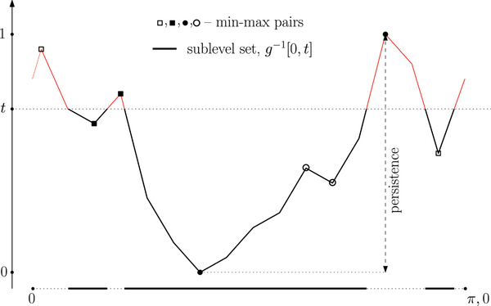
Figure 8. Function g(x) for the expression pattern of Axin2.
Dequéant M-L, Ahnert S, Edelsbrunner H, Fink TMA, et al. (2008) Comparison of Pattern Detection Methods in Microarray Time Series of the Segmentation Clock. PLoS ONE 3(8): e2856. doi:10.1371/journal.pone.0002856
http://www.plosone.org/article/info:doi/10.1371/journal.pone.0002856

Slide 27
Not period 2:

Slide 28
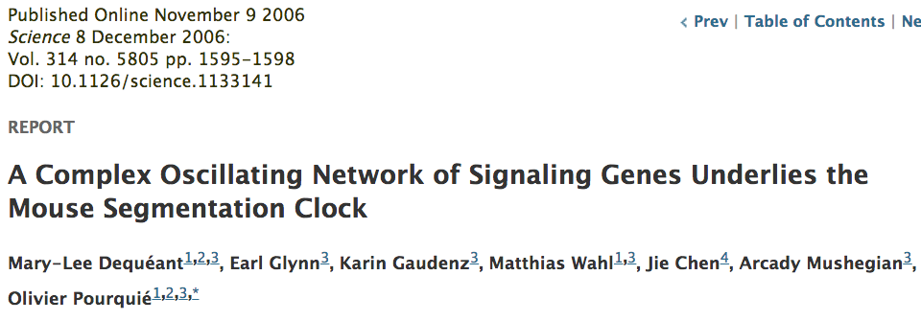
Data from:

Slide 29
During the formation of each somite, Lfng is expressed in the PSM as a wave that sweeps across the tissue in a posterior-to-anterior direction (1). Therefore, by visually comparing the anteroposterior position of the Lfng expression stripes in the PSM in stained embryos, it is possible to define an approximate chronological order of the embryos along the segmentation clock oscillation cycle (3, 4). We collected PSM samples from 40 mouse embryos ranging from 19 to 23 somites and used their Lfng expression patterns as a proxy to select 17 samples covering an entire oscillation cycle.
Indeed, due to technical issues, the right PSM samples of the time series were dissected from mouse embryos belonging to five consecutive somite cycles, and they were ordered based on their phase of Lfng expression pattern (revealed by in situ hybridization on the left PSM of each dissected mouse embryo) to reconstitute a unique oscillation cycle [5].

Slide 30
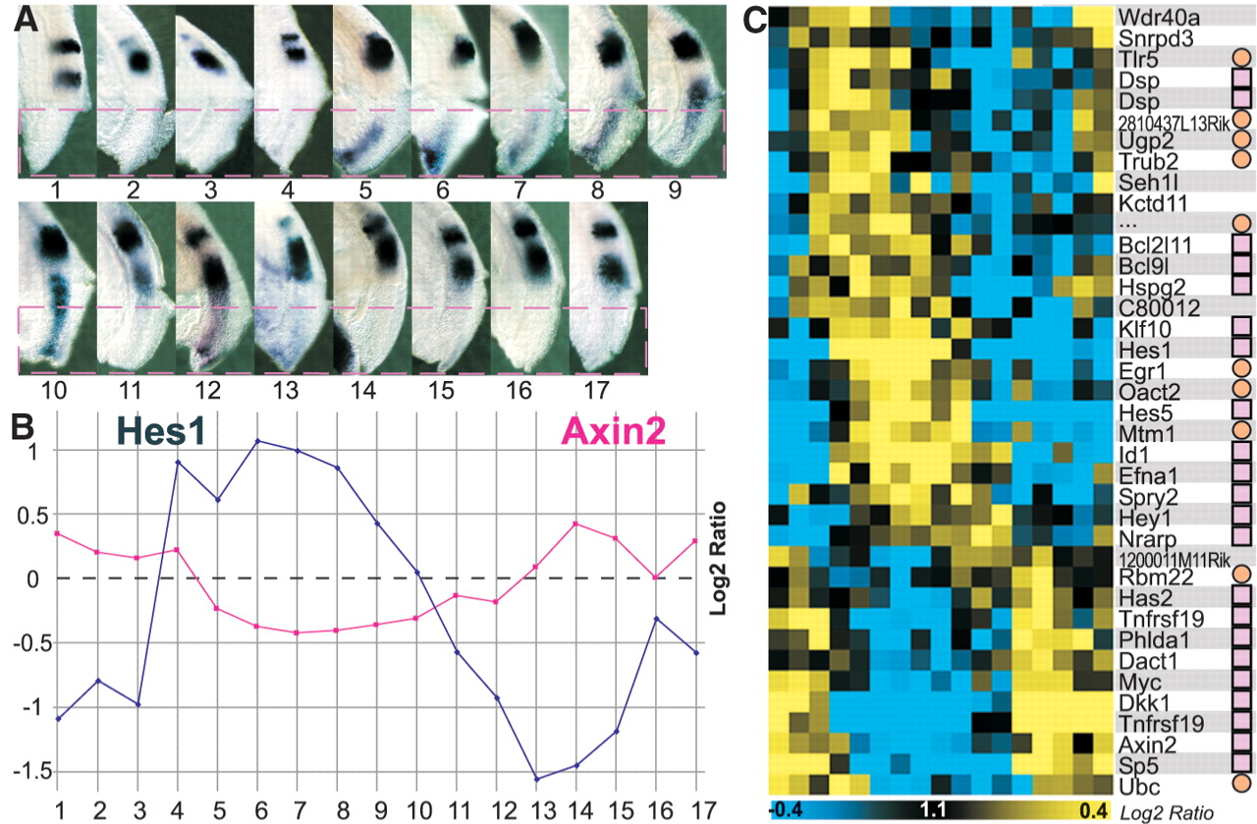
Fig. 2. Identification of cyclic genes based on the PSM microarray time series.
M Dequéant et al. Science 2006;314:1595-1598
Published by AAAS
Notes:
Identification of cyclic genes based on the PSM microarray time series. (A) Left side of the 17 mouse embryos, whose right posterior PSMs (below red hatched line) were dissected for microarray analysis. Embryos were ordered along one segmentation clock cycle according to the position of Lfng stripes in their left PSM as revealed by in situ hybridization (fig. S1). (B) Log₂ ratios of the expression levels of the Hes1 (blue) and Axin2 (red) cyclic genes in each microarray of the time series. (C) Phaseogram of the cyclic genes identified by microarray and L-S analysis. Blue, decrease in gene expression; yellow, increase in gene expression; pink squares, genes validated by in situ hybridization; and orange circles, nonvalidated genes, that is, not evidently cyclical as detected by in situ hybridization.

Slide 31
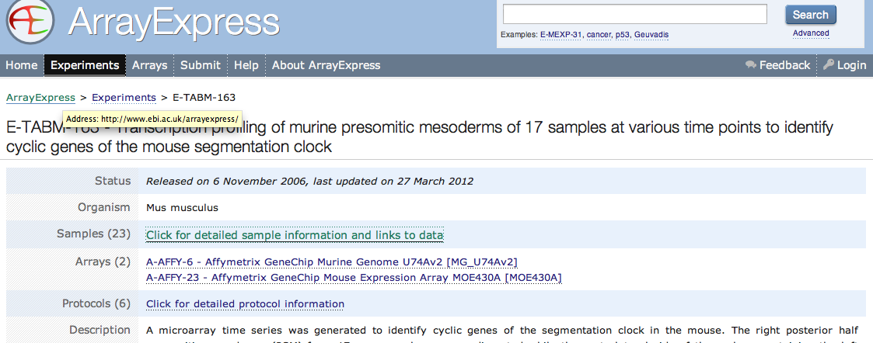
http://www.ebi.ac.uk/arrayexpress/
accession number E-TABM-163

Slide 32
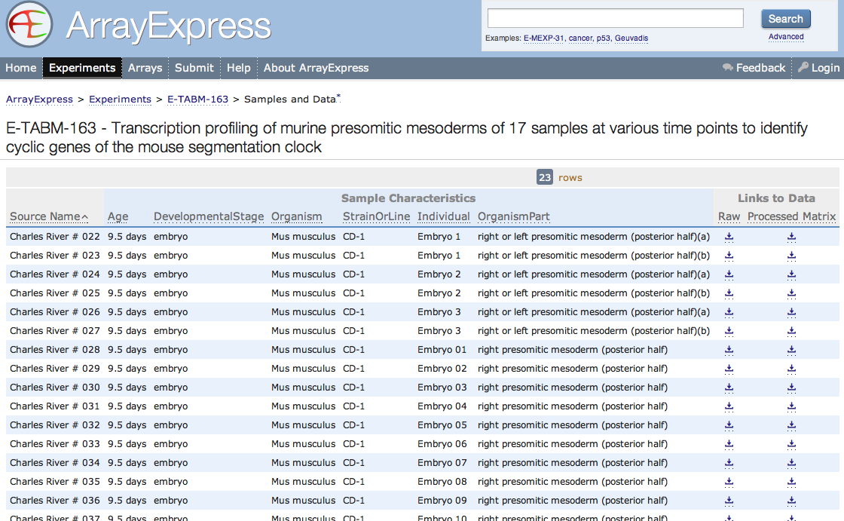

Slide 33
Persistence:
For each of 7549 genes, create
f_{k}: S¹ → R, k = 1, …, 7549
f_{k} (time point i) = amount of RNA at time point i for
gene k

Slide 34
17 time points → 17 equally space time points
microarry expression of gene k at time i → ranked
order of microarry expression of gene k at time i
Ex: (0.41, 0.63, 0.11, 0.23, 0.59) → (3, 5, 1, 2, 4).

Slide 35
f_{k} (time point i) = RNA intensity at time point i for gene k.
π(f_{k}) = replace RNA intensity with rank order.
g(x_{i}) =[ π(f_{k})(x_{i}) – 1] / (17 – 1), for i = 1, …, 17.
g(x) obtained by linear interpolation for x ≠ x_{i} for some i.
Note: 0 ≤ g(x) ≤ 1

Slide 36
Figure 8. Function g(x) for the expression pattern of Axin2.
Dequéant M-L, Ahnert S, Edelsbrunner H, Fink TMA, et al. (2008) Comparison of Pattern Detection Methods in Microarray Time Series of the Segmentation Clock. PLoS ONE 3(8): e2856. doi:10.1371/journal.pone.0002856
http://www.plosone.org/article/info:doi/10.1371/journal.pone.0002856

Slide 38
Not period 2:

Slide 39
17 time points → 17 equally space time points
microarry expression of gene k at time i → ranked
order of microarry expression of gene k at time i
Ex: (0.41, 0.63, 0.11, 0.23, 0.59) → (3, 5, 1, 2, 4).

Slide 41
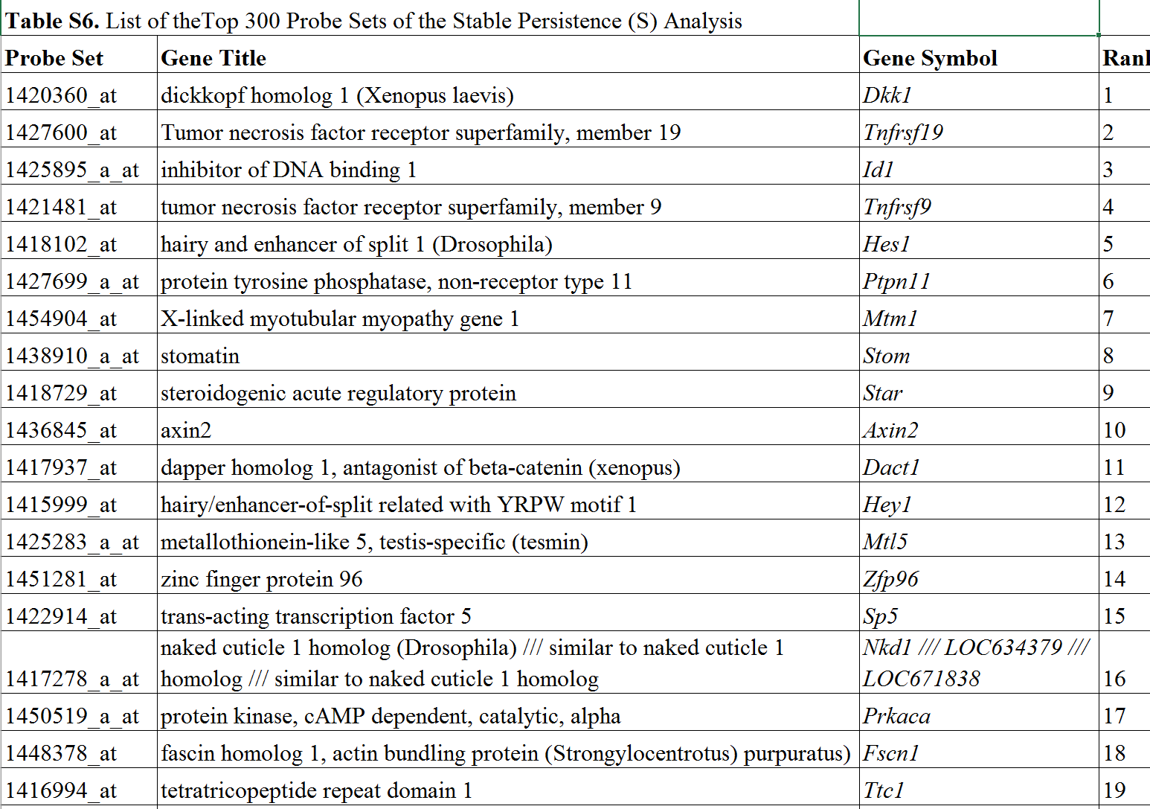
http://journals.plos.org/plosone/article?id=10.1371/journal.pone.0002856

Slide 42
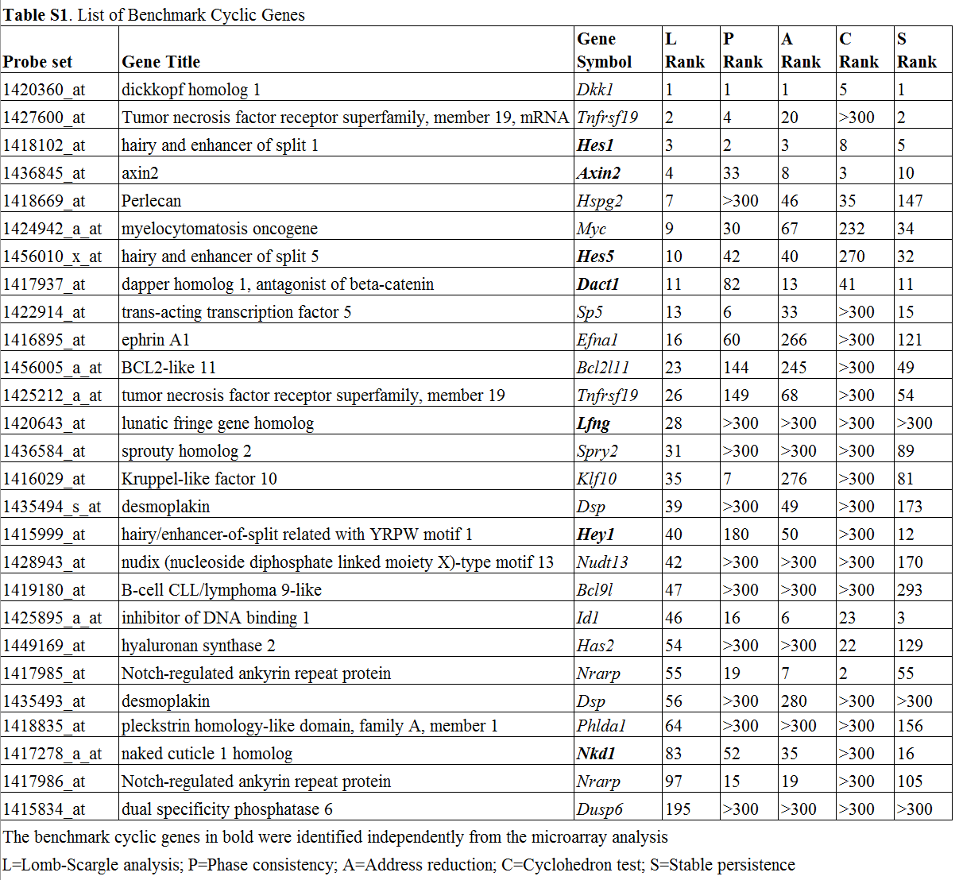
http://journals.plos.org/plosone/article?id=10.1371/journal.pone.0002856
L=Lomb-Scargle analysis;
P=Phase consistencyA=Address reduction; C= Cyclo-hedron test;
S=Stable persistence
The benchmark cyclic genes in bold were identified independ-ently from the microarray analysis

Slide 43
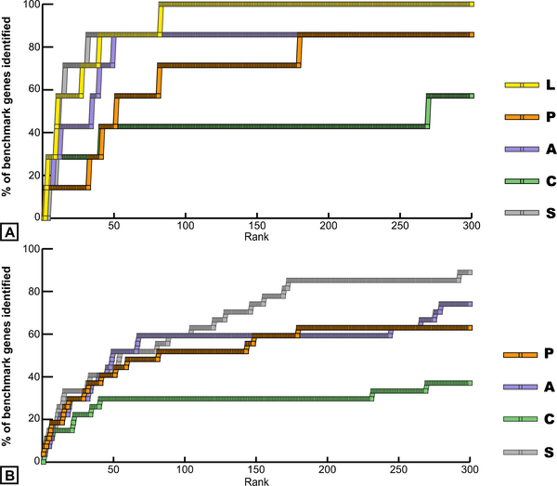
Figure 1. Identification of benchmark cyclic genes in the top 300 probe set lists of the five methods.
Dequéant M-L, Ahnert S, Edelsbrunner H, Fink TMA, et al. (2008) Comparison of Pattern Detection Methods in Microarray Time Series of the Segmentation Clock. PLoS ONE 3(8): e2856. doi:10.1371/journal.pone.0002856
http://www.plosone.org/article/info:doi/10.1371/journal.pone.0002856

Slide 44
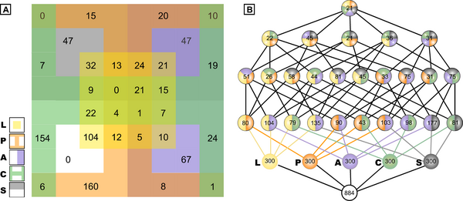
Figure 2. Comparison of the intersection of the top 300 ranked probe sets from the five methods.
Dequéant M-L, Ahnert S, Edelsbrunner H, Fink TMA, et al. (2008) Comparison of Pattern Detection Methods in Microarray Time Series of the Segmentation Clock. PLoS ONE 3(8): e2856. doi:10.1371/journal.pone.0002856
http://www.plosone.org/article/info:doi/10.1371/journal.pone.0002856

Slide 45
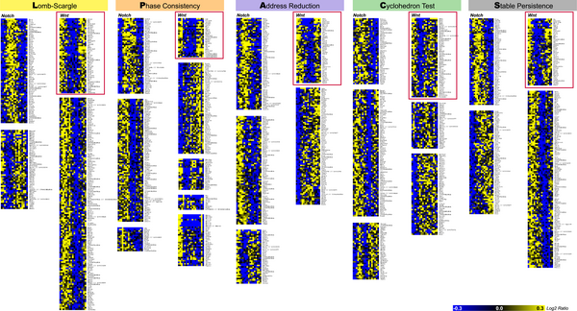
Figure 3. Clustering analysis of the top 300 ranked probe sets from the five methods.
Dequéant ML, Ahnert S, Edelsbrunner H, Fink TMA, Glynn EF, et al. (2008) Comparison of Pattern Detection Methods in Microarray Time Series of the Segmentation Clock. PLoS ONE 3(8): e2856. doi:10.1371/journal.pone.0002856
http://127.0.0.1:8081/plosone/article?id=info:doi/10.1371/journal.pone.0002856

Slide 46
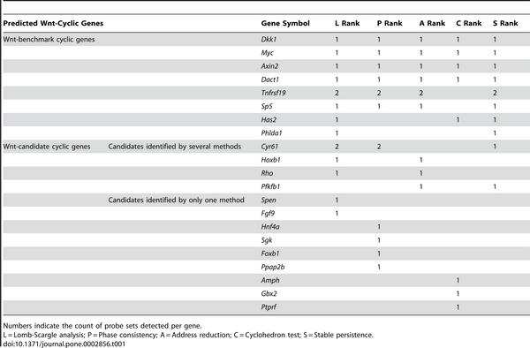
Table 1. Composition of the Wnt Clusters of the Five Methods.
Dequéant ML, Ahnert S, Edelsbrunner H, Fink TMA, Glynn EF, et al. (2008) Comparison of Pattern Detection Methods in Microarray Time Series of the Segmentation Clock. PLoS ONE 3(8): e2856. doi:10.1371/journal.pone.0002856
http://127.0.0.1:8081/plosone/article?id=info:doi/10.1371/journal.pone.0002856

Slide 47
Persistent homology results are stable:
Add noise to data does not change barcodes significantly.

Slide 48
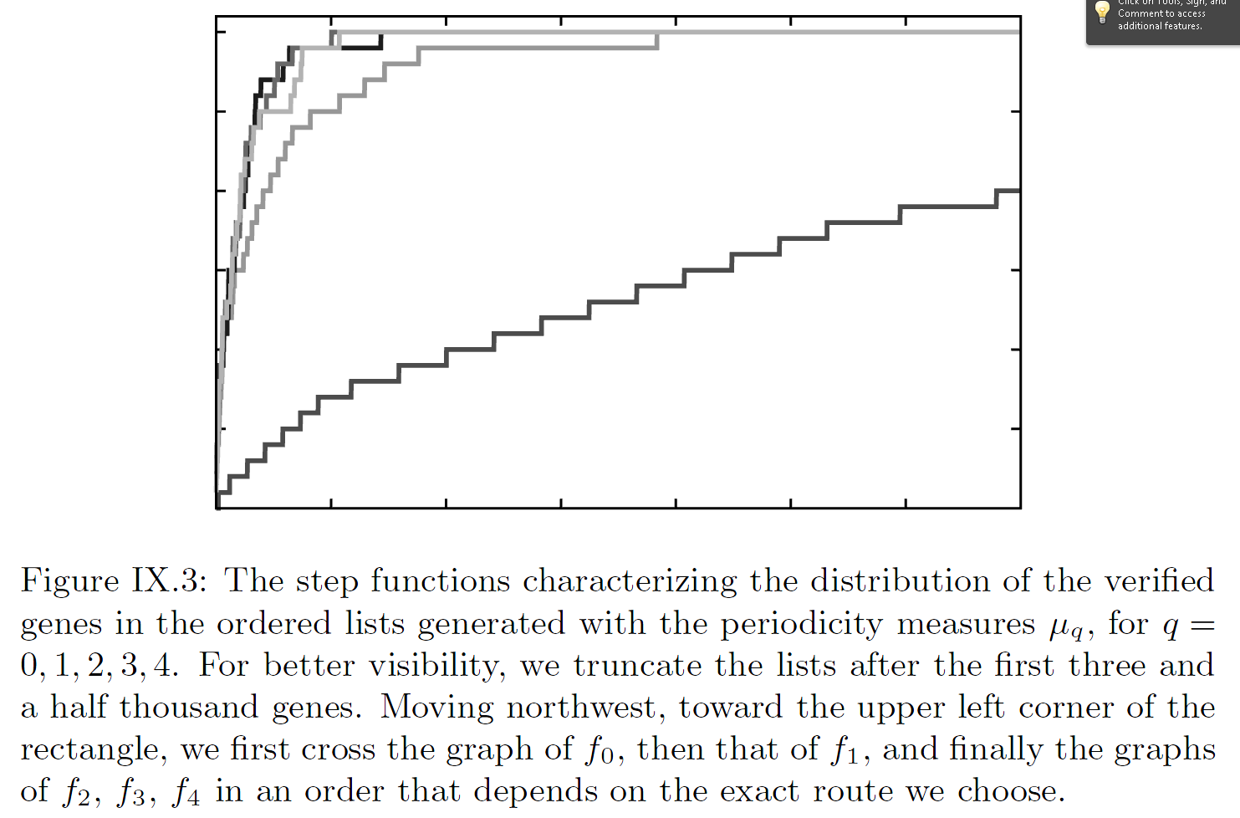
http://www.ams.org/publications/authors/books/postpub/mbk-69

Slide 49
Persistent homology results are stable:
Add noise to data does not change barcodes significantly.
Figure 8. Function g(x) for the expression pattern of Axin2.
Dequéant M-L, Ahnert S, Edelsbrunner H, Fink TMA, et al. (2008) Comparison of Pattern Detection Methods in Microarray Time Series of the Segmentation Clock. PLoS ONE 3(8): e2856. doi:10.1371/journal.pone.0002856
http://www.plosone.org/article/info:doi/10.1371/journal.pone.0002856

Slide 50
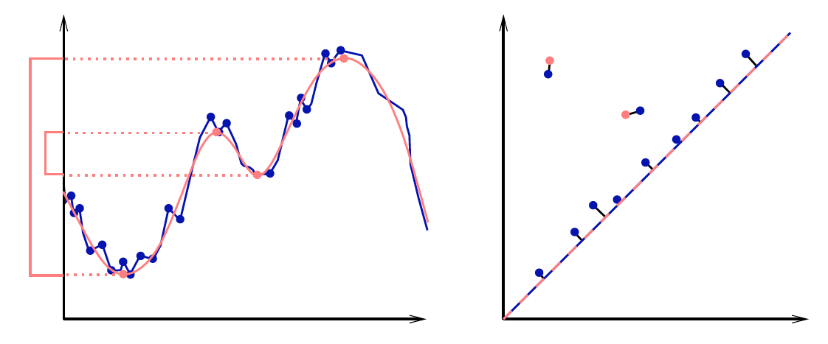
|| (x₁,…,x_{n}) – (y₁,…,y_{n}) ||∞ = max{|x₁ – y₁|,…,|x_{n} - y_{n}|}
Given sets X, Y and bijection g: X → Y,
Bottleneck Distance: d_{B}(X, Y) = inf sup || x – g(x) ||∞
g x

Slide 51
(Wasserstein distance). The p-th Wasserstein distance between two persistence diagrams,
d₁ and d₂, is defined as
where γ ranges over all bijections from d₁ to d₂.
Probability measures on the space of persistence
diagrams
Yuriy Mileyko1, Sayan Mukherjee2 and John Harer1

Slide 52
Persistent homology results are stable:
Add noise to data does not change barcodes significantly.

