Slide 1
Finding generators
for H₁

Slide 2
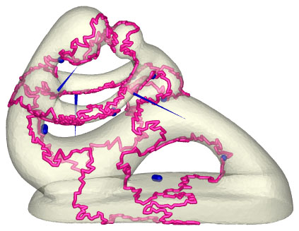
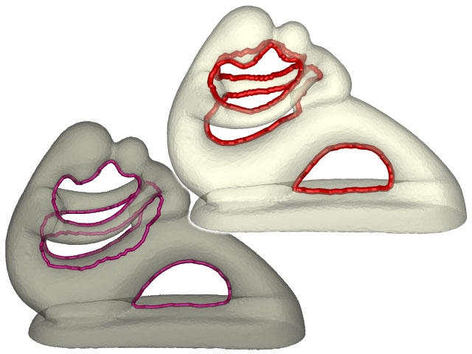
HanTun software available at
http://web.cse.ohio-state.edu/~tamaldey/handle/hantun.html

Slide 3
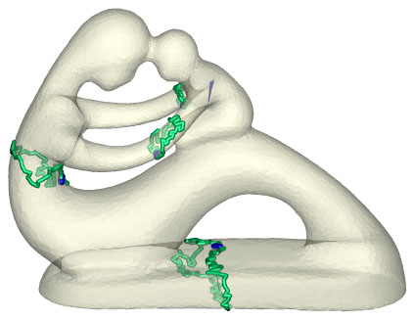
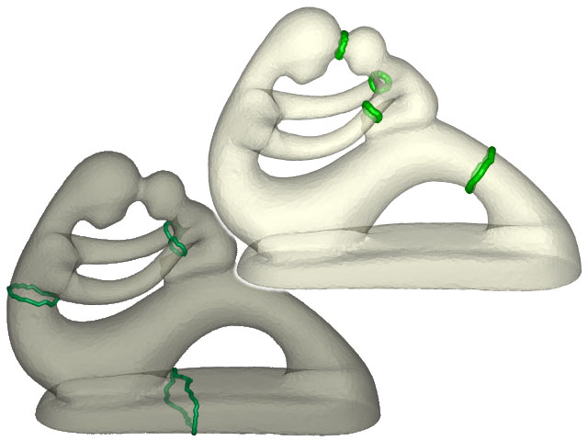
HanTun software available at
http://web.cse.ohio-state.edu/~tamaldey/handle/hantun.html

Slide 4
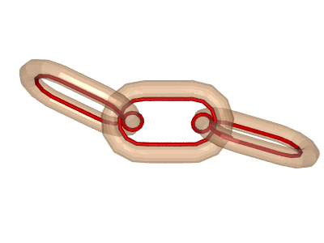
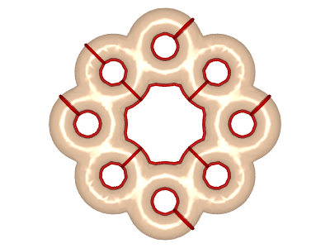
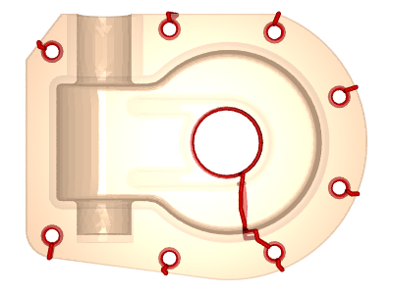
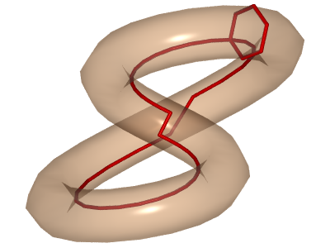
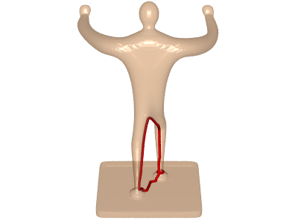
Shortloop software (more general) available at
http://web.cse.ohio-state.edu/~tamaldey/shortloop.html
Figures from http://web.cse.ohio-state.edu/~tamaldey/shortloop-pictures.html

Slide 5
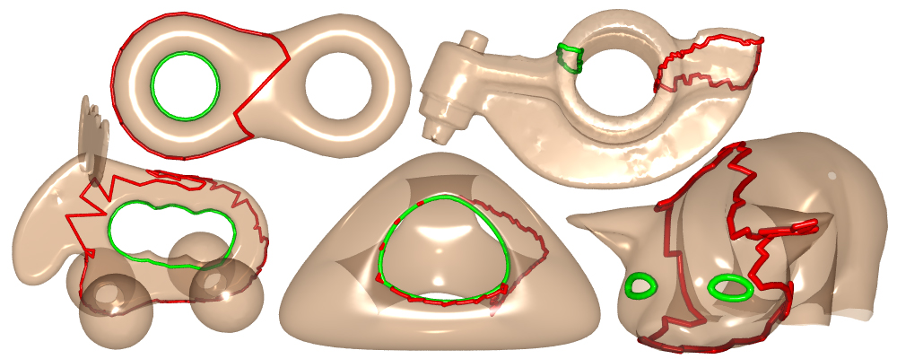
http://web.cse.ohio-state.edu/~tamaldey/homology.html

Slide 6
Finding generators
for H₀

Slide 7
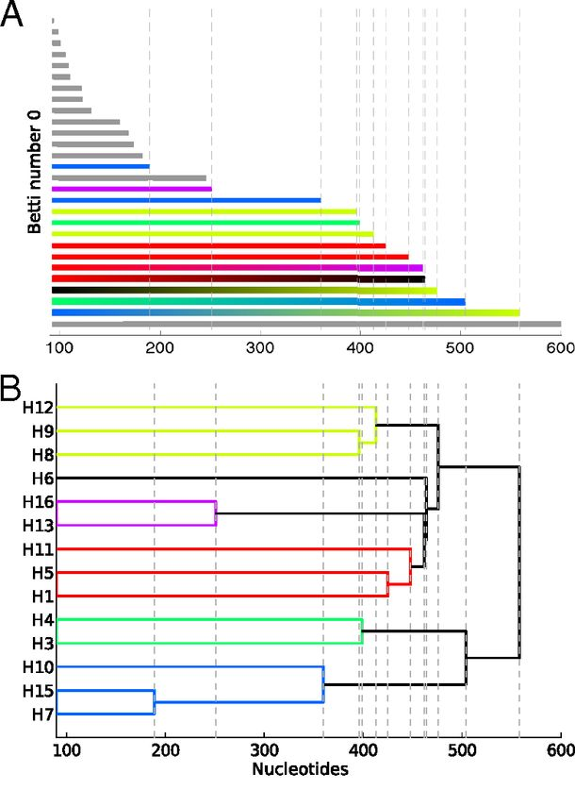
Reconstructing phylogeny from persistent homology of avian influenza HA. (A) Barcode plot in dimension 0 of all avian HA subtypes.
Influenza:
For a single segment,
no H_{k} for k > 0
no horizontal transfer
(i.e., no homologous recombination)
©2013 by National Academy of Sciences
Chan J M et al. PNAS 2013;110:18566-18571
Notes:
Reconstructing phylogeny from persistent homology of avian influenza HA. (A) Barcode plot in dimension 0 of all avian HA subtypes. Each bar represents a connected simplex of sequences given a Hamming distance of ε. When a bar ends at a given ε, it merges with another simplex. Gray bars indicate that two simplices of the same HA subtype merge together at a given ε. Solid color bars indicate that two simplices of different HA subtypes but same major clade merge together. Interpolated color bars indicate that two simplices of different major clades merge together. Colors correspond to known major clades of HA. For specific parameters, see SI Appendix, Supplementary Text. (B) Phylogeny of avian HA reconstructed from the barcode plot in A. Major clades are color-coded. (C) Neighbor-joining tree of avian HA (SI Appendix, Supplementary Text).

Slide 8
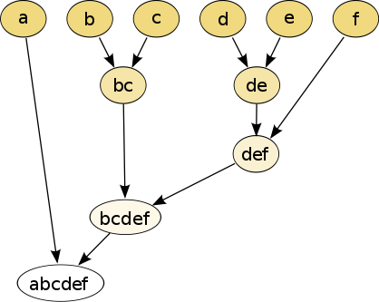
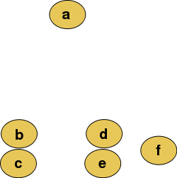
Hierarchical clustering
Data
Dendrogram
http://en.wikipedia.org/wiki/File:Clusters.svg
http://en.wikipedia.org/wiki/File:Hierarchical_clustering_simple_diagram.svg

Slide 9
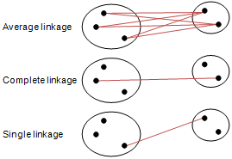
Different type of hierarchical clustering
What is the distance between 2 clusters?
http://en.wikipedia.org/wiki/File:Hierarchical_clustering_simple_diagram.svg
http://www.multid.se/genex/hs515.htm

Slide 10
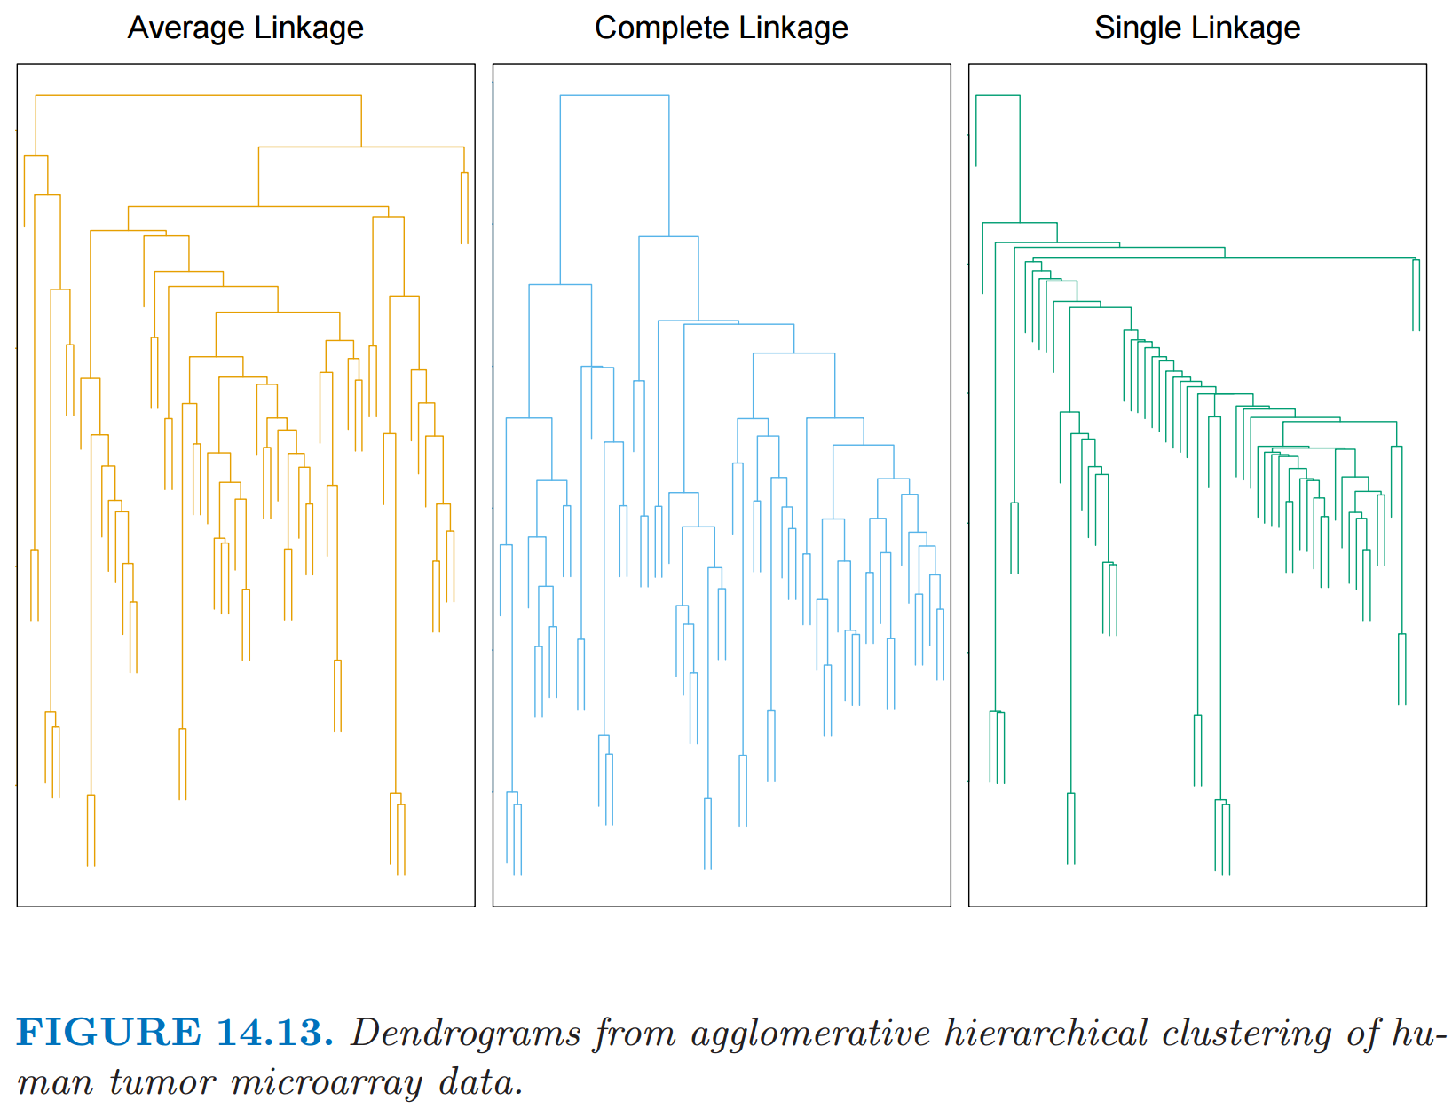
http://statweb.stanford.edu/~tibs/ElemStatLearn/
The Elements of Statistical Learning (2nd edition) Hastie, Tibshirani and Friedman

Slide 11
Background for
k-means clustering

Slide 12
Creating Delaunay triangulation via Voronoi diagrams
Notes:
data points.
In this very simplified case my data points lie in a two-dimensional plane. Normally data points are high dimensional.
For example, I may be comparing the expression or thousands of genes in tumor cells to healthy cells using microarray data. OR I might be comparing politicians voting records. Or I might be comparing the stats of basketball players. These three applications were all, by the way, published by Lum et al this past February in Nature’s Scientific Reports. I have included a link to their paper on my youtube site.
http://www.nature.com/srep/2013/130207/srep01236/full/srep01236.html

Slide 13
Voronoi diagram:
Suppose your data points live in R^{n}.
Choose data point v.
The Voronoi cell
associated with v is
H(v,w)
U
w ≠ v
H(v,w) = { x in R^{n} : d(x, v) ≤ d(x, w) }
Notes:
data points.
In this very simplified case my data points lie in a two-dimensional plane. Normally data points are high dimensional.
For example, I may be comparing the expression or thousands of genes in tumor cells to healthy cells using microarray data. OR I might be comparing politicians voting records. Or I might be comparing the stats of basketball players. These three applications were all, by the way, published by Lum et al this past February in Nature’s Scientific Reports. I have included a link to their paper on my youtube site.
http://www.nature.com/srep/2013/130207/srep01236/full/srep01236.html

Slide 14
Voronoi diagram:
Suppose your data points live in R^{n}.
Choose data point v.
The Voronoi cell associated with v is
H(v,w)
U
w ≠ v
H(v,w) = { x in R^{n} : d(x, v) ≤ d(x, w) }
Notes:
data points.
In this very simplified case my data points lie in a two-dimensional plane. Normally data points are high dimensional.
For example, I may be comparing the expression or thousands of genes in tumor cells to healthy cells using microarray data. OR I might be comparing politicians voting records. Or I might be comparing the stats of basketball players. These three applications were all, by the way, published by Lum et al this past February in Nature’s Scientific Reports. I have included a link to their paper on my youtube site.
http://www.nature.com/srep/2013/130207/srep01236/full/srep01236.html

Slide 15
Choose data point v.
The Voronoi cell associated with v is
H(v,w)
U
w ≠ v
Notes:
data points.
In this very simplified case my data points lie in a two-dimensional plane. Normally data points are high dimensional.
For example, I may be comparing the expression or thousands of genes in tumor cells to healthy cells using microarray data. OR I might be comparing politicians voting records. Or I might be comparing the stats of basketball players. These three applications were all, by the way, published by Lum et al this past February in Nature’s Scientific Reports. I have included a link to their paper on my youtube site.
http://www.nature.com/srep/2013/130207/srep01236/full/srep01236.html

Slide 16
Choose data point v.
The Voronoi cell associated with v is
H(v,w)
U
w ≠ v
Notes:
data points.
In this very simplified case my data points lie in a two-dimensional plane. Normally data points are high dimensional.
For example, I may be comparing the expression or thousands of genes in tumor cells to healthy cells using microarray data. OR I might be comparing politicians voting records. Or I might be comparing the stats of basketball players. These three applications were all, by the way, published by Lum et al this past February in Nature’s Scientific Reports. I have included a link to their paper on my youtube site.
http://www.nature.com/srep/2013/130207/srep01236/full/srep01236.html

Slide 17
Choose data point v.
The Voronoi cell associated with v is
H(v,w)
U
w ≠ v
Notes:
data points.
In this very simplified case my data points lie in a two-dimensional plane. Normally data points are high dimensional.
For example, I may be comparing the expression or thousands of genes in tumor cells to healthy cells using microarray data. OR I might be comparing politicians voting records. Or I might be comparing the stats of basketball players. These three applications were all, by the way, published by Lum et al this past February in Nature’s Scientific Reports. I have included a link to their paper on my youtube site.
http://www.nature.com/srep/2013/130207/srep01236/full/srep01236.html

Slide 18
Choose data point v.
The Voronoi cell associated with v is
H(v,w)
U
w ≠ v
Notes:
data points.
In this very simplified case my data points lie in a two-dimensional plane. Normally data points are high dimensional.
For example, I may be comparing the expression or thousands of genes in tumor cells to healthy cells using microarray data. OR I might be comparing politicians voting records. Or I might be comparing the stats of basketball players. These three applications were all, by the way, published by Lum et al this past February in Nature’s Scientific Reports. I have included a link to their paper on my youtube site.
http://www.nature.com/srep/2013/130207/srep01236/full/srep01236.html

Slide 19
Voronoi diagram:
Suppose your data points live in R^{n}.
Choose data point v.
The Voronoi cell associated with v is
H(v,w)
U
w ≠ v
H(v,w) = { x in R^{n} : d(x, v) ≤ d(x, w) }
Notes:
data points.
In this very simplified case my data points lie in a two-dimensional plane. Normally data points are high dimensional.
For example, I may be comparing the expression or thousands of genes in tumor cells to healthy cells using microarray data. OR I might be comparing politicians voting records. Or I might be comparing the stats of basketball players. These three applications were all, by the way, published by Lum et al this past February in Nature’s Scientific Reports. I have included a link to their paper on my youtube site.
http://www.nature.com/srep/2013/130207/srep01236/full/srep01236.html

Slide 20
Voronoi diagram Suppose your data points live in R^{n}.
Choose data point v.
The Voronoi cell associated with v is
H(v,w)
U
w ≠ v
The Voronoi cell associated with v is
C_{v}= { x in R^{n} : d(x, v) ≤ d(x, w) for all w ≠ v }
Notes:
data points.
In this very simplified case my data points lie in a two-dimensional plane. Normally data points are high dimensional.
For example, I may be comparing the expression or thousands of genes in tumor cells to healthy cells using microarray data. OR I might be comparing politicians voting records. Or I might be comparing the stats of basketball players. These three applications were all, by the way, published by Lum et al this past February in Nature’s Scientific Reports. I have included a link to their paper on my youtube site.
http://www.nature.com/srep/2013/130207/srep01236/full/srep01236.html

Slide 21
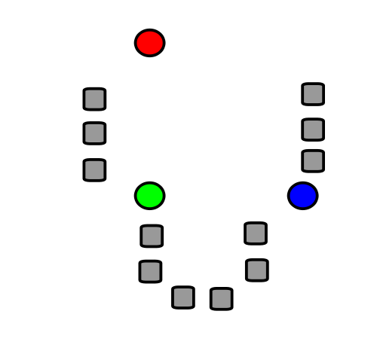
k-means clustering
k = desired number
of clusters
Data set = grey boxes
Let k = 3
Randomly choose 3 points
(points need not be in data set)
3 points = colored circle

Slide 22
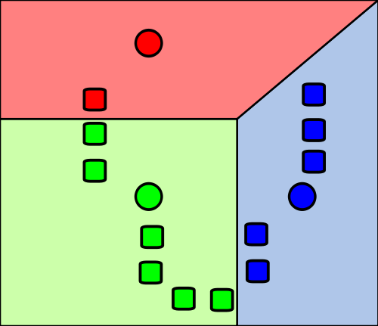
Data set = grey boxes
Let k = 3
Randomly choose 3 points
(points need not be in data set)
3 points = colored circle
Partition data set into 3 voronoi cells corresponding to the 3 colored circles

Slide 23
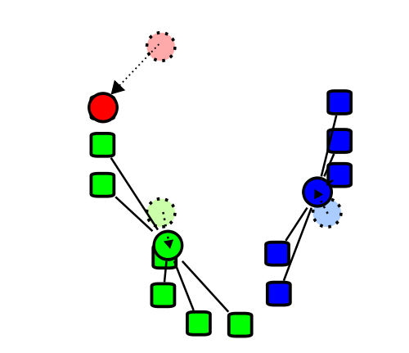
Find the centroids of the data cells in each of the voronoi cells

Slide 24
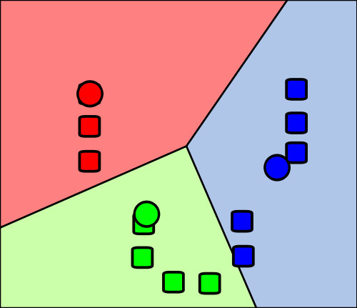
Re-partition data set into 3 voronoi cells corresponding to the 3 centroids

Slide 25
Re-partition data set into 3 voronoi cells corresponding to the 3 centroids
Repeat

Slide 26
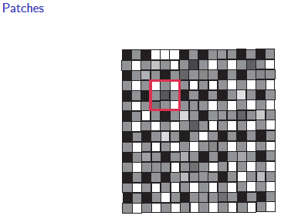
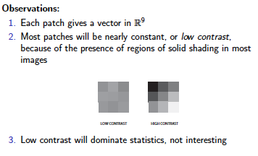
Lee-Mumford-Pedersen [LMP] study only high contrast patches.
Collection: 4.5 x 10⁶ high contrast patches from a
collection of images obtained by van Hateren and van der Schaaf
http://www.kyb.mpg.de/de/forschung/fg/bethgegroup/downloads/van-hateren-dataset.html

Slide 27
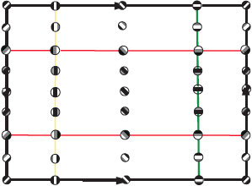
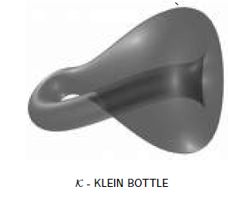
M(100, 10) U Q
where |Q| = 30
On the Local Behavior of Spaces of Natural Images, Gunnar Carlsson, Tigran Ishkhanov, Vin de Silva, Afra Zomorodian, International Journal of Computer Vision 2008, pp 1-12.

Slide 28
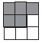
is a point in S⁷
Data set M has over 4 × 10⁶ points in S⁷.
Randomly choose 5000 points.
Take the T% densest points.
Choose a subset of 50 Landmark points.
http://www.ima.umn.edu/2005-2006/PISG7.10-28.06/activities/carlsson/mississippitwo.pdf

Slide 29
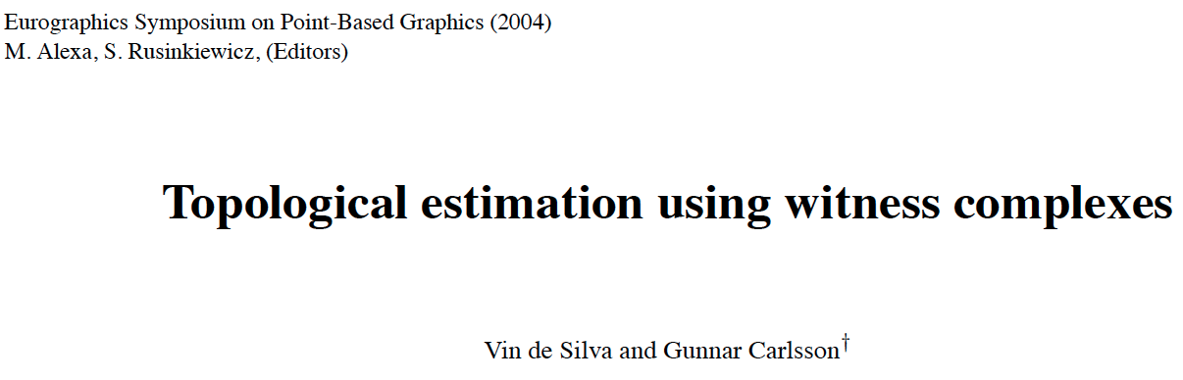
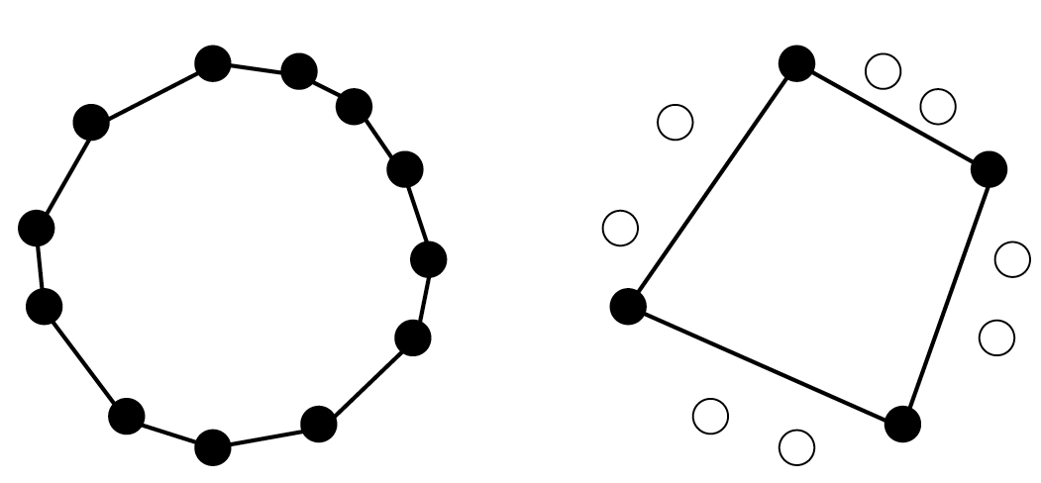
comptop.stanford.edu/preprints/witness.pdf

Slide 30
Witness complex
Let D = set of point cloud data points.
Choose L D, L = set of landmark points.
U

Slide 31
Witness complex
Let D = set of point cloud data points.
Choose L D, L = set of landmark points.
Normally L is a small subset, but in this example, L is a large red subset.
U

Slide 32
W∞(D) = Witness complex
v₀,v₁,...,v_{k} span a k-simplex
iff
there is a point w ∈ D, whose k+1 nearest
neighbours in L are v₀,v₁,...,v_{k}
and all the faces of {v₀,v₁,...,v_{k}} belong to the witness complex.
w is called a “weak” witness.
Let D = set of point cloud data points.
Choose L D,
L = set of landmark points = vertices.
U

Slide 33
W∞(D) = Witness complex
v₀,v₁,...,v_{k} span a k-simplex
iff
there is a point w ∈ D, whose k+1 nearest
neighbours in L are v₀,v₁,...,v_{k}
and all the faces of {v₀,v₁,...,v_{k}} belong to the witness complex.
w is called a “weak” witness.
Let D = set of point cloud data points.
Choose L D,
L = set of landmark points = vertices.
U

Slide 34
W₁(D) = Lazy witness complex
Let L = set of landmark points.
1-skeletion of W₁(D) = 1-skeletion of W∞ (D).
Create the flag (or clique) complex:
Add all possible simplices of dimensional > 1.

Slide 35
W₁(D) = Lazy witness complex
Let L = set of landmark points.
1-skeletion of W₁(D) = 1-skeletion of W∞ (D).
Create the flag (or clique) complex:
Add all possible simplices of dimensional > 1.

Slide 36
W₁(D) = Lazy witness complex
Let L = set of landmark points.
1-skeletion of W₁(D) = 1-skeletion of W∞ (D).
Create the flag (or clique) complex:
Add all possible simplices of dimensional > 1.

Slide 37
Choosing Landmark points:
A.) Random
B.) Maxmin
1.) choose point l₁ randomly
2.) If {l₁, …, l_{k-1}} have been chosen, choose l_{k} such that {l₁, …, l_{k-1}} is in D - {l₁, …, l_{k-1}} and
min {d(l_{k}, l₁), …, d(l_{k}, l_{k-1})} ≥ min {d(v, l₁), …, d(v, l_{k-1})}

Slide 38
Choosing Landmark points
Notes:
data points.
In this very simplified case my data points lie in a two-dimensional plane. Normally data points are high dimensional.
For example, I may be comparing the expression or thousands of genes in tumor cells to healthy cells using microarray data. OR I might be comparing politicians voting records. Or I might be comparing the stats of basketball players. These three applications were all, by the way, published by Lum et al this past February in Nature’s Scientific Reports. I have included a link to their paper on my youtube site.
http://www.nature.com/srep/2013/130207/srep01236/full/srep01236.html

Slide 39
Choosing Landmark points
Notes:
data points.
In this very simplified case my data points lie in a two-dimensional plane. Normally data points are high dimensional.
For example, I may be comparing the expression or thousands of genes in tumor cells to healthy cells using microarray data. OR I might be comparing politicians voting records. Or I might be comparing the stats of basketball players. These three applications were all, by the way, published by Lum et al this past February in Nature’s Scientific Reports. I have included a link to their paper on my youtube site.
http://www.nature.com/srep/2013/130207/srep01236/full/srep01236.html

Slide 40
Choosing Landmark points
Notes:
data points.
In this very simplified case my data points lie in a two-dimensional plane. Normally data points are high dimensional.
For example, I may be comparing the expression or thousands of genes in tumor cells to healthy cells using microarray data. OR I might be comparing politicians voting records. Or I might be comparing the stats of basketball players. These three applications were all, by the way, published by Lum et al this past February in Nature’s Scientific Reports. I have included a link to their paper on my youtube site.
http://www.nature.com/srep/2013/130207/srep01236/full/srep01236.html

Slide 41
Choosing Landmark points
Notes:
data points.
In this very simplified case my data points lie in a two-dimensional plane. Normally data points are high dimensional.
For example, I may be comparing the expression or thousands of genes in tumor cells to healthy cells using microarray data. OR I might be comparing politicians voting records. Or I might be comparing the stats of basketball players. These three applications were all, by the way, published by Lum et al this past February in Nature’s Scientific Reports. I have included a link to their paper on my youtube site.
http://www.nature.com/srep/2013/130207/srep01236/full/srep01236.html

Slide 42
Choosing Landmark points
Notes:
data points.
In this very simplified case my data points lie in a two-dimensional plane. Normally data points are high dimensional.
For example, I may be comparing the expression or thousands of genes in tumor cells to healthy cells using microarray data. OR I might be comparing politicians voting records. Or I might be comparing the stats of basketball players. These three applications were all, by the way, published by Lum et al this past February in Nature’s Scientific Reports. I have included a link to their paper on my youtube site.
http://www.nature.com/srep/2013/130207/srep01236/full/srep01236.html

Slide 43
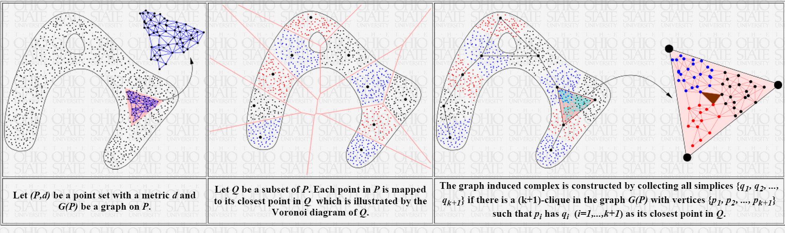
Tamal K. Dey http://www.cse.ohio-state.edu/~tamaldey/ Graph Induced Complex: A Data Sparsifier for Homology Inference
Video: http://www.ima.umn.edu/videos/?id=2497
Slides: http://web.cse.ohio-state.edu/~tamaldey/talk/GIC/GIC.pdf
Paper: http://web.cse.ohio-state.edu/~tamaldey/paper/GIC/GIC.pdf
Graph Induced Complex on Point Data T. K. Dey, F. Fan, and Y. Wang,
(SoCG 2013) Proc. 29th Annu. Sympos. Comput. Geom. 2013, 107-116.
Website: http://web.cse.ohio-state.edu/~tamaldey/GIC/gic.html
The efficiency of extracting topological information from point data depends largely on the complex that is built on top of the data points. From a computational viewpoint, the most favored complexes for this purpose have so far been Vietoris-Rips and witness complexes. While the Vietoris-Rips complex is simple to compute and is a good vehicle for extracting topology of sampled spaces, its size is huge--particularly in high dimensions. The witness complex on the other hand enjoys a smaller size because of a subsampling, but fails to capture the topology in high dimensions unless imposed with extra structures. We investigate a complex called the {em graph induced complex} that, to some extent, enjoys the advantages of both. It works on a subsample but still retains the power of capturing the topology as the Vietoris-Rips complex. It only needs a graph connecting the original sample points from which it builds a complex on the subsample thus taming the size considerably. We show that, using the graph induced complex one can (i) infer the one dimensional homology of a manifold from a very lean subsample, (ii) reconstruct a surface in three dimension from a sparse subsample without computing Delaunay triangulations, (iii) infer the persistent homology groups of compact sets from a sufficiently dense sample. We provide experimental evidences in support of our theory.

