Slide 1
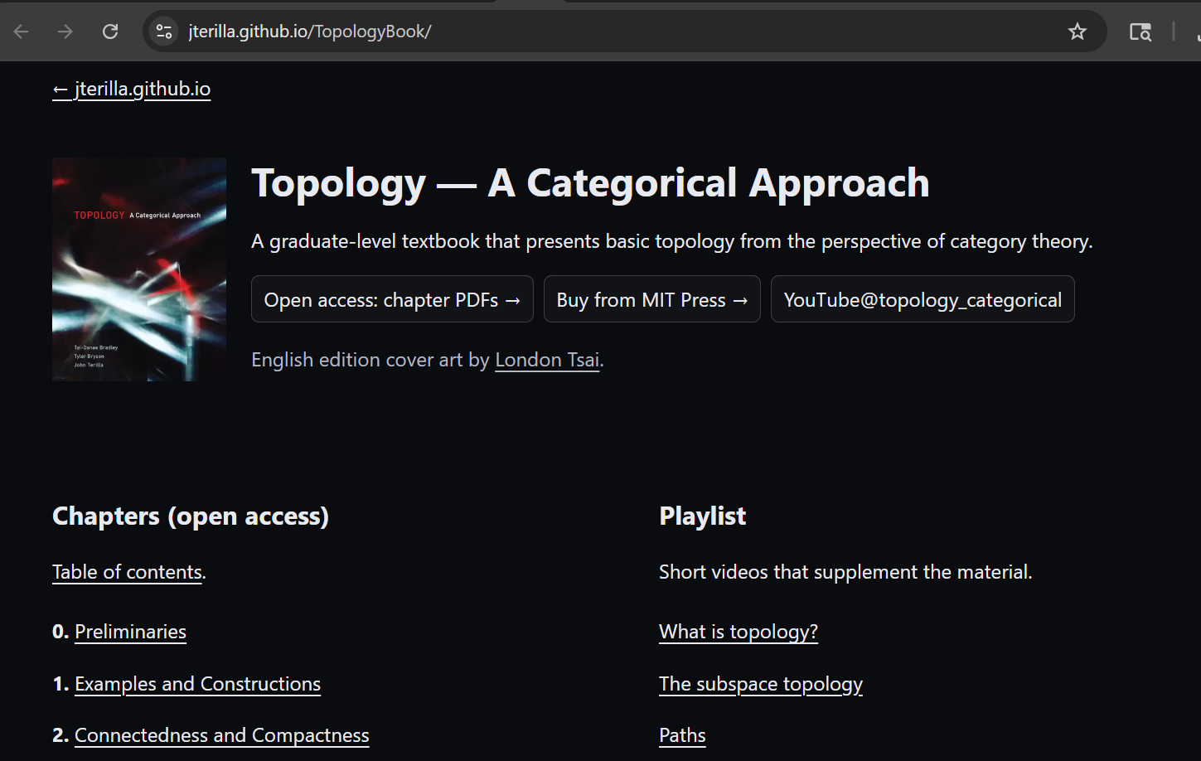
https://jterilla.github.io/TopologyBook oo/
You can create a website in github via pages or …

Slide 2
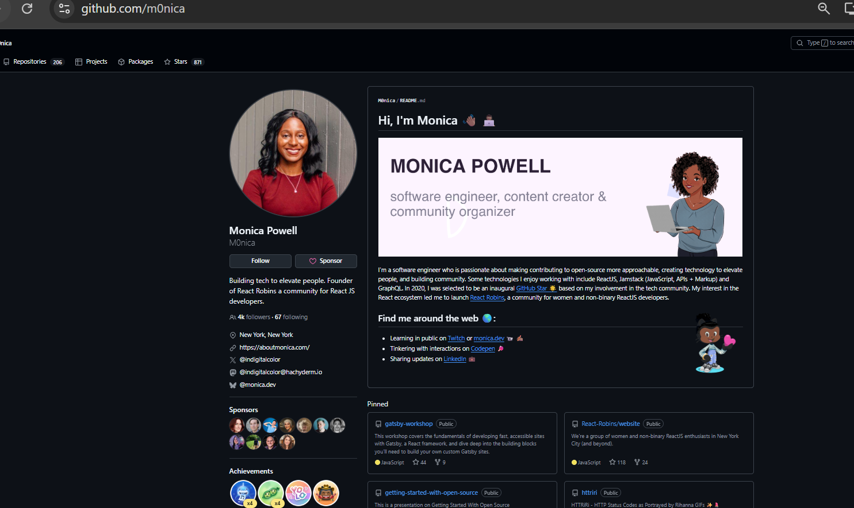
You can also have a simpler github profile README (in addition or instead of website)
https://github.com/m0nica

Slide 3

https://www.aboutmonica.com/blog/how-to-create-a-github-profile-readme/

Slide 4
To create a repository in github (including one containing your website), you can
1.) work locally on your computer and use git to transfer files back/forth to github
2.) Use github without git.

Slide 5
From George’s intro:
Install Git!
Mac:
▶ open Terminal
▶ type git --version
▶ follow instructions if not installed
Windows:
▶ go to https://git-scm.com/download/win
Linux:
▶ Ubuntu/Debian: sudo apt install git-all
▶ Fedora(-flavored): sudo dnf install git-all
▶ Other: look it up: https://git-scm.com/download/linux
Git Config
To be able to collaborate, Git needs to know who you are. Run the following using the values you used for making your GitHub account:
▶ git config --global user.name "Your Name"
▶ example: git config --global user.name “idarcy"
▶ git config --global user.email name@uiowa.edu
▶ example: git config --global user.email Isabel-darcy@uiowa.edu
Only need to do the above once.
Since you have already done this, you don’t need to do it again unless you change computers.
Use git

Slide 6
Useful commands
pwd: print working directory (get name of current directory).
ls: lists files in your current working directory.
ls -lrt: lists all files in your current working directory in reverse chronological order.
man ls: get the manual for ls include all options such as –l –r –t.
man foo: get the manual for foo.
mkdir foo: make (create) a directory named foo.
cd foo: change directory to move into subdirectory foo.
cd ../: change directory to up to the parent directory
cd ../foo1/foo2: change directory to move up into the foo1 directory and then into the foo2 subdirectory
You can use any text editor you like such as notepad, notepad++ or you can open a text editor in the command window.
nano filename: opens filename (creates it if it does not exist if you save before exiting).

Slide 7
Make sure you are in the directory you want to be in.
When using powershell on windows, the default directory is my uiowa math department directory. To change to my documents directory on my laptop
PS H:\> cd C:
PS C:\> cd Users\idarcy\Documents
PS C:\Users\idarcy\Documents
If I wanted to modify my uiowa website, I would cd into the W: directory

Slide 8
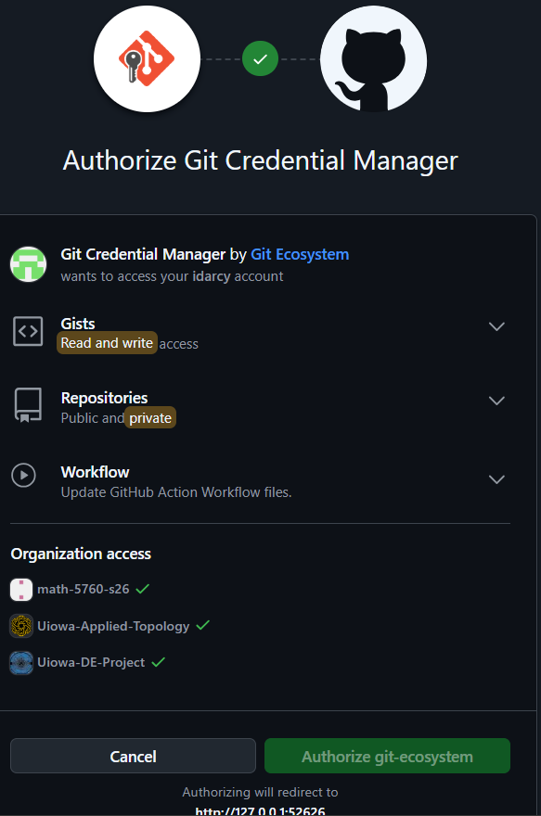
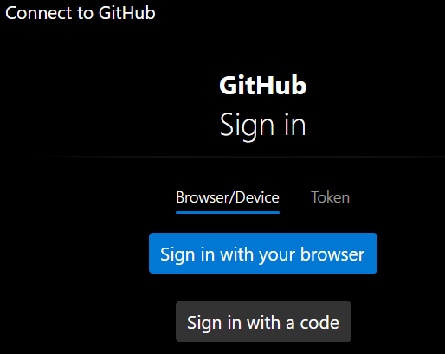
https://git-scm.com/cheat-sheet
Start a new repo: type the following command when in the
directory that you want to turn into a repository
git init
Example:
mkdir gitfolder
cd gitfolder
git init
Clone an existing repo: git clone <url>
Example:
git clone https://github.com/idarcy/umap_intro
git clone https://github.com/uiowa-mgb/personal-site-template
You may wish to fork the mgb website instead (fork is a github command, not a git command).
See https://github.com/uiowa-mgb/personal-site-template/wiki

Slide 9
We will create our website using orcid (optional) and copilot
Go to https://orcid.org/ to create your “free, unique, persistent identifier (PID)” and add information about you.
1’) Alternatively use your CV
2.) Ask Microsoft copilot to create your website by pointing it to https://orcid.org/your PID or by uploading your CV
3.) Download into a directory that you have or will connect to github or upload directly to github.

Slide 10
From copilot via Microsoft 365
How to deploy to GitHub Pages (3 minutes) Create a new repository on GitHub (e.g., isabel-darcy.github.io or any name you like). Upload the zip above, then “Add file → Upload files” and drag the contents in (keep the site/ folder structure). In Settings → Pages, set: Source: Deploy from a branch Branch: main (or master) Folder: /site (because the index.html lives under site/) Save—your site will publish in ~30–90 seconds. The page automatically loads your public ORCID data at runtime. [info.orcid.org]

Slide 11
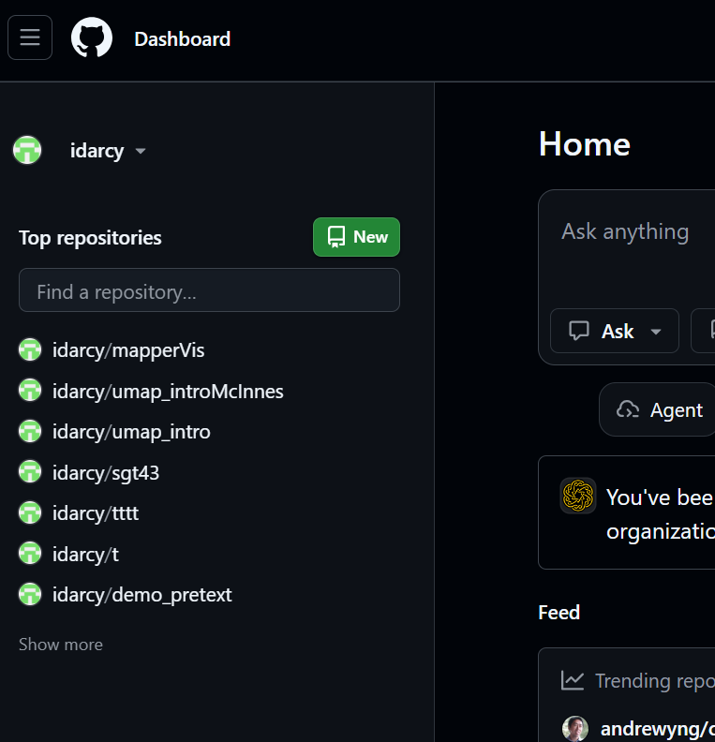
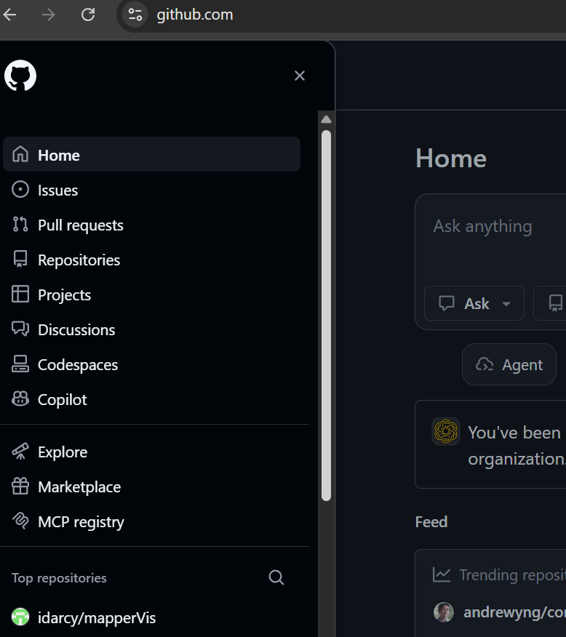

Slide 12
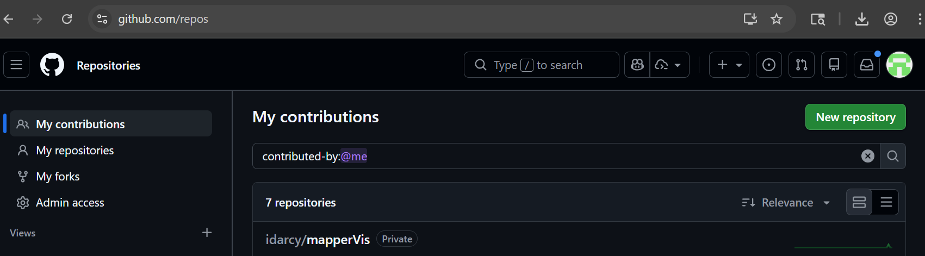

Slide 13
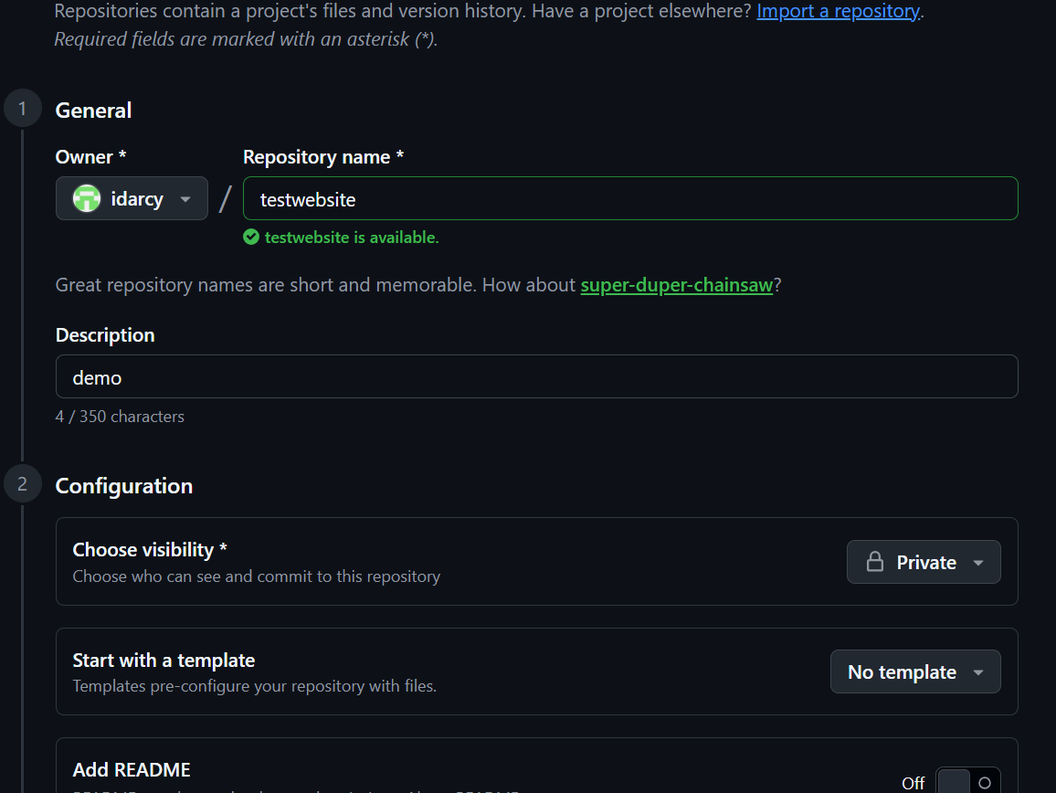
You may want public

Slide 14
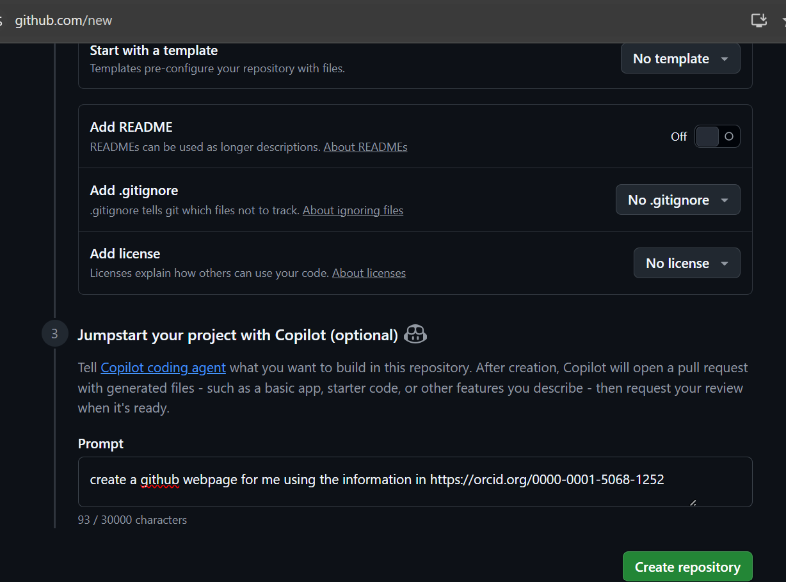

Slide 15
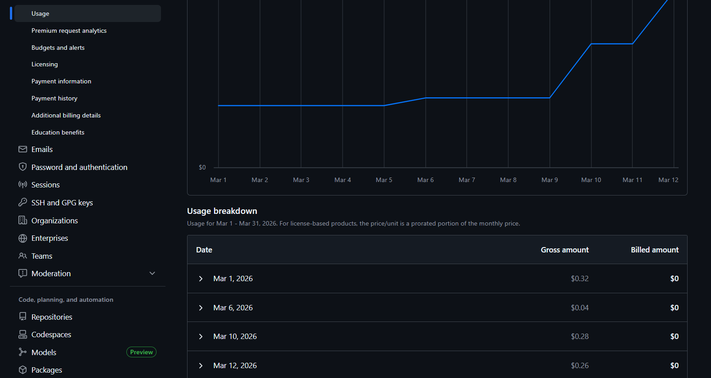

Slide 16
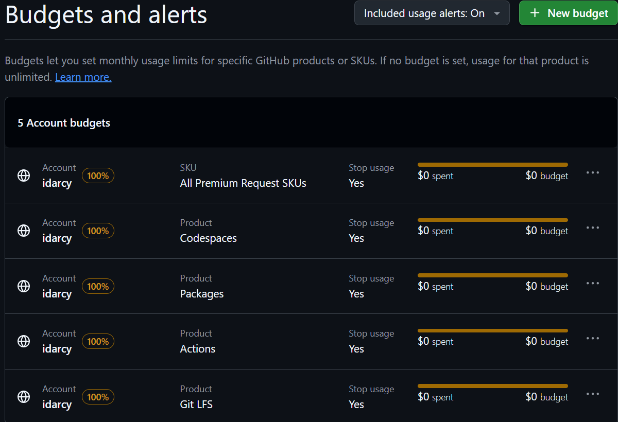
https://github.com/settings/billing/budgets

Slide 17
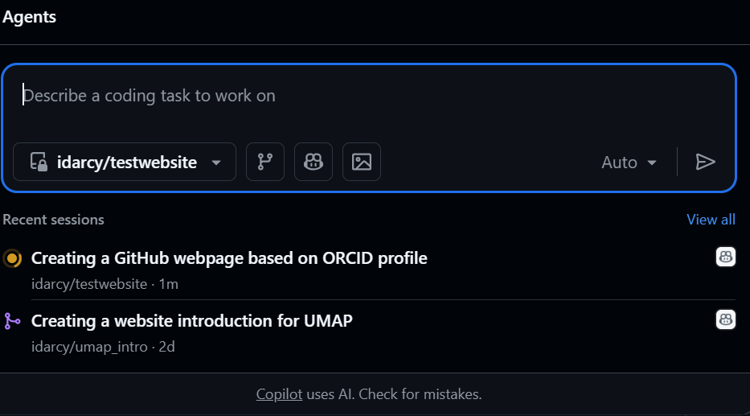

Slide 18
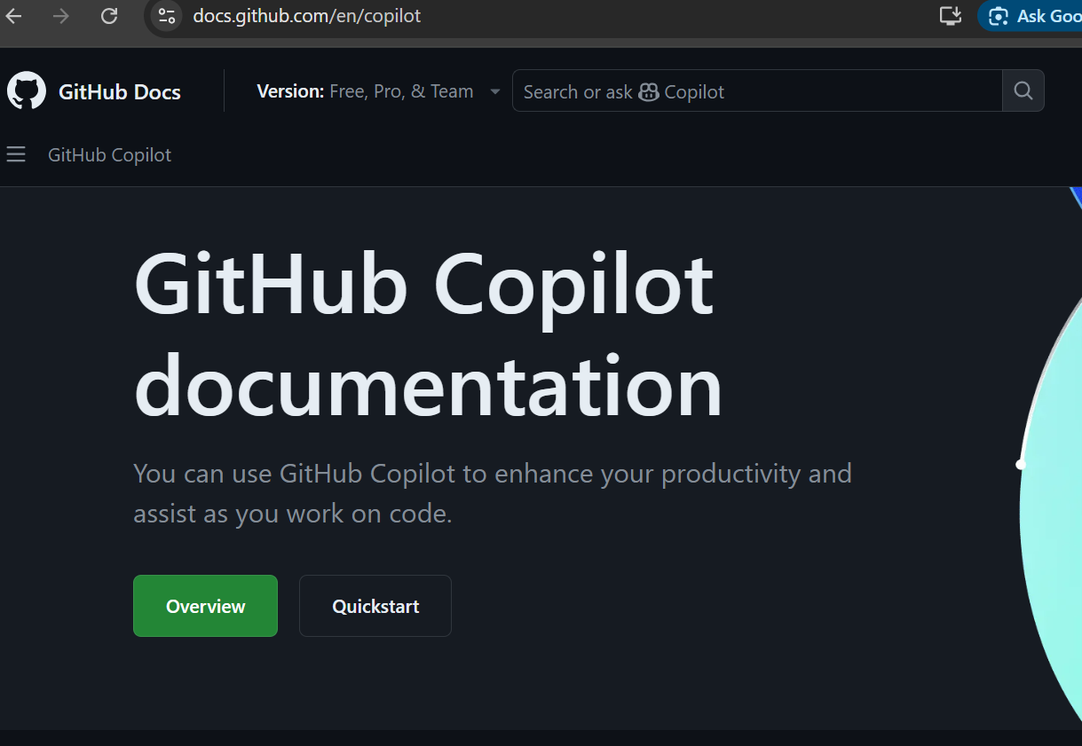
https://docs.github.com/en/copilot

Slide 19
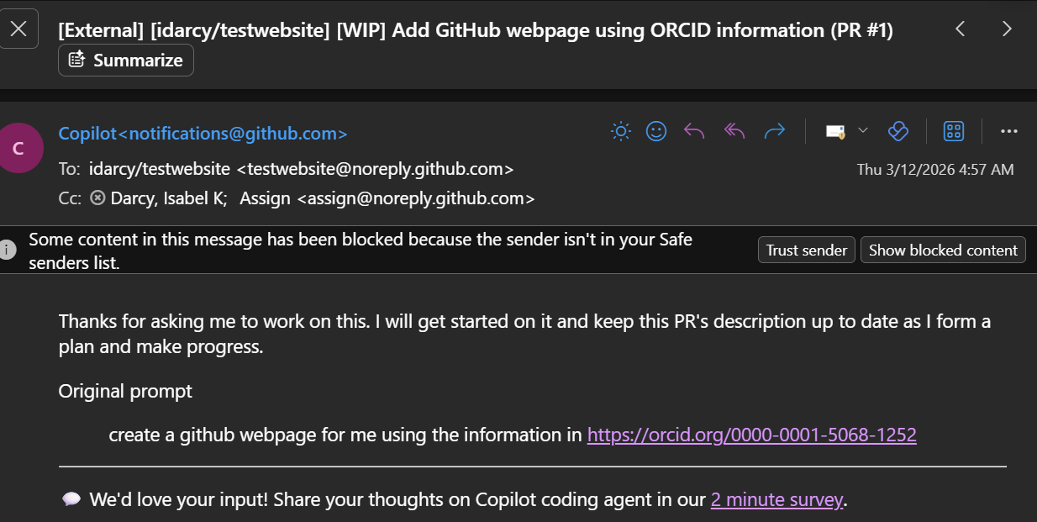

Slide 20
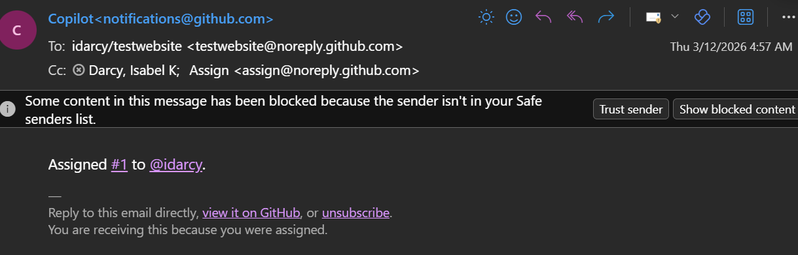

Slide 21
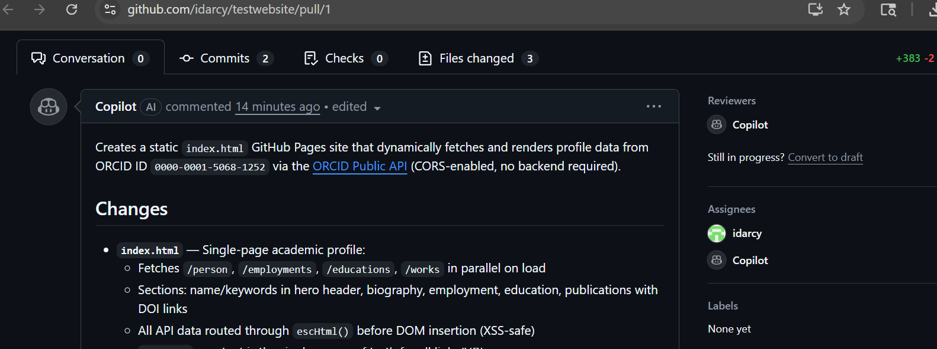
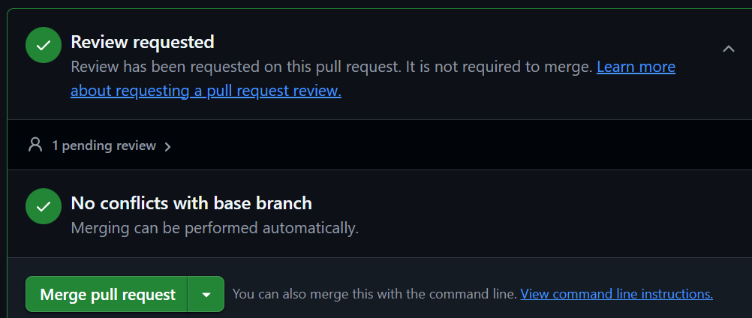

Slide 22
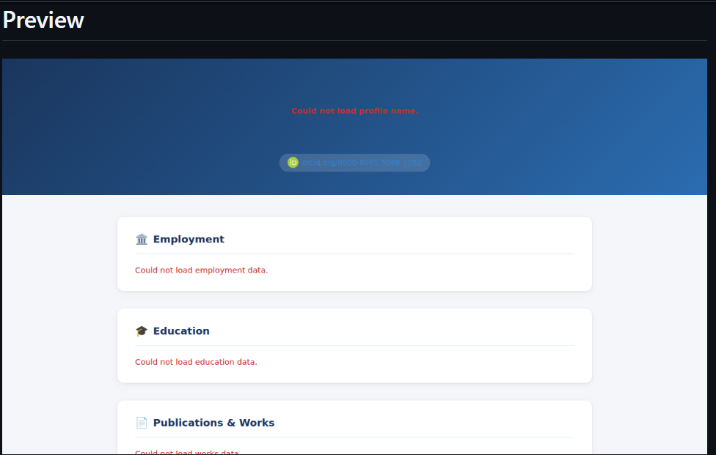

Slide 23
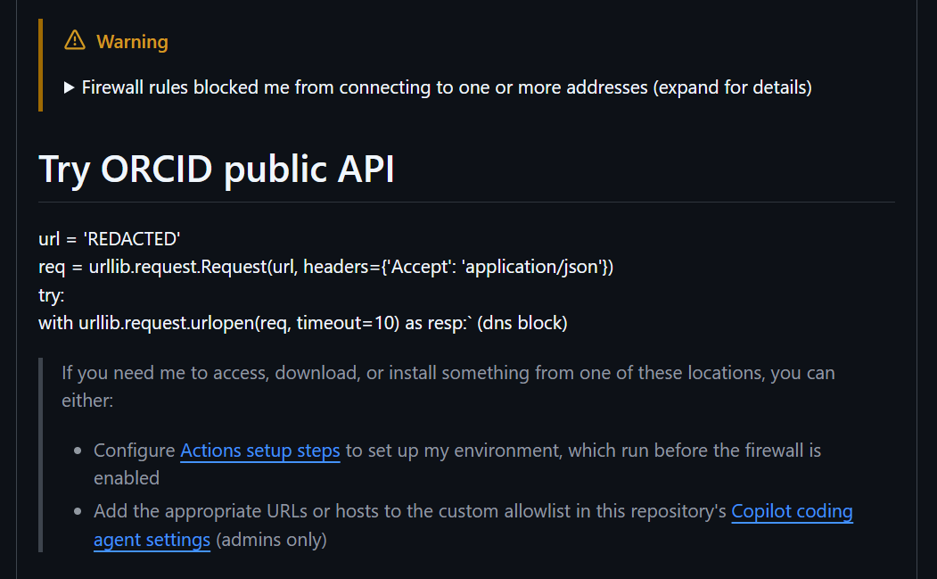

Slide 24
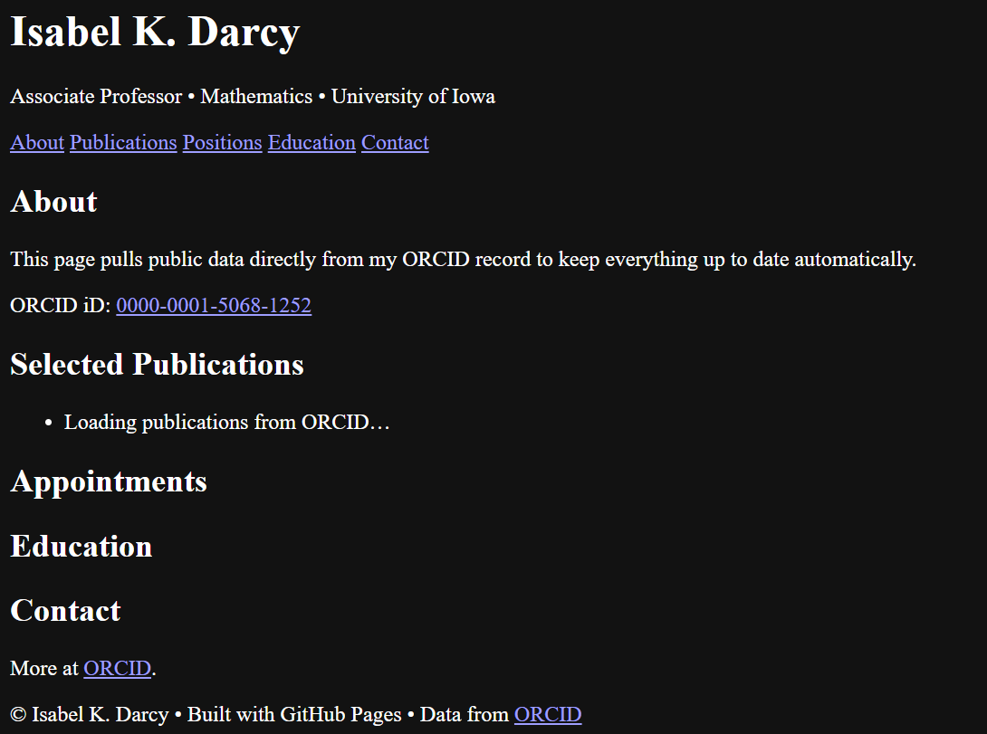
Created using Microsoft 365 copilot

Slide 25
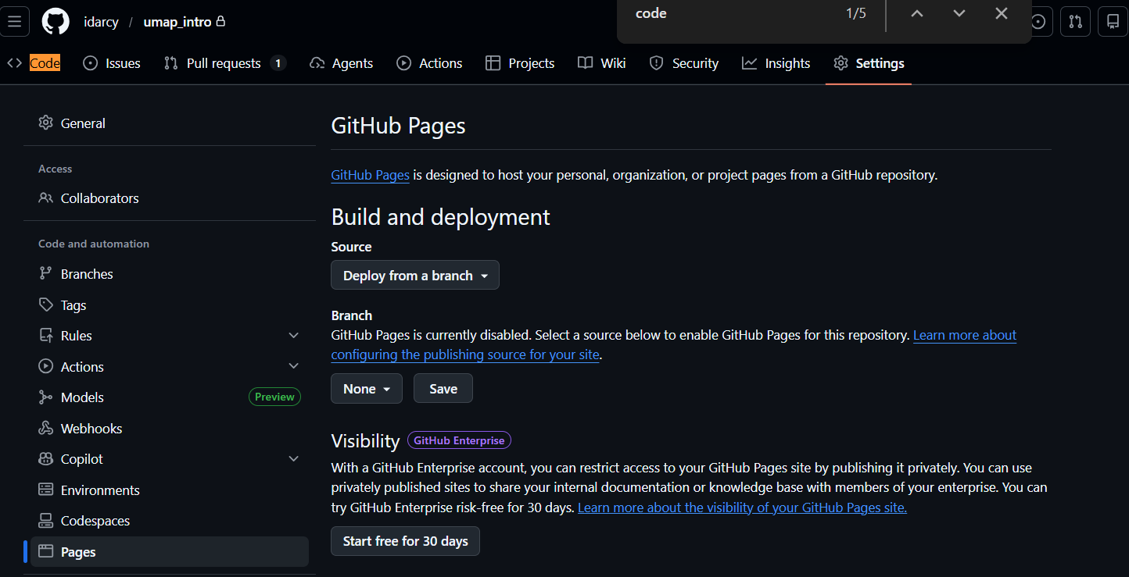
After you create your website, you need to deploy it.

Slide 26
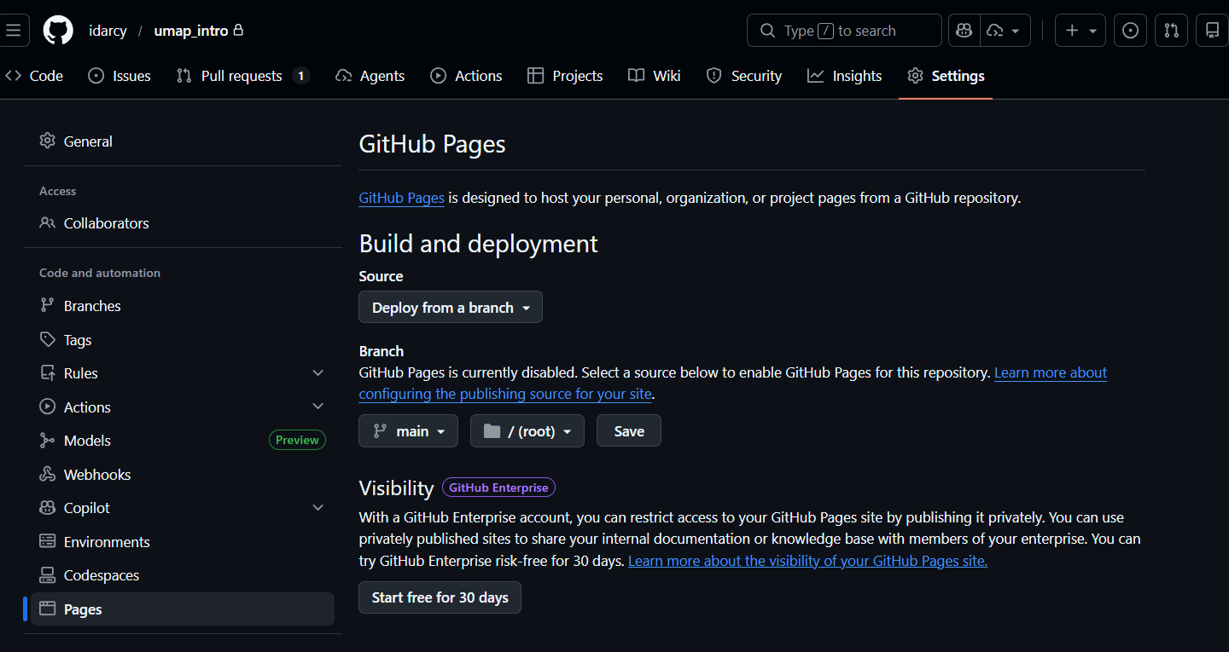

Slide 27
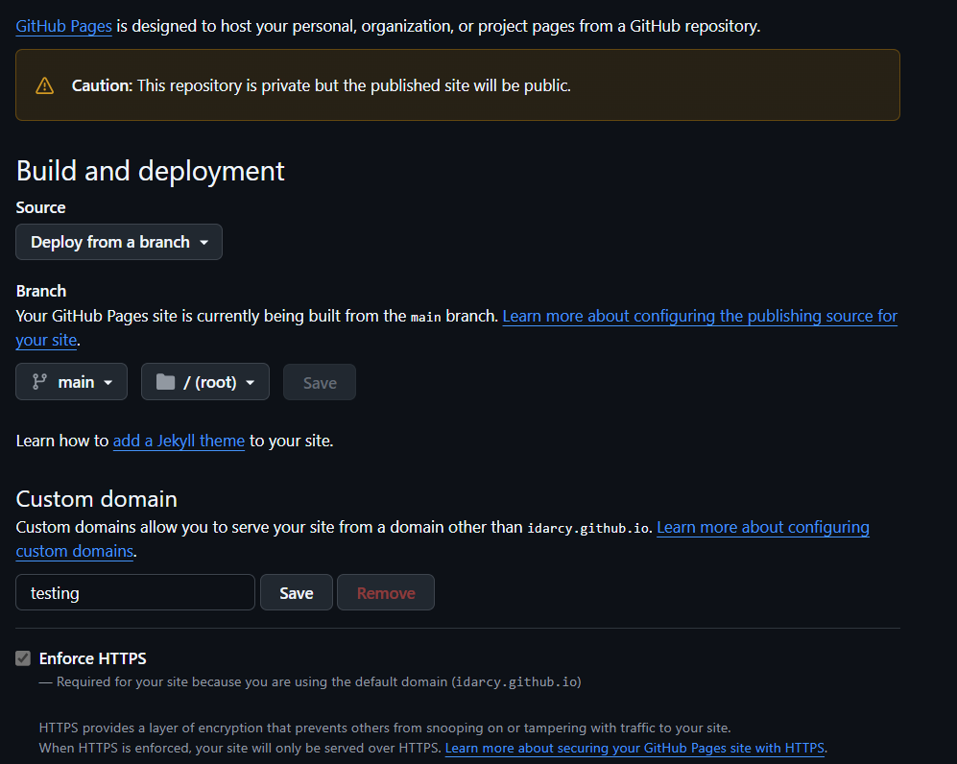

Slide 28
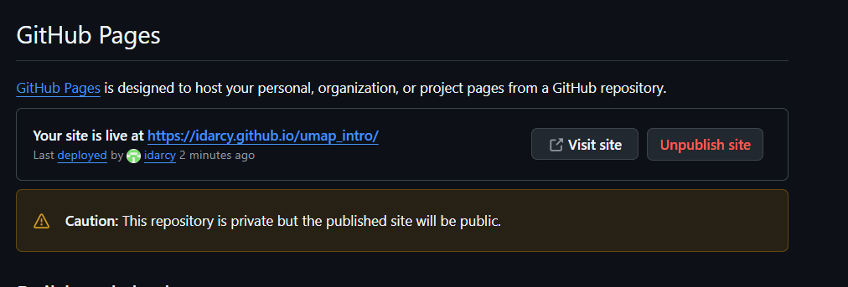

Slide 29
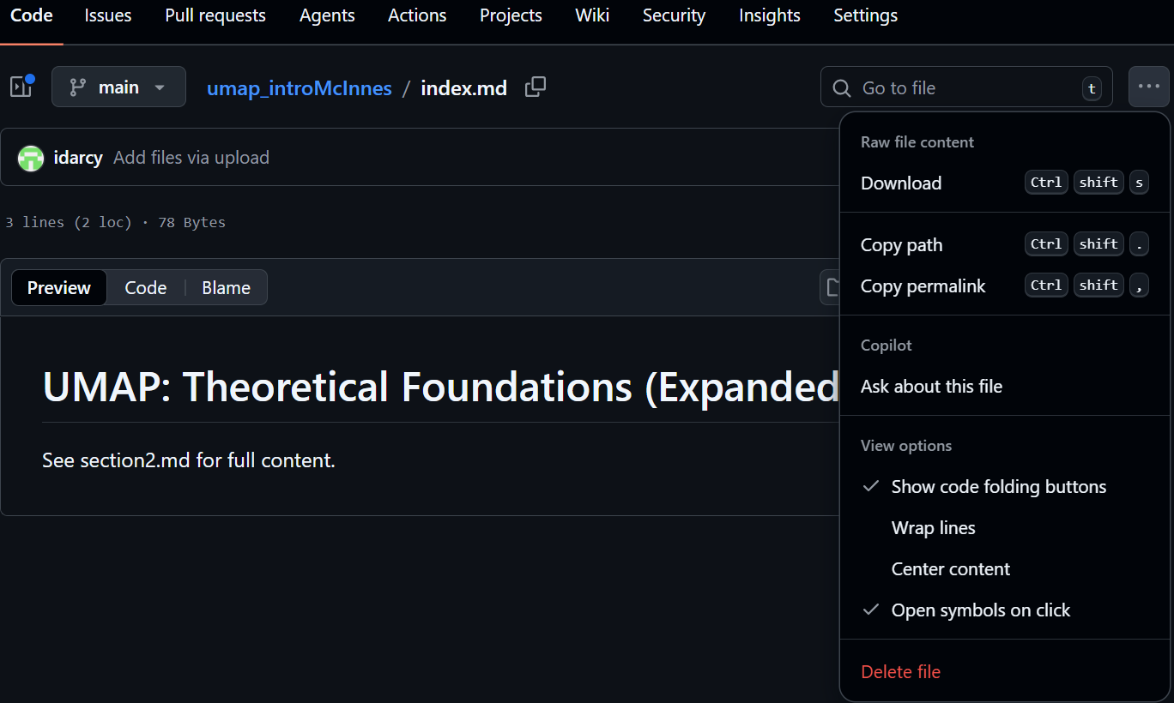
You can delete files working locally on your computer and using git, but you can also directly delete files in github

