Slide 1
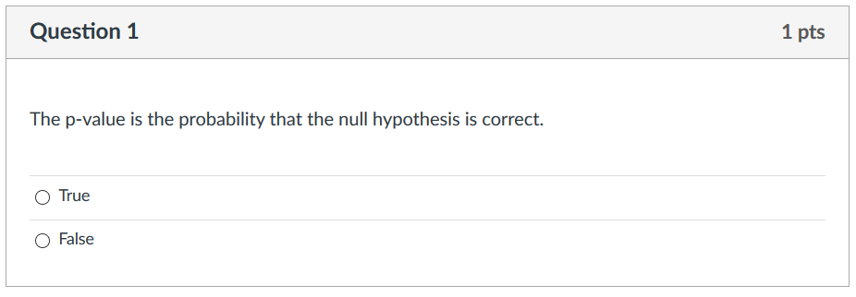
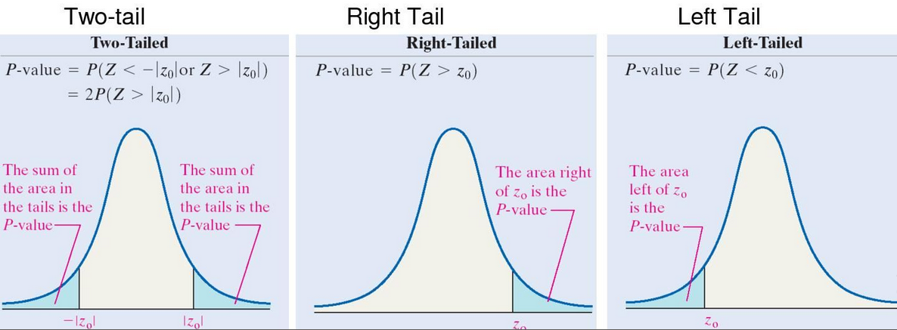
https://i.pinimg.com/originals/4d/96/f0/4d96f07215c63818917df1be3ec4b79c.jpg

Slide 2
The answer is false per the references below.
The p value is the probability of a result at least as extreme as the sample result if the null hypothesis were true.
Note the hypothesis is that the null hypothesis is true.
Given this hypothesis (that the null hypothesis is true), then the p-value gives you the probability of obtaining the sample result.
But we need the assumption that the null hypothesis is true.
To calculate the p-value, we first generate a distribution of some statistic (such as the F-statistic) using data where the null hypothesis is true. We can then compare the sample result (the data we are testing) to this distribution to see how extreme it is compared to the data where the null hypothesis is true.
https://opentext.wsu.edu/carriecuttler/chapter/13-1-understanding-null-hypothesis-testing/
https://www.ncbi.nlm.nih.gov/pmc/articles/PMC5804470/
and https://lsc.cornell.edu/wp-content/uploads/2016/01/P-value.pdf

Slide 3
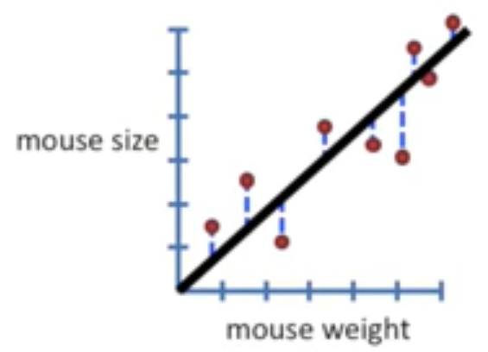
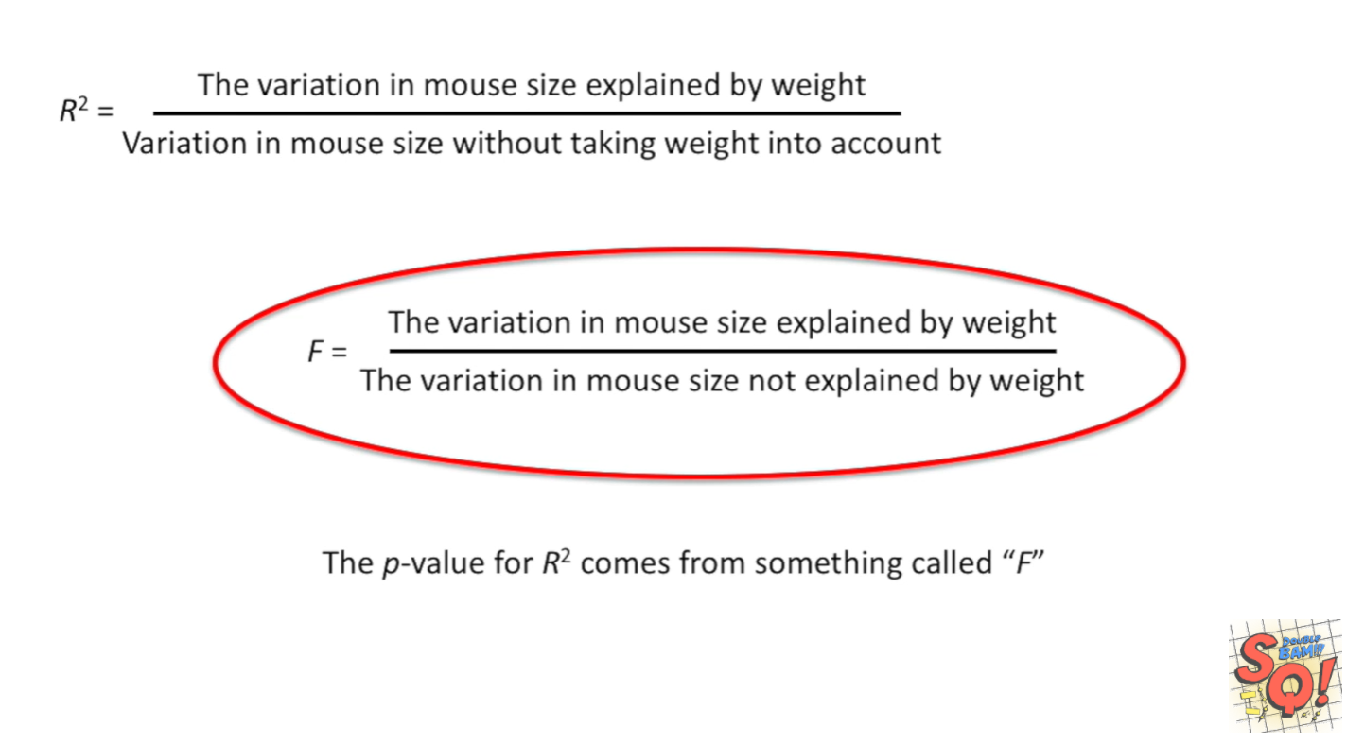
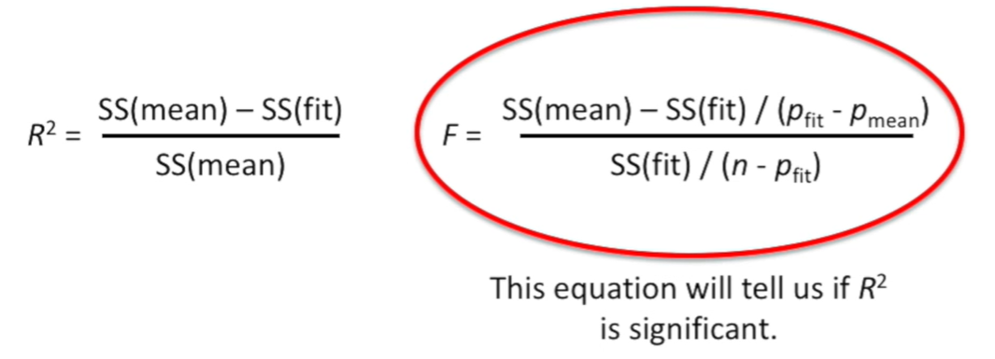
StatQuest: Linear Models Pt.1 - Linear Regression https://www.youtube.com/watch?v=nk2CQITm_eo

Slide 4
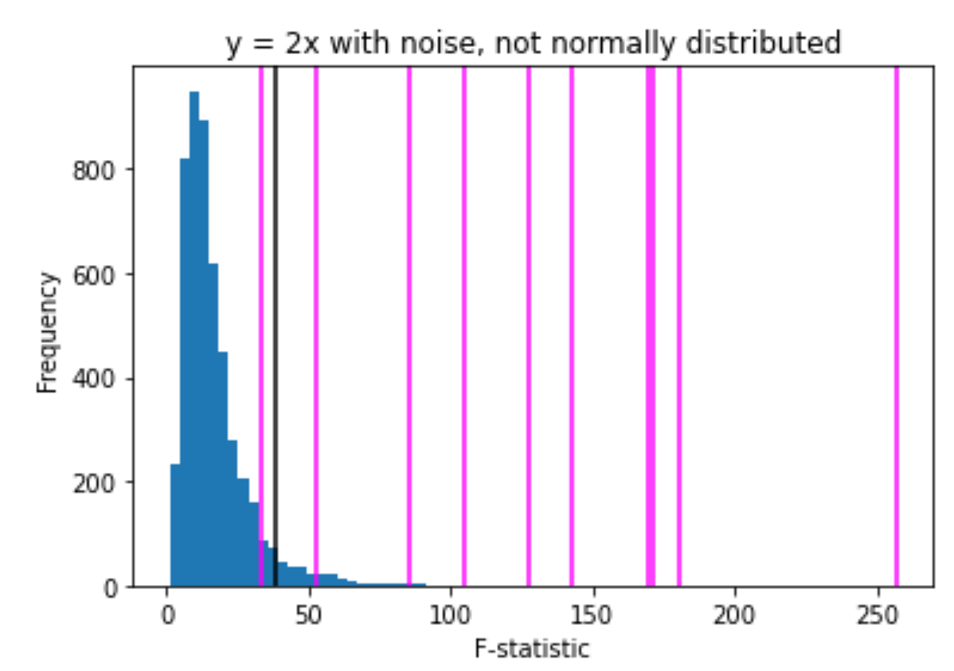
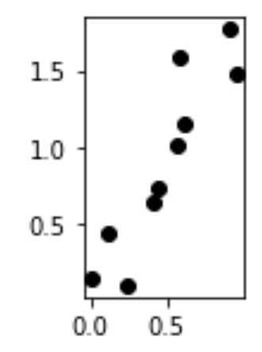
The P value is the probability of obtaining a test statistic at least as extreme as the one that was actually observed, assuming that the null hypothesis is true.
Null hypothesis: the probability that there is no relationship between x and y (i.e. the relationship is null)
False negatives:
There is a relationship between x and y
and
the F-statistic indicates that there is no relationship between x and y
True positive:
There is a relationship between x and y
and
the F-statistic indicates that there is a relationship between x and y

Slide 5
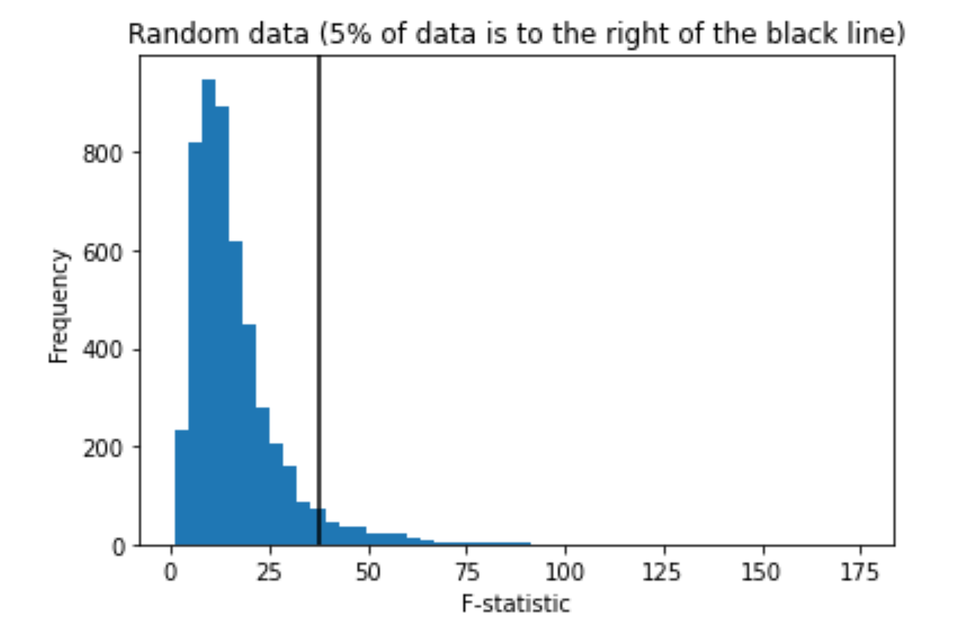
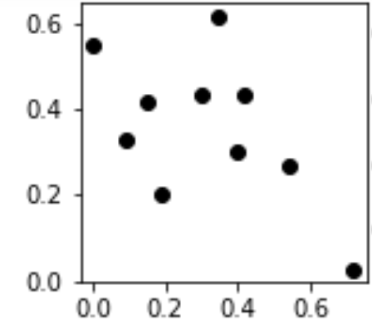
Negative: x does not predict y. There is no relationship between x and y.
The data used to generate the histogram below was randomly generated.
Thus there is no relationship between x and y. Thus the null hypothesis is true for these data sets
True negatives:
There is no relationship between x and y
and
the F-statistic indicates that there is no relationship between x and y
False positive:
There is no relationship between x and y
and
the F-statistic indicates that there is a relationship between x and y

Slide 6
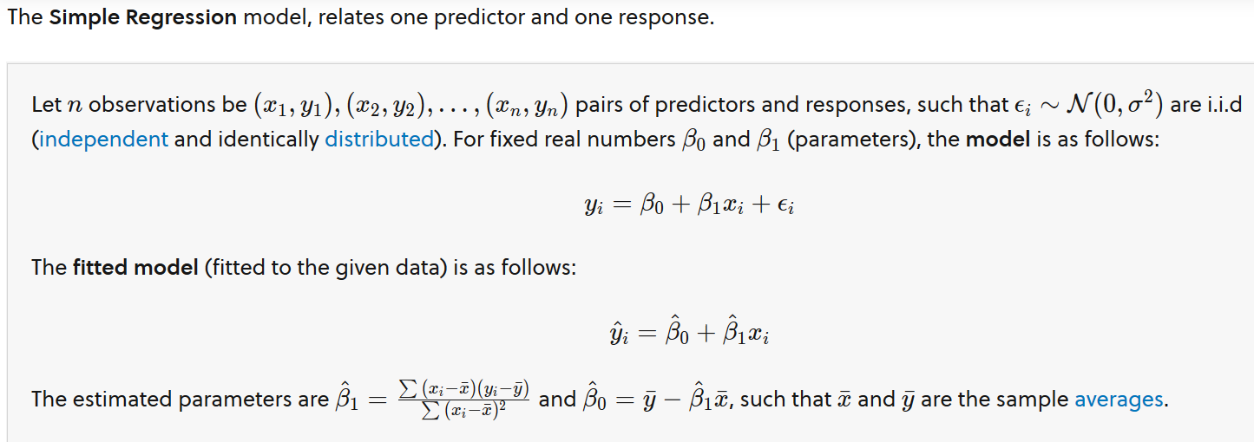
Multivariate Regression. Brilliant.org. Retrieved 19:29, April 16, 2023, from https://brilliant.org/wiki/multivariate-regression/

Slide 7
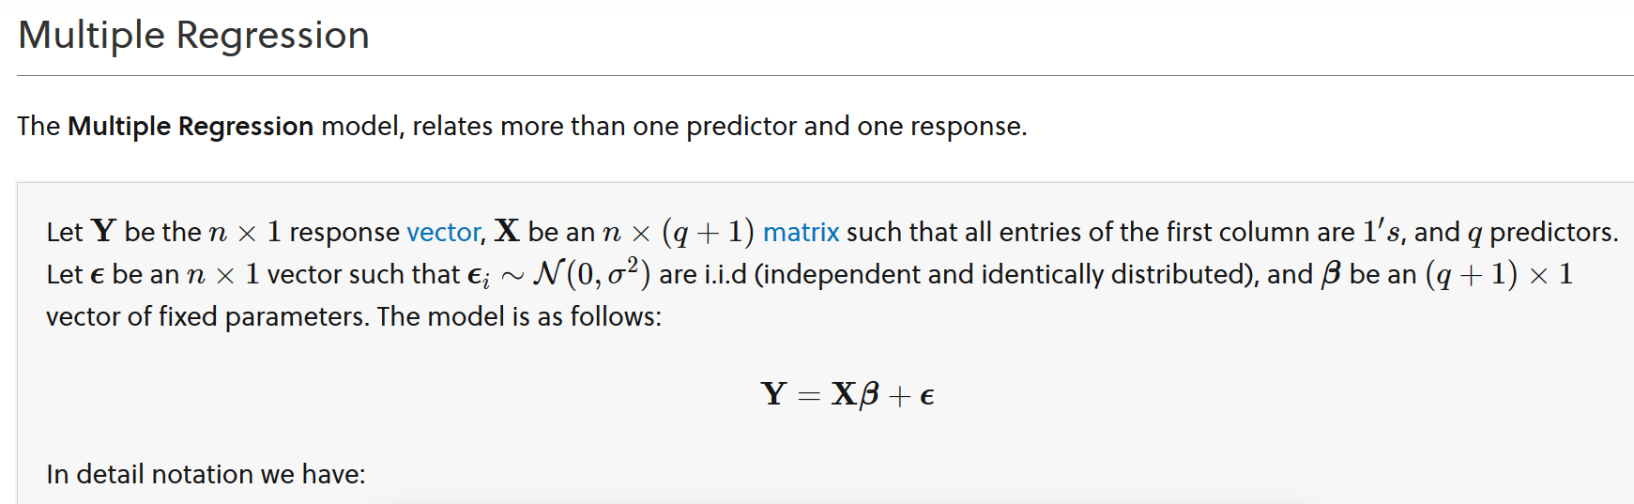
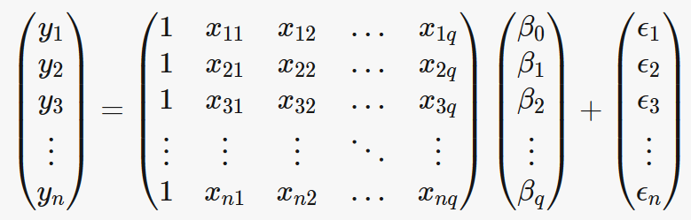
Multiple Variable Regression
Multivariate Regression. Brilliant.org. Retrieved 19:29, April 16, 2023, from https://brilliant.org/wiki/multivariate-regression/

Slide 8
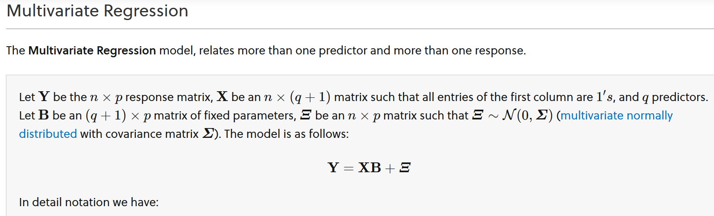
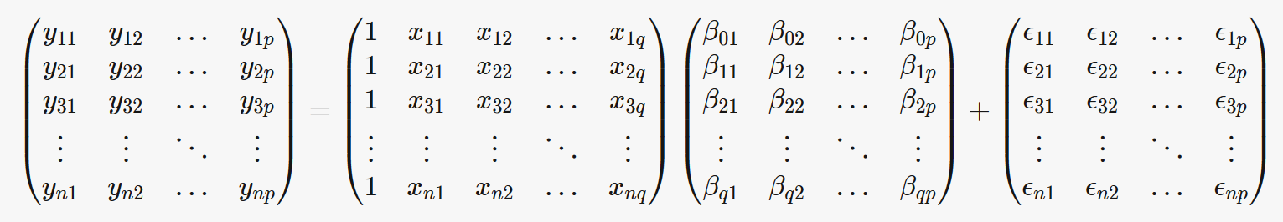
Multivariate Regression. Brilliant.org. Retrieved 19:29, April 16, 2023, from https://brilliant.org/wiki/multivariate-regression/

Slide 9
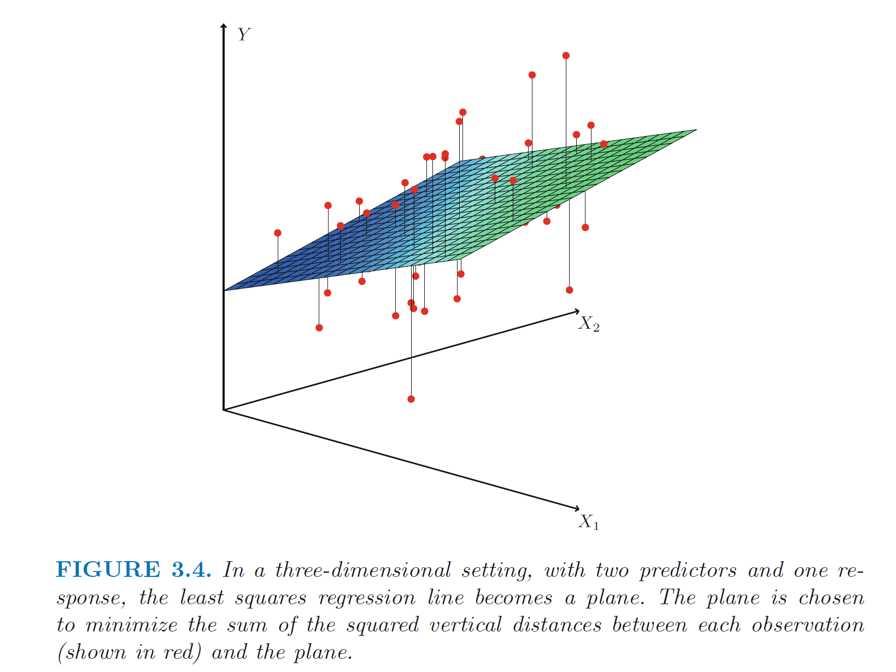
Multivariable
linear regression
(not logistic)
https://www.statlearning.com/

Slide 10
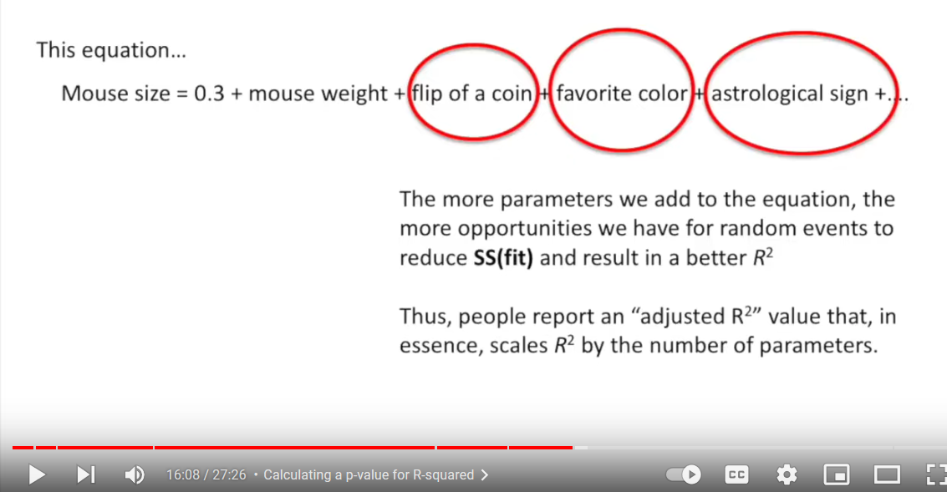
$$f\left(x\right)=a_{0}+a_{1}x_{1}+ax_{2}+⋯+a_{n}x_{n}$$
Overfitting: Too many variables
StatQuest: Linear Models Pt.1 - Linear Regression https://www.youtube.com/watch?v=nk2CQITm_eo

Slide 11
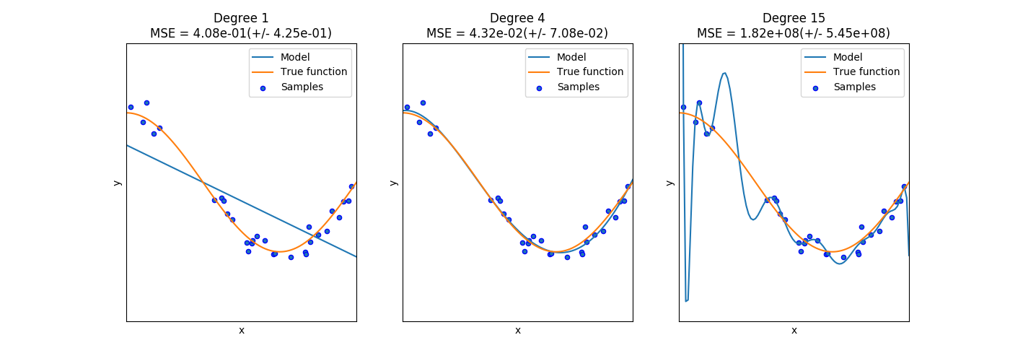
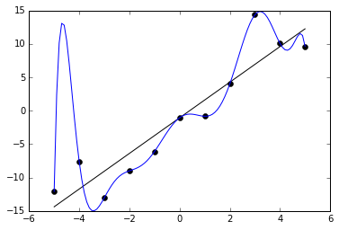
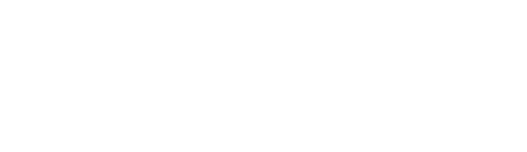
Ivan Meza http://turing.iimas.unam.mx/~ivanvladimir/slides/rpyaa/02_regression.html#/60
Overfitting: Too many parameters
Underfitting versus overfitting
$$Ex: f\left(x\right)=a_{0}+a_{1}x+…+a_{n}x^{n}$$
https://it.wikipedia.org/wiki/Overfitting

Slide 12
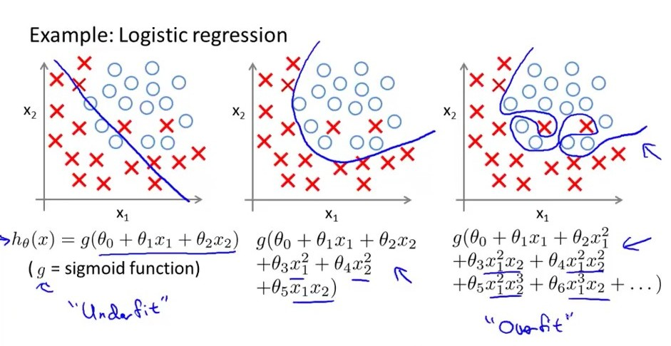
Overfitting: Too many parameters
Underfitting versus overfitting
https://stats.stackexchange.com/questions/71946/overfitting-a-logistic-regression-model

Slide 13
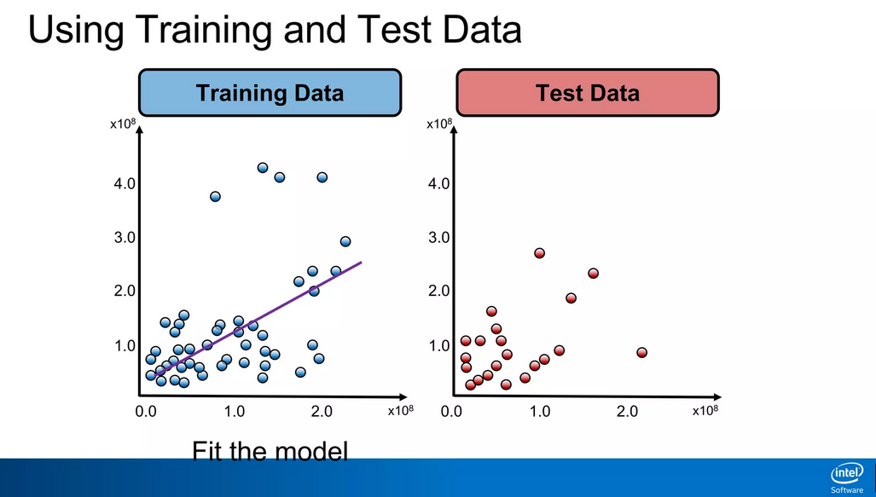
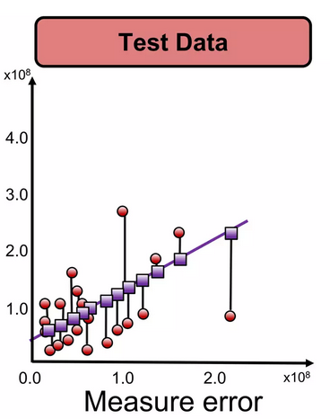
To avoid overfitting due to too many parameters:
https://www.slideshare.net/ankit_ppt/ml2-train-testsplitsvalidationlinearregression

Slide 14
How do you split the data?

Slide 15
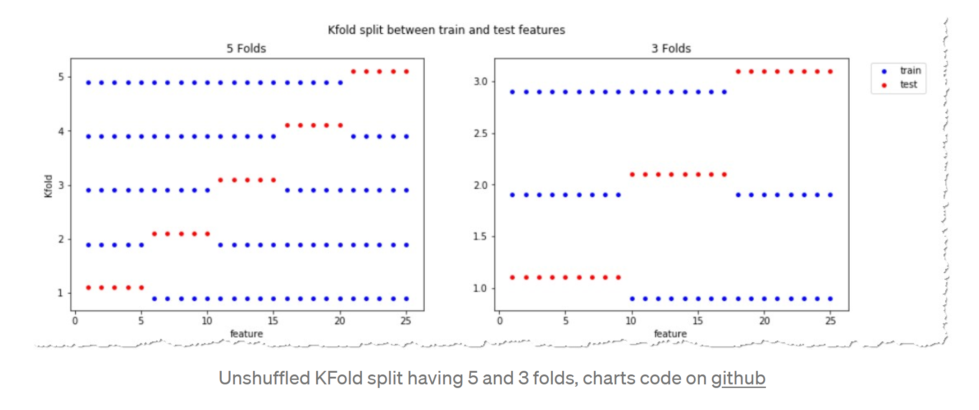
https://towardsdatascience.com/complete-guide-to-pythons-cross-validation-with-examples-a9676b5cac12

Slide 16
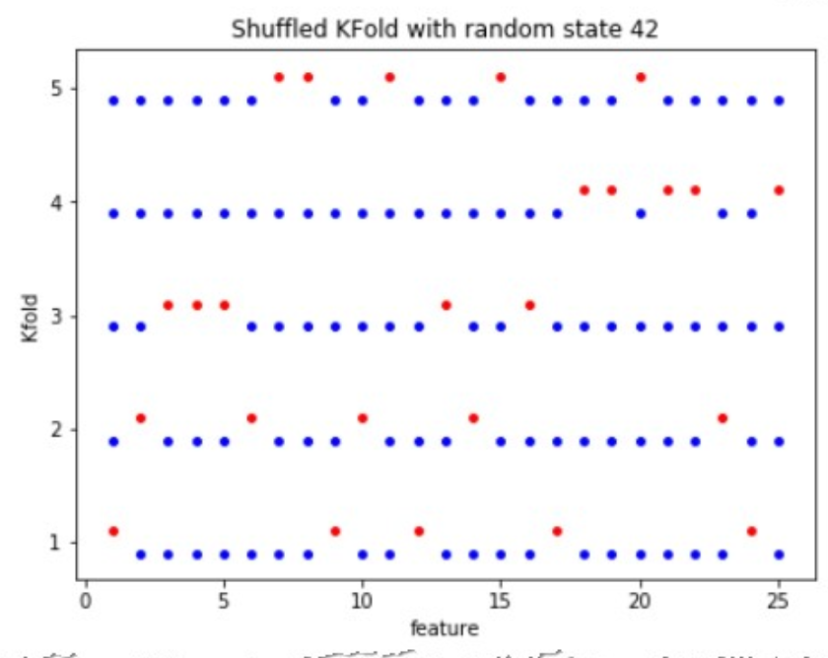
https://towardsdatascience.com/complete-guide-to-pythons-cross-validation-with-examples-a9676b5cac12

Slide 17
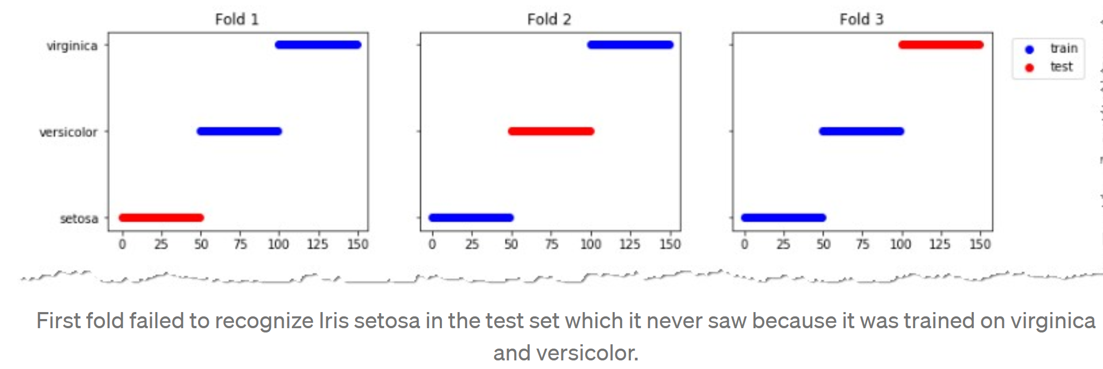
https://towardsdatascience.com/complete-guide-to-pythons-cross-validation-with-examples-a9676b5cac12

Slide 18
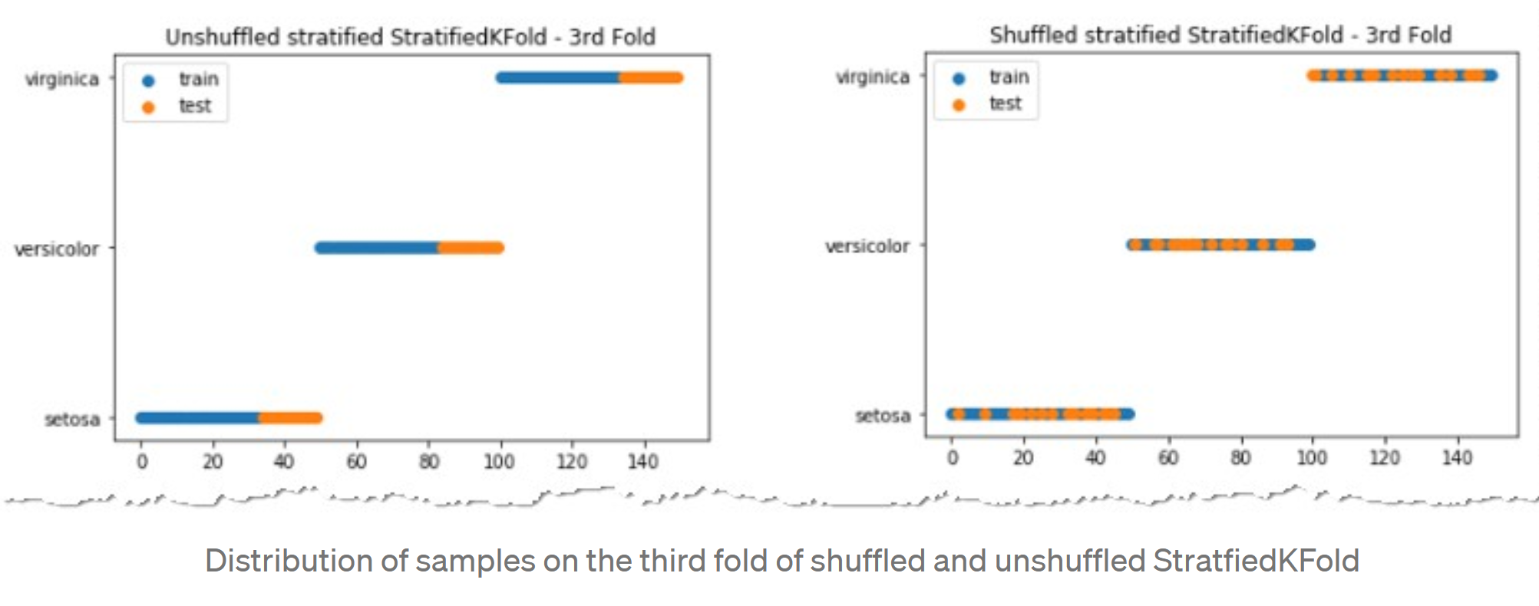
This cross-validation object is a variation of KFold that returns stratified folds. The folds are made by preserving the percentage of samples for each class.
class sklearn.model_selection.StratifiedKFold(n_splits=5, *, shuffle=False, random_state=None)
https://towardsdatascience.com/complete-guide-to-pythons-cross-validation-with-examples-a9676b5cac12

Slide 19
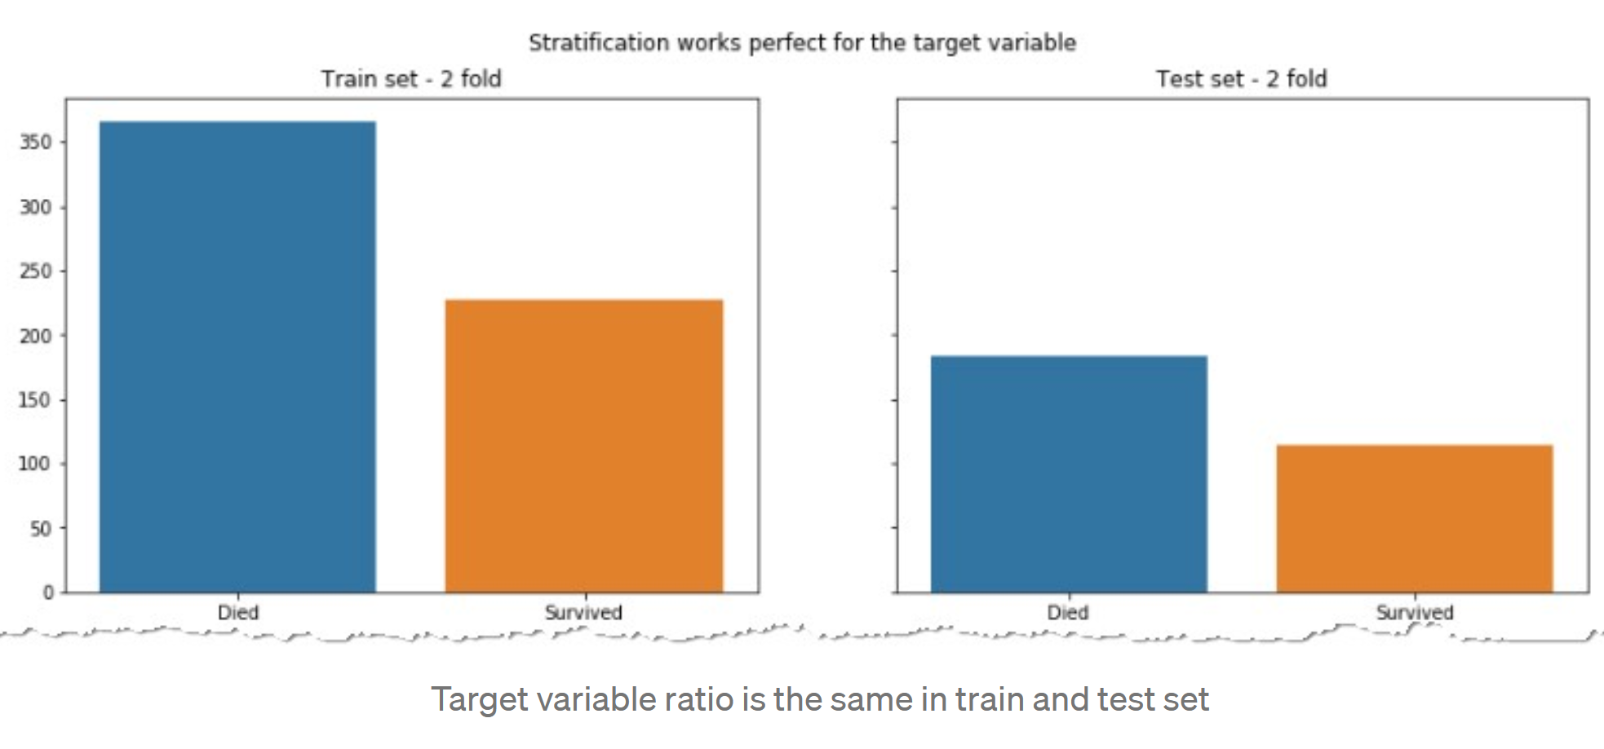
For target variable, ratio of label died vs survived is similar in both the train and test sets.
This need not be true of the input features.
https://towardsdatascience.com/complete-guide-to-pythons-cross-validation-with-examples-a9676b5cac12

Slide 20
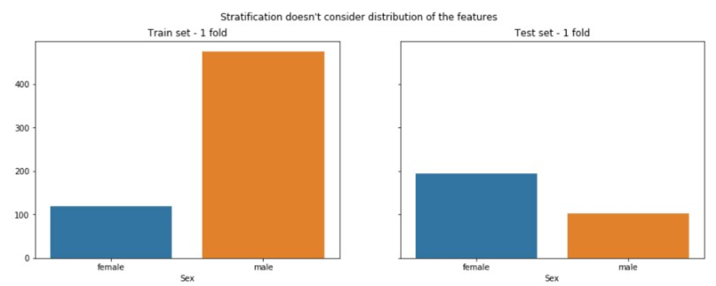
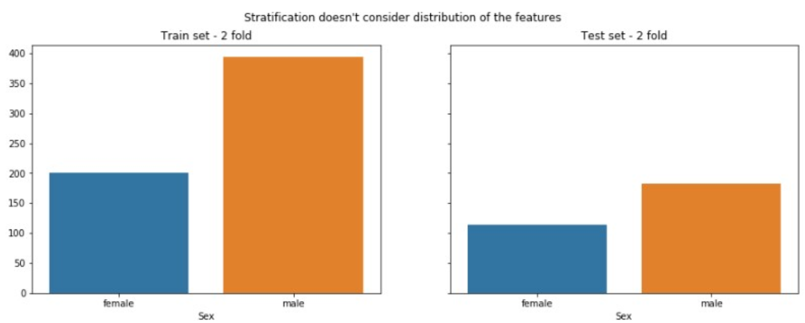
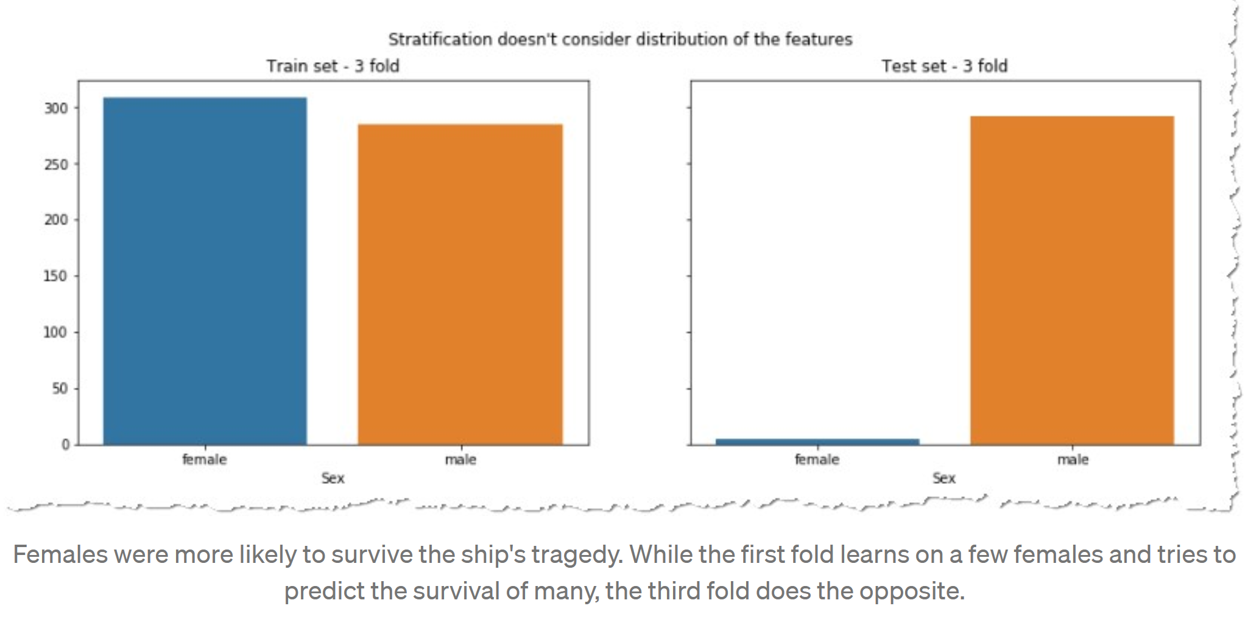
Ratio of input features may differ between train vs test.
https://towardsdatascience.com/complete-guide-to-pythons-cross-validation-with-examples-a9676b5cac12

Slide 21
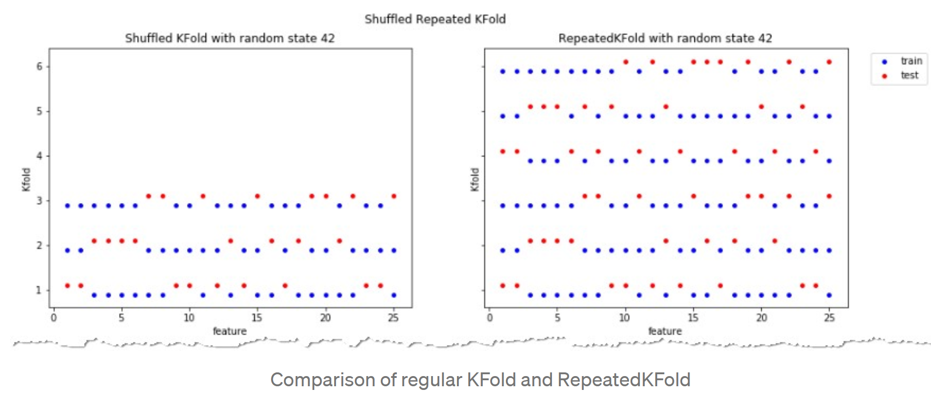
https://towardsdatascience.com/complete-guide-to-pythons-cross-validation-with-examples-a9676b5cac12

Slide 22
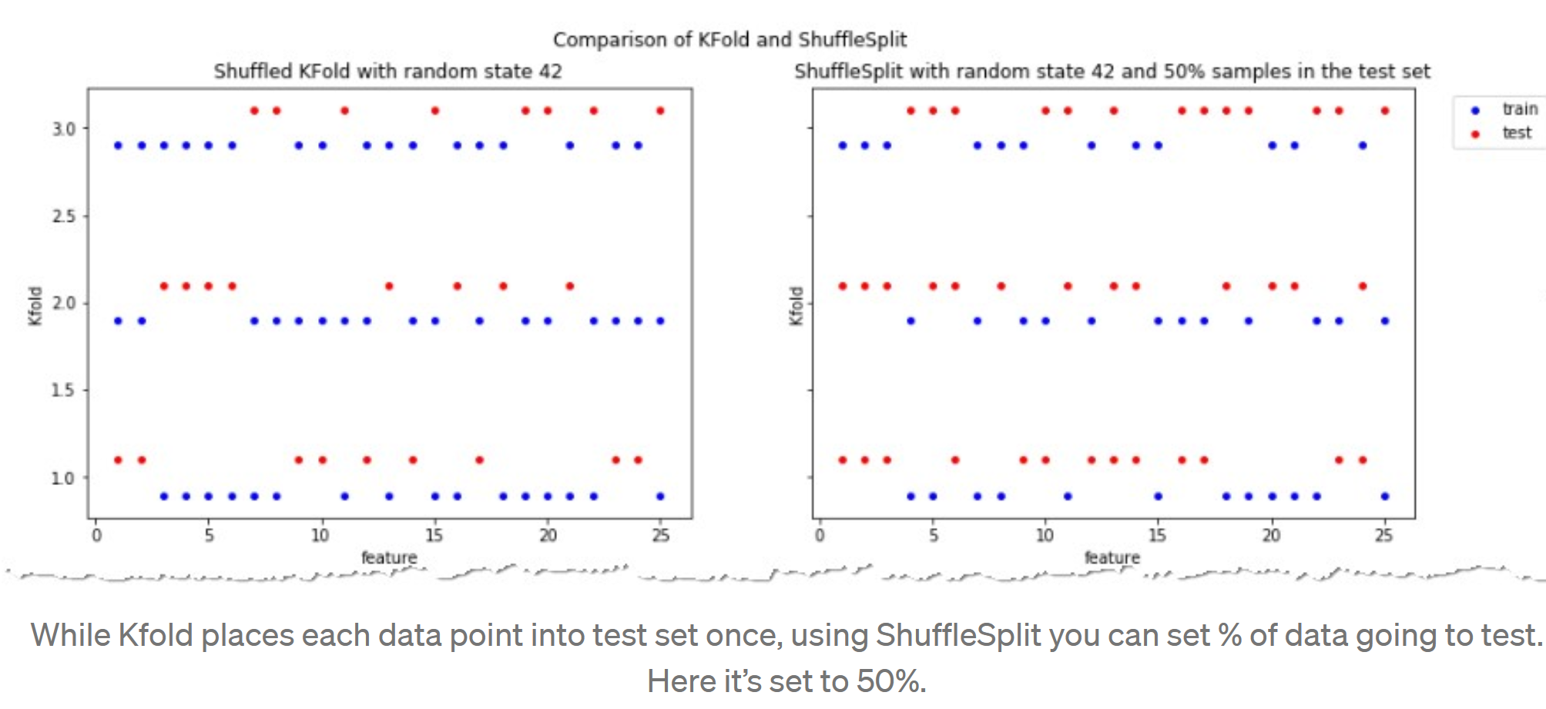
Kfold – no overlap in test sets.
Union of test sets = data set
ShuffleSplit: test sets can overlap.
Not every data point will be in a test set
https://towardsdatascience.com/complete-guide-to-pythons-cross-validation-with-examples-a9676b5cac12

Slide 23
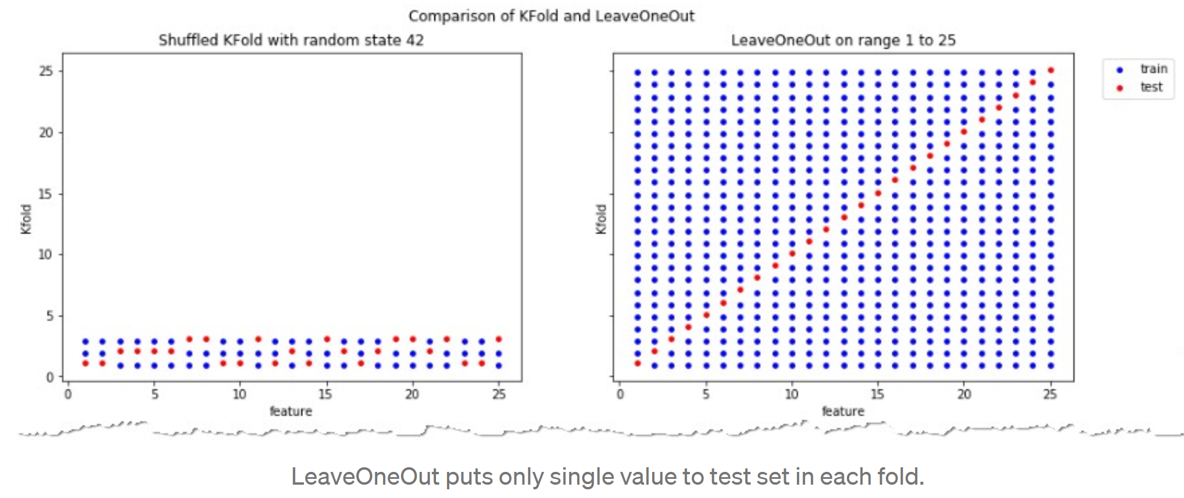
K = 3
If your data set is small consider LeaveOneOut.
Otherwise (repeated) stratified shuffled Kfold works best for most data sets.
https://towardsdatascience.com/complete-guide-to-pythons-cross-validation-with-examples-a9676b5cac12

Slide 24
Bias vs Variance trade-off
If your data set is small consider LeaveOneOut.
Otherwise stratified shuffled Kfold works best for most data sets
K = 3
https://towardsdatascience.com/complete-guide-to-pythons-cross-validation-with-examples-a9676b5cac12
KFold means training on fewer data points: Thus result is more biased than LOOCV.
BUT if k < n = number of data points, then Kfold has lower variance than LOOCV.
Each result of LOOCV will be highly correlated since only leaving out 1 data point, but
the test sets are not correlated since each test set contains 1 data point and these points are all different. Thus the variance of the errors will be higher with LOOCV
With KFold, one is averaging K models that are less correlated to each other than the n LOOCV models. K = 5 or 10 is often a good choice.

Slide 25
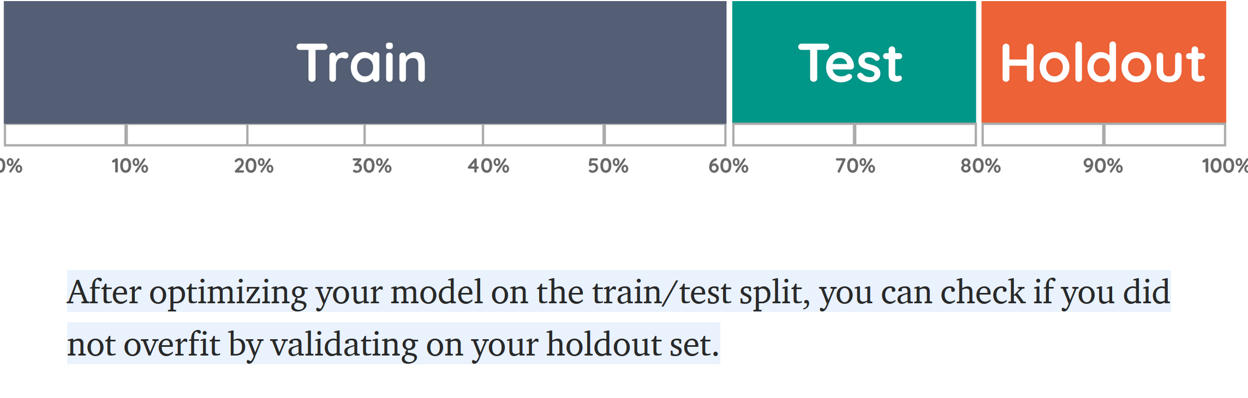
https://towardsdatascience.com/validating-your-machine-learning-model-25b4c8643fb7

Slide 26
Data Leakage

Slide 27
Feature leakage
Feature or column-wise leakage is caused by the inclusion of columns which are one of the following: a duplicate label, a proxy for the label, or the label itself.
For example, including a "MonthlySalary" column when predicting "YearlySalary"; or "MinutesLate" when predicting "IsLate".
Training example leakage
Row-wise leakage is caused by improper sharing of information between rows of data.
If your model is too good to be true, it may be wrong.
https://en.wikipedia.org/wiki/Leakage_(machine_learning)

Slide 28
Training example leakage Row-wise leakage is caused by improper sharing of information between rows of data. Types of row-wise leakage include:
Non-i.i.d. data (Independent and identically distributed random variables)
Time leakage (e.g. splitting a time-series dataset randomly instead of newer data in test set using a TrainTest split or rolling-origin cross validation)
Example: For time-dependent datasets, the structure of the system being studied evolves over time (i.e. it is "non-stationary"). This can introduce systematic differences between the training and validation sets. For example, if a model for predicting stock values is trained on data for a certain five-year period, it is unrealistic to treat the subsequent five-year period as a draw from the same population.
Group leakage -- not including a grouping split column
(e.g. Andrew Ng's group had 100k x-rays of 30k patients, meaning ~3 images per patient. The paper used random splitting instead of ensuring that all images of a patient was in the same split. Hence the model partially memorized the patients instead of learning to recognize pneumonia in chest x-rays.^{[3][4]})
https://en.wikipedia.org/wiki/Leakage_(machine_learning)

Slide 29
Training example leakage Row-wise leakage is caused by improper sharing of information between rows of data. Types of row-wise leakage include:
Premature featurization; leaking from premature featurization before CV/Train/Test split (must fit MinMax/ngrams/etc on only the train split, then transform the test set)
Duplicate rows between train/validation/test (e.g. oversampling a dataset to pad its size before splitting; e.g. different rotations/augmentations of a single image; bootstrap sampling before splitting; or duplicating rows to up sample the minority class)
https://en.wikipedia.org/wiki/Leakage_(machine_learning)

Slide 30
Training example leakage Row-wise leakage is caused by improper sharing of information between rows of data. Types of row-wise leakage include:
Premature featurization; leaking from premature featurization before CV/Train/Test split (must fit MinMax/ngrams/etc on only the train split, then transform the test set)
Example, if you “normalize” your data BEFORE splitting between train and test, then your test data has affected your train data.
Thus AFTER splitting between train and test data
Normalize the train data (excluding the test data).
Use the exact same formula you used to normalize the train data on the test
Min-max example: $x_{ij}=\frac{x_{ij}}{\max_{x∈A_{j}}\{x\}−\min_{x∈A_{j}}\{x\}}$ where A_{j} = { x_{kj} | x $∈$train data}
Duplicate rows between train/validation/test (e.g. oversampling a dataset to pad its size before splitting; e.g. different rotations/augmentations of a single image; bootstrap sampling before splitting; or duplicating rows to up sample the minority class)
https://en.wikipedia.org/wiki/Leakage_(machine_learning)

Slide 31
Sepal.Length Sepal.Width Petal.Length Petal.Width Species
1 5.1 3.5 1.4 0.2 setosa
2 4.9 3.0 1.4 0.2 setosa
3 4.7 3.2 1.3 0.2 setosa
4 4.6 3.1 1.5 0.2 setosa
5 5.0 3.6 1.4 0.2 setosa
6 5.4 3.9 1.7 0.4 setosa
To normalize the petal length column for these 6 data points. If highlighted rows 4 and 6 are in test data set, use only unhighlighted rows corresponding to train data set to calculate max/min.
max{x_{i3} | x in train data} = max{1.4, 1.4, 1.5, 1.4} = 1.5
min{x_{i3} | x in train data} = max{1.4, 1.4, 1.5, 1.4} = 1.4
max – min = 1.5 – 1.4 = 0.1
Sepal.Length Sepal.Width Petal.Length Petal.Width Species
1 5.1 3.5 14 0.2 setosa
2 4.9 3.0 14 0.2 setosa
3 4.7 3.2 13 0.2 setosa
4 4.6 3.1 15 0.2 setosa
5 5.0 3.6 14 0.2 setosa
6 5.4 3.9 17 0.4 setosa
For k-fold and Leave-one-out, max and min depend on fold, so normalization would need to be performed for each fold.

Slide 32

Sepal.Length Sepal.Width Petal.Length Petal.Width Species
1 5.1 3.5 1.4 0.2 setosa
2 4.9 3.0 1.4 0.2 setosa
3 4.7 3.2 1.3 0.2 setosa
4 4.6 3.1 1.5 0.2 setosa
5 5.0 3.6 1.4 0.2 setosa
6 5.4 3.9 1.7 0.4 setosa
To normalize the petal length column for these 6 data points. If highlighted rows 4 and 6 are in test data set, , use only unhighlighted rows corresponding to train data set to calculate max/min.
max = max{x_{i3} | x in train data} = max{1.4, 1.4, 1.5, 1.4} = 1.5
min = min{x_{i3} | x in train data} = max{1.4, 1.4, 1.5, 1.4} = 1.4
max – min = 1.5 – 1.4 = 0.1
Can also subtract min/(max – min) so data between 0 and 1: (P.L – min)/(max-min)
Sepal.Length Sepal.Width Petal.Length Petal.Width Species
1 5.1 3.5 0 0.2 setosa
2 4.9 3.0 0 0.2 setosa
3 4.7 3.2 -1 0.2 setosa
4 4.6 3.1 1 0.2 setosa
5 5.0 3.6 0 0.2 setosa
6 5.4 3.9 3 0.4 setosa
For k-fold and Leave-one-out, max and min depend on fold, so normalization would need to be performed for each fold.

Slide 33
Ivan Meza http://turing.iimas.unam.mx/~ivanvladimir/slides/rpyaa/02_regression.html#/60
Underfitting versus overfitting
$$Ex: f\left(x\right)=a_{0}+a_{1}x+…+a_{n}x^{n}$$
Bias Variance Tradeoff
https://it.wikipedia.org/wiki/Overfitting

Slide 34
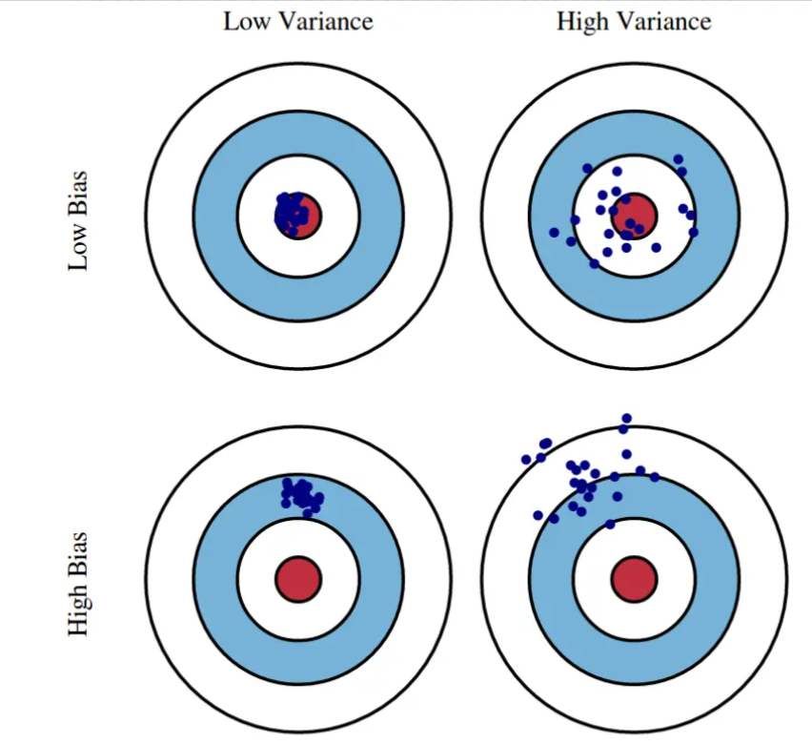
https://www.machinelearningplus.com/
machine-learning/bias-variance-tradeoff/

Slide 35
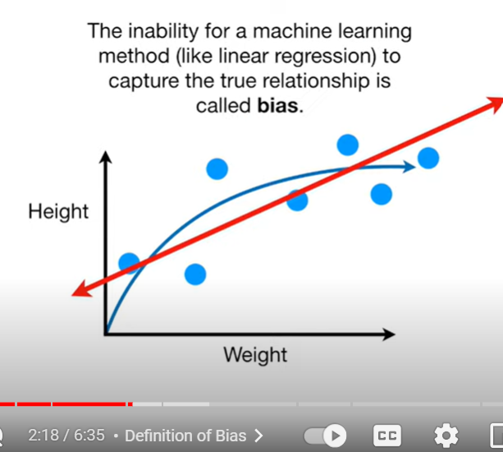
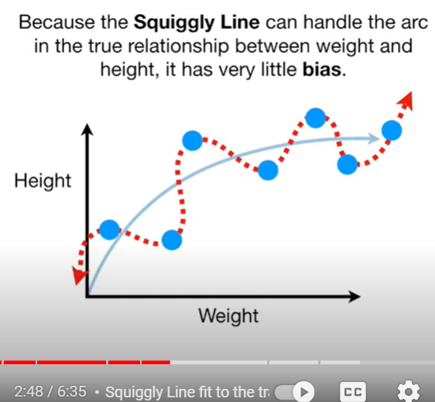
Bias Variance Tradeoff
https://www.youtube.com/watch?v=EuBBz3bI-aA

Slide 36
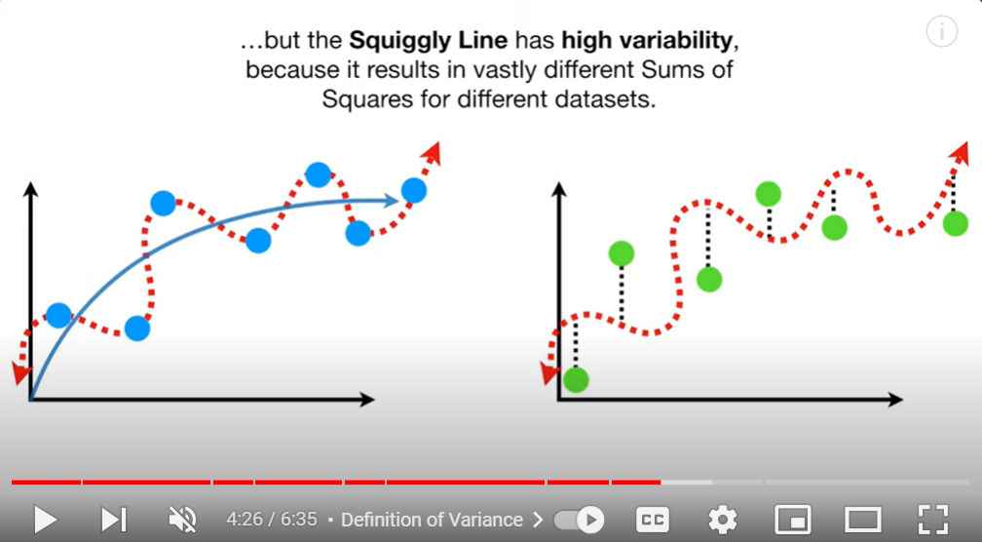
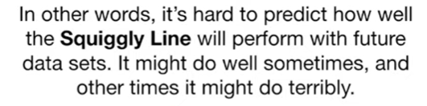
Bias Variance Tradeoff
The squiggly line is not biased towards linearity (or any other shape and thus in this case fits the training set perfectly).
But it does a horrible job on the testing data set:
High Variance:
Calculate RSS = (residual) sum of squares for different testing data sets. The variance for this set of RSS will be high for the squiggly line.

Slide 37
Ivan Meza http://turing.iimas.unam.mx/~ivanvladimir/slides/rpyaa/02_regression.html#/60
High bias High variance
Underfitting versus overfitting
$$Ex: f\left(x\right)=a_{0}+a_{1}x+…+a_{n}x^{n}$$
https://it.wikipedia.org/wiki/Overfitting

Slide 38
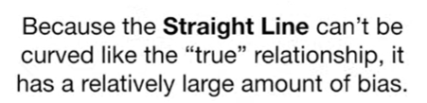
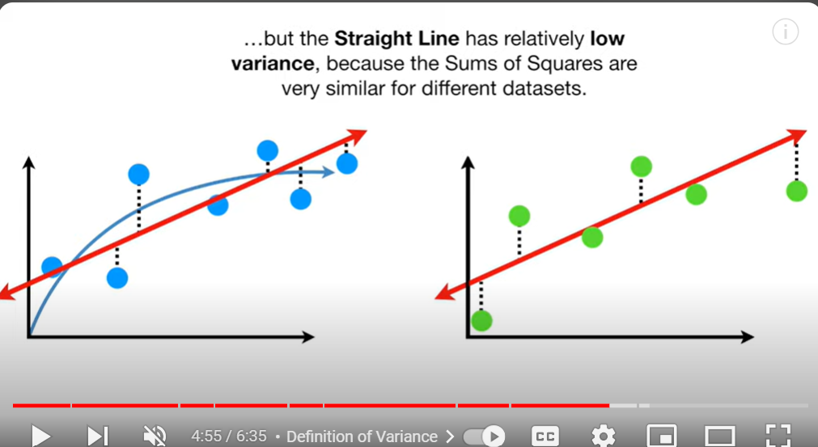
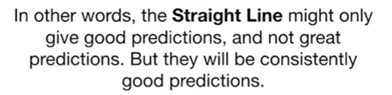
Bias Variance Tradeoff

Slide 39
$$f\left(x\right)=a_{0}+a_{1}x_{1}+ax_{2}+⋯+a_{n}x_{n}$$
Many variables: low bias,
can find a good fit given enough variables.
But High Variance:
Coin flip will improve fit for training set, but will usually result in a bad fit for the testing data set. Thus there will be high variance in sum of squares for different testing sets.
StatQuest: Linear Models Pt.1 - Linear Regression https://www.youtube.com/watch?v=nk2CQITm_eo

Slide 40
Underfitting versus overfitting
https://stats.stackexchange.com/questions/71946/overfitting-a-logistic-regression-model

Slide 41
Multivariable Linear and Logistic Regression:
One normally must perform feature (variable) selection if you have too many variables and/or if they are not independent.
Some methods for feature selection:
• Subset Selection. This approach involves identifying a subset of the p predictors that we believe to be related to the response. We then fit a model using least squares on the reduced set of variables.
• Shrinkage. This approach involves fitting a model involving all p predictors. However, the estimated coefficients are shrunken towards zero relative to the least squares estimates. This shrinkage (also known as regularization) has the effect of reducing variance. Depending on what type of shrinkage is performed, some of the coefficients may be estimated to be exactly zero. Hence, shrinkage methods can also perform
variable selection.
• Dimension Reduction. This approach involves projecting the p predictors into an M-dimensional subspace, where M <p. This is achieved by computing M different linear combinations, or projections, of the variables. Then these M projections are used as predictors to fit a linear regression model by least squares.
An Introduction to Statistical Learning https://www.statlearning.com/

Slide 42
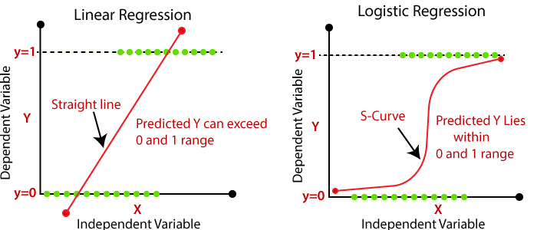
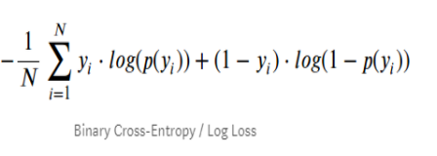
Devopedia. 2022. "Logistic Regression." Version 10, January 19. Accessed 2023-02-11. https://devopedia.org/logistic-regression
Linear model General linear model
Cost function for linear regression Cost function for logistic regression (maximum likelihood)
Minimize cost function to find best function f
(eg: if f(x) = mx + b, find m and b that minimizes Minimize cost function to find best probability function. This
cost function RSS. corresponds to finding best m and b that minimizes cost for
p(x) = 1/[1 + exp(-b - mx)]
Validating model: R², F-statistic, p-value, etc

Slide 43
The coefficients for our model
$$f\left(x\right)=a_{0}+a_{1}x_{1}+ax_{2}+⋯+a_{n}x_{n}$$
are found by optimizing the cost function = $C\left(a_{1},…,a_{n}\right)$
Ridge, lasso, elastic-net apply a penalty to models involving too many (large parameters):
New cost function = $C\left(a_{1},…,a_{n}\right)$ + penalty
Ridge penalty: $λ(Σa_{i}^{2})$
Lasso penalty: $λ(Σ|a_{i}|)$
Elastic-net penalty: $λ1(Σa_{i}^{2})$ + $λ2(Σ|a_{i}|)$
Shrinkage: the estimated coefficients are shrunken towards zero

Slide 44
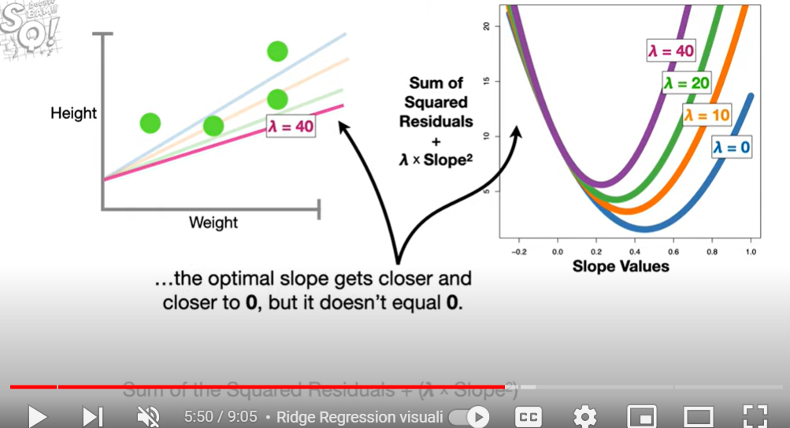
Ridge Regression

Slide 45
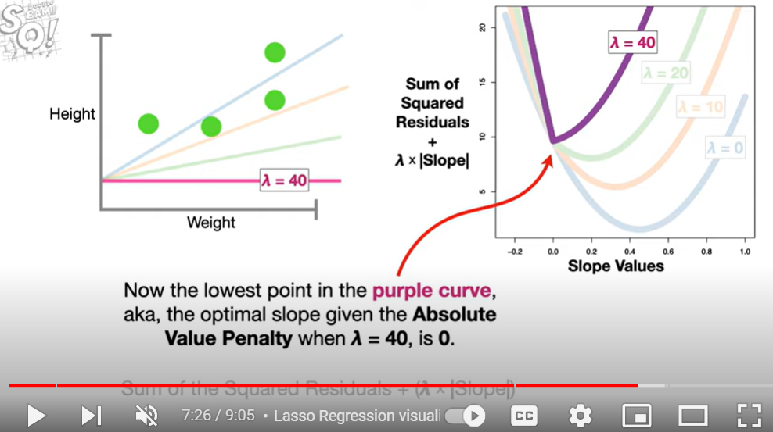
Lasso Regression

Slide 46
The coefficients for our model
$$f\left(x\right)=a_{0}+a_{1}x_{1}+ax_{2}+⋯+a_{n}x_{n}$$
are found by optimizing the cost function = $C\left(a_{1},…,a_{n}\right)$
Ridge, lasso, elastic-net apply a penalty to models involving too many (large parameters):
New cost function = $C\left(a_{1},…,a_{n}\right)$ + penalty
Ridge penalty: $λ(Σa_{i}^{2})$
Lasso penalty: $λ(Σ|a_{i}|)$
Elastic-net penalty: $λ1(Σa_{i}^{2})$ + $λ2(Σ|a_{i}|)$
Shrinkage: the estimated coefficients are shrunken towards zero

Slide 47
Ridge penalty: $λ(Σa_{i}^{2})$ won’t eliminate parameters
better at co-linearity
Ex: column 1 = 2 x column 2
Lasso penalty: $λ(Σ|a_{i}|)$ will “arbitrarily” choose among
co-linear parameters.
Elastic-net penalty: $λ1(Σa_{i}^{2})$ + $λ2(Σ|a_{i}|)$
will either keep all or eliminate
all co-linear parameters.

Slide 48

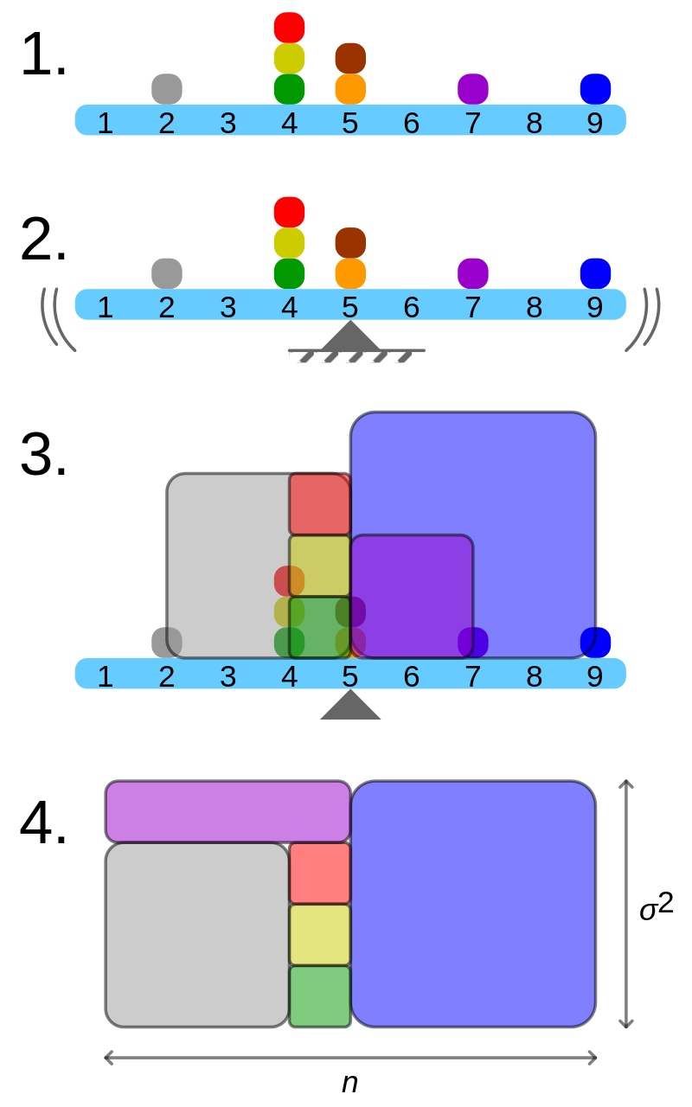
Population variance when size of your population = n
Geometric visualisation of the variance of an arbitrary distribution (2, 4, 4, 4, 5, 5, 7, 9): A frequency distribution is constructed.
The centroid of the distribution gives its mean.
A square with sides equal to the difference of each value from the mean is formed for each value.
Arranging the squares into a rectangle with one side equal to the number of values, n, results in the other side being the distribution's variance, σ².
By Cmglee - Own work, CC BY-SA 3.0, https://commons.wikimedia.org/w/index.php?curid=39472834

Slide 49
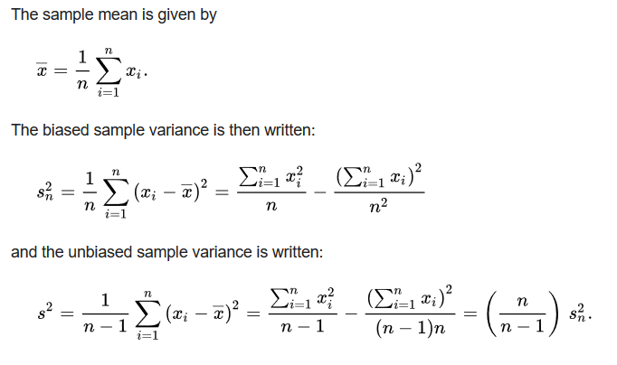
https://en.wikipedia.org/wiki/Bessel's_correction#Source_of_bias
Too small
when sampling
n data points from a larger population

Slide 50
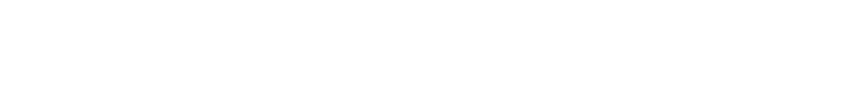
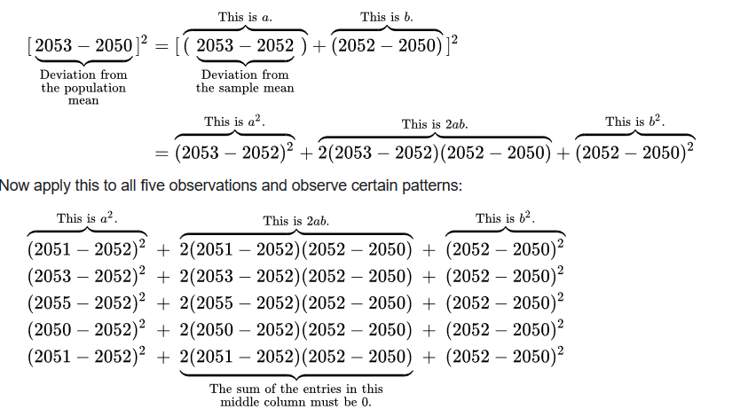
Small sample chosen randomly from the population: 2051, 2053, 2055, 2050, 2051
Sample mean is (2051, 2053, 2055, 2050, 2051)/5 = 2052, but suppose population mean is actually 2050.
https://en.wikipedia.org/wiki/Bessel's_correction#Source_of_bias
(5*sample mean – 5*sample mean)

Slide 51





$\overline{μ}$ = population mean, $\overline{x}$ = sample mean
$$\sum{{\left(x_{\dot{i}}−\overline{μ}\right)}^{2}}=\sum{{\left(x_{i}−\overline{x}\right)}^{2}}+\sum{{\left(\overline{x}−\overline{μ}\right)}^{2}}$$
$$\sum{{\left(x_{\dot{i}}−\overline{μ}\right)}^{2}}≥\sum{{\left(x_{i}−\overline{x}\right)}^{2}}$$
Variance on entire population : vs Variance of sample of population:
$$\operatorname{Var}\left(x\right)=\frac{1}{n−1}\sum_{i=1}^{n}{{\left(x_{i}−\overline{x}\right)}^{2}}$$
$$\frac{n}{n−1}$$
https://en.wikipedia.org/wiki/Bessel's_correction#Source_of_bias

Slide 52



$$\operatorname{Var}\left(x\right)=\frac{1}{n−1}\sum_{i=1}^{n}{{\left(x_{i}−\overline{x}\right)}^{2}}$$
One can understand Bessel's correction as the degrees of freedom in the residuals vector (residuals, not errors, because the population mean is unknown):
While there are n independent observations in the sample, there are only n − 1 independent residuals, as they sum to 0
For 1 data point: Variance does not make sense
https://en.wikipedia.org/wiki/Bessel's_correction#Source_of_bias

