Slide 1
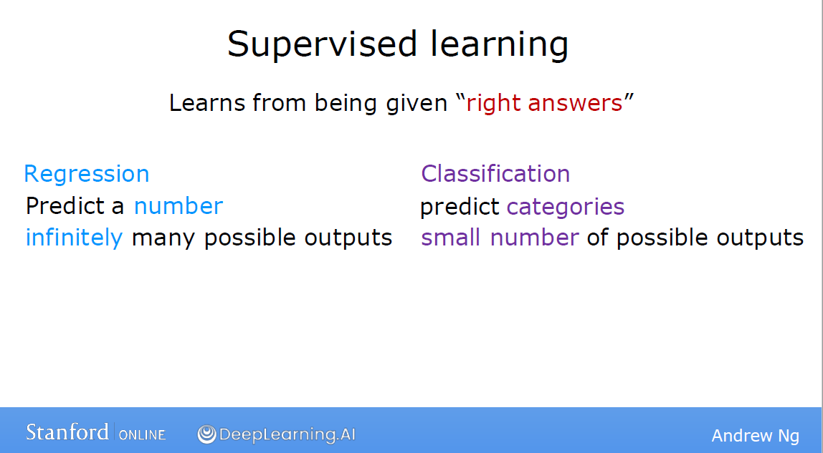
https://www.deeplearning.ai/courses/machine-learning-specialization/
See also Coursera
Currently using python (but octave material is still available).

Slide 2
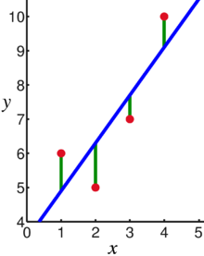
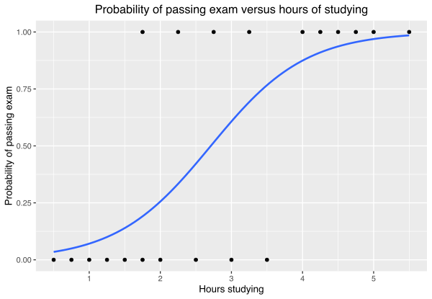
Supervised Learning: Use labeled data to predict unlabeled data.
2 types of supervised learning:
Regression: Predict continuous values.
    Ex: Linear regression.
F(x_{new}) = b₀ + b₁x_{new}
2. Classification: Predict discrete values.
    Ex: Logistic regression
https://en.wikipedia.org/wiki/Linear_regression
https://en.wikipedia.org/wiki/Logistic_regression

Slide 3
Supervised Learning: Use labeled data to predict unlabeled data.
2 types of supervised learning:
Regression: Predict continuous LABELS.
    Ex: Linear regression.
F(x_{new}) = b₀ + b₁x_{new}
2. Classification: Predict discrete LABELS.
    Ex: Logistic regression
https://en.wikipedia.org/wiki/Linear_regression
What are your labels?
https://en.wikipedia.org/wiki/Logistic_regression

Slide 4
Linear regression = Least squares line (single variable x)
(or hyperplane for multiple variables)
Supervised learning
Data: x_{i} = input data with no noise
y_{i} = labels
Find function
f: R → R
f(x) = mx + b
x = independent variable
y = dependent variable
(x, y) → (x, y’)
https://en.wikipedia.org/wiki/Linear_regression

Slide 5
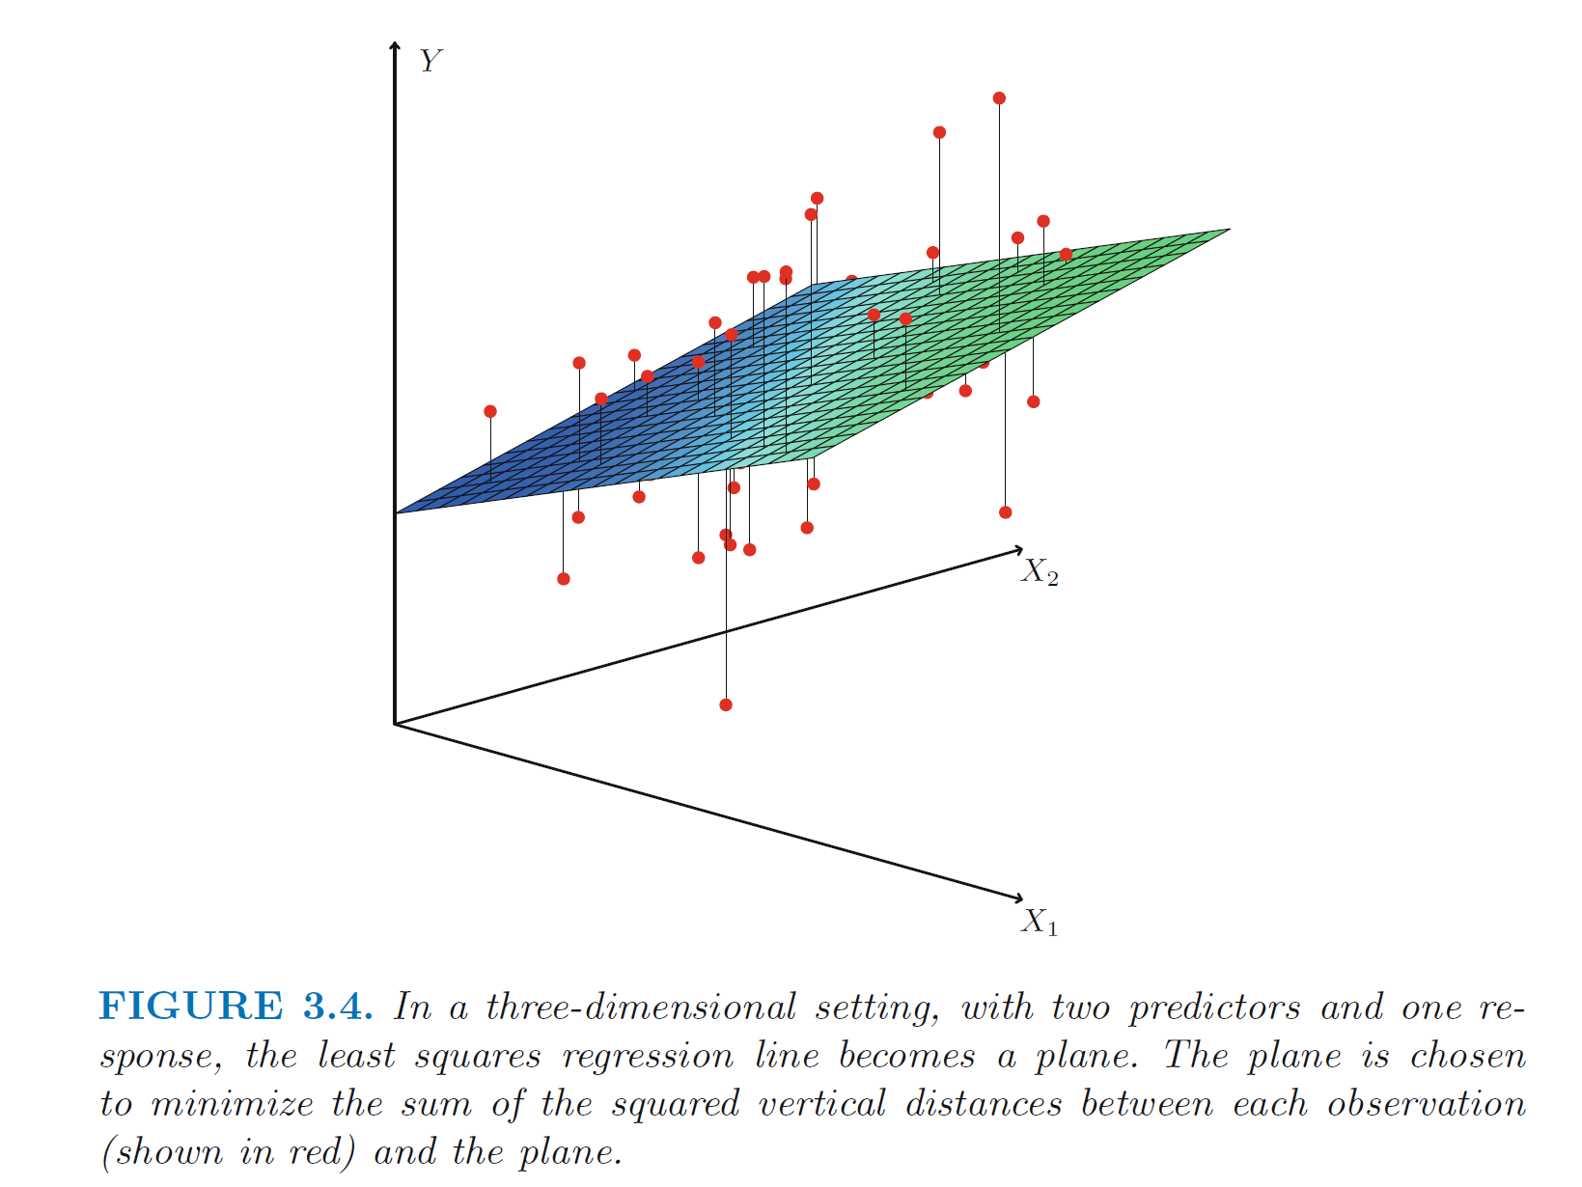
https://en.wikipedia.org/wiki/Linear_regression
https://www.statlearning.com/

Slide 6
PCA: perturb all variables (x, y) → (x’, y’)
1st PCA component (purple line)
= direction of most variance
direction = eigenvector with
largest eigenvalue.
= best fit line, but using
perpendicular distance
Not the same line as 1 variable
linear regression line (blue).
2nd PCA (not needed in this example since data is 2D)
= direction of 2nd most variance,
perpendicular to first.
direction = eigenvector with
2nd largest eigenvalue.
PCA hyperplane not the same plane as multivariable regression hyperplane.
Modified from
https://en.wikipedia.org/wiki/Linear_regression

Slide 7
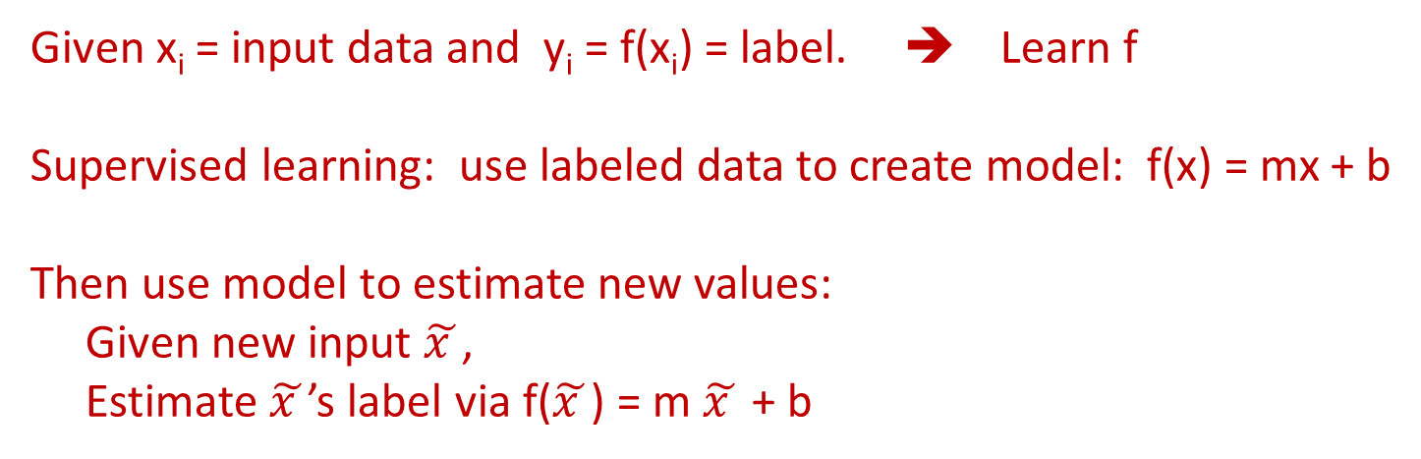
Linear regression (Supervised learning)
Given x_{i} = input data and y_{i} = f(x_{i}) = label. ➔ Learn f
Supervised learning: use labeled data to create model: f(x) = mx + b
Then use model to estimate new values:
Given new input $\tilde{x }$,
Estimate $\tilde{x }$’s label via f($\tilde{x }$) = m $\tilde{x }$ + b
https://en.wikipedia.org/wiki/Linear_regression

Slide 8







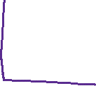





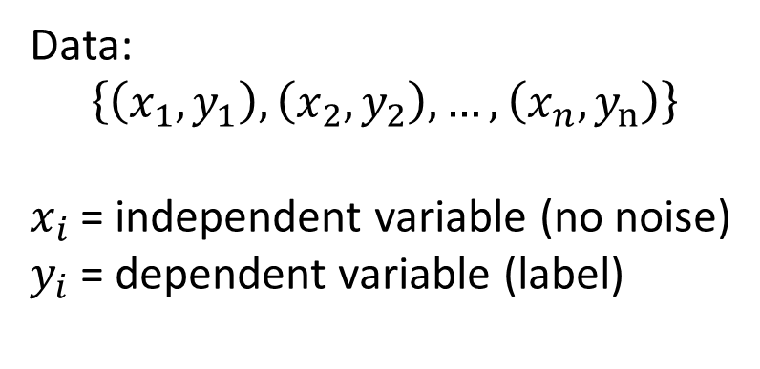


Solve
$$b_{0}+b_{1}x_{1}=y_{1}$$
$$1 x_{1}$$
$$\left[\begin{matrix}y_{1} \\ y_{\begin{aligned}2 \\ \\ \\ \\ \\ \end{aligned}} \\ y_{n}\end{matrix}\right]$$
$$b_{0}+b{1x}_{2}=y_{2}$$
$$1 x_{2}$$
$$\left[\begin{matrix}b_{0} \\ b_{1}\end{matrix}\right]$$
=
$$b_{0}+b_{1}x_{n}=y_{n}$$
$$1 x_{n}$$
Data:
$$\left\{\left(x_{1},y_{1}\right),\left(x_{2},y_{2}\right), …,\left(x_{n},y_{n}\right)\right\}$$
$x_{i}$= independent variable (no noise)
$y_{i}$= dependent variable (label)
Too many equations, so find best solution
= least squares solution

Slide 9
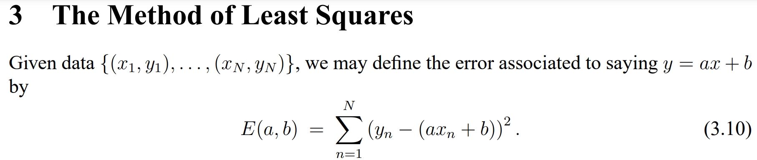
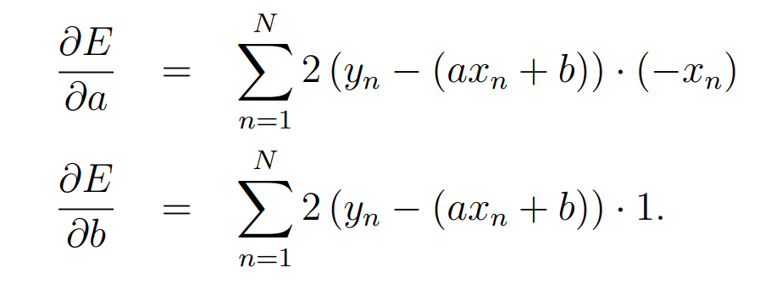
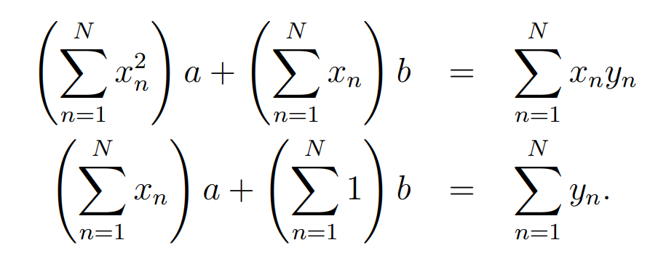
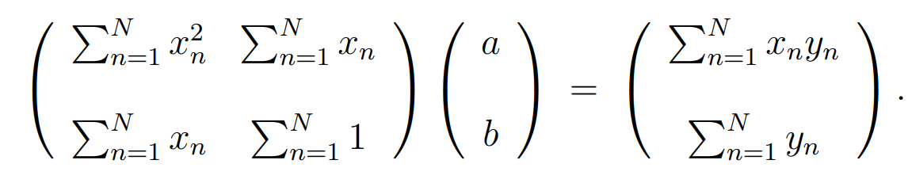
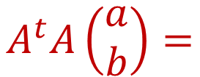

E = RSS = residual sum of squared errors = SSE = sum of squared errors.
= 0 ➔
= 0 ➔
$$A^{t}A\left(\begin{matrix}a \\ b\end{matrix}\right)=$$
$${=A}^{t}\vec{y}$$
https://web.williams.edu/Mathematics/sjmiller/public_html/BrownClasses/54/handouts/MethodLeastSquares.pdf

Slide 10
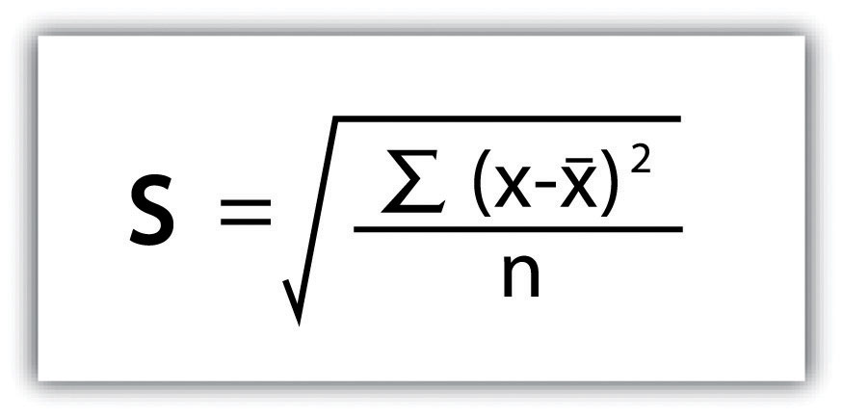
Find the Equation of a Linear Regression Line
The equation is determined by:
  b₀: y-intercept
  b₁: slope
Values that satisfy the least squares criterion:
Standard deviation
-1
Variance = sd
2

Slide 11
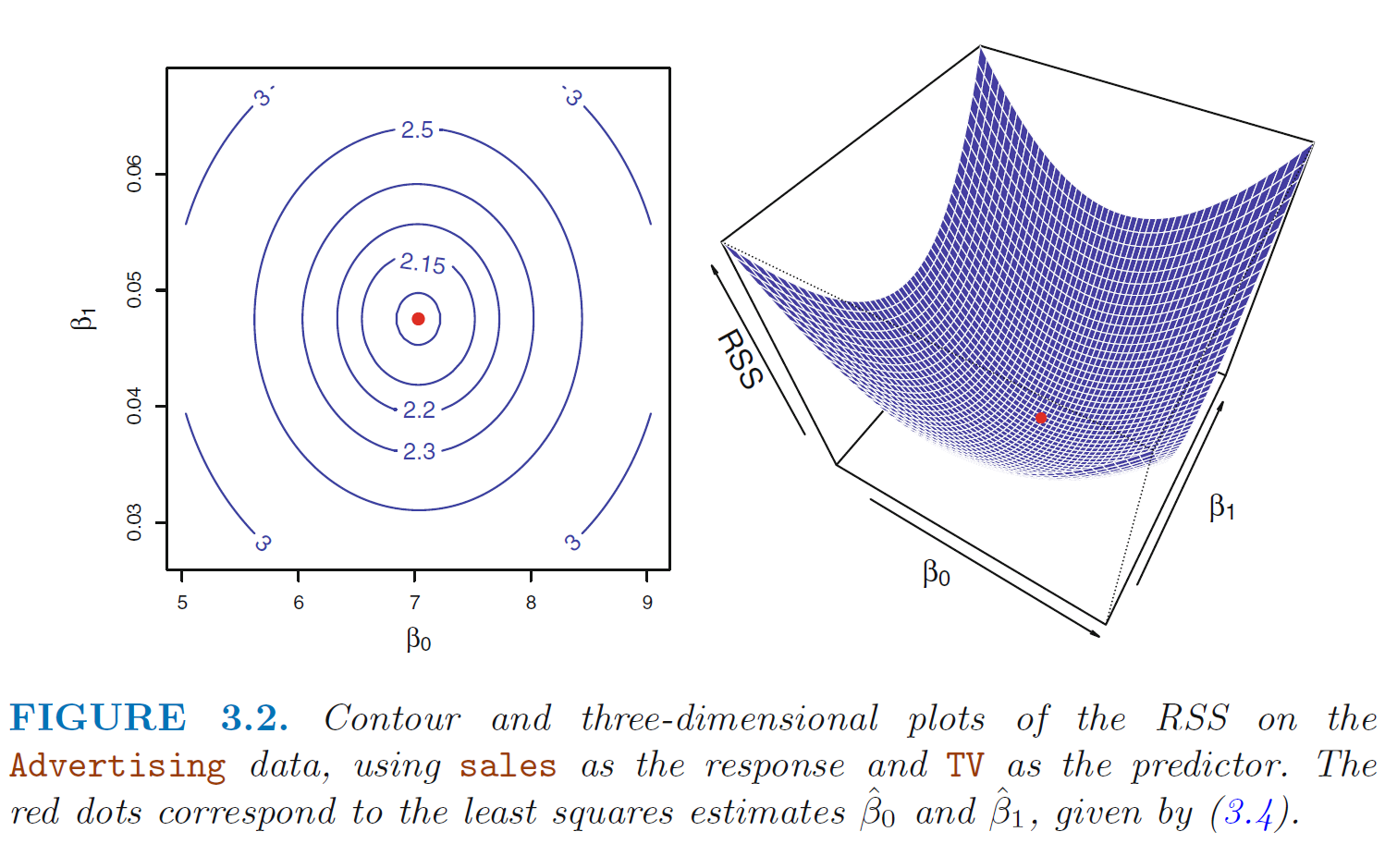
https://www.statlearning.com/

Slide 12
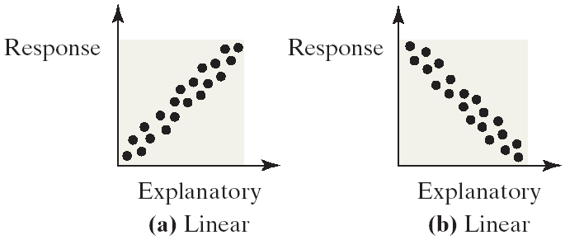
Linear Correlations
Linear relations or linear correlations have points that cluster around a line
Linear relations can be either positive (the points slants upwards to the right) or negative (the points slant downwards to the right)
https://emunix.emich.edu/~schu/MATH_170/Fall09_170/Evening%20session/Unit%203.ppt

Slide 13
Please Note
The slope b₁ represents
the predicted change in y per unit increase in x
The y-intercept is the value of y where the line of best fit intersects the y-axis. That is, it is the predicted value of y when x is zero.
The line of best fit will always pass through the point

Slide 14
6533
0
No data
The intercept is b₀ = 6533.
This is the slope of the line.
For each additional mile on the odometer,
the price decreases by an average of $0.0312
Do not interpret the intercept as the
“Price of cars that have not been driven”
https://web.stanford.edu/class/msande247s/kchap17.ppt

Slide 15
Please Note
Perfect positive correlation: all the points lie along a line with positive slope
Perfect negative correlation: all the points lie along a line with negative slope
If the points lie along a horizontal or vertical line: no correlation
If the points exhibit some other nonlinear pattern: nonlinear relationship
Need some way to measure the strength of correlation

Slide 16
Coefficient of determination
https://web.stanford.edu/class/msande247s/kchap17.ppt
RSS = SSE is very affected by outliers, thus use
  When we want to measure the strength of the linear relationship, we use the coefficient of determination.

Slide 17
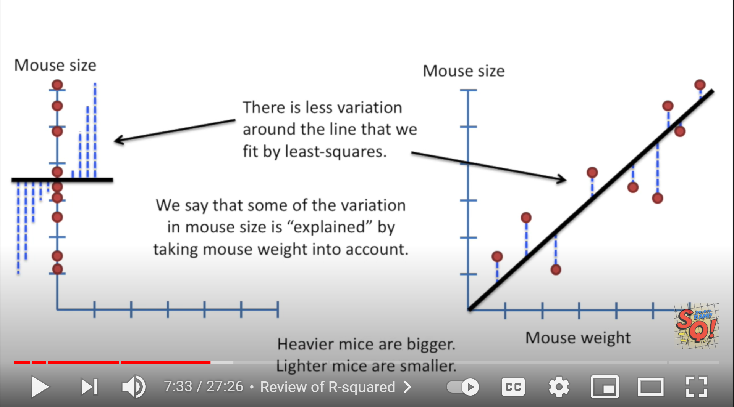
StatQuest: Linear Models Pt.1 - Linear Regression https://www.youtube.com/watch?v=nk2CQITm_eo

Slide 18
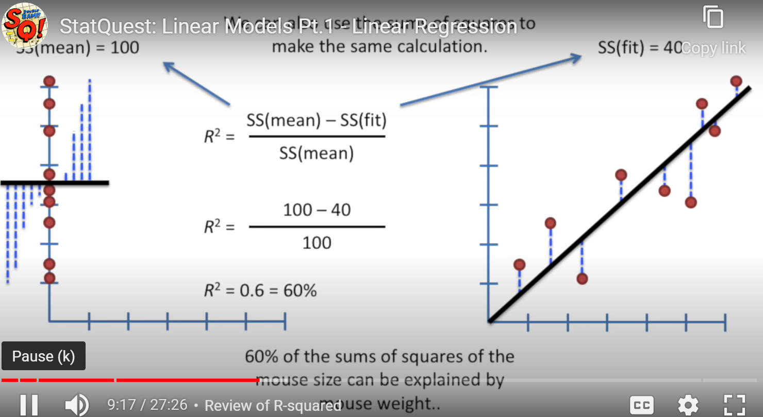

Slide 19
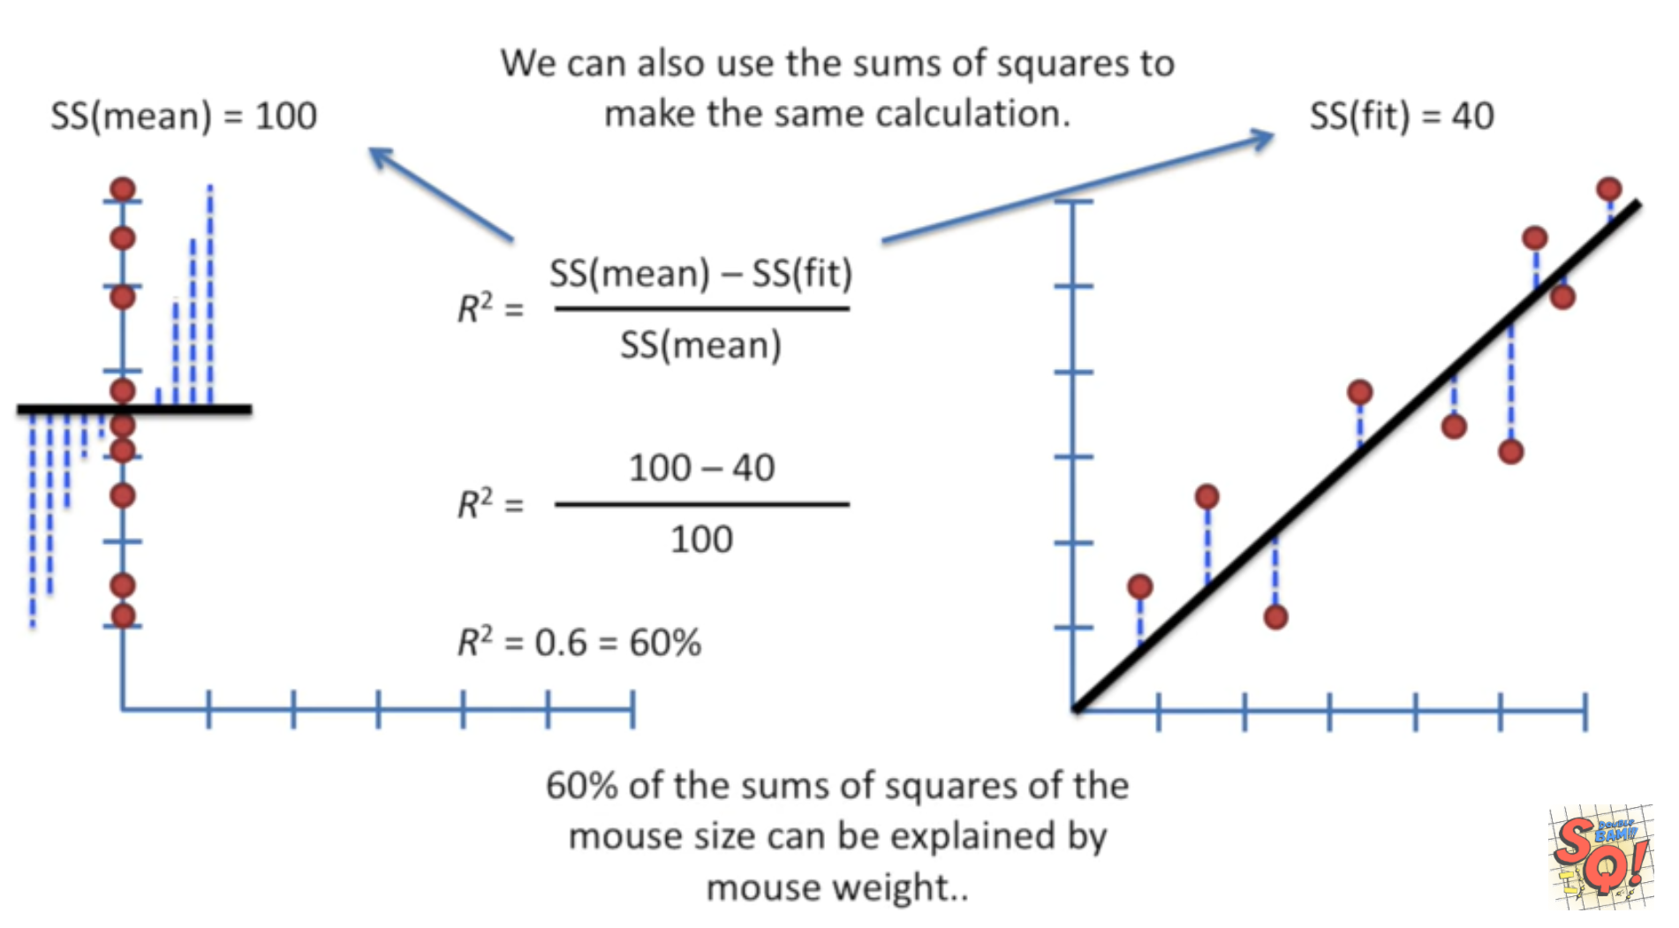
StatQuest: Linear Models Pt.1 - Linear Regression https://www.youtube.com/watch?v=nk2CQITm_eo

Slide 20
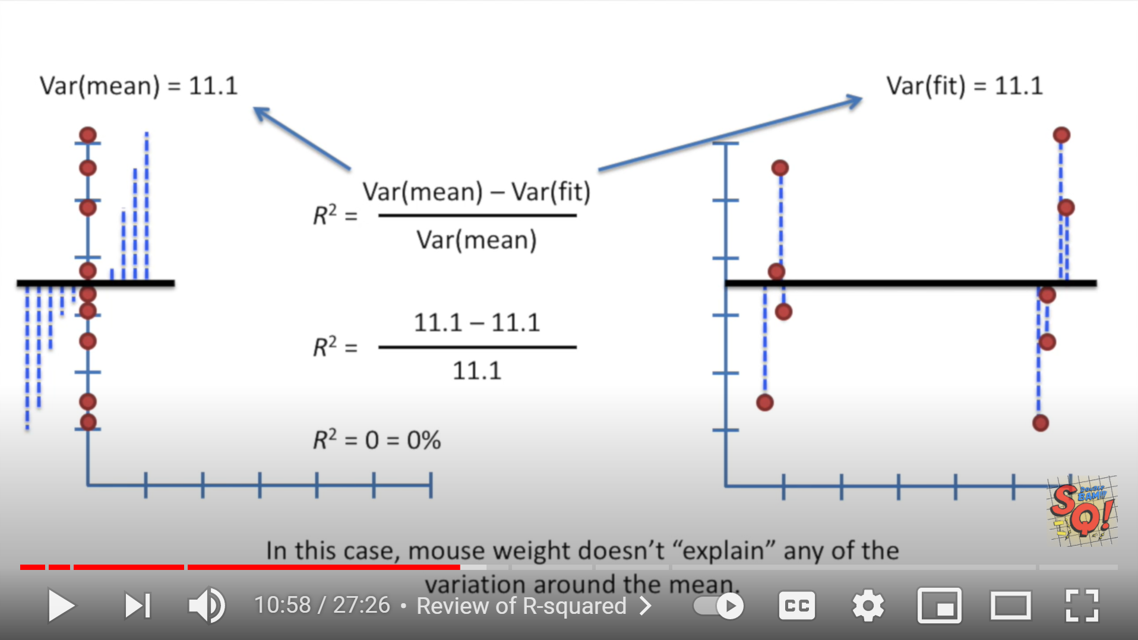
StatQuest: Linear Models Pt.1 - Linear Regression https://www.youtube.com/watch?v=nk2CQITm_eo

Slide 21
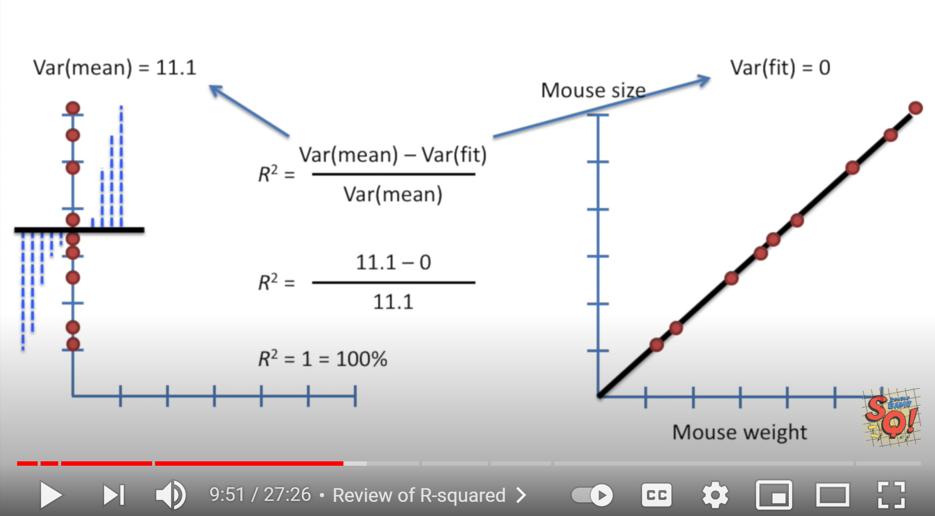
StatQuest: Linear Models Pt.1 - Linear Regression https://www.youtube.com/watch?v=nk2CQITm_eo

Slide 22
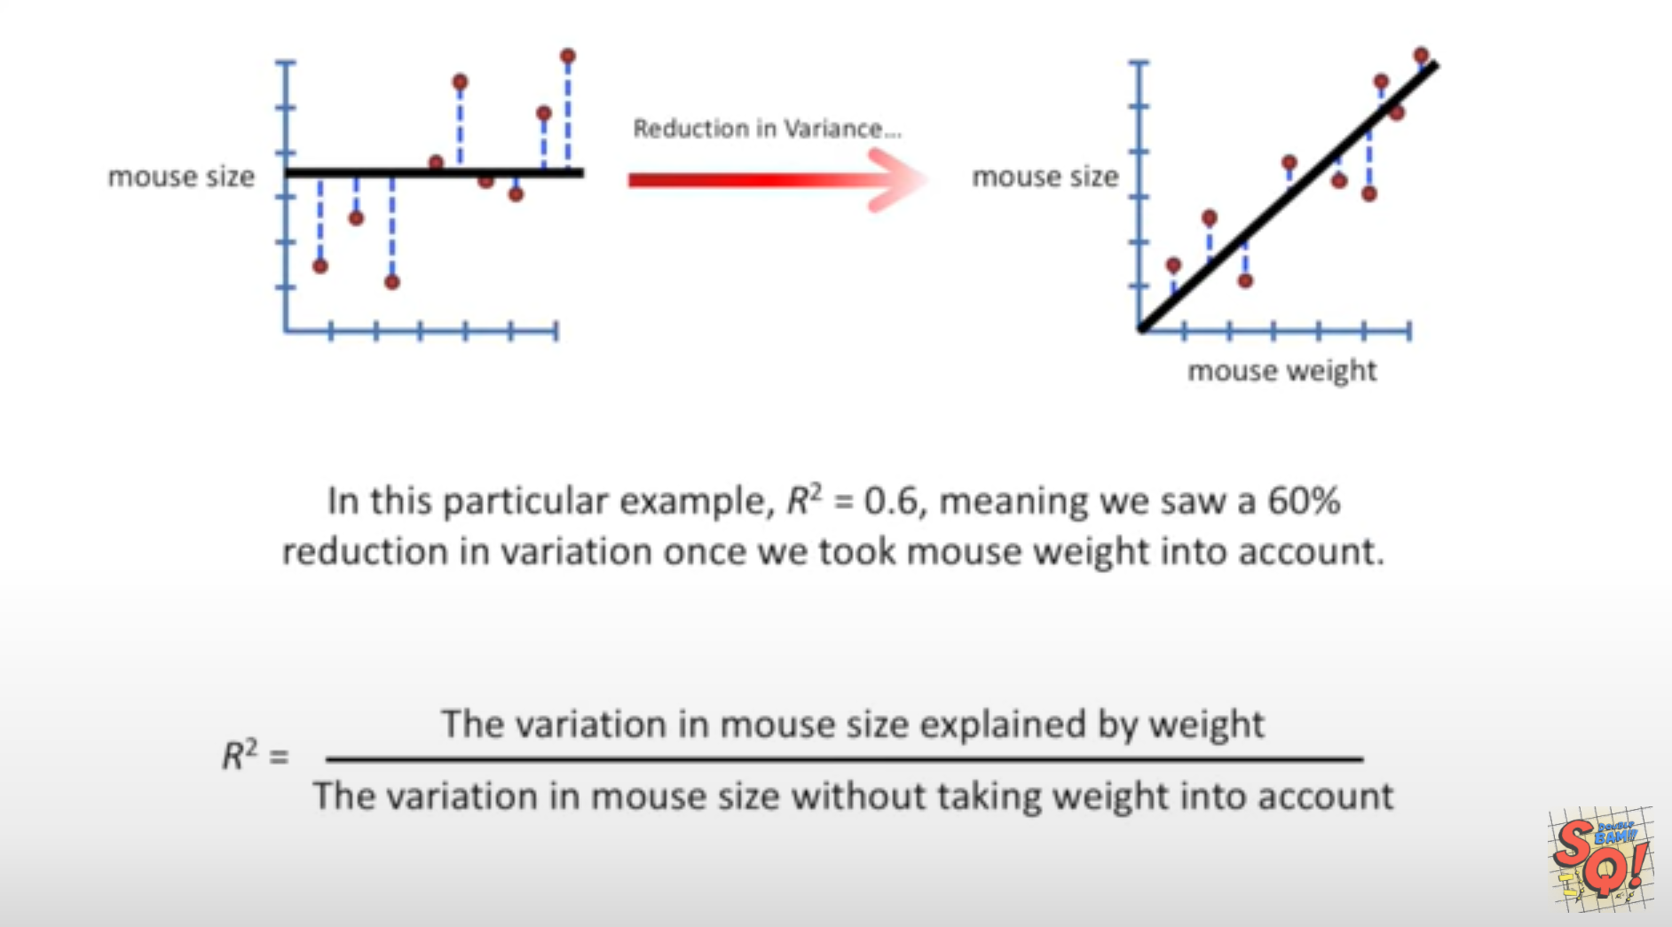
StatQuest: Linear Models Pt.1 - Linear Regression https://www.youtube.com/watch?v=nk2CQITm_eo

Slide 23
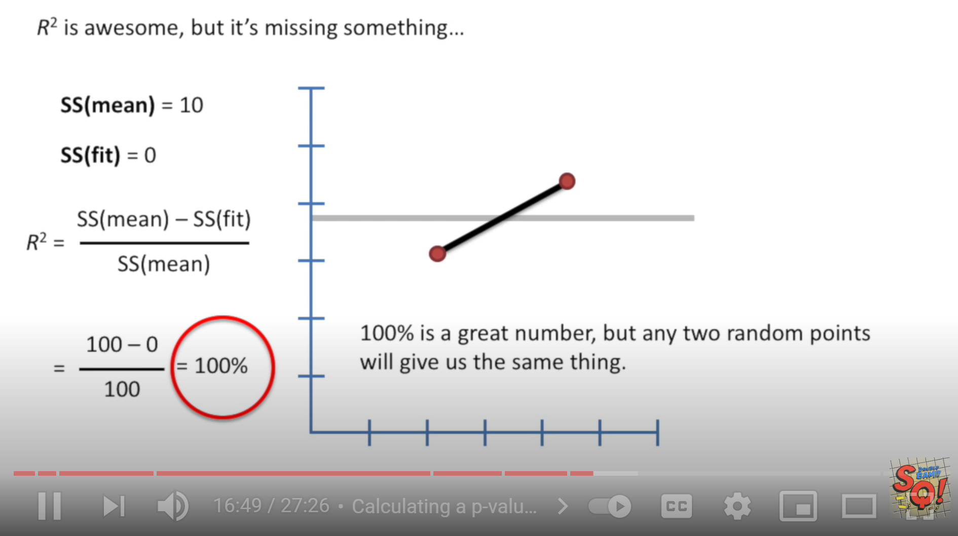
Suppose you only have 2 data points:
StatQuest: Linear Models Pt.1 - Linear Regression https://www.youtube.com/watch?v=nk2CQITm_eo

Slide 24
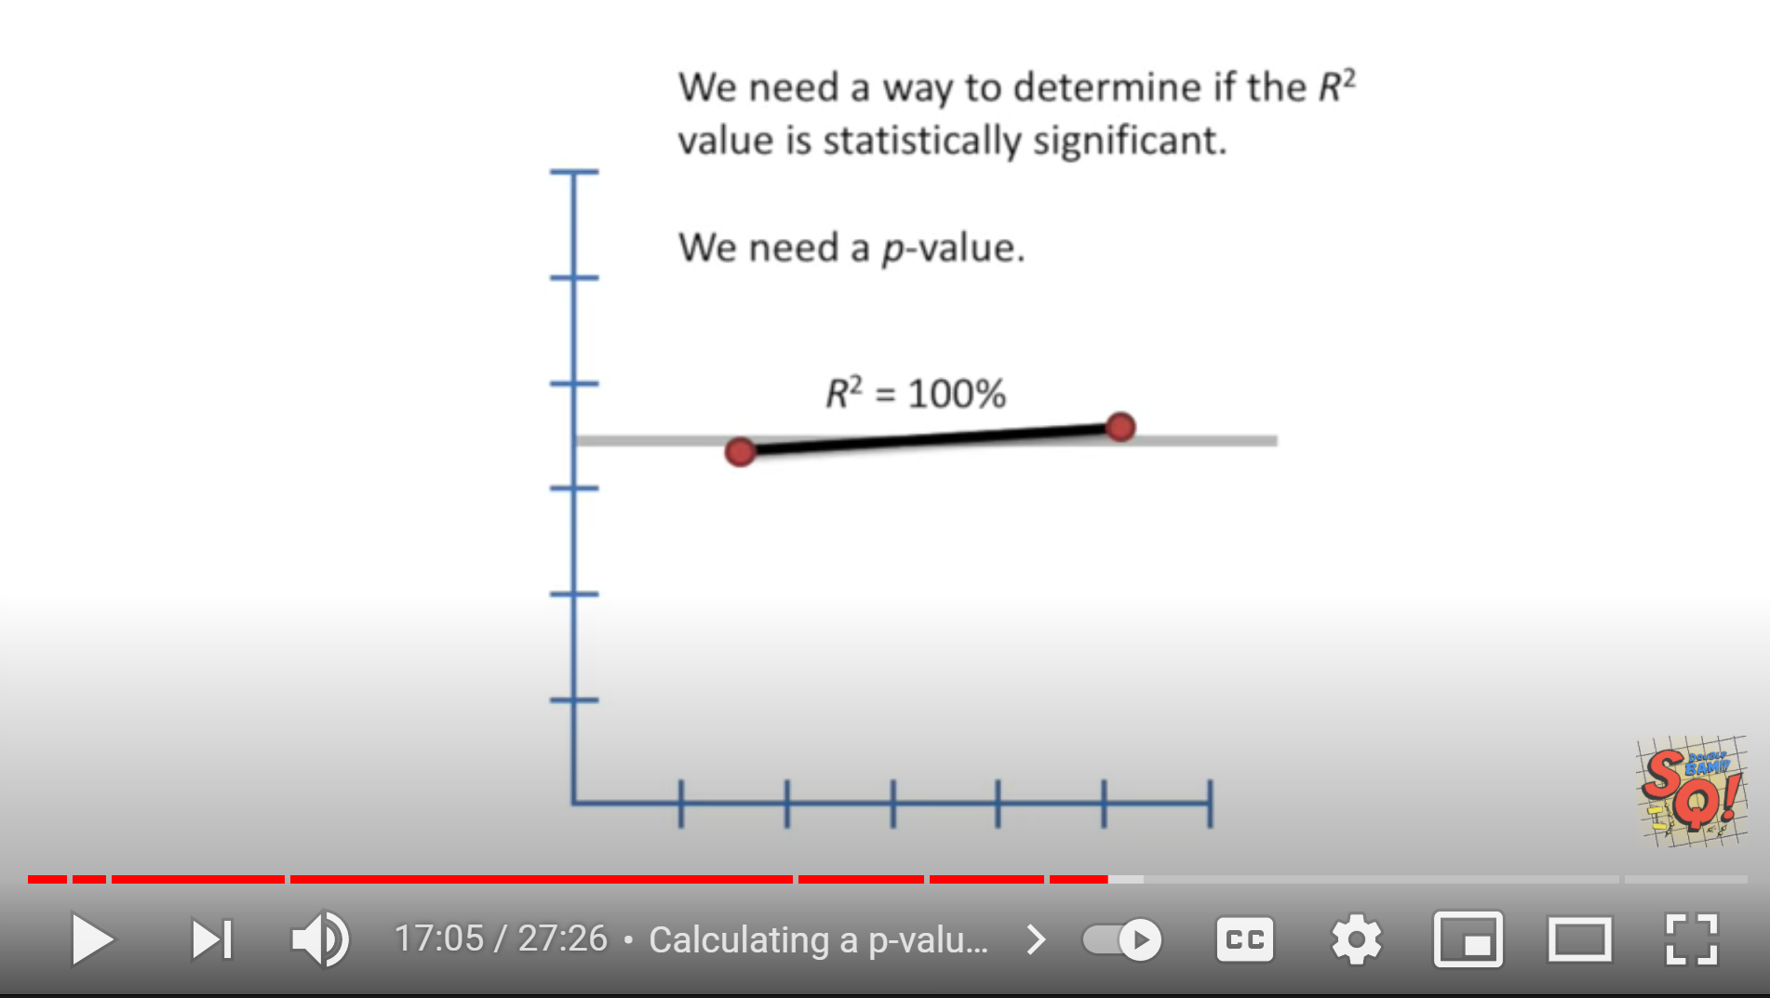
StatQuest: Linear Models Pt.1 - Linear Regression https://www.youtube.com/watch?v=nk2CQITm_eo

Slide 25
Lurking Variable
Sometimes it is not clear which variable is the explanatory variable and which is the response variable
Sometimes the two variables are related without either one being an explanatory variable
Sometimes the two variables are both affected by a third variable, a lurking variable, that had not been included in the study
https://emunix.emich.edu/~schu/MATH_170/Fall09_170/Evening%20session/Unit%203.ppt

Slide 26
Example 1
An example of a lurking variable
A researcher studies a group of elementary school children
  Y = the student’s height
  X = the student’s shoe size
It is not reasonable to claim that shoe size causes height to change
The lurking variable of age affects both of these two variables
https://emunix.emich.edu/~schu/MATH_170/Fall09_170/Evening%20session/Unit%203.ppt

Slide 27
More Examples
Some other examples
Rainfall amounts and plant growth
  Explanatory variable – rainfall
  Response variable – plant growth
  Possible lurking variable – amount of sunlight
Exercise and cholesterol levels
  Explanatory variable – amount of exercise
  Response variable – cholesterol level
  Possible lurking variable – diet
https://emunix.emich.edu/~schu/MATH_170/Fall09_170/Evening%20session/Unit%203.ppt

Slide 28
Find the Equation of a Linear Regression Line
The equation is determined by:
  b₀: y-intercept
  b₁: slope
Values that satisfy the least squares criterion:

