Slide 1
Condorcet Voting
By: Krystle Stehno

Slide 2
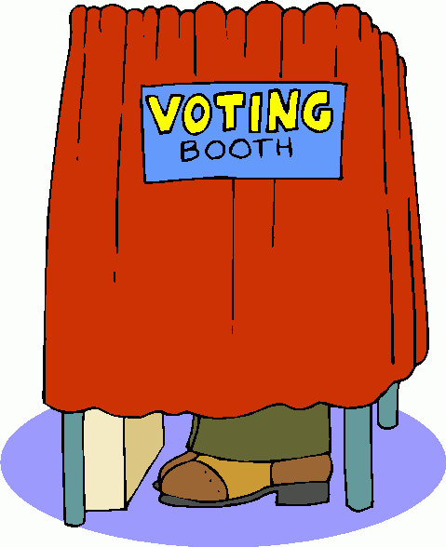

Voting Theory
In voting theory, the goal is to make the largest number of people happy while allowing everyone to vote honestly.
http://www.hamburg.mi.us/clerk/images/vote-graphic.png
http://www.mclib.org/voting_booth.gif

Slide 3
Voting Methods
A voting method contains rules for valid voting and how votes are aggregated to yield a final result. There are many different voting methods including:
Single Winner
Plurarlity Voting
Approval Voting
Condorcet Method
Borda Count
Multiple Winner
Cumulative Voting
Limited Voting
Parallel Voting
Plurality-at-large

Slide 4
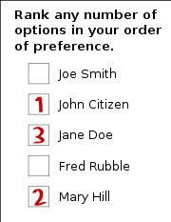
Condorcet Method
Condorcet Voting (Single-Winner): All candidates are ranked and compared in pair-wise elections, whoever has the most wins is elected.
http://wpcontent.answers.com/wikipedia/commons/thumb/1/18/Preferential_ballot.svg/180px-Preferential_ballot.svg.png

Slide 5
Voting
In a Condorcet election the voter ranks the list of candidates in order of preference (for example, the voter gives a 1 to their first preference, a 2 to their second preference…)
When a voter does not give a full list of preferences they are assumed to prefer the candidates they have ranked over all other candidates.

Slide 6

Finding the Winner
The count is conducted by putting every candidate against every other candidate in a series of imaginary one-on-one contests. The winner of each pairing is the candidate preferred by a majority of voters.
http://2.bp.blogspot.com/_I09-P7XJc4U/Rj9BPwP9VlI/AAAAAAAAAbA/s4v7YGgAHTg/s400/kitten-fight.jpg

Slide 7
Condorcet Directed Graph
Given a voting profile for an election with n candidates, its corresponding Condorcet digraph G = (V, A) has one vertex for each of the n candidates. For each candidate pair (x, y), there exists an arc from x to y (denoted by x → y) if x would receive at least as many votes as y in a head-to-head contest. In other words, x → y if x is ranked above y by at least as many voters as ranked y above x. For the candidates that tie there is an arc pointing in each direction (denoted x ↔ y).
The Condorcet digraph of any profile contains at least one arc between every pair of candidates. We call digraphs with at least one edge between any two nodes semi-complete.
Any candidate that beats or ties with all others is called a Condorcet winner. In the Condorcet digraph, this corresponds to having an out-degree of n − 1

Slide 8
Condorcet Voting Algorithm
The Condorcet voting algorithm is a majoritarian method which specifies that the winner of the election is the candidate(s) that beats or ties with every other candidate in a pair-wise comparison
Algorithm 1 Simple Majority Runoff.
1: count = 0
2: for each of the k candidates k_{i} do
3: If k_{i} ranks d1 above d2, count++
4: If k_{i} ranks d2 above d1, count−−
5: If count > 0, rank d1 better than d2
6: Else rank d2 better than d1

Slide 9
Condorcet Voting Algorithm
The Condorcet voting algorithm is a majoritarian method which specifies that the winner of the election is the candidate(s) that beats or ties with every other candidate in a pair-wise comparison
We can generalize the notion of our winner being the winner of all pair-wise contests to generate a ranked list of candidates by modeling the election with our digraph previously described. A Hamiltonian traversal of this graph will produce the election rankings

Slide 10

Condorcet Digraph
To generate the graph takes O(n²k) time which makes it too slow for real applications.
http://school.discoveryeducation.com/clipart/images/snail.gif

Slide 11
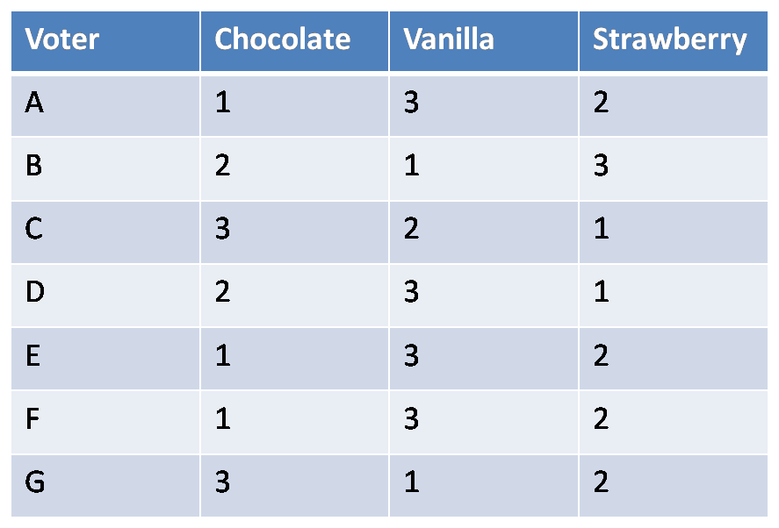
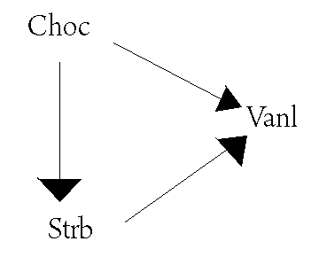
Ice Cream Example
The winner is Chocolate because it has an out-degree of (n-1) = 2 and none of the other vertices do.

Slide 12
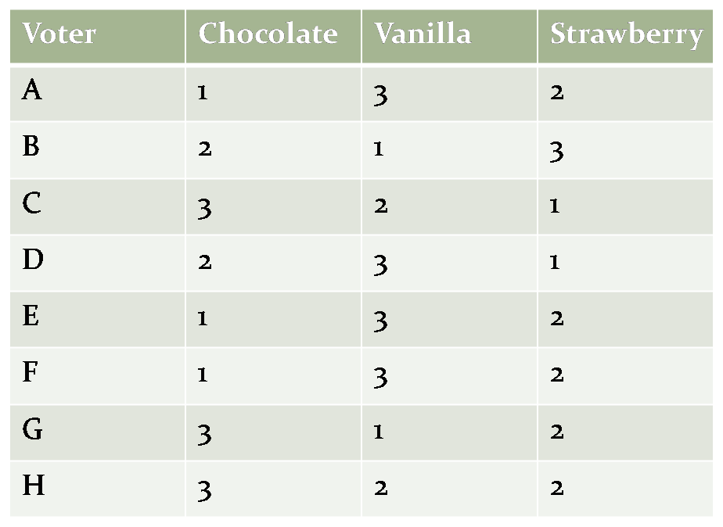
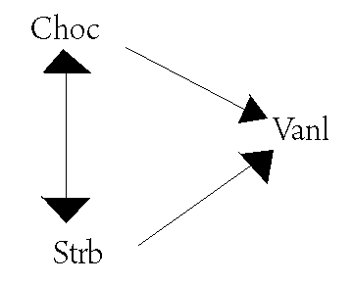
Ice Cream Example
What happens if we add voter H?
We would be left with a tie!
The out-degree of Strawberry is 2 and the out-degree of Chocolate is 2, resulting in no clear winner.

Slide 13

Condorcet’s Paradox
Condorcet’s paradox is a situation in which collective preferences can by cyclic. This means that majority wishes can be in conflict with each other. When this occurs it is because the conflicting majorities are each made up of different groups of individuals.
http://www.atlantamagazine.com/uploadedImages/Atlanta/Blogs/Shop_Girl/QuestionMark.jpg

Slide 14
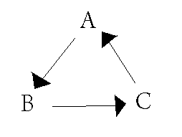
Condorcet’s Paradox
Example: Voter 1: A B C
Voter 2: B C A
Voter 3: C A B
If C is chosen as the winner, it can be argued that B should win instead since two voters prefer B to C and only one voter prefers C to B.
By the same argument, A is preferred to B and C is preferred to A. Thus, there is no clear winner.

Slide 15
Strongly Connected Components of the Condorcet Digraph
The strongly connected components (SCC) of a digraph partition the vertices of the graph.
Strongly connected components of a Condorcet digraph are important so that we can avoid the Condorcet paradox because SCC digraphs are acyclic by design.
Basically, what we are trying to do is simplify our graph.
Our strongly connected components are sets of vertices that contain a cycle (or are strongly connected) and we can call them nodes (or equivalence classes since we are saying each candidate in this group is tied).

Slide 16
Strongly Connected Components of the Condorcet Digraph
Each strongly connected component of the Condorcet digraph contains a set of equivalent nodes. In the strongly connected component digraph, each node represents one strongly connected component and for X, Y in this digraph, X → Y if there exists an x ∈ X and y ∈ Y such that x → y.
in the case of semi-complete graphs, if X → Y , then x_{i} → y_{j} for all x_{i}∈ X and y_{j}∈ Y

Slide 17
Strongly Connected Components of Condorcet Digraphs
Since the original digraph was semi-complete, so is our new digraph. Since our new digraph is acyclic, this implies that there is one node X with in-degree zero. If X is removed from our new digraph, we still have a semi-complete, acyclic graph. Therefore, this graph has node X* with in-degree zero. This process can be repeated until all nodes have been exhausted. This creates a unique ordering.

Slide 18
Summary
In conclusion, the Condorcet voting method would be a very fair method and would probably have the smallest percentage of voters being angry, but it is extremely time consuming to find the winner in a large set.
Because of its complexity, people have come up with many ways to modify it in order to actually implement it on a large data set. A couple of these modifications are:
The Debian Voting System
Condorcet-fuse alorithm

Slide 19
Condorcet Paths
We define a Condorcet-consistent Hamiltonian path (or Condorcet path) to be any Hamiltonian path through the Condorcet digraph. Our goal is to efficiently find such a path. Condorcet paths have two properties relevant to metasearch:
Theorem 1. Every semi-complete graph contains a Hamiltonian path.
Theorem 2. If candidate x is in an SCC ranked above the SCC containing y, then x is ranked above y in every Condorcet path.

Slide 20
Theorem 1
Theorem 1. Every semi-complete graph contains a Hamiltonian path.
Proof by induction.
The base case is a graph with one node and is trivial.
For the inductive step, suppose every semi-complete graph with n−1 nodes contains a Hamiltonian path. For a problem of size n, let H be the Hamiltonian path for a sub-problem containing only an arbitrary n−1 of the nodes. Now the nth node x is introduced, along with its n − 1 edges to or from the other nodes. There are three cases: (1) If x points to the first node in H, then x followed by H is a Hamiltonian path. (2) If not, then the first node in H points to x. Now consider each node in H in turn. A new Hamiltonian path can be created by inserting x into H just before the first node that x points to, if one exists. (3) If x doesn’t point to any of the nodes in H, then the last node in H points to x, so a new Hamiltonian path can be created by appending x to H.

Slide 21
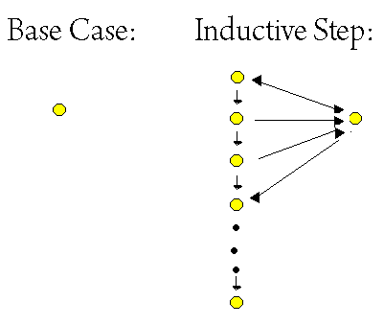
Theorem 1

Slide 22
Theorem 2
Theorem 2. If candidate x is in an SCC (strongly connected component) ranked above the SCC containing y, then x is ranked above y in every Condorcet path.
Proof. This is a simple consequence of the fact that there is only one way to sort the SCCD (strongly connected component digraph); thus there does not exist a path from y to x. So any Hamiltonian path puts x before y. Thus we say Condorcet paths properly order the SCC’s.
In other words, a randomly chosen Condorcet path orders the candidates that don’t tie correctly, and breaks ties arbitrarily

Slide 23
Condorcet Paths
We now know that we can find a unique ordering by generating the entire Condorcet graph, computing it’s SCC’s, sorting them and ordering candidates within each SCC arbitrarily. As stated earlier, this algorithm is O(n²k) for n candidates and k voters, which is impractical for large sets.
Theorems 1 and 2 show that we can find a reasonable ordering by computing a Condorcet path.

Slide 24
Condorcet-fuse Algorithm
The Condorcet-fuse algorithm does exactly that for us, giving us an algorithm that finds a Condorcet path in O(nk lgn) time without actually creating the Condorcet graph.
The key is to use Algorithm 1 as the comparison function in the InsertionSort Algorithm. This could also be used with MergeSort or QuickSort as well.
Algorithm 3 Condorcet-fuse.
1: Create a list L of all the documents
2: Sort(L) using Algorithm 1 as the comparison function
3: Output the sorted list of document

Slide 25
References
Aslam, J, & Montague, M (2002). Condorcet Fusion for Improved Retrieval. ACM, 1-58113-492-4/02/0011, Retrieved April 26, 2009, from http://www.ccs.neu.edu/home/jaa/ISU535.05X1/resources/condorcet.pdf.
(2009, April 20). Condorcet Method. Retrieved April 26, 2009, from Wikipedia Web site: http://en.wikipedia.org/wiki/Condorcet_method#Voting
Crowley, Mark (2006, January 30). Election Theory. Retrieved April 26, 2009, Web site: http://www.cs.ubc.ca/~crowley/academia/papers/gtdt-election-jan302006.pdf

Slide 26

Questions?
http://www.library.uni.edu/instruction/tips/images/questionmark.jpg

