Slide 1
Topology of Machine Learning Activations
Madelyn Shapiro
PNNL Team: Brett Jefferson, Cliff Joslyn, Brenda Praggastis, & Emilie Purvine (PI)
University of Utah Team: Archit Rathore, Bei Wang, & Youjia Zhou
Notes:
Image: Abstract Data Visualization – Stock Photo

Slide 2
Outline
Background
Convolutional Neural Networks (CNNs)
What are they? Why do we want to understand their topology?
Relevant topological data analysis (TDA) techniques
Previous work in TDA for Machine Learning (ML)
Topology of natural images, model weights, and activations
TopoAct: Exploring the Shape of Activations in Deep Learning
Work done by our collaborators at University of Utah: Archit Rathore & Bei Wang
Our work
Extending TopoAct
Improving point cloud activation sampling
Mapper graph purity measures
Robustness to noisy data
Image & convolutional patch topology

Slide 3
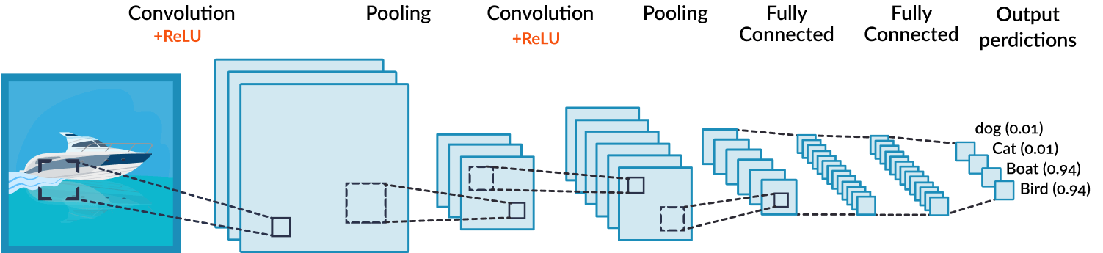
Convolutional Neural Networks (CNNs)
CNNs are powerful classification tools for multi-dimensional data e.g., images
Input is passed through a series of linear and nonlinear transformations
Spatial information is preserved!
Interpretability is a critical research area
Output
predictions
Dog (0.01)
Cat (0.01)
Boat (0.94)
Bird (0.04)

Slide 4

Terms and Definitions
Output
predictions
Dog (0.01)
Cat (0.01)
Boat (0.94)
Bird (0.04)
m
c
Each transformation in the CNN is referred to as a layer
m
Convolutional layers operate on tensors, or n-dimensional matrices
A $c × m × m$ tensor
Channels
Spatial dimensions

Slide 5
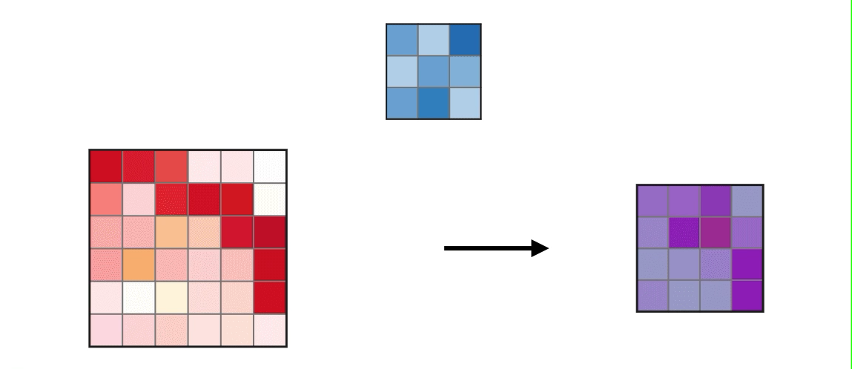
What is a convolution?
Learned weight matrices called filters pass over an image to produce a matrix of activations
We can think of each filter in a convolutional layer as “scanning” an image for specific features
A filter passes over an input matrix to produce an activation matrix
Each section of the input that pairs with the filter is called a receptive field

Slide 6

Terms and Definitions
Output
predictions
Dog (0.01)
Cat (0.01)
Boat (0.94)
Bird (0.04)
m
$$∗$$
n
k
d
c
c
k
n
m
…
Input tensor
Activation tensor
d Filters

Slide 7
Understanding the Topology of CNNs
Output
predictions
Dog (0.01)
Cat (0.01)
Boat (0.94)
Bird (0.04)
Do neural networks encode topology of the data within activations and weights? How?
How does the topology relate across layers? To the input?
Do we see topological structures preserved?

Slide 8
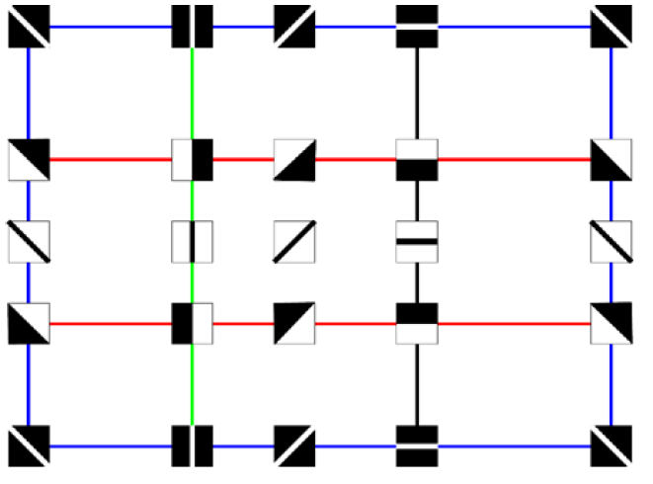
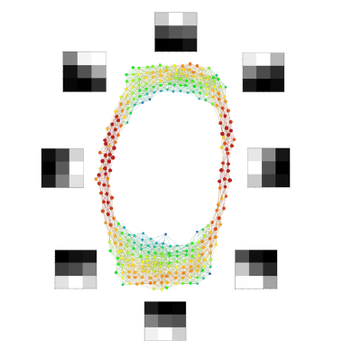
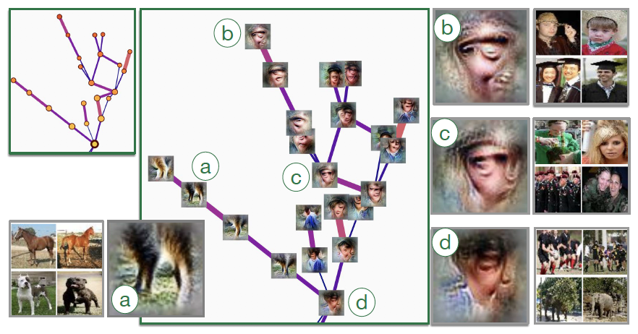
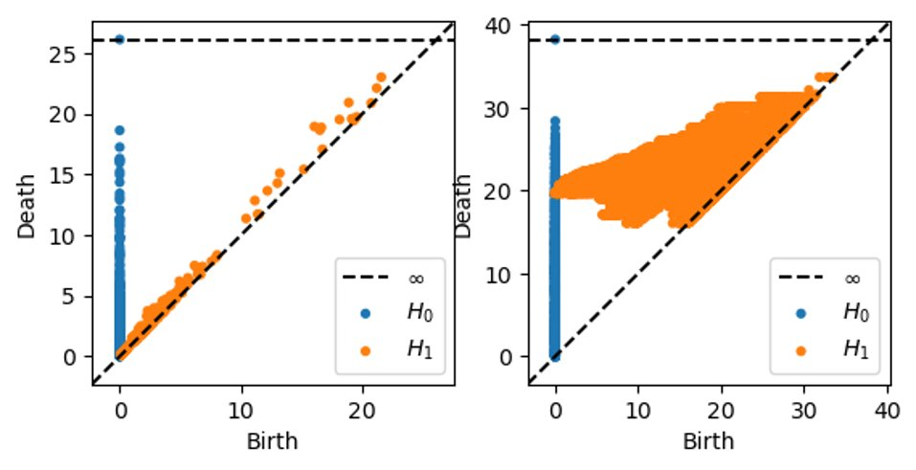
Understanding the Topology of CNNs
Output
predictions
Our work
Dog (0.01)
Cat (0.01)
Boat (0.94)
Bird (0.04)
Input Data
Weights
Activations
???
???
???
Mapper
Persistence
Carlsson, G., Ishkhanov, T., de Silva, V. et al.
Gabrielsson, Rickard Brüel, and Gunnar Carlsson
???

Slide 9
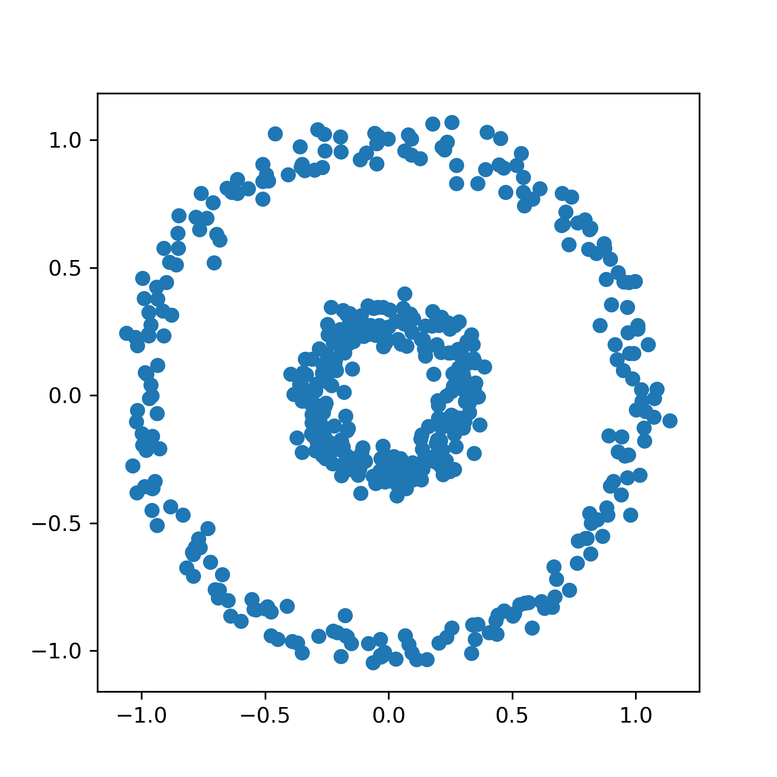
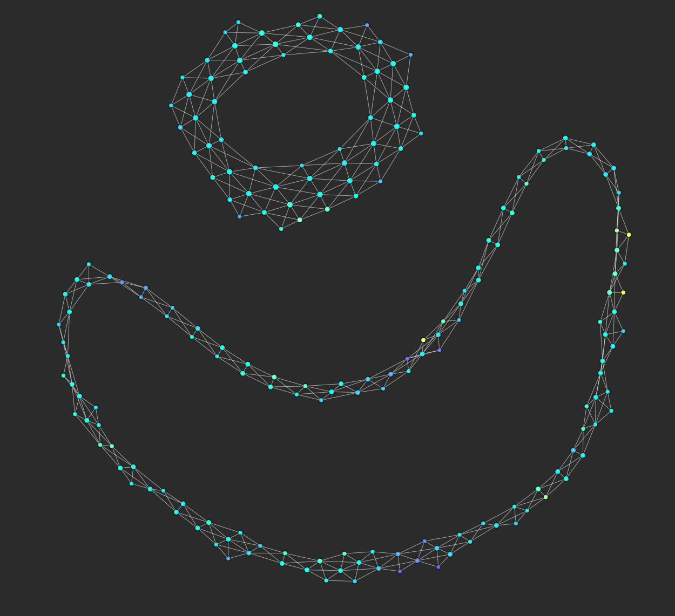
Mapper
Main idea: Turn point cloud data into a simplified graph capturing large scale structure of the point cloud.

Slide 10



Mapper procedure: apply filter function
$$ℝ$$
$$f(x,y) = y$$
Open cover
$$\{U_{i}\}$$

Slide 11
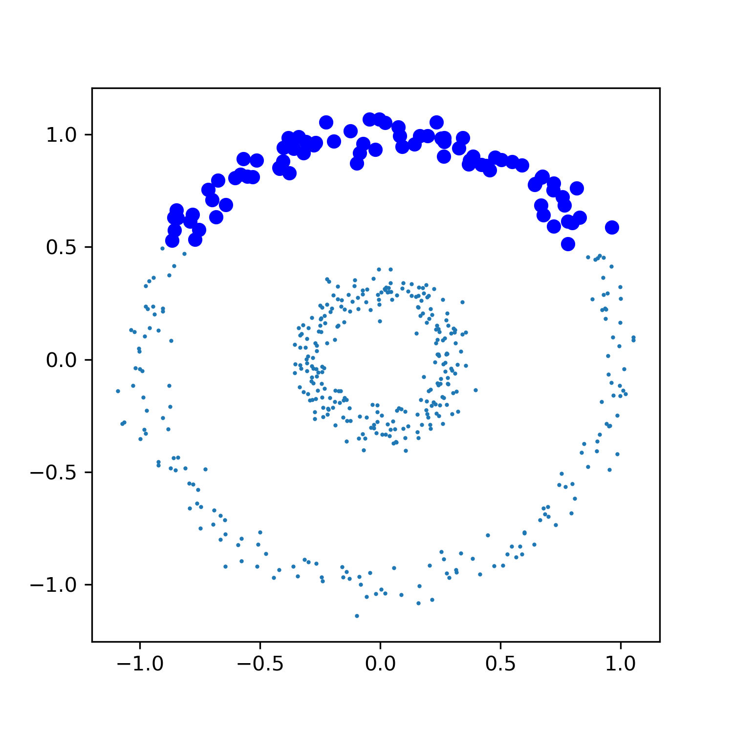
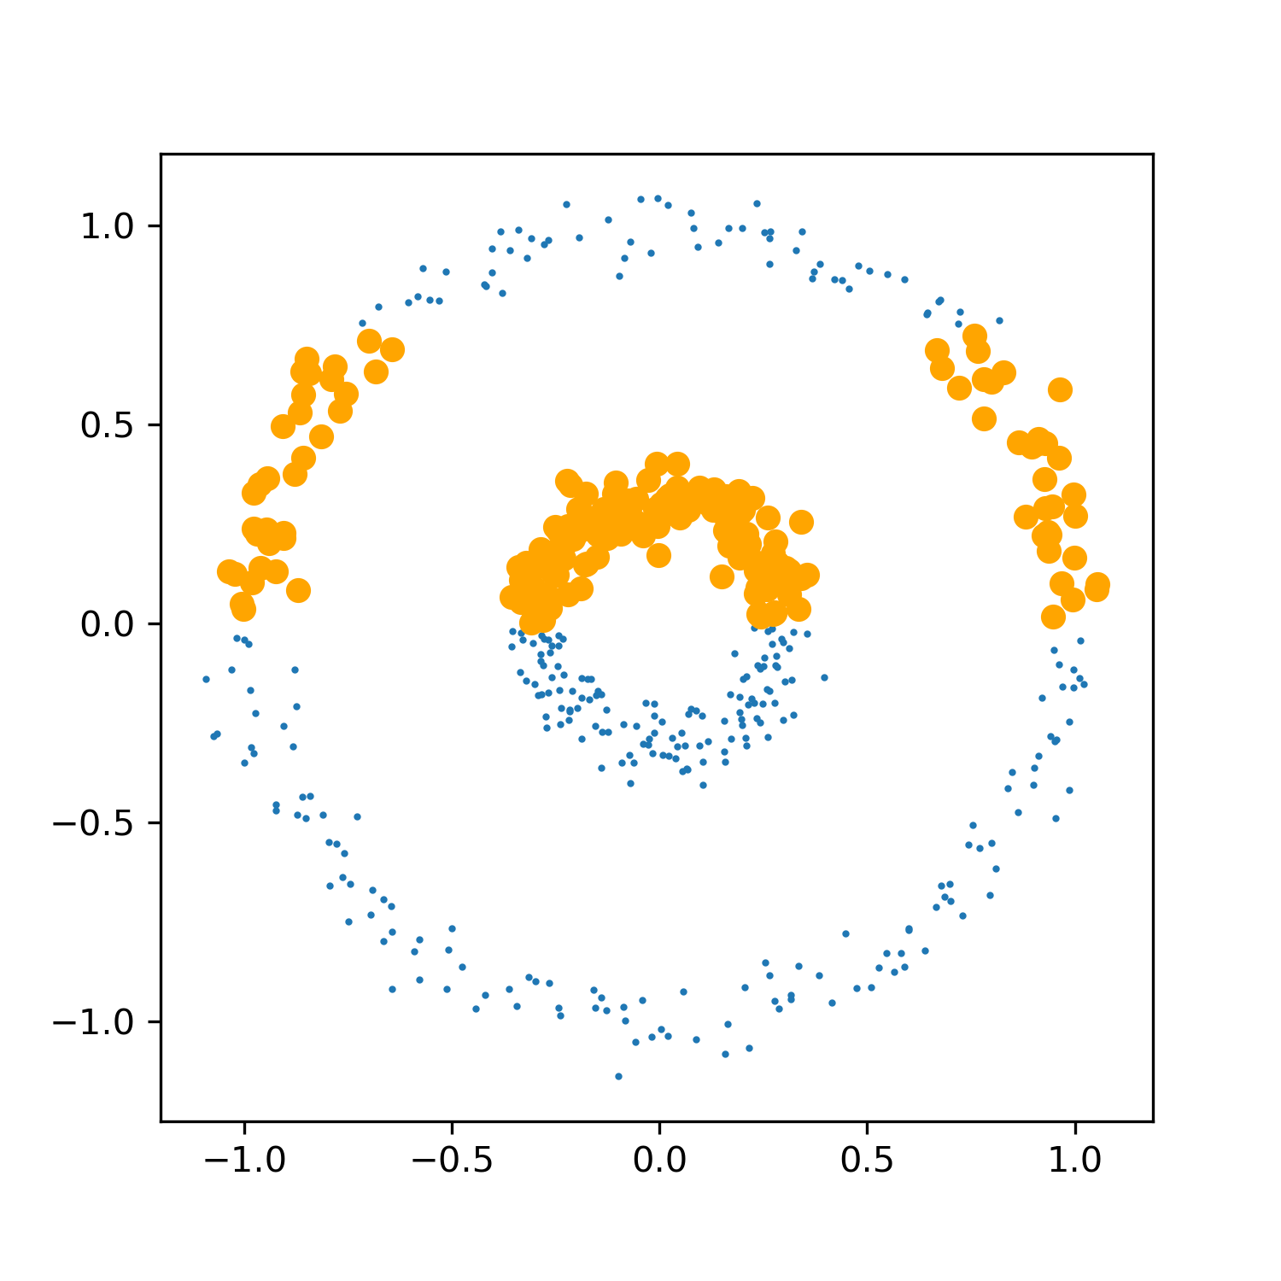
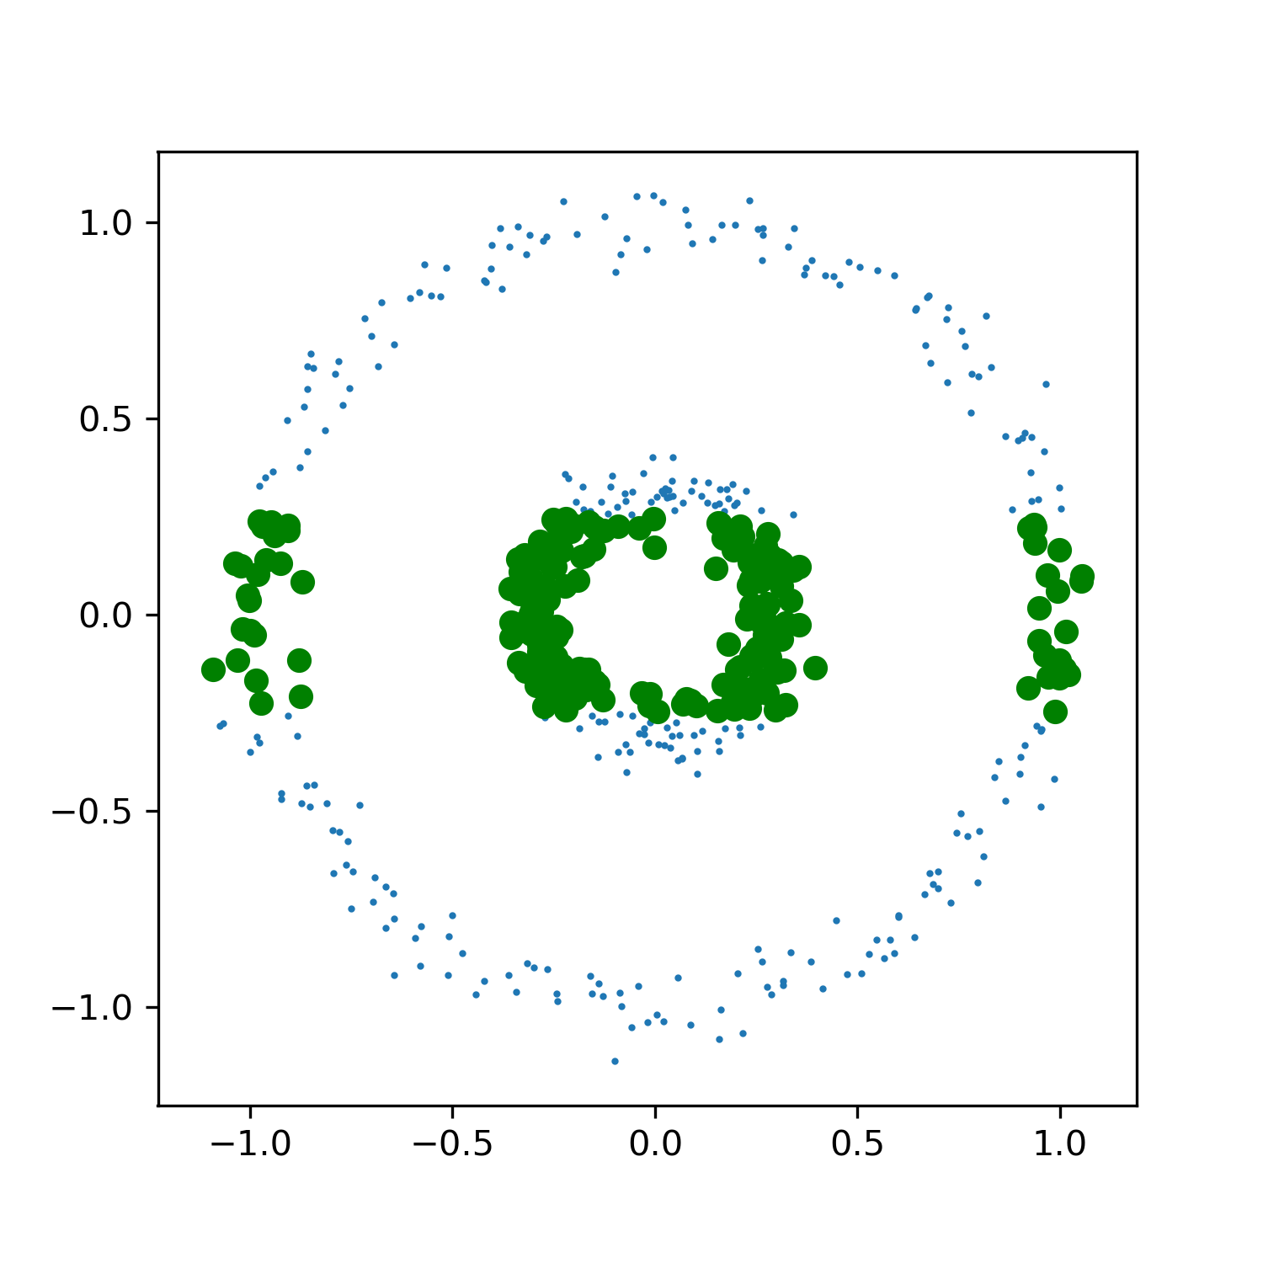
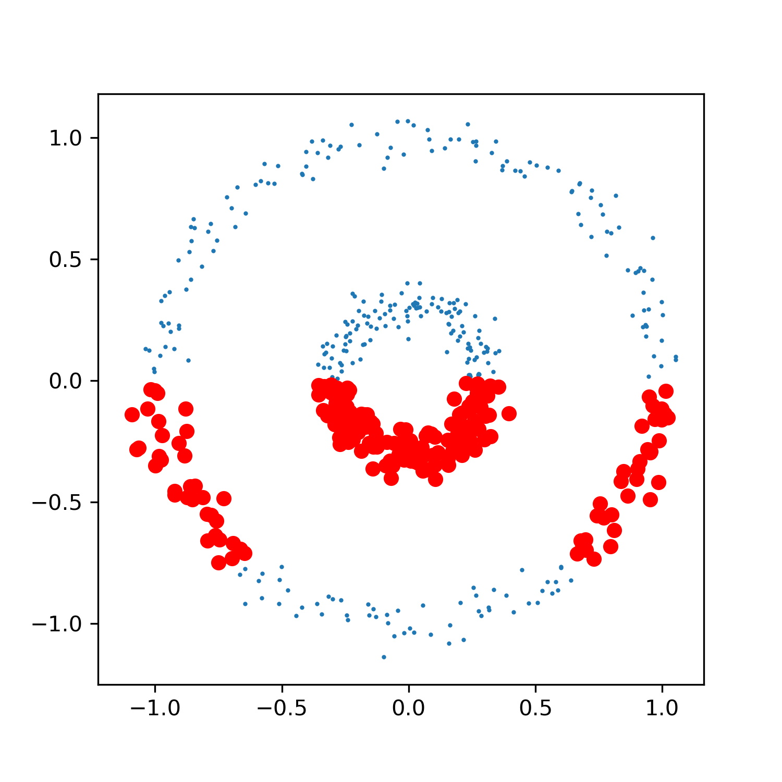
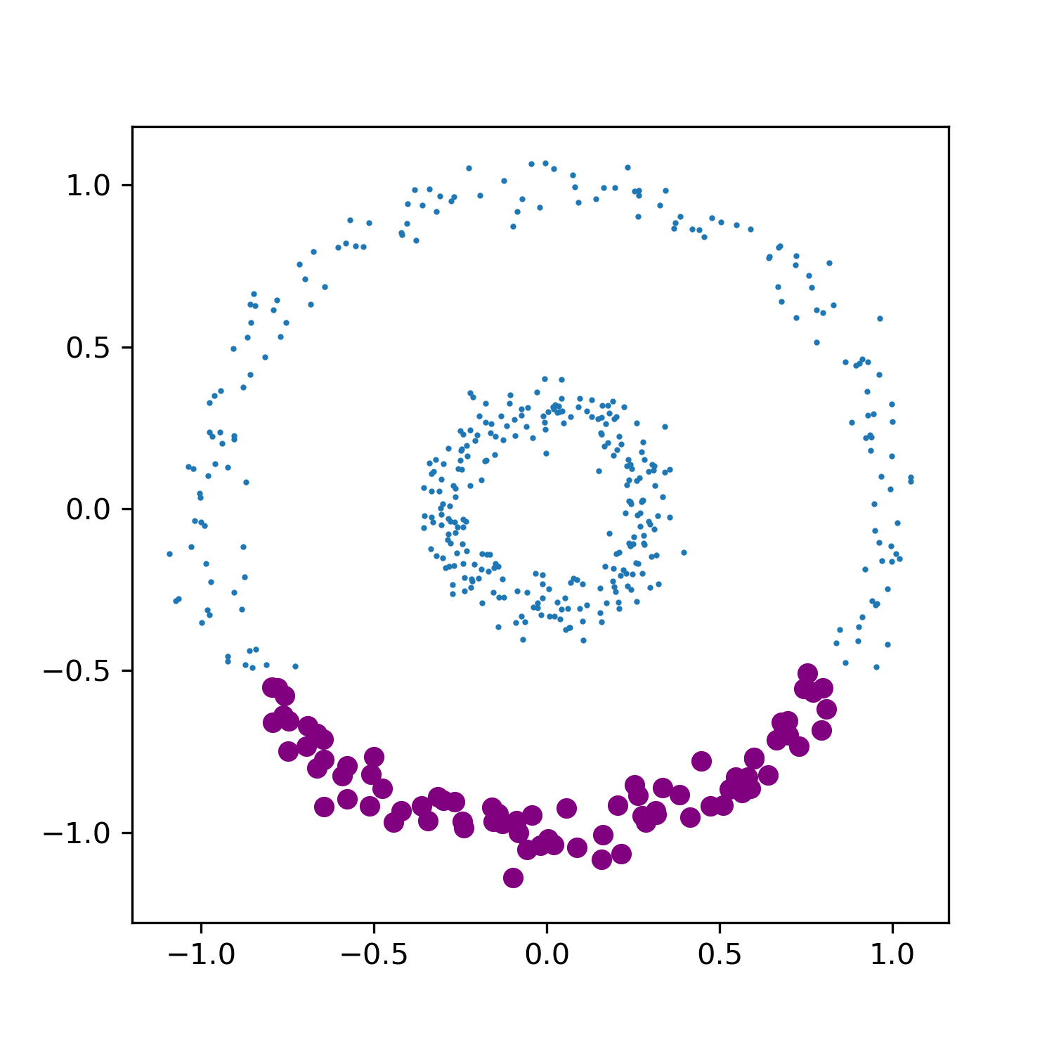
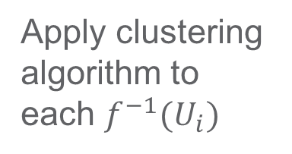

Mapper procedure: take preimages
$$ℝ$$
$$f^{−1}(U_{i})$$
$$f(x,y) = y$$
Open cover
$$\{U_{i}\}$$
Apply clustering algorithm to each $f^{−1}(U_{i})$

Slide 12

Mapper procedure: cluster preimages
$$ℝ$$
$$f^{−1}(U)$$
$$f(x,y) = y$$
Open cover

Slide 13
Mapper procedure: final mapper graph
$$ℝ$$
$$f^{−1}(U)$$
$$f(x,y) = y$$
Open cover

Slide 14
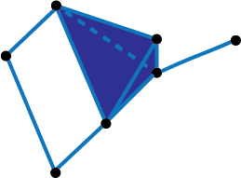
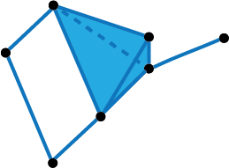
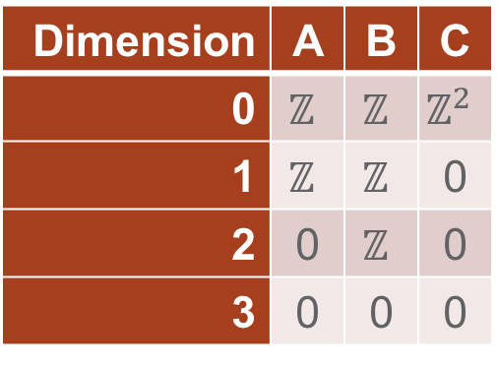
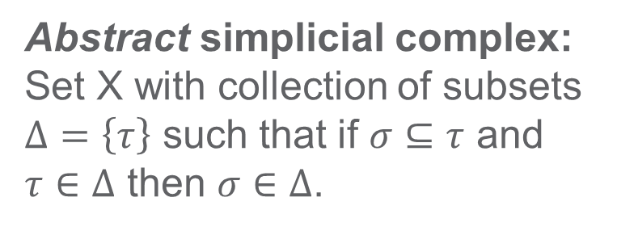
Algebraic Topology - homology
Use abstract algebra to study topological spaces
Main concepts: simplicial complex, homology, (homotopy)
Abstract simplicial complex: Set X with collection of subsets $Δ=\left\{τ\right\}$ such that if $σ⊆τ$ and $τ∈Δ$ then $σ∈Δ$.
Homology: algebraic representation of topological structure. Intuition: homology provides a way to represent and then count the holes in different dimensions
A
B
hollow!
Homology groups
Betti Numbers
Dimension | A | B | C
0 | $$ℤ$$ | $$ℤ$$ | $$ℤ^{2}$$
1 | $$ℤ$$ | $$ℤ$$ | 0
2 | 0 | $$ℤ$$ | 0
3 | 0 | 0 | 0
Dimension | A | B | C
0 | 1 | 1 | 2
1 | 1 | 1 | 0
2 | 0 | 1 | 0
3 | 0 | 0 | 0
C
Geometric realizations of simplicial complexes

Slide 15
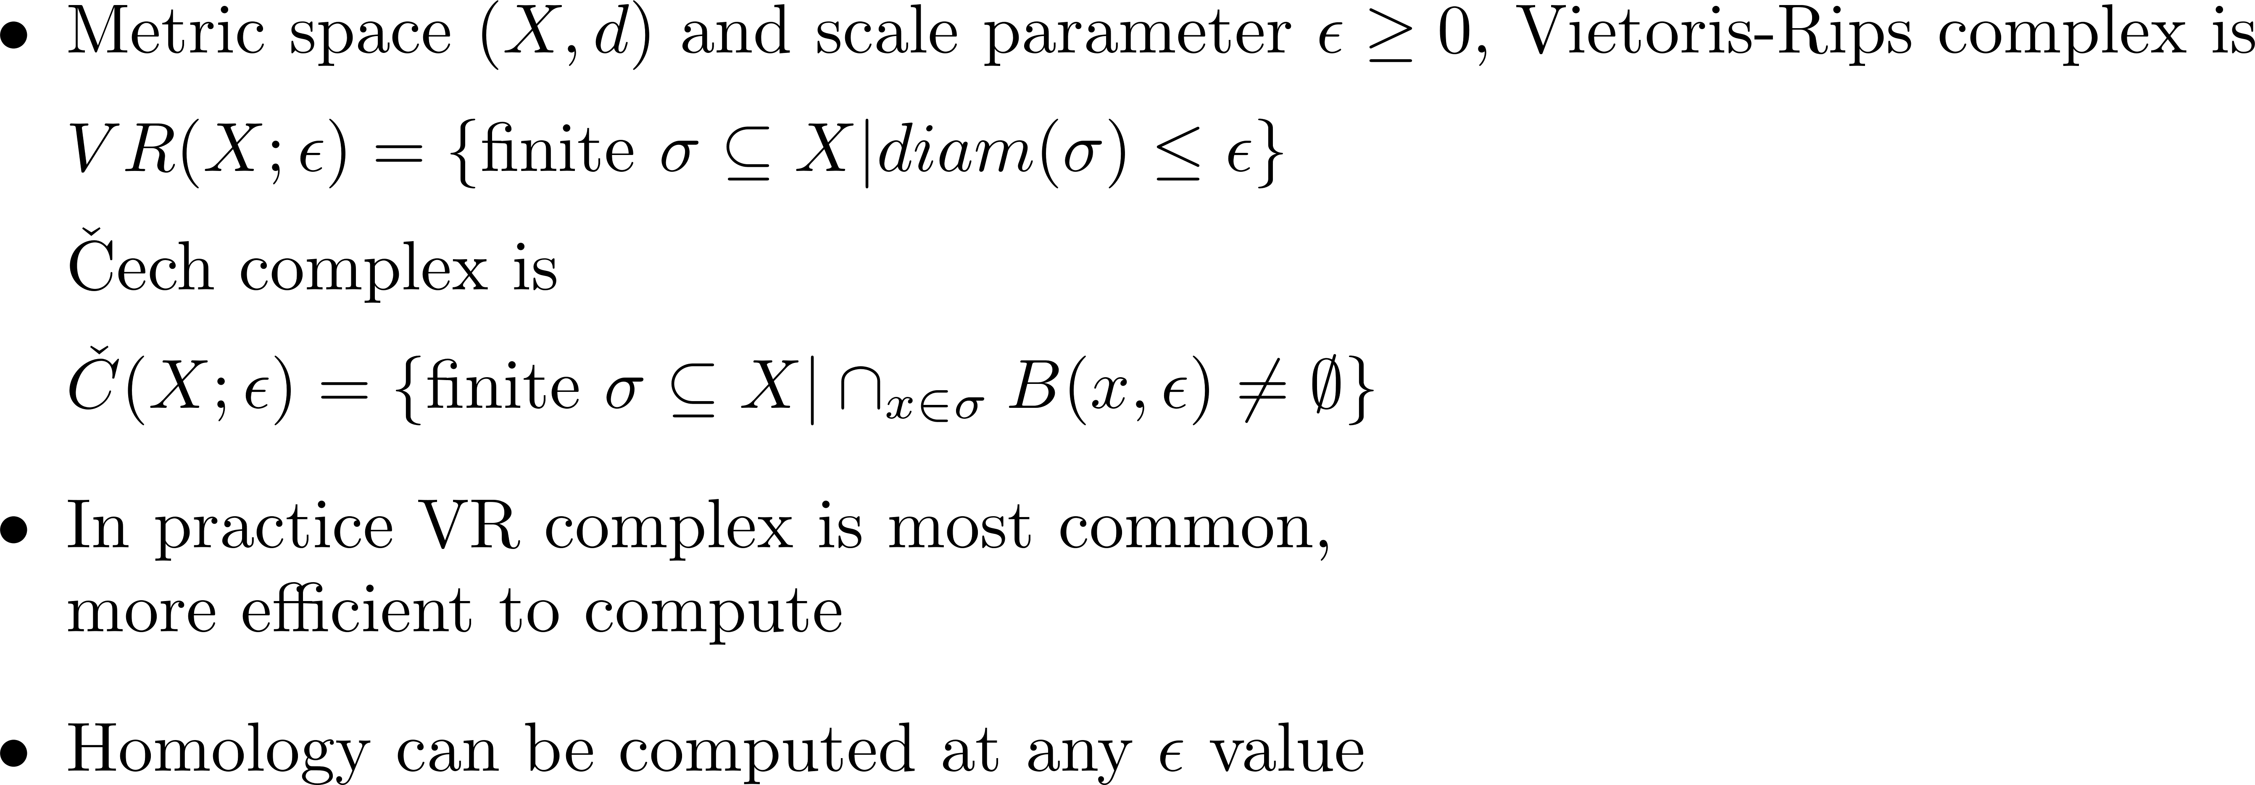
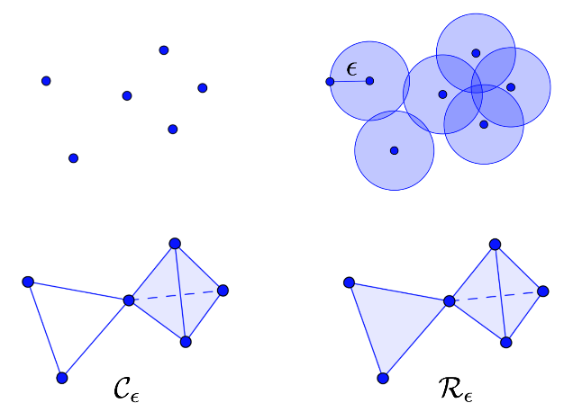
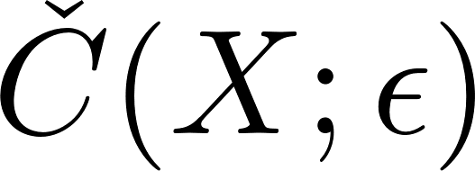
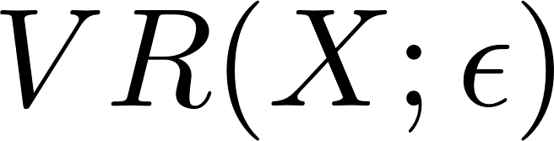
Vietoris-Rips complex from point cloud

Slide 16
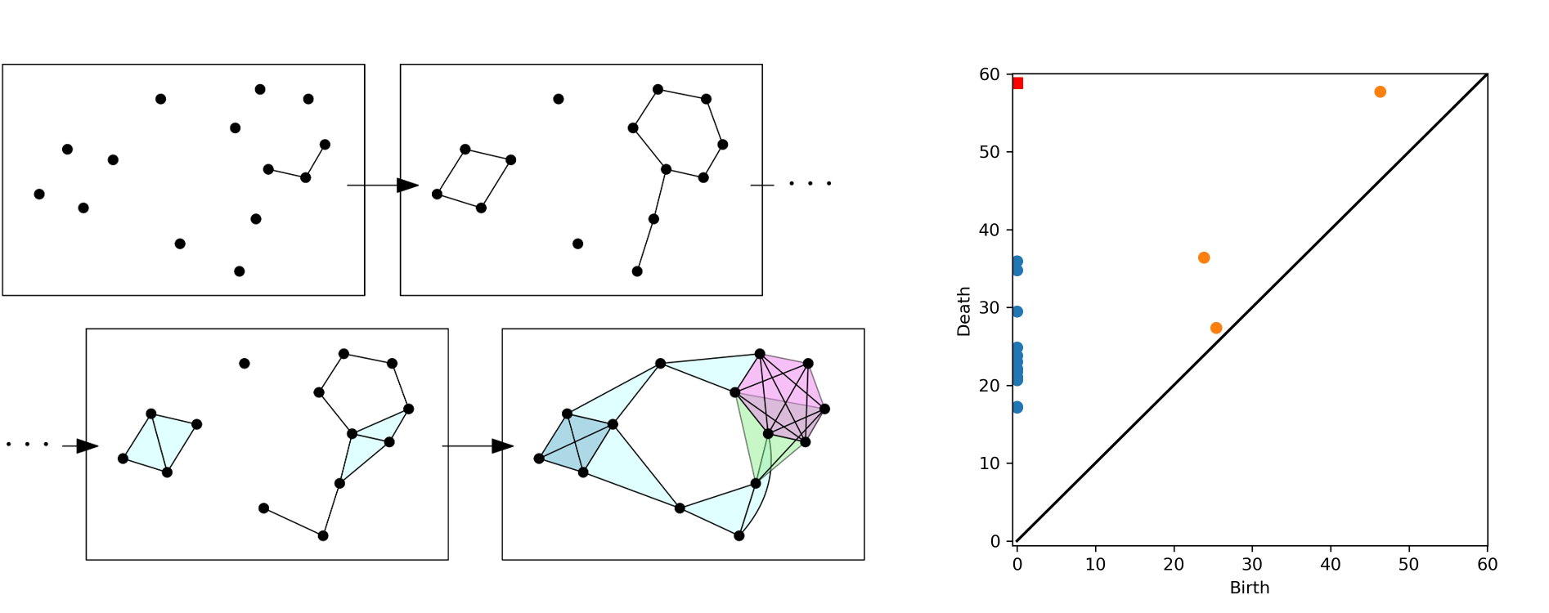
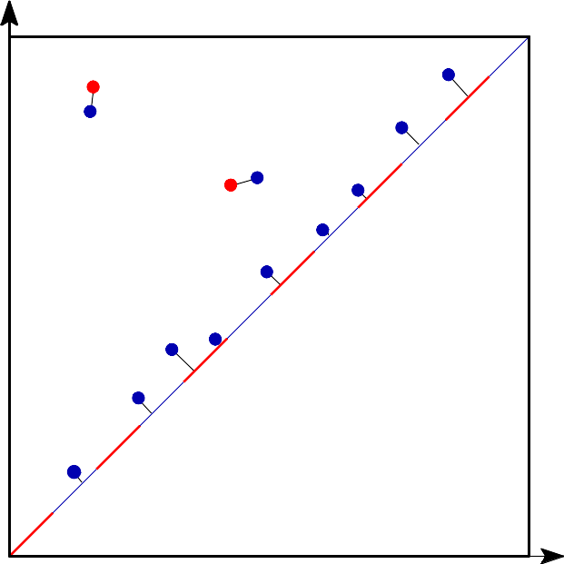
Persistent Homology
Point Cloud (Rips) Filtration
Question: How do you choose the threshold or cover?
Answer: Don’t choose! Do them all!
Sweep across a sequence of thresholds – “filtration”
Compute homology for each one
Track how holes emerge and die
Those that persist the longest are more likely “real” while those that are brief are more likely “noise”
Stability result: If you change your data slightly it only changes the barcode slightly
Robust to noise
Bottleneck distance measures distance between two PDs as length of longest edge in the “best” matching of points
Image from https://gudhi.inria.fr/doc/3.4.1/group__bottleneck__distance.html

Slide 17
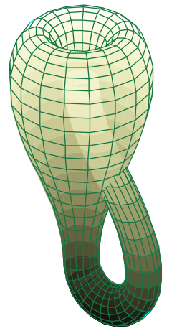
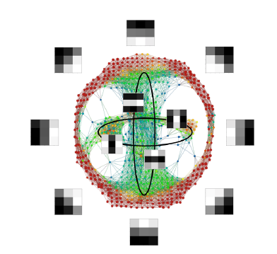
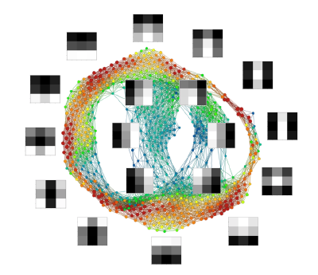
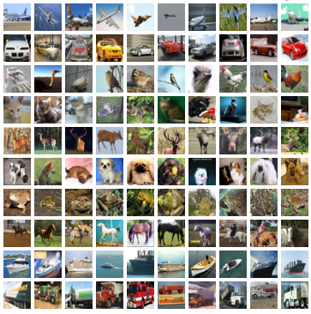
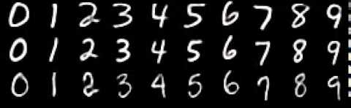
Brief Survey of TDA for Machine Learning
Topology of natural images
Mapper graphs of convolutional layer weights for image classification
Carlsson, G., Ishkhanov, T., de Silva, V. et al. On the Local Behavior of Spaces of Natural Images. Int J Comput Vis 76, 1–12 (2008). https://doi.org/10.1007/s11263-007-0056-x
van Hateren, J. H., & van der Schaaf, A. (1998). Independent component filters of natural images compared with simple cells in primary visual cortex. Proceedings of the Royal Society of London Series B, 265, 359–366.
Gabrielsson, Rickard Brüel, and Gunnar Carlsson. "Exposition and interpretation of the topology of neural networks." 2019 18th ieee international conference on machine learning and applications (icmla). IEEE, 2019.
Layer 1 of two-layer CNN trained on MNIST data
Two different CIFAR-10 models

Slide 18
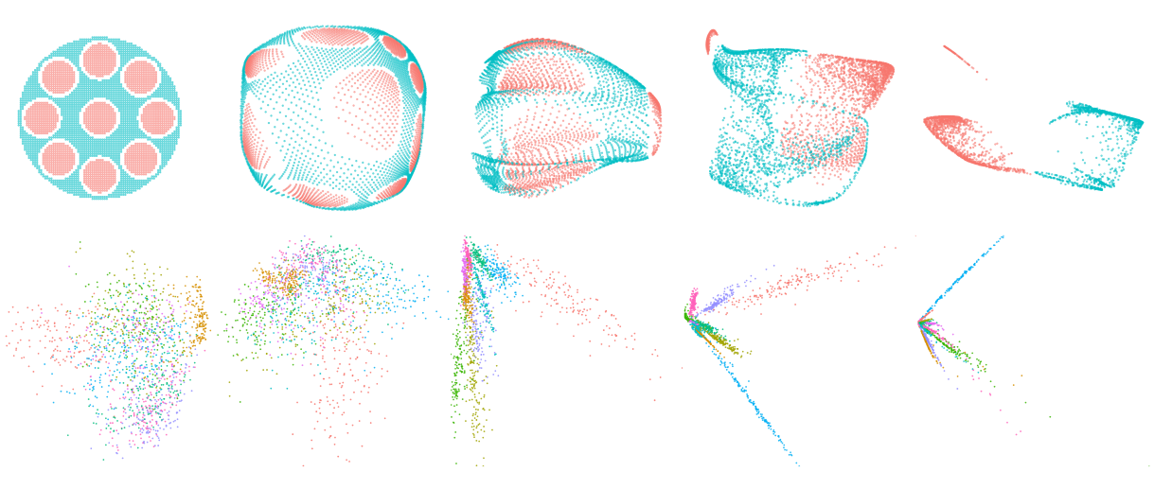
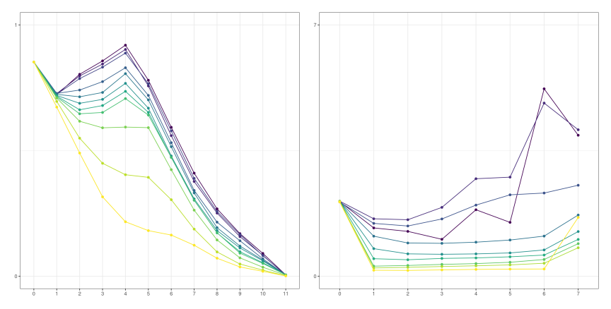
Brief Survey of TDA for Machine Learning
Transforming the topology of activation space
Wheeler, M., Bouza, J. and Bubenik, P., 2021, December. Activation Landscapes as a Topological Summary of Neural Network Performance. In 2021 IEEE International Conference on Big Data (Big Data) (pp. 3865-3870). IEEE. https://ieeexplore.ieee.org/abstract/document/9671368
Naitzat, G., Zhitnikov, A. and Lim, L.H., 2020. Topology of Deep Neural Networks. J. Mach. Learn. Res., 21(184), pp.1-40. https://www.jmlr.org/papers/volume21/20-345/20-345.pdf
PCA of activations at intermediate layers of simple classification network. (Top) Classifying red points vs. blue points. (Bottom) Classifying MNIST digits, colors indicate ground-truth classes.
Topological complexity as measured by norm of persistence landscape of select input points. (Left) from red/blue classification, (right) from MNIST.

Slide 19
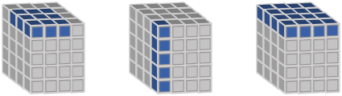
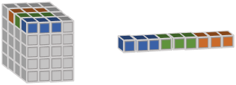
Point clouds from activations
Set of points in n-dimensional space. E.g., in 2 dimensions
Each activation layer is a tensor of numbers
Slice that tensor, and unfold if necessary, in different ways to get high dimensional points
Each (input image, layer) pair can be represented by
One point: chosen by some heuristic from the activations
Collection of points: all or a subset from activations
Then, each point cloud can represent a collection of images or a single image
Patch
Spatial
Channel
Unfolded patch
Start here
Collection of images: How does the neural network change or organize the topology of the space of all images?
Single image: How does the neural network change or capture the topology of each image?

Slide 20
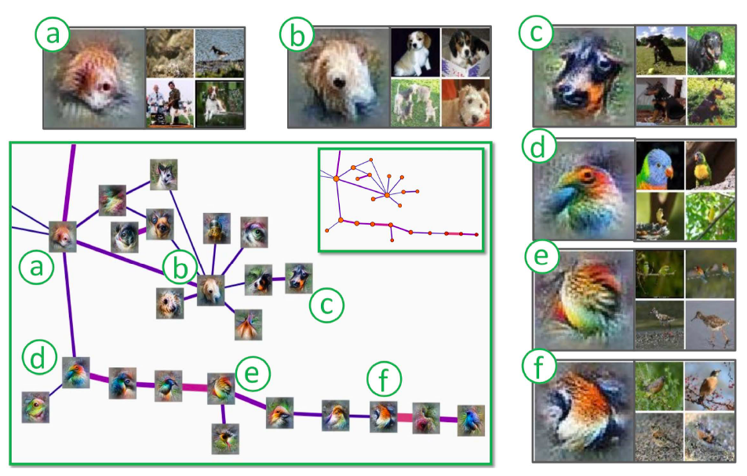
TopoAct: Exploring the Shape of Activations in Deep Learning
Mapper graph of spatial activations rather than the weights
Bifurcations in mapper graph help show how the activations lead to decisions
Our work extends this work
Bird-mammal bifurcation
Leg-face bifurcation
A. Rathore, N. Chalapathi, S. Palande, and B. Wang, “TopoAct: Exploring the Shape of Activations in Deep Learning,” ArXiv191206332 Cs, Dec. 2019, http://arxiv.org/abs/1912.06332.

Slide 21
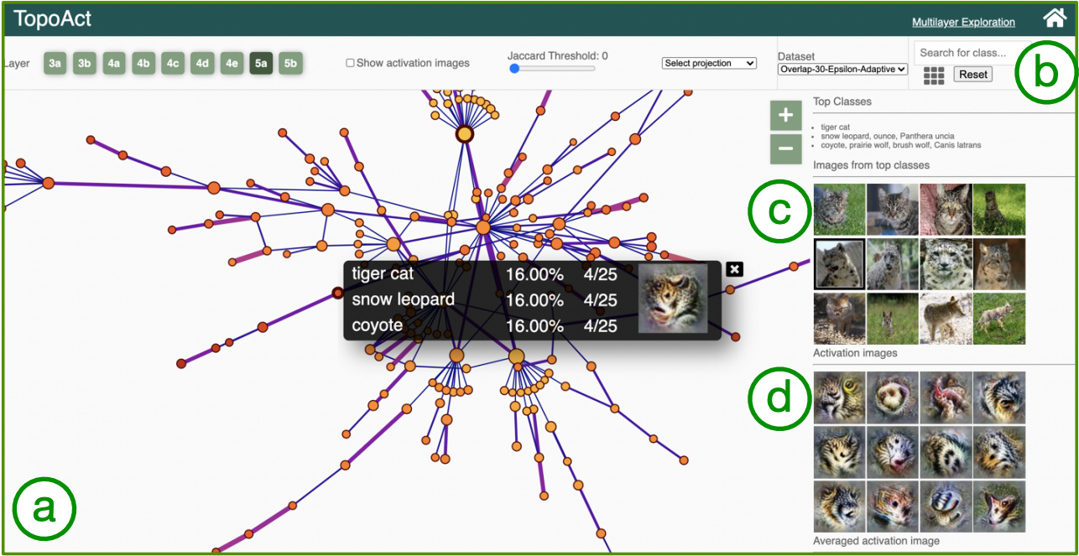
TopoAct: Exploring the Shape of Activations in Deep Learning
A. Rathore, N. Chalapathi, S. Palande, and B. Wang, “TopoAct: Exploring the Shape of Activations in Deep Learning,” ArXiv191206332 Cs, Dec. 2019, http://arxiv.org/abs/1912.06332.
Notes:
“(a) provides a graph-based topological summary of the activation vectors from 300K images across 1K classes, where each node of the mapper graph represents a cluster of activation vectors, and each edge encodes the relationships between the clusters. The size of a node is proportional to the number of activations, and the color is mapped to the average L2 norm of activations in the cluster. The edge thickness is proportional to the Jaccard index between two nodes. The control panel (b) supports the selection of parameters for the mapper construction and visual encoding. For a chosen cluster in the mapper graph, the data example panel (c) gives textual description of the top three classes within the cluster together with (up to) five image examples from each top class. The feature visualization panel (d) applies feature inversion to generate idealized images, called activation images, for individual activation vectors (obtained from data examples) and for an averaged activation vector within a chosen cluster.”
A. Rathore, N. Chalapathi, S. Palande, and B. Wang, “TopoAct: Exploring the Shape of Activations in Deep Learning,” ArXiv191206332 Cs, Dec. 2019, http://arxiv.org/abs/1912.06332.

Slide 22
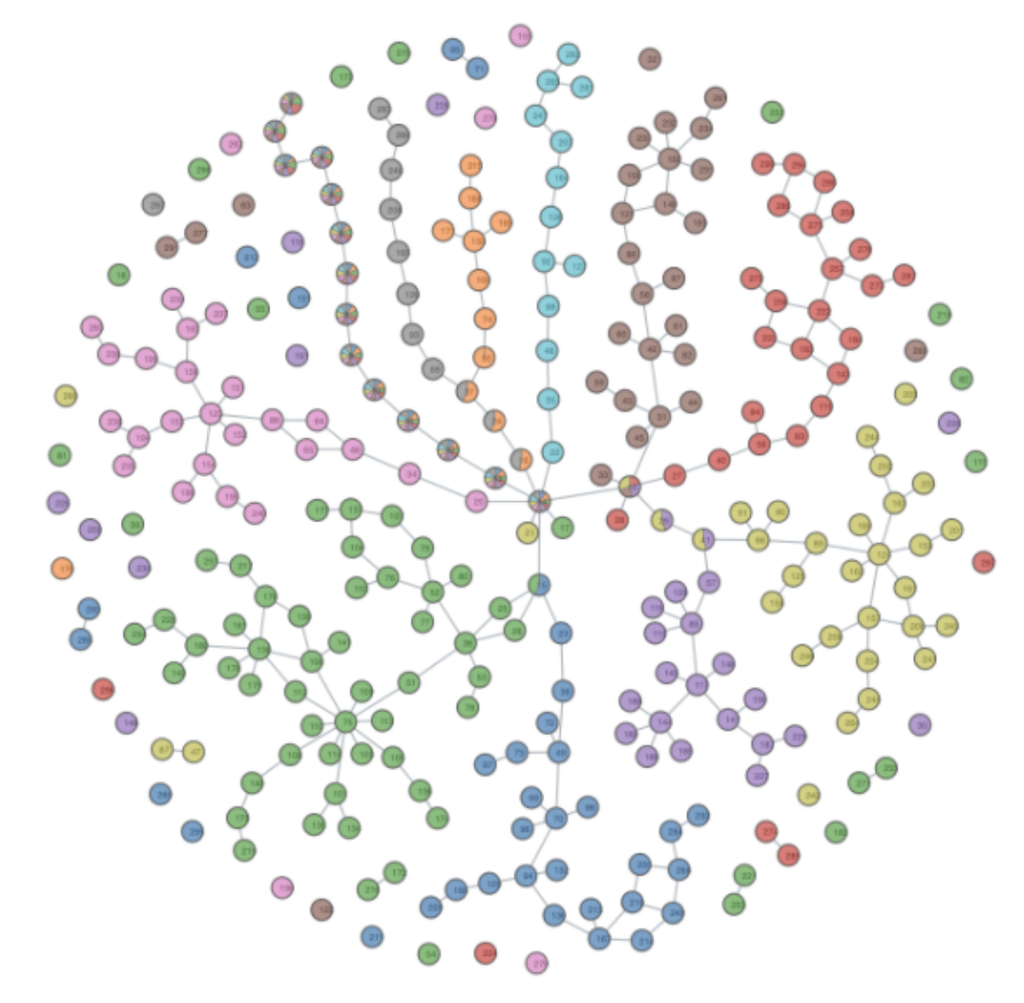
Mapper Graphs of Multi-Image Point Clouds
What is the organizational principle behind neuron activations?
Probe a trained ResNet-18 at various layers and collect spatial neuron activations in response to a set of input images (CIFAR-10)
Study the branching structures in the space of neuron activations
Ship
Truck
Auto
Dog
Cat
Frog
Horse
Bird
All spatial activations for all images at the final convolutional layer. Clear separation of classes, bifurcations make intuitive sense.
Deer
Credit to A. Rathore, B. Wang, Y. Zhou on the following mapper work!
Plane

Slide 23
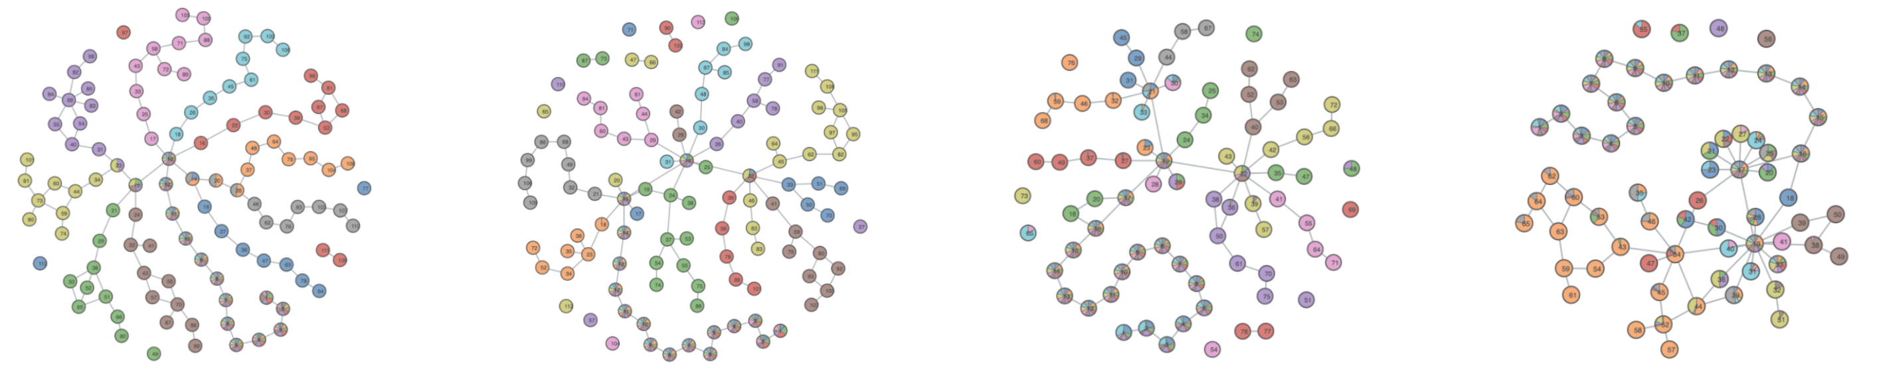
Point Cloud Sampling: Random Activations
Method used by TopoAct: choose one random spatial activation for each image
Can we find a better sampling heuristic?
Layer 16
Layer 15
Layer 13
Layer 12

Slide 24
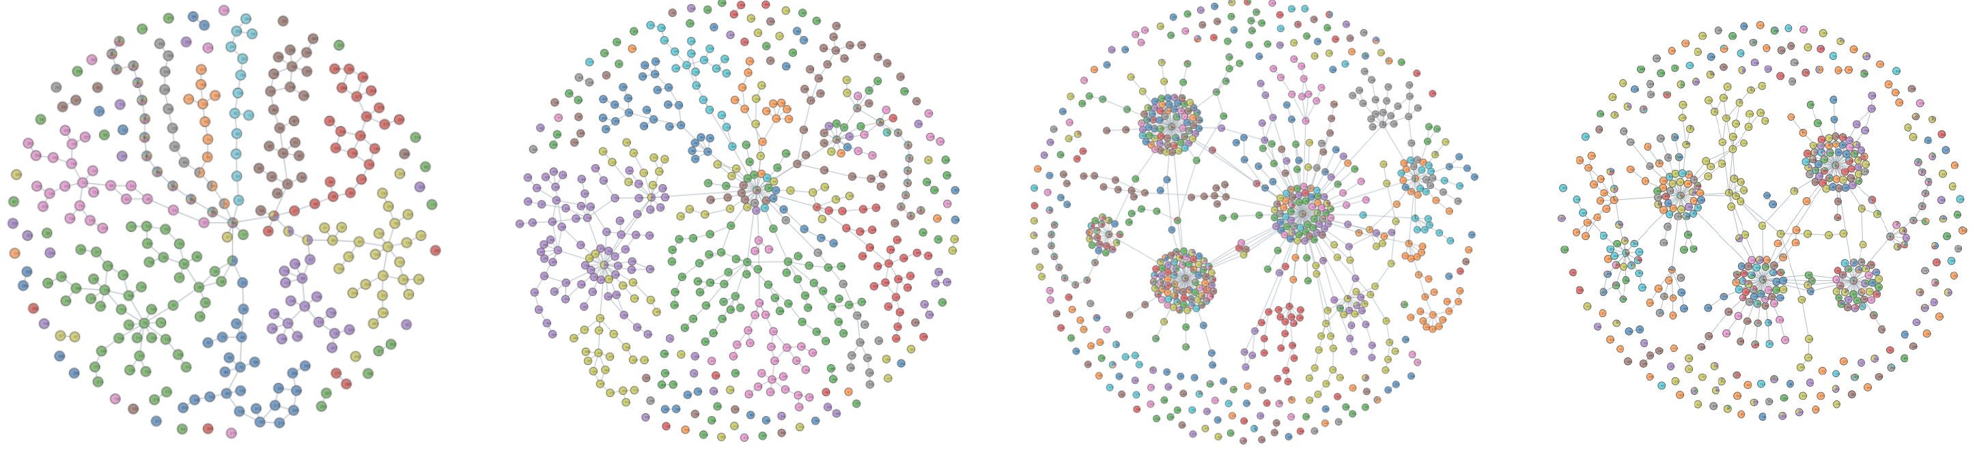
Point Cloud Sampling: All Activations
Choose all spatial activations for each image
Larger point clouds with more complex structure
Not ideal for larger datasets or earlier layers with larger spatial dimensions
Layer 16
Layer 15
Layer 13
Layer 12

Slide 25
Comparing Mapper Graphs
Layer 16
Layer 15
Layer 13
Layer 12
Random
All

Slide 26
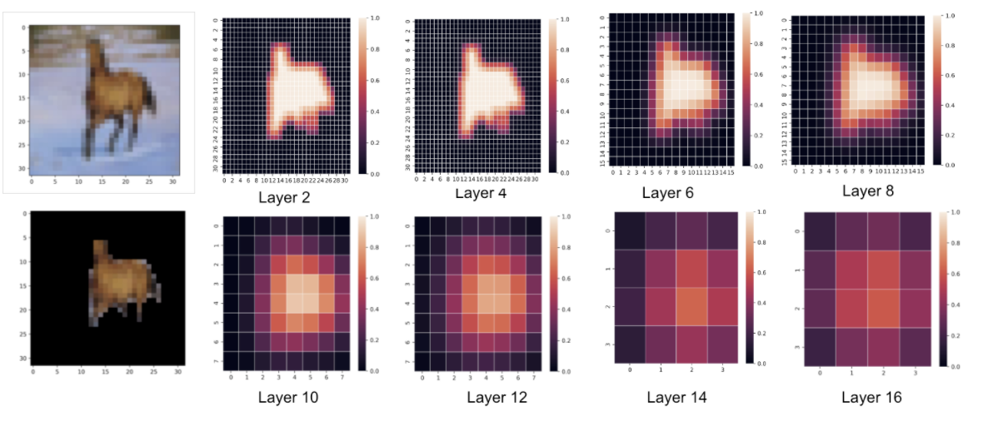
Foreground Activations
Use foreground segmentation to identify object of the image
Choose spatial activations with the greatest percentage of foreground pixels in their effective receptive field

Slide 27
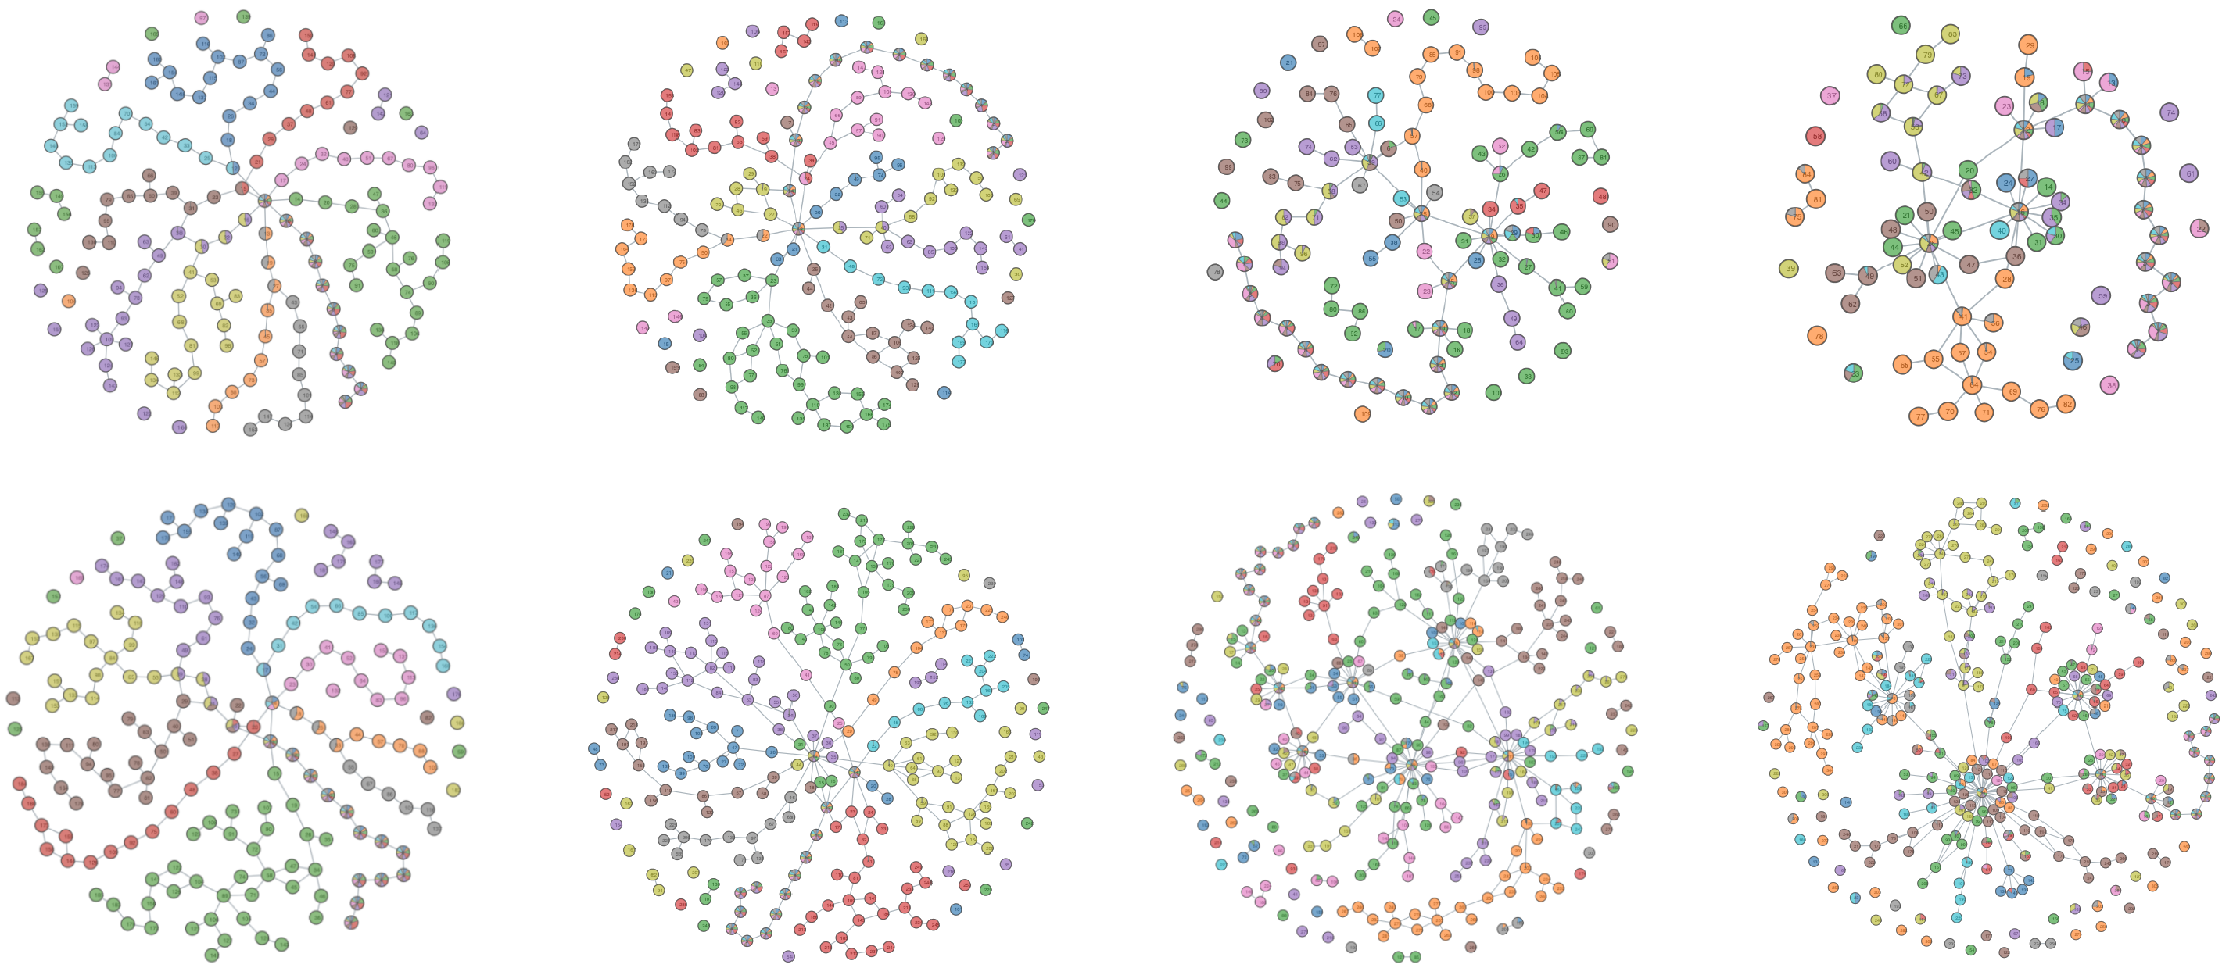
Mapper Graphs from Foreground Activations
Layer 16
Layer 15
Layer 13
Layer 12
Top 1
Top 5

Slide 28
Purity measures in Mapper graphs
Each image corresponds to one or more points in the point cloud, and therefore one or more nodes in the mapper graph
Question: Do the nodes associated to an image include points from the same class or multiple classes? I.e., how “pure” are the mapper nodes?
Node-wise purity
Also consider “point-wise purity” (PP) averaging PN for each data point and “class-wise purity” averaging PP for each class
Hypotheses:
Purity increases as you go through the layers
Purity for mapper graph of full activations and foreground activations are greater than for random activations

Slide 29
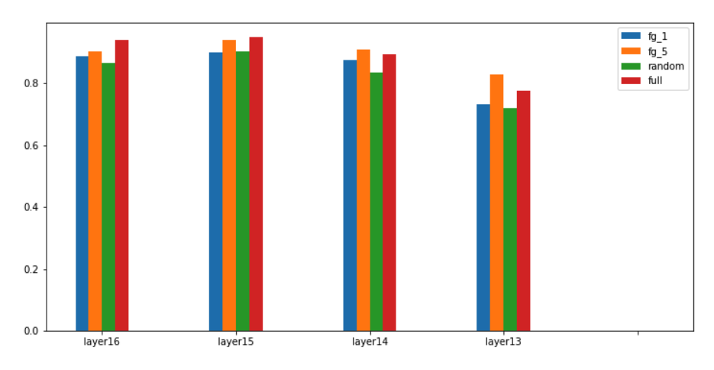
Average Node-Wise Purity

Slide 30
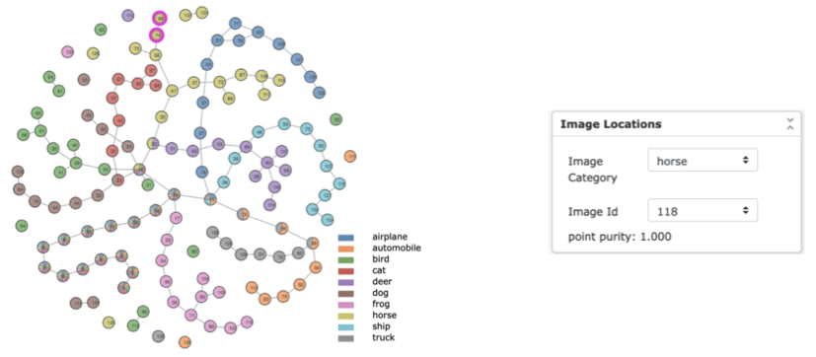
Point-Wise Purity
Which Mapper nodes were activations from the image grouped under?
Were activations from this image grouped with activations from images of the same class?

Slide 31
Class-Wise Purity

Slide 32
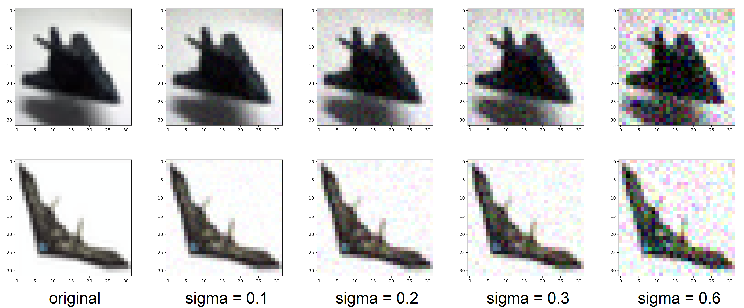
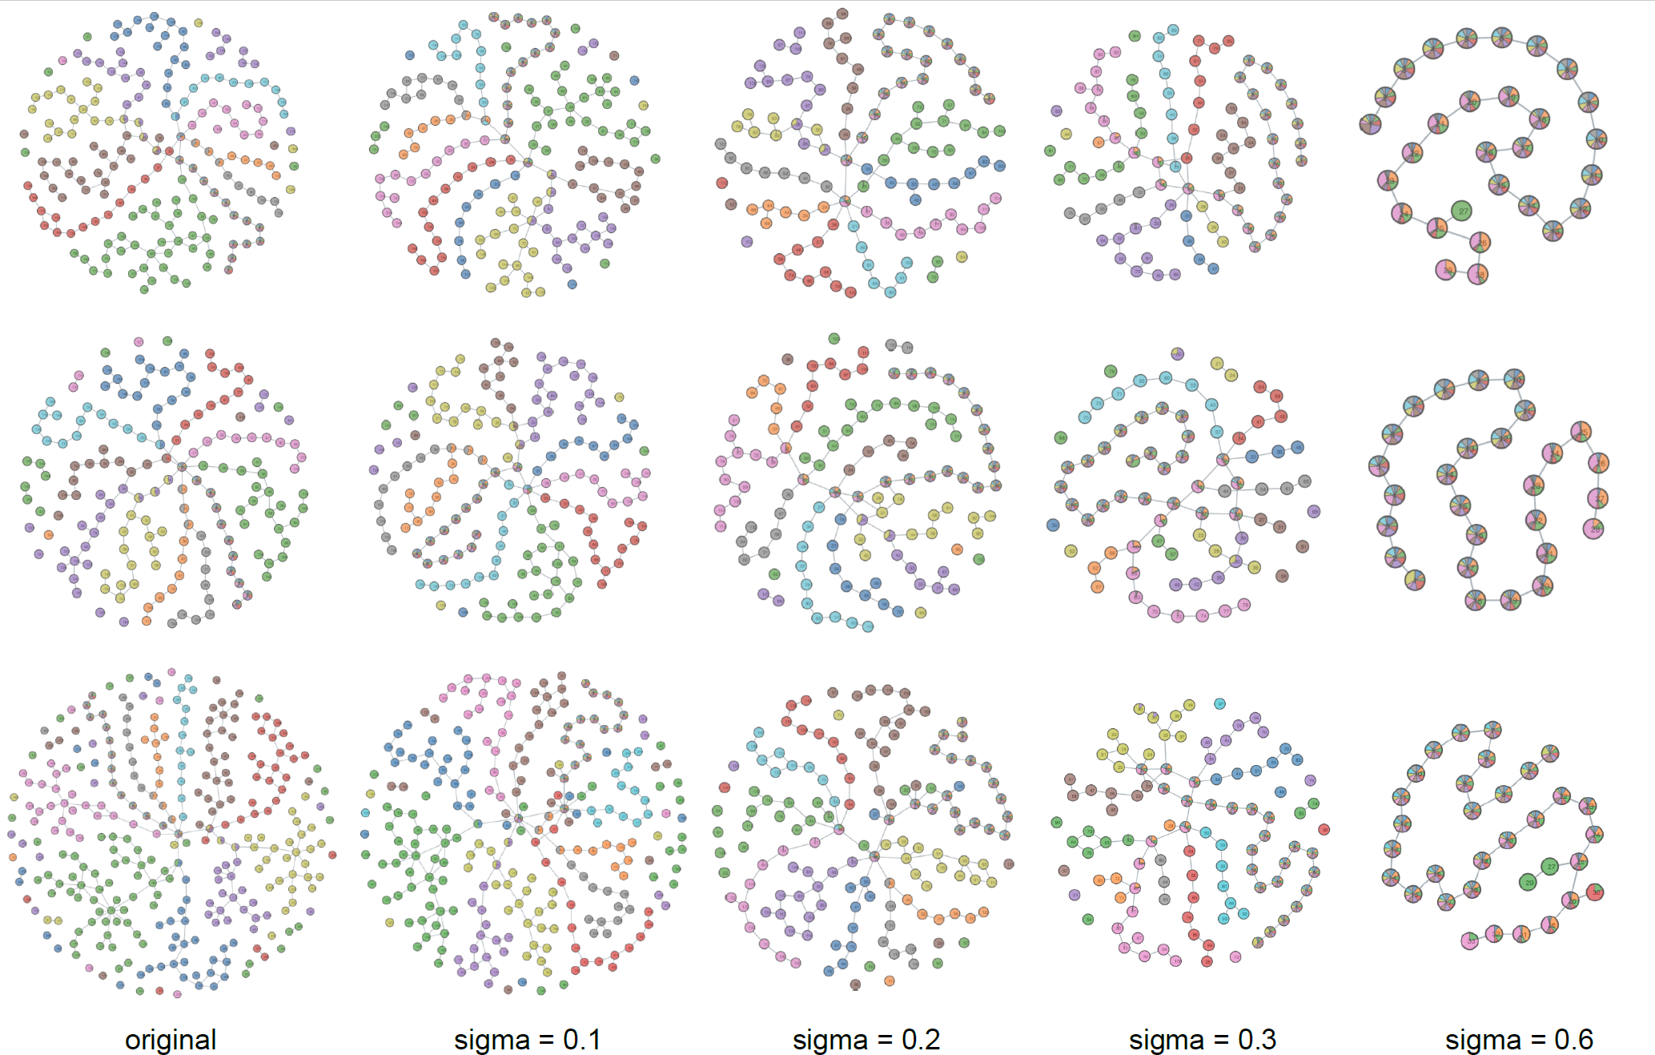
Mapper graphs of noisy images
Injection of pixel-wise Gaussian noise at varying standard deviations
Foreground Top 1
Mapper known robust to point cloud noise
Branching becomes less pronounced with more noise introduced
Foreground Top 5
All activations

Slide 33
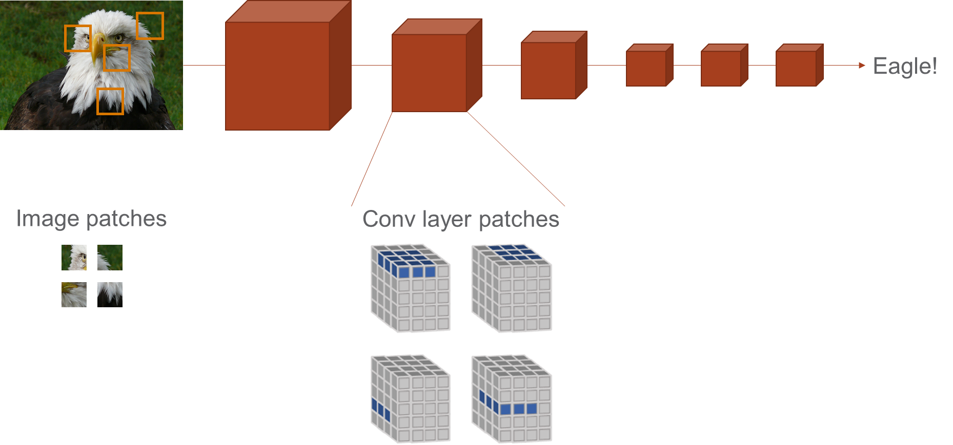
Image and convolutional patch topology
Input images
airplane cat
Early conv. layer
5000 randomly sampled 3x3 patches from input and activation tensors of 2 input images, top 20% contrast
Goal is to see how topology changes as you go deeper into the network – What is preserved? What is destroyed? What is stable?
Max and avg persistence in both H₀ and H₁ decrease through early layers and then hold steady – consistent with expected complexity decreasing
Final conv. layer
Carlsson, Gunnar, et al. "On the local behavior of spaces of natural images." International journal of computer vision 76.1 (2008): 1-12.
Guss, William H., and Ruslan Salakhutdinov. "On characterizing the capacity of neural networks using algebraic topology." arXiv preprint arXiv:1802.04443 (2018).
Naitzat, Gregory, Andrey Zhitnikov, and Lek-Heng Lim. "Topology of deep neural networks." Journal of Machine Learning Research 21.184 (2020): 1-40.

Slide 34
Experimental evidence that topological summaries capture relevant structure in activations
Output
predictions
Dog (0.01)
Cat (0.01)
Boat (0.94)
Bird (0.04)

