Slide 1

Introduction to Topological Data Analysis and Software Installation
Isabel Darcy and Ethan Rooke
University of Iowa,
Topological Data Visualization Workshop
May 16 - 20, 2022

Slide 2
Creating a simplicial complex from Data
Step 0.) Start by adding data points
= 0-dimensional vertices (0-simplices)
Notes:
data points.
In this very simplified case my data points lie in a two-dimensional plane. Normally data points are high dimensional.
For example, I may be comparing the expression or thousands of genes in tumor cells to healthy cells using microarray data. OR I might be comparing politicians voting records. Or I might be comparing the stats of basketball players. These three applications were all, by the way, published by Lum et al this past February in Nature’s Scientific Reports. I have included a link to their paper on my youtube site.
http://www.nature.com/srep/2013/130207/srep01236/full/srep01236.html

Slide 3
Creating a simplicial complex from Data
0.) Start by adding 0-dimensional data points
Note: we only need a definition of closeness between data points. The data points do not need to be actual points in R^{n}
Notes:
since my very simple data is 2-dimensional, each point could represent an ordered pair of numbers. For example,

Slide 4
Creating a simplicial complex from Data
(1, 8)
(2, 7)
(1, 5)
0.) Start by adding 0-dimensional data points
Note: we only need a definition of closeness between data points. The data points do not need to be actual points in R^{n}
Notes:
The points (1, 5), (1, 8), (2, 7). These points could represent actual locations OR each coordinate could represent a particular property. For example, if each point represents a different tumor cell, the first coordinate could represent the gene expression level of the gene coding for the protein ubiquitin hydrolase, while the 2nd coordinate could represent the gene expression level of a different gene. Normally one models thousands of genes at once, Thus each point would have thousands of coordinates where each coordinate represents the expression level of a single gene.
The data points do not need to be described by numbers. Often data is described by numbers but not always.

Slide 5
Creating a simplicial complex from Data
(dog, happy)
(wolf, mirthful)
(dog, content)
0.) Start by adding 0-dimensional data points
Note: we only need a definition of closeness between data points. The data points do not need to be actual points in R^{n}
Notes:
For example, we could be descriptions. The data can be in just about any format as long as we have a definition of closeness between the data points.

Slide 6
Creating a simplicial complex from Data
1.) Adding 1-dimensional edges (1-simplices)
Add an edge between data points that are “close”
Notes:
If two points are “close” , we connect them with an edge
I put quotes around close because we don’t have to use the standard Euclidean distance. Any idea of closeness that is relevant to your application will do. For example correlation is often used. We don’t even need an exact distance or an exact definition of distance, we just need to know when to connect 2 points with an edge.
The definition of closeness will depend upon the application. For now let’s assume standard Euclidean distance.

Slide 7

Creating a simplicial complex from Data
1.) Adding 1-dimensional edges (1-simplices)
Add an edge between data points that are “close”
Notes:
So we can measure (or calculate) the distance between two points to determine if they are “close”. But we still need to define close.

Slide 8
Creating a simplicial complex from Data
1.) Adding 1-dimensional edges (1-simplices)
Let T = Threshold =
Connect vertices v and w with an edge iff
the distance between v and w is less than T
Notes:
So we will connect every pair of vertices if their distance is less than 1.8 cm. If the center of these points represent the 0-dimensional vertices, then this distance is less than our threshold, so we add an edge. Similarly this pair of points satisfy our definition of close, so we add an edge
The distance between this pair of vertices is greater than 1.8, so we won’t connect them with an edge. Continuing to add edges between vertices whenever their distance is less than our threshold of 1.8cm, we now have

Slide 9
Creating a simplicial complex from Data
1.) Adding 1-dimensional edges (1-simplices)
Add an edge between data points that are “close”
Notes:
a one dimensional simplicial complex. Note that we have clustered our data into five disjoint connected sets. So this is one way to cluster our data – that is grouping our data points into disjoint sets based on some definition of similarity. In this case, we have 5 clusters.
We can now add higher dimensional simplices.

Slide 10
Creating a simplicial complex from Data
1.) Adding 1-dimensional edges (1-simplices)
Add an edge between data points that are “close”
Notes:
a one dimensional simplicial complex. Note that we have clustered our data into five disjoint connected sets. So this is one way to cluster our data – that is grouping our data points into disjoint sets based on some definition of similarity. In this case, we have 5 clusters.
We can now add higher dimensional simplices.

Slide 11
Creating a simplicial complex from Data
1.) Adding 1-dimensional edges (1-simplices)
Add an edge between data points that are “close”
Notes:
a one dimensional simplicial complex. Note that we have clustered our data into five disjoint connected sets. So this is one way to cluster our data – that is grouping our data points into disjoint sets based on some definition of similarity. In this case, we have 5 clusters.
We can now add higher dimensional simplices.

Slide 12
Creating the Vietoris Rips simplicial complex
2.) Add all possible simplices of dimensional > 1.
Notes:
Thus we now have the Vietoris Rips simplicial complex. Note we get the same simplex by adding one dimension at a time

Slide 13
Building blocks for a simplicial complex
0-simplex = vertex = v
1-simplex = edge = {v₁, v₂}
Note that the boundary of this edge is v₂ + v₁
v₁
v₂
e
2-simplex = triangle = {v₁, v₂, v₃}
v₂
Note that the boundary
of this triangle is the cycle
e₁ + e₂ + e₃
= {v₁, v₂} + {v₂, v₃} + {v₁, v₃}
e₁
e₂
v₁
v₃
e₃
Notes:
The building blocks for a simplicial complex consist of zero simplices which are zero dimensional vertices, one simplices which are one-dimensional edges, and 2-simplices which are two dimensional triangles,

Slide 14
Building blocks for a simplicial complex
3-simplex = {v₁, v₂, v₃, v₄} = solid tetrahedron
boundary of {v₁, v₂, v₃, v₄} =
{v₁, v₂, v₃} + {v₁, v₂, v₄} + {v₁, v₃, v₄} + {v₂, v₃, v₄}
n-simplex = {v₁, v₂, …, v_{n+1}}
v₂
v₂
Fill in
v₄
v₄
v₁
v₃
v₁
v₃
Notes:
To distinguish between the 2-dimensional boundary of a tetrahedron and the three dimensional 3-simplex, I’ll use dark blue when the simplex is filled in and we have a solid three dimensional tetrahedron.
Thus on the left we have the boundary of the three simplex which consists of the sum of its four 2-dimensional faces while on the right we have the three simplex, the solid filled in tetrahedron.
We can also have higher dimensional n-simplices.
Let’s now create a simplicial complex.

Slide 15
Creating the Vietoris Rips simplicial complex
0.) Start by adding 0-dimensional data points
Note: we only need a definition of closeness between data points. The data points do not need to be actual points in R^{n}
Notes:
We start again by adding our 0-simplices, our data points. I can indicate the threshold using a ball centered at my data point. The diameter of the ball will be my threshold, so if two balls intersect then the distance between the vertices is less than the threshold, so we connect the pair of vertices with an edge if and only if the balls intersect, so we can get edges after which we can then add all possible higher dimensional simplices.
Note how I grew my balls. As the diameter increases, my threshold which is equal to my diameter increases.

Slide 16
H₀ counts clusters
Notes:
a one dimensional simplicial complex. Note that we have clustered our data into five disjoint connected sets. So this is one way to cluster our data – that is grouping our data points into disjoint sets based on some definition of similarity. In this case, we have 5 clusters.
We can now add higher dimensional simplices.

Slide 17
Creating the Vietoris Rips simplicial complex
Notes:
Let’s now compare the following two examples. Based just on eyesight how many clusters do you see on the right and how many clusters do you see on the left? I just see one cluster for both the complex on the left and the complex on the right, but for the cluster on the left I have a hole. To better see this let’s construct it’s Vietoris Rips complex

Slide 18
Creating the Vietoris Rips simplicial complex
Notes:
In step one we add edges

Slide 19
Creating the Vietoris Rips simplicial complex
Notes:
And we then add all possible higher dimensional simplices. I now clearly have a hole.

Slide 20
Creating the Vietoris Rips simplicial complex
Notes:
If I also calculate the Vietoris Rips complex for the data points on the right

Slide 21
Creating the Vietoris Rips simplicial complex
# of components = β₀ = 1
# of loops = β₁ = 1
β₀ = 1
β₁ = 0
H₁ counts loops
Notes:
We don’t have a hole on the right. Note holes can be important in data.

Slide 22
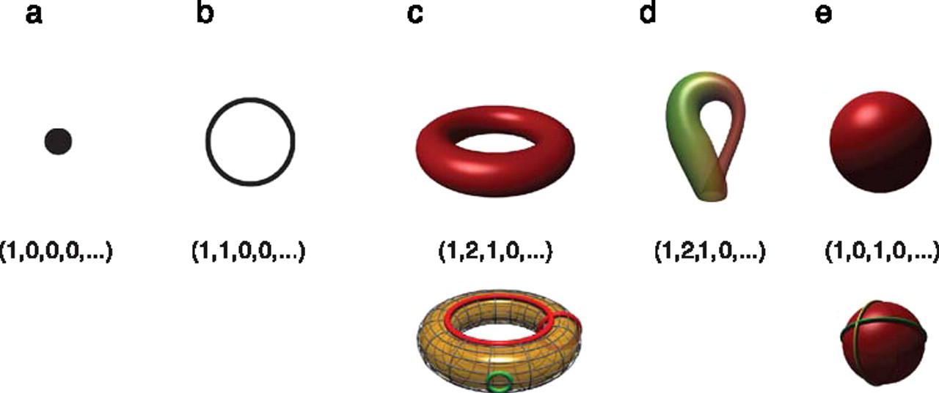

Betti numbers provide a signature of the underlying topology.
Using Z₂ coefficients
Singh G et al. J Vis 2008;8:11
©2008 by Association for Research in Vision and Ophthalmology
Notes:
Betti numbers provide a signature of the underlying topology. Illustrated in the figure are five simple objects (topological spaces) together with their Betti number signatures: (a) a point, (b) a circle, (c) a hollow torus, (d) a Klein bottle, and (e) a hollow sphere. For the case of the torus (c), the figure shows three loops on its surface. The red loops are “essential” in that they cannot be shrunk to a point, nor can they be deformed one into the other without tearing the loop. The green loop, on the other hand, can be deformed to a point without any obstruction. For the torus, therefore, we have b 1 = 2. For the case of the sphere, the loops shown (and actually all loops on the sphere) can be contracted to points, which is reflected by the fact that b 1 = 0. Both the sphere and the torus have b 2 = 1, this is due to the fact both surfaces enclose a part of space (a void).

Slide 23
Betti numbers provide a signature of the underlying topology.
Singh G et al. J Vis 2008;8:11
©2008 by Association for Research in Vision and Ophthalmology
Notes:
Betti numbers provide a signature of the underlying topology. Illustrated in the figure are five simple objects (topological spaces) together with their Betti number signatures: (a) a point, (b) a circle, (c) a hollow torus, (d) a Klein bottle, and (e) a hollow sphere. For the case of the torus (c), the figure shows three loops on its surface. The red loops are “essential” in that they cannot be shrunk to a point, nor can they be deformed one into the other without tearing the loop. The green loop, on the other hand, can be deformed to a point without any obstruction. For the torus, therefore, we have b 1 = 2. For the case of the sphere, the loops shown (and actually all loops on the sphere) can be contracted to points, which is reflected by the fact that b 1 = 0. Both the sphere and the torus have b 2 = 1, this is due to the fact both surfaces enclose a part of space (a void).

Slide 24
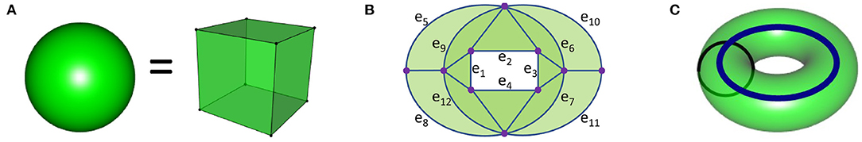
(1, 0, 1, 0, 0, … ) (1, 1, 0, 0, …)
(1, 2, 1, 0, 0, … )

Slide 25
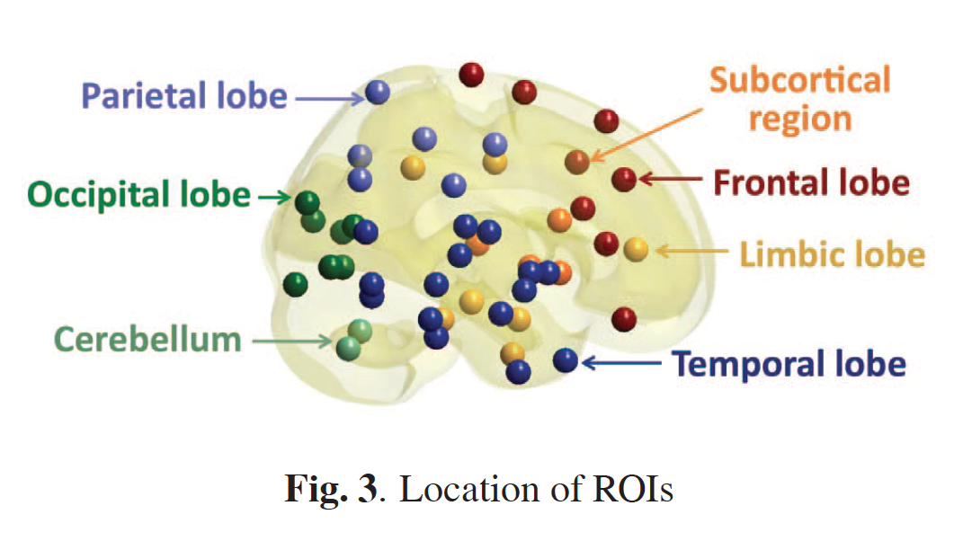
Discriminative persistent homology of brain networks, 2011 Hyekyoung Lee Chung, M.K.; Hyejin Kang; Bung-Nyun Kim;Dong Soo Lee
Constructing functional brain networks with 97 regions of interest (ROIs) extracted from FDG-PET data for
24 attention-deficit hyperactivity disorder (ADHD),
26 autism spectrum disorder (ASD) and
11 pediatric control (PedCon).
Data = measurement f_{j}
taken at region j
Graph: 97 vertices representing 97 regions of interest
edge exists between two vertices i,j if correlation
between f_{j} and f_{j} ≥ threshold
How to choose the threshold? Don’t, instead use persistent homology
https://ieeexplore.ieee.org/document/5872535

Slide 26
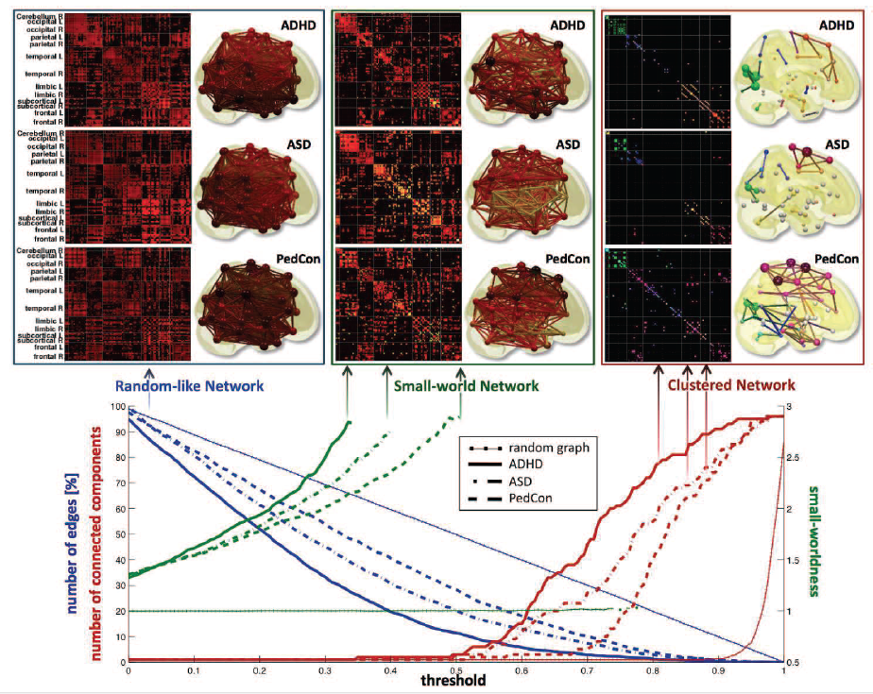
https://ieeexplore.ieee.org/document/5872535

Slide 27
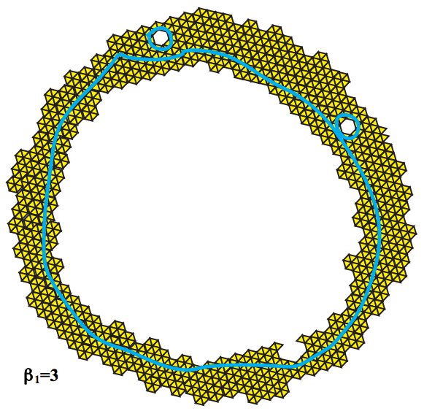
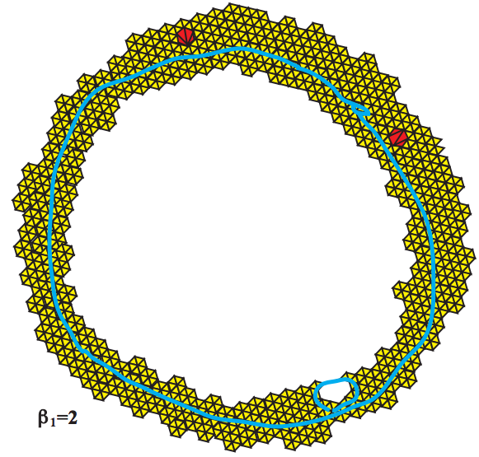
Topology and Data. Gunnar Carlsson
www.ams.org/journals/bull/2009-46-02/S0273-0979-09-01249-X

Slide 28
Creating the Vietoris Rips simplicial complex
0.) Start by adding 0-dimensional data points
Note: we only need a definition of closeness between data points. The data points do not need to be actual points in R^{n}
Notes:
We can compute the number of clusters for a variety of diameters.
We start with 17 data points, so if the diameter is 0, we have 17 clusters. Increasing the diameter, these 2 balls intersect so I now have 16 clusters.
If we continue to increase the diameter, we will eventually create the complex we saw before with 5 clusters, etc until we only have one cluster left.
Eventually this entire page will be purple, but right now, we know have one component.
To choose the threshold, one can determine how long a particular number of clusters lasts, for example for what set of radii do we have five clusters. If we have five clusters for the largest set of radii, then have gives us a good idea where to set the threshold and which simplicial complex best models our data.
I have put links to better animations on my on my YouTube site which may better illustrate this persistence concept. Next month, we will also talk much more about persistence during the live lectures for this course. This is just a preliminary introduction.

Slide 29
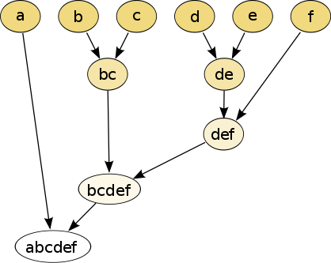
Increasing threshold
Connect vertices whose distance is less than a given threshold
single linkage hierarchical clustering

Slide 30
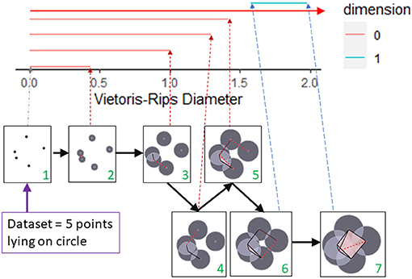
Barcode
This figure was created by modifying the output of the R package TDAstat (Wadhwa et al., 2018) and latex code written by Catalina Betancourt. https://www.frontiersin.org/articles/10.3389/frai.2021.659037/full

Slide 31
Increasing threshold
Connect vertices whose distance is less than a given threshold
single linkage hierarchical clustering

Slide 32
single linkage
hierarchical clustering
Increasing threshold

Slide 33
Increasing threshold

Slide 34
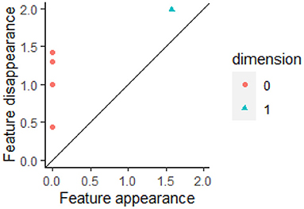
Barcode
Persistence
Diagram
(birth, death)

Slide 35


Slide 36
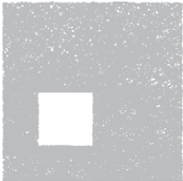
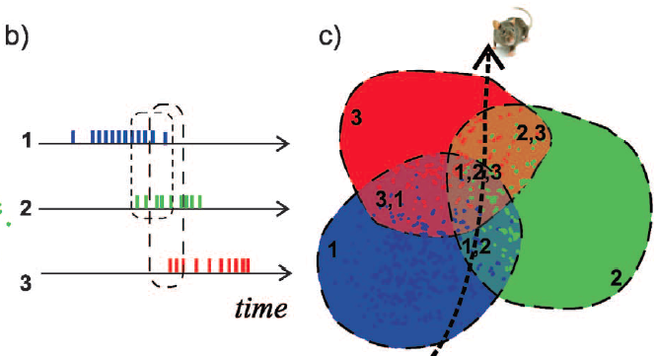

Slide 42
Cycles
Time

Slide 43
Cycles
Time

Slide 44
Cycles
Time

Slide 45
Cycles
Time

Slide 46
Cycles
Time

Slide 47
Cycles
Time

Slide 48
Cycles
Time

Slide 49
Cycles
Time

Slide 50
Cycles
Time

Slide 51
Cycles
Time

Slide 52
Cycles
Time

Slide 53
Cycles
Time

Slide 54
Cycles
Time

Slide 55
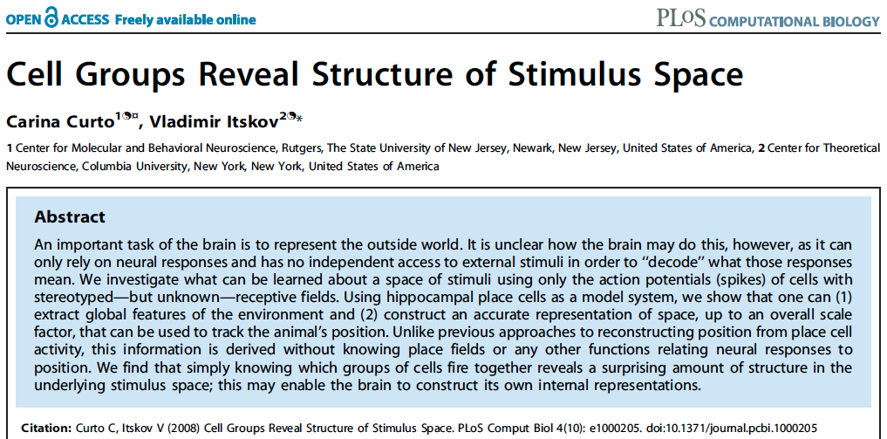
http://www.ploscompbiol.org/article/info%3Adoi%2F10.1371%2Fjournal.pcbi.1000205
2008
First paper to use only the spiking activity of place cells to determine the topology (and geometry) of the environment using homology (and graphs).

Slide 56
Place field = region in space where the firing rates are significantly above baseline
place cells = neurons in the hippocampus that are involved in spatial navigation
http://www.ploscompbiol.org/article/info%3Adoi%2F10.1371%2Fjournal.pcbi.1002581

Slide 57
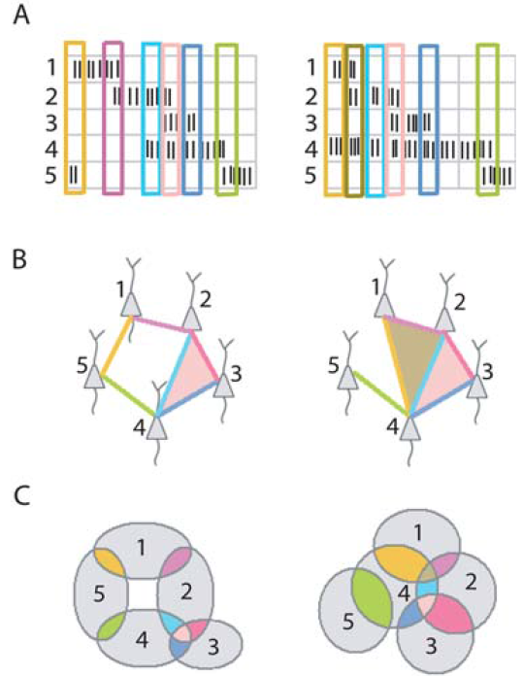
Idea: Can recover the topology of the space traversed by the mouse by looking only at the spiking activity of place cells.
Vertices = place cells
Add simplex if place cells co-fire within a specified time period
http://www.ploscompbiol.org/article/info%3Adoi%2F10.1371%2Fjournal.pcbi.1000205

Slide 58
Creating a simplicial complex
1.) Adding 1-dimensional edges (1-simplices)
Add an edge between data points that are “close”
Notes:
a one dimensional simplicial complex. Note that we have clustered our data into five disjoint connected sets. So this is one way to cluster our data – that is grouping our data points into disjoint sets based on some definition of similarity. In this case, we have 5 clusters.
We can now add higher dimensional simplices.

Slide 59
Creating the Čech simplicial complex
1.) B₁ … B_{k+1} ≠ ⁄ , create k-simplex {v₁, ... , v_{k+1}}.
U
U
0
Notes:
Thus we now have the Vietoris Rips simplicial complex. Note we get the same simplex by adding one dimension at a time

Slide 60
Creating the Čech simplicial complex
1.) B₁ … B_{k+1} ≠ ⁄ , create k-simplex {v₁, ... , v_{k+1}}.
U
U
0
Notes:
Thus we now have the Vietoris Rips simplicial complex. Note we get the same simplex by adding one dimension at a time

Slide 61
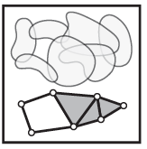
Consider X an arbitrary topological space.
Let V = {V_{i} | i = 1, …, n } where V_{i} X ,
The nerve of V = N(V) where
The k -simplices of N(V) =
nonempty intersections of
k +1 distinct elements of V .
For example,
Vertices = elements of V
Edges = pairs in V which intersect nontrivially.
Triangles = triples in V which intersect nontrivially.
Čech complex =
Mathematical nerve,
not biological nerve
http://www.math.upenn.edu/~ghrist/EAT/EATchapter2.pdf

Slide 62
Mathematical
Nerve Lemma: If V is a finite collection of subsets of X with all non-empty intersections of subcollections of V contractible, then N(V) is homotopic to the union of elements of V.
http://www.math.upenn.edu/~ghrist/EAT/EATchapter2.pdf

Slide 63
Creating the Čech simplicial complex
1.) B₁ … B_{k+1} ≠ ⁄ , create k-simplex {v₁, ... , v_{k+1}}.
U
U
0
Notes:
Thus we now have the Vietoris Rips simplicial complex. Note we get the same simplex by adding one dimension at a time

Slide 64
Creating the Vietoris Rips simplicial complex
0.) Start by adding 0-dimensional data points
Note: we only need a definition of closeness between data points. The data points do not need to be actual points in R^{n}
Notes:
We start again by adding our 0-simplices, our data points. I can indicate the threshold using a ball centered at my data point. The diameter of the ball will be my threshold, so if two balls intersect then the distance between the vertices is less than the threshold, so we connect the pair of vertices with an edge if and only if the balls intersect, so we can get edges after which we can then add all possible higher dimensional simplices.
Note how I grew my balls. As the diameter increases, my threshold which is equal to my diameter increases.

Slide 65
1.) Adding 1-dimensional edges (1-simplices)
Add an edge between data points that are “close”
Notes:
In step 1 Adding 1-simplices connecting data points that are “close”.

Slide 66
Creating the Vietoris Rips simplicial complex
2.) Add all possible simplices of dimensional > 1.
Notes:
And then adding an n-simplex whenever we have n+1 points that are close.
Thus we now have the Vietoris Rips simplicial complex. Note we get the same simplex by adding one dimension at a time.
What if I increase my threshold?

Slide 67
Vietoris Rips complex = flag complex = clique complex
2.) Add all possible simplices of dimensional > 1.
Notes:
Thus we now have the Vietoris Rips simplicial complex. Note we get the same simplex by adding one dimension at a time

Slide 68
Creating the Čech simplicial complex
1.) B₁ … B_{k+1} ≠ ⁄ , create k-simplex {v₁, ... , v_{k+1}}.
U
U
0
Notes:
Thus we now have the Vietoris Rips simplicial complex. Note we get the same simplex by adding one dimension at a time

Slide 69
Creating the Čech simplicial complex
1.) B₁ … B_{k+1} ≠ ⁄ , create k-simplex {v₁, ... , v_{k+1}}.
U
U
0
Notes:
Thus we now have the Vietoris Rips simplicial complex. Note we get the same simplex by adding one dimension at a time

Slide 70
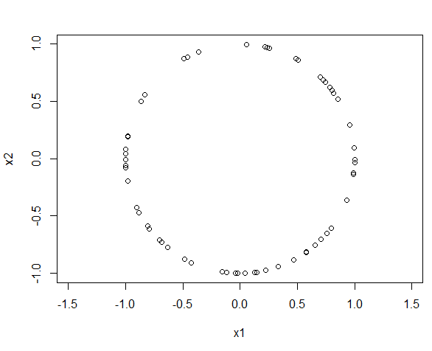
The homology of a circle is as follows:
Rank of H₀ = 1
since a circle has only one component
Rank of H₁ = 1
since a circle has a single 1-d component
Rank of H₂ = 0
since we don’t have any 2-d circles.
This data set consists of 60 points randomly taken from a circle of radius 1.
What should we expect the barcode to look like?
What should we expect the persistence diagram to look like?
Can we use TDA to determine that our points came from a circle

Slide 71
Can we use TDA to determine that our points came from a circle
The homology of a circle is as follows:
Rank of H₀ = 1 since a circle has only one component
Thus we expect 1 persistent (long) bar in the 0-dim barcode
plus some shorter bars that we can “ignore”
Rank of H₁ = 1: circle has a single 1-d cycle that does not bound surface
Thus we expect 1 persistent (long) bar in the 1-dim barcode
plus possible some shorter bars that we can “ignore”
Rank of H₂ = 0 since we don’t have any 2-d ccles.
Thus we expect 0 persistent (long) bars in the 2-dim barcode
plus possible some shorter bars that we can “ignore”

Slide 72
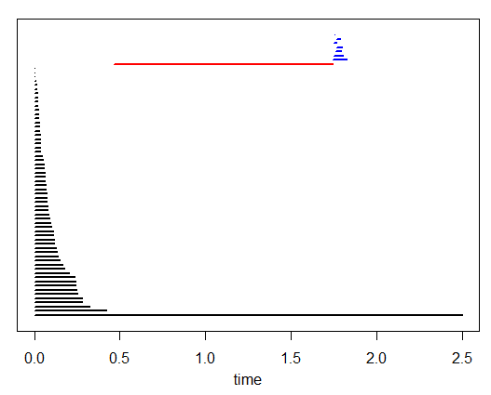
The homology of a circle is as follows:
Rank of H₀ = 1 since a circle has only one component
Thus we expect 1 persistent (long) bar in the 0-dim barcode
plus some shorter bars that we can “ignore”
Rank of H₁ = 1: circle has a single 1-d cycle that does not bound surface
Thus we expect 1 persistent (long) bar in the 1-dim barcode
plus possible some shorter bars that we can “ignore”
Rank of H₂ = 0 since we don’t have any 2-d ccles.
Thus we expect 0 persistent (long) bars in the 2-dim barcode
plus possible some shorter bars that we can “ignore”

Slide 73
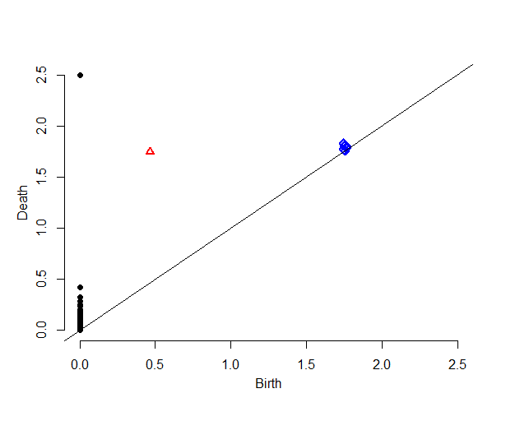
Our data set = 60 points randomly taken from a circle of radius 1
Can you determine from the barcode that our data set came from a circle?
Do you see 1 persistent 0-dim cycle?
Do you see 1 persistent 1-dim cycle?
Do you see 0 persistent 2-dim cycle?
Does the persistent diagram make sense?
1 black point (cycle in H₀) is far from the diagonal, while remaining black points are “close” to diagonal
1 red point (cycle in H₁) is far from diagonal
All blue points (cycles in H₂) are close to diagonal

Slide 74
From the barcode:
1 persistent 0-dim cycle ➔ H₀ = 1
1 persistent 1-dim cycle ➔ H₁ = 1
No persistent 2-dim cycles ➔ H₂ = 0
Ignore bars with “small” length
Definition of “small” depends on dimension, data set, application, etc.
From the persistent diagram:
1 black point far from the diagonal ➔ H₀ = 1
1 red point far from diagonal ➔ H₁ = 1
All blue points close to diagonal ➔ H₂ = 0
Ignore points “close” to diagonal
Definition of “close” depends on dimension, data set, application, etc.

Slide 75
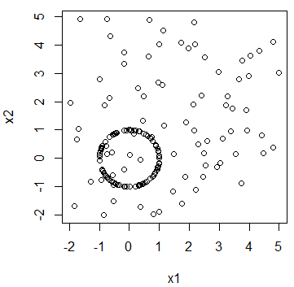
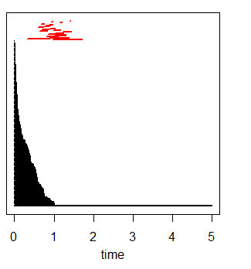
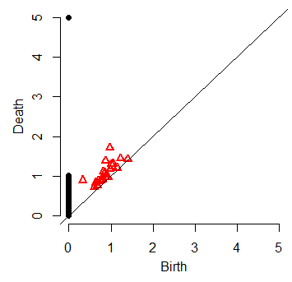
How does background noise affect persistent diagram?

Slide 76
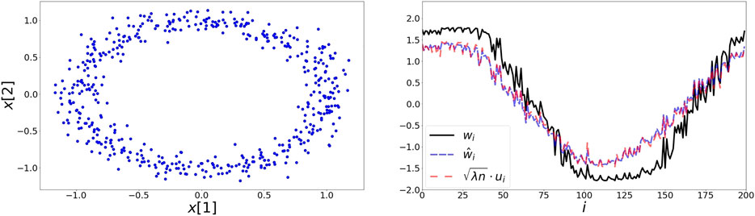
https://www.frontiersin.org/articles/10.3389/fams.2020.593406/full

Slide 77
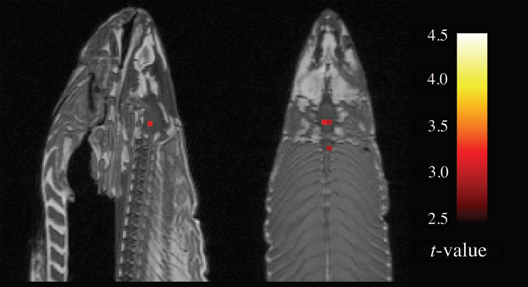
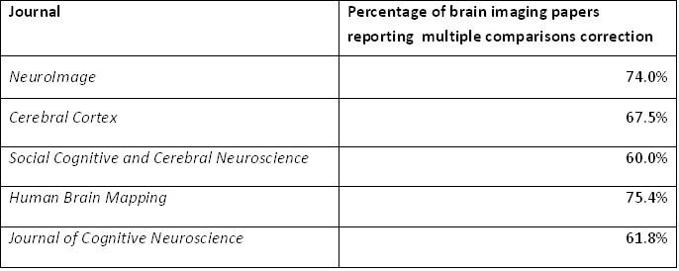
Noise
2012 Ignoble Prize
The Ig Nobel Prizes honor achievements that make people LAUGH, and then THINK.
http://www.improbable.com/ig/
Activated compared to other voxels
fMRI of dead salmon
The salmon was shown images of people in social situations, either socially inclusive situations or socially exclusive situations.
The salmon was asked to respond, saying how the person in the situation must be feeling.
http://blogs.scientificamerican.com/scicurious-brain/2012/09/25/ignobel-prize-in-neuroscience-the-dead-salmon-study/

Slide 78

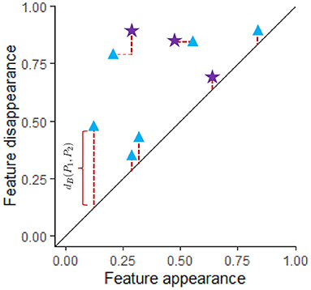
Bottleneck Distance
https://www.frontiersin.org/articles/10.3389/frai.2021.659037/full

Slide 79
Stability theorem:
Let X be a triangulable space with continuous
tame functions f, g : X → R. Then the persistence diagrams, D(f)and D(g), satisfy
d_{B}(D(f), D(g)) ≤ || f − g ||∞ = sup{|f(x) – g(x)|}
x

Slide 80
Barcode
This figure was created by modifying the output of the R package TDAstat (Wadhwa et al., 2018) and latex code written by Catalina Betancourt. https://www.frontiersin.org/articles/10.3389/frai.2021.659037/full

Slide 81
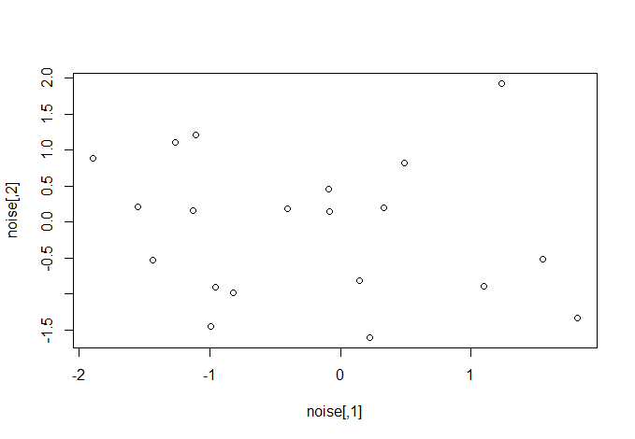
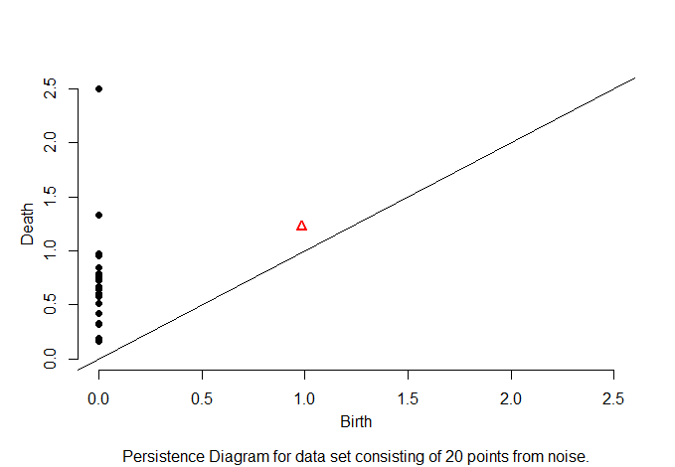
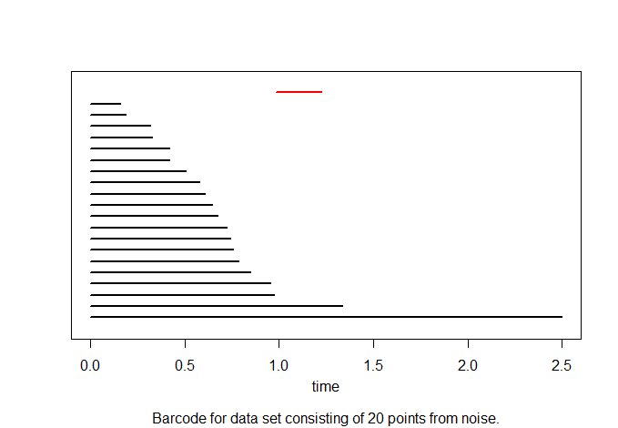
What does noise look like?

Slide 82
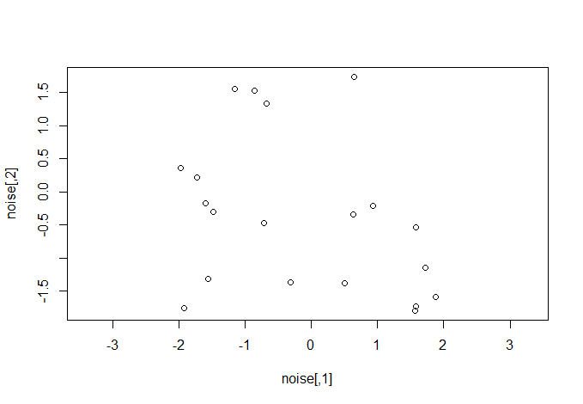
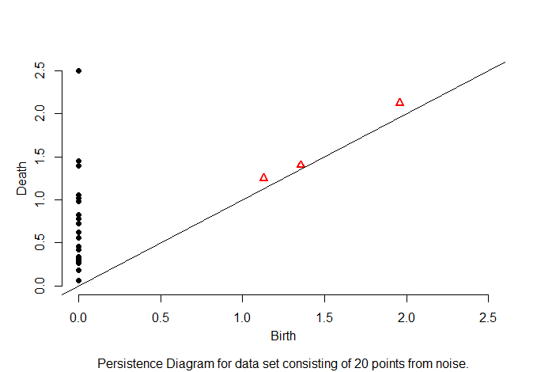
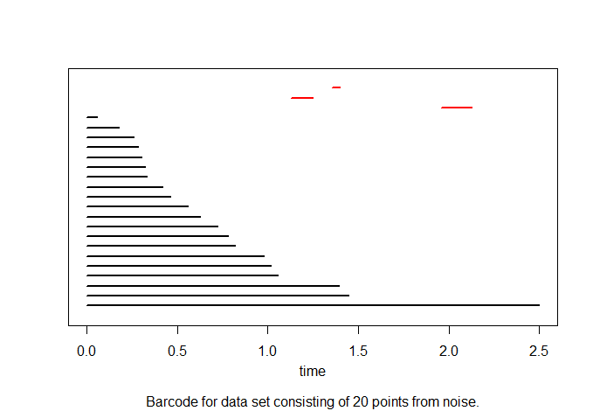
What does noise look like?

Slide 83
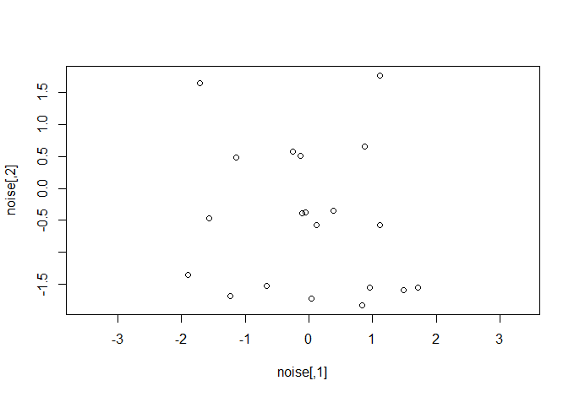
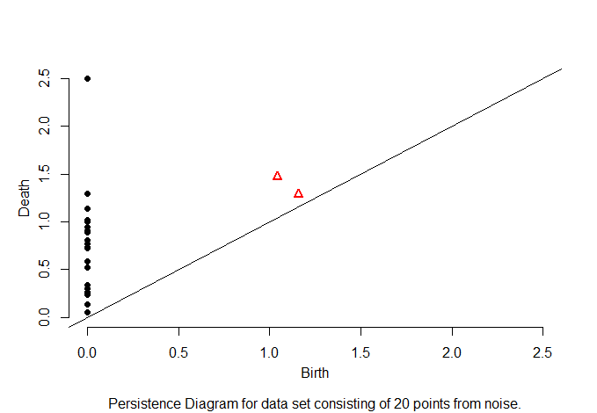
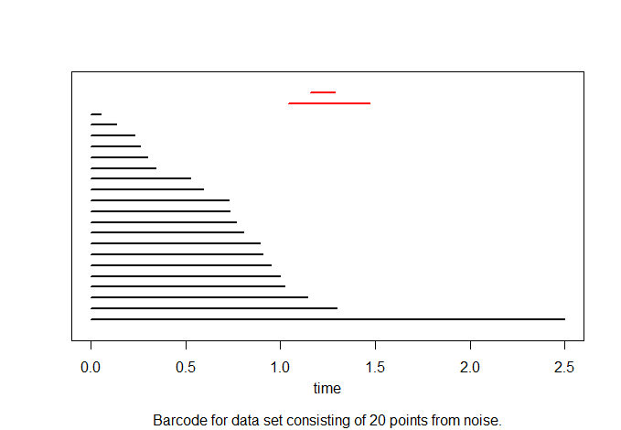
What does noise look like?

Slide 84
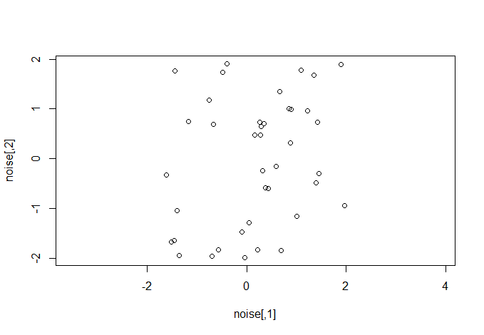
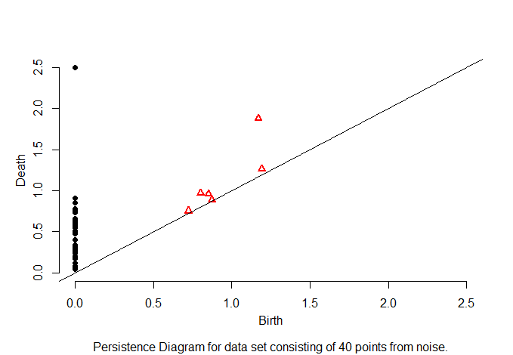
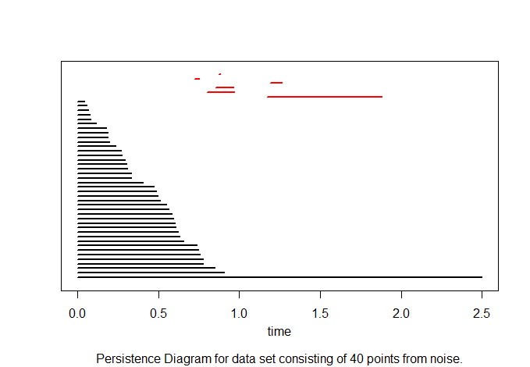
What does noise look like?

Slide 85
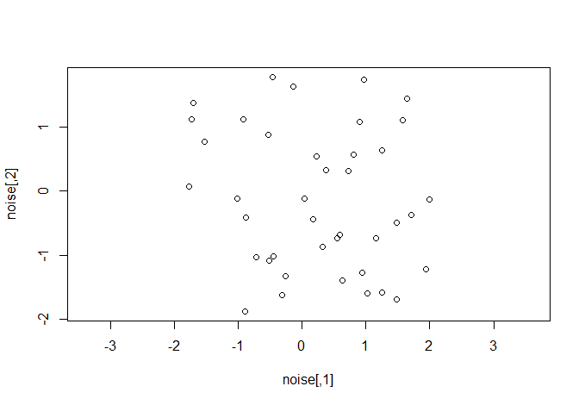
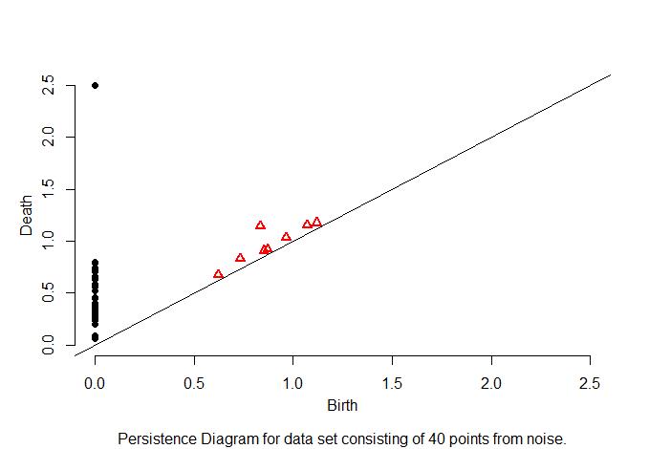
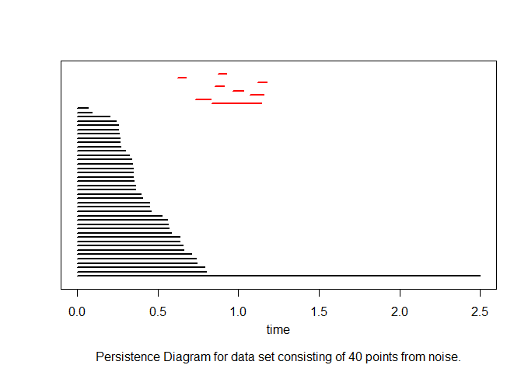
What does noise look like?

Slide 86
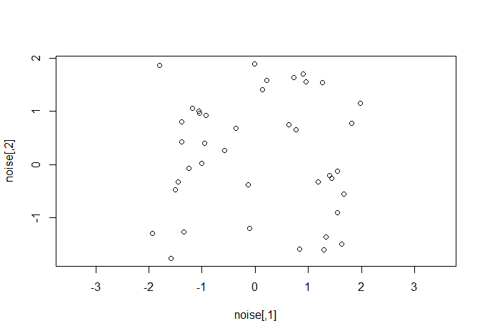
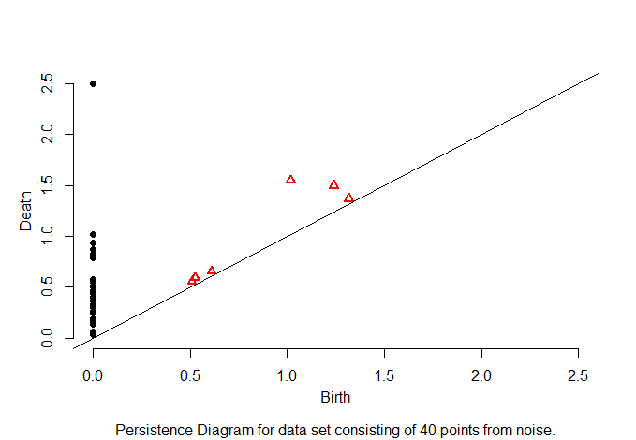
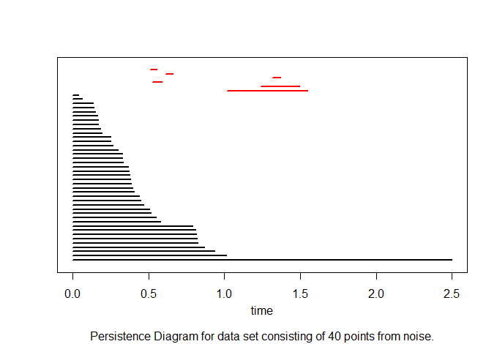
What does noise look like?

Slide 87
What does noise look like?

Slide 88

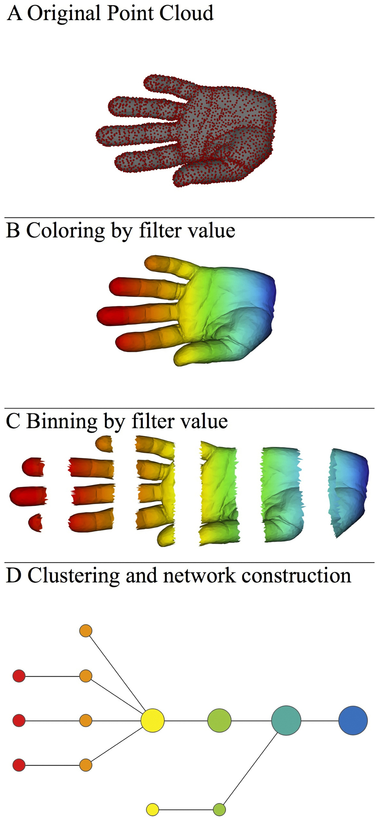
http://www.nature.com/srep/2013/130207/srep01236/full/srep01236.html

Slide 89
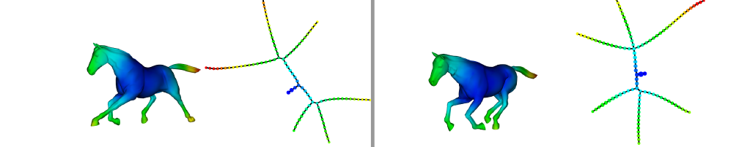
Three key ideas of topology that make extracting of patterns via shape possible.
1.) coordinate free.
No dependence on the coordinate system chosen.
Can compare data derived from different platforms
2.) invariant under “small” deformations.
less sensitive to noise
3.) compressed representations of shapes.
Input: dataset with thousands of points
Output: network with 13 vertices and 12 edges.
http://www.nature.com/srep/2013/130207/srep01236/full/srep01236.html

Slide 90
Application 1: breast cancer gene expression
Data: microarray gene expression data from 2 data sets, NKI and GSE2034
Distance: correlation distance
Filters: (1) L-infinity centrality:
f(x) = max{d(x, p) : p in data set}
captures the structure of the points far removed from the center or norm.
(2) NKI: survival vs. death
GSE2034: no relapse vs. relapse
Clustering: Single linkage.

Slide 91
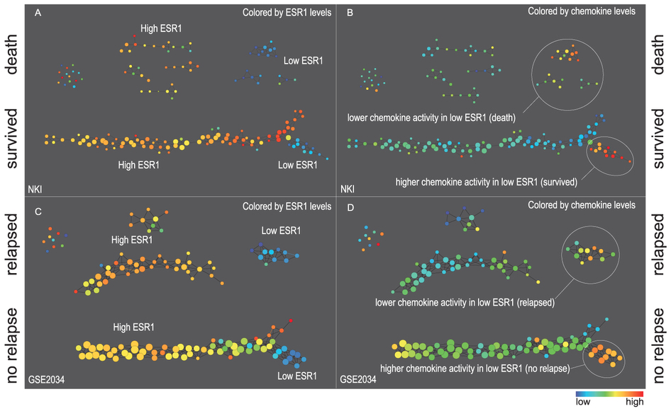
Two filter functions, L-Infinity centrality and survival or relapse were used to generate the networks. The top half of panels A and B are the networks of patients who didn't survive, the bottom half are the patients who survived. Panels C and D are similar to panels A and B except that one of the filters is relapse instead of survival. Panels A and C are colored by the average expression of the ESR1 gene. Panels B and D are colored by the average expression of the genes in the KEGG chemokine pathway. Metric: Correlation; Lens: L-Infinity Centrality (Resolution 70, Gain 3.0x, Equalized) and Event Death (Resolution 30, Gain 3.0x). Color bar: red: high values, blue: low values.
http://www.nature.com/srep/2013/130207/srep01236/full/srep01236.html

Slide 92
Comparison of our results with those of Van de Vijver and colleagues is difficult because of differences in patients, techniques, and materials used.
Their study included node-negative and node-positive patients, who had or had not received adjuvant systemic therapy, and only women younger than 53 years.
microarray platforms used in the studies differ—Affymetrix and Agilent.
Of the 70 genes in the study by van't Veer and co-workers, 48 are present on the Affymetrix U133a array, whereas only 38 of our 76 genes are present on the Agilent array. There is a three-gene overlap between the two signatures (cyclin E2, origin recognition complex, and TNF superfamily protein).
Despite the apparent difference, both signatures included genes that identified several common pathways that might be involved in tumour recurrence. This finding supports the idea that although there might be redundancy in gene members, effective signatures could be required to include representation of specific pathways.
From: Gene-expression profiles to predict distant metastasis of lymph-node-negative primary breast cancer, Yixin Wang et al, The Lancet, Volume 365, Issue 9460, 19–25 February 2005, Pages 671–679

Slide 93
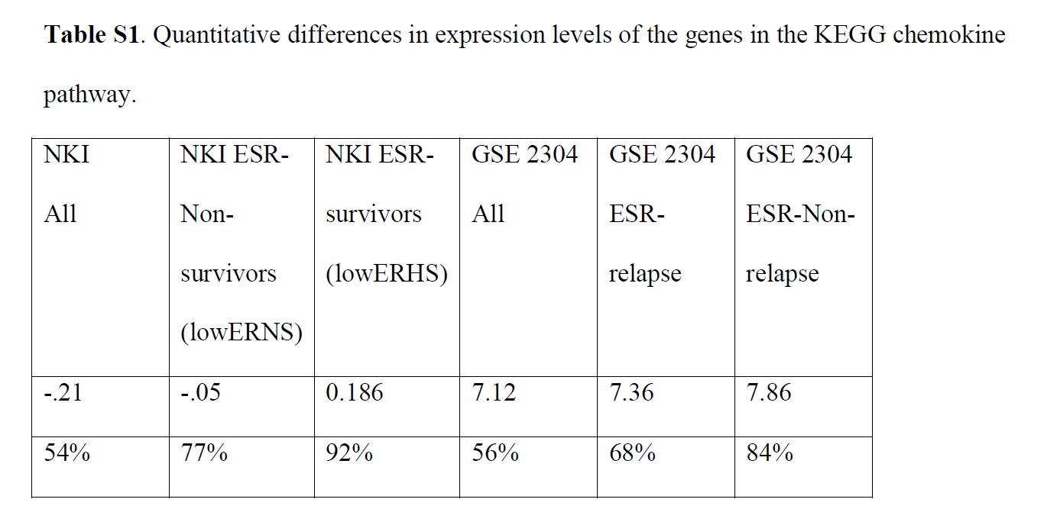
From: http://www.nature.com/srep/2013/130207/srep01236/full/srep01236.html
The numbers in the first row are the average levels of expressions of genes belonging to the chemokine pathway within the relevant groups. The second row gives these same levels reported as percentiles belonging to the collection of the chemokine expression levels across all the patients in the study to which the group belongs. Note that the lowERHS groups display very high chemokine expression levels, 92nd percentile in the case of NKI and 84th percentile in the case of GSE2304. The lowERNS groups are also consistently higher than the general population in the study, although to different degrees in the studies. The difference can perhaps be accounted for by the difference between the survival vs. non-relapse criteria in the two data sets.

Slide 94
Two filter functions, L-Infinity centrality and survival or relapse were used to generate the networks. The top half of panels A and B are the networks of patients who didn't survive, the bottom half are the patients who survived. Panels C and D are similar to panels A and B except that one of the filters is relapse instead of survival. Panels A and C are colored by the average expression of the ESR1 gene. Panels B and D are colored by the average expression of the genes in the KEGG chemokine pathway. Metric: Correlation; Lens: L-Infinity Centrality (Resolution 70, Gain 3.0x, Equalized) and Event Death (Resolution 30, Gain 3.0x). Color bar: red: high values, blue: low values.
http://www.nature.com/srep/2013/130207/srep01236/full/srep01236.html

Slide 95
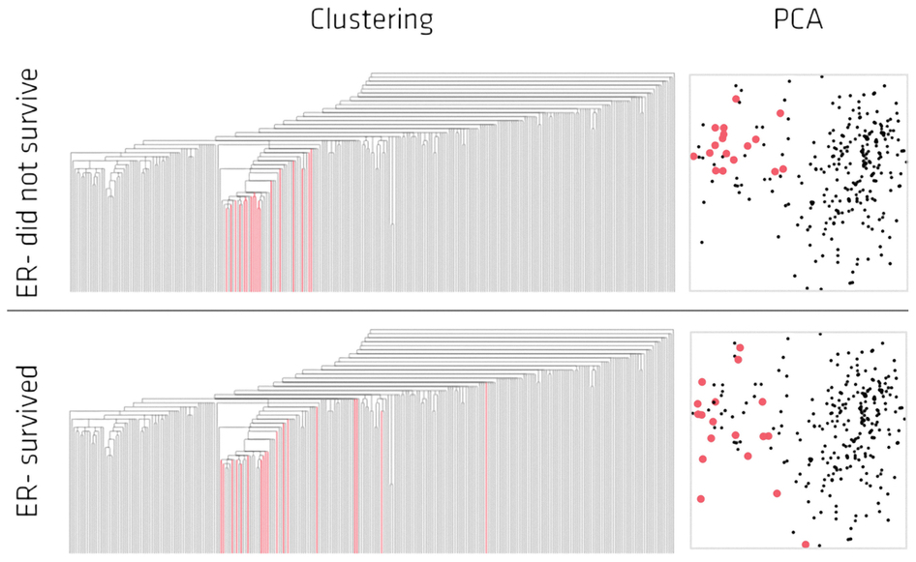
Highlighted in red are the lowERNS (top panel) and the lowERHS (bottom panel) patient sub-groups.
http://www.nature.com/srep/2013/130207/srep01236/full/srep01236.html

Slide 96
Identifying subtypes of cancer in a consistent manner is a challenge in the field since sub-populations can be small and their relationships complex
High expression level of the estrogen receptor gene (ESR1) is positively correlated with improved prognosis, given that this set of patients is likely to respond to standard therapies.
But , there are still sub-groups of high ESR1 that do not respond well to therapy.
Low ESR1 levels are strongly correlated with poor prognosis
But there are patients with low ESR1 levels but high survival rates
Many molecular sub-groups have been identified,
But often difficult to identify the same sub-group in a broader setting, where data sets are generated on different platforms, on different sets of patients and at a different times, because of the noise and complexity in the data.
From: http://www.nature.com/srep/2013/130207/srep01236/full/srep01236.html

Slide 97
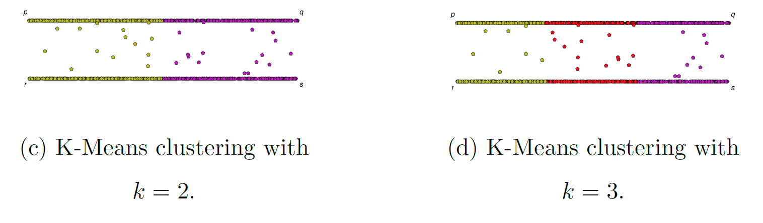
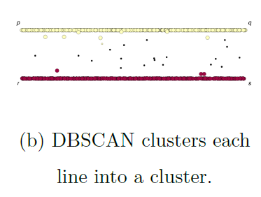
If you care about closeness:
Complete linkage
Average linkage
Ward’s linkage
K-means
If you care about connected components:
  Single linkage
  DBscan
Figures courtesy of Wako Bungula

Slide 98
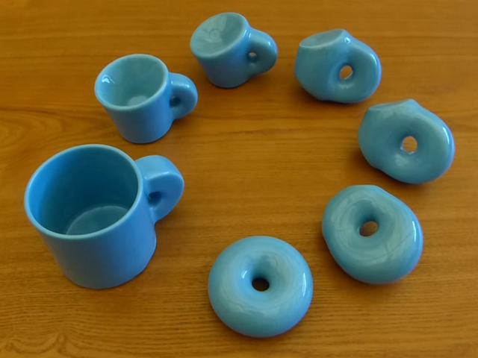

http://images.gmanews.tv/webpics/2016/10/Untitled_2016_10_05_15_45_40.png
http://2.bp.blogspot.com/-SGwFwBjFnBs/ThBqTV1TVUI/AAAAAAAAARw/F1ftHB0teJE/s1600/coffee+cup+as+donut.png

