Slide 1
Comparing and Tracking Topological Structures via Optimal Transport
TDV Workshop at the University of Iowa
Mingzhe Li
Jun 10, 2025

Slide 2
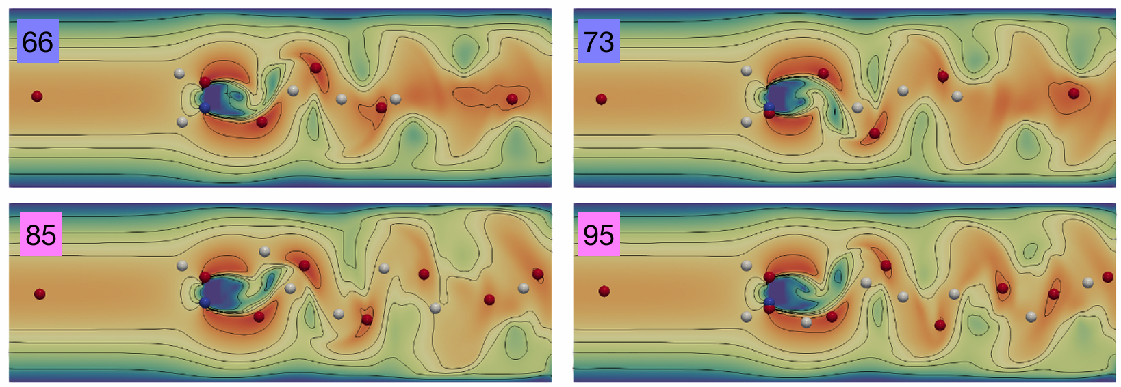
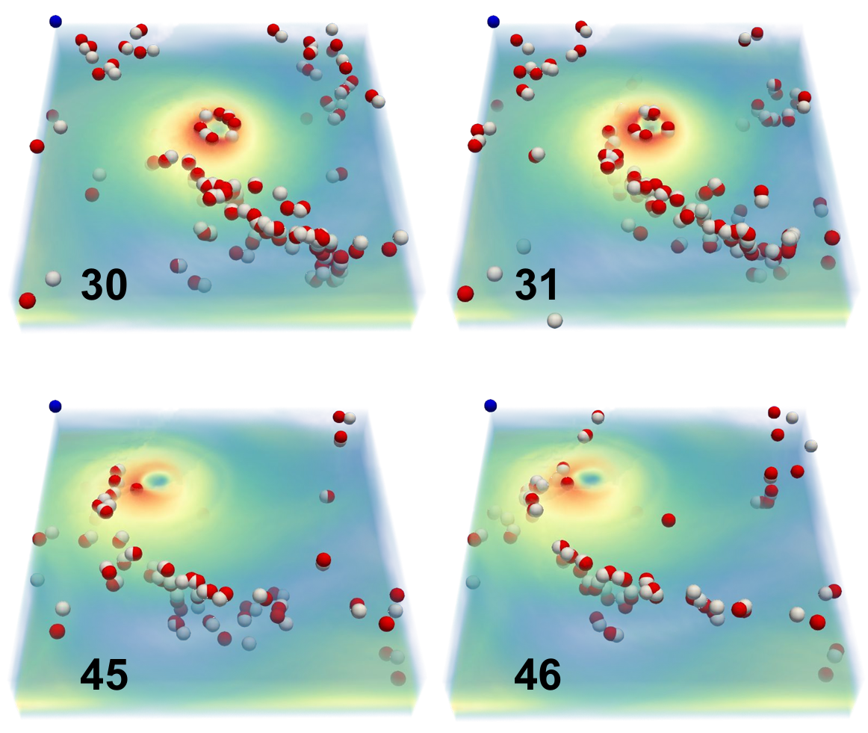
Scalar Field Data
Time-varying
Ensemble
Comparing scalar fields for data analysis
Time-varying flow simulation
3D transient fluid flow simulation
Lyu et al. 2024
3D Isabel Hurricane
P60 Mouse Cortex

Slide 3
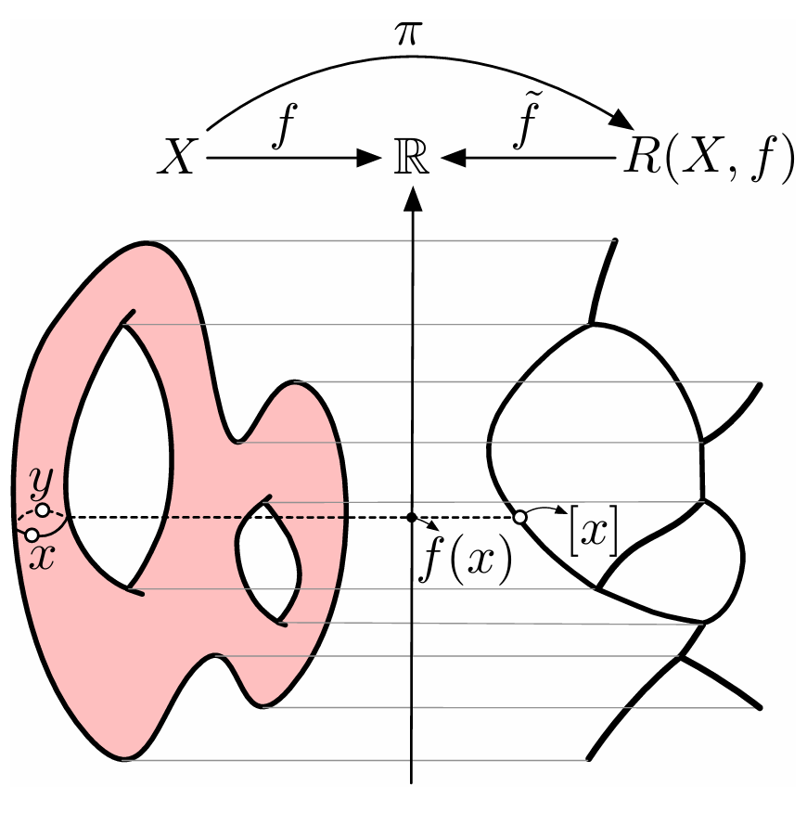
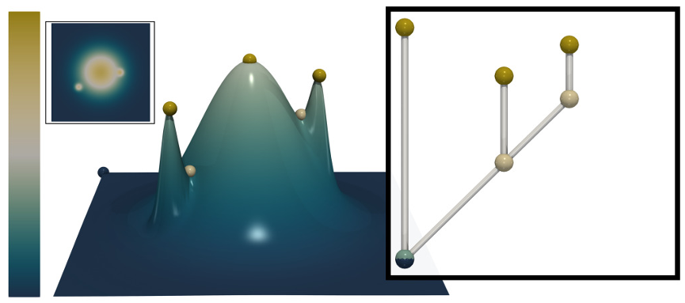
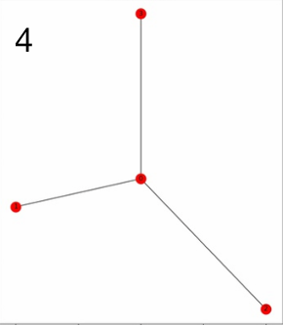
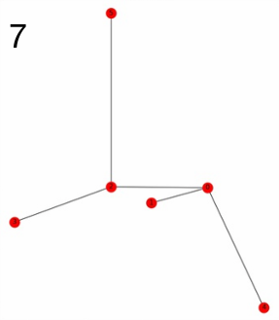
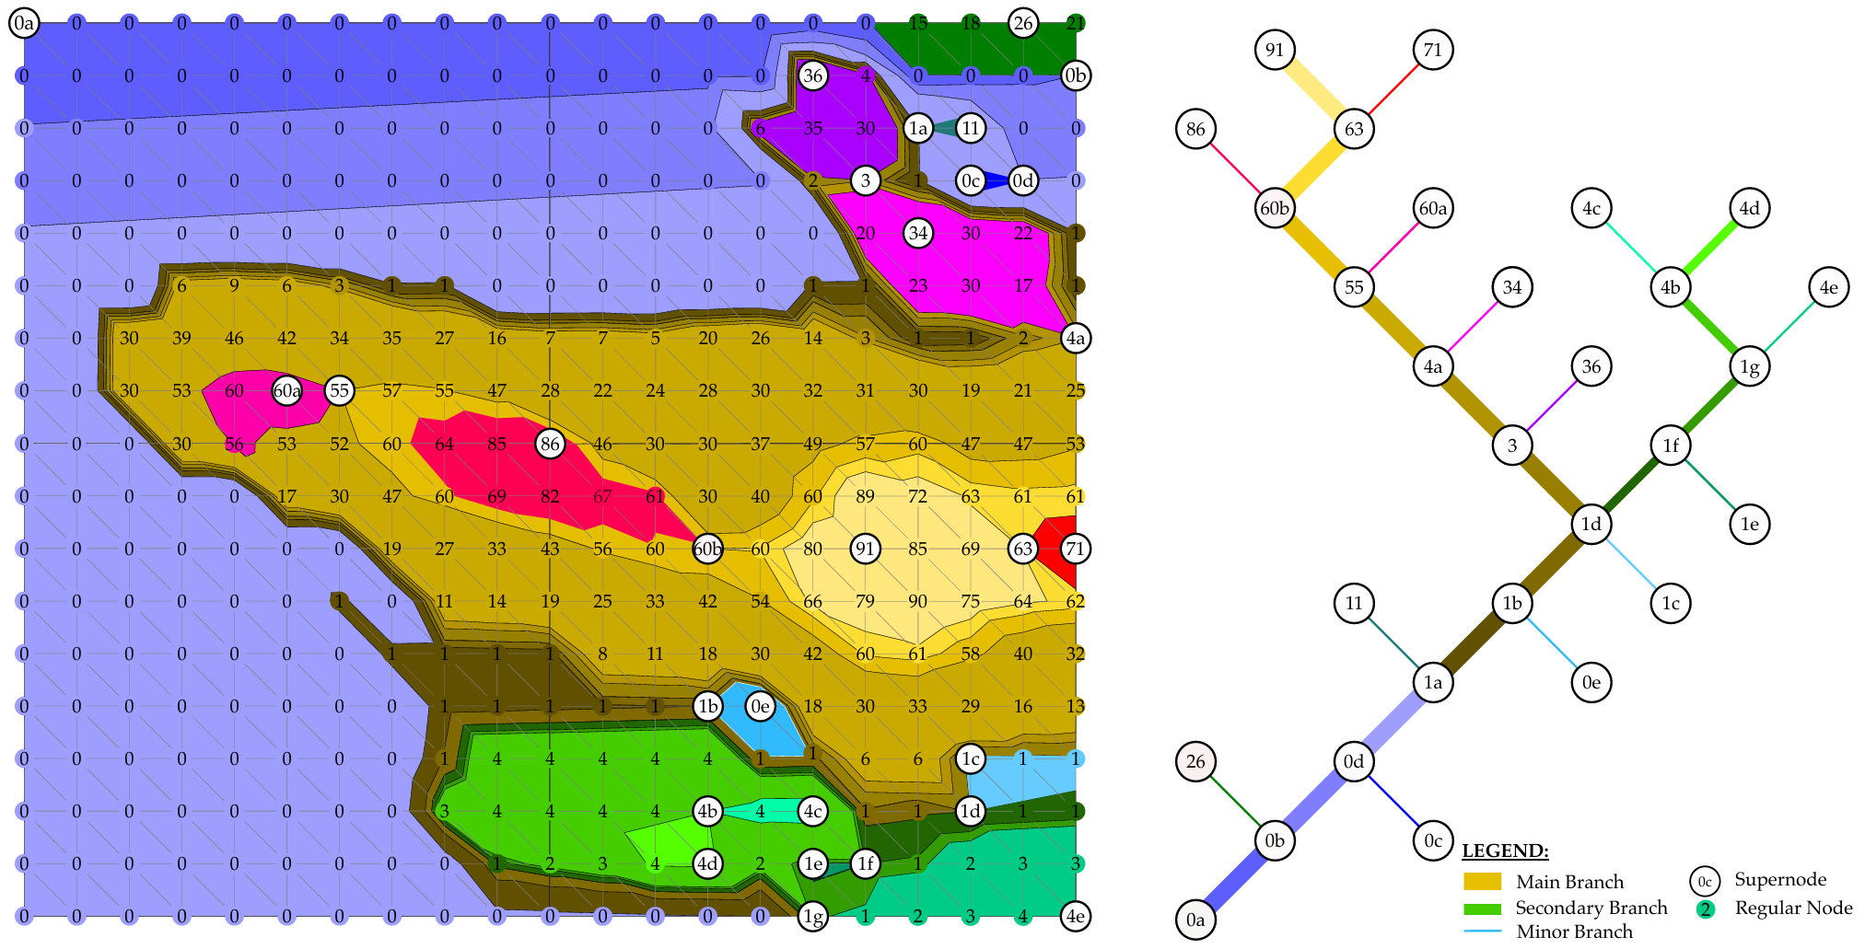
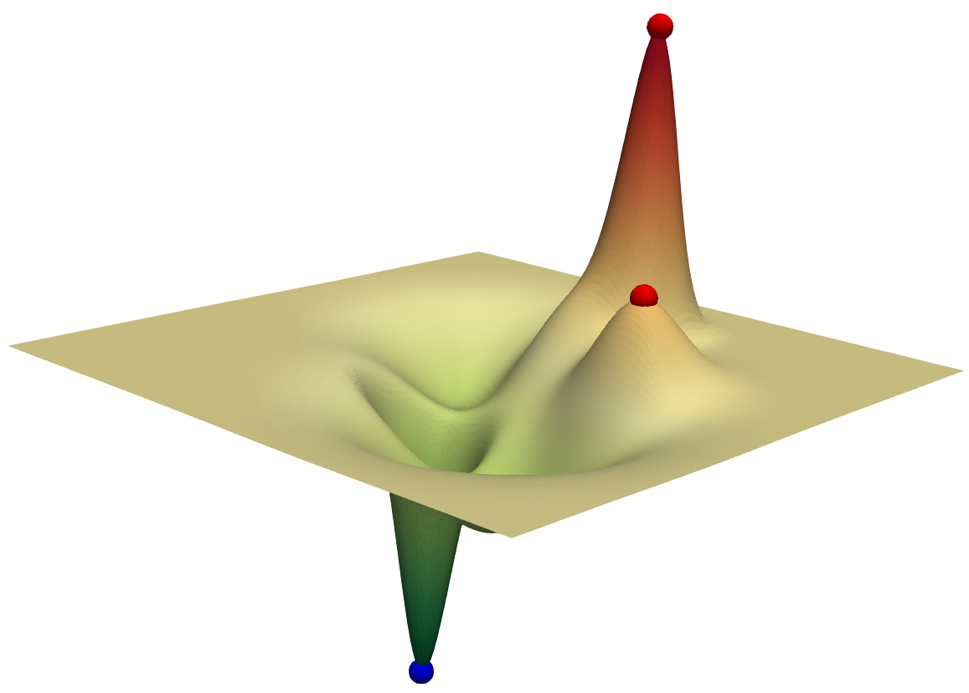
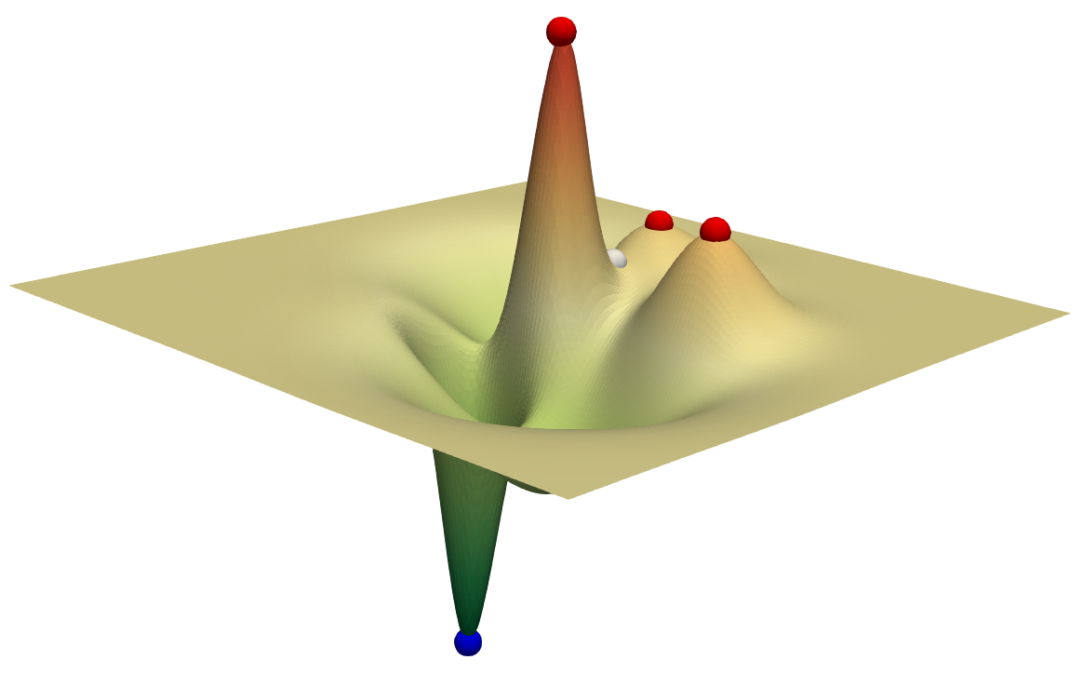
Topological Descriptors
Comparing topological descriptors
2 leaves
3 leaves
Persistence Diagram
Sisouk et al. 2023
Merge Tree
Reeb Graph
Wang et al. 2024
Comparing scalar fields
2 local maxima
3 local maxima
Morse Complex
Contour Tree

Slide 4
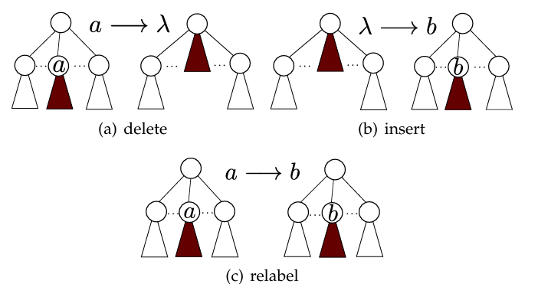
Comparing Topological Descriptors
Problems:
Some are NP-hard
Some require additional restriction / labeling for computation
No existing extension to Morse complexes
Merge Tree Edit Distance
Sridharamurthy et al. 2018
Interleaving Distance
for Labeled Merge Trees
Yan et al. 2021
Merge Tree Wasserstein Distance
Pont et al. 2021

Slide 5
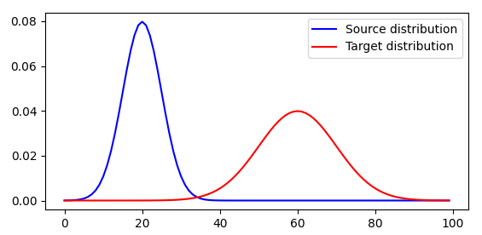
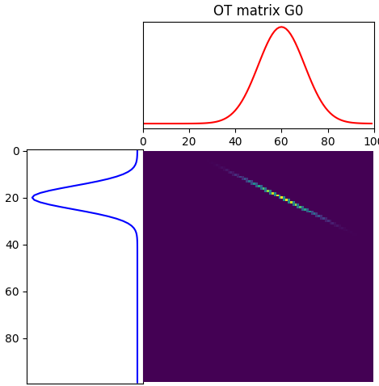
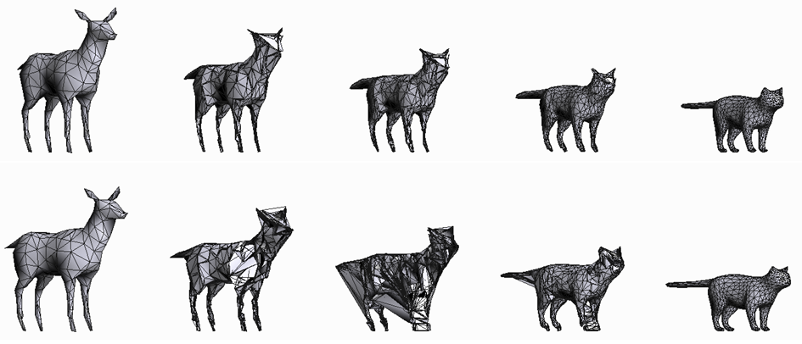
Optimal Transport (OT)
POT documentation
Flamary et al.
Graph matching and shape matching
Vayer et al. 2019
Coupling matrix

Slide 6
Sketching Merge Trees for Scientific Visualization
Mingzhe Li, Sourabh Palande, Lin Yan, Bei Wang
In IEEE Workshop on Topological Data Analysis and Visualization (TopoInVis) at IEEE VIS, 2023.

Slide 7
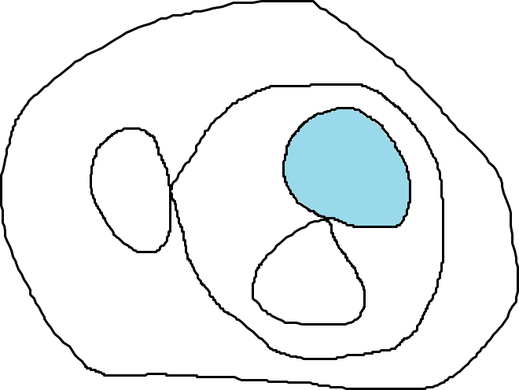
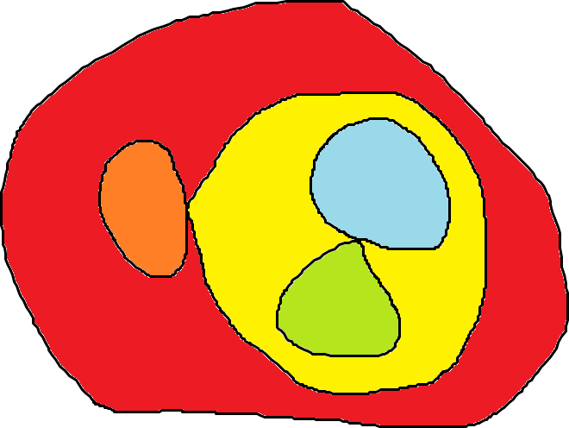
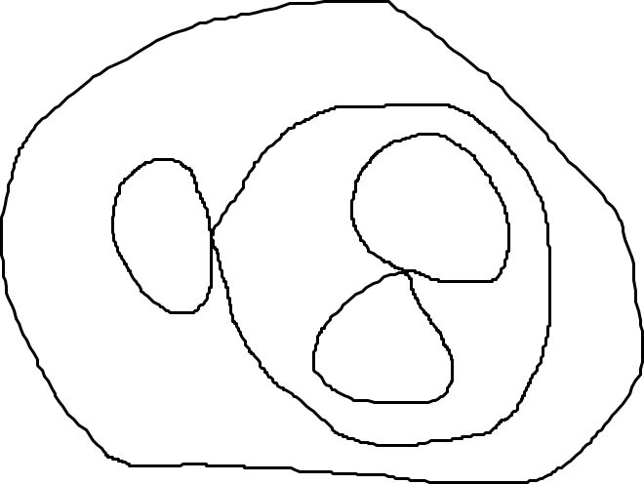
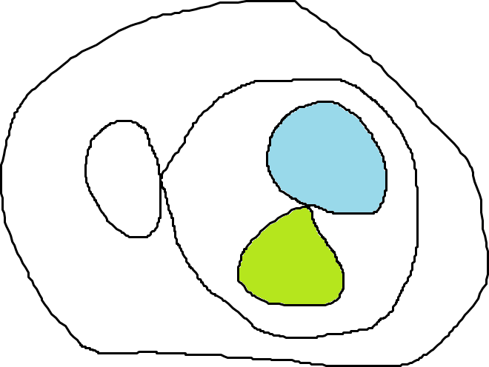
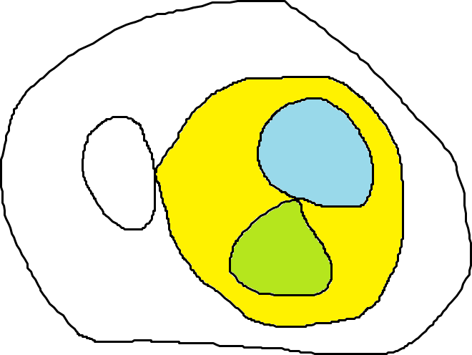
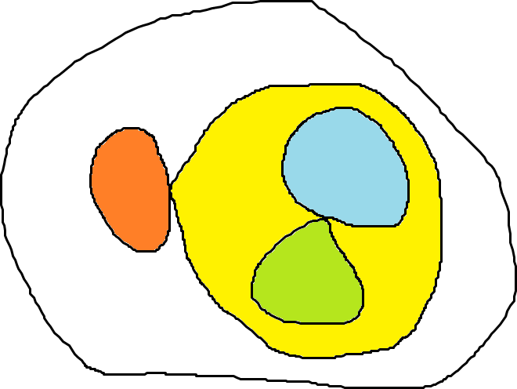
minima
Merge Tree
saddle
$$f$$
maxima
$$a$$

Slide 8
Motivation
data
$$A$$
approx.
$$\hat{A}$$
basis
$$B$$
coefficient
$$Y$$
Matrix Sketching
Popular technique for data reduction
Approximate the data matrix by much smaller matrices
$A≈\hat{A}=BY$
B: basis matrix
Y: coefficient matrix
$$≈$$
$$=$$
$$∙$$
representative vector
of original data

Slide 9
Highlight and Contribution
Gromov-Wasserstein (GW) distance between merge trees
Based on optimal transport
A novel framework to sketch merge trees based on GW distance
Vectorizing merge trees
Finding representatives of data
Identifying modes of physical phenomena

Slide 10
Background: Gromov-Wasserstein Distance
Merge tree as measure networks
$T=(V, p, W)$
$V$: a set of nodes
$p$: a probability distribution on $V$
$W$: pairwise relation between nodes
Example:
$V=\{v_{0},v_{1},v_{2},v_{3},v_{4},v_{5},v_{6},v_{7}\}$
$p=\{\frac{1}{8},\frac{1}{8},\frac{1}{8},\frac{1}{8},\frac{1}{8},\frac{1}{8},\frac{1}{8},\frac{1}{8}\}$
$W∈R^{8×8}$: shortest path distance
$$0$$
$$1$$
$$3$$
$$6$$
Adjacent nodes:
$$W\left(2, 3\right)=\left|3−6\right|=3$$
Non-adjacent nodes:
$$W\left(3, 4\right)=W\left(2,3\right)+W\left(2,4\right)$$
$$=3+6=9$$
$$9$$

Slide 11
Background: Gromov-Wasserstein Distance
Let $T_{1}=(V_{1}, p_{1}, W_{1})$ and $T_{2}=(V_{2}, p_{2}, W_{2})$ be two merge trees
A coupling $C∈R^{\left|V_{1}\right|×\left|V_{2}\right|}$ is a joint probability measure
$\sum_{i, j}{C_{i,j}=1}$
$C1_{|V_{2}|}=p_{1}$
$C^{T}1_{|V_{1}|}=p_{2}$
$$C∈R^{8×6}$$
For each row, $sum=1/8$
$$1_{n}={\left(1, 1, …, 1\right)}^{T}∈R^{n}$$
For each column, $sum=1/6$
8 nodes
6 nodes
11

Slide 12
Background: Gromov-Wasserstein Distance
The GW distance between $T_{1}$ and $T_{2}$ is defined as
$$d_{GW}\left(T_{1},T_{2}\right)=\frac{1}{2}\min_{C}{\sum_{\begin{aligned}0≤i, k<\left|V_{1}\right| \\ 0≤j, l<\left|V_{2}\right|\end{aligned}}{ {\left|W_{1}\left(i, k\right) −W_{2}\left(j, l\right)\right|}^{2}{ C}_{i, j}C_{k, l} }}$$
The optimal coupling of GW distance minimizes the structural distortion between two measure networks.
Structural Distortion
Mémoli 2011

Slide 13
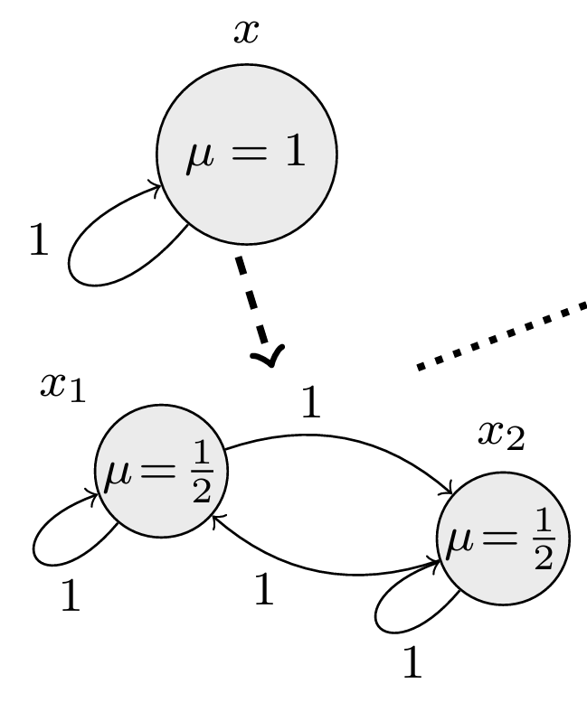
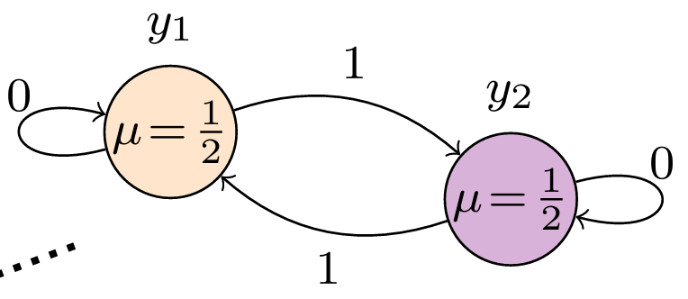
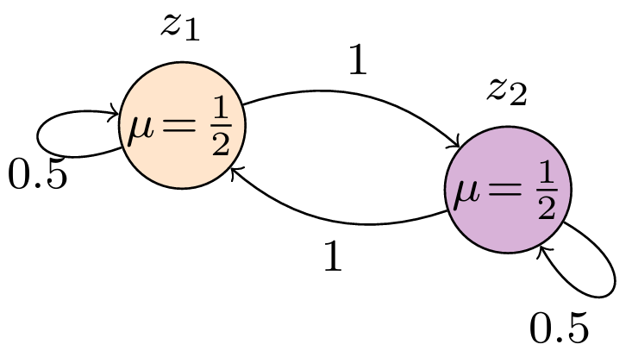
Fréchet Mean
One-to-one correspondence after blow-up & alignment
Geodesics on node relations between corresponding nodes
Given a collection of measure networks $S=\{T_{1},T_{2},…,T_{n}\}$, a Fréchet mean $\overline{T}$ of $S$ is a minimizer of
$$F_{S}\left(\overline{T}\right)=\frac{1}{n}\sum_{i=1}^{n}{d_{GW}(T_{i}, \overline{T})}$$
Chowdhury & Needham 2020
$$X$$
$$Y$$
Fréchet mean
Align
Blow up
$$d_{GW}\left(X, \hat{X}\right)=0$$
$$\hat{X}$$

Slide 14
Fréchet Mean for Merge Trees
Start with a seed measure network ${\overline{T}}^{0}$
Before the k-th iteration, ${\overline{T}}^{k}←{\overline{T}}^{k−1}$
At the k-th iteration, for each merge tree $T_{i}$
Compute the optimal coupling between $T_{i}$ and ${\overline{T}}^{k}$
Blow up $T_{i}$ and ${\overline{T}}^{k−1}$ to the same size based on the coupling
Align two blown-up networks
Compute the gradient and update ${\overline{T}}^{k}$
If the size of ${\overline{T}}^{k}$ is too large, we compress the size of ${\overline{T}}^{k}$

Slide 15
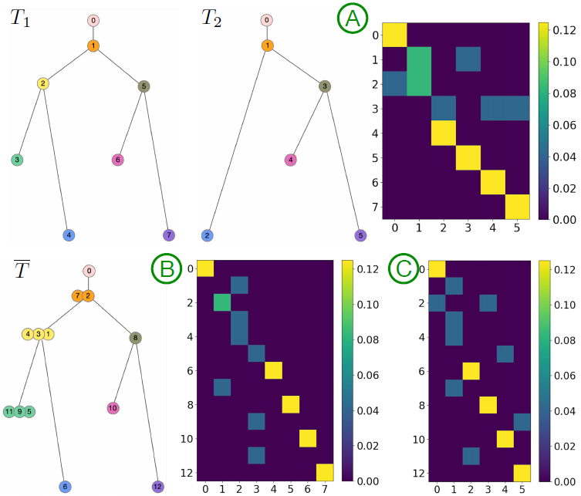
Ideally, each row in $C(\overline{T},T_{1})$ should have exactly one nonzero entry
If multiple nonzero entries exist in a row, we keep the one with the highest probability
$$C(\overline{T},T_{1})$$
$$C(\overline{T},T_{2})$$

Slide 16
Vectorizing Merge Trees
Compute the optimal coupling between $T_{i}$ and ${\overline{T}}^{k}$
Blow up $T_{i}$ to $\hat{T_{i}}$at the same size of ${\overline{T}}^{k}$
There is (theoretically) one-to-one node alignment between $\hat{T_{i}}$and ${\overline{T}}^{k}$
Therefore, we have one-to-one node alignment between every pair of $\hat{T_{i}}$ and $\hat{T_{j}}$
Flattened pairwise distance matrix of $\hat{T_{i}}$ as the vector of the merge tree $T_{i}$
All $\hat{T_{i}}$ are in the same size as $\overline{T}$
Each dimension of the vector has structural correspondences

Slide 17
Matrix Sketching
Column Subset Selection
Iterative Feature Selection (IFS) and Length Squared Sampling (LSS)
Key idea: selecting instances from the original dataset as basis
Advantage: basis as representative merge trees of the dataset

Slide 18
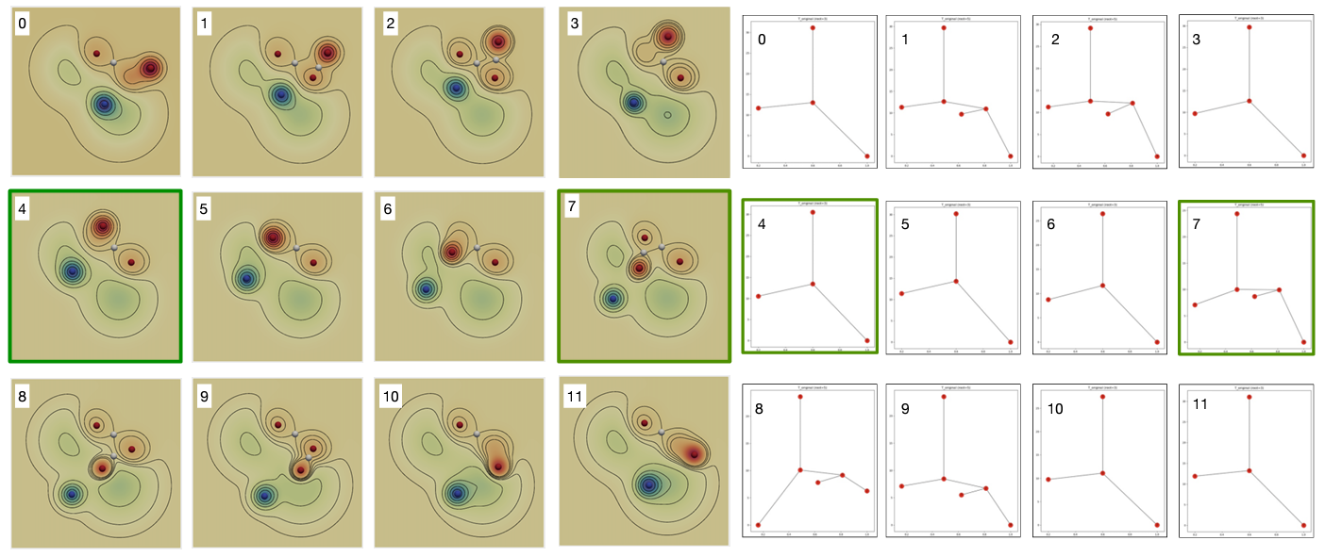
Results: Moving Gaussian
Coefficient matrix
Basis trees

Slide 19
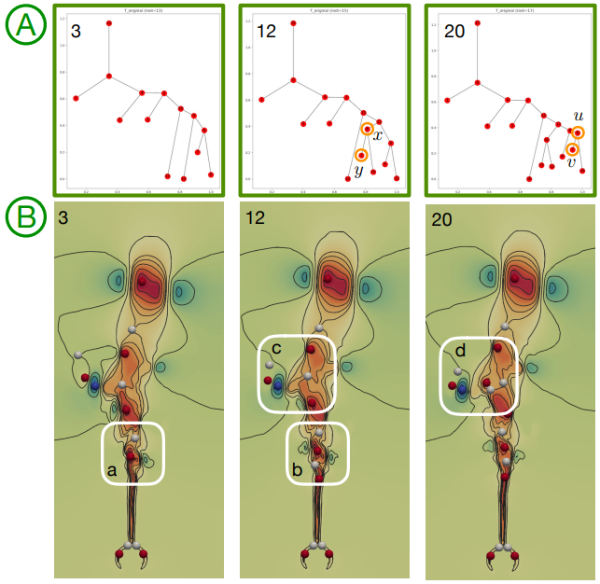
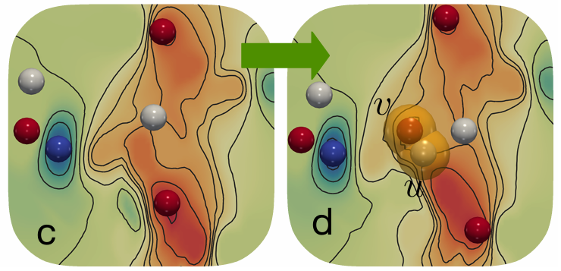
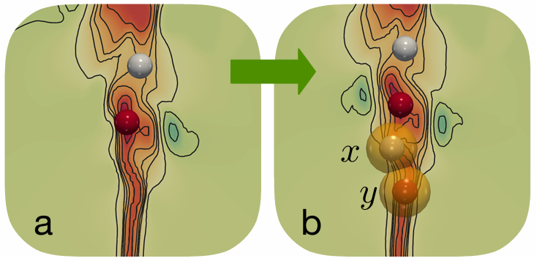
Results: Heated Cylinder
$$T_{0}→T_{7}$$
Coefficient matrix (Column Subset Selection, IFS)

Slide 20
Conclusion
A new distance between merge trees: Gromov-Wasserstein distance
A novel framework to apply matrix sketching to merge trees
Vectorization of merge trees
Finding representatives of data
Identifying modes of physical phenomena

Slide 21
Flexible Topology Tracking Using Partial Optimal Transport
Mingzhe Li, Xinyuan Yan, Lin Yan, Tom Needham, Bei Wang
in IEEE Transactions on Visualization and Computer Graphics (TVCG), 2025

Slide 22
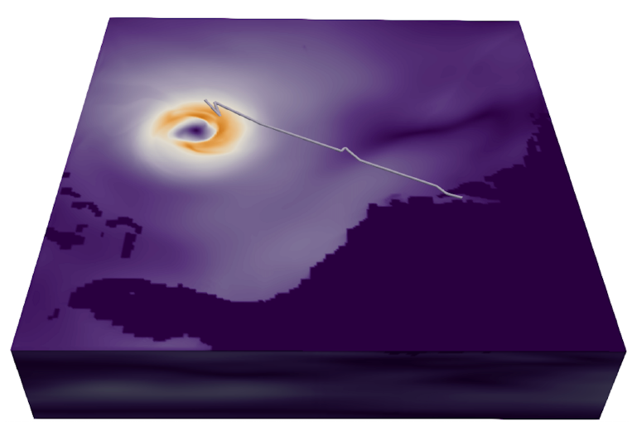
hurricane trajectory
feature tracking
Pipeline:
Extract features from scalar fields
Match features between adjacent time steps
Concatenate matchings to trajectories
Time-varying dataset for Isabel Hurricane

Slide 23
Contribution
A flexible framework to compare merge trees and to track topological features using partial optimal transport
encoding intrinsic and extrinsic information in the comparison
allowing partial matching between features
providing probabilistic tracking results

Slide 24
Attributed Measure Network
Merge tree $T=(V, p, W, A)$
$V$: a set of nodes
$p$: a probability distribution on $V$
$W$: pairwise relation between nodes
$A$: geometric location of nodes

Slide 25
Wasserstein Distance
$d_{2}^{W}{\left(T_{1},T_{2}\right)}^{2}= \min_{C}{\sum_{i, j}{d_{A}{\left(a_{i}, b_{j}\right)}^{2}C_{i, j} }}$
$d_{A}{\left(a_{i}, b_{j}\right)}^{2}$ : Squared Euclidean Distance between points
Matching faraway points leads to high cost
Kantorovich 1939
$$a_{i}=(1.1, 3.0)$$
$$d_{A}{\left(a_{i}, b_{j}\right)}^{2}$$
$$={\left(1.1 −0.9\right)}^{2}+{\left(3.0 −1.2\right)}^{2}$$
$$=3.28$$
$$i$$
$$b_{j}=(0.9, 1.2)$$
$$j$$

Slide 26
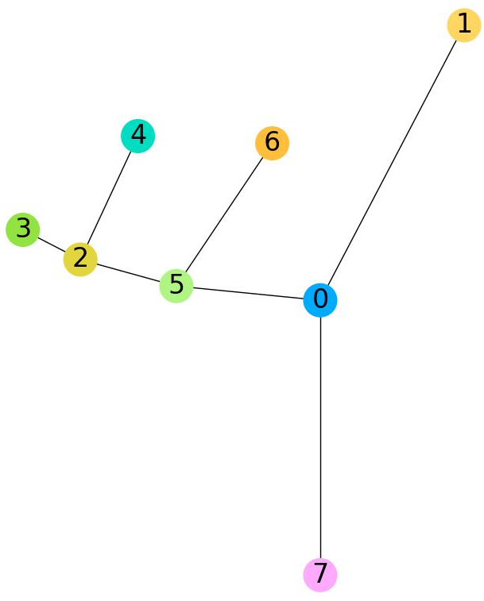
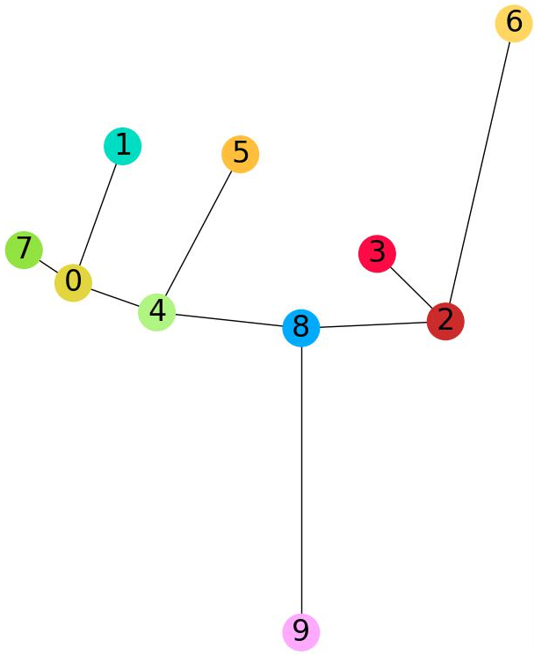
Gromov-Wasserstein Distance
$d_{2}^{GW}{\left(T_{1},T_{2}\right)}^{2}= \min_{C}{\sum_{i, j, k, l}{ {\left|W_{1}\left(i, k\right) −W_{2}\left(j, l\right)\right|}^{2}{ C}_{i, j}C_{k, l} }}$
$W$: shortest path distance in merge trees
${\left|W_{1}\left(i, k\right) −W_{2}\left(j, l\right)\right|}^{2}$: distortion of node relations
The optimal coupling minimizes the structure distortion between merge trees
$$k$$
$$i$$
${\left|W_{1}\left(i,k\right)−W_{2}\left(j, l\right)\right|}^{2}$
$$={\left(1.8 −1.3\right)}^{2}=0.25$$
$$l$$
Mémoli 2011
$$W_{1}\left(i, k\right)=1.8$$
$$W_{2}\left(j, l\right)=1.3$$
$$j$$

Slide 27
Fused Gromov-Wasserstein (FGW) Distance
$d_{2}^{FGW}{\left(T_{1},T_{2}\right)}^{2}=\min_{C}{\sum_{i, j, k, l}{\left[\left(1−α\right)d_{A}{\left(a_{i}, b_{j}\right)}^{2}+ α{\left|W_{1}\left(i, k\right)−W_{2}\left(j, l\right)\right|}^{2}\right]C_{i,j}C_{k,l} }}$
Combination of Wasserstein distance and GW distance
$α$: balance hyperparameter
Vayer et al. 2019
$d_{A}{\left(a_{i}, b_{j}\right)}^{2}$: geometric location
${\left|W_{1}\left(i, k\right)−W_{2}\left(j, l\right)\right|}^{2}$: intrinsic tree structure

Slide 28
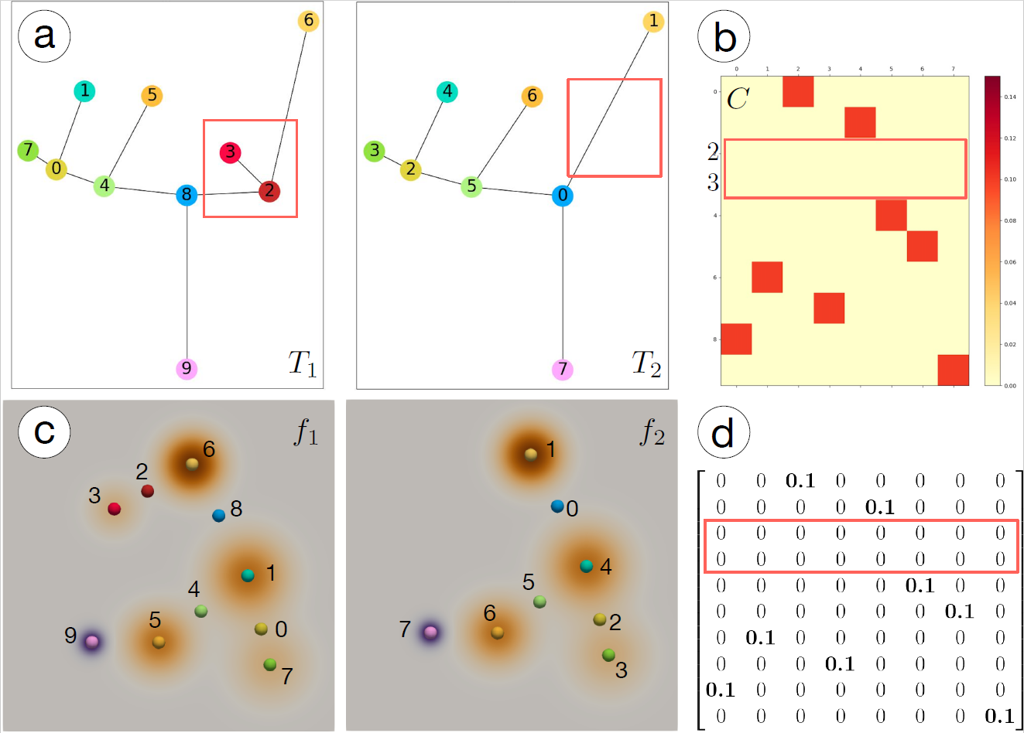
Partial Optimal Transport
$$m=0.8$$
Optimal Transport forces a full probabilistic matching.
$\sum_{i,j}{C_{i,j}=1}$
Partial Optimal Transport allows certain probability to be ignored.
$\sum_{i,j}{C_{i,j}=m (0<m≤1)}$
More robust to noise
Chapel et al. 2020

Slide 29
Partial Fused Gromov-Wasserstein (pFGW) Distance
We have
$$d_{2}^{pFGW}{\left(T_{1},T_{2}\right)}^{2}=\min_{C}{\sum_{i, j, k, l}{\left[\left(1−α\right)d_{A}{\left(a_{i}, b_{j}\right)}^{2}+ α{\left|W_{1}\left(i, k\right)−W_{2}\left(j, l\right)\right|}^{2}\right]C_{i,j}C_{k,l} }}$$
where $C$ is restricted by
$\sum_{i,j}{C_{i,j}=m (0<m≤1)}$
$C1_{|V_{2}|}≤p_{1}$
$C^{T}1_{|V_{1}|}≤p_{2}$
geometric location
intrinsic tree structure
partial optimal transport
$$1_{n}={\left(1, 1, …, 1\right)}^{T}∈R^{n}$$
Refer to the paper for more details…

Slide 30
Results
T
T
Vortex Street
Heated Cylinder

Slide 31
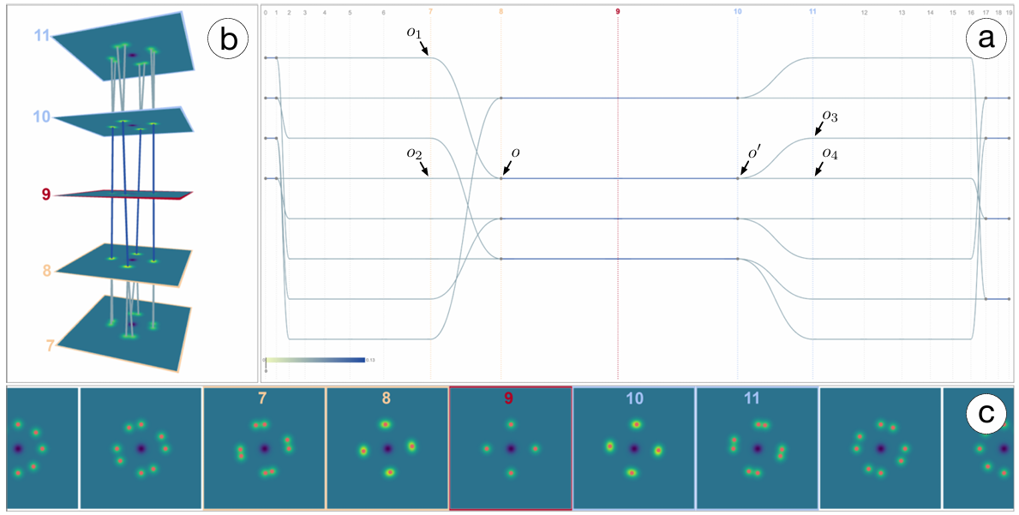
Probabilistic Feature Tracking
split
merge
merge
split

Slide 32
Conclusion
A flexible framework to track topological features using merge trees
pFGW distance between merge trees
Merge tree node matching for feature tracking
Probabilistic feature tracking graphs
Visualizing uncertainty of matching
Indicating feature merge/split events
New stability results for GW distance between merge trees
See paper for details

Slide 33
Tracking Low-Level Cloud Systems Based on Topology
Mingzhe Li, Dwaipayan Chatterjee, Franziska Glassmeier, Fabian Senf, Bei Wang

Slide 34
Background
Data: Satellite image of clouds
Scalar field: optical thickness
High-value regions --> thick clouds
Task: tracking cloud systems
Difficulty:
Ambiguous definitions of clouds
High data complexity in terms of topology
Frequent feature appearance/disappearance
min
max

Slide 35
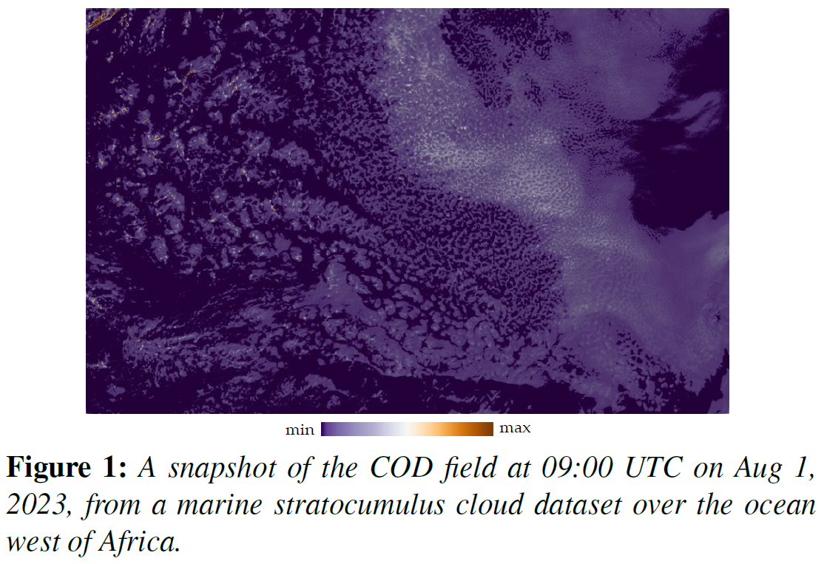
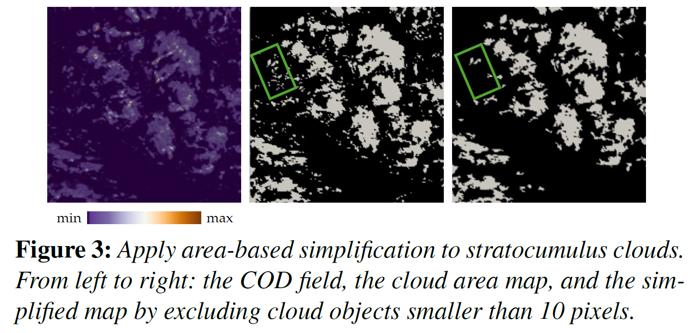
Background: Cloud Detection
Cloud object
Contribution: geometrically close cloud objects are considered as a whole system, which we call a cloud system.

Slide 36
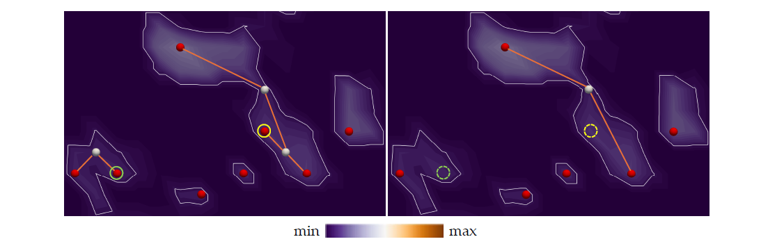
Contribution: Merge Tree for Anchor Points
Merge Tree
Maxima as anchor points for cloud object

Slide 37
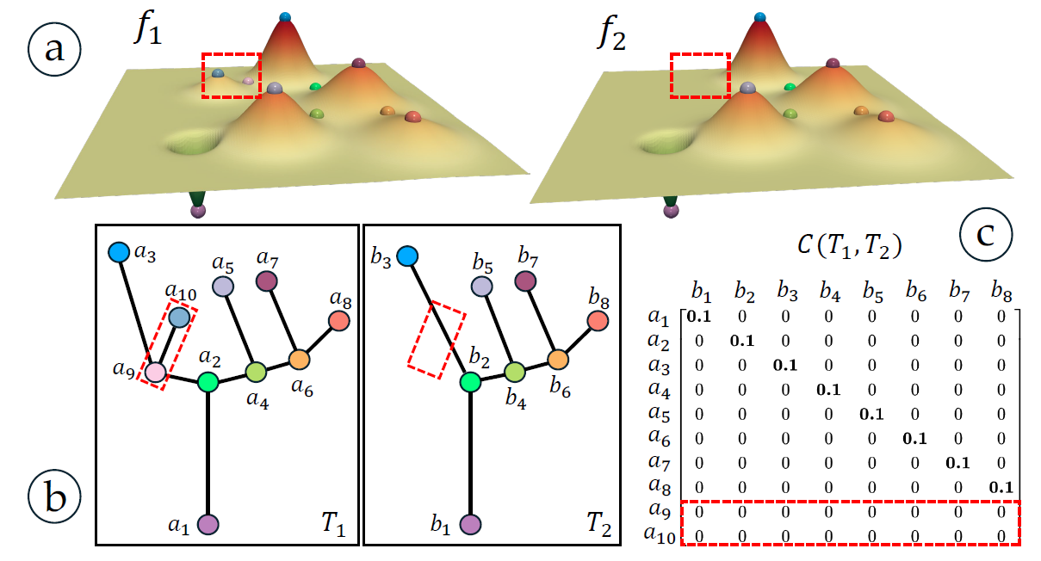
Tracking Anchor Points
Framework: pFGW distance
- location as node attributes
- tree distance as node relations
* Encoding locality of local maxima (within the same cloud object)
- partial OT for flexible matching

Slide 38
Tracking Anchor Points for Cloud Systems

Slide 39
Tracking Results: Shallow Cumulus Clouds

Slide 40
Tracking Results: Stratocumulus Clouds

Slide 41
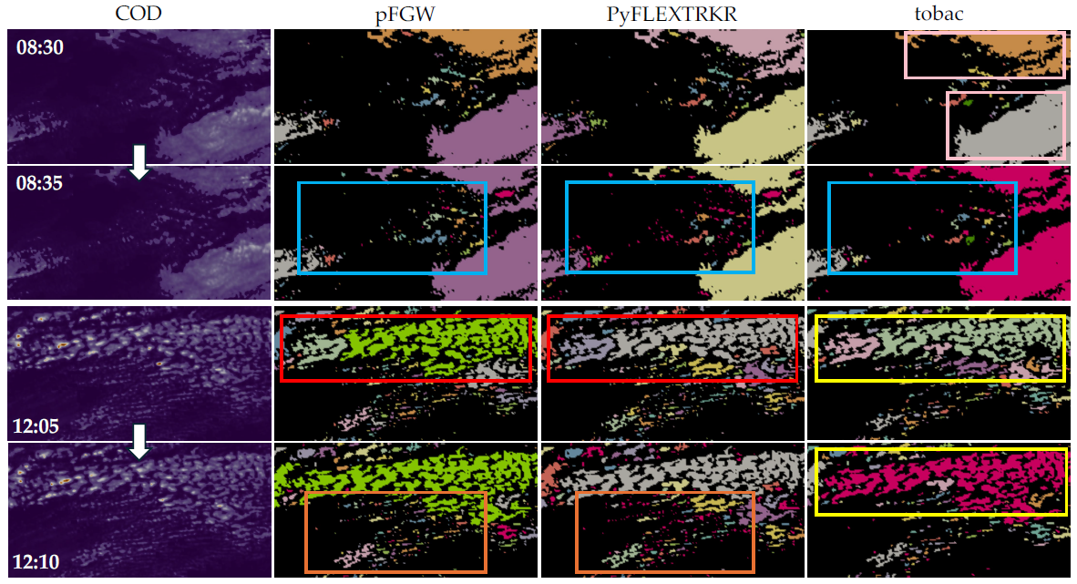
Comparing with State-of-the-art (Shallow Cumulus)
Scalar field
ours
Region overlap
Centroid Tracking

Slide 42
Conclusion
Topology-based Tracking Framework for Cloud Tracking
superlevel set for cloud objects/systems
pFGW distance as measure
Optimal coupling for critical point matching
local maxima as anchor points for cloud objects/systems

Slide 43
Comparing Morse Complexes Using Optimal Transport
Mingzhe Li, Carson Storm, Austin Yang Li, Tom Needham, Bei Wang
In IEEE Visualization and Visual Analytics (VIS) Short Paper, 2023

Slide 44
Morse Complex and Morse Graph
Peak (Maxima)
Saddle
Pit (Minima)
2D Scalar Field
Morse Complex (Descending Manifold)

Slide 45
Morse Graph
Morse Complex
(Descending Manifold)
1D Skeleton
Morse Graph
OT Distances
3

Slide 46
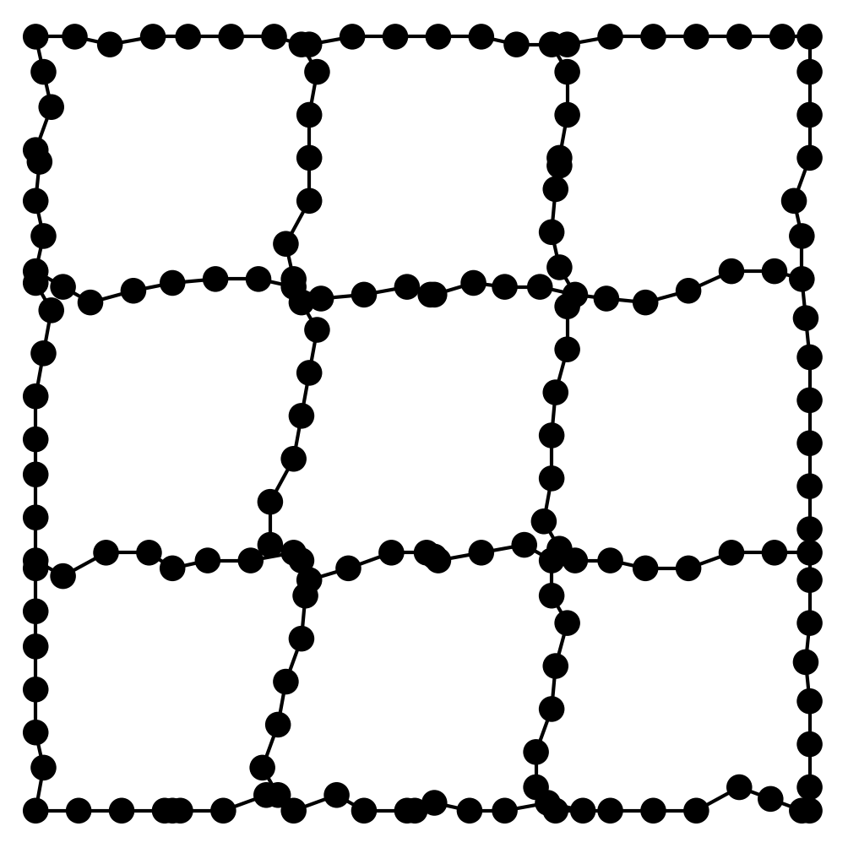
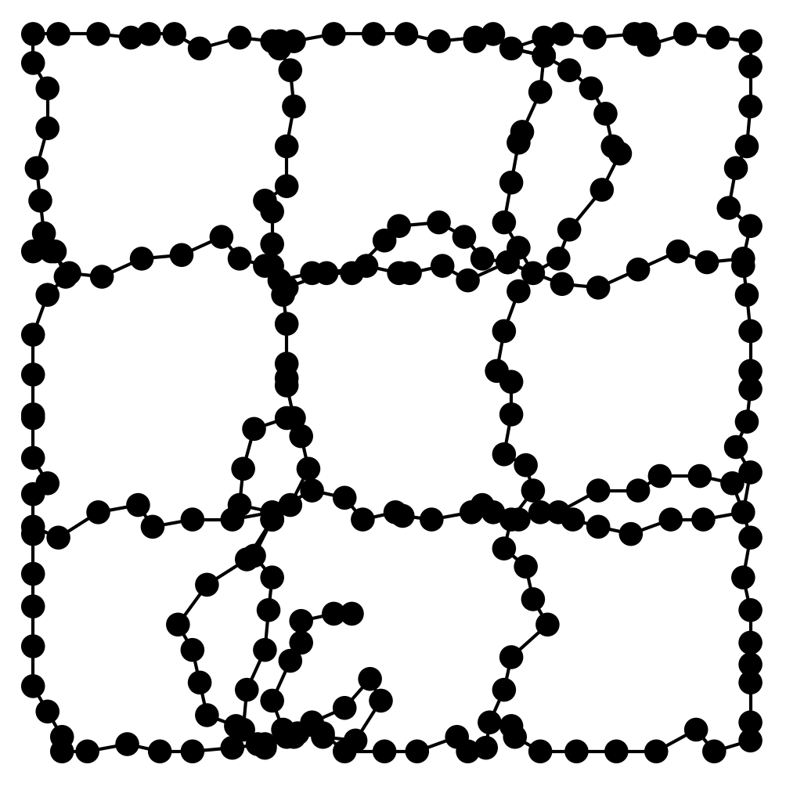
Optimal Transport (OT) Distances
$$G_{1}=(V_{1}, p_{1}, W_{1})$$
Coupling Matrix
$$C∈R^{{|V}_{1}|×|V_{2}|}$$
x₁
y₁
x₁
$$\sum_{i∈V_{1}}{p1(x_{i})}=1$$
Optimal Transport
$$G_{2}=(V_{2}, p_{2}, W_{2})$$
$$\sum_{j∈V_{2}}{p2(y_{j})}=1$$
y₁
$$W_{1},W_{2}:$$
Node relation
- Nonzero entry

Slide 47
Wasserstein Distance
$d_{q}^{W}{\left(G_{1},G_{2}\right)}^{2}= \min_{C}{\sum_{i, j}{d_{A}{\left(a_{i}, b_{j}\right)}^{2}C_{i, j} }}$
$d_{A}{\left(a_{i}, b_{j}\right)}^{2}$ : Squared Euclidean Distance between points
Matching faraway points leads to high cost
$$a_{i}=(1.1, 3.0)$$
$$i$$
$$b_{j}=(0.0, 2.7)$$
$$j$$
$$d_{A}{\left(a_{i}, b_{j}\right)}^{2}$$
$$={\left(1.1 −0.0\right)}^{2}+{\left(3.0 −2.7\right)}^{2}$$
$$=1.30$$

Slide 48
Gromov-Wasserstein Distance (GW)
$d_{q}^{GW}{\left(G_{1},G_{2}\right)}^{2}= \min_{C}{\sum_{i, j, k, l}{ {\left|W_{1}\left(i, k\right) −W_{2}\left(j, l\right)\right|}^{2}{ C}_{i, j}C_{k, l} }}$
$W_{1}\left(i, k\right)$ & $W_{2}\left(j, l\right)$: shortest path between nodes
Matched nodes in two networks should have similar intrinsic graph structure
$$W_{2}\left(j, l\right)=0.9$$
$$i$$
$$W_{1}\left(i, k\right)=1.8$$
$$l$$
$$j$$
$$k$$
${\left|W_{1}\left(i,k\right)−W_{2}\left(j, l\right)\right|}^{2}$
$$={\left(1.8 −0.9\right)}^{2}=0.81$$

Slide 49
Fused Gromov-Wasserstein Distance (FGW)
$d_{q}^{FGW}{\left(G_{1},G_{2}\right)}^{2}=\min_{C}{\sum_{i, j, k, l}{\left[\left(1−α\right)d_{A}{\left(a_{i}, b_{j}\right)}^{2}+ α{\left|W_{1}\left(i, k\right)−W_{2}\left(j, l\right)\right|}^{2}\right]C_{i,j}C_{k,l} }}$
Combination of Wasserstein distance and GW distance
$α$: balance hyperparameter
$d_{A}{\left(a_{i}, b_{j}\right)}^{2}$: geometric location
${\left|W_{1}\left(i, k\right)−W_{2}\left(j, l\right)\right|}^{2}$: intrinsic graph structure
$$a_{i}=(1.1, 3.0)$$
$$b_{j}=(0.0, 2.7)$$
$$W_{1}\left(i, k\right)=1.8$$
$$W_{2}\left(j, l\right)=0.9$$
$$i$$
$$j$$
$$i$$
$$l$$
$$k$$
$$j$$
+

Slide 50
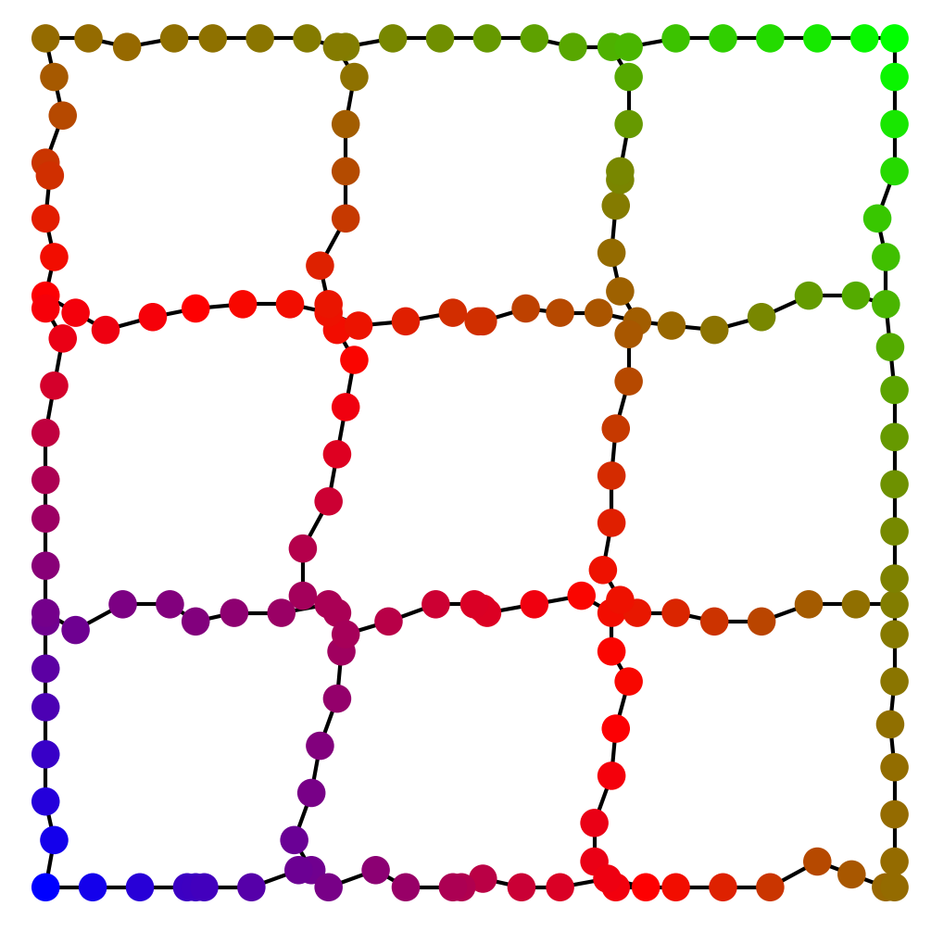
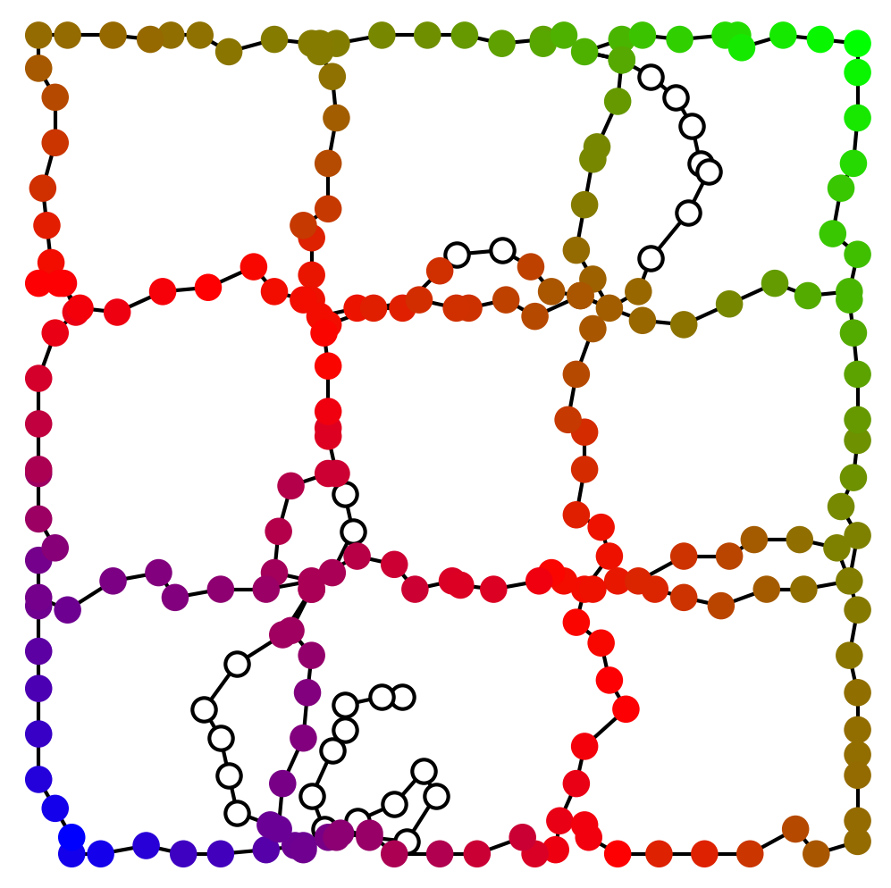
Partial Optimal Transport (pOT)
Optimal Transport forces a full probability matching.
$\sum_{i,j}{C_{i,j}=1}$
Partial Optimal Transport allows certain probability to be ignored.
$\sum_{i,j}{C_{i,j}=m (0<m≤1)}$
More robust to noise
Distances
Partial Wasserstein (pW)
Partial Gromov-Wasserstein (pGW)
Partial Fused Gromov-Wasserstein (pFGW)
Noise

Slide 51
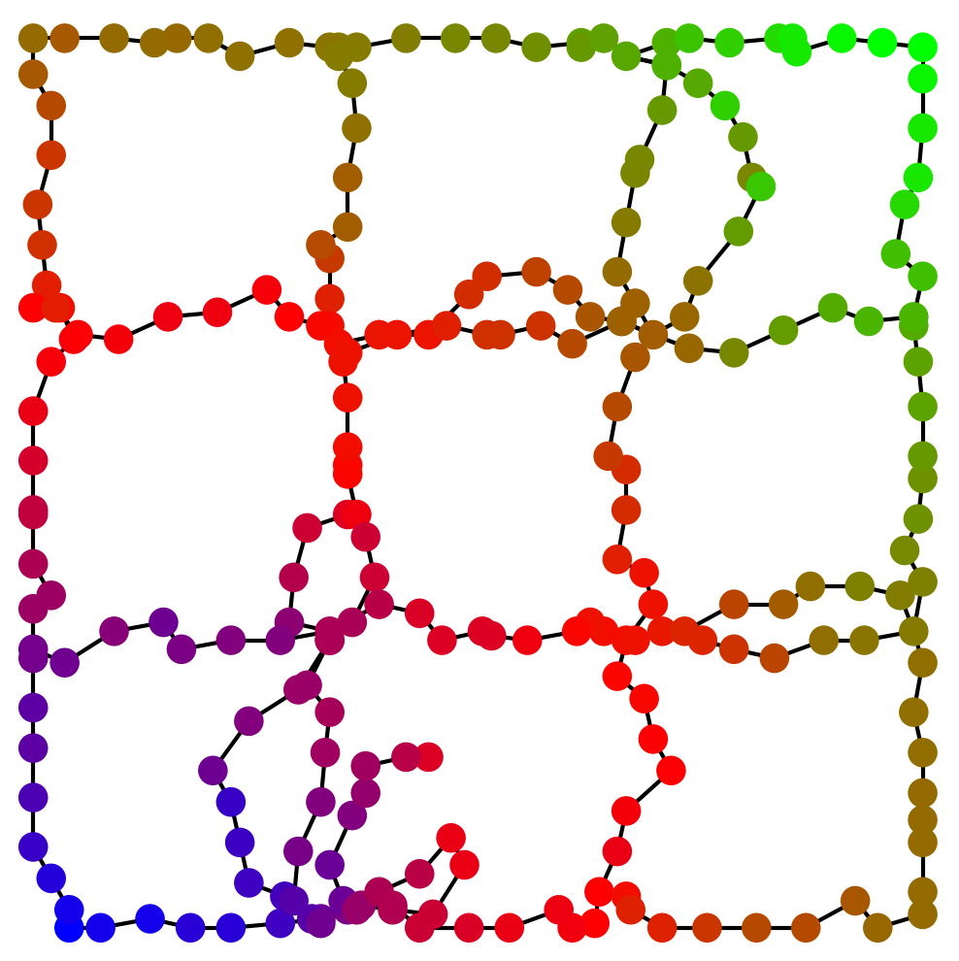
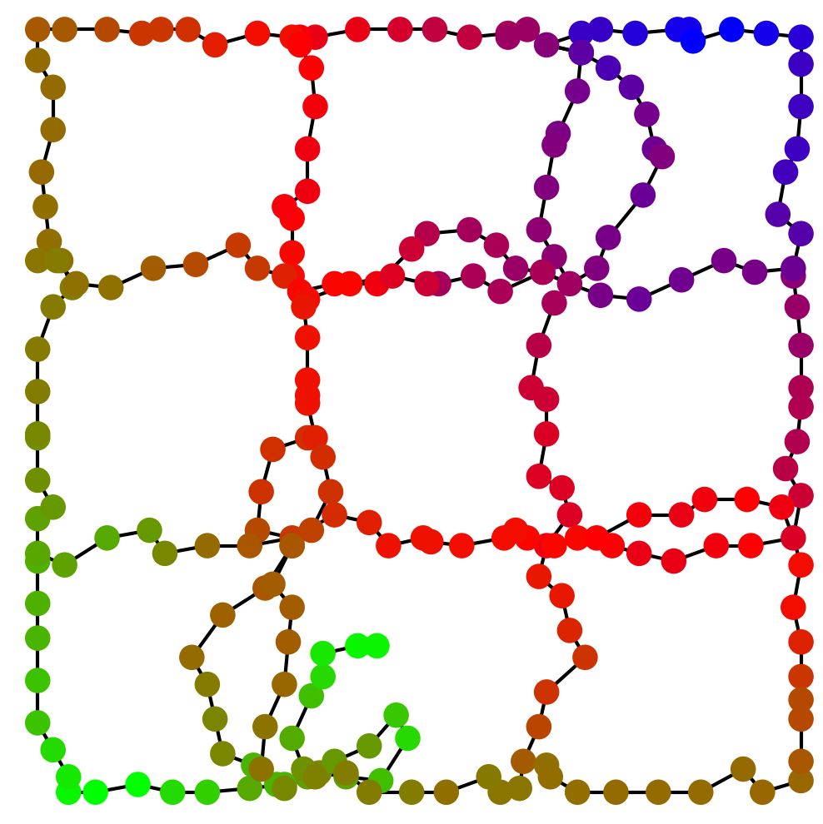
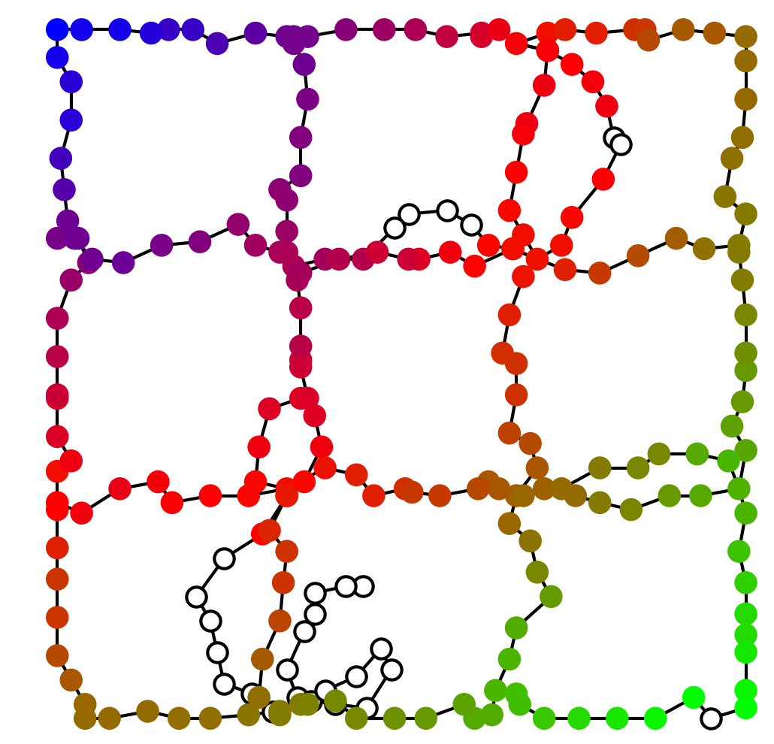
Target
Geometric location
Graph structure
Geometric location +
Graph structure
Source
Wasserstein
GW
FGW
OT
pW
pGW
pFGW
Partial OT

Slide 52
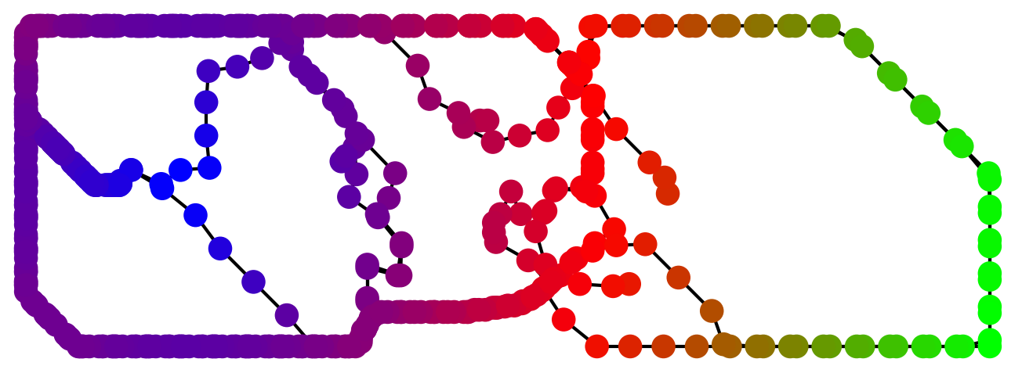
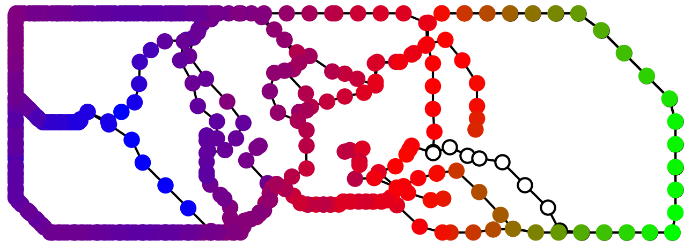
Result – Feature Correspondence
Dataset: Heated Cylinder ^{[1]}
Source
Target (pFGW)
[1]. Computer graphics laboratory. https://cgl.ethz.ch/research/visualization/data.php.

Slide 53
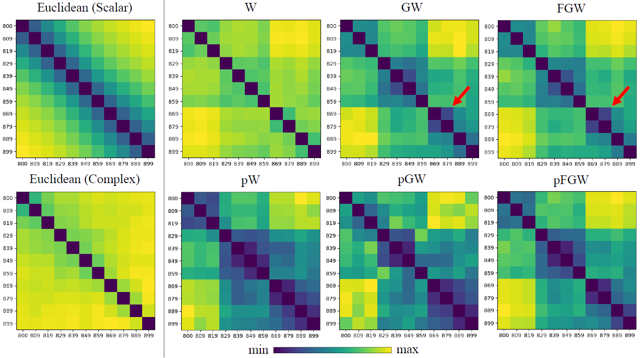
Detecting Structure Similarities – Heated Cylindner

Slide 54
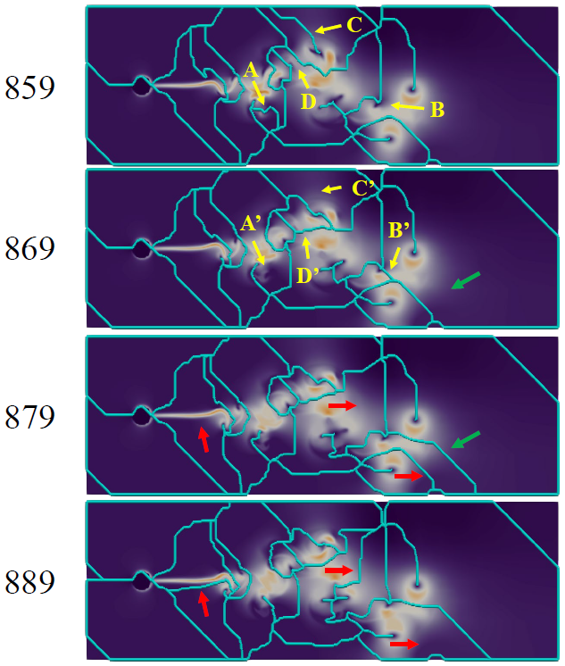
Detecting Structure Similarities – Heated Cylindner

Slide 55
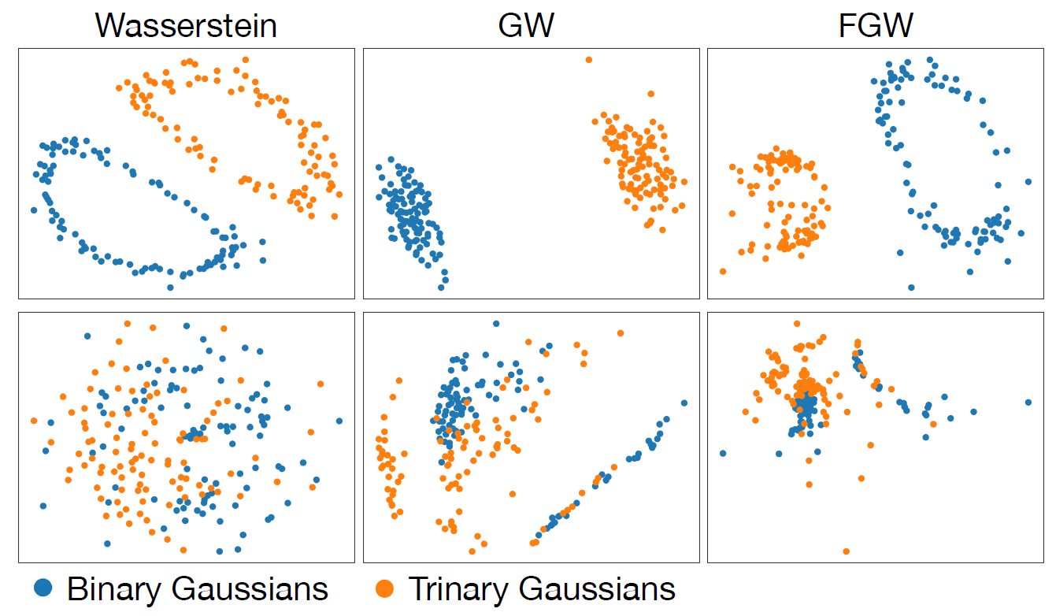
Classification

Slide 56
Conclusion
A class of OT-based distances between Morse graphs
serve as a type of Morse-complex comparative measures
can encode different information
can be robust to noise: partial OT

Slide 57
Summary

Slide 58
Summary
My webpage
(preprints available)
https://mingzhefluorite.github.io
Optimal Transport: useful tool for comparing graph-based topological descriptors
Theoretical foundation + Easy-to-compute
Output: structure correspondence and similarity measure
Different encodings / variations
Gromov-Wasserstein Distance: intra-graph relations
Wasserstein Distance: node attributes
Partial OT: flexibility in matching
More to explore…

Slide 59
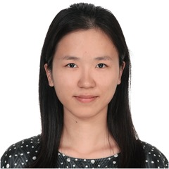
Collaborators and Grants
My webpage
(preprints available)
https://mingzhefluorite.github.io
Bei Wang
Tom Needham
Lin Yan
Xinyuan Yan
Sourabh Palande
Grants
NSF IIS-2145499, IIS-1910733, DMS-2107808
DOE DE-SC0021015
And more:
C. Storm, A. Y. Li
D. Chatterjee, F. Glassmeier, F. Senf

Slide 60
References
H. Carr, O. R¨ubel, and G. H. Weber. Distributed hierarchical contour trees. In 2022 IEEE 12th Symposium on Large Data Analysis and Visualization (LDAV), pages 1–10, New York, 2022. IEEE.
H. Carr, J. Snoeyink, and M. van de Panne. Flexible isosurfaces: Simplifying and displaying scalar topology using thecontour tree. Computational Geometry: Theory and Applications, 43(1):42–58, 2010.
L. Chapel, M. Z. Alaya, and G. Gasso. Partial optimal tranport with applications on positive-unlabeled learning. Advances in Neural Information Processing Systems, 33:2903–2913, 2020.
S. Chowdhury and T. Needham. Gromov-Wasserstein averaging in a Riemannian framework. Proceedings of the IEEE/CVF Conference on Computer Vision and Pattern Recognition Workshops, pages 842–843, 2020.
S. Chowdhury and T. Needham. Generalized spectral clustering via Gromov-Wasserstein learning. Proceedings of The 24th International Conference on Artificial Intelligence and Statistics, PMLR, 130:712–720, 2021.
P. Hristov, G. H. Weber, H. Carr, O. R¨ubel, and J. Ahrens. Data parallel hypersweeps for in situ topological analysis. In 2020 IEEE 10th Symposium on Large Data Analysis and Visualization (LDAV), pages 12–21, New York, 2020. IEEE.
M. Li, H. Carr, O. R¨ubel, B. Wang, and G. H. Weber. Distributed augmentation, hypersweeps, and branch decomposition of contour trees for scientific exploration. IEEE Transactions on Visualization and Computer Graphics, pages 1–11, 2024.

Slide 61
References
F. Mémoli. Gromov-Wasserstein distances and the metric approach to object matching. Foundations of Computational Mathematics, 11(4):417–487, 2011.
M. Pont, J. Vidal, J. Delon, and J. Tierny. Wasserstein distances, geodesics and barycenters of merge trees. IEEE Transactions on Visualization and Computer Graphics, 2021.
G. Reeb. Sur les points singuliers d’une forme de pfaff completement intergrable ou d’une fonction numerique (on the singular points of a complete integral pfaff form or of a numerical function). Comptes Rendus Acad. Science Paris, 222:847–849, 1946.
T. Vayer, N. Courty, R. Tavenard, and R. Flamary. Optimal transport for structured data with application on graphs. International Conference on Machine Learning, pages 6275–6284, 2019.
H. Xu, D. Luo, H. Zha, and L. Carin. Gromov-Wasserstein learning for graph matching and node embedding. International Conference on Machine Learning, pages 6932–6941, 2019.
L. Yan, T. B. Masood, F. Rasheed, I. Hotz, and B. Wang. Geometry-aware merge tree comparisons for time-varying datawith interleaving distances. IEEE Transactions on Visualization and Computer Graphics (TVCG), 2022.

