Slide 1
On the importance of compulsory retirement for professional baseball umpires
Riley Post

Slide 2
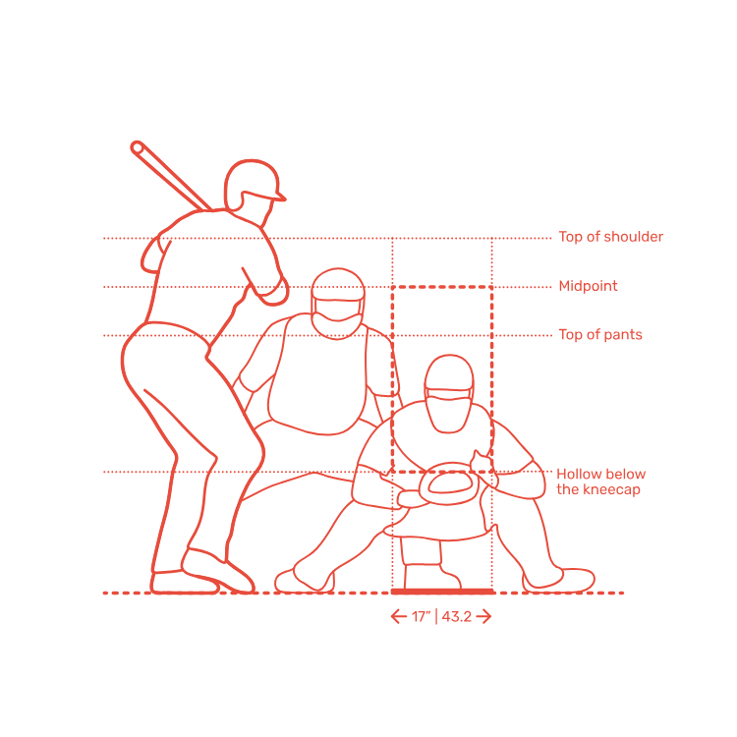
A quick refresher

Slide 3
A quick refresher
Strike Zone

Slide 4
For a long time, umpires were instructed to “watch the slot”
SLOT

Slide 5
This positioning can make it difficult for umpires to see outside pitches

Slide 6
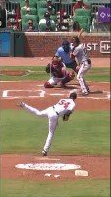
Watch how the umpire sets up in the slot and doesn’t adjust to the pitch
Major league pitchers can hit any spot so once they know that the outside is in play, they will pitch there all game

Slide 7
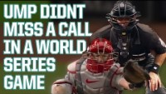

Slide 8
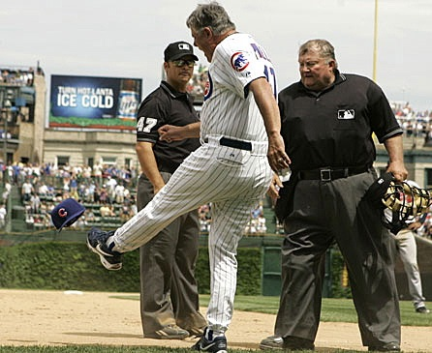
Since 2015 UmpScorecards.com has held umpires accountable for their antics
Recording Accuracy to RBSZ
Consistency of Effective Strike Zone
A season’s worth of this data can:
  Help Umpires Improve
  Identify the best/worse umps
  Help choose post season umps
  Provide interesting data for this project
Cubs Manager, Lou Pinella, kicks hat after being ejected for arguing balls and strikes

Slide 9
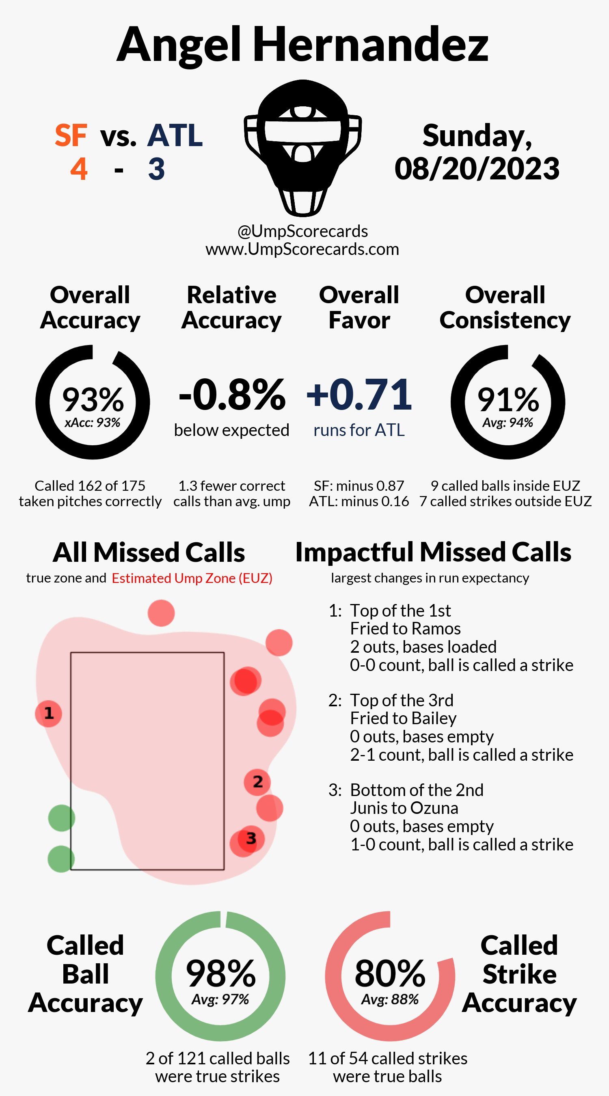
% of Correctly Called Pitches
% of Called Pitches Consistent with Effective SZ
% of True Strikes called Strikes
% of True Balls called Balls

Slide 10
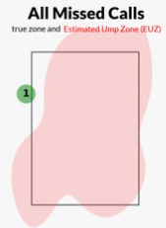
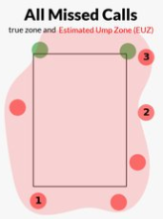
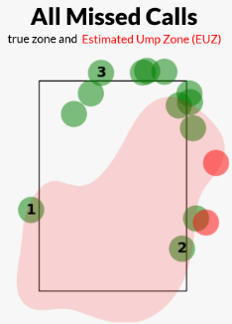
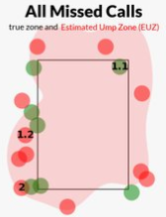

Consistent
Not Consistent
One missed call and it was borderline
Called balls that were closer to the plate than called strikes
Accurate
These are strikes that were consistently called balls
Not Accurate

Slide 11
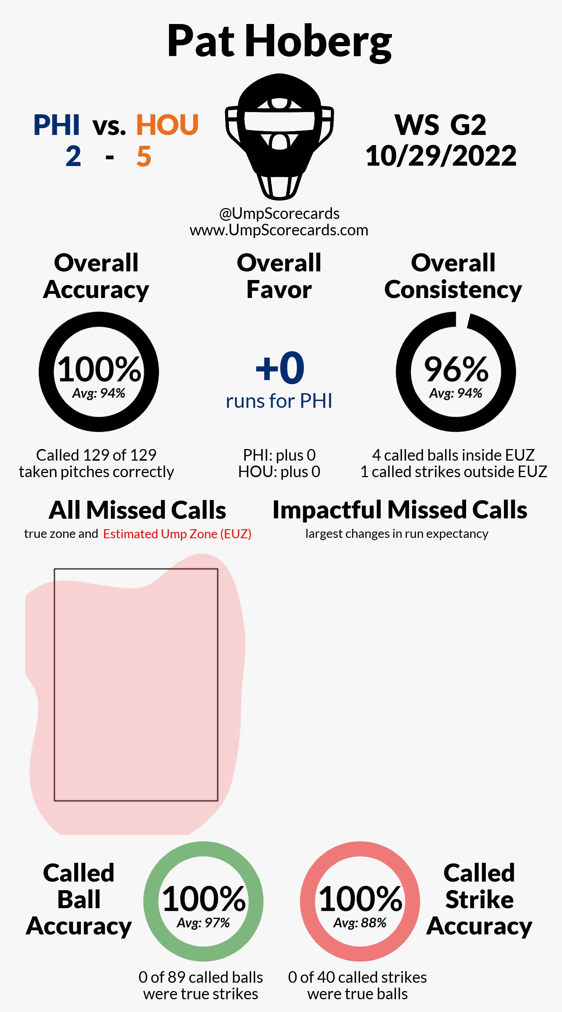
Perfection has happened once

Slide 12
Does anything interesting appear if we look at the data from the 2430 games played in 2023?

Slide 13
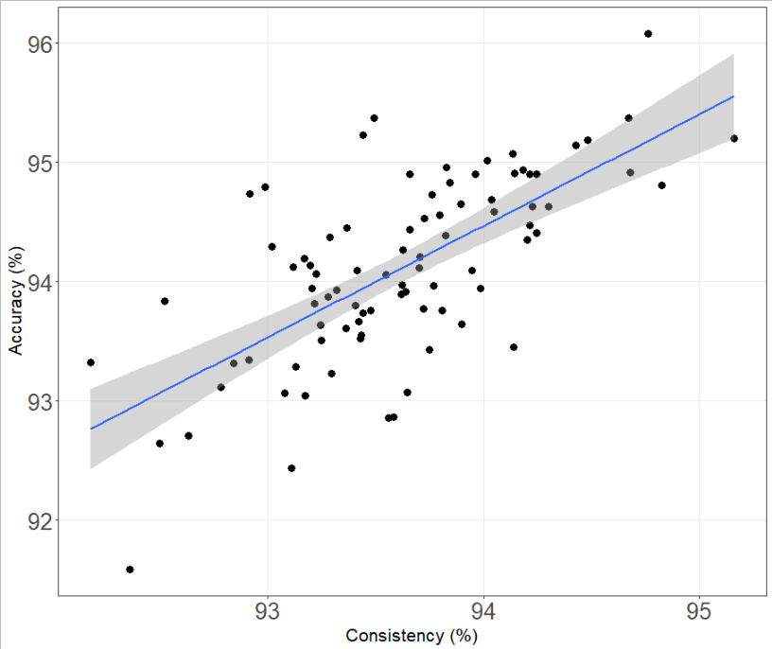

Slide 14
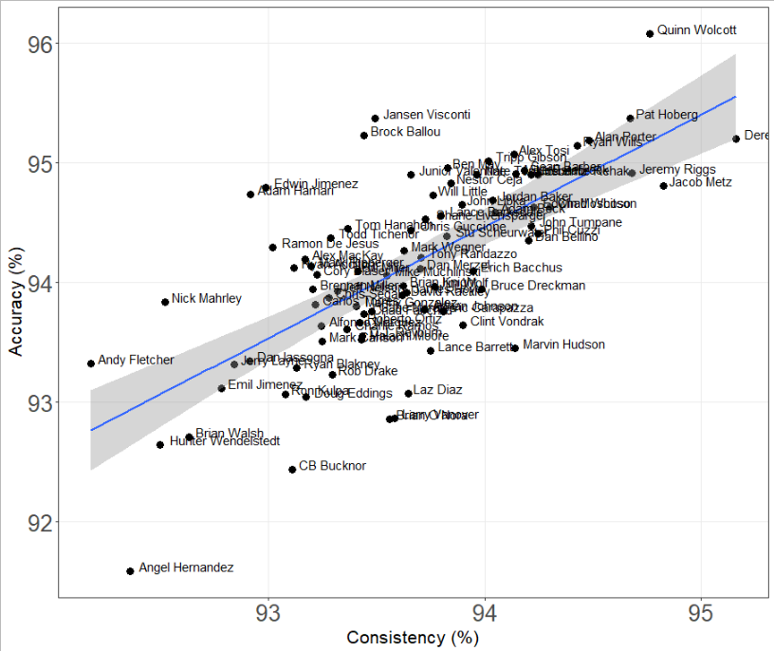

Slide 15
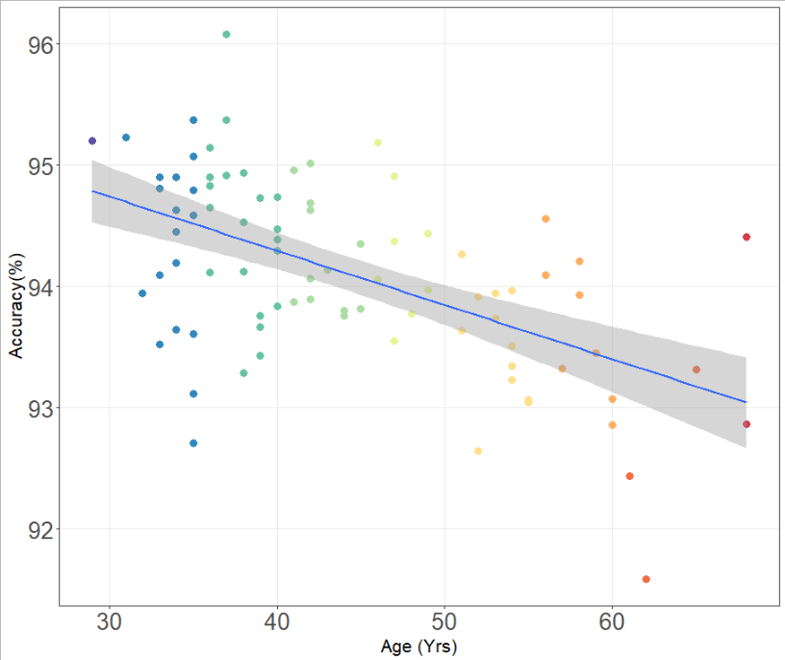

Slide 16
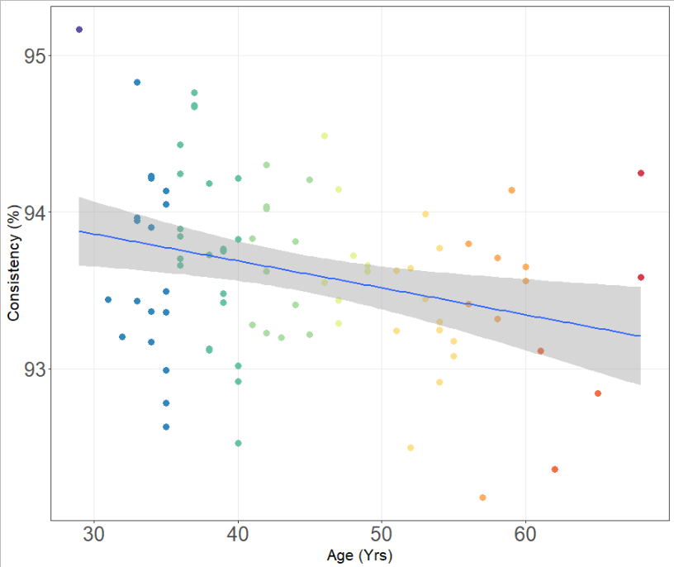

Slide 17
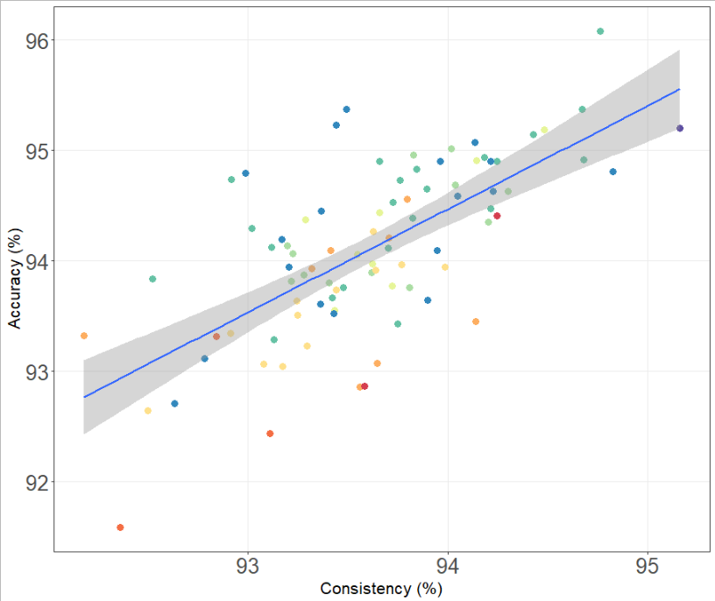

Slide 18
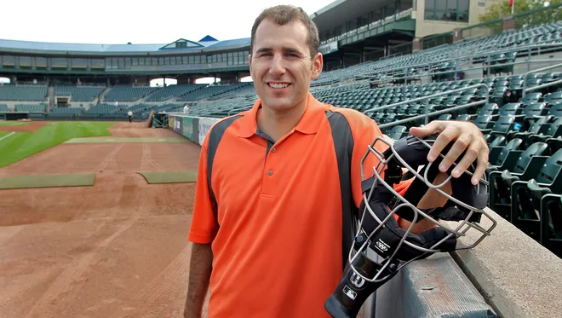
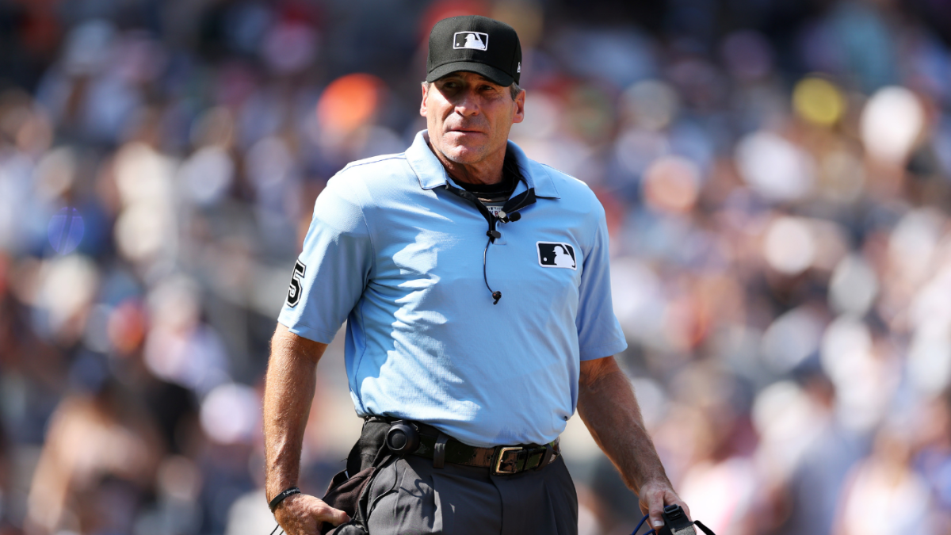

Slide 19
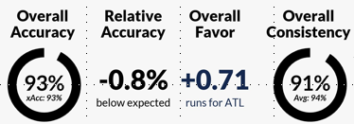

Despite the inconsistency do umpires tend to favor the home team?
We can separate all the (+) favor values and (-) values and compare the means via Wilcoxon Ranked Sum
Not enough evidence to say that the umpires are favoring the home team

Slide 20
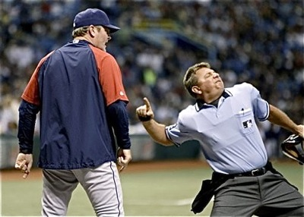
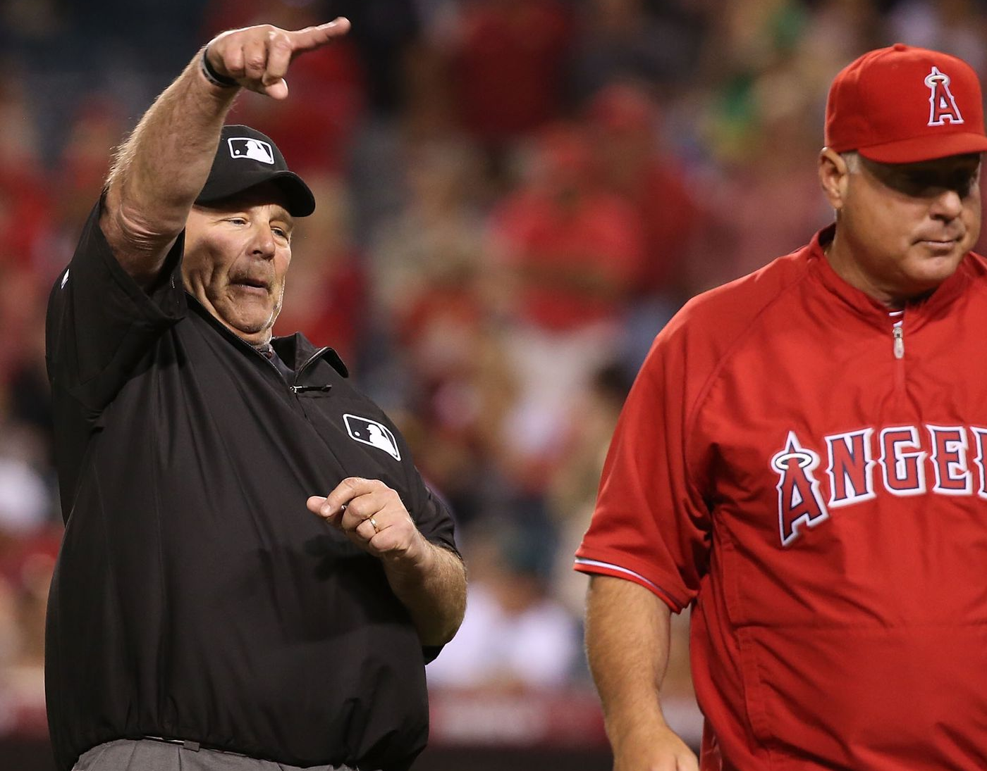
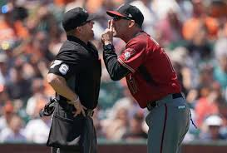
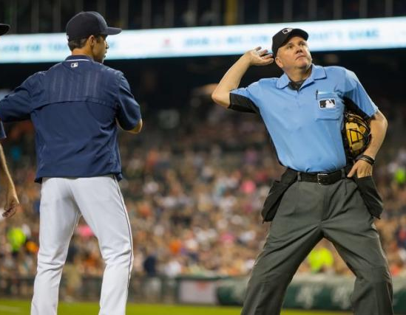
Thanks!

