Slide 1




Detecting Sources of Healthcare Associated Infections
[AAAI 2023]
Presenter: Hankyu Jang
Co-authors: Andrew Fu, Jiaming Cui, Methun Kamruzzaman,
B. Aditya Prakash, Anil Vullikanti, Bijaya Adhikari, *Sriram V. Pemmaraju
Notes:
We propose …

Slide 2
Overview
Background
  Healthcare associated infections (HAIs)
  Modeling HAI via load sharing model
Our paper “Detecting Sources of Healthcare Associated Infections”
  Motivation
  Problem formulation
  Submodularity in the load sharing model
  Algorithms
  Results

Slide 3
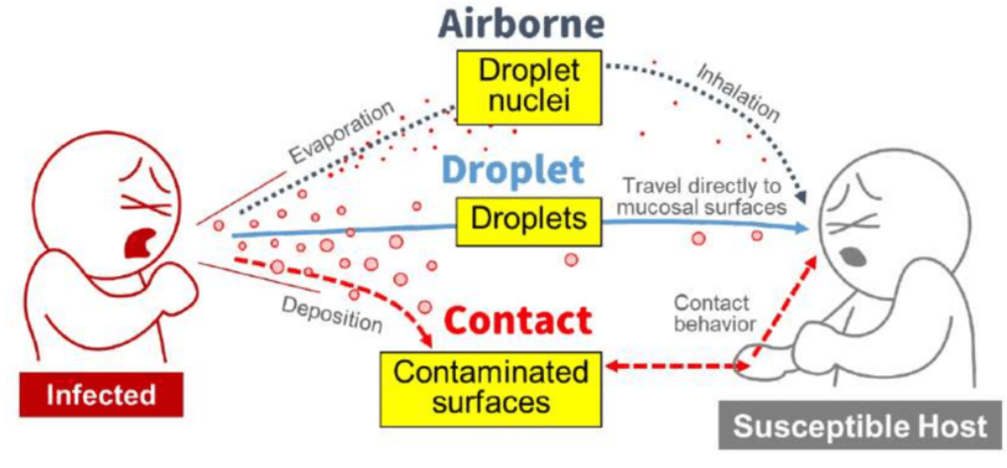
Healthcare associated infections
Healthcare-associated infections (HAIs): infections that spread in healthcare settings
  Each year, roughly 4% of patients in the US are diagnosed with HAI [*]
  Immunocompromised patients are at risk of HAI, and infections can lead to severe outcomes
Common HAIs, such as Methicillin-resistant Staphylococcus aureus (MRSA) infection or Clostridioides difficile infection (CDI) spread via contact
[-]
[*] CDC, "Healthcare-associated infections (hais),“ https://www.cdc.gov/winnablebattles/report/HAIs.html.
[-] Gameiro Silva, M. An analysis of the transmission modes of COVID-19 in light of the concepts of Indoor Air Quality. 2020
Notes:
.

Slide 4
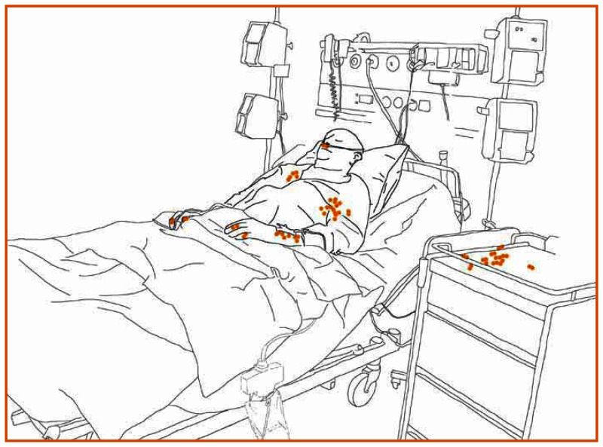
Transmission of pathogens via HCPs’ hands
Organisms are present on the patient’s skin, or have been shed onto inanimate objects immediately surrounding the patient
WHO. "World Alliance for Safer Health Care. WHO Guidelines on Hand Hygiene in Health Care. First Global Patient Safety Challenge Clean Care is Safer Care." Geneva, Switzerland: Author. Retrieved from http://whqlibdoc. who. int/publications/2009/9789241597906_ eng. pdf (2009).

Slide 5
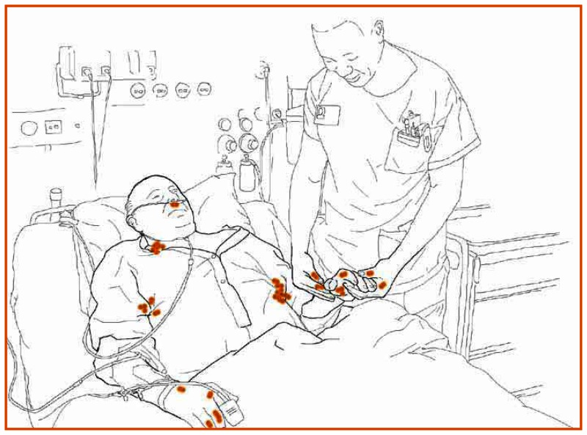
Transmission of pathogens via HCPs’ hands
Organisms must be transferred to the hands of HCWs
WHO. "World Alliance for Safer Health Care. WHO Guidelines on Hand Hygiene in Health Care. First Global Patient Safety Challenge Clean Care is Safer Care." Geneva, Switzerland: Author. Retrieved from http://whqlibdoc. who. int/publications/2009/9789241597906_ eng. pdf (2009).

Slide 6
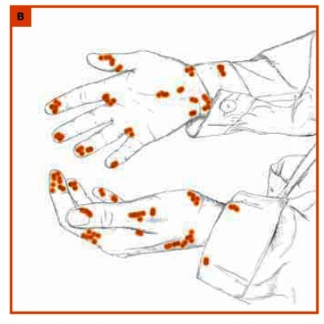
Transmission of pathogens via HCPs’ hands
Organisms must be capable of surviving for at least several minutes on HCWs’ hands
WHO. "World Alliance for Safer Health Care. WHO Guidelines on Hand Hygiene in Health Care. First Global Patient Safety Challenge Clean Care is Safer Care." Geneva, Switzerland: Author. Retrieved from http://whqlibdoc. who. int/publications/2009/9789241597906_ eng. pdf (2009).

Slide 7
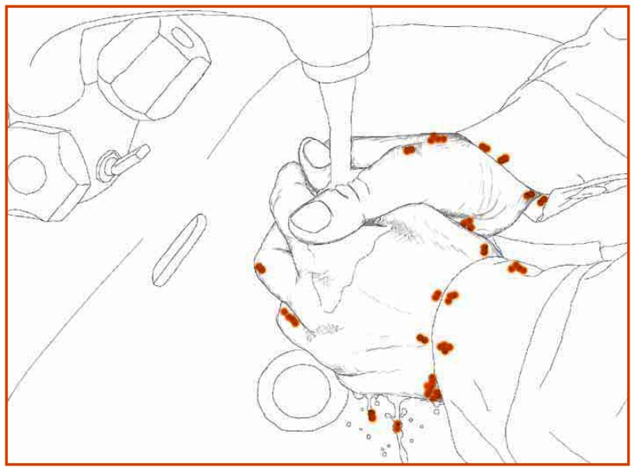
Transmission of pathogens via HCPs’ hands
Handwashing or hand antisepsis by the HCW must be inadequate or entirely omitted, or the agent used for hand hygiene inappropriate
WHO. "World Alliance for Safer Health Care. WHO Guidelines on Hand Hygiene in Health Care. First Global Patient Safety Challenge Clean Care is Safer Care." Geneva, Switzerland: Author. Retrieved from http://whqlibdoc. who. int/publications/2009/9789241597906_ eng. pdf (2009).

Slide 8
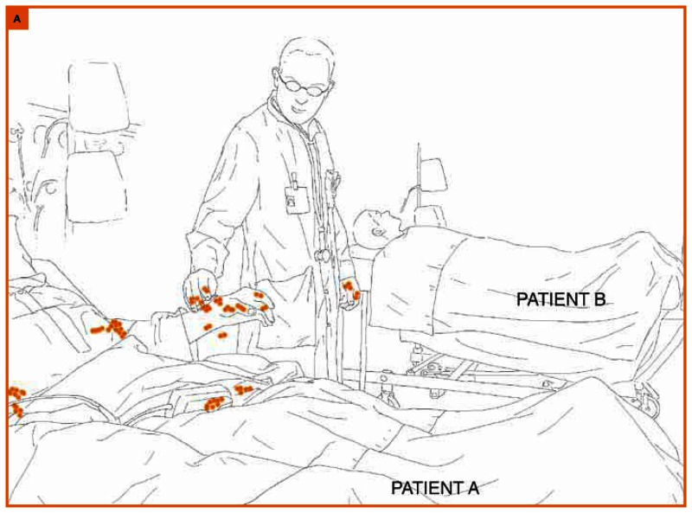
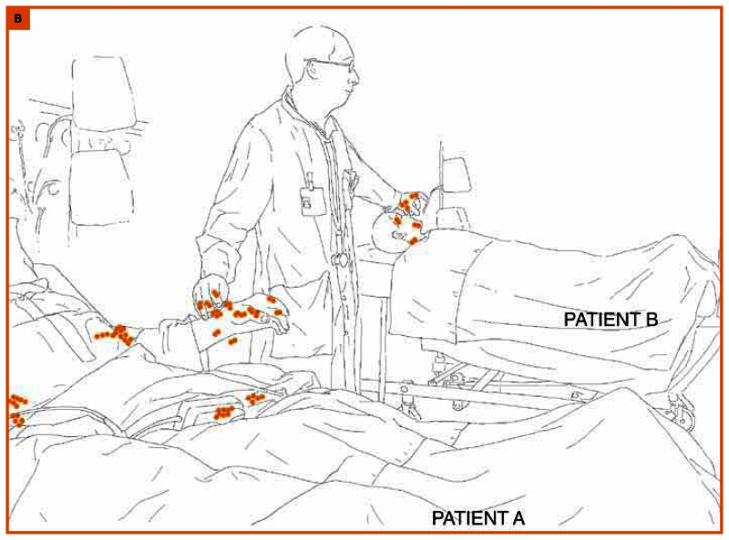
Transmission of pathogens via HCPs’ hands
The contaminated hand or hands of the caregiver must come into direct contact with another patient or with an inanimate object that will come into direct contact with the patient
WHO. "World Alliance for Safer Health Care. WHO Guidelines on Hand Hygiene in Health Care. First Global Patient Safety Challenge Clean Care is Safer Care." Geneva, Switzerland: Author. Retrieved from http://whqlibdoc. who. int/publications/2009/9789241597906_ eng. pdf (2009).

Slide 9
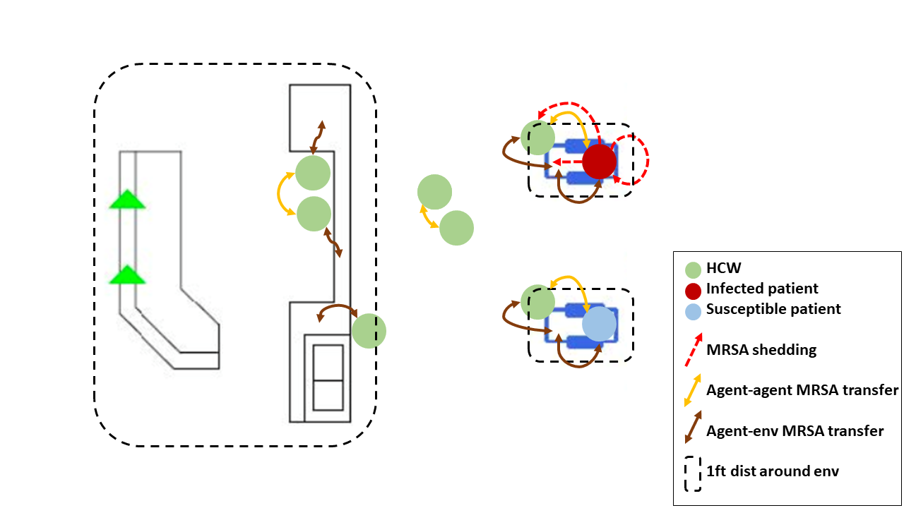
So, how do we model the transmission of HAIs?
H. Jang, et al, "Evaluating Architectural Changes to Alter Pathogen Dynamics in a Dialysis Unit," ASONAM 2019

Slide 10
Transmission of pathogens via HCPs’ hands
Organisms are present on the patient’s skin, or have been shed onto inanimate objects immediately surrounding the patient
H. Jang, et al, "Evaluating Architectural Changes to Alter Pathogen Dynamics in a Dialysis Unit," ASONAM 2019
Notes:
Cfu: number of alive and active microorganisms

Slide 11
Transmission of pathogens via HCPs’ hands
Organisms must be transferred to the hands of HCWs
H. Jang, et al, "Evaluating Architectural Changes to Alter Pathogen Dynamics in a Dialysis Unit," ASONAM 2019

Slide 12

Transmission of pathogens via HCPs’ hands
Organisms must be capable of surviving for at least several minutes on HCWs’ hands
H. Jang, et al, "Evaluating Architectural Changes to Alter Pathogen Dynamics in a Dialysis Unit," ASONAM 2019

Slide 13

Transmission of pathogens via HCPs’ hands
Handwashing or hand antisepsis by the HCW must be inadequate or entirely omitted, or the agent used for hand hygiene inappropriate
H. Jang, et al, "Evaluating Architectural Changes to Alter Pathogen Dynamics in a Dialysis Unit," ASONAM 2019

Slide 14
Transmission of pathogens via HCPs’ hands
The contaminated hand or hands of the caregiver must come into direct contact with another patient or with an inanimate object that will come into direct contact with the patient
H. Jang, et al, "Evaluating Architectural Changes to Alter Pathogen Dynamics in a Dialysis Unit," ASONAM 2019

Slide 15

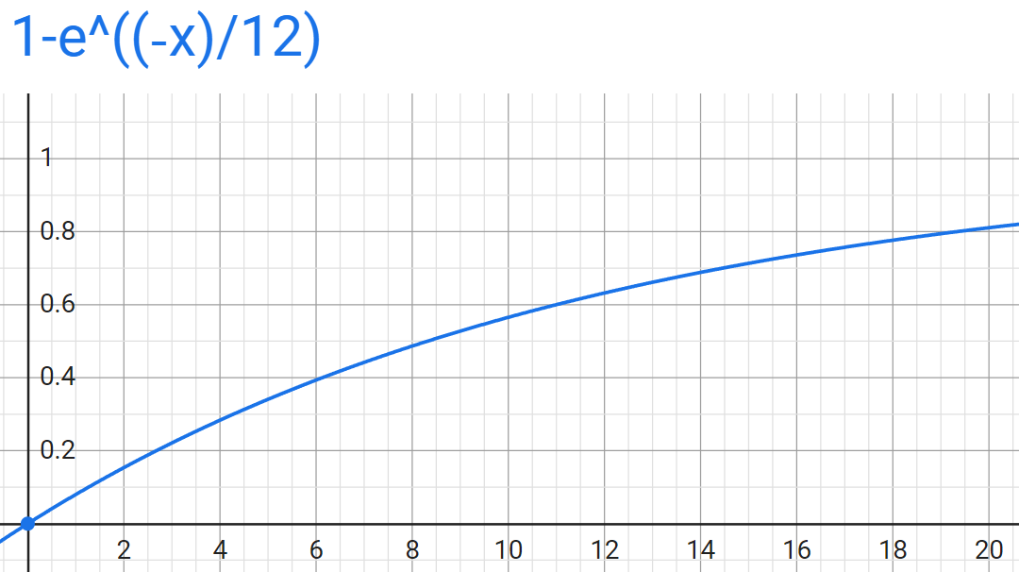
Disease state transition
Colonization leading patient becoming infected
Dose-response functions
  Input: pathogen concentration on patient's skin
  Output: probability of infection
Probability of node y getting infected
Patient B gets infected due to pathogens
Pathogen load on a node y
H. Jang, et al, "Evaluating Architectural Changes to Alter Pathogen Dynamics in a Dialysis Unit," ASONAM 2019

Slide 16
The original load sharing model
Disease model for patients: SIS
Bidirectional pathogen transfer
Pathogen increase
  Shedding of infected agent
Pathogen reduction
  HCP hand hygiene
  Environment cleaning
  Natural decay
Disease state transition
  Concave dose-response function
H. Jang, et al, "Evaluating Architectural Changes to Alter Pathogen Dynamics in a Dialysis Unit," ASONAM 2019

Slide 17
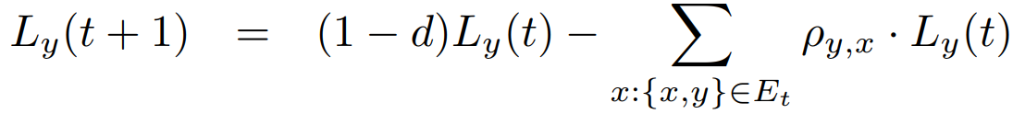
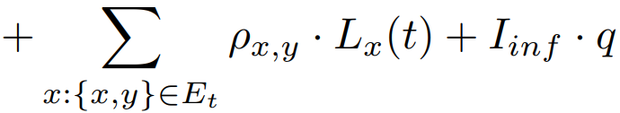
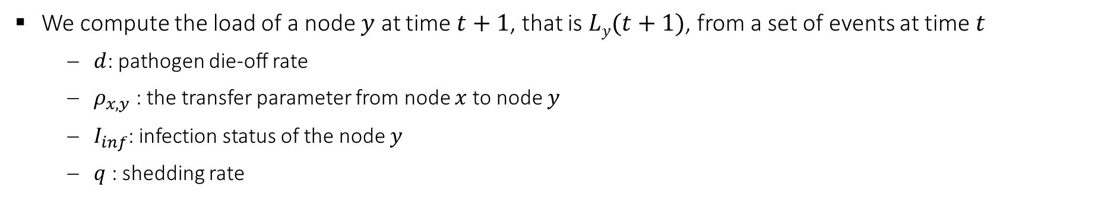
Load sharing model (simple version)
?
?
?
?
Load remaining after natural decay
Outgoing load
Incoming load
Shedding
We compute the load of a node $y$ at time $t+1$, that is $Ly(t+1)$, from a set of events at time $t$
  $d$: pathogen die-off rate
  $ρ_{x, y}$ : the transfer parameter from node $x$ to node $y$
  $I_{inf}$: infection status of the node $y$
  $q$ : shedding rate
H. Jang, et al, "Detecting Sources of Healthcare Associated Infections," AAAI 2023

Slide 18
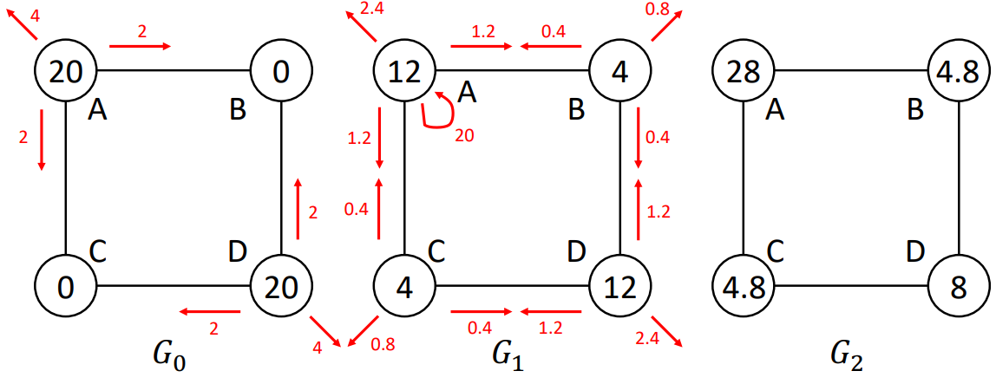
Load sharing model (simple version. continued)
Load remaining after natural decay
Outgoing load
Incoming load
Shedding
Contact network over time
  Node: person or location
  Edge: contact
Load sharing model (right)
  Shedding: 20 units
  Die-off: 1/5
  Transfer: 1/10
  Dose response: f(x) = 1-e^{-x/12}
Q: In G₁ , what’s the probability of node A getting infected?
H. Jang, et al, "Detecting Sources of Healthcare Associated Infections," AAAI 2023

Slide 19







Motivation
When some HAIs are detected, a lot of effort is invested into rapidly identifying the source of infection
This corresponds to the classical source detection problem [+,-,=]
Source detection problem remains open for HAIs, and is the focus of our paper
[-] Shah, D. and Zaman, T. Detecting Sources of Computer Viruses in Networks: Theory and Experiment. SIGMETRICS Perform. Eval. Rev 2010
[=] Lappas, T.; Terzi, E.; Gunopulos, D.; and Mannila, H. Finding Effectors in Social Networks. KDD 2010
[+] Prakash BA, Vreeken J, Faloutsos C. Efficiently spotting the starting points of an epidemic in a large graph. KAIS 2014
Notes:
- Previous works in source detection are restricted to disease models that spread via person-to-person contacts
- However, these methods are not suitable for infections where environment plays an important role

Slide 20
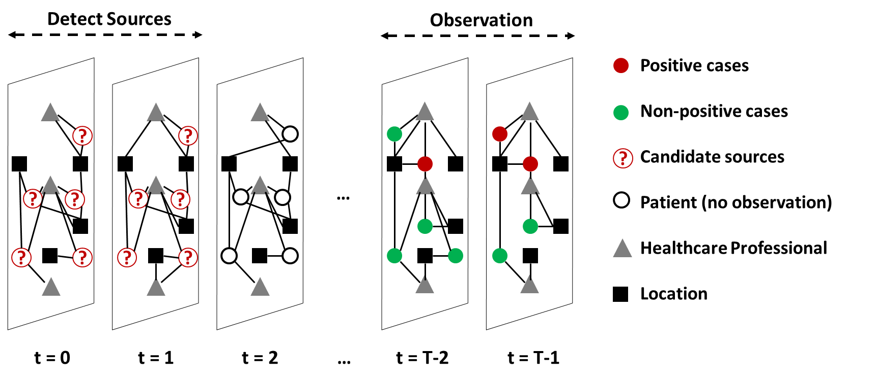
The source detection problem (informal definition)
We have some cases of HAI observed at a later time
We want to find the seed set S in the earlier time that best describe the observation
Q: How would you formulate this problem as ‘risk minimization’?

Slide 21
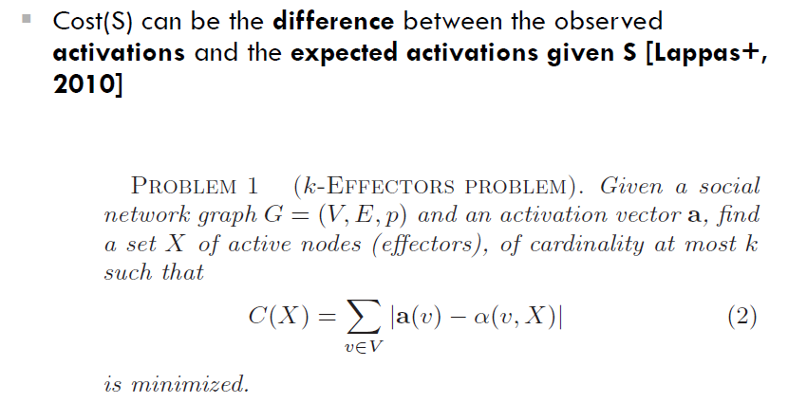
Empirical risk minimization (discussed in Lecture 10, slide 5)
Our work is motivated by this problem formulation

Slide 22
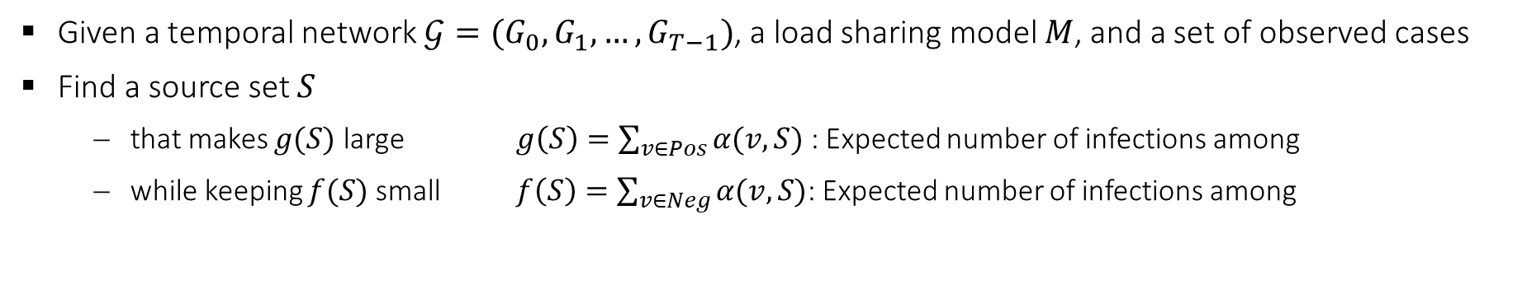
The source detection problem
Given a temporal network $𝒢=(G_{0},G_{1},…,G_{T−1})$, a load sharing model $M$, and a set of observed cases
Find a source set $S$
  that makes $g(S)$ large $g\left(S\right)=\sum_{v∈Pos}{α(v, S)}$ : Expected number of infections among
  while keeping $f(S)$ small $f\left(S\right)=\sum_{v∈Neg}{α(v, S)}$: Expected number of infections among
$α(v, S)$ : Probability of $v$ that get infected according to $M$ due to disease starting at $S$
Notes:
(1) Observation time period and a source detection time period and these are disjoint
(2) During the observation time period you get to observe positive cases
(3) We are given a temporal contact network. This involves patients, HCPs, and locations. There are people-people edges as well as people-location edges.
(4) We are given parameters of a load-sharing model
(5) Let us define alpha(v, S), g(S) and f(S)…
Now let us define the problem

Slide 23
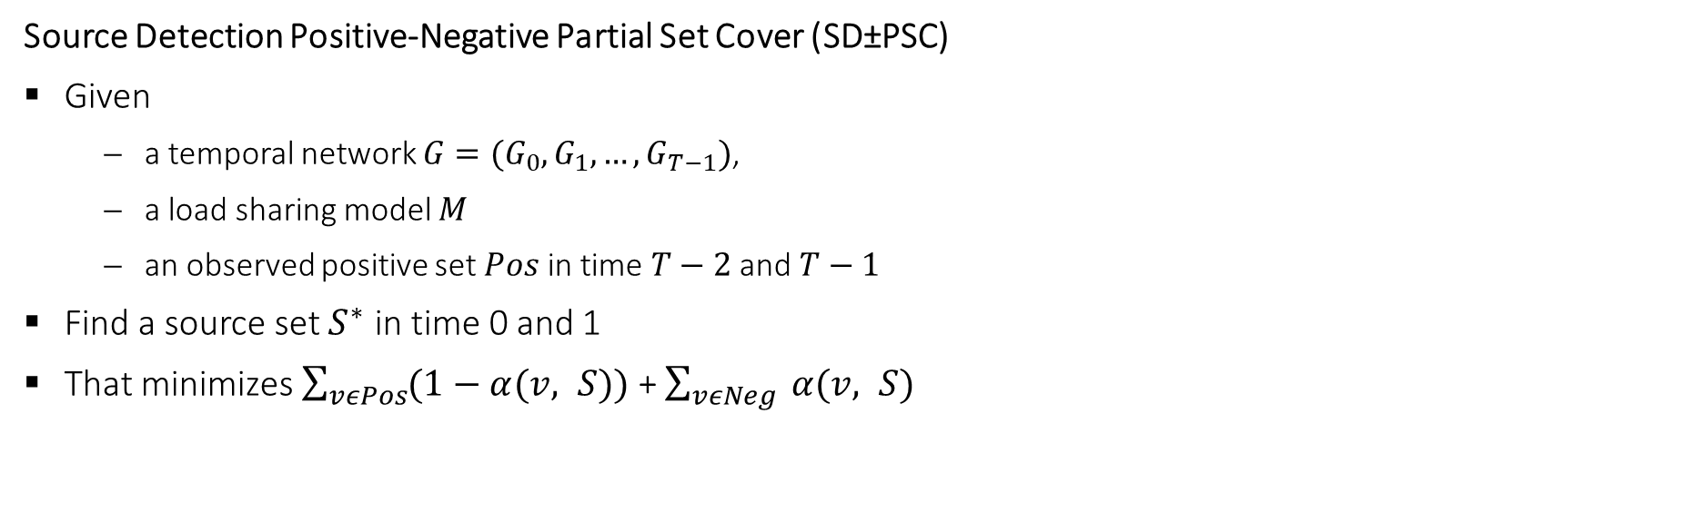
Problem formulation. SD±PSC
Source Detection Positive-Negative Partial Set Cover (SD±PSC)
Given
  a temporal network $G=(G_{0},G_{1}, …,G_{T−1})$,
  a load sharing model $M$
  an observed positive set $Pos$ in time $T−2$ and $T−1$
Find a source set $S^{∗}$ in time 0 and 1
That minimizes $\sum_{vεPos}{(1−α(v, S))}$ + $\sum_{vεNeg}{ α(v, S)}$
The objective function is a simple and natural model for the Source Detection problem
However, no reasonable approximation exists for the problem
Proof of hardness of approximation is in the paper
Expected number of positive cases not infected by an infection starting at source set S
Expected number of negative cases infected by an infection starting at source set S
Notes:
Here, we define the source detection problem, inspired by the k-effectors problem and the positive-negative partial set cover problem.
…
Note that the source detection period and the observation period is 2 timesteps, but the paper considers the general problem.
Due to the hardness of the problem, we present two computationally tractable surrogates for the problem.

Slide 24
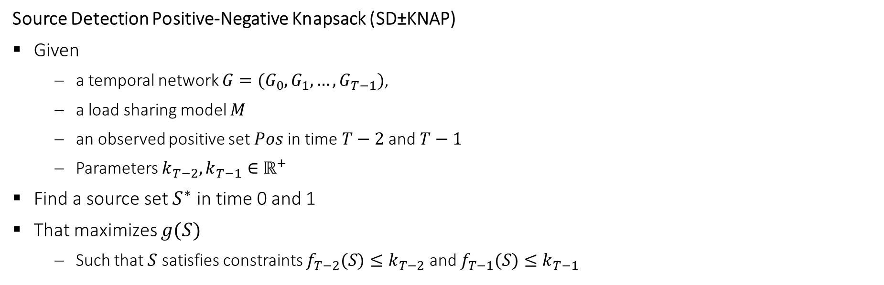
Tractable problem formulation. SD±KNAP
Source Detection Positive-Negative Knapsack (SD±KNAP)
Given
  a temporal network $G=(G_{0},G_{1}, …,G_{T−1})$,
  a load sharing model $M$
  an observed positive set $Pos$ in time $T−2$ and $T−1$
  Parameters $k_{T−2},k_{T−1}∈ℝ^{+}$
Find a source set $S^{∗}$ in time 0 and 1
That maximizes $g(S)$
  Such that $S$ satisfies constraints $f_{T−2}(S)≤k_{T−2}$ and $f_{T−1}(S)≤k_{T−1}$
Q: This problem formulation have flexibility in the bounds of f.
E.g., if you want seeds that infect very small fraction of non-cases, how shall you set the parameters?
Q: Which constraint should be larger? $k_{T−2}$ or $k_{T−1}$ ?
Notes:
SD Knap is a problem of maximizing a submodular function subject to multiple submodular knapsack constraints.
Again, we show the time periods of sources and observation to be 2 timesteps in the slides for simplicity, but the paper considers the general problem.
Notice that we have a flexibility in the bounds: E.g., setting k to be a small value forces the solution to have tighter constraint in terms of the f

Slide 25
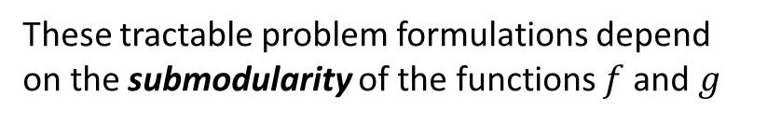
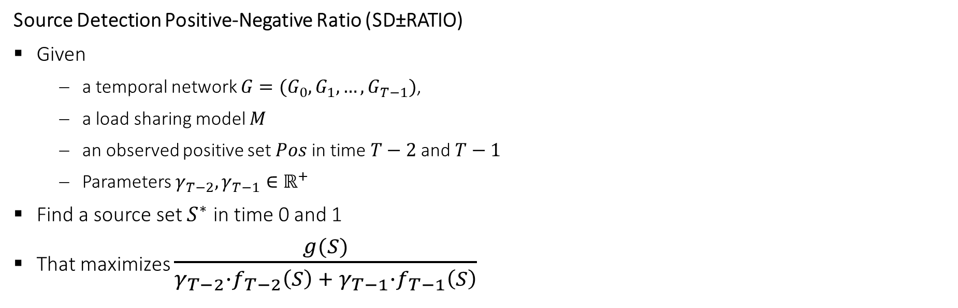
Tractable problem formulation. SD±RATIO
Source Detection Positive-Negative Ratio (SD±RATIO)
Given
  a temporal network $G=(G_{0},G_{1}, …,G_{T−1})$,
  a load sharing model $M$
  an observed positive set $Pos$ in time $T−2$ and $T−1$
  Parameters $γ_{T−2},γ_{T−1}∈ℝ^{+}$
Find a source set $S^{∗}$ in time 0 and 1
That maximizes $\frac{g(S)}{γ_{T−2}∙f_{T−2}\left(S\right) + γ_{T−1}∙f_{T−1}\left(S\right)}$
These tractable problem formulations depend on the submodularity of the functions $f$ and $g$
Q: This problem formulation have flexibility in the penalty of f.
E.g., if you want seeds that infect very small fraction of non-cases, how shall you set the parameters?
Q: Which constraint should be larger? $γ_{T−2}$ or $γ_{T−1}$ ?
Notes:
We maximize the ratio of $g$ over the linear combination of expected number of infections in the negative set in the observation period ($f_{t}$)
(coefficients gamma can be viewed as penalties, which could vary with time
the penalty for getting it wrong in later time steps could be smaller than the penalty of getting it wrong in earlier time steps)
…
I’ll briefly explain what ‘submodularity’ is, and what means to have the submodularity in the objective functions

Slide 26
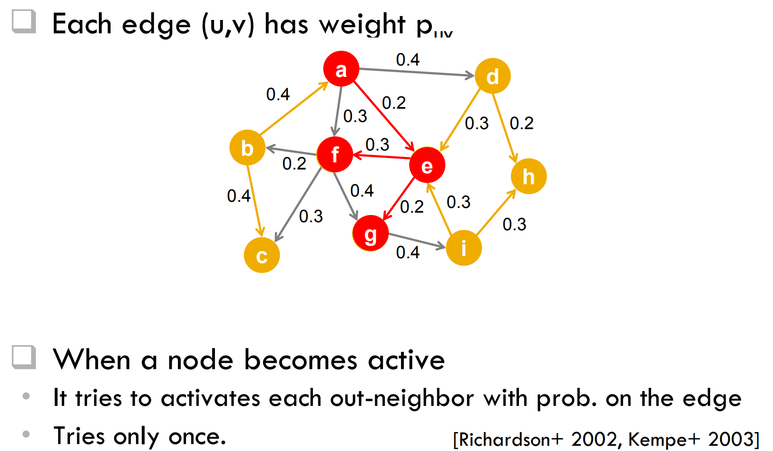
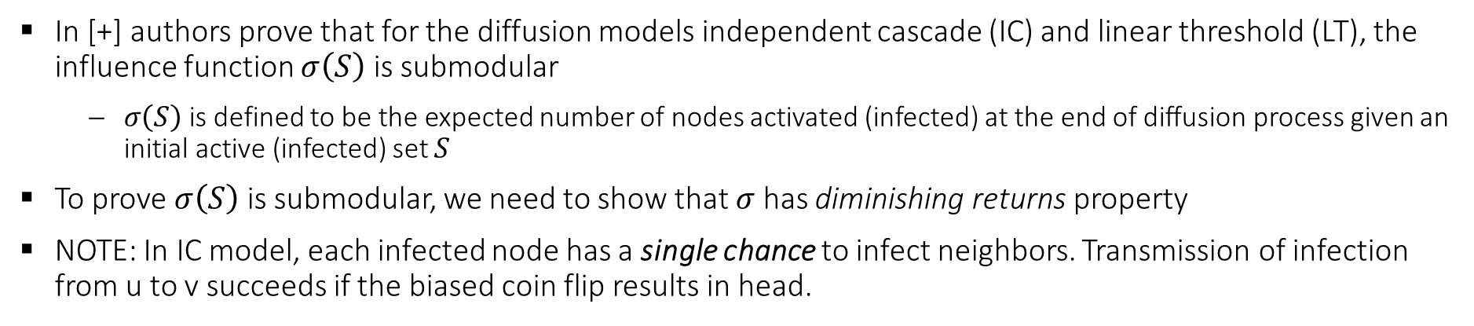
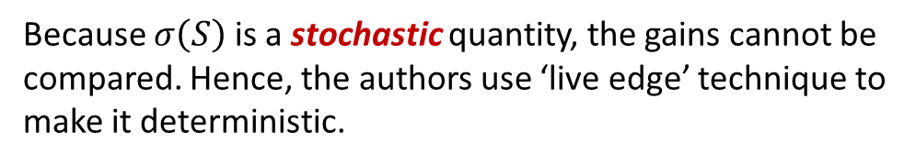
Background: submodularity in other diffusion models
In [+] authors prove that for the diffusion models independent cascade (IC) and linear threshold (LT), the influence function $σ\left(S\right)$ is submodular
  $σ\left(S\right)$ is defined to be the expected number of nodes activated (infected) at the end of diffusion process given an initial active (infected) set $S$
To prove $σ\left(S\right)$ is submodular, we need to show that $σ$has diminishing returns property
NOTE: In IC model, each infected node has a single chance to infect neighbors. Transmission of infection from u to v succeeds if the biased coin flip results in head.
Lecture 4, slide 21
Because $σ\left(S\right)$ is a stochastic quantity, the gains cannot be compared. Hence, the authors use ‘live edge’ technique to make it deterministic.
[+] Kempe D, Kleinberg J, Tardos É. Maximizing the spread of influence through a social network. KDD 03’
Notes:
there is no “live edges” interpretation of infection flow in the load sharing model

Slide 27
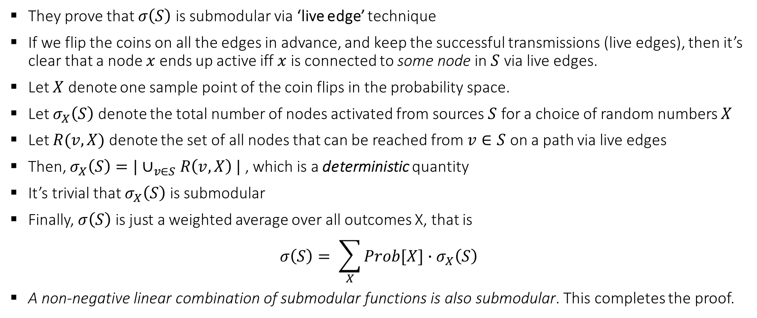
Background: submodularity in other diffusion models
They prove that $σ\left(S\right)$ is submodular via ‘live edge’ technique
If we flip the coins on all the edges in advance, and keep the successful transmissions (live edges), then it’s clear that a node $x$ ends up active iff $x$ is connected to some node in $S$ via live edges.
Let $X$ denote one sample point of the coin flips in the probability space.
Let $σ_{X}\left(S\right)$ denote the total number of nodes activated from sources $S$ for a choice of random numbers $X$
Let $R(v, X)$ denote the set of all nodes that can be reached from $v∈S$ on a path via live edges
Then, $σ_{X}\left(S\right)=|∪_{v∈S}R\left(v, X\right) |$ , which is a deterministic quantity
It’s trivial that $σ_{X}\left(S\right)$ is submodular
Finally, $σ\left(S\right)$ is just a weighted average over all outcomes X, that is
$${σ\left(S\right)= \sum_{X}{Prob[X]}∙σ}_{X}\left(S\right)$$
A non-negative linear combination of submodular functions is also submodular. This completes the proof.
Q: Can we use this live edge technique for our load sharing model?
[+] Kempe D, Kleinberg J, Tardos É. Maximizing the spread of influence through a social network. KDD 03’
Notes:
there is no “live edges” interpretation of infection flow in the load sharing model

Slide 28
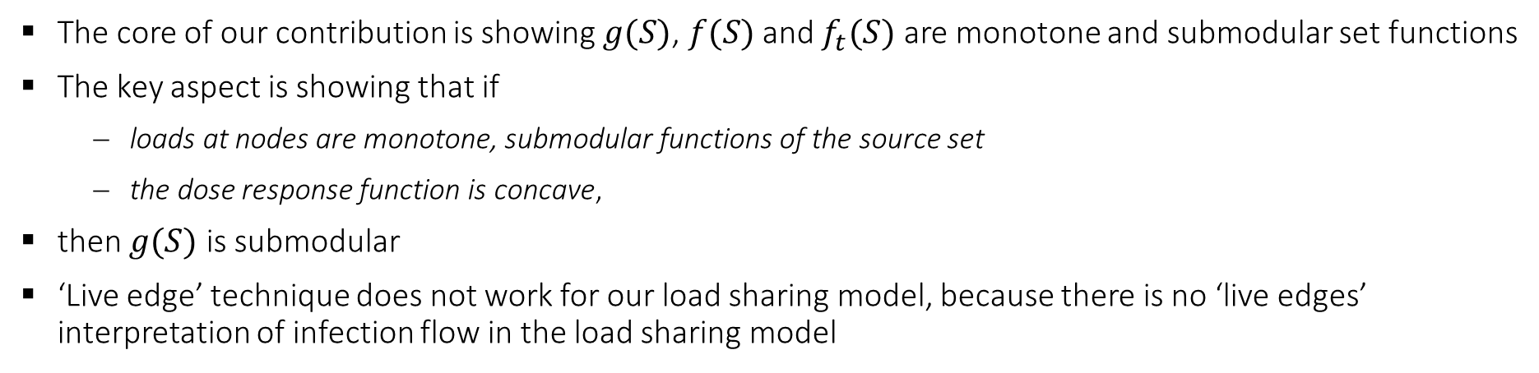
Submodularity in the load sharing model
The core of our contribution is showing $g(S)$, $f(S)$ and $f_{t}(S)$ are monotone and submodular set functions
The key aspect is showing that if
  loads at nodes are monotone, submodular functions of the source set
  the dose response function is concave,
then $g(S)$ is submodular
‘Live edge’ technique does not work for our load sharing model, because there is no ‘live edges’ interpretation of infection flow in the load sharing model
Q: Where is the stochasticity in the load sharing model?
Load remaining after natural decay
Outgoing load
Incoming load
Shedding
Notes:
For proving (i), we couldn’t use the classical ‘live edge’ technique that is used to prove submodularity in other disease models such as IC and LT. Because of the stochasticity in the mechanism of a node getting infected, we couldn’t yield a deterministic version of the loads on the nodes that can be easily shown to be submodular. To get around with this obstacle, … With this 4-way coupling in place and using induction over time, we are able to show the submodularity of loads.
We’ve modified these approaches to build scalable algorithms for our problems. I won’t go into details of these algorithms due to the time constraints. Please see the paper for the details.
(An example: f(X) = max(X). V = {1,2,3,4,5}, S = {1,2}, T = {1,2,5}.)

Slide 29
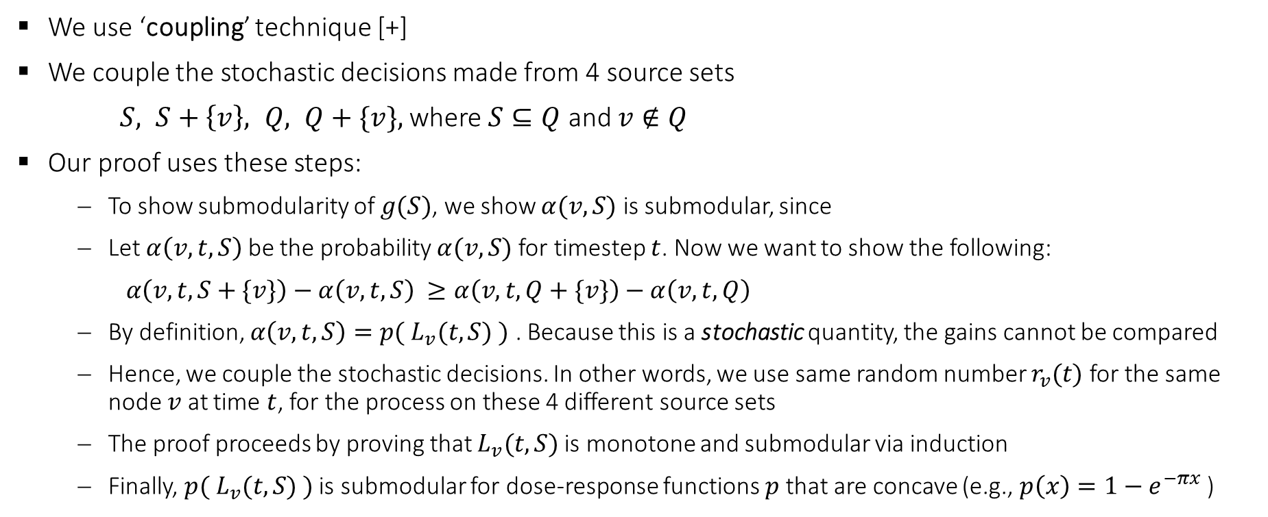
Submodularity in the load sharing model
We use ‘coupling’ technique [+]
We couple the stochastic decisions made from 4 source sets
$S, S+\left\{v\right\}, Q, Q+\{v\},$ where $S⊆Q$ and $v∉Q$
Our proof uses these steps:
  To show submodularity of $g(S)$, we show $α(v, S)$ is submodular, since
  Let $α\left(v, t, S\right)$ be the probability $α(v, S)$for timestep $t$. Now we want to show the following:
  $α\left(v, t, S+\{v\}\right)−α\left(v, t, S\right) ≥α\left(v, t, Q+\{v\}\right)−α\left(v, t, Q\right)$
  By definition, $α\left(v, t, S\right)=p( L_{v}(t, S) )$ . Because this is a stochastic quantity, the gains cannot be compared
  Hence, we couple the stochastic decisions. In other words, we use same random number $r_{v}(t)$ for the same node $v$ at time $t$, for the process on these 4 different source sets
  The proof proceeds by proving that $L_{v}(t, S)$ is monotone and submodular via induction
  Finally, $p( L_{v}(t, S) )$ is submodular for dose-response functions $p$ that are concave (e.g., $p\left(x\right)=1−e^{−πx}$ )
[+] Mossel E, Roch S. On the submodularity of influence in social networks. In Proceedings of the thirty-ninth annual ACM symposium on Theory of computing 2007 Jun 11 (pp. 128-134).
Notes:
Sum (submodular functions) is submodular

Slide 30
Algorithms SD±KNAP and SD±RATIO
The submodularity in the objective functions allows access to various algorithmic approaches
SD±KNAP
  Adapted from Bilmes-Iyer, gradient ascent framework [-]
  Azar-Gamzu, multiplicative update [=]
SD±RATIO
  Adapted from Bai et. al, greedy for maximizing ratio of submodular functions [*]
[=] Azar Y, Gamzu I. Efficient submodular function maximization under linear packing constraints. ICALP 2012
[-] Iyer RK, Bilmes JA. Submodular optimization with submodular cover and submodular knapsack constraints. NIPS 2013
[*] Bai W, Iyer R, Wei K, Bilmes J. Algorithms for optimizing the ratio of submodular functions. ICML 2016
Notes:
We’ve modified these approaches to build scalable algorithms for our problems. Please see the paper for the details.

Slide 31
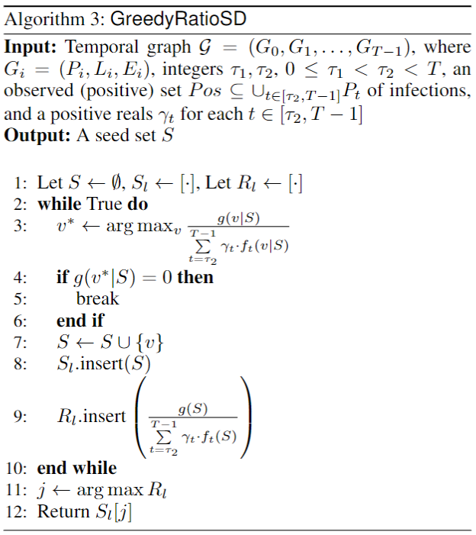
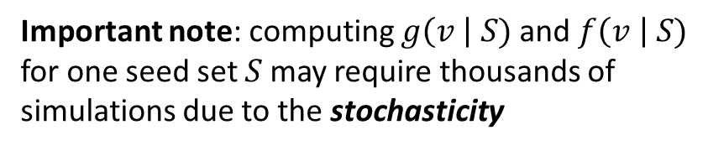
Algorithm
This is one of the 4 proposed algorithms
Greedy algorithm. At each step, select a seed in a greedy fashion
Q: This is a very simple algorithm, and in practice, it’ll exit the while loop within few iterations.
Which line in the algorithm will consume most of the time?
Important note: computing $g\left(v \right| S)$ and $f\left(v \right| S)$ for one seed set $S$may require thousands of simulations due to the stochasticity

Slide 32
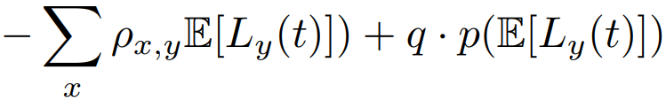
Challenges due to the stochasticity in the disease model
Load remaining after natural decay
Outgoing load
Incoming load
Shedding
Since $f$ and $g$are stochastic, it requires a substantial number of simulations to get good estimates
Q: Any ideas on how to approximate $f$ and $g$ fast?
We propose expected load propagation heuristic
Load remaining after natural decay
Incoming load
Outgoing load
Probabilistic shedding
Notes:
While running the algorithms, we noticed bottleneck in runtime, due to the need to run a large number of simulations from each candidate seed set.
This is because…
We experimentally show that this heuristic significantly reduces the running time, with no sacrifice on the performance

Slide 33
Data
Daily interactions between healthcare personnel (HCP), patients, and locations
31 daily snapshots each of the datasets
Hospital | Number of nodes | Number of edges ( / day) | Description
UIHC¹ whole graph | 10.4 K | 13.8 K | Interactions captured in UIHC, the whole hospital
UIHC unit | 0.8 K | 0.5 K | A unit in UIHC with the most number of CDI cases
UVA² pre COVID | 2.4 K | 0.4 K | Interactions recorded in Cardiology department, 2011
UVA post COVID | 0.9 K | 0.4 K | Interactions recorded in Cardiology department, 2020
Carilion | 2.3 K | 29.6 K | Public dataset. Interactions captured in Carilion Hospital in VA
¹ UIHC: University of Iowa Hospitals and Clinics
² UVA: University of Virginia Hospital
Notes:
.

Slide 34



UIHC contact network
HCP mobility: HCP terminal logins data
Patient mobility: Admission-discharge-transfer (ADT) data
Edges
Room
Nodes
Room
Room
Room
Notes:
.

Slide 35
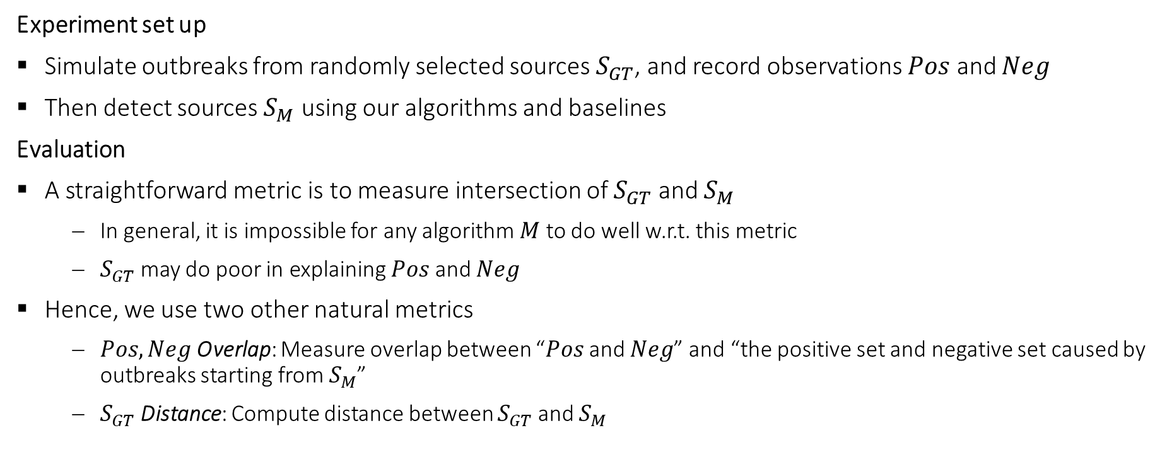
Experiments
Experiment set up
Simulate outbreaks from randomly selected sources $S_{GT}$, and record observations $Pos$ and $Neg$
Then detect sources $S_{M}$ using our algorithms and baselines
Evaluation
A straightforward metric is to measure intersection of $S_{GT}$ and $S_{M}$
  In general, it is impossible for any algorithm $M$ to do well w.r.t. this metric
  $S_{GT}$ may do poor in explaining $Pos$ and $Neg$
Hence, we use two other natural metrics
  $Pos,Neg$Overlap: Measure overlap between “$Pos$ and $Neg$” and “the positive set and negative set caused by outbreaks starting from $S_{M}$”
  $S_{GT}$ Distance: Compute distance between $S_{GT}$and $S_{M}$
Notes:
Due to the stochasticity of the load sharing model, even if we start simulation from same set of sources, the outcome of the simulation; the infection cascades differ a lot.
This means that even if we observed Pos and Neg from a simulation starting from S_GT, there could be other set of sources that better describe Pos and Neg.

Slide 36
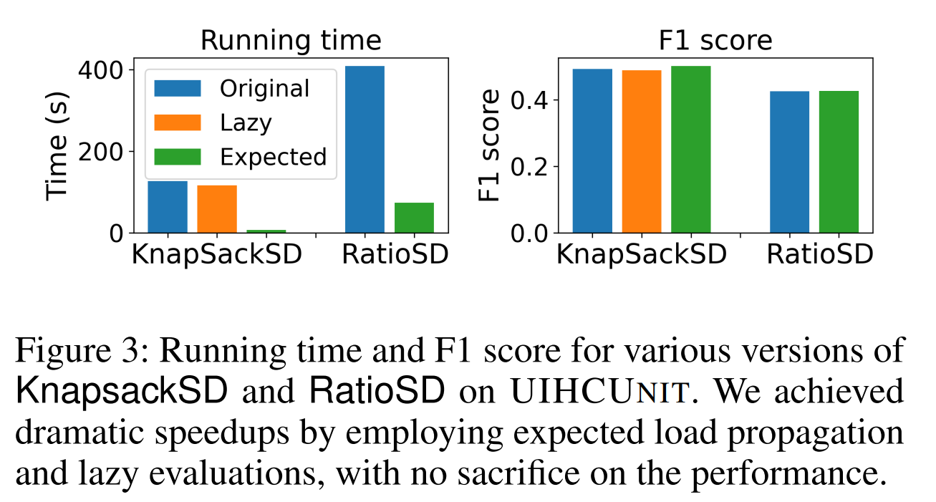

Results. Original load sharing vs expected load sharing
Metric: $Pos,Neg$Overlap
Our expected load propagation heuristic gives us a good speed up, and it doesn’t seem to degrade the performance of the solution
Hence, we use this heuristic for experiments in the remaining graphs

Slide 37
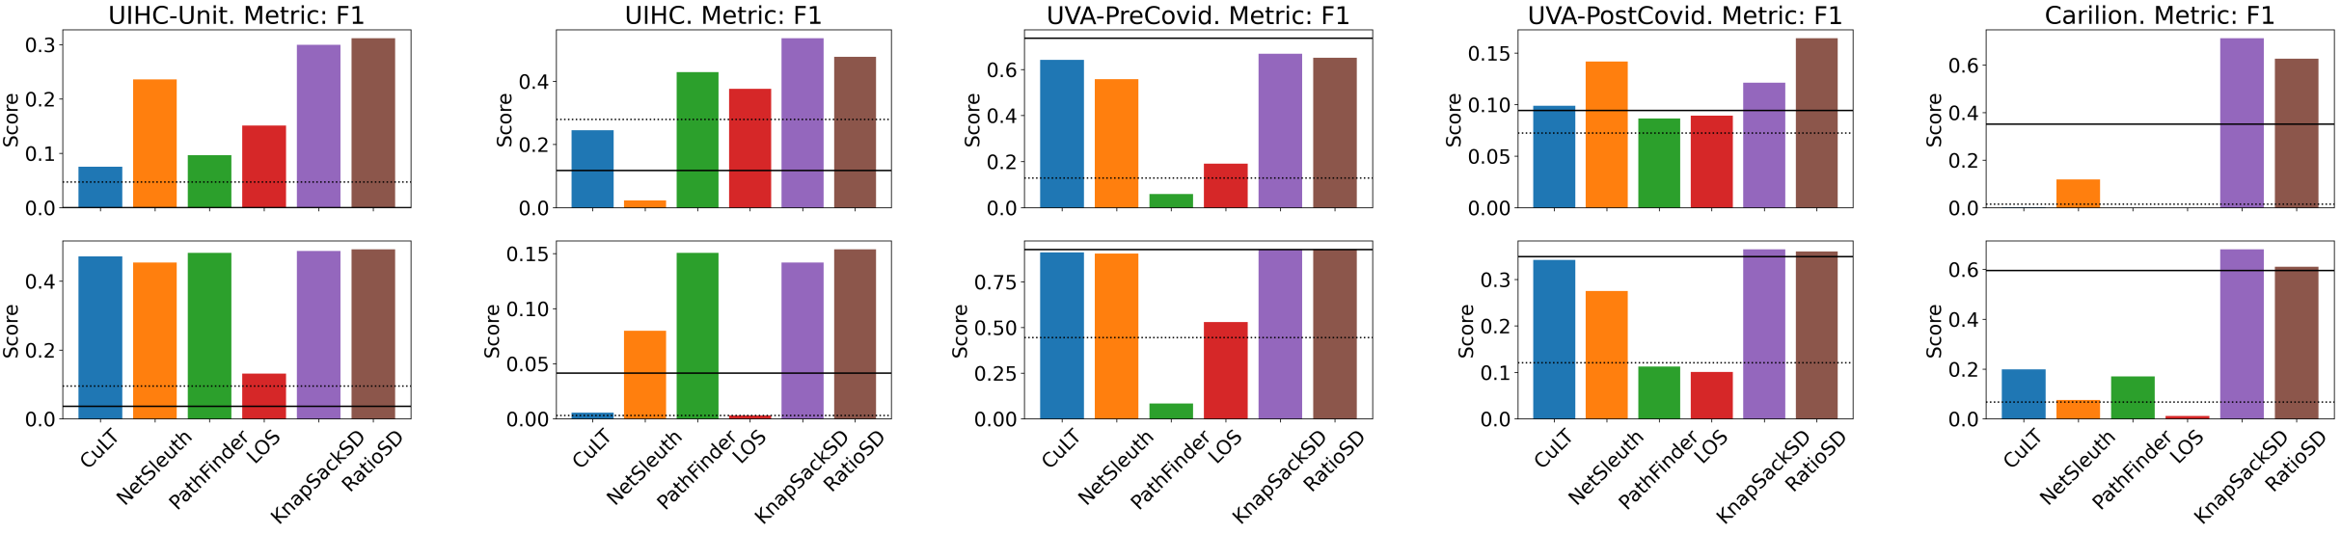

Results. Metric: $Pos,Neg$Overlap
KnapsackSD and RatioSD consistently outperform all baselines
Other baselines, e.g., CuLT [+] and NetSleuth [-] are inconsistent
  Baselines do not capture instances where multiple pathways plays role in infections
  In such settings, their performance may drop
|S⁺|=2
|S⁺|=6
[-] Prakash BA, Vreeken J, Faloutsos C. Spotting culprits in epidemics: How many and which ones?. ICDM 2012
[+] Rozenshtein P, Gionis A, Prakash BA, Vreeken J. Reconstructing an epidemic over time. KDD 2016
Notes:
10 figures. 5 columns, each column represent result on different hospital
Top row: when there are 2 GT seeds.
Bottom row: when 6 seeds.

Slide 38
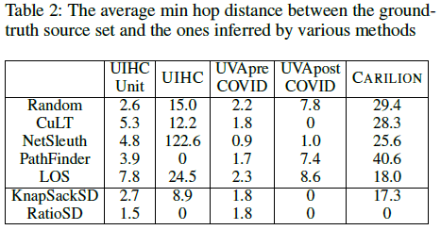

Results. Metric: $S_{GT}$ Distance
Our methods (especially, RatioSD) outperform other methods
Notes:
“distance” (e.g., in the physical hospital space) between the nodes in S+ and Sm for each method m. However, spatial distances were not available and instead we computed a proxy measure by computing the number of
hops between s and s0 in the time-expanded version Gs of G while ignoring directions.

Slide 39
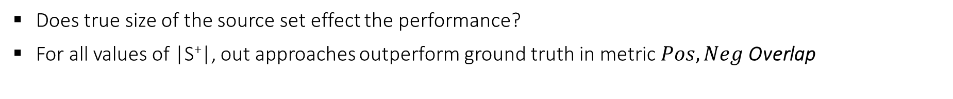
Results. Effect of the true size of source set on performance
Does true size of the source set effect the performance?
For all values of |S⁺|, out approaches outperform ground truth in metric $Pos,Neg$Overlap

Slide 40
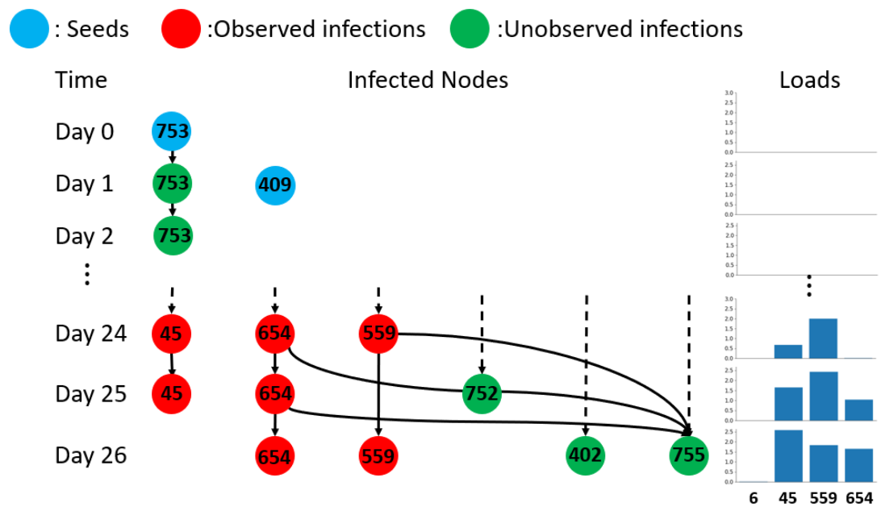
Case study on real CDI outbreak at UIHC
In UIHC unit dataset, there were 5 CDI cases
  1 case on day and 4 cases on day 25
We make the 4 observed CDI cases available to our methods then ran them to infer sources on days 0 and 1
Our methods returned sources 753 and 409, which were not the CDI case on day 1
However, these patients had several of the known risk factors for CDI
  High comorbidity score
  Was marked as high severity admission
  Transferred from external acute care hospital
Simulations starting from these two patients did better job at explaining observations, compared to simulations starting from the CDI case on day 1
Notes:
An illustration of one simulation for the CDI outbreak in UIHC unit.
The sources (blue nodes) {409, 753} identified by our algorithm were able to infect 3 out of 4 observed infections (red nodes) on day 25.
Additionally, in this simulation there were only 3 spurious infections (green nodes) out of a total 43 patients not observed to be cases

Slide 41


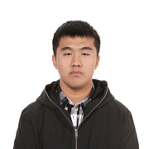

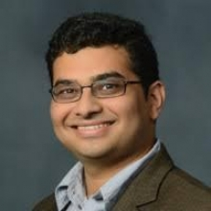
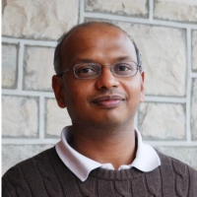





Thank you!
Hankyu Jang | Andrew Fu | Jiaming Cui | Methun Kamruzzaman | B.Aditya Prakash | Anil Vullikanti | Bijaya Adhikari | * Sriram V. Pemmaraju
U Iowa | U Virginia | Georgia Tech | U Virginia | Georgia Tech | U Virginia | U Iowa | U Iowa
Sponsors
Collaborative work
UIowa startup, Georgia Tech,
Facebook faculty research award
* Corresponding author: Sriram V. Pemmaraju. Department of Computer Science, University of Iowa. sriram-pemmaraju@uiowa.edu
Notes:
.

