Slide 1
What You Should Know About Machine Learning
Tianbao Yang (assistant Professor)
Department of Computer Science
The University of Iowa

Slide 2
Outline
Where it stands now
Where it comes from
Where it goes

Slide 3
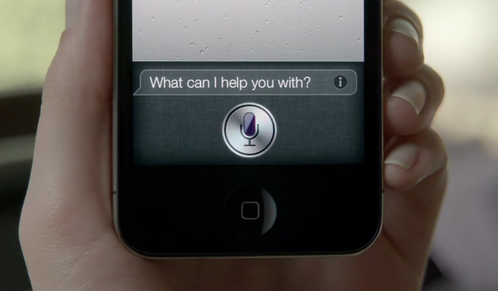
SIRI: Speech Recognition

Slide 4
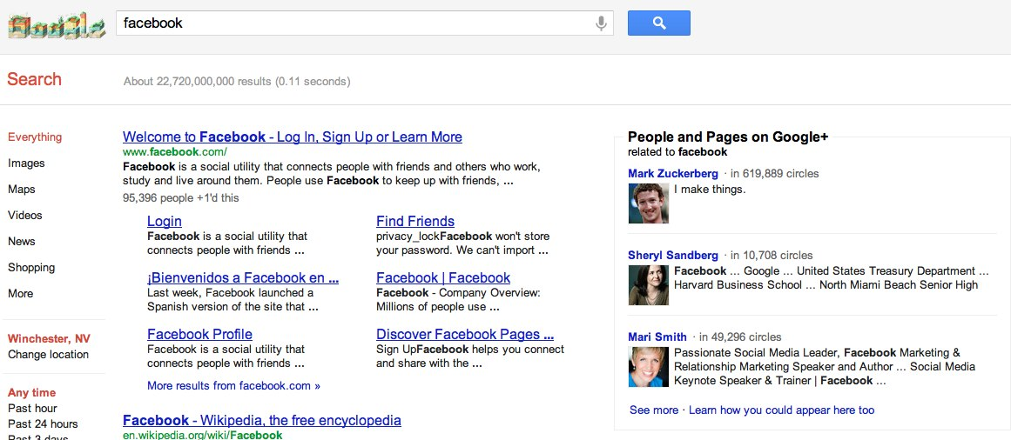
Google Search

Slide 5
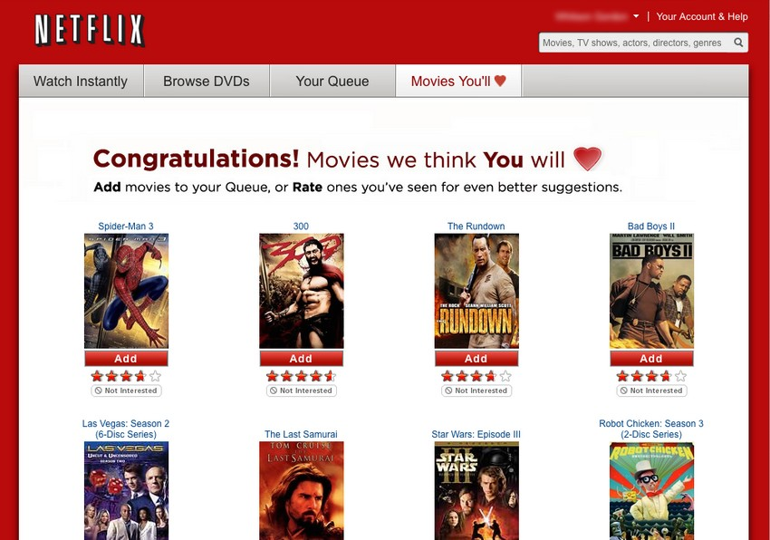
Movie Recommendation

Slide 6
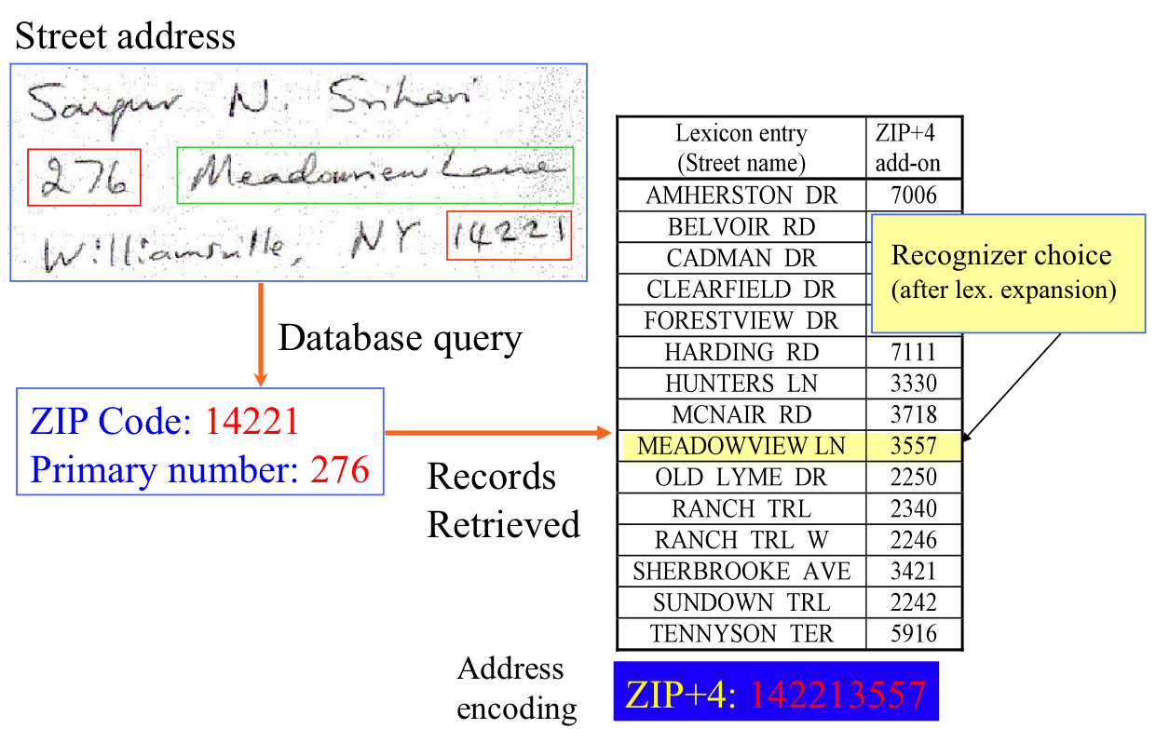
Handwritten Recognition

Slide 7
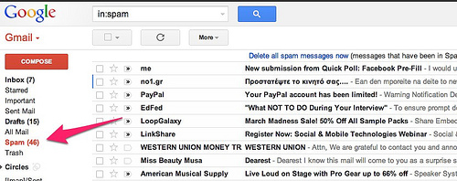
Email Spam Detection

Slide 8
Help Doctors Predict disease

Slide 9
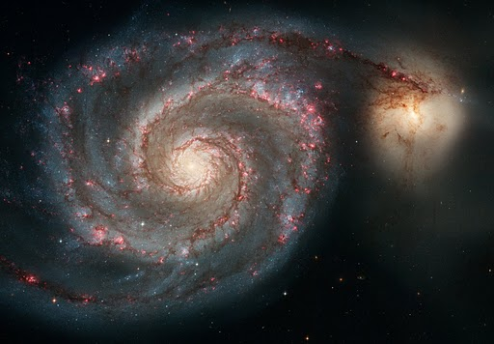
Classification of Galaxy

Slide 10
AlphaGo

Slide 11
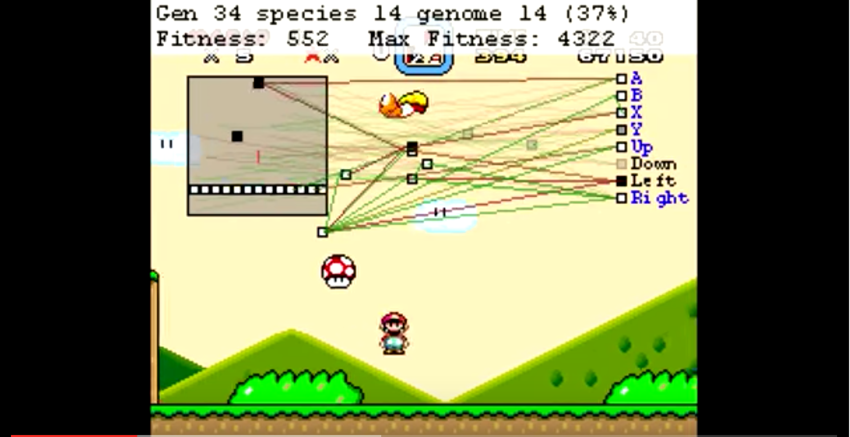
MarI/O
https://www.youtube.com/watch?v=qv6UVOQ0F44

Slide 12
Outline
Where it stands now
Where it comes from
Where it goes

Slide 13
Machine Learning
What is Machine Learning?
To Give Computer Intelligence: Artificial Intelligence
What is Human Intelligence?
“humans possess the cognitive abilities to learn, form concepts, understand, apply logic, and reason, including the capacities to recognize patterns, comprehend ideas, plan, problem solve, make decisions, retain information, and use language to communicate.” -wikipedia

Slide 14
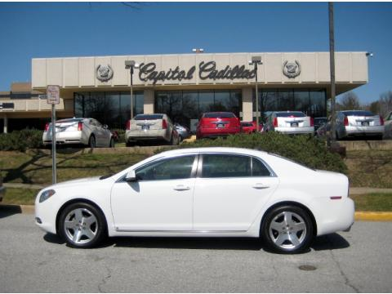
What a machine can do now?
Much more beyond Computing
humans possess the cognitive abilities to learn, form concepts, understand, apply logic, and reason, including the capacities to recognize patterns, comprehend ideas, plan, problem solve, make decisions, retain information, and use language to communicate.
General Object Recognition
AlaphaGo
SIRI
Recognizing Patterns
Making Decisions
Use language to communicate

Slide 15
How to teach computer to learn?
General Object Recognition
AlaphaGo
SIRI
Recognizing Patterns
Making Decisions
Use language to communicate

Slide 16
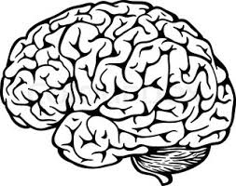
How do People learn things?
Memorization
accumulation of individual facts Limited by
time to observe and memory to store the facts

Slide 17
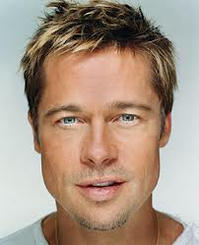
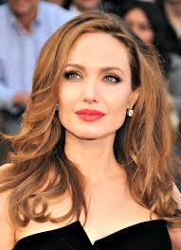
How do People learn things?
Generalization
deduce new facts from old ones
Man or Woman?
Man might have
1. short hair
2. beard
Women might have
1. long hair
2. lipstick
Features
man
woman
Rules
classification

Slide 18
How do People learn things?
Generalization
deduce new facts from old ones
limited by the number of facts
Man or Woman?
Man might have
1. short hair
2. beard
Women might have
1. long hair
2. lipstick
Features
man
woman
Rules
classification

Slide 19
How do Machine Learn?
People can learn from experience
memorization and generalization
Machine can learn from data
training and predicting
man
training
Model/Program
(brain)
predicting
man
woman
woman
training data
new data

Slide 20
What computer sees is different
Image
What people see
What computers see

Slide 21
Learning a good model
the More Data it sees, the better decision it makes
adults make better decisions than kids
Smart Algorithms
deep learning
Features: hair, lipstick, beard

Slide 22
Deep Learning
also known as Deep Neural Networks
inspired by human brain (biological neural networks)

Slide 23
Interesting experiment from Neuro-science
“Jennifer Aniston Neuron”
Picture courtesy: star2.com
Please don’t take this image seriously. Seriously…

Slide 24
Interesting experiment from Neuro-science
100 persons are shown different photos (celebrities, animals, buildings, etc)
activity of neurons are tracked
when showing pictures of Jennifer Aniston, a particular neuron always flashing
when showing other pictures, that particular neuron does not flash
Jennifer Aniston is not the only one
Halle Berry Neuron
Kobe Bryant Neuron
…
How does this happen?
interactions of billions of neurons

Slide 25
Artificial Neural Networks

Slide 26
Artificial Neuron Networks
How are neurons connected?
eye neuron
picture
Cat neuron
dog neuron
cat
Low-level feature
nose neuron
mouth neuron
pixel values

Slide 27
MarI/O
https://www.youtube.com/watch?v=qv6UVOQ0F44

Slide 28
Demo
http://www.cvtell.com

Slide 29
Outline
Where it stands now
Where it comes from
Where it goes

Slide 30
The Era of Artificial Intelligence
Autonomous Driving

Slide 31
The Era of Artificial Intelligence
Design Medicine

Slide 32
The Era of Artificial Intelligence
https://www.youtube.com/watch?v=vvimBPJ3XGQ
Smart Home

Slide 33
The Era of Artificial Intelligence
Machine Learns by itself (in a good way)

Slide 34
Thank you!

