Slide 1
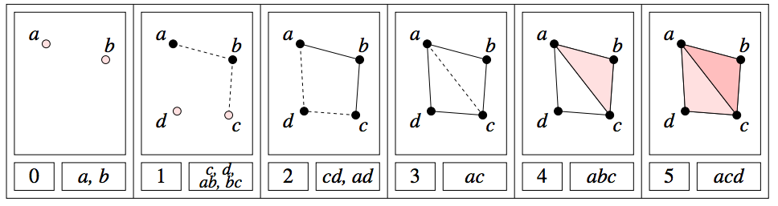
A filtered complex is an increasing sequence of simplicial complexes: C⁰ C¹ C² …
U
U
U
http://link.springer.com/article/10.1007%2Fs00454-004-1146-y

Slide 2
A filtered complex is an increasing sequence of simplicial complexes: C⁰ C¹ C² …
U
U
U
a, b is in C⁰ C¹ C² … C⁵
{a, b, c} is in C⁴ C⁵
₀
U
₀
U
₀
U
U
₀
₂
U
₂
http://link.springer.com/article/10.1007%2Fs00454-004-1146-y

Slide 3
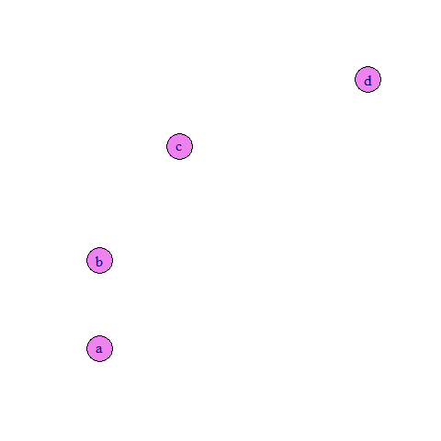
Filtered complex from data points:

Slide 4
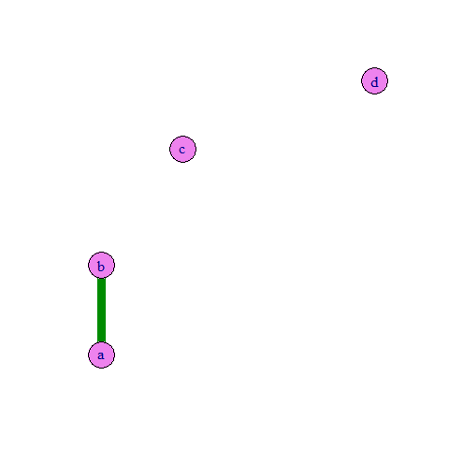
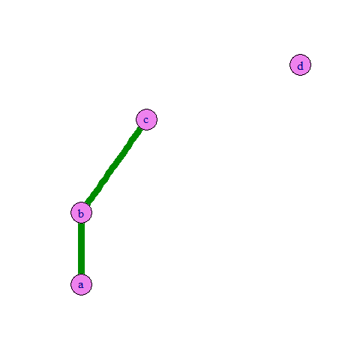
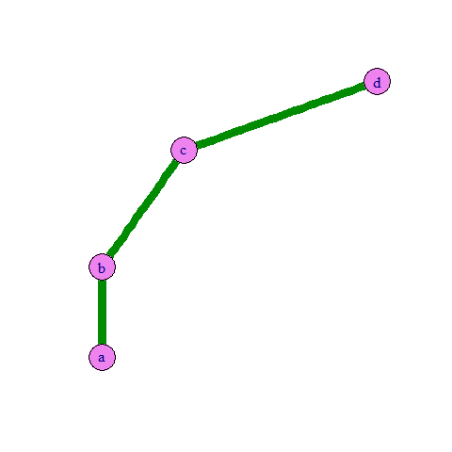
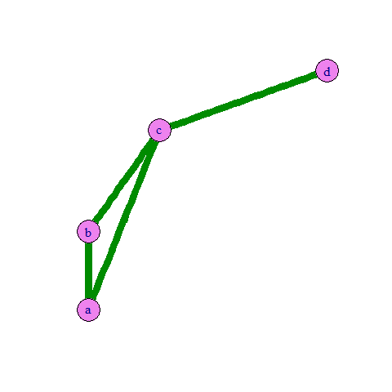
Filtered 1d-complex from data points:

Slide 5
Filtered Rips complex from data points:

Slide 6
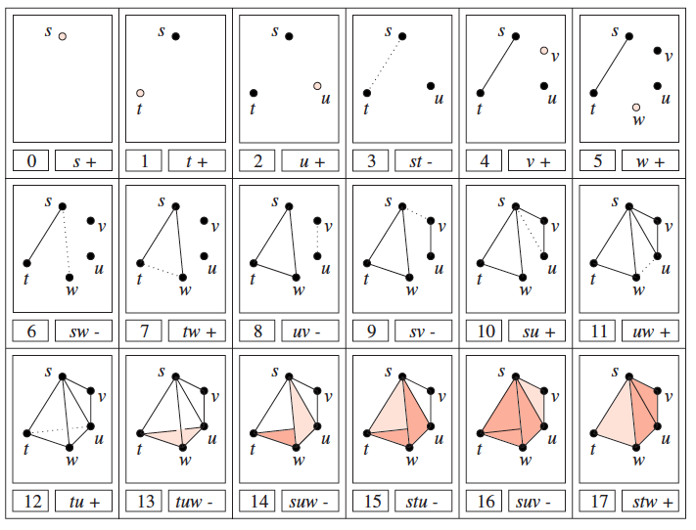
A filtered complex is an increasing sequence of simplicial complexes: C⁰ C¹ C² …
U
U
U
Notes:
Superscript = time, subscript = dimension

Slide 7
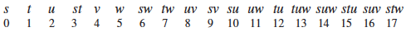
Barcode for H₀
H₀ = Z₀/B₀ =
cycles
boundaries

Slide 8
Barcode for H₁
H₁ = Z₁/B₁ =
cycles
boundaries

Slide 9
Barcode for H₂
H₂ = Z₂/B₂ =
cycles
boundaries

Slide 10
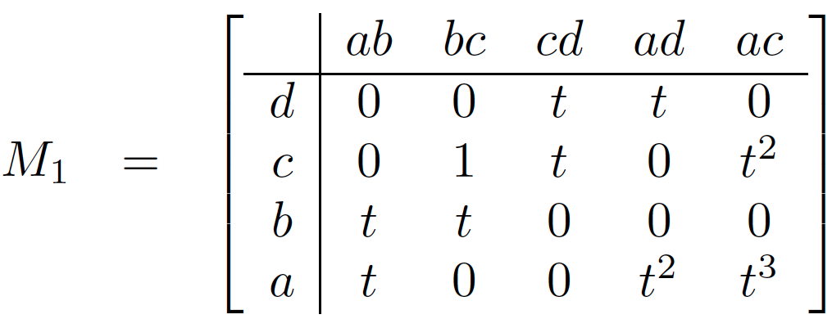
Computing Persistent Homology by Afra Zomorodian, Gunnar Carlsson
_{i, p}
H_{k} =
Z_{k} / ( B_{k} Z_{k} )
_{i}
_{i+p}
_{i}
U
http://link.springer.com/article/10.1007%2Fs00454-004-1146-y

Slide 11
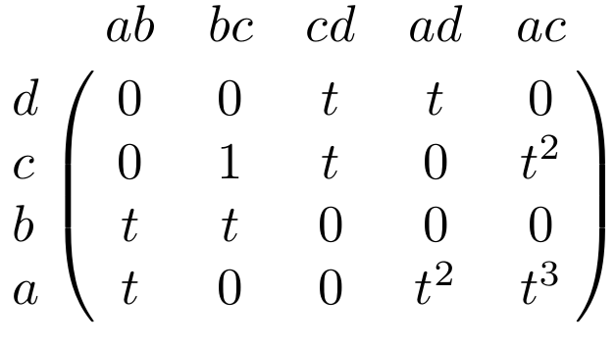
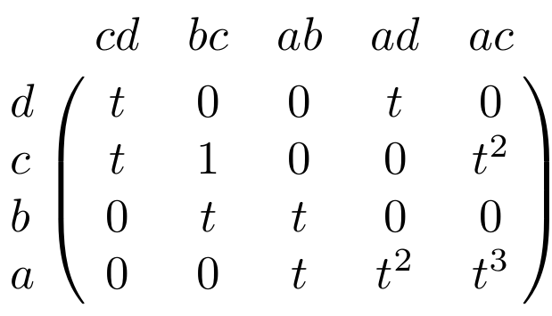
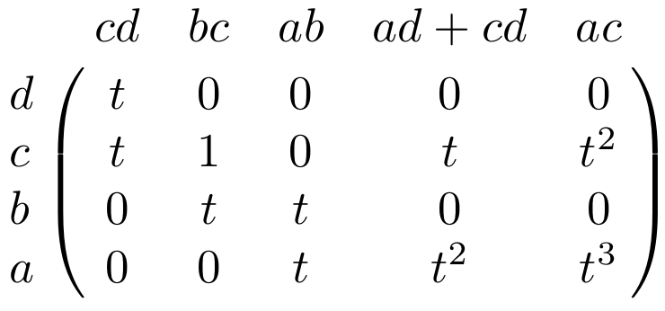
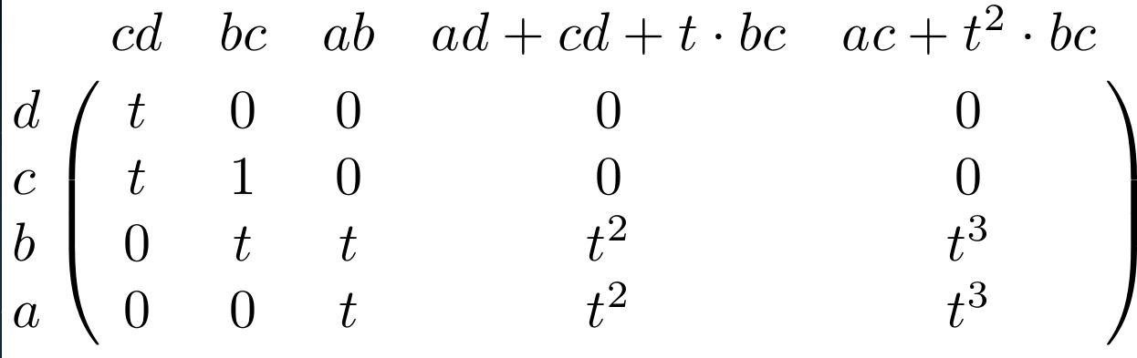

Slide 12
