Slide 1
o_{n+1}
o_{n}
o₂
o₁
o₀
C_{n+1} → C_{n} → C_{n-1} →. . . → C₂ → C₁ → C₀ → 0
H_{n} = Z_{n}/B_{n} = (kernel of )/ (image of )
null space of M_{n}
column space of M_{n+1}
cycles
boundaries
Rank H_{n} = Rank Z_{n} – Rank B_{n}
o_{n}
o_{n+1}
=
=

Slide 2
Counting number of connected components using homology
v₂
v₅
o₁
o₀
C₁ → C₀ → 0
e₁
e₂
e₃
e₄
v₁
v₃
v₄
v₆
e₅
Z₀/B₀ = <v₁, v₂, v₃, v₄, v₅, v₆ : v₁ + v₂ = 0, v₂ + v₃ = 0,
v₄ + v₅ = 0, v₅ + v₆ = 0, v₄ + v₆ = 0>
Z₀/B₀ = <[v₁], [v₄]> where [v₁] = {v₁, v₂, v₃}
and [v₄] = {v₄, v₅, v₆}

Slide 3
v₂
v₅
Counting 1-dimensional cycles:
e₁
e₂
e₃
e₄
v₁
v₃
v₄
v₆
o₂
o₁
e₅
C₂ → C₁ → C₀
H₁ = Z₁/B₁ = (kernel of )/ (image of )
null space of M₁
column space of M₂
Rank H₁ = Rank Z₁ – Rank B₁
o₁
o₂
=

Slide 4
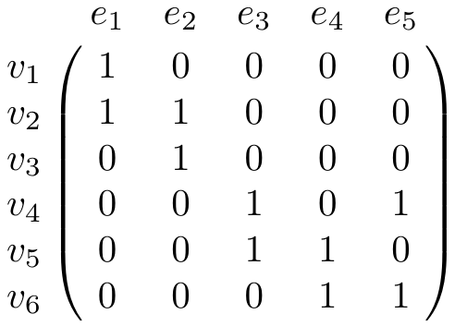
v₂
v₅
e₁
e₂
e₃
e₄
o₁
C₁ → C₀
v₁
v₃
v₄
v₆
e₅
Z₁ = kernel of = null space of M₁
o₁

Slide 5
Let e₁ = {v₁, v₂} =
Let e₂ = {v₂, v₃} =
Let e₃ =
{v₄, v₅} =
Let e₄ =
{v₅, v₆} =
Let e₅ =
{v₄, v₆} =

Slide 6
v₁ =
, v₂ =
, v₃ =
, v₄ =
, v₅ =
v₆ =

Slide 7
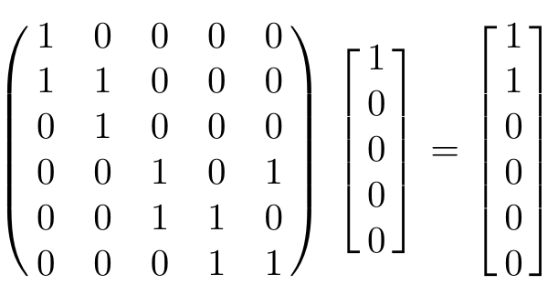
v₂
v₅
(e₁) = v₁ + v₂
e₁
e₂
e₃
e₄
o
v₁
v₃
v₄
v₆
e₅

Slide 8
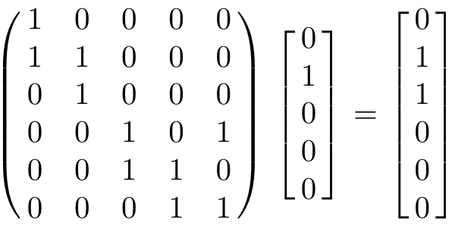
v₂
v₅
(e₂) = v₂ + v₃
e₁
e₂
e₃
e₄
o
v₁
v₃
v₄
v₆
e₅

Slide 9
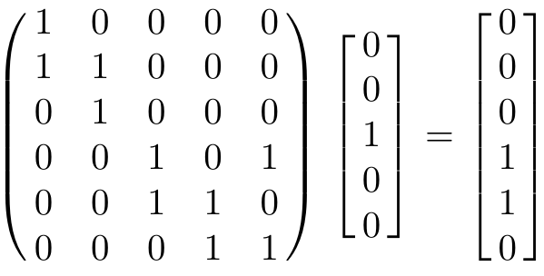
v₂
v₅
(e₃) = v₄ + v₅
e₁
e₂
e₃
e₄
o
v₁
v₃
v₄
v₆
e₅

Slide 10
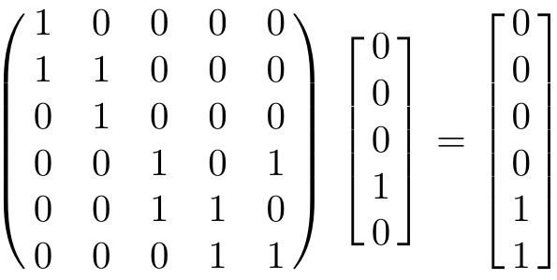
v₂
v₅
(e₄) = v₅ + v₆
e₁
e₂
e₃
e₄
o
v₁
v₃
v₄
v₆
e₅

Slide 11
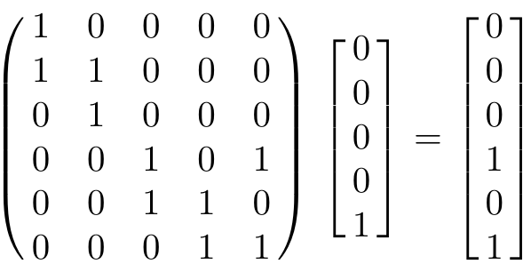
v₂
v₅
(e₅) = v₄ + v₆
e₁
e₂
e₃
e₄
o
v₁
v₃
v₄
v₆
e₅

Slide 12
Counting number of connected components using homology
v₂
v₅
e₁
e₂
e₃
e₄
v₁
v₃
v₄
v₆
e₅
: C₁ → C₀
o
(e₁) = v₁ + v₂
o
Extend linearly:
(e₂) = v₂ + v₃
o
(Σn_{i}e_{i}) = n_{i} Σ (e_{i})
o
o
(e₃) = v₄ + v₅
o
(e₄) = v₅ + v₆
o
(e₅) = v₄ + v₆
o

Slide 13
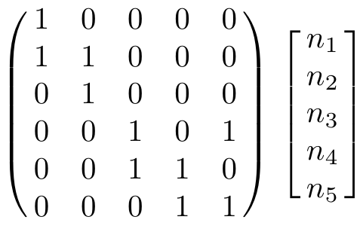

Slide 14
=

Slide 15
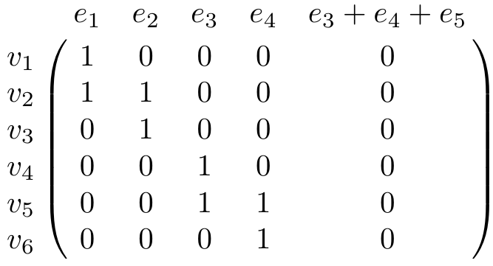
o₂
o₁
C₂ → C₁ → C₀
Z₁ = kernel of = null space of M₁
o₁

Slide 16
o₂
o₁
C₂ → C₁ → C₀
Z₁ = kernel of = null space of M₁
o₁

Slide 17
New basis
Let e₁ = {v₁, v₂} =
Let e₂ = {v₂, v₃} =
Let e₃ =
{v₄, v₅} =
Let e₄ =
{v₅, v₆} =
Let b₅ =
e₃ + e₄ + e₅

Slide 18
o₂
o₁
C₂ → C₁ → C₀
Z₁ = kernel of = null space of M₁
= <e₃ + e₄ + e₅>
o₁

Slide 19
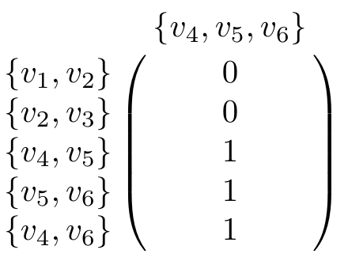
o₂
o₁
v₂
C₂ → C₁ → C₀
e₁
e₂
v₁
v₃
v₅
e₃
e₄
v₄
v₆
e₅
B₁ = image of = column space of M₂
o₂

Slide 20
o₂
o₁
v₂
C₂ → C₁ → C₀
e₁
e₂
v₁
v₃
v₅
e₃
e₄
v₄
v₆
e₅
B₁ = image of = column space of M₂
= <{v₄, v₅} + {v₅, v₆} + {v₄, v₆}> = <e₃ + e₄ + e₅>
o₂

Slide 21
v₂
v₅
o₂
o₁
e₁
e₂
e₃
e₄
C₂ → C₁ → C₀
v₁
v₃
v₄
e₅
v₆
H₁ = Z₁/B₁ = (kernel of )/ (image of )
null space of M₁
column space of M₂
<e₃ + e₄ + e₅>
<e₃ + e₄ + e₅>
Rank H₁ = Rank Z₁ – Rank B₁ = 1 – 1 = 0
o₁
o₂
=
=

Slide 22
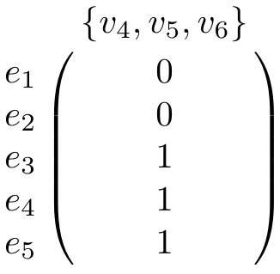
o₂
o₁
v₂
C₂ → C₁ → C₀
e₁
e₂
v₁
v₃
v₅
e₃
e₄
v₄
v₆
e₅
B₁ = image of = column space of M₂
= <{v₄, v₅} + {v₅, v₆} + {v₄, v₆}> = <e₃ + e₄ + e₅>
o₂

Slide 23
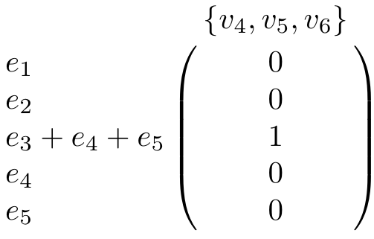
o₂
o₁
v₂
C₂ → C₁ → C₀
e₁
e₂
v₁
v₃
v₅
e₃
e₄
v₄
v₆
e₅
B₁ = image of = column space of M₂
= <{v₄, v₅} + {v₅, v₆} + {v₄, v₆}> = <e₃ + e₄ + e₅>
o₂

Slide 24
v₂
v₅
o₂
o₁
e₁
e₂
e₃
e₄
C₂ → C₁ → C₀
v₁
v₃
v₄
e₅
v₆
H₁ = Z₁/B₁ = (kernel of )/ (image of )
null space of M₁
column space of M₂
<e₃ + e₄ + e₅>
<e₃ + e₄ + e₅>
Rank H₁ = Rank Z₁ – Rank B₁ = 1 – 1 = 0
o₁
o₂
=
=

