Slide 1
Lecture 6: Creating a simplicial complex from data.
in a series of preparatory lectures for the Fall 2013 online course MATH:7450 (22M:305) Topics in Topology: Scientific and Engineering Applications of Algebraic Topology
Target Audience: Anyone interested in topological data analysis including graduate students, faculty, industrial researchers in bioinformatics, biology, business, computer science, cosmology, engineering, imaging, mathematics, neurology, physics, statistics, etc.
Isabel K. Darcy
Mathematics Department/Applied Mathematical & Computational Sciences
University of Iowa
http://www.math.uiowa.edu/~idarcy/AppliedTopology.html
Notes:
Lecture 6: Creating a simplicial complex from data.

Slide 2
Creating a simplicial complex
Step 0.) Start by adding 0-dimensional vertices
(0-simplices)
Notes:
Recall that to create a simplicial complex, we start by adding 0-simplices (ie 0-dimensional vertices). So our step zero will be to add 0-simplices, but in this case our 0-dimensional points will be

Slide 3
Creating a simplicial complex
Step 0.) Start by adding data points
= 0-dimensional vertices (0-simplices)
Notes:
data points.
In this very simplified case my data points lie in a two-dimensional plane. Normally data points are high dimensional.
For example, I may be comparing the expression or thousands of genes in tumor cells to healthy cells using microarray data. OR I might be comparing politicians voting records. Or I might be comparing the stats of basketball players. These three applications were all, by the way, published by Lum et al this past February in Nature’s Scientific Reports. I have included a link to their paper on my youtube site.
http://www.nature.com/srep/2013/130207/srep01236/full/srep01236.html

Slide 4
Creating a simplicial complex
0.) Start by adding 0-dimensional data points
Note: we only need a definition of closeness between data points. The data points do not need to be actual points in R^{n}
Notes:
since my very simple data is 2-dimensional, each point could represent an ordered pair of numbers. For example,

Slide 5
Creating a simplicial complex
(1, 8)
(2, 7)
(1, 5)
0.) Start by adding 0-dimensional data points
Note: we only need a definition of closeness between data points. The data points do not need to be actual points in R^{n}
Notes:
The points (1, 5), (1, 8), (2, 7). These points could represent actual locations OR each coordinate could represent a particular property. For example, if each point represents a different tumor cell, the first coordinate could represent the gene expression level of the gene coding for the protein ubiquitin hydrolase, while the 2nd coordinate could represent the gene expression level of a different gene. Normally one models thousands of genes at once, Thus each point would have thousands of coordinates where each coordinate represents the expression level of a single gene.
The data points do not need to be described by numbers. Often data is described by numbers but not always.

Slide 6
Creating a simplicial complex
(dog, happy)
(wolf, mirthful)
(dog, content)
0.) Start by adding 0-dimensional data points
Note: we only need a definition of closeness between data points. The data points do not need to be actual points in R^{n}
Notes:
For example, we could be descriptions. The data can be in just about any format as long as we have a definition of closeness between the data points.

Slide 7
Creating a simplicial complex
1.) Adding 1-dimensional edges (1-simplices)
Note: we only need a definition of closeness between data points. The data points do not need to be actual points in R^{n}
Notes:
We need an idea of closeness in order to determine when to add an edge between two data points.

Slide 8
Creating a simplicial complex
1.) Adding 1-dimensional edges (1-simplices)
Add an edge between data points that are “close”
Notes:
If two points are “close” , we connect them with an edge
I put quotes around close because we don’t have to use the standard Euclidean distance. Any idea of closeness that is relevant to your application will do. For example correlation is often used. We don’t even need an exact distance or an exact definition of distance, we just need to know when to connect 2 points with an edge.
The definition of closeness will depend upon the application. For now let’s assume standard Euclidean distance.

Slide 9

Creating a simplicial complex
1.) Adding 1-dimensional edges (1-simplices)
Add an edge between data points that are “close”
Notes:
So we can measure (or calculate) the distance between two points to determine if they are “close”. But we still need to define close.

Slide 10
Creating a simplicial complex
1.) Adding 1-dimensional edges (1-simplices)
Let T = Threshold
Connect vertices v and w with an edge iff
the distance between v and w is less than T
Notes:
Thus we will choose a threshold. We will connect a pair of vertices with an edge if and only if their distance is less then our chosen threshold.
But it is not always obvious how to choose the threshold. This problem can be dealt with by using persistence which we will briefly introduce later in this lecture. For now let’s somewhat arbitrarily choose a distance, say 1.8 cm.

Slide 11
Creating a simplicial complex
1.) Adding 1-dimensional edges (1-simplices)
Let T = Threshold =
Connect vertices v and w with an edge iff
the distance between v and w is less than T
Notes:
So we will connect every pair of vertices if their distance is less than 1.8 cm. If the center of these points represent the 0-dimensional vertices, then this distance is less than our threshold, so we add an edge. Similarly this pair of points satisfy our definition of close, so we add an edge
The distance between this pair of vertices is greater than 1.8, so we won’t connect them with an edge. Continuing to add edges between vertices whenever their distance is less than our threshold of 1.8cm, we now have

Slide 12
Creating a simplicial complex
1.) Adding 1-dimensional edges (1-simplices)
Add an edge between data points that are “close”
Notes:
a one dimensional simplicial complex. Note that we have clustered our data into five disjoint connected sets. So this is one way to cluster our data – that is grouping our data points into disjoint sets based on some definition of similarity. In this case, we have 5 clusters.
We can now add higher dimensional simplices.

Slide 13
Creating the Vietoris-Rips simplicial complex
2.) Add all possible simplices of dimensional > 1.
Notes:
How we add higher dimensional simplices depends on what kind of simplicial complex we wish to create.
The simplest simplicial complex from a computational point of view is the Vietoris-Rips complex where we add all possible simplices of dimensional > 1
So for example, if 3 edges form a triangle, we fill in that triangle with a 2-simplex., so we fill in this triangle, this triangle, this triangle
Note that after I fill in these four triangles I now have the boundary of a tetrahedron. Thus it is now possible to fill it in with a three Symplex obtaining the solid tetrahedron.
I want to add the highest dimensional Symplex possible. Since these four points are all close that means I can add a three simplex
Since these three points are close I can add a 2-simplex. Similarly I can fill in all these other triangles. These 5 close points will give me a total of 10 triangles. I just added 4 triangles none of which involved this vertex. I can now add six more triangles involving this vertex for a total of 10 triangles, the triangle formed by these three vertices, these three vertices, these three vertices
Since these three points are close I can add a 3-simplex. Note that it’s boundary also it exists, as I do have it’s 4 two dimensional faces. Similarly these 4 points are close, so I get another 3-simplex, these four, these four. So I have now added 5 3-simplicies, ie 5 solid tetrahedron.
Since these 4 points are close I can add a 4-simplex. . Note that it’s boundary also it exists, as I do have it’s 5 three dimensional faces, the 5 solid tetrahedron I just added.

Slide 14
Creating the Vietoris Rips simplicial complex
2.) Add all possible simplices of dimensional > 1.
Notes:
Thus we now have the Vietoris Rips simplicial complex. Note we get the same simplex by adding one dimension at a time

Slide 15
Creating the Vietoris Rips simplicial complex
Step 0.) Start by adding data points
= 0-dimensional vertices (0-simplices)
Notes:
We Start with 0-simplices, our data points in step 0

Slide 16
Creating the Vietoris Rips simplicial complex
1.) Adding 1-dimensional edges (1-simplices)
Add an edge between data points that are “close”
Notes:
In step 1 we Add 1-simplices connecting data points that are “close”.

Slide 17
Creating the Vietoris Rips simplicial complex
2.) Add 2-dimensional triangles (2-simplices)
Add all possible 2-simplices.
Notes:
In step 2 we add all possible 2-simplices, so whenever 3 points are close, we get 3 edges forming a triangle, so we fill in all triangles with 2-simplices.

Slide 18
Creating the Vietoris Rips simplicial complex
3.) Add 3-dimensional tetrahedrons (3-simplices)
Add all possible 3-simplices.
Notes:
In step 3 Adding all possible 3-simplices, so whenever 4 points are close, we get 4 triangles forming a tetrahedron, so we fill in all tetrahedron boundaries with 3-simplices, .

Slide 19
Creating the Vietoris Rips simplicial complex
4.) Add 4-simplices
Add all possible 4-simplices.
Notes:
In step 4 Adding all possible 4-simplices, so whenever 5 points are close, so we can add the 4-simplex {v1, .. v5}. Note the boundary of this 4-simplex consisting of
five 3-simplices was constructed in the previous step.
Note that we can use the vertices to encode a simplex when writing computational software. To encode this complex, I actually only need 5 objects:
By identifying the edge v1v2, I know that I not only have this edge, I also have all subsets of the edge {v1, v2}, so I also have the vertices v1, v2.
Similarly having the triangle, {v3, v4, v5} means I also have the edges {v3, v4}, … as well as the vertices v3, v4, v5. Similarly for this triangle v6, v7, c8 , I have all its subsets,
. Similarly for this 3-simplex v9, v12 , I have all its subsets, and for this 4simplex v13, v17 , I have all its subsets, all the tetrahedron, all the triangles, all the edges, all the vertices.
For faster computation, you may want to encode all simplices in memory, but with a Vietoris Rips complex, if you have for example a 4-simplex, you also have all subsets of that four simplex.
To review, we can create the Vietoris Rips complex in just 3 steps:

Slide 20
Creating the Vietoris Rips simplicial complex
Step 0.) Start by adding data points
= 0-dimensional vertices (0-simplices)
Notes:
Starting with 0-simplices, our data points in step 0

Slide 21
Creating the Vietoris Rips simplicial complex
1.) Adding 1-dimensional edges (1-simplices)
Add an edge between data points that are “close”
Notes:
In step 1 Adding 1-simplices connecting data points that are “close”.

Slide 22
Creating the Vietoris Rips simplicial complex
2.) Add all possible simplices of dimensional > 1.
Notes:
And then adding an n-simplex whenever we have n+1 points that are close.
Thus we now have the Vietoris Rips simplicial complex. Note we get the same simplex by adding one dimension at a time.
What if I increase my threshold?

Slide 23
Creating the Vietoris Rips simplicial complex
Let T = Threshold =
Connect vertices v and w with an edge iff
the distance between v and w is less than T
Notes:
Well if I increase my threshold to say 2.1 cm, I can get more edges. For example, we now need to add this edge here.
I now only have four components. The choice of threshold affects what kind of simplicial complex we get. It is often unclear what threshold should be chosen. The solution is to use persistence and check all thresholds

Slide 24
Creating the Vietoris Rips simplicial complex
0.) Start by adding 0-dimensional data points
Note: we only need a definition of closeness between data points. The data points do not need to be actual points in R^{n}
Notes:
We start again by adding our 0-simplices, our data points. I can indicate the threshold using a ball centered at my data point. The diameter of the ball will be my threshold, so if two balls intersect then the distance between the vertices is less than the threshold, so we connect the pair of vertices with an edge if and only if the balls intersect, so we can get edges after which we can then add all possible higher dimensional simplices.
Note how I grew my balls. As the diameter increases, my threshold which is equal to my diameter increases.

Slide 25
Creating the Vietoris Rips simplicial complex
0.) Start by adding 0-dimensional data points
Note: we only need a definition of closeness between data points. The data points do not need to be actual points in R^{n}
Notes:
We can compute the number of clusters for a variety of diameters.
We start with 17 data points, so if the diameter is 0, we have 17 clusters. Increasing the diameter, these 2 balls intersect so I now have 16 clusters.
If we continue to increase the diameter, we will eventually create the complex we saw before with 5 clusters, etc until we only have one cluster left.
Eventually this entire page will be purple, but right now, we know have one component.
To choose the threshold, one can determine how long a particular number of clusters lasts, for example for what set of radii do we have five clusters. If we have five clusters for the largest set of radii, then have gives us a good idea where to set the threshold and which simplicial complex best models our data.
I have put links to better animations on my on my YouTube site which may better illustrate this persistence concept. Next month, we will also talk much more about persistence during the live lectures for this course. This is just a preliminary introduction.

Slide 26
Creating the Vietoris Rips simplicial complex
Notes:
Let’s now compare the following two examples. Based just on eyesight how many clusters do you see on the right and how many clusters do you see on the left? I just see one cluster for both the complex on the left and the complex on the right, but for the cluster on the left I have a hole. To better see this let’s construct it’s Vietoris Rips complex

Slide 27
Creating the Vietoris Rips simplicial complex
Notes:
So starting with the cluster on the left, we have our zero dimensional data points are zero simplices

Slide 28
Creating the Vietoris Rips simplicial complex
Notes:
In step one we add edges

Slide 29
Creating the Vietoris Rips simplicial complex
Notes:
And we then add all possible higher dimensional simplices. I now clearly have a hole.

Slide 30
Creating the Vietoris Rips simplicial complex
Notes:
If I also calculate the Vietoris Rips complex for the data points on the right

Slide 31
Creating the Vietoris Rips simplicial complex
Notes:
We don’t have a hole on the right. Note holes can be important in data.

Slide 32
Creating the Vietoris Rips simplicial complex
Notes:
Suppose I create advertising targeted to the average person or suppose I create a drug targeted towards the average patient. Well for the data points on the left the imaginary average patient is not that close to a real patient. But for the right the targeting may more useful. Holes can have important meaning.
This is a very simplified description of one potential application. We will talk more about real applications during the live lecture portion of this class.

Slide 33
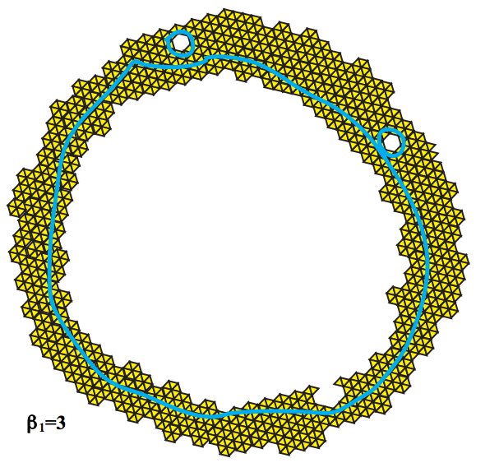
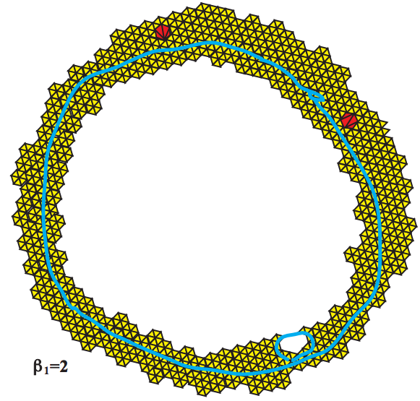
Topology and Data. Gunnar Carlsson
www.ams.org/journals/bull/2009-46-02/S0273-0979-09-01249-X

Slide 34
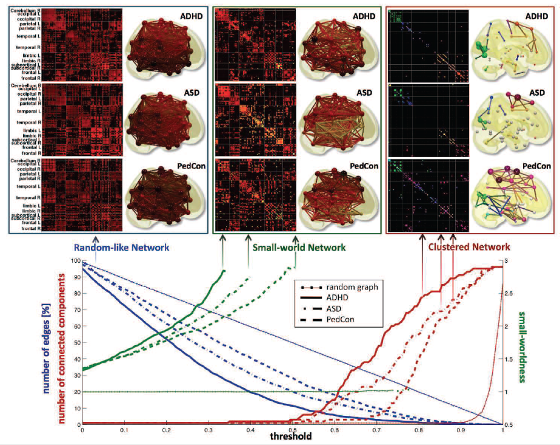

Slide 35
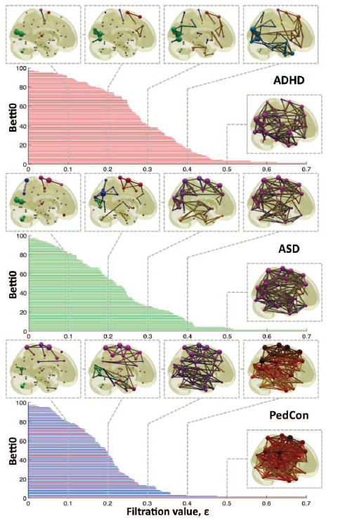

Vertices = Regions of Interest
Create Rips complex by growing epsilon balls (i.e. decreasing threshold) where distance between two vertices is given by
where f_{i} =
measurement at location i

Slide 36
How many connected components?

Slide 37

Your name homology
3 ingredients:
1.) Objects
2.) Grading
3.) Boundary map
_{n} : C_{n} → C_{n-1} such that ² = 0

Slide 38
Counting number of connected components using homology
v₂
v₅
e₁
e₂
e₃
e₄
v₁
v₃
v₄
v₆
e₅
C₀ = Z₂[v₁, v₂, v₃, v₄, v₅, v₆] = set of 0-chains
C₁ = Z₂[e₁, e₂, e₃, e₄, e₅] = set of 1-chains

Slide 39
Counting number of connected components using homology
v₂
v₅
e₁
e₂
e₃
e₄
v₁
v₃
v₄
v₆
e₅

Slide 40
Counting number of connected components using homology
v₂
v₅
e₁
e₂
e₃
e₄
v₁
v₃
v₄
v₆
e₅
(e₁) = v₁ + v₂
o
Components are
{v₁, v₂, v₃} and
{v₄, v₅, v₆}
(e₂) = v₂ + v₃
o
(e₃) = v₄ + v₅
o
(e₄) = v₅ + v₆
o
(e₅) = v₄ + v₆
o

Slide 41
Counting number of connected components using homology
v₂
v₅
e₁
e₂
e₃
e₄
v₁
v₃
v₄
v₆
e₅
C₀ = Z₂[v₁, v₂, v₃, v₄, v₅, v₆] = set of 0-chains
C₁ = Z₂[e₁, e₂, e₃, e₄, e₅] = set of 1-chains
: C₁ → C₀
o

Slide 42
Counting number of connected components using homology
v₂
v₅
e₁
e₂
e₃
e₄
v₁
v₃
v₄
v₆
e₅
: C₁ → C₀
o
(e₁) = v₁ + v₂
o
(e₂) = v₂ + v₃
o
(e₃) = v₄ + v₅
o
(e₄) = v₅ + v₆
o
(e₅) = v₄ + v₆
o

Slide 43
Counting number of connected components using homology
v₂
v₅
e₁
e₂
e₃
e₄
v₁
v₃
v₄
v₆
e₅
: C₁ → C₀
o
(e₁) = v₁ + v₂
Extend linearly:
o
(e₂) = v₂ + v₃
o
(e₃) = v₄ + v₅
o
(e₄) = v₅ + v₆
o
(e₅) = v₄ + v₆
o

Slide 44
Counting number of connected components using homology
v₂
v₅
e₁
e₂
e₃
e₄
v₁
v₃
v₄
v₆
e₅
: C₁ → C₀
o
(e₁) = v₁ + v₂
Extend linearly:
o
(e₂) = v₂ + v₃
o
(e₃) = v₄ + v₅
o
(e₄) = v₅ + v₆
o
(e₅) = v₄ + v₆
o

Slide 45
Counting number of connected components using homology
v₂
v₅
e₁
e₂
e₃
e₄
v₁
v₃
v₄
v₆
e₅
: C₁ → C₀
o
(e₁) = v₁ + v₂
Extend linearly:
o
(e₂) = v₂ + v₃
o
(e₃) = v₄ + v₅
o
(e₄) = v₅ + v₆
o
(e₅) = v₄ + v₆
o

Slide 46
Counting number of connected components using homology
v₂
v₅
e₁
e₂
e₃
e₄
v₁
v₃
v₄
v₆
e₅
o₁
o₀
C₁ → C₀ → 0
Z₀ = kernal of
= {x : (x) = 0}
o₀
o₀

Slide 47
Counting number of connected components using homology
v₂
v₅
e₁
e₂
e₃
e₄
v₁
v₃
v₄
v₆
e₅
o₁
o₀
C₁ → C₀ → 0
Z₀ = kernal of
= {x : (x) = 0}
= C₀ = Z₂[v₁, v₂, v₃, v₄, v₅, v₆]
o₀
o₀

Slide 48
Counting number of connected components using homology
v₂
v₅
e₁
e₂
e₃
e₄
v₁
v₃
v₄
v₆
e₅
o₁
o₀
(e₁) = v₁ + v₂
C₁ → C₀ → 0
Z₀ = Z₂[v₁, v₂, v₃, v₄, v₅, v₆]
B₀ = image of
o
(e₂) = v₂ + v₃
o
(e₃) = v₄ + v₅
o
(e₄) = v₅ + v₆
o
o₁
(e₅) = v₄ + v₆
o

Slide 49
Counting number of connected components using homology
v₂
v₅
e₁
e₂
e₃
e₄
v₁
v₃
v₄
v₆
e₅
H₀ = Z₀/B₀ = <v₁, v₂, v₃, v₄, v₅, v₆ :
v₁ + v₂ = 0,
v₂ + v₃ = 0,
v₄ + v₅ = 0,
v₅ + v₆ = 0,
v₄ + v₆ = 0>

Slide 50
Counting number of connected components using homology
v₂
v₅
e₁
e₂
e₃
e₄
v₁
v₃
v₄
v₆
e₅
Z₀/B₀ = <v₁, v₂, v₃, v₄, v₅, v₆ : v₁ + v₂ = 0, v₂ + v₃ = 0,
v₄ + v₅ = 0, v₅ + v₆ = 0, v₄ + v₆ = 0>

Slide 51
Counting number of connected components using homology
v₂
v₅
e₁
e₂
e₃
e₄
v₁
v₃
v₄
v₆
e₅
Z₀/B₀ = <v₁, v₂, v₃, v₄, v₅, v₆ : v₁ + v₂ = 0, v₂ + v₃ = 0,
v₄ + v₅ = 0, v₅ + v₆ = 0, v₄ + v₆ = 0>
= <v₁, v₂, v₃, v₄, v₅, v₆ : v₁ + v₂ , v₂ + v₃ , v₄ + v₅ , v₅ + v₆ ,
v₄ + v₆ >

Slide 52
Counting number of connected components using homology
v₂
v₅
e₁
e₂
e₃
e₄
v₁
v₃
v₄
v₆
e₅
Z₀/B₀ = <v₁, v₂, v₃, v₄, v₅, v₆ : v₁ + v₂ = 0, v₂ + v₃ = 0,
v₄ + v₅ = 0, v₅ + v₆ = 0, v₄ + v₆ = 0>

Slide 53
Counting number of connected components using homology
v₂
v₅
e₁
e₂
e₃
e₄
v₁
v₃
v₄
v₆
e₅
Z₀/B₀ = <v₁, v₂, v₃, v₄, v₅, v₆ : v₁ + v₂ = 0, v₂ + v₃ = 0,
v₄ + v₅ = 0, v₅ + v₆ = 0, v₄ + v₆ = 0>
v₁ + v₂ = 0 implies v₁ = v₂
Z₀/B₀ = <v₁, v₃, v₄, v₅, v₆ : v₂ + v₃ = 0, v₄ + v₅ = 0,
v₅ + v₆ = 0, v₄ + v₆ = 0>

Slide 54
Counting number of connected components using homology
v₂
v₅
e₁
e₂
e₃
e₄
v₁
v₃
v₄
v₆
e₅
Z₀/B₀ = <v₁, v₃, v₄, v₅, v₆ : v₂ + v₃ = 0, v₄ + v₅ = 0,
v₅ + v₆ = 0, v₄ + v₆ = 0>
Z₀/B₀ = <v₁, v₄>

Slide 55
Counting number of connected components using homology
v₂
v₅
e₁
e₂
e₃
e₄
v₁
v₃
v₄
v₆
e₅
Z₀/B₀ = <v₁, v₂, v₃, v₄, v₅, v₆ : v₁ + v₂ = 0, v₂ + v₃ = 0,
v₄ + v₅ = 0, v₅ + v₆ = 0, v₄ + v₆ = 0>
Z₀/B₀ = <[v₁], [v₄]> where [v₁] = {v₁, v₂, v₃}
and [v₄] = {v₄, v₅, v₆}

Slide 56
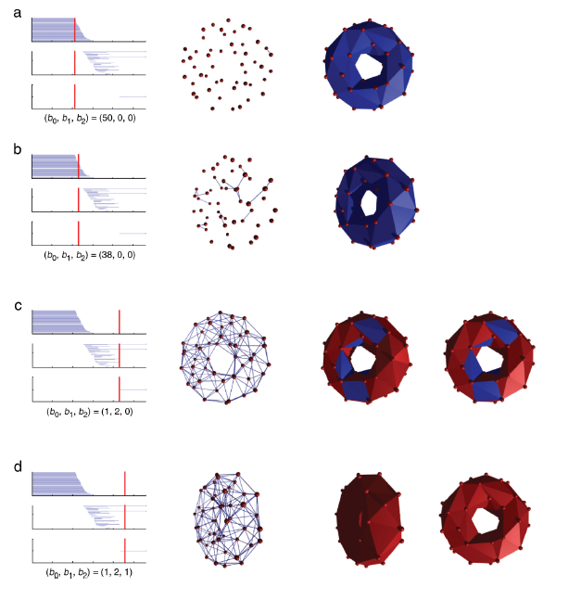
http://www.journalofvision.org/
content/8/8/11.full
Figure 3 from
Topological analysis of population activity in visual cortex
Gurjeet Singh, Facundo Memoli, Tigran Ishkhanov, Guillermo Sapiro, Gunnar Carlsson, and Dario L. Ringach
J Vis June 30, 2008 8(8): 11
See also Figure 4 animation

Slide 57
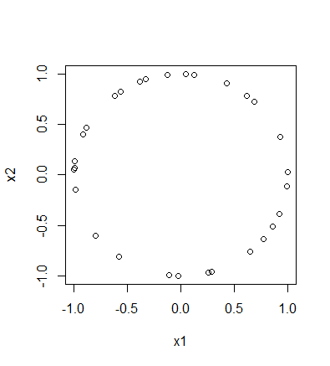
To install the TDA package on a PC:
install.packages("TDA")
To install the TDA package on a Mac:
install.packages("TDA", type = "source")
XX = circleUnif(30)

Slide 58
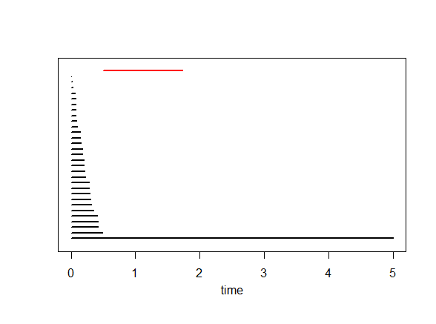
Plot of data points Barcode
Each bar in the barcode represents a cycle in some H_{i}.
The red bar represents the element in H₁ (i.e., the circle = 1 dimensional cycle = sum of edges where the boundary of this sum = 0).
Bars representing an element in H₀ (i.e, 0-dimensional cycles = vertices) are drawn in black

Slide 59
Plot of data points Barcode
Each bar in the barcode represents a cycle in some H_{i}.
A bar starts at the birth time of the cycle it represents and ends at its death time.

Slide 60
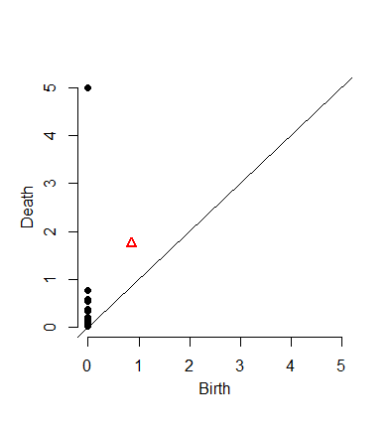
Barcode
A bar starts at the birth time of the cycle it represents and ends at its death time
For each cycle in H_{i} = bar in barcode, we can plot the point (birth, death)
where
birth = birth time of this cycle
death = death time of this cycle
Black point = cycle in H₀.
Red triangle = cycle in H₁.

Slide 61
Barcode
A bar starts at the birth time of the cycle it represents and ends at its death time
This plot of points
(birth, death)
is called the
Persistence Diagram
where we also throw in the diagonal.

Slide 62
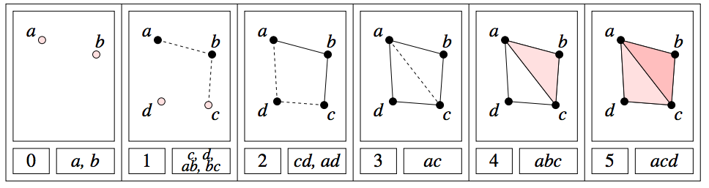
H₀ = < a, b, c, d : tc + td, tb + c, ta + tb>
H₁ = <z₁, z₂ : t z₂, t³z₁ + t²z₂ >
[ )
[ )
[ )
[ )
[
z₁ = ad + cd + t(bc) + t(ab), z₂ = ac + t²bc + t²ab

Slide 63
Since we can’t plot (0, ∞), we instead plot (0, 5) where
5 = maximum time = maximum threshold
= 3rd argument in ripsDiag(XX,maxdimension,maxscale, …)
[ )
[ )
[ )
[ )
[
(3, 4)
(1, 2)
(2, 5)
(0, 1)
(0, ∞) → (0, 5)

Slide 64
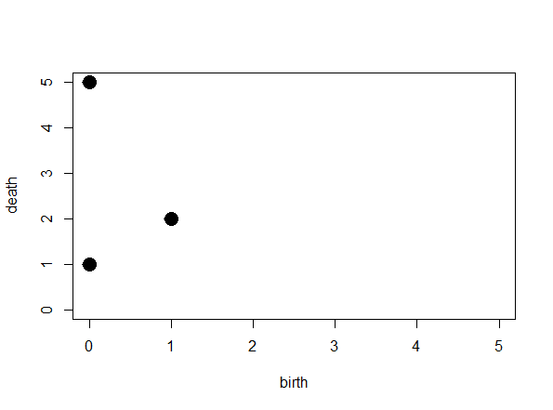
[ )
[ )
[ )
[ )
[
(3, 4)
(1, 2)
(2, 5)
(0, 1)
(0, 5)

Slide 65
[ )
[ )
[ )
[ )
[
(3, 4)
(1, 2)
(2, 5)
(0, 1)
(0, 5)
Remember to add the diagonal

Slide 66
[ )
[ )
[ )
[ )
[
(3, 4)
(1, 2)
(2, 5)
(0, 1)
(0, 5)
The diagonal will be useful when we compute distance between persistence diagrams
Remember to add the diagonal

Slide 67
The homology of a circle is as follows:
Rank of H₀ = 1
since a circle has only one component
Rank of H₁ = 1
since a circle has a single 1-d component
Rank of H₂ = 0
since we don’t have any 2-d circles.

Slide 68
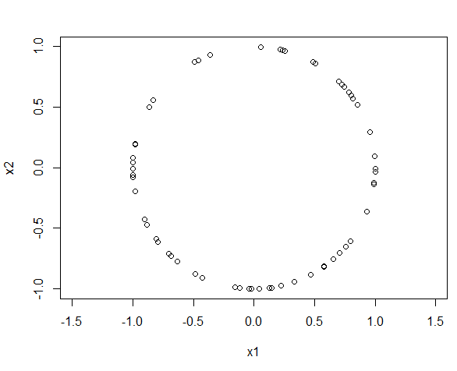
The homology of a circle is as follows:
Rank of H₀ = 1
since a circle has only one component
Rank of H₁ = 1
since a circle has a single 1-d component
Rank of H₂ = 0
since we don’t have any 2-d circles.
This data set consists of 60 points randomly taken from a circle of radius 1.
What should we expect the barcode to look like?
What should we expect the persistence diagram to look like?
Can we use TDA to determine that our points came from a circle

Slide 69
Can we use TDA to determine that our points came from a circle
The homology of a circle is as follows:
Rank of H₀ = 1 since a circle has only one component
Thus we expect 1 persistent (long) bar in the 0-dim barcode
plus some shorter bars that we can “ignore”
Rank of H₁ = 1: circle has a single 1-d cycle that does not bound surface
Thus we expect 1 persistent (long) bar in the 1-dim barcode
plus possible some shorter bars that we can “ignore”
Rank of H₂ = 0 since we don’t have any 2-d ccles.
Thus we expect 0 persistent (long) bars in the 2-dim barcode
plus possible some shorter bars that we can “ignore”

Slide 70
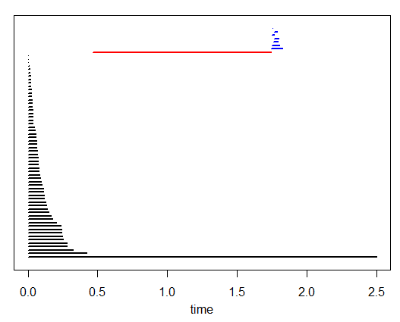
The homology of a circle is as follows:
Rank of H₀ = 1 since a circle has only one component
Thus we expect 1 persistent (long) bar in the 0-dim barcode
plus some shorter bars that we can “ignore”
Rank of H₁ = 1: circle has a single 1-d cycle that does not bound surface
Thus we expect 1 persistent (long) bar in the 1-dim barcode
plus possible some shorter bars that we can “ignore”
Rank of H₂ = 0 since we don’t have any 2-d ccles.
Thus we expect 0 persistent (long) bars in the 2-dim barcode
plus possible some shorter bars that we can “ignore”

Slide 71
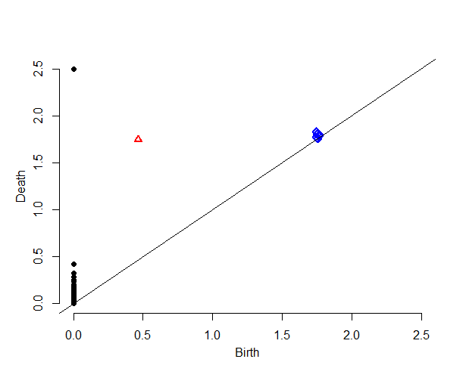
Our data set = 60 points randomly taken from a circle of radius 1
Can you determine from the barcode that our data set came from a circle?
Do you see 1 persistent 0-dim cycle?
Do you see 1 persistent 1-dim cycle?
Do you see 0 persistent 2-dim cycle?
Does the persistent diagram make sense?
1 black point (cycle in H₀) is far from the diagonal, while remaining black points are “close” to diagonal
1 red point (cycle in H₁) is far from diagonal
All blue points (cycles in H₂) are close to diagonal

Slide 72
From the barcode:
1 persistent 0-dim cycle ➔ H₀ = 1
1 persistent 1-dim cycle ➔ H₁ = 1
No persistent 2-dim cycles ➔ H₂ = 0
Ignore bars with “small” length
Definition of “small” depends on dimension, data set, application, etc.
From the persistent diagram:
1 black point far from the diagonal ➔ H₀ = 1
1 red point far from diagonal ➔ H₁ = 1
All blue points close to diagonal ➔ H₂ = 0
Ignore points “close” to diagonal
Definition of “close” depends on dimension, data set, application, etc.

Slide 73
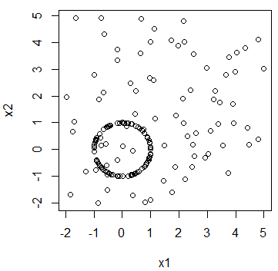
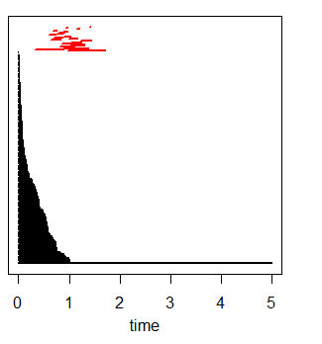
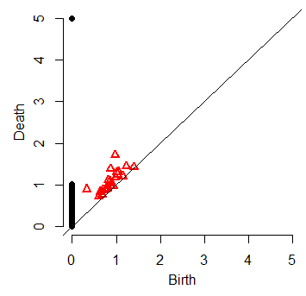
On Thursday in B5 MLH you will explore the difference between circle and (circle + various amounts of noise)

