Slide 2
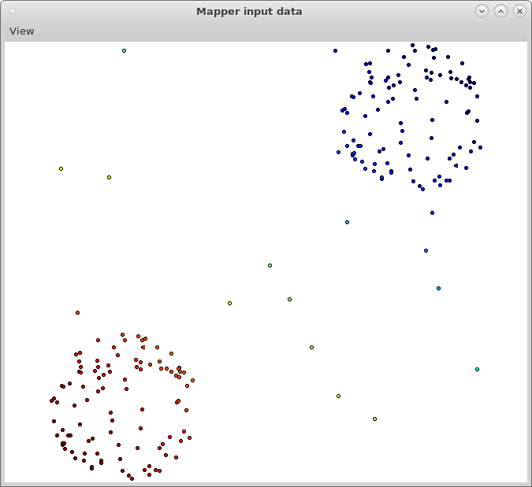
View Screen shot to output png of figure

Slide 3
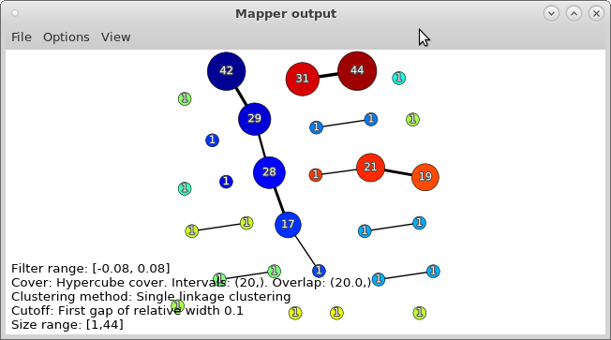
Save figure to output pdf of figure

Slide 4
