Slide 1
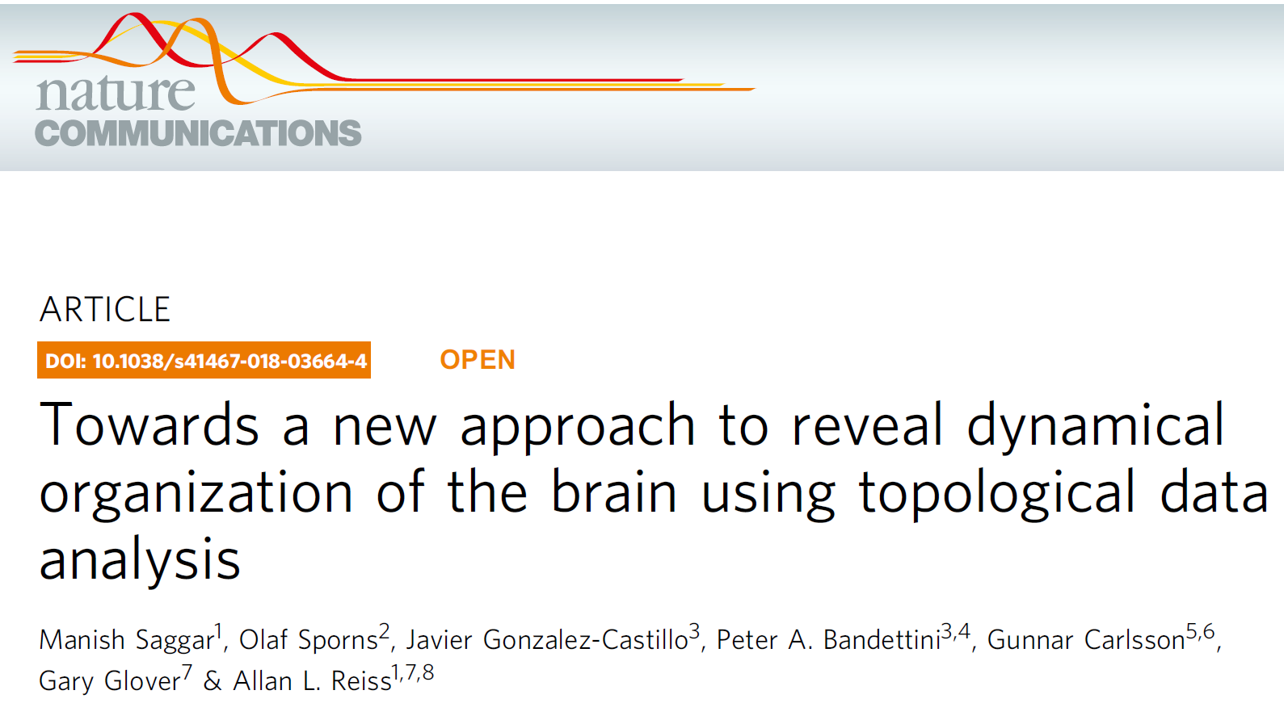
https://www.nature.com/articles/s41467-018-03664-4
Published online:
11 April 2018

Slide 2
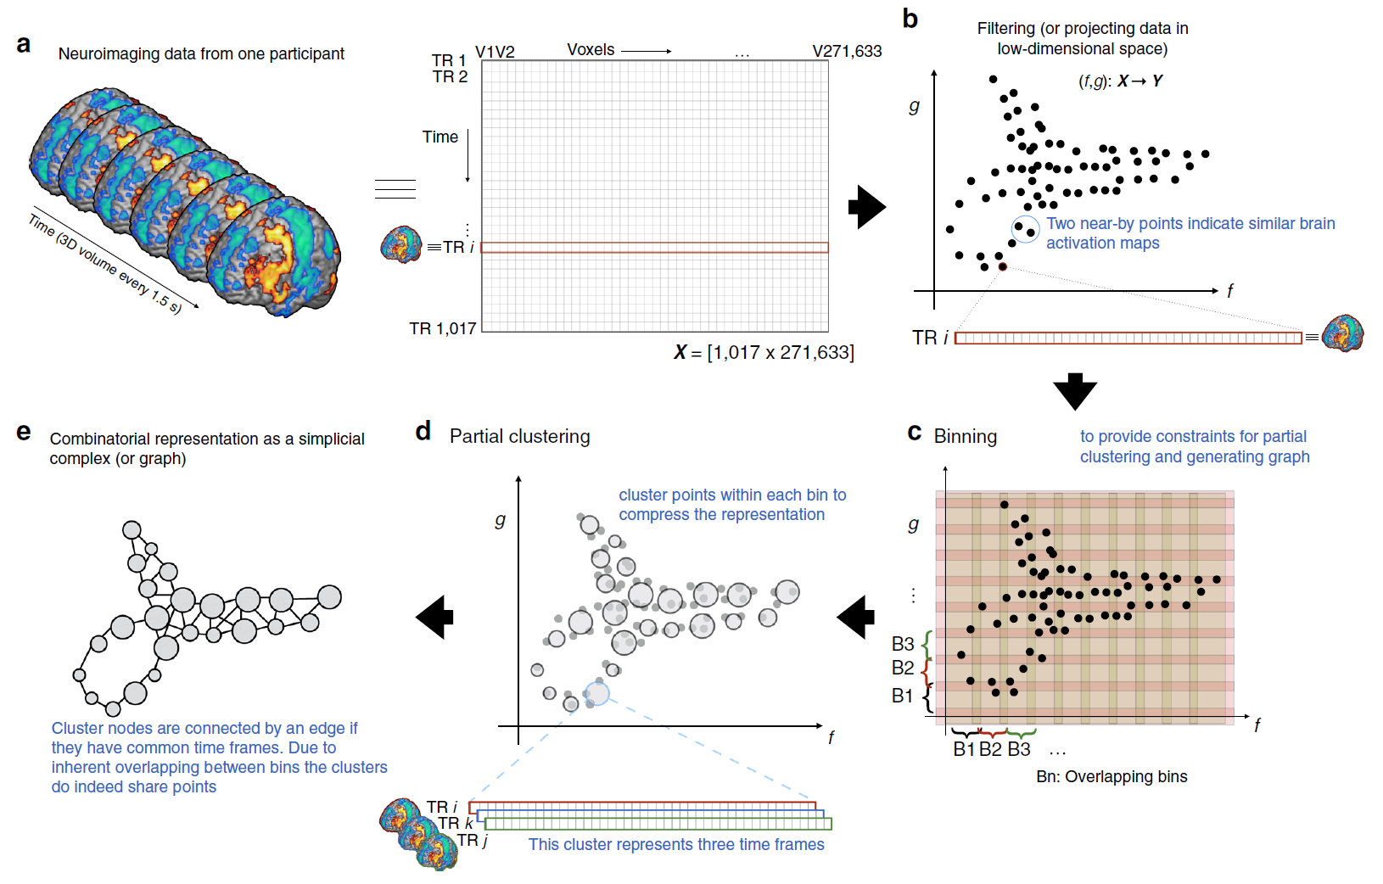
Nonlinear dimensionality reduction method using a variant of stochastic
neighborhood estimation (SNE
1017 data points = 1017 acquired time frames

Slide 3
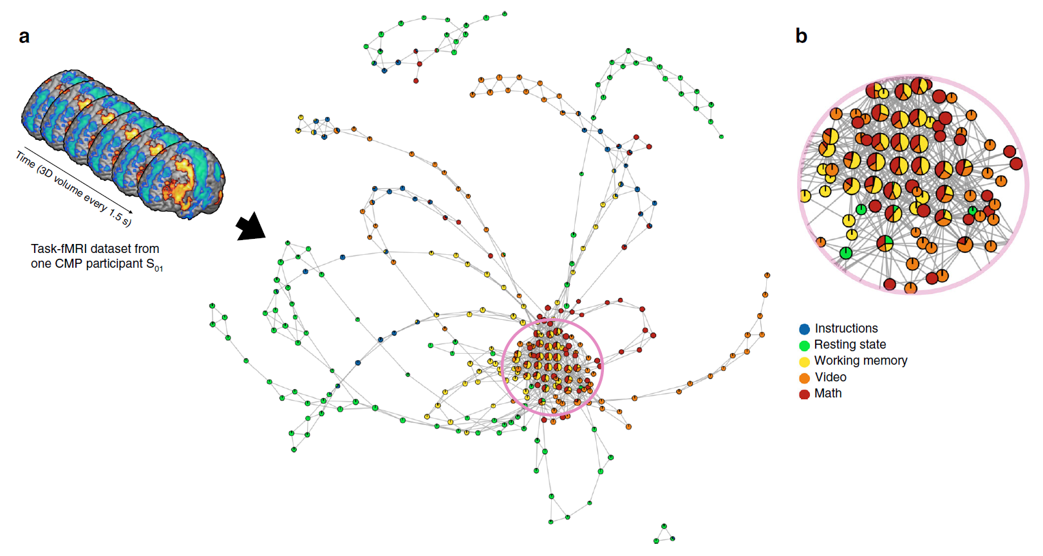
Fig. 2 Revealing the shape of brain’s dynamical organization. a Depicts the shape graph for one of the representative participants (S01) from the CMP
dataset. The shape graph was annotated using colors and pie-chart visualization scheme to depict how the tasks were represented in each shape graph. b
Shows a zoomed-in version of the densely connected region of the shape graph to show the use of pie-chart visualization

Slide 4
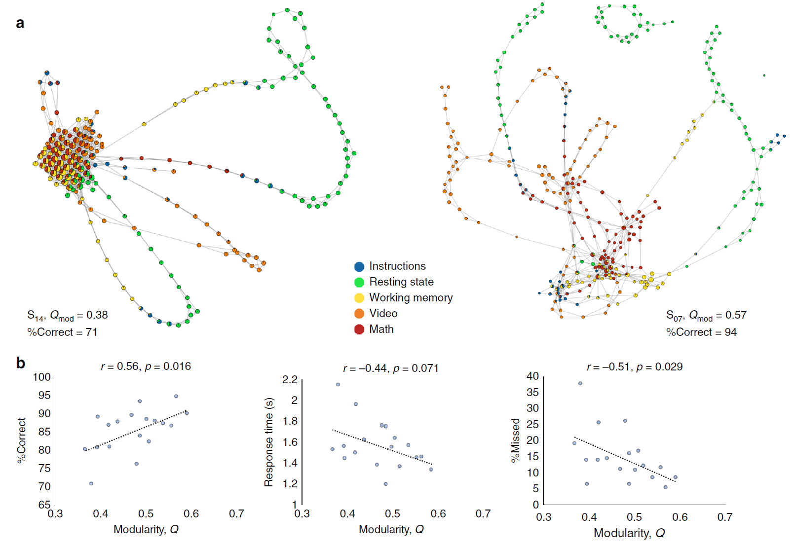

Slide 5
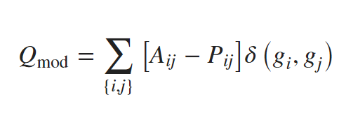
A is the weighted adjacency matrix.
P_{ij} represents the expected number of edges between
vertices i and j in the null model.
g _{k} denotes the community for node k.

Slide 6
