Slide 2
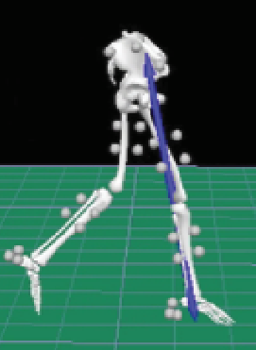
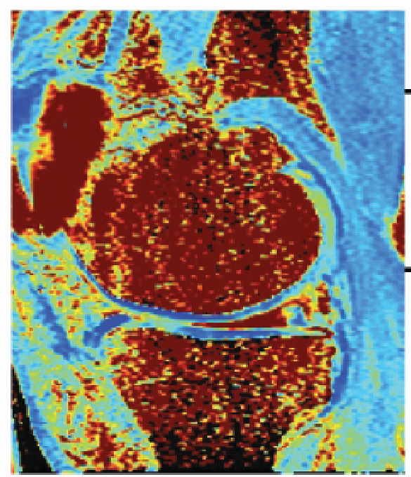
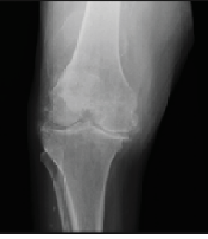
https://onlinelibrary.wiley.com/doi/full/10.1002/jmri.25750

Slide 3
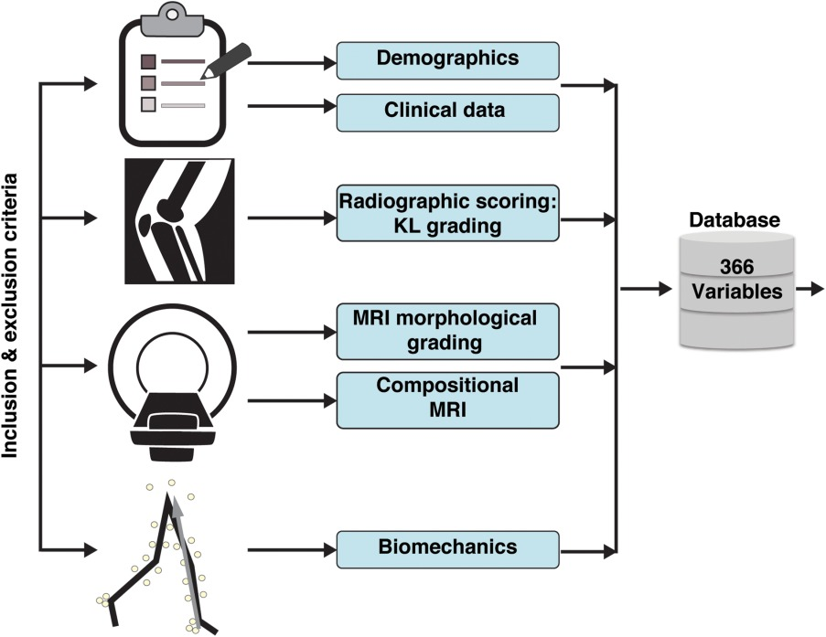
The Data
9
23
2
44
256
32
178 subjects

Slide 4
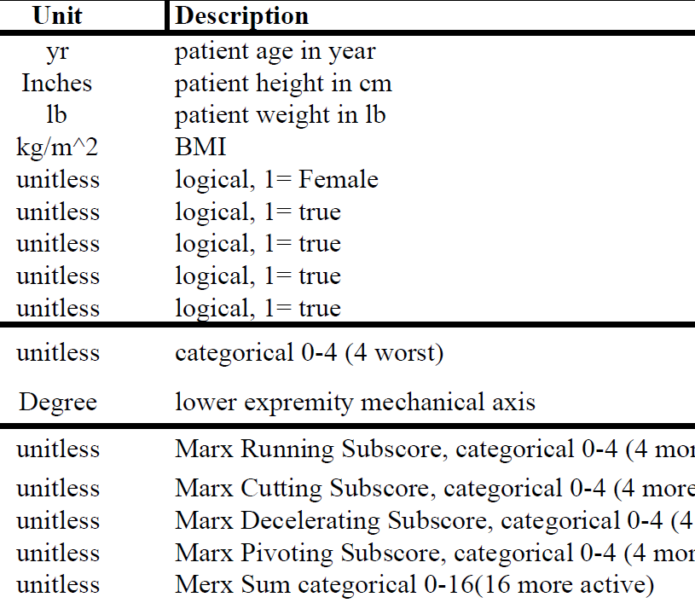

Slide 5
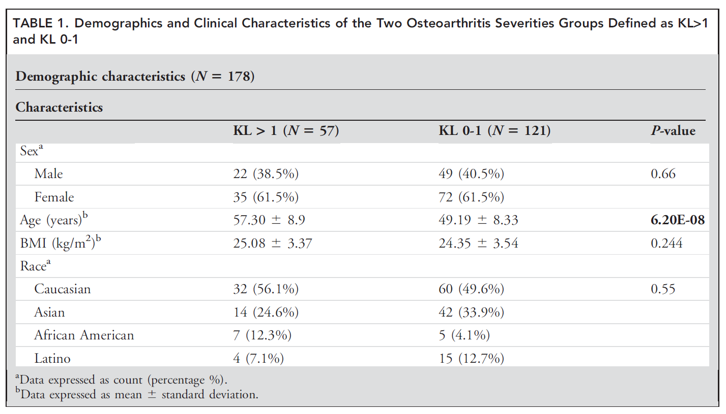

Slide 6
column‐wise: mean centered,
and variance normalized

Slide 7
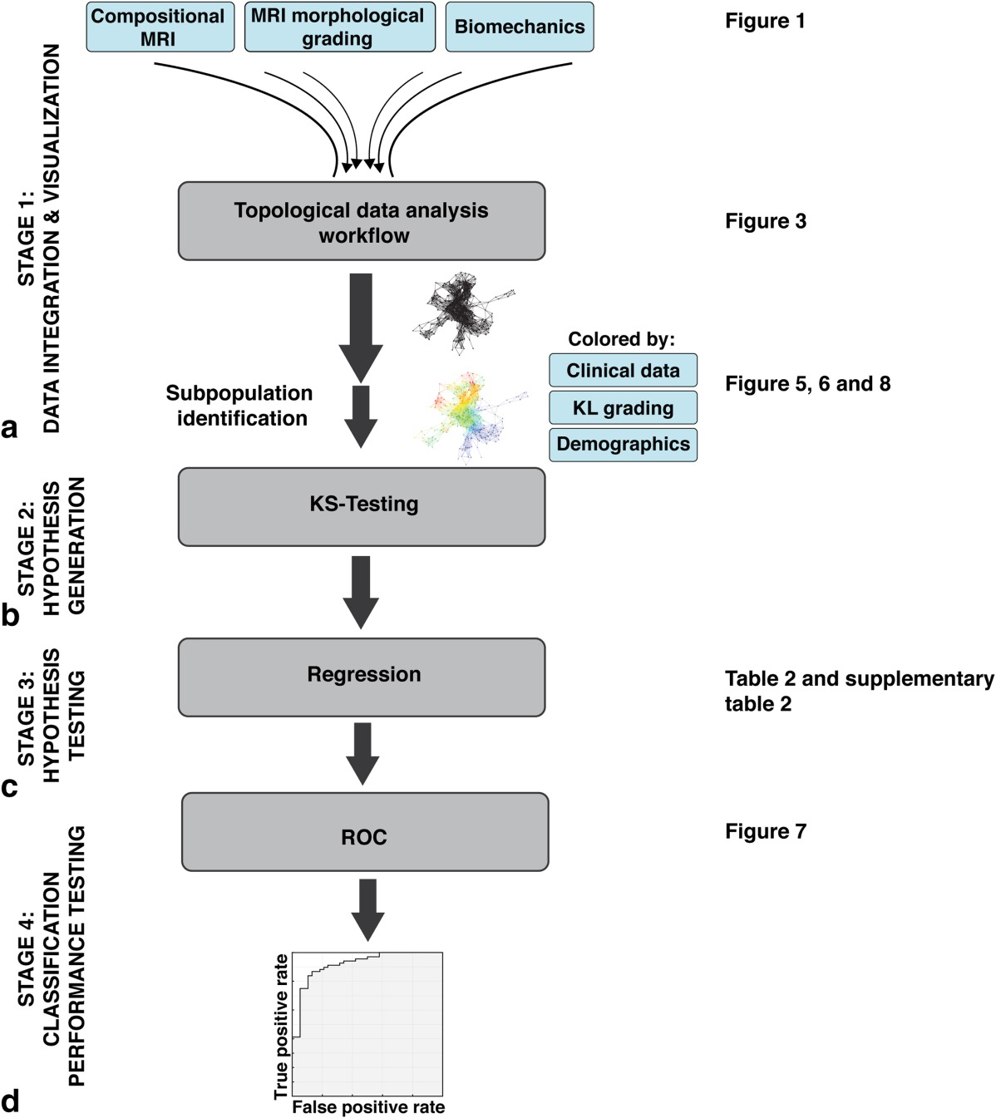
TDA parameters:
2D filter function: PCA1, PCA2
Number of intervals: 30
%overlap: 3.5

Slide 11
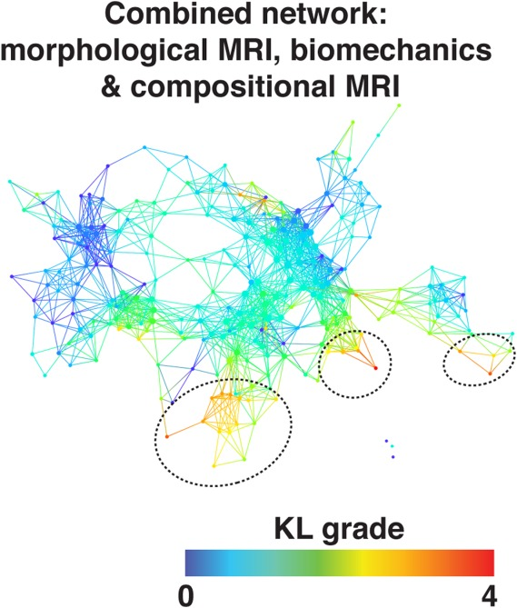
TDA parameters:
2D filter function:
PCA1, PCA2
Number of
intervals: 30
%overlap: 3.5
178 subjects
366 variables

Slide 12
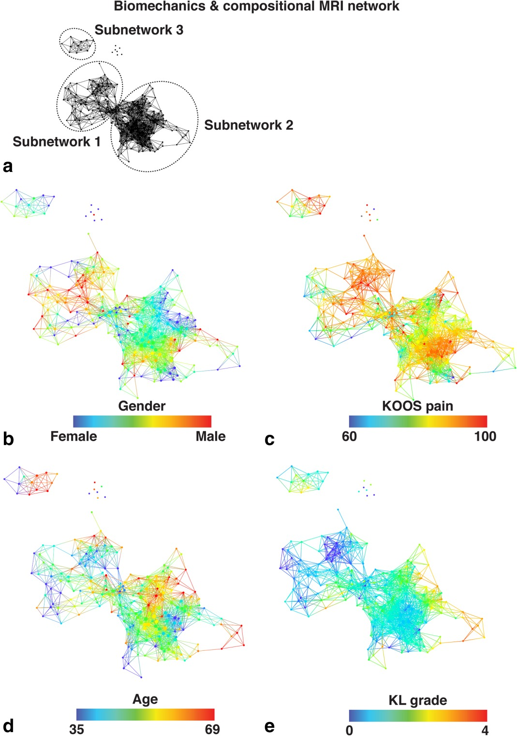
48 in subnetwork 1
109 in subnetwork 2
6 in both 1 and 2
15 in subnetwork 3
and singletons(?).
TDA parameters:
2D filter function:
PCA1, PCA2
Number of
intervals: 30
%overlap: 3.5
178 subjects
288 variables

Slide 13
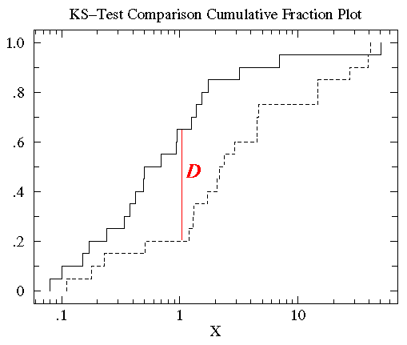
http://www.physics.csbsju.edu/stats/KS-test.html
The KS-test uses the maximum vertical deviation between the two curves as the statistic D. In this case the maximum deviation occurs near x=1 and has D=.45. (The fraction of the treatment group that is less then one is 0.2 (4 out of the 20 values); the fraction of the control group that is less than one is 0.65 (13 out of the 20 values). Thus the maximum difference in cumulative fraction is D=.45.)

Slide 14
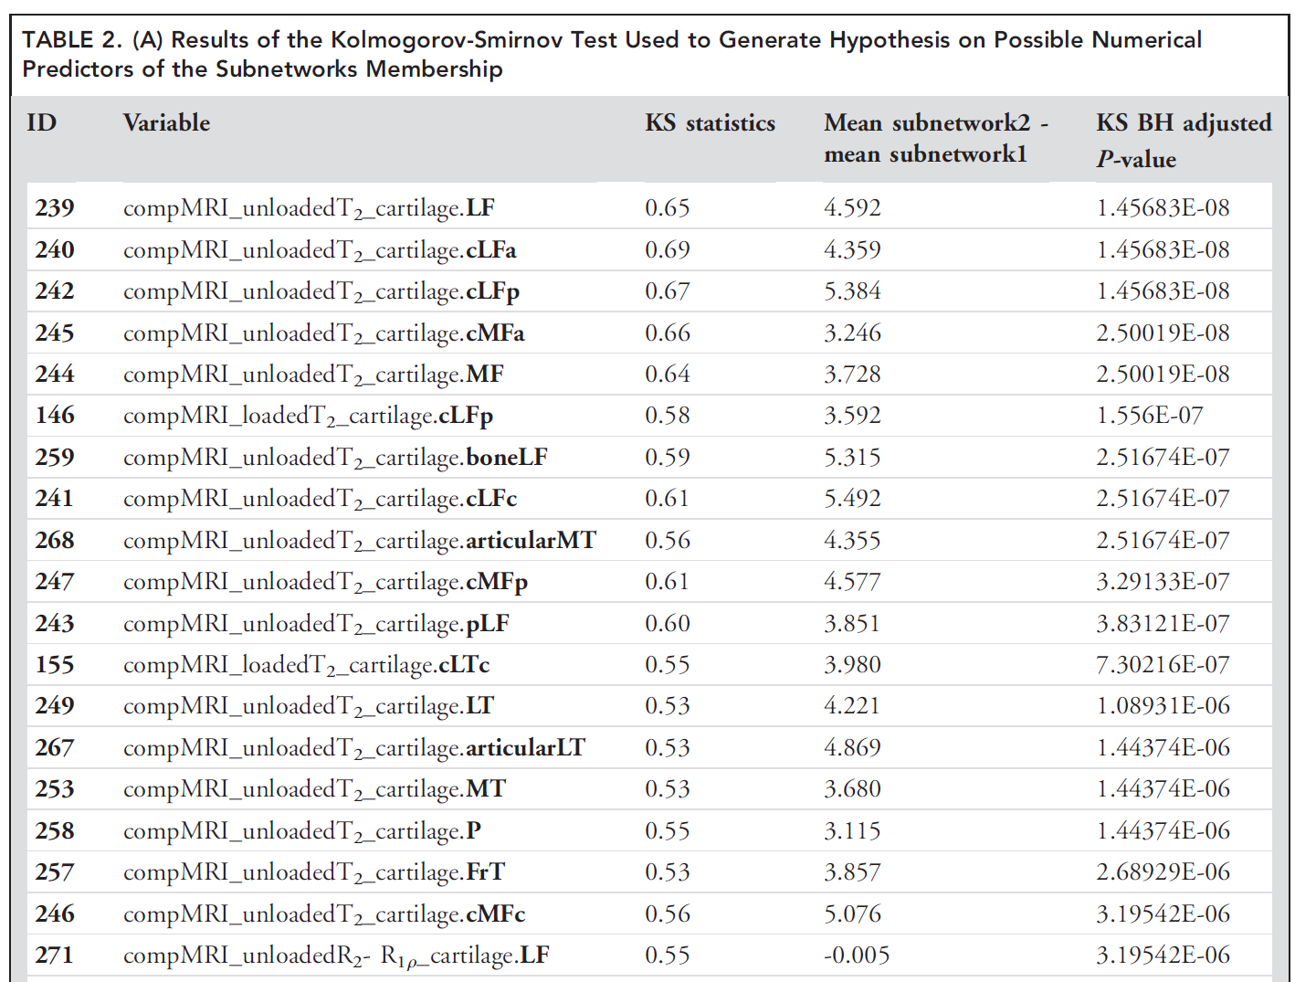

Slide 15
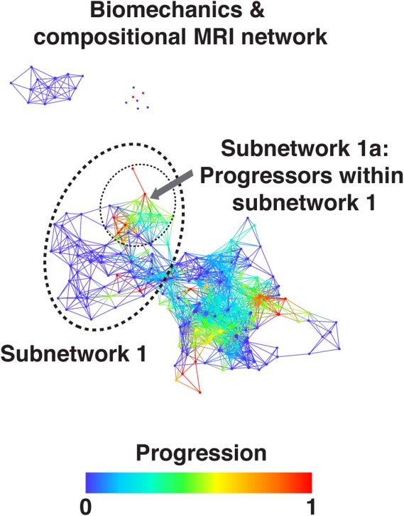
Within the less sever osteoarthritis subpopulation (subnetwork 1) the progressors are marked (dashed circle, subnetwork 1a) and statistically compared to the remaining subjects within subnetwork 1.
This analysis suggests R2-R1q as one of the possible
predictors of cartilage lesion progression in just one of the
two subpopulations identified by the multidimensional analysis approach, highlighting the value of using data-driven
TDA-based grouping.

Slide 17
Department of Radiology and Biomedical Imaging, University of California, San Francisco,
Department of Neurological Surgery, Brain and Spinal Injury Center, UCSF,
Therapy and Rehabilitation Science, University of California, San Francisco,
San Francisco Veterans Affairs Medical Center
https://onlinelibrary.wiley.com/doi/full/10.1002/jmri.25750

Slide 18
From: https://onlinelibrary.wiley.com/doi/full/10.1002/jmri.25750
Acknowledgements: Usually at the end, sometimes at the beginning of talk or section. Grant funding often also on title slide

Slide 19
The Data
9
23
2
44
256
32
178 subjects

Slide 23
column‐wise: mean centered,
and variance normalized

Slide 24
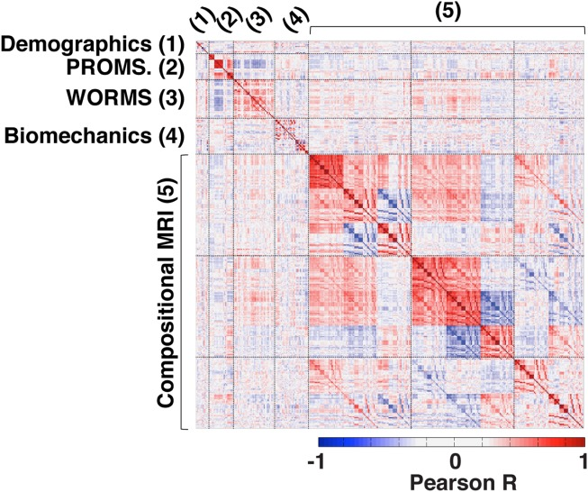

Slide 25
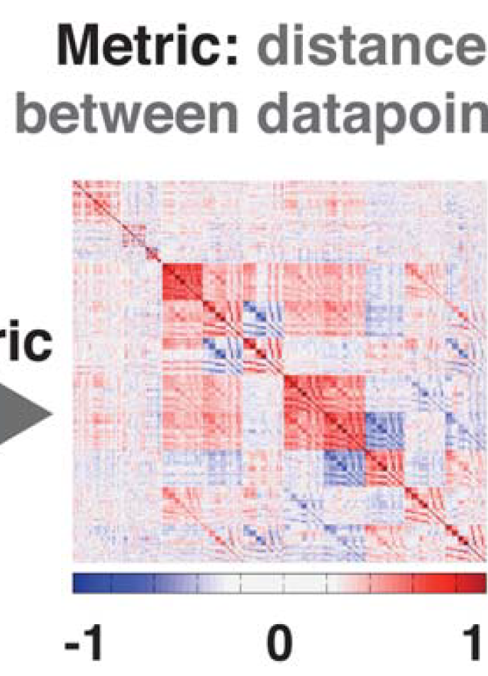

Slide 26
TDA parameters:
2D filter function: PCA1, PCA2
Number of intervals: 30
%overlap: 3.5

Slide 30
TDA parameters:
2D filter function:
PCA1, PCA2
Number of
intervals: 30
%overlap: 3.5
178 subjects
366 variables

Slide 31
48 in subnetwork 1
109 in subnetwork 2
6 in both 1 and 2
15 in subnetwork 3
and singletons(?).
TDA parameters:
2D filter function:
PCA1, PCA2
Number of
intervals: 30
%overlap: 3.5
178 subjects
288 variables

Slide 33
Within the less sever osteoarthritis subpopulation (subnetwork 1) the progressors are marked (dashed circle, subnetwork 1a) and statistically compared to the remaining subjects within subnetwork 1.
This analysis suggests R2-R1q as one of the possible
predictors of cartilage lesion progression in just one of the
two subpopulations identified by the multidimensional analysis approach, highlighting the value of using data-driven
TDA-based grouping.

Slide 39
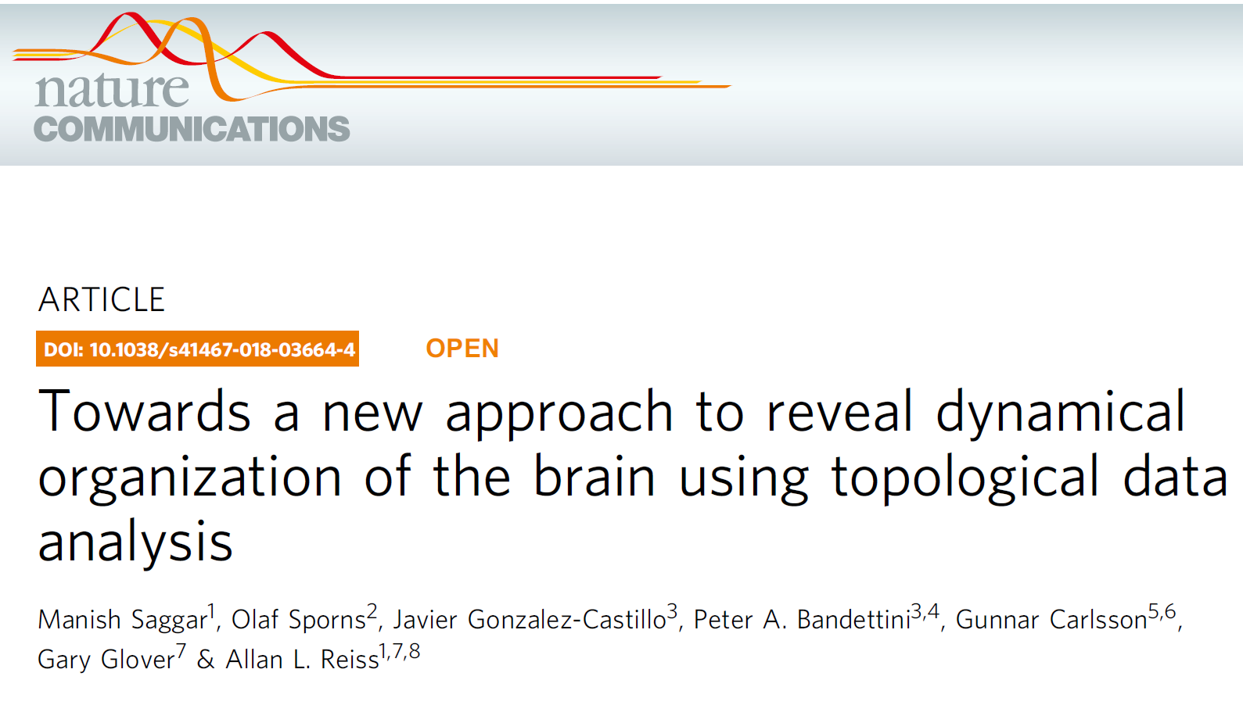
https://www.nature.com/articles/s41467-018-03664-4
Published online:
11 April 2018

Slide 40
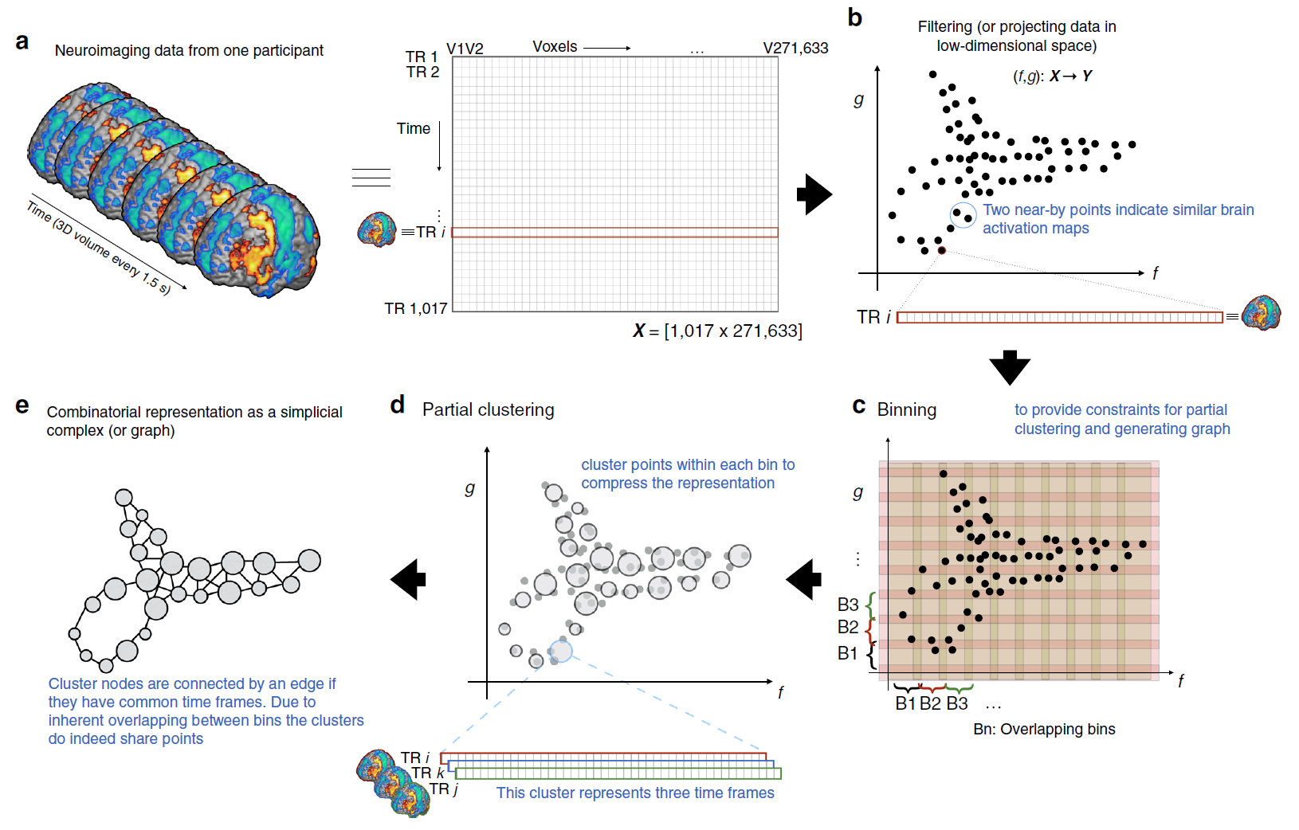
Nonlinear dimensionality reduction method using a variant of stochastic
neighborhood estimation (SNE
1017 data points = 1017 acquired time frames

Slide 41
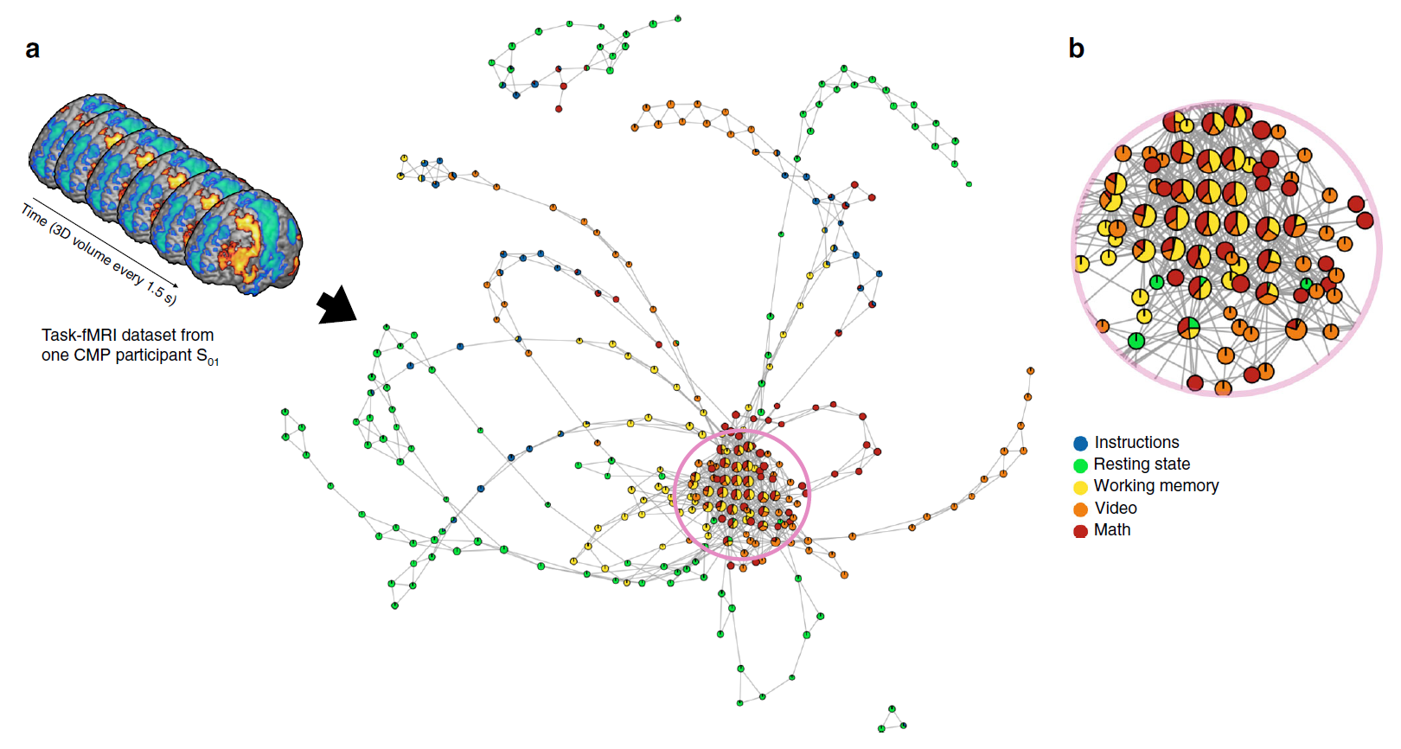
Fig. 2 Revealing the shape of brain’s dynamical organization. a Depicts the shape graph for one of the representative participants (S01) from the CMP
dataset. The shape graph was annotated using colors and pie-chart visualization scheme to depict how the tasks were represented in each shape graph. b
Shows a zoomed-in version of the densely connected region of the shape graph to show the use of pie-chart visualization

Slide 42
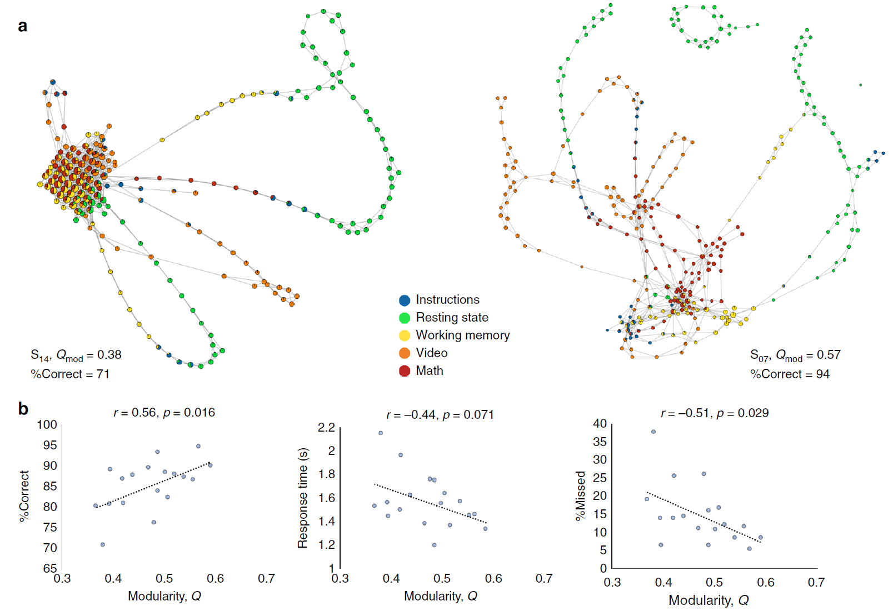

Slide 43
