Slide 1
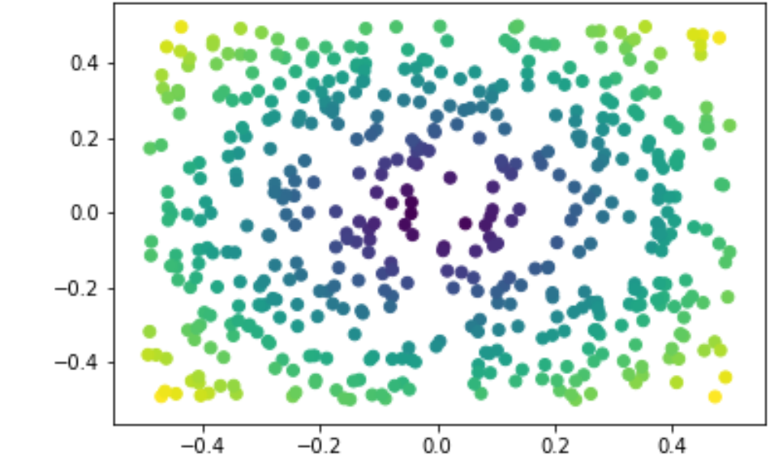
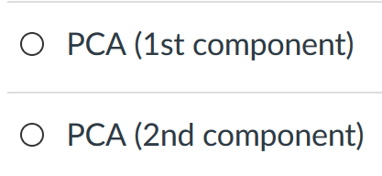
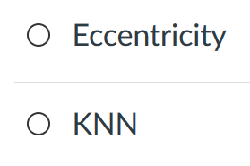
The dataset shown here is colored according to a filter function. What is the filter function used to color the dataset?

Slide 2
Distances

Slide 3
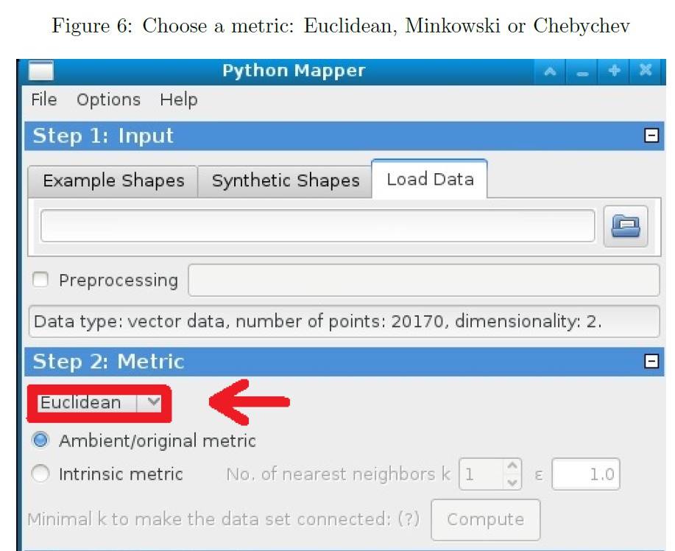

Slide 4
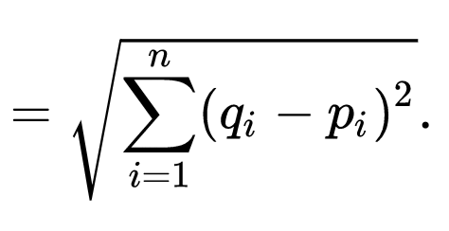
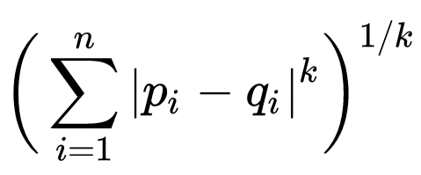
q
d(p, q) = ??
Euclidean
Minkowski distance
Chebyshev distance
5
4
p
3

Slide 5
q
d(p, q) = ??
Euclidean
= (3² + 4²)^{1/2} = 5
5
4
p
3

Slide 6
q
d(p, q) = ??
Minkowski distance
= 3 + 4 = 7
for k = 1
For k = 2, Minkowski = Euclidean
5
4
p
3

Slide 7
q
d(p, q) = ??
Chebyshev distance
= max{3, 4} = 4
5
4
p
3

Slide 8
q
d(p, q) = ??
Euclidean
5
Minkowski distance
7
Chebyshev distance
4
5
4
p
3

Slide 9
q
d(p, q) = ??
Euclidean
Minkowski distance
Chebyshev distance
5
4
p
3

Slide 10
Why use PCA in data analysis?
Consider the points (0, 0, …, 0), (1, 0, …, 0), (10, 0, …, 0)
Add noise to first point (0, 0, …, 0) → (0, 1, …, 1)
In R¹⁰⁰, d((0, 1, …, 1), (1, 0, …, 0)) = 10 > 9.
Add small noise to first point (0, 0, …, 0) → (0, 0.1, …, 0.1)
In R^{39,900}, d((0, 0.1, …, 0.1), (1, 0, …, 0)) = 20 > 9.
0 1 10

Slide 11
In R^{n}
If n small, Euclidean distance often makes sense
If n is large, consider Chebyshev distance or
performing PCA first to project data into R^{d}, for small d
and then using Euclidean distance
Chebyshev distance:

Slide 12
But you may want to focus on Euclidean distance AFTER normalizing:
From databasics3900.r:
> # one way to normalize data
> scaledata2 <- scale(data2) # scales data so that mean = 0, sd = 1
> colMeans(scaledata2) # faster version of apply(scaled.dat, 2, mean)
# shows that mean of each column is 0
Sepal.Length Sepal.Width Petal.Length Petal.Width
-4.480675e-16 2.035409e-16 -2.844947e-17 -3.714621e-17
> apply(scaledata2, 2, sd) # shows that standard deviation
# of each column is 1
Sepal.Length Sepal.Width Petal.Length Petal.Width
1 1 1 1
-------------------------------------------------------------------------------------------
P<- select(tbl_df(scaledata2), Petal.Length) # Choose filter
m1 <- mapper1D( # Apply mapper
distance_matrix = dist(data.frame(scaledata2)),
filter_values = P,
num_intervals = 10,
percent_overlap = 50,
num_bins_when_clustering = 10)
# save data to current working
# directory as a text file
write.table(scaledata2, "data.txt", sep=" ",
row.names = FALSE, col.names = FALSE)

Slide 13
> ?dist
Distance Matrix Computation
Description
This function computes and returns the distance matrix
computed by using the specified distance measure to
compute the distances between the rows of a data matrix.
Usage
dist(x, method = "euclidean", diag = FALSE,
upper = FALSE, p = 2)
method: the distance measure to be used. This must be
one of "euclidean", "maximum", "manhattan", "canberra",
"binary" or "minkowski". Any unambiguous substring
can be given.

Slide 14
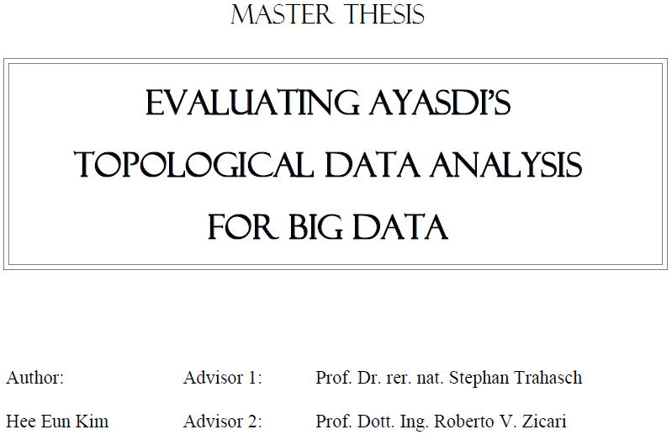
http://www.bigdata.uni-frankfurt.de/wp-content/uploads/2015/10/
Evaluating-Ayasdi’s-Topological-Data-Analysis-For-Big-Data_HKim2015.pdf

Slide 15
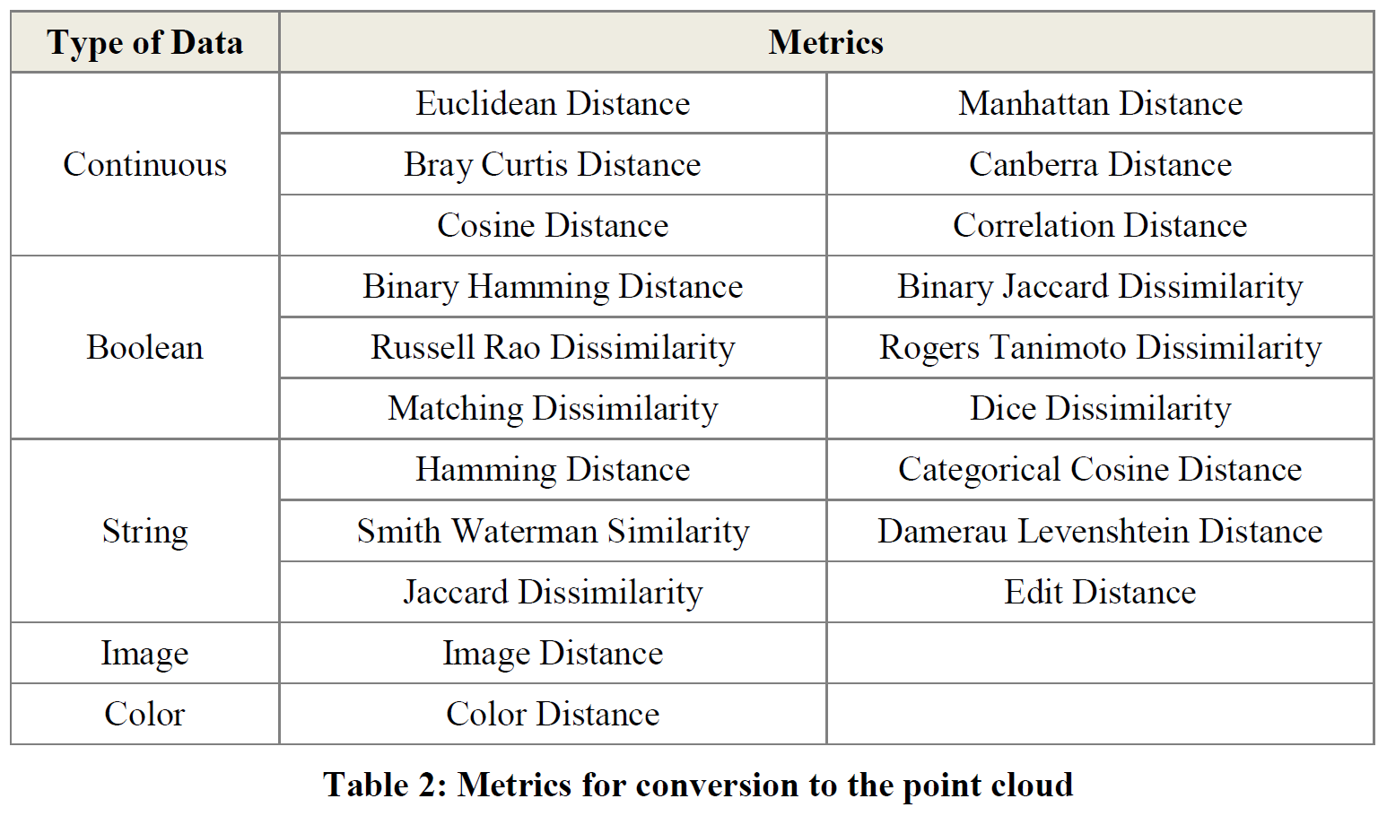
Section 2.2.2: Distances (optional)

Slide 17
http://d-roger.com/2016/09/07/finding-similar-items-查找相似项/
Jacard Distance = 1 – J(A, B)

Slide 18
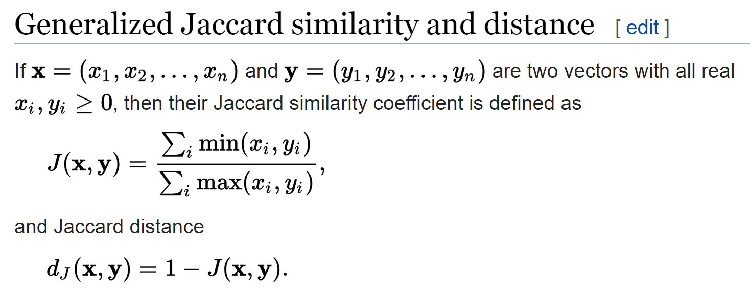
https://en.wikipedia.org/wiki/Jaccard_index

Slide 19
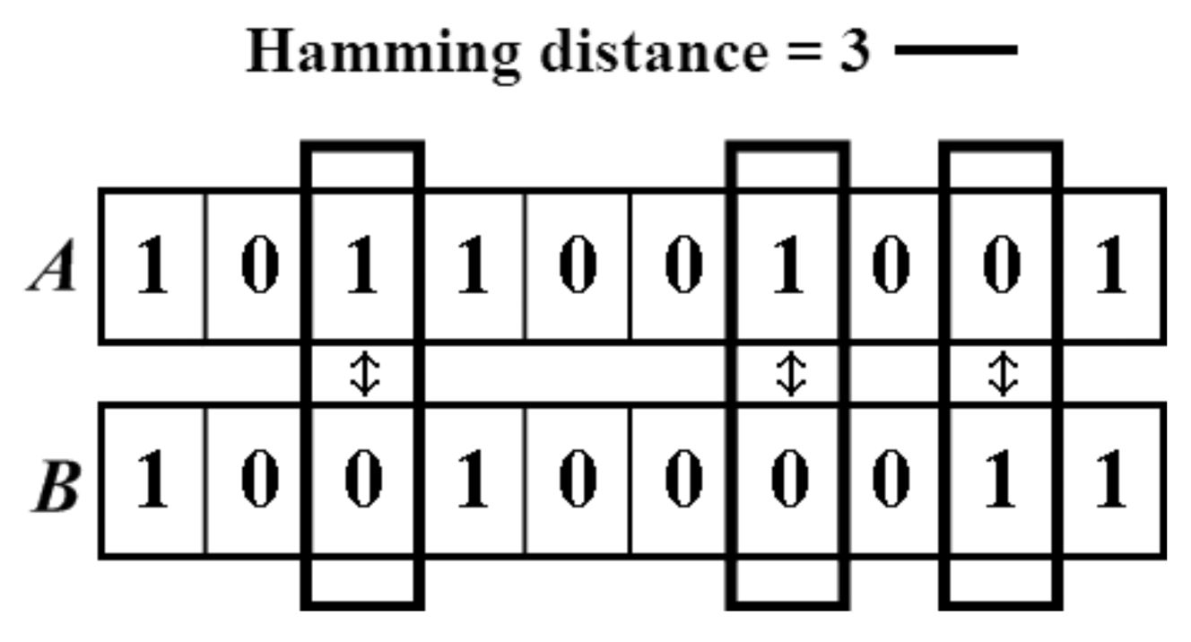
https://people.rit.edu/rmb5229/320/project3/hamming.html
http://rosalind.info/glossary/hamming-distance/
Hamming Distance = 7

Slide 20
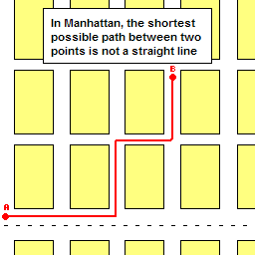
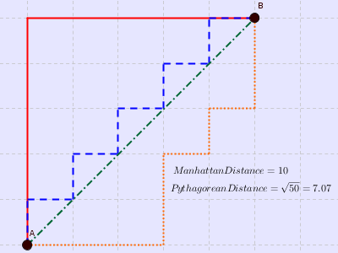
http://www.joachimdespland.com/mammoth.html
http://bloggity.nurdz.com/gamedev-math/manhattan/
http://www.improvedoutcomes.com/docs/WebSiteDocs/Clustering/Clustering_Parameters/Manhattan_Distance_Metric.htm

Slide 22
Filter functions
http://www.bigdata.uni-frankfurt.de/wp-content/uploads/2015/10/
Evaluating-Ayasdi’s-Topological-Data-Analysis-For-Big-Data_HKim2015.pdf

Slide 23
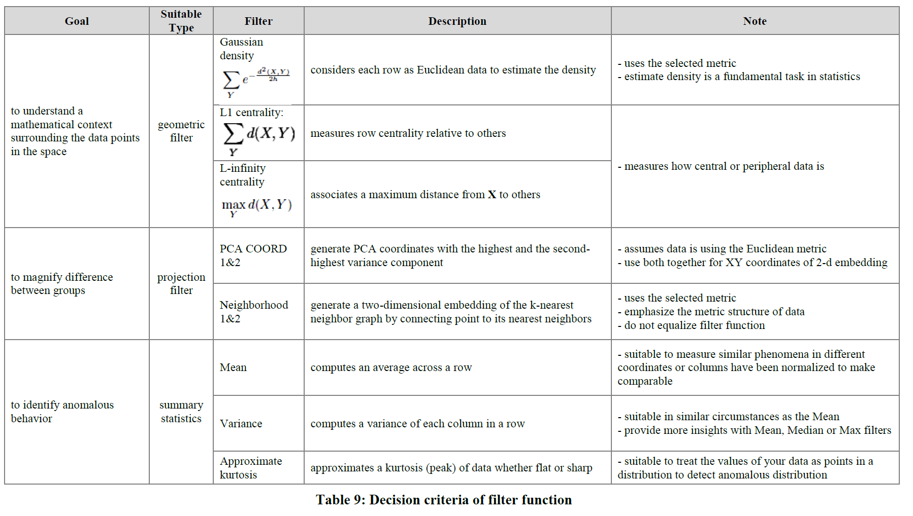

Slide 24
To access a restricted article from off-campus, add the following to the URL:
.proxy.lib.uiowa.edu
For example, change http://stm.sciencemag.org/content/7/311/311ra174.full
to
http://stm.sciencemag.org.proxy.lib.uiowa.edu/content/7/311/311ra174.full

Slide 25
Hypothesize: a data-driven analysis of a clinical population could identify new T2D (Type 2 diabetes) subtypes and factors.
Here, we develop a data-driven, topology-based approach to
map the complexity of patient populations using clinical data from electronic medical records (EMRs) and
identify new, emergent T2D patient subgroups with subtype-specific clinical and genetic characteristics.
data set = EMRs and genotype data from > 11,000 individuals.
Topological analysis of these data revealed three distinct T2D subtypes that exhibited distinct patterns of clinical characteristics and disease comorbidities.
Further, we identified genetic markers associated with each T2D subtype and performed gene- and pathway-level analysis of subtype genetic associations.
From: http://stm.sciencemag.org/content/7/311/311ra174.full

Slide 26
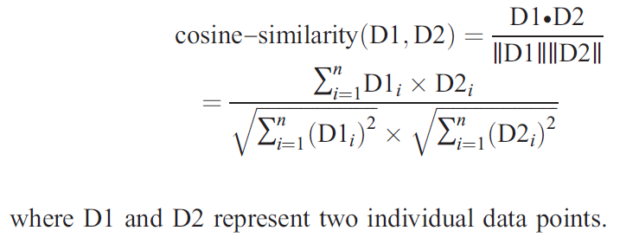
Distance between data points:
From: http://stm.sciencemag.org/content/7/311/311ra174.full

Slide 27
Patient population
11,210 unique patients who are consented participants in the Mount Sinai BioMe Biobank Program, an ongoing, EMR-linked bio- and data repository.
The data set comprises adult patients recruited nonselectively from MSMC’s large outpatient population.
Participants are predominantly recruited from local diverse
communities in New York with 46% Hispanic, 32% African American,
20% European white, and 2% others as self-reported.
6857 (61%) females and 4350 (39%) males.
average age is 55.5 years.
From: http://stm.sciencemag.org/content/7/311/311ra174.full

Slide 28
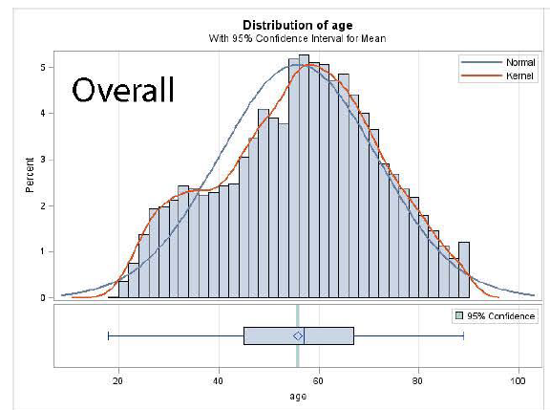
Fig. S1. Age distributions for overall, female, and male populations. Age distributions (top) and box plots (bottom) for overall, female, and male populations. The box plots show the minimum, 25th percentile, mean (diamond), median, 75th percentile, and maximum of the age.
From: http://stm.sciencemag.org/content/7/311/311ra174.full

Slide 29
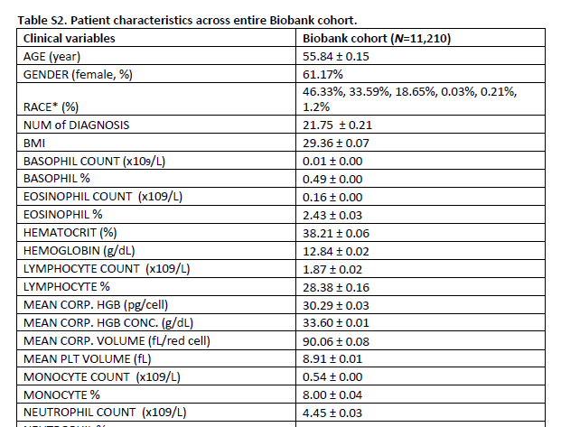
From: http://stm.sciencemag.org/content/7/311/311ra174.full

Slide 30
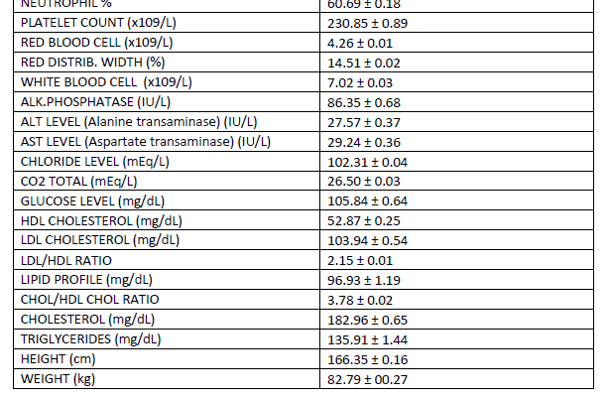
From: http://stm.sciencemag.org/content/7/311/311ra174.full

Slide 31
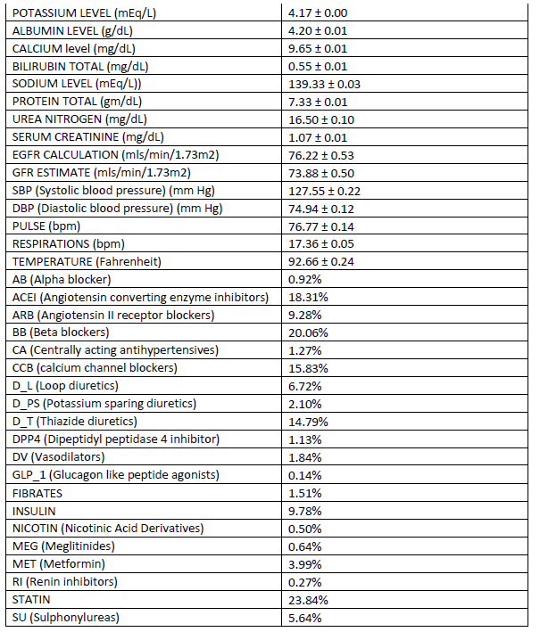
From: http://stm.sciencemag.org/content/7/311/311ra174.full

Slide 32
The processed data were then assembled into a data matrix of n patients by P clinical variables.
The data set used for analysis represented
11,210 individual patients, 505 clinical variables (480 of which were clinical laboratory measures), and 7097 unique ICD-9-CM codes (1 to 218 per patient).
On average, there were 64 clinical variables collected per
patient (range, 25 to 212).
To avoid overfitting, we selected the clinical variables with at least 50% of patients who had the values, resulting in 73 variables to perform the analysis (table S1).
From: http://stm.sciencemag.org/content/7/311/311ra174.full

Slide 33
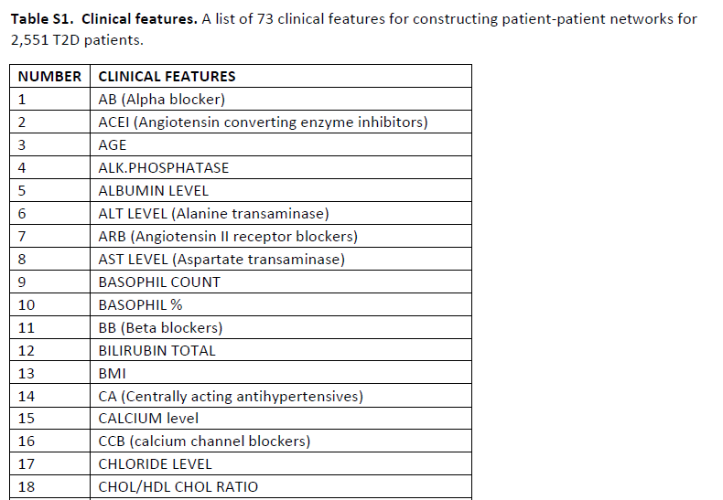
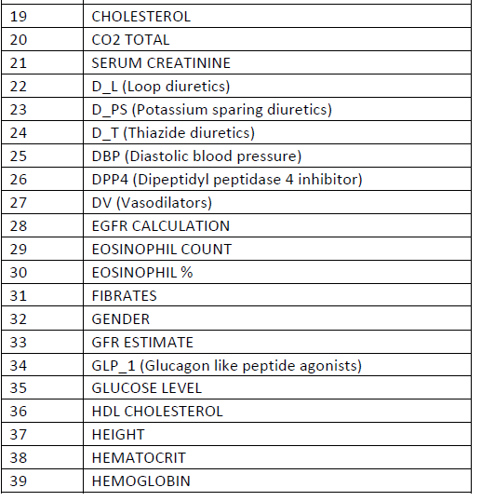
From: http://stm.sciencemag.org/content/7/311/311ra174.full

Slide 34
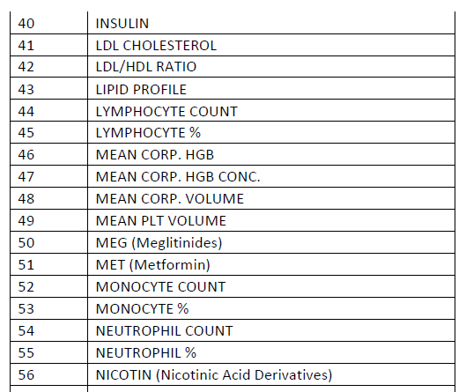
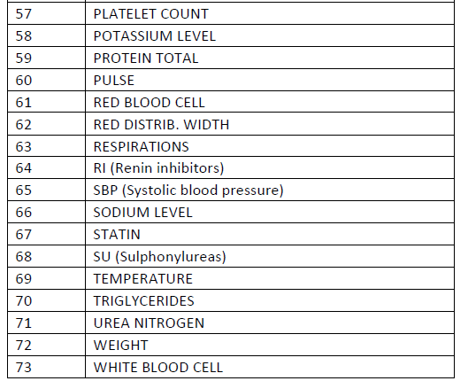
From: http://stm.sciencemag.org/content/7/311/311ra174.full

Slide 35
Disease classification
Each individual patient had at least one ICD-9-CM code diagnosis at the time his or her DNA sample was collected. CCS is a tool that was developed at AHRQ for clustering patient diagnoses and procedures into a manageable number of clinically meaningful categories (18).
The single level of CCS is used to classify all diagnoses and procedures into unique groups based on the patient’s ICD-9-CM codes.
The multilevel characterization of CCS is used to group single-level CCS categories into broader body systems or condition categories (for example, “Diseases of the Circulatory System,” “Mental Disorders”).
The multilevel system has four levels of groupings for diagnoses, and we use the highest, most broad level to examine and assess general groupings for the disease category (18).
In our study, we used 281 mutually exclusive single-level and 18 multilevel categories (broadest level) from CCS to map the disease categories based on their ICD-9-CM codes.
From: http://stm.sciencemag.org/content/7/311/311ra174.full

Slide 36
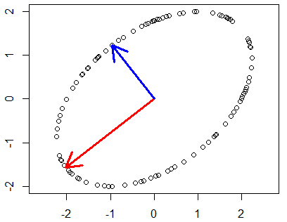
Distance between data points:
Filter functions:
L-infinity centrality:
f(x) = max{d(x, p) : p in data set}
captures the structure of the points far removed from the center or norm.
and
principal metric singular value
decomposition (SVD1)
From: http://stm.sciencemag.org/content/7/311/311ra174.full

Slide 37
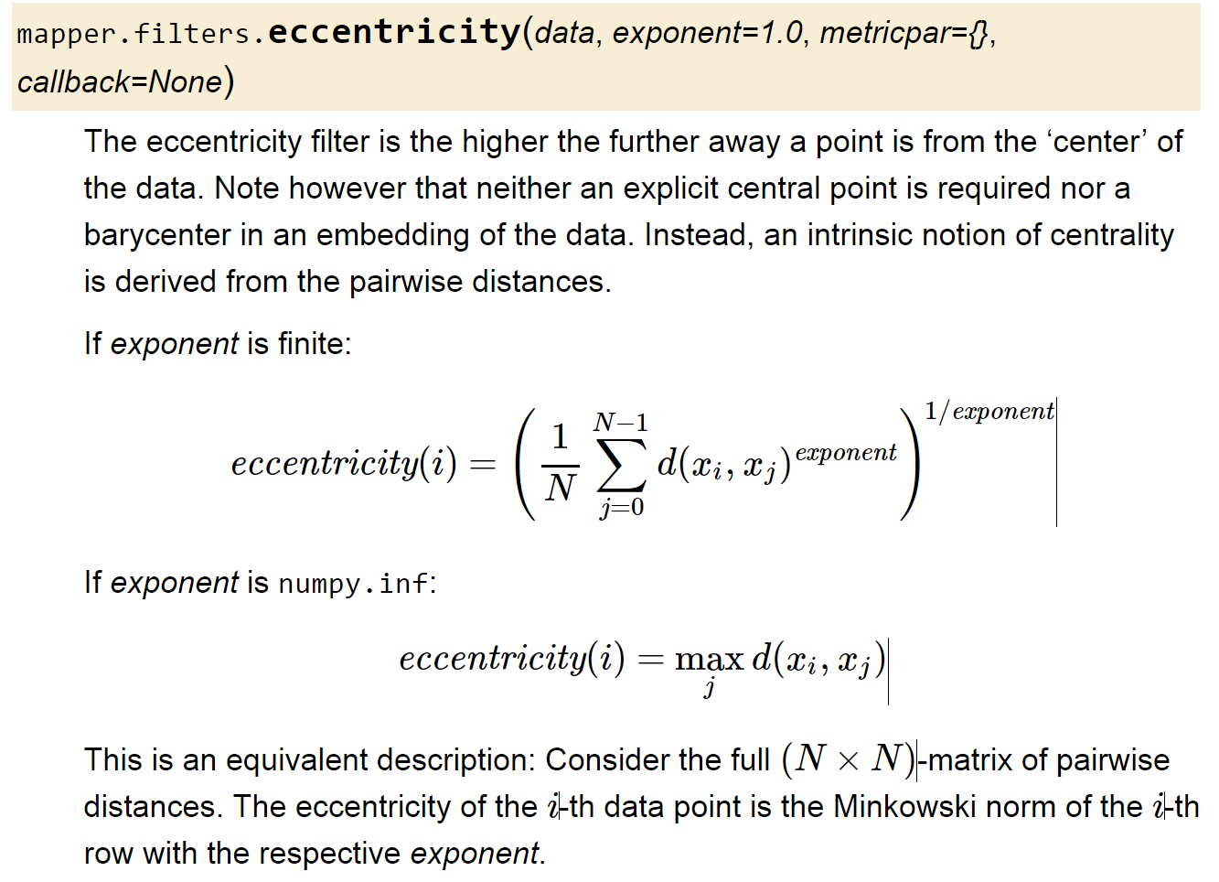
From: http://danifold.net/mapper/filters.html#filter-functions-in-python-mapper

Slide 38
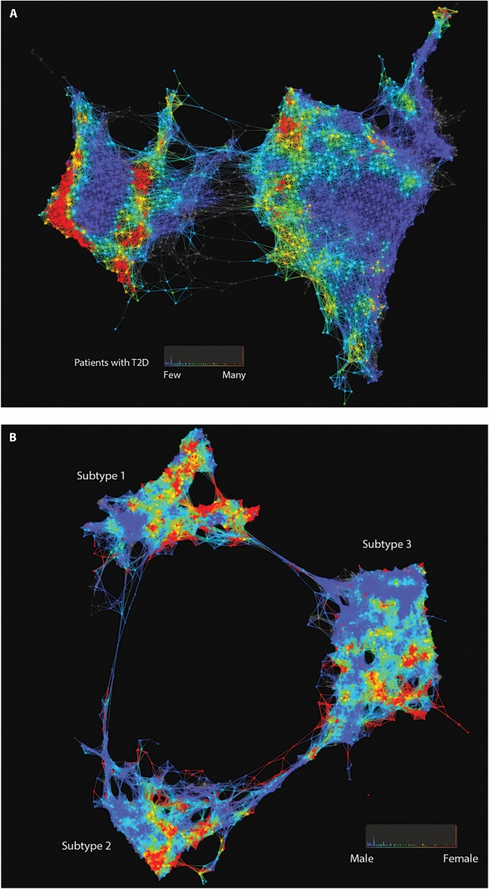
Fig. 1. Patient and genotype networks.
Patient-patient network for topology patterns on 11,210 Biobank patients. Each node represents a single or a group of patients with the significant similarity based on their clinical features. Edge connected with nodes indicates the nodes have shared patients. Red color represents the enrichment for patients with T2D diagnosis, and blue color represents the nonenrichment for patients with T2D diagnosis.
(B) Patient-patient network for topology patterns on 2551 T2D patients. Each node represents a single or a group of patients with the significant similarity based on their clinical
features. Edge connected with nodes indicates the nodes have shared patients. Red color represents the enrichment for patients with females, and blue color represents the enrichment for males.
Li Li et al., Sci Transl Med 2015;7:311ra174
From: http://stm.sciencemag.org/content/7/311/311ra174.full
Published by AAAS
Notes:
Patient and genotype networks. (A) Patient-patient network for topology patterns on 11,210 Biobank patients. Each node represents a single or a group of patients with the significant similarity based on their clinical features. Edge connected with nodes indicates the nodes have shared patients. Red color represents the enrichment for patients with T2D diagnosis, and blue color represents the nonenrichment for patients with T2D diagnosis. (B) Patient-patient network for topology patterns on 2551 T2D patients. Each node represents a single or a group of patients with the significant similarity based on their clinical features. Edge connected with nodes indicates the nodes have shared patients. Red color represents the enrichment for patients with females, and blue color represents the enrichment for males.

Slide 39
From: http://stm.sciencemag.org/content/7/311/311ra174.full

Slide 40
(B) Patient-patient network for topology patterns on 2551 T2D patients. Each node represents a single or a group of patients with the significant similarity based on their clinical features. Edge connected with nodes indicates the nodes have shared patients. Red color represents the enrichment for patients with females, and blue color represents the enrichment for males.
From: http://stm.sciencemag.org/content/7/311/311ra174.full
Published by AAAS
Notes:
Patient and genotype networks. (A) Patient-patient network for topology patterns on 11,210 Biobank patients. Each node represents a single or a group of patients with the significant similarity based on their clinical features. Edge connected with nodes indicates the nodes have shared patients. Red color represents the enrichment for patients with T2D diagnosis, and blue color represents the nonenrichment for patients with T2D diagnosis. (B) Patient-patient network for topology patterns on 2551 T2D patients. Each node represents a single or a group of patients with the significant similarity based on their clinical features. Edge connected with nodes indicates the nodes have shared patients. Red color represents the enrichment for patients with females, and blue color represents the enrichment for males.

Slide 41
Subtype 1 was characterized
by T2D complications
diabetic nephropathy and diabetic retinopathy;
subtype 2 was enriched
for cancer malignancy
and cardiovascular diseases;
subtype 3 was associated most strongly with cardiovascular diseases,
neurological diseases, allergies, and HIV infections.
From: http://stm.sciencemag.org/content/7/311/311ra174.full
Published by AAAS
Notes:
Patient and genotype networks. (A) Patient-patient network for topology patterns on 11,210 Biobank patients. Each node represents a single or a group of patients with the significant similarity based on their clinical features. Edge connected with nodes indicates the nodes have shared patients. Red color represents the enrichment for patients with T2D diagnosis, and blue color represents the nonenrichment for patients with T2D diagnosis. (B) Patient-patient network for topology patterns on 2551 T2D patients. Each node represents a single or a group of patients with the significant similarity based on their clinical features. Edge connected with nodes indicates the nodes have shared patients. Red color represents the enrichment for patients with females, and blue color represents the enrichment for males.

Slide 42
We performed a genetic association analysis of the emergent T2D subtypes to identify subtype-specific genetic markers and identified 1279, 1227, and 1338 single-nucleotide polymorphisms (SNPs) that mapped to 425, 322, and 437 unique genes specific to subtypes 1, 2, and 3, respectively.
By assessing the human disease–SNP association for each subtype, the enriched phenotypes and biological functions at the gene level for each subtype matched with the disease comorbidities and clinical differences that we identified through EMRs.
From: http://stm.sciencemag.org/content/7/311/311ra174.full
Published by AAAS
Notes:
Patient and genotype networks. (A) Patient-patient network for topology patterns on 11,210 Biobank patients. Each node represents a single or a group of patients with the significant similarity based on their clinical features. Edge connected with nodes indicates the nodes have shared patients. Red color represents the enrichment for patients with T2D diagnosis, and blue color represents the nonenrichment for patients with T2D diagnosis. (B) Patient-patient network for topology patterns on 2551 T2D patients. Each node represents a single or a group of patients with the significant similarity based on their clinical features. Edge connected with nodes indicates the nodes have shared patients. Red color represents the enrichment for patients with females, and blue color represents the enrichment for males.

Slide 43
Correlation does not equal causation!!!
But correlation can be very helpful!!!

Slide 44
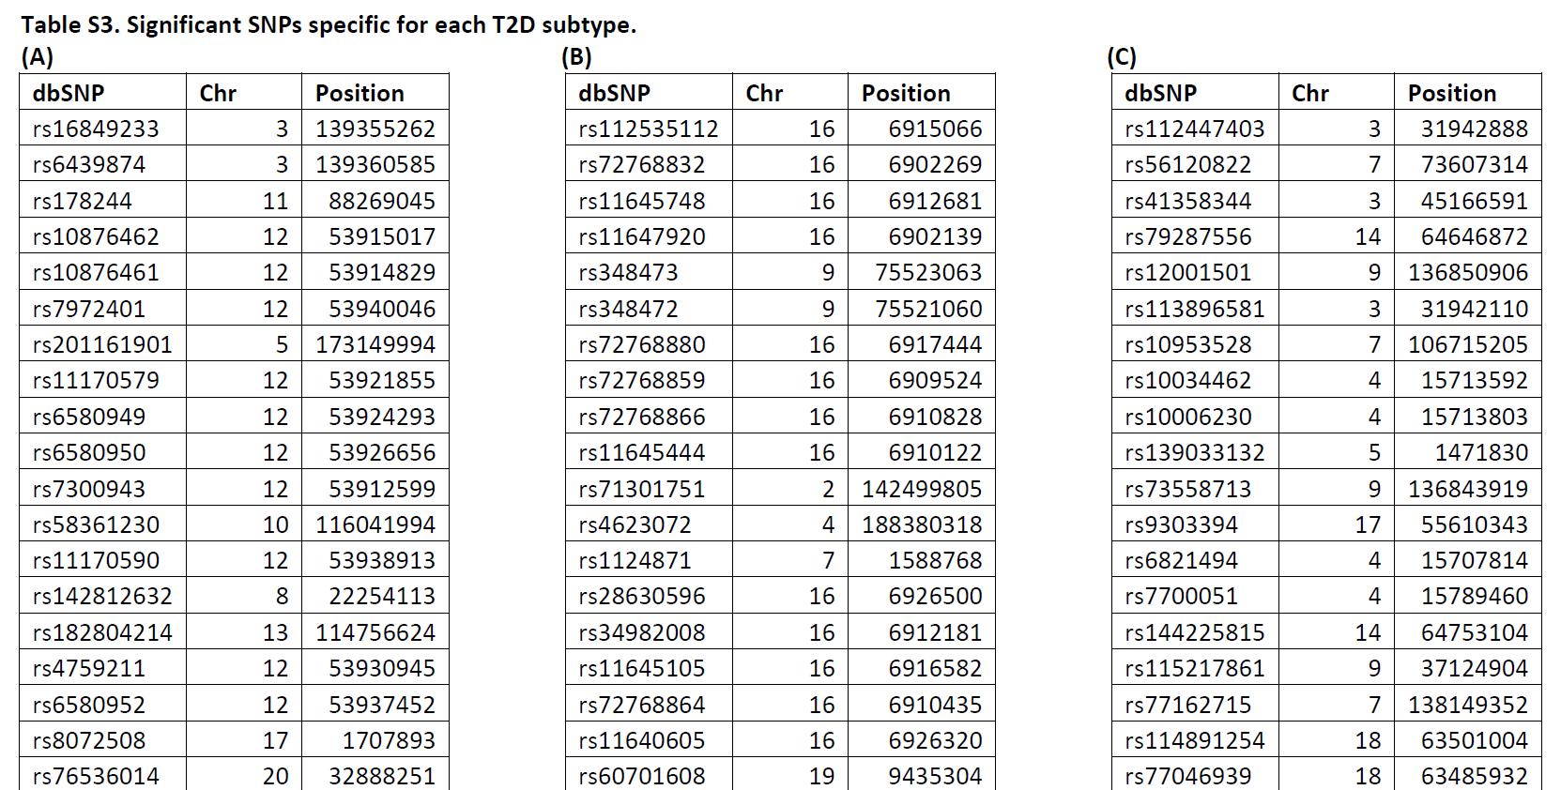
A total of 11,210 unique patients were genotyped for genome-wide Illumina OmniExpress and Illumina Human Exome BeadChip arrays.
From: http://stm.sciencemag.org/content/7/311/311ra174.full

Slide 45
Table S4. Genes and variants. The number of variants, in coding regions, and genes using Genome build GRCh37/hg19 in both original genotype and the imputed data.
From: http://stm.sciencemag.org/content/7/311/311ra174.full

