Slide 1
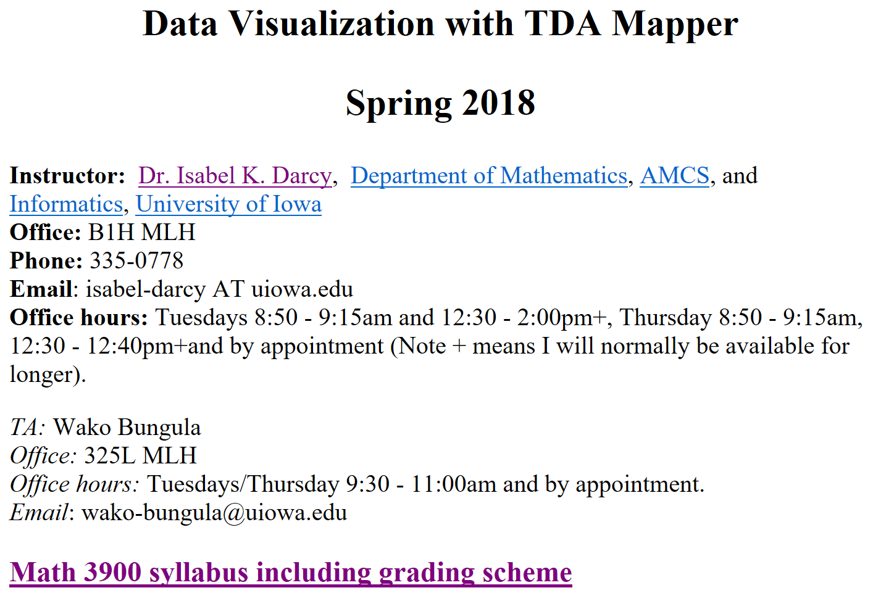

Slide 2
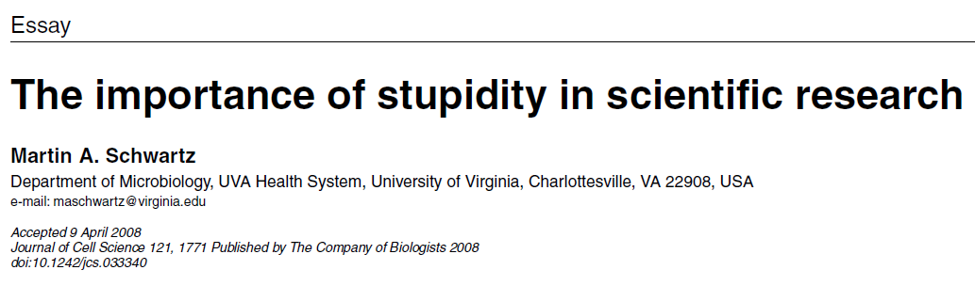
http://jcs.biologists.org/content/121/11/1771
I'd like to suggest that our Ph.D. programs often do students a disservice in two ways. First, I don't think students are made to understand how hard it is to do research. And how very, very hard it is to do important research. It's a lot harder than taking even very demanding courses. What makes it difficult is that research is immersion in the unknown. We just don't know what we're doing. We can't be sure whether we're asking the right question or doing the right experiment until we get the answer or the result.

Slide 3
Submit paper
to math journal to biology journal
Wait 6 – 12 months Wait 3 – 6 weeks
Implement reviewers’ suggestions
and respond to reviewers.
Submit revised version
If accepted, paper will (eventually or almost immediately) be published.

Slide 4
Reviewer first gives brief summary of the paper (often using authors’ wording) and motivates recommendation for or against publication
This is referee's report for the paper…
Some protein complexes interact with multiple DNA segments during
biological processes.These processes can change the topology of DNA which results in knotted or linked DNA. Tangle analysis was introduced to study/model various protein actions mathematically. The protein is modeled by a 3-dimensional ball and the protein-bound DNA is modeled by strings embedded in the ball.
A protein complex bound to a circular DNA molecule at four sites can be modeled by a 4-string tangle. In this paper, the authors provide a biologically relevant 4-string tangle model of a DNA-protein complex and develop mathematics to determine the topology of DNA within the protein complex. The paper contains new and interesting results, and it is carefully written. The proofs are technical and elaborate. In referee's opinion, the paper deserves to be published in JKTR, after taking into account the corrections/suggestions given below.
List of corrections/suggestions:
page 2, line 8: delete the space after \DNA segments".
- last paragraph in the Introduction: replace \section i" with\Section i".
- Section 2: italicize the terms newly introduced:
page 2, line -4: \jumping DNA"
page 2, line -2:\ transposable element"
page 2, line -1: \transposon" and \transposition"
...
Reviewer gives specific list of corrections that must (?) be implemented

Slide 5
Response to referee's report:
We thank the reviewer for their detailed comments ….
We have implemented their suggestions as described below:
page 2, line 8: delete the space after \DNA segments".
done,
- last paragraph in the Introduction: replace \section i" with\Section i".
done
- Section 2: italicize the terms newly introduced:
done
Often additional explanation is needed
E.g.: We addressed the reviewers concern on new page ?, lines ??
often quote of the lines included in the report.
If you disagree with the reviewer and do not want to implement one of the suggestions, you must explain why.

Slide 6
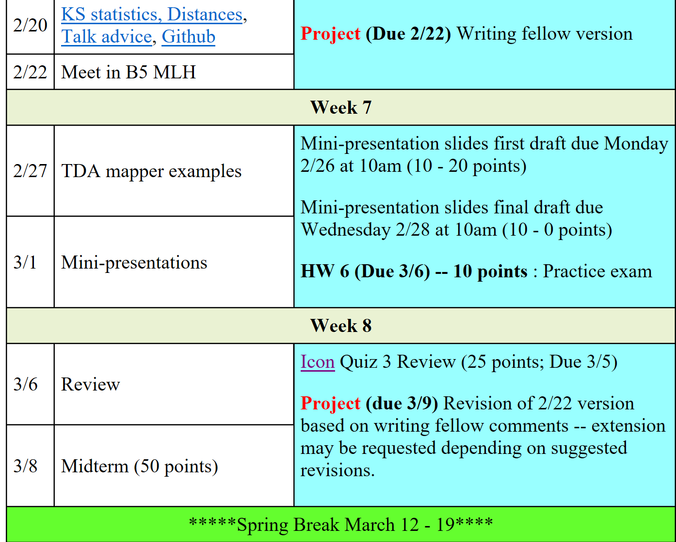
Feb 22 FIRM DEADLINE
When describing the TDA mapper algorithm, it may help to think of writing a manual on how to create the graph output from the data input. For example, a manual for how to put a bookcase together has figures and the text refers often to these figures.

Slide 8
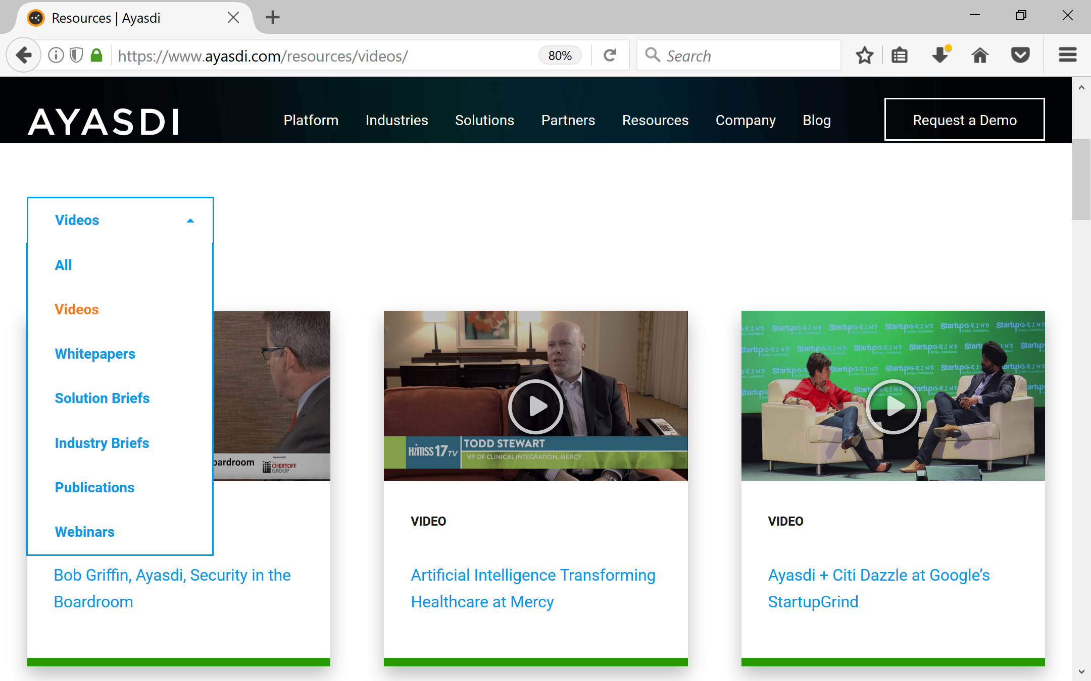
https://www.ayasdi.com/resources/

Slide 9
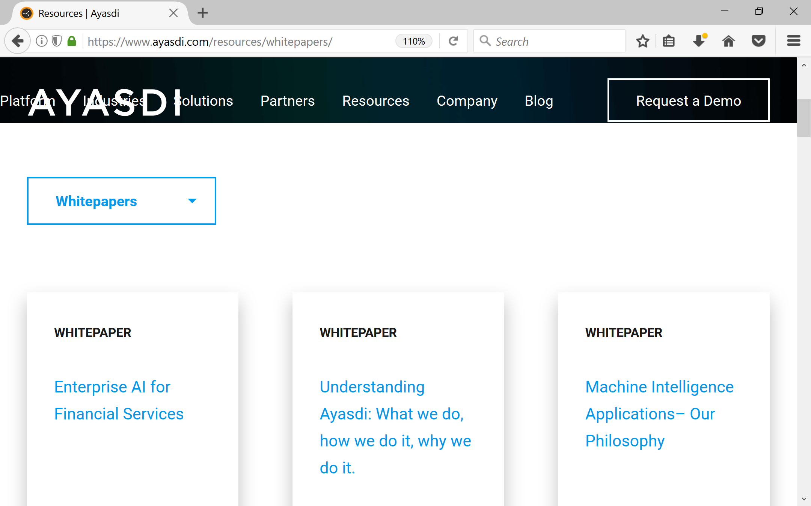
https://www.ayasdi.com/resources/

Slide 10
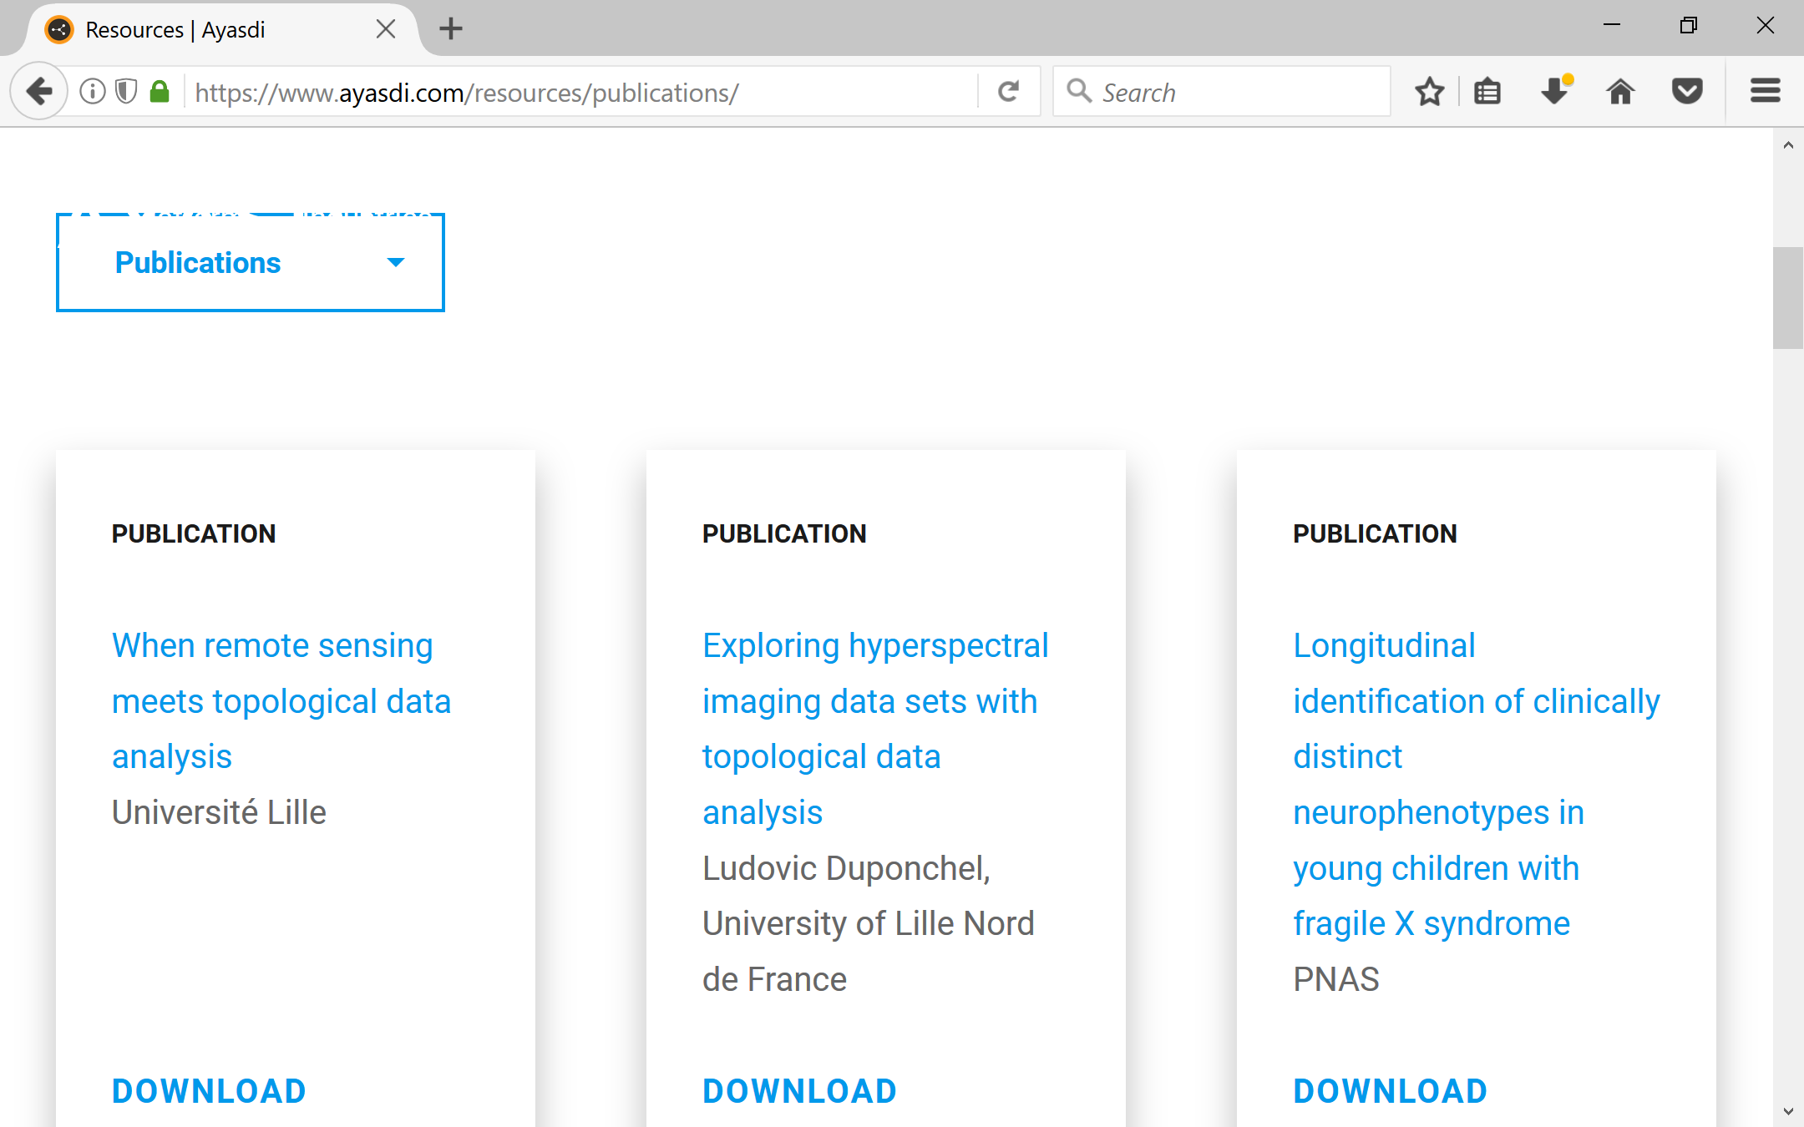
https://www.ayasdi.com/resources/

Slide 11

https://speakingcenter.uiowa.edu/about-us

Slide 12
Modified from http://www.garrreynolds.com/preso-tips/design/
1. Keep it Simple
  Lots of white space is good: The less clutter you have on your slide, the more powerful your visual message will become.
2. Limit bullet points & text
  3. Limit transitions & builds (animation)
  Only use animations that illustrate a point.
  Don’t use unnecessary animations.
4. Use high-quality LARGE graphics (and fonts)
5. Have a visual theme, but avoid using PowerPoint templates
6. Use appropriate charts
7. Use color well
8. Choose your fonts well
  use the same font set throughout your entire slide presentation, and use no more than two complementary sans-serif fonts (e.g., Arial and Arial Bold).
9. Use video or audio when appropriate.
10. Organize your talk: Spend time in the slide sorter (or print out your slides at least 6 to a page).

Slide 13
In an assertion-evidence slide, the headline is a sentence that succinctly states the slide’s main message
Photograph, drawing, diagram, or graph
supporting the headline message (no bulleted list)
Call-out(s), if needed:
no more than two lines
PowerPoint Template: http://writing.engr.psu.edu/AE_template_PSU.ppt
Notes:
13
This file presents a template for making Assertion–Evidence (A–E) slides in a technical presentation. The design advocated by this template arises from pages 113-152 of The Craft of Scientific Presentations (Springer, 2003) and from the first Google listing for “presentation slides”:
http://www.writing.engr.psu.edu/slides.html
To follow this template, make sure that you create the slide within this PowerPoint file. Working with a New Slide (under Insert in older versions or as a button on the Home tab in version 2007) , you should first craft a sentence headline that states an assertion about your topic. Having no assertion translates to having no slide. In the body of the slide, you should then support that headline assertion visually: photographs, drawings, diagrams, equations, or words arranged visually. Use supporting text only where necessary. Do not use bulleted lists, because bulleted lists do not reveal the connections between details.
This slide shows one orientation for the image and supporting text. Other orientations exist, as shown in the sample slides that follow.

Slide 14
Coloring

Slide 15
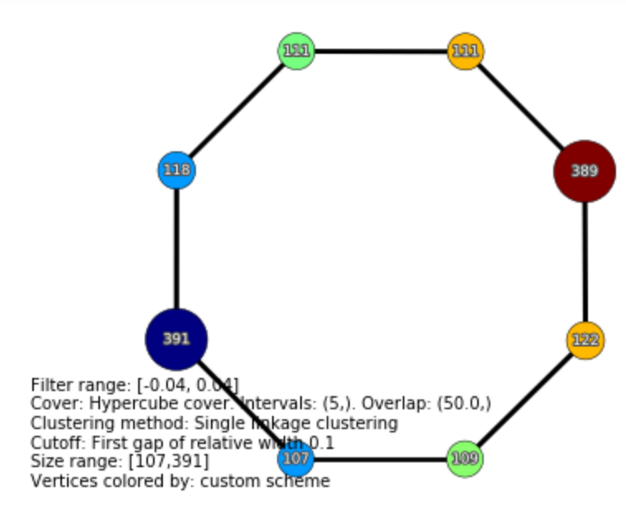
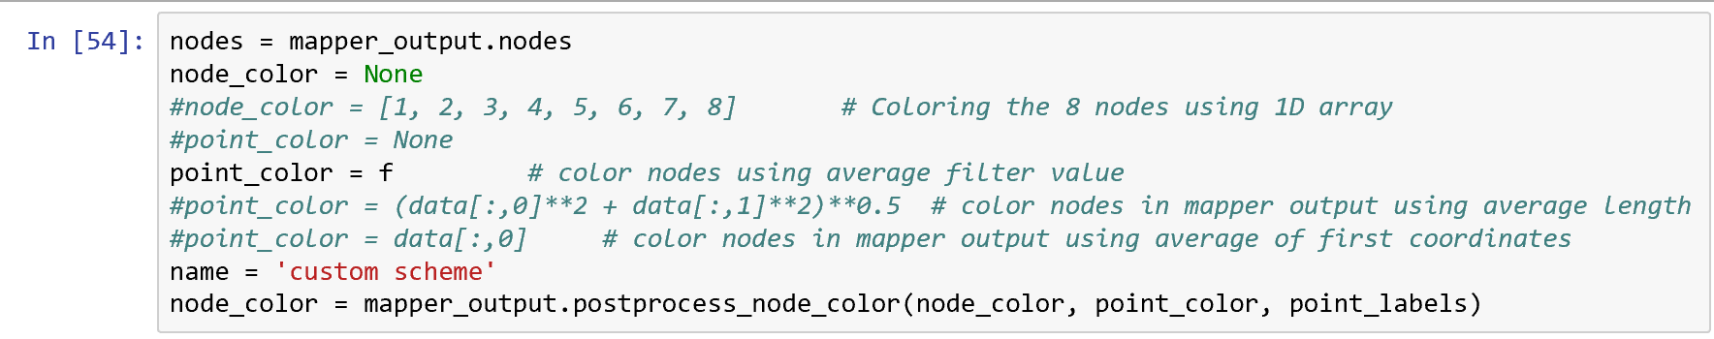
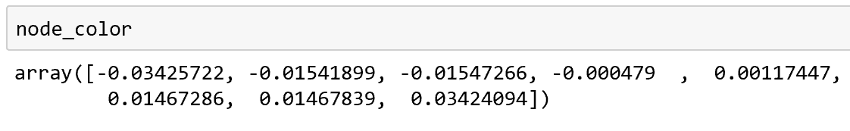
In Jupyter notebook
Choose how to color vertices in TDA mapper graph
Output the color code for each node in TDA mapper graph

Slide 16
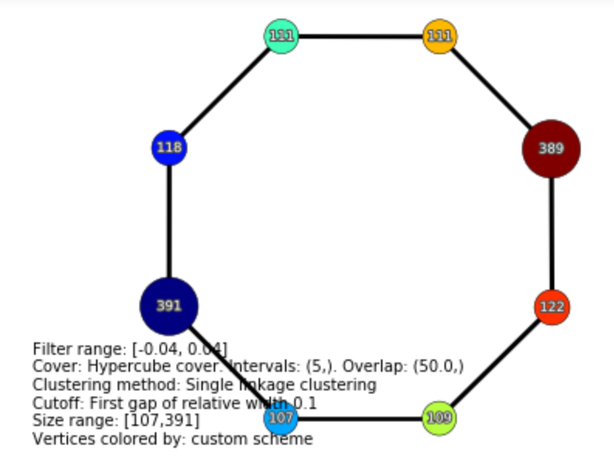
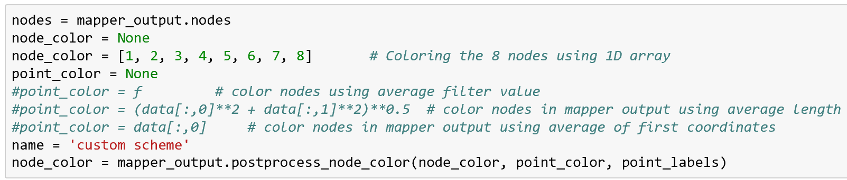
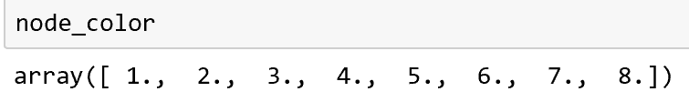
In Jupyter notebook
Choose how to color vertices in TDA mapper graph
Output the color code for each node in TDA mapper graph

Slide 17
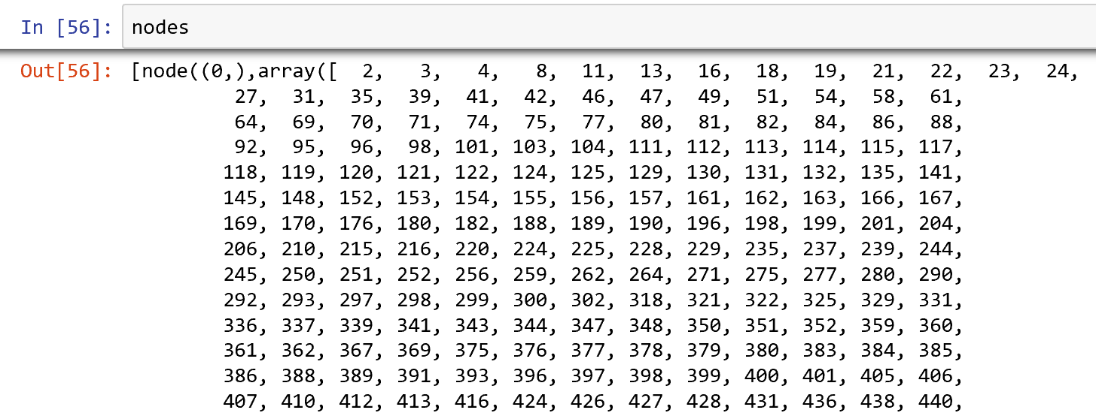

Slide 18
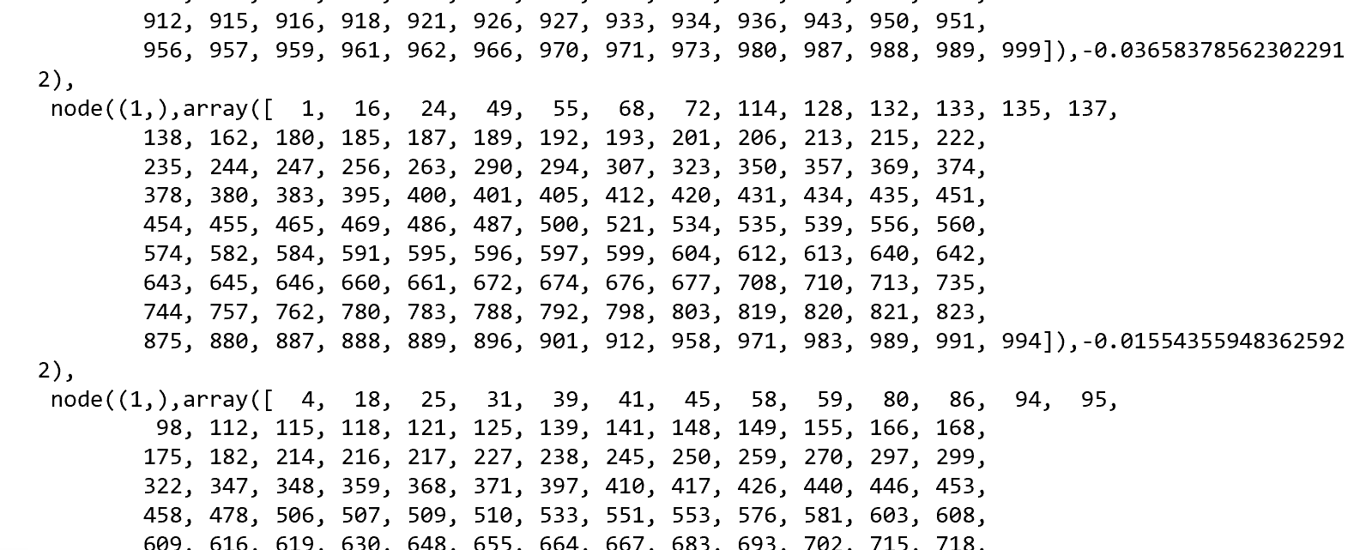

Slide 19
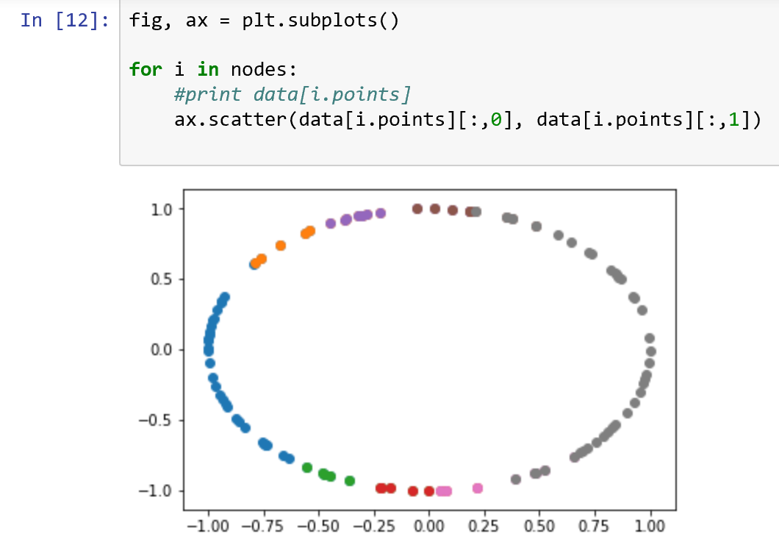

Slide 20
Kolmogorov-Smirnov Test

Slide 21
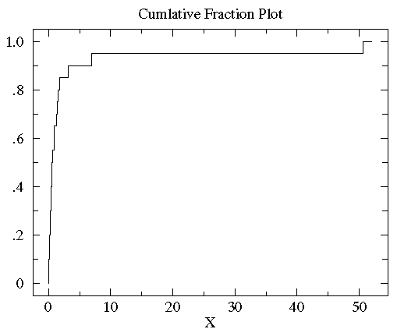
http://www.physics.csbsju.edu/stats/KS-test.html
Sorted controlB={0.08, 0.10, 0.15, 0.17, 0.24, 0.34, 0.38, 0.42, 0.49, 0.50, 0.70, 0.94, 0.95, 1.26, 1.37, 1.55, 1.75, 3.20, 6.98, 50.57}

Slide 22
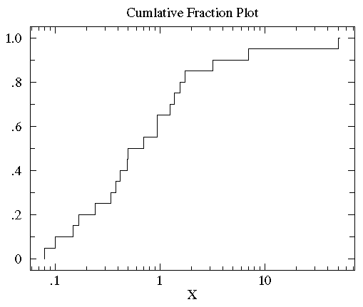
http://www.physics.csbsju.edu/stats/KS-test.html
Sorted controlB={0.08, 0.10, 0.15, 0.17, 0.24, 0.34, 0.38, 0.42, 0.49, 0.50, 0.70, 0.94, 0.95, 1.26, 1.37, 1.55, 1.75, 3.20, 6.98, 50.57}

Slide 23
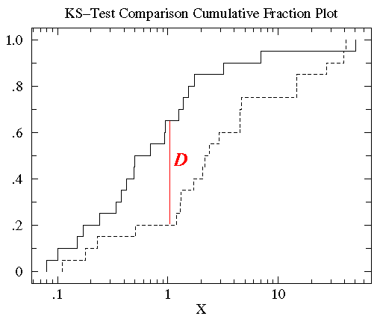
http://www.physics.csbsju.edu/stats/KS-test.html
treatmentB= {2.37, 2.16, 14.82, 1.73, 41.04, 0.23, 1.32, 2.91, 39.41, 0.11, 27.44, 4.51, 0.51, 4.50, 0.18, 14.68, 4.66, 1.30, 2.06, 1.19}

Slide 24
http://www.physics.csbsju.edu/stats/KS-test.html
treatmentB= {0.11, 0.18, 0.23, 0.51, 1.19, 1.30, 1.32, 1.73, 2.06, 2.16, 2.37, 2.91, 4.50, 4.51, 4.66, 14.68, 14.82, 27.44, 39.41, 41.04}

Slide 25
http://www.physics.csbsju.edu/stats/KS-test.html
The KS-test uses the maximum vertical deviation between the two curves as the statistic D. In this case the maximum deviation occurs near x=1 and has D=.45. (The fraction of the treatment group that is less then one is 0.2 (4 out of the 20 values); the fraction of the control group that is less than one is 0.65 (13 out of the 20 values). Thus the maximum difference in cumulative fraction is D=.45.)

Slide 26
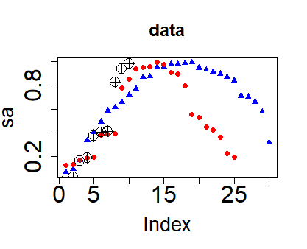
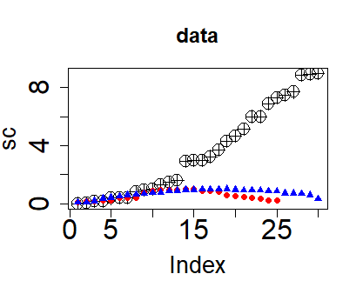
a <- sort(runif(30, 0,3))
sa <-sin(a)
b <- sort(runif(25, 0,3))
sb <-sin(b)
c <- sort(runif(30, 0,3))
sc <- c^2
plot(sa, main = "data", col="blue", pch = 17,
cex.main = 1.5, cex.lab = 1.7, cex.axis = 2)
points(sb, col="red", pch = 19)
points(sc, pch = 10, cex=2)
plot(sc, main = "data", pch = 10,
cex=2, cex.main = 1.5,
cex.lab = 1.7, cex.axis = 2)
points(sb, col="red", pch = 19)
points(sa, col="blue", pch = 17)

Slide 27
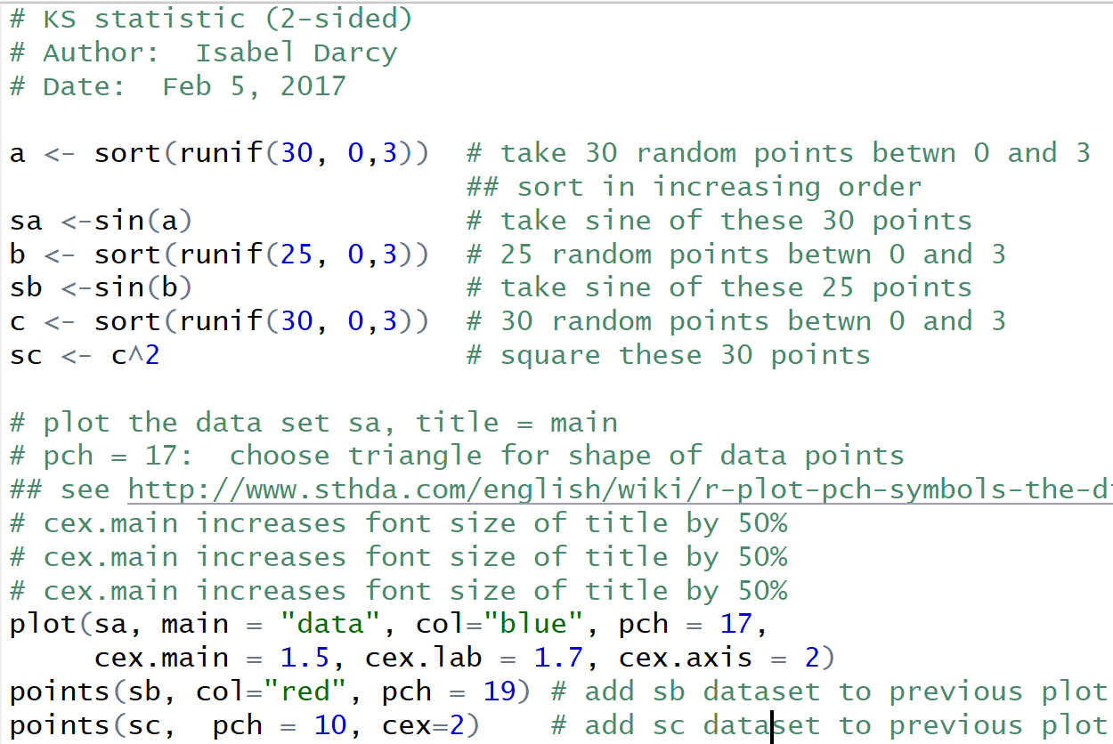
ks.r

Slide 28
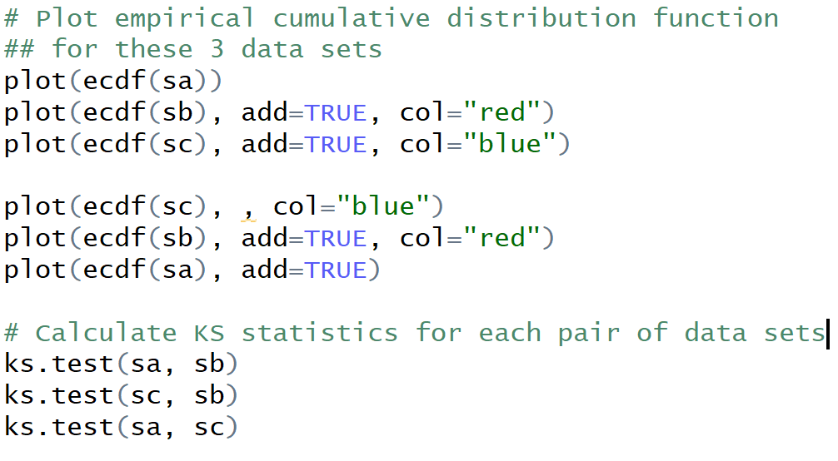
ks.r (cont.)

Slide 29
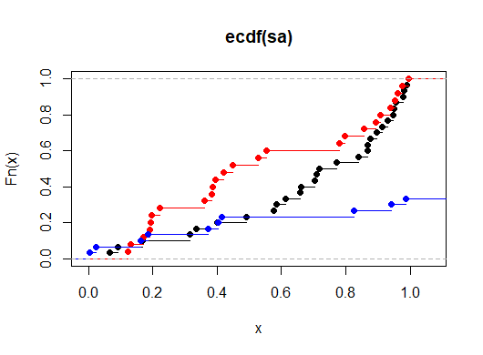
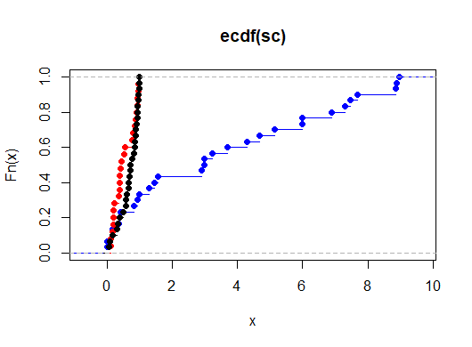
# Plot empirical cumulative
## distribution function
## for these 3 data sets
plot(ecdf(sa))
plot(ecdf(sb), add=TRUE,
col="red")
plot(ecdf(sc), add=TRUE,
col="blue")
plot(ecdf(sc), , col="blue")
plot(ecdf(sb), add=TRUE,
col="red")
plot(ecdf(sa), add=TRUE)

Slide 30
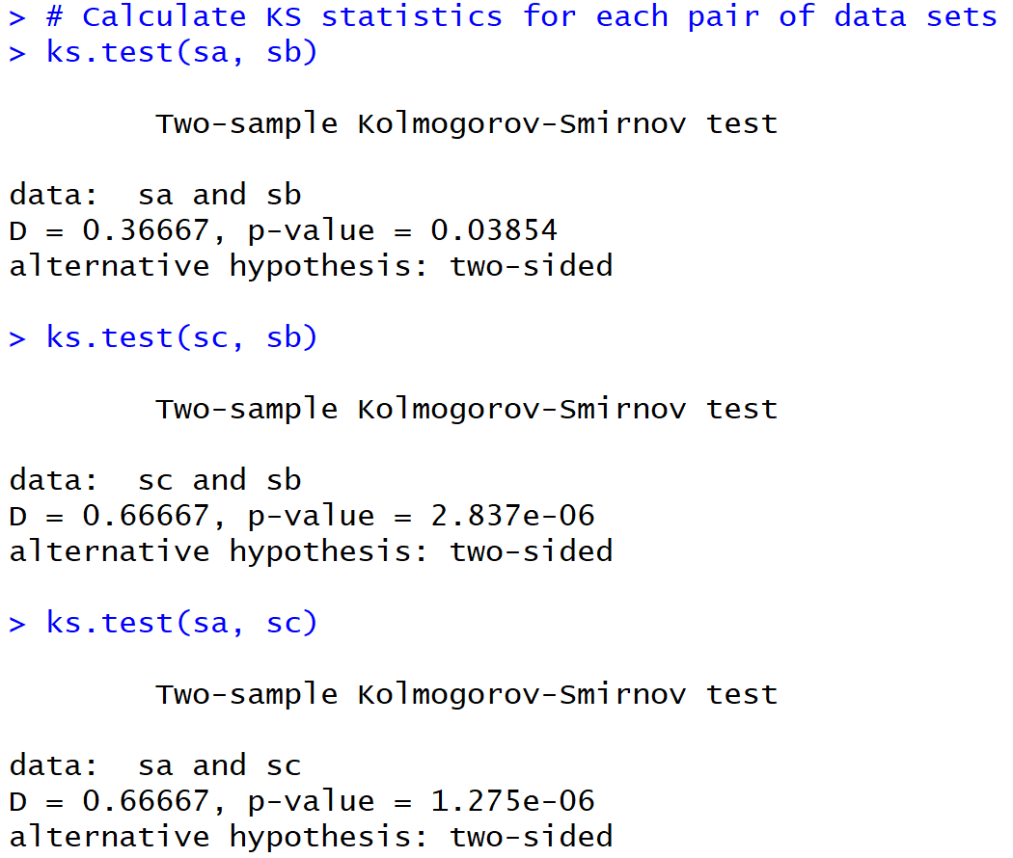

Slide 31
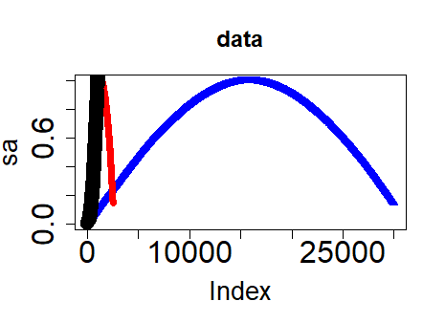
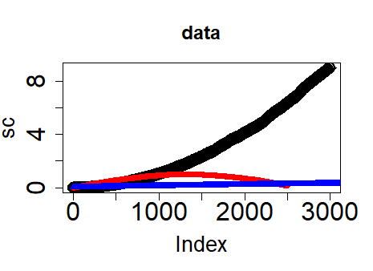
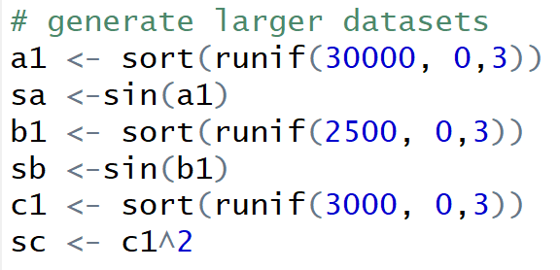

Slide 32
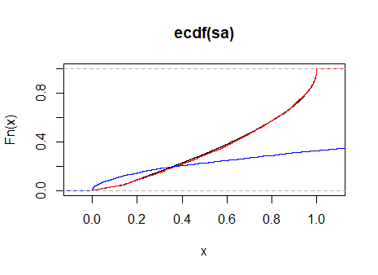
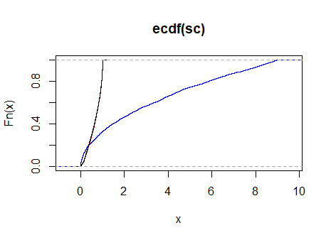

Slide 33
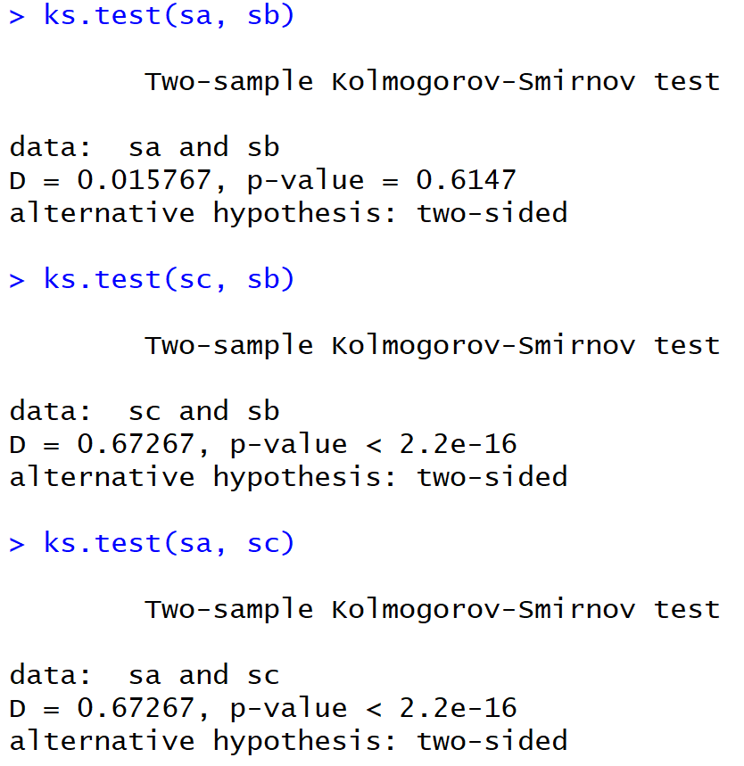
For large dataset

Slide 34
For smaller dataset

Slide 35
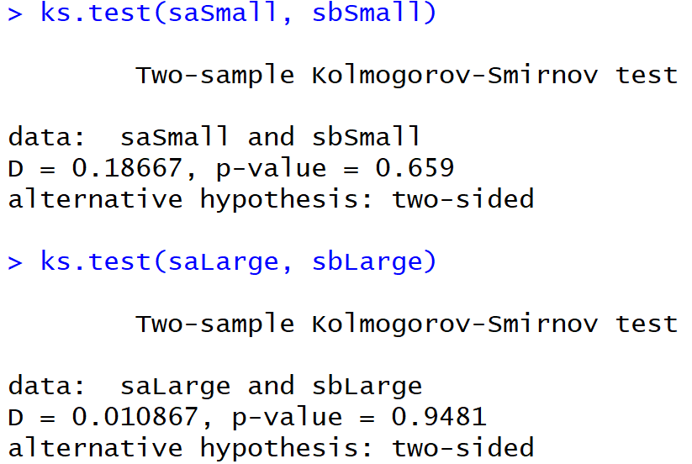

Slide 36
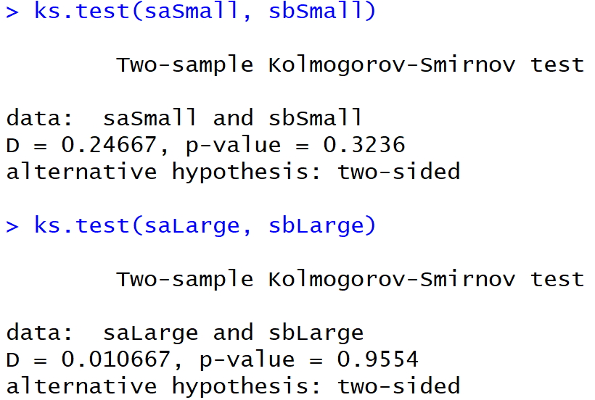

Slide 37
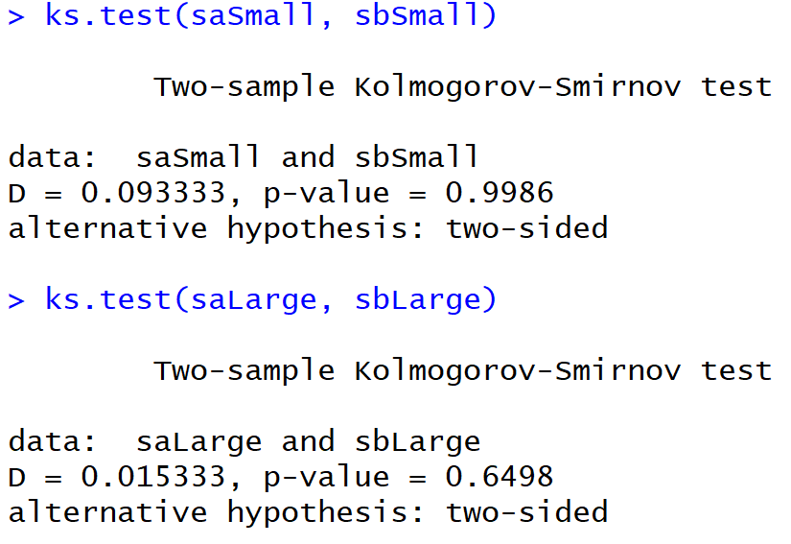

Slide 38
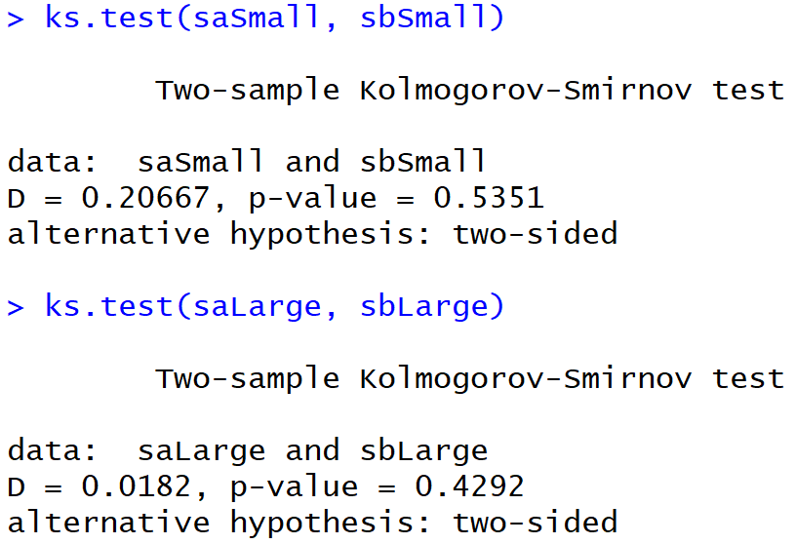

Slide 39
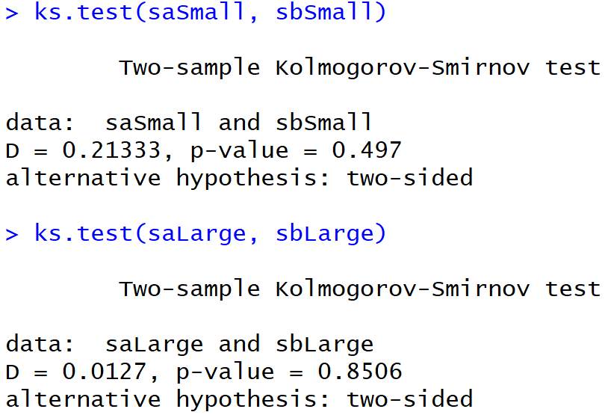

Slide 40
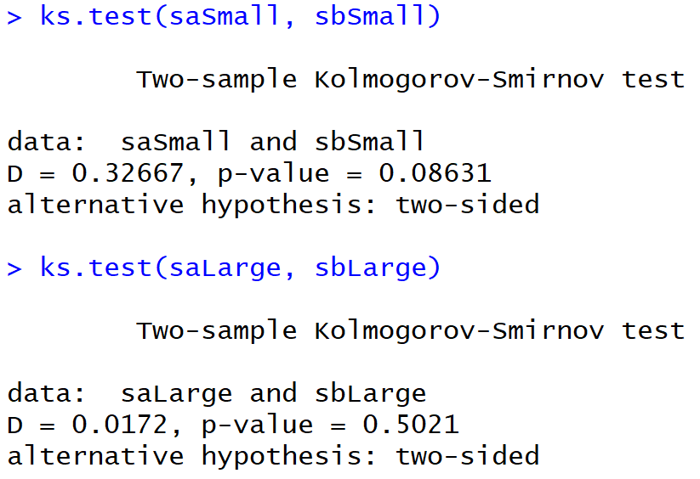

Slide 41
For smaller dataset

Slide 42
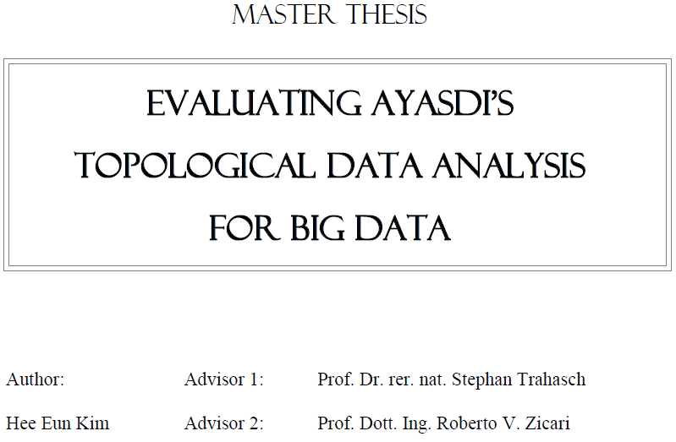


http://www.bigdata.uni-frankfurt.de/wp-content/uploads/2015/10/
Evaluating-Ayasdi’s-Topological-Data-Analysis-For-Big-Data_HKim2015.pdf

Slide 43

“Color ranges over red to blue and it has different meanings, depending on the type of attributes. For the continuous values, color represents an average of value. A red node contains data samples that have higher average values. In contrast, a blue node contains lower average values. In contrast, for the categorical values, color represents a value concentration.”
Analyze your data

Slide 44
“Color ranges over red to blue and it has different meanings, depending on the type of attributes. For the continuous values, color represents an average of value. A red node contains data samples that have higher average values. In contrast, a blue node contains lower average values. In contrast, for the categorical values, color represents a value concentration.”
1 node is orange
But maybe all the red nodes consist of 90% 3rd class and 10% first class
Analyze your data

Slide 45
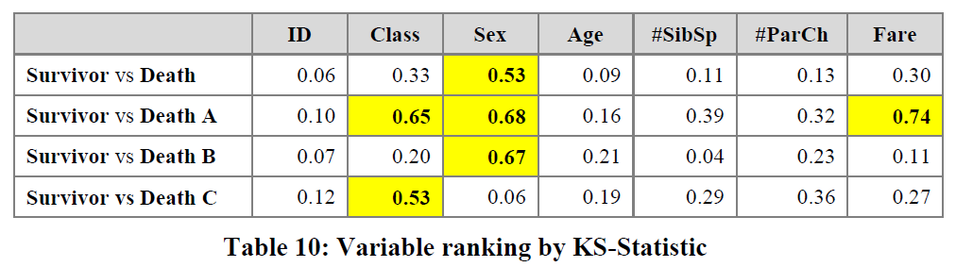
3.2.2.2 Insight by Ranked Variables
Going back to the Titanic example, the result of the KS-statistic show, that the variable “Sex” is the most strongly related to passengers death. We could generally assume that men conceded the places in lifeboats to women. Furthermore, it is feasible to deduct the subtle reasons of the death of each group. The passengers in group A died because of two reasons: they were man and the cabin class type was low. The passengers in the group B died because they were man. Finally, the passengers in the group C died because they were staying at third class even though most of them were women.

Slide 46
Note for titanic analysis, only the affects of individual variables was analyzed.
One could also study how linear combinations of these variables affect survival.
For example, the analysis could be redone using principal components or machine learning or clustering.

Slide 47
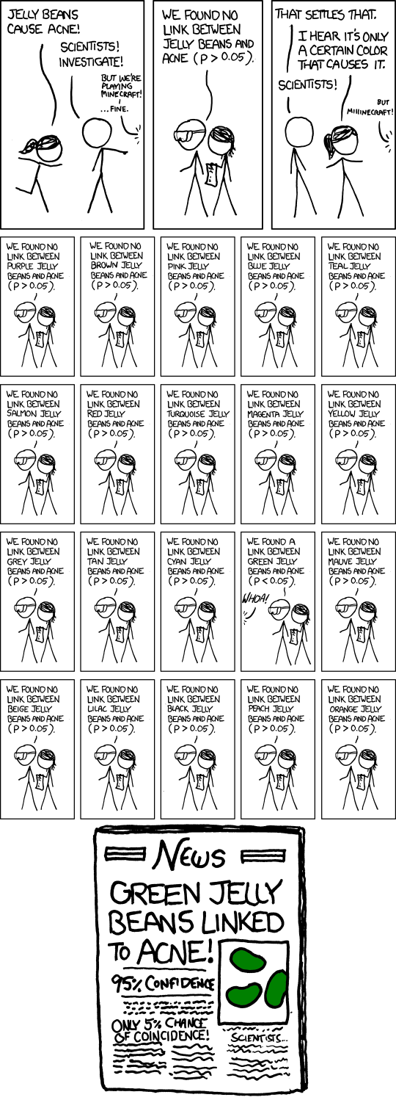
False Positives will occur
https://xkcd.com/882/

Slide 48
Git & Github
Timothy McRoy

Slide 49
Distances

Slide 50
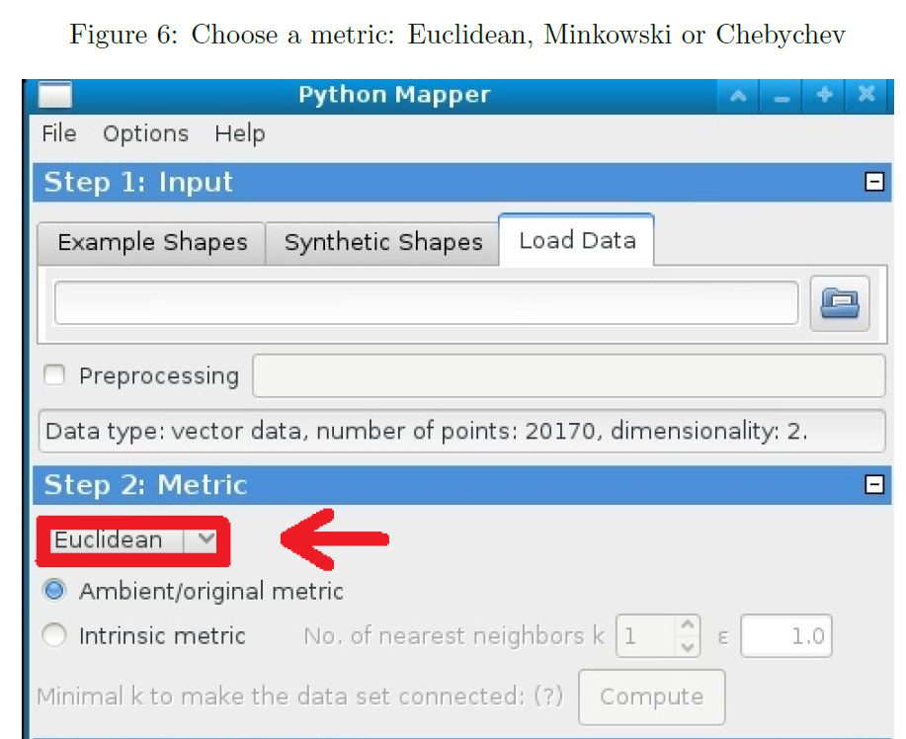

Slide 51
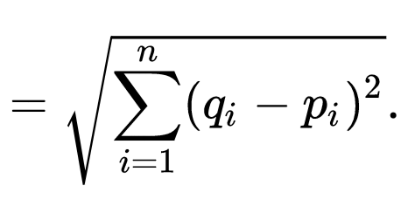

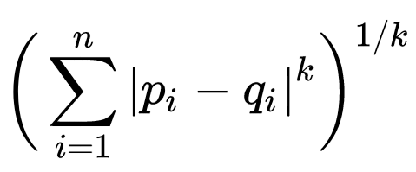

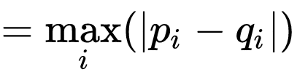
q
d(p, q) = ??
Euclidean
Minkowski distance
Chebyshev distance
5
4
p
3

Slide 52
Why use PCA in data analysis?
Consider the points (0, 0, …, 0), (1, 0, …, 0), (10, 0, …, 0)
Add noise to first point (0, 0, …, 0) → (0, 1, …, 1)
In R¹⁰⁰, d((0, 1, …, 1), (1, 0, …, 0)) = 10 > 9.
Add small noise to first point (0, 0, …, 0) → (0, 0.1, …, 0.1)
In R^{39,900}, d((0, 0.1, …, 0.1), (1, 0, …, 0)) = 20 > 9.
0 1 10

Slide 53
In R^{n}
If n small, Euclidean distance often makes sense
If n is large, consider Chebyshev distance or
performing PCA first to project data into R^{d}, for small d
and then using Euclidean distance
Chebyshev distance:

Slide 54
But you may want to focus on Euclidean distance AFTER normalizing:
From databasics3900.r:
> # one way to normalize data
> scaledata2 <- scale(data2) # scales data so that mean = 0, sd = 1
> colMeans(scaledata2) # faster version of apply(scaled.dat, 2, mean)
# shows that mean of each column is 0
Sepal.Length Sepal.Width Petal.Length Petal.Width
-4.480675e-16 2.035409e-16 -2.844947e-17 -3.714621e-17
> apply(scaledata2, 2, sd) # shows that standard deviation
# of each column is 1
Sepal.Length Sepal.Width Petal.Length Petal.Width
1 1 1 1
-------------------------------------------------------------------------------------------
P<- select(tbl_df(scaledata2), Petal.Length) # Choose filter
m1 <- mapper1D( # Apply mapper
distance_matrix = dist(data.frame(scaledata2)),
filter_values = P,
num_intervals = 10,
percent_overlap = 50,
num_bins_when_clustering = 10)
# save data to current working
# directory as a text file
write.table(scaledata2, "data.txt", sep=" ",
row.names = FALSE, col.names = FALSE)

Slide 55
> ?dist
Distance Matrix Computation
Description
This function computes and returns the distance matrix
computed by using the specified distance measure to
compute the distances between the rows of a data matrix.
Usage
dist(x, method = "euclidean", diag = FALSE,
upper = FALSE, p = 2)
method: the distance measure to be used. This must be
one of "euclidean", "maximum", "manhattan", "canberra",
"binary" or "minkowski". Any unambiguous substring
can be given.

Slide 56
http://www.bigdata.uni-frankfurt.de/wp-content/uploads/2015/10/
Evaluating-Ayasdi’s-Topological-Data-Analysis-For-Big-Data_HKim2015.pdf

Slide 57
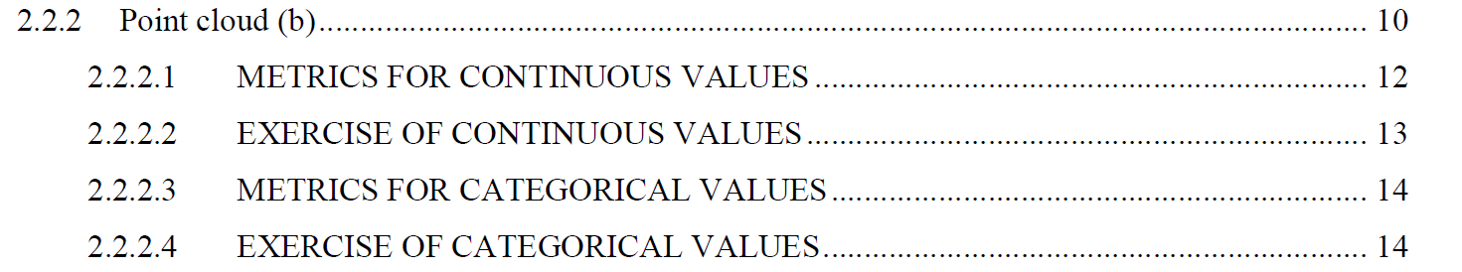
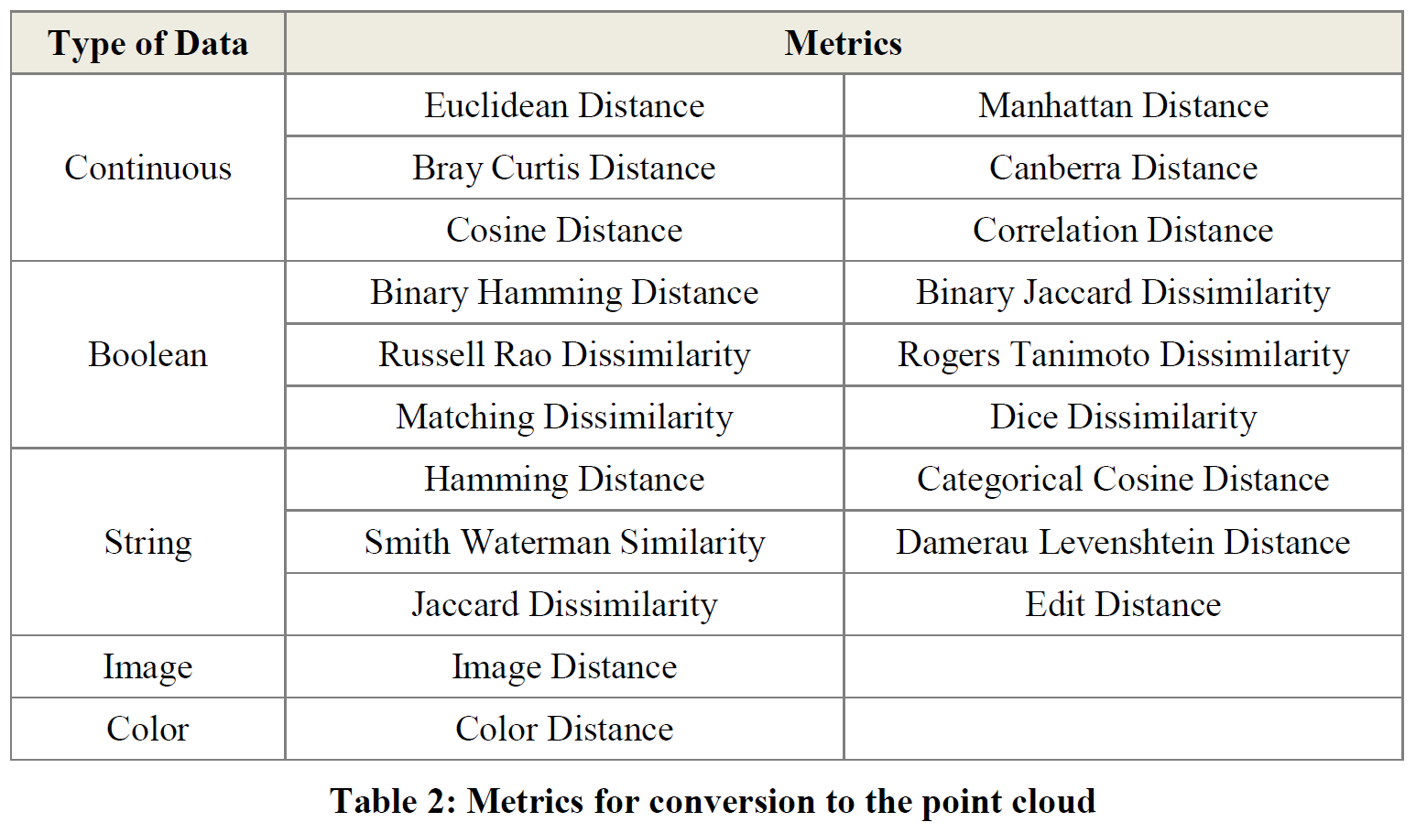
Section 2.2.2: Distances (optional)

Slide 58
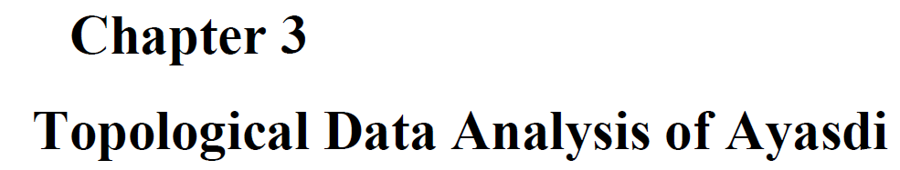
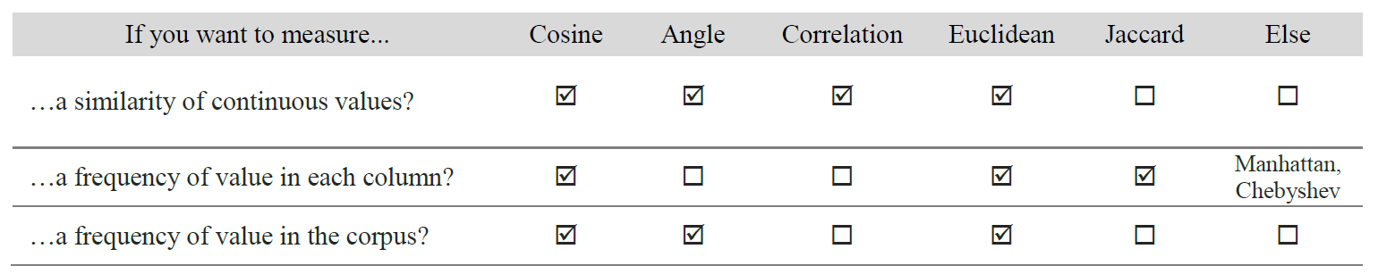
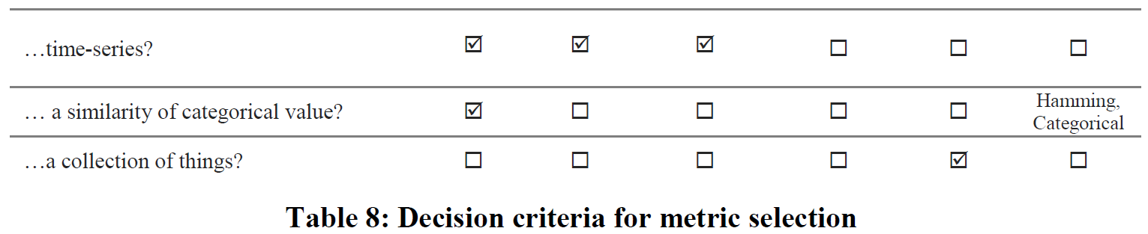

Slide 59
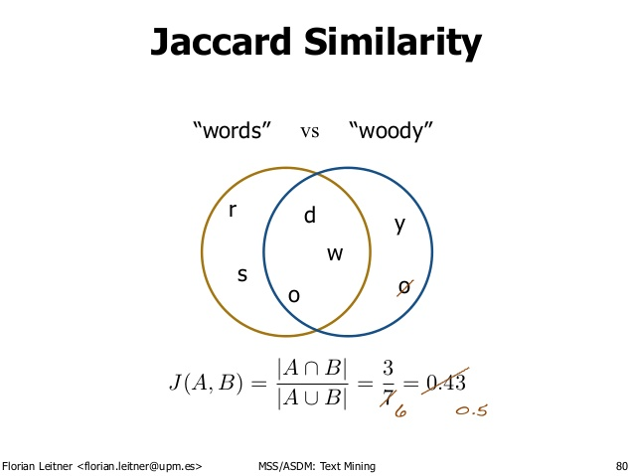
http://d-roger.com/2016/09/07/finding-similar-items-查找相似项/
Jacard Distance = 1 – J(A, B)

Slide 60

https://en.wikipedia.org/wiki/Jaccard_index

Slide 61


https://people.rit.edu/rmb5229/320/project3/hamming.html
http://rosalind.info/glossary/hamming-distance/
Hamming Distance = 7

Slide 62



http://www.joachimdespland.com/mammoth.html
http://bloggity.nurdz.com/gamedev-math/manhattan/
http://www.improvedoutcomes.com/docs/WebSiteDocs/Clustering/Clustering_Parameters/Manhattan_Distance_Metric.htm

Slide 64


