Slide 1
Lab 3 goals
1.) Create slide(s) similar to last week where slide includes picture of data set and several different pythonmapper outputs for this data set (similar to last week's sample.pptx). Upload to Lab 2 slides on ICON. Include slides from a “real” data set. Put your name on these slides. They will be collated and posted on ICON so that the entire class can see what data sets you are interested in.
2.) Take Survey 2/1 on ICON.
3.) Work with pythonmapper (see mappersummary2a.pdf and http://danifold.net/mapper/index.html ) on a linux machine.
4.) Create figures that you can use to illustrate TDA mapper both for your poster and project. Consider constructing some artificial data sets by modifying createArtificalDataSets2.r and/or using the datasets in pythonmapper and/or examples in TDAmapper README.
5.) Spend time working with a real data set. You can find a real data set via
googling (or duckduckgoing, etc): "topic of interest" type:.csv
http://archive.ics.uci.edu/ml/datasets.html
https://www.kaggle.com/datasets
Using the following command in R: data()

Slide 2
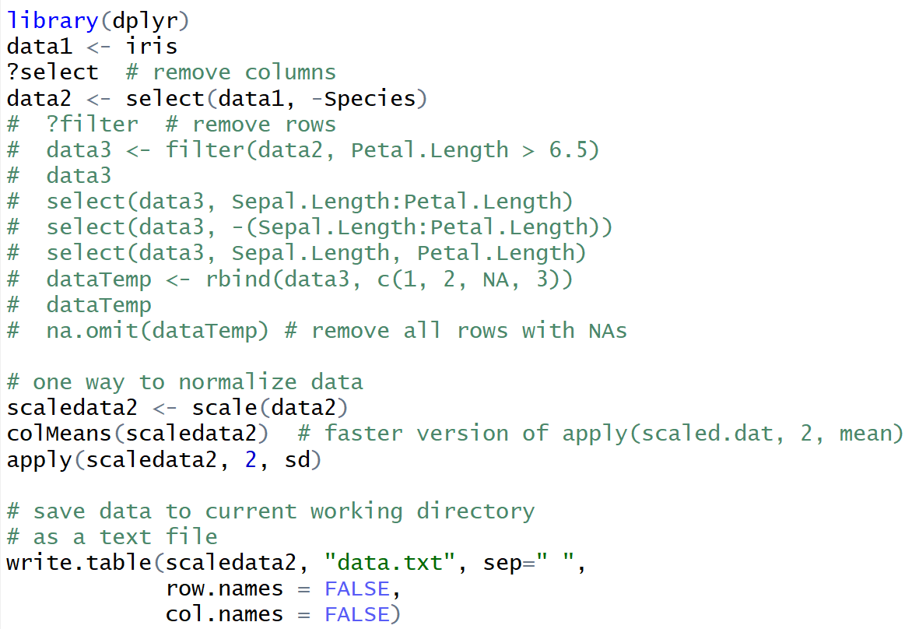
From: createArtificalDataSets2.r
You can also clean up data using excel, python scripts, etc.

Slide 3
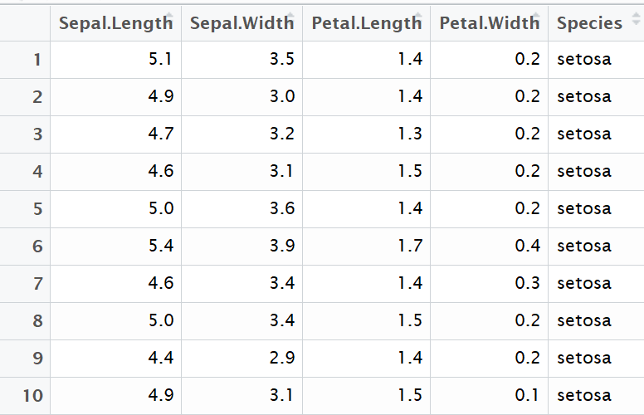
First 10 rows from iris data

Slide 4
?write

Slide 5
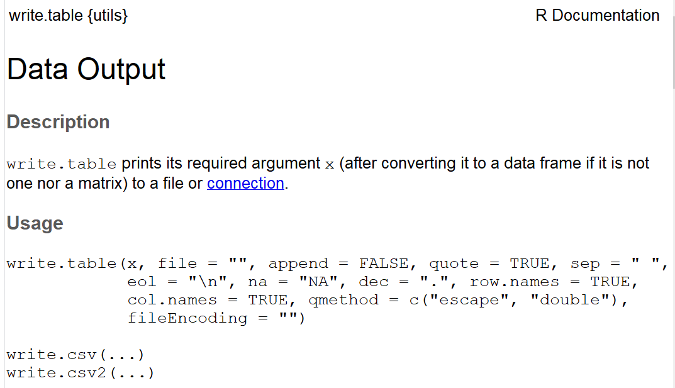
?write.table

Slide 6
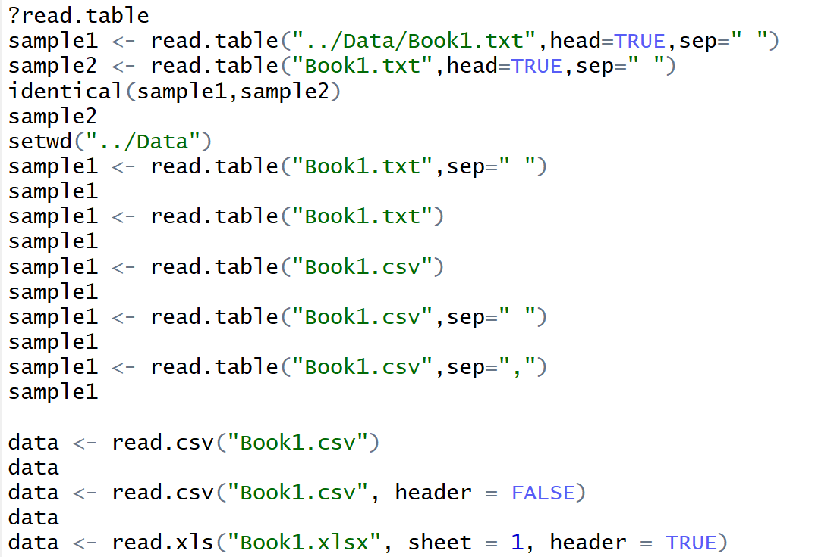
From: uploadDatatoRetc.R

Slide 7
mapper.filters.dm_eigenvector(data, k=0, mean_center=True, metricpar={}, verbose=True, callback=None)
Return the k-th eigenvector of the distance matrix.
The matrix of pairwise distances is symmetric, so it has an orthonormal basis of eigenvectors.
The parameter k can be either an integer or an array of integers (for multi-dimensional filter functions).
The index is zero-based, and eigenvalues are sorted by absolute value, so k=0 returns the eigenvector corresponding to the largest eigenvalue in magnitude.
If mean_center is True, the distance matrix is double-mean-centered before the eigenvalue decomposition.
Reference: [R6], subsection “Principal metric SVD filters”.

Slide 8
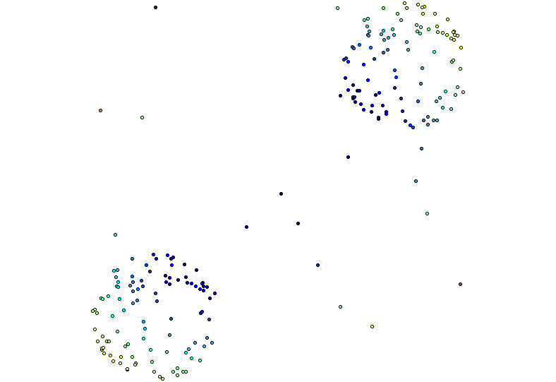
Distance Matrix Eigenvector
Order of eigenvector: 0

Slide 9
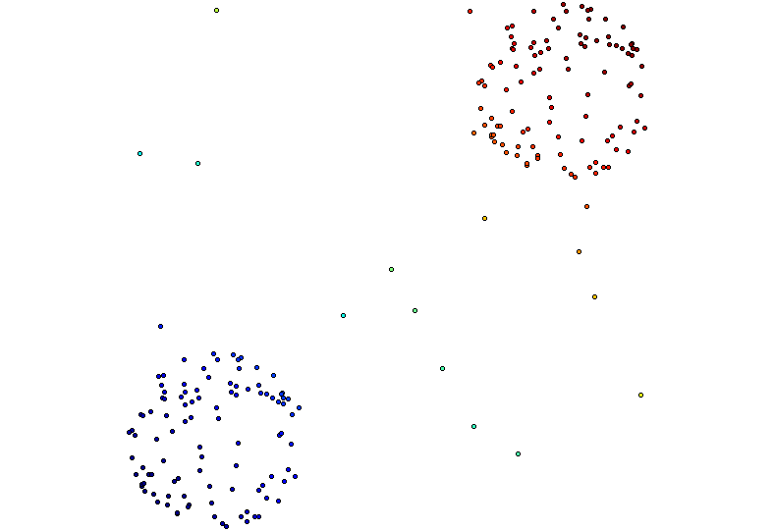
Distance Matrix Eigenvector, Mean Centered Distance Matrix
Order of eigenvector: 0

Slide 10
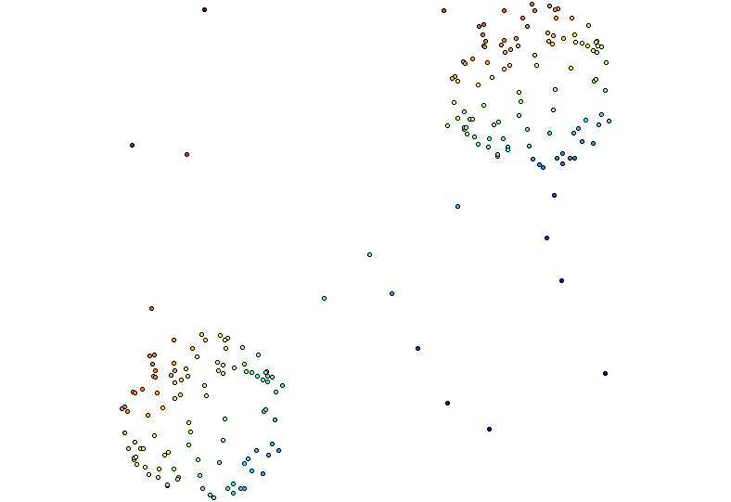
Distance Matrix Eigenvector, Mean Centered Distance Matrix
Order of eigenvector: 1

Slide 11
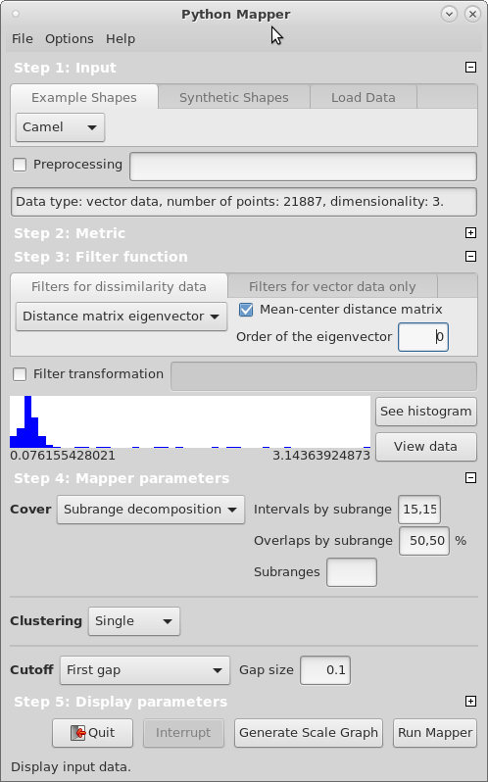

Slide 12
Distance Matrix Eigenvector, Mean Centered Distance Matrix
Order of eigenvector: 0
5 intervals, 50% Overlap

Slide 13
Distance Matrix Eigenvector, Mean Centered Distance Matrix
Order of eigenvector: 1
5 intervals, 50% Overlap

Slide 14
Distance Matrix Eigenvector, Mean Centered Distance Matrix
Order of eigenvector: 1
20 intervals, 20% Overlap

Slide 15
Distance Matrix Eigenvector, Mean Centered Distance Matrix
Order of eigenvector: 1
20 intervals, 50% Overlap

Slide 16
Distance Matrix Eigenvector, Mean Centered Distance Matrix
Order of eigenvector: 1
20 intervals, 80% Overlap

Slide 17
Distance Matrix Eigenvector, Mean Centered Distance Matrix
Order of eigenvector: 1
20 intervals, 80% Overlap
--Balanced

Slide 19
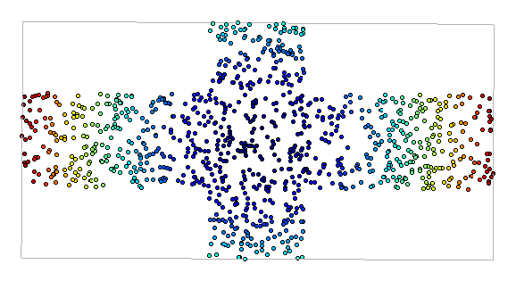
Metric: Euclidian
Filter Function: Eccentricity with exponent = 1
Cover: Uniform 1-d cover
Clustering: Single
modified slide from Maria Gommel

Slide 20
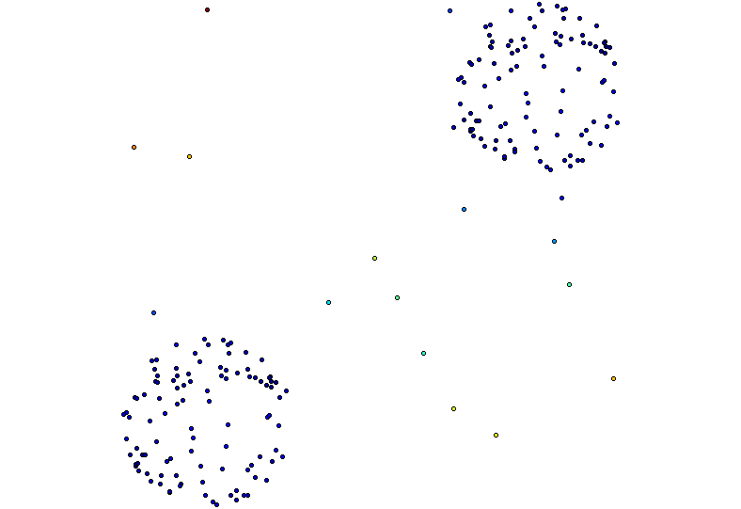
knn distance with k = 5 and 3 bins???
[ ( ) ) ]
(

