Slide 1
Git & Github
Timothy McRoy

Slide 2
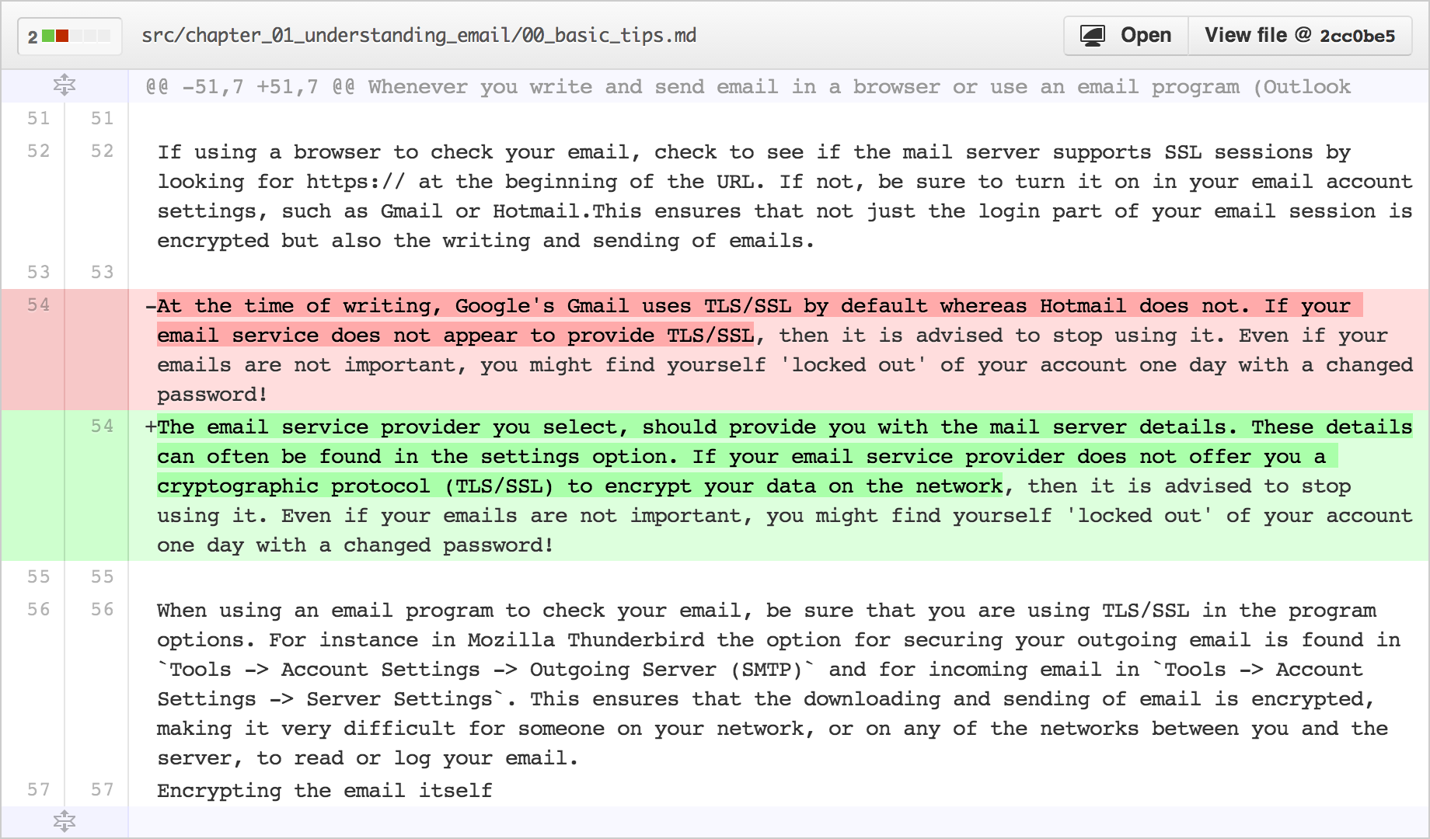
Git
Version Control System
Allows you to track changes in a project
Old Line
New Line
Modified from slides
Of Timothy McRoy
https://github.com/blog/1707-soft-wrapping-on-prose-diffs

Slide 3
Git: Can download and run on your own computer.
Not a backup system
A backup system is used to recover files in case something bad happens to the original copy
Git tracks changes locally in a directory called .git
If that directory was deleted, git would lose all of the previous versions
Modified from slides
Of Timothy McRoy

Slide 4
Github: Web-based collaboration
Github is a website which will help visualize some of the features of git
Github, like many code hosting websites, allows for public hosting of programs
This allows for interested programmers to take part in furthering development
Modified from slides
Of Timothy McRoy

Slide 5
Github
Github will store your work, but it is not a backup system
It may be somewhere other than your computer
Limited file size (100MB)
Not part of the design of Git or Github
Encryption, distributed copies, guarantee of uptime, etc.
Modified from slides
Of Timothy McRoy

Slide 6
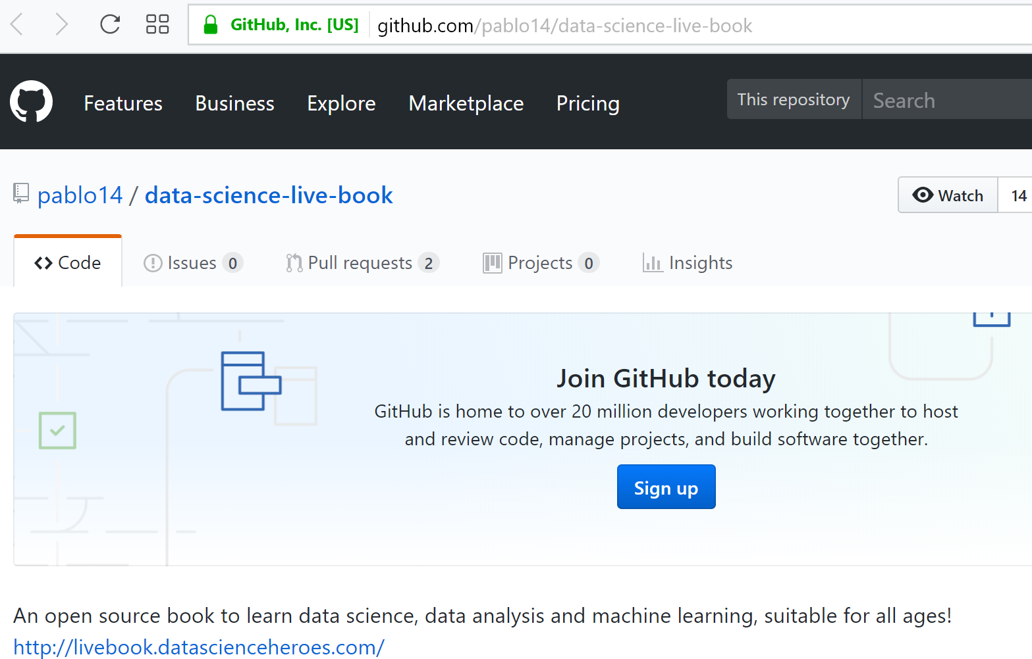
Can use github to collaborate on writing a book.
For example (which I have not looked at yet):

Slide 7
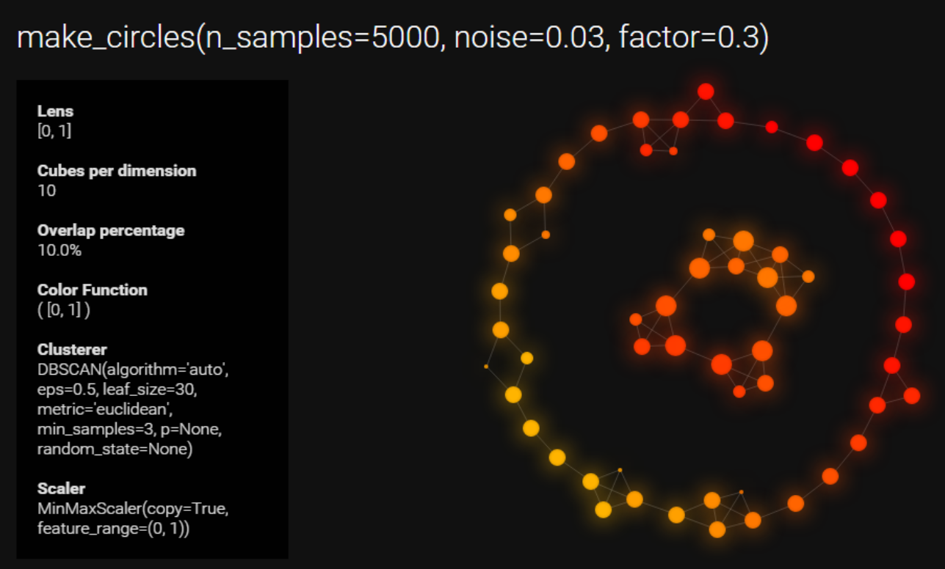
https://github.com/MLWave/kepler-mapper

Slide 8
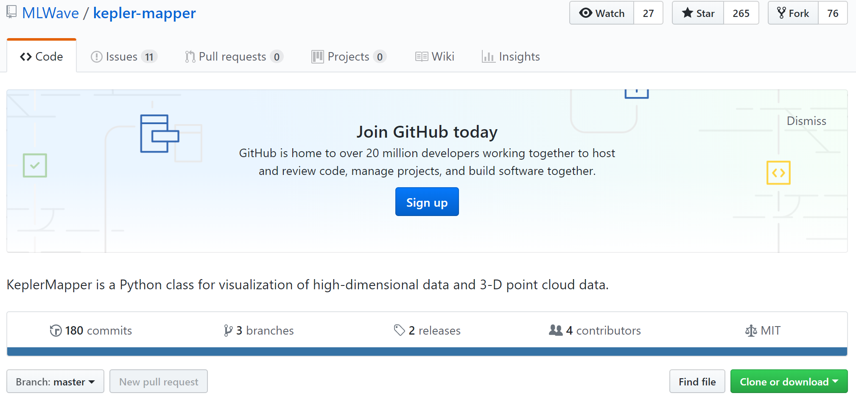

Slide 9
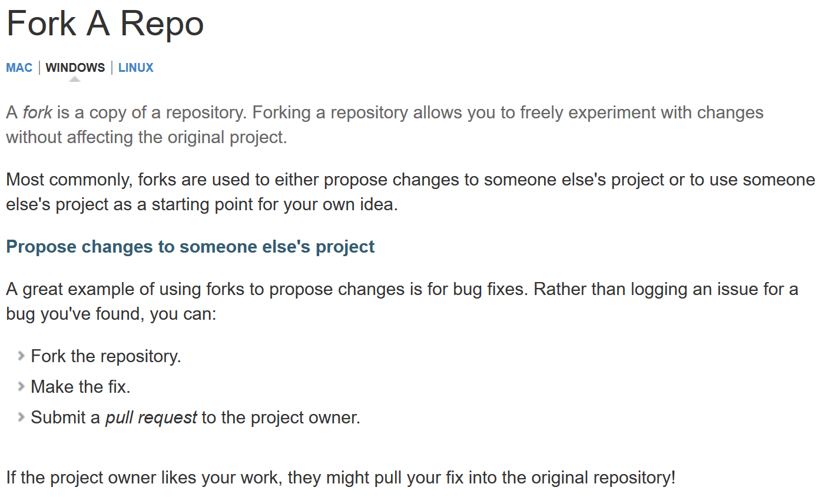

Slide 10
Share and collaborate
Easy to distribute work
clone
Easy to improve on the work of others
fork
Easy to take help from others
pull
Résumé pad
A Github profile is a great way to showcase your work
Link to LinkedIn, but it’s not a LinkedIn replacement
Modified from slides
Of Timothy McRoy

Slide 11
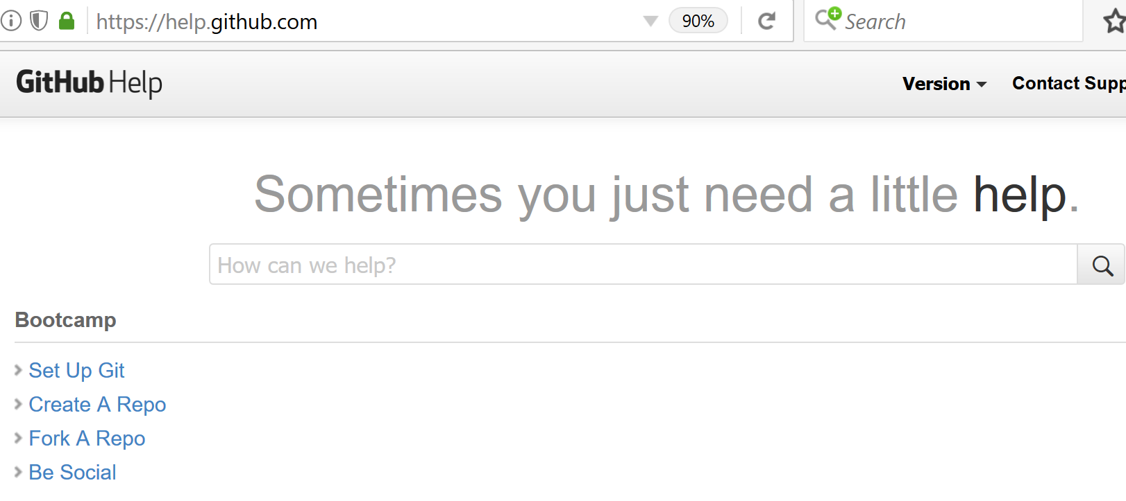
https://help.github.com/

Slide 12
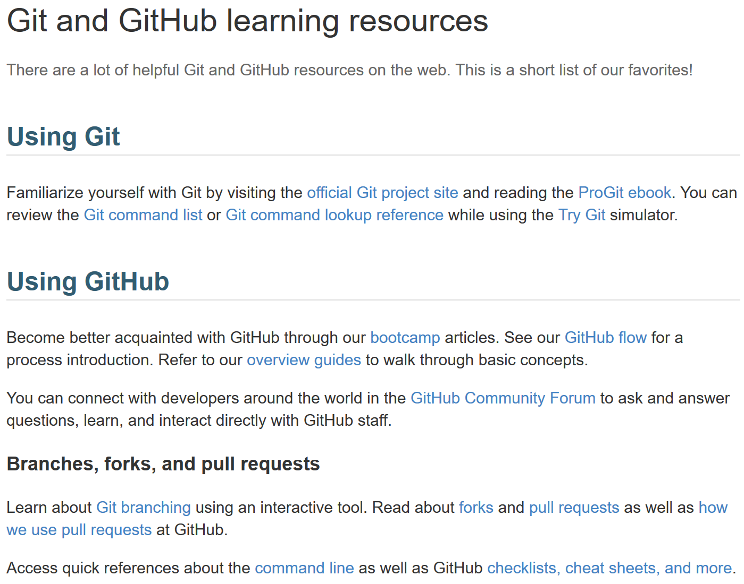
https://help.github.com/articles/git-and-github-learning-resources/

Slide 13
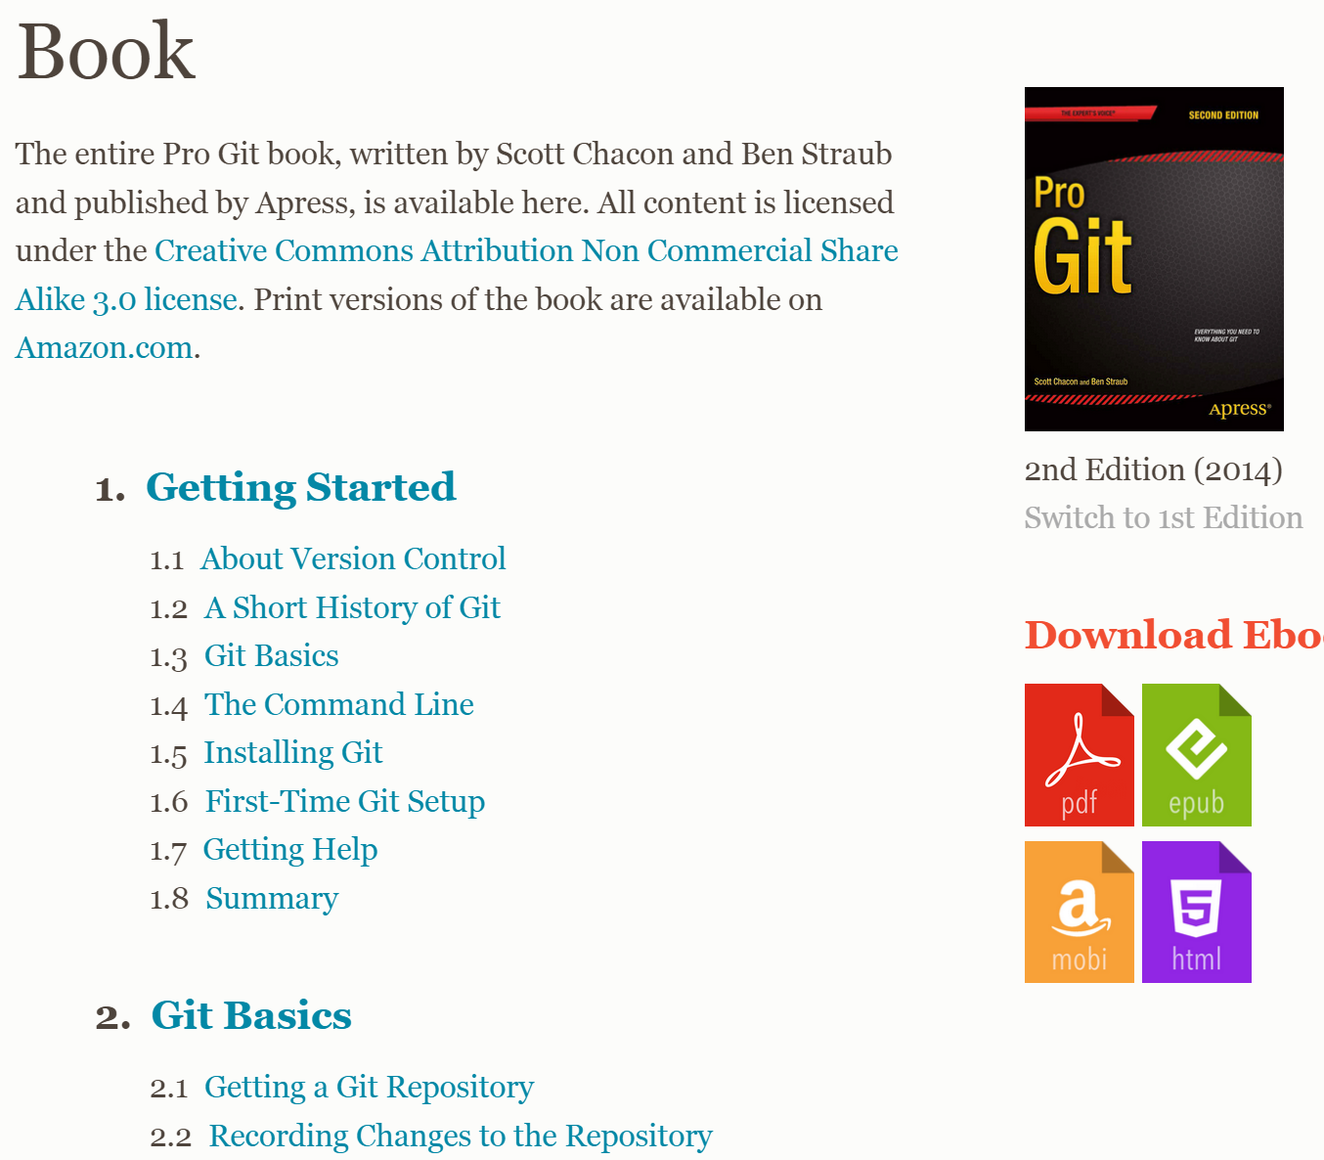
http://git-scm.com/book/en/v2

Slide 14
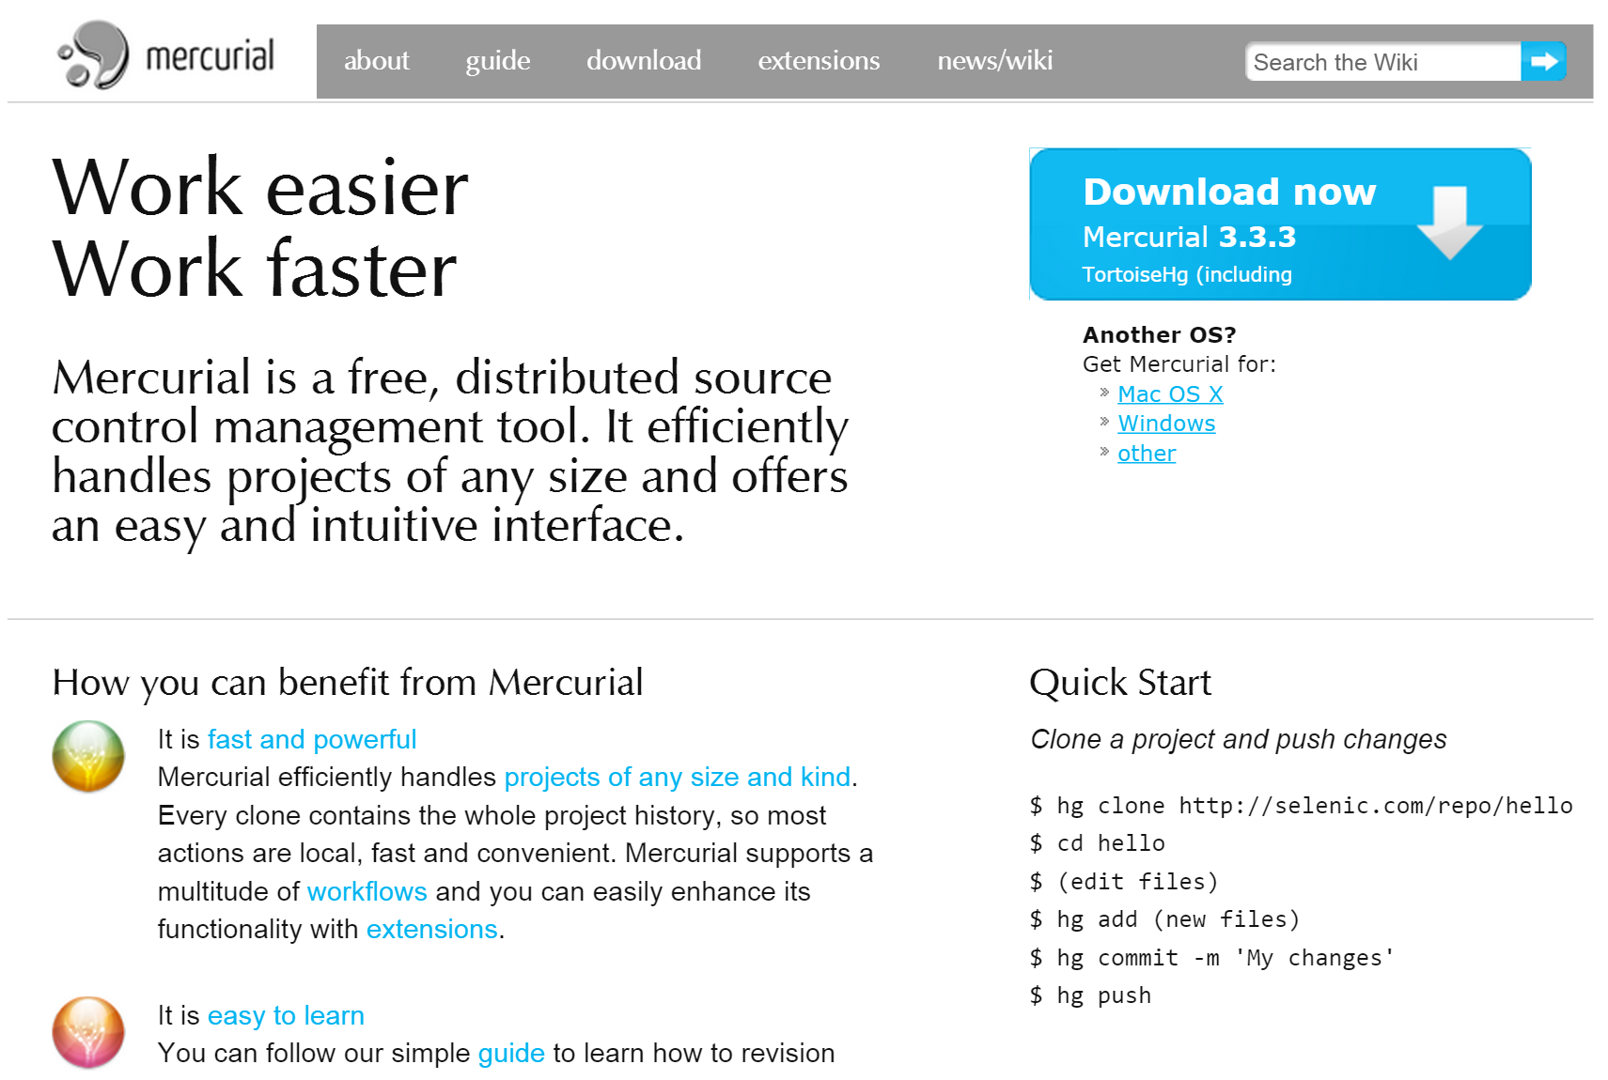
Other Distributed Version Control Systems

Slide 15
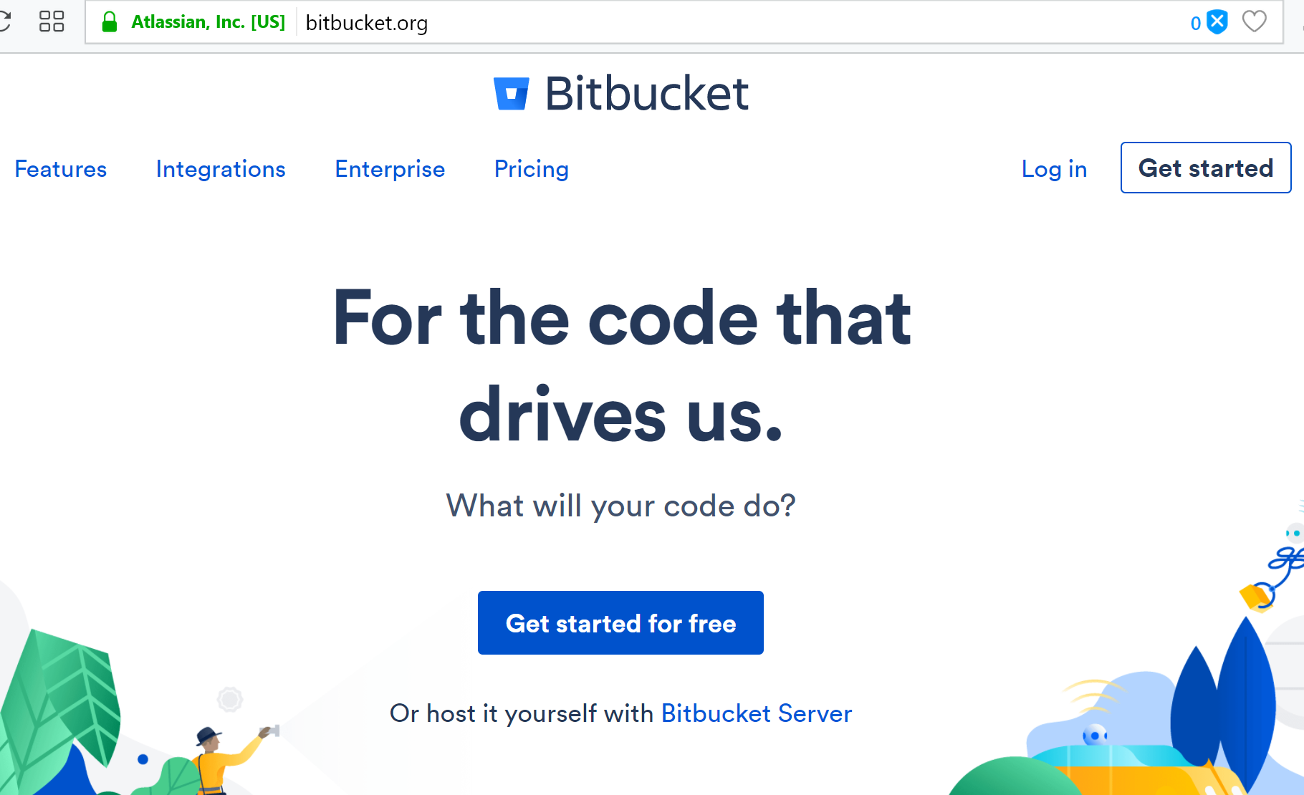
https://bitbucket.org

