Slide 1
Introduction to
Gurjeet Singh , Facundo Mémoli and Gunnar Carlsson’s
Mapper Algorithm
Guest lecturer: Isabel K. Darcy
Mathematics Department/Applied Mathematical & Computational Sciences
University of Iowa
http://www.math.uiowa.edu/~idarcy/
This material is based upon work supported by the National Science Foundation under Grant No. DMS-1407216: EXTREEMS-QED: Large Data Analysis and Visualization at the University of Iowa
Any opinions, findings, and conclusions or recommendations expressed in this material are those of the author(s) and do not necessarily reflect the views of the National Science Foundation.

Slide 2

Mapper

Slide 3

http://www.ayasdi.com/

Slide 4
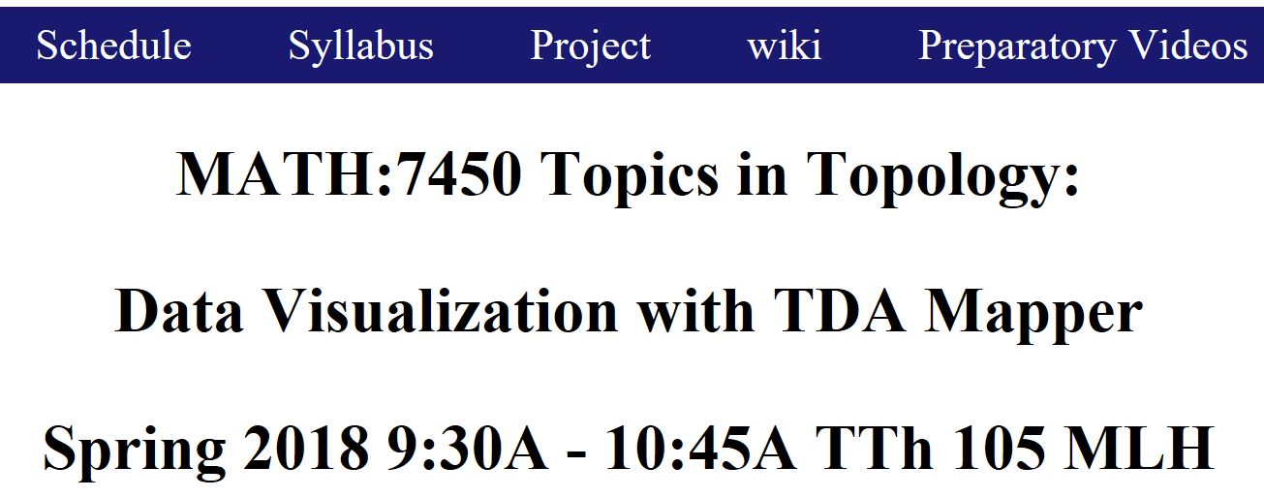


Slide 5
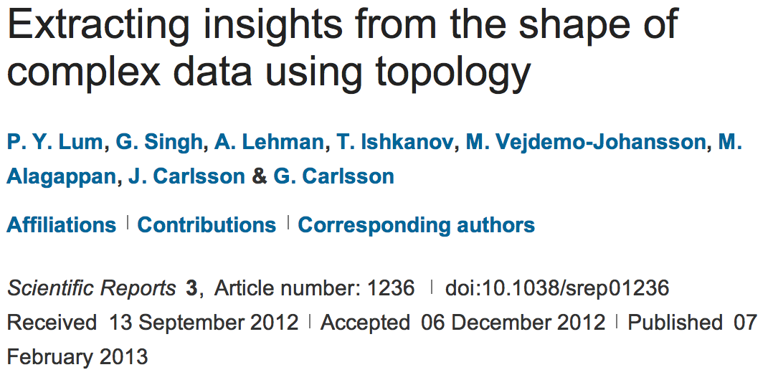
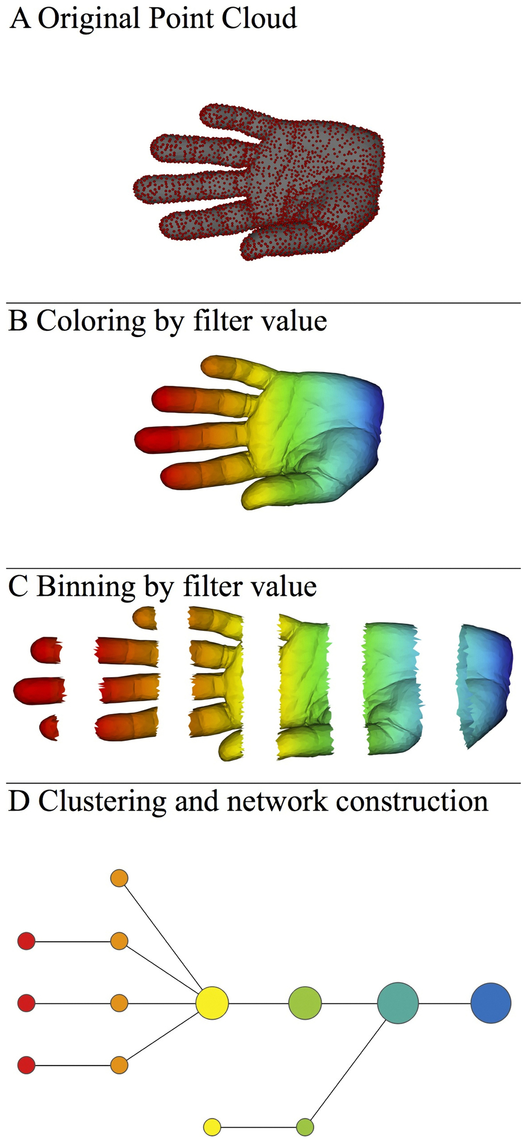
http://www.nature.com/srep/2013/130207/srep01236/full/srep01236.html

Slide 6
Mapper
Data Overlapping bins Graph
http://www.nature.com/srep/2013/130207/srep01236/full/srep01236.html

Slide 7

A) Data Set
Example: Point cloud data
representing a hand.
http://www.nature.com/srep/2013/130207/srep01236/full/srep01236.html

Slide 8
Function f : Data Set → R
Ex 1: x-coordinate
f : (x, y, z) → x
http://www.nature.com/srep/2013/130207/srep01236/full/srep01236.html

Slide 9
Function f : Data Set → R
Ex 1: x-coordinate
f : (x, y, z) → x
http://www.nature.com/srep/2013/130207/srep01236/full/srep01236.html

Slide 10
Put data into overlapping bins.
Example: f⁻¹(a_{i}, b_{i})
( ( ) ( ) ( ) ( ) ( ) )
Function f : Data Set → R
Ex 1: x-coordinate
f : (x, y, z) → x
http://www.nature.com/srep/2013/130207/srep01236/full/srep01236.html

Slide 11
Put data into overlapping bins.
Example: f⁻¹(a_{i}, b_{i})
( ( ) ( ) ( ) ( ) ( ) )
Function f : Data Set → R
Ex 1: x-coordinate
f : (x, y, z) → x
http://www.nature.com/srep/2013/130207/srep01236/full/srep01236.html

Slide 12
D) Cluster each bin
http://www.nature.com/srep/2013/130207/srep01236/full/srep01236.html
Notes:
Need covering Resolution multiscale

Slide 13
D) Cluster each bin
Vertex = a cluster of a bin.
http://www.nature.com/srep/2013/130207/srep01236/full/srep01236.html
Notes:
Need covering Resolution multiscale

Slide 14
D) Cluster each bin
& create network.
Vertex = a cluster of a bin.
Edge = nonempty intersection
between clusters
http://www.nature.com/srep/2013/130207/srep01236/full/srep01236.html
Notes:
Need covering Resolution multiscale

Slide 15
D) Cluster each bin
& create network.
Vertex = a cluster of a bin.
Edge = nonempty intersection
between clusters
http://www.nature.com/srep/2013/130207/srep01236/full/srep01236.html
Notes:
Need covering Resolution multiscale

Slide 16
A) Data Set
Example: Point cloud data
representing a hand.
B) Function f : Data Set → R
Example: x-coordinate
f : (x, y, z) → x
Put data into overlapping bins.
Example: f⁻¹(a_{i}, b_{i})
Cluster each bin & create network.
Vertex = a cluster of a bin.
Edge = nonempty intersection
between clusters
http://www.nature.com/srep/2013/130207/srep01236/full/srep01236.html

Slide 17
Note: we made many, many choices
It helps to know what you are doing when you make choices, so collaborating with others is highly recommended.

Slide 18
We chose how to model the data set
A) Data Set
Example: Point cloud data
representing a hand.
http://www.nature.com/srep/2013/130207/srep01236/full/srep01236.html
Notes:
Be creative. Use ideas from pure and applied math (including stat) as well as area of application
Missing data, noise

Slide 19
Function f : Data Set → R
Ex 1: x-coordinate
f : (x, y, z) → x
Chose filter function
http://www.nature.com/srep/2013/130207/srep01236/full/srep01236.html

Slide 20
Function f : Data Set → R
Ex 1: x-coordinate
f : (x, y, z) → x
Ex 2: y-coordinate
g : (x, y, z) → y
Chose filter function
http://www.nature.com/srep/2013/130207/srep01236/full/srep01236.html

Slide 21
Function f : Data Set → R
Ex 1: x-coordinate
f : (x, y, z) → x
Chose filter function
Possible filter functions:
Principle component analysis
L-infinity centrality:
f(x) = max{d(x, p) : p in data set}
Norm: f(x) = ||x || = length of x
http://www.nature.com/srep/2013/130207/srep01236/full/srep01236.html
Notes:
Need distance
Depends on what prop you want to explore
Can also choose any co-domain

Slide 22
Chose bins
Put data into overlapping bins.
Example: f⁻¹(a_{i}, b_{i})
If equal length intervals:
Choose length.
Choose % overlap.
http://www.nature.com/srep/2013/130207/srep01236/full/srep01236.html
Notes:
Need covering Resolution multiscale

Slide 23
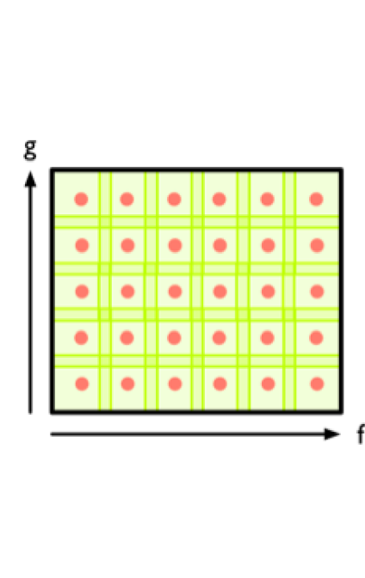
Create overlapping bins:
http://www.nature.com/srep/2013/130207/srep01236/full/srep01236.html

Slide 24
Chose how to cluster.
Normally need a definition of distance between data points
Cluster each bin & create network.
Vertex = a cluster of a bin.
Edge = nonempty intersection
between clusters
http://www.nature.com/srep/2013/130207/srep01236/full/srep01236.html

Slide 25
Note: Many, many choices were made
It helps to know what you are doing when you make choices, so collaborating with others is highly recommended.

Slide 26
Note: Many, many choices were made
“It is useful to think of it as a camera, with lens adjustments and other settings. A different filter function may generate a network with a different shape, thus allowing one to explore the data from a different mathematical perspective.”
http://www.nature.com/srep/2013/130207/srep01236/full/srep01236.html

Slide 27
Note: we made many, many choices
“It is useful to think of it as a camera, with lens adjustments and other settings. A different filter function may generate a network with a different shape, thus allowing one to explore the data from a different mathematical perspective.”
False positives???
http://www.nature.com/srep/2013/130207/srep01236/full/srep01236.html

Slide 28
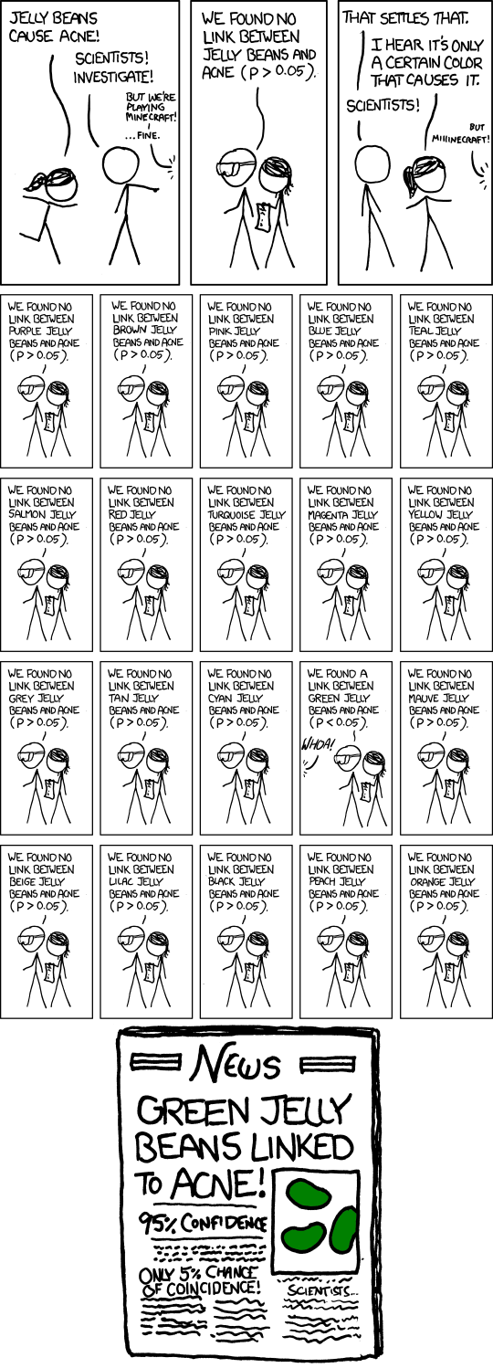
False Positives will occur
https://xkcd.com/882/

Slide 29
Note: Many, many choices were made
“It is useful to think of it as a camera, with lens adjustments and other settings. A different filter function may generate a network with a different shape, thus allowing one to explore the data from a different mathematical perspective.”
False positives vs. robustness
http://www.nature.com/srep/2013/130207/srep01236/full/srep01236.html

Slide 30
Topological Data Analysis (TDA): Three key ideas of topology that make extracting of patterns via shape possible.
1.) coordinate free.
No dependence on the coordinate system chosen.
Can compare data derived from different platforms
vital when one is studying data collected with different technologies, or from different labs when the methodologies cannot be standardized.
http://www.nature.com/srep/2013/130207/srep01236/full/srep01236.html

Slide 31
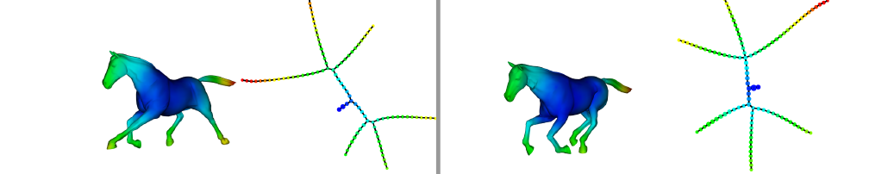
Topological Data Analysis (TDA): Three key ideas of topology that make extracting of patterns via shape possible.
2.) invariant under “small” deformations.
less sensitive to noise
Topological Methods for the Analysis of High Dimensional
Data Sets and 3D Object Recognition, Singh, Mémoli, Carlsson
Figure from http://comptop.stanford.edu/u/preprints/mapperPBG.pdf
http://www.nature.com/srep/2013/130207/srep01236/full/srep01236.html

Slide 32
Topological Data Analysis (TDA): Three key ideas of topology that make extracting of patterns via shape possible.
3.) compressed representations of shapes.
Input: dataset with thousands of points
Output: network with
13 vertices and 12 edges.
http://www.nature.com/srep/2013/130207/srep01236/full/srep01236.html

Slide 33
Chose filter
Only need to cover the data points.
http://www.nature.com/srep/2013/130207/srep01236/full/srep01236.html

Slide 34
Chose filter
http://www.nature.com/srep/2013/130207/srep01236/full/srep01236.html

Slide 35
Application 3 (in paper): Basketball
Data: rates (per minute played) of rebounds, assists, turnovers, steals, blocked shots, personal fouls, and points scored for 452 players.
➔ Input: 452 points in R⁷
For each player, we have a vector
= (r, a, t, s, b, f, p) in R⁷
Distance: variance normalized Euclidean distance.
Clustering: Single linkage.
( min , min , min , min , min , min , min )
rebounds assists turnovers steals blocked shots personal fouls points scored
http://www.nature.com/srep/2013/130207/srep01236/full/srep01236.html

Slide 36
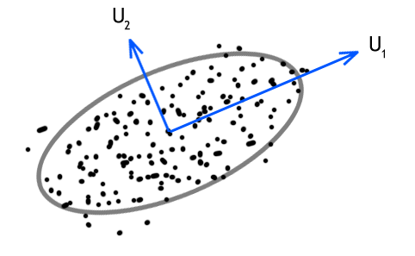
Filters: principle and secondary SVD values.
http://commons.wikimedia.org/wiki/File:SVD_Graphic_Example.png
Data
http://www.nature.com/srep/2013/130207/srep01236/full/srep01236.html

Slide 37
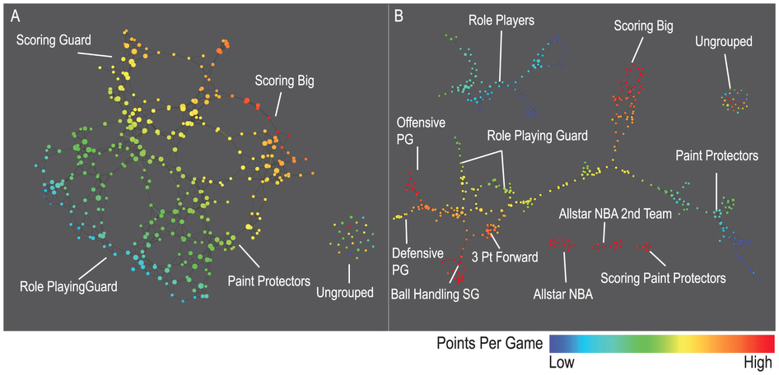
A) Low resolution map at 20 intervals for each filter B) High resolution map at 30 intervals for each filter. The overlap is such at that each interval overlaps with half of the adjacent intervals, the graphs are colored by points per game, and a variance normalized Euclidean distance metric is applied. Metric: Variance Normalized Euclidean; Lens: Principal SVD Value (Resolution 20, Gain 2.0x, Equalized) and Secondary SVD Value (Resolution 20, Gain 2.0x, Equalized). Color: red: high values, blue: low values.
http://www.nature.com/srep/2013/130207/srep01236/full/srep01236.html

Slide 38
LeBron James , Kobe Bryant, Brook Lopez
A) Low resolution map at 20 intervals for each filter B) High resolution map at 30 intervals for each filter. The overlap is such at that each interval overlaps with half of the adjacent intervals, the graphs are colored by points per game, and a variance normalized Euclidean distance metric is applied. Metric: Variance Normalized Euclidean; Lens: Principal SVD Value (Resolution 20, Gain 2.0x, Equalized) and Secondary SVD Value (Resolution 20, Gain 2.0x, Equalized). Color: red: high values, blue: low values.
http://www.nature.com/srep/2013/130207/srep01236/full/srep01236.html
Notes:
Compare how graphs drawn. Note disconnected means not close Don’t be mislead by graph drawing

Slide 39
Application 2: US House of Representatives Voting records
Data: (aye, abstain, nay, …. )
= ( +1 , 0 , -1 , … )
Distance: Pearson correlation
Filters: principal and secondary metric SVD
Clustering: Single linkage.
http://www.nature.com/srep/2013/130207/srep01236/full/srep01236.html

Slide 40
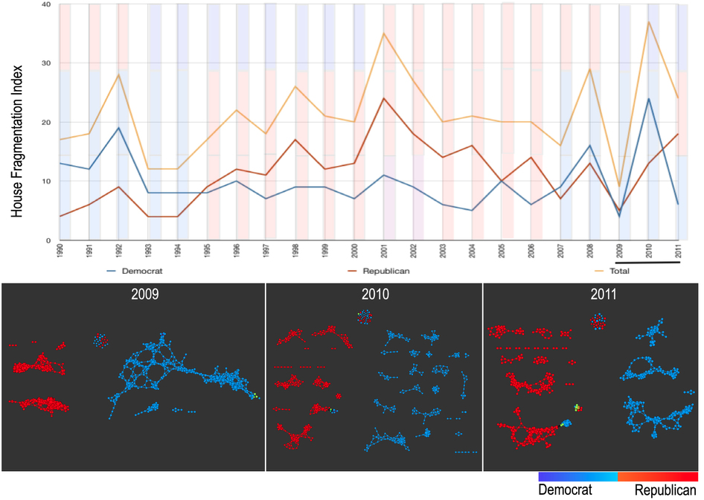
number of sub-networks formed each year per political party.
X-axis: 1990–2011. Y-axis: Fragmentation index. Color bars denote, from top to bottom, party of the President, party for the House, party for the Senate (red: republican; blue: democrat; purple: split). The bottom 3 panels are the actual topological networks for the members. Networks are constructed from voting behavior of the member of the house, with an “aye” vote coded as a 1, “abstain” as zero, and “nay” as a -1. Each node contains sets of members. Each panel labeled with the year contains networks constructed from all the members for all the votes of that year. Note high fragmentation in 2010 in both middle panel and in the Fragmentation Index plot (black bar). The distance metric and filters used in the analysis were Pearson correlation and principal and secondary metric SVD. Metric: Correlation; Lens: Principal SVD Value (Resolution 120, Gain 4.5x, Equalized) and Secondary SVD Value (Resolution 120, Gain 4.5x, Equalized). Color: Red: Republican; Blue: Democrats.
http://www.nature.com/srep/2013/130207/srep01236/full/srep01236.html

Slide 41
They determined what issues divided Republicans into the two main sub-groups in 2009:
The Credit Cardholders' Bill of Rights,
To reauthorize the Marine Turtle Conservation Act of 2004,
Generations Invigorating Volunteerism and Education (GIVE) Act,
To restore sums to the Highway Trust Fund and for other purposes,
Captive Primate Safety Act, Solar Technology Roadmap Act, Southern Sea Otter Recovery and Research Act.
http://www.nature.com/srep/2013/130207/srep01236/full/srep01236.html

Slide 42
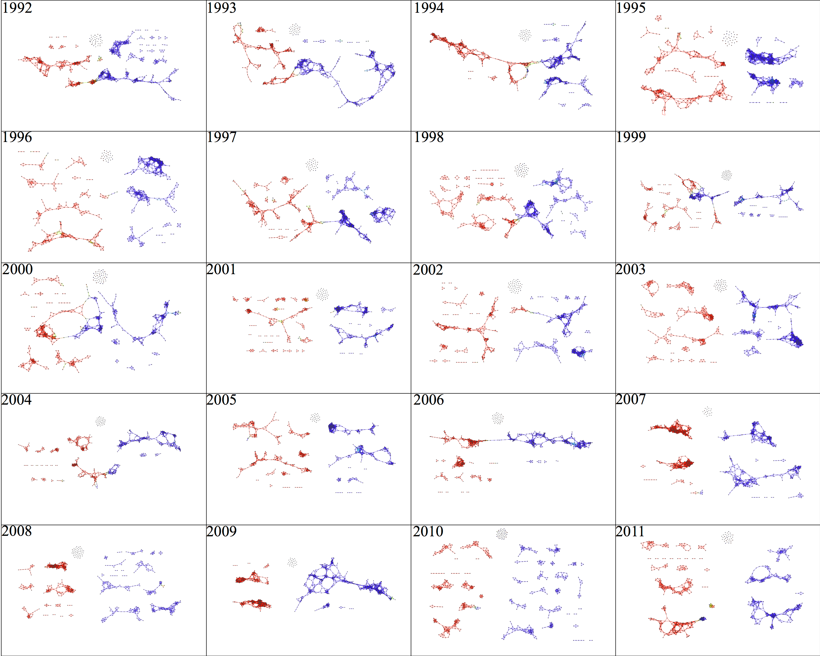

Slide 43
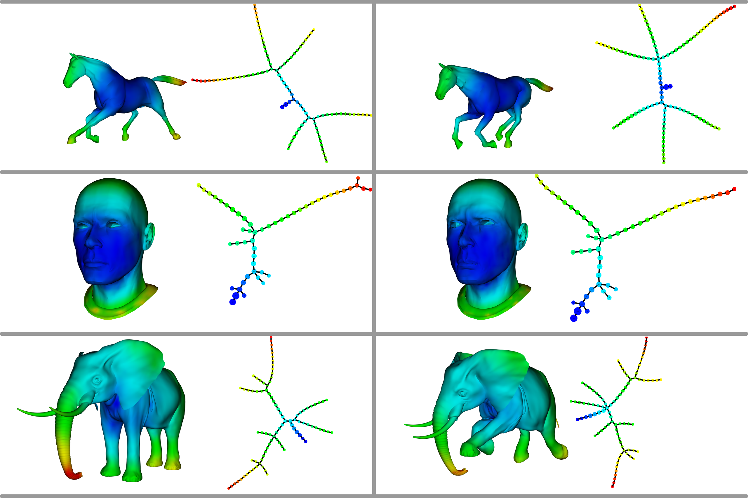
Topological Methods for the Analysis of High Dimensional Data Sets and 3D Object Recognition
Singh, Gurjeet; Memoli, Facundo; Carlsson, Gunnar
http://diglib.eg.org/handle/10.2312/SPBG.SPBG07.091-100

Slide 44
Topological Methods for the Analysis of High Dimensional Data Sets and 3D Object Recognition
Singh, Gurjeet; Memoli, Facundo; Carlsson, Gunnar
http://diglib.eg.org/handle/10.2312/SPBG.SPBG07.091-100

Slide 45
Application 1: breast cancer gene expression
Data: microarray gene expression data from 2 data sets, NKI and GSE2034
Distance: correlation distance
Filters: (1) L-infinity centrality:
f(x) = max{d(x, p) : p in data set}
captures the structure of the points far removed from the center or norm.
(2) NKI: survival vs. death
GSE2034: no relapse vs. relapse
Clustering: Single linkage.

Slide 46
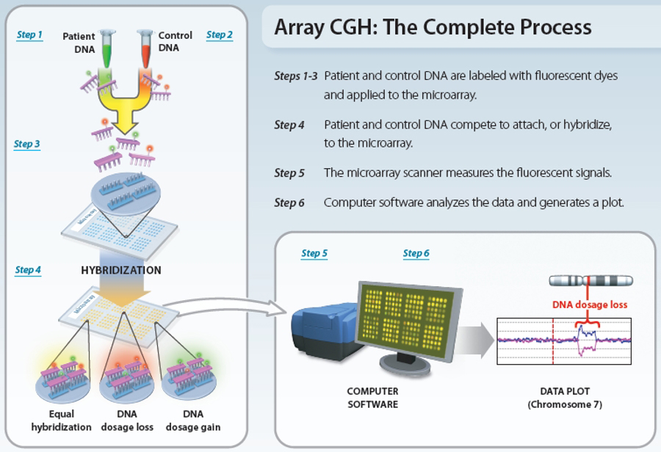
www.nature.com/scitable/topicpage/microarray-based-comparative-genomic-hybridization-acgh-45432

Slide 47
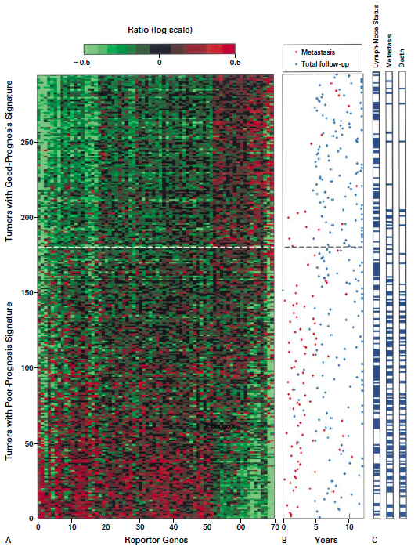
Gene expression profiling predicts clinical outcome of breast cancer
van 't Veer LJ, Dai H, van de Vijver MJ, He YD, Hart AA, Mao M, Peterse HL, van der Kooy K, Marton MJ, Witteveen AT, Schreiber GJ, Kerkhoven RM, Roberts C, Linsley PS, Bernards R, Friend SH
Nature. 2002 Jan 31;415(6871):530-6.

Slide 48
2 breast cancer data sets:
1.) NKI (2002):
gene expression levels of 24,000 from 272 tumors. Includes node-negative and node-positive patients, who had or had not received adjuvant systemic therapy. Also includes survival information.
2.) GSE203414 (2005)
expression of 22,000 transcripts from total RNA of frozen tumour samples from 286 lymph-node-negative patients who had not received adjuvant systemic treatment. Also includes time to relapse information.

Slide 49
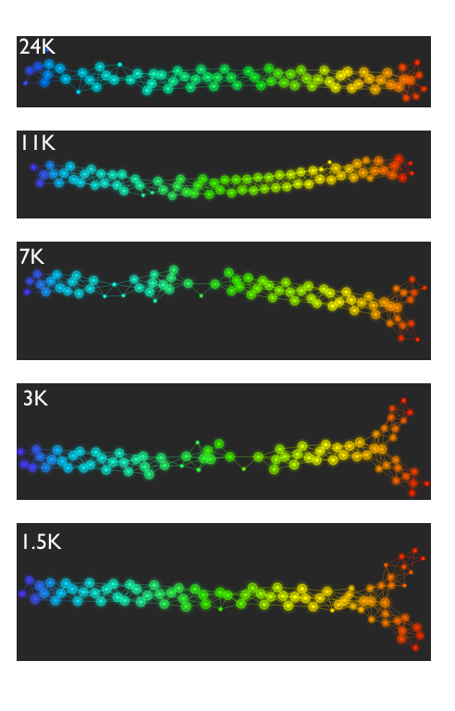
Fig. S1. Shape of the data becomes more distinct as the analysis columns are restricted to the top
varying genes.
24K: all the genes on the microarray were used in the analysis;
11K: 10,731 top most varying genes were used in the analysis;
7K: 6.688 top most varying genes were used in the analysis;
3K: 3212 top most varying genes were used in the analysis;
1.5K: 1553 top most varying genes were used in the analysis.
Graphs colored by the L-infinity centrality values. Red: high; Blue: low
http://www.nature.com/srep/2013/130207/srep01236/full/srep01236.html

Slide 50
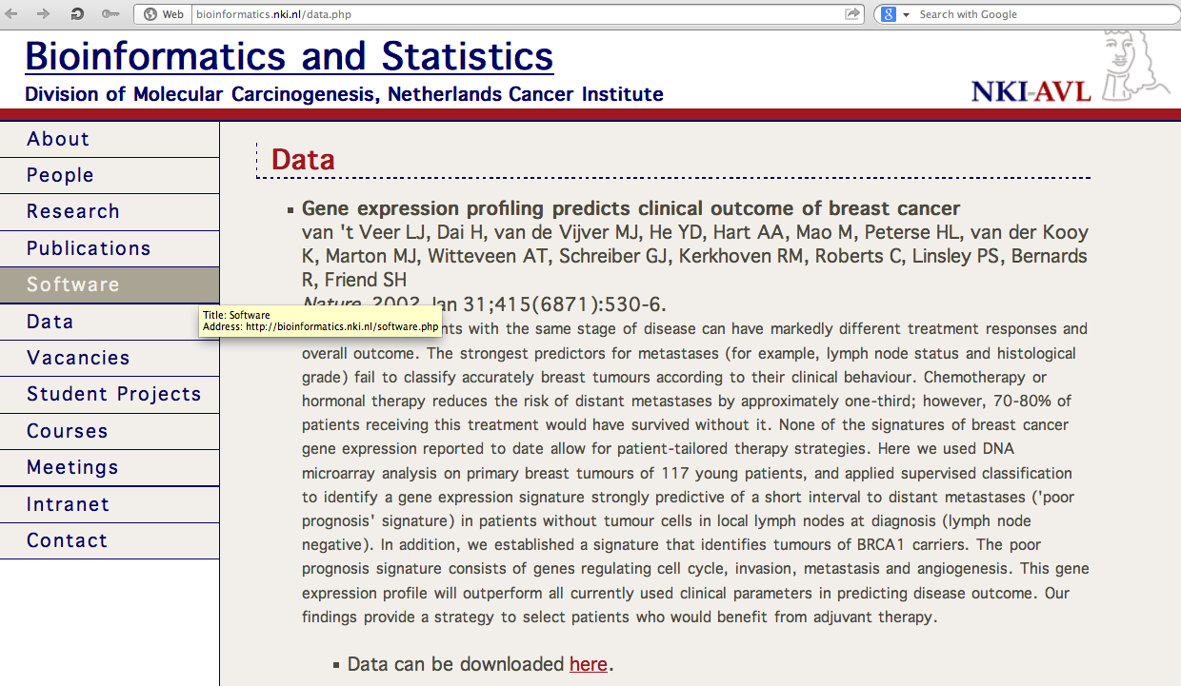
http://bioinformatics.nki.nl/data.php

Slide 51
Comparison of our results with those of Van de Vijver and colleagues is difficult because of differences in patients, techniques, and materials used.
Their study included node-negative and node-positive patients, who had or had not received adjuvant systemic therapy, and only women younger than 53 years.
microarray platforms used in the studies differ—Affymetrix and Agilent.
Of the 70 genes in the study by van't Veer and co-workers, 48 are present on the Affymetrix U133a array, whereas only 38 of our 76 genes are present on the Agilent array. There is a three-gene overlap between the two signatures (cyclin E2, origin recognition complex, and TNF superfamily protein).
Despite the apparent difference, both signatures included genes that identified several common pathways that might be involved in tumour recurrence. This finding supports the idea that although there might be redundancy in gene members, effective signatures could be required to include representation of specific pathways.
From: Gene-expression profiles to predict distant metastasis of lymph-node-negative primary breast cancer, Yixin Wang et al, The Lancet, Volume 365, Issue 9460, 19–25 February 2005, Pages 671–679

Slide 52
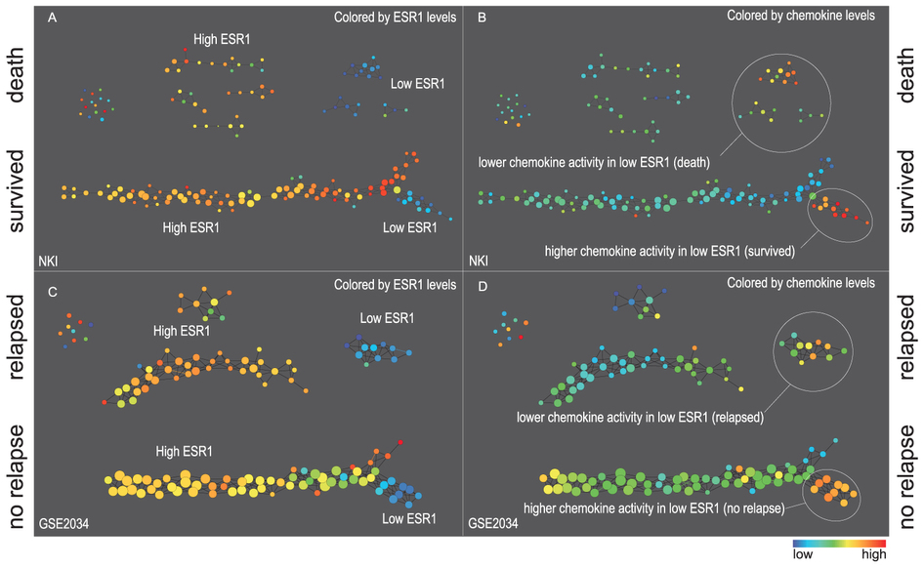
Two filter functions, L-Infinity centrality and survival or relapse were used to generate the networks. The top half of panels A and B are the networks of patients who didn't survive, the bottom half are the patients who survived. Panels C and D are similar to panels A and B except that one of the filters is relapse instead of survival. Panels A and C are colored by the average expression of the ESR1 gene. Panels B and D are colored by the average expression of the genes in the KEGG chemokine pathway. Metric: Correlation; Lens: L-Infinity Centrality (Resolution 70, Gain 3.0x, Equalized) and Event Death (Resolution 30, Gain 3.0x). Color bar: red: high values, blue: low values.
http://www.nature.com/srep/2013/130207/srep01236/full/srep01236.html

Slide 53
Identifying subtypes of cancer in a consistent manner is a challenge in the field since sub-populations can be small and their relationships complex
High expression level of the estrogen receptor gene (ESR1) is positively correlated with improved prognosis, given that this set of patients is likely to respond to standard therapies.
But , there are still sub-groups of high ESR1 that do not respond well to therapy.
Low ESR1 levels are strongly correlated with poor prognosis
But there are patients with low ESR1 levels but high survival rates
Many molecular sub-groups have been identified,
But often difficult to identify the same sub-group in a broader setting, where data sets are generated on different platforms, on different sets of patients and at a different times, because of the noise and complexity in the data.
http://www.nature.com/srep/2013/130207/srep01236/full/srep01236.html

Slide 54
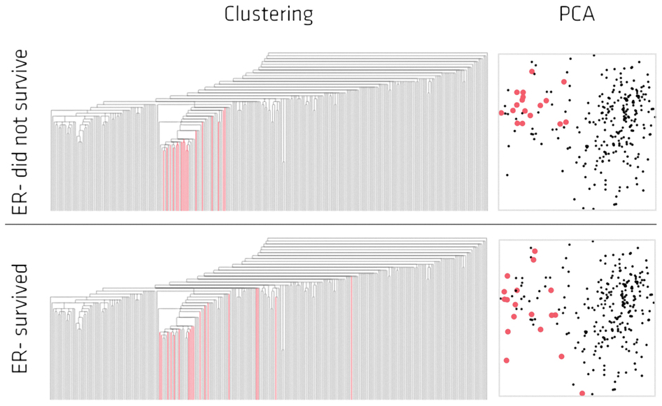
Highlighted in red are the lowERNS (top panel) and the lowERHS (bottom panel) patient sub-groups.
http://www.nature.com/srep/2013/130207/srep01236/full/srep01236.html

Slide 55
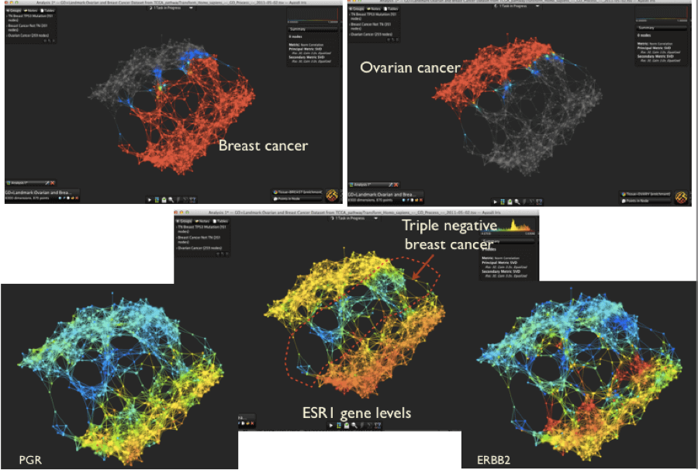
used both the genome information at the DNA level (what mutations occurred in the tumor) and at the RNA level (what genes are being expressed in the tumor).
870 tumors; about 500 from breast cancer patients, the rest are ovarian tumors Pek Lum
https://www.ayasdi.com/blog/office-of-the-cdo/when-is-breast-cancer-like-ovarian-cancer/

Slide 56
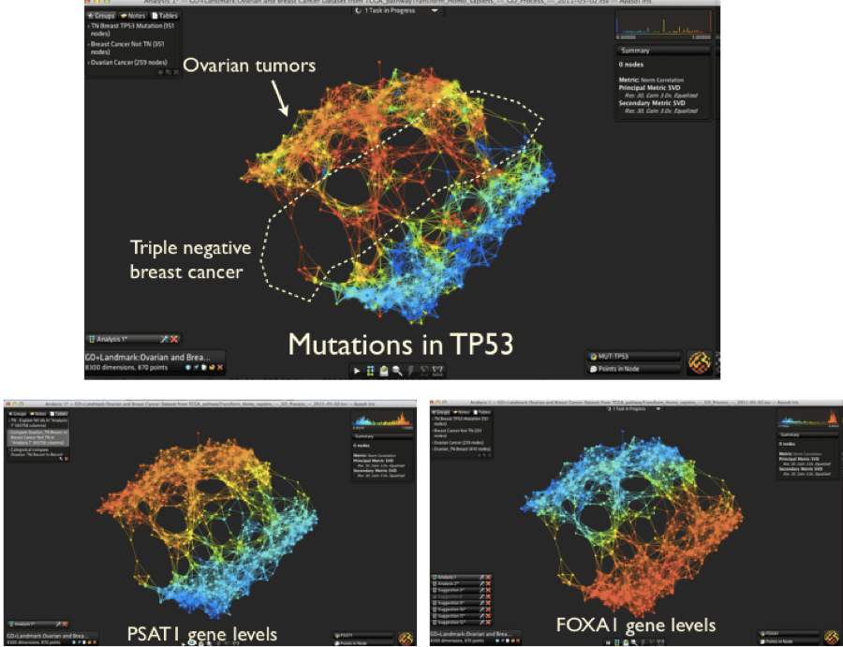
https://www.ayasdi.com/blog/office-of-the-cdo/when-is-breast-cancer-like-ovarian-cancer

Slide 57
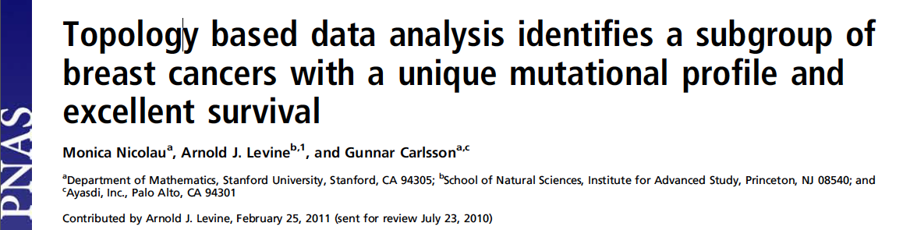
http://www.pnas.org/content/early/2011/04/07/1102826108

Slide 58
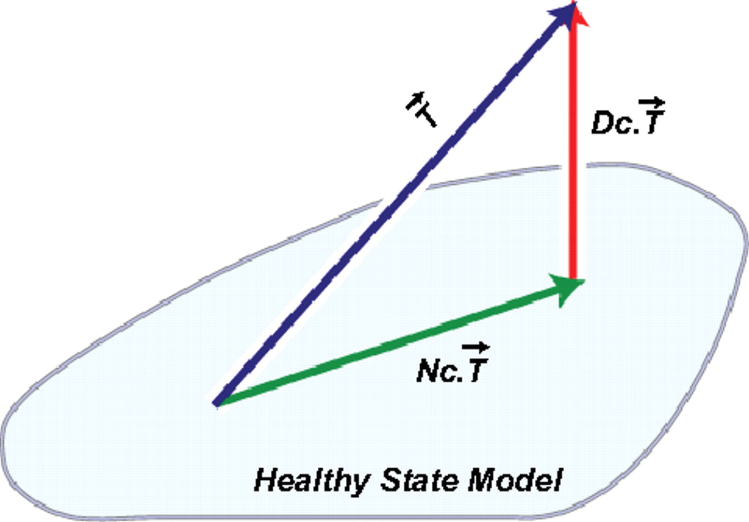
DSGA decomposition of the original tumor vector into the Normal component its linear models fit onto the Healthy State Model and the Disease component vector of residuals.
Nicolau M et al. PNAS 2011;108:7265-7270
©2011 by National Academy of Sciences
Notes:
DSGA decomposition of the original tumor vector into the Normal component its linear models fit onto the Healthy State Model and the Disease component vector of residuals.

Slide 59
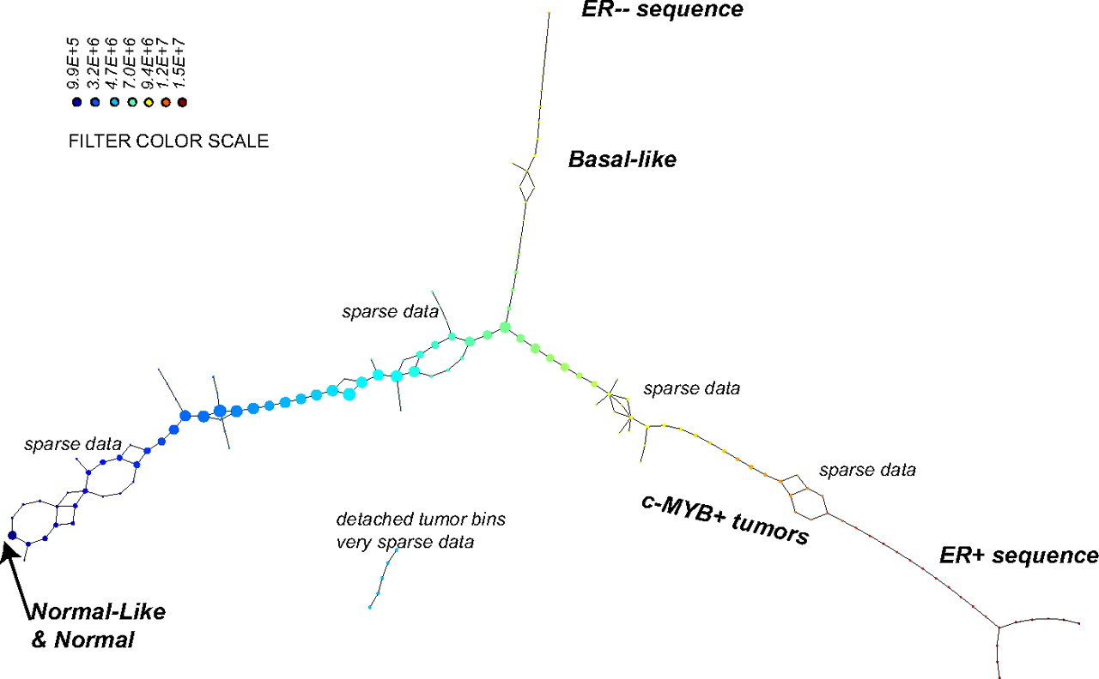
PAD analysis of the NKI data. The output has three progression arms, because tumors (data points) are ordered by the magnitude of deviation from normal (the HSM). Each bin is colored by the mean of the filter map on the points. Blue bins contain tumors whose total deviation from HSM is small (normal and Normal-like tumors). Red bins contain tumors whose deviation from HSM is large. The image of f was subdivided into 15 intervals with 80% overlap. All bins are seen (outliers included). Regions of sparse data show branching. Several bins are disconnected from the main graph. The ER− arm consists mostly of Basal tumors. The c-MYB+ group was chosen within the ER arm as the tightest subset, between the two sparse regions.
PAD analysis of the NKI data.
Nicolau M et al. PNAS 2011;108:7265-7270
©2011 by National Academy of Sciences
Notes:
PAD analysis of the NKI data. The output has three progression arms, because tumors (data points) are ordered by the magnitude of deviation from normal (the HSM). Each bin is colored by the mean of the filter map on the points. Blue bins contain tumors whose total deviation from HSM is small (normal and Normal-like tumors). Red bins contain tumors whose deviation from HSM is large. The image of f was subdivided into 15 intervals with 80% overlap. All bins are seen (outliers included). Regions of sparse data show branching. Several bins are disconnected from the main graph. The ER− arm consists mostly of Basal tumors. The c-MYB+ group was chosen within the ER arm as the tightest subset, between the two sparse regions.

Slide 60
PAD analysis of the NKI data. The output has three progression arms, because tumors (data points) are ordered by the magnitude of deviation from normal (the HSM). Each bin is colored by the mean of the filter map on the points. Blue bins contain tumors whose total deviation from HSM is small (normal and Normal-like tumors). Red bins contain tumors whose deviation from HSM is large. The image of f was subdivided into 15 intervals with 80% overlap. All bins are seen (outliers included). Regions of sparse data show branching. Several bins are disconnected from the main graph. The ER− arm consists mostly of Basal tumors. The c-MYB+ group was chosen within the ER arm as the tightest subset, between the two sparse regions.
PAD analysis of the NKI data.
Nicolau M et al. PNAS 2011;108:7265-7270
©2011 by National Academy of Sciences
Notes:
PAD analysis of the NKI data. The output has three progression arms, because tumors (data points) are ordered by the magnitude of deviation from normal (the HSM). Each bin is colored by the mean of the filter map on the points. Blue bins contain tumors whose total deviation from HSM is small (normal and Normal-like tumors). Red bins contain tumors whose deviation from HSM is large. The image of f was subdivided into 15 intervals with 80% overlap. All bins are seen (outliers included). Regions of sparse data show branching. Several bins are disconnected from the main graph. The ER− arm consists mostly of Basal tumors. The c-MYB+ group was chosen within the ER arm as the tightest subset, between the two sparse regions.

Slide 61
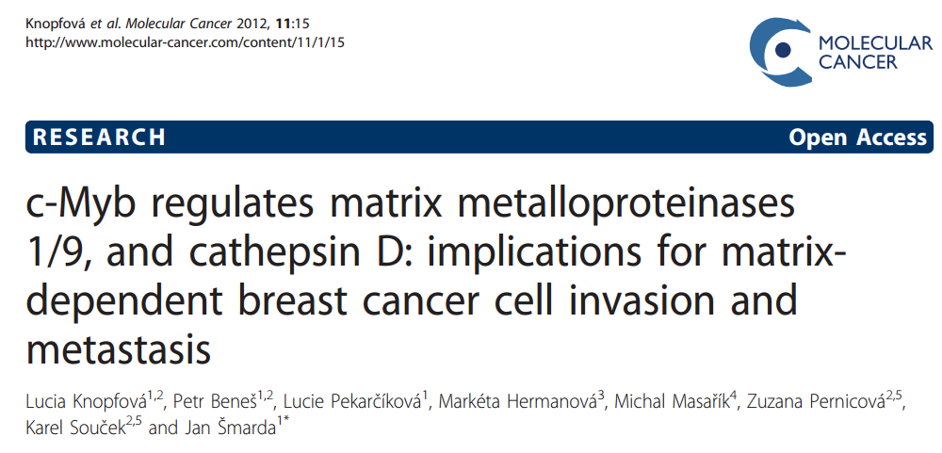
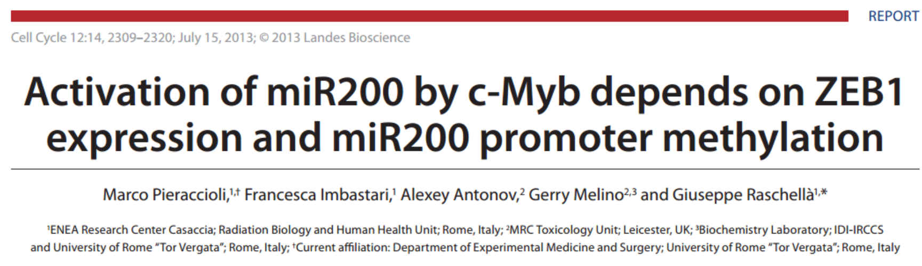

Slide 62
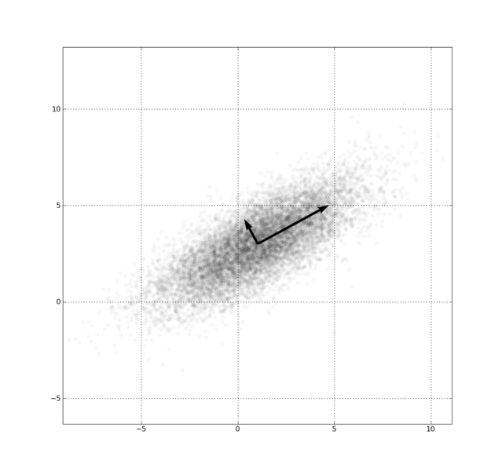
Example: Principle component analysis (PCA)
http://en.wikipedia.org/wiki/File:GaussianScatterPCA.png

Slide 63
Dimensionality Reduction: Given dataset D R^{N}
Want: embedding f: D → R^{n} where n << N
    which “preserves” the structure of the data.
Many reduction methods:
f₁: D → R, f₂: D → R, … f_{n}: D → R
(f₁, f₂, … f_{n}): D → R^{n}
Many are linear, M: R^{N} → R^{n}, Mx = y
But there are also non-linear dimensionality reduction algorithms.
U

Slide 64
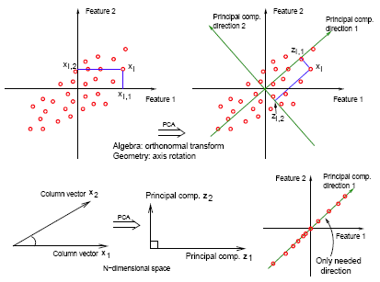
https://onlinecourses.science.psu.edu/stat857/book/export/html/11

Slide 65
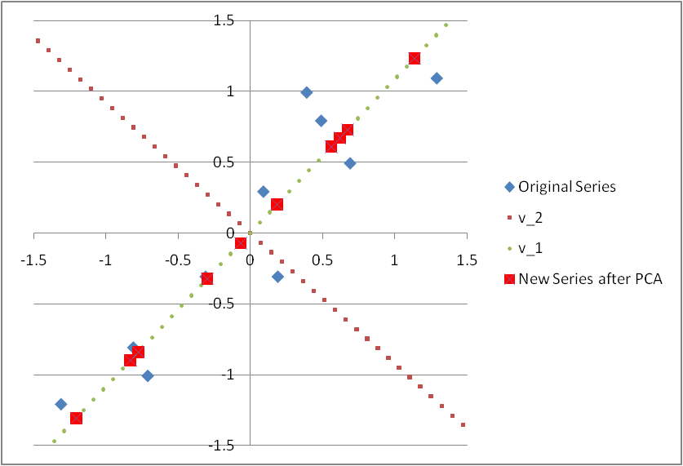
※ If only the principal component x’ is considered in the Principal Component Analysis (PCA), it is equivalent to project all points onto the v₁ vector
※ It can be observed in the above figure that the projection onto v₁ vector can retains as much as possible the interpoint distance information (variance) that was contained in the original series of (x, y)
http://homepage.ntu.edu.tw/~jryanwang/course/Mathematics%20for%20Management%20(undergraduate%20level)/MM_Ch07.pptx

Slide 66
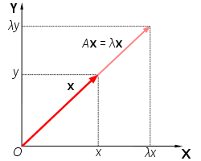
By Lyudmil Antonov Lantonov 16:35, 13 March 2008 (UTC) –
This vector image was created with Inkscape., GFDL,
https://commons.wikimedia.org/w/index.php?curid=3698599

Slide 67
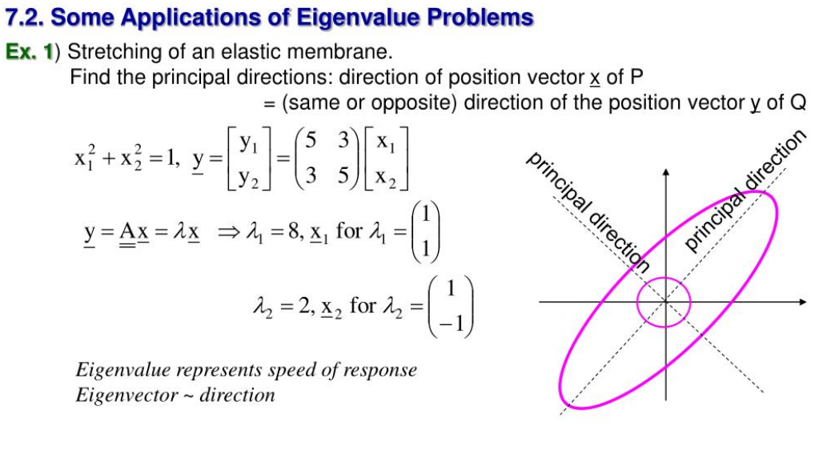
http://www.slideserve.com/wilma/chap-7-linear-algebra-matrix-eigenvalue-problems

Slide 68
Why use PCA in data analysis?
Consider the points (0, 0, …, 0), (1, 0, …, 0), (10, 0, …, 0)
Add noise to first point (0, 0, …, 0) → (0, 1, …, 1)
In R¹⁰⁰, d((0, 1, …, 1), (1, 0, …, 0)) = 10 > 9.
Add small noise to first point (0, 0, …, 0) → (0, 0.1, …, 0.1)
In R^{39,900}, d((0, 0.1, …, 0.1), (1, 0, …, 0)) = 20 > 9.
0 1 10

Slide 69
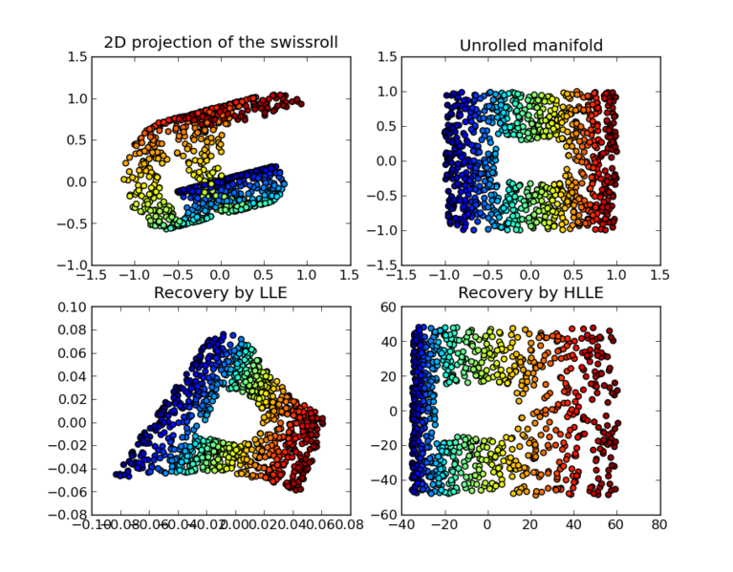
https://en.wikipedia.org/wiki/Nonlinear_dimensionality_reduction

Slide 70
4databasics3900.r

Slide 71
Topological Methods for the Analysis of High Dimensional Data Sets and 3D Object Recognition
Singh, Gurjeet; Memoli, Facundo; Carlsson, Gunnar
http://diglib.eg.org/handle/10.2312/SPBG.SPBG07.091-100

Slide 73
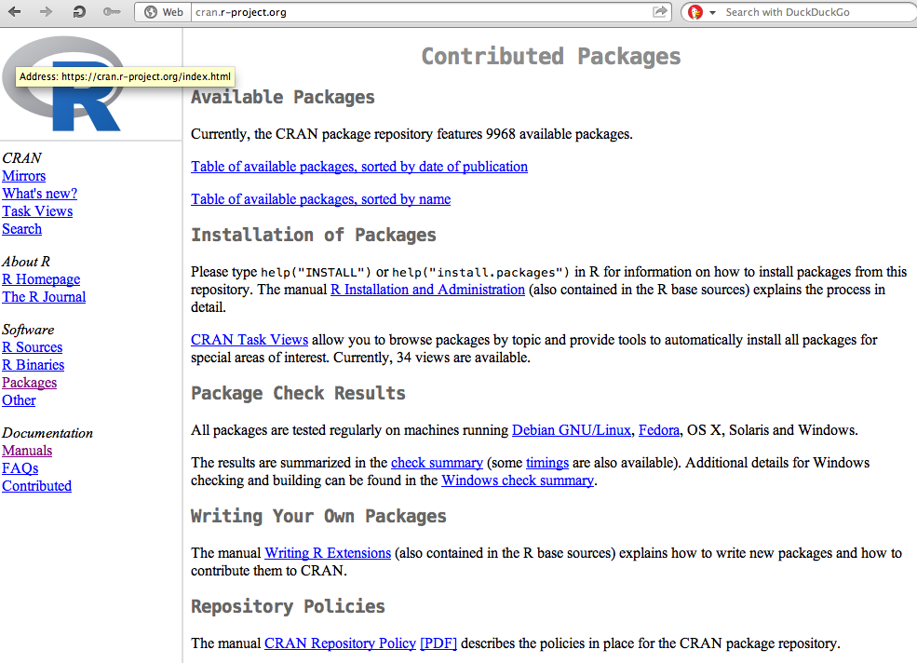
https://cran.r-project.org/
Packages

Slide 74
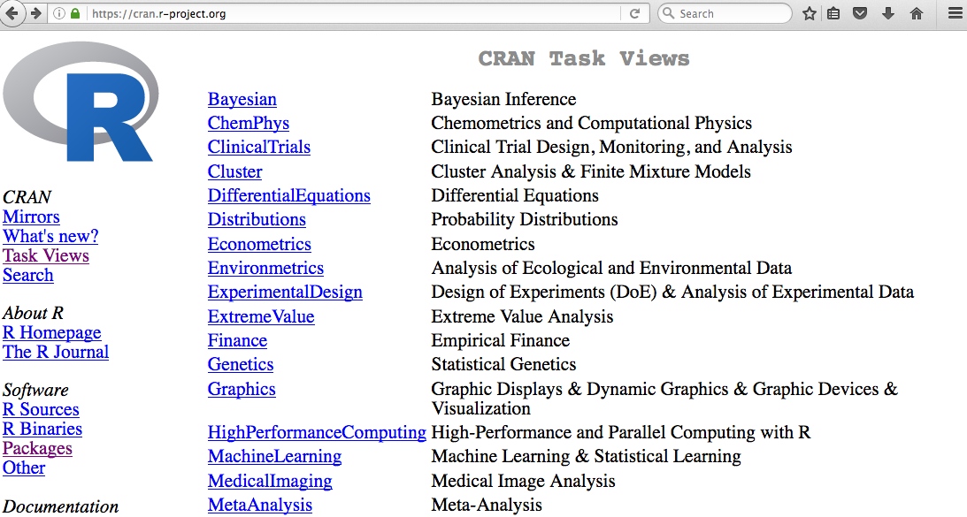

Slide 75
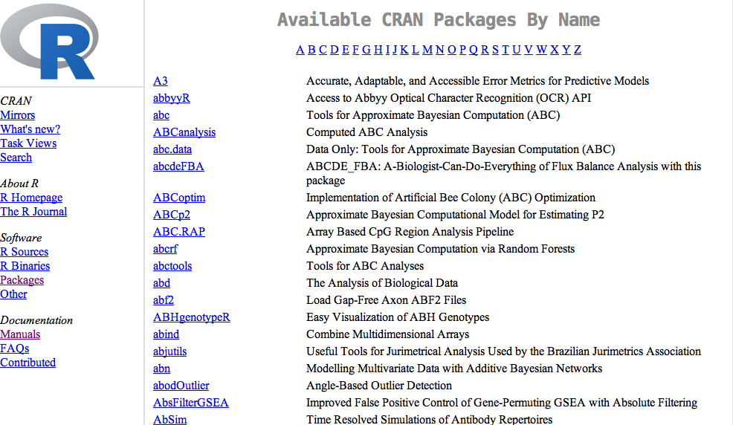

Slide 76

Additional packages can be found at other repositories such as http://bioconductor.org/

Slide 77
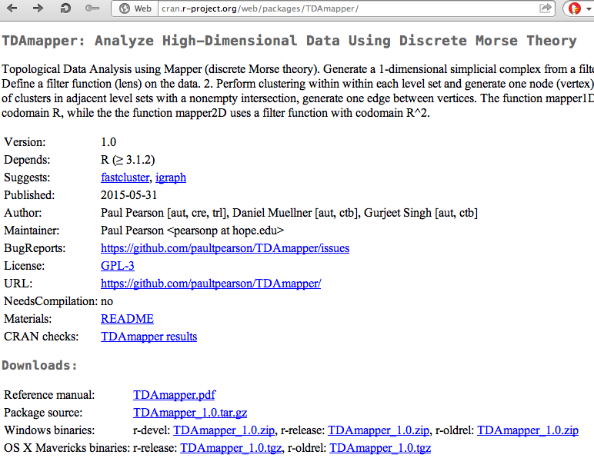
The TDAmapper package
Can download source code
useful info

Slide 78
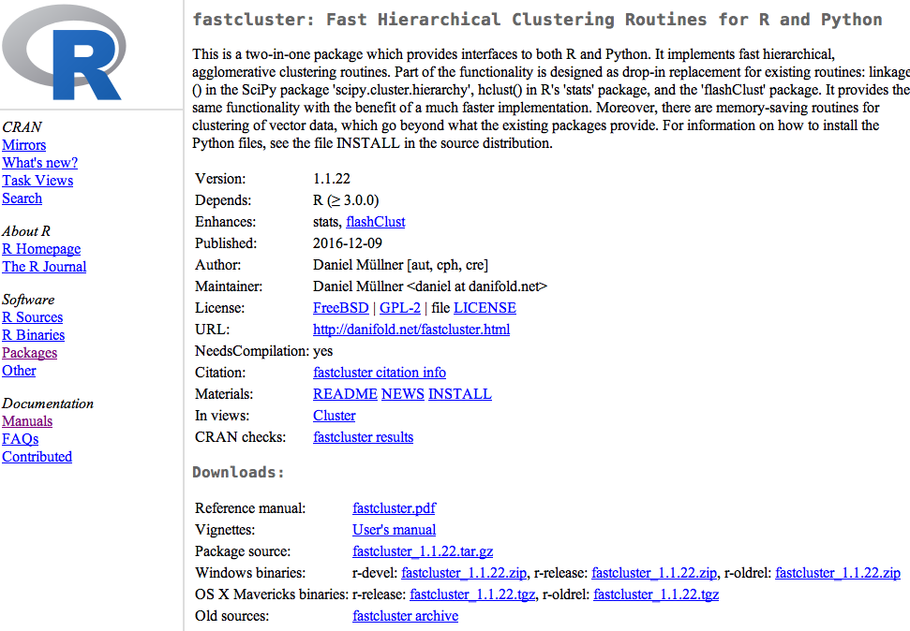
Vignettes are also useful

Slide 79
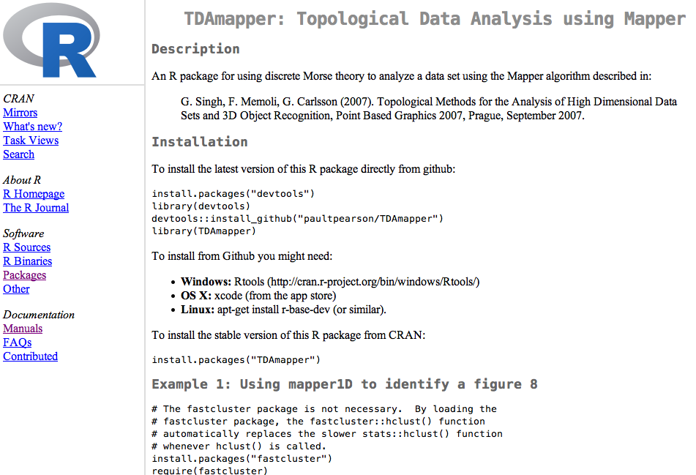
README
Do not install from GitHub unless you know what your are doing
Install in Rstudio
Examples are sometimes found in READMEs or Vignettes

Slide 80
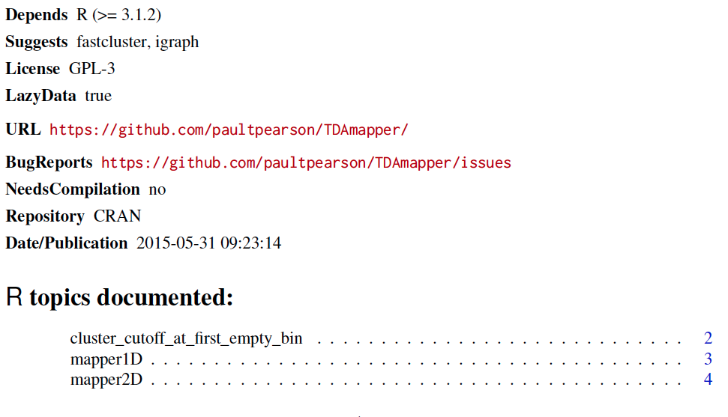
Reference manual:
The reference manual lists all commands contained in the package.

Slide 81
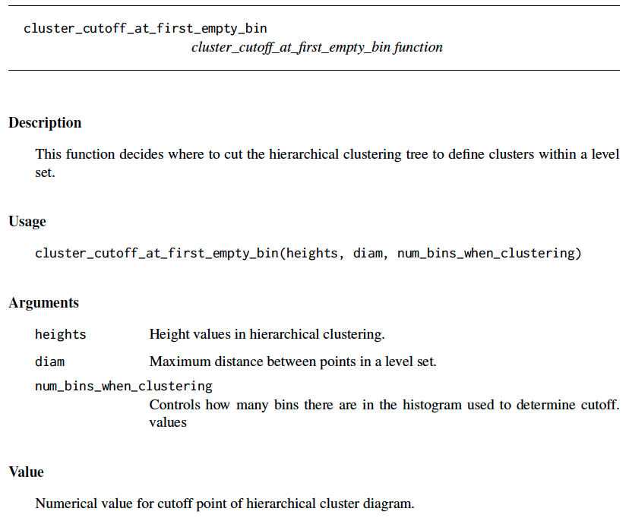
command name
All reference manuals follow same format.
Function inputs
Description of inputs
Description of output(s)

Slide 82
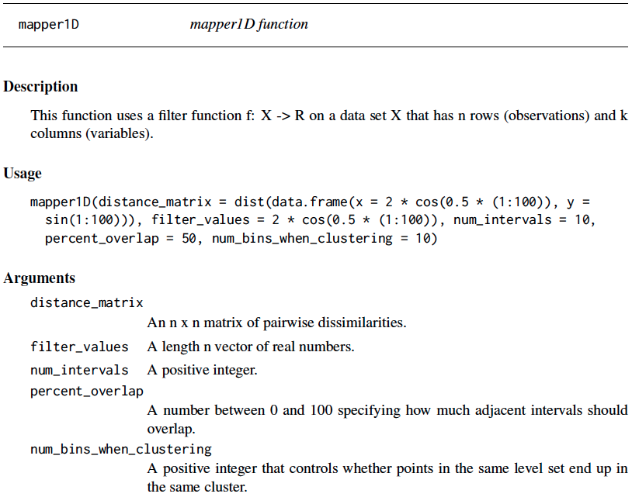

Slide 83
Can download source code
useful info

Slide 84
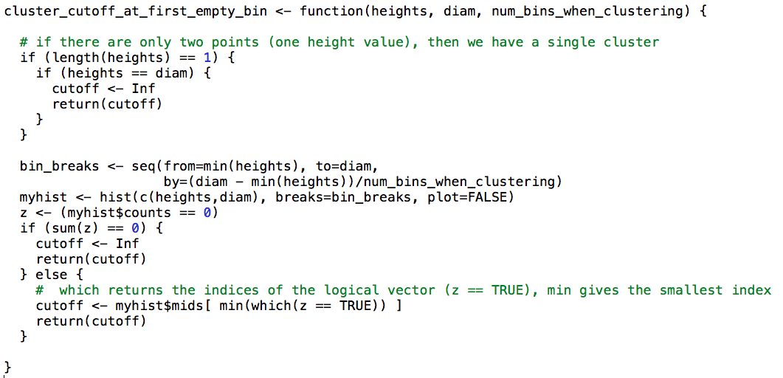

Slide 85
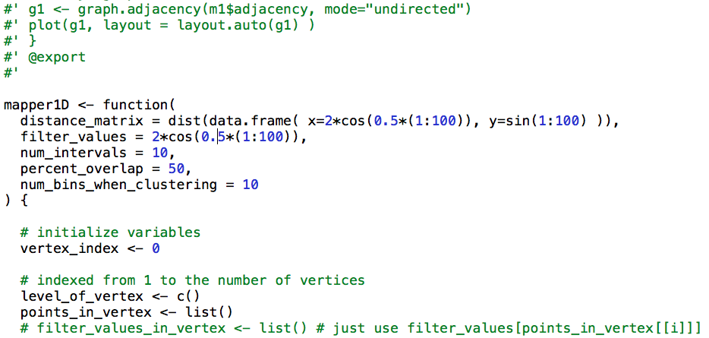
Note the version on GitHub contains commenting

Slide 86
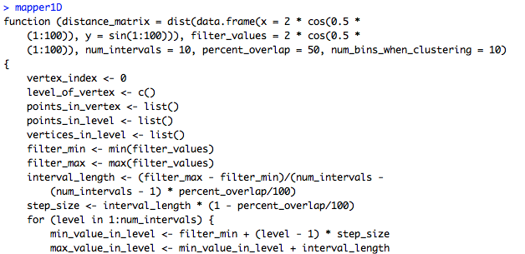
You can take a look at the code in Rstudio for any command just by typing the name of the command.
Note: mapper1d() calls this function
mapper1d allows you to view the code. Note no ()

Slide 87
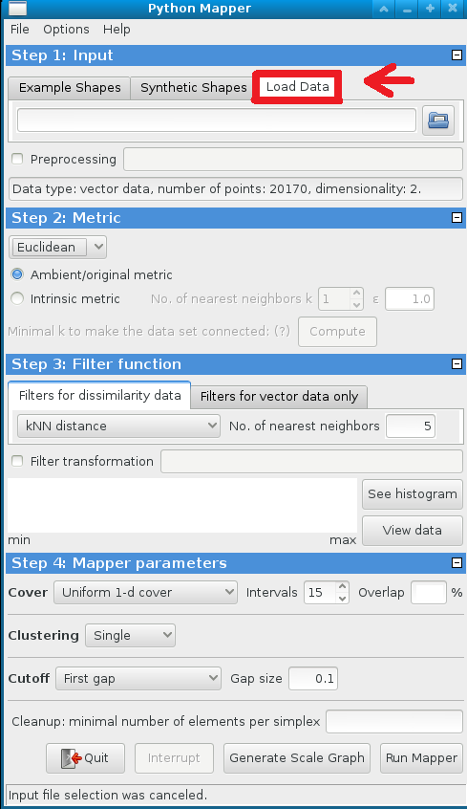
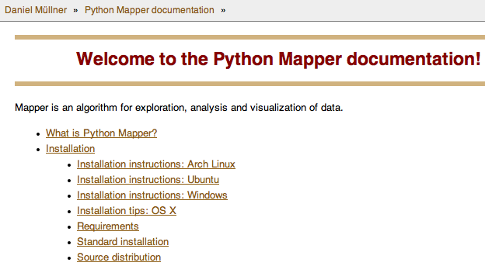
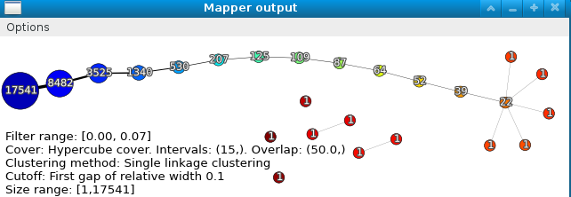
Python Mapper: http://danifold.net/mapper/
See also mappersummary2a.pdf - A quick introduction to Mapper for linux computers in B5 MLH

