Slide 1
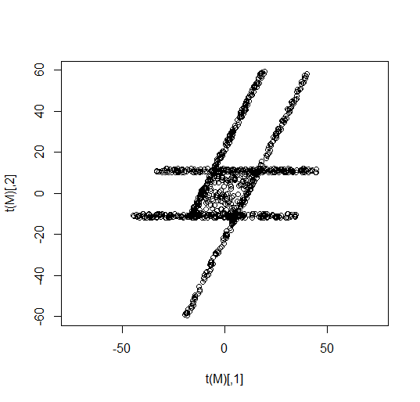
Project HW 6 (Due 3/4) -- 20 points You are given the following dataset to analyze using TDA Mapper
a.) What do you expect the output of TDA mapper to be if using a PCA type filter. Note your answer need not be correct -- your focus should be on the explanation.
b.) Use python mapper to explore this data set using a variety of filters.
c.) Analyze the results.
See flaresTransformed.r
in LABS/ directory

Slide 2
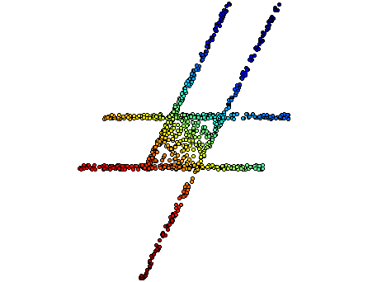
a.) The figure on the right was created using python mapper. The chosen filter was distance matrix eigenvector with mean centered distance matrix and order of eigenvector = 0.
The data points are colored using their filter value.
For simplicity, I will use 5 overlapping bins with 50% overlap as shown in the figure on the right (also see figures on next page).
Note the red line
indicates the first
principle component axis
(i.e. direction of eigenvector with largest eigenvalue for the covariance matrix).
Thus the overlapping bins are perpendicular to this line.

Slide 3
My expectation regarding output of TDA mapper
The red bin contains
3 cluster.
This orange bin contains 1 cluster.
This yellow bin contains 1 cluster.
This green bin contains 2 cluster.
If my assumptions regarding number of clusters is correct, then the output of mapper should be
This blue bin contains 2 cluster.

Slide 4
a & c.) If my assumptions regarding
number of clusters is correct,
then the output of mapper
should be the figure to the right:
Or equivalently (same graph, just
drawn differently):
The actual output of python mapper is shown below:
It appears there may have been
2 blue clusters: 84 + 135 (thus my blue bin may have been a little off).
2 green cluster: 274 + 16
1 yellow cluster : 386
1 orange clusters : 447
2 red clusters : 354 + 41 (thus my red bin may have been a little off).

Slide 5
b & c.) Mapper output for different numbers of intervals
3 intervals
4 intervals
5 intervals
10 intervals
Thus it appears that 3 or 4 overlapping bins is too few (as these outputs are different from the other outputs – though 4 is not that different from 5).
Note the similarity in shape between the output for 10 and 20 overlapping bins.
20 intervals

Slide 6
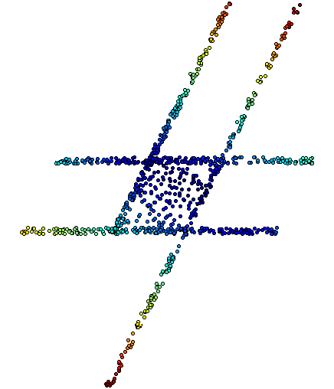
Mapper output with different filters
Eccentricity (infinity) kNN where k = 300
Note k = 300 was chosen based on visualizing the data set (which is not possible when dim > 3)
5 intervals
5 intervals
10 intervals
10 intervals
20 intervals
20 intervals

