Slide 1
vol. 110 no. 46, 18566–18571, 2013
http://www.pnas.org/content/110/46/18566.full

Slide 2
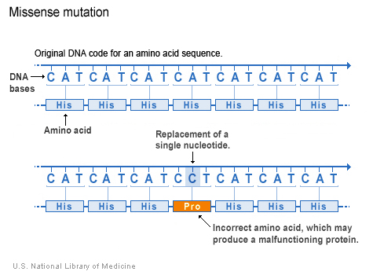
http://ghr.nlm.nih.gov/handbook/mutationsanddisorders/possiblemutations

Slide 3
Where do we get distances from?
Distances can be derived from Multiple Sequence Alignments (MSAs).
The most basic distance is just a count of the number of sites which differ between two sequences divided by the sequence length. These are sometimes known as p-distances.
 | Cat | Dog | Rat | Cow
Cat | 0 | 0.2 | 0.4 | 0.7
Dog | 0.2 | 0 | 0.5 | 0.6
Rat | 0.4 | 0.5 | 0 | 0.3
Cow | 0.7 | 0.6 | 0.3 | 0
Cat | ATTTGCGGTA
Dog | ATCTGCGATA
Rat | ATTGCCGTTT
Cow | TTCGCTGTTT
http://www.allanwilsoncentre.ac.nz/massey/fms/AWC/download/SK_DistanceBasedMethods.ppt

Slide 4
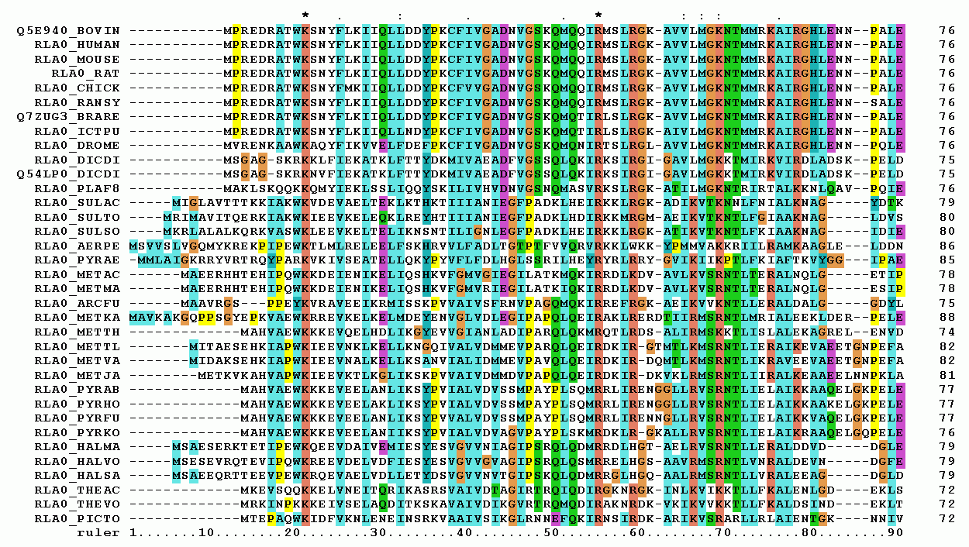
Multiple sequence alignment
http://upload.wikimedia.org/wikipedia/commons/7/79/RPLP0_90_ClustalW_aln.gif

Slide 5
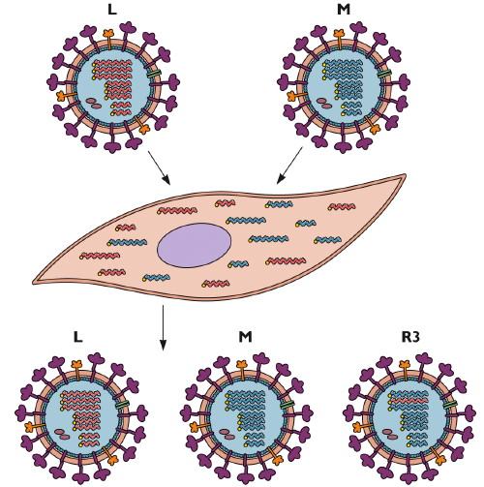
Reassortment
http://www.virology.ws/2009/06/29/reassortment-of-the-influenza-virus-genome/

Slide 6
Homologous recombination
http://en.wikipedia.org/wiki/File:HR_in_meiosis.svg

Slide 7
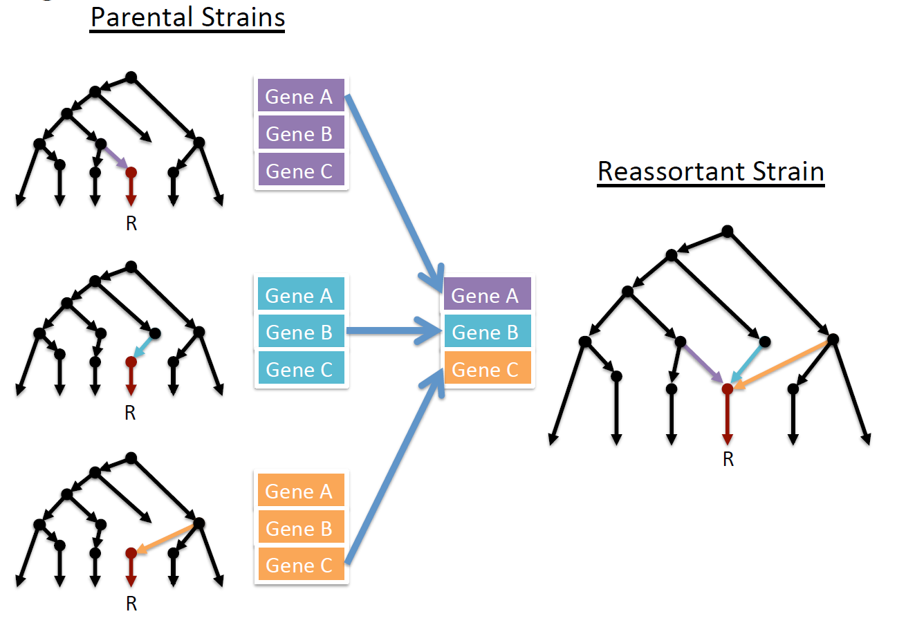

Slide 8
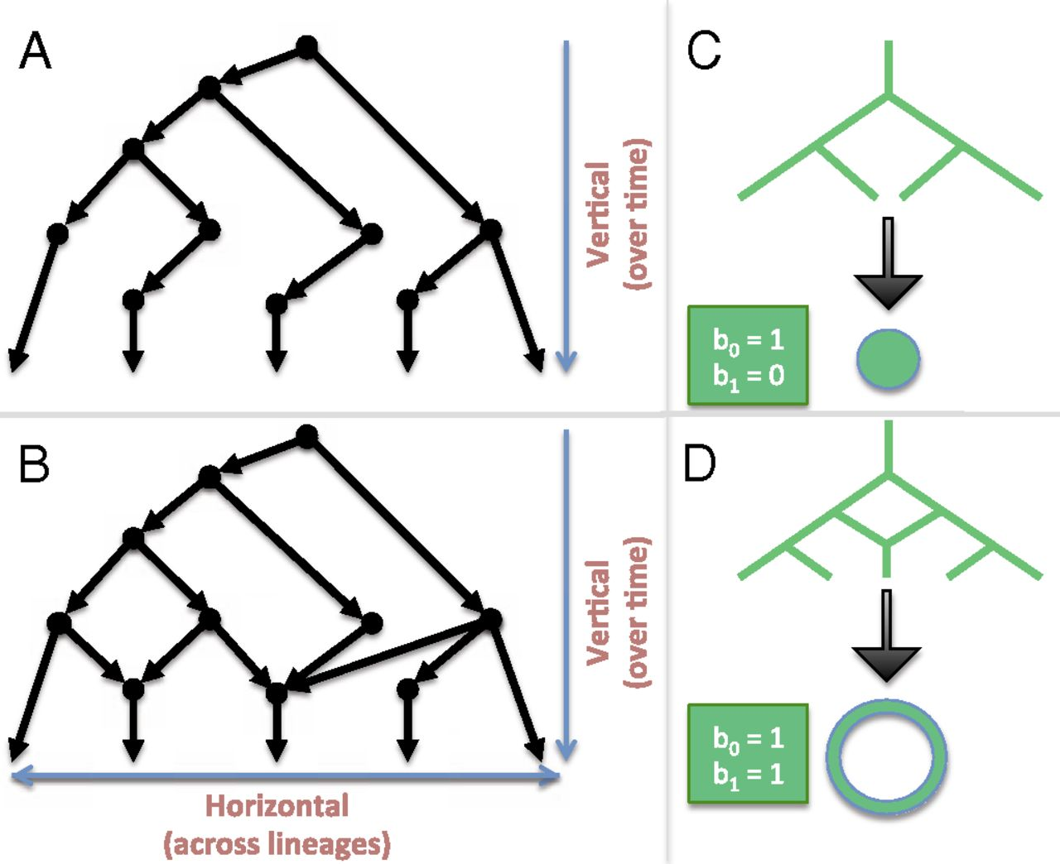
Linking algebraic topology to evolution.
Reticulation
Chan J M et al. PNAS 2013;110:18566-18571
©2013 by National Academy of Sciences
Notes:
Linking algebraic topology to evolution. (A) A tree depicting vertical evolution. (B) A reticulate structure capturing horizontal evolution, as well. (C) A tree can be compressed into a point. (D) The same cannot be done for a reticulate structure without destroying the hole at the center.

Slide 9
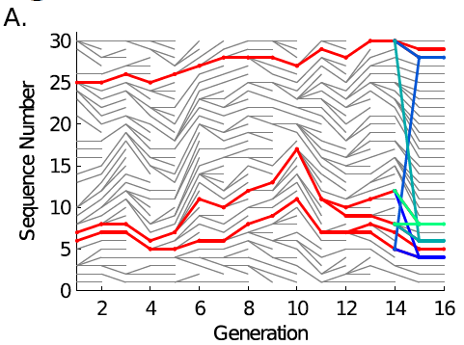
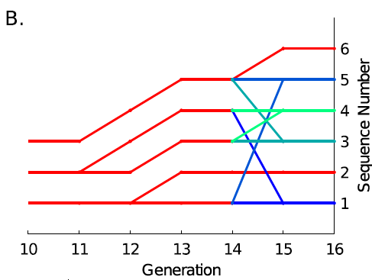
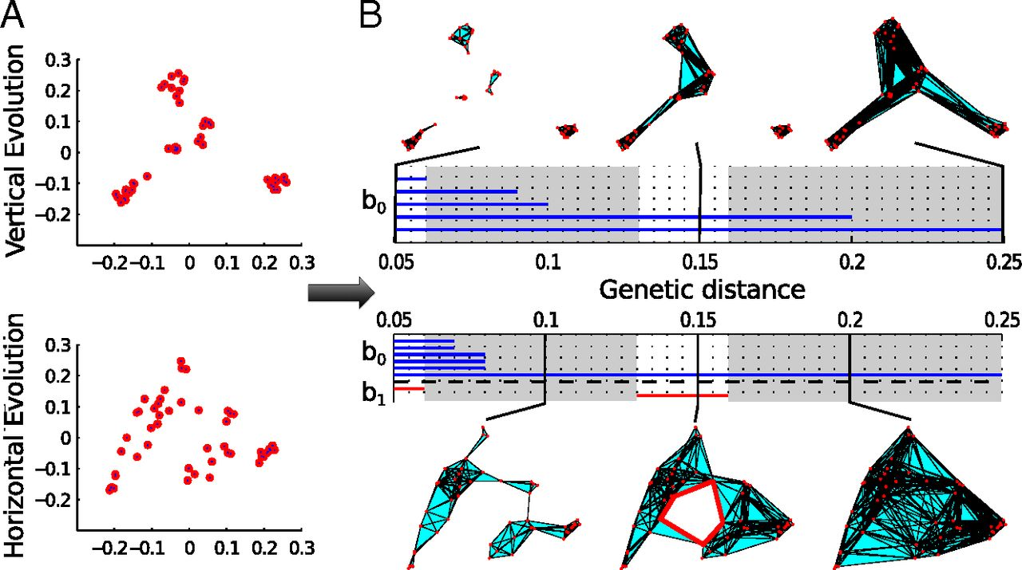

Slide 10
Persistent homology characterizes topological features of vertical and horizontal evolution.
Joseph Minhow Chan et al. PNAS 2013;110:18566-18571
©2013 by National Academy of Sciences
Notes:
Persistent homology characterizes topological features of vertical and horizontal evolution. Evolution was simulated with and without reassortment (SI Appendix, Supplementary Text). (A) A metric space of pairwise genetic distances d(i,j) can be calculated for a given population of genomic sequences g₁,…, g_{n}. We visualize these data points using principal coordinate analysis (PCoA) (SI Appendix, Supplementary Text). (B) In the construction of simplicial complexes, two genomes are considered related (joined by a line) if their genetic distance is smaller than ε. Three genomes within ε of each other form a triangle, and so on (SI Appendix, Supplementary Text). From there, we calculate the homology groups at different genetic scales. In the barcode, each bar in different dimensions represents a topological feature of a filtration of simplicial complexes persisting over an interval of ε. A one-dimensional cycle (red highlight) exists at ε = [0.13, 0.16 Hamming distance] and corresponds to a reticulate event. The evolutionary scales I where b₁ = 0 are highlighted in gray.

Slide 11
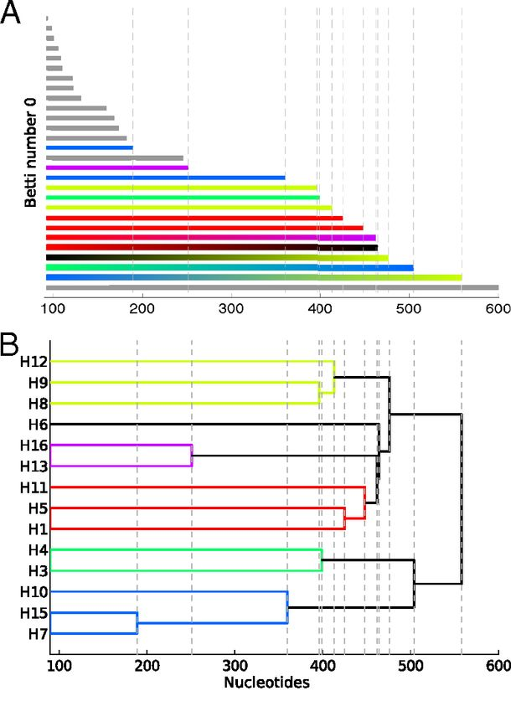
Reconstructing phylogeny from persistent homology of avian influenza HA. (A) Barcode plot in dimension 0 of all avian HA subtypes.
Influenza:
For a single segment,
no H_{k} for k > 0
no horizontal transfer
(i.e., no homologous recombination)
©2013 by National Academy of Sciences
Chan J M et al. PNAS 2013;110:18566-18571
Notes:
Reconstructing phylogeny from persistent homology of avian influenza HA. (A) Barcode plot in dimension 0 of all avian HA subtypes. Each bar represents a connected simplex of sequences given a Hamming distance of ε. When a bar ends at a given ε, it merges with another simplex. Gray bars indicate that two simplices of the same HA subtype merge together at a given ε. Solid color bars indicate that two simplices of different HA subtypes but same major clade merge together. Interpolated color bars indicate that two simplices of different major clades merge together. Colors correspond to known major clades of HA. For specific parameters, see SI Appendix, Supplementary Text. (B) Phylogeny of avian HA reconstructed from the barcode plot in A. Major clades are color-coded. (C) Neighbor-joining tree of avian HA (SI Appendix, Supplementary Text).

Slide 12
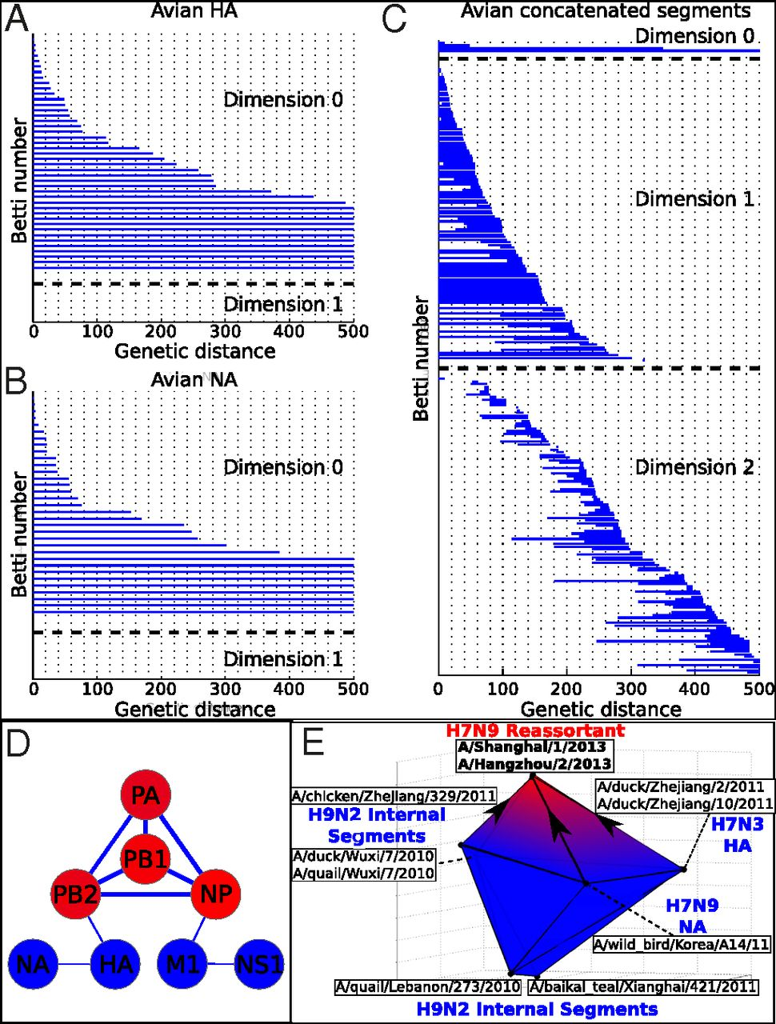
Persistent homology of reassortment in avian influenza.
For multiple segments,
non-trivial H_{k}
k = 1, 2.
Thus
horizontal transfer via reassortment
but not homologous recombination
www.virology.ws/2009/06/29/reassortment-of-the-influenza-virus-genome/
Chan J M et al. PNAS 2013;110:18566-18571
©2013 by National Academy of Sciences
Notes:
Persistent homology of reassortment in avian influenza. Analysis of (A) HA and (B) NA reveal no significant one-dimensional topological structure. (C) Concatenated segments reveal rich 1D and 2D topology, indicating reassortment. For specific parameters, see SI Appendix, Supplementary Text. (D) Network representing the reassortment pattern of avian influenza deduced from high-dimensional topology. Line width is determined by the probability that two segments reassort together. Node color ranges from blue to red, correlating with the sum of connected line weights for a given node. For specific parameters, see SI Appendix, Supplementary Text. (E) b₂ polytope representing the triple reassortment of H7N9 avian influenza. Concatenated genomic sequences forming the polytope were transformed into 3D space using PCoA (SI Appendix, Supplementary Text). Two-dimensional barcoding was performed using Vietoris–Rips complex and a maximum scale ε of 4,000 nucleotides.

Slide 13
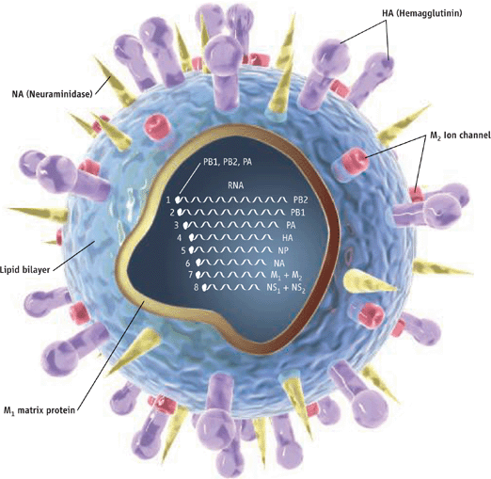
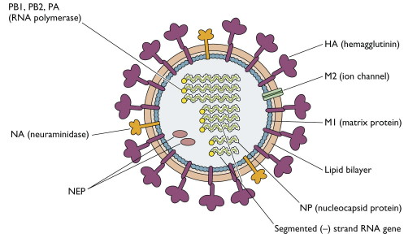
http://www.pnas.org/content/110/46/18566.full
http://www.sciencemag.org/content/312/5772/380.full
http://www.virology.ws/2009/04/30/structure-of-influenza-virus/
Notes:
Persistent homology of reassortment in avian influenza. Analysis of (A) HA and (B) NA reveal no significant one-dimensional topological structure. (C) Concatenated segments reveal rich 1D and 2D topology, indicating reassortment. For specific parameters, see SI Appendix, Supplementary Text. (D) Network representing the reassortment pattern of avian influenza deduced from high-dimensional topology. Line width is determined by the probability that two segments reassort together. Node color ranges from blue to red, correlating with the sum of connected line weights for a given node. For specific parameters, see SI Appendix, Supplementary Text. (E) b₂ polytope representing the triple reassortment of H7N9 avian influenza. Concatenated genomic sequences forming the polytope were transformed into 3D space using PCoA (SI Appendix, Supplementary Text). Two-dimensional barcoding was performed using Vietoris–Rips complex and a maximum scale ε of 4,000 nucleotides.

Slide 14
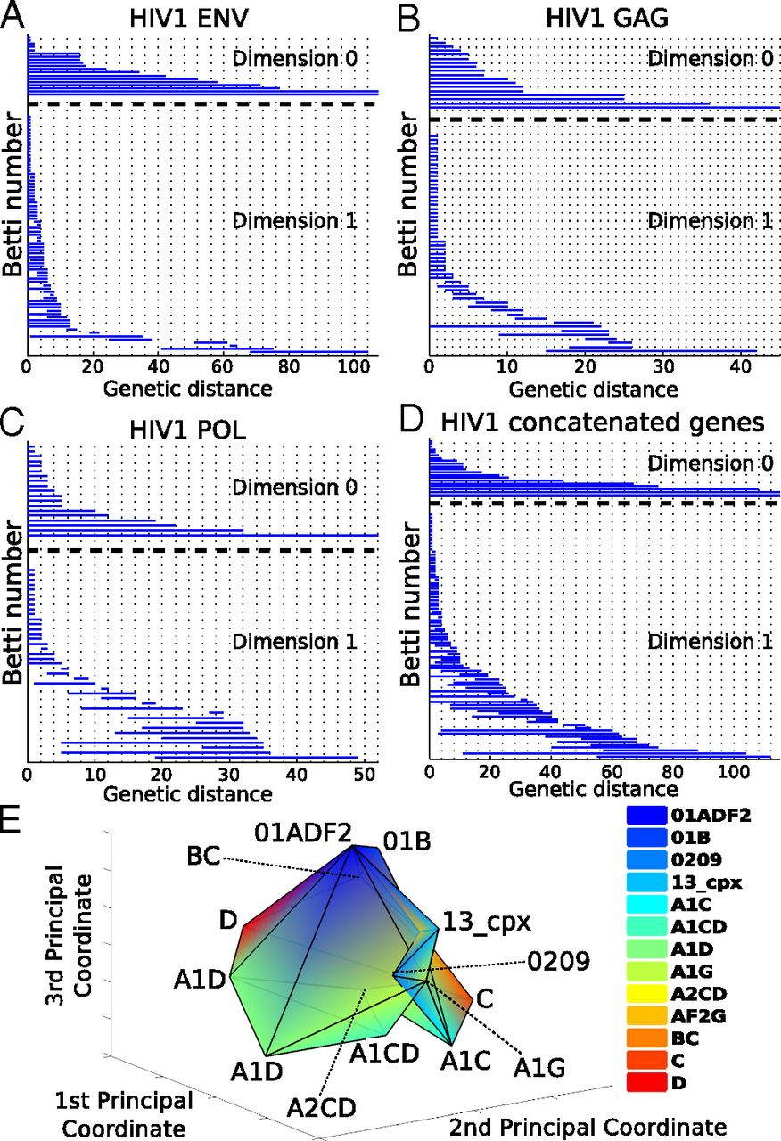
Barcoding plots of HIV-1 reveal evidence of recombination in (A) env, (B), gag, (C) pol, and (D) the concatenated sequences of all three genes.
HIV –
single segment
(so no reassortment)
Non-trivial H_{k}
k = 1, 2.
Thus horizontal transfer via homologous recombination.
©2013 by National Academy of Sciences
Chan J M et al. PNAS 2013;110:18566-18571
Notes:
Barcoding plots of HIV-1 reveal evidence of recombination in (A) env, (B), gag, (C) pol, and (D) the concatenated sequences of all three genes. One-dimensional topology present for alignments of individual genes as well as the concatenated sequences suggests recombination. (E) b₂ polytope representing a complex recombination event with multiple parental strains. Sequences of the [G4] generator of concatenated HIV-1 gag, pol, and env were transformed into 3D space using PCoA (SI Appendix, Supplementary Text) of the Nei–Tamura pairwise genetic distances. Two-simplices from the [G4] generator defined a polytope whose cavity represents a complex recombination. Each vertex of the polytope corresponds to a sequence that is color-coded by HIV-1 subtype. For specific parameters, see SI Appendix, Supplementary Text.

Slide 15
From Supplementary Info:
Using the Javaplex software package at http://code.google.com/p/javaplex, we
implemented lazy witness stream to filter different viral strains with the following
parameters:
Fig. 3A: 20% of dataset as landmarks, max scale ε of 1000 nucleotides, and max
dimension of 0.
Fig. 4C: 20% landmarks, max scale ε of 500 nucleotides, and max dimension of 2.
Fig. 4D: one-third landmarks, max scale ε of 1000 nucleotides, and max dimension of 1.
Fig. 5D: one-third landmarks, max scale ε of 1000 nucleotides, and max dimension of 1.
Fig. 5E: 20% landmarks, max scale ε of 150 nucleotides, and max dimension of 2.
Fig. S10: one-third landmarks, max scale ε of 1000 nucleotides, and max dimension of 1.
Fig. S11: one-third landmarks, max scale ε of 1000 nucleotides, and max dimension of 1.
All supplementary tables used one-third of sequences as landmarks except for 20%
landmarks in Table S3, S5, and S13.
While lazy witness streams can largely recapitulate the homology groups of Vietoris-Rips
at a lower computational cost, the sensitivity to detect irreducible cycles can drop if the
number of landmark points is insufficient. However, through our evolutionary
simulations, we show that even with a landmark set of 20% of the sequences, our
sensitivity surpasses other popular methods of recombinant detection (see Simulations).

Slide 16
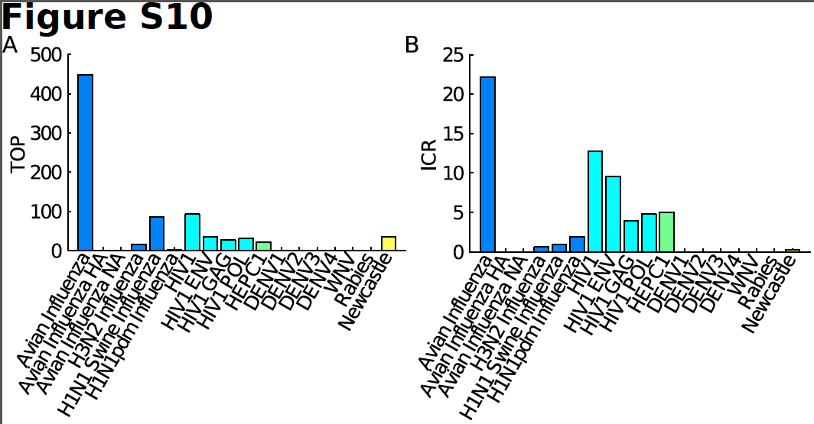
TOP = Topological obstruction
= maximum barcode length in non-zero dimensions
TOP ≠ 0 ➔ no additive distance tree
TOP is stable

Slide 17
ICR = irreducible cycle rate
= average number of the one-dimensional
irreducible cycles per unit of time
Simulations show that ICR is proportional to and provides a lower bound for recombination/reassortment rate

Slide 19
Persistent homology Viral evolution
Filtration value ε Genetic distance
(evolutionary scale)
β₀ at filtration value ε Number of clusters at scale ε
Generators of H₀ A representative element of
the cluster
Hierarchical Hierarchical clustering
relationship among
H₀ generators
β₁ Number of reticulate events
(recombination and
reassortment)

Slide 20
Persistent homology Viral evolution
Generators of H₁ Reticulate events
Generators of H₂ Complex horizontal
genomic exchange
H_{k} ≠ 0 for some k > 0 No phylogenetic tree
representation
Number of Lower bound on rate of
higher-dimensional reticulate events
generators over time
(irreducible cycle rate)

Slide 21
http://www.nytimes.com/2016/02/07/opinion/sunday/give-up-your-data-to-cure-disease.html

Slide 22
http://americangut.org

Slide 23
https://fundrazr.com/campaigns/4Tqx5

Slide 24
http://www.medscape.com/viewarticle/749577

Slide 25
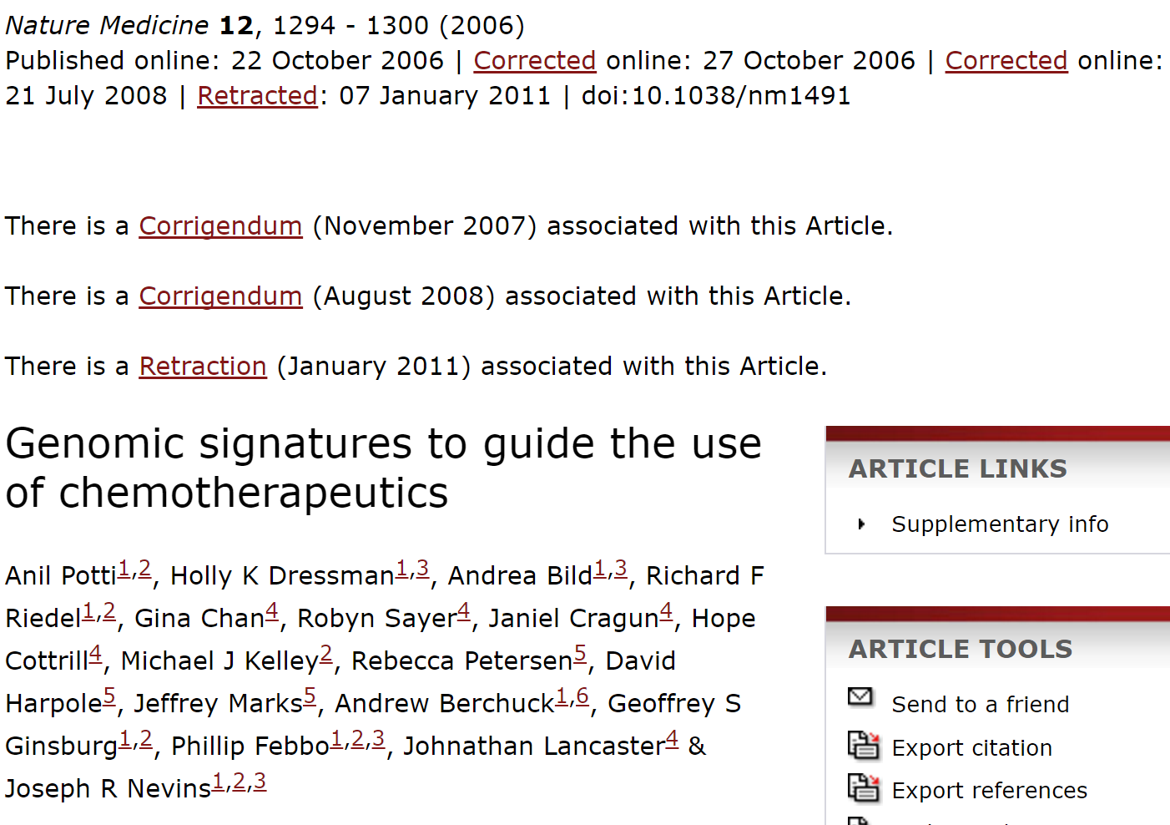
http://www.nature.com/nm/journal/v12/n11/full/nm1491.html

Slide 26
http://projecteuclid.org/download/pdfview_1/euclid.aoas/1267453942
High-throughput biological assays such as microarrays let us ask very detailed questions about how diseases operate, and promise to let us personalize therapy. Data processing, however, is often not described well enough to allow for exact reproduction of the results, leading to exercises in “forensic bioinformatics” where aspects of raw data and reported results are used to infer what methods must have been employed. Unfortunately, poor documentation can shift from an inconvenience to an active danger when it obscures not just methods but errors. In this report we examine several related papers purporting to use microarray-based signatures of drug sensitivity derived from cell lines to predict patient response. Patients in clinical trials are currently being allocated to treatment arms on the basis of these results. However, we show in five case studies that the results incorporate several simple errors that may be putting patients at risk. One theme that emerges is that the most common errors are simple (e.g., row or column offsets); conversely, it is our experience that the most simple errors are common. We then discuss steps we are taking to avoid such errors in our own investigations.

Slide 27
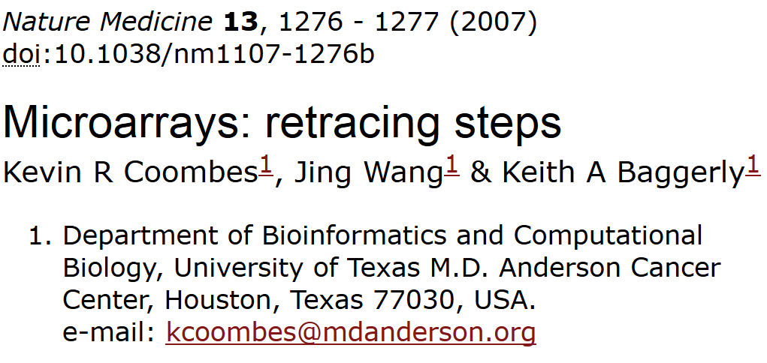
“We report here our inability to reproduce their findings.”

Slide 28
2. The lists of genes initially reported in the supplementary information on the Nature Medicine website¹ are wrong because of an 'off-by-one' indexing error.
3. Using their software and lists of cell lines, we reproduced their published heatmaps for six out of seven drugs. (We could not reproduce the heatmap for cytoxan.) However, after correcting for the off-by-one error, we matched the reported gene lists exactly for only three out of seven drugs (Supplementary Report 9). The other lists contain outliers.
5. Their software does not maintain the independence of training and test sets, and the test data alter the model.
7. When we apply the same methods but maintain the separation of training and test sets, predictions are poor (Fig. 1 and Supplementary Report 7). Simulations show that the results are no better than those obtained with randomly selected cell lines (Supplementary Report 8).

Slide 29
http://blog.ecu.edu/sites/dailyclips/blog/2015/05/04/duke-university-settles-suit-with-cancer-patients-over-clinical-trials-the-news-observer/
By Joseph Neff
Duke University has settled the lawsuit filed by the families of eight cancer patients treated in clinical trials based on bogus science, a Duke spokesman said Saturday.
The settlement ends another chapter in the long-running scandal over research conducted by Dr. Anil Potti, once a rising scientist who has retracted 11 research papers and left Duke in disgrace in 2011.
Duke spokesman Michael Schoenfeld declined to discuss the amount of settlement or any other questions about the lawsuit.
But the dollar amount of the settlement is likely to be substantial, given the depth of the research misconduct and damaging evidence discovered in the lawsuit, including a whistleblower who alerted Duke to the misconduct in 2008 but went ignored.
Duke officials shut down the trials in 2010 and flatly said they should never have been done.
Potti is now working at a cancer center in North Dakota.

Slide 30
http://www.bna.com/patients-researchers-demand-n57982065145/
By Llewellyn Hinkes-JonesDec. 2 — Patients and researchers have harshly criticized the leniency of research misconduct findings against former Duke University cancer researcher Anil Potti and the sole focus on Potti by the Department of Health and Human Services Office of Research Integrity.
On Nov. 9, the ORI made a formal finding of research misconduct against Potti for altering data sets, falsifying grant applications and disregarding accepted scientific methodology surrounding his widely celebrated “Holy Grail” of cancer research. While Potti neither admits nor denies his guilt, the ORI banned Potti from U.S. Public Health Service-supported research for five years

Slide 31
http://www.medscape.com/viewarticle/854595
However, the Cancer Letter editorialists have damning words for Duke about the handling of the protracted scandal.
"This case is about as serious as one can imagine at the individual level. At the institutional level, it is beyond disappointing at every turn: in handing an internal whistleblower; in responding to credible, serious, and repeated external scientific queries; in managing the multiple conflicts of interest in the situation; in limiting the information available to an interim scientific review; in how its leaders testified to an IOM review committee; in its legal responses," the pair write.

Slide 32
http://retractionwatch.com/2012/08/20/anil-potti-resurfaces-with-job-at-north-dakota-cancer-center/

Slide 34
http://www.nature.com/nm/journal/v12/n11/full/nm1491.html

Slide 35
http://cancerletter.com/articles/20151113_2
This case is about as serious as one can imagine at the individual level. At the institutional level, it is beyond disappointing at every turn: in handing an internal whistleblower, in responding to credible, serious and repeated external scientific queries, in managing the multiple conflicts of interest in the situation, in limiting the information available to an interim scientific review, in how its leaders testified to an IOM review committee, in its legal responses.

Slide 36
Cite original source.
Cite everything including figures (copywrite might not allow modifying figures – but even if modified, must still be referenced)
For more info:
http://www.biomedicalcomputationreview.org/7/2/9.pdf
ERROR! What biomedical computing can learn from its mistakes BY KRISTIN SAINANI, PhD

Slide 37
http://projecteuclid.org/download/pdfview_1/euclid.aoas/1267453942
We now require most of our reports to be written using Sweave [Leisch(2002)], a literate programming combination of LATEX source and R [R Development Core Team (2008)] code (SASweave and odfWeave are also available) so
that we can rerun the reports as needed and get the same results.
http://www.statistik.lmu.de/~leisch/Sweave/
help("Sweave", package="utils")
http://yihui.name/knitr/

Slide 38
http://www.nature.com/naturejobs/science/articles/10.1038/nj7396-137a
http://journals.plos.org/plosone/article?id=10.1371/journal.pone.0005738
A pooled weighted average of 1.97% (N = 7, 95%CI: 0.86–4.45) of scientists admitted to have fabricated, falsified or modified data or results at least once –a serious form of misconduct by any standard– and up to 33.7% admitted other questionable research practices.

Slide 39
http://dana.org/Cerebrum/Default.aspx?id=39490

Slide 40
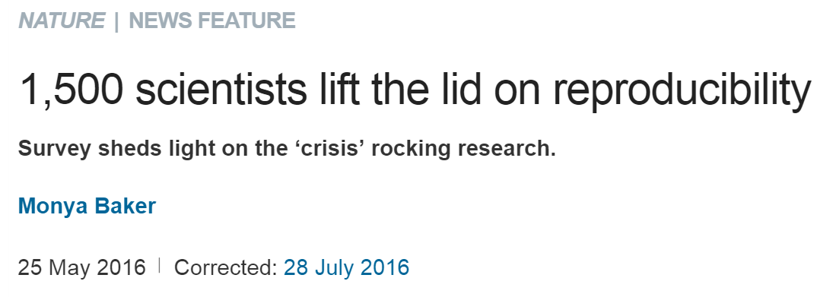
http://www.nature.com/news/1-500-scientists-lift-the-lid-on-reproducibility-1.19970
Note the following are based on researchers opinions,
not actual facts

Slide 41
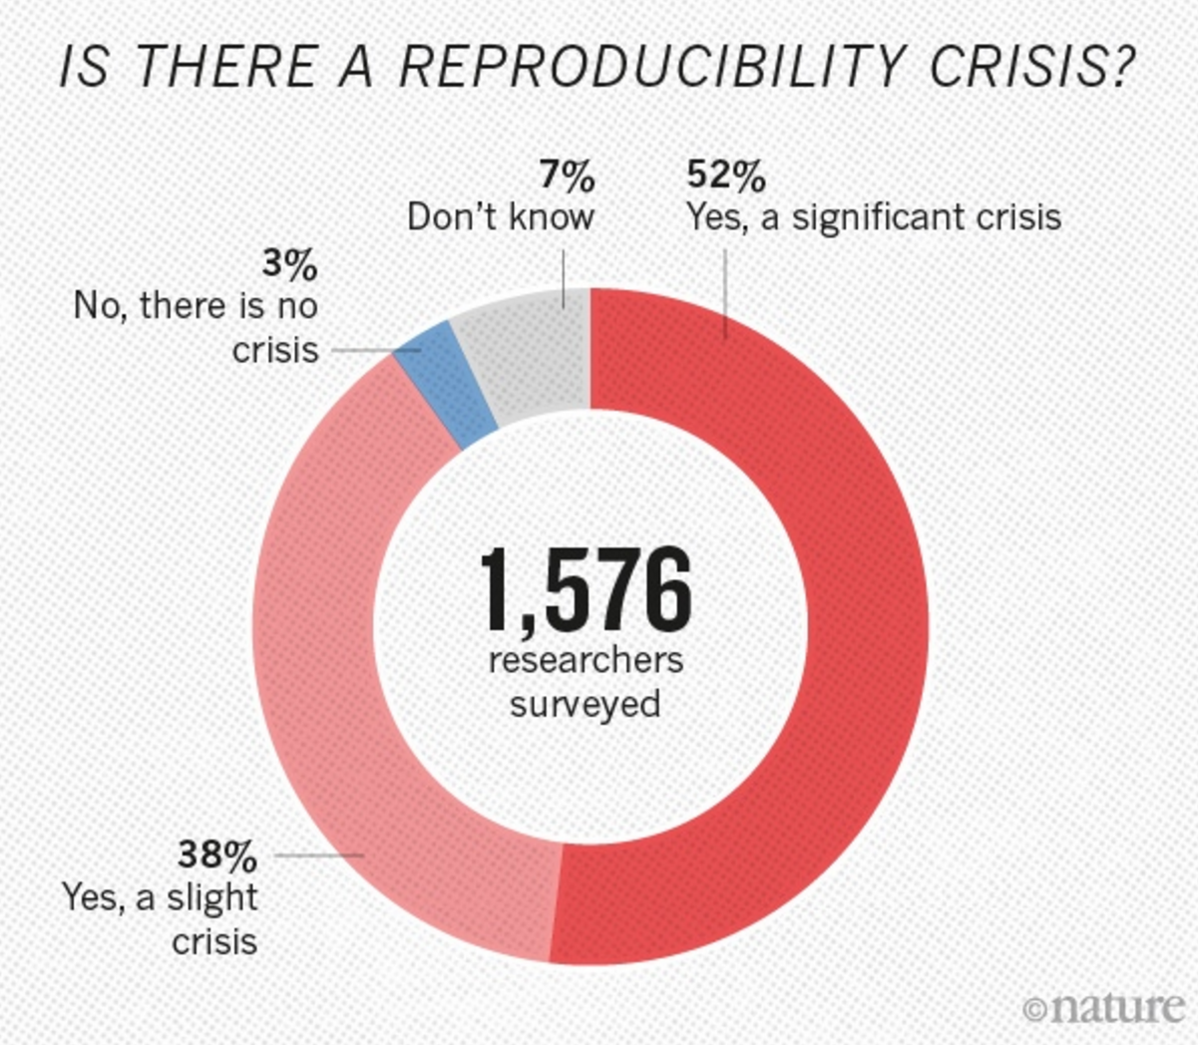
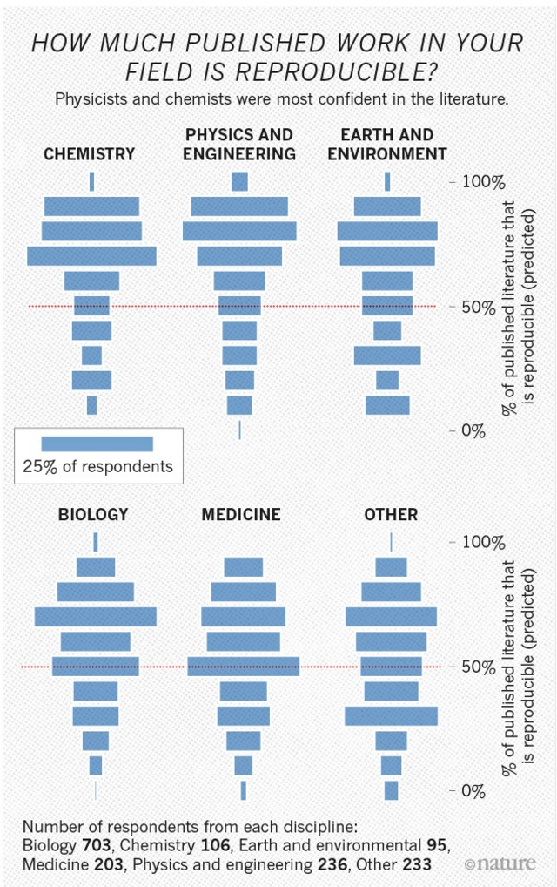

Slide 43
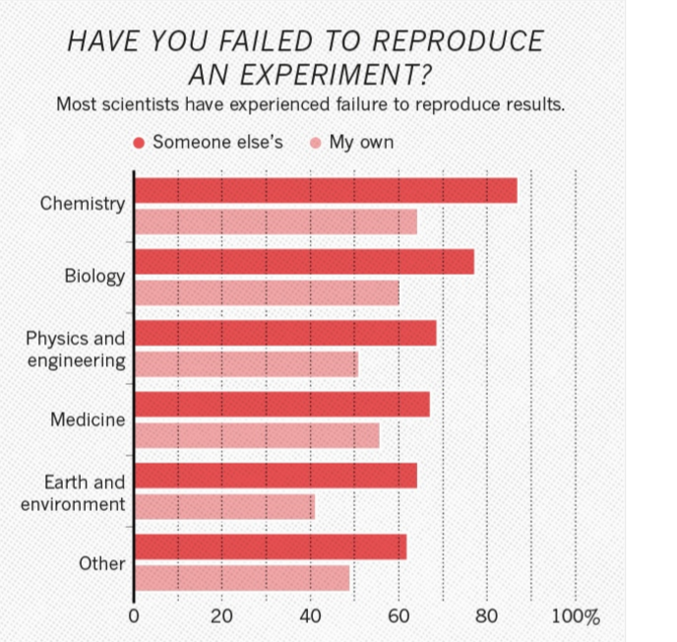

Slide 44
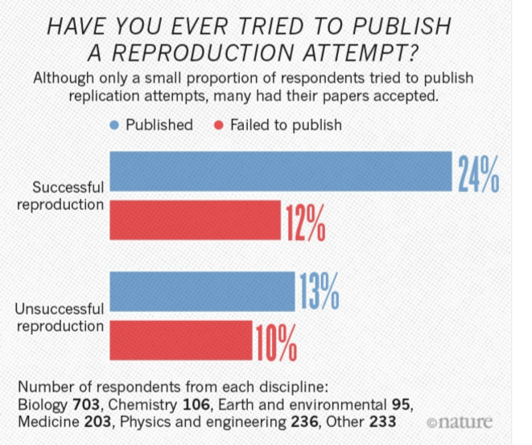

Slide 45
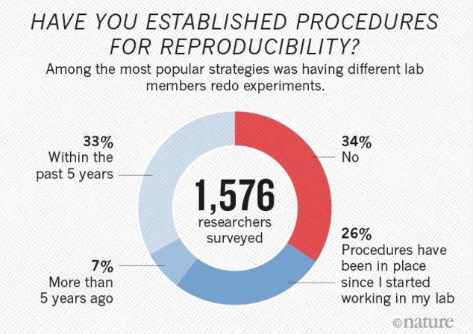

Slide 46
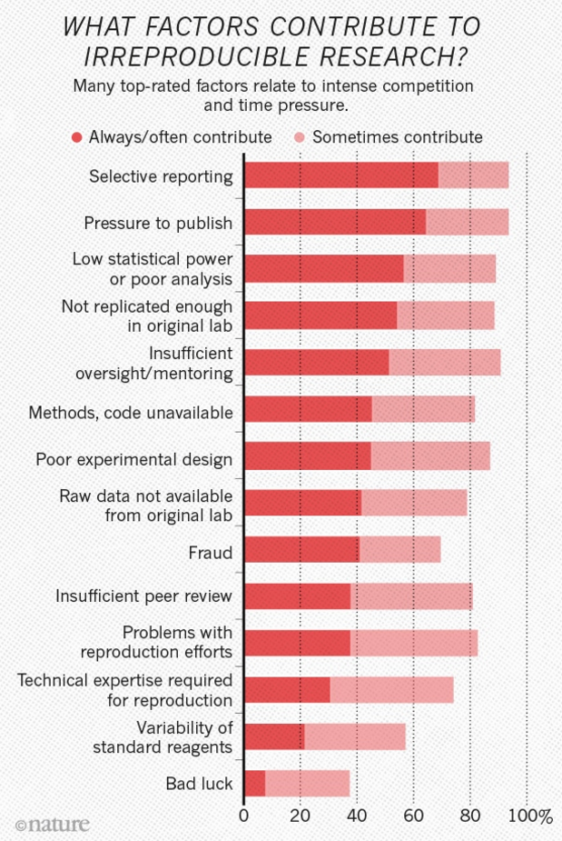
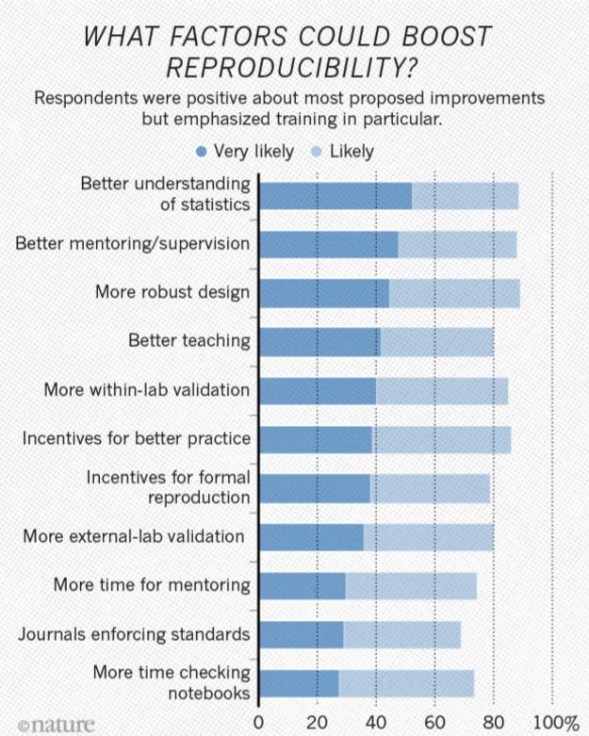

Slide 47
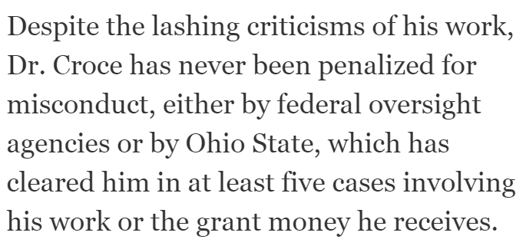
https://www.nytimes.com/2017/03/08/science/cancer-carlo-croce.html

Slide 48
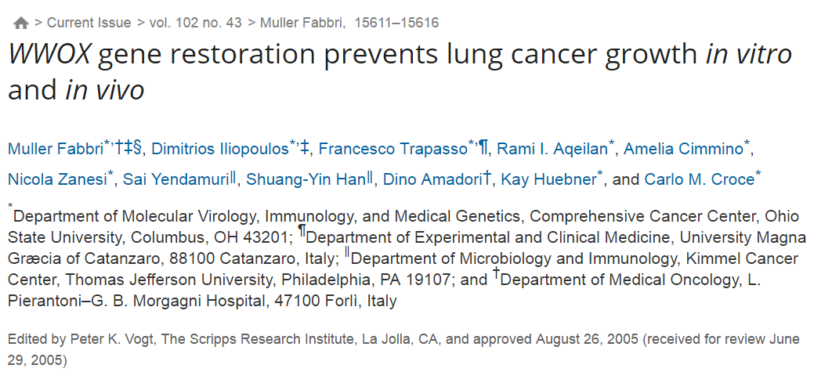
http://www.pnas.org/content/102/43/15611.full
https://www.nytimes.com/2017/03/08/science/cancer-carlo-croce.html

Slide 49
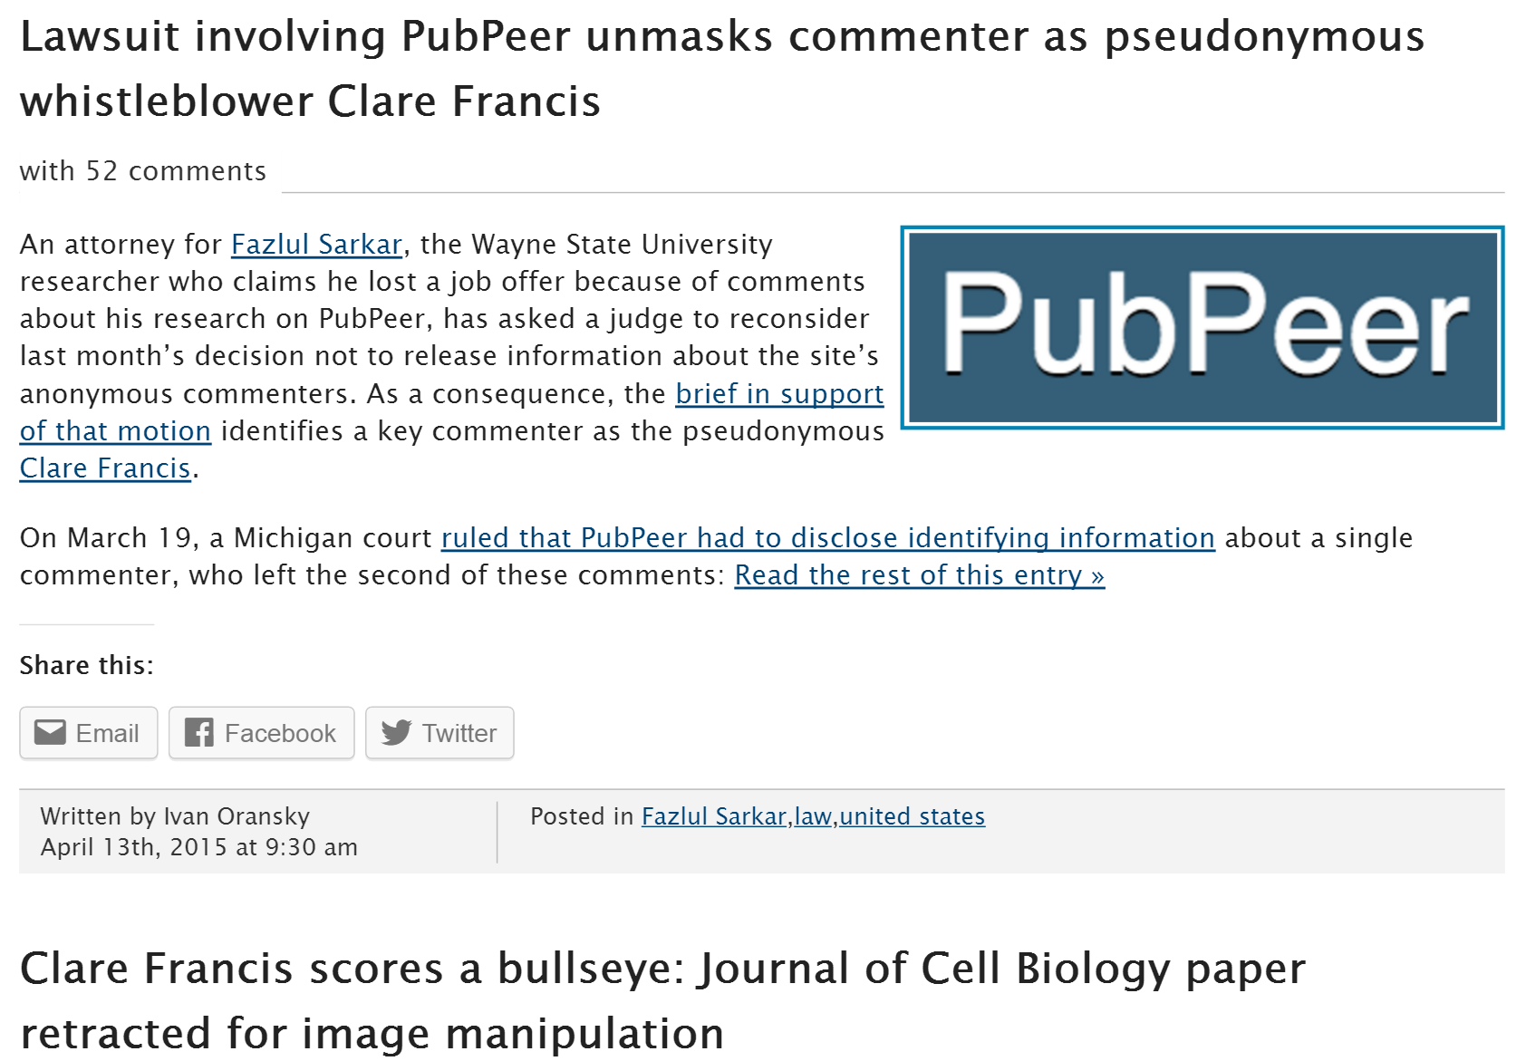
http://retractionwatch.com/?s=clare+francis

Slide 50
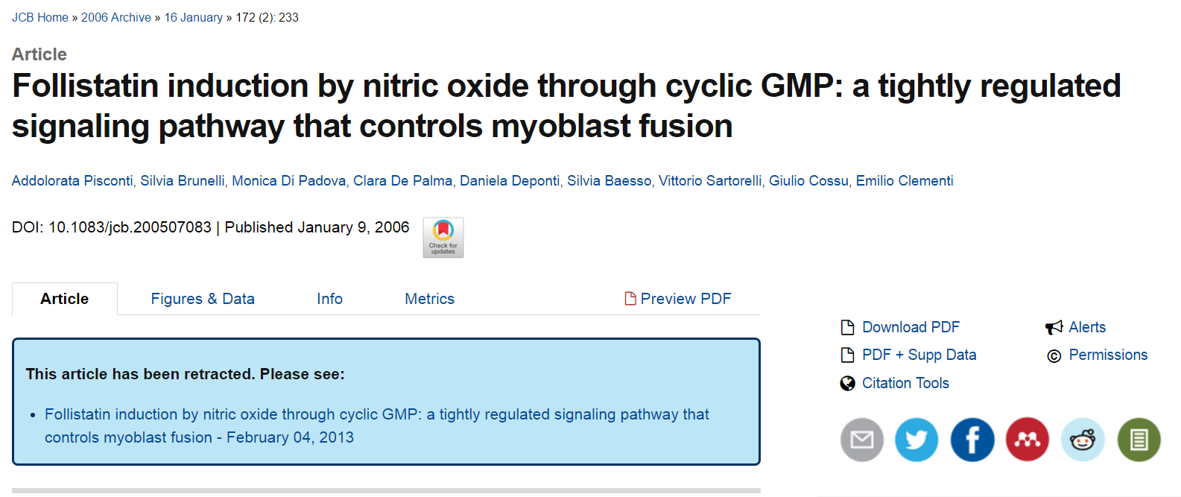
http://jcb.rupress.org/content/172/2/233
http://jcb.rupress.org/content/early/2013/01/21/jcb.2005070832003r

Slide 51
http://jcb.rupress.org/content/early/2013/01/21/jcb.2005070832003r
Vol. 172 No. 2, January 9, 2006. Pages 233–244.
After concerns were raised by a reader, the Editors of The Journal of Cell Biology detected the following issues with the data in the above article:
(1) The top panel in Fig. 1 F (NOS-1μ) is identical to the top panel in Fig. 2 B (α-sGC).
(2) The bottom panel in Fig. 1 F (NOS-III) is identical to the bottom panel in Fig. 2 B (GAPDH).
(3) Lanes 2 and 3 of the Follistatin panel for satellite cells in Fig. 4 A are identical to lanes 1 and 2 of the Myostatin panel for satellite cells in the same figure.
(4) A band appears to have been erased from lane 4 of the Follistatin panel for satellite cells in Fig. 4 A.
(5) Lane 4 of the Myostatin panel for satellite cells in Fig. 4 A is identical to lane 1 of the Follistatin panel for E12.5/E15.5 in the same figure.
(6) The E9.5 explants and E12.5/E15.5 panels for GAPDH in Fig. 4 A are identical.
Given the above issues with the experimental data in Fig. 4 A, the quantification data in Fig. S1 A cannot be validated.
No issues were detected with the other figures in the paper nor with the other parts of the figures listed above (Fig. 1, A–E, G, and H; Fig. 2, A and C–E; Fig. 4 B; and Fig. S1 B).
The authors were contacted by the Executive Editor of the journal and provided the following statement:
“Given the time that has elapsed since the original date of publication, we are unable to find the original data used to prepare these figures and are not able to explain these observations. We thus retract the paper and apologize for any confusion it may have caused to the research community. Because of the issues noted above, the conclusions presented in this paper that changes in NOS activity are the consequence of activation and inhibition of enzyme activity and not of changes in protein expression (Fig. 1 F), that regulation of guanylate cyclase occurs through posttranslational events (Fig. 2 B), that there is a role for nitric oxide in expression of follistatin mRNA in cultured cells (Figs. 4 A and S1 A), and that there are roles for nitric oxide and cGMP in expression of follistatin mRNA in vivo (Figs. 4 A and S1 A) cannot be validated. The reported observations on the effects of nitric oxide and cGMP on myoblast fusion in cultured cells, of cGMP on myogenesis in vivo, of cGMP on expression of follistatin mRNA in cultured cells, of cGMP and nitric oxide on expression of follistatin protein in cultured cells, and of cGMP on expression of follistatin protein in vivo are not affected by the flaws detected in the figures.”
As a result of this retraction, no data in this paper should be cited in the scientific literature.
The Authors and Editors have informed the University of Milan of this retraction. © 2013 Pisconti et al.

Slide 52
https://www.ncbi.nlm.nih.gov/pmc/articles/PMC2686470/
ABSTRACT
In the scientific research community, plagiarism and covert multiple publications of the same data are considered unacceptable because they undermine the public confidence in the scientific integrity. Yet, little has been done to help authors and editors to identify highly similar citations, which sometimes may represent cases of unethical duplication. For this reason, we have made available Déjà vu, a publicly available database of highly similar Medline citations identified by the text similarity search engine eTBLAST. Following manual verification, highly similar citation pairs are classified into various categories ranging from duplicates with different authors to sanctioned duplicates. Déjà vu records also contain user-provided commentary and supporting information to substantiate each document's categorization. Déjà vu and eTBLAST are available to authors, editors, reviewers, ethicists and sociologists to study, intercept, annotate and deter questionable publication practices. These tools are part of a sustained effort to enhance the quality of Medline as ‘the’ biomedical corpus. The Déjà vu database is freely accessible at http://spore.swmed.edu/dejavu. The tool eTBLAST is also freely available at http://etblast.org.

Slide 53
https://www.ncbi.nlm.nih.gov/pmc/articles/PMC1933238/
ABSTRACT
Authors, editors and reviewers alike use the biomedical literature to identify appropriate journals in which to publish, potential reviewers for papers or grants, and collaborators (or competitors) with similar interests. Traditionally, this process has either relied upon personal expertise and knowledge or upon a somewhat unsystematic and laborious process of manually searching through the literature for trends. To help with these tasks, we report three utilities that parse and summarize the results of an abstract similarity search to find appropriate journals for publication, authors with expertise in a given field, and documents similar to a submitted query. The utilities are based upon a program, eTBLAST, designed to identify similar documents within literature databases such as (but not limited to) MEDLINE. These services are freely accessible through the Internet at http://invention.swmed.edu/etblast/etblast.shtml, where users can upload a file or paste text such as an abstract into the browser interface.

Slide 54
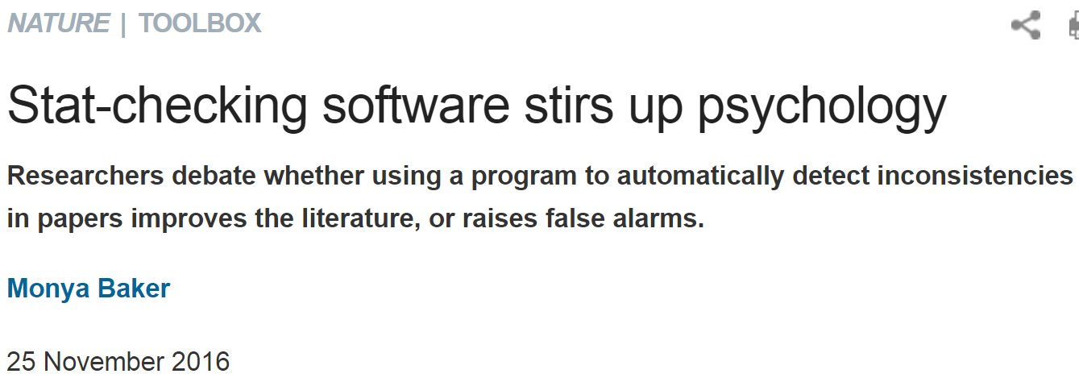
https://link.springer.com/article/10.3758%2Fs13428-015-0664-2
http://www.nature.com/news/stat-checking-software-stirs-up-psychology-1.21049

Slide 55
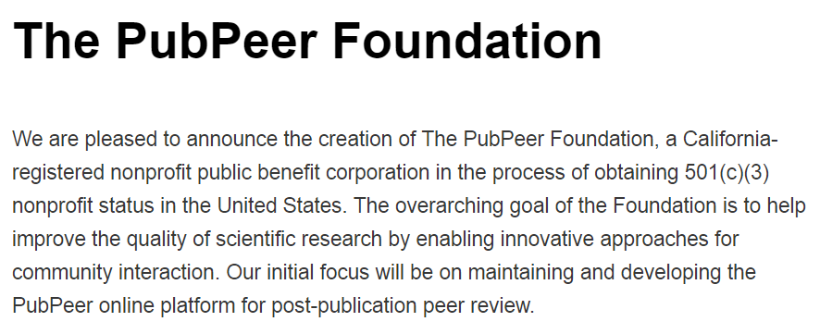
http://blog.pubpeer.com/?p=190

Slide 56
https://pubpeer.com

Slide 57
http://retractionwatch.com

Slide 59
http://www.ncbi.nlm.nih.gov/pubmed/22784623

Slide 60
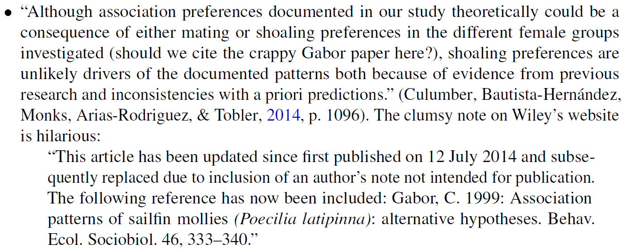

Slide 61
False Positives will occur
https://xkcd.com/882/

Slide 62
http://www.ncbi.nlm.nih.gov/pubmed/2406472?dopt=Abstract&holding=npg

Slide 63
http://jcs.biologists.org/content/121/11/1771
I'd like to suggest that our Ph.D. programs often do students a disservice in two ways. First, I don't think students are made to understand how hard it is to do research. And how very, very hard it is to do important research. It's a lot harder than taking even very demanding courses. What makes it difficult is that research is immersion in the unknown. We just don't know what we're doing. We can't be sure whether we're asking the right question or doing the right experiment until we get the answer or the result.

Slide 64
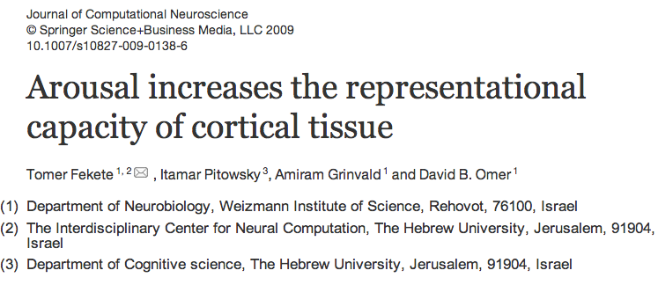
Studied via method 1: voltage sensitive dyes plus optical imaging (VSDI)
Voltage changes = color differences in the imaging
Voltage changes over time = changes in optical images = movies

Slide 65
The imaged cortical area was 6x6 mm, and sampling rate 200 Hz.
Three distinct experimental conditions lying along the continuum of states of arousal were induced:
(1) in the first condition imaging was carried out while the primate was under Ketamine anesthesia (dose was set to achieve cortical inactivation, see Section 4). During imaging the monkeys’ eyes were covered and the room dark. This condition was to serve as a model of loss of consciousness.
(2) In the second condition, the primate was awake, with his eyes covered and again the room was kept dark. This condition was to serve as a model of drowsiness.
(3) Finally, imaging took place while the primate was awake and viewing simple stimuli presented on a screen while fixating. This last condition was to serve as a model of alertness.
In all conditions the primate was seated in a monkey seat.

Slide 66
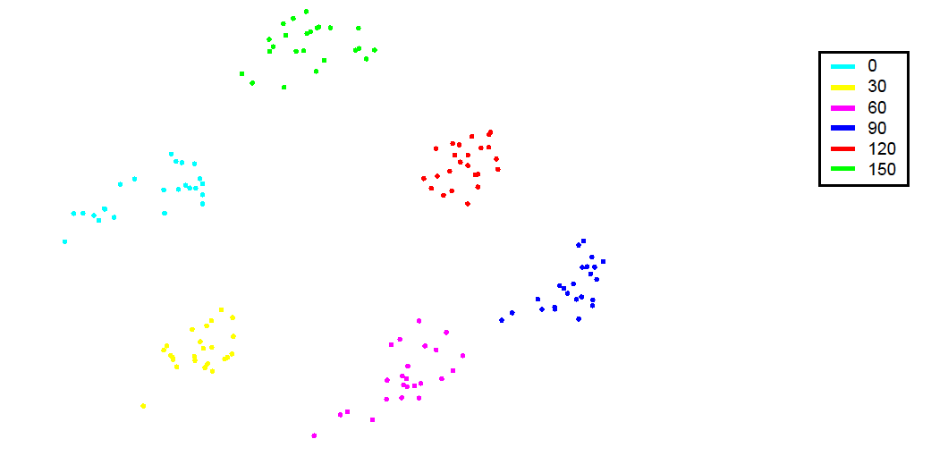
A set of points originating from VSDI movies (anesthetized cat V1) obtained by presenting oriented moving gratings of 6 evenly spaced orientations spanning the circle (0°-300°). Points were projected onto the plane via PCA (each 1 second response (movie) is taken as one data point) and color coded according to orientation. This resulted in a ring of clusters ordered by orientation.

Slide 67
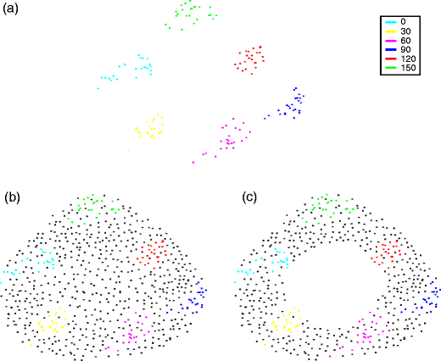
(b-c) Schematic depiction of 2 possible scenarios which could result if the underlying cortical activity space would have been sampled densely (i.e. more samples & more sampled orientations). (b) the apparent ring structure in A disappears (c) the apparent ring structure in A persists.

Slide 68
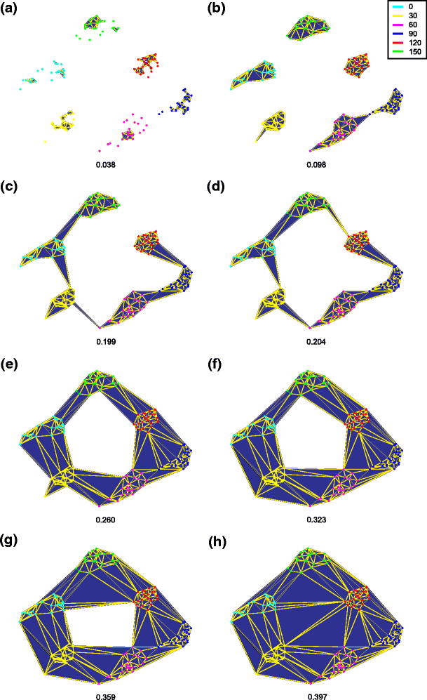
Fig. 5 Generating a filtration from a set of points (a–h). Several stages of growing a maximal complex from a set of points (i.e. producing a filtration). Numeral at bottom of each figure indicates the scale parameter ɛ (arbitrary units). The set of points originates from VSDI movies (anesthetized cat V1—see Sharon and Grinvald 2002 for details) obtained by presenting oriented moving gratings of six evenly spaced orientations spanning the entire range (0°, 60°, 180°, 240°, 300°). Points were projected onto the first two principle components of the data and color coded according to orientation. This resulted in a ring of clusters ordered by orientation. The points were triangulated using the Delaunay method, resulting in a convex simplicial complex. Next, a series of simplicial complexes (a filtration) was obtained by applying a metric threshold. Starting with the initial complex, the set of points (vertices), the scale parameter was incrementally increased. At various stages along this progression, the scale parameter equaled the length of an edge connecting two vertices in the triangulation. At this point this edge was added to the complex. As soon as all edges comprising a triangle were added to the complex, so was its face (the area of the triangle). This resulted in a series of complexes—one for each value of the threshold (scale) in which a simplex (edge or surface) was added to the complex. The region of topological interest starts the moment points form a single component (i.e. c in which ɛ = 0.199, see text for explanation) and continues up until the maximal complex is formed (i.e. h—ɛ = 0.397). Note that during most of this interval the complexes exhibit a ring structure—the length of the region of interest is 0.397–0.199 = 0.198; the ring structure first appears at ɛ = 0.204 (i.e. d), and is persists along the interval 0.397–0.204 = 0.193 (i.e. d–h); thus the ring structure persists in 97% of the interest interval (i.e. 0.193/0.198)

Slide 69
The dual nature of representational capacity, that is, the coupling between the complexity of activity and the complexity of activity space.
The idea was to first construct a function defined over movie space which was sensitive to the complexity of structure of instances of activity (which we will refer to as a state indicator function or SIF)—in this case second long VSDI movies.6 Thus, according to our hypothesis, such a function should be able to classify activity (movies) according to state of arousal (experimental condition) by their complexity. Ideally, such a function could serve as a continuous measure of arousal. Thus, clear cut states of arousal, for example a given level of anesthesia, would be associated with a characteristic value of the SIF.7 By the same token, deviance from the characteristic value would indicate a shift in state of arousal.
The reason for segmenting data into second long movies is that EEG measurements indicate that arousal related phenomena occur (that is to say, can be detected) at this time scale. The exact duration (a second rather than 2, 3 or 5) was chosen as a compromise between the number of resulting points (which decreases as the duration of each movie is increased) and the ability to detect state dependent differences in the VSDI data.

Slide 70
Each recorded frame represented the instantaneous pattern of activity over a large patch of cortex (6x6 mm in size; size of each pixel is 60 by 60 μm). Data was normalized by the pattern of illumination (i.e.—the average frame). Then data was corrected for dye bleaching by fitting a general exponent. Next, data was cleaned for breathing artifacts through high-pass temporal filtering above 0.5 Hz. Heart artifacts were removed by first averaging optics triggered on ECG and then subtracting the average heart pattern for each pixel again triggering on the ECG (as in Arieli et al. 1995, 1996; Tsodyks et al. 1999; Kenet et al. 2003).
All experiments were performed in strict accordance with institutional and NIH guidelines.

Slide 71
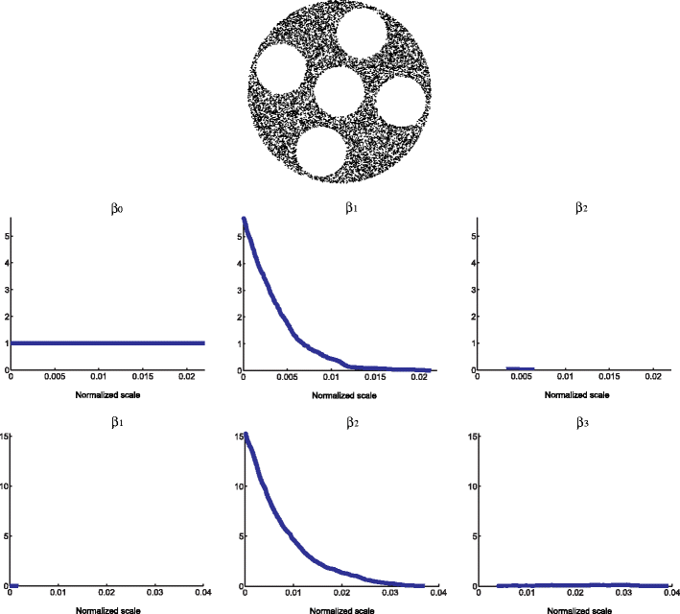

Slide 72
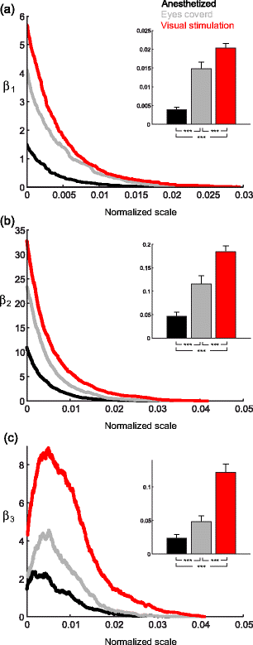
Fig. 7
The state dependent complexity of cortical activity spaces (modeled by level set manifolds) as measured by persistent homology. (a–c) Bottom Each curve is an average of 100 computations of Betti numbers as a function of normalized scale (a–c) top: The distribution of the Betti graphs integrals (i.e. area under the graph—mean ± SE). Note that all comparisons were significant (p << 0.001 using ANOVA; post hoc analysis p << 0.001 using Mann Whitney for all nine comparisons). For all scales shown the zero Betti number β 0 was 1 (indicating that given the covering by landmarks the data set consisted of a single component)

Slide 73
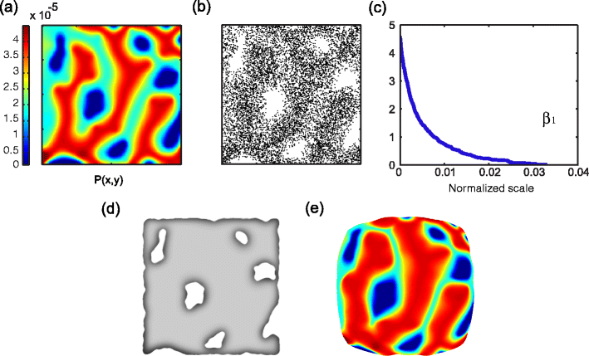
Fig. 8 The origin of homological structure in activity spaces. In this case we consider a scenario in which a neuronal system is to represent two variables. (a) An artificial joint probability distribution of the two variables. Note that there are several combinations of variables which have zero probability. (b) A random sample of 104 points drawn from (a). Variable combinations of zero probability results in holes in the distribution. In essence, such distributions are provided to neuronal systems via the sensory organs (receptor arrays) (c) The first Betti graph of the point cloud in (b). Dense samples such as this allow for the estimate of the topology and homology of the underlying distribution. Accordingly, similar information can be used to estimate and reconstruct this structure. (d) A schematic depiction of the reconstruction of the structure of ‘a’ using the points in ‘b’ which preserves the homological structure (i.e. the five one-holes) of ‘a’. (e) A schematic representation of the geometry of the neuronal activity space generated. In this space, volume is allocated according to probability. Accordingly, the high density areas in ‘a’ occupy more of the overall area in ‘e’, whereas the non zero low density areas occupy less

