Slide 1
TDA is a form of Exploratory Data Analysis (EDA)
https://onlinecourses.science.psu.edu/stat857/node/4
Exploratory Data Analysis (EDA) is described as data-driven hypothesis generation.
http://en.wikipedia.org/wiki/Exploratory_data_analysis
In statistics, exploratory data analysis (EDA) is an approach to analyzing data sets to summarize their main characteristics, often with visual methods. A statistical model can be used or not, but primarily EDA is for seeing what the data can tell us beyond the formal modeling or hypothesis testing task.
Exploratory data analysis was promoted by John Tukey starting in the 1960’s.

Slide 2

http://www.jstor.org/discover/10.2307/2392291?uid=3739256&uid=2&uid=4&sid=21106098896651
Exploratory Data Analysis
John W. Tukey, Princeton University
ISBN-10: 0201076160
ISBN-13: 9780201076165
©1977 • Pearson • Paper, 688 pp
Published 01/01/1977 • Instock

Slide 3
http://www.uta.edu/faculty/sawasthi/Statistics/stdatmin.html#eda1
EDA vs. Hypothesis Testing
As opposed to traditional hypothesis testing designed to verify a priori hypotheses about relations between variables (e.g., "There is a positive correlation between the AGE of a person and his/her RISK TAKING disposition"), exploratory data analysis (EDA) is used to identify systematic relations between variables when there are no (or not complete) a priori expectations as to the nature of those relations. In a typical exploratory data analysis process, many variables are taken into account and compared, using a variety of techniques in the search for systematic patterns.

Slide 4
http://www.uta.edu/faculty/sawasthi/Statistics/stdatmin.html#eda1
EDA vs. Hypothesis Testing
Hypothesis testing: verify a priori hypotheses
Exploratory data analysis (EDA): No (or not complete) a priori
expectations as to the nature of those relations.

Slide 5


Slide 6
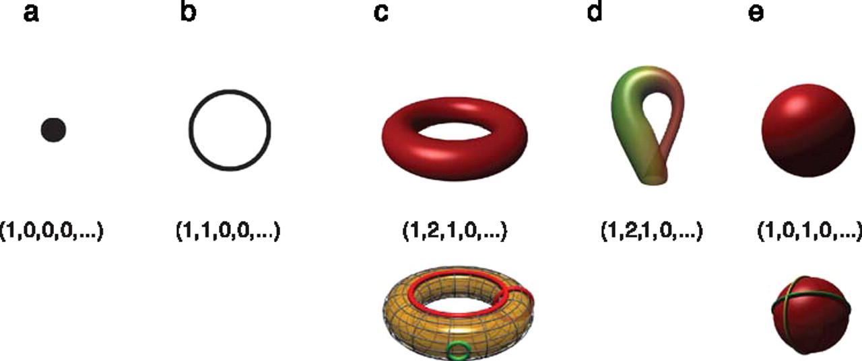

Betti numbers provide a signature of the underlying topology.
Use (β₀, β₁, β₂, …) for classification, where β_{i} = rank of H_{i}
Singh G et al. J Vis 2008;8:11
©2008 by Association for Research in Vision and Ophthalmology
Notes:
Betti numbers provide a signature of the underlying topology. Illustrated in the figure are five simple objects (topological spaces) together with their Betti number signatures: (a) a point, (b) a circle, (c) a hollow torus, (d) a Klein bottle, and (e) a hollow sphere. For the case of the torus (c), the figure shows three loops on its surface. The red loops are “essential” in that they cannot be shrunk to a point, nor can they be deformed one into the other without tearing the loop. The green loop, on the other hand, can be deformed to a point without any obstruction. For the torus, therefore, we have b 1 = 2. For the case of the sphere, the loops shown (and actually all loops on the sphere) can be contracted to points, which is reflected by the fact that b 1 = 0. Both the sphere and the torus have b 2 = 1, this is due to the fact both surfaces enclose a part of space (a void).

Slide 7
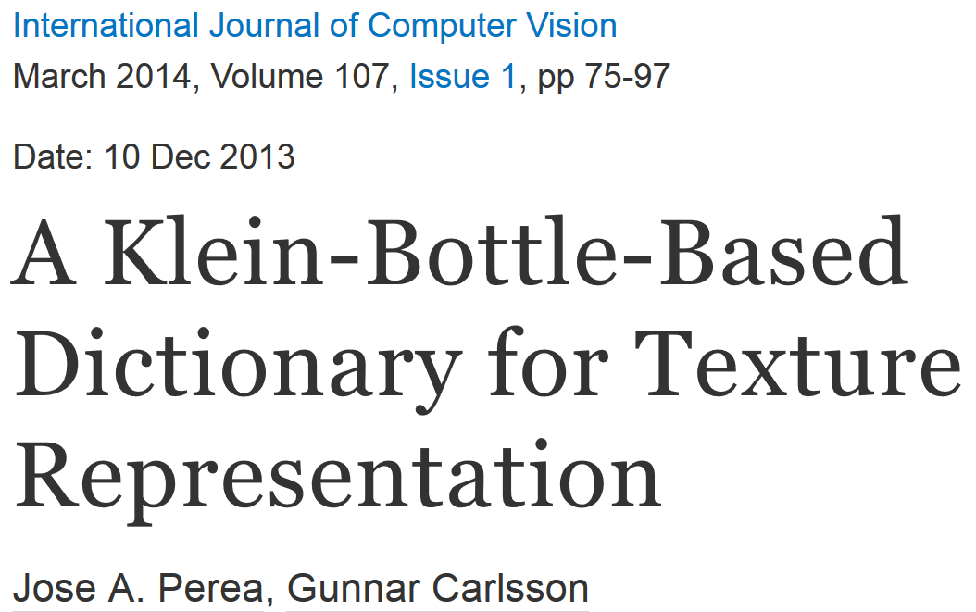
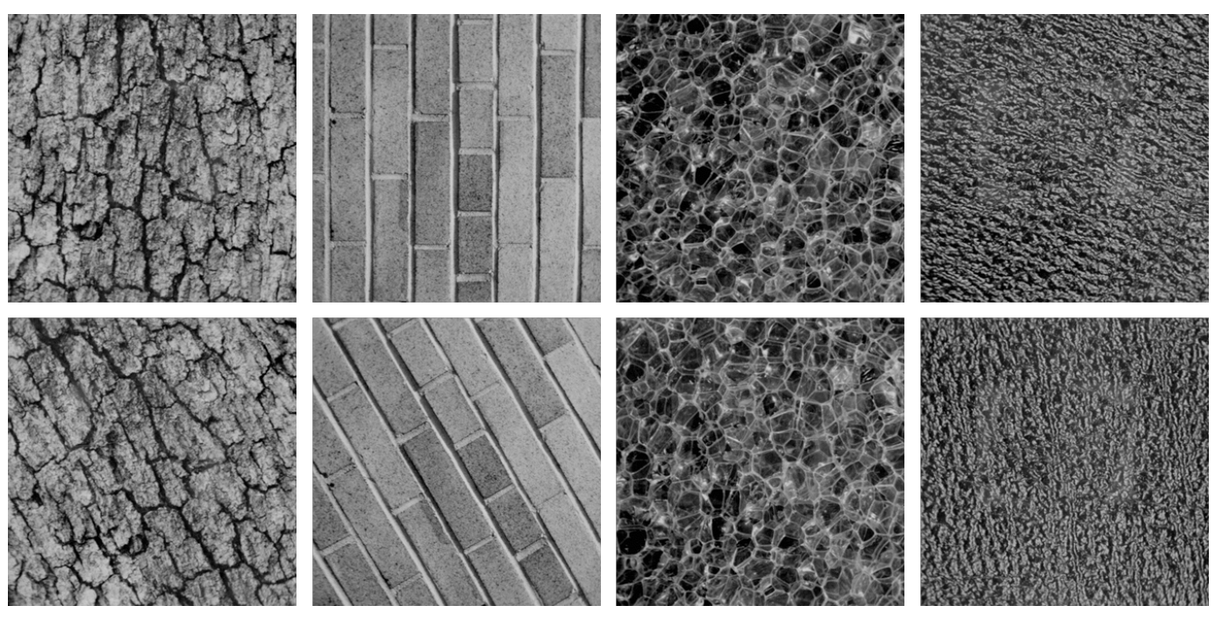
Combine your analysis with other tools

Slide 8
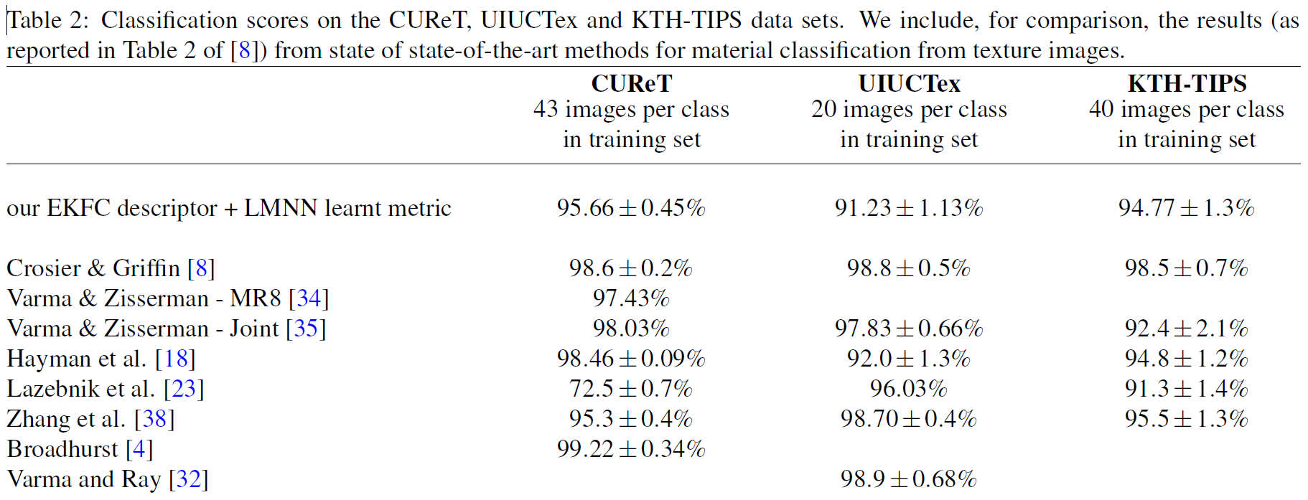
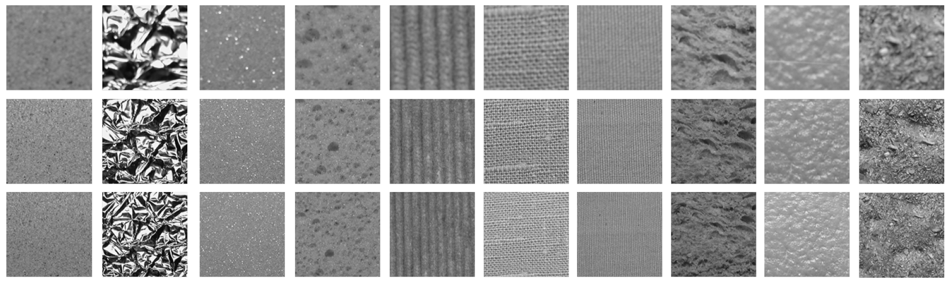

Slide 9
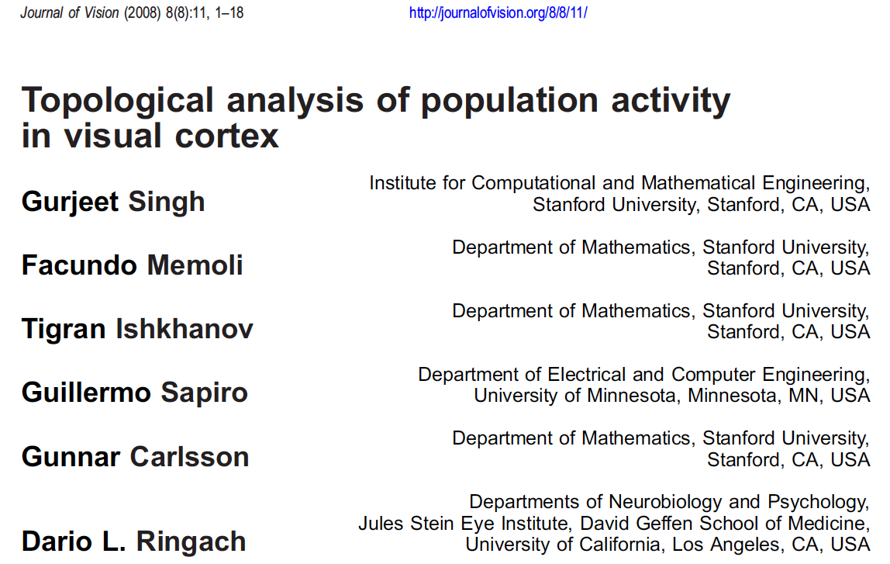

Slide 10
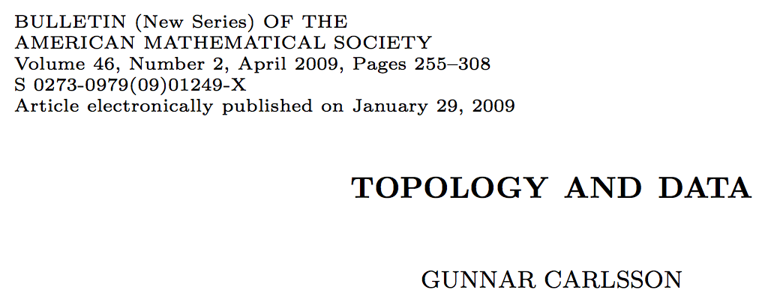
The primary visual cortex (V1)
1.) V1 is a component in the visual pathway, which begins with
the retinal cells in the eye,
proceeds through the lateral geniculate locus,
then to the primary visual cortex,
and then through a number of higher level processing units, such as V2, V3, V4, middle temporal area (MT), and others
2.) V1 performs low level tasks, such as edge and line detection, and its output is then processed for higher level and larger scale properties further along the visual pathway. However, the mechanism by which it carries out these tasks is not understood.

Slide 11
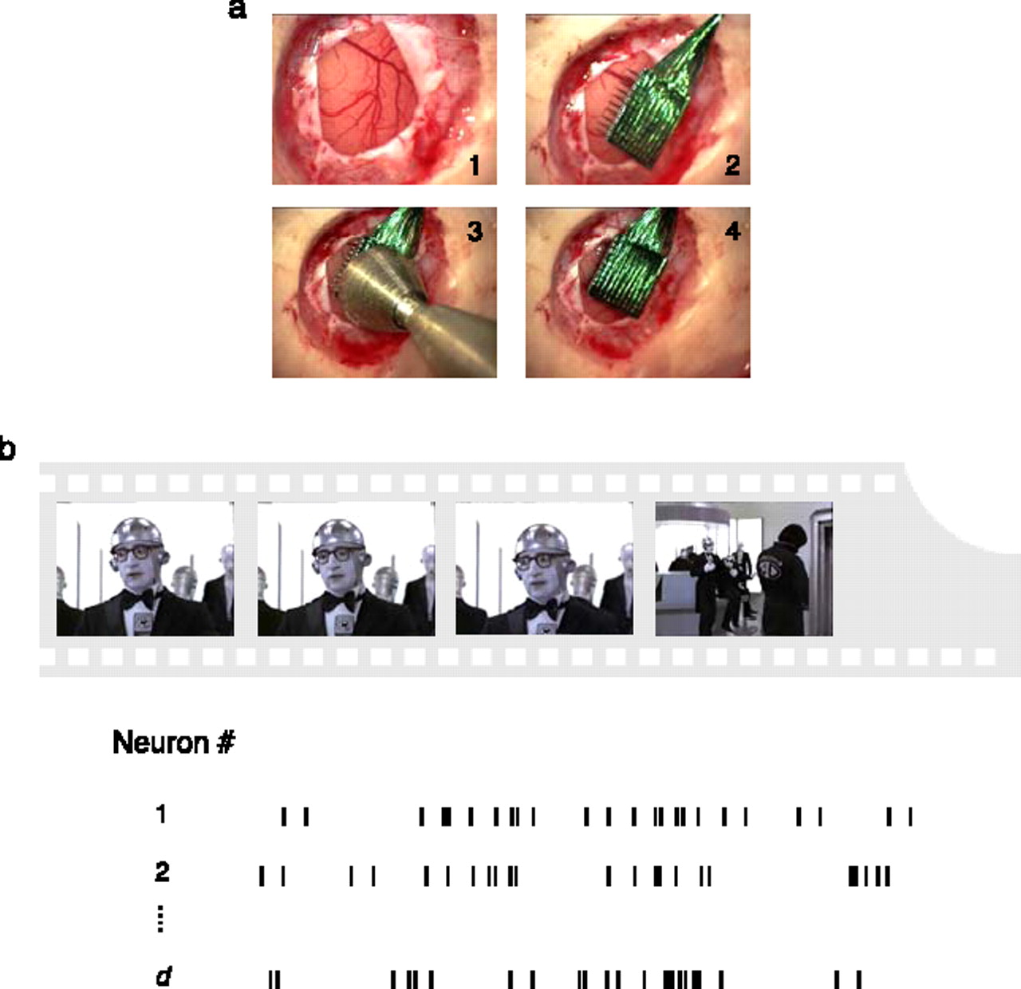
Experimental recordings in primary visual cortex.
Singh G et al. J Vis 2008;8:11
©2008 by Association for Research in Vision and Ophthalmology
Notes:
Experimental recordings in primary visual cortex. (a) Insertion sequence of a multi-electrode array into primary visual cortex (Nauhaus & Ringach, 2007). (b) Natural image sequences, sampled from commercial movies, were used to stimulate all receptive fields of neurons isolated by the array. In the spontaneous condition, activity was recorded while both eyes were occluded.

Slide 12
Studied via method 2: embedded electrode arrays
Record voltages at points in time at each electrode.
Spike train: lists of firing times for a neuron
  obtained via spike sorting –i.e. signal processing.
Data = an array of N spike trains.
Compared spontaneous (eyes occluded) to evoked (via movie clips).
10 second segments broken into 50 ms bins
The 5 neurons with the highest firing rate in each ten second window were chosen
For each bin, create a vector in R⁵ corresponding to the number of firings of each of the 5 neurons.
200 bins = 200 data points in R⁵
Many 10 second segments = many data sets

Slide 13
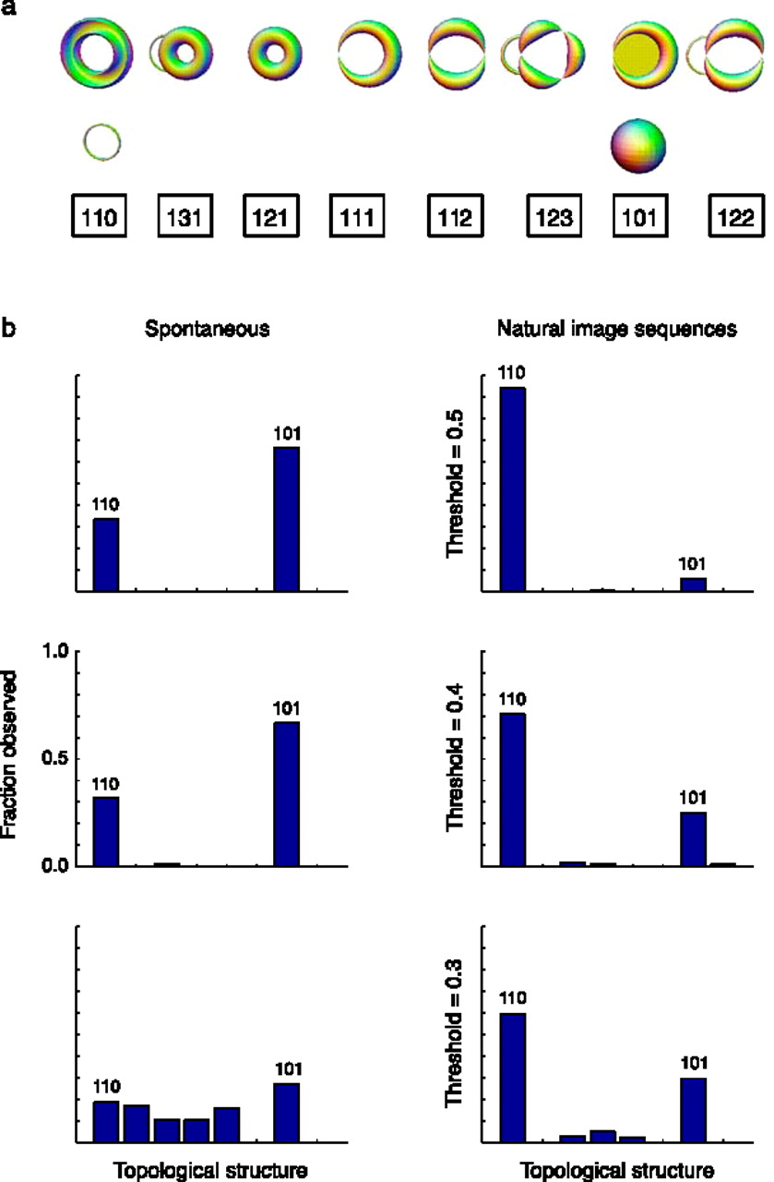
Estimation of topological structure in driven and spontaneous conditions.
Record voltages at points in time at each electrode.
Spike train: lists of firing times for a neuron
  obtained via spike sorting –i.e. signal processing.
Data = an array of N spike trains.
Compared spontaneous (eyes occluded) to evoked (via movie clips).
10 second segments broken into 50 ms bins
  Thus have 200 bins/segment
  Transition between states about 80ms
The 5 neurons with the highest firing rate in each ten second window were chosen
For each bin, create a vector in R⁵ corresponding to the number of firings of each of the 5 neurons.
200 bins = 200 data points in R⁵.
  Used 35 landmark points.
20-30minutes of data = many data sets
Control: shuffled data 52700 times.
Singh G et al. J Vis 2008;8:11
©2008 by Association for Research in Vision and Ophthalmology
Notes:
Estimation of topological structure in driven and spontaneous conditions. (a) Ordering of topological signatures observed in our experiments. Each triplet ( b 0, b 1, b 2) is shown along an illustration of objects consistent with these signature. (b) Distribution of topological signatures in the spontaneous and natural image stimulation conditions pooled across the three experiments performed. Each row correspond to signatures with a minimum interval length (denoted as the threshold) expressed as a fraction of the covering radius of the data cloud (see Appendix A for the definition of the covering radius).

Slide 14
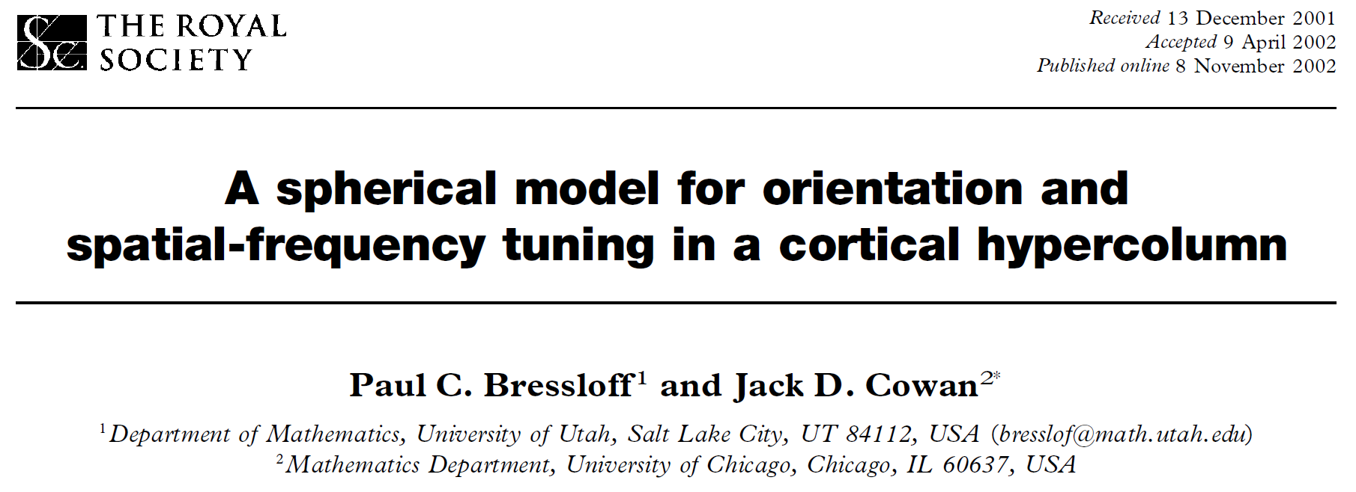

Slide 15
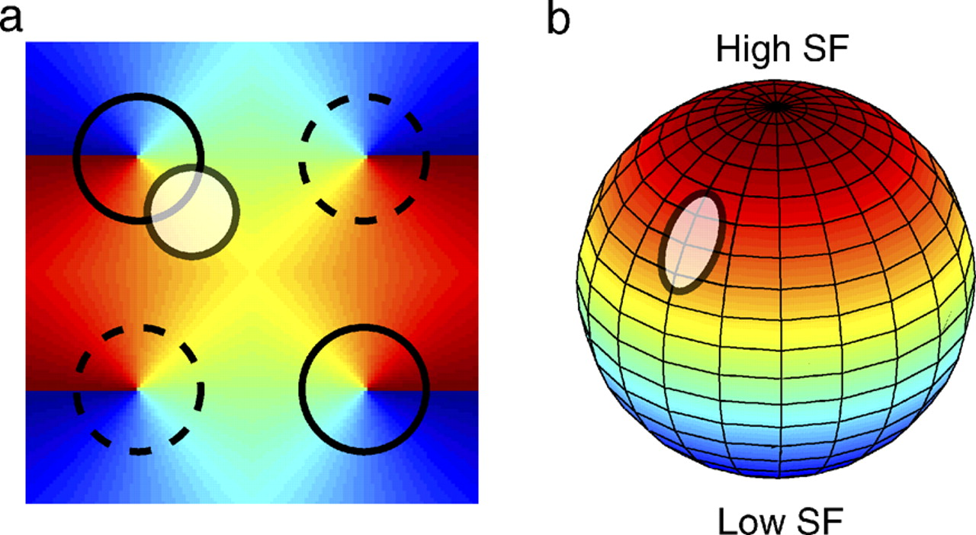
A possible origin of the spherical topological structure in visual cortex.
A possible origin of the spherical topological structure in visual cortex. (a) Cartoon organization of orientation and spatial frequency maps in V1. An orientation map tiling V1 is shown along the locations of extremes spatial frequency tuning. Extreme spatial frequency selectivity (solid circles indicates high spatial frequency preference; dashed circles represents low spatial frequency preference) tends to overlap with orientation pinwheels. The white transparent disk indicates a localized region of activity in this hypercolumn. (b) A the activity profile shifts to different locations on the cortex the resulting topological structure of the population response is equivalent to that of a sphere, where extreme spatial frequencies are mapped to the poles and orientation is coded by the azimuth (Bressloff & Cowan, 2003).
©2008 by Association for Research in Vision and Ophthalmology
Singh G et al. J Vis 2008;8:11
Notes:
A possible origin of the spherical topological structure in visual cortex. (a) Cartoon organization of orientation and spatial frequency maps in V1. An orientation map tiling V1 is shown along the locations of extremes spatial frequency tuning. Extreme spatial frequency selectivity (solid circles indicates high spatial frequency preference; dashed circles represents low spatial frequency preference) tends to overlap with orientation pinwheels. The white transparent disk indicates a localized region of activity in this hypercolumn. (b) A the activity profile shifts to different locations on the cortex the resulting topological structure of the population response is equivalent to that of a sphere, where extreme spatial frequencies are mapped to the poles and orientation is coded by the azimuth (Bressloff & Cowan, 2003).

Slide 16
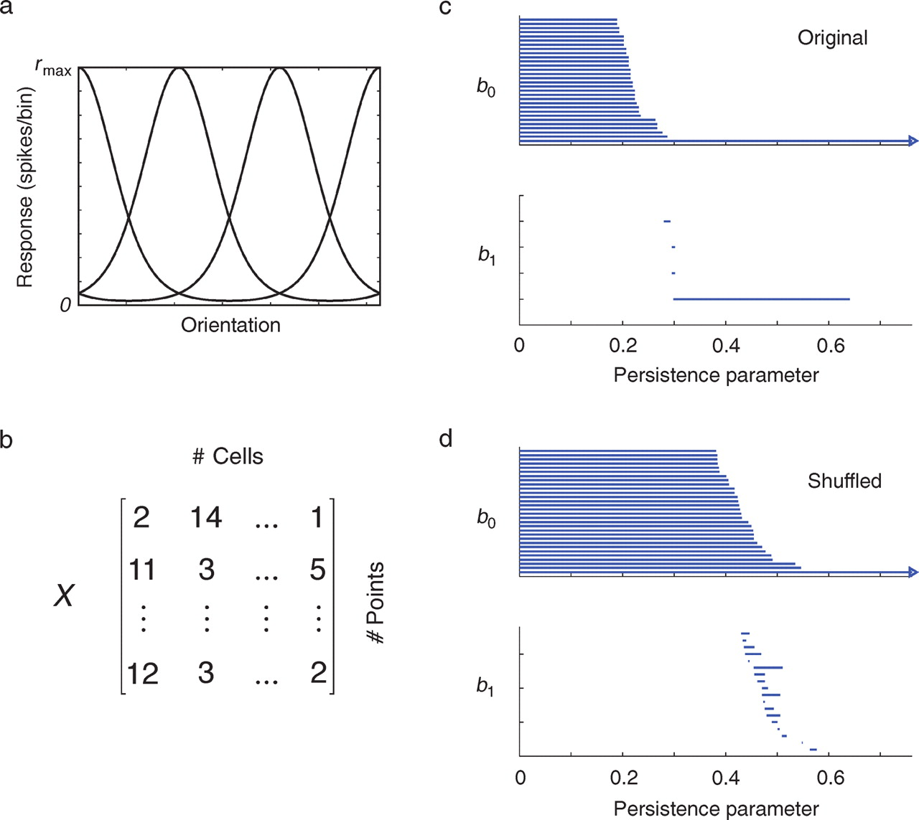
Testing the statistical significance of barcodes.
Singh G et al. J Vis 2008;8:11
©2008 by Association for Research in Vision and Ophthalmology
Notes:
Testing the statistical significance of barcodes. (a) We assume an initial population of Poisson-spiking neurons tuned for orientation. (b) The simulated response of this population to the presentation of different orientations is collected into a data matrix (or point cloud). (c) Analysis of the simulated data shows a long interval with a signature (b0, b1) = (1, 1), which correctly identifies the underlying object as a circle. (d) We also compute the barcodes by shifting the relative positions of the columns (data shuffling). In this case, the statistical distributions of spike counts for each axis remain unchanged, but their relationship is destroyed. By computing the distribution of maximal b1 lengths under this null hypothesis, we can evaluate the likelihood that our data was generated by the null hypothesis that there the coordinates of the points are independent.

Slide 17
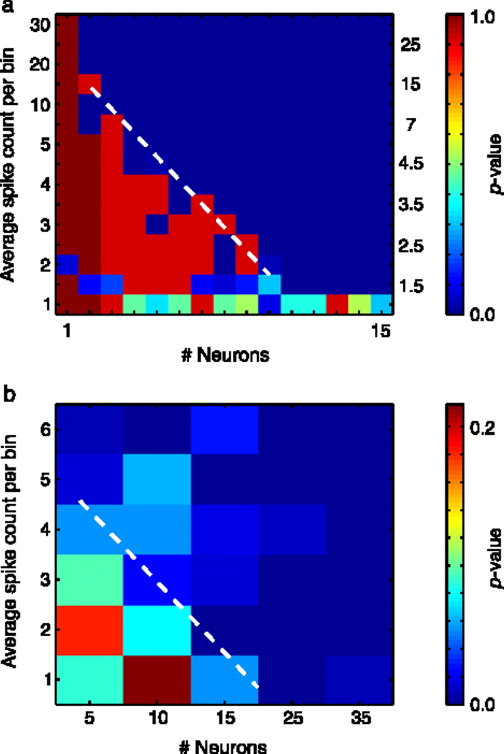
The ability of the method in recovering the underlying structure depends on the mean firing rate and number of cells.
circle
10 simulations were performed.
Results statistically significant for values below dotted line.
torus
Singh G et al. J Vis 2008;8:11
©2008 by Association for Research in Vision and Ophthalmology
Notes:
The ability of the method in recovering the underlying structure depends on the mean firing rate and number of cells. Small p-values are regions where the algorithm correctly identified the circle (a) and the torus (b), as the likelihood of obtaining such barcodes by chance is very low. There is a trade-off between number of neurons and maximal spike rates. The more neurons the smaller the firing rates can be to be able to detect the structures at the same level of statistical significance.

Slide 18
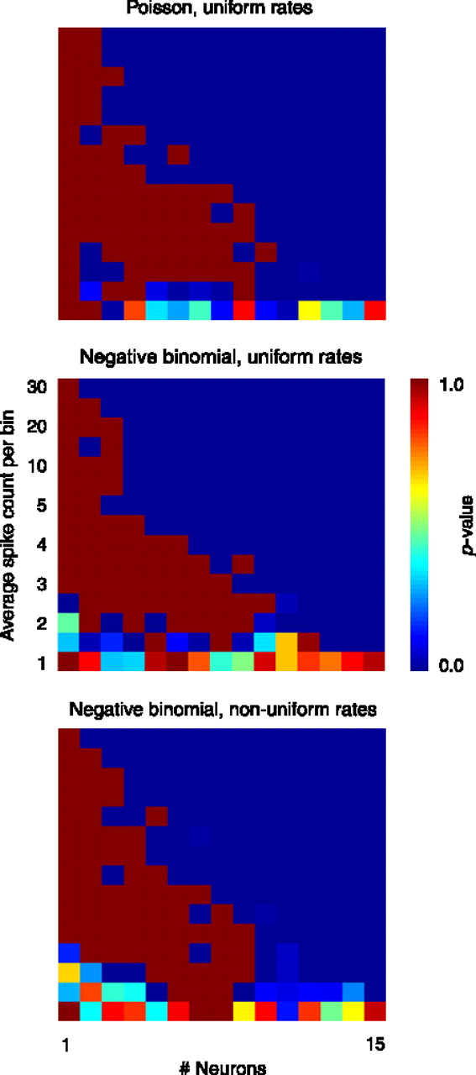
Robustness of the method to changes in count statistics and in the homogeneity of firing rates in the population.
Singh G et al. J Vis 2008;8:11
©2008 by Association for Research in Vision and Ophthalmology
Notes:
Robustness of the method to changes in count statistics and in the homogeneity of firing rates in the population. Top, simulation of Poisson firing and non-uniform rates. Middle, non-Poisson statistics and uniform rates. Bottom, non-Poisson statistics and non-uniform rates. It can be seen that there is little impact of these in the ability of the method to recover the structure of the embedded circle. Compare with Figure 6a.

Slide 19

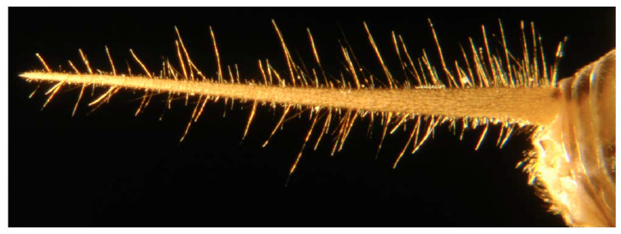
2012
Thursday December 12, 2013
9:00am-9:50am Structure of the Afferent Terminals in Terminal Ganglion of a Cricket and Persistent Homology Tomas Gedeon (Montana State University)

Slide 20
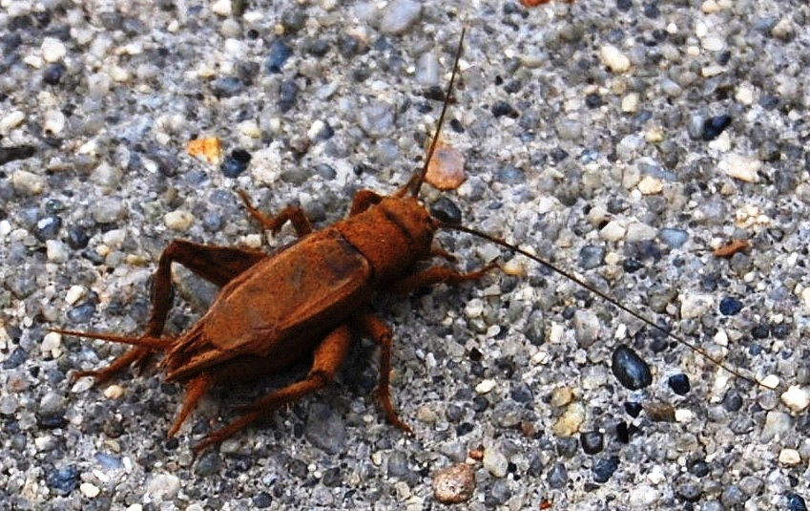
Cricket
http://upload.wikimedia.org/wikipedia/commons/8/8d/Cricket900ppx_crop.jpg

Slide 21
Nerve endings
2012
dense nerve center

Slide 22
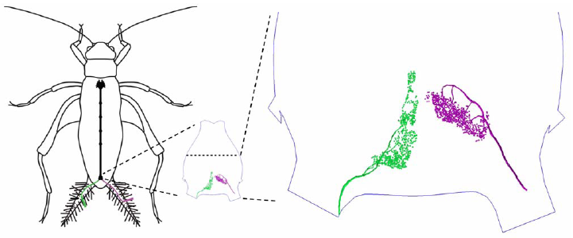

Slide 23
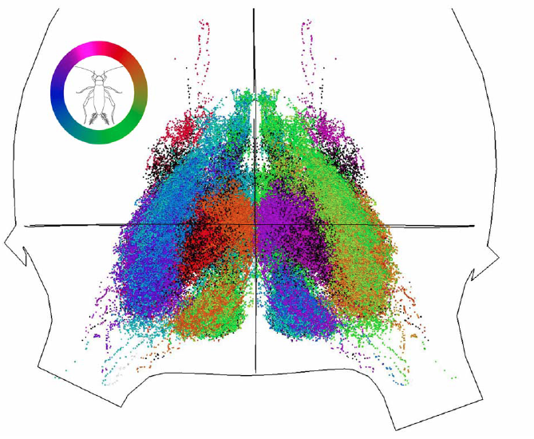
Terminal Ganglion

Slide 25
distal data: long
sparse since harder to obtain (6194).
proximal data:
long, medium, short 42428, 27442, 29297
distal vs proximal
furthest 30%
closest 15%

Slide 26
Proximal data was filtered:
1.) remove outliers (noise)
experimental error
using data obtained from many
different crickets
2.) remove (redundant) points in densest regions to improve computational speed
Performed comparison using data sampled from a
Gaussian Mixture Model.

Slide 27
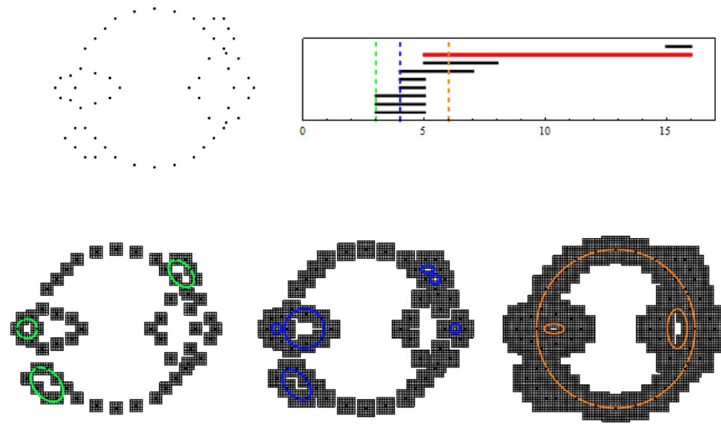
cubical homology: for reducing memory requirements (bitmap).
To calculate persistent homology:
Mrozek, Batko and Wanner’s
cubPersistenceMD.
To find cycles:
Homcubes in CHomP.

Slide 28
cubical homology
To calculate persistent homology:
Mrozek, Batko and Wanner’s cubPersistenceMD.
www.ii.uj.edu.pl/~mrozek/software/homology.html
Kaczynski T, Mischaikow K, Mrozek M (2004) Computational Homology.
Applied Mathematical Sciences. Springer.
http://chomp.rutgers.edu
http://www.sagemath.org/doc/reference/homology/sage/interfaces/chomp.html
To find cycles: Homcubes in CHomP.

Slide 29
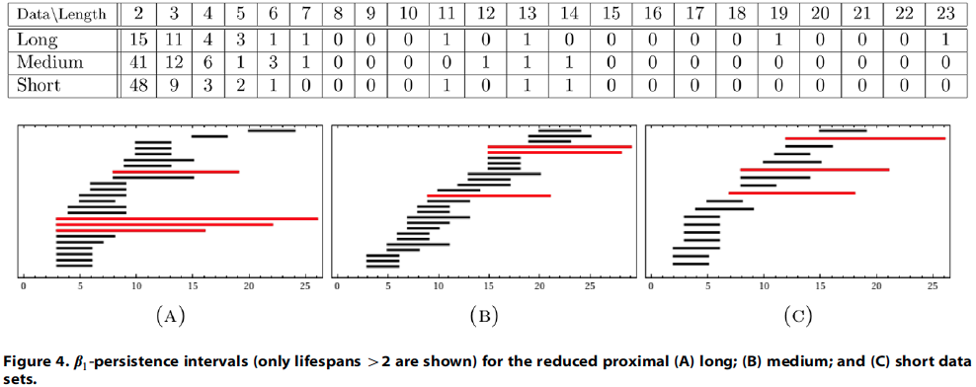

Slide 30
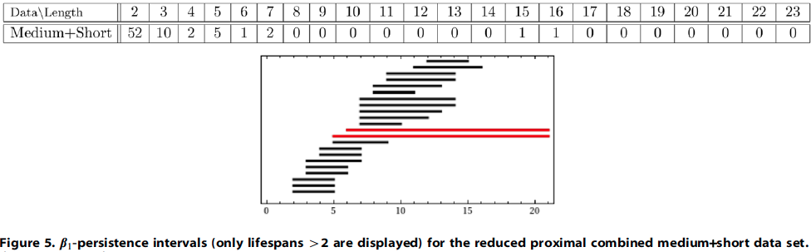

Slide 31
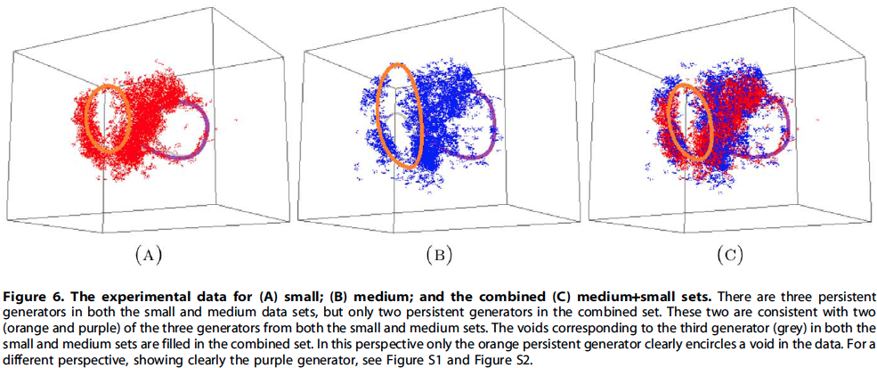

Slide 32
medium+small

Slide 33
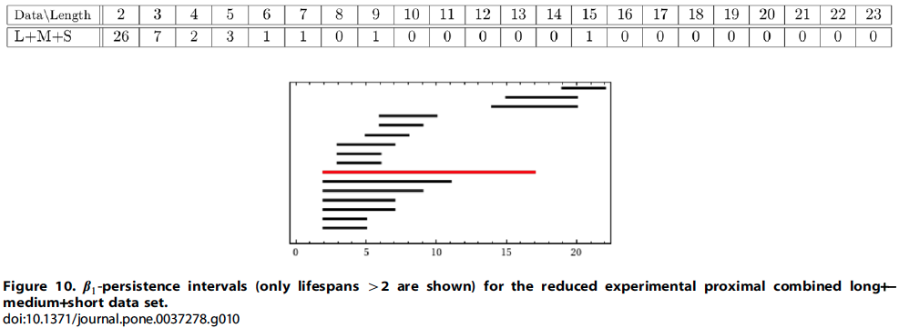

Slide 34
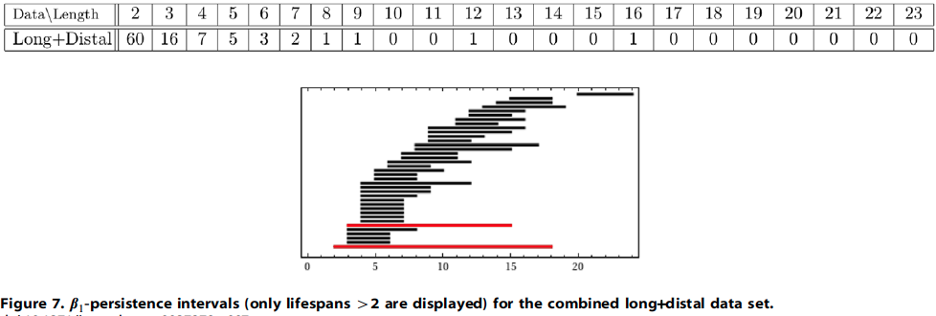

Slide 35
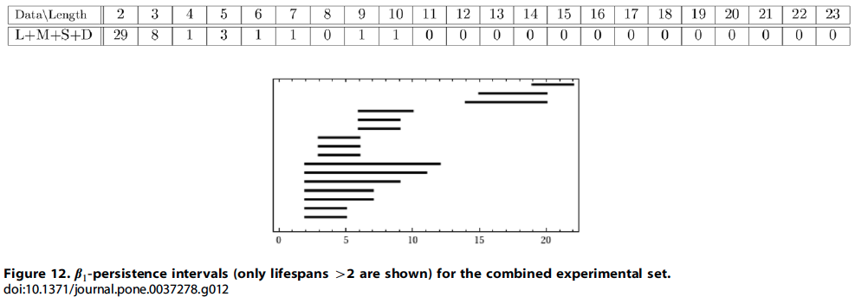

Slide 36
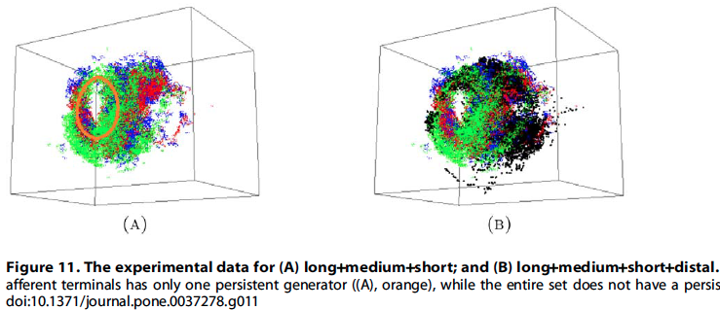

Slide 37

vol. 110 no. 46, 18566–18571, 2013
http://www.pnas.org/content/110/46/18566.full

Slide 38
Background

Slide 39
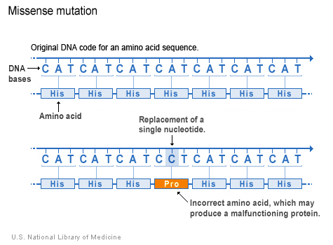
http://ghr.nlm.nih.gov/handbook/mutationsanddisorders/possiblemutations

Slide 40
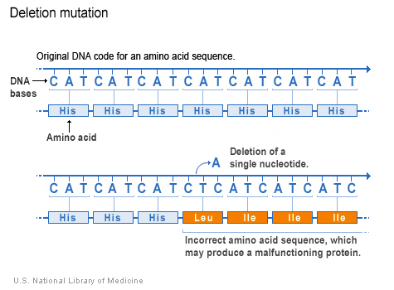
http://ghr.nlm.nih.gov/handbook/mutationsanddisorders/possiblemutations

Slide 41
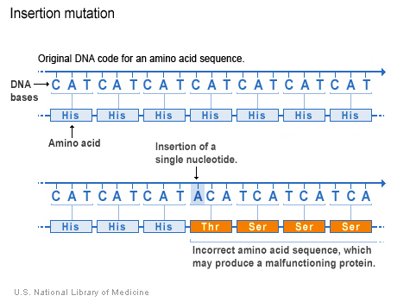
http://ghr.nlm.nih.gov/handbook/mutationsanddisorders/possiblemutations

Slide 42
Recombination:

Slide 43
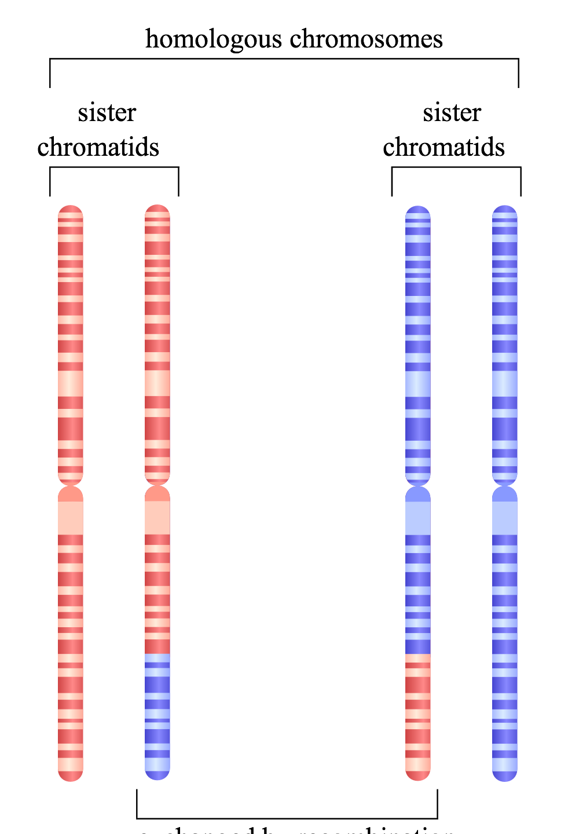
Homologous recombination
http://en.wikipedia.org/wiki/File:HR_in_meiosis.svg

Slide 44
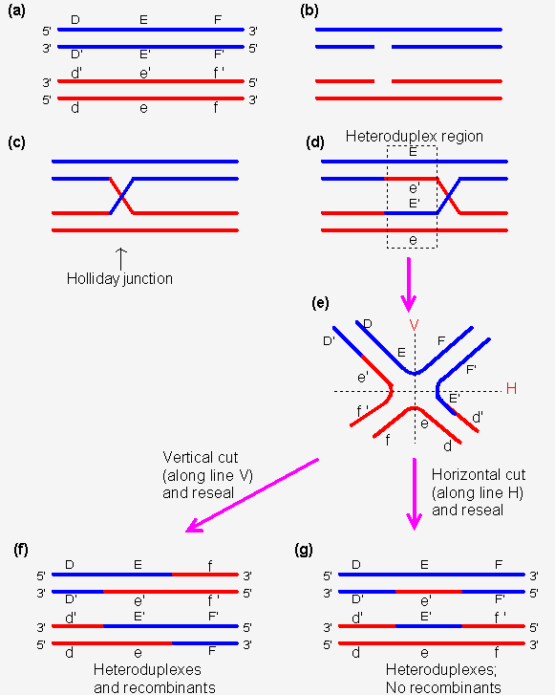
http://www.web-books.com/MoBio/Free/Ch8D2.htm

Slide 45
Homologous recombination
http://www.web-books.com/MoBio/Free/Ch8D2.htm

Slide 46
Homologous recombination
http://en.wikipedia.org/wiki/File:HR_in_meiosis.svg

Slide 47
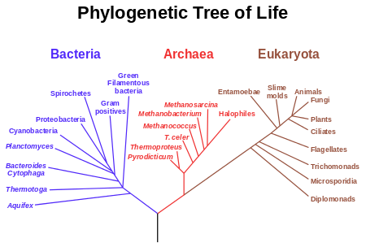

Slide 48
Where do we get distances from?
Distances can be derived from Multiple Sequence Alignments (MSAs).
The most basic distance is just a count of the number of sites which differ between two sequences divided by the sequence length. These are sometimes known as p-distances.
 | Cat | Dog | Rat | Cow
Cat | 0 | 0.2 | 0.4 | 0.7
Dog | 0.2 | 0 | 0.5 | 0.6
Rat | 0.4 | 0.5 | 0 | 0.3
Cow | 0.7 | 0.6 | 0.3 | 0
Cat | ATTTGCGGTA
Dog | ATCTGCGATA
Rat | ATTGCCGTTT
Cow | TTCGCTGTTT
http://www.allanwilsoncentre.ac.nz/massey/fms/AWC/download/SK_DistanceBasedMethods.ppt

Slide 50
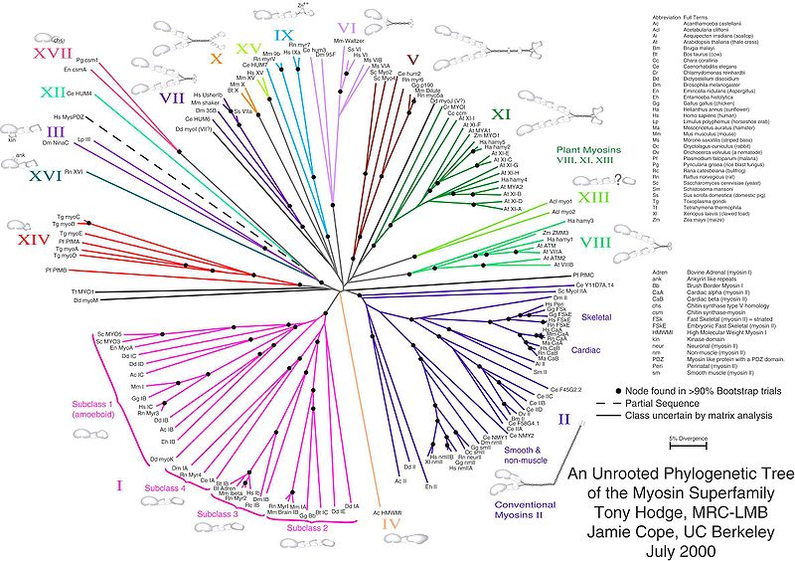

Slide 51
Perfectly “tree-like” distances
 | Cat | Dog | Rat
Dog | 3
Rat | 4 | 5
Cow | 6 | 7 | 6
Cat
Rat
1
2
1
2
4
Dog
Cow
http://www.allanwilsoncentre.ac.nz/massey/fms/AWC/download/SK_DistanceBasedMethods.ppt

Slide 52
Perfectly “tree-like” distances
 | Cat | Dog | Rat
Dog | 3
Rat | 4 | 5
Cow | 6 | 7 | 6
Cat
Rat
1
2
1
2
4
Dog
Cow
http://www.allanwilsoncentre.ac.nz/massey/fms/AWC/download/SK_DistanceBasedMethods.ppt

Slide 53
Perfectly “tree-like” distances
 | Cat | Dog | Rat
Dog | 3
Rat | 4 | 5
Cow | 6 | 7 | 6
Cat
Rat
1
2
1
2
4
Dog
Cow
http://www.allanwilsoncentre.ac.nz/massey/fms/AWC/download/SK_DistanceBasedMethods.ppt

Slide 54
Perfectly “tree-like” distances
 | Cat | Dog | Rat
Dog | 3
Rat | 4 | 5
Cow | 6 | 7 | 6
Cat
Rat
1
2
1
2
4
Dog
Cow
http://www.allanwilsoncentre.ac.nz/massey/fms/AWC/download/SK_DistanceBasedMethods.ppt

Slide 55
Perfectly “tree-like” distances
 | Cat | Dog | Rat
Dog | 3
Rat | 4 | 5
Cow | 6 | 7 | 6
Cat
Rat
1
2
1
2
4
Dog
Cow
http://www.allanwilsoncentre.ac.nz/massey/fms/AWC/download/SK_DistanceBasedMethods.ppt

Slide 56
Perfectly “tree-like” distances
 | Cat | Dog | Rat
Dog | 3
Rat | 4 | 5
Cow | 6 | 7 | 6
Cat
Rat
1
2
1
2
4
Dog
Cow
http://www.allanwilsoncentre.ac.nz/massey/fms/AWC/download/SK_DistanceBasedMethods.ppt

Slide 57
 | Cat | Dog | Rat
Dog | 3
Rat | 4 | 5
Cow | 6 | 7 | 6
Cat
Rat
1
2
1
2
4
Dog
Cow
 | Rat | Dog | Cat
Dog | 3
Cat | 4 | 5
Cow | 6 | 7 | 6
Rat
Cat
1
2
1
2
4
Dog
Cow

Slide 58
 | Cat | Dog | Rat
Dog | 3
Rat | 4 | 5
Cow | 6 | 7 | 6
Cat
Rat
1
2
1
2
4
Dog
Cow
 | Cat | Dog | Rat
Dog | 4
Rat | 4 | 4
Cow | 6 | 7 | 6
 | Rat | Dog | Cat
Dog | 3
Cat | 4 | 5
Cow | 6 | 7 | 6
Rat
Cat
1
2
1
2
4
Dog
Cow

Slide 59
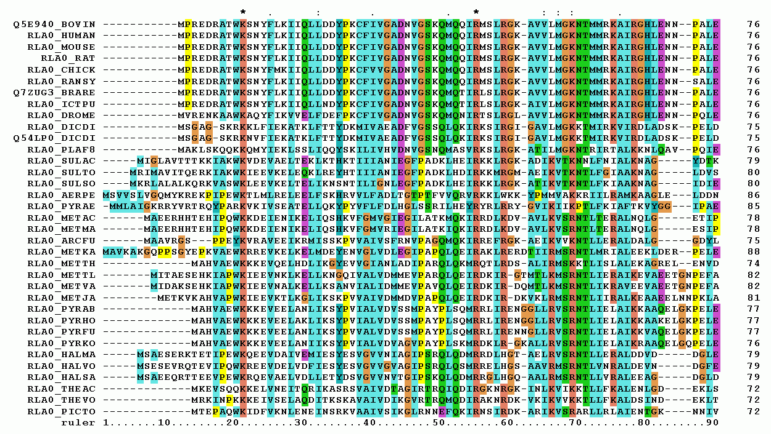
Multiple sequence alignment
http://upload.wikimedia.org/wikipedia/commons/7/79/RPLP0_90_ClustalW_aln.gif

Slide 60
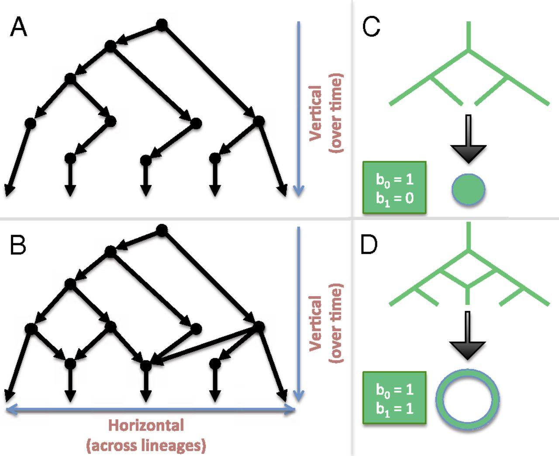
Linking algebraic topology to evolution.
Chan J M et al. PNAS 2013;110:18566-18571
©2013 by National Academy of Sciences
Notes:
Linking algebraic topology to evolution. (A) A tree depicting vertical evolution. (B) A reticulate structure capturing horizontal evolution, as well. (C) A tree can be compressed into a point. (D) The same cannot be done for a reticulate structure without destroying the hole at the center.

Slide 61
Linking algebraic topology to evolution.
Reticulation
Chan J M et al. PNAS 2013;110:18566-18571
©2013 by National Academy of Sciences
Notes:
Linking algebraic topology to evolution. (A) A tree depicting vertical evolution. (B) A reticulate structure capturing horizontal evolution, as well. (C) A tree can be compressed into a point. (D) The same cannot be done for a reticulate structure without destroying the hole at the center.

Slide 62
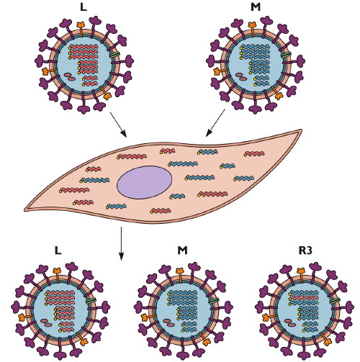
Reassortment
http://www.virology.ws/2009/06/29/reassortment-of-the-influenza-virus-genome/

Slide 63
Homologous recombination
http://en.wikipedia.org/wiki/File:HR_in_meiosis.svg

Slide 64
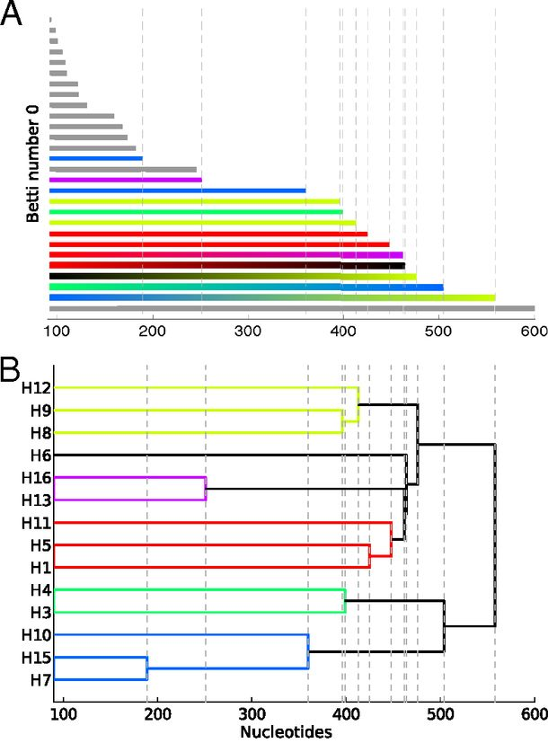
Reconstructing phylogeny from persistent homology of avian influenza HA. (A) Barcode plot in dimension 0 of all avian HA subtypes.
Influenza:
For a single segment,
no H_{k} for k > 0
no horizontal transfer
(i.e., no homologous recombination)
©2013 by National Academy of Sciences
Chan J M et al. PNAS 2013;110:18566-18571
Notes:
Reconstructing phylogeny from persistent homology of avian influenza HA. (A) Barcode plot in dimension 0 of all avian HA subtypes. Each bar represents a connected simplex of sequences given a Hamming distance of ε. When a bar ends at a given ε, it merges with another simplex. Gray bars indicate that two simplices of the same HA subtype merge together at a given ε. Solid color bars indicate that two simplices of different HA subtypes but same major clade merge together. Interpolated color bars indicate that two simplices of different major clades merge together. Colors correspond to known major clades of HA. For specific parameters, see SI Appendix, Supplementary Text. (B) Phylogeny of avian HA reconstructed from the barcode plot in A. Major clades are color-coded. (C) Neighbor-joining tree of avian HA (SI Appendix, Supplementary Text).

Slide 65
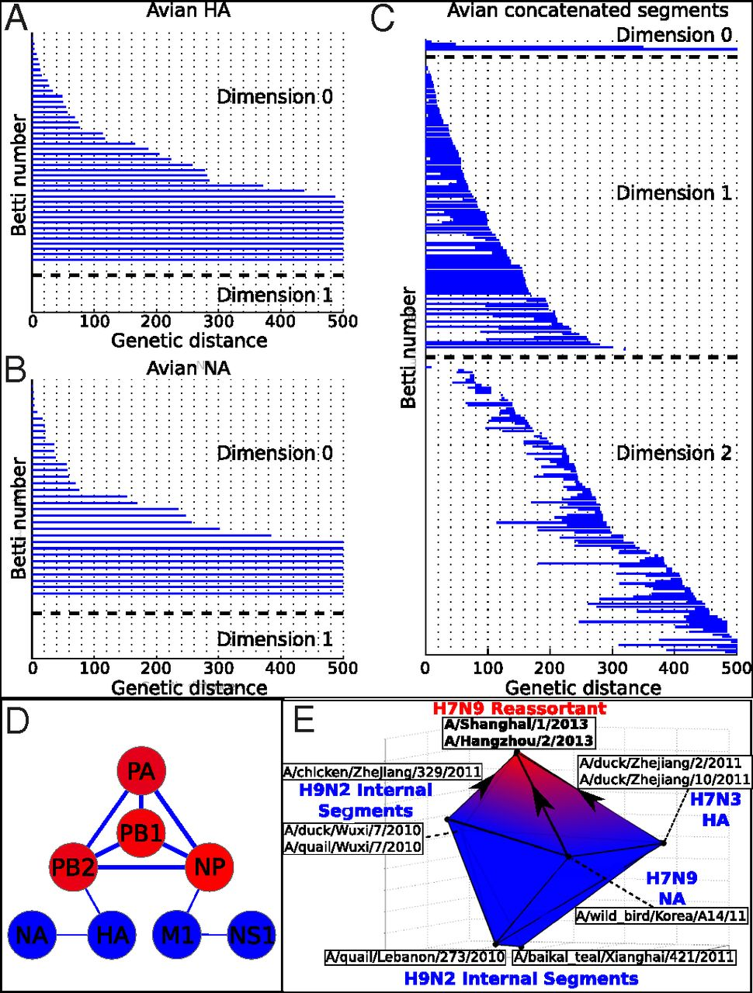
Persistent homology of reassortment in avian influenza.
For multiple segments,
non-trivial H_{k}
k = 1, 2.
Thus
horizontal transfer via reassortment
but not homologous recombination
www.virology.ws/2009/06/29/reassortment-of-the-influenza-virus-genome/
Chan J M et al. PNAS 2013;110:18566-18571
©2013 by National Academy of Sciences
Notes:
Persistent homology of reassortment in avian influenza. Analysis of (A) HA and (B) NA reveal no significant one-dimensional topological structure. (C) Concatenated segments reveal rich 1D and 2D topology, indicating reassortment. For specific parameters, see SI Appendix, Supplementary Text. (D) Network representing the reassortment pattern of avian influenza deduced from high-dimensional topology. Line width is determined by the probability that two segments reassort together. Node color ranges from blue to red, correlating with the sum of connected line weights for a given node. For specific parameters, see SI Appendix, Supplementary Text. (E) b₂ polytope representing the triple reassortment of H7N9 avian influenza. Concatenated genomic sequences forming the polytope were transformed into 3D space using PCoA (SI Appendix, Supplementary Text). Two-dimensional barcoding was performed using Vietoris–Rips complex and a maximum scale ε of 4,000 nucleotides.

Slide 66
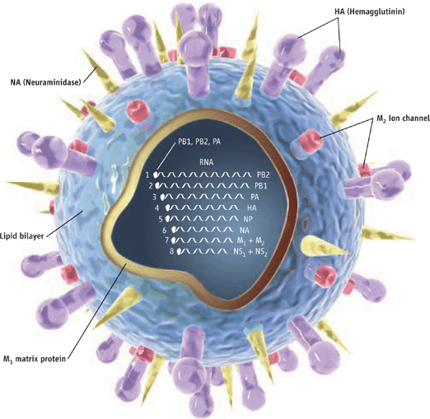
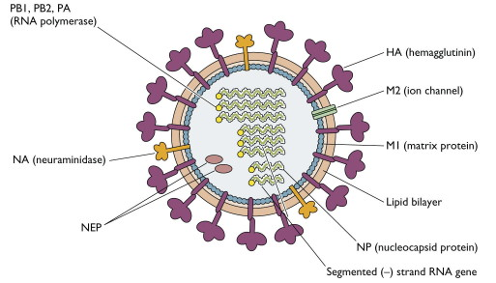
http://www.pnas.org/content/110/46/18566.full
http://www.sciencemag.org/content/312/5772/380.full
http://www.virology.ws/2009/04/30/structure-of-influenza-virus/
Notes:
Persistent homology of reassortment in avian influenza. Analysis of (A) HA and (B) NA reveal no significant one-dimensional topological structure. (C) Concatenated segments reveal rich 1D and 2D topology, indicating reassortment. For specific parameters, see SI Appendix, Supplementary Text. (D) Network representing the reassortment pattern of avian influenza deduced from high-dimensional topology. Line width is determined by the probability that two segments reassort together. Node color ranges from blue to red, correlating with the sum of connected line weights for a given node. For specific parameters, see SI Appendix, Supplementary Text. (E) b₂ polytope representing the triple reassortment of H7N9 avian influenza. Concatenated genomic sequences forming the polytope were transformed into 3D space using PCoA (SI Appendix, Supplementary Text). Two-dimensional barcoding was performed using Vietoris–Rips complex and a maximum scale ε of 4,000 nucleotides.

Slide 67
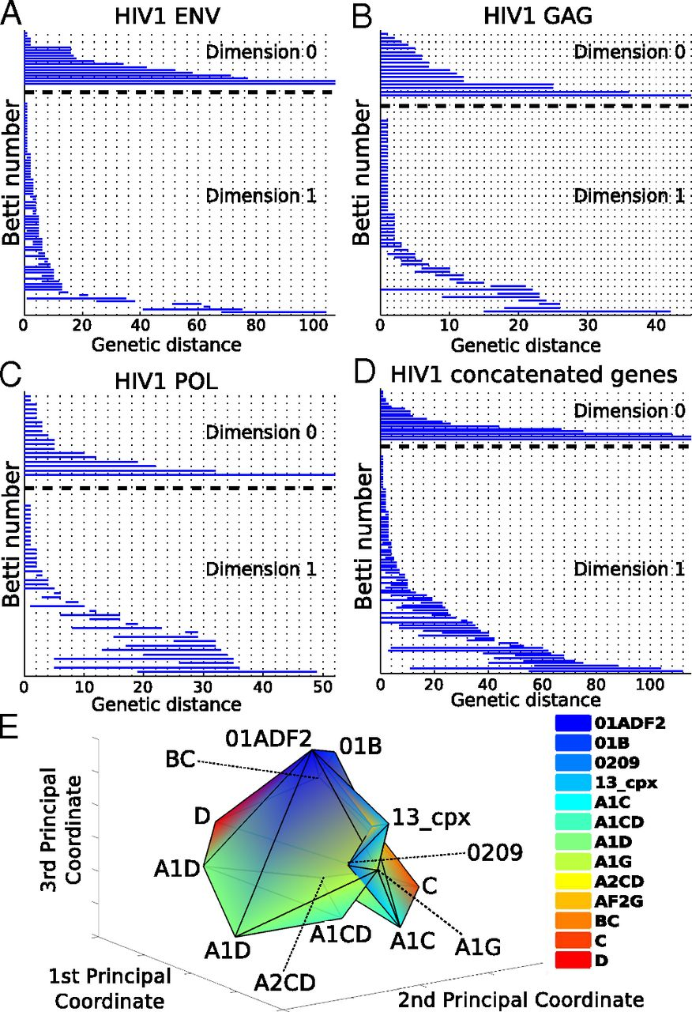
Barcoding plots of HIV-1 reveal evidence of recombination in (A) env, (B), gag, (C) pol, and (D) the concatenated sequences of all three genes.
HIV –
single segment
(so no reassortment)
Non-trivial H_{k}
k = 1, 2.
Thus horizontal transfer via homologous recombination.
©2013 by National Academy of Sciences
Chan J M et al. PNAS 2013;110:18566-18571
Notes:
Barcoding plots of HIV-1 reveal evidence of recombination in (A) env, (B), gag, (C) pol, and (D) the concatenated sequences of all three genes. One-dimensional topology present for alignments of individual genes as well as the concatenated sequences suggests recombination. (E) b₂ polytope representing a complex recombination event with multiple parental strains. Sequences of the [G4] generator of concatenated HIV-1 gag, pol, and env were transformed into 3D space using PCoA (SI Appendix, Supplementary Text) of the Nei–Tamura pairwise genetic distances. Two-simplices from the [G4] generator defined a polytope whose cavity represents a complex recombination. Each vertex of the polytope corresponds to a sequence that is color-coded by HIV-1 subtype. For specific parameters, see SI Appendix, Supplementary Text.

Slide 68
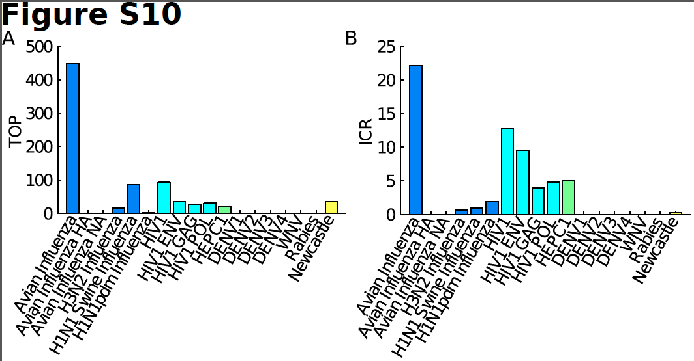
TOP = Topological obstruction
= maximum barcode length in non-zero dimensions
TOP ≠ 0 ➔ no additive distance tree
TOP is stable

Slide 69
ICR = irreducible cycle rate
= average number of the one-dimensional
irreducible cycles per unit of time
Simulations show that ICR is proportional to and provides a lower bound for recombination/reassortment rate

Slide 70
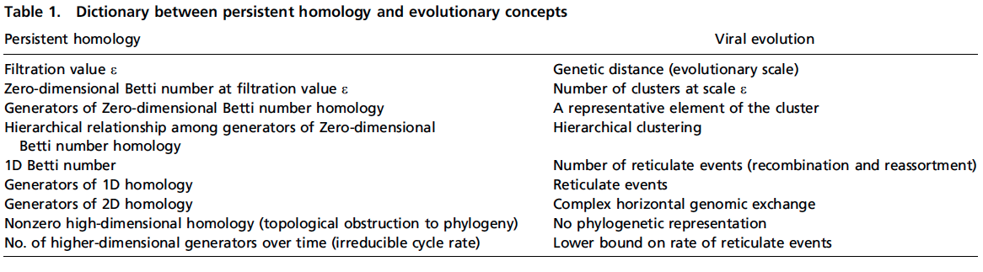

Slide 71
Persistent homology Viral evolution
Filtration value ε Genetic distance
(evolutionary scale)
β₀ at filtration value ε Number of clusters at scale ε
Generators of H₀ A representative element of
the cluster
Hierarchical Hierarchical clustering
relationship among
H₀ generators
β₁ Number of reticulate events
(recombination and
reassortment)

Slide 72
Persistent homology Viral evolution
Generators of H₁ Reticulate events
Generators of H₂ Complex horizontal
genomic exchange
H_{k} ≠ 0 for some k > 0 No phylogenetic tree
representation
Number of Lower bound on rate of
higher-dimensional reticulate events
generators over time
(irreducible cycle rate)

Slide 73
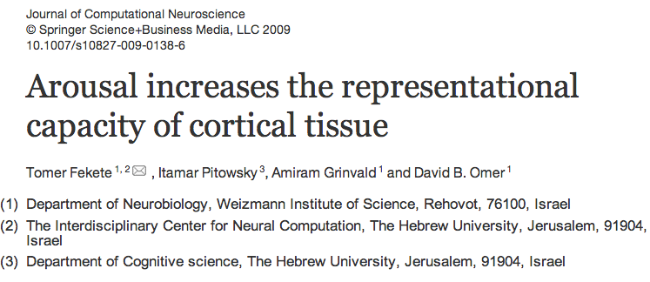
Studied via method 1: voltage sensitive dyes plus optical imaging (VSDI)
Voltage changes = color differences in the imaging
Voltage changes over time = changes in optical images = movies

Slide 74
The imaged cortical area was 6x6 mm, and sampling rate 200 Hz.
Three distinct experimental conditions lying along the continuum of states of arousal were induced:
(1) in the first condition imaging was carried out while the primate was under Ketamine anesthesia (dose was set to achieve cortical inactivation, see Section 4). During imaging the monkeys’ eyes were covered and the room dark. This condition was to serve as a model of loss of consciousness.
(2) In the second condition, the primate was awake, with his eyes covered and again the room was kept dark. This condition was to serve as a model of drowsiness.
(3) Finally, imaging took place while the primate was awake and viewing simple stimuli presented on a screen while fixating. This last condition was to serve as a model of alertness.
In all conditions the primate was seated in a monkey seat.

Slide 75
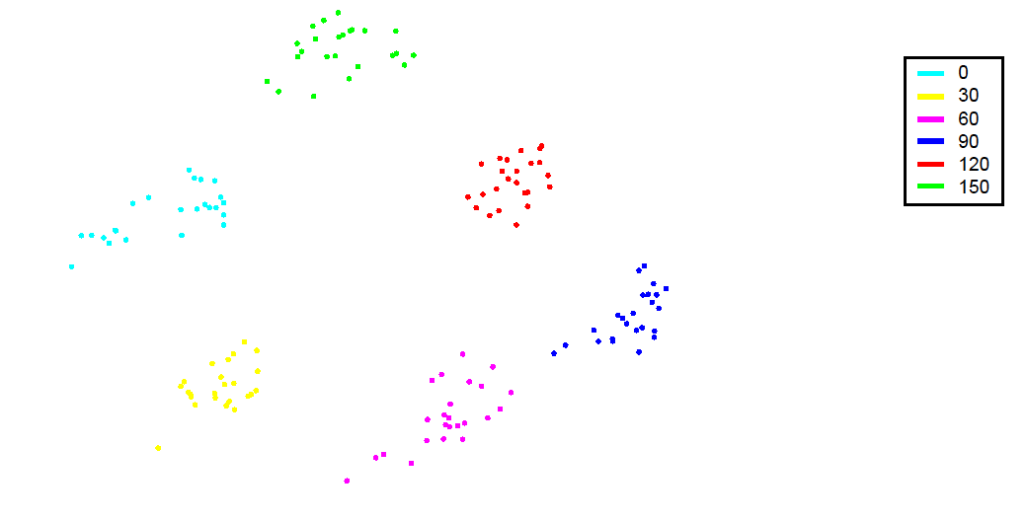
A set of points originating from VSDI movies (anesthetized cat V1) obtained by presenting oriented moving gratings of 6 evenly spaced orientations spanning the circle (0°-300°). Points were projected onto the plane via PCA (each 1 second response (movie) is taken as one data point) and color coded according to orientation. This resulted in a ring of clusters ordered by orientation.

Slide 76
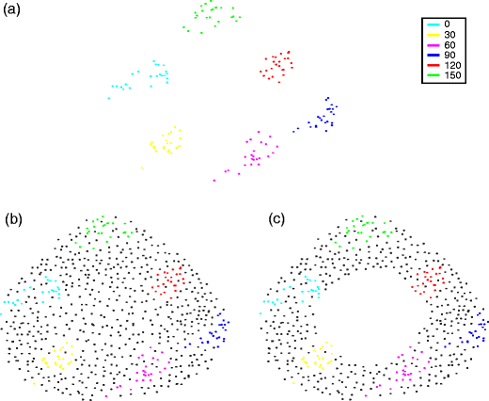
(b-c) Schematic depiction of 2 possible scenarios which could result if the underlying cortical activity space would have been sampled densely (i.e. more samples & more sampled orientations). (b) the apparent ring structure in A disappears (c) the apparent ring structure in A persists.

Slide 77
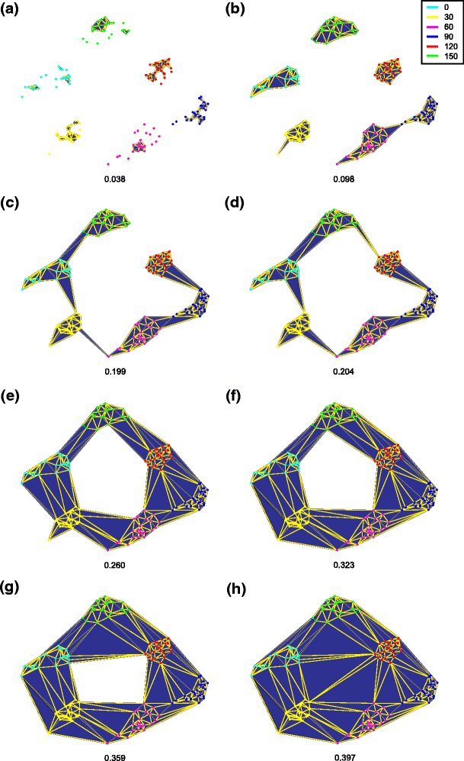
Fig. 5 Generating a filtration from a set of points (a–h). Several stages of growing a maximal complex from a set of points (i.e. producing a filtration). Numeral at bottom of each figure indicates the scale parameter ɛ (arbitrary units). The set of points originates from VSDI movies (anesthetized cat V1—see Sharon and Grinvald 2002 for details) obtained by presenting oriented moving gratings of six evenly spaced orientations spanning the entire range (0°, 60°, 180°, 240°, 300°). Points were projected onto the first two principle components of the data and color coded according to orientation. This resulted in a ring of clusters ordered by orientation. The points were triangulated using the Delaunay method, resulting in a convex simplicial complex. Next, a series of simplicial complexes (a filtration) was obtained by applying a metric threshold. Starting with the initial complex, the set of points (vertices), the scale parameter was incrementally increased. At various stages along this progression, the scale parameter equaled the length of an edge connecting two vertices in the triangulation. At this point this edge was added to the complex. As soon as all edges comprising a triangle were added to the complex, so was its face (the area of the triangle). This resulted in a series of complexes—one for each value of the threshold (scale) in which a simplex (edge or surface) was added to the complex. The region of topological interest starts the moment points form a single component (i.e. c in which ɛ = 0.199, see text for explanation) and continues up until the maximal complex is formed (i.e. h—ɛ = 0.397). Note that during most of this interval the complexes exhibit a ring structure—the length of the region of interest is 0.397–0.199 = 0.198; the ring structure first appears at ɛ = 0.204 (i.e. d), and is persists along the interval 0.397–0.204 = 0.193 (i.e. d–h); thus the ring structure persists in 97% of the interest interval (i.e. 0.193/0.198)

Slide 78
The dual nature of representational capacity, that is, the coupling between the complexity of activity and the complexity of activity space.
The idea was to first construct a function defined over movie space which was sensitive to the complexity of structure of instances of activity (which we will refer to as a state indicator function or SIF)—in this case second long VSDI movies.6 Thus, according to our hypothesis, such a function should be able to classify activity (movies) according to state of arousal (experimental condition) by their complexity. Ideally, such a function could serve as a continuous measure of arousal. Thus, clear cut states of arousal, for example a given level of anesthesia, would be associated with a characteristic value of the SIF.7 By the same token, deviance from the characteristic value would indicate a shift in state of arousal.
The reason for segmenting data into second long movies is that EEG measurements indicate that arousal related phenomena occur (that is to say, can be detected) at this time scale. The exact duration (a second rather than 2, 3 or 5) was chosen as a compromise between the number of resulting points (which decreases as the duration of each movie is increased) and the ability to detect state dependent differences in the VSDI data.

Slide 79
Each recorded frame represented the instantaneous pattern of activity over a large patch of cortex (6x6 mm in size; size of each pixel is 60 by 60 μm). Data was normalized by the pattern of illumination (i.e.—the average frame). Then data was corrected for dye bleaching by fitting a general exponent. Next, data was cleaned for breathing artifacts through high-pass temporal filtering above 0.5 Hz. Heart artifacts were removed by first averaging optics triggered on ECG and then subtracting the average heart pattern for each pixel again triggering on the ECG (as in Arieli et al. 1995, 1996; Tsodyks et al. 1999; Kenet et al. 2003).
All experiments were performed in strict accordance with institutional and NIH guidelines.

Slide 80
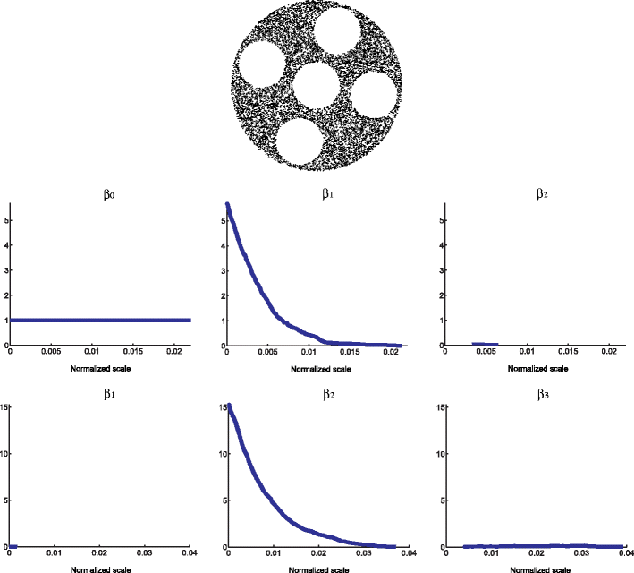

Slide 81
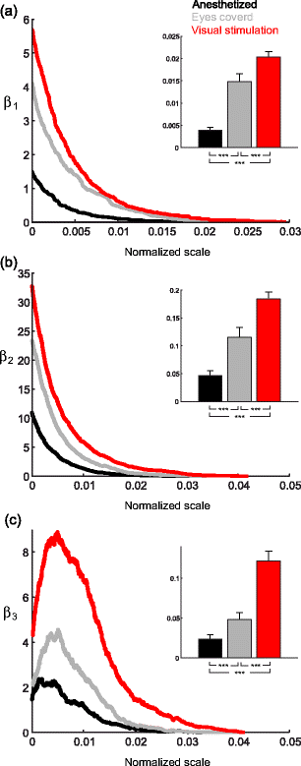
Fig. 7
The state dependent complexity of cortical activity spaces (modeled by level set manifolds) as measured by persistent homology. (a–c) Bottom Each curve is an average of 100 computations of Betti numbers as a function of normalized scale (a–c) top: The distribution of the Betti graphs integrals (i.e. area under the graph—mean ± SE). Note that all comparisons were significant (p << 0.001 using ANOVA; post hoc analysis p << 0.001 using Mann Whitney for all nine comparisons). For all scales shown the zero Betti number β 0 was 1 (indicating that given the covering by landmarks the data set consisted of a single component)

Slide 82
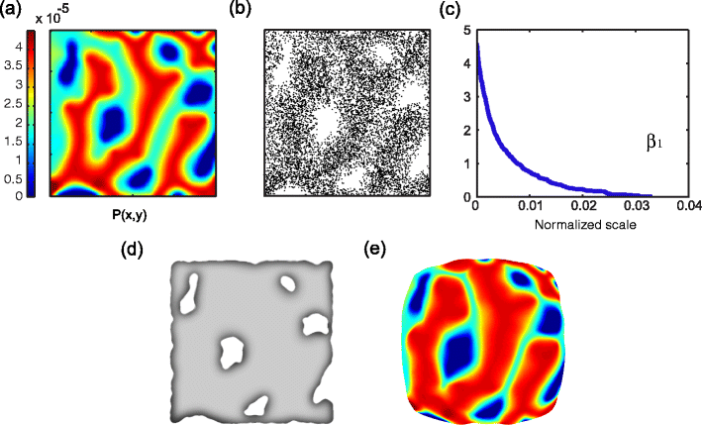
Fig. 8 The origin of homological structure in activity spaces. In this case we consider a scenario in which a neuronal system is to represent two variables. (a) An artificial joint probability distribution of the two variables. Note that there are several combinations of variables which have zero probability. (b) A random sample of 104 points drawn from (a). Variable combinations of zero probability results in holes in the distribution. In essence, such distributions are provided to neuronal systems via the sensory organs (receptor arrays) (c) The first Betti graph of the point cloud in (b). Dense samples such as this allow for the estimate of the topology and homology of the underlying distribution. Accordingly, similar information can be used to estimate and reconstruct this structure. (d) A schematic depiction of the reconstruction of the structure of ‘a’ using the points in ‘b’ which preserves the homological structure (i.e. the five one-holes) of ‘a’. (e) A schematic representation of the geometry of the neuronal activity space generated. In this space, volume is allocated according to probability. Accordingly, the high density areas in ‘a’ occupy more of the overall area in ‘e’, whereas the non zero low density areas occupy less

