Slide 1


http://www.plosone.org/article/info%3Adoi%2F10.1371%2Fjournal.pone.0002856
2008
And section 9.1 in Computational Topology: An Introduction By Herbert Edelsbrunner, John Harer

Slide 2
Goal: To determine what genes are involved in a particular periodic pathway
Application: segmentation clock of mouse embryo.
1 somite develops about every 2 hours
What genes are involved in somite development?

Slide 3
Persistence:
For each of 7549 genes, create
f_{k}: S¹ → R, k = 1, …, 7549
f_{k} (time point i) = amount of RNA at time point i for gene k
If gene k is involved in somite development, then f_{k} should have period 2

Slide 4
Not period 2:

Slide 5
Not period 2:

Slide 6
Not period 2:

Slide 7
Not period 2:

Slide 8
Period 2

Slide 9
Persistence:
For each of 7549 genes, create
f_{k}: S¹ → R, k = 1, …, 7549
f_{k} (time point i) = amount of RNA at time point i for gene k

Slide 10
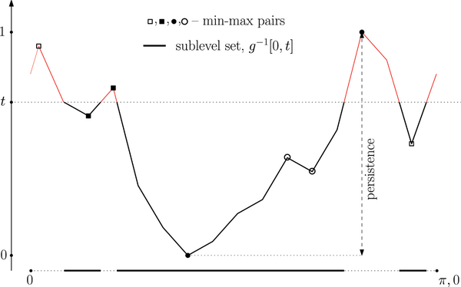

Figure 8. Function g(x) for the expression pattern of Axin2.
Dequéant M-L, Ahnert S, Edelsbrunner H, Fink TMA, et al. (2008) Comparison of Pattern Detection Methods in Microarray Time Series of the Segmentation Clock. PLoS ONE 3(8): e2856. doi:10.1371/journal.pone.0002856
http://www.plosone.org/article/info:doi/10.1371/journal.pone.0002856

Slide 11
Not period 2:

Slide 12

Data from:

Slide 13
During the formation of each somite, Lfng is expressed in the PSM as a wave that sweeps across the tissue in a posterior-to-anterior direction (1). Therefore, by visually comparing the anteroposterior position of the Lfng expression stripes in the PSM in stained embryos, it is possible to define an approximate chronological order of the embryos along the segmentation clock oscillation cycle (3, 4). We collected PSM samples from 40 mouse embryos ranging from 19 to 23 somites and used their Lfng expression patterns as a proxy to select 17 samples covering an entire oscillation cycle.
Indeed, due to technical issues, the right PSM samples of the time series were dissected from mouse embryos belonging to five consecutive somite cycles, and they were ordered based on their phase of Lfng expression pattern (revealed by in situ hybridization on the left PSM of each dissected mouse embryo) to reconstitute a unique oscillation cycle [5].

Slide 14
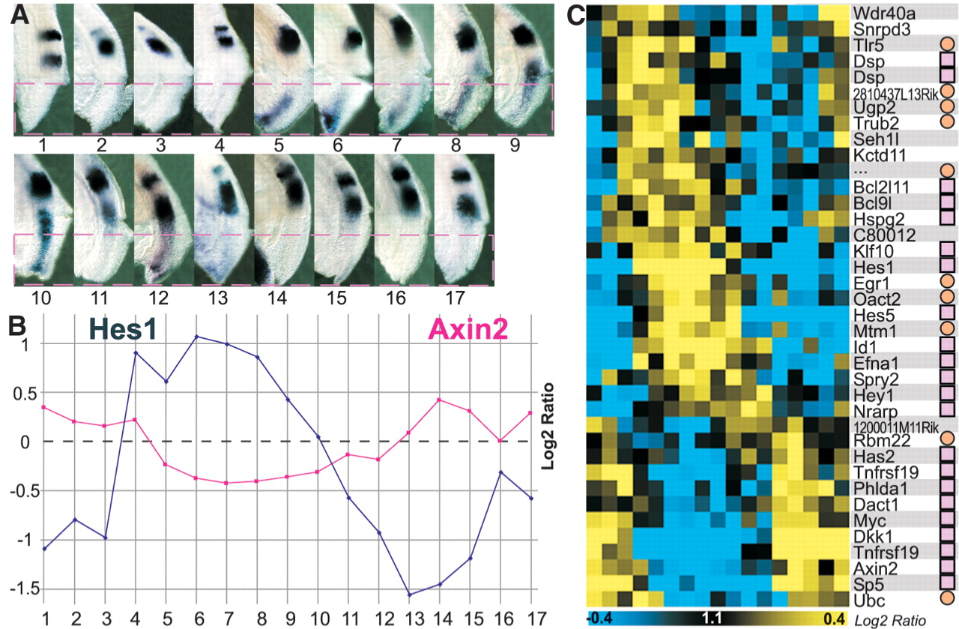

Fig. 2. Identification of cyclic genes based on the PSM microarray time series.
M Dequéant et al. Science 2006;314:1595-1598
Published by AAAS
Notes:
Identification of cyclic genes based on the PSM microarray time series. (A) Left side of the 17 mouse embryos, whose right posterior PSMs (below red hatched line) were dissected for microarray analysis. Embryos were ordered along one segmentation clock cycle according to the position of Lfng stripes in their left PSM as revealed by in situ hybridization (fig. S1). (B) Log₂ ratios of the expression levels of the Hes1 (blue) and Axin2 (red) cyclic genes in each microarray of the time series. (C) Phaseogram of the cyclic genes identified by microarray and L-S analysis. Blue, decrease in gene expression; yellow, increase in gene expression; pink squares, genes validated by in situ hybridization; and orange circles, nonvalidated genes, that is, not evidently cyclical as detected by in situ hybridization.

Slide 15

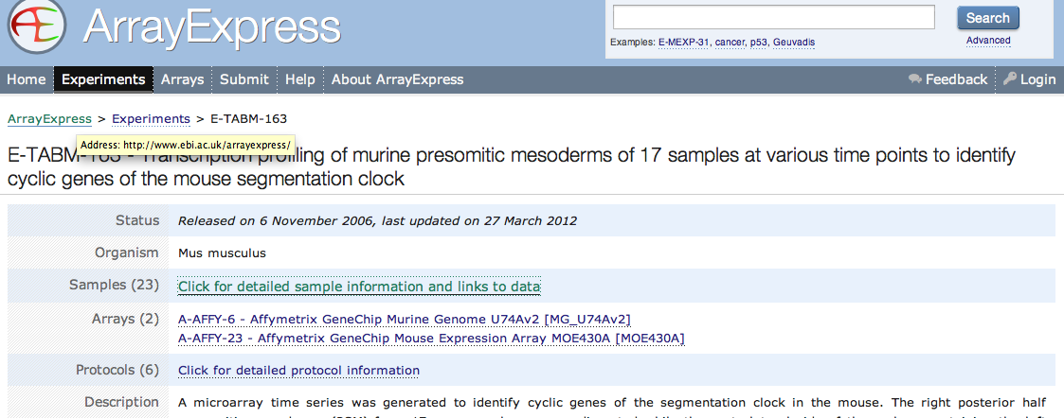
http://www.ebi.ac.uk/arrayexpress/
accession number E-TABM-163

Slide 16
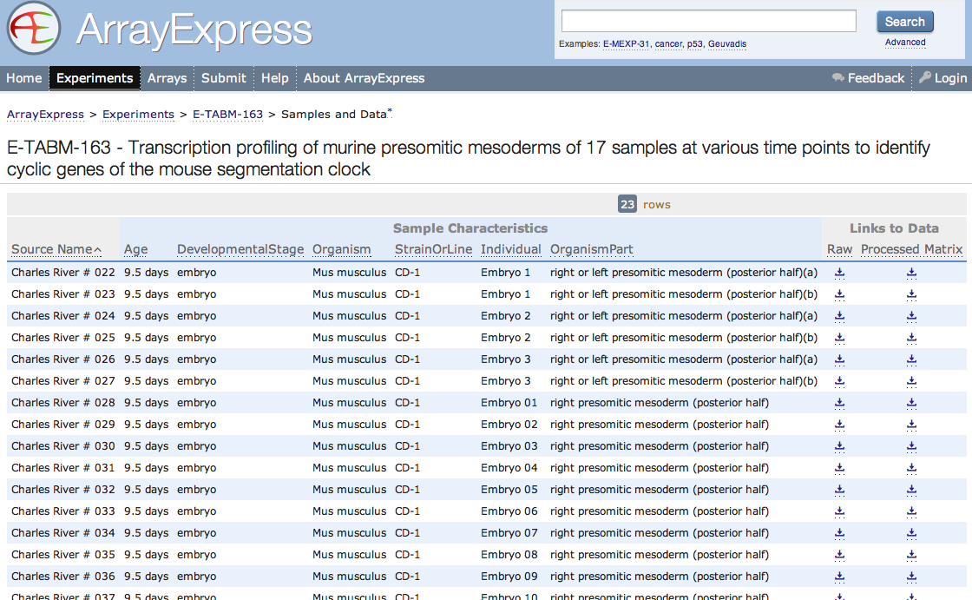

Slide 17
Persistence:
For each of 7549 genes, create
f_{k}: S¹ → R, k = 1, …, 7549
f_{k} (time point i) = amount of RNA at time point i for
gene k

Slide 18
17 time points → 17 equally space time points
microarry expression of gene k at time i → ranked
order of microarry expression of gene k at time i
(0.41, 0.63, 0.11, 0.23, 0.59, …) → (3, 5, 1, 2, 4, …).
f_{k} (time point i) = RNA intensity at time point i for
gene k.
π(f_{k}) = replace RNA intensity with rank order.
g(x_{i}) =[ π(f_{k})(x_{i}) – 1] / (17 – 1), for i = 1, …, 17.
g(x) obtained by linear interpolation for x ≠ x_{i} for some i. Note: 0 ≤ g(x) ≤ 1

Slide 19
Figure 8. Function g(x) for the expression pattern of Axin2.
g: S¹ → R
( 0, )
( 14, )
( 15, )
( 3, )
( 13, )
( 1, )
( 2, )
( 12, )
( 10, )
( 16, )
( 4, )
( 11, )
( 8, )
( 9, )
( 5, )
( 7, )
( 6, 0 )
Dequéant M-L, Ahnert S, Edelsbrunner H, Fink TMA, et al. (2008) Comparison of Pattern Detection Methods in Microarray Time Series of the Segmentation Clock. PLoS ONE 3(8): e2856. doi:10.1371/journal.pone.0002856
http://www.plosone.org/article/info:doi/10.1371/journal.pone.0002856

Slide 20
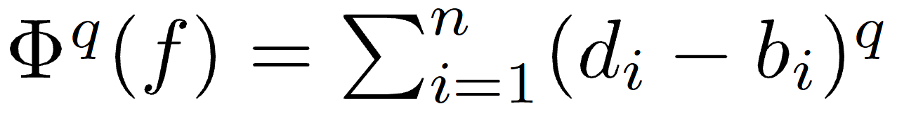
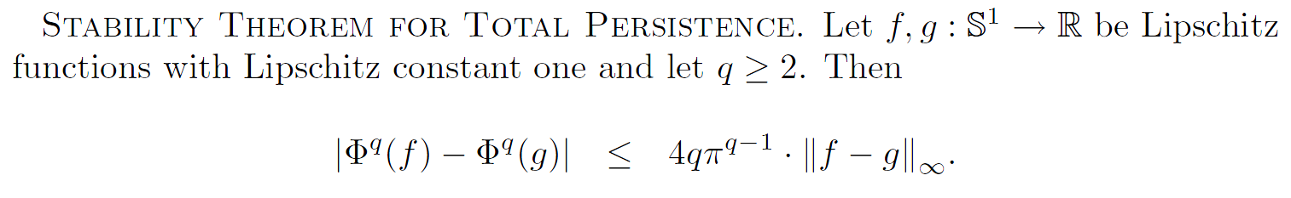

Slide 21
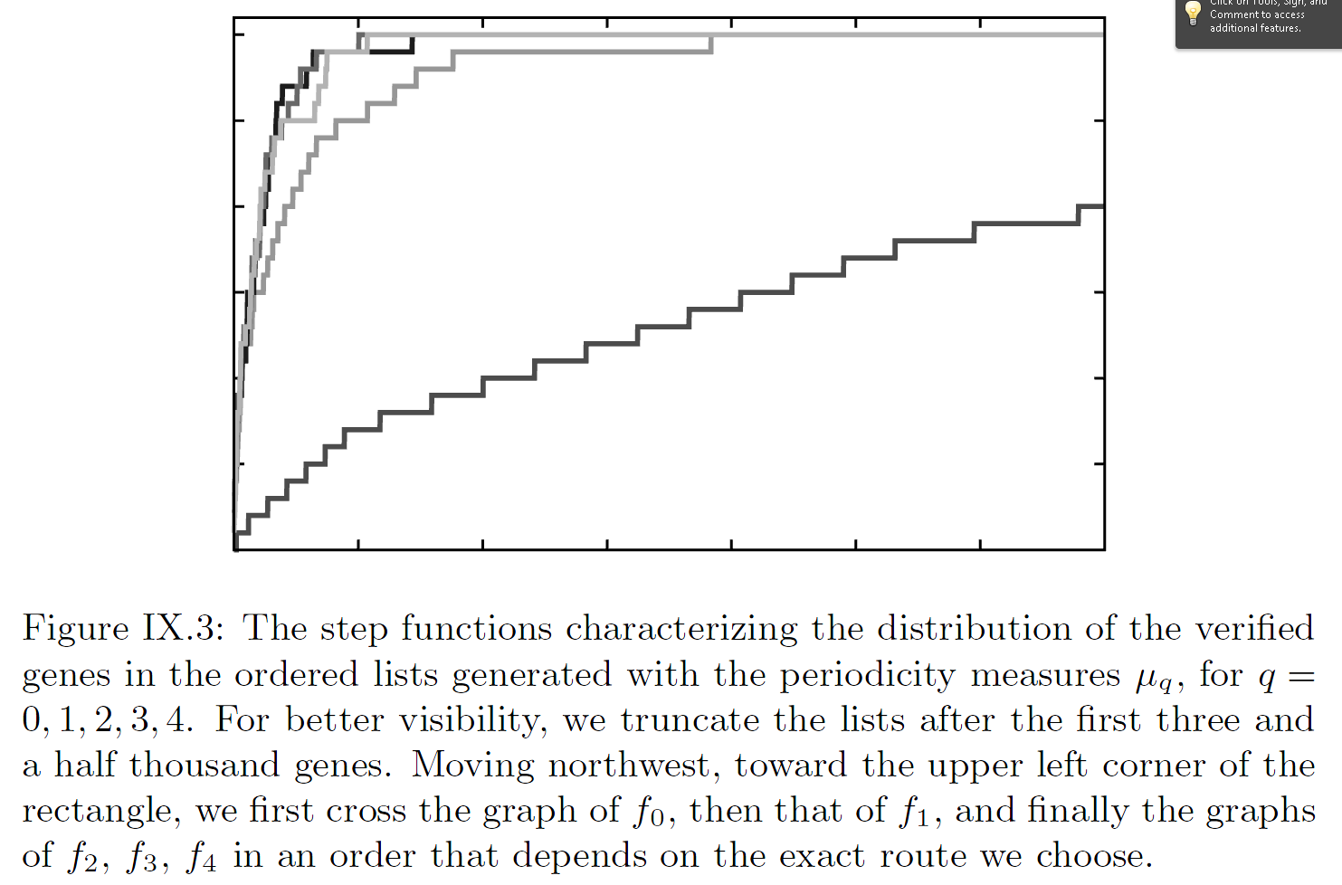
http://www.ams.org/publications/authors/books/postpub/mbk-69

Slide 22
Not period 2 implies Φ^{q}(f) large.

Slide 23
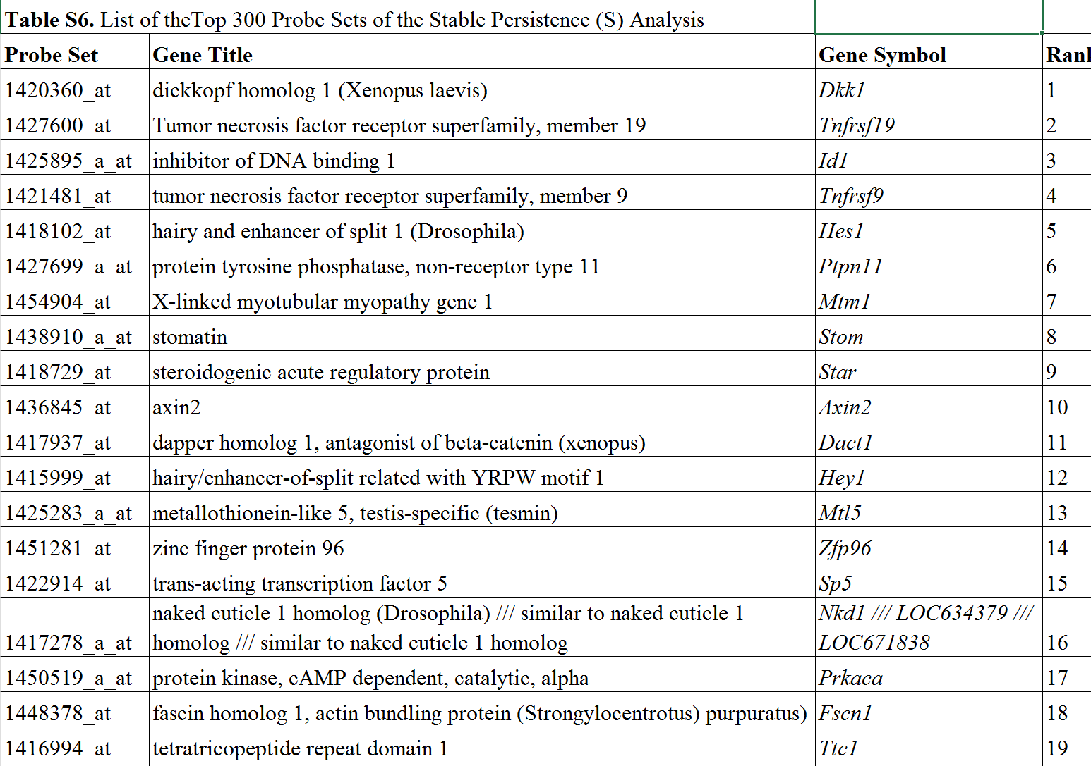
http://journals.plos.org/plosone/article?id=10.1371/journal.pone.0002856

Slide 24
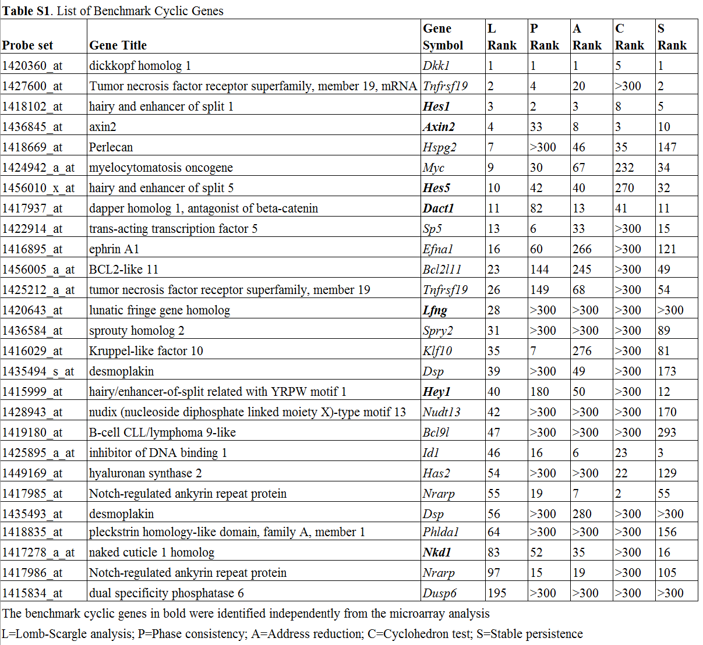
http://journals.plos.org/plosone/article?id=10.1371/journal.pone.0002856
L=Lomb-Scargle analysis;
P=Phase consistencyA=Address reduction; C= Cyclo-hedron test;
S=Stable persistence
The benchmark cyclic genes in bold were identified independ-ently from the microarray analysis

Slide 25
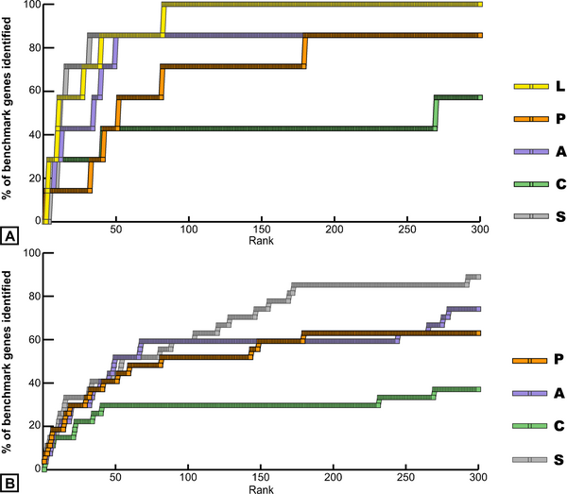
Figure 1. Identification of benchmark cyclic genes in the top 300 probe set lists of the five methods.
Dequéant M-L, Ahnert S, Edelsbrunner H, Fink TMA, et al. (2008) Comparison of Pattern Detection Methods in Microarray Time Series of the Segmentation Clock. PLoS ONE 3(8): e2856. doi:10.1371/journal.pone.0002856
http://www.plosone.org/article/info:doi/10.1371/journal.pone.0002856

Slide 26
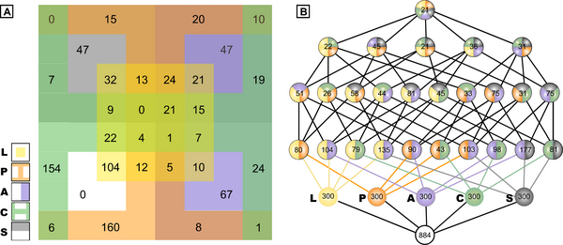
Figure 2. Comparison of the intersection of the top 300 ranked probe sets from the five methods.
Dequéant M-L, Ahnert S, Edelsbrunner H, Fink TMA, et al. (2008) Comparison of Pattern Detection Methods in Microarray Time Series of the Segmentation Clock. PLoS ONE 3(8): e2856. doi:10.1371/journal.pone.0002856
http://www.plosone.org/article/info:doi/10.1371/journal.pone.0002856

Slide 27
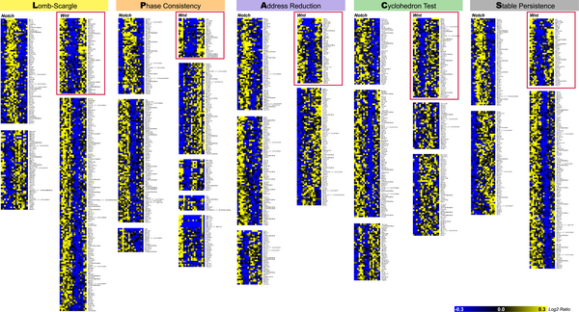
Figure 3. Clustering analysis of the top 300 ranked probe sets from the five methods.
Dequéant ML, Ahnert S, Edelsbrunner H, Fink TMA, Glynn EF, et al. (2008) Comparison of Pattern Detection Methods in Microarray Time Series of the Segmentation Clock. PLoS ONE 3(8): e2856. doi:10.1371/journal.pone.0002856
http://127.0.0.1:8081/plosone/article?id=info:doi/10.1371/journal.pone.0002856

Slide 28
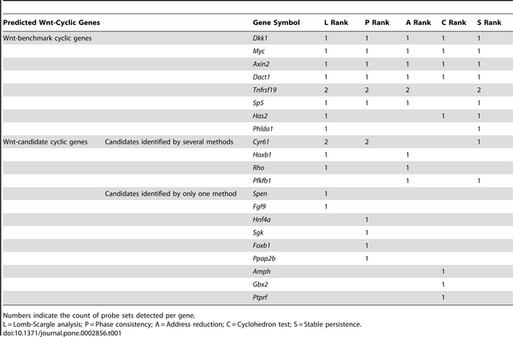
Table 1. Composition of the Wnt Clusters of the Five Methods.
Dequéant ML, Ahnert S, Edelsbrunner H, Fink TMA, Glynn EF, et al. (2008) Comparison of Pattern Detection Methods in Microarray Time Series of the Segmentation Clock. PLoS ONE 3(8): e2856. doi:10.1371/journal.pone.0002856
http://127.0.0.1:8081/plosone/article?id=info:doi/10.1371/journal.pone.0002856

Slide 29
Persistent homology results are stable:
Add noise to data does not change barcodes significantly.

Slide 30
Persistent homology results are stable:
Add noise to data does not change barcodes significantly.
Figure 8. Function g(x) for the expression pattern of Axin2.
Dequéant M-L, Ahnert S, Edelsbrunner H, Fink TMA, et al. (2008) Comparison of Pattern Detection Methods in Microarray Time Series of the Segmentation Clock. PLoS ONE 3(8): e2856. doi:10.1371/journal.pone.0002856
http://www.plosone.org/article/info:doi/10.1371/journal.pone.0002856

Slide 31
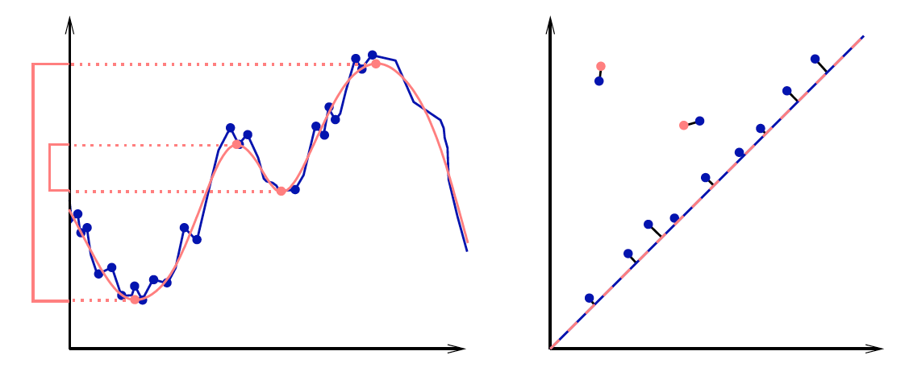
|| (x₁,…,x_{n}) – (y₁,…,y_{n}) ||∞ = max{|x₁ – y₁|,…,|x_{n} - y_{n}|}
Given sets X, Y and bijection g: X → Y,
Bottleneck Distance: d_{B}(X, Y) = inf sup || x – g(x) ||∞
g x

Slide 32
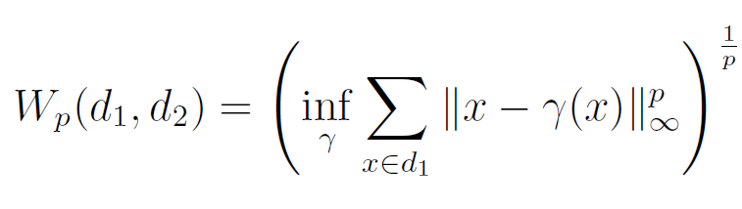
(Wasserstein distance). The p-th Wasserstein distance between two persistence diagrams,
d₁ and d₂, is defined as
where γ ranges over all bijections from d₁ to d₂.
Probability measures on the space of persistence
diagrams
Yuriy Mileyko1, Sayan Mukherjee2 and John Harer1

Slide 33
Persistent homology results are stable:
Add noise to data does not change barcodes significantly.

Slide 34
But are the results in this case stable?
How stable is the mathematical model?

Slide 35
Figure 8. Function g(x) for the expression pattern of Axin2.
g: S¹ → R
( 0, )
( 14, )
( 15, )
( 3, )
( 13, )
( 1, )
( 2, )
( 12, )
( 10, )
( 16, )
( 4, )
( 11, )
( 8, )
( 9, )
( 5, )
( 7, )
( 6, 0 )
Dequéant M-L, Ahnert S, Edelsbrunner H, Fink TMA, et al. (2008) Comparison of Pattern Detection Methods in Microarray Time Series of the Segmentation Clock. PLoS ONE 3(8): e2856. doi:10.1371/journal.pone.0002856
http://www.plosone.org/article/info:doi/10.1371/journal.pone.0002856

Slide 36
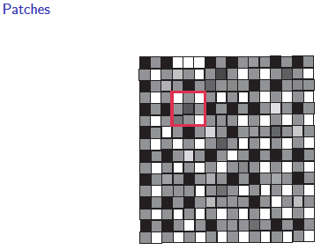
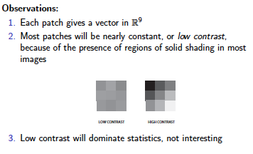
Lee-Mumford-Pedersen [LMP] study only high contrast patches.
Collection: 4.5 x 10⁶ high contrast patches from a
collection of images obtained by van Hateren and van der Schaaf
http://www.kyb.mpg.de/de/forschung/fg/bethgegroup/downloads/van-hateren-dataset.html

Slide 37
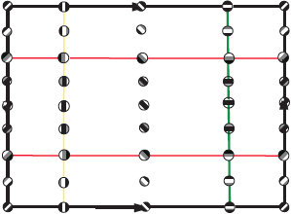
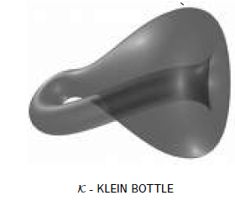
M(100, 10) U Q
where |Q| = 30
On the Local Behavior of Spaces of Natural Images, Gunnar Carlsson, Tigran Ishkhanov, Vin de Silva, Afra Zomorodian, International Journal of Computer Vision 2008, pp 1-12.

Slide 38
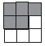
is a point in S⁷
Data set M has over 4 × 10⁶ points in S⁷.
Randomly choose 5000 points.
Take the T% densest points.
Choose a subset of 50 Landmark points.
http://www.ima.umn.edu/2005-2006/PISG7.10-28.06/activities/carlsson/mississippitwo.pdf

Slide 39

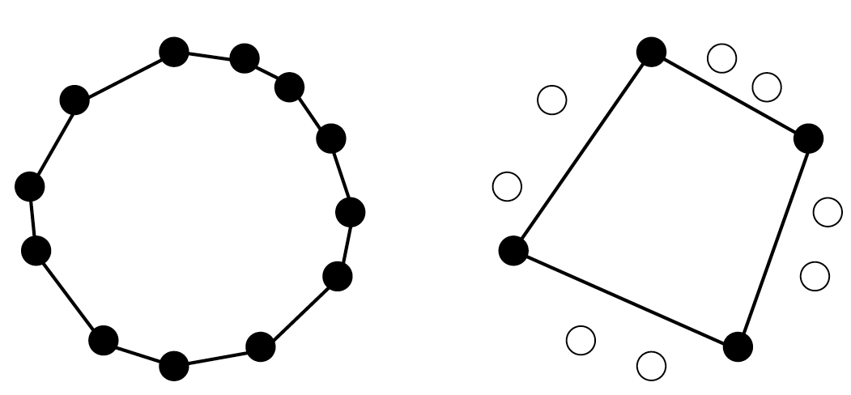
comptop.stanford.edu/preprints/witness.pdf

Slide 40
Witness complex
Let D = set of point cloud data points.
Choose L D, L = set of landmark points.
U

Slide 41
Witness complex
Let D = set of point cloud data points.
Choose L D, L = set of landmark points.
Normally L is a small subset, but in this example, L is a large red subset.
U

Slide 42
W∞(D) = Witness complex
v₀,v₁,...,v_{k} span a k-simplex
iff
there is a point w ∈ D, whose k+1 nearest
neighbours in L are v₀,v₁,...,v_{k}
and all the faces of {v₀,v₁,...,v_{k}} belong to the witness complex.
w is called a “weak” witness.
Let D = set of point cloud data points.
Choose L D,
L = set of landmark points = vertices.
U

Slide 43
W∞(D) = Witness complex
v₀,v₁,...,v_{k} span a k-simplex
iff
there is a point w ∈ D, whose k+1 nearest
neighbours in L are v₀,v₁,...,v_{k}
and all the faces of {v₀,v₁,...,v_{k}} belong to the witness complex.
w is called a “weak” witness.
Let D = set of point cloud data points.
Choose L D,
L = set of landmark points = vertices.
U

Slide 44
W₁(D) = Lazy witness complex
Let L = set of landmark points.
1-skeletion of W₁(D) = 1-skeletion of W∞ (D).
Create the flag (or clique) complex:
Add all possible simplices of dimensional > 1.

Slide 45
W₁(D) = Lazy witness complex
Let L = set of landmark points.
1-skeletion of W₁(D) = 1-skeletion of W∞ (D).
Create the flag (or clique) complex:
Add all possible simplices of dimensional > 1.

Slide 46
W₁(D) = Lazy witness complex
Let L = set of landmark points.
1-skeletion of W₁(D) = 1-skeletion of W∞ (D).
Create the flag (or clique) complex:
Add all possible simplices of dimensional > 1.

Slide 47
Choosing Landmark points:
A.) Random
B.) Maxmin
1.) choose point l₁ randomly
2.) If {l₁, …, l_{k-1}} have been chosen, choose l_{k} such that {l₁, …, l_{k-1}} is in D - {l₁, …, l_{k-1}} and
min {d(l_{k}, l₁), …, d(l_{k}, l_{k-1})} ≥ min {d(v, l₁), …, d(v, l_{k-1})}

Slide 48
Choosing Landmark points: MaxMin
1.) choose point l₁ randomly
Notes:
data points.
In this very simplified case my data points lie in a two-dimensional plane. Normally data points are high dimensional.
For example, I may be comparing the expression or thousands of genes in tumor cells to healthy cells using microarray data. OR I might be comparing politicians voting records. Or I might be comparing the stats of basketball players. These three applications were all, by the way, published by Lum et al this past February in Nature’s Scientific Reports. I have included a link to their paper on my youtube site.
http://www.nature.com/srep/2013/130207/srep01236/full/srep01236.html

Slide 49
Choosing Landmark points: MaxMin
1.) choose point l₁ randomly
Notes:
data points.
In this very simplified case my data points lie in a two-dimensional plane. Normally data points are high dimensional.
For example, I may be comparing the expression or thousands of genes in tumor cells to healthy cells using microarray data. OR I might be comparing politicians voting records. Or I might be comparing the stats of basketball players. These three applications were all, by the way, published by Lum et al this past February in Nature’s Scientific Reports. I have included a link to their paper on my youtube site.
http://www.nature.com/srep/2013/130207/srep01236/full/srep01236.html

Slide 50
Choosing Landmark points: MaxMin
2.) If {l₁, …, l_{k-1}} have been chosen, choose l_{k} such that {l₁, …, l_{k-1}} is in D - {l₁, …, l_{k-1}} and
min {d(l_{k}, l₁), …, d(l_{k}, l_{k-1})} ≥ min {d(v, l₁), …, d(v, l_{k-1})}
Notes:
data points.
In this very simplified case my data points lie in a two-dimensional plane. Normally data points are high dimensional.
For example, I may be comparing the expression or thousands of genes in tumor cells to healthy cells using microarray data. OR I might be comparing politicians voting records. Or I might be comparing the stats of basketball players. These three applications were all, by the way, published by Lum et al this past February in Nature’s Scientific Reports. I have included a link to their paper on my youtube site.
http://www.nature.com/srep/2013/130207/srep01236/full/srep01236.html

Slide 51
Choosing Landmark points: MaxMin
2.) If {l₁} chosen, choose l₂ such that {l₁} is in D - {l₁, …, l_{k-1}} and
min {d(l₂, l₁)} ≥ min {d(v, l₁)}
Notes:
data points.
In this very simplified case my data points lie in a two-dimensional plane. Normally data points are high dimensional.
For example, I may be comparing the expression or thousands of genes in tumor cells to healthy cells using microarray data. OR I might be comparing politicians voting records. Or I might be comparing the stats of basketball players. These three applications were all, by the way, published by Lum et al this past February in Nature’s Scientific Reports. I have included a link to their paper on my youtube site.
http://www.nature.com/srep/2013/130207/srep01236/full/srep01236.html

Slide 52
Choosing Landmark points: MaxMin
2.) If {l₁, …, l_{k-1}} have been chosen, choose l_{k} such that {l₁, …, l_{k-1}} is in D - {l₁, …, l_{k-1}} and
min {d(l_{k}, l₁), …, d(l_{k}, l_{k-1})} ≥ min {d(v, l₁), …, d(v, l_{k-1})}
Notes:
data points.
In this very simplified case my data points lie in a two-dimensional plane. Normally data points are high dimensional.
For example, I may be comparing the expression or thousands of genes in tumor cells to healthy cells using microarray data. OR I might be comparing politicians voting records. Or I might be comparing the stats of basketball players. These three applications were all, by the way, published by Lum et al this past February in Nature’s Scientific Reports. I have included a link to their paper on my youtube site.
http://www.nature.com/srep/2013/130207/srep01236/full/srep01236.html

Slide 53
Choosing Landmark points: MaxMin
2.) If {l₁, l₂} have been chosen, choose l₂ such that {l₁, …, l_{k-1}} is in D - {l₁, …, l_{k-1}} and
min {d(l₃, l₁), d(l₃, l₂)} ≥ min {d(v, l₁), d(v, l₂)}
Notes:
data points.
In this very simplified case my data points lie in a two-dimensional plane. Normally data points are high dimensional.
For example, I may be comparing the expression or thousands of genes in tumor cells to healthy cells using microarray data. OR I might be comparing politicians voting records. Or I might be comparing the stats of basketball players. These three applications were all, by the way, published by Lum et al this past February in Nature’s Scientific Reports. I have included a link to their paper on my youtube site.
http://www.nature.com/srep/2013/130207/srep01236/full/srep01236.html

Slide 54
Choosing Landmark points: MaxMin
2.) If {l₁, …, l_{k-1}} have been chosen, choose l_{k} such that {l₁, …, l_{k-1}} is in D - {l₁, …, l_{k-1}} and
min {d(l_{k}, l₁), …, d(l_{k}, l_{k-1})} ≥ min {d(v, l₁), …, d(v, l_{k-1})}
Notes:
data points.
In this very simplified case my data points lie in a two-dimensional plane. Normally data points are high dimensional.
For example, I may be comparing the expression or thousands of genes in tumor cells to healthy cells using microarray data. OR I might be comparing politicians voting records. Or I might be comparing the stats of basketball players. These three applications were all, by the way, published by Lum et al this past February in Nature’s Scientific Reports. I have included a link to their paper on my youtube site.
http://www.nature.com/srep/2013/130207/srep01236/full/srep01236.html

Slide 55
Strong witness complex:
Let D = set of point cloud data points.
Choose L D, L = set of landmark points.
Let m_{v} = dist (v, L) = min{ d(v, l ) : l in L }
U
{l₁, …, l_{k+1}} is a k-simplex
iff
d(v, l_{i}) ≤ m_{v} + ε for all i
v is the witness

Slide 56
Weak witness complex:
Let D = set of point cloud data points.
Choose L D, L = set of landmark points.
U
σ = {l₁, …, l_{k+1}} is a k-simplex
iff
d(v, l_{i}) ≤ d(v, x) for all i
and all x not in σ
v is the weak witness

Slide 57
Weak witness complex:
Let D = set of point cloud data points.
Choose L D, L = set of landmark points.
U
σ = {l₁, …, l_{k+1}} is a k-simplex
iff
d(v, l_{i}) ≤ d(v, x) + ε for all i
and all x not in σ
v is the ε-weak witness

Slide 58
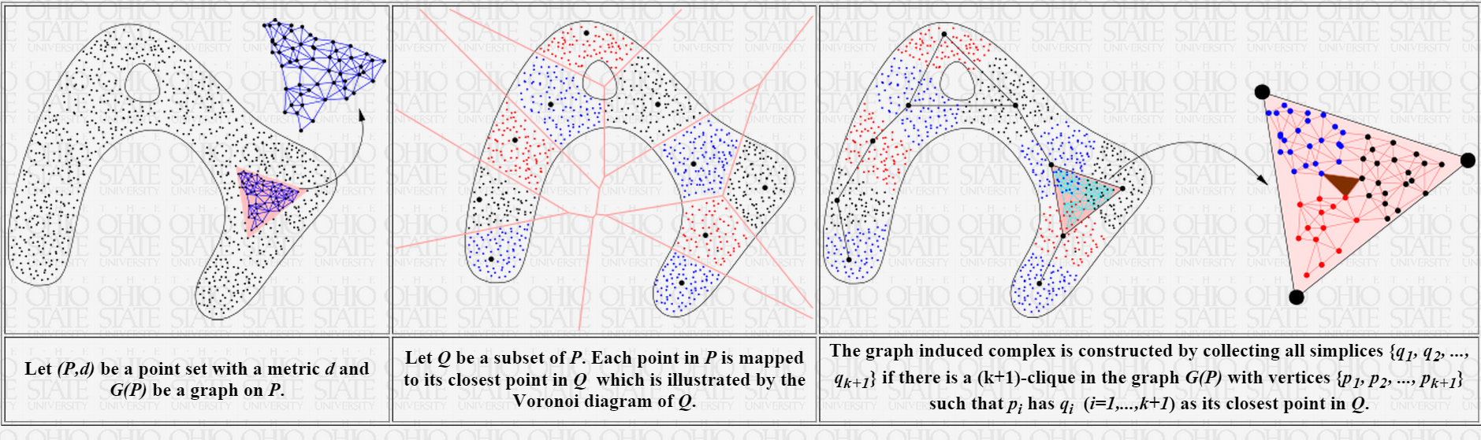
Tamal K. Dey http://www.cse.ohio-state.edu/~tamaldey/
Graph Induced Complex: A Data Sparsifier for Homology Inference
Video: http://www.ima.umn.edu/videos/?id=2497
Slides: http://web.cse.ohio-state.edu/~tamaldey/talk/GIC/GIC.pdf
Paper: http://web.cse.ohio-state.edu/~tamaldey/paper/GIC/GIC.pdf
Graph Induced Complex on Point Data T. K. Dey, F. Fan, and Y. Wang,
(SoCG 2013) Proc. 29th Annu. Sympos. Comput. Geom. 2013, 107-116.
Website: http://web.cse.ohio-state.edu/~tamaldey/GIC/gic.html
The efficiency of extracting topological information from point data depends largely on the complex that is built on top of the data points. From a computational viewpoint, the most favored complexes for this purpose have so far been Vietoris-Rips and witness complexes. While the Vietoris-Rips complex is simple to compute and is a good vehicle for extracting topology of sampled spaces, its size is huge--particularly in high dimensions. The witness complex on the other hand enjoys a smaller size because of a subsampling, but fails to capture the topology in high dimensions unless imposed with extra structures. We investigate a complex called the {em graph induced complex} that, to some extent, enjoys the advantages of both. It works on a subsample but still retains the power of capturing the topology as the Vietoris-Rips complex. It only needs a graph connecting the original sample points from which it builds a complex on the subsample thus taming the size considerably. We show that, using the graph induced complex one can (i) infer the one dimensional homology of a manifold from a very lean subsample, (ii) reconstruct a surface in three dimension from a sparse subsample without computing Delaunay triangulations, (iii) infer the persistent homology groups of compact sets from a sufficiently dense sample. We provide experimental evidences in support of our theory.

Slide 59
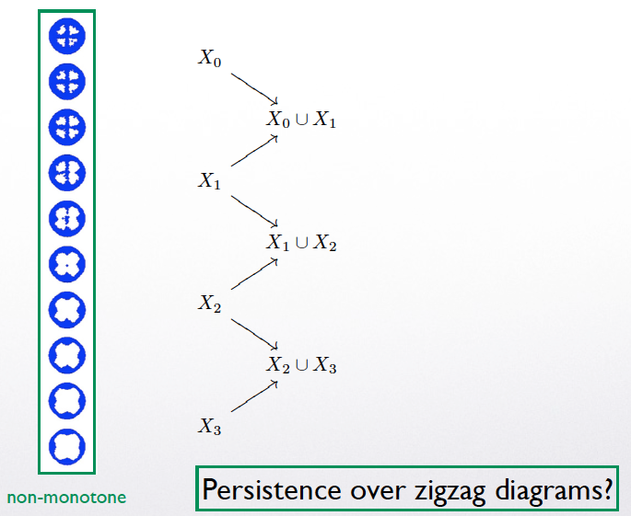

Slide 60

Witness Complexes

Slide 61
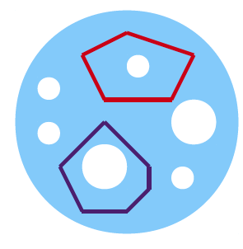
Witness Complexes

