Slide 1

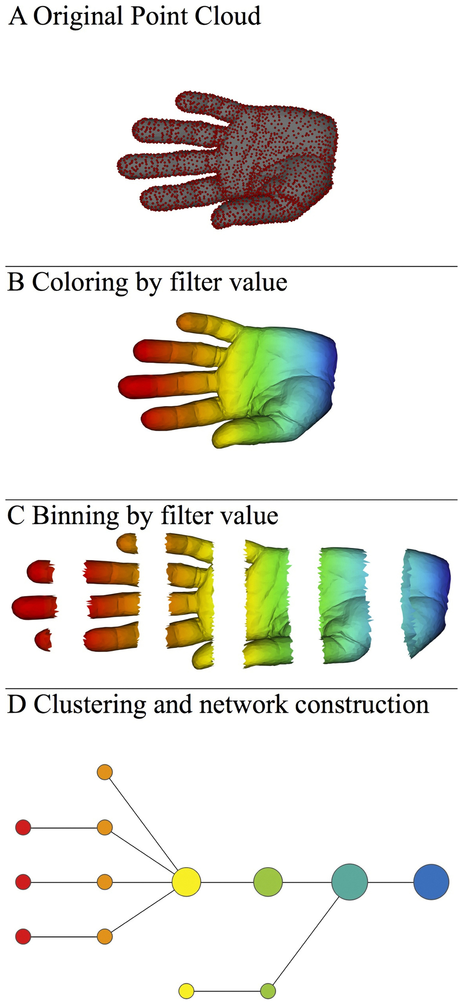
http://www.nature.com/srep/2013/130207/srep01236/full/srep01236.html

Slide 2

A) Data Set
Example: Point cloud data
representing a hand.
B) Function f : Data Set → R
Example: x-coordinate
f : (x, y, z) → x
Put data into overlapping bins.
Example: f⁻¹(a_{i}, b_{i})
Cluster each bin & create network.
Vertex = a cluster of a bin.
Edge = nonempty intersection
between clusters
http://www.nature.com/srep/2013/130207/srep01236/full/srep01236.html

Slide 3
Three key ideas of topology that make extracting of patterns via shape possible.
1.) coordinate free.
No dependence on the coordinate system chosen.
Can compare data derived from different platforms
2.) invariant under “small” deformations.
less sensitive to noise
3.) compressed representations of shapes.
Input: dataset with thousands of points
Output: network with 13 vertices and 12 edges.
http://www.nature.com/srep/2013/130207/srep01236/full/srep01236.html

Slide 4
Application 1: breast cancer gene expression
Data: microarray gene expression data from 2 data sets, NKI and GSE2034
Distance: correlation distance
Filters: (1) L-infinity centrality:
f(x) = max{d(x, p) : p in data set}
captures the structure of the points far removed from the center or norm.
(2) NKI: survival vs. death
GSE2034: no relapse vs. relapse
Clustering: Single linkage.

Slide 5
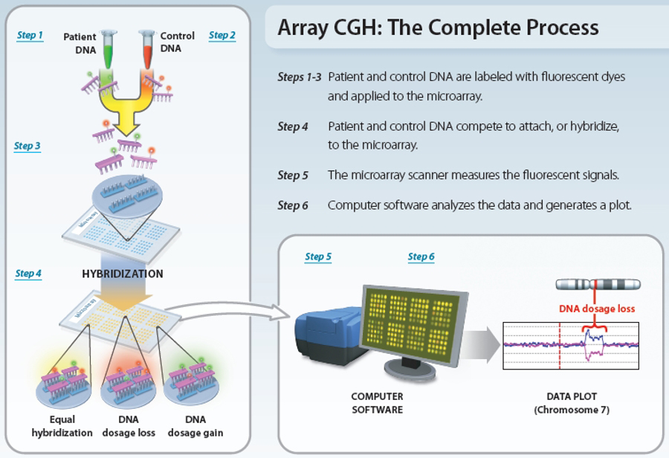
www.nature.com/scitable/topicpage/microarray-based-comparative-genomic-hybridization-acgh-45432

Slide 6
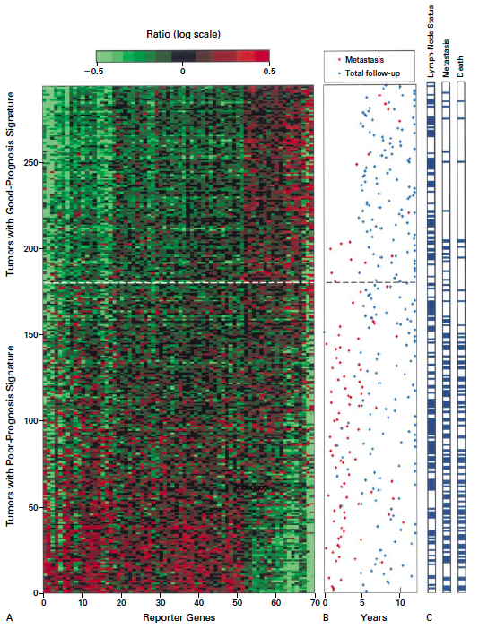
Gene expression profiling predicts clinical outcome of breast cancer
van 't Veer LJ, Dai H, van de Vijver MJ, He YD, Hart AA, Mao M, Peterse HL, van der Kooy K, Marton MJ, Witteveen AT, Schreiber GJ, Kerkhoven RM, Roberts C, Linsley PS, Bernards R, Friend SH
Nature. 2002 Jan 31;415(6871):530-6.

Slide 7
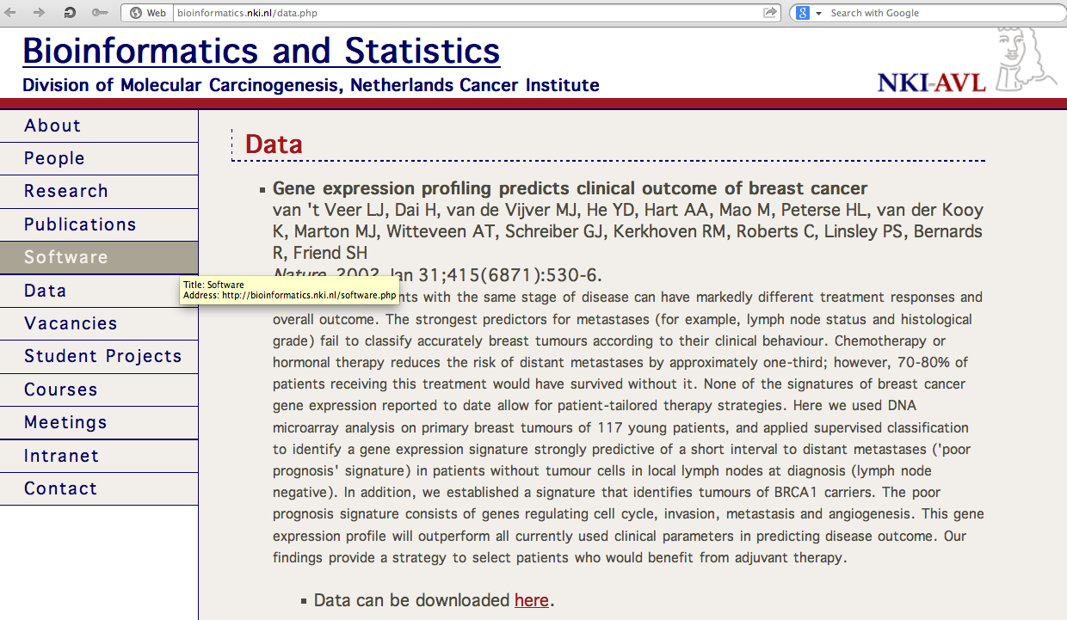
http://bioinformatics.nki.nl/data.php

Slide 8
2 breast cancer data sets:
1.) NKI (2002):
gene expression levels of 24,000 from 272 tumors. Includes node-negative and node-positive patients, who had or had not received adjuvant systemic therapy. Also includes survival information.
2.) GSE203414 (2005)
expression of 22,000 transcripts from total RNA of frozen tumour samples from 286 lymph-node-negative patients who had not received adjuvant systemic treatment. Also includes time to relapse information.

Slide 9
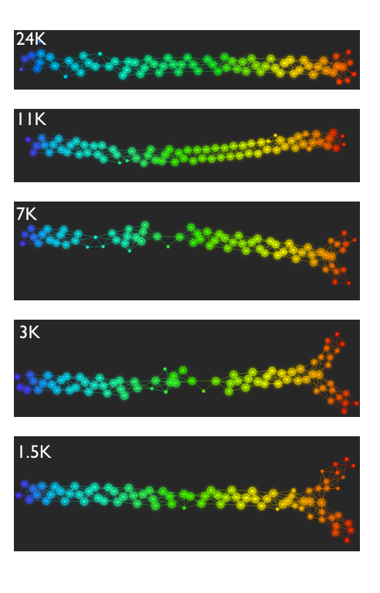
Fig. S1. Shape of the data becomes more distinct as the analysis columns are restricted to the top
varying genes.
24K: all the genes on the microarray were used in the analysis;
11K: 10,731 top most varying genes were used in the analysis;
7K: 6.688 top most varying genes were used in the analysis;
3K: 3212 top most varying genes were used in the analysis;
1.5K: 1553 top most varying genes were used in the analysis.
Graphs colored by the L-infinity centrality values. Red: high; Blue: low
http://www.nature.com/srep/2013/130207/srep01236/full/srep01236.html

Slide 10
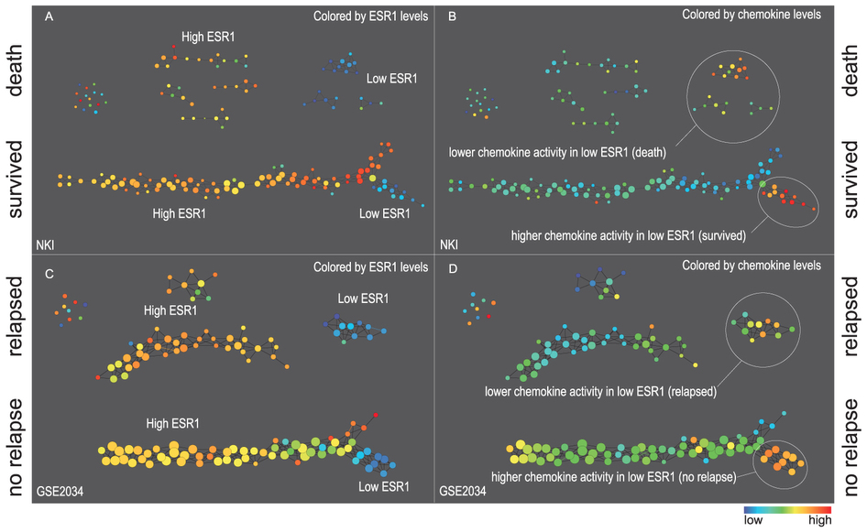
Two filter functions, L-Infinity centrality and survival or relapse were used to generate the networks. The top half of panels A and B are the networks of patients who didn't survive, the bottom half are the patients who survived. Panels C and D are similar to panels A and B except that one of the filters is relapse instead of survival. Panels A and C are colored by the average expression of the ESR1 gene. Panels B and D are colored by the average expression of the genes in the KEGG chemokine pathway. Metric: Correlation; Lens: L-Infinity Centrality (Resolution 70, Gain 3.0x, Equalized) and Event Death (Resolution 30, Gain 3.0x). Color bar: red: high values, blue: low values.
http://www.nature.com/srep/2013/130207/srep01236/full/srep01236.html

Slide 11
Comparison of our results with those of Van de Vijver and colleagues is difficult because of differences in patients, techniques, and materials used.
Their study included node-negative and node-positive patients, who had or had not received adjuvant systemic therapy, and only women younger than 53 years.
microarray platforms used in the studies differ—Affymetrix and Agilent.
Of the 70 genes in the study by van't Veer and co-workers, 48 are present on the Affymetrix U133a array, whereas only 38 of our 76 genes are present on the Agilent array. There is a three-gene overlap between the two signatures (cyclin E2, origin recognition complex, and TNF superfamily protein).
Despite the apparent difference, both signatures included genes that identified several common pathways that might be involved in tumour recurrence. This finding supports the idea that although there might be redundancy in gene members, effective signatures could be required to include representation of specific pathways.
From: Gene-expression profiles to predict distant metastasis of lymph-node-negative primary breast cancer, Yixin Wang et al, The Lancet, Volume 365, Issue 9460, 19–25 February 2005, Pages 671–679

Slide 12
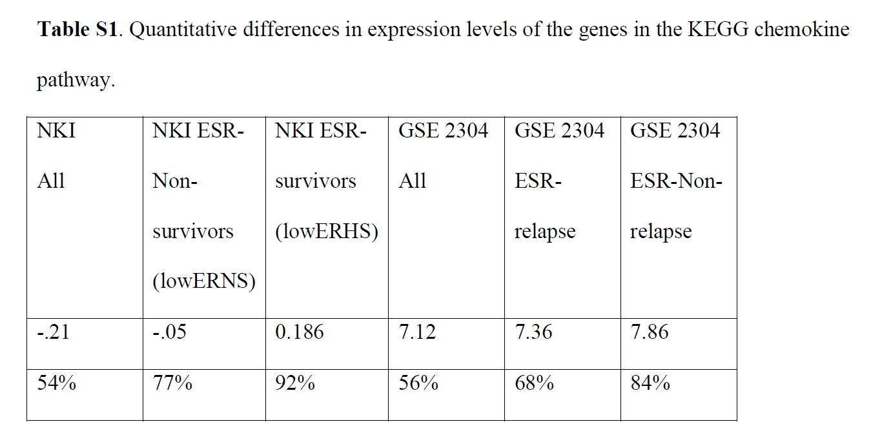
From: http://www.nature.com/srep/2013/130207/srep01236/full/srep01236.html
The numbers in the first row are the average levels of expressions of genes belonging to the chemokine pathway within the relevant groups. The second row gives these same levels reported as percentiles belonging to the collection of the chemokine expression levels across all the patients in the study to which the group belongs. Note that the lowERHS groups display very high chemokine expression levels, 92nd percentile in the case of NKI and 84th percentile in the case of GSE2304. The lowERNS groups are also consistently higher than the general population in the study, although to different degrees in the studies. The difference can perhaps be accounted for by the difference between the survival vs. non-relapse criteria in the two data sets.

Slide 13
www.nature.com/scitable/topicpage/microarray-based-comparative-genomic-hybridization-acgh-45432

Slide 14
Three key ideas of topology that make extracting of patterns via shape possible.
1.) coordinate free.
No dependence on the coordinate system chosen.
Can compare data derived from different platforms
2.) invariant under “small” deformations.
less sensitive to noise
3.) compressed representations of shapes.
Input: dataset with thousands of points
Output: network with 13 vertices and 12 edges.
http://www.nature.com/srep/2013/130207/srep01236/full/srep01236.html

Slide 15
Two filter functions, L-Infinity centrality and survival or relapse were used to generate the networks. The top half of panels A and B are the networks of patients who didn't survive, the bottom half are the patients who survived. Panels C and D are similar to panels A and B except that one of the filters is relapse instead of survival. Panels A and C are colored by the average expression of the ESR1 gene. Panels B and D are colored by the average expression of the genes in the KEGG chemokine pathway. Metric: Correlation; Lens: L-Infinity Centrality (Resolution 70, Gain 3.0x, Equalized) and Event Death (Resolution 30, Gain 3.0x). Color bar: red: high values, blue: low values.
http://www.nature.com/srep/2013/130207/srep01236/full/srep01236.html

Slide 16
Identifying subtypes of cancer in a consistent manner is a challenge in the field since sub-populations can be small and their relationships complex
High expression level of the estrogen receptor gene (ESR1) is positively correlated with improved prognosis, given that this set of patients is likely to respond to standard therapies.
But , there are still sub-groups of high ESR1 that do not respond well to therapy.
Low ESR1 levels are strongly correlated with poor prognosis
But there are patients with low ESR1 levels but high survival rates
Many molecular sub-groups have been identified,
But often difficult to identify the same sub-group in a broader setting, where data sets are generated on different platforms, on different sets of patients and at a different times, because of the noise and complexity in the data.
http://www.nature.com/srep/2013/130207/srep01236/full/srep01236.html

Slide 17
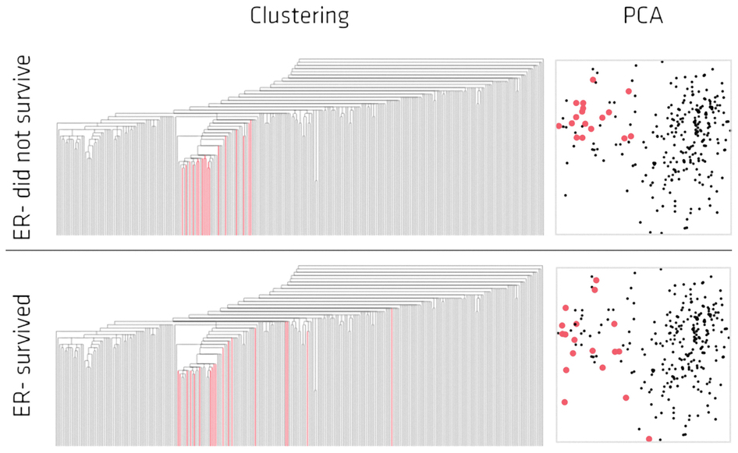
Highlighted in red are the lowERNS (top panel) and the lowERHS (bottom panel) patient sub-groups.
http://www.nature.com/srep/2013/130207/srep01236/full/srep01236.html

Slide 18

http://www.pnas.org/content/early/2011/04/07/1102826108

Slide 19
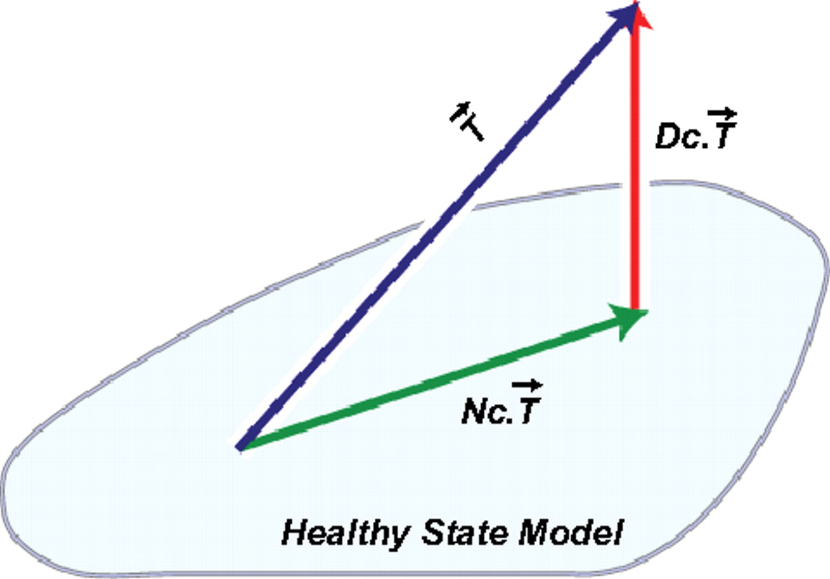
DSGA decomposition of the original tumor vector into the Normal component its linear models fit onto the Healthy State Model and the Disease component vector of residuals.
Nicolau M et al. PNAS 2011;108:7265-7270
©2011 by National Academy of Sciences
Notes:
DSGA decomposition of the original tumor vector into the Normal component its linear models fit onto the Healthy State Model and the Disease component vector of residuals.

Slide 20
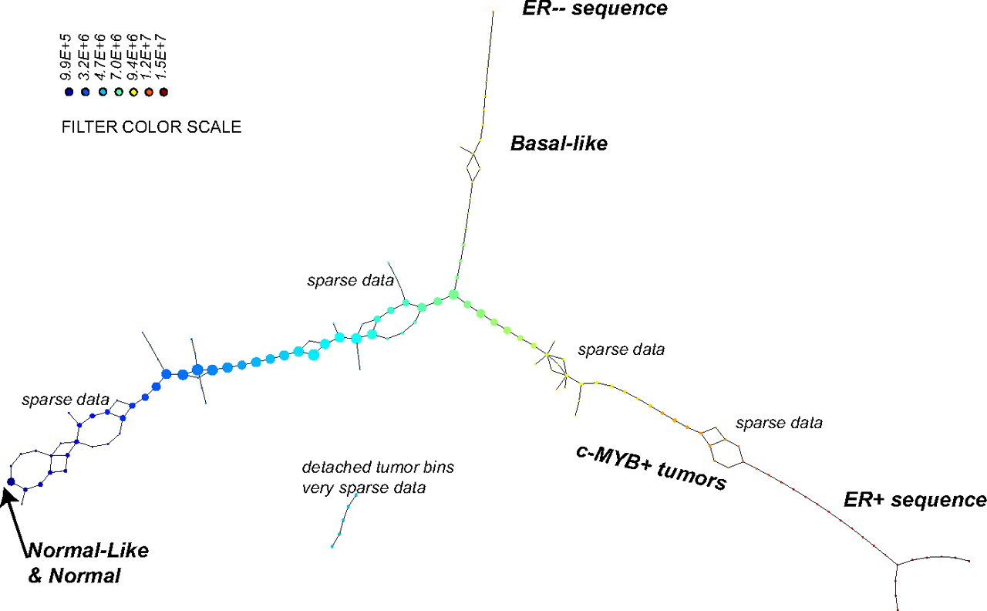
PAD analysis of the NKI data. The output has three progression arms, because tumors (data points) are ordered by the magnitude of deviation from normal (the HSM). Each bin is colored by the mean of the filter map on the points. Blue bins contain tumors whose total deviation from HSM is small (normal and Normal-like tumors). Red bins contain tumors whose deviation from HSM is large. The image of f was subdivided into 15 intervals with 80% overlap. All bins are seen (outliers included). Regions of sparse data show branching. Several bins are disconnected from the main graph. The ER− arm consists mostly of Basal tumors. The c-MYB+ group was chosen within the ER arm as the tightest subset, between the two sparse regions.
PAD analysis of the NKI data.
Nicolau M et al. PNAS 2011;108:7265-7270
©2011 by National Academy of Sciences
Notes:
PAD analysis of the NKI data. The output has three progression arms, because tumors (data points) are ordered by the magnitude of deviation from normal (the HSM). Each bin is colored by the mean of the filter map on the points. Blue bins contain tumors whose total deviation from HSM is small (normal and Normal-like tumors). Red bins contain tumors whose deviation from HSM is large. The image of f was subdivided into 15 intervals with 80% overlap. All bins are seen (outliers included). Regions of sparse data show branching. Several bins are disconnected from the main graph. The ER− arm consists mostly of Basal tumors. The c-MYB+ group was chosen within the ER arm as the tightest subset, between the two sparse regions.

Slide 21
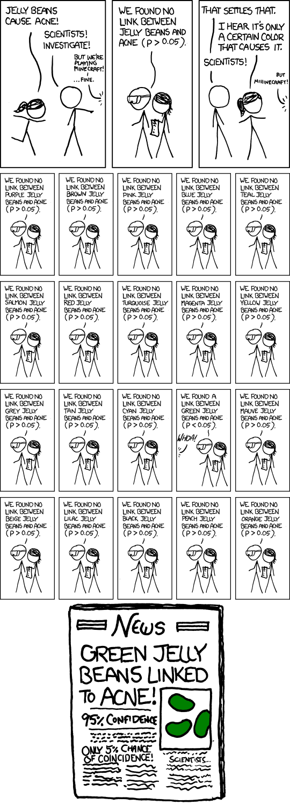
False Positives will occur

Slide 22
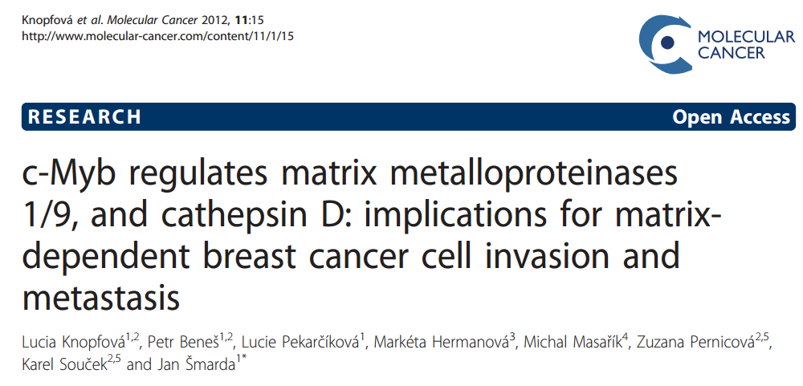


Slide 23
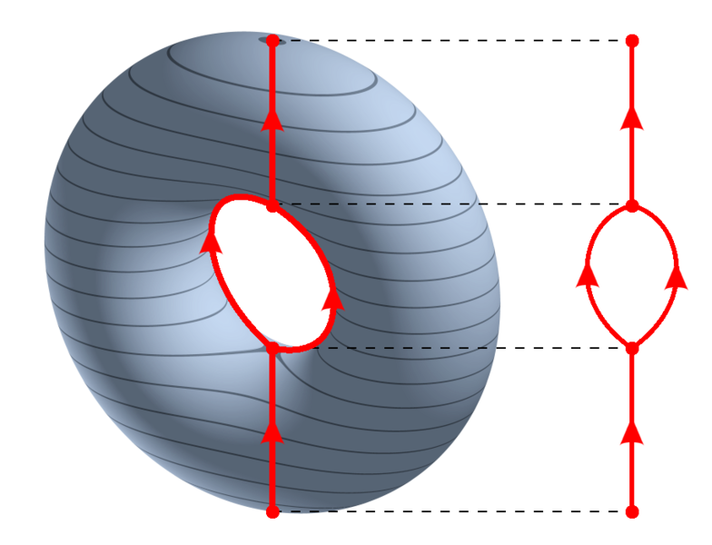
https://en.wikipedia.org/wiki/Reeb_graph

Slide 24

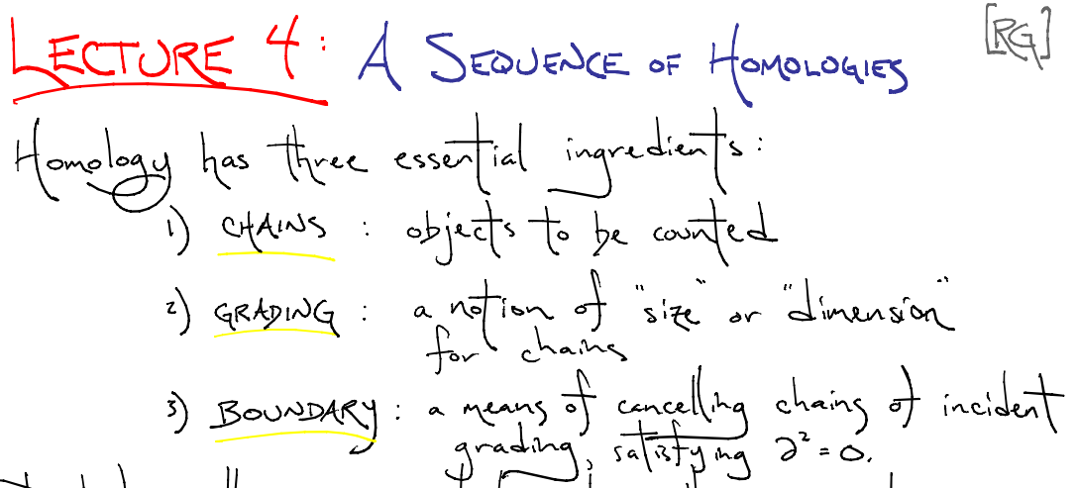

http://www.ima.umn.edu/2008-2009/ND6.15-26.09/

Slide 25
Create your own homology
3 ingredients:
1.) Objects
2.) Grading
3.) Boundary map

Slide 26
Building blocks for a simplicial homology
0-simplex = vertex = v
1-simplex = edge
v₁
v₂
e
2-simplex = triangle
v₂
e₁
e₂
v₁
v₃
e₃
Notes:
The building blocks for a simplicial complex consist of zero simplices which are zero dimensional vertices, one simplices which are one-dimensional edges, and 2-simplices which are two dimensional triangles,

Slide 27
Grading
Grading: Each object is assigned a unique grade
Grading = Partition of R[x]
Ex: Grade = dimension
Grade 0: 0-simplex = vertex = v
v₁
v₂
e
Grade 1: 1-simplex = edge = {v₁, v₂}
v₂
Grade 2: 2-simplex = triangle = {v₁, v₂, v₃}
e₁
e₂
v₁
v₃
e₃

Slide 28

Boundary Map
_{n} : C_{n} → C_{n-1} such that ² = 0
v₁
v₂
→
v₁
v₂
→ 0
e
v₂
v₂
→
→ 0
e₁
e₂
e₁
e₂
v₁
v₃
v₁
v₃
e₃
e₃

Slide 29
_{n+1}
_{n}
₂
₁
₀
C_{n+1} → C_{n} → C_{n-1} →. . . → C₂ → C₁ → C₀ → 0
H_{n} = Z_{n}/B_{n} = (kernel of )/ (image of )
cycles
boundaries
_{n}
_{n+1}
=
v₂
e₁
e₂
v₁
v₃
e₃

Slide 30
Čech homology
Given U V_{α} where V_{α} open for all α in A.
Objects = finite intersections = { V_{α} : α_{i} in A }
Grading = n = depth of intersection.
( V_{α} ) = Σ V_{α}
Ex: (V_{α}) = 0, (V_{α} V_{β}) = V_{α} + V_{β}
(V_{α} V_{β} V_{γ}) = (V_{α} V_{β}) + (V_{α} V_{γ}) + (V_{β} V_{γ})
α in A
n
U
i = 1
i
( )
n
n
n
U
_{n+1}
U
i = 1
i
j = 1
i = 1
i ≠ j
i
U
₀
₁
U
U
U
U
U
₂

Slide 31
Your name homology
3 ingredients:
1.) Objects
2.) Grading
3.) Boundary map
_{n} : C_{n} → C_{n-1} such that ² = 0

Slide 32
Creating a simplicial complex from Data
Step 0.) Start by adding data points
= 0-dimensional vertices (0-simplices)
Notes:
data points.
In this very simplified case my data points lie in a two-dimensional plane. Normally data points are high dimensional.
For example, I may be comparing the expression or thousands of genes in tumor cells to healthy cells using microarray data. OR I might be comparing politicians voting records. Or I might be comparing the stats of basketball players. These three applications were all, by the way, published by Lum et al this past February in Nature’s Scientific Reports. I have included a link to their paper on my youtube site.
http://www.nature.com/srep/2013/130207/srep01236/full/srep01236.html

Slide 33
Creating a simplicial complex from Data
0.) Start by adding 0-dimensional data points
Note: we only need a definition of closeness between data points. The data points do not need to be actual points in R^{n}
Notes:
since my very simple data is 2-dimensional, each point could represent an ordered pair of numbers. For example,

Slide 34
Creating a simplicial complex from Data
(1, 8)
(2, 7)
(1, 5)
0.) Start by adding 0-dimensional data points
Note: we only need a definition of closeness between data points. The data points do not need to be actual points in R^{n}
Notes:
The points (1, 5), (1, 8), (2, 7). These points could represent actual locations OR each coordinate could represent a particular property. For example, if each point represents a different tumor cell, the first coordinate could represent the gene expression level of the gene coding for the protein ubiquitin hydrolase, while the 2nd coordinate could represent the gene expression level of a different gene. Normally one models thousands of genes at once, Thus each point would have thousands of coordinates where each coordinate represents the expression level of a single gene.
The data points do not need to be described by numbers. Often data is described by numbers but not always.

Slide 35
Creating a simplicial complex from Data
(dog, happy)
(wolf, mirthful)
(dog, content)
0.) Start by adding 0-dimensional data points
Note: we only need a definition of closeness between data points. The data points do not need to be actual points in R^{n}
Notes:
For example, we could be descriptions. The data can be in just about any format as long as we have a definition of closeness between the data points.

Slide 36
Creating a simplicial complex from Data
1.) Adding 1-dimensional edges (1-simplices)
Add an edge between data points that are “close”
Notes:
If two points are “close” , we connect them with an edge
I put quotes around close because we don’t have to use the standard Euclidean distance. Any idea of closeness that is relevant to your application will do. For example correlation is often used. We don’t even need an exact distance or an exact definition of distance, we just need to know when to connect 2 points with an edge.
The definition of closeness will depend upon the application. For now let’s assume standard Euclidean distance.

Slide 37

Creating a simplicial complex from Data
1.) Adding 1-dimensional edges (1-simplices)
Add an edge between data points that are “close”
Notes:
So we can measure (or calculate) the distance between two points to determine if they are “close”. But we still need to define close.

Slide 38
Creating a simplicial complex from Data
1.) Adding 1-dimensional edges (1-simplices)
Let T = Threshold =
Connect vertices v and w with an edge iff
the distance between v and w is less than T
Notes:
So we will connect every pair of vertices if their distance is less than 1.8 cm. If the center of these points represent the 0-dimensional vertices, then this distance is less than our threshold, so we add an edge. Similarly this pair of points satisfy our definition of close, so we add an edge
The distance between this pair of vertices is greater than 1.8, so we won’t connect them with an edge. Continuing to add edges between vertices whenever their distance is less than our threshold of 1.8cm, we now have

Slide 39
Creating a simplicial complex from Data
1.) Adding 1-dimensional edges (1-simplices)
Add an edge between data points that are “close”
Notes:
a one dimensional simplicial complex. Note that we have clustered our data into five disjoint connected sets. So this is one way to cluster our data – that is grouping our data points into disjoint sets based on some definition of similarity. In this case, we have 5 clusters.
We can now add higher dimensional simplices.

Slide 40
Creating a simplicial complex from Data
1.) Adding 1-dimensional edges (1-simplices)
Add an edge between data points that are “close”
Notes:
a one dimensional simplicial complex. Note that we have clustered our data into five disjoint connected sets. So this is one way to cluster our data – that is grouping our data points into disjoint sets based on some definition of similarity. In this case, we have 5 clusters.
We can now add higher dimensional simplices.

Slide 41
Creating the Vietoris Rips simplicial complex
2.) Add all possible simplices of dimensional > 1.
Notes:
Thus we now have the Vietoris Rips simplicial complex. Note we get the same simplex by adding one dimension at a time

Slide 42
Creating the Vietoris Rips simplicial complex
0.) Start by adding 0-dimensional data points
Note: we only need a definition of closeness between data points. The data points do not need to be actual points in R^{n}
Notes:
We start again by adding our 0-simplices, our data points. I can indicate the threshold using a ball centered at my data point. The diameter of the ball will be my threshold, so if two balls intersect then the distance between the vertices is less than the threshold, so we connect the pair of vertices with an edge if and only if the balls intersect, so we can get edges after which we can then add all possible higher dimensional simplices.
Note how I grew my balls. As the diameter increases, my threshold which is equal to my diameter increases.

Slide 43
H₀ counts clusters
Notes:
a one dimensional simplicial complex. Note that we have clustered our data into five disjoint connected sets. So this is one way to cluster our data – that is grouping our data points into disjoint sets based on some definition of similarity. In this case, we have 5 clusters.
We can now add higher dimensional simplices.

Slide 44
H₀ counts clusters
Notes:
a one dimensional simplicial complex. Note that we have clustered our data into five disjoint connected sets. So this is one way to cluster our data – that is grouping our data points into disjoint sets based on some definition of similarity. In this case, we have 5 clusters.
We can now add higher dimensional simplices.

Slide 45
Creating the Vietoris Rips simplicial complex
0.) Start by adding 0-dimensional data points
Note: we only need a definition of closeness between data points. The data points do not need to be actual points in R^{n}
Notes:
We can compute the number of clusters for a variety of diameters.
We start with 17 data points, so if the diameter is 0, we have 17 clusters. Increasing the diameter, these 2 balls intersect so I now have 16 clusters.
If we continue to increase the diameter, we will eventually create the complex we saw before with 5 clusters, etc until we only have one cluster left.
Eventually this entire page will be purple, but right now, we know have one component.
To choose the threshold, one can determine how long a particular number of clusters lasts, for example for what set of radii do we have five clusters. If we have five clusters for the largest set of radii, then have gives us a good idea where to set the threshold and which simplicial complex best models our data.
I have put links to better animations on my on my YouTube site which may better illustrate this persistence concept. Next month, we will also talk much more about persistence during the live lectures for this course. This is just a preliminary introduction.

Slide 46
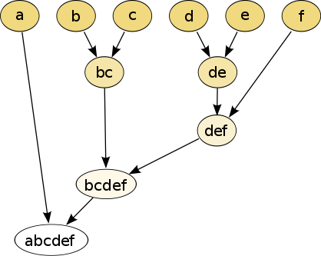
Increasing threshold
Connect vertices whose distance is less than a given threshold
single linkage hierarchical clustering

Slide 47
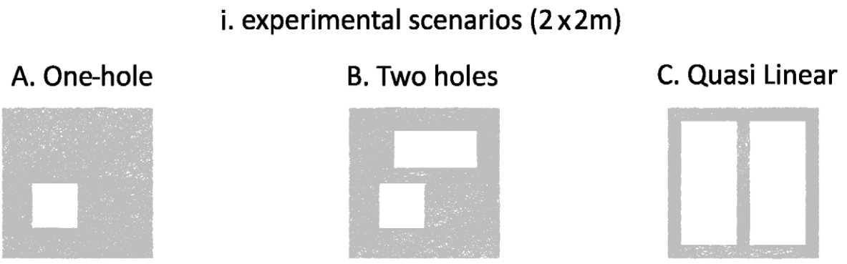
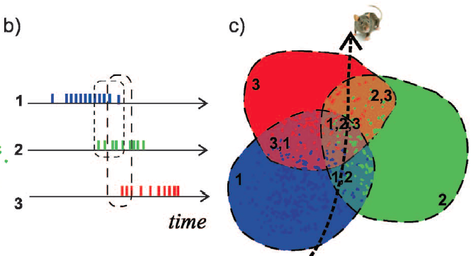
Cycles
Time
Instead of growing balls, we have a growing path (along with the cover of the path)

Slide 48
Creating the Vietoris Rips simplicial complex
0.) Start by adding 0-dimensional data points
Note: we only need a definition of closeness between data points. The data points do not need to be actual points in R^{n}
Notes:
We can compute the number of clusters for a variety of diameters.
We start with 17 data points, so if the diameter is 0, we have 17 clusters. Increasing the diameter, these 2 balls intersect so I now have 16 clusters.
If we continue to increase the diameter, we will eventually create the complex we saw before with 5 clusters, etc until we only have one cluster left.
Eventually this entire page will be purple, but right now, we know have one component.
To choose the threshold, one can determine how long a particular number of clusters lasts, for example for what set of radii do we have five clusters. If we have five clusters for the largest set of radii, then have gives us a good idea where to set the threshold and which simplicial complex best models our data.
I have put links to better animations on my on my YouTube site which may better illustrate this persistence concept. Next month, we will also talk much more about persistence during the live lectures for this course. This is just a preliminary introduction.

Slide 49
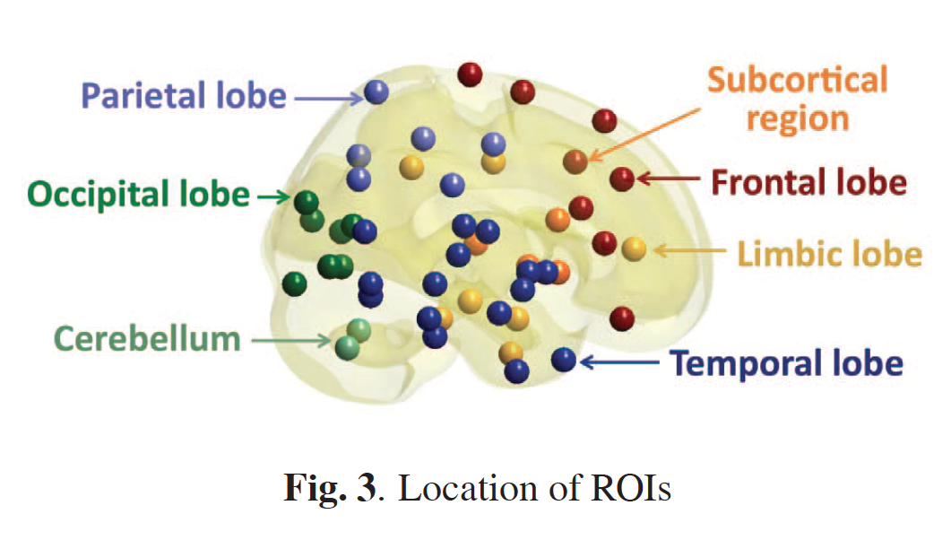
Discriminative persistent homology of brain networks, 2011 Hyekyoung Lee Chung, M.K.; Hyejin Kang; Bung-Nyun Kim;Dong Soo Lee
Constructing functional brain networks with 97 regions of interest (ROIs) extracted from FDG-PET data for
24 attention-deficit hyperactivity disorder (ADHD),
26 autism spectrum disorder (ASD) and
11 pediatric control (PedCon).
Data = measurement f_{j}
taken at region j
Graph: 97 vertices representing 97 regions of interest
edge exists between two vertices i,j if correlation
between f_{j} and f_{j} ≥ threshold
How to choose the threshold? Don’t, instead use persistent homology

Slide 50
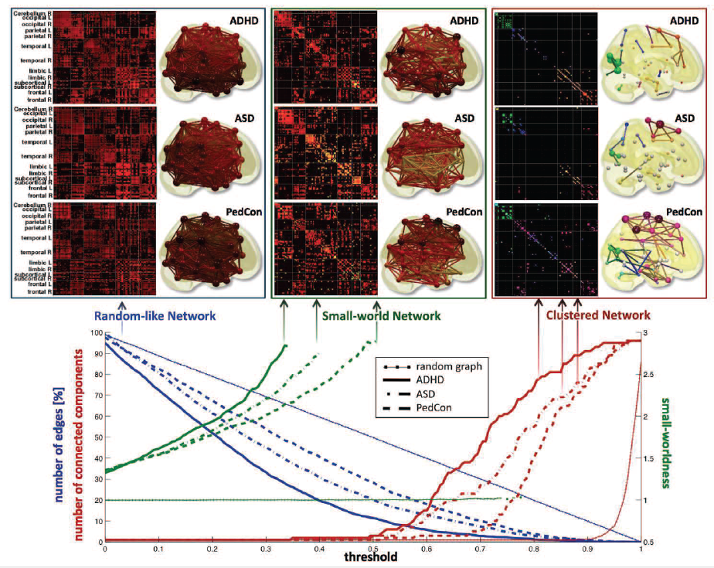

Slide 51
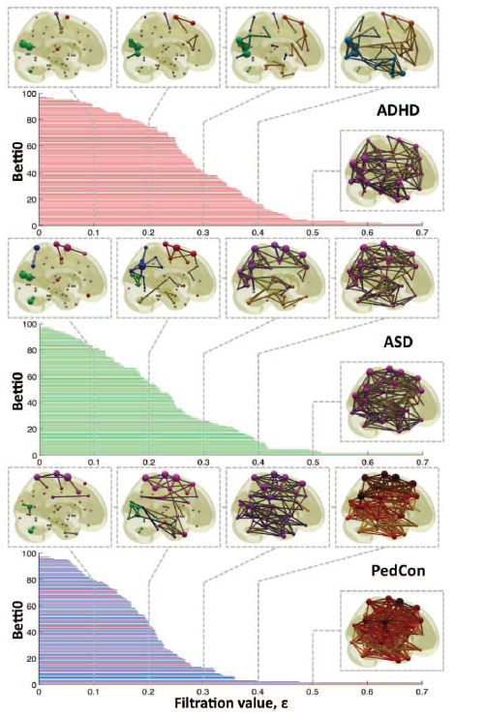

Vertices = Regions of Interest
Create Rips complex by growing epsilon balls (i.e. decreasing threshold) where distance between two vertices is given by
where f_{i} =
measurement at location i

Slide 52
Discriminative persistent homology of brain networks, 2011 Hyekyoung Lee Chung, M.K.; Hyejin Kang; Bung-Nyun Kim;Dong Soo Lee
Constructing functional brain networks with 97 regions of interest (ROIs) extracted from FDG-PET data for
24 attention-deficit hyperactivity disorder (ADHD),
26 autism spectrum disorder (ASD) and
11 pediatric control (PedCon).
Data = measurement f_{j}
taken at region j
Graph: 97 vertices representing 97 regions of interest
edge exists between two vertices i,j if correlation
between f_{j} and f_{j} ≥ threshold
How to choose the threshold? Don’t, instead use persistent homology

Slide 53
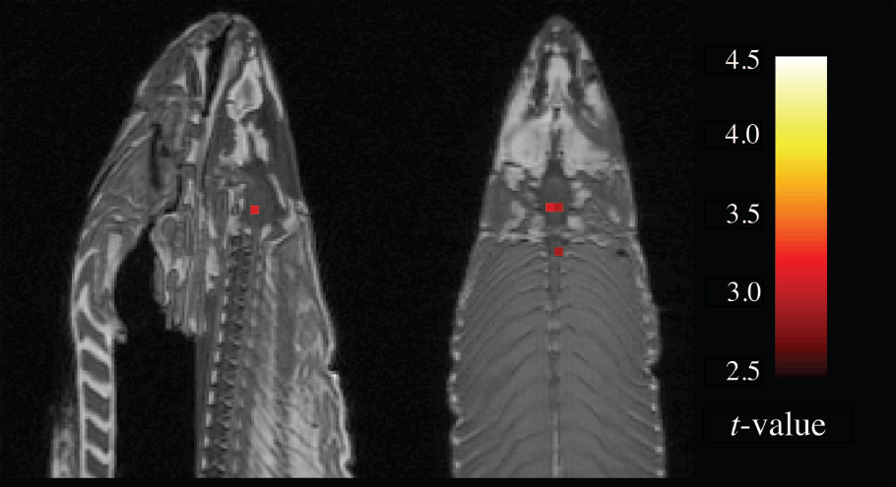
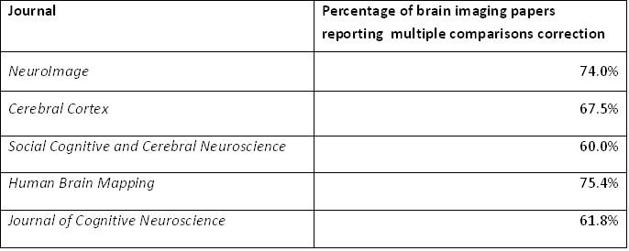
2012 Ignoble Prize
The Ig Nobel Prizes honor achievements that make people LAUGH, and then THINK.
http://www.improbable.com/ig/

Slide 54
2012 Ignoble Prize
The Ig Nobel Prizes honor achievements that make people LAUGH, and then THINK.
http://www.improbable.com/ig/
Activated compared to other voxels
fMRI of dead salmon
The salmon was shown images of people in social situations, either socially inclusive situations or socially exclusive situations.
The salmon was asked to respond, saying how the person in the situation must be feeling.
http://blogs.scientificamerican.com/scicurious-brain/2012/09/25/ignobel-prize-in-neuroscience-the-dead-salmon-study/

Slide 55
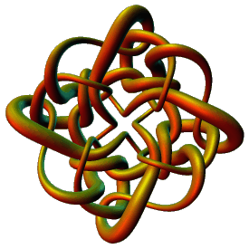
Persistent Homology
Place Cell Application
Isabel K. Darcy
Mathematics Department
Applied Mathematical and
Computational Sciences (AMCS)
University of Iowa
http://www.math.uiowa.edu/~idarcy
This work was partially supported by the Joint DMS/NIGMS Initiative to Support Research in the Area of Mathematical Biology (NSF 0800285).
©2008 I.K. Darcy. All rights reserved

Slide 56
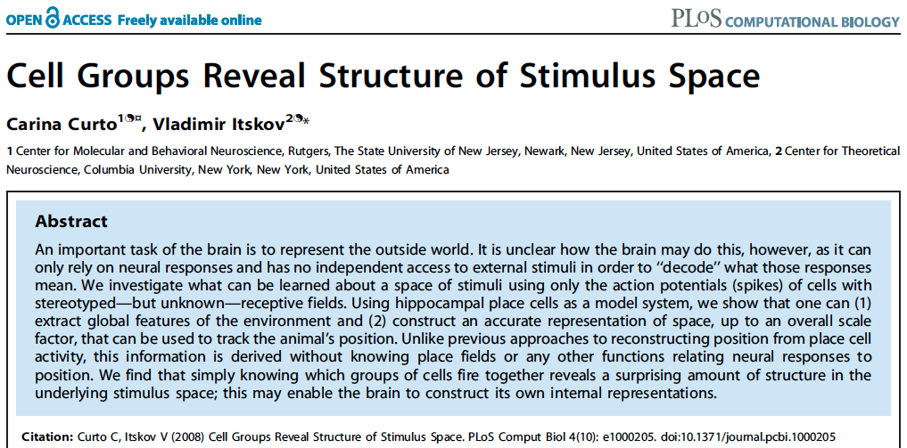
http://www.ploscompbiol.org/article/info%3Adoi%2F10.1371%2Fjournal.pcbi.1000205
2008
First paper to use only the spiking activity of place cells to determine the topology (and geometry) of the environment using homology (and graphs).

Slide 57

Edvard Moser
May-Britt Moser
John O’Keefe
http://www.nature.com/news/nobel-prize-for-decoding-brain-s-sense-of-place-1.16093

Slide 58

http://www.nature.com/news/neuroscience-brains-of-norway-1.16079
May-Britt Moser
Edvard Moser
John O’Keefe
http://www.nature.com/news/nobel-prize-for-decoding-brain-s-sense-of-place-1.16093

Slide 59
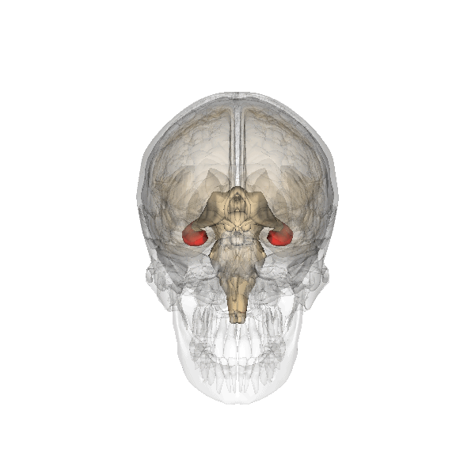
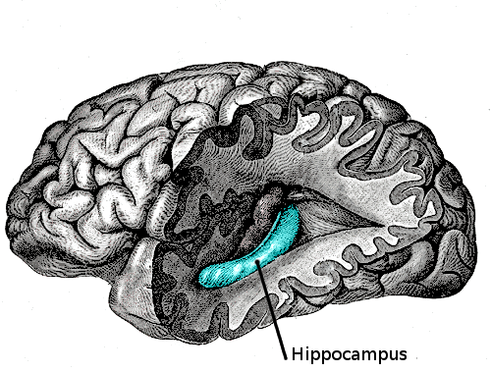
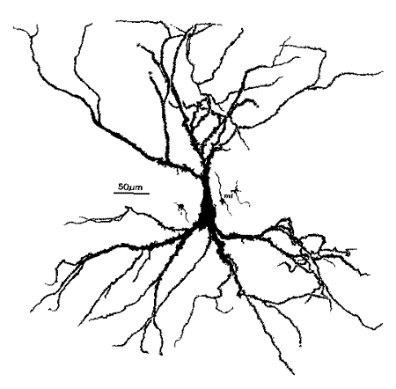
place cells = neurons in the hippocampus that are involved in spatial navigation
http://en.wikipedia.org/wiki/File:Gray739-emphasizing-hippocampus.png
http://en.wikipedia.org/wiki/File:Hippocampus.gif
http://en.wikipedia.org/wiki/File:Hippocampal-pyramidal-cell.png

Slide 60
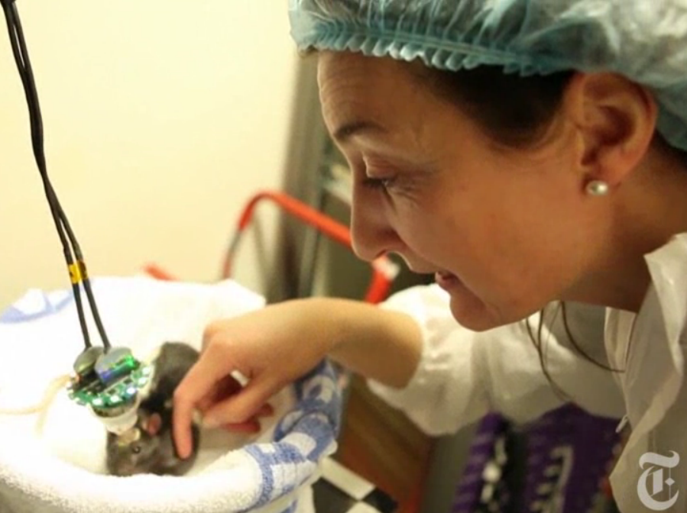
http://www.nytimes.com/2014/10/07/science/nobel-prize-medicine.html

Slide 61
http://www.ploscompbiol.org/article/info%3Adoi%2F10.1371%2Fjournal.pcbi.1002581

Slide 62
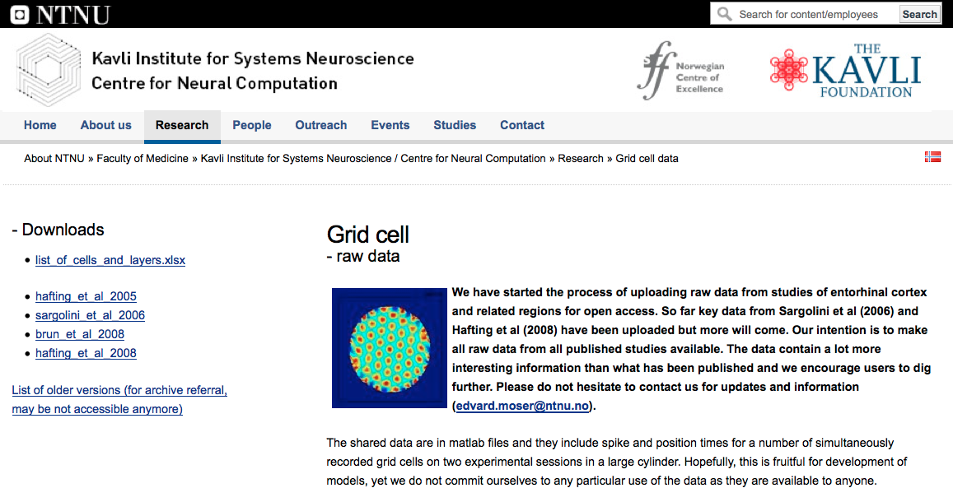
http://www.ntnu.edu/kavli/research/grid-cell-data

Slide 63
http://www.ploscompbiol.org/article/info%3Adoi%2F10.1371%2Fjournal.pcbi.1000205
2008
First paper to use only the spiking activity of place cells to determine the topology (and geometry) of the environment using homology (and graphs).

Slide 64
Place field = region in space where the firing rates are significantly above baseline
place cells = neurons in the hippocampus that are involved in spatial navigation
http://www.ploscompbiol.org/article/info%3Adoi%2F10.1371%2Fjournal.pcbi.1002581

Slide 65
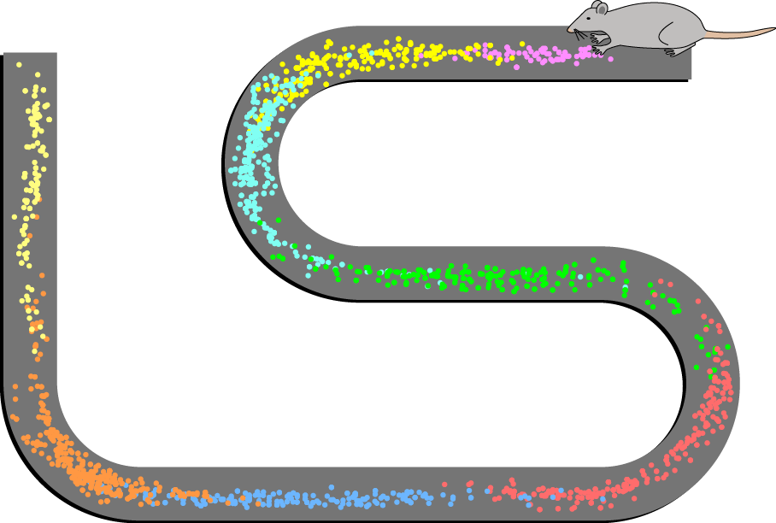
How can the brain understand the spatial environment based only on action potentials (spikes) of place cells?
http://upload.wikimedia.org/wikipedia/en/5/5e/Place_Cell_Spiking_Activity_Example.png

Slide 74
Cycles
Time

Slide 75
Cycles
Time

Slide 76
Cycles
Time

Slide 77
Cycles
Time

Slide 78
Cycles
Time

Slide 79
Cycles
Time

Slide 80
Cycles
Time

Slide 81
Cycles
Time

Slide 82
Cycles
Time

Slide 83
Cycles
Time

Slide 84
Cycles
Time

Slide 85
Cycles
Time

Slide 86
Cycles
Time

Slide 87
How can the brain understand the spatial environment based only on action potentials (spikes) of place cells?
http://upload.wikimedia.org/wikipedia/en/5/5e/Place_Cell_Spiking_Activity_Example.png

Slide 88
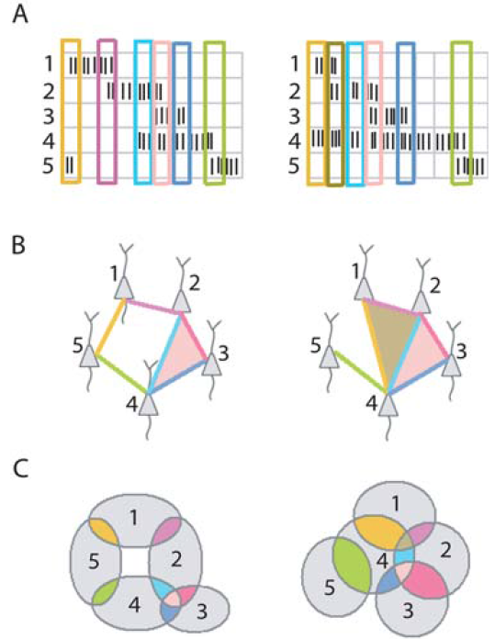
Place field = region in space where the firing rates are significantly above baseline
http://www.ploscompbiol.org/article/info%3Adoi%2F10.1371%2Fjournal.pcbi.1000205

Slide 89
Idea: Can recover the topology of the space traversed by the mouse by looking only at the spiking activity of place cells.
http://www.ploscompbiol.org/article/info%3Adoi%2F10.1371%2Fjournal.pcbi.1000205

Slide 90
Creating a simplicial complex
Notes:
So we will connect every pair of vertices if their distance is less than 1.8 cm. If the center of these points represent the 0-dimensional vertices, then this distance is less than our threshold, so we add an edge. Similarly this pair of points satisfy our definition of close, so we add an edge
The distance between this pair of vertices is greater than 1.8, so we won’t connect them with an edge. Continuing to add edges between vertices whenever their distance is less than our threshold of 1.8cm, we now have

Slide 91
Creating a simplicial complex
1.) Adding 1-dimensional edges (1-simplices)
Add an edge between data points that are “close”
Notes:
a one dimensional simplicial complex. Note that we have clustered our data into five disjoint connected sets. So this is one way to cluster our data – that is grouping our data points into disjoint sets based on some definition of similarity. In this case, we have 5 clusters.
We can now add higher dimensional simplices.

Slide 92
Creating the Čech simplicial complex
1.) B₁ … B_{k+1} ≠ ⁄ , create k-simplex {v₁, ... , v_{k+1}}.
U
U
0
Notes:
Thus we now have the Vietoris Rips simplicial complex. Note we get the same simplex by adding one dimension at a time

Slide 93
Creating the Čech simplicial complex
1.) B₁ … B_{k+1} ≠ ⁄ , create k-simplex {v₁, ... , v_{k+1}}.
U
U
0
Notes:
Thus we now have the Vietoris Rips simplicial complex. Note we get the same simplex by adding one dimension at a time

Slide 94
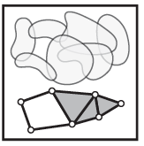
Consider X an arbitrary topological space.
Let V = {V_{i} | i = 1, …, n } where V_{i} X ,
The nerve of V = N(V) where
The k -simplices of N(V) =
nonempty intersections of
k +1 distinct elements of V .
For example,
Vertices = elements of V
Edges = pairs in V which intersect nontrivially.
Triangles = triples in V which intersect nontrivially.
http://www.math.upenn.edu/~ghrist/EAT/EATchapter2.pdf

Slide 95
Consider X an arbitrary topological space.
Let V = {V_{i} | i = 1, …, n } where V_{i} X ,
The nerve of V = N(V) where
The k -simplices of N(V) =
nonempty intersections of
k +1 distinct elements of V .
For example,
Vertices = elements of V
Edges = pairs in V which intersect nontrivially.
Triangles = triples in V which intersect nontrivially.
Čech complex =
Mathematical nerve,
not biological nerve
http://www.math.upenn.edu/~ghrist/EAT/EATchapter2.pdf

Slide 96
Creating the Čech simplicial complex
1.) B₁ … B_{k+1} ≠ ⁄ , create k-simplex {v₁, ... , v_{k+1}}.
U
U
0
Notes:
Thus we now have the Vietoris Rips simplicial complex. Note we get the same simplex by adding one dimension at a time

Slide 97
Mathematical
Nerve Lemma: If V is a finite collection of subsets of X with all non-empty intersections of subcollections of V contractible, then N(V) is homotopic to the union of elements of V.
http://www.math.upenn.edu/~ghrist/EAT/EATchapter2.pdf

Slide 98
Idea: Can recover the topology of the space traversed by the mouse by looking only at the spiking activity of place cells.
Vertices = place cells
Add simplex if place cells co-fare within a specified time period
http://www.ploscompbiol.org/article/info%3Adoi%2F10.1371%2Fjournal.pcbi.1000205

Slide 99
Cell group = collection of place cells that co-fire within a specified time period (above a specified threshold) .
Simplices correspond to cell groups.
dimension of simplex = number of place cells in cell group - 1
http://www.ploscompbiol.org/article/info%3Adoi%2F10.1371%2Fjournal.pcbi.1000205

Slide 100
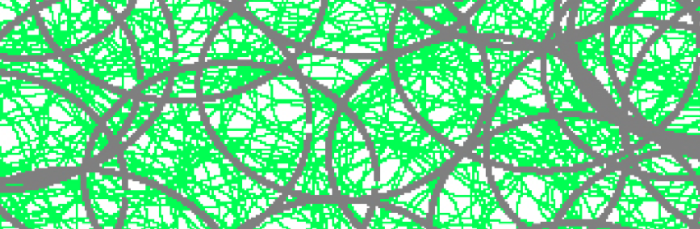
Idea: Can recover the topology of the space traversed by the mouse by looking only at the spiking activity of place cells.
Proof of concept: Data obtained via computer simulations of mouse trajectories using biologically relevant parameters.
http://www.ploscompbiol.org/article/info%3Adoi%2F10.1371%2Fjournal.pcbi.1000205

Slide 101
a smoothed random-walk trajectory was generated, with speed = 0.1 L/s, which was constrained to ‘‘bounce’’ off boundaries and stay within the environment.
The total duration of each simulated trajectory was 50 minutes.
http://www.ploscompbiol.org/article/info%3Adoi%2F10.1371%2Fjournal.pcbi.1000205

Slide 102
For each of 300 trials, N= 70 place fields were generated as disks of radii 0.1 L to 0.15 L, with radii and centers chosen uniformly at random.
              Centers were chosen initially uniformly at random from uncovered space. Once all space covered, remaining centers chosen at random.
http://www.ploscompbiol.org/article/info%3Adoi%2F10.1371%2Fjournal.pcbi.1000205

Slide 103
For each place cell in each trial, an average firing rate was chosen uniformly at random from the interval 2–3 Hz.
A spike train was generated from the trajectory and corresponding place field as an inhomogeneous Poisson process with constant rate when the trajectory passed inside the place field, and zero outside, so that the overall firing rate was preserved.

Slide 104
Add noise. r% spikes were deleted from the spike train, and then added back to the spike train at
random times, irrespective of position along trajectory, so as to preserve overall firing rate.
Control : ‘Shuffled’ data sets were constructed by randomly choosing cells from each of the five environments, and pooling them together to yield population spiking activity that did not come from a single environment.

Slide 105
Assumptions about Place Fields
Place fields are omni-directional
I.e. direction does not affect
the firing rate.
http://www.ploscompbiol.org/article/info%3Adoi%2F10.1371%2Fjournal.pcbi.1000205

Slide 106
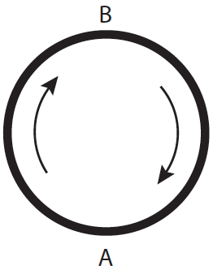
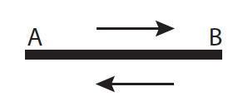
Assumptions about Place Fields
Place fields are omni-directional
Correct assumption in open field.
Not correct in linear track.
Place cells can also encode
angles and directions
http://www.ploscompbiol.org/article/info%3Adoi%2F10.1371%2Fjournal.pcbi.1000205

Slide 107
Assumptions about Place Fields
Place fields are omni-directional
(2) Place fields have been previously formed and are stable.
http://www.ploscompbiol.org/article/info%3Adoi%2F10.1371%2Fjournal.pcbi.1000205

Slide 108
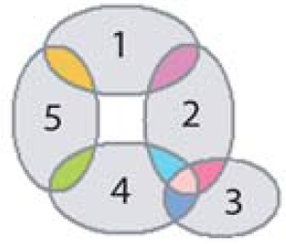
Assumptions about Place Fields
Place fields are omni-directional
(2) Place fields have been previously formed and are stable.
Note: the hippocampus can undergo rapid context dependent remapping.
http://www.ploscompbiol.org/article/info%3Adoi%2F10.1371%2Fjournal.pcbi.1000205

Slide 109
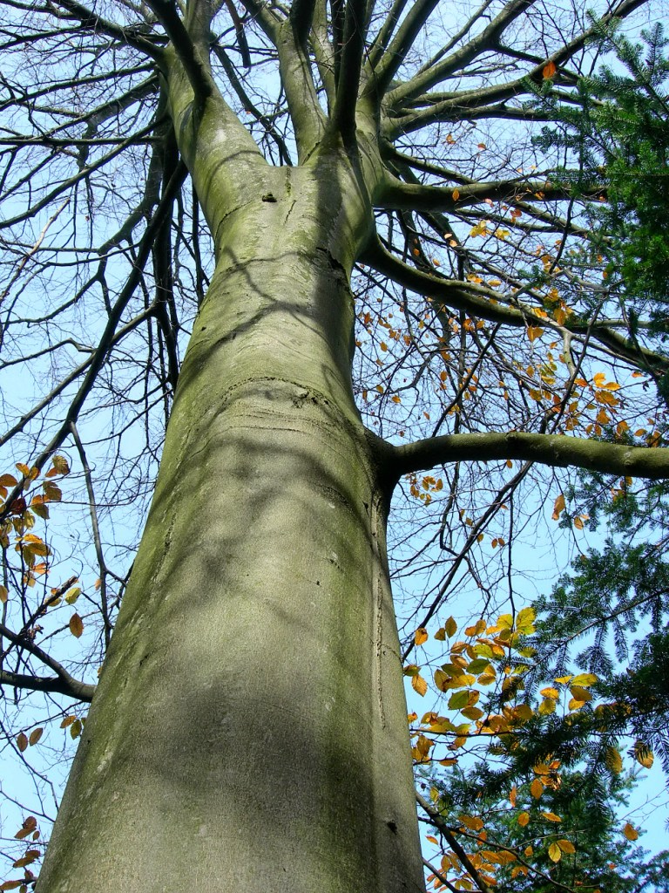
Assumptions about Place Fields
Place fields are omni-directional
(2) Place fields have been previously formed and are stable.
Note: the hippocampus can undergo rapid context dependent remapping.
http://www.ploscompbiol.org/article/info%3Adoi%2F10.1371%2Fjournal.pcbi.1000205

Slide 110
Assumptions about Place Fields
Place fields are omni-directional
(2) Place fields have been previously formed and are stable.
Note: the hippocampus can undergo rapid context dependent remapping.
http://www.ploscompbiol.org/article/info%3Adoi%2F10.1371%2Fjournal.pcbi.1000205

Slide 111
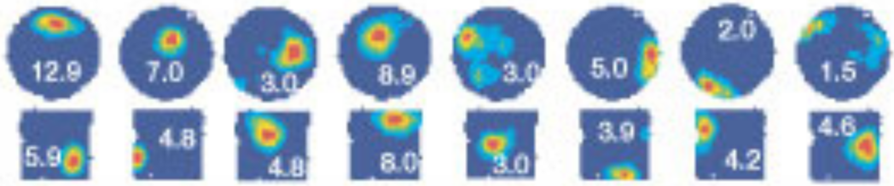
Assumptions about Place Fields
Place fields are omni-directional
(2) Place fields have been previously formed and are stable.
Note: the hippocampus can undergo rapid context dependent remapping.
Nature 2002, Long-term plasticity in hippocampal place-cell representation of environmental geometry, Colin Lever, Tom Wills, Francesca Cacucci, Neil Burgess, John O'Keefe
http://www.nature.com/nature/journal/v416/n6876/fig_tab/416090a_F2.html

Slide 112
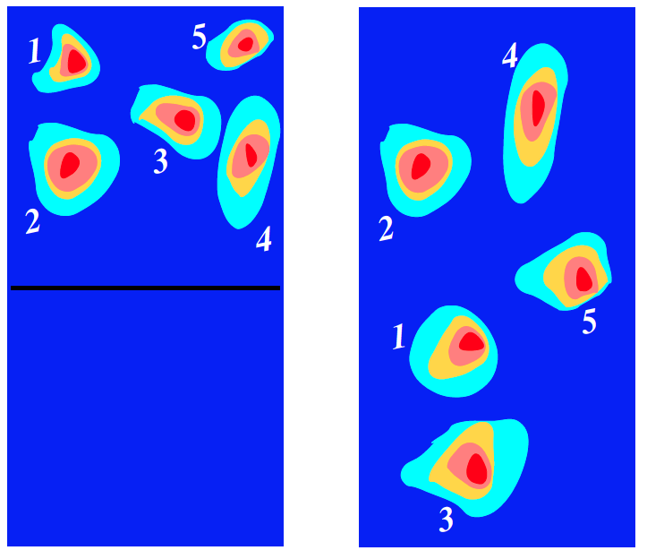
Remodeling: the hippocampus can undergo rapid context dependent remapping.
http://arxiv.org/abs/q-bio/0702052

Slide 113
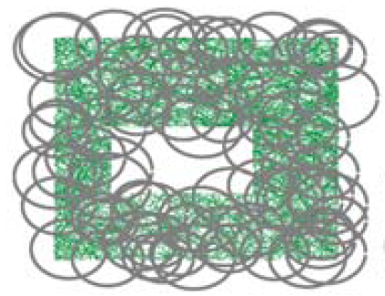
Assumptions about Place Fields
Place fields are omni-directional
(2) Place fields have been previously formed and are stable.
(3) The collection of place fields corresponding to observed cells covers the entire traversed environment.
I.e., the trajectory must be dense enough to sample the majority of cell groups.
http://www.ploscompbiol.org/article/info%3Adoi%2F10.1371%2Fjournal.pcbi.1000205

Slide 114
Assumptions about Place Fields
Place fields are omni-directional
(2) Place fields have been previously formed and are stable.
(3) The collection of place fields corresponding to observed cells covers the entire traversed environment.
Biologically: place cells multiply cover the environment.
http://www.ploscompbiol.org/article/info%3Adoi%2F10.1371%2Fjournal.pcbi.1000205

Slide 115
Assumptions about Place Fields
Place fields are omni-directional
(2) Place fields have been previously formed and are stable.
(3) The collection of place fields corresponding to observed cells covers the entire traversed environment.
For accurate computation of the nth homology group H_{n}, we need up to (n+1)-fold intersections to be detectable via cell groups.
http://www.ploscompbiol.org/article/info%3Adoi%2F10.1371%2Fjournal.pcbi.1000205

Slide 116
Assumptions about Place Fields
Place fields are omni-directional
(2) Place fields have been previously formed and are stable.
(3) The collection of place fields corresponding to observed cells covers the entire traversed environment.
(4) The holes/obstacles are larger
than the diameters of place fields.
http://www.ploscompbiol.org/article/info%3Adoi%2F10.1371%2Fjournal.pcbi.1000205

Slide 117
Assumptions about Place Fields
(5) Each (connected) component field of a single or multipeaked place field is convex.
(6) Background activity is low compared to the firing inside the place fields.
(7) Place fields are roughly circular and have similar sizes, as is typical in dorsal hippocampus [41,42].
http://www.ploscompbiol.org/article/info%3Adoi%2F10.1371%2Fjournal.pcbi.1000205

Slide 118
For each place cell in each trial, an average firing rate was chosen uniformly at random from the interval 2–3 Hz.
A spike train was generated from the trajectory and corresponding place field as an inhomogeneous Poisson process with constant rate when the trajectory passed inside the place field, and zero outside, so that the overall firing rate was preserved. Noise added.

Slide 119
Cell group = collection of place cells that co-fire within a specified time period (above a specified threshold) .
Simplices correspond to cell groups.
dimension of simplex = number of place cells in cell group - 1
http://www.ploscompbiol.org/article/info%3Adoi%2F10.1371%2Fjournal.pcbi.1000205

Slide 120
Homology calculated via the GAP software package: http://www.cis.udel.edu/linbox/gap.html
Simplices correspond to cell groups.
dimension of simplex = number of place cells in cell group - 1
http://www.ploscompbiol.org/article/info%3Adoi%2F10.1371%2Fjournal.pcbi.1000205

Slide 121
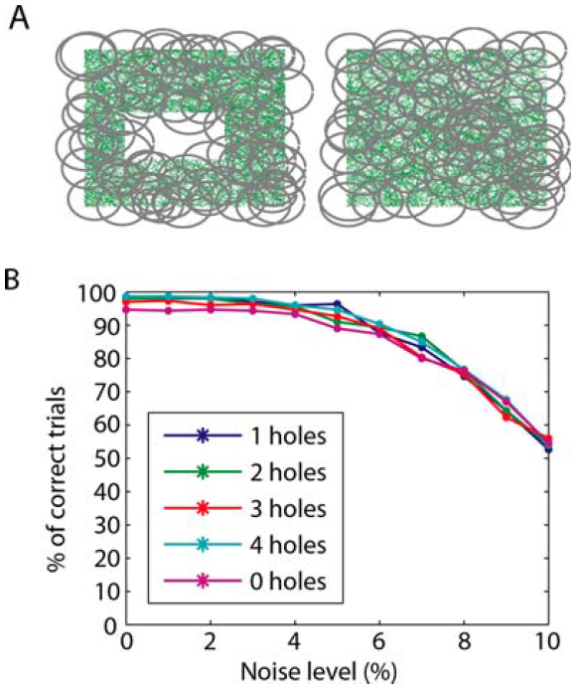
Recovering the topology
Trial is correct if H_{i} correct for i = 0, 1, 2, 3, 4.
http://www.ploscompbiol.org/article/info%3Adoi%2F10.1371%2Fjournal.pcbi.1000205

Slide 122
Geometry???

Slide 123
http://www.ploscompbiol.org/article/info%3Adoi%2F10.1371%2Fjournal.pcbi.1000205
First paper to use only the spiking activity of place cells to determine the topology (and geometry) of the environment using homology (and graphs).

Slide 124
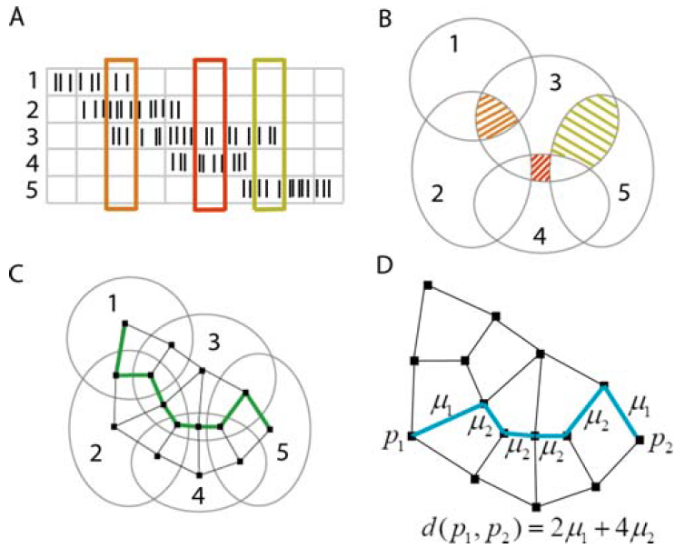
http://www.ploscompbiol.org/article/info%3Adoi%2F10.1371%2Fjournal.pcbi.1000205

Slide 125
μ₁ = 1
μ_{k} = 1 – π √(k-1)/N
where N = number of cells.
http://www.ploscompbiol.org/article/info%3Adoi%2F10.1371%2Fjournal.pcbi.1000205

Slide 126
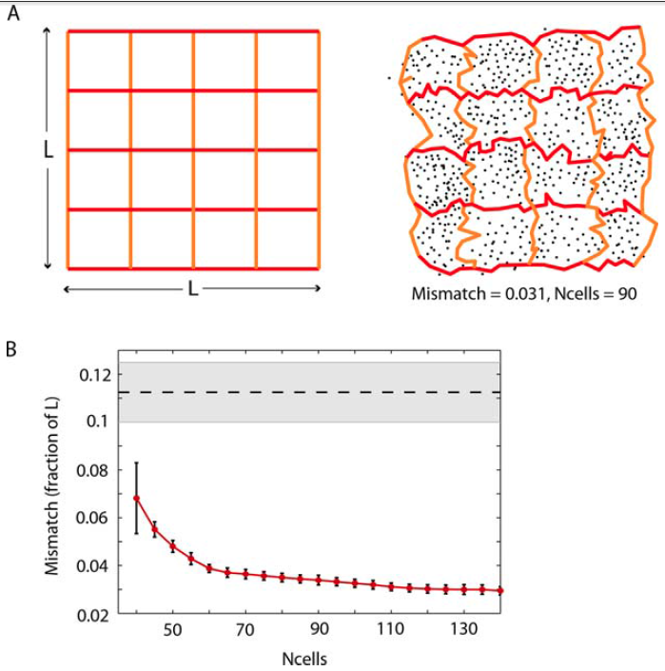
Normalize distance so mean pairwise distances same for both simulated and calculated data.
http://www.ploscompbiol.org/article/info%3Adoi%2F10.1371%2Fjournal.pcbi.1000205

Slide 127
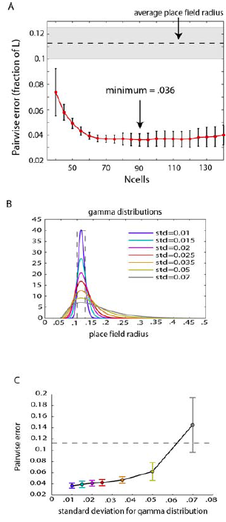
http://www.ploscompbiol.org/article/info%3Adoi%2F10.1371%2Fjournal.pcbi.1000205

Slide 128
Normalize distance so mean pairwise distances same for both simulated and calculated data.
http://www.ploscompbiol.org/article/info%3Adoi%2F10.1371%2Fjournal.pcbi.1000205

Slide 129
http://www.ploscompbiol.org/article/info%3Adoi%2F10.1371%2Fjournal.pcbi.1000205

Slide 130
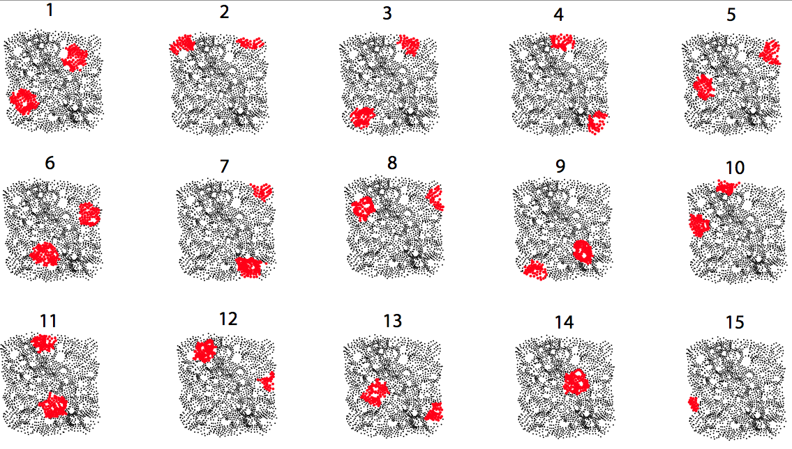
Multipeaked place fields
http://www.ploscompbiol.org/article/info%3Adoi%2F10.1371%2Fjournal.pcbi.1000205

Slide 132
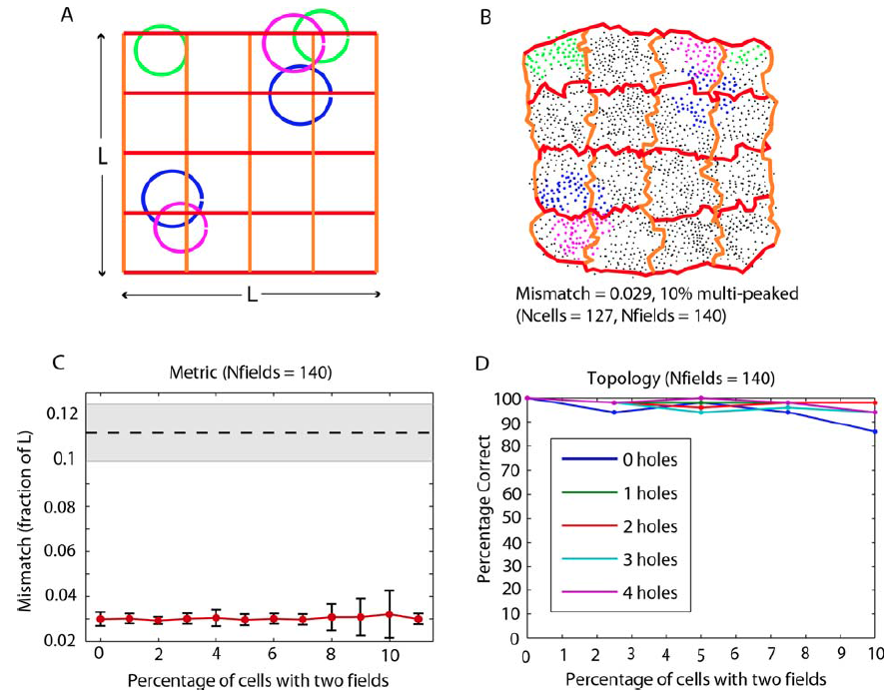
http://www.ploscompbiol.org/article/info%3Adoi%2F10.1371%2Fjournal.pcbi.1000205

Slide 134
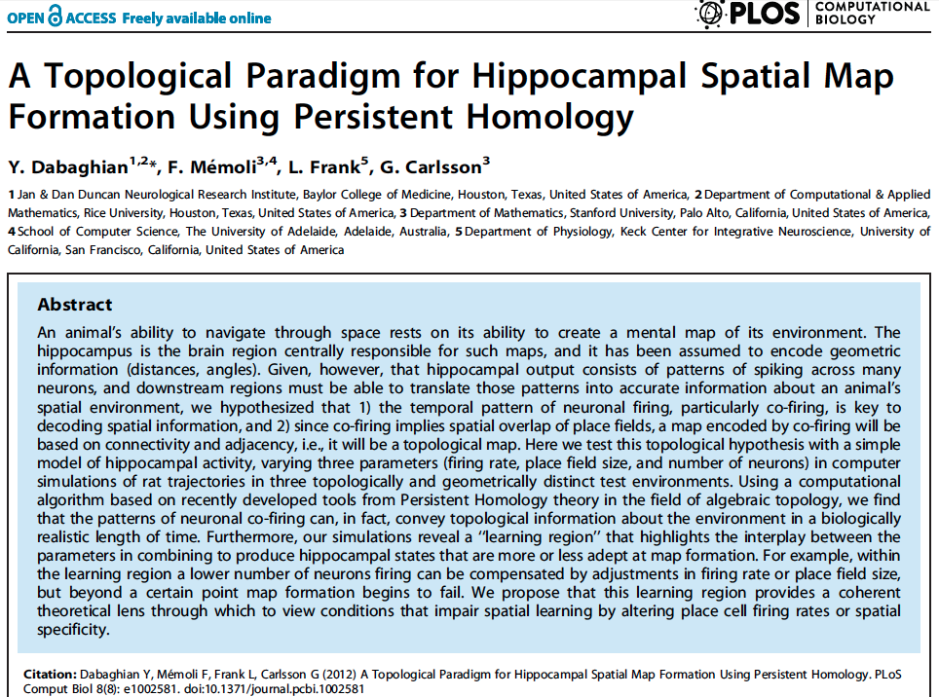
http://www.ploscompbiol.org/article/info%3Adoi%2F10.1371%2Fjournal.pcbi.1002581
2012

Slide 135

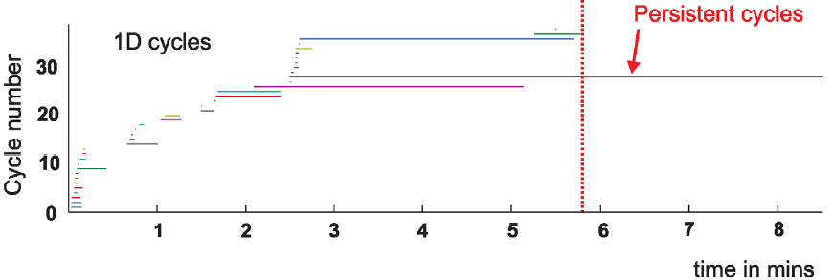
2012

Slide 136
2012

Slide 137
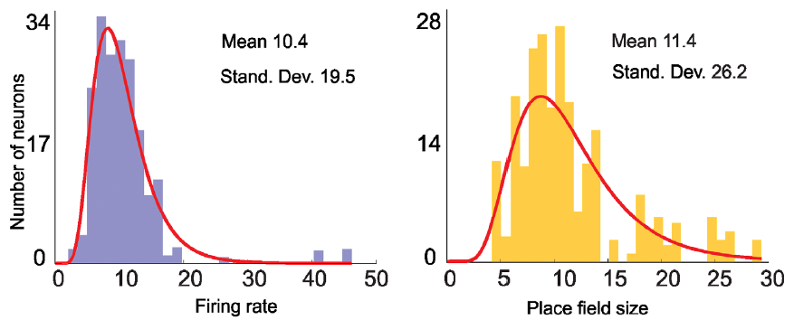

Slide 138
Data obtained via computer simulations

Slide 139
http://www.ntnu.edu/kavli/research/grid-cell-data

Slide 140
Note the above examples use the Čech complex to determine the topology of the mouse environment.
But often in topological data analysis for computational efficiency, one uses the Rips complex instead of the Čech complex.
Unfortunately there is no nerve lemma for the Rips complex.

Slide 141
Creating the Vietoris Rips simplicial complex
0.) Start by adding 0-dimensional data points
Note: we only need a definition of closeness between data points. The data points do not need to be actual points in R^{n}
Notes:
We start again by adding our 0-simplices, our data points. I can indicate the threshold using a ball centered at my data point. The diameter of the ball will be my threshold, so if two balls intersect then the distance between the vertices is less than the threshold, so we connect the pair of vertices with an edge if and only if the balls intersect, so we can get edges after which we can then add all possible higher dimensional simplices.
Note how I grew my balls. As the diameter increases, my threshold which is equal to my diameter increases.

Slide 142
Creating the Vietoris Rips simplicial complex
Step 0.) Start by adding data points
= 0-dimensional vertices (0-simplices)
Notes:
Starting with 0-simplices, our data points in step 0

Slide 143
Creating the Vietoris Rips simplicial complex
1.) Adding 1-dimensional edges (1-simplices)
Add an edge between data points that are “close”
Notes:
In step 1 Adding 1-simplices connecting data points that are “close”.

Slide 144
Creating the Vietoris Rips simplicial complex
2.) Add all possible simplices of dimensional > 1.
Notes:
And then adding an n-simplex whenever we have n+1 points that are close.
Thus we now have the Vietoris Rips simplicial complex. Note we get the same simplex by adding one dimension at a time.
What if I increase my threshold?

Slide 145
Vietoris Rips complex = flag complex = clique complex
2.) Add all possible simplices of dimensional > 1.
Notes:
Thus we now have the Vietoris Rips simplicial complex. Note we get the same simplex by adding one dimension at a time

Slide 146
Creating the Čech simplicial complex
1.) B₁ … B_{k+1} ≠ ⁄ , create k-simplex {v₁, ... , v_{k+1}}.
U
U
0
Notes:
Thus we now have the Vietoris Rips simplicial complex. Note we get the same simplex by adding one dimension at a time

Slide 147
Creating the Čech simplicial complex
1.) B₁ … B_{k+1} ≠ ⁄ , create k-simplex {v₁, ... , v_{k+1}}.
U
U
0
Notes:
Thus we now have the Vietoris Rips simplicial complex. Note we get the same simplex by adding one dimension at a time

Slide 148
2012 Ignoble Prize
The Ig Nobel Prizes honor achievements that make people LAUGH, and then THINK.
http://www.improbable.com/ig/

Slide 149
2012 Ignoble Prize
The Ig Nobel Prizes honor achievements that make people LAUGH, and then THINK.
http://www.improbable.com/ig/
Activated compared to other voxels
fMRI of dead salmon
The salmon was shown images of people in social situations, either socially inclusive situations or socially exclusive situations.
The salmon was asked to respond, saying how the person in the situation must be feeling.
http://blogs.scientificamerican.com/scicurious-brain/2012/09/25/ignobel-prize-in-neuroscience-the-dead-salmon-study/

Slide 150
False Positives will occur

