Slide 1
Main Project total points: 500
Introduction, Background,
Partial Results/Discussion,
Acknowledgement, Author contribution,
funding/conflicts, References
200/500 = 40% finished by March 27
250/500 = 50% finished by April 5
400/500 = 80% finished by April 17
500/500 = 100% finished by April 26

Slide 2
For 200 point draft due March 27, I recommend
Introduction (25 points)
Include description of your data set.
  How many points and in what dimension?
  Describe each coordinate of a point in your dataset (what do the variables mean).
  How will you compute distances between data points (or put in later section).
What is your goal and how do you plan to achieve it?
Background
Describe the TDA algorithm including benefits and limitations. Consider using example(s) to illustrate your points. (100 points)
Describe background needed to understand your data set (50+ points).
Partial Results/Discussion (50+ points)
Include many images from python TDA mapper and analyze these images.
  Can put some images in appendix if you don’t have time to analyze all images.
Consider comparing to other techniques (e.g. hierarchical clustering).
Acknowledgement,
Author contribution, Please also include your commented R code.
Funding/conflicts,
References (yes, these points add up to more than 200)
Include all parameters in figure caption.
(20 points)

Slide 3
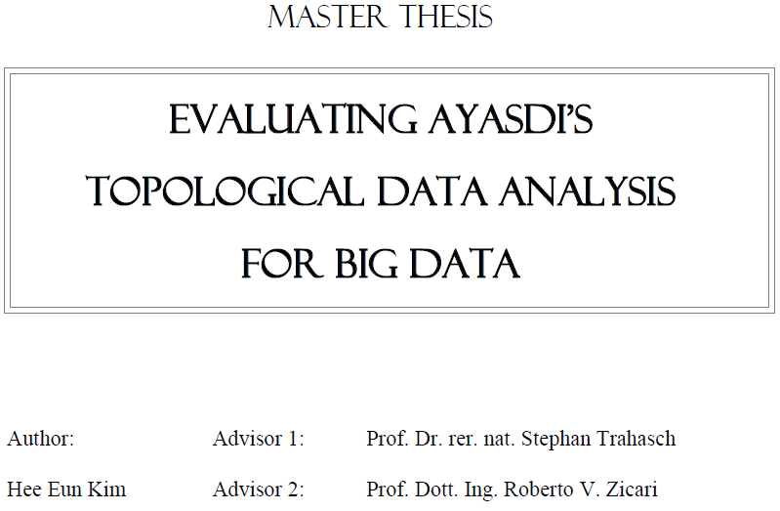


http://www.bigdata.uni-frankfurt.de/wp-content/uploads/2015/10/
Evaluating-Ayasdi’s-Topological-Data-Analysis-For-Big-Data_HKim2015.pdf

Slide 4

“Color ranges over red to blue and it has different meanings, depending on the type of attributes. For the continuous values, color represents an average of value. A red node contains data samples that have higher average values. In contrast, a blue node contains lower average values. In contrast, for the categorical values, color represents a value concentration.”
Analyze your data

Slide 5
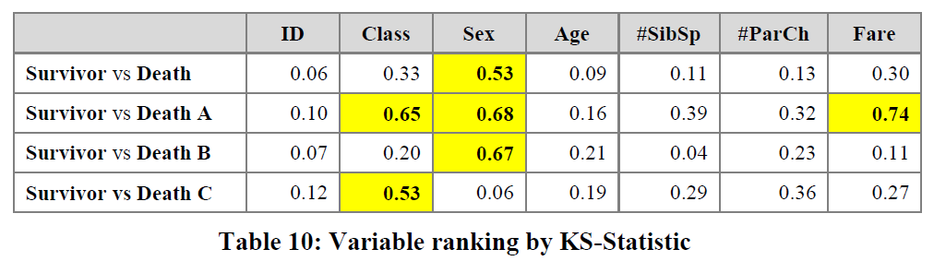
3.2.2.2 Insight by Ranked Variables
Going back to the Titanic example, the result of the KS-statistic show, that the variable “Sex” is the most strongly related to passengers death. We could generally assume that men conceded the places in lifeboats to women. Furthermore, it is feasible to deduct the subtle reasons of the death of each group. The passengers in group A died because of two reasons: they were man and the cabin class type was low. The passengers in the group B died because they were man. Finally, the passengers in the group C died because they were staying at third class even though most of them were women.

Slide 7



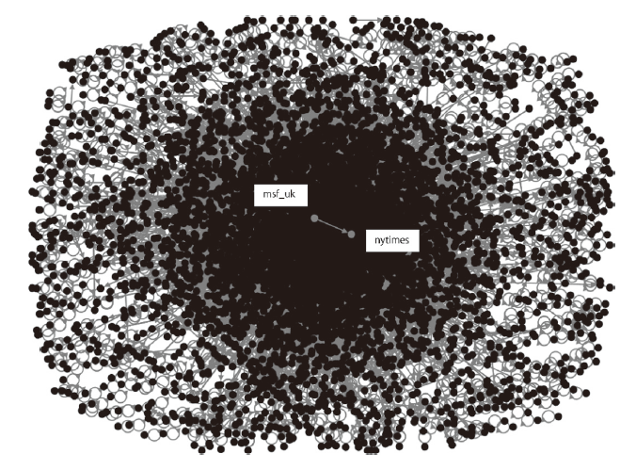
Fig. 1 Ebola Tweet Network Plotted with NodeXL. Nodes represent vertices whose tweets contain the keyword “ebola”, mentions or replies-to other vertices. The “who-mentions-who” or “who-replies to-whom” relationship between msf_uk and nytimes is illustrated above. Here, msf_uk follows the nytimes

Slide 8
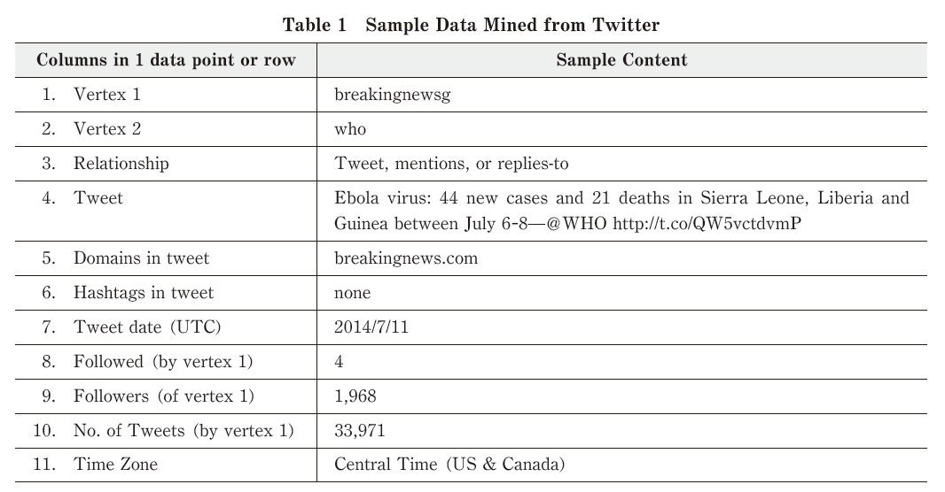

Slide 9
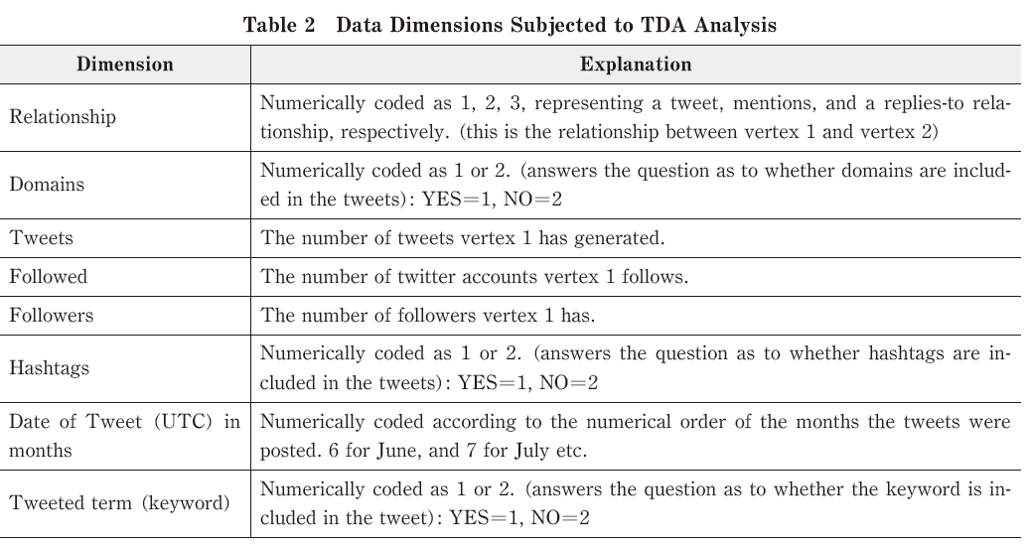
Data points = tweets

Slide 10
Relationship numerically coded as
1: A tweet which contains the keyword “Ebola”, but does not contain @foo where foo is the twitter name of someone who has sent a tweet containing the keyword “Ebola”
2: A mention: a tweet that contains @foo anyplace except at the beginning.
3: a replies-to relationship: a tweet that contains @foo at the beginning.

Slide 11
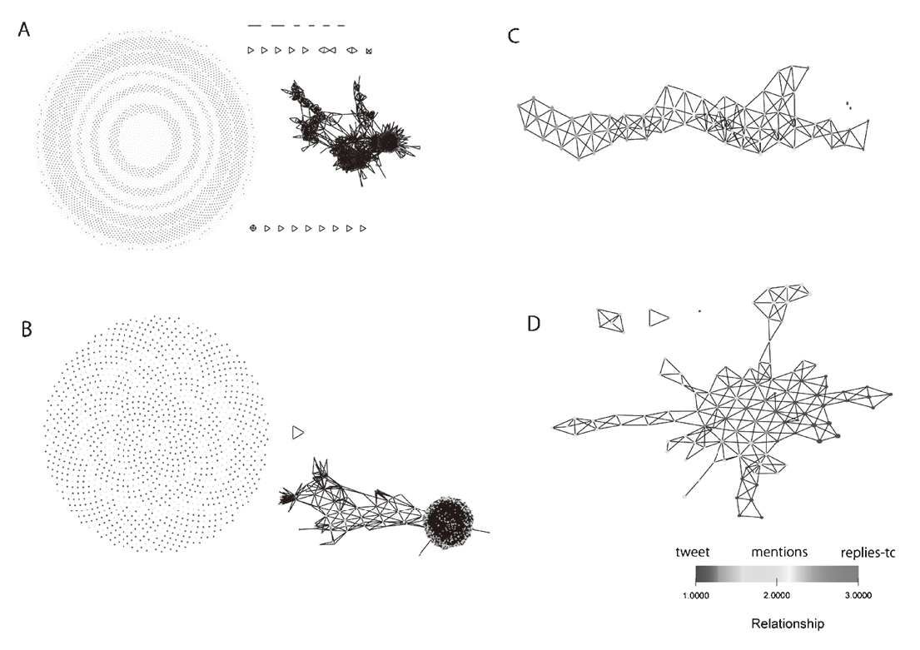
“However, this is only a visual comparison, and thus the metric that suits the data better needs to be determined.”
Hamming,
Manhattan
Jaccard
Variance
Normalized
Euclidean.

Slide 12
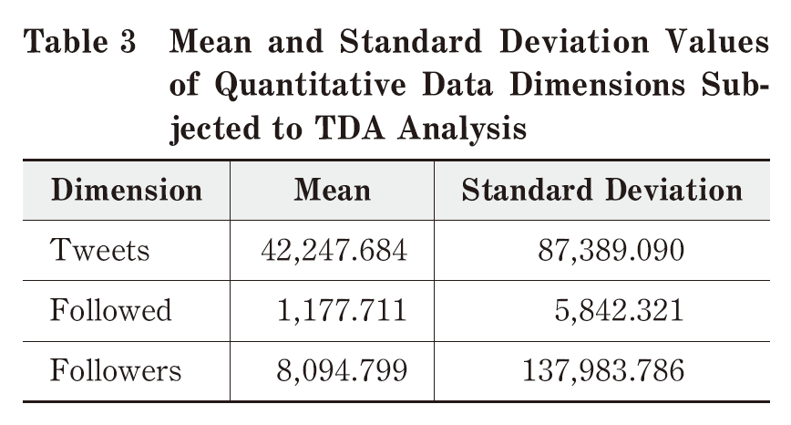

Slide 13
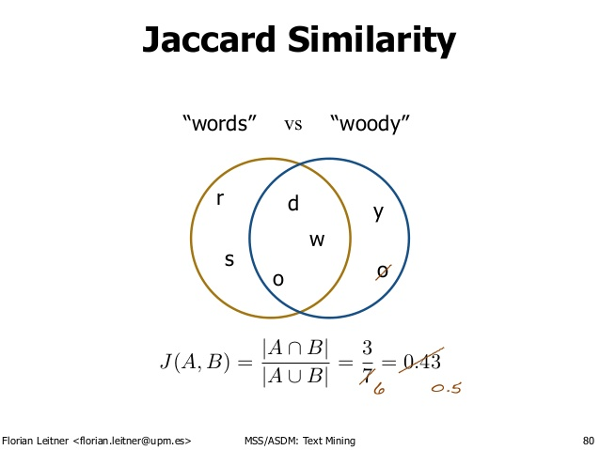
http://d-roger.com/2016/09/07/finding-similar-items-查找相似项/
Jacard Distance = 1 – J(A, B)

Slide 14
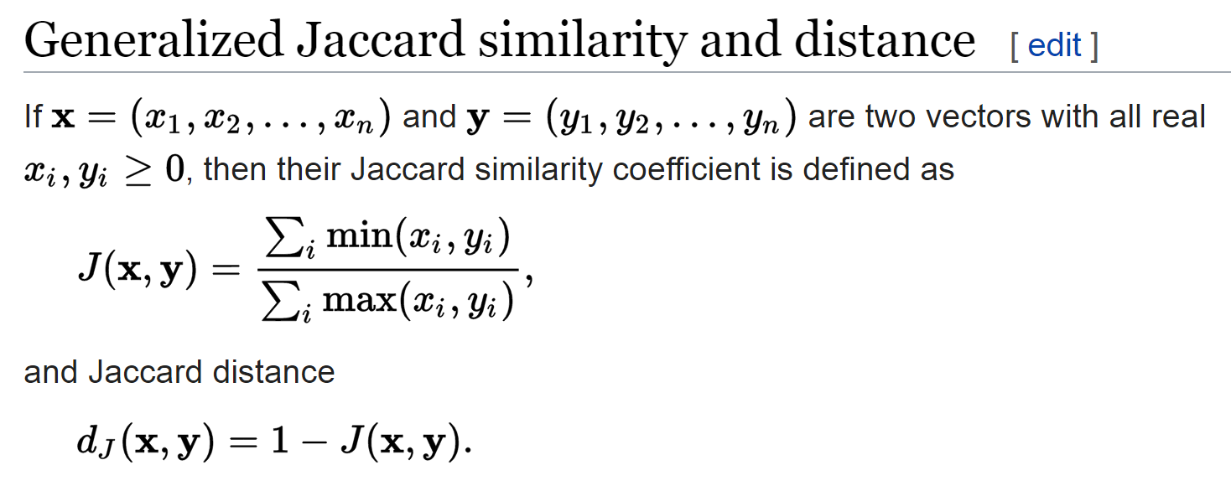
https://en.wikipedia.org/wiki/Jaccard_index

Slide 15
Data points = tweets

Slide 16
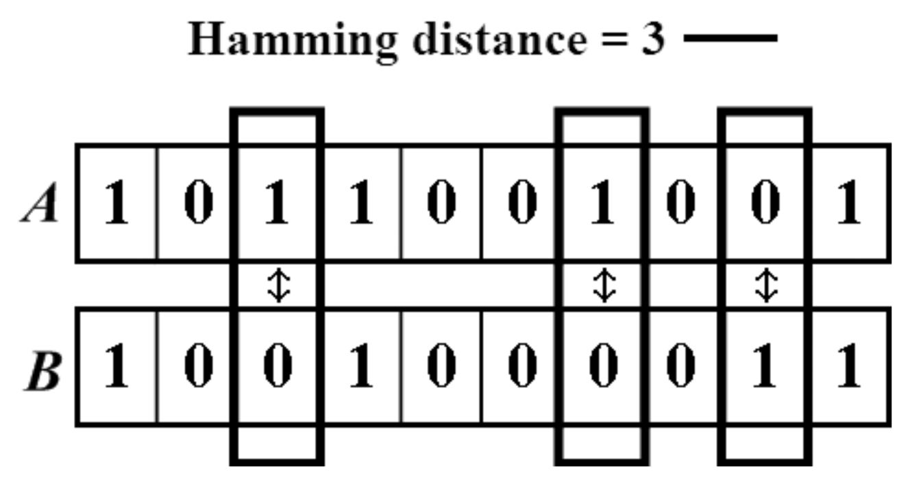

https://people.rit.edu/rmb5229/320/project3/hamming.html
http://rosalind.info/glossary/hamming-distance/
Hamming Distance = 7

Slide 17
Data points = tweets

Slide 18
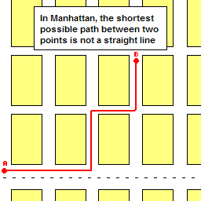
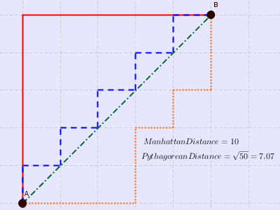

http://www.joachimdespland.com/mammoth.html
http://bloggity.nurdz.com/gamedev-math/manhattan/
http://www.improvedoutcomes.com/docs/WebSiteDocs/Clustering/Clustering_Parameters/Manhattan_Distance_Metric.htm

Slide 19
Data points = tweets

Slide 21
“However, this is only a visual comparison, and thus the metric that suits the data better needs to be determined.”
Hamming,
Manhattan
Jaccard
Variance
Normalized
Euclidean.
k-nearest neighbors, resolution = 15, gain = 2.

Slide 22
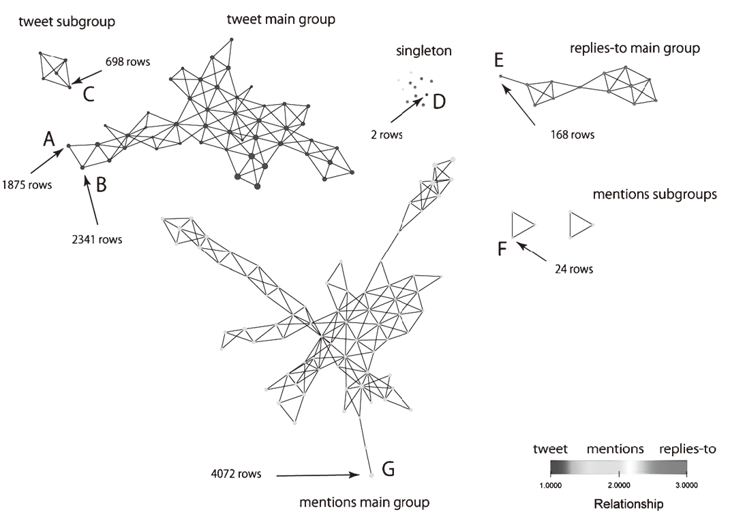
2D filter:

Slide 24
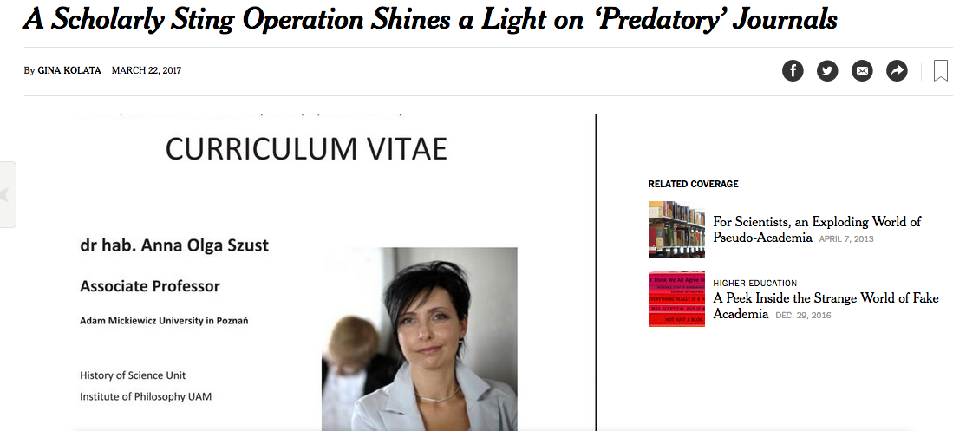
https://www.nytimes.com/2017/03/22/science/open-access-journals.html

Slide 25
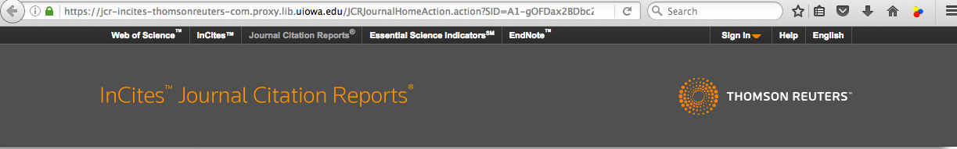
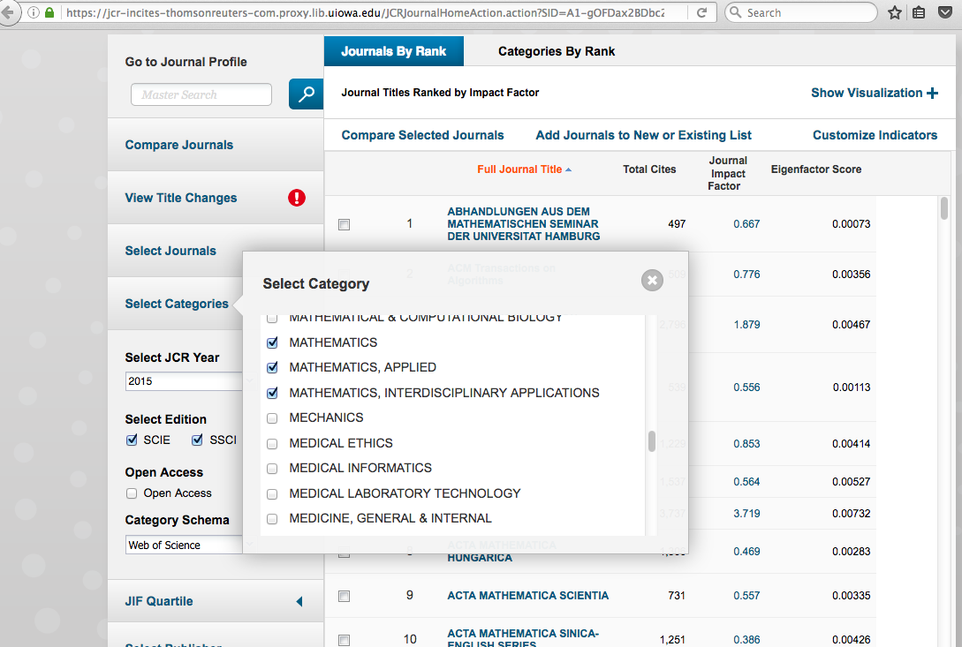
Web of Science Journal Citation Reports

Slide 27
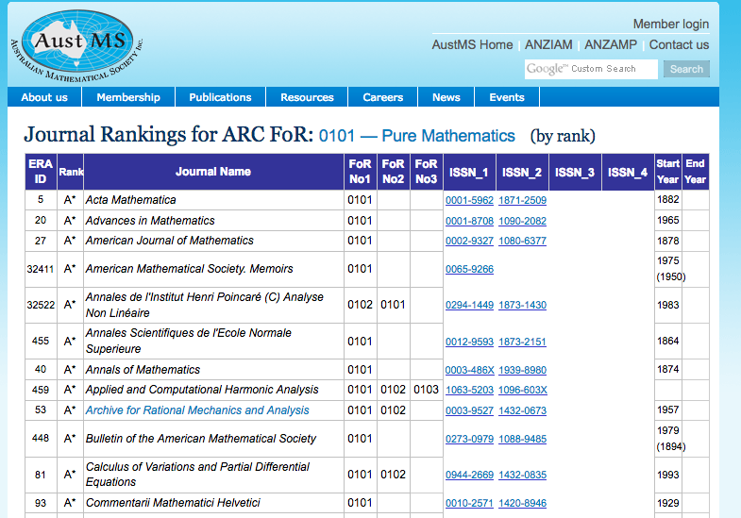
http://www.austms.org.au/Rankings/0101_AustMS_final_ranked.html

Slide 28
http://www.austms.org.au/Rankings/0101_AustMS_final_ranked.html

Slide 29
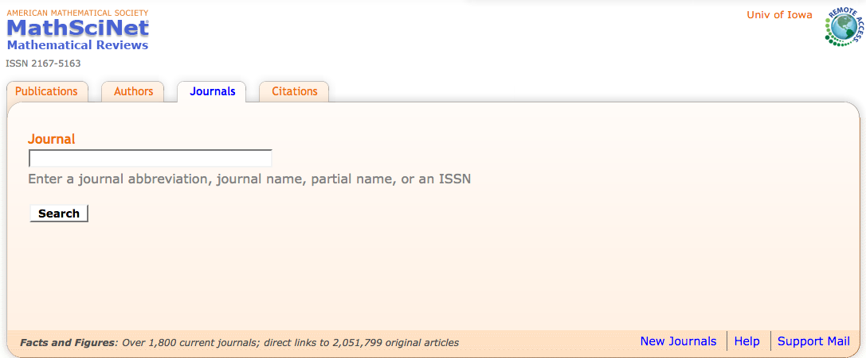
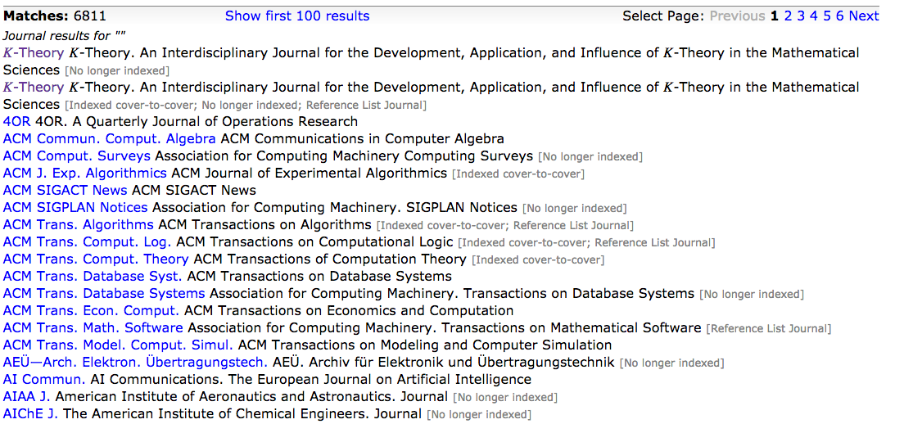

Slide 31
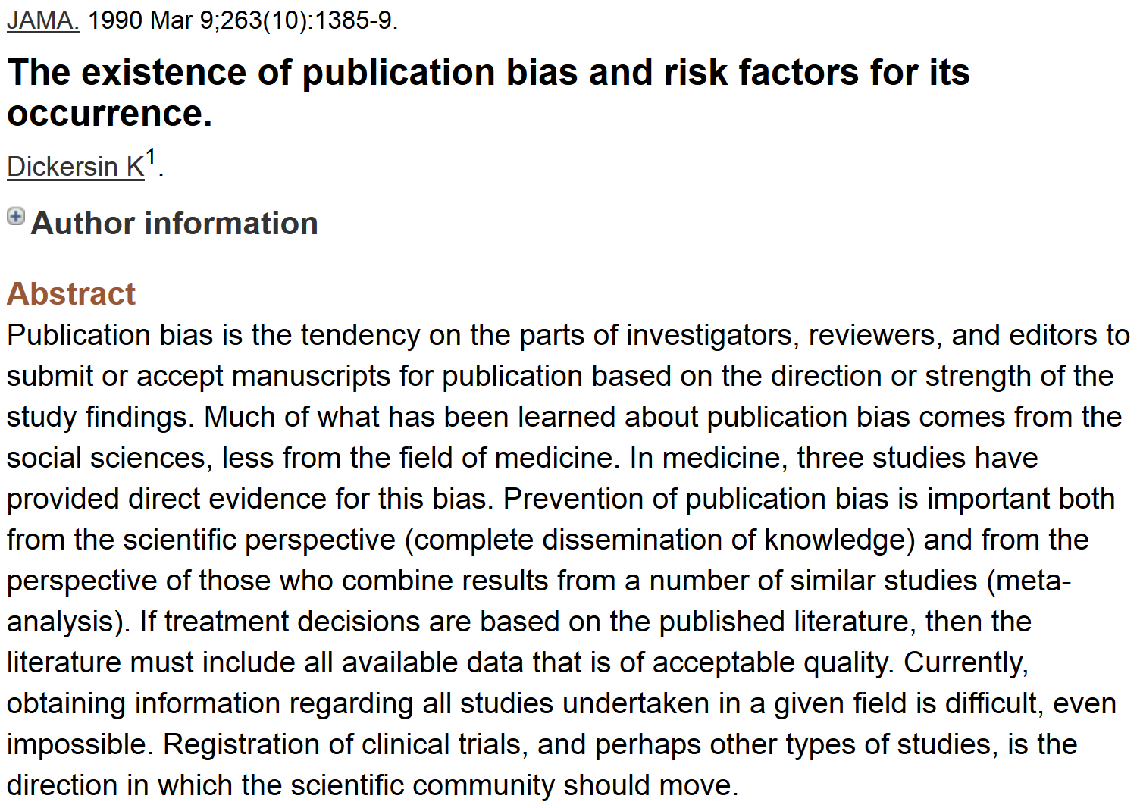
http://www.ncbi.nlm.nih.gov/pubmed/2406472?dopt=Abstract&holding=npg

Slide 32
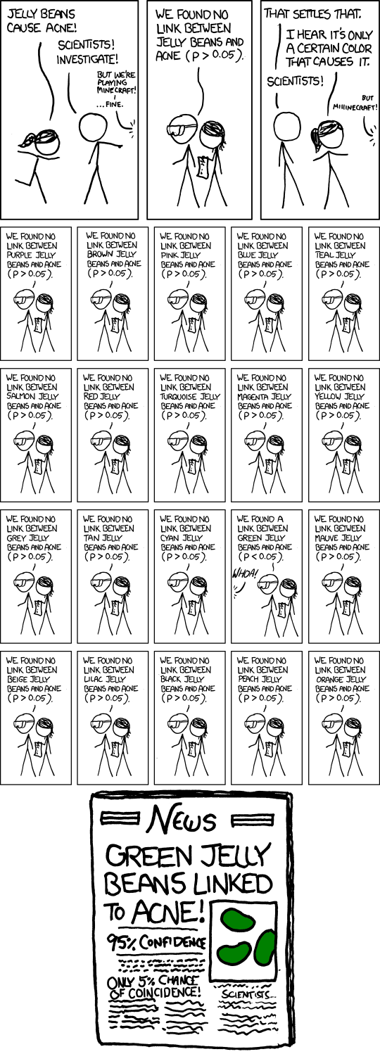
False Positives will occur
https://xkcd.com/882/

Slide 33
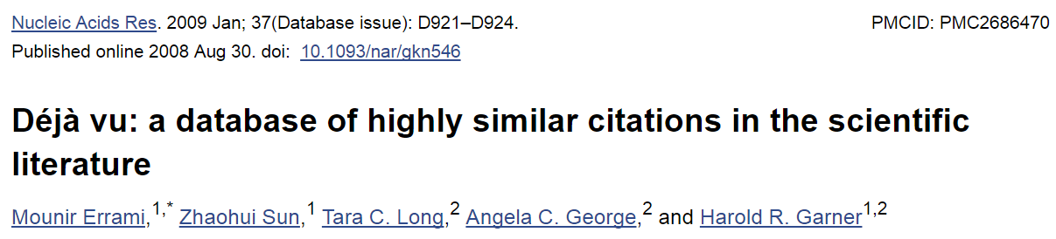
https://www.ncbi.nlm.nih.gov/pmc/articles/PMC2686470/
ABSTRACT
In the scientific research community, plagiarism and covert multiple publications of the same data are considered unacceptable because they undermine the public confidence in the scientific integrity. Yet, little has been done to help authors and editors to identify highly similar citations, which sometimes may represent cases of unethical duplication. For this reason, we have made available Déjà vu, a publicly available database of highly similar Medline citations identified by the text similarity search engine eTBLAST. Following manual verification, highly similar citation pairs are classified into various categories ranging from duplicates with different authors to sanctioned duplicates. Déjà vu records also contain user-provided commentary and supporting information to substantiate each document's categorization. Déjà vu and eTBLAST are available to authors, editors, reviewers, ethicists and sociologists to study, intercept, annotate and deter questionable publication practices. These tools are part of a sustained effort to enhance the quality of Medline as ‘the’ biomedical corpus. The Déjà vu database is freely accessible at http://spore.swmed.edu/dejavu. The tool eTBLAST is also freely available at http://etblast.org.

Slide 34
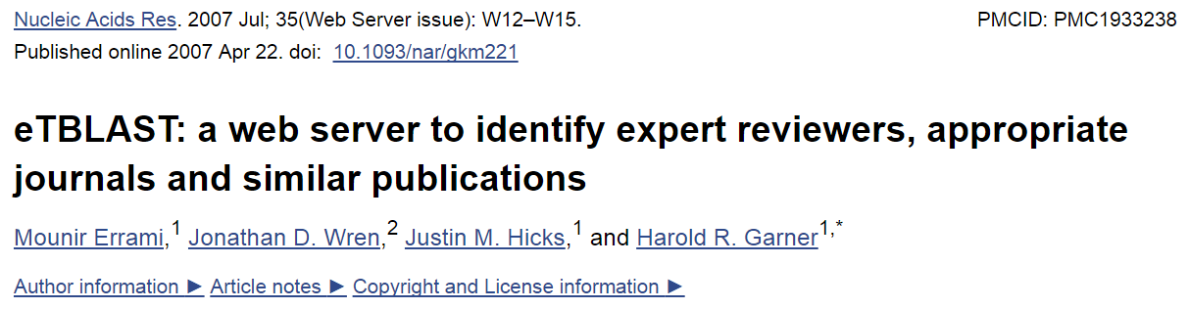
https://www.ncbi.nlm.nih.gov/pmc/articles/PMC1933238/
ABSTRACT
Authors, editors and reviewers alike use the biomedical literature to identify appropriate journals in which to publish, potential reviewers for papers or grants, and collaborators (or competitors) with similar interests. Traditionally, this process has either relied upon personal expertise and knowledge or upon a somewhat unsystematic and laborious process of manually searching through the literature for trends. To help with these tasks, we report three utilities that parse and summarize the results of an abstract similarity search to find appropriate journals for publication, authors with expertise in a given field, and documents similar to a submitted query. The utilities are based upon a program, eTBLAST, designed to identify similar documents within literature databases such as (but not limited to) MEDLINE. These services are freely accessible through the Internet at http://invention.swmed.edu/etblast/etblast.shtml, where users can upload a file or paste text such as an abstract into the browser interface.

Slide 35
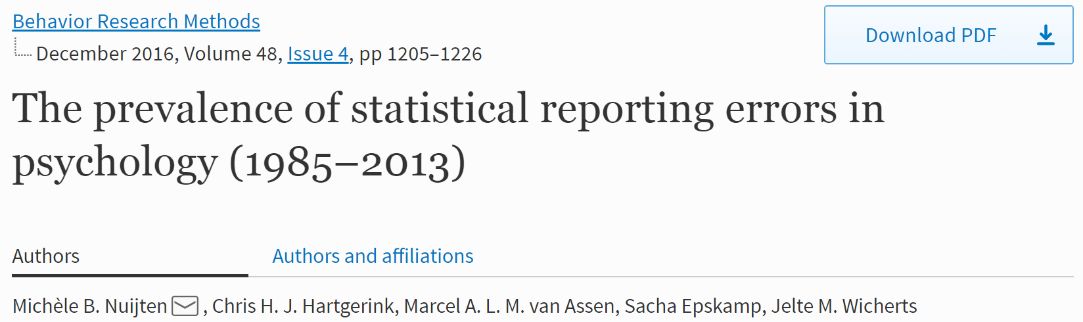
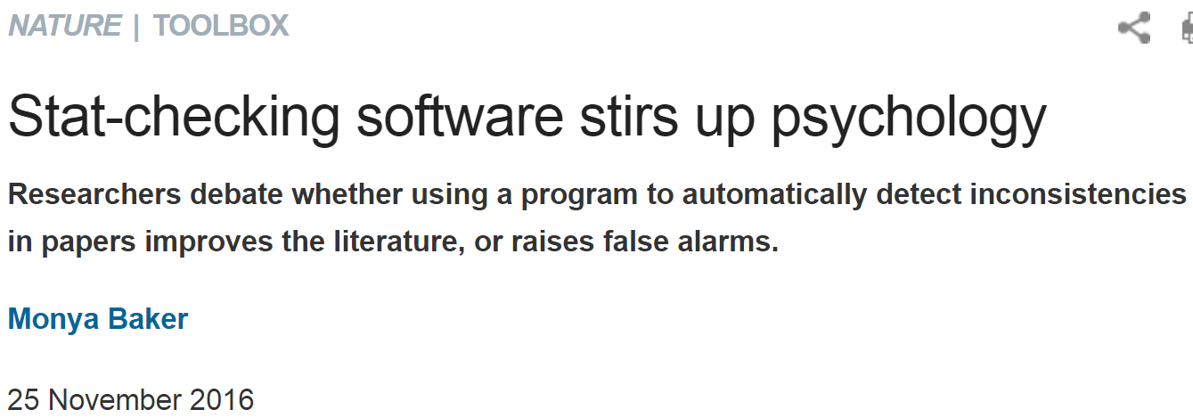
https://link.springer.com/article/10.3758%2Fs13428-015-0664-2
http://www.nature.com/news/stat-checking-software-stirs-up-psychology-1.21049

Slide 36
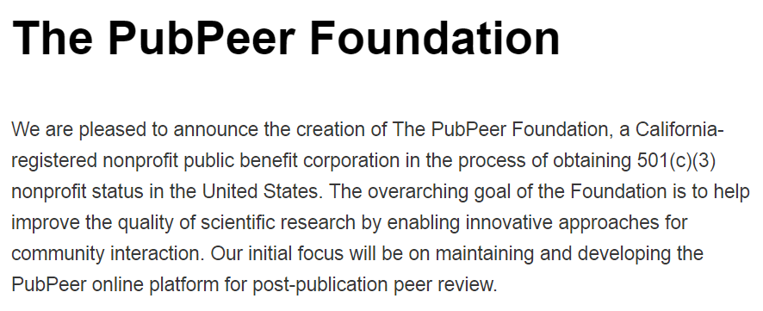
http://blog.pubpeer.com/?p=190

Slide 37
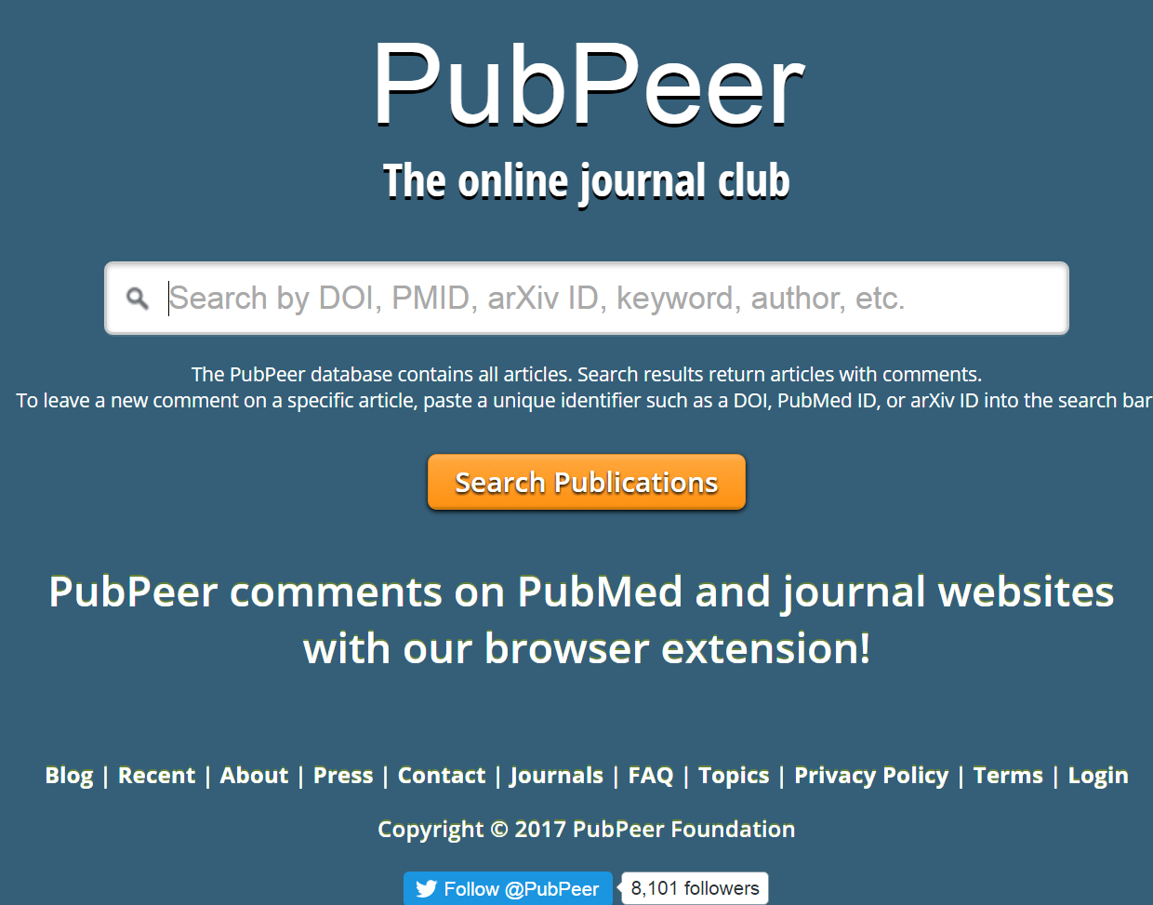
https://pubpeer.com

Slide 38
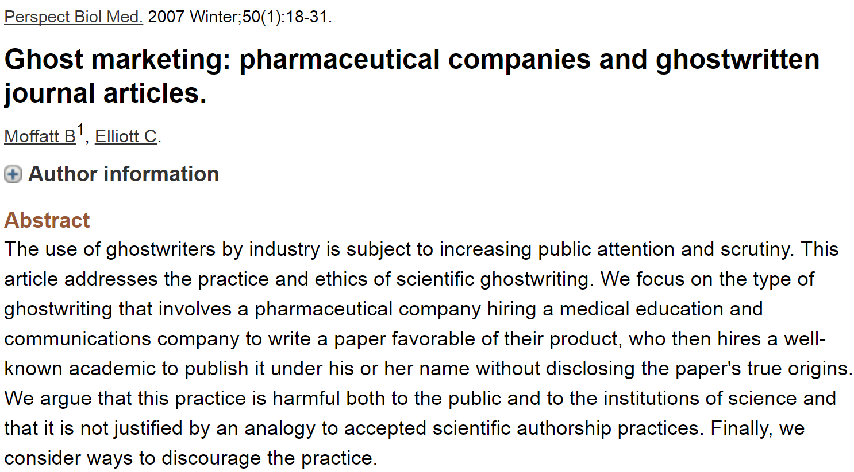
Most journals now require at least a conflicts of interest statement.
Many also require author contribution list.

Slide 39
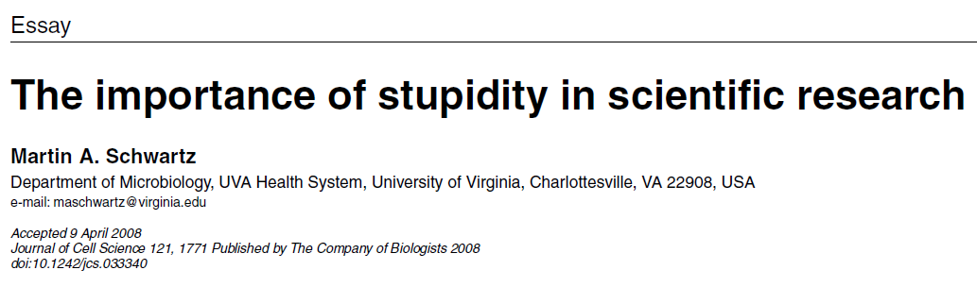
http://jcs.biologists.org/content/121/11/1771
I'd like to suggest that our Ph.D. programs often do students a disservice in two ways. First, I don't think students are made to understand how hard it is to do research. And how very, very hard it is to do important research. It's a lot harder than taking even very demanding courses. What makes it difficult is that research is immersion in the unknown. We just don't know what we're doing. We can't be sure whether we're asking the right question or doing the right experiment until we get the answer or the result.

